Slide 1
Search for ALPs at ICARUS and
LArTPC R&D
Atharva Dange
ICARUS Collaboration Meeting – Flash Talk
28 March 2023
1

Slide 2


Introduction
About me:
My name is Atharva Dange
Third year PhD student, from UT Arlington, currently working at CERN
Marie Cure fellow at CERN, doing R&D on ProtoDUNE - vertical drift.
Supervisors – Dr. Jaehoon Yu, UTA. Dr. Francesco Pietropaolo, CERN.
Goals:
Search for Axion Like Particles (ALPs) at ICARUS using the NuMI off-axis beam
  Understand and eliminate background to discover ALPs at ICARUS.
  Develop relevant energy-mass scale constraints to expand the exclusion boundary.
Hardware construction of field cage for the ProtoDUNE – VD
  Installation and commissioning of the field cage
  R&D on LArTPCs, specifically DUNE and ProtoDUNE - Data taking and analysis
2
Atharva Dange | ALP Search and LArTPC R&D | ICARUS CM Meeting | 28/03/23
2

Slide 3
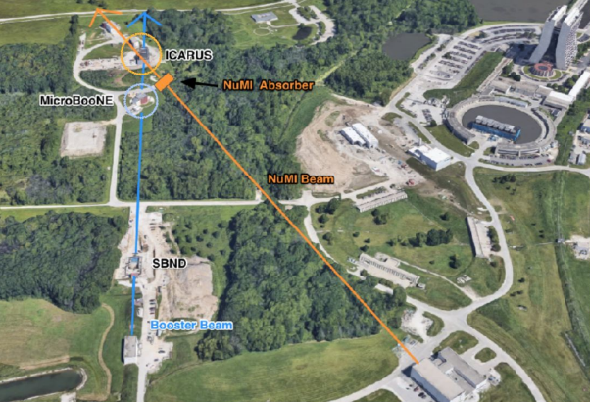
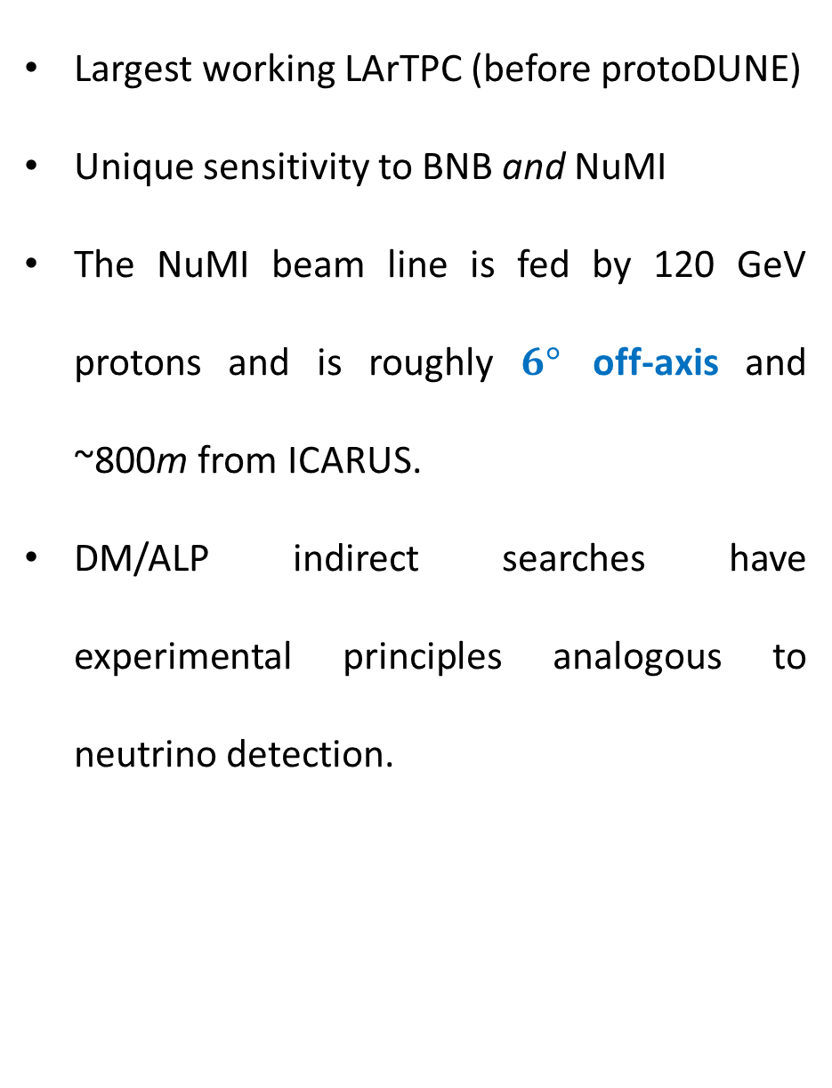
Why ICARUS?
https://www.osti.gov/biblio/1867676/
Largest working LArTPC (before protoDUNE)
Unique sensitivity to BNB and NuMI
The NuMI beam line is fed by 120 GeV protons and is roughly $6°$ off-axis and ~800m from ICARUS.
DM/ALP indirect searches have experimental principles analogous to neutrino detection.
ICARUS
NuMI Absorber
MicroBooNe
NuMI Beam
SBND
Booster Beam
3
Atharva Dange | ALP Search and LArTPC R&D | ICARUS CM Meeting | 28/03/23
2

Slide 4

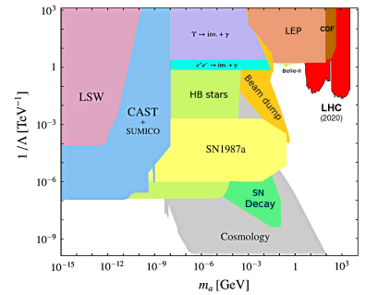
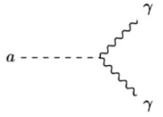

ALP Decay – Signature of Interest
ALPs may decay into a 2 photons $a→γγ$ via the $g_{aγ}$ coupling constant and the decay width as
https://arxiv.org/abs/2102.08971
5
Atharva Dange | ALP Search and LArTPC R&D | ICARUS CM Meeting | 28/03/23
2

Slide 5

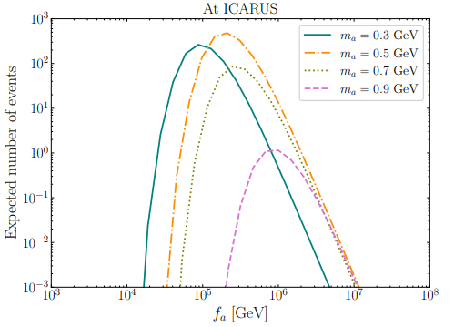
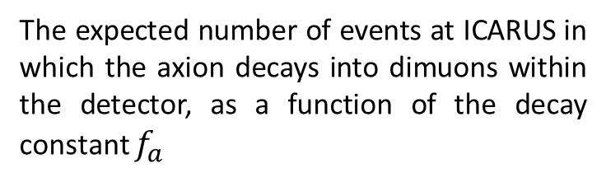
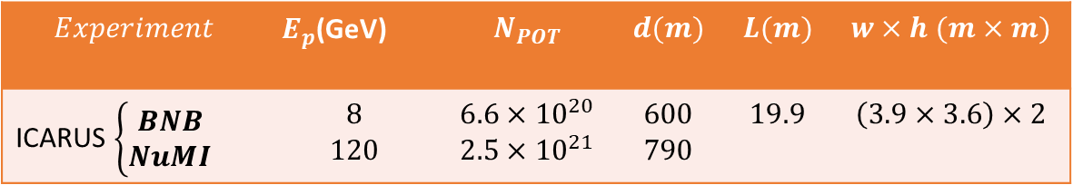
ICARUS and ALPs
arXiv:2210.02462
for 8 GeV BNB
For 120 GeV NuMI
The expected number of events at ICARUS in which the axion decays into dimuons within the detector, as a function of the decay constant $f_{a}$
Similar graph necessary for axion decays into the diphoton signature
Explore dominant decay channels related to ALP masses
$$Experiment$$ | $E_{p}$(GeV) | $$N_{POT}$$ | $$d(m)$$ | $$L(m)$$ | $$w×h (m×m)$$
ICARUS $\left\{\begin{aligned}BNB \\ NuMI\end{aligned}\right.$ | $$8$$ $$120$$ | $$6.6×{10}^{20}$$ $$2.5×{10}^{21}$$ | $$600$$ $$790$$ | $$19.9$$ | $$\left(3.9×3.6\right)×2$$
Detector Specifications for ICARUS
4
Atharva Dange | ALP Search and LArTPC R&D | ICARUS CM Meeting | 28/03/23
2

Slide 6
Conclusion and Future Work
  Well motivated opportunities exist in the axion coupling to gauge bosons with a single or diphoton signature space.
  Identifying the ICARUS parameter space with its constraints is the key! Backgrounds to be made recognizable and possible to be significantly reduced.
  Data analysis with goal of completing dissertation by the end of 2024
ProtoDUNE II and LArTPC R&D Work
  Completion of VD Module 0 construction and start data taking and analysis
6
Atharva Dange | ALP Search and LArTPC R&D | ICARUS CM Meeting | 28/03/23
2

Slide 7
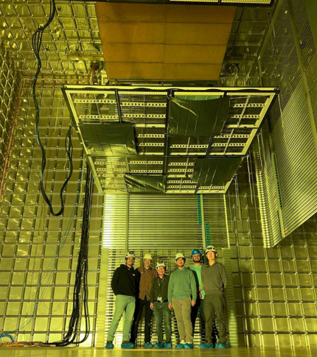
Thank you

