Slide 2

LabVIEW FPGA @ CERN 2023
Unofficial
For fun
Share knowledge

Slide 3
About the workshop
  25.04 at 16:00 2 hours
  26.04 at 16:00 2 hours

Slide 4
About the workshops
Minimize theory
Maximize practice
Some fun examples

Slide 5
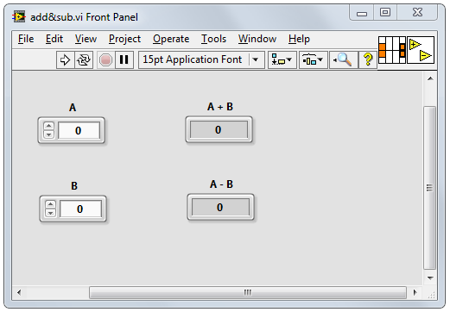
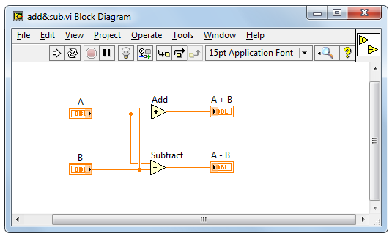
LabVIEW
Intuitive
Data driven
Hardware integration

Slide 6
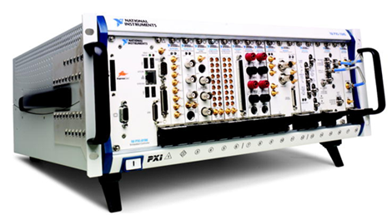
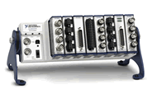
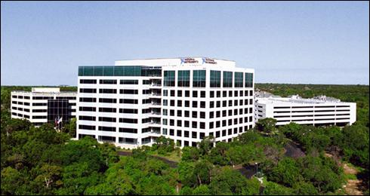


National Instruments
Corporate headquarters in Austin, TX
Offices in nearly 50 countries
35,000+ companies served annually
More than 1,000 products
Approx. 7,100 employees
600 Alliance Partners
Leader in data acquisition technology with innovative modular instruments and LabVIEW graphical programming software
Eric Starkloff CEO
Notes:
Founded in 1976
© National Instruments Corporation 3 Introduction to LabVIEW Hands-On

Slide 7

Diversity of applications
Notes:
Those are just a few examples. NI works with engineers in virtually every industry. NI customers have brought hundreds of thousands of products to market, overcome innumerable technological roadblocks, and engineered a better life for us all. If you can turn it on, connect it, drive it, or launch it, chances are that NI technology helped make it happen.
Because we work with engineers in so many industries and application areas, NI is in a unique position to closely monitor trends across industries and develop solutions that integrate the ever-increasing power of available technology to leverage these trends. This is another way NI achieves its mission of equipping engineers and scientists with systems that accelerate productivity, innovation, and discovery.

Slide 8

Diversity of applications
SpaceX
Falcon rocket launch pad software
Notes:
Those are just a few examples. NI works with engineers in virtually every industry. NI customers have brought hundreds of thousands of products to market, overcome innumerable technological roadblocks, and engineered a better life for us all. If you can turn it on, connect it, drive it, or launch it, chances are that NI technology helped make it happen.
Because we work with engineers in so many industries and application areas, NI is in a unique position to closely monitor trends across industries and develop solutions that integrate the ever-increasing power of available technology to leverage these trends. This is another way NI achieves its mission of equipping engineers and scientists with systems that accelerate productivity, innovation, and discovery.

Slide 9
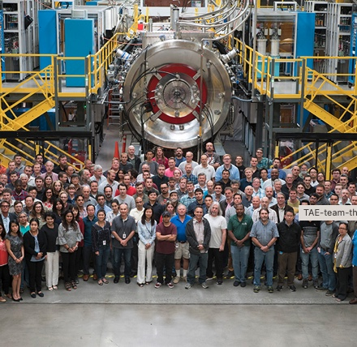
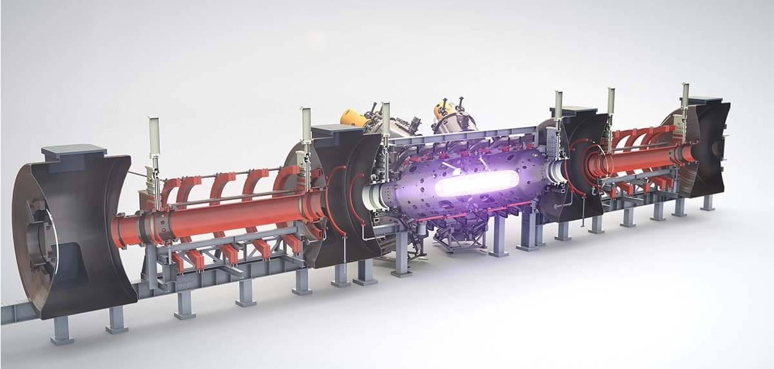
Diversity of applications
Commercial nuclear fusion power
Notes:
Those are just a few examples. NI works with engineers in virtually every industry. NI customers have brought hundreds of thousands of products to market, overcome innumerable technological roadblocks, and engineered a better life for us all. If you can turn it on, connect it, drive it, or launch it, chances are that NI technology helped make it happen.
Because we work with engineers in so many industries and application areas, NI is in a unique position to closely monitor trends across industries and develop solutions that integrate the ever-increasing power of available technology to leverage these trends. This is another way NI achieves its mission of equipping engineers and scientists with systems that accelerate productivity, innovation, and discovery.

Slide 10
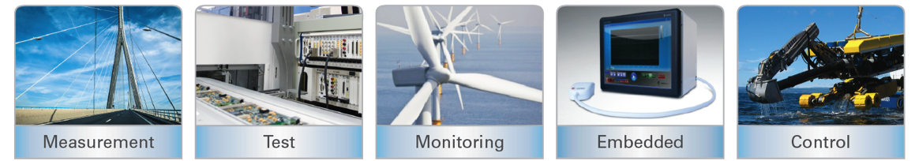


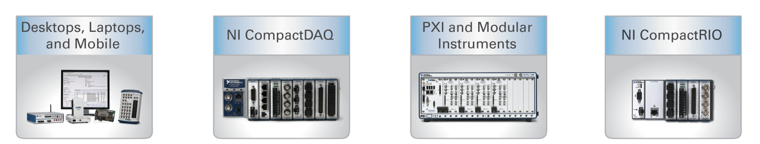
LabVIEW on different hardware
Applications
Hardware
Notes:
Those are just a few examples. NI works with engineers in virtually every industry. NI customers have brought hundreds of thousands of products to market, overcome innumerable technological roadblocks, and engineered a better life for us all. If you can turn it on, connect it, drive it, or launch it, chances are that NI technology helped make it happen.
Because we work with engineers in so many industries and application areas, NI is in a unique position to closely monitor trends across industries and develop solutions that integrate the ever-increasing power of available technology to leverage these trends. This is another way NI achieves its mission of equipping engineers and scientists with systems that accelerate productivity, innovation, and discovery.

Slide 11
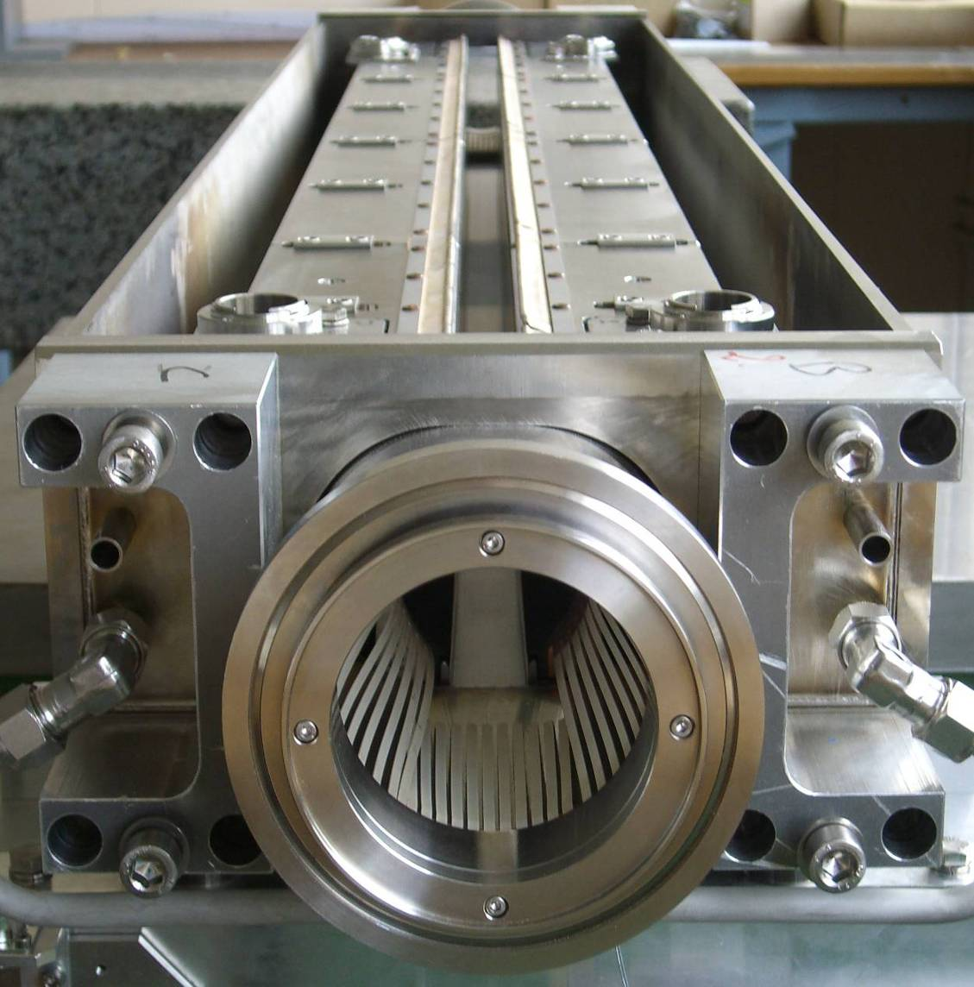
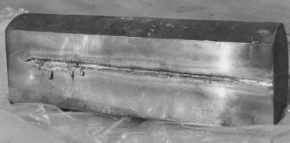
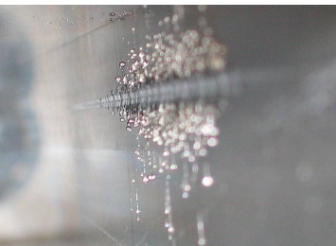
Projects based on NI @ CERN
LHC collimators real-time control system
Control system requirements
Axes positioning accuracy | few µm
Axes motion synchronization | below 1 ms
Response delay to a digital start trigger | 100 µs
Position sensors RT survey frequency | 100 Hz
Reliability | Very high
Notes:
120 kJ / bunch * 2808 bunches = 362 MJ / beam
- One beam melts 0.5 tone of copper
1.8 tone car going 2280 km / h
77.5 t of TNT

Slide 12
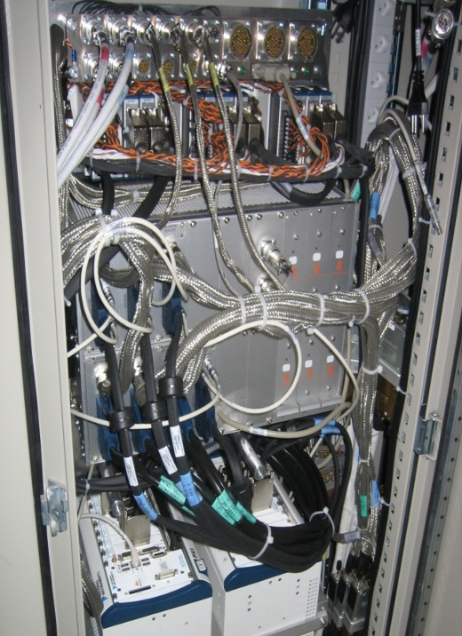
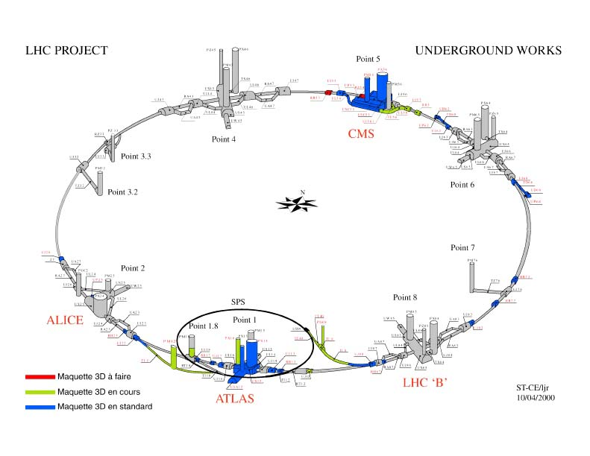
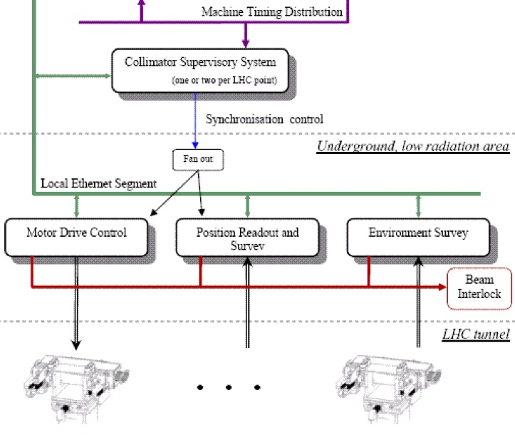
LHC collimators real-time control system
Layout
120 systems
Architecture

Slide 13
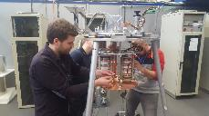
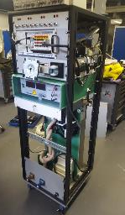
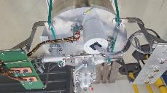

Projects based on NI @ CERN
Measurement setup for characterization of the radiation hardness of cryogenic bypass diodes for the LHC-HL
Power supplies for heaters
PXI system components:
- 7 x DMM 4081
- DAQ M-series 6251
- GPIB
- Ethernet
LHC by-pass diodes
HV power supply – 3kV max
Mu-metal shield (against magnetic field)
Discharge circuit
Capacitor bank 13,3 mF, 1500V
Feedthrough 18kA
Cryostat
$$≈30m$$
Measurement rack
Measurement setup assembly and closed cryostat

Slide 14

CERN LabVIEW support
Website: cern.ch/labview
E-mail: labview.support@cern.ch

Slide 15
Getting the Most out of This Course
  Ask questions!
  Experiment with hands-on exercises to understand the methods used
  Explore other solutions - you may find a better one

Slide 16
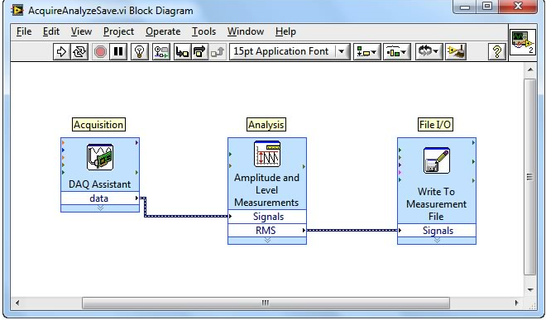
Why LabVIEW?
  Same concepts as in most traditional languages (data types, loops, event handling, recursion and OOP)
  Data flow (execution is data-driven, not determined by sequential lines of text)
  Intuitive
  Easy to debug
  Automatic parallelism
  Hardware integration
  Combines with other languages

Slide 17
B. Project Explorer
Project Explorer Window
Files Types
Project Folders

Slide 18
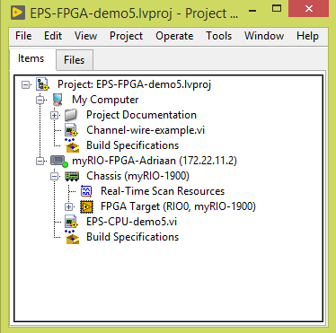
Project Explorer
  See the hierarchy
  Organise project files
  Deploy files to targets
  Manage code for build options
    Executables, installers, and zip files
  Integrate with source code control providers
PC
ARM
FPGA
Notes:
In this course we will use the LabVIEW project for accessing and organizing project files. You view project files in the Project Explorer window. Project files can include LabVIEW and non-LabVIEW files.
In future courses, you will use LabVIEW projects in other ways. For example, in LabVIEW Core 2 you will use LabVIEW to build an executable and installer. Various hardware courses will use the project explorer to configure and deploy applications to a target. In advanced LabVIEW courses, such as Managing Software Engineering in LabVIEW, you learn how to integrate with a source code control provider.

Slide 19

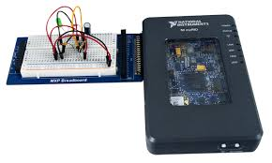
Project Explorer
PC
PC
ARM
Xilinx Zynq 7010
FPGA
Notes:
In this course we will use the LabVIEW project for accessing and organizing project files. You view project files in the Project Explorer window. Project files can include LabVIEW and non-LabVIEW files.
In future courses, you will use LabVIEW projects in other ways. For example, in LabVIEW Core 2 you will use LabVIEW to build an executable and installer. Various hardware courses will use the project explorer to configure and deploy applications to a target. In advanced LabVIEW courses, such as Managing Software Engineering in LabVIEW, you learn how to integrate with a source code control provider.

Slide 20
Connect to myRIO
Don’t have the myRIO connected yet
Power up the myRIO
Wait until the Status LED is off
Connect the myRIO to your PC
PC
myRIO
Notes:
In this course we will use the LabVIEW project for accessing and organizing project files. You view project files in the Project Explorer window. Project files can include LabVIEW and non-LabVIEW files.
In future courses, you will use LabVIEW projects in other ways. For example, in LabVIEW Core 2 you will use LabVIEW to build an executable and installer. Various hardware courses will use the project explorer to configure and deploy applications to a target. In advanced LabVIEW courses, such as Managing Software Engineering in LabVIEW, you learn how to integrate with a source code control provider.

Slide 21
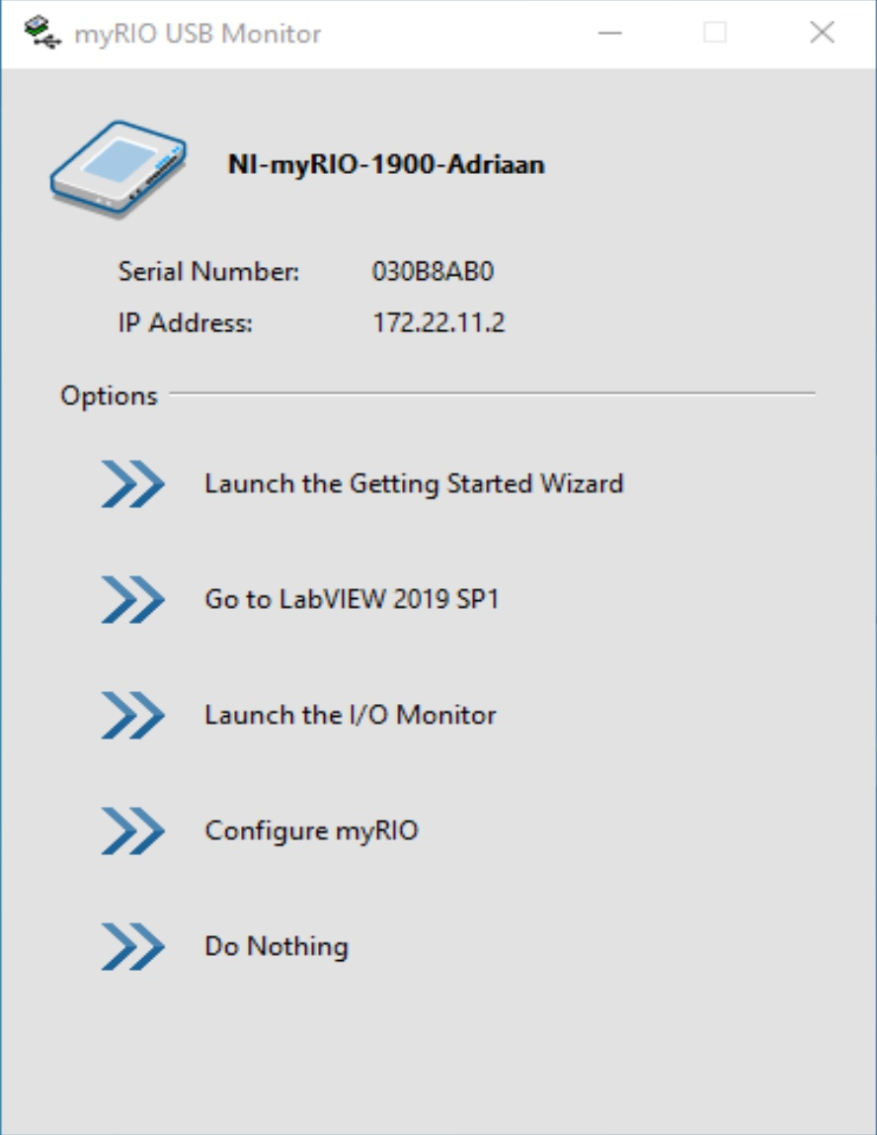
Start LabVIEW
PC
myRIO
Go to LabVIEW
Notes:
In this course we will use the LabVIEW project for accessing and organizing project files. You view project files in the Project Explorer window. Project files can include LabVIEW and non-LabVIEW files.
In future courses, you will use LabVIEW projects in other ways. For example, in LabVIEW Core 2 you will use LabVIEW to build an executable and installer. Various hardware courses will use the project explorer to configure and deploy applications to a target. In advanced LabVIEW courses, such as Managing Software Engineering in LabVIEW, you learn how to integrate with a source code control provider.

Slide 22
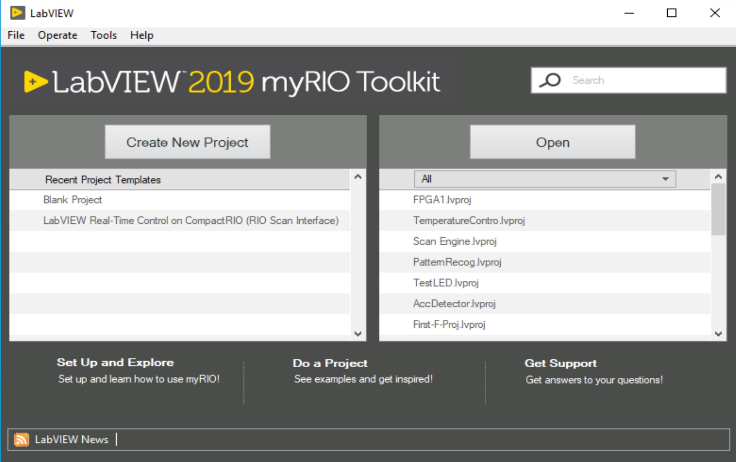
Project
Blank Project
PC
myRIO
Notes:
In this course we will use the LabVIEW project for accessing and organizing project files. You view project files in the Project Explorer window. Project files can include LabVIEW and non-LabVIEW files.
In future courses, you will use LabVIEW projects in other ways. For example, in LabVIEW Core 2 you will use LabVIEW to build an executable and installer. Various hardware courses will use the project explorer to configure and deploy applications to a target. In advanced LabVIEW courses, such as Managing Software Engineering in LabVIEW, you learn how to integrate with a source code control provider.

Slide 23
New target
Right click Project
Choose: New -> targets and devices
PC
myRIO
Notes:
In this course we will use the LabVIEW project for accessing and organizing project files. You view project files in the Project Explorer window. Project files can include LabVIEW and non-LabVIEW files.
In future courses, you will use LabVIEW projects in other ways. For example, in LabVIEW Core 2 you will use LabVIEW to build an executable and installer. Various hardware courses will use the project explorer to configure and deploy applications to a target. In advanced LabVIEW courses, such as Managing Software Engineering in LabVIEW, you learn how to integrate with a source code control provider.

Slide 24
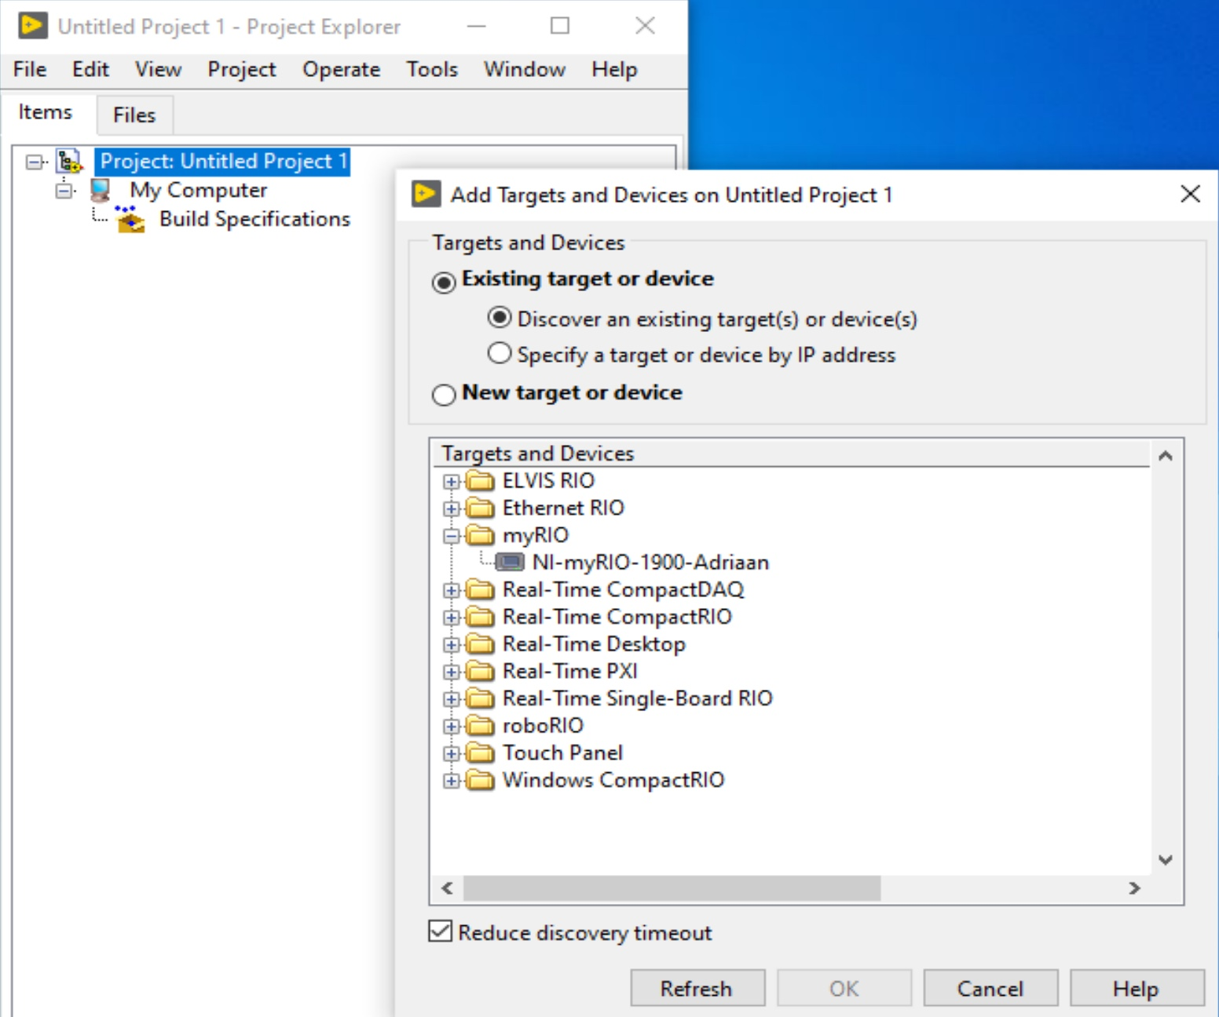
Select myRIO
PC
Open myRIO with +
Select NI myRIO
OK
myRIO
Notes:
In this course we will use the LabVIEW project for accessing and organizing project files. You view project files in the Project Explorer window. Project files can include LabVIEW and non-LabVIEW files.
In future courses, you will use LabVIEW projects in other ways. For example, in LabVIEW Core 2 you will use LabVIEW to build an executable and installer. Various hardware courses will use the project explorer to configure and deploy applications to a target. In advanced LabVIEW courses, such as Managing Software Engineering in LabVIEW, you learn how to integrate with a source code control provider.

Slide 25
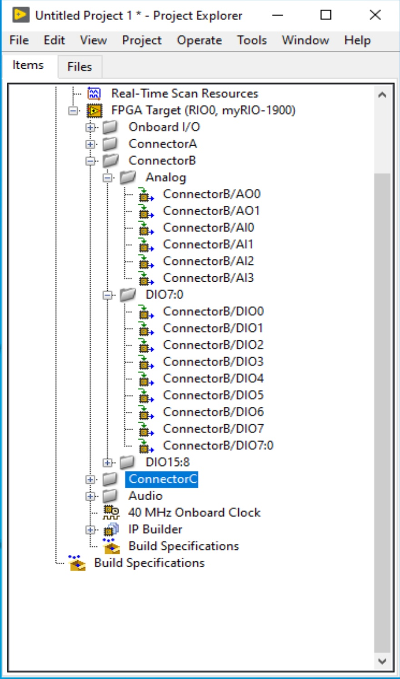
Prepare myRIO
Close tabs:
Onboard I/O
Connector A
Connector B DIO15:8
Connector C
Audio
PC
myRIO
Notes:
In this course we will use the LabVIEW project for accessing and organizing project files. You view project files in the Project Explorer window. Project files can include LabVIEW and non-LabVIEW files.
In future courses, you will use LabVIEW projects in other ways. For example, in LabVIEW Core 2 you will use LabVIEW to build an executable and installer. Various hardware courses will use the project explorer to configure and deploy applications to a target. In advanced LabVIEW courses, such as Managing Software Engineering in LabVIEW, you learn how to integrate with a source code control provider.

Slide 26
LabVIEW Files
Common LabVIEW file extensions:
  LabVIEW project —.lvproj
  Virtual instrument (VI) — .vi
  Custom control — .ctl
Notes:
LabVIEW uses many different types of files. In this class you will learn about three different LabVIEW files – LabVIEW projects, VIs, and custom controls.
Historically, LabVIEW programs are called virtual instruments, or VIs, because their appearance and operation imitate physical instruments, such as oscilloscopes and multimeters. Today LabVIEW VIs can be extremely powerful and sophisticated programs with elegant graphical user interfaces.
Later in this course you learn how custom controls can improve maintainability of your LabVIEW application.
LabVIEW projects can also include non-LabVIEW file types. For example, you can include documentation files.

Slide 27
Adding Folders to a Project
  Virtual folder
    Organizes project items and does not represent files on disk
  Auto-populating folder
    Adds a directory on disk to the project
    LabVIEW continuously updates the folder according to changes made in the project and on disk
Notes:
Adding Folders to a Project
Use the Project Explorer window to add folders to create an organizational structure for items in a LabVIEW project.
Adding auto-populated folders adds a directory on disk to the project. LabVIEW continuously monitors and updates the folder according to changes made in the project and on disk. A blue folder icon with a yellow cylinder identifies this type of folder. To disconnect an auto-populated folder from disk, right-click the auto-populated folder on the Items page and select Stop Auto-populating from the shortcut menu. LabVIEW disconnects the folder from the corresponding folder on disk. This option is available only to top-level folders and applies recursively to subfolders of auto-populated folders.
A virtual folder is a folder in the project that organizes project items and does not represent files on disk. A silver folder icon identifies this type of folder. You can convert a virtual folder to an auto-populated folder. Right-click the virtual folder and select Convert to Auto-populating Folder to display a file dialog box. Select a folder on disk to auto-populate with. An auto-populated folder appears in the project. LabVIEW automatically renames the virtual folder to match the disk folder and adds all contents of the disk folder to the project. If items in the directory already exist in the project, the items move within the auto-populated folder. Items in the virtual folder that do not exist in the directory on disk move to the target.

Slide 28
Show-off(1)
Project Explorer

Slide 29
C. Parts of a VI
Front Panel
Block Diagram
Icon
Connector Pane

Slide 30
Parts of a VI
VIs have 3 main components:
Icon/Connector pane
Front panel
Block diagram

Slide 31
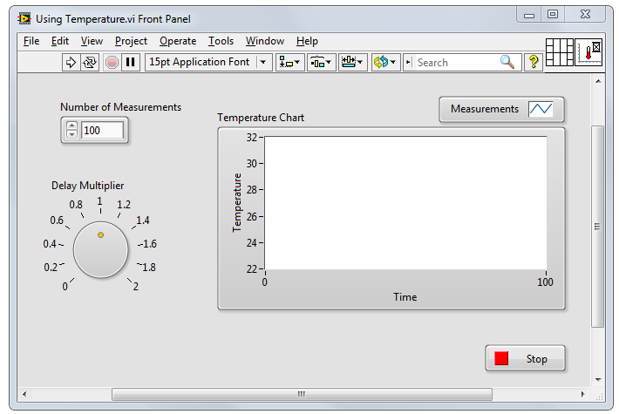
Parts of a VI – Front Panel
Front Panel – User interface for the VI
  You build the front panel with
  controls (inputs) and indicators (outputs).
Notes:
The best way to explain that is to imagine an old, analog osciloscope.
Front panel is how the device interacts with an user.

Slide 32
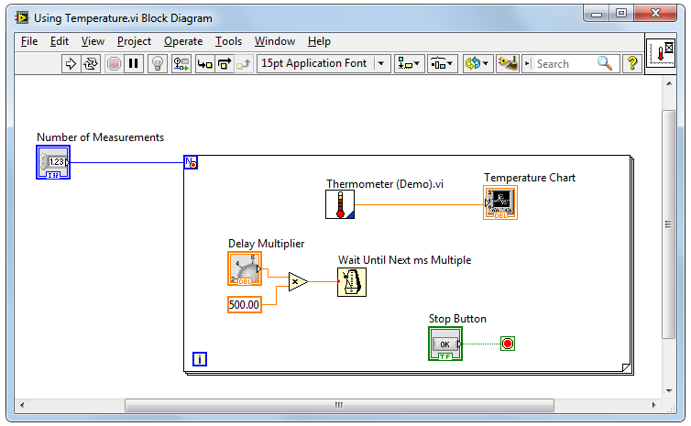
Parts of a VI – Block Diagram
Block Diagram – Contains the graphical source code
  Front panel objects appear as terminals on the block diagram.

Slide 33


Parts of a VI – Icon/Connector Pane
Icon – Graphical representation
of a VI
Connector Pane – Map of the inputs and outputs of a VI
  Icons and connector panes are necessary to use
  a VI as a subVI.
    A subVI is a VI that appears on the block diagram of another VI.
    A subVI is similar to a subroutine or function in a text-based programming language.
Notes:
Connector Pane- similar way as a Function+ Vi Inception

Slide 34
Show – off (2)
Figures

Slide 35
D. Front Panel
Controls and Indicators
Object Styles
Object Types
Boolean
Numeric
String

Slide 36
Front Panel
Notes:
The items on the toolbar:
Run, Run Continuously, Abort Execution, Pause, Text Settings, Align Objects, Distribute Objects, Resize Objects, Reorder, Search, Help
Click the Run button to run the VI. LabVIEW compiles the VI, if necessary. You can run a VI if the Run button appears as a solid white arrow. Note that the Run button appears broken when the VI contains edit-time errors. Students will learn about fixing edit-time errors in the next lesson.

Slide 37
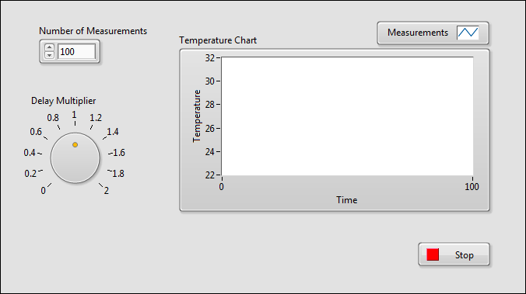
Controls and Indicators
  Controls
    Input devices
    Knobs, buttons, slides
    Supply data to the block diagram
  Indicators
    Output devices
    Graphs, LEDs
    Display data the block diagram acquires or generates
Notes:
Identify controls and indicators on this front panel.
In the next few slides, we discuss basic data types: numerics, strings and Booleans.
We discuss representation, mechanical action, and string display types in the next lesson.

Slide 38
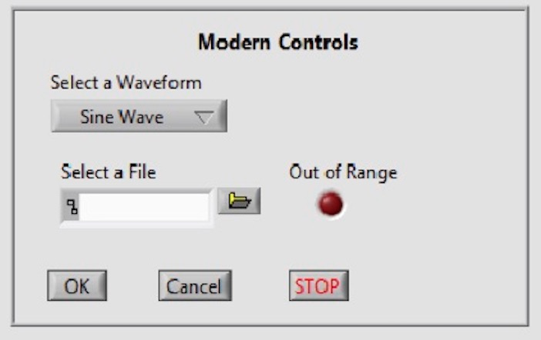
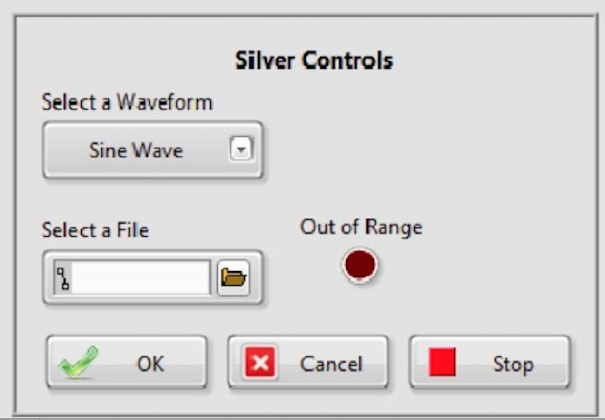
Front Panel Object Styles
Notes:
LabVIEW has different control palettes with objects for building user interface, including the Modern, Silver, Classic, and System palettes.
The controls and indicators on the Silver palette are the newest to LabVIEW. They provide a rich user interface. Because of the added glyphs, the Silver objects tend to be a little larger than other styles.
Use objects from the System palette when you want a dialog that matches your operating system. The System controls (also known as dialog controls) change appearance depending on which platform you run the VI. For example, when running on a Mac OS, the controls adapt a different color and appearance than they have on a Windows OS so that they match the appearance of the Mac OS system.
Not all palettes have the same options. For example, the System palette does not have a LED.
Similarly, if you use Quick Drop, you will notice multiple options. The new Silver controls will have “Silver” in the parentheses.

Slide 39
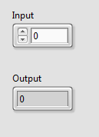
Numeric Controls and Indicators
The numeric data in a control or indicator can represent numbers of various types, such as integer or floating-point.
Numeric
control
Increment/Decrement
buttons
Numeric
indicator
Notes:
Make out , discriminate << rozróżnić

Slide 40

Boolean Controls and Indicators
  The Boolean data type represents data that has only two options, such as True/False or On/Off.
  Use Boolean controls and indicators to enter and display Boolean (TRUE/FALSE) values.
  Boolean objects simulate switches, push buttons and LEDs.
Boolean
control
Boolean
indicator

Slide 41
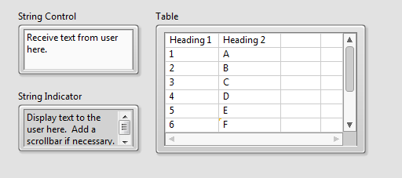
Strings
  The string data type is a sequence of ASCII characters.
  Use string controls to receive text from the user.
  Use string indicators to display text to the user.

Slide 42
E. Block Diagram
Terminals
Nodes
Wires
Help

Slide 43
Block Diagram
Notes:
The items on the toolbar:
Run, Run Continuously, Abort Execution, Pause, Highlight Execution, Retain Wire Values, Step Into, Step over, Step Out, Text Settings, Align Objects, Distribute Objects, Reorder, Clean Up Diagram
Students learn about debugging tools in the next lesson. Use next slide to discuss different objects on block diagram.
Click the Run button to run the VI. LabVIEW compiles the VI, if necessary. You can run a VI if the Run button appears as a solid white arrow. If the Run button appears broken, the VI contains edit-time errors. Students learn about fixing edit-time errors in the next lesson.

Slide 44
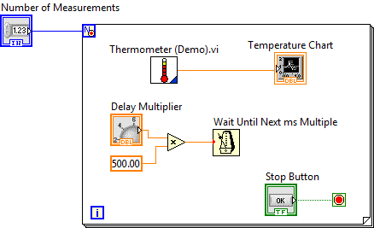
Block Diagram
Block diagram items:
  Terminals
  Constants
  Nodes
    Functions
    SubVIs
    Structures
  Wires
  Free labels
Notes:
Objects on the block diagram include terminals and nodes. You build block diagrams by connecting the objects with wires. The color and symbol of each terminal indicate the data type of the corresponding control or indicator. Constants are terminals on the block diagram that supply fixed data values to the block diagram.
Nodes are objects on the block diagram that have inputs and/or outputs and perform operations when a VI runs.

Slide 45
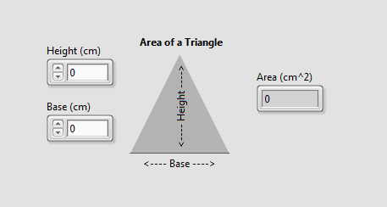
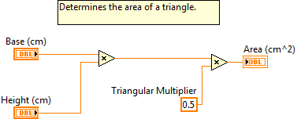
Terminals
Same label name
Notes:
Data values you enter on the front panel controls enter the block diagram through the control terminals on the block diagram.
During execution, the output data values from the block diagram pass from indicator terminals to the front panel indicators.
Front panel items share the same label name as the block diagram terminal.
You can notice visual difference between controls and indicators on the block diagram. There are differences in operation between controls, constants, and indicators. Note that constants are available only on the block diagram.
You can right-click a terminal to change it between a control or indicator.

Slide 46


Terminals for Front Panel Objects
  Terminals are:
    Entry and exit ports that exchange information between the front panel and block diagram.
    Analogous to parameters in text-based programming languages.
  Double-click a terminal to locate the corresponding front panel object.
Notes:
Front panel objects appear as terminals on the block diagram.
Double-click a block diagram terminal to highlight the corresponding control or indicator on the front panel.
On the next slide, you can see the two formats for block diagram terminals: Icon view and standard (compact) view.

Slide 47
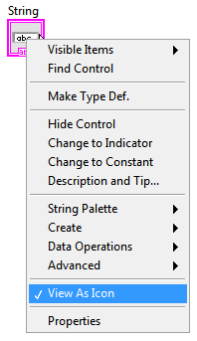
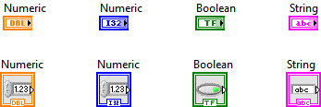
View Terminals as Icons
  By default, View as Icon option enabled.
  Deselect View as Icon for a more compact view.
Notes:
This slide also shows a shortcut menu. In LabVIEW, many options are found in shortcut menus. If you are not sure how to do something, right-click the object. Chances are good that the option you need is in the shortcut menu.

Slide 48
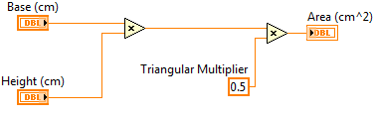
Nodes
  Nodes are objects on the block diagram that have inputs and/or outputs and perform operations when a VI runs.
Nodes
Notes:
Nodes are analogous to statements, operators, functions, and subroutines in text-based programming languages.
Nodes can be functions, subVIs, or structures.

Slide 49
Function Nodes
  Functions are:
    Fundamental operating elements of LabVIEW.
    Do not have front panels or block diagrams, but do have connector panes.
    Has a pale yellow background on its icon.
  Double-clicking a function only selects the function.
  Functions do not open like VIs and subVIs.

Slide 50

SubVI Nodes
  SubVIs :
    Are VIs that you use on the block diagram of another VI.
    Have front panels and block diagrams.
    Use the icon from the upper-right corner of the front panel as the icon that appears when you place the subVI on a block diagram.
  When you double-click a subVI, the front panel and block diagram open.
  Any VI has the potential to be used as a subVI.
Notes:
In lesson 4, the student will learn how to build a subVI.

Slide 51
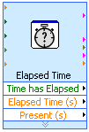
Express VIs
  Express VIs:
    Are a special type of subVI.
    Require minimal wiring because you configure them with GUI dialog boxes.
    Save each configuration as a subVI.
  Icons for Express VIs appear on the block diagram as icons surrounded by a blue field.

Slide 52


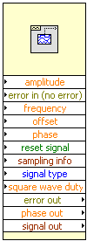
VI Node View Options
Notes:
You can display VIs and Express VIs as icons or as expandable nodes. Expandable nodes appear as icons surrounded by a colored field. SubVIs appear with a yellow field, and Express VIs appear with a blue field. Use icons if you want to conserve space on the block diagram. Use expandable nodes to make wiring easier and to aid in documenting block diagrams. By default, subVIs appear as icons on the block diagram, and Express VIs appear as expandable nodes.
To change the view of a subVI, right-click on it and check or uncheck the option View as Icon. To expand an expandable node, click and drag the small arrow at the bottom of it.

Slide 53
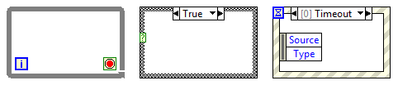
Structures
  Structures in LabVIEW have the form of frames.
  Other nodes (functions, subVIs, more structures) can be inserted into the frames.

Slide 54
Wires
  Wires transfer data between block diagram objects.
  Wires are different colors, styles, and thicknesses, depending on their data types.
  A broken wire appears as a dashed
  black line with a red X in the middle.
Floating-point
Integer
String
Boolean
Scalar
1-D Array
2-D Array

Slide 55

Constants
  Constants are the source of values just as control terminals, but their value is fixed in the code.
  You can create a constant of each data type.
Notes:
What are constants and when should you use them?
Constants are terminals on the block diagram that supply fixed data values to the block diagram. Use constants when your VI needs to use the same value every time the VI runs.
Can you recognize which data types these constants are?
Answer (from left to right):
integer, floating-point numeric, Boolean, string.

Slide 56


Free labels
  A free label is a label (a text box) not attached to any object.
  Free labels can be put on the front panel or block diagram. They are created by double-clicking on empty space in the window.
  They can serve as comments or instructions to the user of the application.
Notes:
What are free labels and when should you use them?
Free labels are not attached to any object. You can create, move, rotate, or delete them independently.
Free labels are useful for documenting code on the block diagram and for listing user instructions on the front panel. Double-click an open space or use the Labeling tool to create free labels or to edit labels.

Slide 57
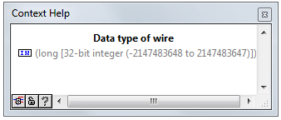
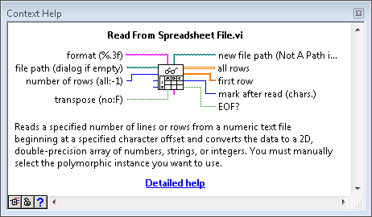
Context Help
  Displays basic information about wires and nodes when you move the cursor over an object.
  Can be shown or hidden in the following ways:
    Select Help»Show Context Help from the LabVIEW menu.
    Press <Ctrl-H>.
    Click the following button on the toolbar:
Notes:
I’d like to point at..
Hold down mouse for a second

Slide 58
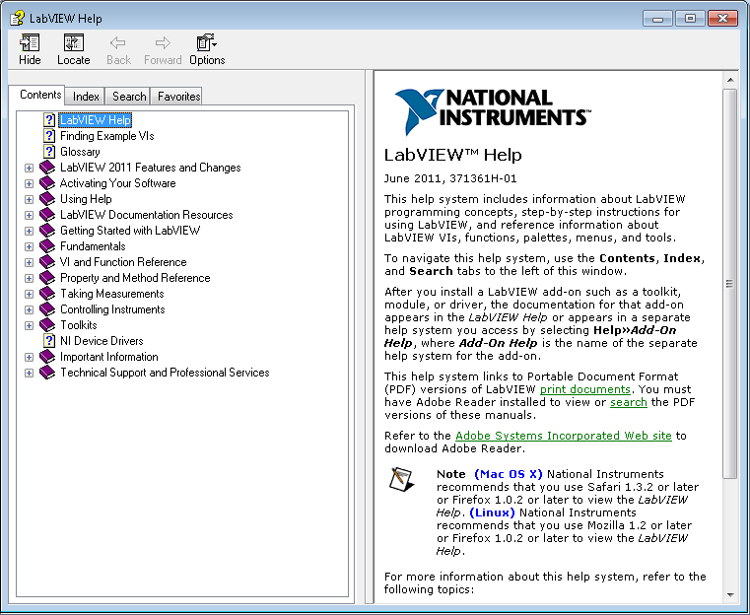
LabVIEW Help
  Contains detailed descriptions and instructions for most palettes, menus, tools, VIs, and functions.
  Can be accessed by:
    Selecting Help»
    LabVIEW Help from the menu.
    Clicking the Detailed help
    link in the
    Context Help window.
    Right-clicking an object
    and selecting Help from
    the shortcut menu.

Slide 59
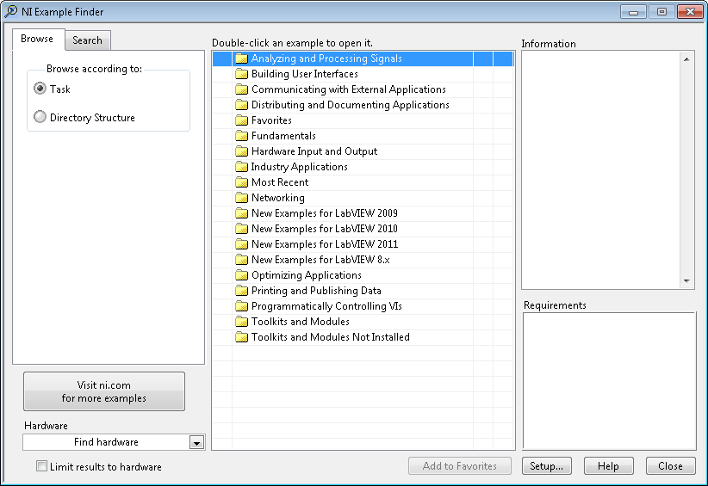

Examples
  LabVIEW includes hundreds of example VIs.
  Use NI Example Finder to browse and search installed examples.
    Select Help»Find Examples in the menu.
  Click the example buttons in LabVIEW Help topics.
Notes:
Use the NI Example Finder to search all installed examples and examples located in the NI Developer Zone on the web.
Modify any example VI to fit an application, or copy and paste from an example into a VI that you create.
Methods of accessing the NI Example Finder:
Select Help»Find Examples
Click the Find Examples link in the Getting Started window
You can access examples using the Open example and Find related examples buttons located at the bottom of certain VI and function reference topics in the LabVIEW Help. Click the Open example button to open the example VI to which the topic refers. Click the Find related examples button to open the NI Example Finder and display related example VIs.

Slide 60
Group Exercise
Concept: Exploring a VI
Identify the parts of an existing VI.
Notes:
Open an existing VI. Examine its front panel and block diagram and find the elements that were described in the previous slides.
E2 > 82.41 Hz
E4 > 329.63 Hz

Slide 61
F. Searching for Controls, VIs and Functions
Palettes
Quick Drop
NI Global Search

Slide 62
Searching for Controls, VIs and Functions
  Ways to find controls, VIs, and functions:
  Search or navigate the palettes.
    Controls palette
    Functions palette
  Search by name of object.
    Quick Drop dialog box
  Search palettes, LabVIEW Help, and ni.com.
    Search text box in toolbar

Slide 63
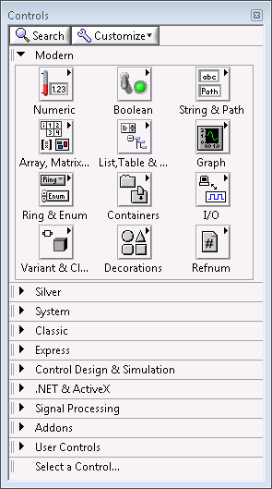
Controls Palette
  Contains the controls and indicators you use to create the front panel.
  Navigate the subpalettes or use the Search button to search the Controls palette.
Notes:
Controls palette is available only when the front panel window is the active window.

Slide 64
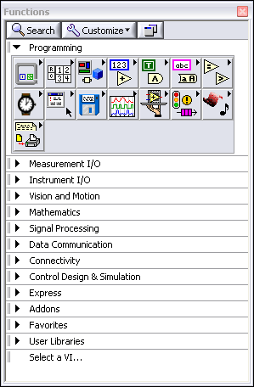
Functions Palette
  Contains the VIs, functions, and constants you use to create the block diagram.
  Navigate the subpalettes or use the Search button to search the Functions palette.
Notes:
Functions palette is available only when the block diagram window is the active window.

Slide 65
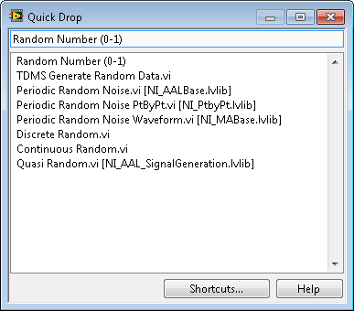
Searching with Quick Drop
  Lets you quickly find controls, functions, VIs, and other items by name.
  Press the <Ctrl-Space> keys to display the Quick Drop dialog box.

Slide 66
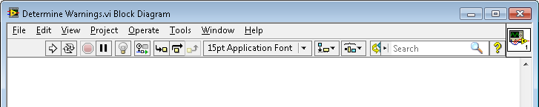
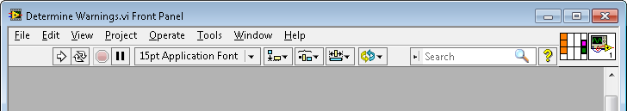
Global Search
Use the Search bar in the top right of the front panel and block diagram windows to search palettes, LabVIEW Help, and ni.com.
Notes:
Searches the local help files and palettes as you type. If you press <Enter>, the Search bar also searches ni.com.

Slide 67
Search for Controls, VIs and Functions
  Configure palettes to customize visible palettes.
  Search and navigate the palettes.
  Search for help using global search.
  Use Quick Drop to search by name.
Notes:
Accessing palettes:
Access the Controls palette from the front panel by selecting View»Controls Palette, or right-clicking an open area on the front panel.
Access the Functions palette from the block diagram by selecting View»Functions Palette, or right-clicking an open area on the block panel.
Configuring palettes:
To change visible palettes in either Controls or Functions Palette, first pin the palette, then select Customize»Change Visible Palettes… and check the boxes by the palettes you want to be displayed. Configure the following palettes to be visible:
* Show the Silver controls palette on the Controls Palette
* Show the Programming palette on the Functions palette.
These changes persist on subsequent launches of LabVIEW.
Search and navigate palettes:
If you do not know the name of an object or want to discover available functionality, use the palette navigation. The palettes are context-sensitive. Tile the front panel and block diagrams left and right or top and bottom. Note that the Controls palette is active only when front panel window is active. The Functions palette is active only when the block diagram window is active.
Show how to select and drop items on the front panel and block diagram.
Search using global search:
Use global search to find help on items.
Use Quick Drop to find items by name:
Once the student is familiar with the Quick Drop functionality, Quick Drop is the fastest mechanism for finding and dropping front panel and block diagram objects. Note that Quick Drop will find items with partial names. You do not need to memorize the complete name.

Slide 68
G. Selecting a Tool
Selecting a Tool
Block Diagram Clean-Up

Slide 69

Selecting a Tool
  A tool is a special operating mode of the mouse cursor.
  Create, modify, and debug VIs using the tools provided by LabVIEW.
  By default, LabVIEW automatically selects tools based on the context of the cursor.
  If you need more control, use the Tools palette to select a specific tool.
    Select View»Tools Palette to open the Tools palette.
Notes:
By default, LabVIEW selects tools for you based on the context of your cursor. If you need more control over which tool is selected, use the Tools palette to select a specific tool to operate or to modify front panel and block diagram objects. Select View»Tools Palette (or right-click on empty space in the window while pressing <Shift>) to display the Tools palette.

Slide 70


Wiring Tips
  Press <Ctrl-B> to delete broken wires.
  Right-click and select Clean Up Wire to reroute the wire.
Notes:
If you make a selection first and then press <Ctrl-B>, broken wires are deleted only in the selection and not on the whole block diagram.

Slide 71


Wiring Tips – Clean Up Diagram
  Use the Clean Up Diagram tool to reroute multiple wires and objects and to improve readability.
    Select a section of your block diagram.
    Click the Clean Up Diagram button on the block diagram toolbar (or press <Ctrl-U>).

Slide 72
Cloning and Moving Items
  Clone an object in Windows using the following steps:
    Select the Positioning tool.
    Press the <Ctrl> key while clicking an object.
    Drag the copy to new location.
  Move an object using the following steps:
    Select the Positioning tool.
    Click and drag the object to new location.
Note: Avoid cutting and pasting objects as this can impact related items. For example, cutting and pasting a block diagram terminal also moves the front panel object.

Slide 73
Selecting, Editing, Resizing and Wiring
  Select item to move, copy, or delete
  Edit text
  Resize an object
  Wire terminals and nodes
  Automatic and manual tool selection
Notes:
Select an item before moving, cloning or deleting it. When selecting an item, you can select the label and move it independently of the item. Typically you want to select the item, not the label.
You can move a terminal using drag operation. If you cut/paste a terminal, the front panel object moves too. Typically this is not desirable as the user probably started with a nice front panel layout.
Drop a Boolean button. Change the label and the Boolean text using the Text tool (if automatic tool selection is enabled, you only need to double click a text to edit it). Note than the label associates the control with the block diagram terminal, but the Boolean text is cosmetic and used only on the front panel.
Resize a control (LED, Knob) using the resize handles. Note that the technique to resize an item is different than the technique to select an item to move.
Try basic wiring of nodes. See how the cursor changes when hovering over a node terminal.
Try to change the color of a front panel control. Not all tools are available automatically – sometimes you need to select View»Tools to get to the tools palette, e.g. to access the paint brush.
How do you enable automatic tool selection?
Make sure that the Automatic Tool Selection button is enabled on the Tools palette. To view the Tools palette, you can either select View»Tools Palette or hold the <Shift> key while right-clicking the front panel.

Slide 74
Setting Options for the Environment
In Tools»Options… dialog box you can customize settings for the LabVIEW environment.
Suggested changes:
  Front Panel page
    Set Control Style for New VIs to Silver style
  Block Diagram page
    Uncheck Place front panel terminals as icons
    Configure Block Diagram Cleanup to customize your block diagram
Notes:
- If you would like to change the default control and terminal style:
Exercises can be completed with any control style and terminal style. However, if you would like to, select Silver (or other) style for controls.
You may also want to uncheck Place front panel terminals as icons option in the Block Diagram page.
While in the Tools»Options dialog box, you can view, examine and customize other common settings.

Slide 75
H. Dataflow

Slide 76

Dataflow
  LabVIEW follows a dataflow model for running VIs.
  A node executes only when data are available at all of its required input terminals.
  A node supplies data to the output terminals only when the node finishes execution.
Notes:
When a node executes, it produces output data and passes the data to the next node in the dataflow path.
The movement of data through the nodes determines the execution order of the VIs and functions on the block diagram.
LabVIEW does NOT use a control flow program execution model like Visual Basic, C++, JAVA, and most other text-based programming languages. In a control flow model, the sequential order of program elements determines the execution order of a program.

Slide 77

Dataflow – Quiz
What are the nodes in this fragment of code?
Which node executes first?
Notes:
This quiz is intended to encourage students to think about dataflow and its implications. The answers are on the next slide.

Slide 78
Dataflow – Quiz Answer
There are two nodes: „square” and „greater than?” functions.
Square executes first.
78
Notes:
Nodes are functions, subVIs and structures – so in this slide there are two nodes: „square” function and „greater than?” function.
Square function executes first because the comparison function has to wait for the output of square function before it can run.

Slide 79

Dataflow – Quiz
Which node executes first?
Add
Subtract
Random Number
Divide
Sine
79
Notes:
This quiz is intended to encourage students to think about dataflow and its implications. The answers are on the next slide.

Slide 80
Dataflow – Quiz Answer
No single correct answer.
Which node executes first?
Add – Possibly
Subtract –
Definitely not
Random Number –
Possibly
Divide – Possibly
Sine – Definitely not
80
Notes:
In LabVIEW, the flow of data rather than the sequential order of commands determines the execution order of block diagram elements. Therefore, you can create block diagrams that have simultaneous operations.

Slide 81
Group Exercise
Concept: Dataflow
Identify dataflow execution order in the following block diagrams.

Slide 82

Group Exercise
Concept: Dataflow
Which node executes first? Last?
Where are the data dependencies?
Notes:
Use this diagram to discuss dataflow. Focus on the wiring dependencies and data flow between nodes. Students should not to be concerned with specific data types nor the functionality of actual nodes for this exercise.
Discussion areas:
Which node executes first? Last?
Is there any dependency between the File Dialog node and the Simulate Signal node?
Since the green path wire is wired from the File Dialog to the TDMS – File Viewer.vi, can the TDMS – File Viewer.vi execute before the TDMS Close functions? Point out that all the inputs have to be available before the node can execute.
Should a well-designed block diagram flow in a particular direction? Yes, a well-designed block diagram typically flows from left to right. This makes it easier to see the flow of data on the block diagram.

Slide 83
I. Building a Simple VI

Slide 84


Building a Simple VI
Notes:
Most LabVIEW VIs have three main tasks:
Acquiring data.
Analyzing the acquired data.
Presenting the result.
Express VIs are designed specifically for completing common, frequently used operations in each of these three task areas.

Slide 85




Acquire Express VIs
  DAQ Assistant Express VI
  Instrument I/O Assistant Express VI
  Simulate Signal Express VI
  Read from Measurement File Express VI

Slide 86





Analyze Express VIs
  Amplitude and Level
  Measurements Express VI
  Statistics Express VI
  Spectral Measurements Express VI
  Tone Measurements Express VI
  Filter Express VI

Slide 87







Present Express VIs and Indicators
  Display Message Express VI
  Play Waveform Express VI
  Report Express VI
  Write to Measurement
  File Express VI
  DIAdem Report Express VI
Notes:
Indicators include the Waveform Chart, the Waveform Graph, and the XY Graph.
Express VIs include the Write to Measurement File Express VI, Display Message to User Express VI.
DIAdem is another NI product for reporting. If you have DIAdem, it includes an express VI to assist with report creation.

Slide 88
Building and Running a VI
Place Express VI on the block diagram.
Configure the dialog box that opens.
Wire Express VIs together.
Save and run the VI.
The Run button appears broken when the VI you are creating or editing contains errors.

Slide 89
Homework:
Navigating LabVIEW
Practice navigating the LabVIEW environment - add things to the front panel and block diagram, align and resize objects, use simple functions.
Notes:
This homework is to practice navigating the LabVIEW environment - adding things to the front panel and block diagram, aligning and resizing objects – and using simple functions.
Instructions are provided on the course webpage.
Introduction to LabVIEW Hands-On 24 ni.com

Slide 90
Homework:
Simple AAP VI
Build a simple Acquire-Analyze-Present VI.
You may use some of the Express VIs mentioned on the slides or different VIs that can be found in LabVIEW palettes.
To find a function or VI, use ‘Search’ button on the palette or use Quick Drop window (<Ctrl+space>).
Notes:
Introduction to LabVIEW Hands-On 24 ni.com

Slide 91

Homework:
Simple AAP VI
Example: using Express VIs
Notes:
Introduction to LabVIEW Hands-On 24 ni.com

Slide 92

Homework:
Simple AAP VI
Example: without Express VIs
Notes:
Introduction to LabVIEW Hands-On 24 ni.com

Slide 93
Homework:
Simple AAP VI
Example – scenario:
Acquire a sine waveform for 0.1 seconds.
Determine the average value of the waveform.
Log the data to a file.
Display the data to a graph.
Notes:
Which Express VIs presented in the slides would you use for these steps?

