Slide 1

2023 AGM

Slide 2
Membership
Membership numbers as at 16 March 2023
AGM 16/03/2023
Notes:
2

Slide 3
Book orders
Book orders since 2005
AGM 16/03/2023
Notes:
3

Slide 4


Matters arising from 2022 AGM
Resumption of subscriptions and change of door codes end May
Election of new treasurer
Two book selections, one in spring one in autumn
Promotions tables
Club room cleaning
Launch of Mattermost channels
Articles of Association rewrite and approval in EGM
AGM 16/03/2023

Slide 5
2022
Other things that came up
Donated-books shelves moved from outside CERN Library to « games area » in Restaurant 1.
New poster designed by Sergio
Safety inspection in June – all OK
Advertisement in August edition of the Staff Association ECHO.
Promotions stand at "Connecting the dots" onboarding in November
Discussions with CERN Records Club (more later).
Problem with access to EBC bank account…
AGM 16/03/2023

Slide 6
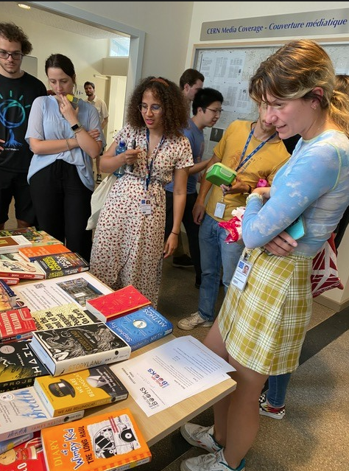
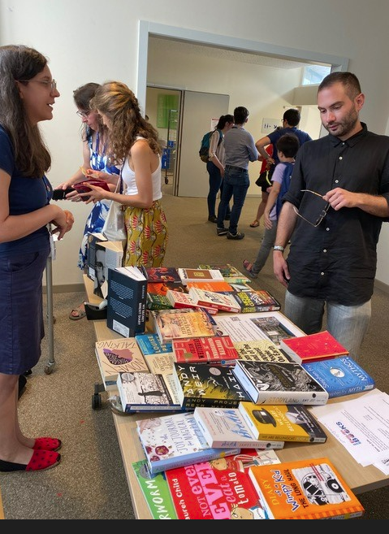
2022
June promotions table
AGM 16/03/2023

Slide 7
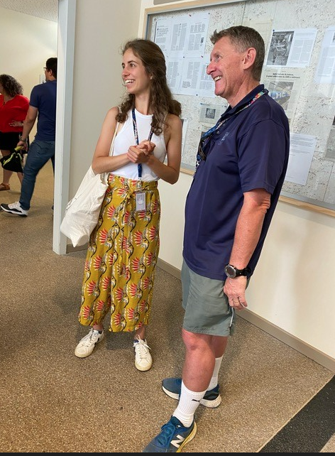
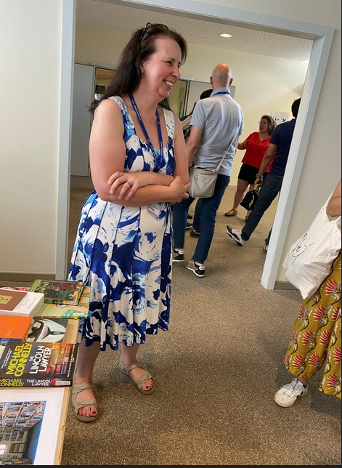
2022
June promotions table
AGM 16/03/2023

Slide 8
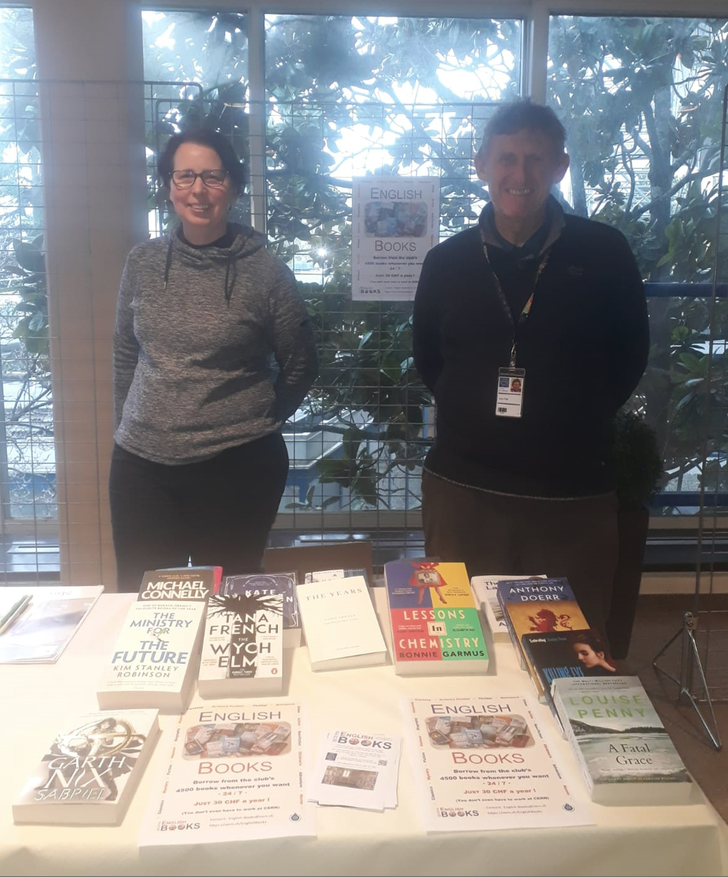
2022
Onboarding stand in November
AGM 16/03/2023

Slide 9
Once again thanks
To the committee members:
  Kate (secretary)
  Sharon (treasurer)
  Eva (rooms)
  Sergio (book selection)
  Klaudia (website and Mattermost).
AGM 16/03/2023

Slide 10
Any questions ?
AGM 16/03/2023

Slide 11
Programme for 2023 – much to-do!
To-do list:
  Call for subscriptions to go out soon, subject to decision on subscription rates under previous agenda item
  Spring book selection
  Solve the heating problem in the club rooms ?
  Attract new members – promotions tables, onboarding, Club membership for Jardin des Particles – TBD
  Data privacy notice
  Spring/autumn cleaning?
AGM 16/03/2023

Slide 12
2023 – To be discussed
Partnership with Jardin des Particules
Meeting with new Director, Roberta, and English teacher, Justina
Two possible schemes:
  Jardin holds regular reading classes for the children in our book rooms (books to remain in place)
  EBC to take part in "Reading Day" , held either in our club rooms or in kindergarten premises
Institutional membership ?
Membership fee ?
AGM 16/03/2023

Slide 13
2023 – To be discussed
Appeal from CERN Record (DVD) club President (Martin Jaekel) to save their collection – about 2000 films
Club members almost exclusively retirees
Club membership dwindled close to zero due to combined effects of pandemic and competition with Netflix etc.
Would we be prepared to house their collection in our club rooms and/or merge with them?
AGM 16/03/2023

