Slide 1

Bunch length monitoring with Electro-optical sampling at CLEAR
E. Senes, A. Schloegelhofer, S. Mazzoni, T. Lefevre

Slide 2
1
The CLEAR facility
2
Past implementations
3
Experiment proposal
4
Discussion

Slide 3
The CLEAR facility

Slide 4
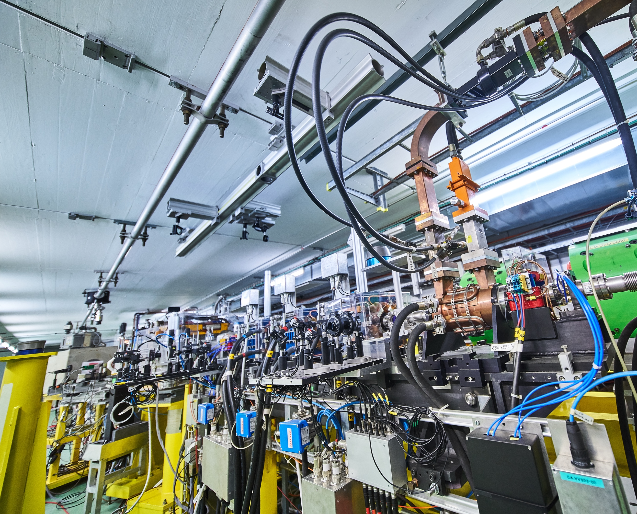
CLEAR@CERN
Electron test beamline for internal and external users
Beam parameters
Energy 60-220 MeV
Charge 0.01 – 1.5 nC
Bunch length (1σ) 100 fs – 5 ps
Rep. rate 0.8 – 10 Hz
Full details in D. Gamba et al., The CLEAR user facility at CERN, NIMA 909 (2018) pg. 480-483
CERN-PHOTO-201711-271-18

Slide 5
CLEAR@CERN
Interesting building blocks:
SPECTROMETER
USER STATION #1
eGUN
3x ACCELERATING SECTIONS
DUMP
PREVIOUS TEST AREA
RF DEFLECTOR

Slide 6
CLEAR@CERN
Interesting building blocks:
SPECTROMETER
USER STATION #1
eGUN
3x ACCELERATING SECTIONS
DUMP
PREVIOUS TEST AREA
RF DEFLECTOR
Existing bunch length measurement:
Deflecting cavity + screen
Destructive measurement
Resolution ~100 fs sigma

Slide 7
CLEAR@CERN
Interesting building blocks:
SPECTROMETER
USER STATION #1
eGUN
3x ACCELERATING SECTIONS
DUMP
PREVIOUS TEST AREA
RF DEFLECTOR
Previous EOS measurements in vacuum
In just few slides …

Slide 8
CLEAR@CERN
Interesting building blocks:
SPECTROMETER
USER STATION #1
eGUN
3x ACCELERATING SECTIONS
DUMP
PREVIOUS TEST AREA
IN-AIR TEST AREA
RF DEFLECTOR
Proposed EOS new measurement
In air, at the end of the beamline

Slide 9
In-vacuum implementation
With some slides taken from M. Bergamaschi, others from S. Mazzoni, a few stolen from I. Gorgysyan … I even did some by myself !

Slide 10
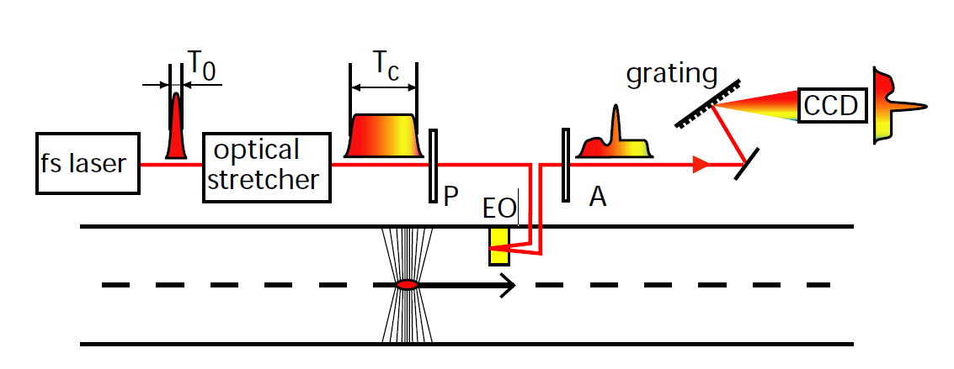
In-vacuum system
Redesigned chamber installed in 2019
Laser reflected from the back surface of the crystal (non-metallic coating)
B. Steffen et al. Proc. DIPAC09 (2009)

Slide 11
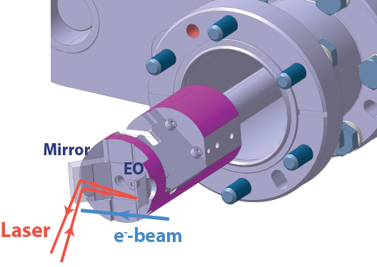
In-vacuum system
Redesigned chamber installed in 2019
Laser reflected from the back surface of the crystal (non-metallic coating)
B. Steffen et al. Proc. DIPAC09 (2009)

Slide 12
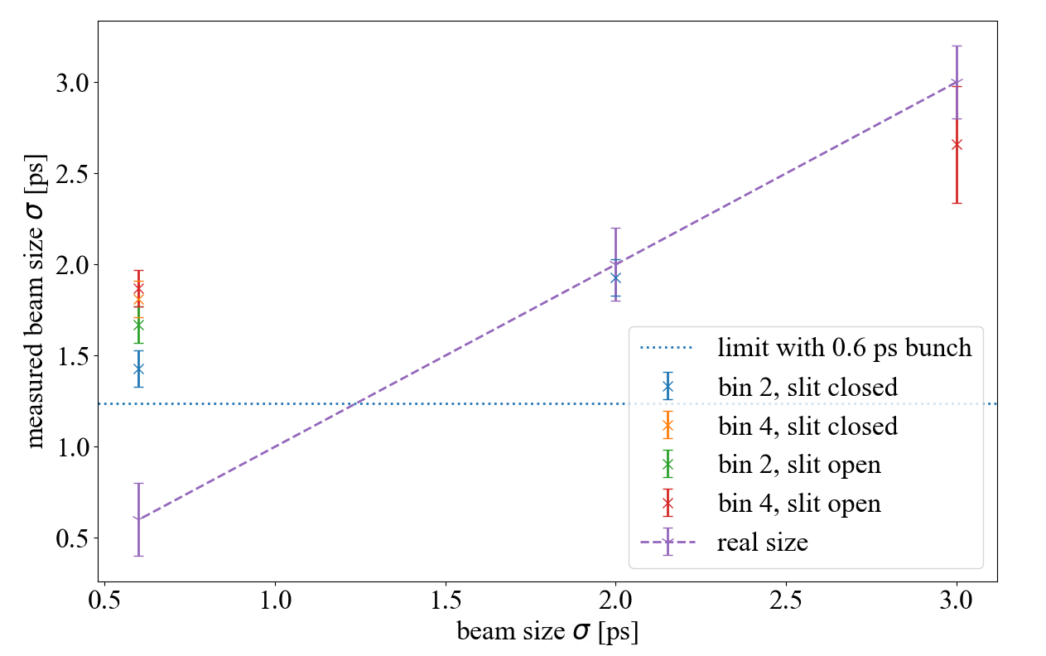
Results
M. Bergamaschi
First measurement in 2020
ZnTe crystal
Resolution limited by the 3 mm-thick crystal (0.7 ps)

Slide 13
In-air setup proposal

Slide 14
Why a new design ?
The in-vacuum design is quite difficult to align.
Need for a setup that allows for DEOS.
It is now possible to leverage the recently installed fibre infrastructure.

Slide 15
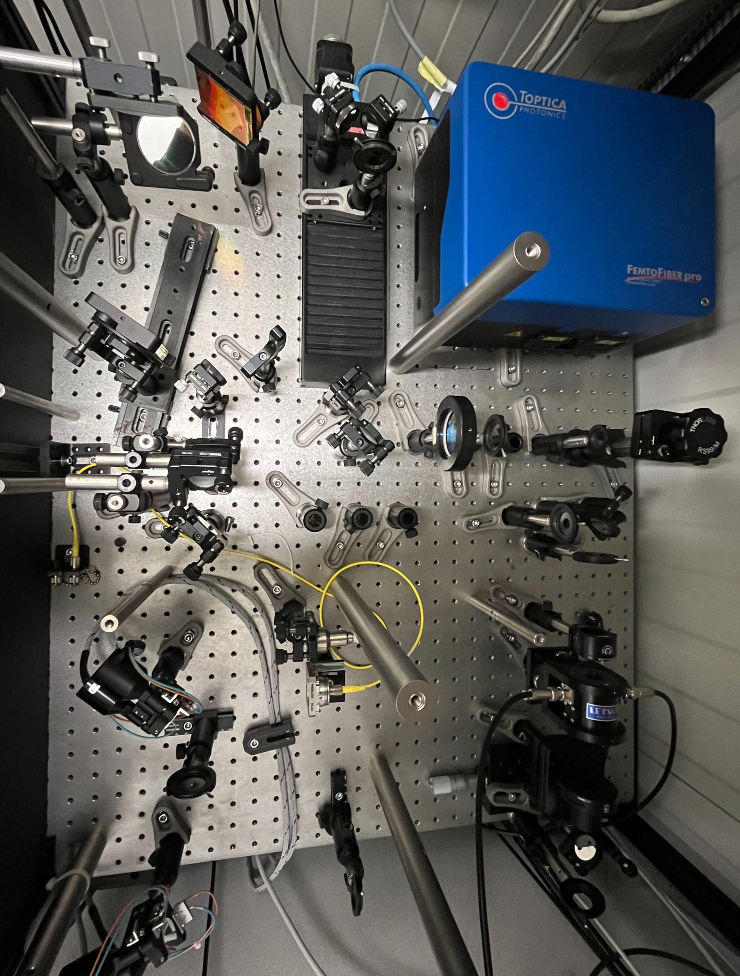
Laser system
DELAY
STAGE
GRATINGS
LASER UNIT
The 780 nm laser system produces a chirped pulse of ~10 ps (1σ)
Pulse avg. power < 200 mW
Pulse repetition 13 ns
IN-FIBRE
LASER
The pulse is sent to the setup in a PM fibre. The pulse stretching in the fibre is to be measured.
IN-FIBRE
COUPLING
POCKELS
CELL

Slide 16
Bunch length measurement setup
IN-FIBRE POLARIZING BEAM SPLITTER
POL1
SM
Laser launch
POL2
COLLIMATOR
Laser polarisation defined by the PM fibre orientation (and launch collimator rotation)
QWP
HWP
CRYSTAL
Launch collimator to keep the beam size at the crystal of ~1-2 mm
POLARISER
HWP
HWP and polariser to set the polarisation at the crystal
LASER
BEAM
COLLIMATOR
LASER SYSTEM
PM FIBRE

Slide 17
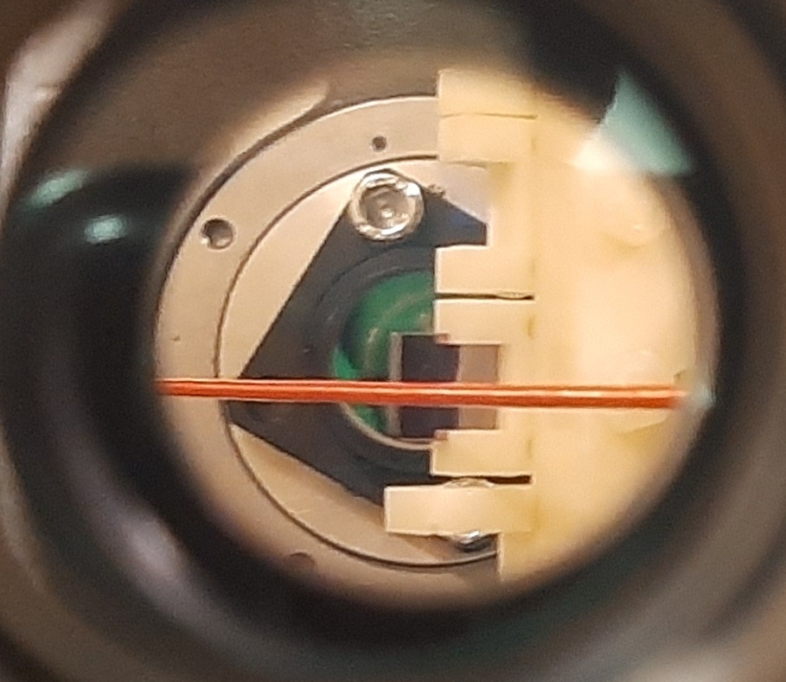
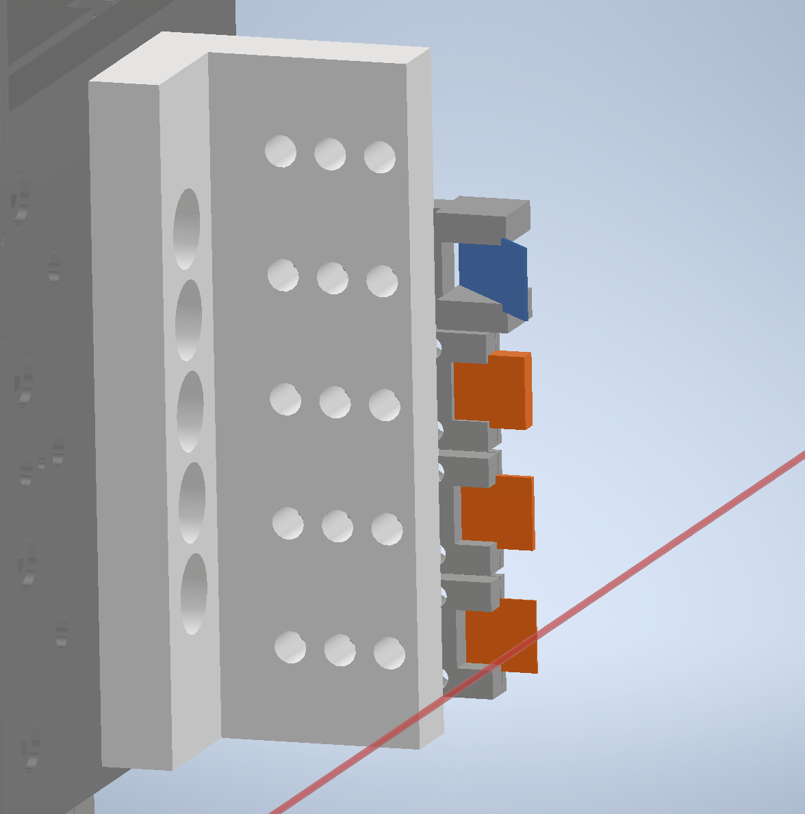
Bunch length measurement setup
IN-FIBRE POLARIZING BEAM SPLITTER
CRYSTAL
POL1
SM
EO crystals
POL2
COLLIMATOR
BEAM
OTR/YAG screen mount for beam alignment.
QWP
HWP
VIEW FROM HWP
3D printed holder for 3 crystals + beam screen.
CRYSTAL
ZnTe crystals in inventory (110)
(110) cut
4, 2, 1, 0.5, 0.3 mm thickness
POLARISER
OTR
HWP
EO
CRYSTALS
LASER
BEAM
COLLIMATOR
LASER
LASER SYSTEM
PM FIBRE
BEAM

Slide 18
Bunch length measurement setup
IN-FIBRE POLARIZING BEAM SPLITTER
POL1
SM
Coupling back to fibre
POL2
BEAM
COLLIMATOR
Motorised QWP and HWP to tune the fibre coupling.
HWP
QWP
CRYSTAL
Polarizing beam splitter in-fibre splits the 2 orthogonal components.
POLARISER
Multimode fibres from the beam splitter output
HWP
LASER
COLLIMATOR
LASER SYSTEM
PM FIBRE

Slide 19
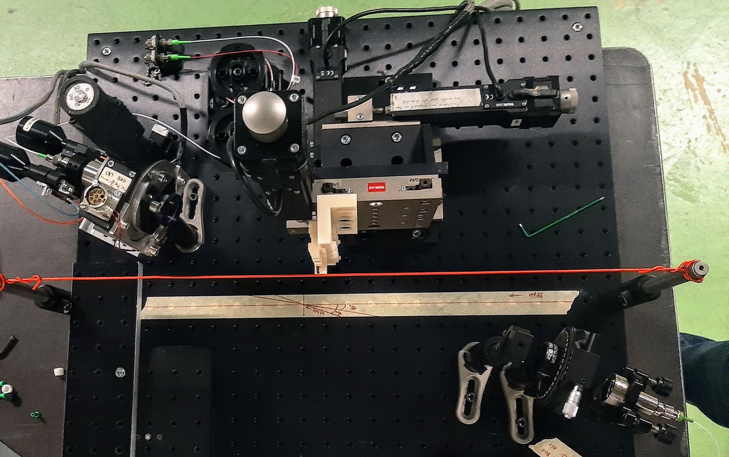
How does it look like
IN-FIBRE POLARISING BEAM SPLITTER
TO OPTICS LAB
2+1D
MOTORISED
COLLIMATOR
3D STAGE
MOTORISED
HWP
CRYSTAL ARRAY
MOTORISED
QWP
BEAM
LASER
LAUNCH
COLLIMATOR
FIXED POLARISER
HWP
FROM
OPTICS
LAB

Slide 20
Timing alignment setup
IN-FIBRE POLARIZING BEAM SPLITTER
TIMING FIBRE
POL1
SM
10% of the laser is split to a multimode fibre intercepting the beam at 45°.
POL2
COLLIMATOR
The beam generates Cherenkov light intercepting the fibre.
CRYSTAL
A 12 GHz photodiode is used to check align the laser and beam pulses. Streak camera is also an option.
POLARISER
HALF WAVEPLATE
LASER
90/10 IN-FIBRE SPLITTER
BEAM
LASER SYSTEM
COLLIMATOR
PM FIBRE

Slide 21
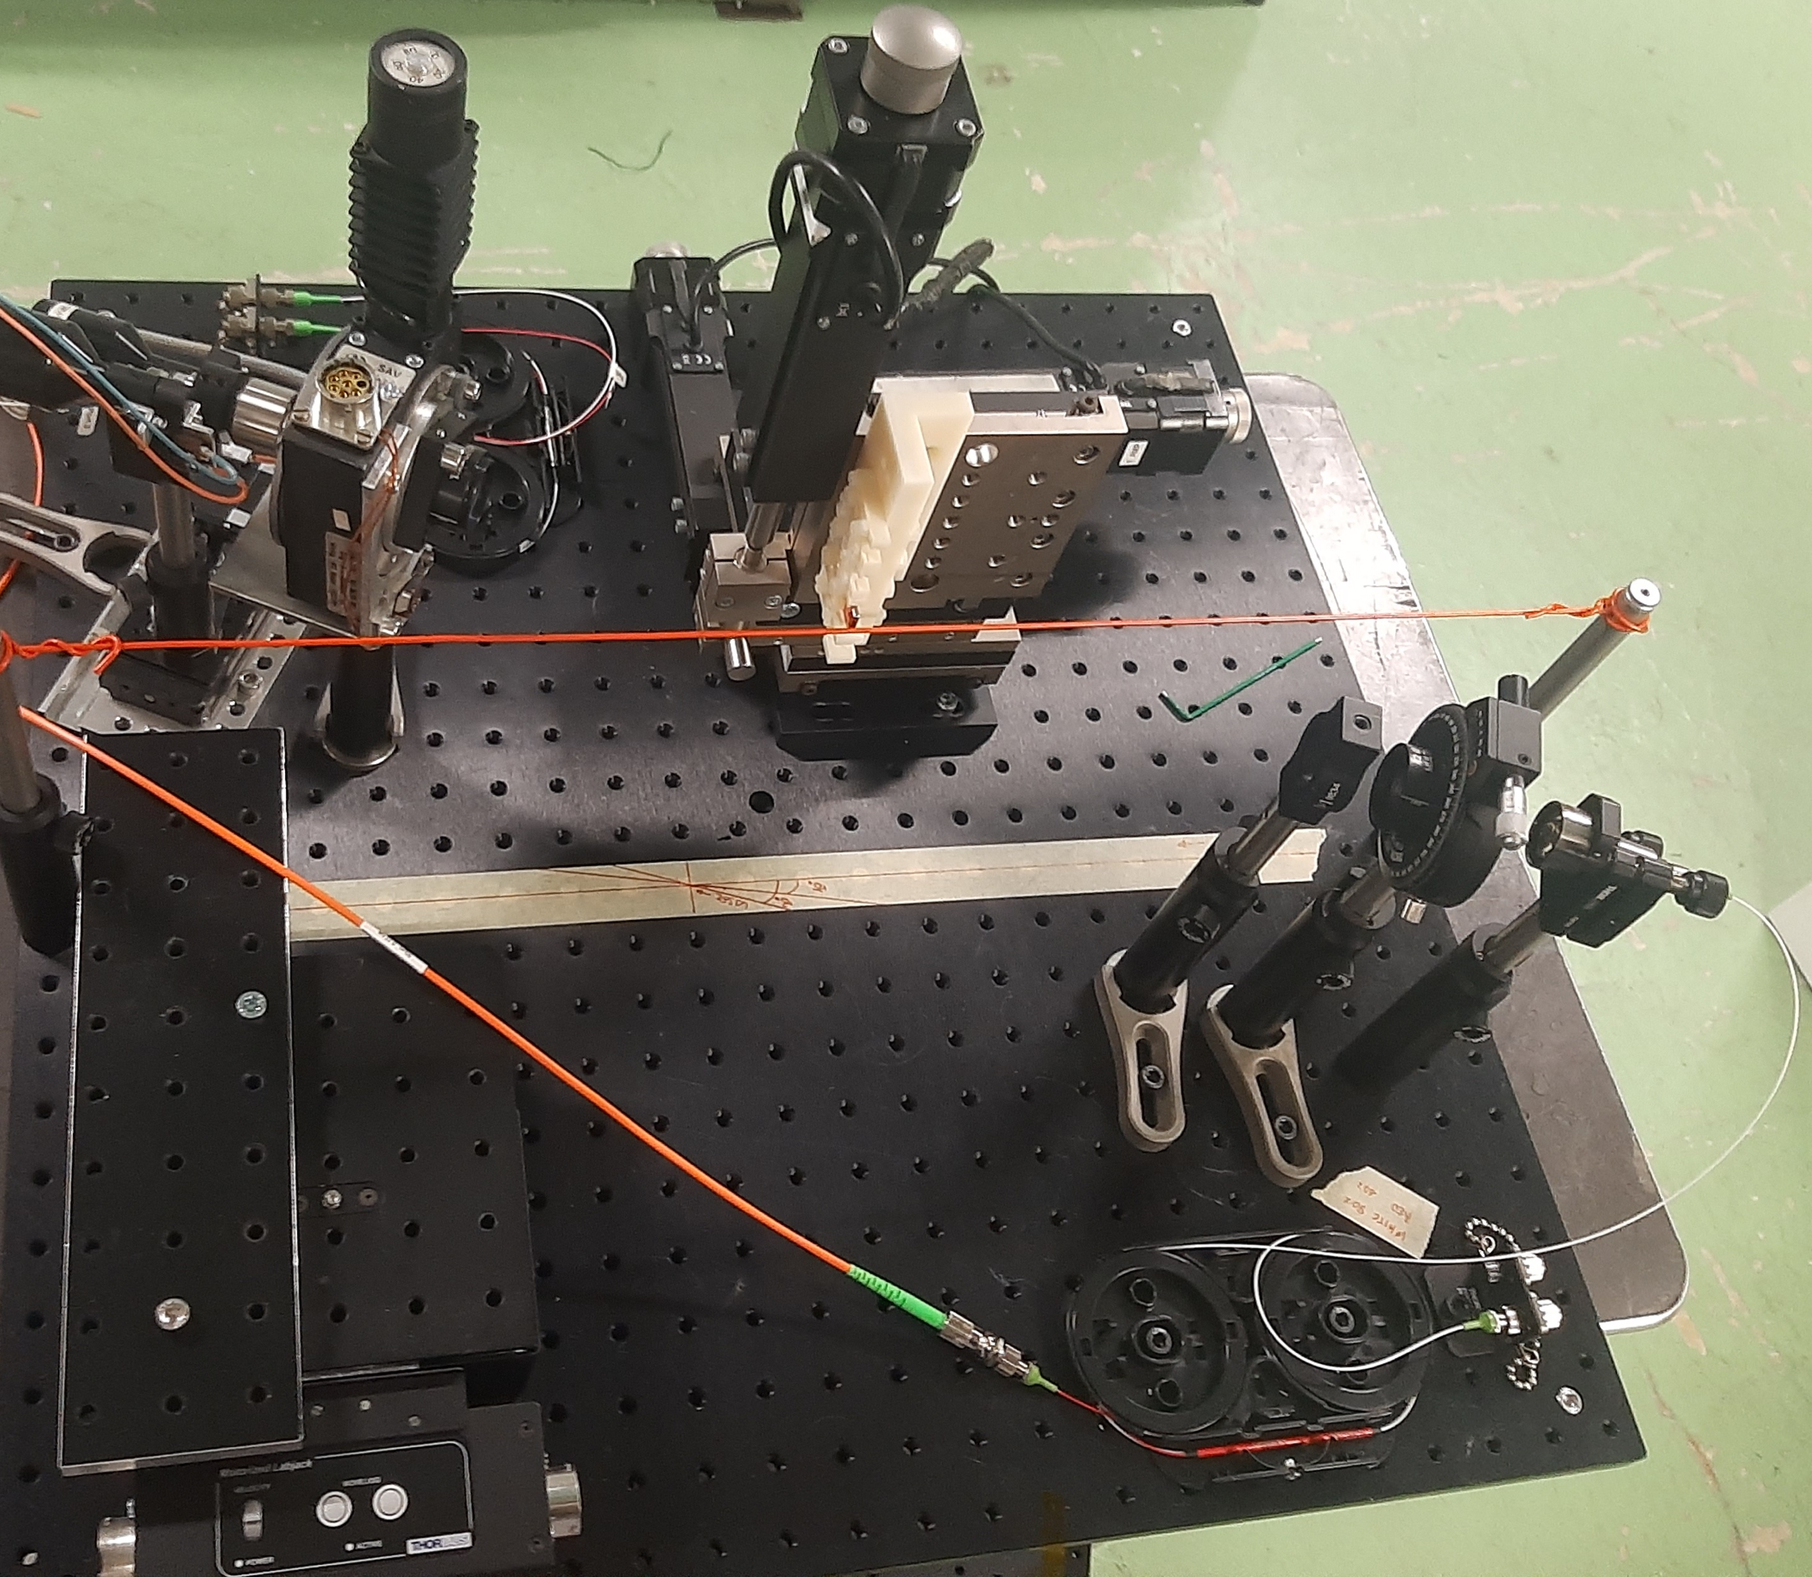
How does it look like
CRYSTAL ARRAY
Vertical stage up:
The fibre produces Cherenkov light to the 12 GHz photodiode
TO OPTICS LAB
BEAM
VERTICAL
STAGE
LASER
Vertical stage down:
The fibre brings the unmodulated laser reference to the spectrometer
LAUNCH
COLLIMATOR
FROM
OPTICS
LAB
MULTIMODE
FIBRE AT 45°
90/10
SPLITTER

Slide 22
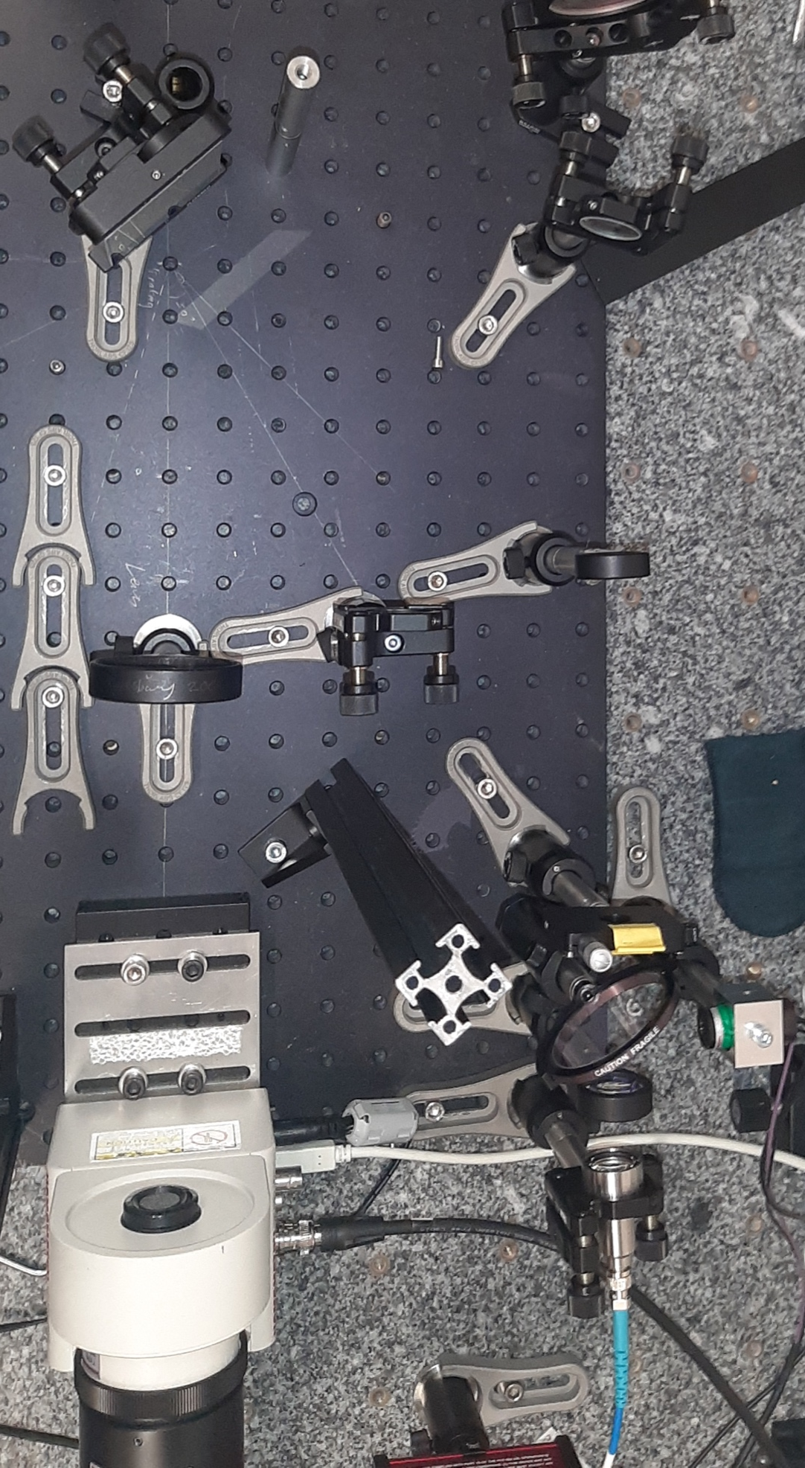
Spectrometer (current status)
GRATING
Developed for classic spectrally decoded EO sampling
Single fibre input
Past resolution for ps pulses:
0.29 nm = 0.47 ps (closed slit)
0.35 nm = 0.57 ps (open slit)
SLIT
BEAM
SPLIT.
PMT
IMAGE
INTENSIFIER
FIBRE
LAUNCHER

Slide 23
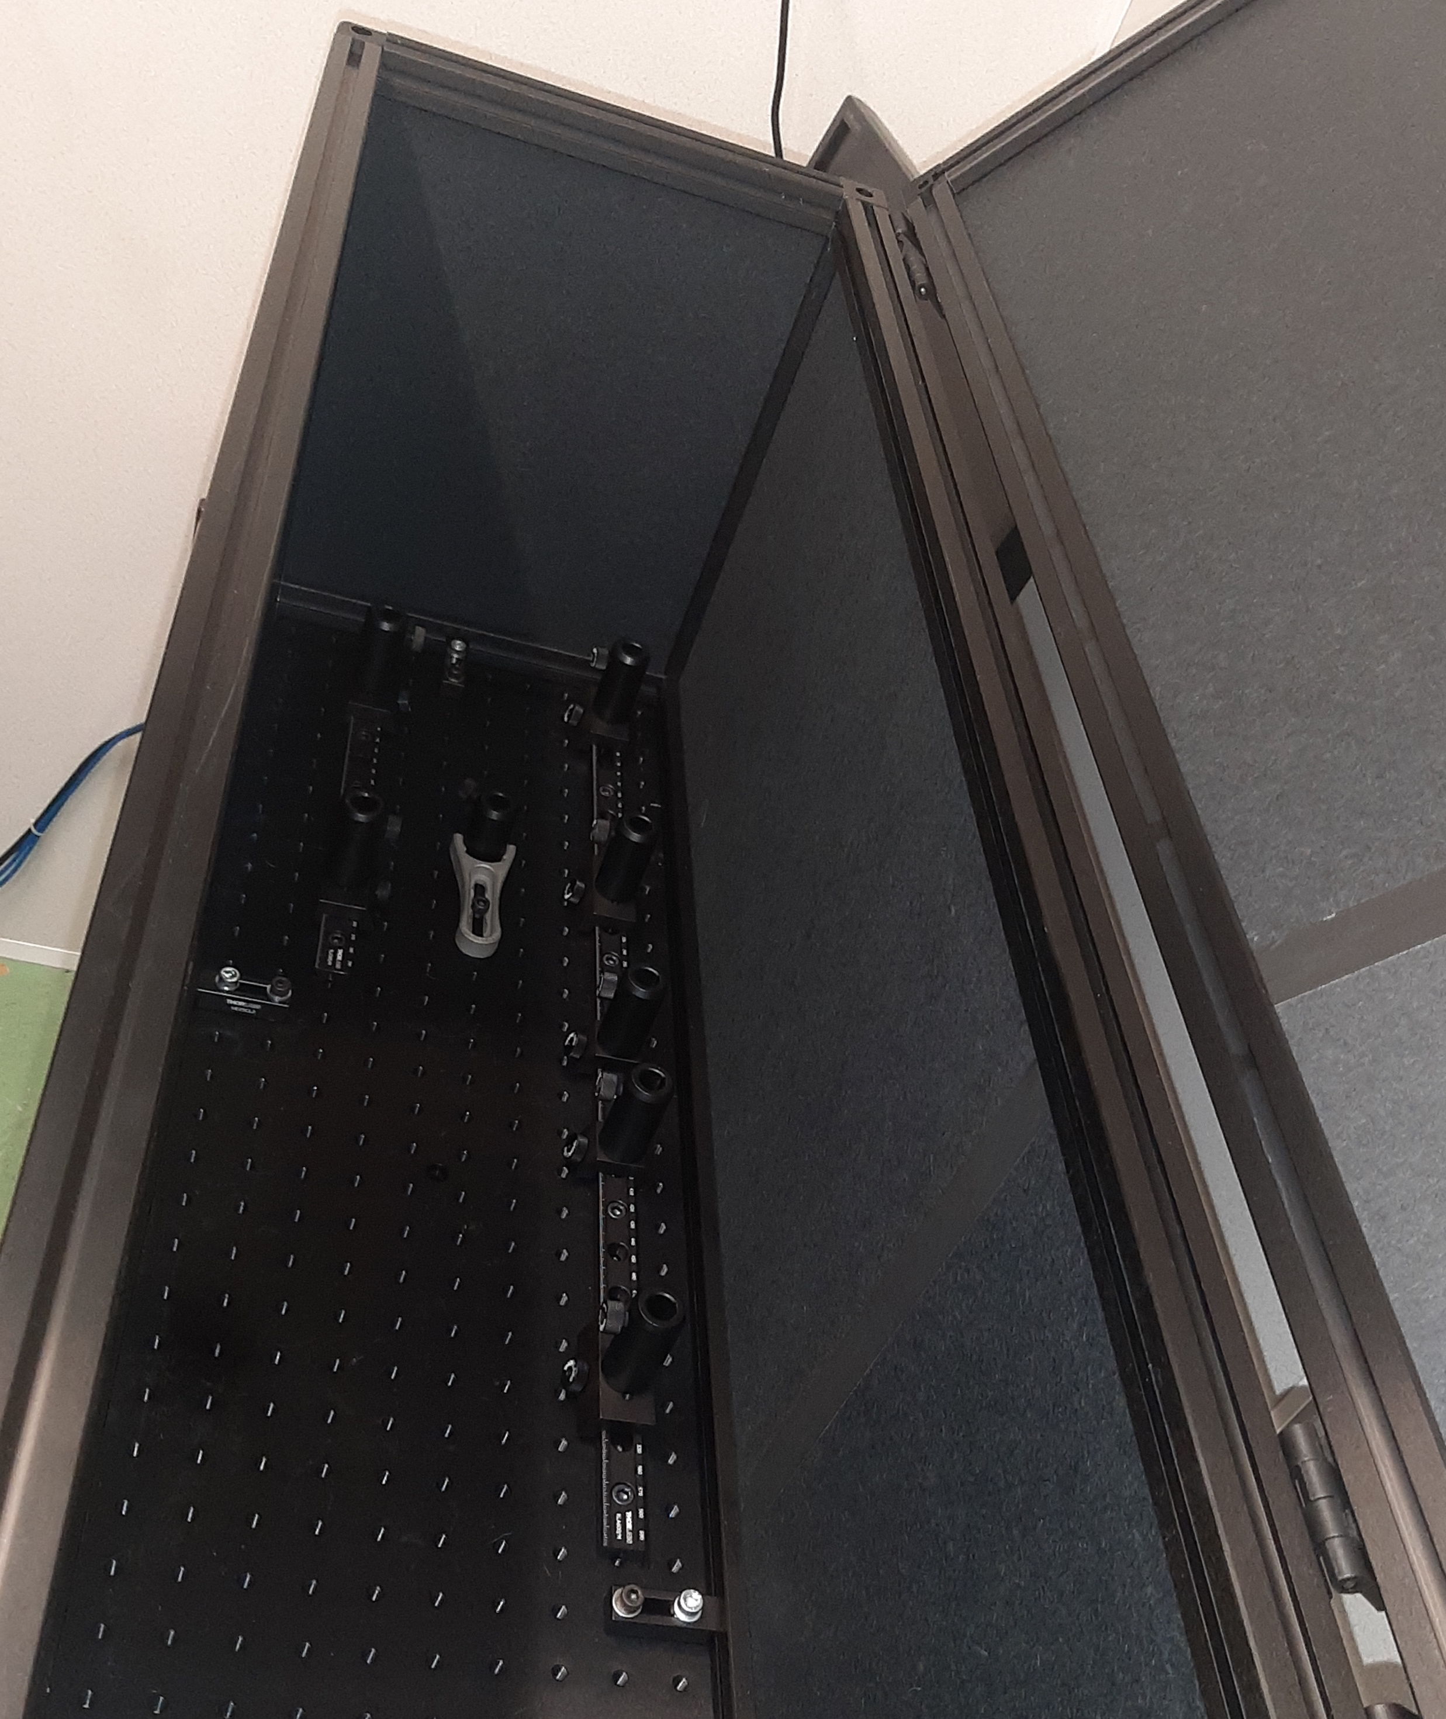
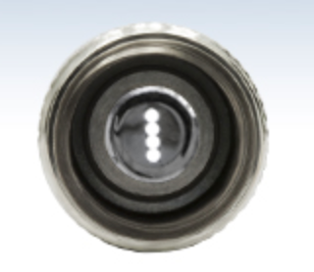
Spectrometer (after the upgrade)
Being developed for the DEOS technique
GRATING
Improved enclosure
4-to-1 input fibre bundle 1) Unmodulated pulse 2) Polarisation #1 3) Polarisation #2 4) Calibration lamp
IMAGE
INTENSIFIER
Transplant in progress … (next week)
FIBRE BUNDLE
LAUNCHER
Resolution to be assessed and possibly improved after the realignment
THORLABS
BFL44LS01

Slide 24

Thanks a lot for your help !!!
eugenio.senes@cern.ch

Slide 25
Backup

Slide 26
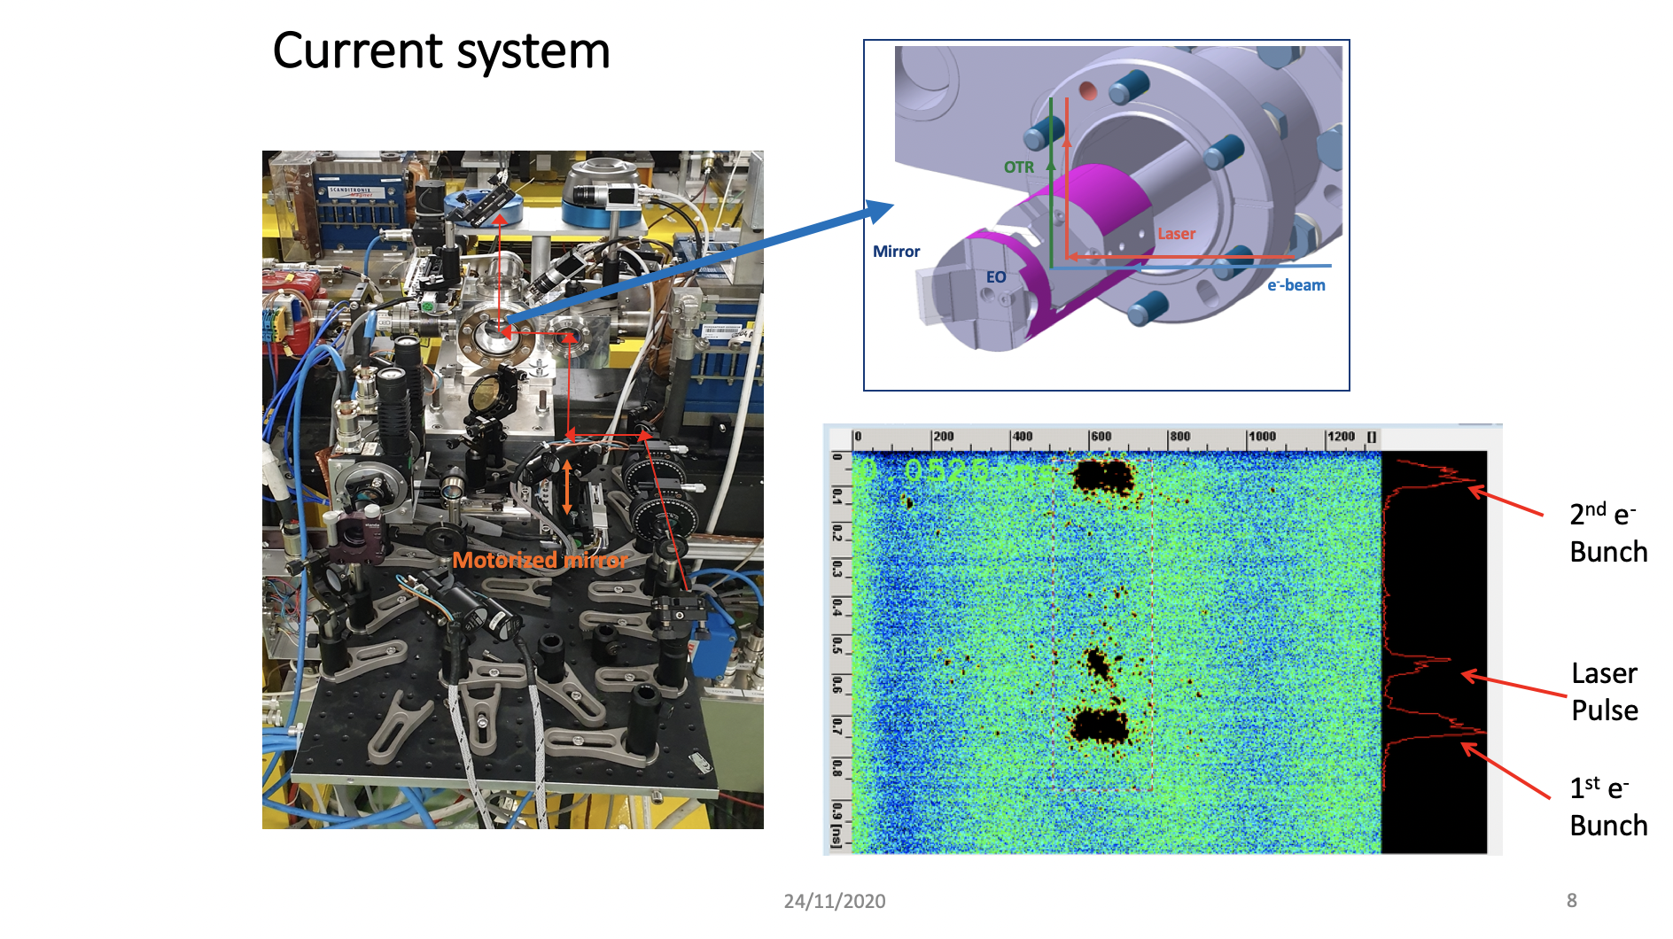

Slide 27
