Slide 1

ELI metrics
David Bereczkei
8 June 2023
Heptech best practice

Slide 2
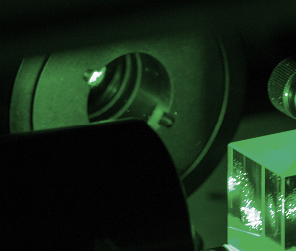
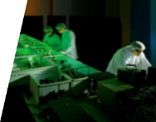
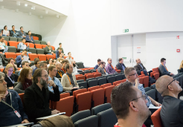
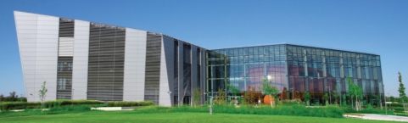
ELI ALPS achievements to date
Over 600 researchers
Over 1600 workshop participants
3 workshops
21 research groups
Over 435 peer-reviewed articles
433 summer school participants
from 43 countries
5 buildings
24 462 square metre floor space

Slide 3
ELI ALPS Project Numerical Indicators (GOP)
 | Result indicators by 2022 / 2032 | Values reached
Personnel
New researchers employed at the beneficiary organization | 110 | 100,3
Number of PhD degrees obtained using research infrastructure | 100 | 13
Number of MSc degrees obtained using research infrastructure | 60 | 2
Number of researchers involved during construction | 110 | 307
Science/publication
Number of research projects completed | 90 | 28
Number of scientific papers published in high-impact journals | 40 | 36
Number of scientific papers published in journals | 300 | 216
Building and equipment
Net square metres of experimental area (square metres) | 5700 | 6080
Net square metres of visitors’ and conference zone (square metres) | 1800 | 1890,07
Net square metres of buildings constructed (square metres) | 24300 | 24462
PR
Number of communication/publicity events held | 10 | 33
Number of conferences held | 12 | 13
Number of external visitors | 7 500 | 8300
Collaborations
Number of scientific institutions involved in research activity in the ELI ALPS | 30 | 21
Number of primarily market based professional R&D institutions involved in research activity in the ELI ALPS | 5 | 5
Number of non-EU scientific or professional R&D institutions involved | 10 | 4
Notes:
KATI

Slide 4
Indicators to be reached by end of major project
No. | Type of indicator | Name of indicator | Target value | Date | Definition
1 | GINOP KIMENETI | Experimental area in net square meters | 5 700 nm | 2017 | To be performed for the whole building, not separately Announced already in EDIOP report no. 1
2 | GINOP KIMENETI | Visitor and conference area in net square meters | 1 800 nm | 2017
3 | GINOP KIMENETI | Buildings in net square meters | 24 300 nm | 2017
4 | GINOP KIMENETI | Number of research target chambers | 10 db | 2017
5 | Felhívás módosítás | Number of new researchers at the supported organization | 90 | 2020. | Announced in EDIOP report no. 3
6 |  | Number of researchers working in a facility with a better research infrastructure | 90 | 2020.
7 |  | number of scientific institutions involved in research activities in the ELI ALPS | 30 | 2020. | Announced in EDIOP report no. 4.
8 |  |  | 35 | 2023.
9 | GOP EREDMÉNY | Average statistical headcount - R & D male | 90/ 130 | 2021 | To be announced by 15 June 2022
10 | GOP EREDMÉNY | Average statistical headcount - R&D female | 40/ 130 | 2021
11 | GOP EREDMÉNY | Size of R & D & I service infrastructure created (net useful floor area) | 24300 | 2021
12 | GOP EREDMÉNY | Proportion of people in the key target group of equal opportunities (women, people with disabilities and Roma) in the new jobs created as a result of the program | 0,35 | 2021
13 | GOP EREDMÉNY | Increase in corporate gross value added (GVA) per unit of energy consumption in enterprises supported under relevant GOP interventions | 0,12 | 2021
14 | Felhívás módosítás | number of new laser systems pcs | 5 | 2022. | Valid for EDOP and EDIOP projects together subcommitments (2022,2023) to be reached by 31 December
15 |  | number of new laser systems pcs | 6 | 2023.
16 | GOP KIMENETI | Number of researchers employed during the construction phase | 110 fő | 2023 | The value determined by the indicator is cumulative and the duration of application is not relevant. To be reached by end of major project
17 | GOP KIMENETI | Number of female researchers employed during the construction phase | 33 fő | 2023
18 | GOP KIMENETI | Number of communication and press events | 10 db | 2023
19 | GINOP KIMENETI | The number of new researchers at the supported organization (male) | 110 FTE | 2023. | - Number of full-time equivalent R&D jobs created as a result of the project and filled by research engineers or MSc graduates in the last closed business year.
20 | GINOP KIMENETI | The number of researchers working in a performance with a better research infrastructure (male) | 110 FTE | 2023.
21 | GINOP KIMENETI | The number of new researchers at the supported organization (female) | 15 FTE | 2023.
22 | GINOP KIMENETI | Number of researchers employed during the construction phase (female) | 15 FTE | 2023.

Slide 5
Milestones of major project

Slide 6
Impact indicators by 2028 (2013/16, AF)
Number of scientific papers published in high-impact journals (pieces, minimum of) 40
Number of scientific papers published in journals (pieces, minimum of) 300
Number authors of EU citizenship publishing in high-impact scientific papers (persons, minimum of) 150
Number authors from the CEE region publishing in scientific papers (persons, minimum of) 500
Number of European patents (pieces, minimum of) 15

Slide 7
Output indicators (2013/16, AF)
Net square metres of experimental area (square metres), 5 700
Net square metres of visitors’ and conference zone (square metres) 1 800
Net square metres of buildings constructed (square metres) 24 300
Number of research target areas (pieces) 10
Number of researchers involved during construction (persons, minimum of) 110
Share of female researchers involved during construction (persons) 30%
Number of communication/publicity events held (pieces) 10

Slide 8
Result indicators and target values (2013/16, AF)
Number of experiments completed (pieces, minimum of) 150
Number of research projects completed (pieces, minimum of) 90
Number of PhD degrees obtained using research infrastructure (pieces, minimum of) 100
Share of PhD degrees obtained by female researchers (minimum of) 20%
Number of MSc degrees obtained using research infrastructure (pieces) 60
Share of MSc degrees obtained by female graduates (minimum of) 25%
Number of conferences held (pieces, minimum of) 12
Number of participants at conferences (persons, minimum of) 1500
Number of external visitors (persons, minimum of) 7 500
Number of scientific institutions involved in research activity in the ELI ALPS (pieces, minimum of) 30
Number of primarily market based professional R&D institutions involved in research activity in the ELI ALPS (pieces, minimum of) 5 *
Number of non-EU scientific or professional R&D institutions involved (pieces, minimum of) 10
Number of scientific personnel involved (persons, minimum of) 250 *
Share of female scientific personnel involved (minimum of) 30%
Share of scientific personnel of non-EU citizenship involved (minimum of) 10%

Slide 9
Metrics of innovations – ELI ALPS
Impact indicators of the ELI ALPS major project
No. of European patents by 2033: 15
Number of scientific papers published in high-impact journals – 40 by 2033
Number of scientific papers published in journals – 300 by 2033-ig
Output indicators:
  number of scientific institutions involved in research activites in the ELI ALPS – 35 by 2023
Apart from indicators listed above:
number of other forms of protection: e.g. utility model protection, possibly trademark (eg the planned ELI brand)
Number of purchases and investments qualified as R+D (requiring a SZTNH decision), we already have 20-25 such investments at the ALPS.
Knowledge transfer can include Summer Schools, scientific conferences (, seminars

Slide 10
Metrics of innovations – ELI-BL
Monetary – limited incomes from technology transfer (app. 3000 EUR/year)
Non-monetary
  Number of innovation-driven leads -app. 10
  Number of collaborations (contract/collaborative research, sponsored students) - 4 collaborations, 1 student
  Filed patents (national/international) - 3
  Marketed innovations (measured by leaflets/one-pagers/presentation materials/web/…) – 5

Slide 11
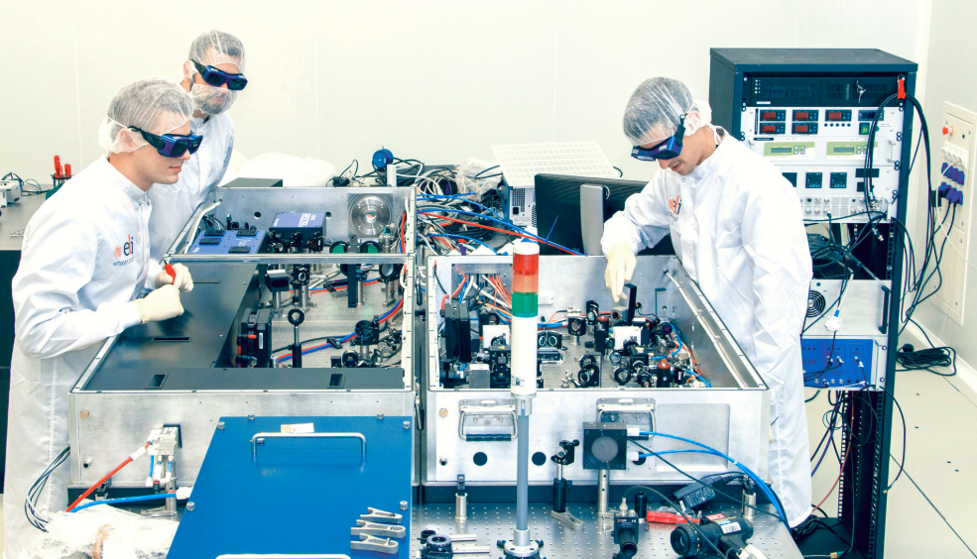
Research statistics
Registry | All Proposals | Finished Experiments | User projects in progress
INVITED USERS | 15 | 15 | 0
CUC19 | 17 | 9 | 0
CUC20 | 16 | 8 | 7
UC21 | 24 | 13 | 10
CUC23 | 2 | 0 | 2
ECA | 16 | 6 | 10
ERIC1st | 10 | 2 | 6
SUM | 88 | 53 | 35
Year | Scientific publications
2020 | 61
2021 | 43
2022 | 46
2023 | 9

Slide 12











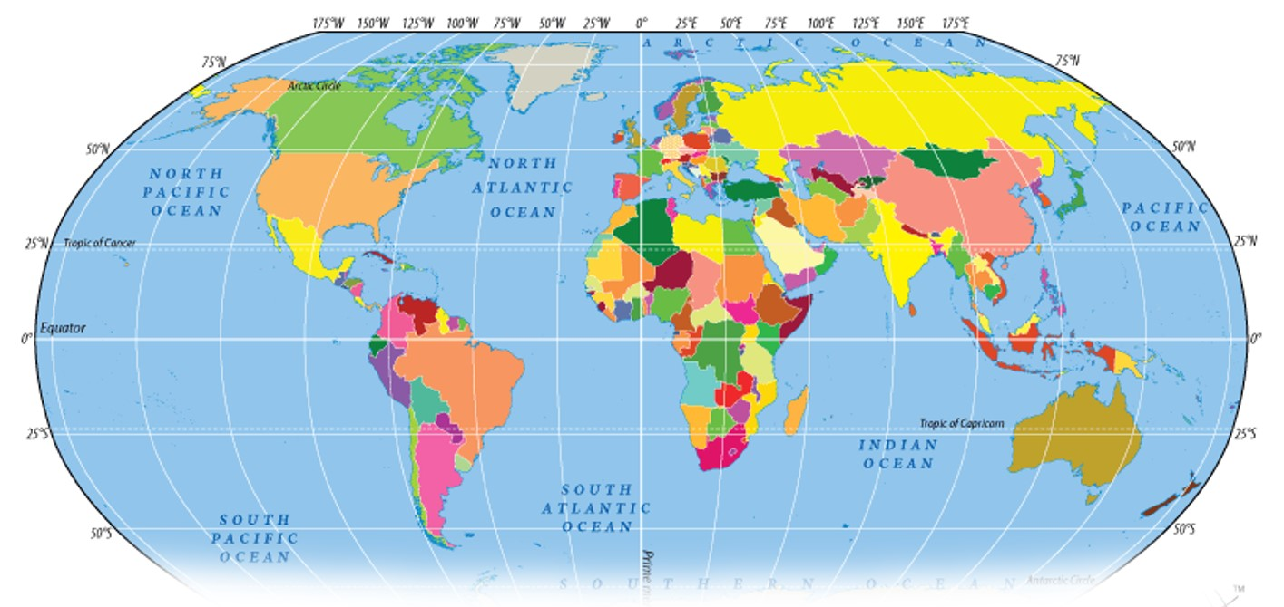
















ELI ALPS collaborations
AUT
DEN
SWE
FIN
NED
SUI
GER
FRA
KOR
CHN
USA
ISR
HUN
GRE

Slide 13
















Application areas
The ELI-ALPS facility provides users from the fields of scientific research and industrial applications with a unique combination of laser sources and secondary sources and enduser stations. The sources with globally unique parameters offer attractive opportunities for users in many application areas.
Gérard Mourou, the initiator of the ELI project, and his two colleagues received the Nobel Prize for a breakthrough in the field of laser technology: for converting light rays into powerful, high-precision devices.
Application areas:
Laser physics
Nuclear physics
Plasma physics
Molecular physics
Optics
Surface science
Biomedics
Inorganic chemistry
Cell biology
Applied spectroscopy
Biotechnology/medicine research
Radar technology
Nuclear waste treatment
Climate change
Archeology
Nano-technology

Slide 14
For further information please visit: https://www.eli-alps.hu/
Location:
6728 Szeged, Wolfgang Sandner u. 3.
E-mail: info@eli-alps.hu
Phone: +36 62 550 190
Thank you for your attention!

