Slide 1

Metrics
V. Venturi - E. Bains

Slide 2

HEPTech metrics
Knowledge Transfer Metrics - Towards a European-wide set of harmonised indicators
CAMPBELL Alison; CAVALADE Cecile; HAUNOLD Christophe; KARANIKIC Petra; PICCALUGA Andrea
“This report has been prepared by an Expert Group on Knowledge Transfer Metrics appointed by the Competence Centre on Technology Transfer of the EC's Joint Research Centre in partnership with the Association of European Science & Technology Transfer Professionals (ASTP).”
https://publications.jrc.ec.europa.eu/repository/handle/JRC120716

Slide 3
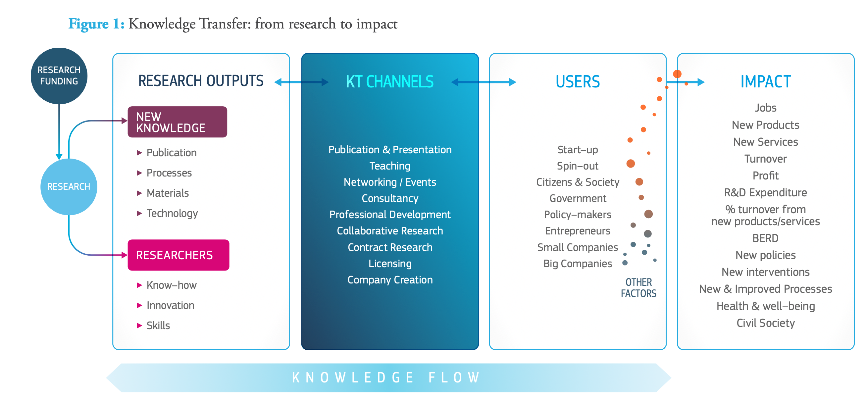
HEPTech metrics
https://publications.jrc.ec.europa.eu/repository/handle/JRC120716

Slide 4
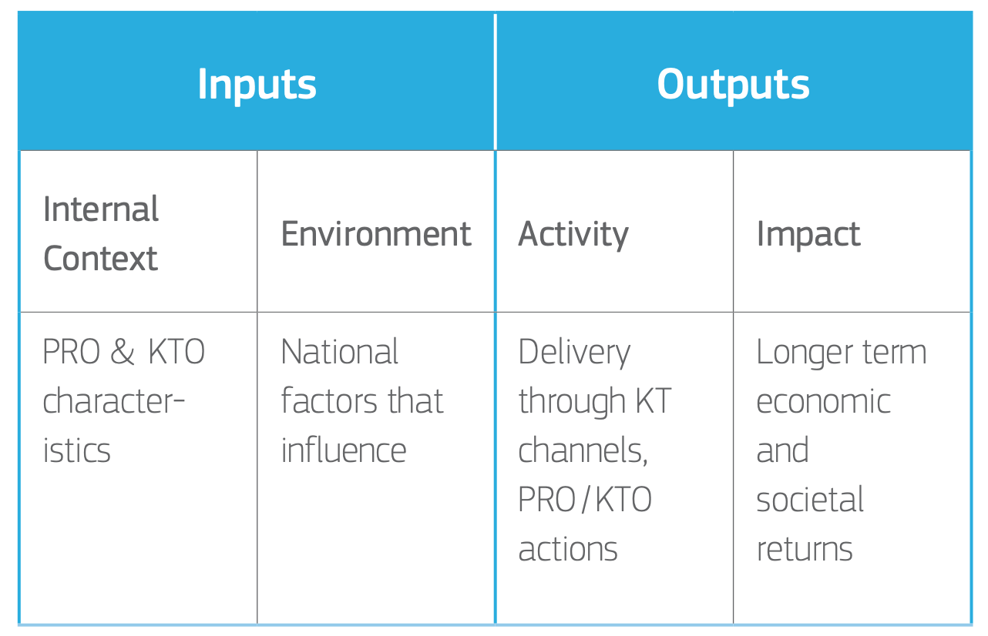
Inputs and outputs
Given the breadth of KT, the significance of underlying factors and the desire to balance complexity with simplicity, it is recommended that a core set of indicators is combined with a supplementary set of indicators and that a number of contextual indicators are also reported.
https://publications.jrc.ec.europa.eu/repository/handle/JRC120716

Slide 5
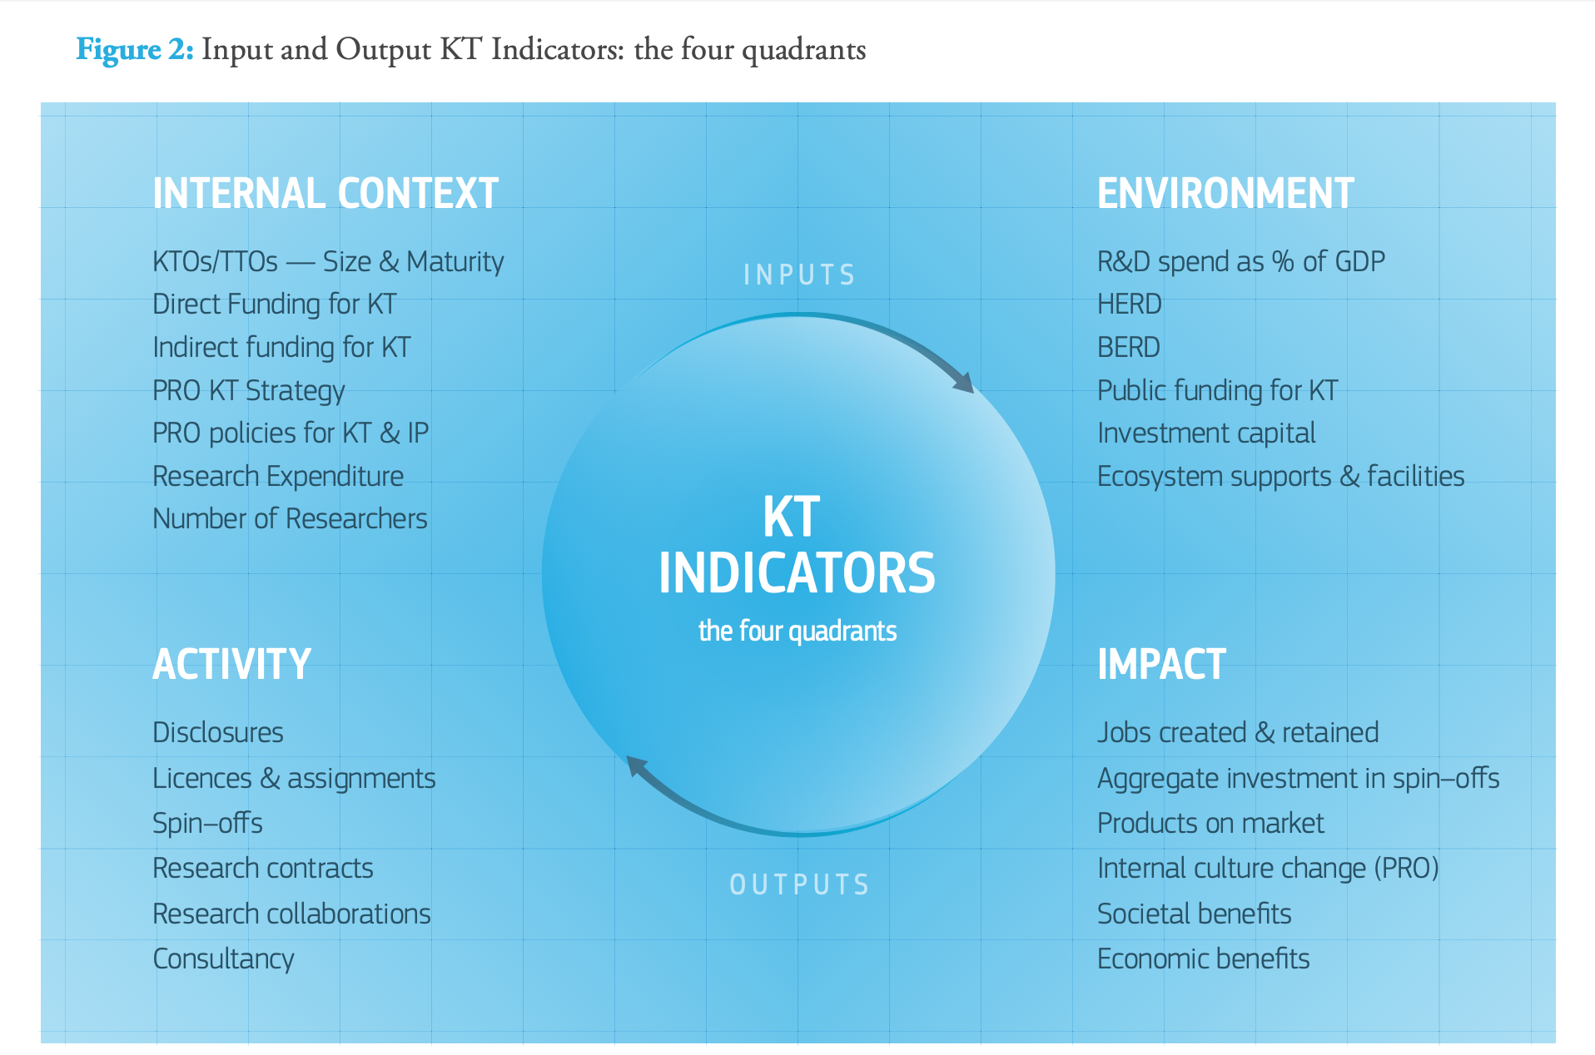
HEPTech metrics
https://publications.jrc.ec.europa.eu/repository/handle/JRC120716

Slide 6
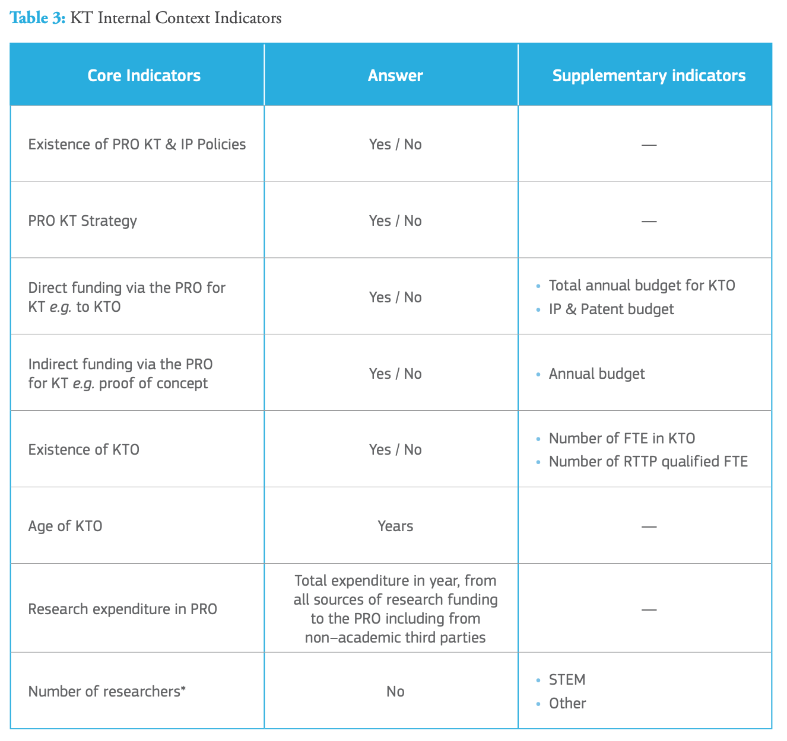
HEPTech metrics
https://publications.jrc.ec.europa.eu/repository/handle/JRC120716

Slide 7
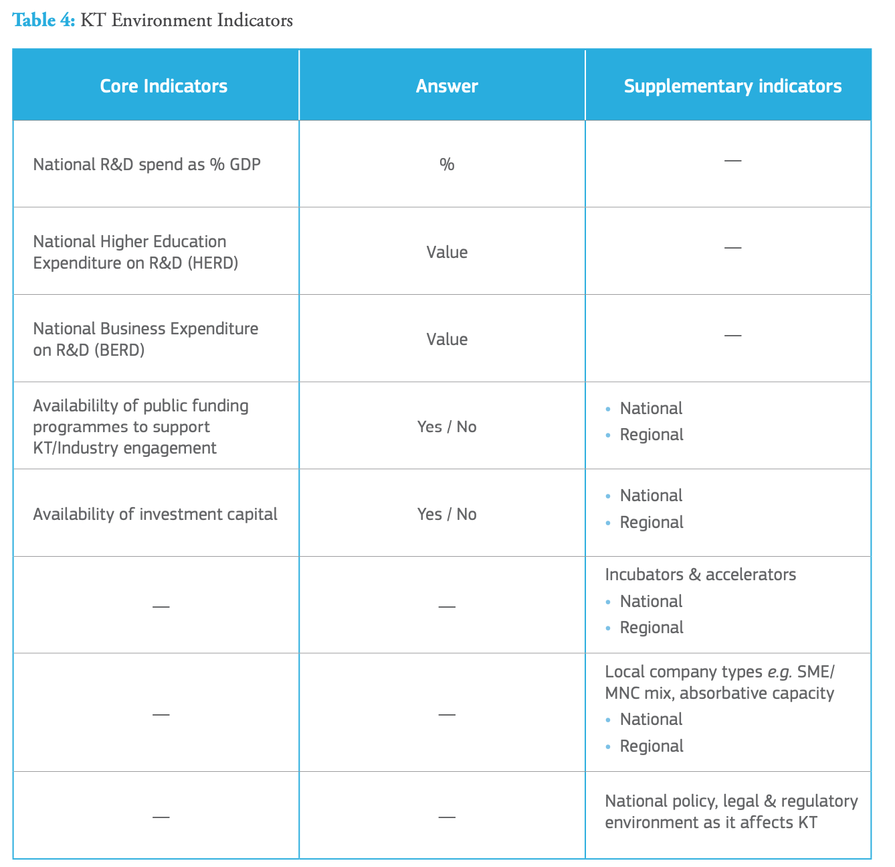
HEPTech metrics
https://publications.jrc.ec.europa.eu/repository/handle/JRC120716

Slide 8
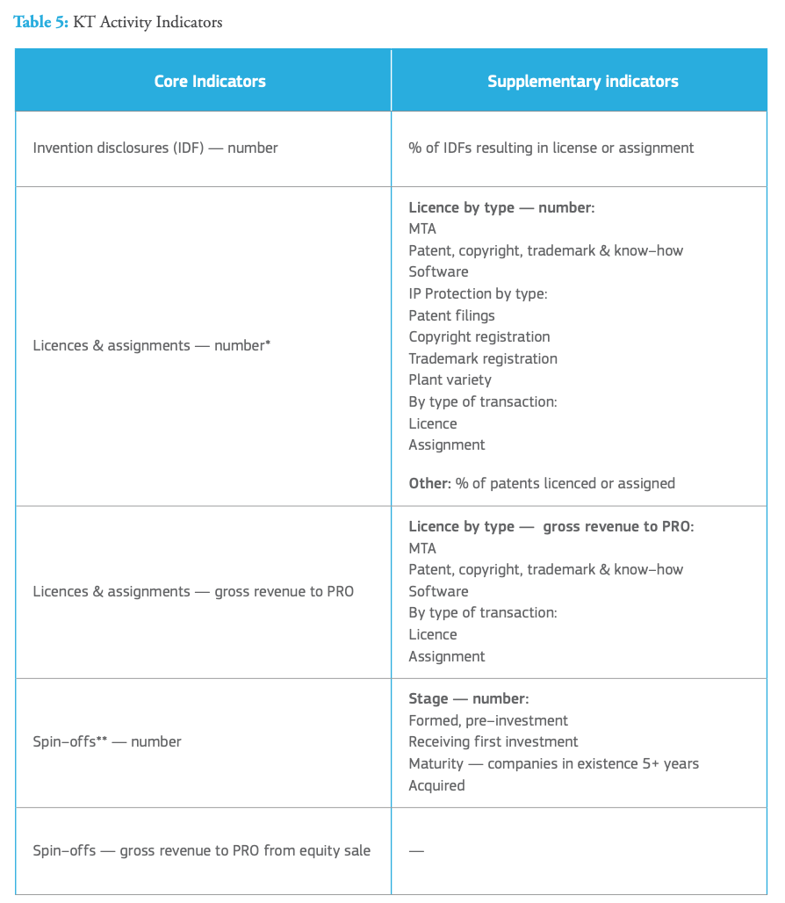
HEPTech metrics
https://publications.jrc.ec.europa.eu/repository/handle/JRC120716

Slide 9
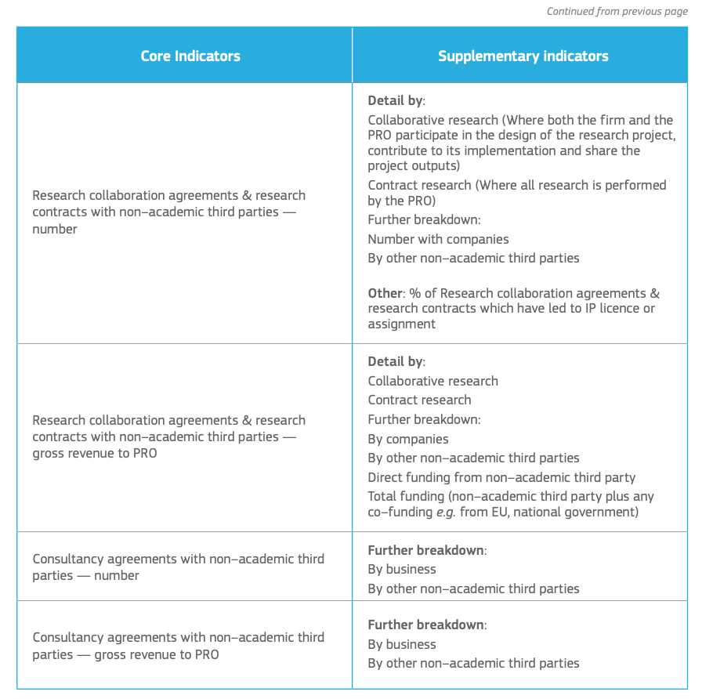
HEPTech metrics
https://publications.jrc.ec.europa.eu/repository/handle/JRC120716

Slide 10
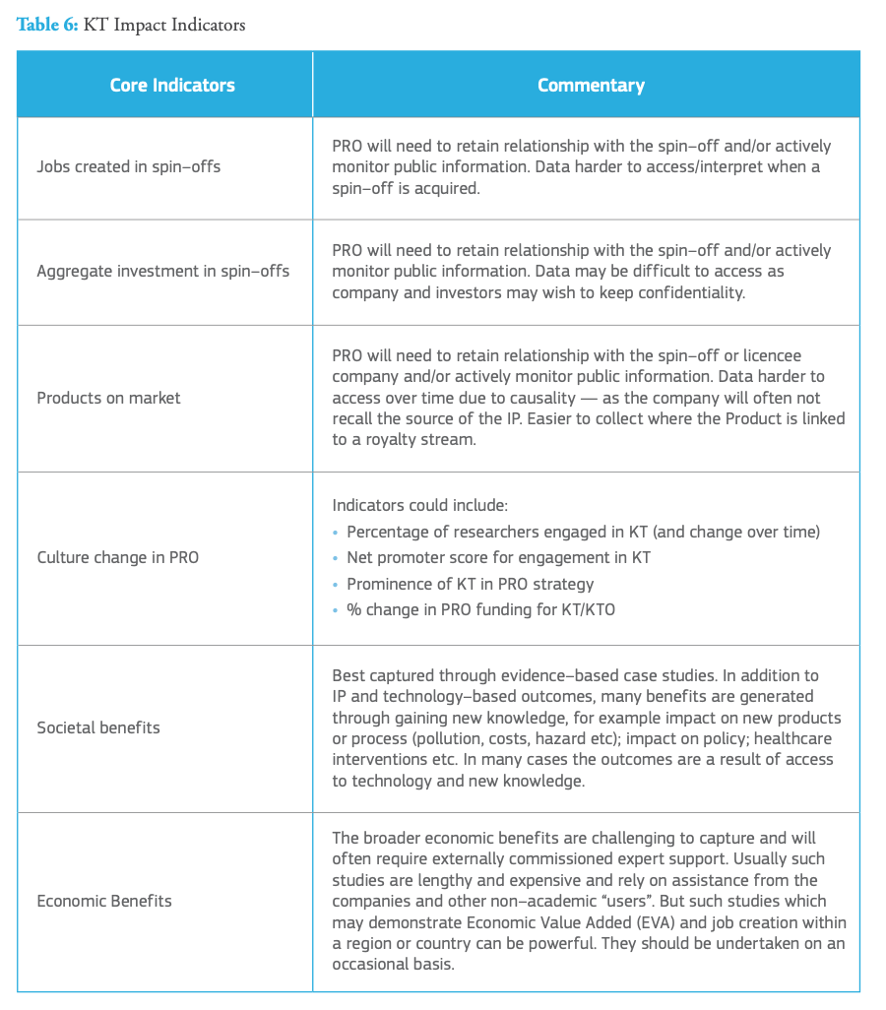
HEPTech metrics
https://publications.jrc.ec.europa.eu/repository/handle/JRC120716

Slide 11
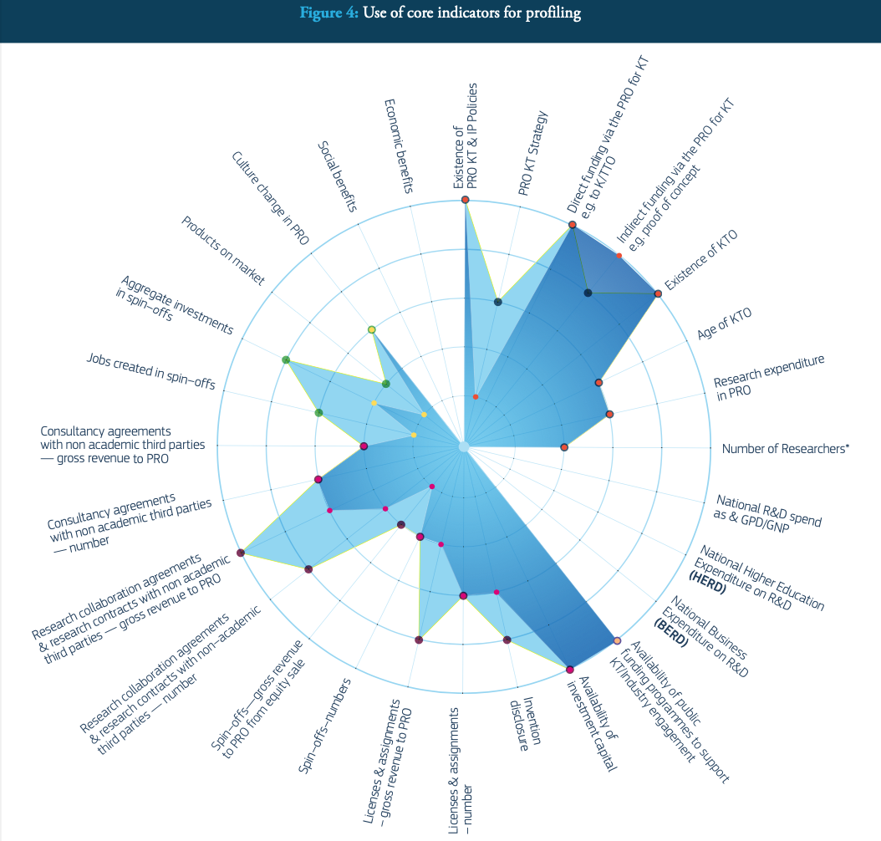
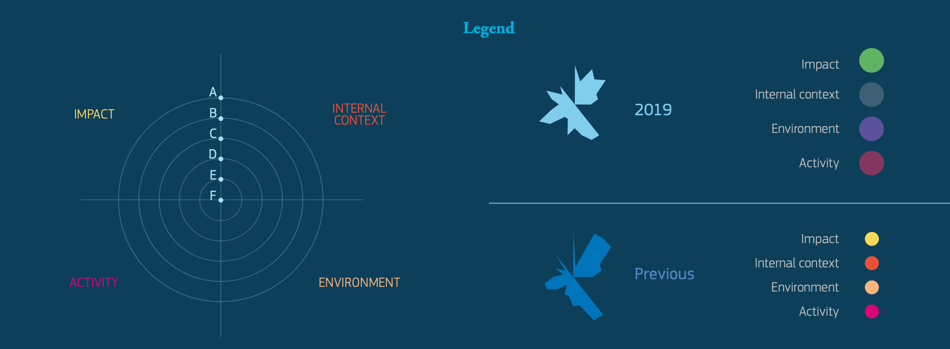
HEPTech metrics
Using indicators in practice:
In this case, the university is using the profiling as a self– assessment tool and scores itself across a number of indicators that it finds meaningful, where A — excellent; B — strong; C — moderate; D — emerging activity; E — not active.
https://publications.jrc.ec.europa.eu/repository/handle/JRC120716

Slide 12
Thank you for the attention!
V. Venturi-E.bains

