Slide 1
Feedback from Project Managers
PMO Team
20th March 2023

Slide 2
Feedback from Project Managers
Main contact | Group | Meeting date | Participants
Jose Benito | CA | 20/02/2023 | Jose, Lars
Thomas Baron | CA | 21/02/2023 | Vincent, Line, Thomas
Hugo Gonzalez | SD | 23/02/2023 | Hugo, Jan
Arne Wiebalck | CD | 24/02/2023 | Arne, Spyridon
Joao Gomes | CS | 24/02/2023 | Joao
Hannah Short | PW | 27/02/2023 | Hannah
Pablo Diaz | DA | 27/02/2023 | Pedro, Borja A, Borja G, Emil, Pablo
Domenico Giordano | GOV | 28/02/2023 | Domenico, Ewoud
Wayne Salter | FA | 06/03/2023 | Wayne, Olof, Jarek, Eric
Maria Girone | INN |  | Maria, Sofia, Stefan
Exchanges with representatives from all groups from IT
  Follow up after the Project Managers Workshop
  Preparation for the CoP meeting
One to one discussions or small groups
Summarised feedback is available in:
  https://codimd.web.cern.ch/YPdU0m7JRz2unNG-iMN6Ww#

Slide 3
Questions that were discussed
Are project related processes clear?
How to be more efficient
What are you missing from the PMO?
Do you find them useful? If not, what is it missing?
How could PMO do things different/better?
Do you have any concrete proposals?

Slide 4
Purpose & benefits are clear for the majority
Feedback Highlights
Purpose & benefits not clear for the majority
Strong resistance
Project Charters
This document is in general OK
Main Milestones/ Deliverables
Not clear how this information will be used:
  What happens if a deadline is not met?
  Who is responsible for verifying the expected completion date?
Extra burden for EU projects
Project Reports
Reports are already produced for other boards/meetings
Harmonise/centralise reporting before asking for yet another report
Extra burden for EU projects
Impact Reports
ITTF presentations are useful for dissemination
Inviting external stakeholders should be considered
If written report is needed (apart from slides + ITTF recording), it should be clear who validates/endorses it
Governance
Not clear project vs service and which one to use to ask for resources
Lightweight processes for small impact projects (only charter and impact report at the end) with clear criteria/definition of small vs big impact project
Incubation process for technical delivery is not clear
Not clear what happens when projects are deferred by DMRB
PMO is about project management, or about portfolio management, or both?

Slide 5
Back up slides

Slide 6






How we work together
Do projects right
Do the right projects
PMO
Engagement Channels Reps & Externally funded projects
Project Managers
Project Catalogue
Project Templates
Project Lifecycle
Project Reports
DHO + GLs
Tracking
Reporting
Liaising
Project Management
Best practices
Standards
Training
Community of practice
Strategy
Governance
PoW
Review Boards
Support

Slide 7
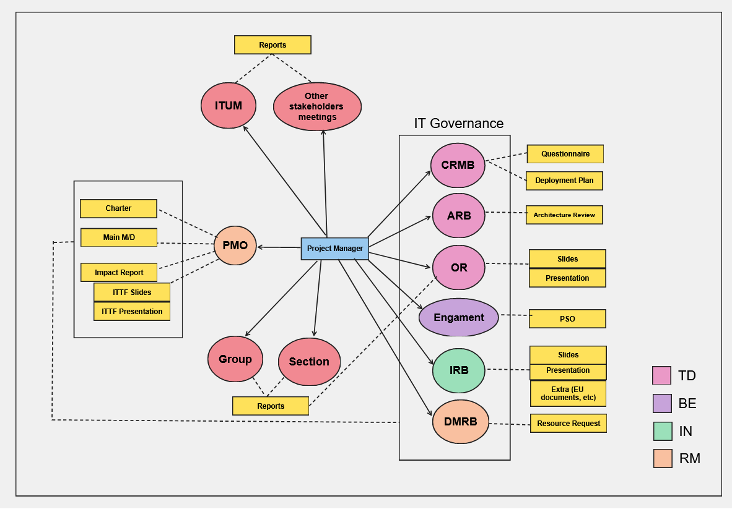
Documents requested to PMs (that PMO is aware of)

Slide 8
Status set by Ini pathways
Status set by PPR
Status set by DMRB
Status set by PMO
Incubating
Initiating
Planning
NO
NO
NO
NO
Pending Approval
Endorsed by Ini Pathway?
Accepted
Approved by DMRB?
YES
Approved
Resources allocated & plan ready?
YES
Plan pending approval
Approved for execution?
YES
YES
Rejected by Ini Pathway
Rejected by DMRB
Stopped
Stopped
Closed
Executing
Closing
YES
On-going
Review accepted?
NO
Impact Report Missing
Impact report submitted?
YES
NO
NO
End Date?
Requested extension?
Impact Report Under Evaluation
On hold
Extension pending approval
Impact report approved?
YES
YES
Extension approved?
NO
YES

