Slide 1
Update Slides
Sam Eriksen
24/02/2023 (DD/MM/YYYY)

Slide 2
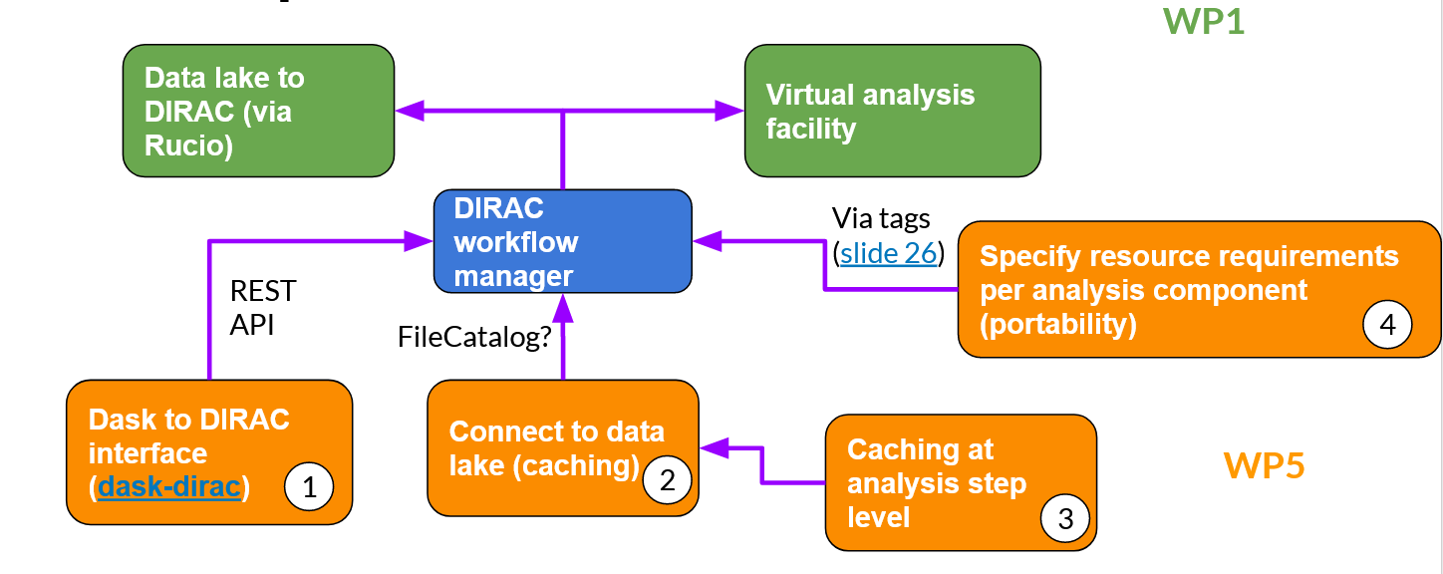
Overview
(dask-dirac)
Luke slides

Slide 3
Overview
(dask-dirac)
Luke slides

Slide 4
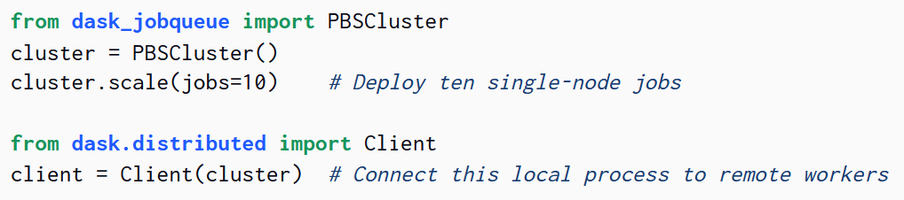
Steps for WP5 Step 1
Submit jobs via https
Create DIRAC dask-jobqueue
(dask-dirac)

Slide 5
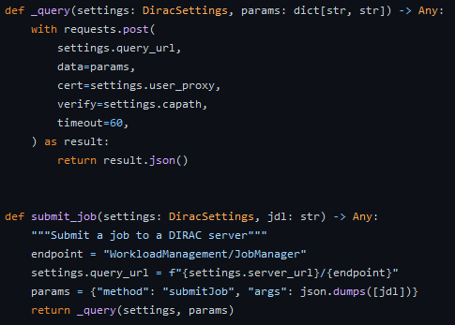
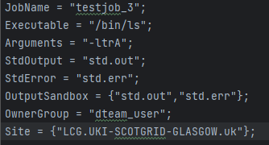
Job submission
Short story
Setup and working
Steps
Get diracos2
Get proxy
Write job description
Submit to https://lbcertifdirac70.cern.ch:8443

Slide 6
Dask jobqueue
Dask scheduler needs access to port 8786
New VM at Bristol setup for this
Waiting on port being open

Slide 7
Dask jobqueue
What do we want?
Replace PBSCluster with DiracCluster
Have workers running on grid
import DiracCluster
DiracCluster()

Slide 8
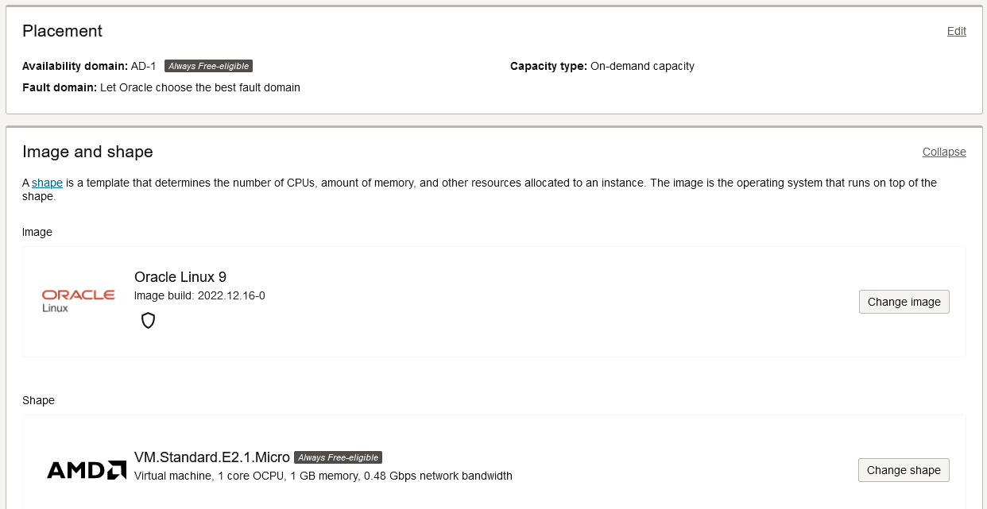
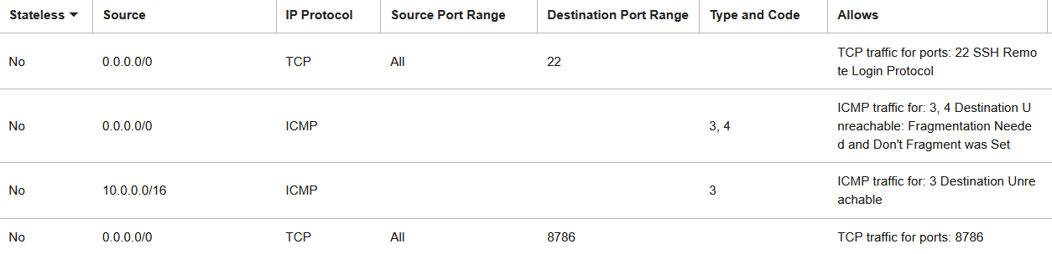
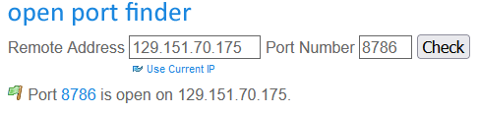
Dask jobqueue
Dask scheduler needs access to port 8786
New VM at Bristol setup for this
Waiting on port being open
Temporary solution;
Using Oracle Cloud (OCI)
Why?
a lot of previous experience with it
easy to manage
free tier account offers enough for this

Slide 9
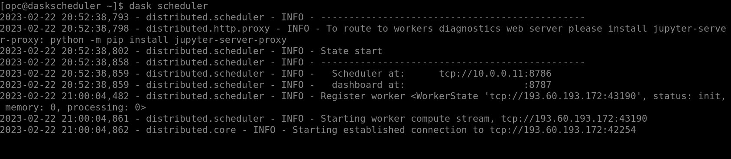
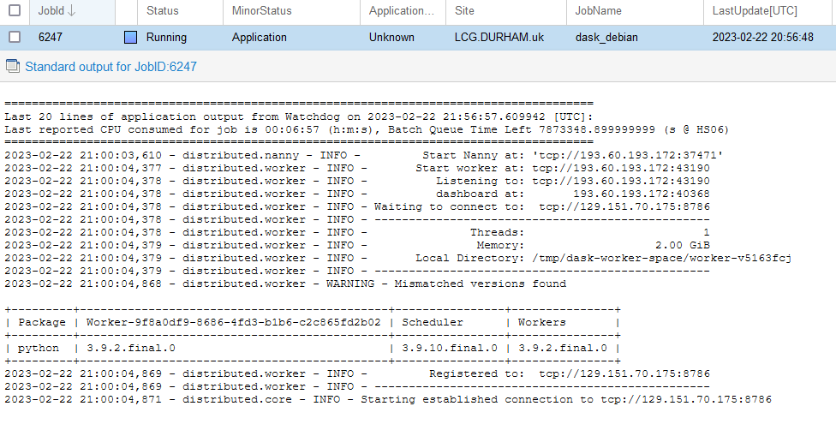
Temporary solution
Example of hard-way working
Manually start scheduler on OCI node
Submit job which starts worker

Slide 10
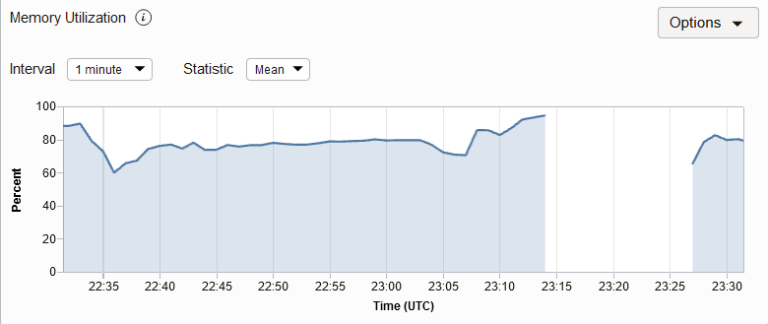
Temporary solution
Hiccups
Low memory -> so easy to crash

Slide 11
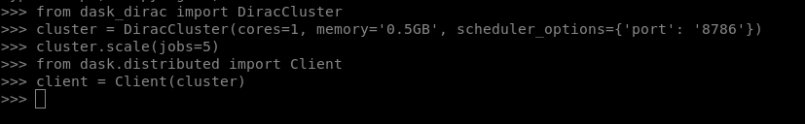
Current Status

Slide 12
Current Status
When running;
Scheduler is started locally
Workers are created by a job description file being created and then submitted to https://lbcertifdirac70.cern.ch:8443
Executable is `singularity`
Arguments are `docker container and dask commands`

Slide 13
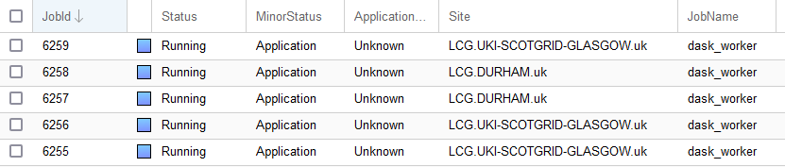
Current Status
Able to start on OCI
Workers start

Slide 14
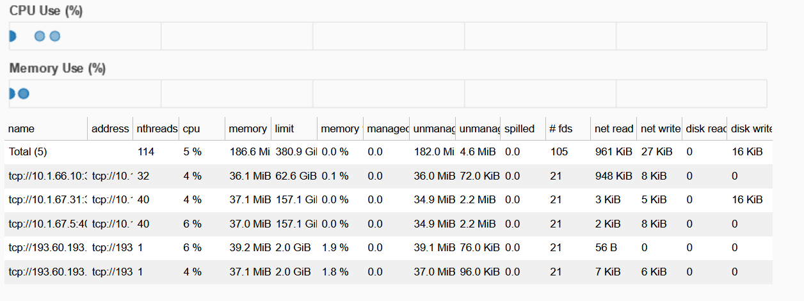
Current Status
Monitorable in dask dashboard

Slide 15
Going forward and summary
Move onto VM at Bristol
  Waiting for port to be opened
  dask-dirac
  Pass more dask setup parameters through
  Work out why port address needs to be specified all of a sudden
  Actually test out doing something with it

