Slide 1
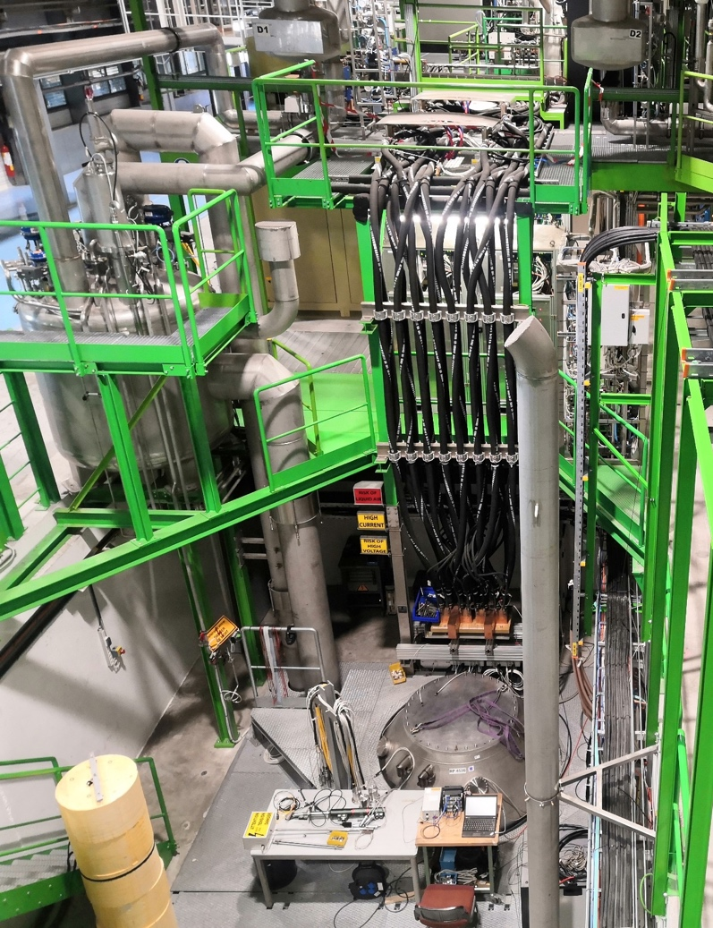
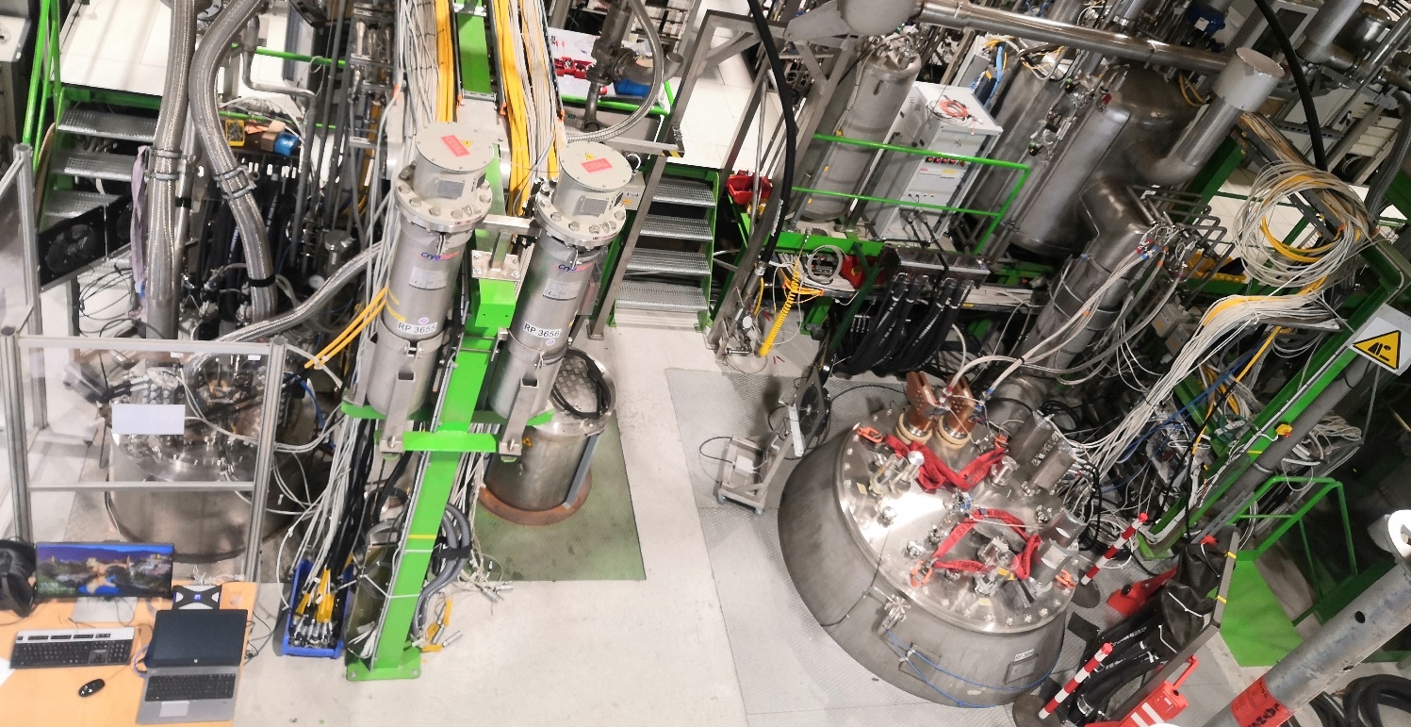
SM18 vertical benches
Expectations for 2023 (+)
Cluster D
F. Mangiarotti
Cluster G

Slide 2
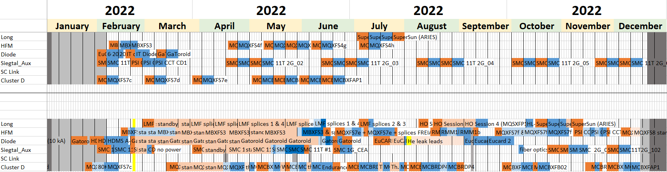
Planned versus performed tests 2022
Planned as of 15.12.2021
Performed as of 07.12.2022
 | Item tests | Test runs | Weeks at cold | Item types
Planned 15.12.2021 | 21 | 29 | 32 | 10
Performed 07.12.2022 | 29 | 42 | 51 | 14
Color code:
Cold tests
Cold standby
Warm tests
Warm standby
Holidays & shutdown

Slide 3
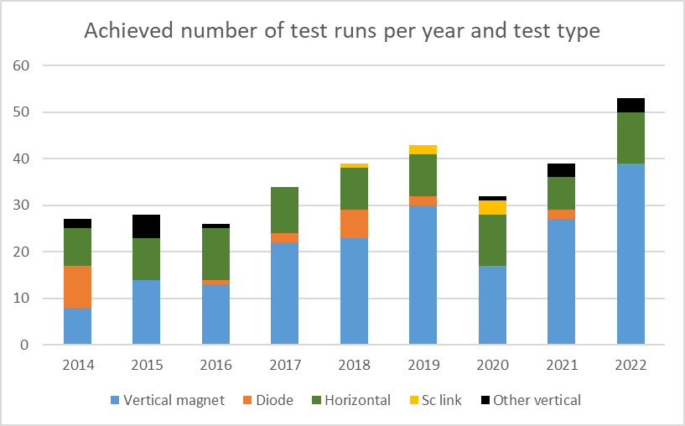
SM18 tests per year
Each “test run” comprises all the tests between a cool down and the successive warm up on a given test item

Slide 4
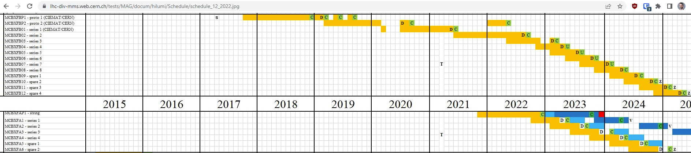
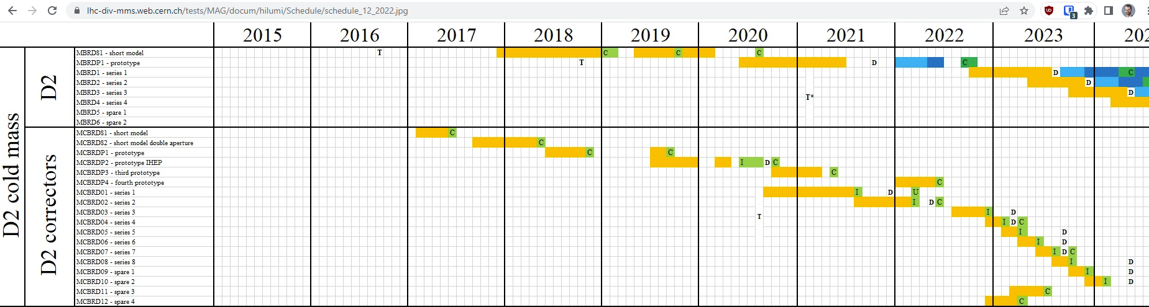
2023 onwards: “official” expectations from HL-LHC WP3
WP3 planning 12.2022 (link)

Slide 5
Test requests from 2023 onwards
LHC:
  Spare diodes: 5 sets
WP3:
  Insourcing of MCBXF[A,B]: up to 16 magnets, not initially foreseen
  Additional tests of MCBRD: new request to test at least four magnets
  MQXF short models: 4-5 iterations of 2-3 magnets, need to be flexible to adapt to new requests
  Busbars and conduction-cooled leads
WP6a:
  Current leads: 8 sets
WP7:
  Inner triplet diodes: 6 sets
WP11:
  One double aperture short model
Plan as of 07.2022
HFM TDP and 14T+:
Other sources (all TBC):
  HFM mirror configuration in 2024
  HFM 12 T: expected in 2026
  HFM demonstrators (e.g., SMC, RMM)
  Fusillo: 3-5 magnets, starting Q2 2023
  Other R&D demonstators (e.g., SIG, HFM HTS …)
  Outside requests, e.g., PSI, SuperSun …
TESTS | SMC | eRMC | MQXFS | RMM | eRMC | 14T+
2022 | 3 |  |  | 2
2023 | 4 |  | 1 | 3 | 1
2024 | 5 | 1 | 4 | 2
2025 | 2 | 1 | 3 | 3
2026 | 2 | 1 | 1 |  |  | 3
2027 + |  |  | 1 |  |  | 3

