Slide 1
Normal conductive magnets
2022 – 2023
C Petrone 02-02-2023

Slide 2
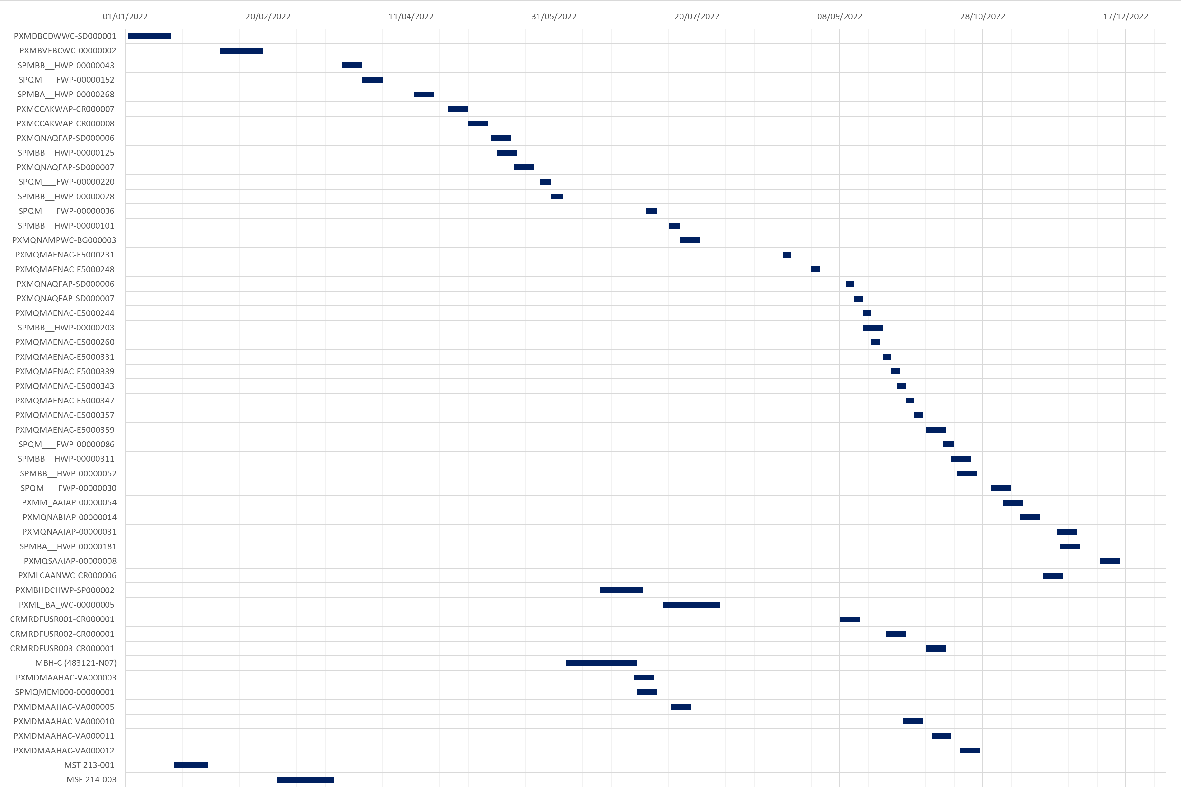
Magnetic measurements on normal-conducting magnets - 2022
Operation: 37 magnets
PSB, PS, SPS, Linac.
Others: 15 magnets
Experiments, collaborations, magnet construction follow-up

Slide 3
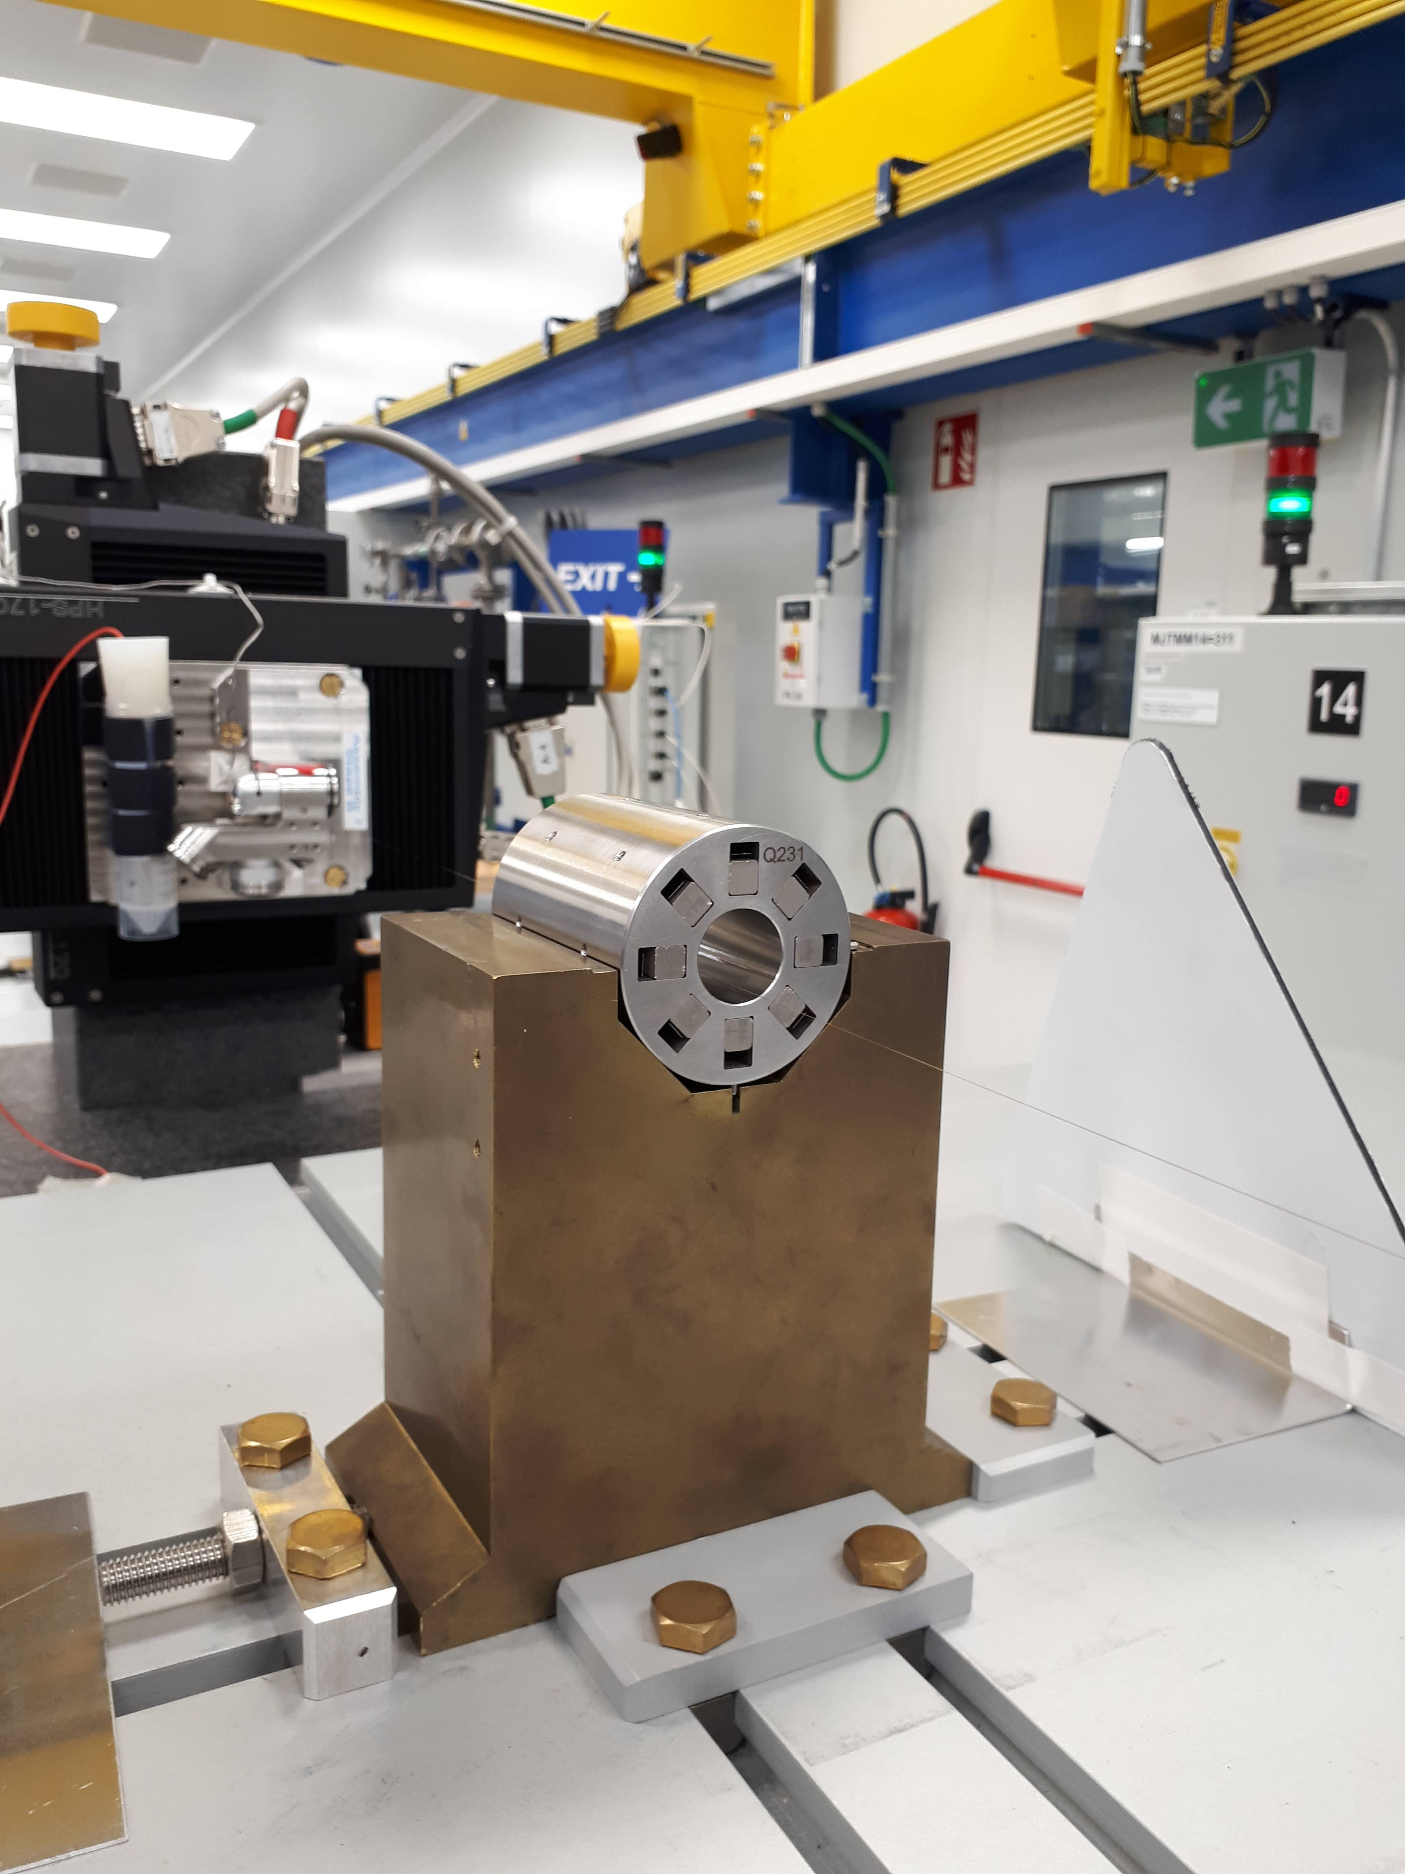
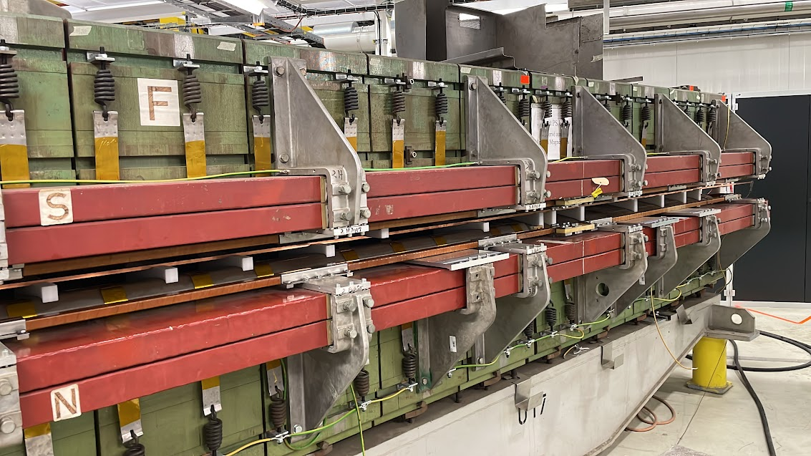
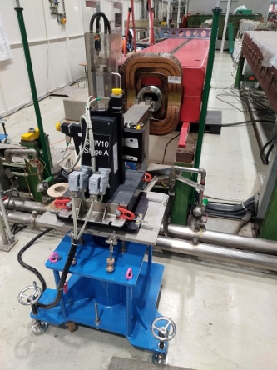
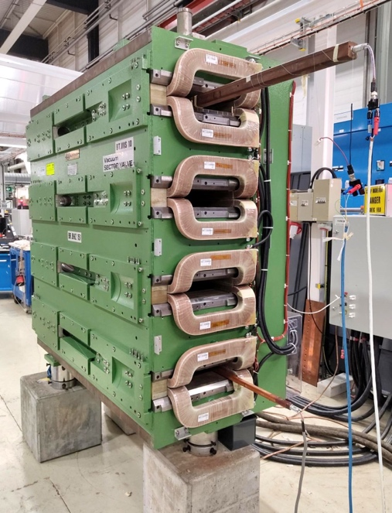
Operation (NC magnets) - 2022
PS
Linac
Magnet name | Requestor | MM request # | Laboratory | Project / Machine | Pryority | MM report (EDMS)
PXMDBCDWWC-SD000001 | DBODART | 29813985 | 311 | PS | Operation | 2686783
PXMBVEBCWC-00000002 | DBODART | 29424491 | 867 | Linac 2 | Operation | 2788677
SPMBB__HWP-00000043 | CYCOT | 30833941 | 867 | SPS | Operation | 2720909
SPQM___FWP-00000152 | CYCOT | 30834036 | 867 | SPS | Operation | 2723403
SPMBA__HWP-00000268 | CYCOT | 30859960 | 867 | SPS | Operation | 2729721
PXMCCAKWAP-CR000007 | DBODART | 31013351 | 311 | Linac 4 | Operation | 2741382
PXMCCAKWAP-CR000008 | DBODART | 31013360 | 311 | Linac 4 | Operation | 2741382
PXMQNAQFAP-SD000006 | DBODART | 30840103 | 311 | Linac 4 | Operation | 2741382
SPMBB__HWP-00000125 | CYCOT | 30963107 | 867 | SPS | Operation | 2739590
PXMQNAQFAP-SD000007 | DBODART | 30840109 | 311 | Linac 4 | Operation | 2741382
SPQM___FWP-00000220 | CYCOT | 30992768 | 867 | SPS | Operation | 2742209
SPMBB__HWP-00000028 | CYCOT | 31006918 | 867 | SPS | Operation | 2745303
SPQM___FWP-00000036 | CYCOT | 31106946 | 867 | SPS | Operation | 2755606
SPMBB__HWP-00000101 | CYCOT | 31149986 | 867 | SPS | Operation | 2757580
PXMQNAMPWC-BG000003 | DBODART | 29866322 | 311 | PS | Operation | 2754867
PXMQMAENAC-E5000231 | PTHONET | 26979349 | 311 | Linac 4 | Operation | 2773586
PXMQMAENAC-E5000248 | PTHONET | 26979365 | 311 | Linac 4 | Operation | 2773586
PXMQNAQFAP-SD000006 | DBODART | 31148061 | 311 | Linac 3 | Operation | 2801220
PXMQNAQFAP-SD000007 | DBODART | 31148063 | 311 | Linac 3 | Operation | 2801220
PXMQMAENAC-E5000244 | PTHONET | 26979353 | 311 | Linac 4 | Operation | 2773586
SPMBB__HWP-00000203 | HHAALIEN | 31206477 | 867 | SPS | Operation | 2782124
PXMQMAENAC-E5000260 | PTHONET | 26979367 | 311 | Linac 4 | Operation | 2773586
PXMQMAENAC-E5000331 | PTHONET | 26979461 | 311 | Linac 4 | Operation | 2773586
PXMQMAENAC-E5000339 | PTHONET | 26979572 | 311 | Linac 4 | Operation | 2773586
PXMQMAENAC-E5000343 | PTHONET | 26979715 | 311 | Linac 4 | Operation | 2773586
PXMQMAENAC-E5000347 | PTHONET | 26979871 | 311 | Linac 4 | Operation | 2773586
PXMQMAENAC-E5000357 | PTHONET | 26980010 | 311 | Linac 4 | Operation | 2773586
PXMQMAENAC-E5000359 | PTHONET | 26980053 | 311 | Linac 4 | Operation | 2773586
SPQM___FWP-00000086 | CYCOT | 31245585 | 867 | SPS | Operation | 2782485
SPMBB__HWP-00000311 | CYCOT | 31245590 | 867 | SPS | Operation | 2791054
SPMBB__HWP-00000052 | CYCOT | 31386119 | 867 | SPS | Operation | 2792308
SPQM___FWP-00000030 | CYCOT | 31386120 | 867 | SPS | Operation | 2796043
PXMM_AAIAP-00000054 | DBODART | 29424819 | 867 | PS | Operation | 2805111
PXMQNABIAP-00000014 | DBODART | 29424810 | 867 | PS | Operation | 2805111
PXMQNAAIAP-00000031 | DBODART | 29425193 | 867 | PS | Operation | 2805111
SPMBA__HWP-00000181 | CYCOT | 31484498 | 867 | SPS | Operation | 2803570
PXMQSAAIAP-00000008 | DBODART | 29424824 | 867 | PS | Operation | 2805111
SPS
PS-Booster

Slide 4
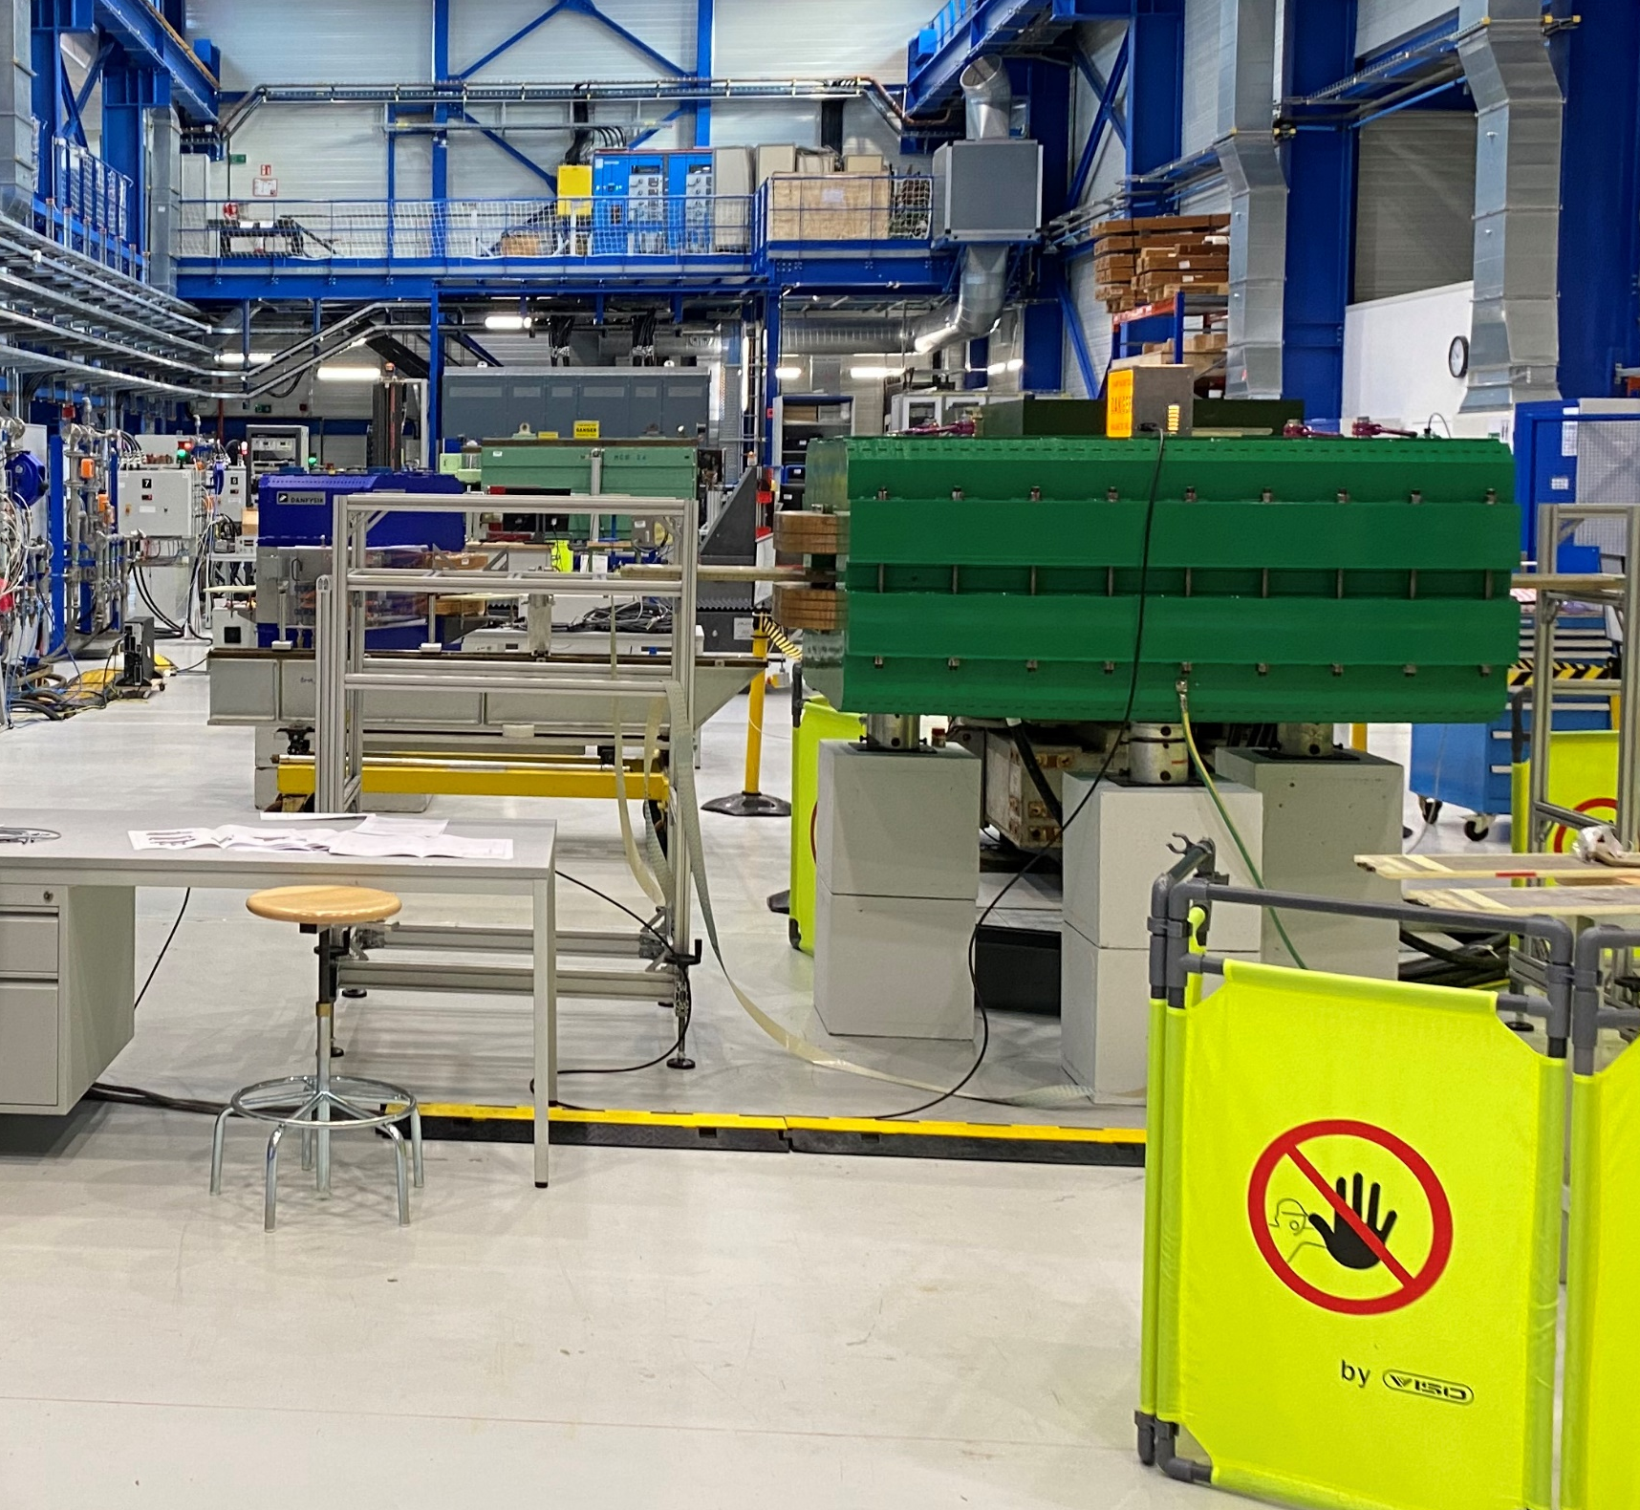
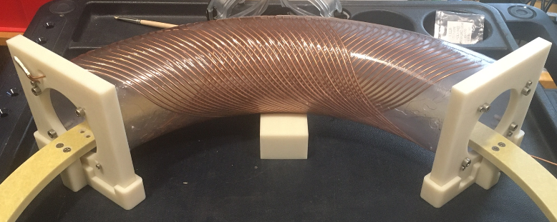
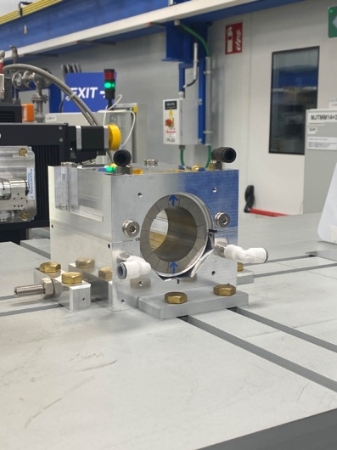
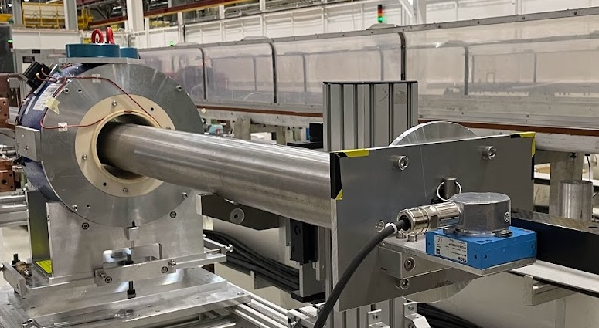
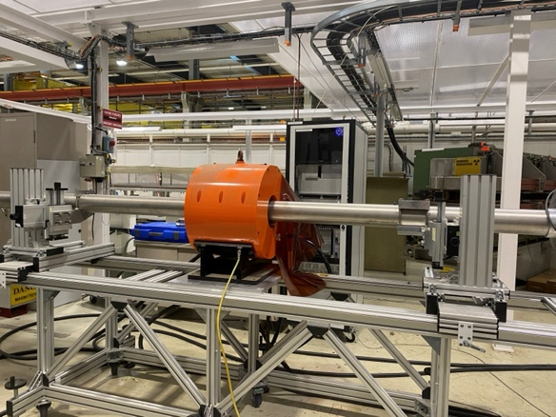
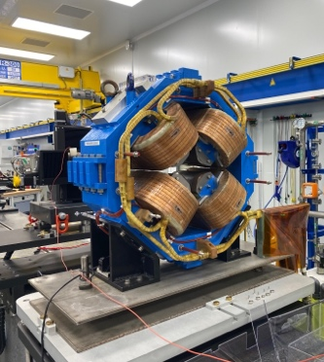
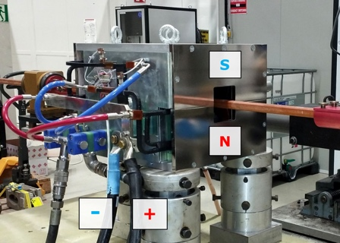
Others - 2022 (Experiments, collaborations, magnet construction follow-up)
MedAustron
Magnet name | Requestor | MM request # | Laboratory | Project / Machine | Pryority | MM report (EDMS)
PXMLCAANWC-CR000006 | ANEWBORO | 31199854 | 867 | HEL | Experiments | 2801211
PXMBHDCHWP-SP000002 | DBODART | 30309724 | 311 | LEIR | Experiments | 2788679
PXML_BA_WC-00000005 | ANEWBORO | 31189466 | 867 | LEIR | Experiments | 2746983
CRMRDFUSR001-CR000001 | Ariel Haziot | 31253313 | 927 | Fusilllo | Development | 2773427
CRMRDFUSR002-CR000001 | Ariel Haziot | 31253314 | 927 | Fusilllo | Development | 2773427
CRMRDFUSR003-CR000001 | Ariel Haziot | 31253329 | 927 | Fusilllo | Development | 2773427
MBH-C (483121-N07) | MedAustron Coll. | - | 311 | MedAustron | Collaboration | 2753462
PXMDMAAHAC-VA000003 | PTHONET | 31128468 | 311 | Collaboration | Collaboration | 2748165
SPMQMEM000-00000001 | Ansaldo collab. | 31052341 | 311 | Collaboration | Collaboration | Internal Approval
PXMDMAAHAC-VA000005 | PTHONET | 31128525 | 311 | Collaboration | Collaboration | 2748165
PXMDMAAHAC-VA000010 | PTHONET | 31128526 | 311 | Collaboration | Collaboration | 2714216
PXMDMAAHAC-VA000011 | PTHONET | 31128528 | 311 | Collaboration | Collaboration | 2714216
PXMDMAAHAC-VA000012 | PTHONET | 31128529 | 311 | Collaboration | Collaboration | 2714216
MST 213-001 | MedAustron Coll. | - | 867 | MedAustron | Collaboration | 2684921
MSE 214-003 | MedAustron Coll. | - | 867 | MedAustron | Collaboration | 2716714
FUSILLO
HEL
LEIR
INFN
MedAustron
UniGe

Slide 5
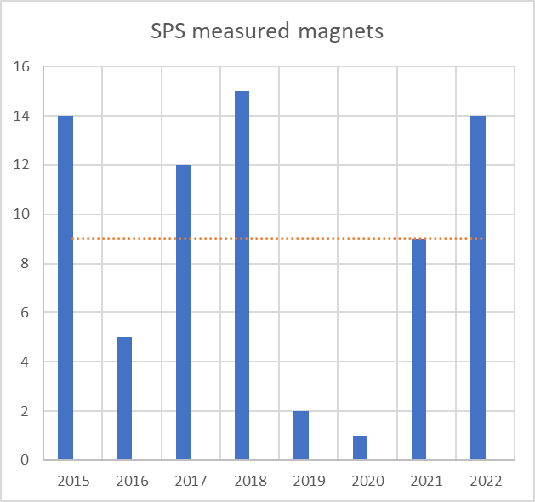
Is 2022 a typical year’s workload?
Forecast 2023
Project | Magnets #
NA | 15
Operation | 35
Others | 10
7 days per magnet x | > 60
Magnet name | Requestor | MM request #
PXMU_HUCWP-AF000017 | DBODART | 29424841
PXMBXGACWP-01000005 | DBODART | 30309726
SPQNL__8WP-00000140 | TZICKLER | 31681213
PXMBHDDCWC-CR000008 | ANEWBORO | 22482238
SPLQS__NWP-00000028 | PTHONET | 31642134
…….
Covid

Slide 6
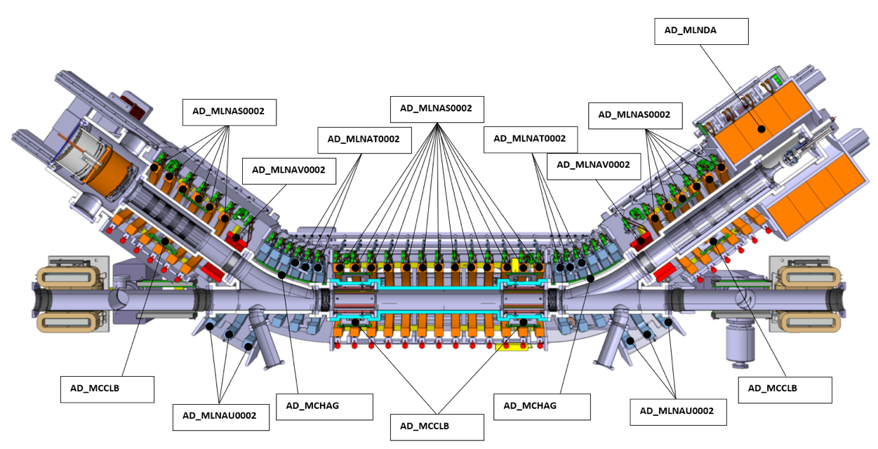
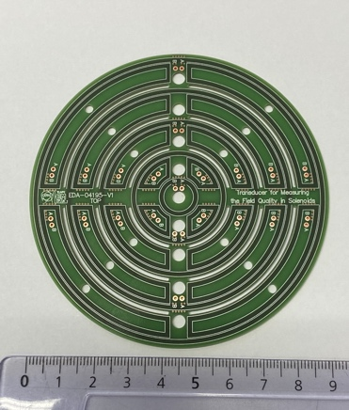
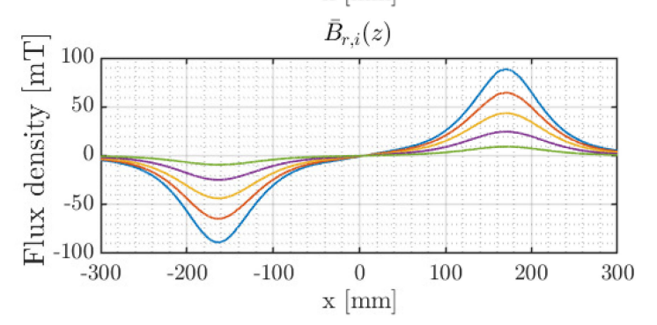
Requiring the development of new methods and/or transducers (e.g., AD Electron cooler ) - 2023

Slide 7
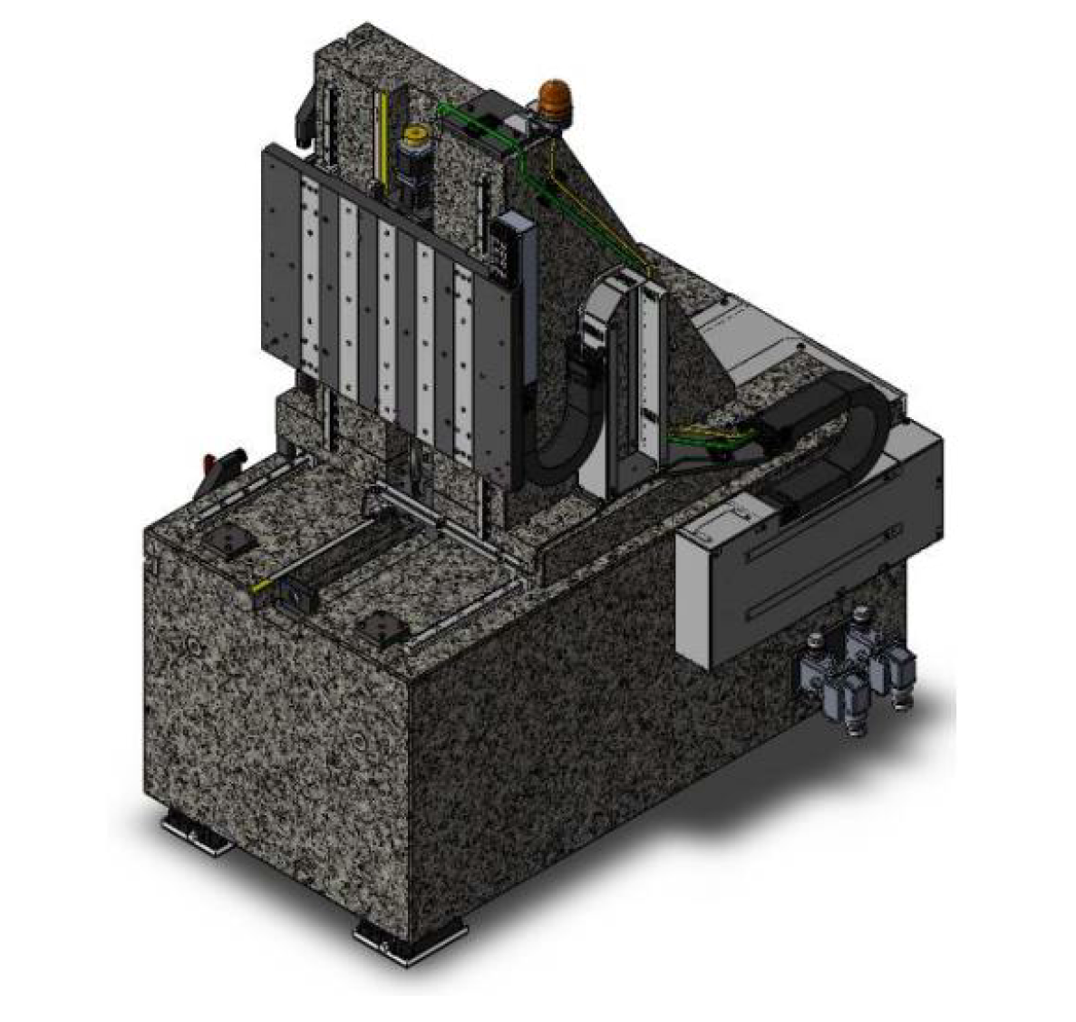
New RCM - 2023

Slide 8
Thank you
MERCI!

