Slide 1
Section Mandate
(1) Responsible for the testing, qualification, and magnetic characterization of components, magnets and devices for the CERN accelerator complex and experimental areas; development and maintenance of online monitoring systems (B-trains) for the operation of the CERN LHC injector chain, AD and ELENA;
(2) Magnetic measurement and analysis of SC magnets for HL-LHC at various stages of production at CERN and at partner institutes; magnetic measurements of NC magnets for CERN’s accelerators; measurements in support of projects at partner institutes and of approved physics experiments at CERN;
(3) Operation, maintenance and upgrade of the SM18 cryogenic-test stations and of the laboratories for magnetic measurements (311 and 867); contribution to development and operation of test and measurement facilities at partner institutes;
(4) Development and maintenance of transducers, measurement systems, as well as novel data acquisition/processing and diagnostic techniques for various magnet types, configurations, and operation scenarios;
(5) Performance analysis of components and magnet systems installed in the CERN accelerator complex and experimental areas; coordination of development and maintenance of software for magnet design and analysis, and for data acquisition and storage at the SM18 test stations and measurement laboratories.

Slide 2
Top-down for HL-LHC workpackages from MERIT objectives
TE-MSC-TM as of 02.2023
Section Head
S. Russenschuck
80%
80%
80%
30%
70%
LD
40%
Test management, instumentation and diagnostics
G. Willering
Data processing, software and analysis
F. Mangiarotti (LD)
Real time and DAQ electronics
M. Buzio
Software for MM and field simulation
M. Bonora (LD)
Signal processing and analysis
L. Fiscarelli (LD)
MM Transducers
C. Petrone (LD)
10%
Mechanics SM18
P. Viret
80%
Oper hor. Benches, Diodes
replacement
100%
Electronics, B-train
D. Giloteaux
50%
311 Infrastructure,
MM Measurements
G. Deferne
40%
MM Operation
(867, 180. 311)
R. Chritin
Operation, Coord. hor.
G. Ninet
100%
Oper vert Electronics
G. Pichon
100%
PLC, Control, DAQ, DB
Stian Juberg
100%
Mechanics
(Coils and calibration)
R. Beltron
60%
Mechanics, MM Measurements
O. Dunkel
Instrum., DAQ, PLC
O. Ditsch
100%
Operation
Coord. Vert.
J. Feuvrier
60%
Electronics, B-train
U. Martinez
20%
10%
100%
20%
80%
MM Analysis, FIDEL
A. Chmielinska
60%
Operation
Philip Kosowski
Operation/Quench
Deepak Paudel
Instrumentation
V. Di Capua HFM?
Test software
D. Dardanis HFM?
MM Operation
M. Pentella
Theory and MM postprocessing
M. Liebsch
MM Operation
P. Rogacki
100%
Nb3Sn magnet performance
R. Keijzer (2.2023)
Francesca Nicoletti
Rotating-coil magnetometer
A. Lauria
ROXIE (KT)
K. Diamantis
Systems engineering
J. Kaeske
Transducers and MM operation
V. Mattsson
Theory and MM postprocessing
L. Fleig
Transducers and MM operation
V. Andersem
Theory and MM postprocessing
T. Rimobot

Slide 3
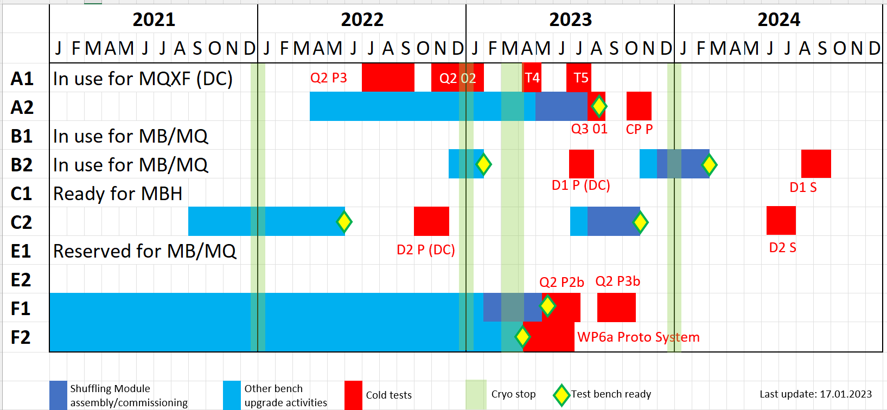
Test bench upgrade – schedule summary

Slide 4

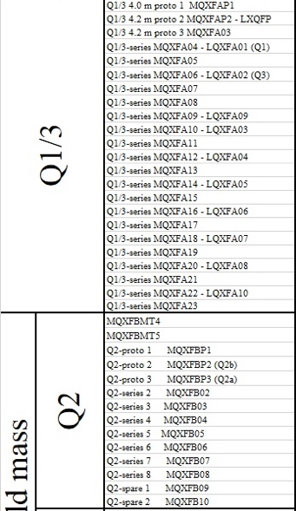
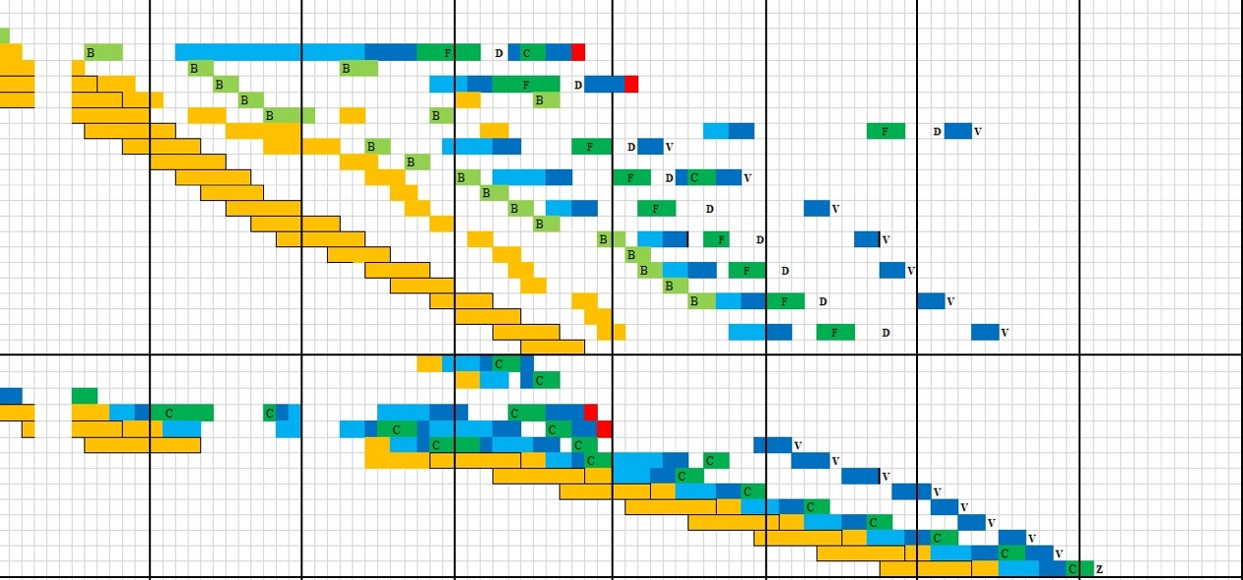
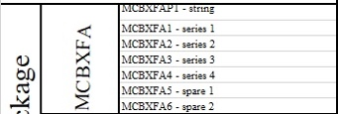
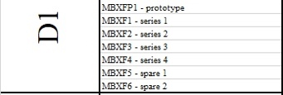
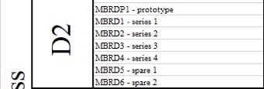

HL-LHC test requests – horizontal benches
From: 2023 to 2026
1/A2
1/A2
Item | #
MQXF test cryostat (A1) | 4
Q1/Q3 | 2
Q2 | 11
CP | 7
D1 | 7
D2 | 7
MB | 8
MBH-11T | 1
SC-link – type triplet | 5
SC-link – type D2 | 5
Q10 (refurbished, for 2026-2027) | 4
2/F1
3/F1
2/A1
2/A1
4/A1
3/F1
3/F1
1 on A2
2/A2
CP
1/A2
2/A2
+1/A2
3/B2
1/B2
1/B2
2/B2
3/C2
1/C2
38 magnets/assemblies for WP3
12 magnets for LHC
10 SC link assemblies
1 MBH 11T
Total 61
1/C2
1/C2
2/C2
1/??
3/??
SC link
2023
1/F2
2024
4/F2
2025
4/F2
2026
1/F2
MB 2 4 3 2 2 2 2
11T 1
Total per year HL-LHC+others 12+2 14+3 13+2 10+2 4

Slide 5
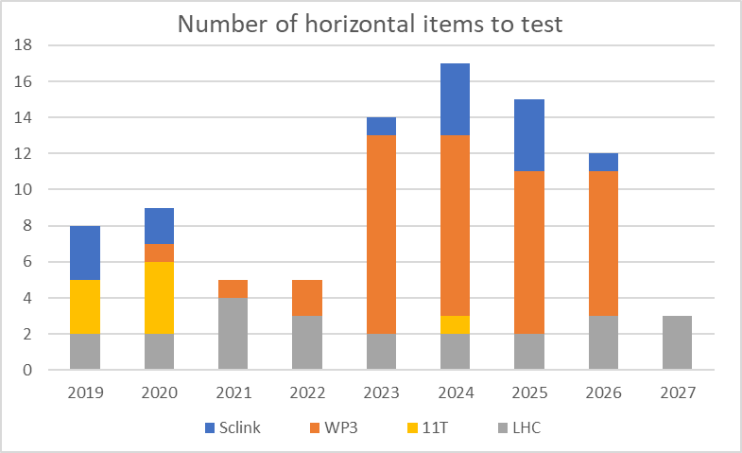
SM18 horizontal benches
Past years had less items on test, but significant load on personnel.
Long test programs for HL-LHC prototype magnets with extensive training and protection studies.
Endurance tests and 3 or more cool downs.
Bench modifications were often required (CLIQ, Trim powering, new quench antenna, lifted ground testing, power converters, uQDS, etc.)
For next years we need to:
Test about 2.5 times more objects. This means:
  Reduce test plans to the minimum
  We expect a small number of non-conformities
  Avoid test bench modifications and focus on operation
In case of magnet delay, non-conformities, additional tests
There is limited flexibility in horizontal test (benches, coactivity, cryo resources, personnel resources)

Slide 6
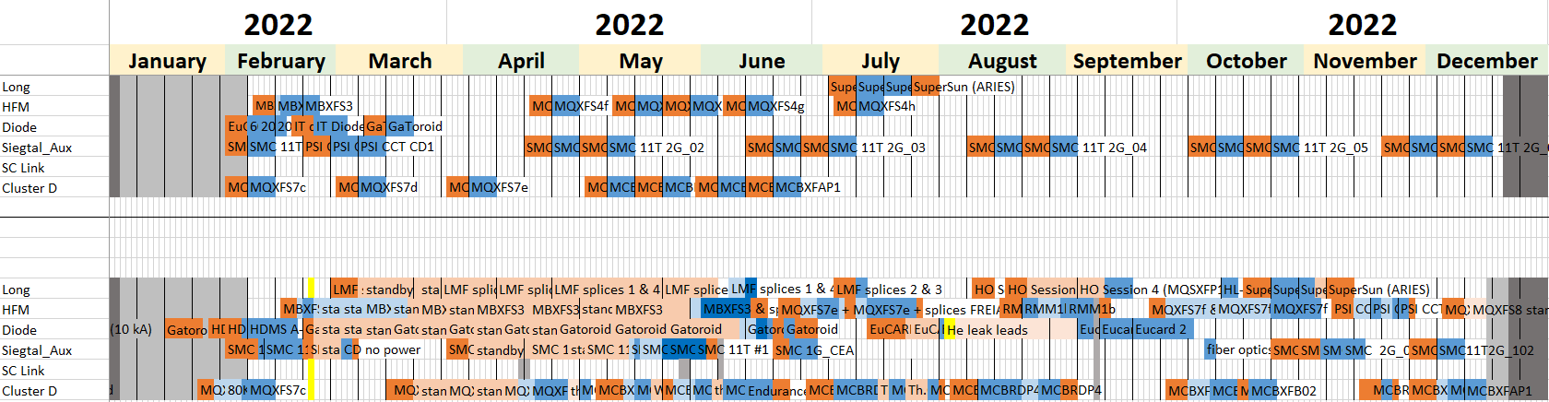
Example of VB flexibility: planned versus performed tests 2022
Planned as of 15.12.2021
Performed as of 07.12.2022
 | Item tests | Test runs | Weeks at cold | Item types
Planned 15.12.2021 | 21 | 29 | 32 | 10
Performed 07.12.2022 | 29 | 42 | 51 | 14
Color code:
Cold tests
Cold standby
Warm tests
Warm standby
Holidays & shutdown

Slide 7
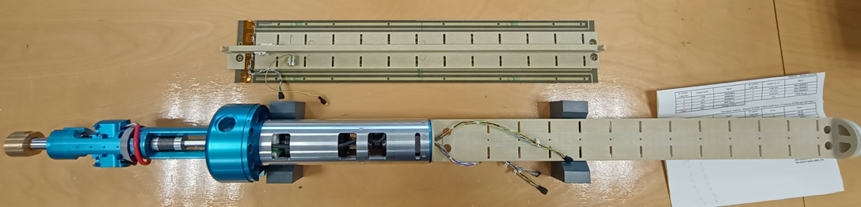
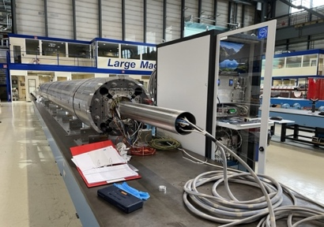
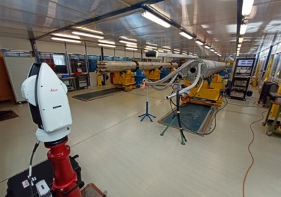
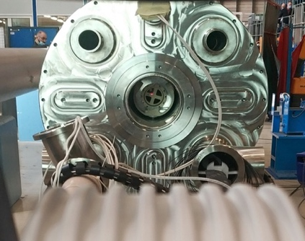
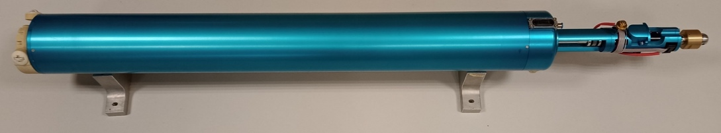
Types of measurement and instrumentation
  In 180, 927, and CIEMAT at ambient temperature:
5 measurements on each assembly
  Coil-pack
  Centering
  Loading
  Angle alignment before end covers
  Final check and alignment
Magnet assembly
Cold-mass assembly
Different measurements during assembly
Rotating coil scanner
7

Slide 8
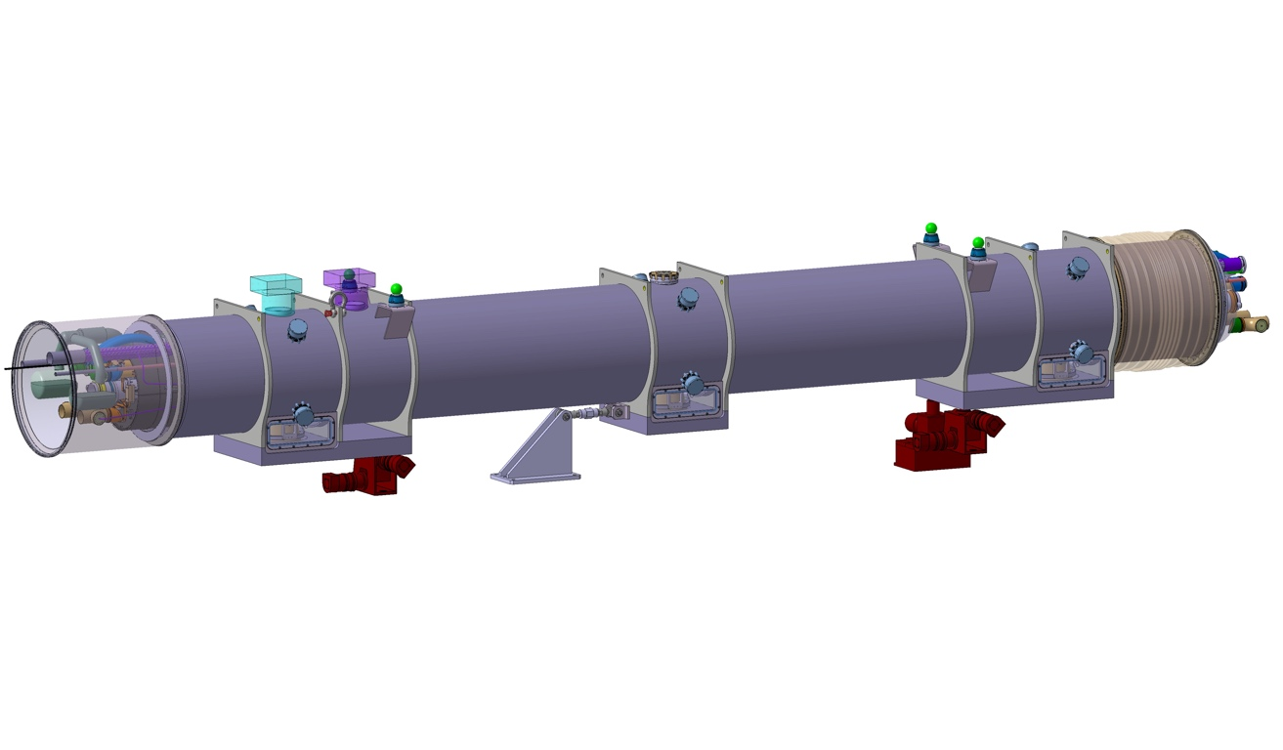
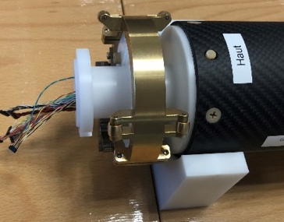
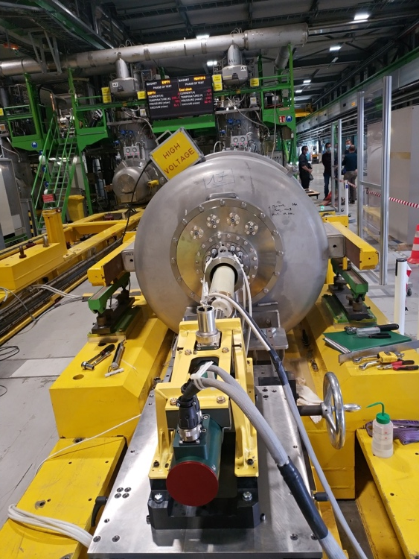
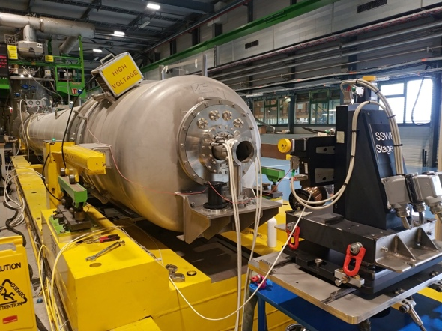
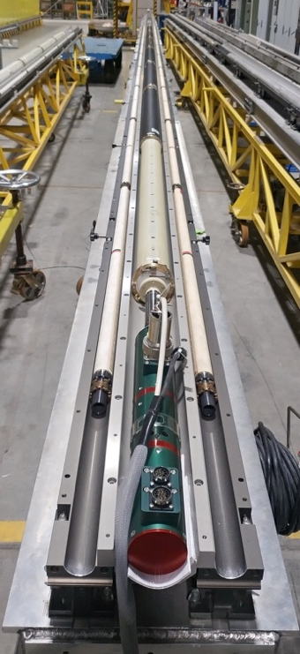
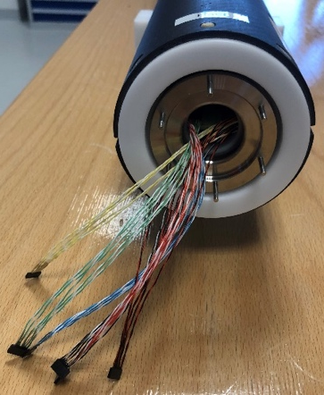
Types of measurement and instrumentation
  In SM18 at cryogenic temperature:
3 measurements on each assembly
  Check at low current before training
  3 powering cycles by using rotating coils
  TF calibration and alignment by using the stretched wire
Rotating coils
Stretched wire
8

Slide 9
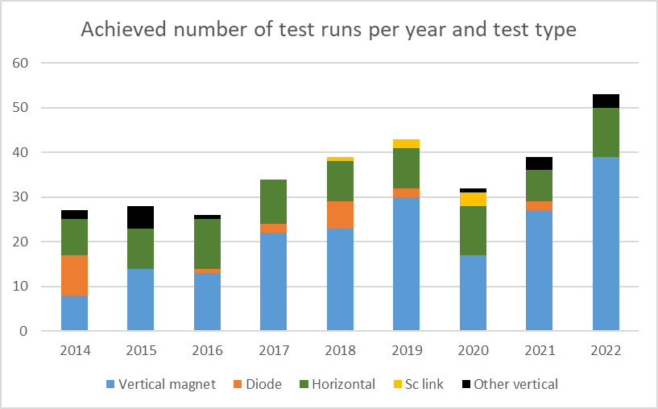
Expectations for 2023 and beyond
Vertical bench occupancy predictions at the start of the year are typically off by up to +50%. Sometimes a magnet is delayed, but two others take its place.
Weekly and daily optimization of test plans, priorities, and overall planning to achieve maximize throughput, and to adapt to unexpected results
FTE | Eng Staff | Tech Staff | Fellow | FSU
On average over the year | 1.0 | 1.5 | 0.4 | 3
Peak during high occupancy (few weeks per year) | 1.3 | 3 | 1.0 | 3
Resource needs for the operation of the vertical stations. Difference peak/average: “borrowed” from other stations/projects
Each “test run” comprises all the tests between a cool down and the successive warm up on a given test item

Slide 10
Activities not accounted for
Support to string operation (11:2024-12:2025)
Support to operation other than HL-LHC magnet testing, preparation of HL-LHC-operation, group support on DAQ software and DB structures.
Infrastructure other than horizontal bench upgrade: 311, 867 (MM equipment and new PC), safety upgrades Cluster G, asset management in SM18.
Competence center: Field-simulations (ROXIE), HTS modelling, CCT modelling, in-depth test analysis, training sessions (EMAG, ROXIE user’s course, CAS, scientific writing), consultancy to superconducting test and magnetic measurement labs, material measurements, magnetic-field safety
Diversification and test/measurement method development: HFM workpackage (design 12 T robust and 14+, instrumentation, cold test), Fusillo, Medical accelerators, transducer development for HTS magnets
Follow up on collaborations: Upsala anticryostat, support to magnetic measurements at Tesla, CIEMAT, INFN, CEA/Saclay

Slide 11
Conclusion
FSU needs for 2023-2025 covered by WP3 according to scrutiny group and provisions from project.
Technical staff critical in 2023-2025. Does not allow support to any other activity such as IT-String or WP6a. Situation will ease earliest after 2025.
Scientific staff just enough for the operation of test facilities and magnetic measurement labs.
No provisions for diversification, competence center, upgrades, collaborations, HFM. Today covered by fellows and students.

Slide 12
A Personal Comment
Our section, almost at group strength, has to be managed as such
In order to help the SL and your direct supervisors with the over boarding admin tasks please assist us with bottom up information
  Safety issues
  QA/QC documentation
  Procedures, guidelines, documentation
  Resource and budget needs
  Training plan
  Weekly reporting on activities

