Slide 1





Muon Collider
D. Schulte
for the International Muon Collider Collaboration
Annual meeting, Orsay, June 2023
This project has received funding from the European Union’s Research and Innovation programme under GA No 101094300.

Slide 2
Accelerator R&D Roadmap
No insurmountable obstacle found for the muon collider
but important need for R&D
Aim at 10+ TeV and potential initial stage at 3 TeV
Full scenario deliverables by next ESPPU/other processes
Project Evaluation Report
R&D Plan that describes a path towards the collider;
Allows to make informed decisions
Interim report by end of 2023
Do not yet have the resources of the reduced scenario
Following priorities and available expertise and resources
Are approaching O(40-50 FTE) for accelerator
Efforts to increase resources
Scenario | FTEy | M MCHF
Full scenario | 445.9 | 11.9
Reduced scenario | 193 | 2.45
http://arxiv.org/abs/2201.07895
2

Slide 3
Cost and Sustainability
Compactness promises cost effectiveness
And low CO₂ footprint for construction
Increasing luminosity per beam power promises power efficiency
Staging is possible
Synergies exist (neutrino/higgs)
Unique opportunity for a high-energy, high-luminosity lepton collider
3

Slide 4
US Snowmass Implementation Task Force
ITP investigated the muon collider and concluded:
Muon Collider is a viable option for the HEP future
ITP provided parametric cost and power estimate for muon collider take it cum grano salis
ITP places MC in same risk tier as FCC-hh
Th. Roser, R. Brinkmann, S. Cousineau, D. Denisov, S. Gessner, S. Gourlay, Ph. Lebrun, M. Narain, K. Oide, T. Raubenheimer, J. Seeman, V. Shiltsev, J. Straight, M. Turner, L. Wang et al.
4

Slide 5
Roadmap: Technically Limited Timeline
To be reviewed considering progress, funding and decisions
Muon collider important in the long term
Fastest track option with important ramp-up of resources to see if muon collider could come directly after HL-LHC
Compromises in performance, e.g. 3 TeV
Needs to be revised but do not have enough information at this point for final plan
Evaluation+decision
Evaluation+decision
5

Slide 6
Roadmap Schedule
2023
Interim Report to gauge progress
Initial baseline defined
2025
Assessment Report
2025-2027
R&D plan will be refined
6

Slide 7
Initial Target Parameters
Parameter | Unit | 3 TeV | 10 TeV | 14 TeV
L | 10³⁴ cm⁻²s⁻¹ | 1.8 | 20 | 40
N | 10¹² | 2.2 | 1.8 | 1.8
f_{r} | Hz | 5 | 5 | 5
P_{beam} | MW | 5.3 | 14.4 | 20
C | km | 4.5 | 10 | 14
<B> | T | 7 | 10.5 | 10.5
ε_{L} | MeV m | 7.5 | 7.5 | 7.5
σ_{E} / E | % | 0.1 | 0.1 | 0.1
σ_{z} | mm | 5 | 1.5 | 1.07
β | mm | 5 | 1.5 | 1.07
ε | μm | 25 | 25 | 25
σ_{x,y} | μm | 3.0 | 0.9 | 0.63
CLIC at 3 TeV
Target integrated luminosities
Note: currently focus on 10 TeV, also explore 3 TeV
Tentative parameters based on MAP study, might add margins
Achieve goal in 5 years
FCC-hh to operate for 25 years
Aim to have two detectors
2 (6)
28
7

Slide 8
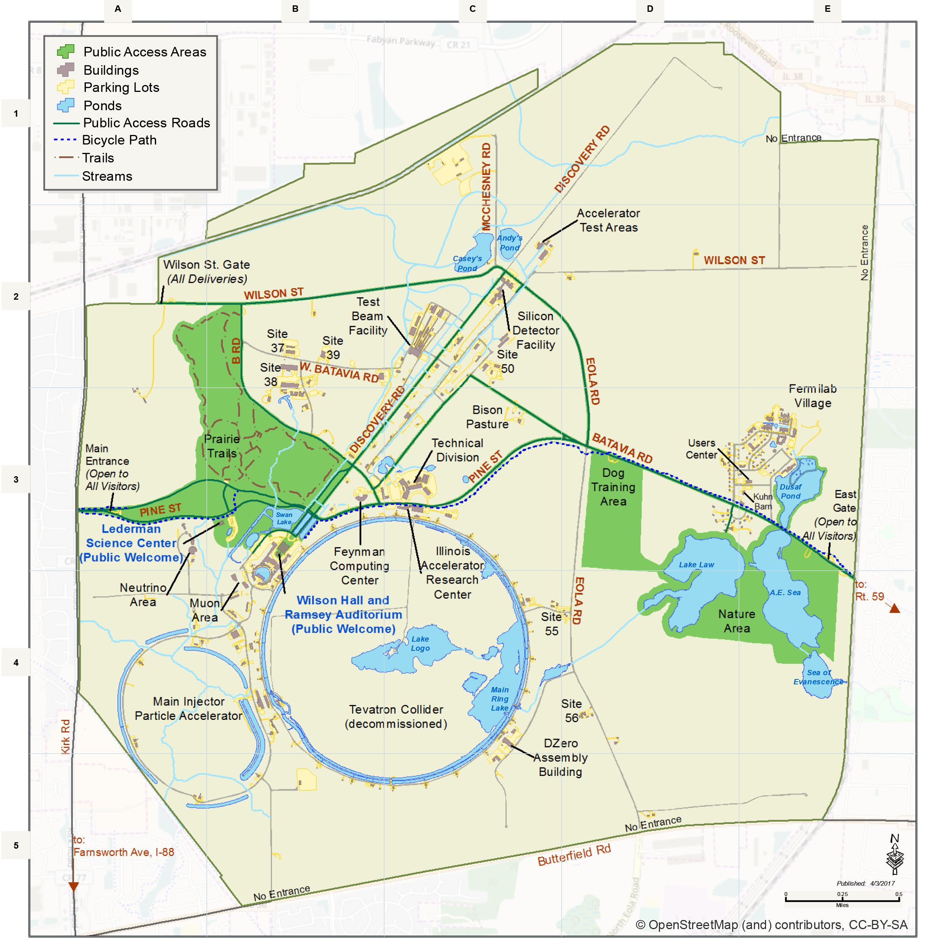
Muon Collider Community
Formed collaboration to implement and R&D Roadmap for CERN Council
EU Design Study approved
(EU+Switzerland+UK and partners)
50+ partner institutions
30+ already signed formal agreement
Plan to participate to HORIZON-INFRA-2024-TECH
Goal: prepare experimental programme, e.g. demonstrator, prototypes, …
TIARA wants magnet proposal
US Snowmass has strong support
to contribute to R&D
as a collider in the US
Lia Merminga appointed team to prepare P5
ask
Some first contacts with others

Slide 9
MoC and Design Study Partners
IEIO | CERN
FR | CEA-IRFU
 | CNRS-LNCMI
DE | DESY
 | Technical University of Darmstadt
 | University of Rostock
 | KIT
IT | INFN
 | INFN, Univ., Polit. Torino
 | INFN, Univ. Milano
 | INFN, Univ. Padova
 | INFN, Univ. Pavia
 | INFN, Univ. Bologna
 | INFN Trieste
 | INFN, Univ. Bari
 | INFN, Univ. Roma 1
 | ENEA
Mal | Univ. of Malta
BE | Louvain
UK | RAL
 | UK Research and Innovation
 | University of Lancaster
 | University of Southampton
 | University of Strathclyde
 | University of Sussex
 | Imperial College London
 | Royal Holloway
 | University of Huddersfield
 | University of Oxford
 | University of Warwick
 | University of Durham
SE | ESS
 | University of Uppsala
PT | LIP
NL | University of Twente
FI | Tampere University
LAT | Riga Technical Univers.
US | Iowa State University
 | Wisconsin-Madison
 | Pittsburg University
 | Old Dominion
 | BNL
China | Sun Yat-sen University
 | IHEP
 | Peking University
EST | Tartu University
AU | HEPHY
 | TU Wien
ES | I3M
 | CIEMAT
 | ICMAB
CH | PSI
 | University of Geneva
 | EPFL
KO | KEU
 | Yonsei University
India | CHEP
IT | INFN Frascati
 | INFN, Univ. Ferrara
 | INFN, Univ. Roma 3
 | INFN Legnaro
 | INFN, Univ. Milano Bicocca
 | INFN Genova
 | INFN Laboratori del Sud
 | INFN Napoli
US | FNAL
 | LBL
 | JLAB
 | Chicago
 | Tenessee
9

Slide 10
Organisation
Collaboration Board (ICB)
Elected chair: Nadia Pastrone
Steering Board (ISB)
Chair Steinar Stapnes
CERN members: Mike Lamont, Gianluigi Arduini
ICB members: Dave Newbold (STFC), Mats Lindroos (ESS), Pierre Vedrine (CEA), N. Pastrone (INFN)
Study members: SL and deputies
Will add US but wait for US decision on members
Advisory Committee
To be defined, discussion in SB
Coordination committee (CC)
Study Leader: Daniel Schulte
Deputies: Andrea Wulzer, Donatella Lucchesi, Chris Rogers

Slide 11
Coordination Committee Members
Physics | Andrea Wulzer
Detector and MDI | Donatella Lucchesi
US (detector) | Sergo Jindariani
US (accelerator) | Mark Palmer
Asia (China) | Jingyu Tang
Asia (Japan) | tbd
Protons | Natalia Milas
Muon production and cooling | Chris Rogers
Muon acceleration | Antoine Chance
Collider | Christian Carli
Magnets | Luca Bottura
RF | Alexej Grudiev, Claude Marchand
Beam-matter int. target systems | Anton Lechner
Collective effects | Elias Metral
A strengthening on the physics and detector side is planned
Cooling cell design | Lucio Rossi
Demonstrator | Roberto Losito

Slide 12
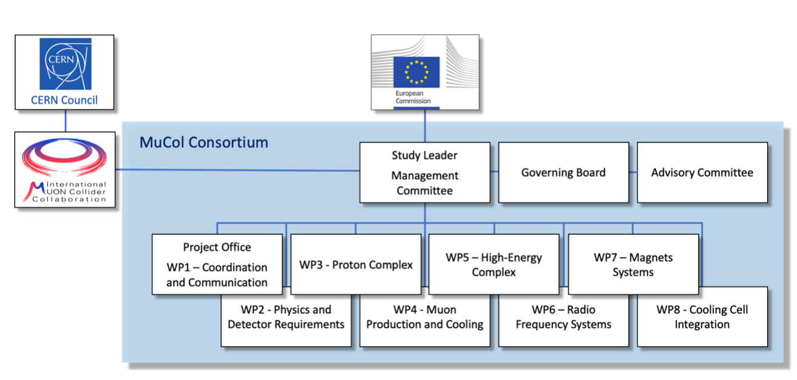
EU Design Study
Has been approved summer 2022
Very helpful to kick-start collaboration
Reapproved early 2023
It appears that there has been some issue with the refereeing of several projects, probably not directly with the muon collider
Brings 3 MEUR from the European Commission, the UK and Switzerland and about 4 MEUR from the partners
Basically nothing for CERN
Kick-off meeting in March 2023:
https://indico.cern.ch/event/1219912
Many thanks to all that contributed
https://mucol.web.cern.ch
Sat celeriter fieri quidquid fiat satis bene

Slide 13
EU Design Study Work Programme
Workpackage leaders:
WP 1: R. Losito (CERN)
WP 2: D. Lucchesi (INFN, Padua)
WP 3: N. Milas (ESS)
WP 4: Ch. Rogers (RAL)
WP 5: A. Choince (CEA)
WP 6: C. Marchand (CEA)
WP 7: L. Bottura (CERN)
WP 8: L. Rossi (U. Milano)
Study Leader: D. Schulte (CERN)
Deputy Study Leader: Ch. Rogers (RAL)
Technical Coordinator: R. Losito (CERN)
Gender Advisor: E.J. Bahng (ISU)
Publications: E. Metral
Includes an important part of the work directly and much indirectly

Slide 14
MuCol Timeline
Finish February 2027
Preliminary report by early 2026, in case EU strategy takes place in 2026
Iterating on parameters ad design each year
More detail in Roberto’s presentation

Slide 15
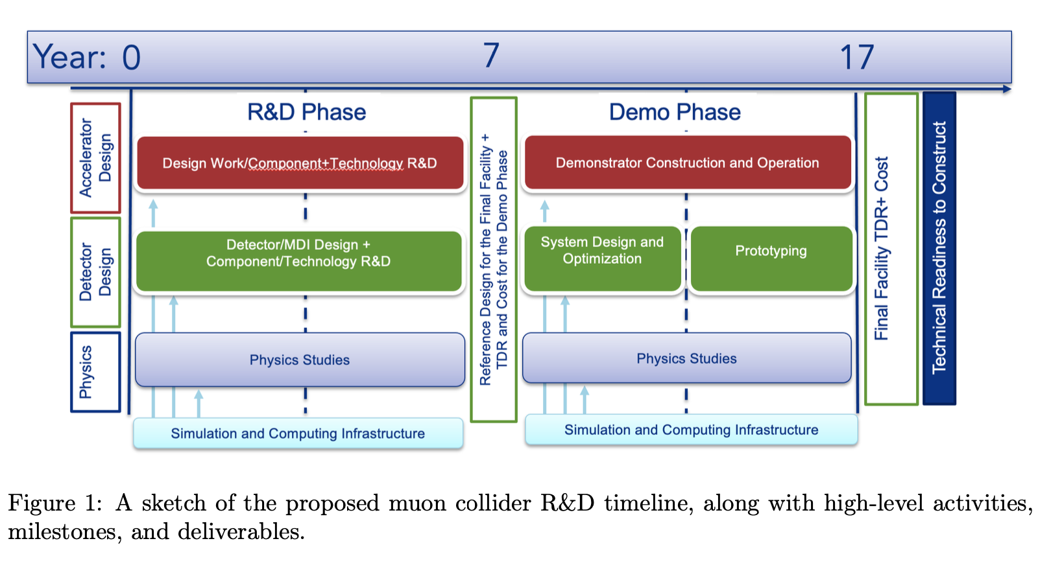
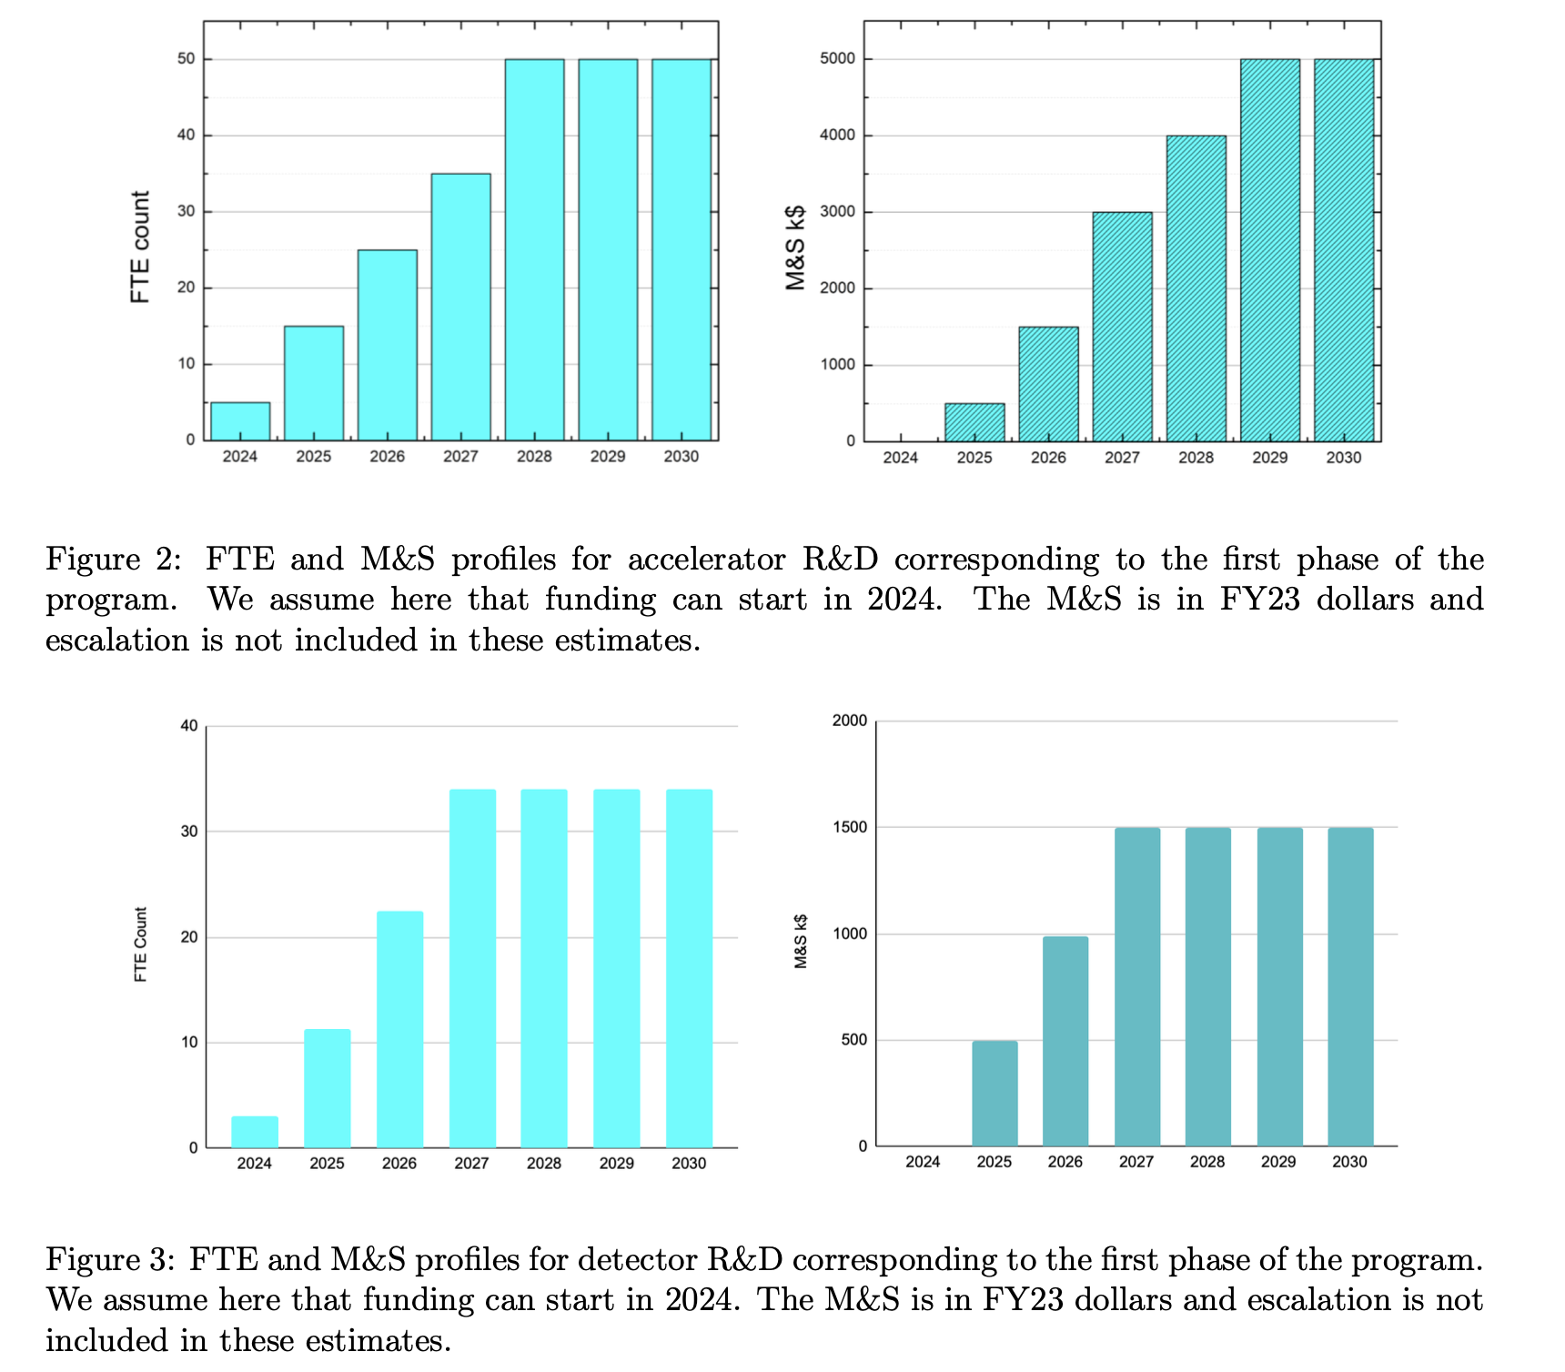
US P5 Ask
S. Jindariani, D. Stratakis, Sridhara Dasu et al.
Goal is to contribute as much as Europe
Start of construction a bit later than in Roadmap
Will try to harmonise/define scenarios once US joins
Total resources would approach Roadmap
Some increase in Europe and Asia assumed
1-2 years delay
But profile is different
15

Slide 16
US Integration
Participation of US experts to CC and ICB
Preparing open data and code policy
  You can use data and codes from the collaboration, as far as we own them
Want to allow everyone to publish under the IMCC or to speak for the IMCC
  Provided our procedures are respected
Small task force to understand how a common work programme can be developed
  Progress will have to synchronise with US progress
Plan to review organization next year to integrate US
  But have to wait for US decisions
Will find common timelines/scenarios

Slide 17
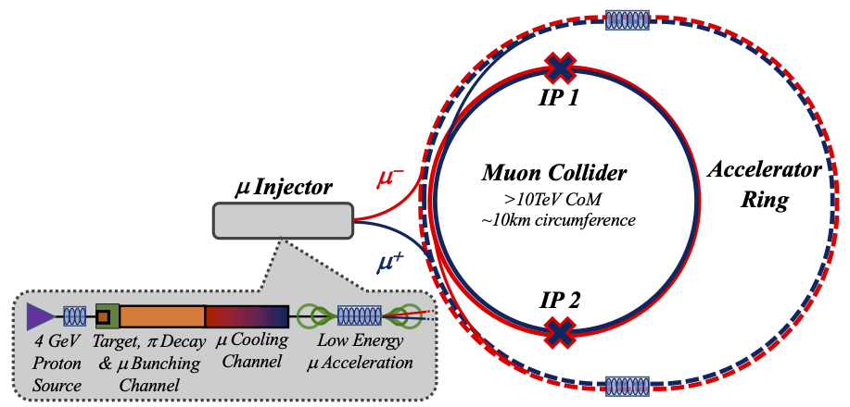
Key Challenges
0) Physics case
4) Drives the beam quality
MAP put much effort in design
optimise as much as possible
2) Beam-induced background
1) Dense neutrino flux
mitigated by mover system and site selection
3) Cost and power consumption limit energy reach
e.g. 35 km accelerator for 10 TeV, 10 km collider ring
Also impacts beam quality
17

Slide 18
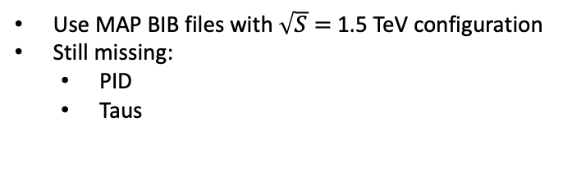
Detector Study Status
A non optimized detector used to evaluate major physics performance by using detailed simulation
Photons
Electrons
Muons
Use MAP BIB files with $\sqrt{S}=$1.5 TeV configuration
Still missing:
  PID
  Taus
Tracking+jets+b-tag
Meet requirements for
precision SM measurements
D. Lucchesi et al.
D. Schulte Muon Collider Status, Annual Meeting, Orsay, June 2023

Slide 19
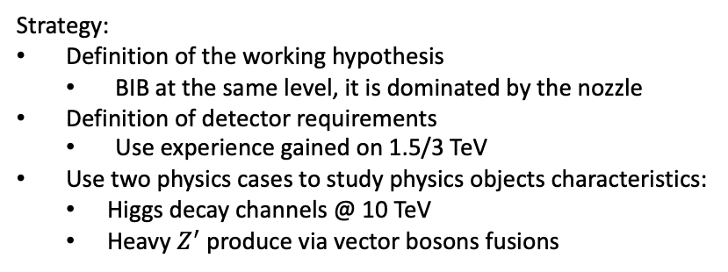
Strategy Toward 10 TeV Detector
Strategy:
Definition of the working hypothesis
  BIB at the same level, it is dominated by the nozzle
Definition of detector requirements
  Use experience gained on 1.5/3 TeV
Use two physics cases to study physics objects characteristics:
  Higgs decay channels @ 10 TeV
  Heavy $Z^{′}$ produce via vector bosons fusions
L. Buonincontri IMCC October 2022
D. Lucchesi et al.
D. Schulte Muon Collider Status, Annual Meeting, Orsay, June 2023

Slide 20
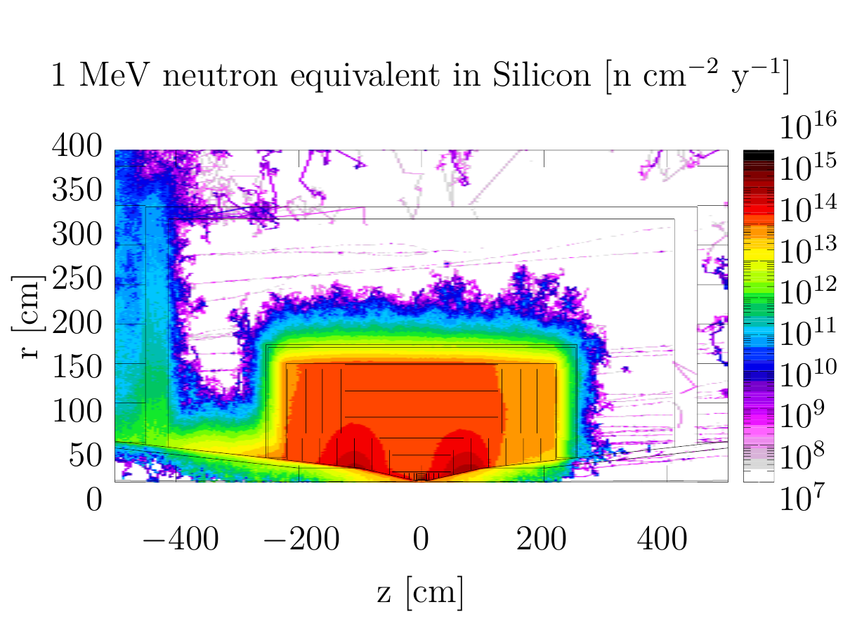
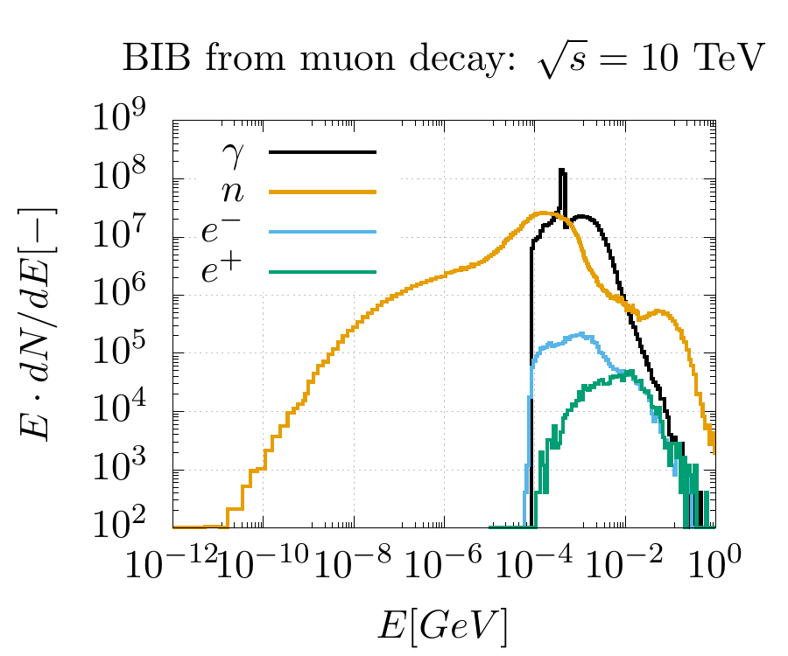
Machine-detector Interface
Study the beam-induced background (BIB) and identify mitigation strategies.
Achieve a conceptual interaction region (IR) design compatible with detector operations
Address different centre-of-mass energies, with particular focus on √s = 3 TeV and √s = 10 TeV
FLUKA studies with various lattice configurations:
  A dipole component mitigates only slightly the BIB
  Nozzle is the determinant component for the BIB. As starting point, the 1.5 TeV MAP design (N. Mokhov) was taken
Similar BIB multiplicity for all collider energies
Simulation with the latest 10 TeV optics (K. Skoufaris et al.) and nozzle optimization currently ongoing
D. Calzolari, A. Lechner et al.
Long term radiation damage assessment in detectors
Evaluate BIB with different lattice and nozzle configurations

Slide 21
Proton Complex
N. Milas et al.
Review of linac parameters is ongoing.
  High intensity machine development through LINAC4 : high intensity beam (35mA peak) has reached the end of the linac and it has been successfully injected in the PSB
We have a baseline lattice for accumulator compressor
  Based on the lattice for the neutrino factory) for the 5 GeV case.
Work ongoing on limitations to accommodate the 2MW beam at 5 Hz
PhD student at ESS for accumulator/compressor selected, will start in August.
Hiring postdoc (ESS/Uppsala) is in the process.
Discussions about possible machine development at the CERN injector complex to verify ideas/simulations for the accumulator/compressor are ongoing.

Slide 22
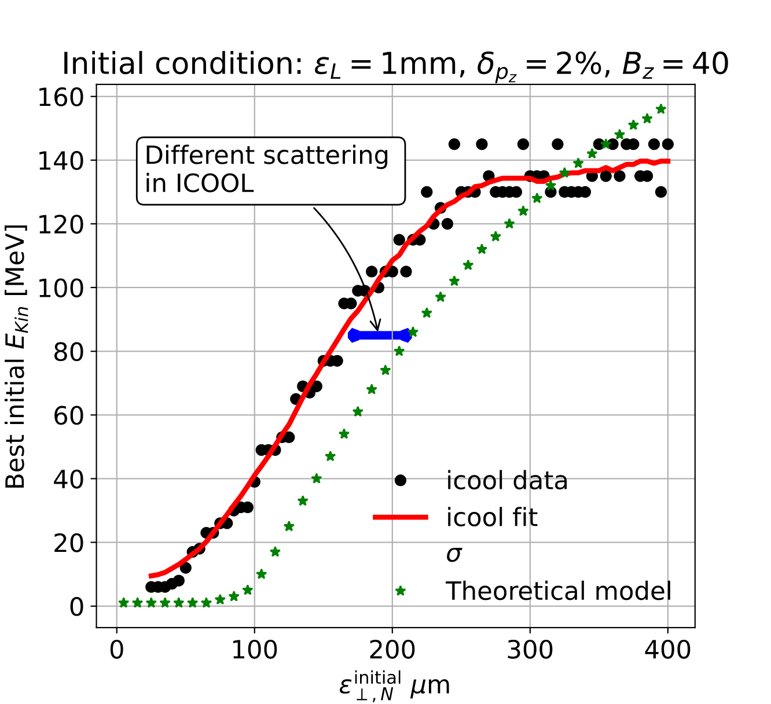
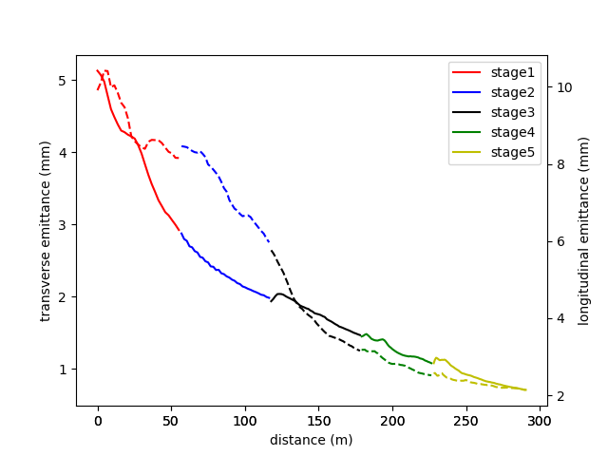
Muon Cooling
Rectilinear cooling channel:
Building on MAP design
Optimising baseline cooling channel
Examining alternative arrangements
  e.g. High pressure gas in RF cavities
A. Latina, E. Fol, B. Stechauner at al.
Code development: Integrating multiple scattering in RFTRACK, code maintained at CERN, including collective effects
 | ε⊥(mm) | ε∥(mm) | ε_{6D}(mm³) | T(%)
initial | 5.13 | 9.91 | 260
Stage 1 | 2.92 | 8.16 | 71.6 | 87.1
Stage 2 | 1.99 | 5.97 | 24 | 91.2
Stage 3 | 1.47 | 3.16 | 7.12 | 88
Stage 4 | 1.08 | 2.52 | 3.11 | 92.2
Stage 5 | 0.712 | 2.14 | 1.14 | 89.2
Final Cooling 1:
Determine optimum cooling energy based on emittances
B. Stechauner et al.
Ch. Rogers, Zhu Ruihu et al.

Slide 23
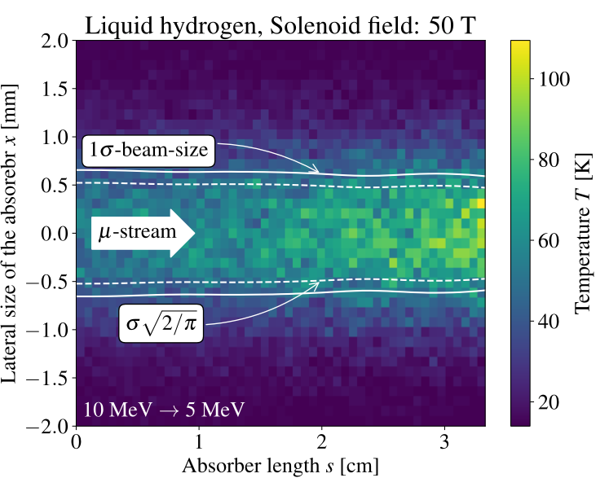
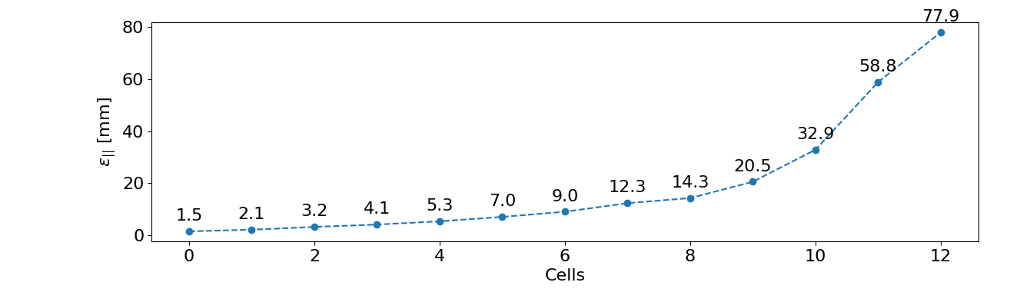
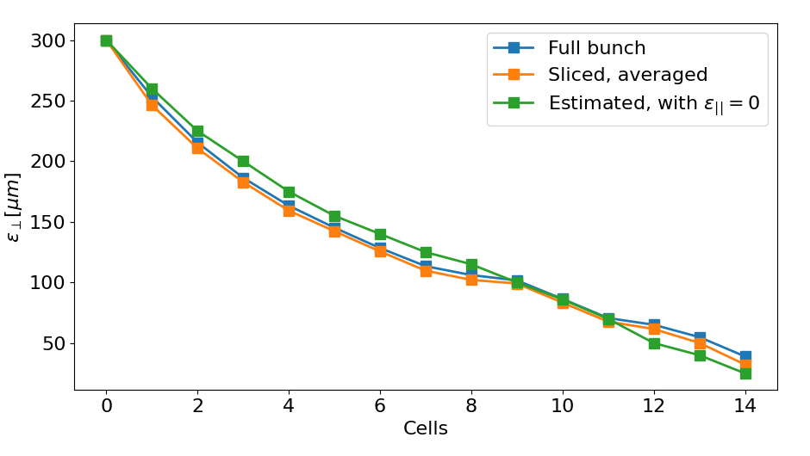
Muon Cooling
Final cooling design
Simplified RF, 40 T solenoids, 4 MeV after last window
Comes closer to target performance
E. Fol, Ch. Rogers et al.
Cooling technology
Started considering absorber for final cooling
Muon beam is dense, have to consider heating
Can limit pressure rise limited with gas density
  Leads to acceptable absorber lengths
Windows are under investigation
  Plan experiments at HiRadMat
B. Stechauner, J. Ferreira et al.

Slide 24
RCS Design
A. Chance, F. Batsch et al.
Example parameters for the muon RCSs
 | RCS1 | RCS2 | RCS3 | RCS4
Hybrid RCS | No | Yes | Yes | Yes
Circumference [m] | 5990 | 5990 | 10700 | 26659
Injection/extr. energy [TeV] | 0.06/0.30 | 0.30/0.75 | 0.75/1.5 | 1.5/4.2
Survival rate [%] | 90 | 90 | 90 | 90
Acceleration time [ms] | 0.34 | 1.10 | 2.37 | 5.75
Number of turns | 17 | 55 | 66 | 65
Energy gain/turn [GeV] | 14.8 | 7.9 | 11.4 | 41.5
NC dipole field [T] | 0.36/1.8 | -1.8/1.8 | -1.8/1.8 | -1.8/1.8
SC dipole field [T] | - | 10 | 10 | 16
NC/SC dipole length [m] | 2.6/- | 4.9/1.1 | 4.9/1.3 | 8.0/1.3
Number of arcs | 34 | 26 | 26 | 26
Number of cells/arc | 7 | 10 | 17 | 19
Cell length [m] | 21.4 | 19.6 | 20.6 | 45.9
Path length diff. [mm] | 0 | 9.1 | 2.7 | 9.4
Orbit difference [mm] | 0 | 12.2 | 5.9 | 13.2
Min. dipole width [mm] | 17.4 | 19.6 | 10.7 | 18.8
Min. dipole height [mm] | 14.8 | 6.4 | 4.2 | 4.4
Detailed parameter table (by F. Batsch): https://cernbox.cern.ch/index.php/s/I9VpITncUeCBtiz
Parameters of the 4th RCS under study.
Several proceedings at IPAC’23:
  “Parameter Ranges For A Chain Of Rapid Cycling Synchrotrons For A Muon Collider Complex”
  “Longitudinal beam dynamics and RF requirements for a chain of muon RCSs”
  “Transverse impedance and beam stability studies for the Muon collider Rapid Cycling Synchrotrons”
Next steps:
  To refine the parameters tables.
  To improve the lattice generator to get a full optics of the RCS (integration of the RF cavities).
Collective effects and shielding not included

Slide 25
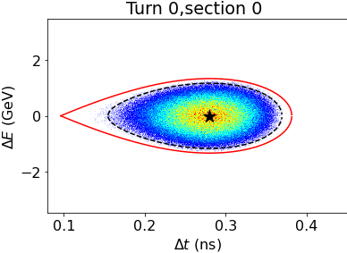
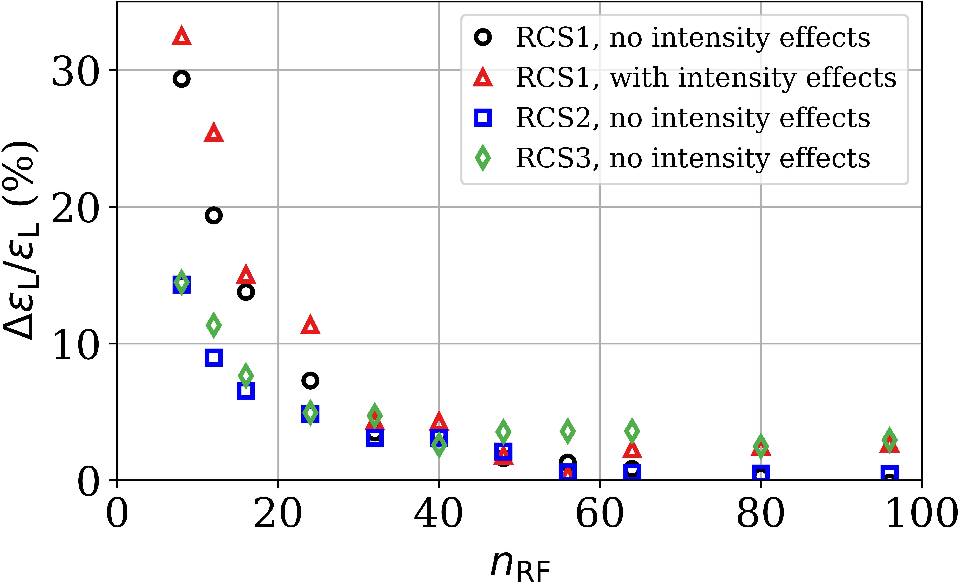
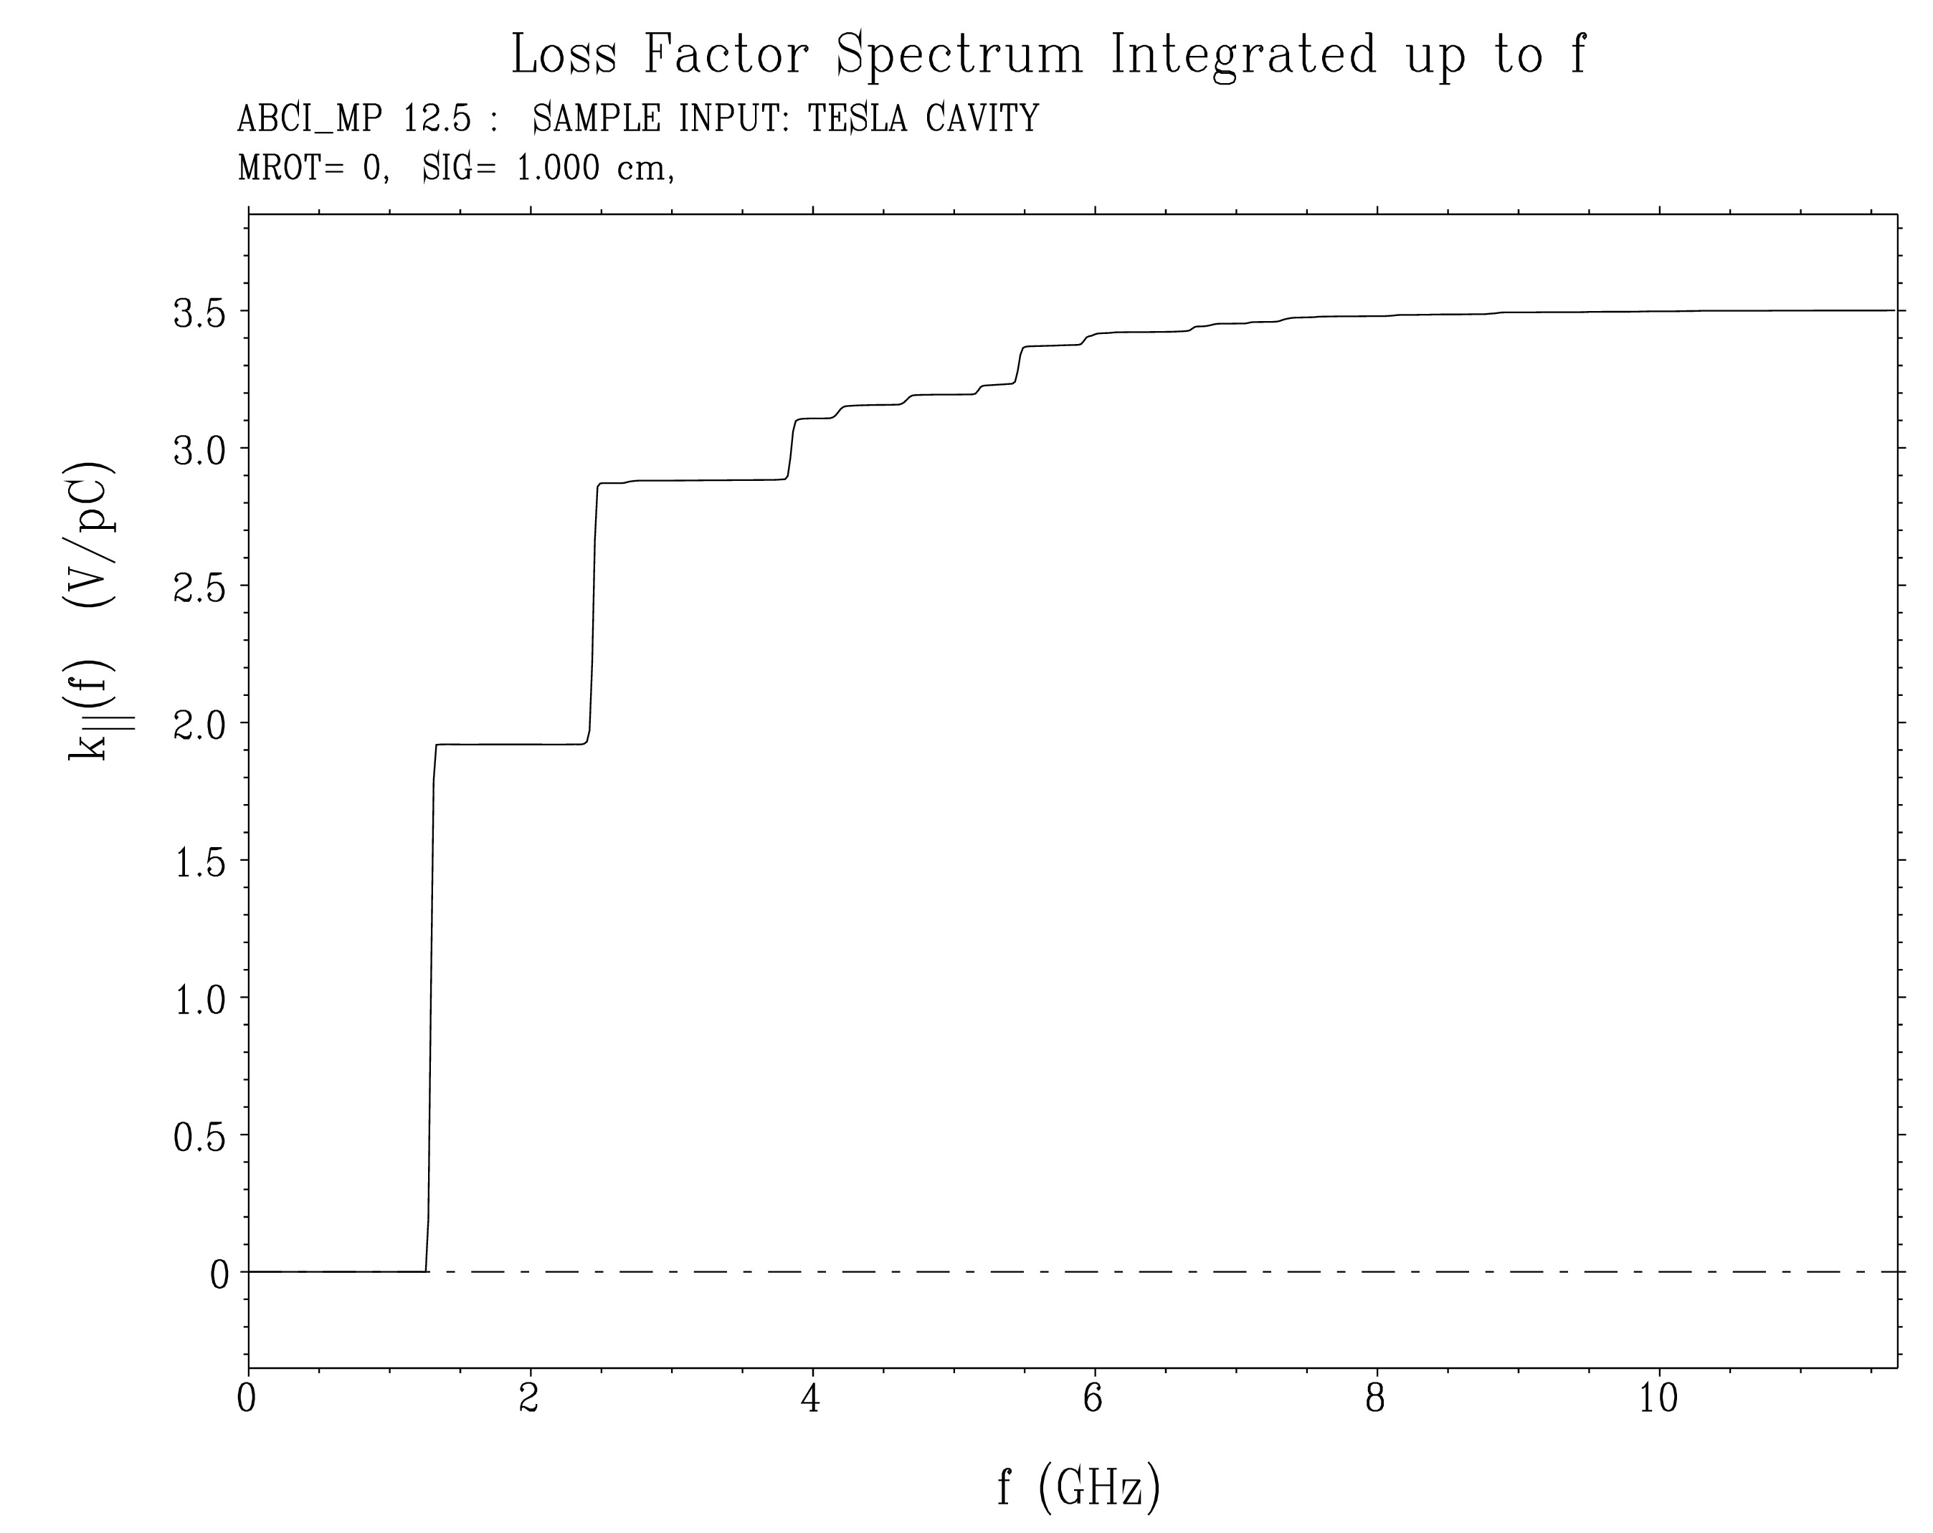
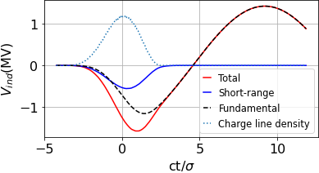
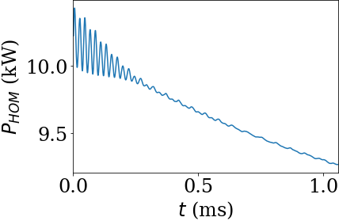

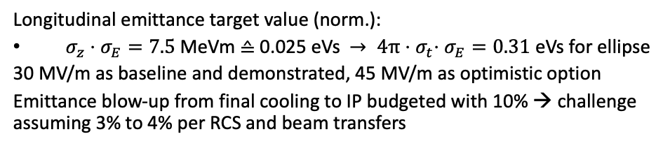

RF Progress
F. Batsch, H. Damerau, A: Grudiev, U. van Rienen et al.
Long. Distribution assumed at injection in RCS1
Longitudinal emittance target value (norm.):
$σ_{z}⋅σ_{E}=7.5$ MeVm ≙ 0.025 eVs ${→ 4π⋅σ}_{t}⋅σ_{E}=0.31$ eVs for ellipse
30 MV/m as baseline and demonstrated, 45 MV/m as optimistic option
Emittance blow-up from final cooling to IP budgeted with 10% → challenge assuming 3% to 4% per RCS and beam transfers
Around 30 RF stations needed for longitudinal stability and focusing
Changes in orbit length require frequency tuning required (A. Chancé)
Single-bunch HOM power loss up to 10 kW averaged over the acceleration time
CW average is lower, development of high-capacity couplers needed
P_{HOM} for RCS2
Induced voltages in RCS1 for a single bunch
Integrated loss factor to compute
$$P_{HOM}=k_{||,SR}∗\frac{Q^{2}}{T_{B}}$$
ABCI file from S.-A. Odongwo
D. Schulte Muon Collider Status, Annual Meeting, Orsay, June 2023

Slide 26
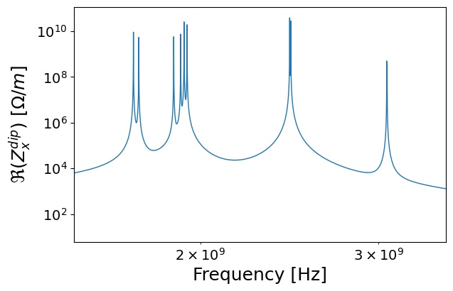
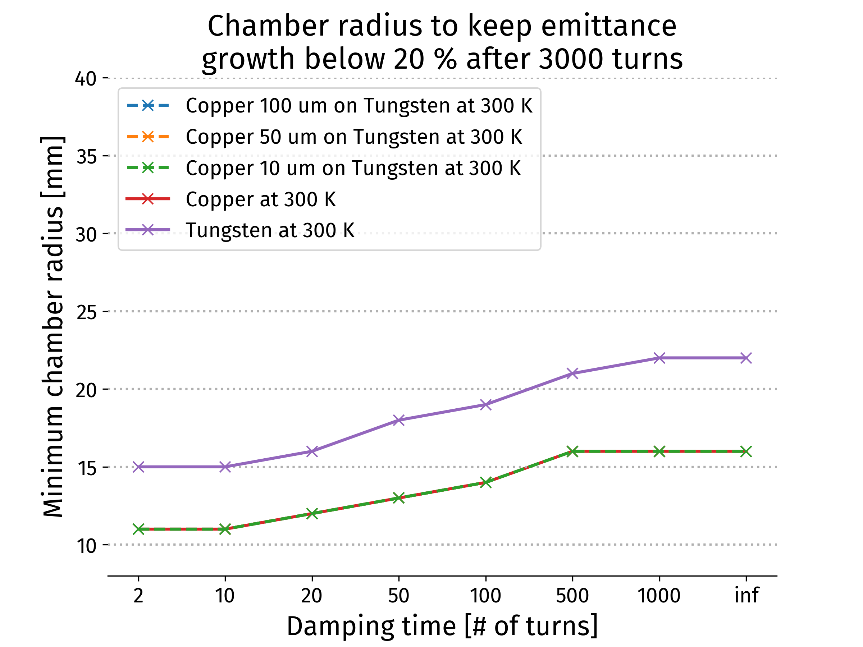
Collective Effects
D. Amorim, E. Metral, X. Buffat
RCS:
Assuming O(700) TESLA type RF cavities
  Impact of initial transverse offset for single beam
Two beam under investigation
Horizontal dipolar impedance,
670 TESLA type cavities
Collider ring
Single beam instability limits
  Conservative feedback
  Copper coating beneficial (few microns)
  Minimum radius from impedance:
    14mm with copper coating
    19mm for direct tungsten
D. Schulte Muon Collider Status, Annual Meeting, Orsay, June 2023

Slide 27
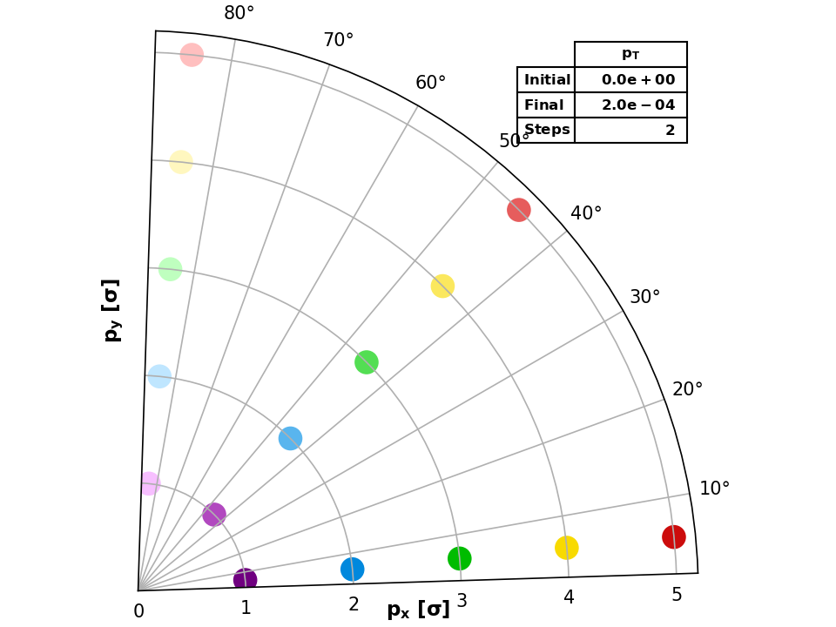
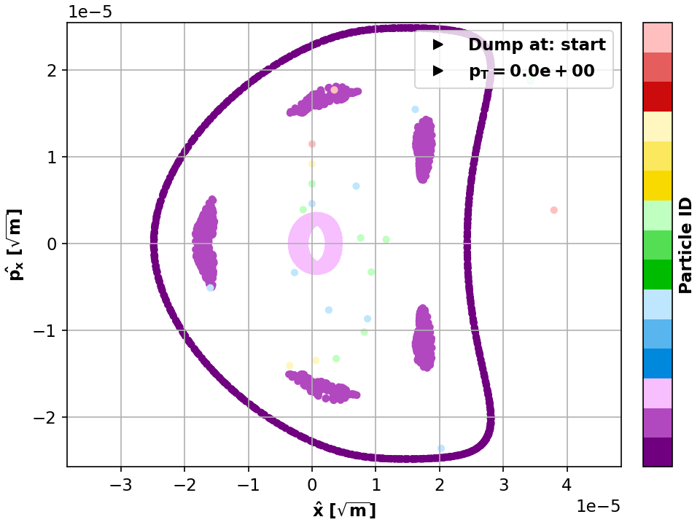
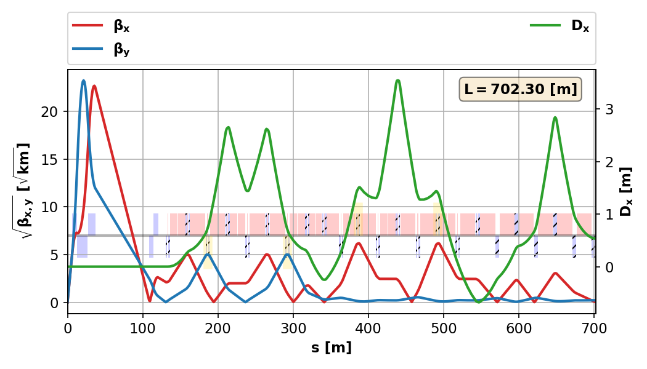
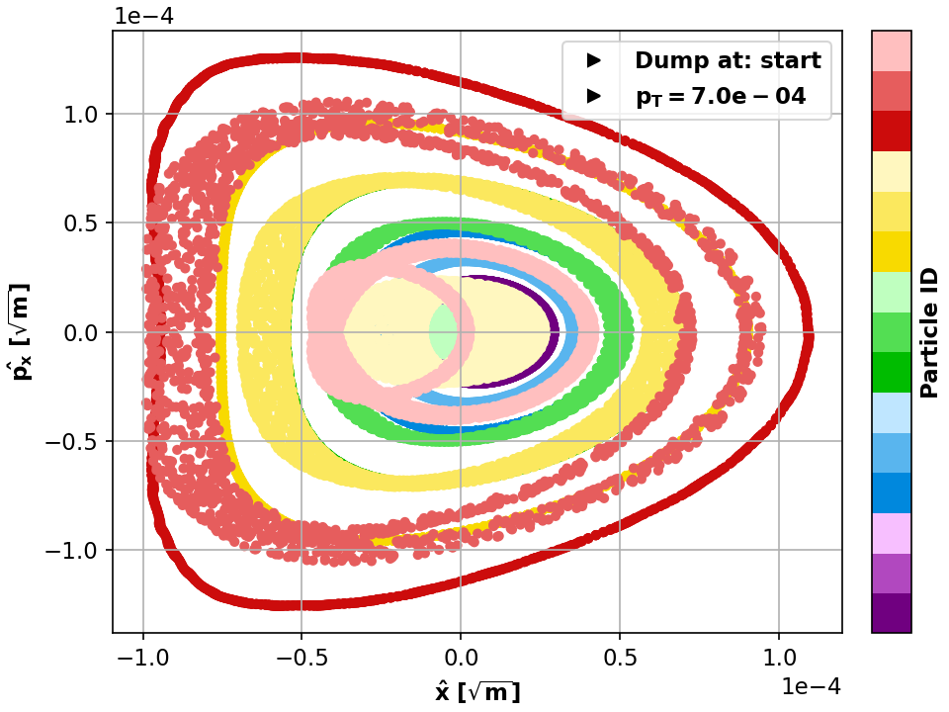
Collider Ring Lattice
K. Skoufaris, Ch. Carli, support from P. Raimondi, K. Oide, R. Tomas
Important progress:
V0.4 (last annual meeting) almost no dynamic aperture for on-energy particles
  Very challenging lattice design and becomes harder at higher energies
V0.6 good dynamic aperture at almost 0.1% off-energy
  Approaching the target
pT [%] | DAmin [σ]
0.07 | 5
0.08 | 4
0.09 | 3
0.1 | <1

Slide 28
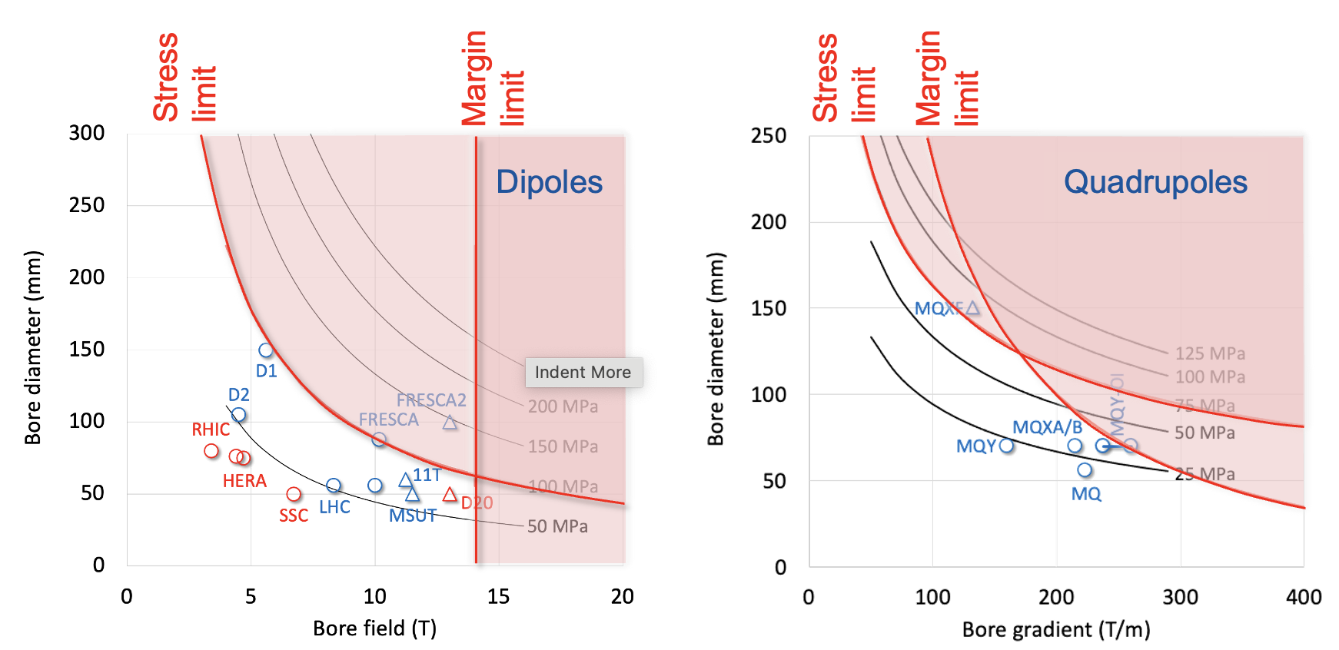
Collider Ring Technology
 | thickness | outer
Beam aperture | 23.49 | 23.49
Copper coating | 0.01 | 23.5
Tungsten shield | 40 | 63.5
Support/ins. | 11 | 74.5
Cold bore | 3 | 77.5
Kapton | 0.5 | 78
Clearance | 1 | 79
K. Skoufaris, Ch. Carli, D. Amorim, A. Lechner, R. Van Weelderen, P. De Sousa, L. Bottura et al.
Started definition of cross section
Lattice
Impedance
Shielding
Cooling
Vacuum
Magnets
Initial estimate of field limits for magnets: 9 T for NbTi, 14 T for Nb₃Sn
Important progress on cooling
Different cooling scenarios being followed
Tungsten shield cooled close to room temperature CO₂ (preferred) or water (to be verified)
Support of shield is important for heat transfer
Discussion on options for magnet cooling
R. Van Weelderen, P. De Sousa
L. Bottura et al.

Slide 29
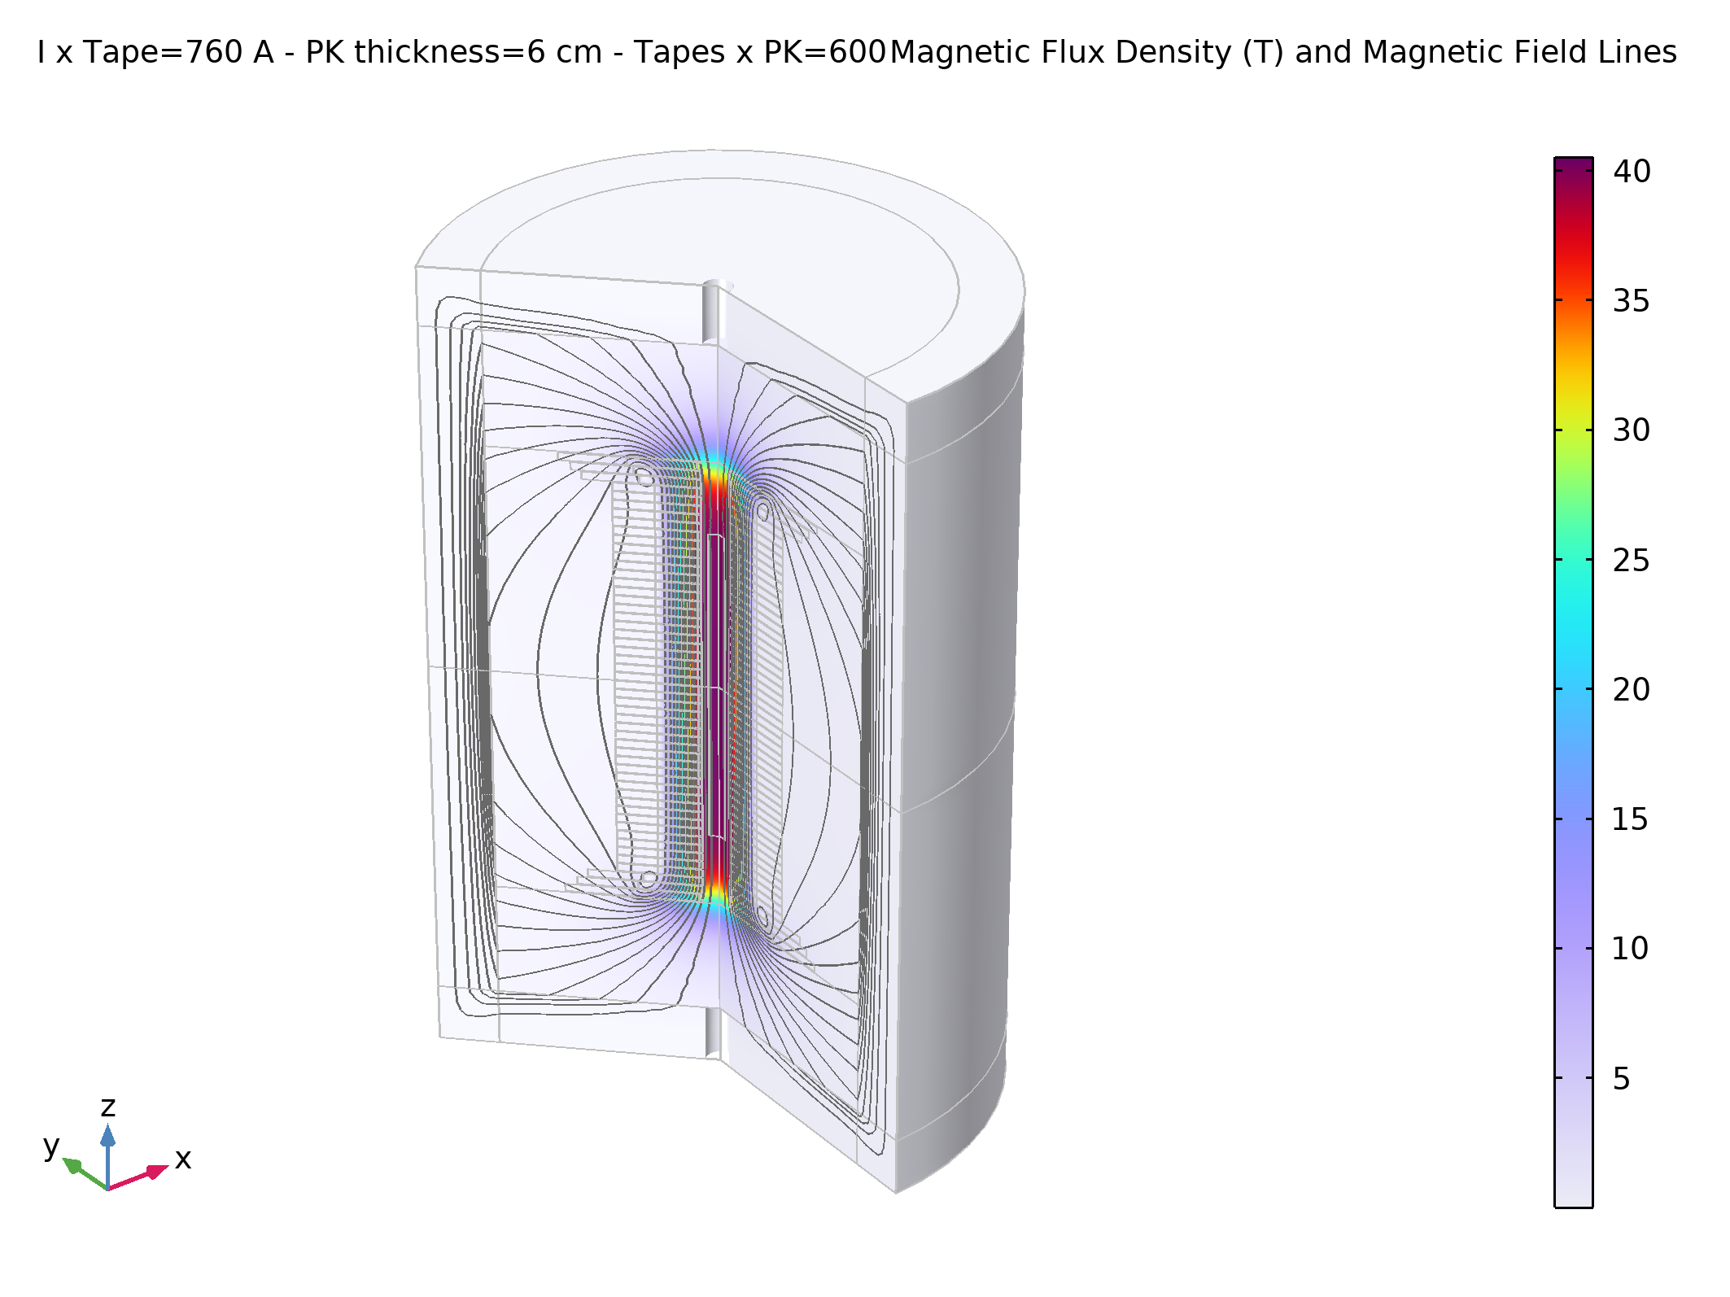
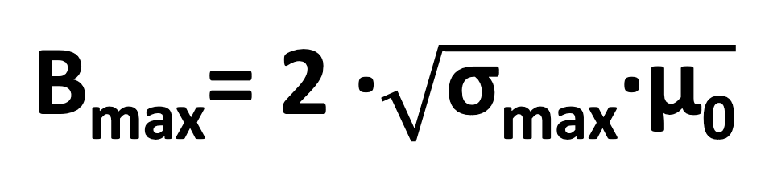
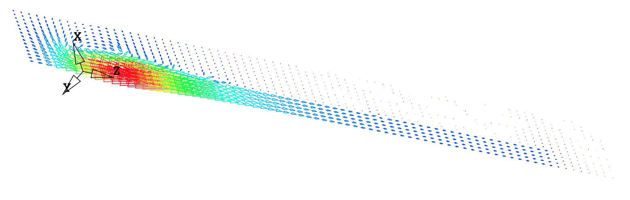
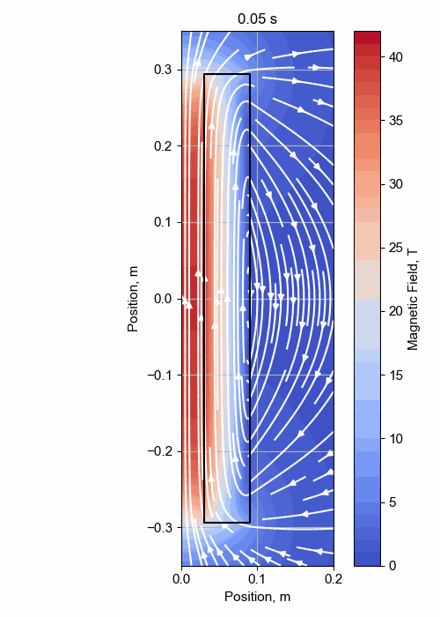
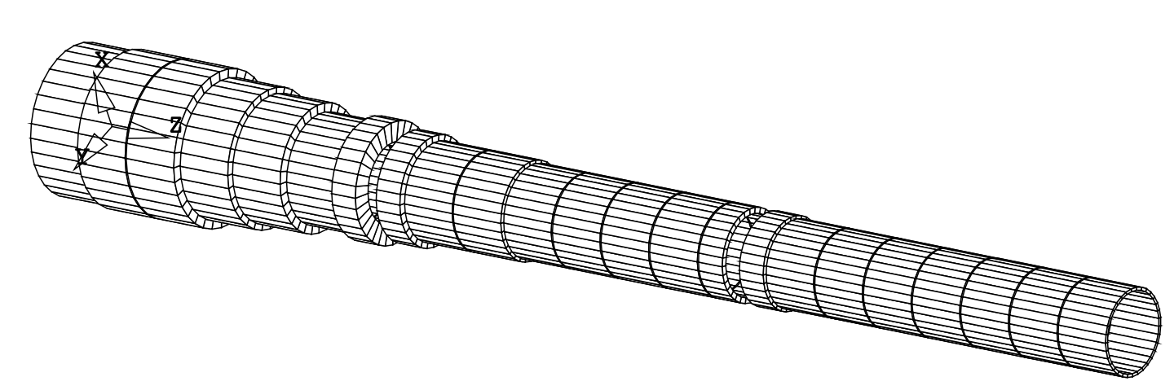

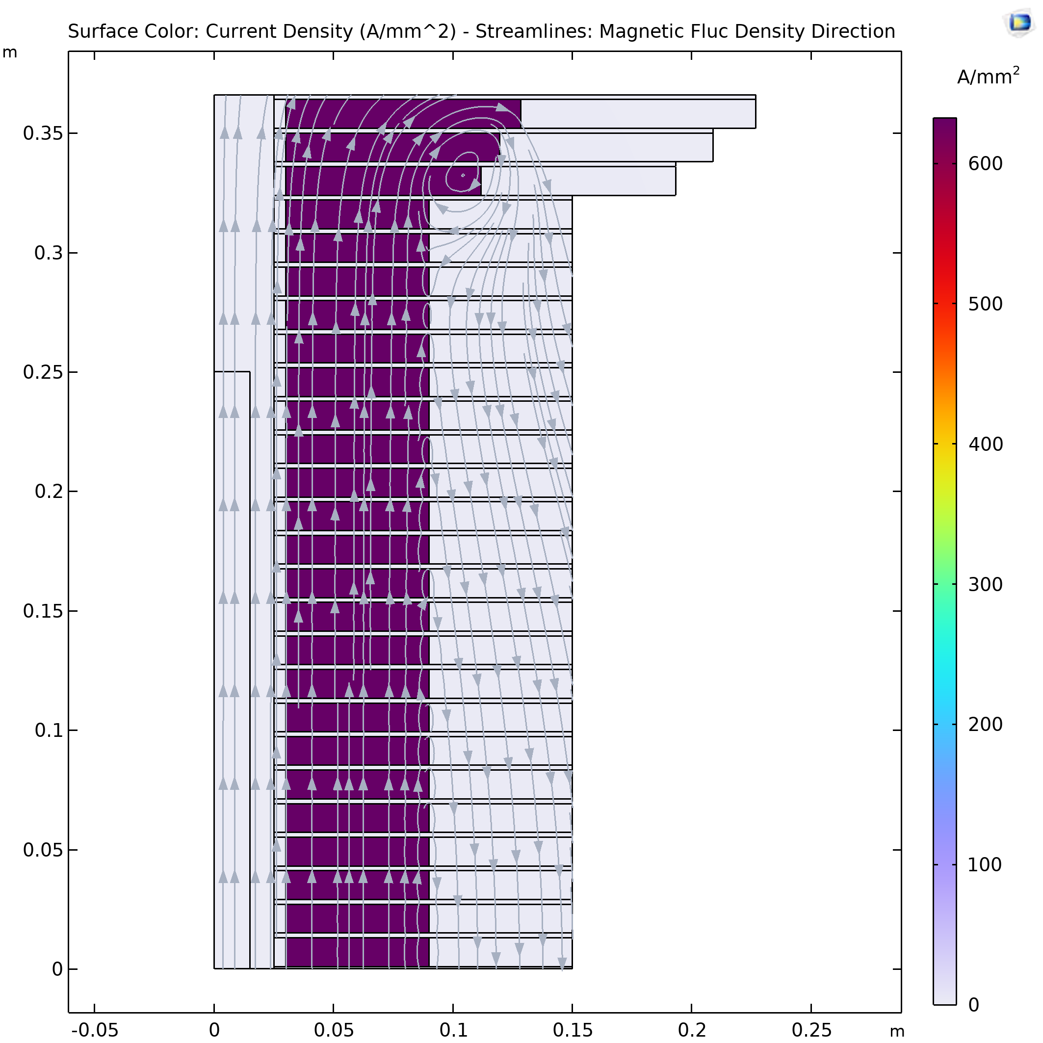
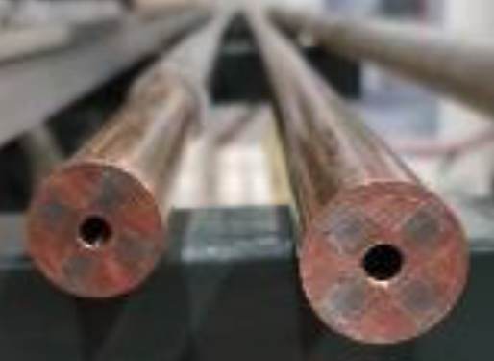
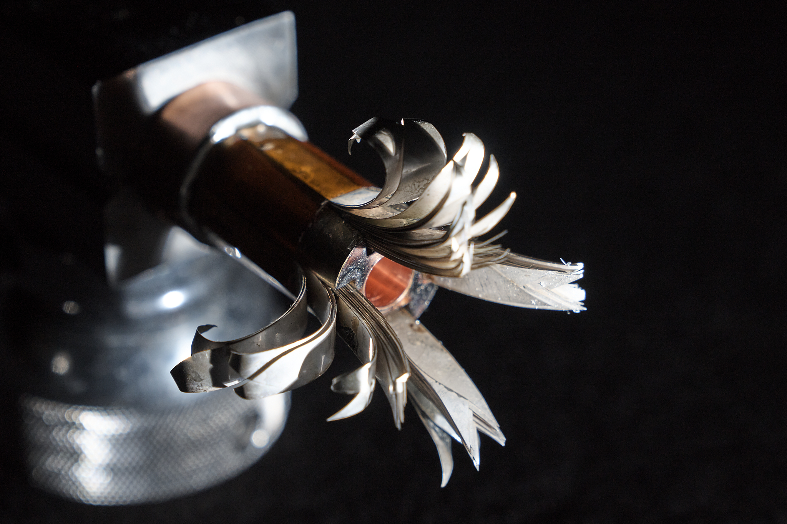
Solenoids
Target solenoid
Operating field: 20 T
Operating temperature: 20 K
Final Cooling solenoid
σ_{max} = 600 MPa
A Portone, P. Testoni, J. Lorenzo Gomez, F4E
A. Dudarev, B. Bordini, T. Mulder, S. Fabbri
MIT “VIPER” conductor
MuCol HTS conductor
Operating current: 61 kA
Inner Ring
‘Correction’ Coil
Outer Ring
Bore
‘Modular’ Coil
1 % Field Homogeneity
Support Plate
M. Takayasu et al., IEEE TAS, 21 (2011) 2340
Z. S. Hartwig et al., SUST, 33 (2020) 11LT01
Strong connection to HTS magnets for fusion

Slide 30
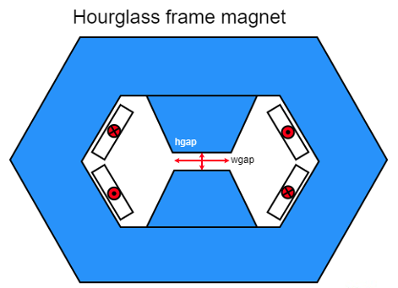
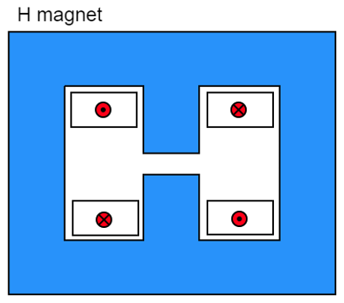
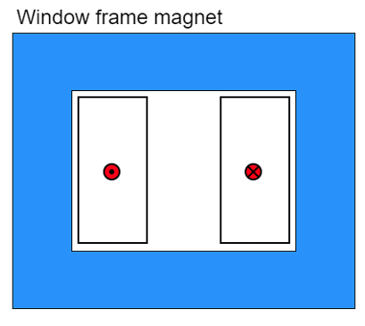
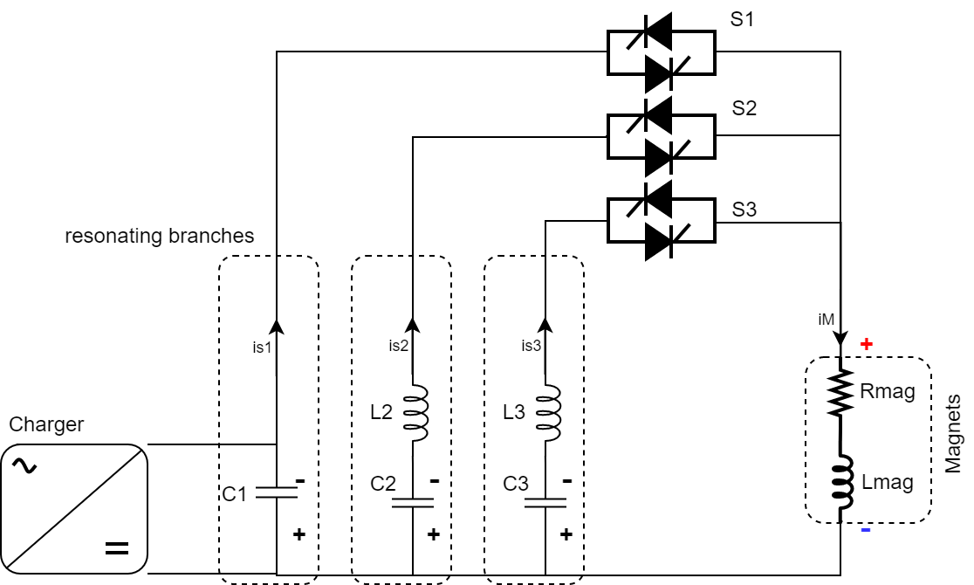
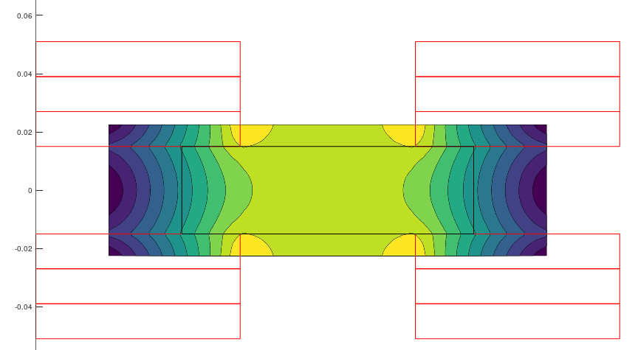
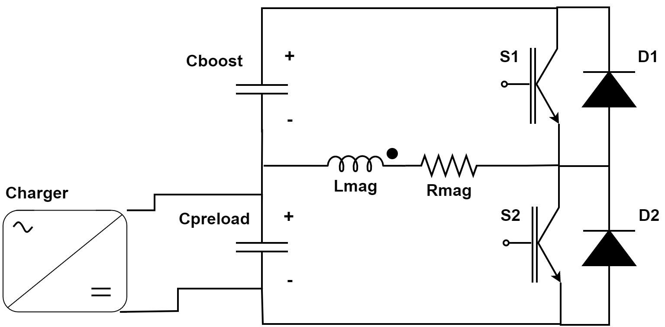
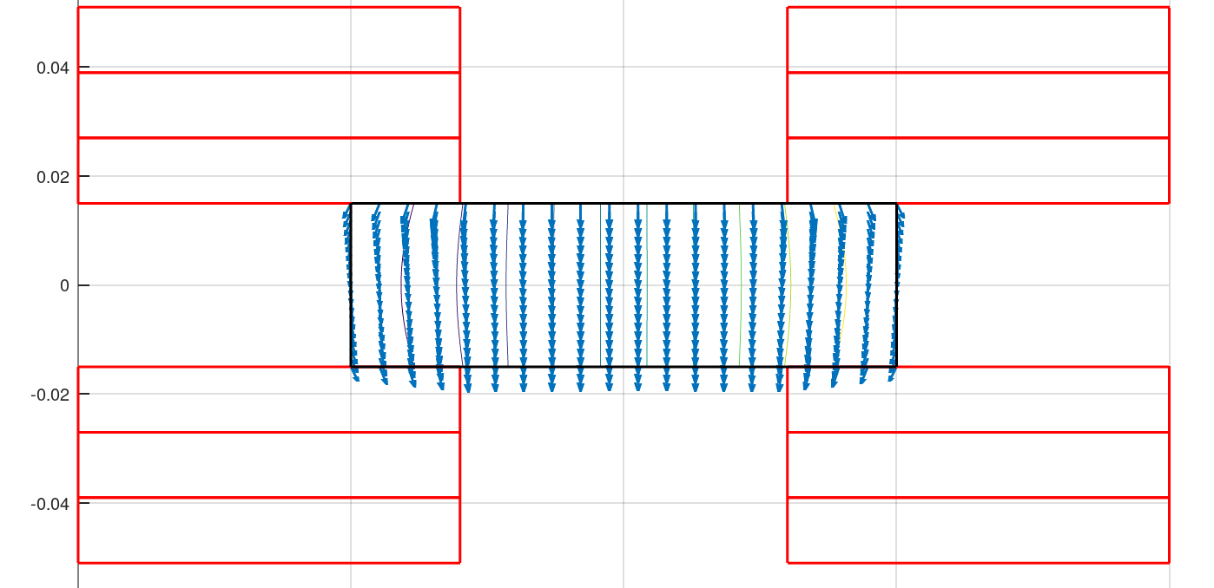
Fast-ramping Magnets
F. Boattini et al.
Differerent power converter options investigated
Full wave resonance
5.07 kJ/m
5.65…7.14 kJ/m
5.89 kJ/m
Main challenge is management of the power in the resistive dipoles (several tens of GW):
Minimum stored magnetic energy
Highly efficient energy storage and recovery
Commutated resonance (new)
Simple HTS racetrack dipole could match the beam requirements and aperture
HTS flat racetracks
b3 = -7.2 units
b5 = -1.4 units
b7 = -0.03 units
peak field
10.4 T
Rectangular magnet bore 100 mm x 30 mm

Slide 31
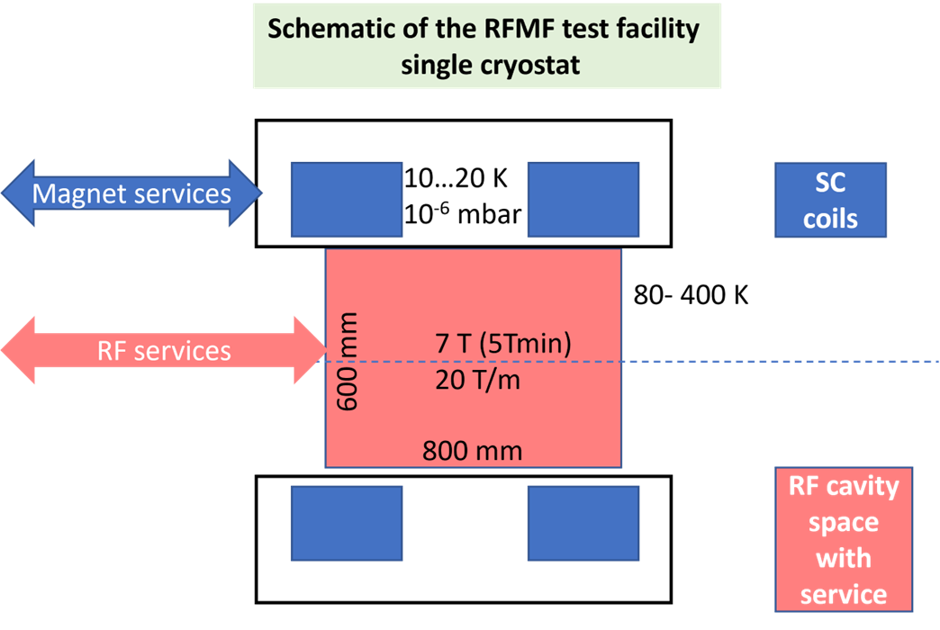
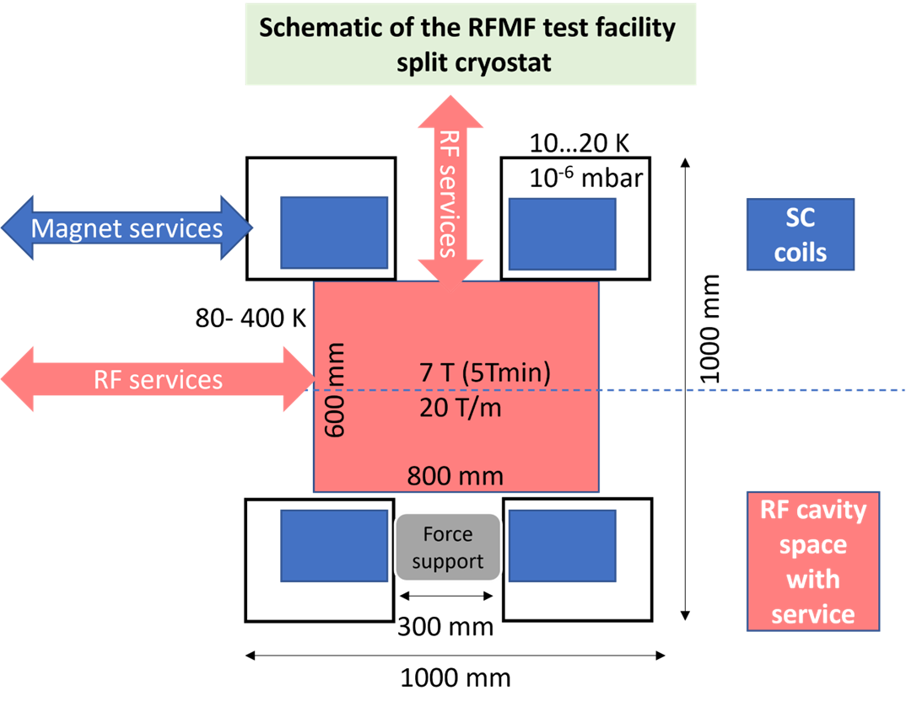
RF Test Station Layout
Module work focuses on RF test stand at this moment
One of the most urgent actions to ensure timely implementation of R&D programme
Try to identify infrastructure for this
  CEA, INFN, Cockroft, CERN, …
  Will not be cheap so need to find resources
L. Rossi, C. Marchand, D. Giove, A. Gurdiev, G. Ferrand et al.
Scheme 1: single cryostat
Scheme 2: split cryostat
Two coils to vary magnetic field distribution
Preliminary design allows down to 700 MHz system → ∅600 RT free bore for RF → ∅700 mm minimum SC coil diameter
Currently study single cryostat, next split cryostat
Coils are expensive

Slide 32
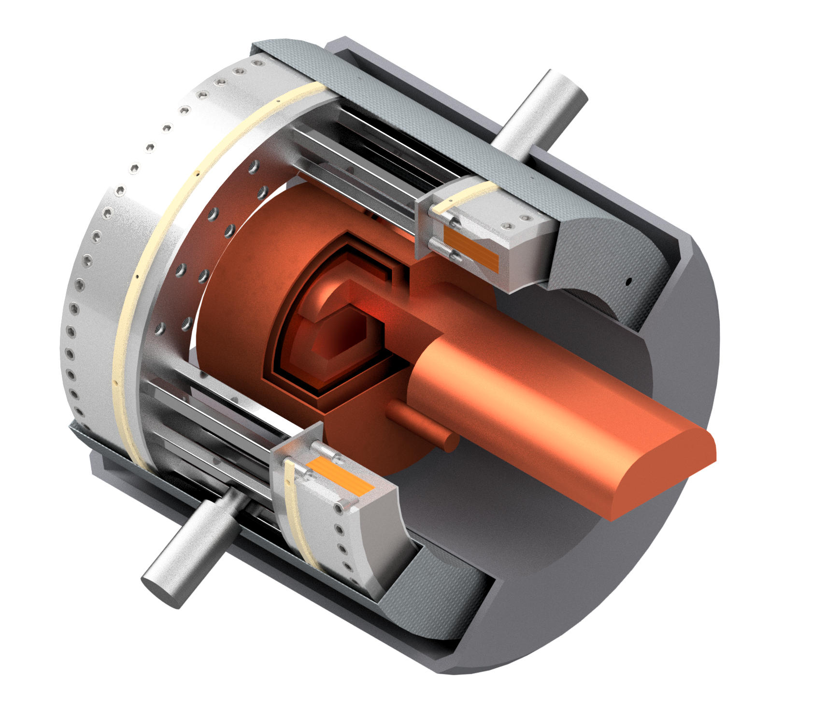
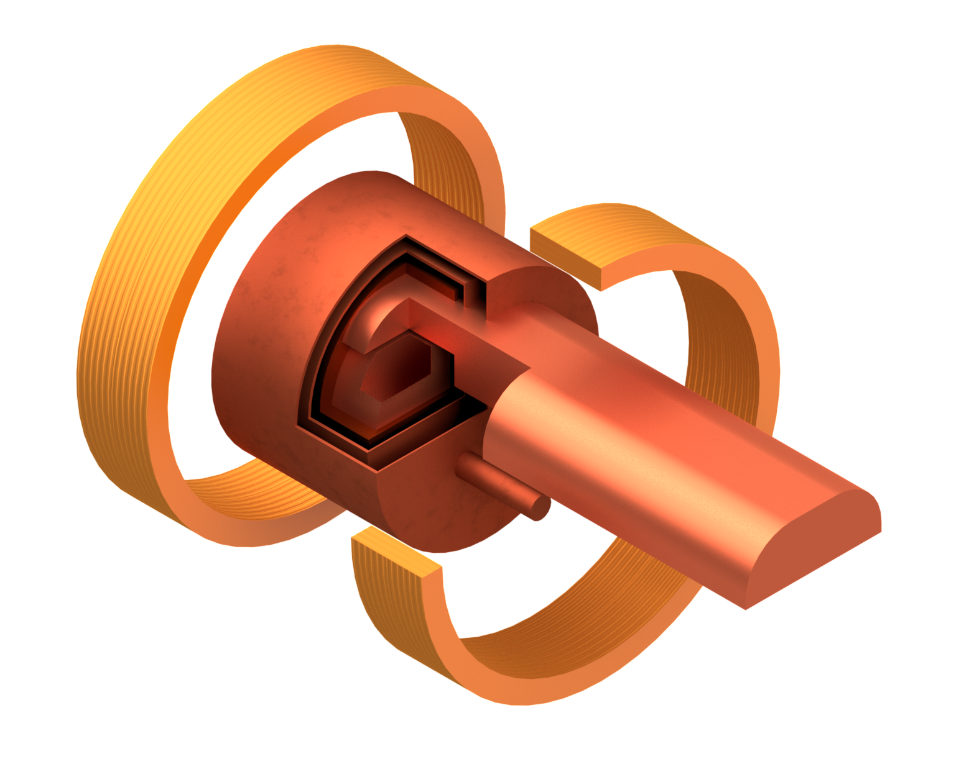
First Sketches
Bare coils and RF cavity
With cryostat
Two stage
cryocooler
SC HTS coils
Coil support structure
Thermal shield
Vacuum vessel
Tie rods for repulsion and compression forces
RF Wave guide
Pillbox test cavity
Sc magnet/cryostat sketch by M. Castoldi & Stefano Sorti, UMIL & INFN-LASA
(RF drawing by Guillaume Ferrand –CEA)
SC HTS coils

Slide 33
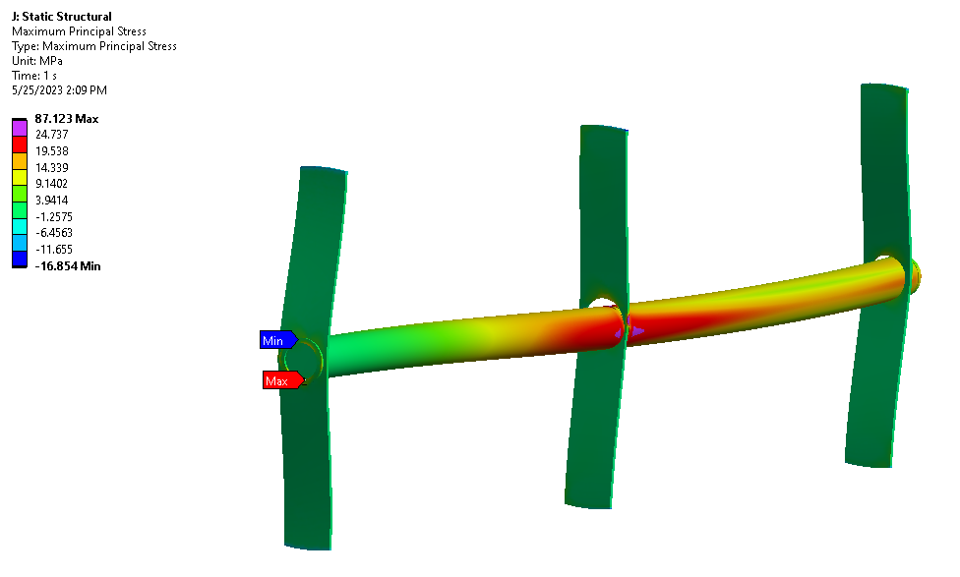
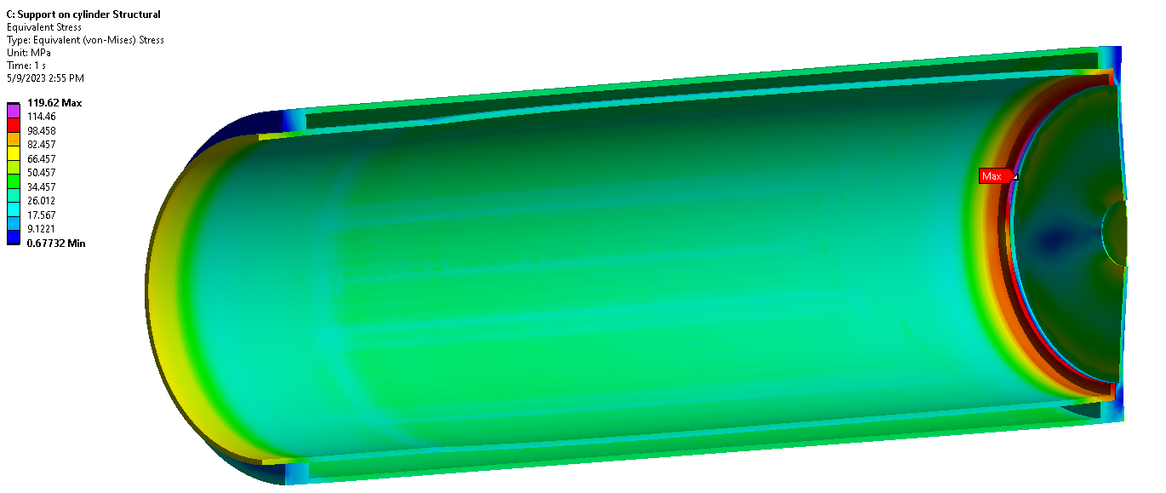
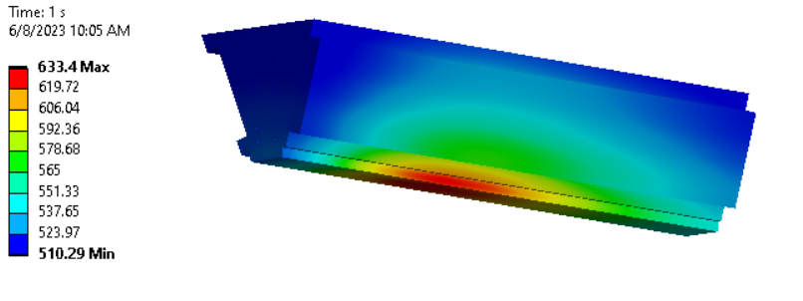
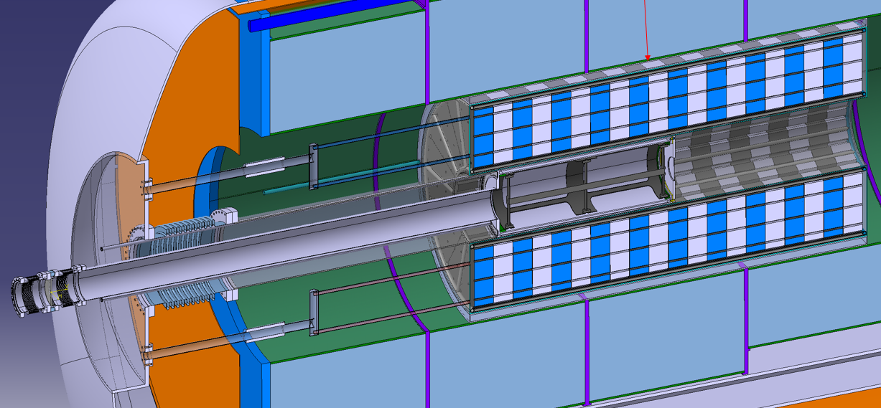

Target Studies
Studying 2 MW target
Stress in target, shielding, vessel and window being studied
In general very promising, need to have closer look at window
A. Lechner, et al.
Integration with magnet is being addressed
Cooling of the shield also
Radiation to magnet has been studied
33

Slide 34

CDR Phase, R&D and Demonstrator Facility
Broad R&D programme required and can be distributed world-wide
Models and prototypes
  Magnets, Target, RF systems, Absorbers, …
CDR development
Integrated tests, also with beam
Integrated cooling demonstrator is a key facility
look for an existing proton beam with significant power
Different sites are being considered
CERN, FNAL, ESS are being discussed
J-PARC also interesting as option
FNAL is considering this in the ACE
Could be used to house physics facility
Are trying to explore what are good options
C. Rogers, R. Losito, et al.

Slide 35


Demonstrator Progress
Ch. Rogers et al.
200 MeV/c beam
FNAL consideres the demonstrator in the Accelerator Complex Evolution (ACE)
Element positions are indicative
Fixed
Dipole
Beam
preparation
system
Movable
Dipole
NuSTORM set to 6 GeV/c
NuSTORM set to 1 GeV/c
1-6 GeV/c beam
Quad
Target
Dipole
Continue to explore synergies
Past meeting in Venice
Synergy workshop after the annual meeting
Design Studies are ongoing
Studying layout options from target
  NuSTORM-compatible option
  TT7-compatible option
Optimisation of rectilinear cooling system ongoing

Slide 36



Neutrino Flux
Goal: similar to LHC: limit neutrino flux to have negligible impact, “fully optimised” (10% of MAP goal)
Verify performance of concept to be good for 14 TeV
Mover and support system
FLUKA dose studies
Conformity Verification Scheme
Tentative specifications to study system in detail
Plan a mockup with existing equipment and new movers to verify system
Improved estimates of impact of neutrino flux
Estimates of impact on the accelerator
F. Bertinelli et al. (CERN, Riga)
G. Lerner, D. Calzolari, A. Lechner, C. Ahdida
G. Lacerda, Y. Robert, N. Guilhaudin (CERN)
C. Ahdida, P. Vojtyla, M. Widorski, H. Vincke
Flux direction map / lattice design / mover impact on beam
Civil engineering studies continue
Mitigation:
Site choice tool
C. Carli, K. Skoufaris (CERN)
36

Slide 37
Interim Report
Purpose
Help to increase support from Council and other funding agencies, the laboratories and the community
Manage expectation for next reports
Prepare key elements of the R&D
Scope
Cover physics, detector, accelerator and technologies
Describe progress in funding and work
Describe what we are doing by 2025
Identify further resource needs and motivate further increase of support
Earmark key elements of the study
  e.g. RF test stand to support the need of an infrastructure
  e.g. highlight that options exist to site the demonstrator
Due end of 2023 or early 2024

Slide 38
Tentative Interim Report Structure
Collaboration Development
Physics Potential
…
Accelerator technologies
Synergies
Technologies
Facilities
Experiments
R&D programme development
Demonstrator
RF test stand
Executive Summary
Layout for each section
But maybe group differently
After all a matrix
System Overview
Short description of the system
Key challenges
Reminder of key challenges of the system?
Work progress since Roadmap
Status of the current concept
Work planned for Evaluation Report
Based on existing resources
Important missing Effort
What would be important to add?

Slide 39
Other Points
Preparing publication policy
  Devil is in the detail, will profit from CLIC model
  Goal is to be open, anyone following our procedure can talk or publish for the muon collider collaboration
Preparing data policy
  As open as possible: instill confidence in our results, profit from voluntary contributions
Started INDICO page to collect information about resources by all partners
  Thanks to Luca and Alexia Augier, help also from Steinar, Chris, Sergo, and Nadia
CERN extended MTP for muon collider until 2028
  Total material budget has increased by a factor two, but needs to redistributed
CERN will create an EP-UMC unit to ease inscription of users, moving forward with grey book
EPJC article still under review (thanks to all contributors, in particular Andrea and Federico)

Slide 40
Conclusion
The study is moving forward at good speed
Will prepare Interim Report
Will define tentative parameters
Hope to further increase rate of progress
  More team getting up to speed, often in MuCol
  US contribution
  …

Slide 41
Reserve

Slide 42
Muon Collider Luminosity Scaling
Fundamental limitation
Requires emittance preservation and advanced lattice design
Applies to MAP scheme
High beam power
High energy
Large energy acceptance
Dense beam
High field in collider ring
Luminosity per power increases with energy
Provided technologies can be made available
Constant current for required luminosity scaling

Slide 43

Staging
Ideally would like full energy right away, but
staging could lead to faster implementation
Substantially less cost for a first stage
Can make technical compromises
  e.g. 8 T NbTi magnets would increase collider ring from 4.5 to 6 km and reduce luminosity by 25%
Timeline might be more consistent with human lifespan
Upgrade adds one more accelerator and new collider ring
only first collider ring is not being reused

Slide 44
Alternatives: The LEMMA Scheme
LEMMA scheme (INFN) P. Raimondi et al.
Note: New proposal by C. Curatolo and L. Serafini needs to be looked at
Uses Bethe-Heitler production with electrons
45 GeV positrons to produce muon pairs
Accumulate muons from several passages
Excellent idea, but nature is cruel
Detailed estimates of fundamental limits show that we require a very large positron bunch charge to reach the same luminosity as the proton-based scheme
Need same game changing invention

Slide 45

Muon Decay
About 1/3 of energy in electrons and positrons:
Experiments needs to be protected from background by masks
simulations of 1.5, 3 and 10 TeV
optimisation of masks and lattice design started
first results look encouraging
will be discussed at ICHEP
Collider ring magnets need to be shielded from losses
Losses elsewhere will also need to be considered but are less severe
D. Lucchesi, A. Lechner, C Carli et al.
Neutrino flux to have negligible impact on environment
want to be negligible (same level as LHC)
opening cone decreases, cross section and shower energy increase with energy
Above about 3 TeV need to make beam point in different vertical directions
Mechanical system with 15cm stroke, 1% vertical bending
Length of pattern to be optimised for minimal impact on beam
~2 x 600 m
45

Slide 46
Key Challenges
Proton complex
- Compressing protons to few bunches
Target
- Target
- Solenoid
Cooling channel
- Channel design
- Solenoids
- RF in magnetic field
- Absorbers
- Integration
RCS
- Beam dynamics
- Ramping magnets
- Power converter
- RF system
Collider ring
- Optics
- Magnets
- Neutrino flux
- Detector background
46

Slide 47
Roadmap
In aspirational scenario can make informed decisions:
Three main deliverables are foreseen:
a Project Evaluation Report for the next ESPPU will contain an assessment of whether the 10 TeV muon collider is a promising option and identify the required compromises to realise a 3 TeV option by 2045. In particular the questions below would be addressed.
  What is a realistic luminosity target?
  What are the background conditions in the detector?
  Can one consider implementing such a collider at CERN or other sites, and can it have one or two detectors?
  What are the key performance specifications of the components and what is the maturity of the technologies?
  What are the cost drivers and what is the cost scale of such a collider?
  What are the power drivers and what is the power consumption scale of the collider?
  What are the key risks of the project?
an R&D Plan that describes an R&D path towards the collider;
an Interim Report by the end of 2023 that documents progress and allows the wider community to update their view of the concept and to give feedback to the collaboration.
47

Slide 48
R&D Plan
The R&D plan will describe the R&D path toward the collider, in particular during the CDR phase, and will comprise the elements below.
An integrated concept of a muon cooling cell that will allow construction and testing of this key novel component.
A concept of the facility to provide the muon beam to test the cells.
An evaluation of whether this facility can be installed at CERN or another site.
A description of other R&D efforts required during the CDR phase including other demonstrators.
This R&D plan will allow the community to understand the technically limited timeline for the muoncollider development after the next ESPPU.

Slide 49
Minimal Scenario
Will allow partially informed decisions
No conceptual design of neutrino flux and alignment system
No alternative superconducting fast-ramping magnet system
Several collider systems would (almost) not be covered, in particular
  the linacs
  the target complex
  the proton complex
  engineering considerations of the muon cooling cells
  alternative designs for the final cooling system, acceleration, collider ring
No RF test stand would be constructed for the muon cooling accelerating cavities
No conceptual design of a muon cooling cell for the test programme
No conceptual design of a muon cooling demonstrator facility
No concept of RF power sources
No tests/models to develop solenoid technology.

Slide 50
Key Technologies
Magnets
Superconducting solenoids for target and cooling profit from developments for society
  target solenoid comparable to ITER central solenoid fusion
  6D cooling solenoids similar and wind power generators, motors
  final cooling solenoids synergetic with high-field research, NMR
Collider ring magnets
  profit from developments for other colliders FCC-hh, stress-managed magnets
Fast-ramping normal-conducting magnet system
  HTS alternative, power converter
RF systems
superconducting RF, normal-conducting RF, efficient klystrons
Target, cooling absorbers, windows, shielding
Neutrino mitigation mover system, cooling cell integration, …
Detector

Slide 51
Key Technologies, cont.
RF systems
Normal-conducting cooling cavities in magnetic field
  profit from CLIC work
Superconducting accelerator RF
  profit from ILC, …
Efficient power sources
  profit from CLIC work
Beam-matter interaction
Proton target
Cooling absorbers
Shielding (accelerator and detector)
Mechanical system
Neutrino flux mitigation system
Muon cooling cell integration

Slide 52
Collaboration Vision
IMCC is an international collaboration and aims to
Enlarge the collaboration
  Physics interest in all regions, strong US contribution to the muon collider physics and detector, interest in Japan
  First US university have joined collaboration, try to see how to move forward, also with labs
Combine the R&D efforts for the design and its technologies
  Critical contributions in all relevant fields in the US
Consider several sites for the collider
  CERN would be one, FNAL and others should also be considered
  A proposal with alternative sites is stronger for a single site
Consider several sites for the demonstrators
  E.g. Muon production and cooling demonstrator at CERN, FNAL, ESS, JPARC
  e.g. RCS at ESRF or elsewhere
  Target tests
  …

Slide 53
Initial Target Parameters
Target integrated luminosities
Note: currently focus on 10 TeV, also explore 3 TeV
Tentative parameters based on MAP study, might add margins
Achieve goal in 5 years
FCC-hh to operate for 25 years
Aim to have two detectors
Parameter | Unit | 3 TeV | 10 TeV | 14 TeV
L | 10³⁴ cm⁻²s⁻¹ | 1.8 | 20 | 40
N | 10¹² | 2.2 | 1.8 | 1.8
f_{r} | Hz | 5 | 5 | 5
P_{beam} | MW | 5.3 | 14.4 | 20
C | km | 4.5 | 10 | 14
<B> | T | 7 | 10.5 | 10.5
ε_{L} | MeV m | 7.5 | 7.5 | 7.5
σ_{E} / E | % | 0.1 | 0.1 | 0.1
σ_{z} | mm | 5 | 1.5 | 1.07
β | mm | 5 | 1.5 | 1.07
ε | μm | 25 | 25 | 25
σ_{x,y} | μm | 3.0 | 0.9 | 0.63
CLIC at 3 TeV
2 (6)
28
53

Slide 54
US Snowmass
Strong interest in the US community in muon collider
seen as an energy frontier machine
decoupled from LC
US community wants funding for R&D
Goal: match European effort
Community interested in the US to host a muon collider
Meenakshi Narain: Energy Frontier / Large Experiments, Snowmass Community Summer Study July 17-26, 2022
54

Slide 55
US Snowmass, cont.
Implementation Task Force
Muon Collider is a viable option for the HEP future
They made cost and power estimate for muon collider
take it cum grano salis
Place MC in same risk tier as FCC-hh
Thomas Roser et al
55

Slide 56



Muon Collider magnets
HTS !
NC ±1.8 T, 400 Hz 100 mm x 30 mm
SC < 10T
100 mm x 30 mm
20 T, 200 mm
Radiation heat load ≈ 5…10 kW
Radiation dose: 80 MGy
HTS ?
SC dipole
NC dipole
NC dipole
SC dipole
RCS
> 40 T, 60 mm
16 T peak, 150 mm
Radiation heat load ≈ 5 W/m
Radiation dose ≈ 20…40 MGy
HTS ?
HTS !

Slide 57
US Snowmass
Strong interest in the US community in muon collider
seen as an energy frontier machine
decoupled from LC
US community wants funding for R&D
Goal: match European effort
Community interested in the US to host a muon collider
Meenakshi Narain: Energy Frontier / Large Experiments, Snowmass Community Summer Study July 17-26, 2022
57

Slide 58


CARBON TARGET
TARGET VESSEL
Simply supported vessel – stress field
Cantilever supported vessel – stress field
Update to 2 MW
Titanium vessel
Thermomechanical studies made to check the resistance to
high temperatures and cooling pressures
  Titanium vessel capable of withstanding the requirements
No significant dynamic effects observed. Quasi-steady state behavior
Two concepts being studied: simply supported cylinder and cantilever
Graphite rod & supports: stress field
Baseline updated form 1.5 to 2MW
Modeling supports in the model
Studying tilted beam:
  Effect found positive. Reduction of peak temperature from 3280 K (straight) to 2940 K (tilted) due to the lower energy deposition.
  Mechanical stresses: stress wave expected to be “small” but dynamic analysis is ongoing
Evolutions from the design, manufacturing & assembly point of view of every component
Also progress on integration with the solenoid cryostat

Slide 59


RADIATION SHIELDING
BEAM WINDOW
Cooled window concept
Tungsten slice – Temperature field
Baseline updated to 2 MW
Improved and more detailed concept aiming for a more realistic implementation:
Tungsten slices bounded by a stainless steel vessel filled with pressurized He coolant
Optimization of the helium cooling operational point in function of:
  Number of pipes
  Diameter
  Mass flow
  Max. admissible flow speed & pumping power
  Heat transfer coefficient and temperature
Operational Point: Helium / ø5 mm/0.3 kg/s / 10 bar / 150 pipes
Subsequent thermomechanical analysis found that temperatures and stresses are acceptable for tungsten (633 K at the core)
Temperature at the interface with solenoid around 300 – 310 K
Dynamic stress waves due to one beam shot (at joint)
Stress field shape around the window joint
High requirements in terms of energy density and cooling capabilities
Parametric study made in function of material, thickness, and cooling pressure
Found that 250 microns Berylium can survive one single beam shot far from plasticity.
There is still little safety factor to guarantee the fatigue endurance. More work will be done at this aspect
Radiation damage is biggest challenge. Work on progress to mitigate it.

