Slide 1
ICB meetings 2022-23 and the governance structure
Formal organization
International Collaboration Board (ICB)
  Operational, chair elected in October, Nadia Pastrone
Steering Board (SB) (links to LDG, CERN Council, major FAs, strategy … )
  Chair Steinar Stapnes, now operational with 6 members plus IMCC reps.
Coordination committee (CC)
  Study Leader Daniel Schulte, deputies: Andrea Wulzer, Donatella Lucchesi, Chris Rogers, endorsed by the ICB
  The members are already working
International Advisory Committee (IAC) – later

Slide 2
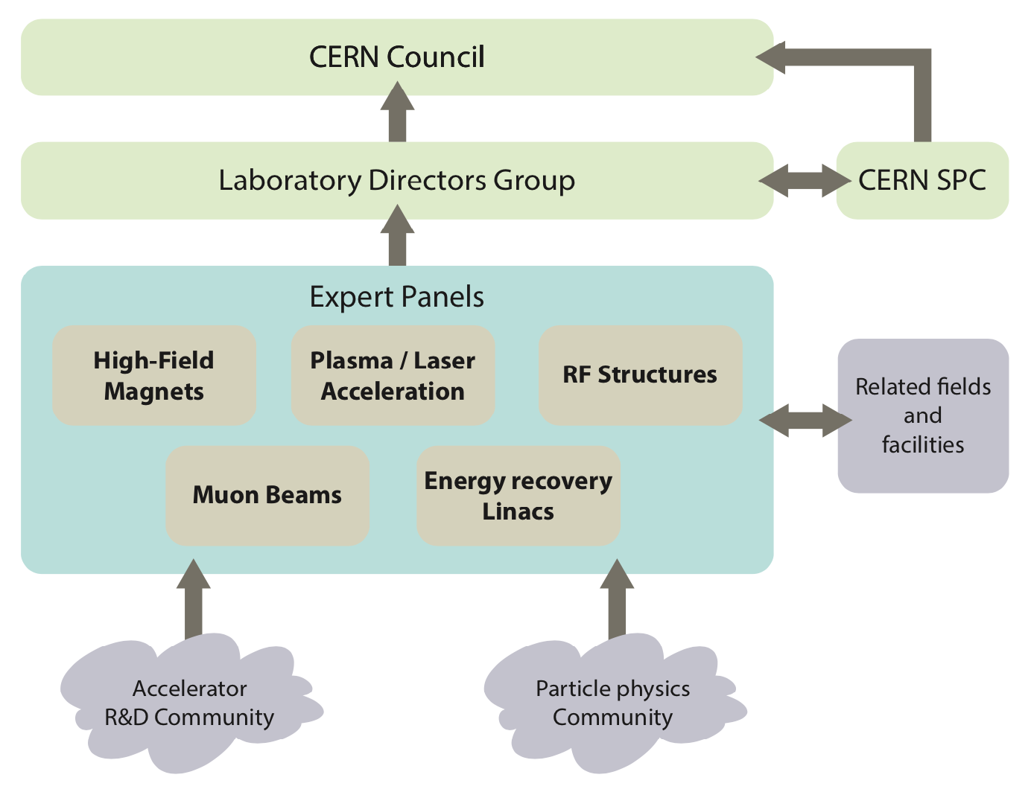
European Accelerator R&D roadmap –> muon SB
The roadmap: https://cds.cern.ch/record/2800190/files/146-138-PB.pdf
Note: For the muon collaboration this is addressed with the Steering Board

Slide 3
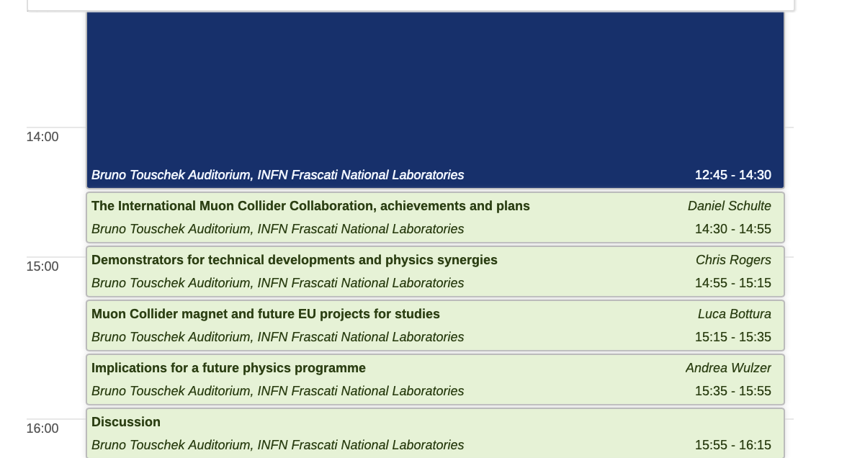
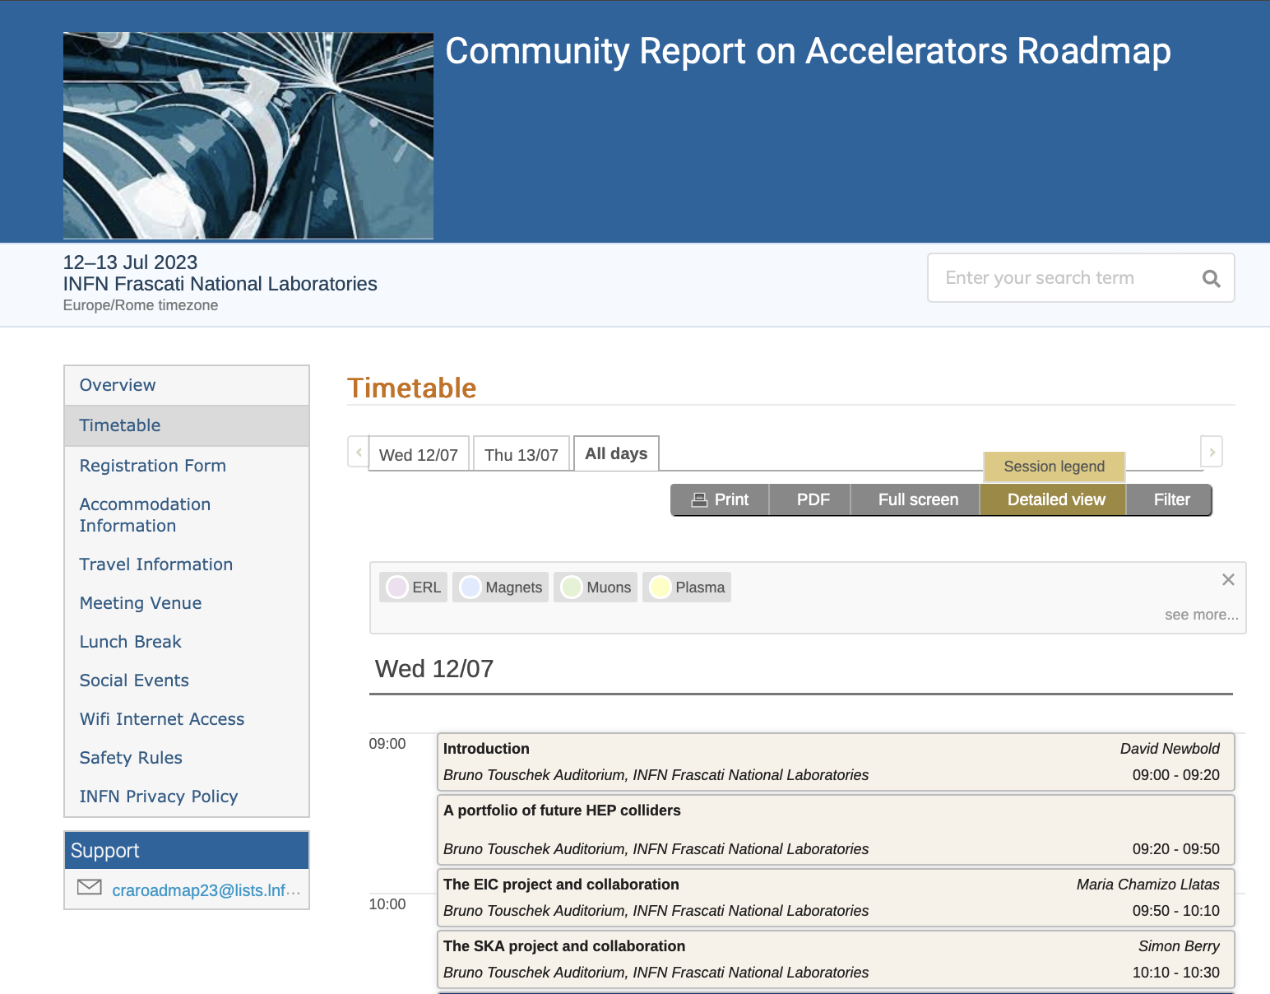
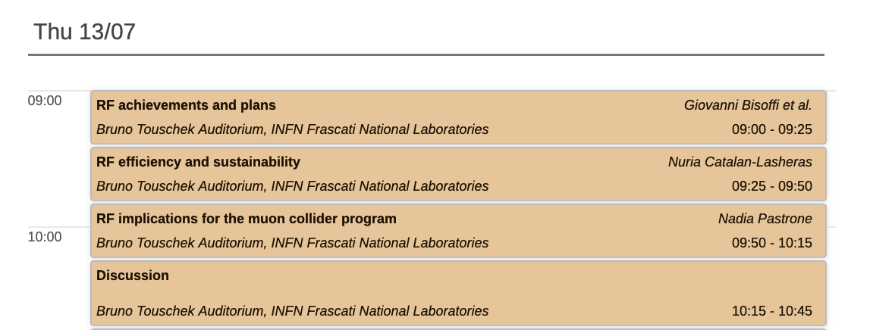
  LDG interactions, reporting, following up:
    Meeting in Nov 22, Review in Nov 22, Input to report to Council March 2023, Meeting May 23, wider meeting in Frascati 12-13 July

Slide 4
The Steering Board
The SB is composed of:
The lead representative of the Host Organisation (for CERN the ATS director Mike Lamont)
Up to two additional members appointed by the Host Organisation, Gianluigi Arduini, Steinar Stapnes (Chair)
Up to three members appointed by the ICB
Dave Newbold (STFC), Mats Lindroos (ESS), Pierre Vedrine (CEA)
  Director of National laboratories and Particle Physics, STFC and Leader of the LDG
  ESS Head of Accelerator Division and Accelerator sub-project
  Head of Accelerators, Cryogenics and Magnetism Division (DACM), CEA – IRFU
The Study Leader and Deputies
The ICB chair is invited.
In the longer term include representation from both Americas and Asia.
Need to strengthen Physics and Detectors, improve diversity -> 1-2 more members
For June meeting:
Invited from the US:
Mark Palmer (BNL), Sergo Jindariani (FNAL), Sridhara Dasu (Wisc), Diktys Stratakis (FNAL)
Notes:
Executive Director of National Laboratories and Director of Particle Physics STFC, Leader of the LDG
ESS Head of Accelerator Division and Accelerator sub-project
Head of Accelerators, Cryogenics and Magnetism Division (DACM), CEA – IRFU

Slide 5
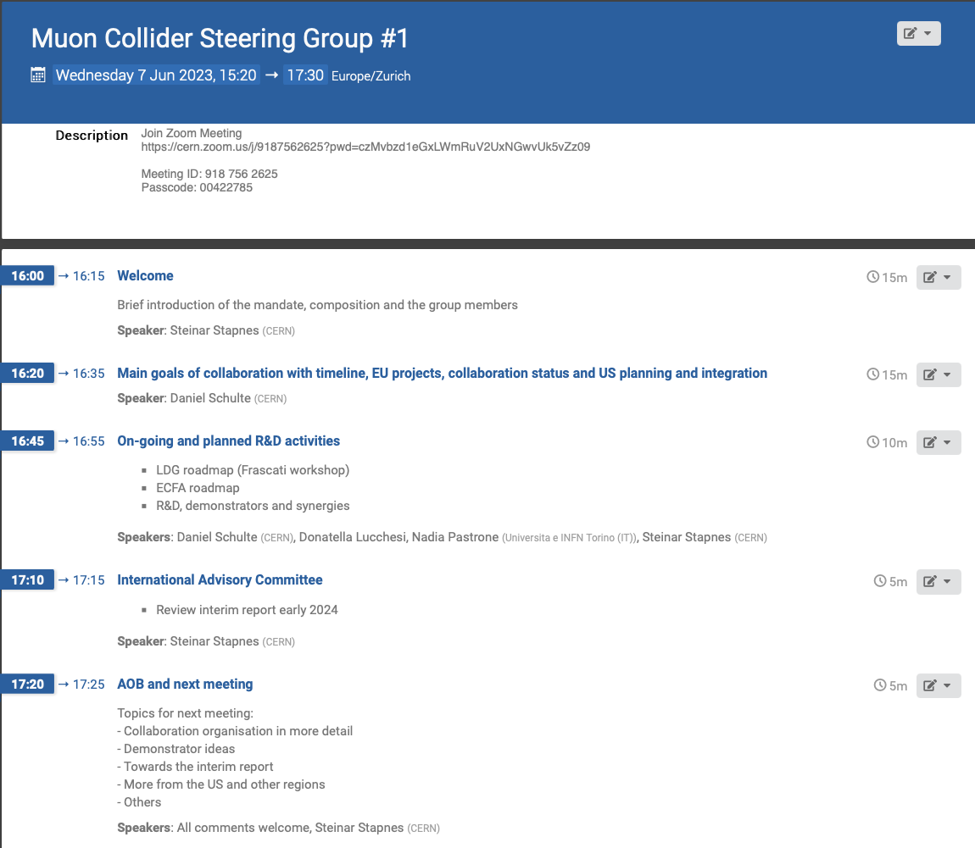

Slide 6
SB meeting in June
Discussed the role of the SB and overlaps/complementarity to the actual collaboration – main SB focus points:
  Strategies for project development in 1-5 year timeframe (e.g. demonstrators, test-facilities, synergetic studies - and ”implementation planning” for these)
  Interfaces to various bodies (e.g. the SB is set up by the European LDG and reports regularly to it), and processes (roadmaps, funding opportunities and parallel projects (e.g. magnet developments))
  International collaboration development – remain open and inclusive, while operative
  Follow the collaboration towards the 2025 goals
Presented the goals for 2025-26 – Project Evaluation Report and R&D Plan, including interim report end 2023
  Focus on interim report – content overview next, review early next year (IAC)
Links to the ECFA detector roadmap process – ongoing
US planning related to the P5 process

Slide 7
Next SB meeting in ~October
Tune membership as mentioned, continued to work with invited members from the US and Asia
Collaboration organisation in more detail
  Structure of scientific and technical studies and tasks/duties, interfaces, coordinators (in some cases more than one person) -> offer new members opportunities and welcome new initiatives.
Towards the interim report
  A detail description and status
  More on the demonstrator ideas and planning
International Advisory Committee
  Review interim report early 2024
  Proposal in this meeting - with mandate. Small number of fixed members, one or two SB members ex-officio, specialists review by review ?
More from the US and other regions

Slide 9
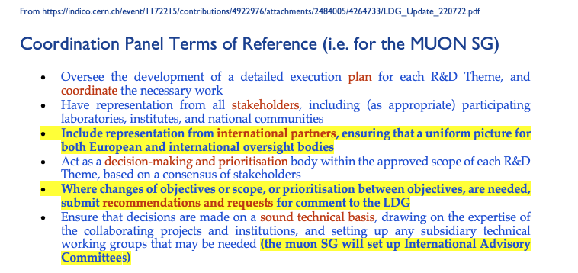
From the LDG-I

Slide 10
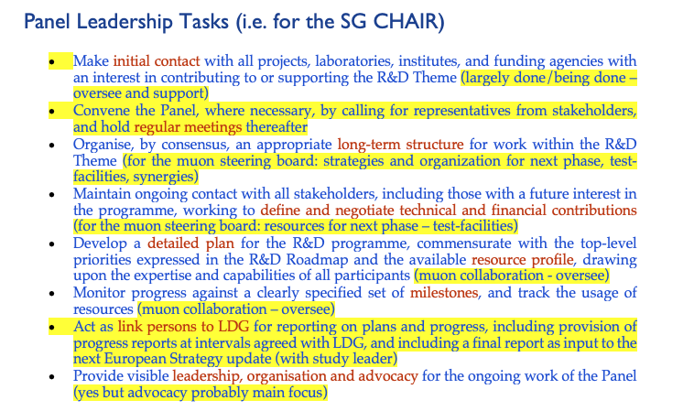
From the LDG-II

