Slide 1




IMCC Annual Meeting
JICLAB – June 22, 2023
International Collaboration Board
Report
Nadia Pastrone
PARTICIPANTS
155 + 30-late Annual Meeting
74 ( partially overlapping) Synergy Workshop

Slide 2
Agenda
18:00 → 18:20 ICB chair report Nadia Pastrone
18:20 → 18:35 IMCC Project Leader : key points - including publication policies proposal Daniel Schulte
18:35 → 18:50 Steering Board chair: key points to CB Steinar Stapnes
18:50 → 19:05 MuCol EU project: plans and key points Roberto Losito 19:05 → 19:20 Resources: status of contributions and future plans Luca Bottura et al.
19:25 → 19:45 Publications/authors policies: discussion
19:50 → 20:00 AOB - any news
Crucial time to enlarge and strengthen the community!
Very OPEN ICB:
SL and deputies – SB full committee – IMCC and MuCol Coordination Committee
Institutes – MoC signed/considering
Institutes – EU MuCol beneficiaries/associated
US laboratories waiting for P5 final report

Slide 3
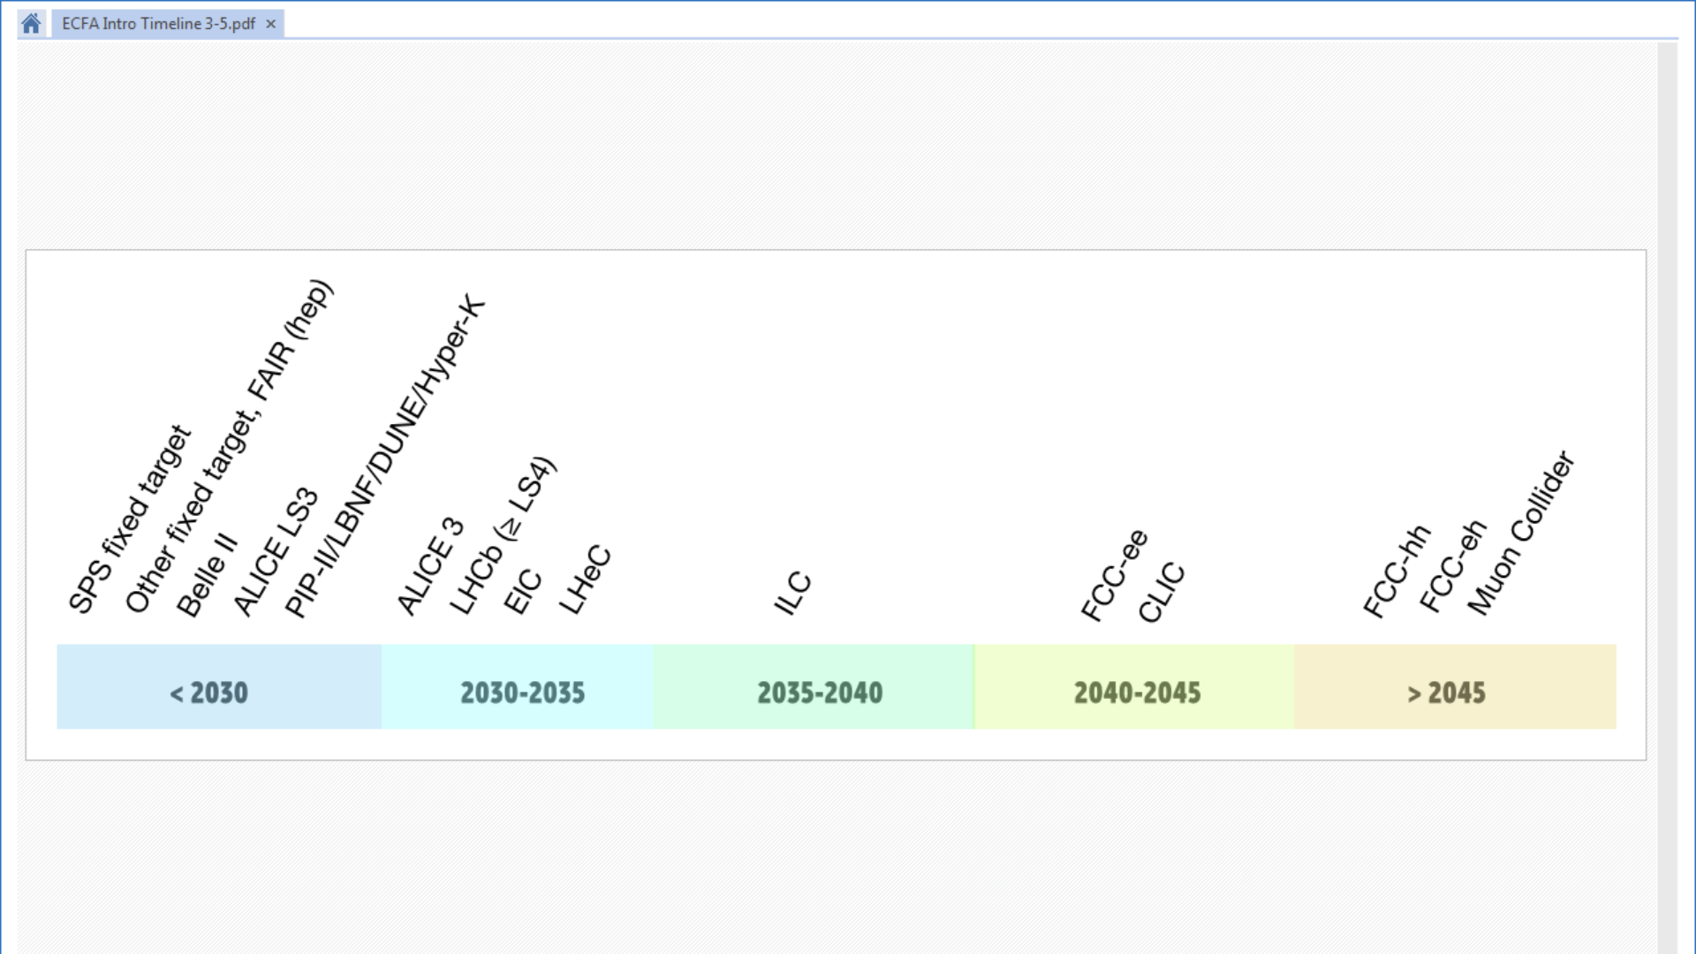
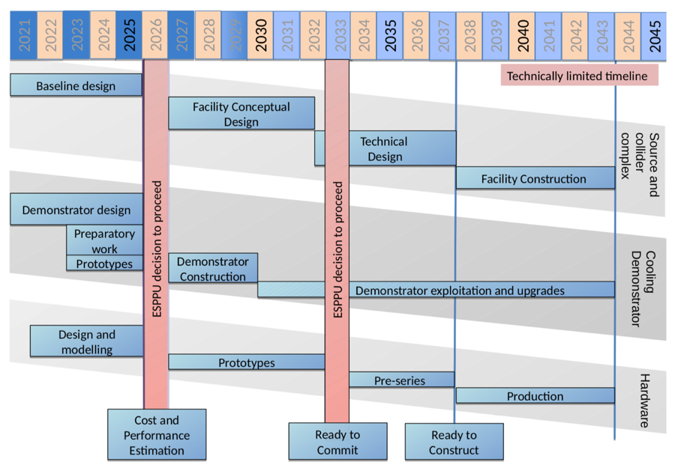
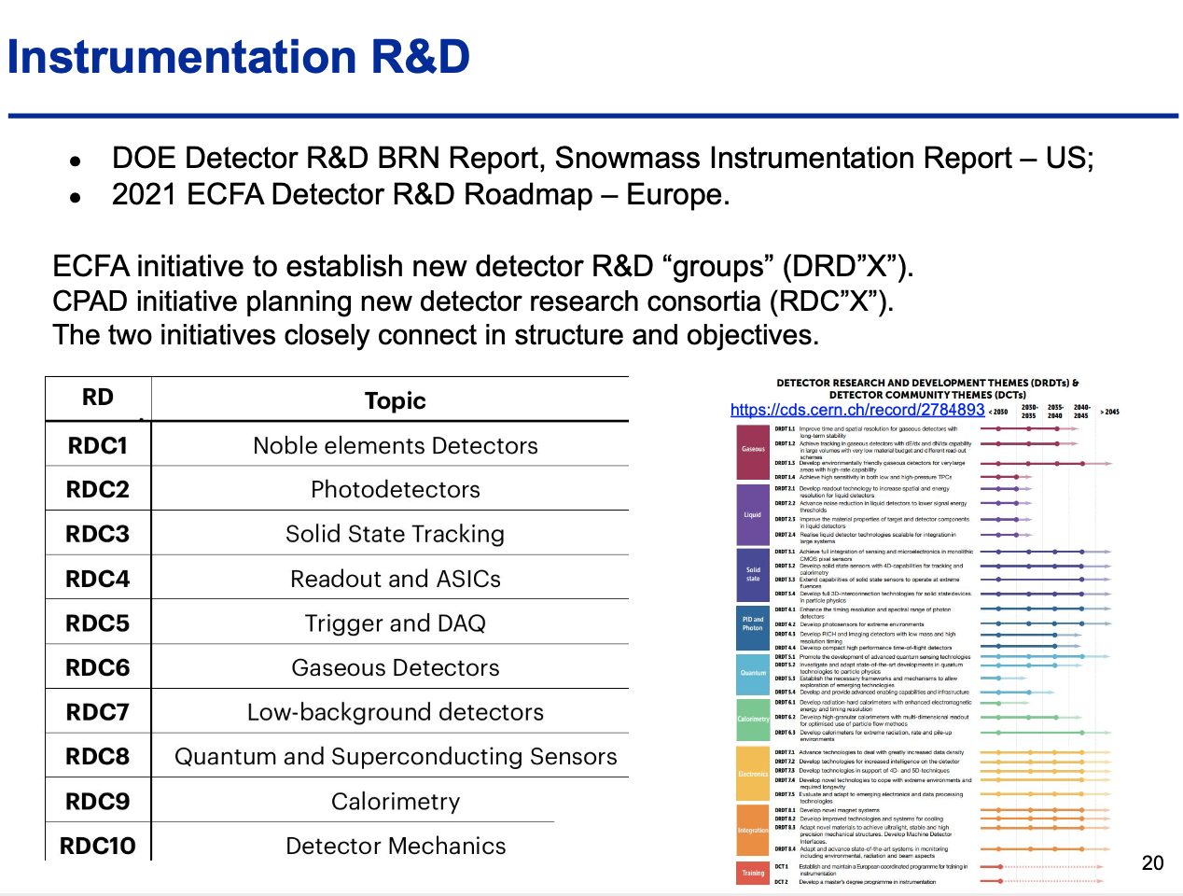
Interesting and challenging time …..
Detector R&D Roadmap
Accelerator R&D Roadmap
to promote collaboration participating to common R&D efforts

Slide 4

Shared aspiration
Advances in detector and accelerator pair
with the opportunities of the physics case
Objective:
In time for the next ESPPU, the Design Study based at CERN
aims to establish whether the investment into a full CDR and
a demonstrator is scientifically justified.
It will provide a baseline concept….
It will also identify an R&D path to demonstrate the feasibility of the collider.
Scope:
• Focus on the high-energy frontier and two energy ranges:
– 3 TeV
if possible with technology ready for construction in 10-20 years
– 10+ TeV with more advanced technology,
the reason to choose muon colliders
• Explore synergies with other options (neutrino/higgs factory)
• Define R&D path
Muon4Future
    Snowmass future collider planning schedule
    preparation – construction - physics - ee, hh, μμ
    Muon Collider Forum Report

Slide 5
Institutes/Countries/Funding Agencies
IMCC Activities |  | MuCol
1 | Physics | WP2
2 | Detector | WP2
2 | MDI | WP5
3 | Proton Complex | WP3
4 | Muon Prod/cooling | WP4
5 | Accelerator | WP5
6 | Collider | WP5
7 | Magnets | WP7
8 | RF | WP6
9 | Beam matter/target
10 | Collective effects
11 | Demonstrator
12 | Cooling Cell | WP8
We need:
all our enthusiasm!
our diverse great knowledge
better shared rules to:
identify resources
publish our results in a fair way
recognize authorship
……
49 + 4 (+ 4 considering) institutes Memorandum of Cooperation signed
2 institutes only MuCol beneficiaries
5 institutes only MuCol associates (including BNL)
a few URGENT to investigate (i.e. IFAE….)
3 + ? DOE laboratories
Japan ?

Slide 6
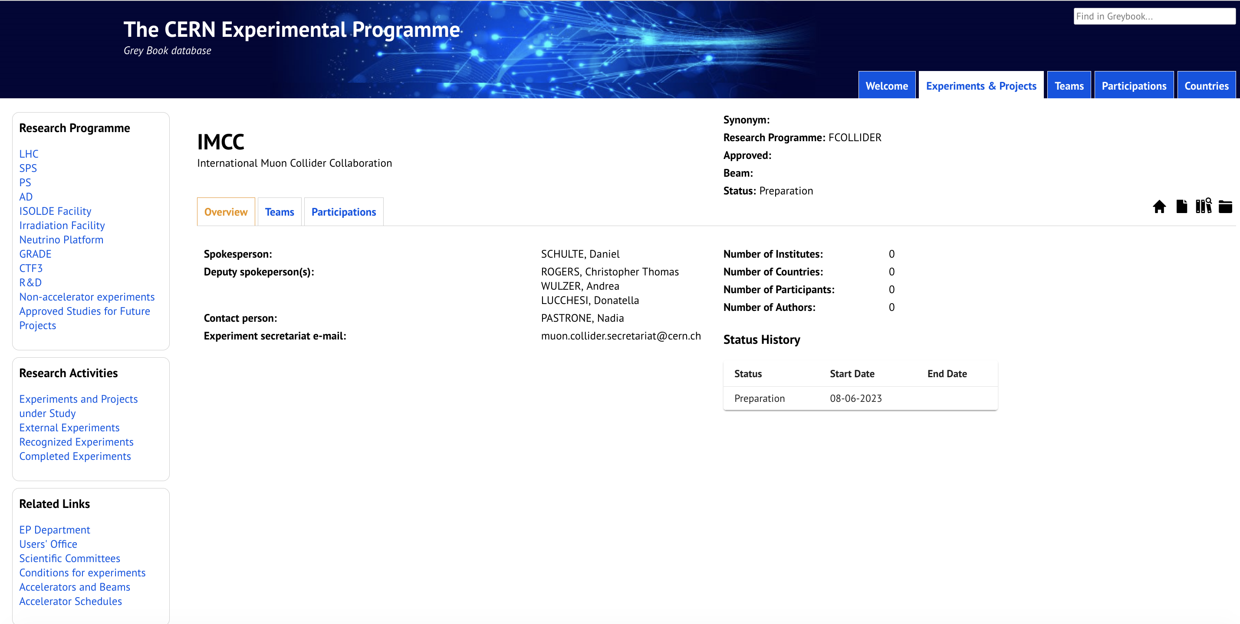
Grey Book @ CERN – Future Collider
IMCC finally included as one of the:
“Experiments and Projects under Study” https://greybook.cern.ch/experiment/detail?id=IMCC

Slide 7
Grey Book @ CERN – get ready to join!
To join and Institute has to be signed the MoC (Memorandum of Cooperation)
There are already recognized institutes at CERN – but we can add others
All the rules are at: Team Leaders' corner | Users Office (cern.ch)
We can start to list the institutes and for each of them (Team)
a Team leader and a deputy should be identified and they should get ready to join
following the rules
We will send a dedicated email to each eligible institute and try to facilitate the enrollment
aiming to populate the grey book asap
By end of July a specific Muon Collider User Unit will be available to collect all
institutes and partecipants to IMCC projects as CERN users.

Slide 8
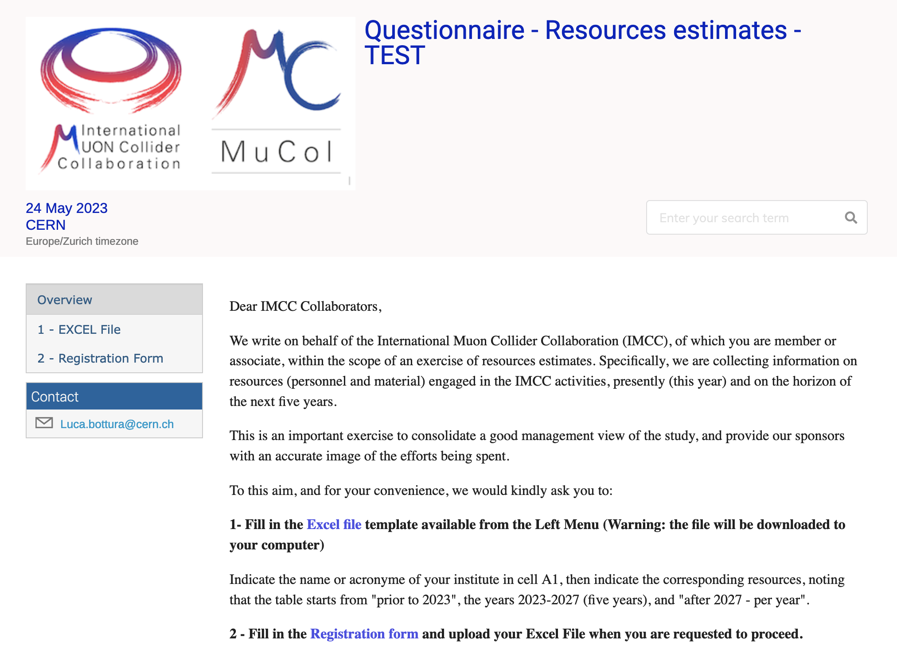
Main aim is to collect the resources committed to the study, in terms of secured material (M in kEUR) and personnel (P in FTE), as well as prospective funding.
This will give a good and quantified image of the on-going efforts.
Two parts, institute data (indico registration form) and resource data (MSexcel file)
https://indico.cern.ch/event/1289904/

Slide 9
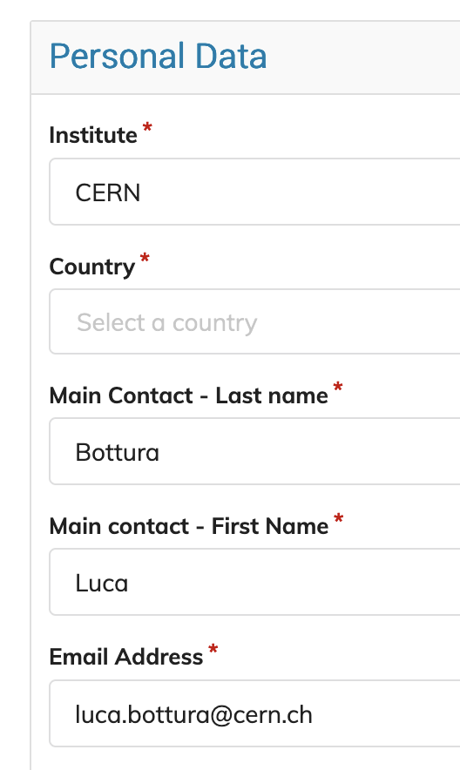
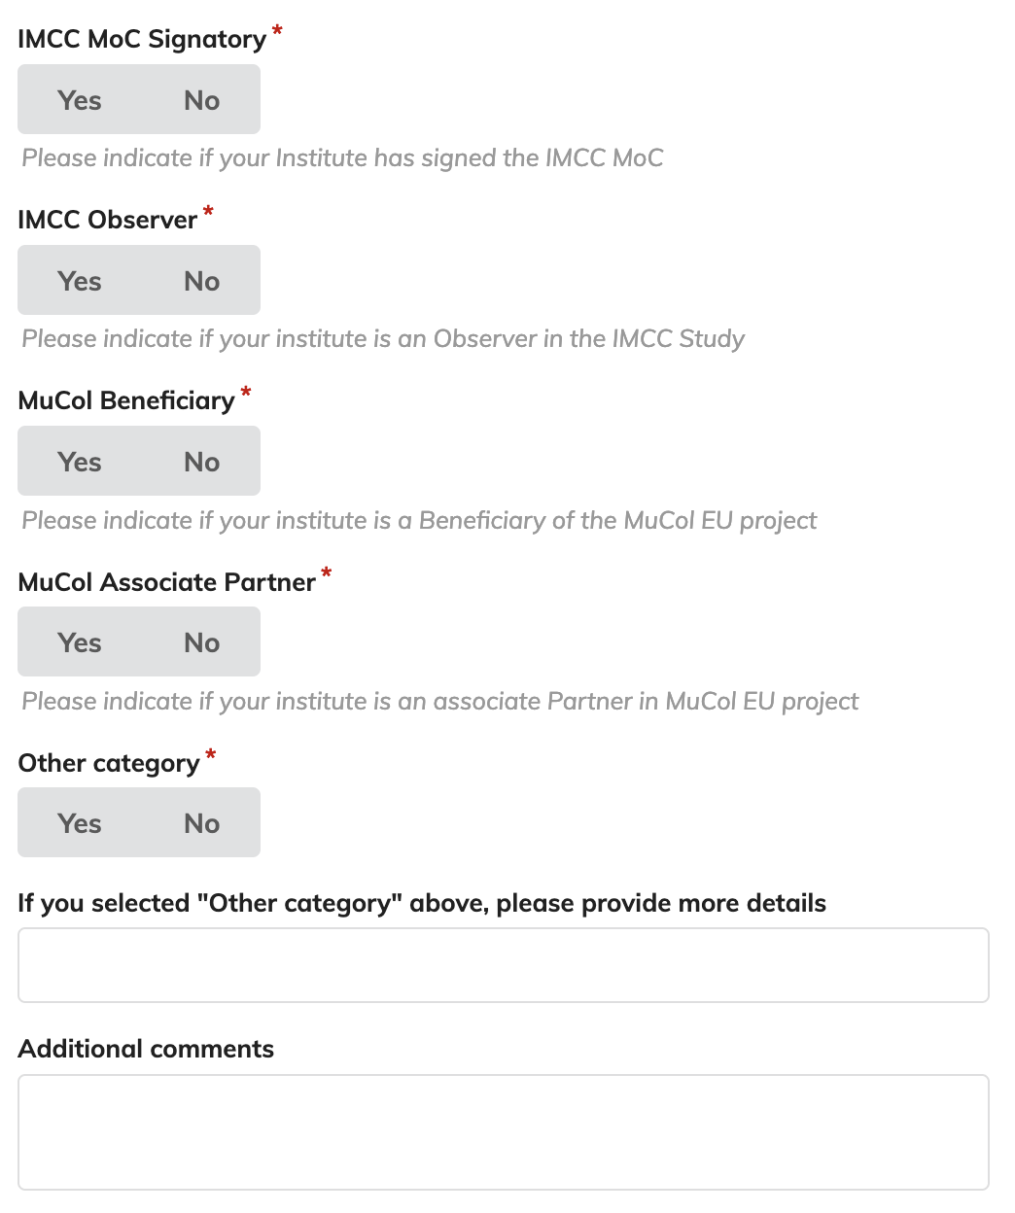
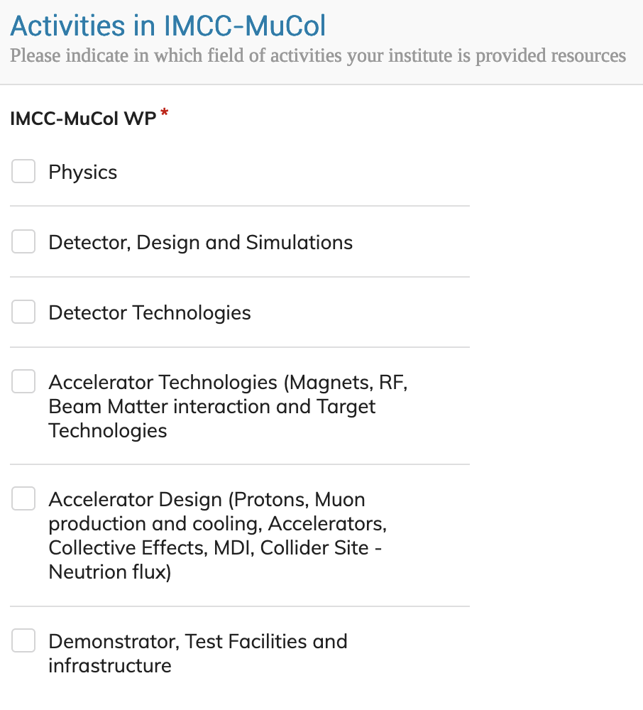
Registration form:
Institute, contact and status
Activities of interest

Slide 10
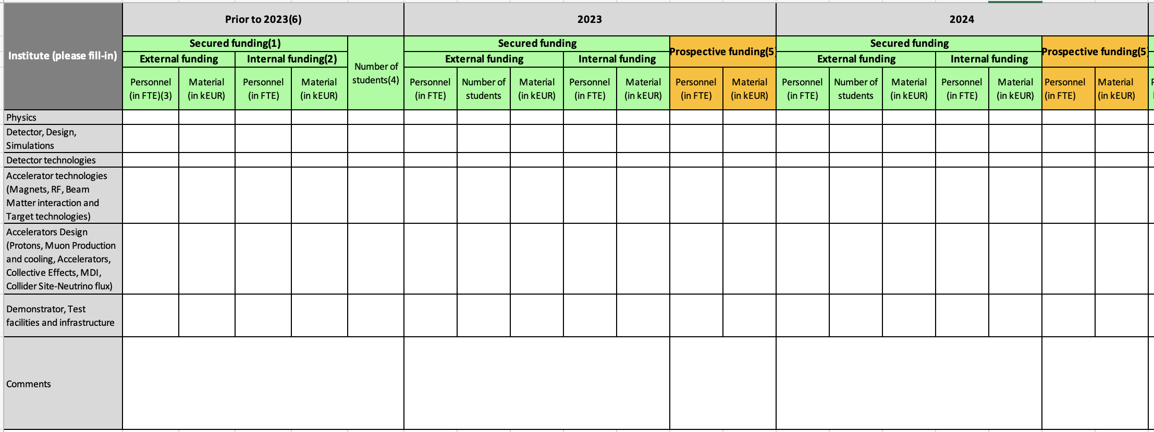
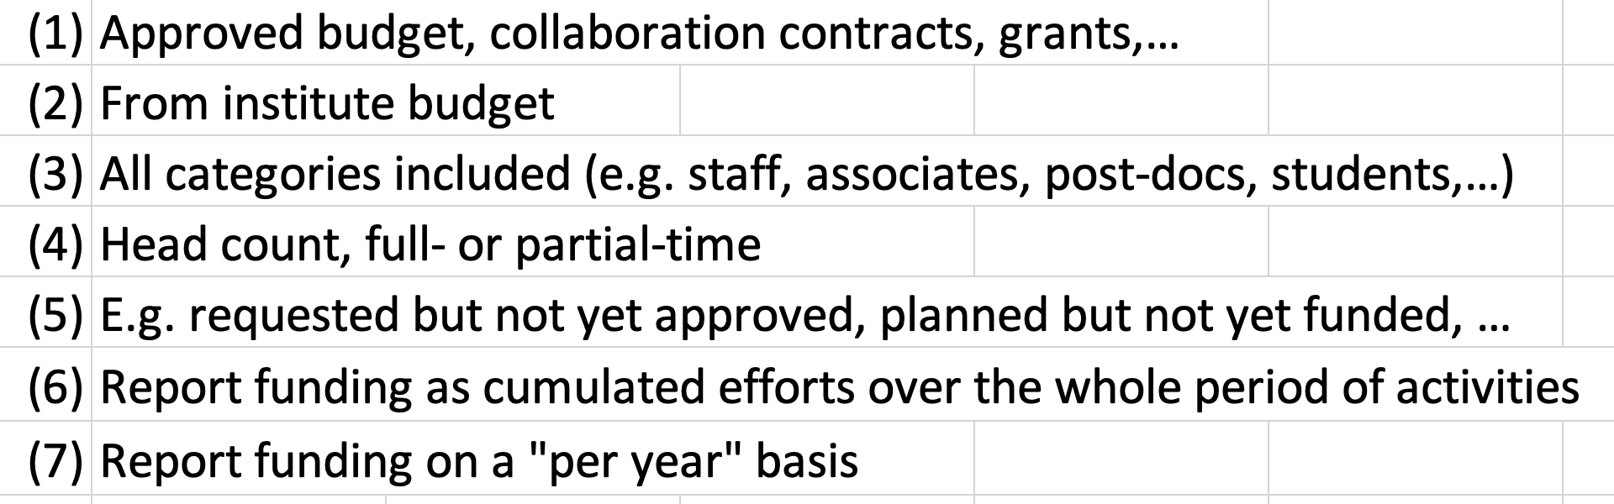
year
Data in an excel file:
prior to 2023 (cumulative)
2023-2027 (per year)
After 2027 (per year)
activities
Notes to guide the collection

Slide 11
Accelerator R&D Roadmap
No insurmountable obstacle found for the muon collider
but important need for R&D
Aim at 10+ TeV and potential initial stage at 3 TeV
Full scenario deliverables by next ESPPU/other processes
Project Evaluation Report
R&D Plan that describes a path towards the collider;
Allows to make informed decisions
Interim report by end of 2023
Do not yet have the resources of the reduced scenario
Following priorities and available expertise and resources
Are approaching O(40 FTE)
Efforts to increase resources
Scenario | FTEy | M MCHF
Full scenario | 445.9 | 11.9
Reduced scenario | 193 | 2.45
http://arxiv.org/abs/2201.07895
11

Slide 12
US Integration
Participation of US experts to CC and ICB
Preparing open data and code policy
  You can use data and codes from the collaboration, as far as we own them
Want to allow everyone to publish under the IMCC or to speak for the IMCC
  Provided our procedures are respected
Small task force to understand how a common work programme can be developed
  Progress will have to synchronise with US progress
Plan to review organization next year to integrate US
  But have to wait for US decisions
Will find common timelines/scenarios

Slide 13
Data/Code Access Policy
Open policy is preferred scenario
To gain the trust of the community at large
To help people that are not yet in the collaboration to engage
To ease setting up servers in different locations
To comply with EC rules
Will publish data and code once produced
Already during the study once ready for publication
  Check for correctness, but no need to wait for studies to have used them
  Helps to get feedback early
Provide a reference for each set that must be used if the data/code is used (with version)
  Have to find way to implement versioning system
Offer lightweight registration on INDICO
Ask people to do what is morally good
  Provide email to establish mailing list to inform about potential updates and mistakes
  Provide information about the (planned) use to help us justify our effort
  Suggest to submit papers and talks to our review process

Slide 14
Publication Board ==> ICB role
Publication and Speakers Board
Prefer one board at this moment but can have members with a focus more on one or the other
Will provide quality control
  Review and approve MuCol and IMCC publications
  Including review of author list
  Review and approve talks and posters
Will foster muon collider visibility
  Propose talks and posters for IMCC and MuCol at important conferences and workshops
  Identify opportunities for publications
MuCol publications and talks will also have an IMCC reference
Members will be appointed by study leader on proposal of board chair (Elias Metral)
Board will propose detailed procedures to the CC, CLICdp rules are an excellent starting point
Board will report to CC/study leader
COMMENTS DUE IN TWO WEEKS!

Slide 15
Publication/Conference talk
The present working MuonCollider-ConferencePreparationTeam
will keep acting as the Publication Board with
Elias Metral
elected for the MuCol project as Dissemination and Communication Officer

Slide 16
MuCol EU project: Organisation
The consortium includes 32 31Institutes:
  CERN as coordinator and beneficiary
  11 more Beneficiaries (no UK Institutes)
  19 Associated Partners
  https://mucol.web.cern.ch/
WP Coordinators:
  WP1: Roberto Losito (CERN)
  WP2: Donatella Lucchesi (UNIPD)
  WP3: Natalia Milas (ESS)
  WP4: Chris Rogers (UKRI)
  WP5: Antoine Chance (CEA)
  WP6: Claude Marchand (CEA)
  WP7: Luca Bottura (CERN)
  WP8: Lucio Rossi (UNIMI)
Study Leader : Daniel Schulte (CERN)
Technical Coordinator (WP1 leader) : Roberto Losito (CERN)
Deputy Study Leader: Chris Rogers (UKRI)
Transversal Roles :
  Gender Adviser Officer : E.J. Bahng (Iowa State University)
  Communication and dissemination Officer: Elias Metral (CERN)
An excellent reviewers score 14.5/15!
  “The scientific goals of the project are clear and important”
  “A muon Collider offers a way (..) that is novel and complementary to existing approaches”

Slide 17
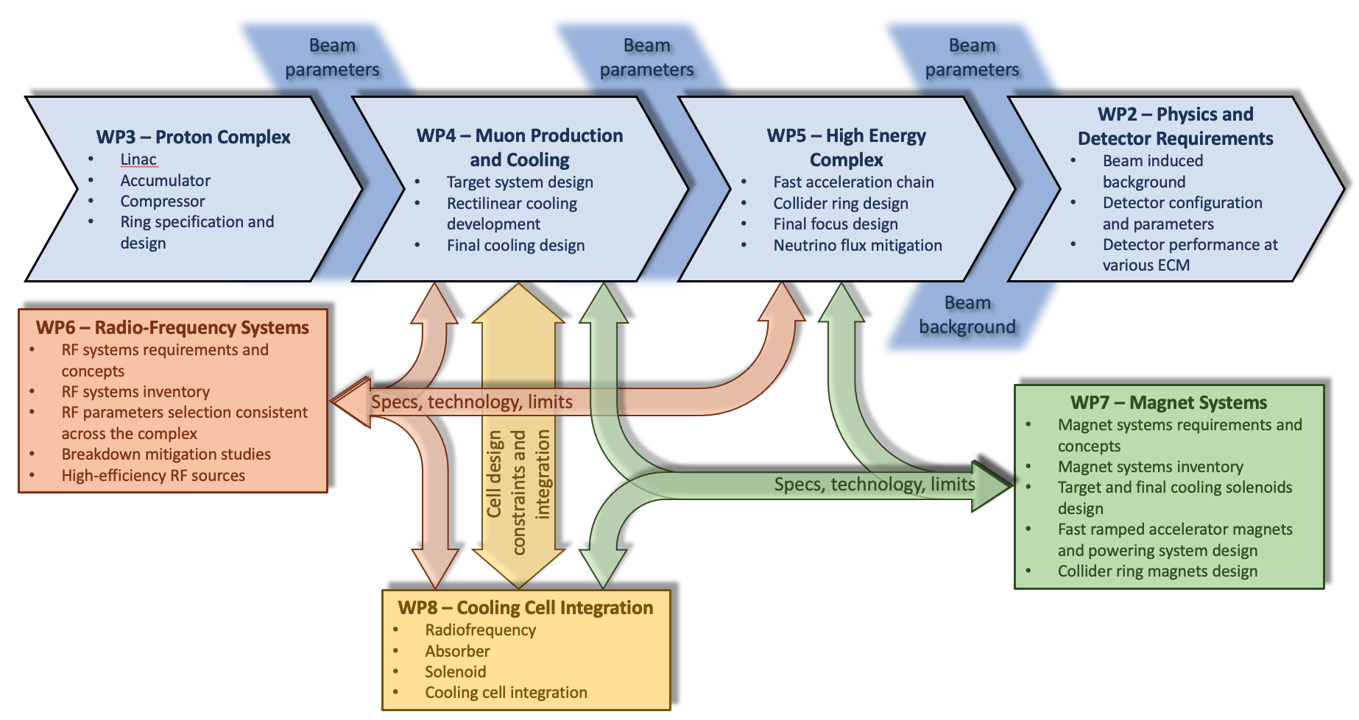
Goals of the project
MuCol has been shaped to coordinate the effort of the International Muon Collider Collaboration towards the specific goal of providing a comprehensive input for the next European Strategy for Particle Physics Update
The main deliverables will be yearly progress reports, that will be used to edit the report that will be submitted to the ESPPU in 2025/26 as input from the Collaboration.
The same material can be used by the collaboration to provide input to other prioritization processes/funding agencies (e.g. P5 in US).

Slide 18
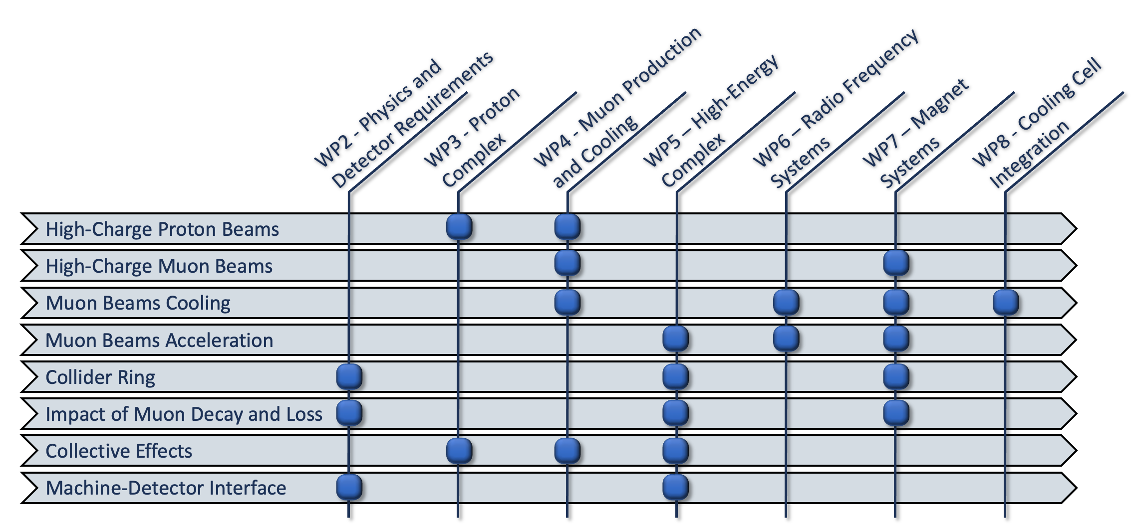
Scientific and technical organization
All along the duration of the project we will animate a table of parameters, covering both the accelerator layout and the main technologies (magnets, RF, beam diagnostics…)
Overleaf document being edited, during the project we will publish
  M6: Tentative Parameters
  M18: Preliminary Parameters
  M30: Consolidated Parameters

Slide 19
Milestones & Deliverables
Milestones for year 1:
  Website online, M2: WP1 (CERN)
  Kick-off meeting, by M3: M2
  Tentative Parameters available, M6: WP1 (SL) + all
  Training on detector design and physics performance tools, M6, WP2

Slide 20
Next steps to enlarge the international collaboration
Both partecipation and resources!
IMCC
EU project MuCol
US Muon Collider Coordination Group
P5
INFRA-TECH
Detector R&D:
  DRD – Implementation of Roadmap coordinated by ECFA
  CPAD initiative – new detector research U.S. consortia –
Accelerator R&D:
  Roadmap coordinated by LDG
  Strong motivation through the U.S. Snowmass/P5 process
IMCC Interim Report
Many important places to show our updated progress as a strong community!

Slide 21
MUST— I.FAST
The I.FAST (Innovation Fostering in Accelerator Science and Technology) Innovation Pilot project for the Particle Accelerator community is organising its second Annual Meeting in Trieste, Italy 17–21 Apr 2023
Be aware of synergies to enlarge for IMCC
https://indico.cern.ch/event/1204855/

Slide 22
extras

