Slide 1
Interface between Collider Ring Design and Magnets
(Field quality and other parameters)
C. Carli Muon Collider annual meeting, 20th June 2023
Consequences on Collider Lattice Design
Neutrino Radiation Issue
Open questions between WPs Magnets and Collider Design

Slide 2
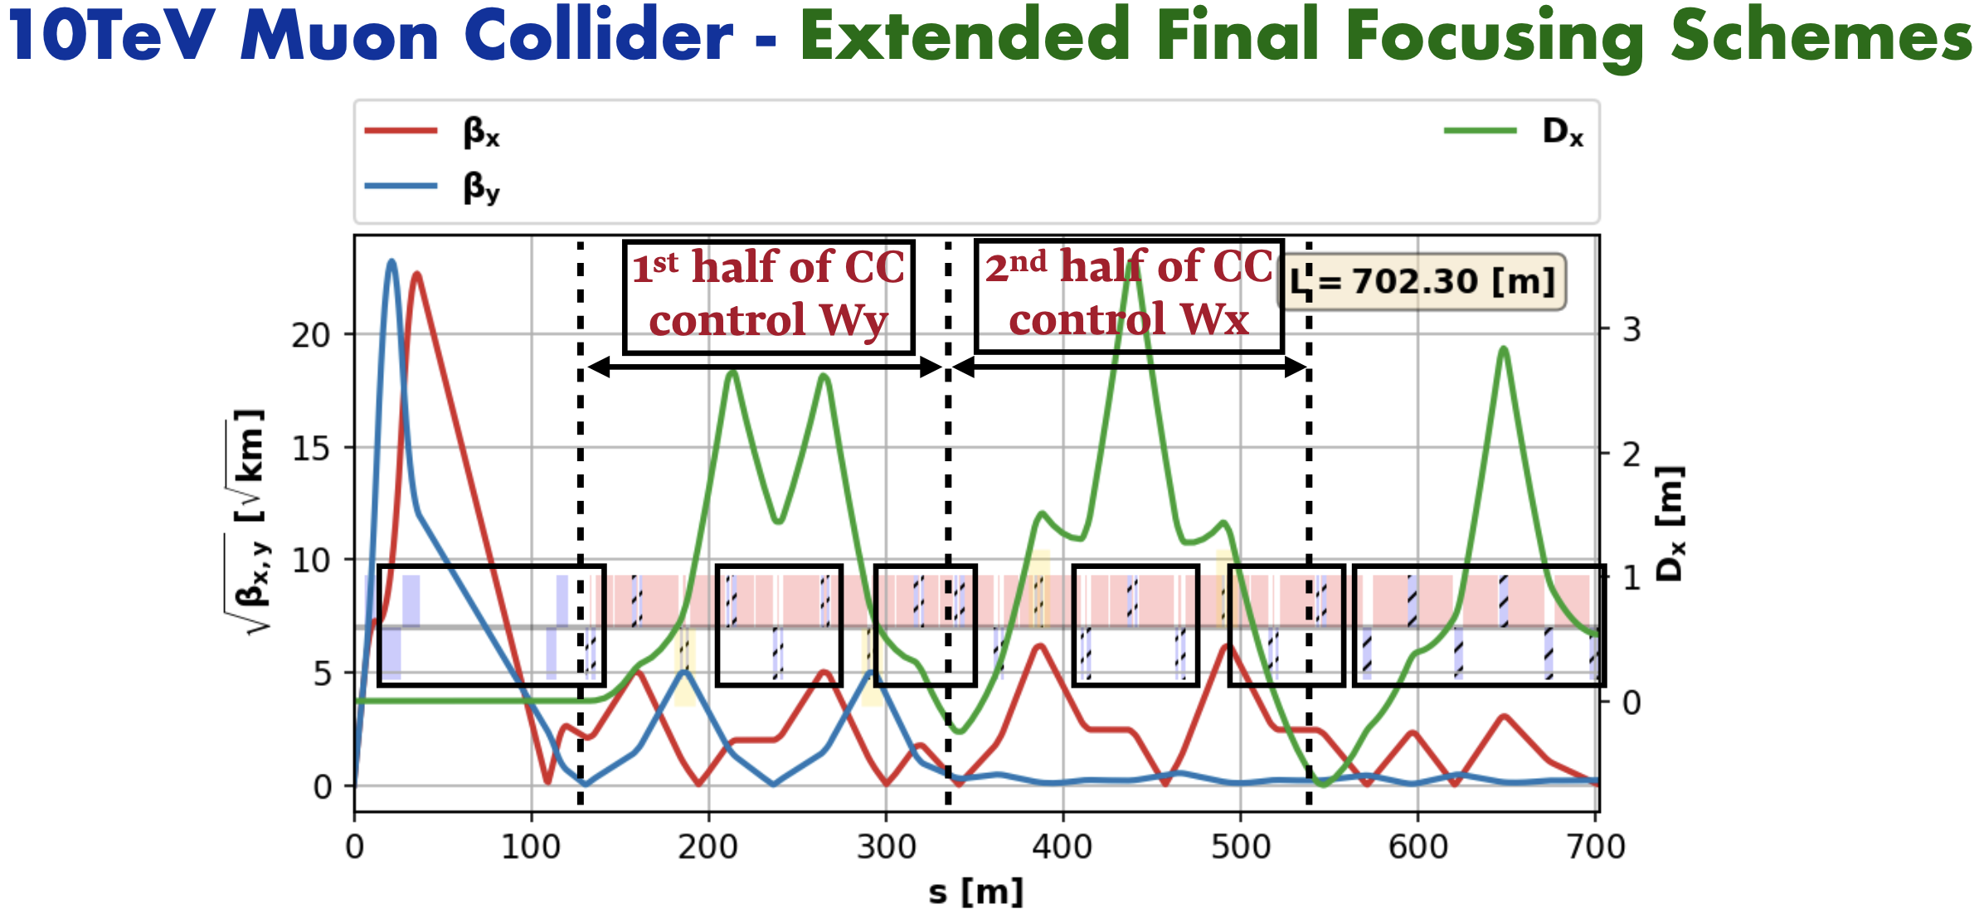
Collider Lattice Design
Slide and work
from K. Skoufaris
Strong quadrupoles at locations with large Twiss betas and large momentum spread
  Strong chromatic aberrations from IP to be corrected by local compensation
  Sensitivity to unwanted mutipolar components and
    Short beam life-time helps for slow diffusion driven by high orders
  Sections with large beam sizes and, thus, apertures
Note: lattice design still done with (too) optimistic assumptions (maximum fields, apertures ..)

Slide 3
Neutrino Radiation Issue
Muons decay (say in
some straight section)
Radiation due to neutrino beam reaching the earth surface
  Narrow radiation “cone” for a short piece
  of the machine
  Very small interaction cross sections
    Earth does not act as shielding (very small cross sections)
    Showers from neutrinos interacting close to earth surface generate dose seen at surface
Strong increase of maximum dose with muon energy
  Cross sections about proportional to energy
  Typical energy per interaction of neutrino
  with matter proportional to muon energy
  Opening of radiation cone inversely proportional to muon energy
Neutrino radiation cone
(rotating with muon beam)
Radiation cone
Collider
ring
3
3

Slide 4
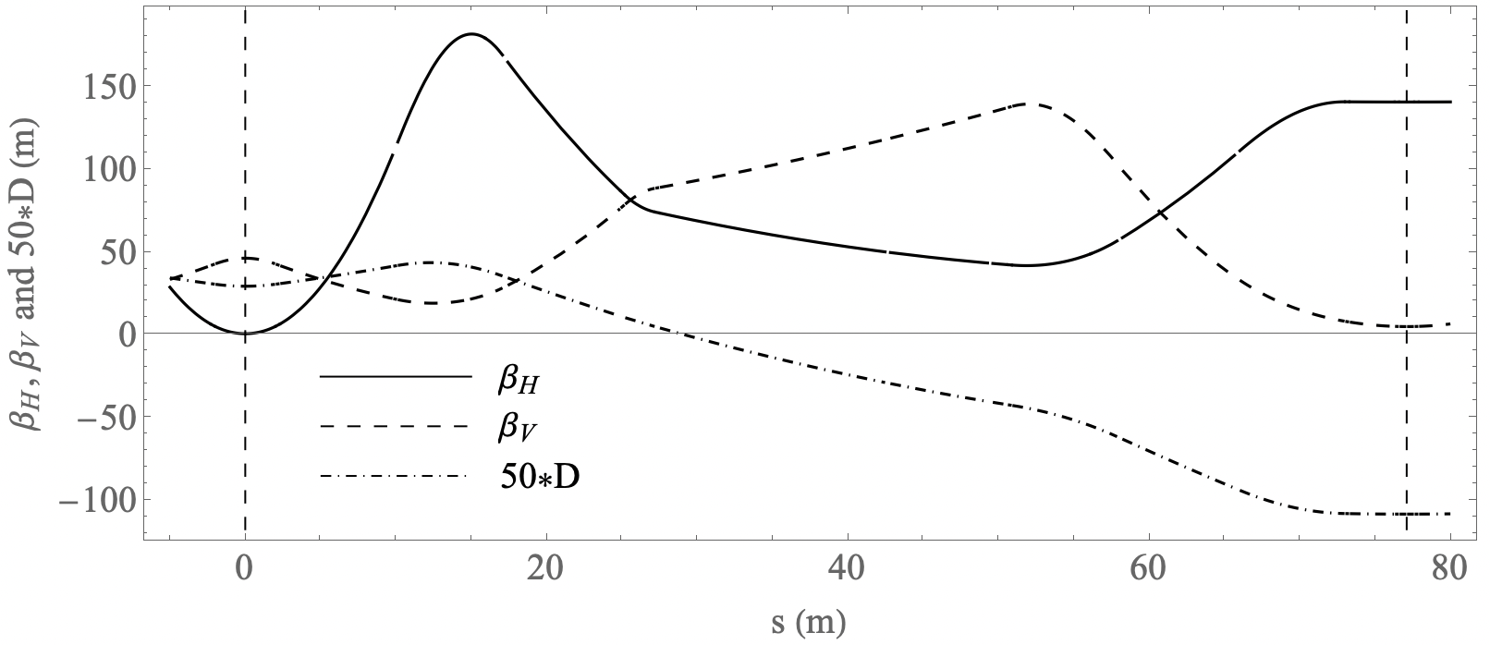
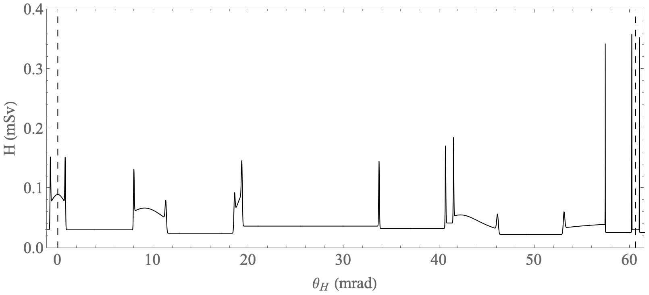
Neutrino Radiation Issue
Integrals evaluated for present (work in progress by K. Skoufaris) 10 TeV collider arc half cell
  In collider mid-plane as function of (i.e., ) for one year (5000 h operation)
Peaks from 30 cm straight sections
=> Some lower due to beam
divergence (D’ or betatron motion)
Longer regions with higher radiation
from quadrupoles and X-poles
=> Lower dipolar magnetic field
30 cm short straights with hard edge transitions probably unrealistic?
=> Get realistic bending field versus
position profile and reevaluate

Slide 5
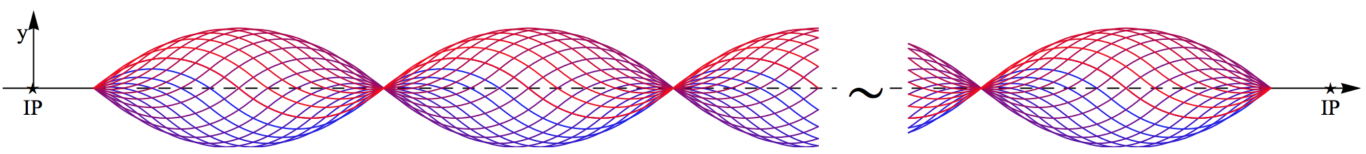
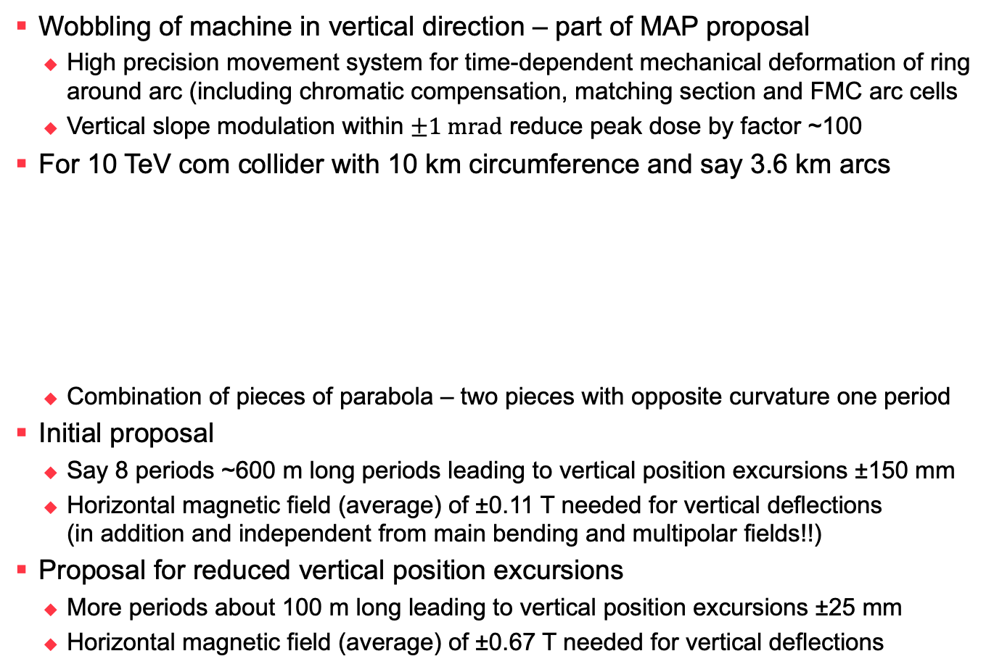
Neutrino Radiation Issue
Mitigation by “Wobbling”
Wobbling of machine in vertical direction – part of MAP proposal
  High precision movement system for time-dependent mechanical deformation of ring around arc (including chromatic compensation, matching section and FMC arc cells
  Vertical slope modulation within $±1 \text{mrad}$ reduce peak dose by factor ~100
For 10 TeV com collider with 10 km circumference and say 3.6 km arcs
  Combination of pieces of parabola – two pieces with opposite curvature one period
Initial proposal
  Say 8 periods ~600 m long periods leading to vertical position excursions ±150 mm
  Horizontal magnetic field (average) of ±0.11 T needed for vertical deflections
  (in addition and independent from main bending and multipolar fields!!)
Proposal for reduced vertical position excursions
  More periods about 100 m long leading to vertical position excursions ±25 mm
  Horizontal magnetic field (average) of ±0.67 T needed for vertical deflections
Arc with an integer – say eight – vertical machine deformation periods
Vertical bend ±16.7 Tm

Slide 6
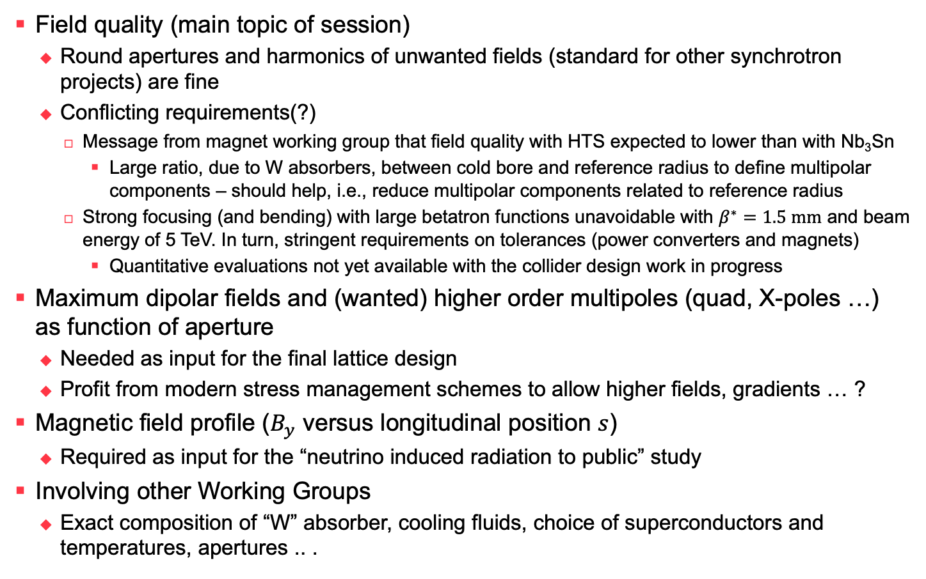
Some open questions between
WPs Magnets and Muon Collider Design
Field quality (main topic of session)
  Round apertures and harmonics of unwanted fields (standard for other synchrotron
  projects) are fine
  Conflicting requirements(?)
    Message from magnet working group that field quality with HTS expected to lower than with Nb₃Sn
      Large ratio, due to W absorbers, between cold bore and reference radius to define multipolar components – should help, i.e., reduce multipolar components related to reference radius
    Strong focusing (and bending) with large betatron functions unavoidable with $β^{∗}=1.5 \text{mm}$ and beam energy of 5 TeV. In turn, stringent requirements on tolerances (power converters and magnets)
      Quantitative evaluations not yet available with the collider design work in progress
Maximum dipolar fields and (wanted) higher order multipoles (quad, X-poles …)
as function of aperture
  Needed as input for the final lattice design
  Profit from modern stress management schemes to allow higher fields, gradients … ?
Magnetic field profile ($B_{y}$ versus longitudinal position $s$)
  Required as input for the “neutrino induced radiation to public” study
Involving other Working Groups
  Exact composition of “W” absorber, cooling fluids, choice of superconductors and temperatures, apertures .. .

