Slide 1




Cryogenic options and concepts for the Muon Collider
P. Borges de Sousa, M. Rhandi, T. Koettig, R. van Weelderen
IMCC Annual Meeting 2023
19th to 22nd June 2023, Orsay, France

Slide 2
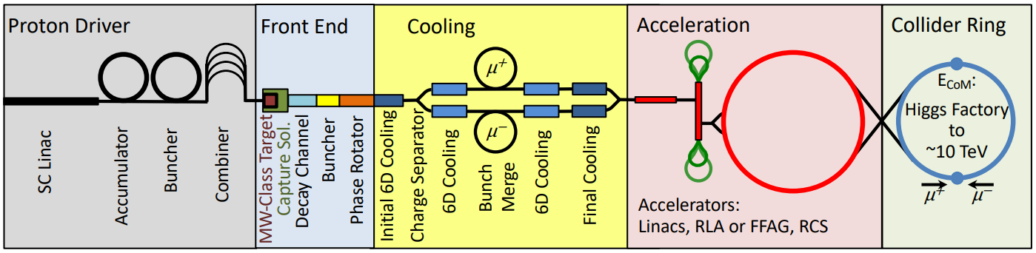
Foreword
The study presented here is an overview of cooling options for collider-type magnets using a combined approach to the overall optimization of cryogenic infrastructures considering:
  Sustainable magnet design;
  Optimization of cryogenic infrastructures accounting for all temperature levels (i.e. not only coil)
Here we focus on discussing the cooling options for the collider ring.
Source: MAP collaboration

Slide 3
Introduction
The dipole (and quadrupole) arc magnets are starting to take shape, there is a preliminary radial build and aperture, the beam-induced loads to the magnets are known
The rest of the static heat loads need to be calculated to have an idea of total heat load budget to the cold mass and the warmer “absorber” that intercepts incoming radiation
The operating temperature needs to be defined → this depends not only on conductor choice and magnet design, but also on the overall cost of cooling
This talk aims to define the range of expected heat loads on the collider magnets (cold mass and absorber), and to provide an estimate of the resulting cooling effort for each option

Slide 4
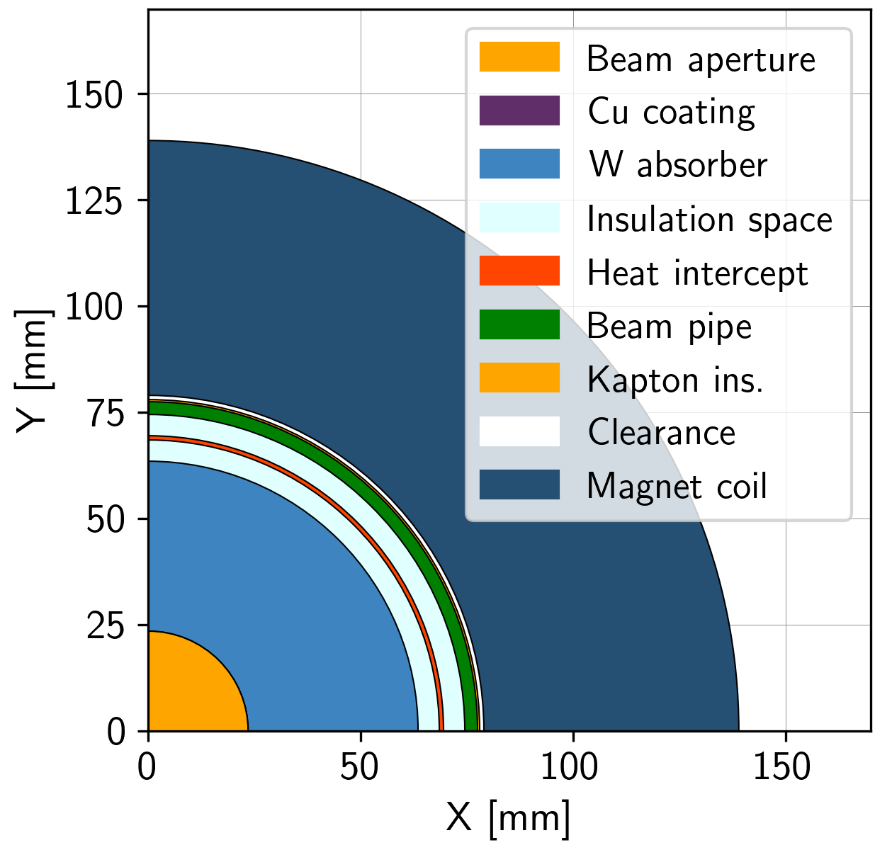
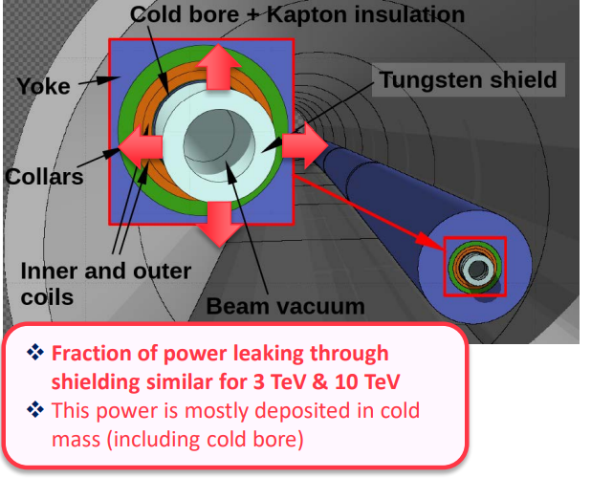
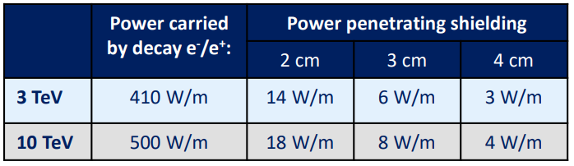
Input: radial build and beam-induced heat loads
Dimensions from 12/06/23 radial build:
Beam aperture (5σ) 23.5 mm radius
Cu layer beam screen 0.01 mm thick
Tungsten absorber 40 mm thick
Insulation space 5 mm thick
Heat intercept 1 mm thick
Insulation space 5 mm thick
Beam pipe 3 mm thick
Kapton insulation 0.5 mm thick
Clearance 1 mm thick
Coil pack* (60 mm thick)
*thickness TBD, placeholder
Even for 2 cm shielding, power density on coil is <10 mW/cm³
Calculations based on the 10 TeV machine!
Only beam-induced heat loads included; other contributions?
Source: Informal meeting on muon collider absorber, vacuum and cryogenics integration (18 January 2023) · Indico (cern.ch)

Slide 5
(steady-state) Heat loads in the collider magnets
Static heat inleaks:
Thermal radiation from thermal shield
Thermal radiation from absorber
Conduction via support posts
Conduction via absorber supports
Beam-induced losses:
Muon decay
Image currents
Synchrotron radiation
E-cloud
Resistive heating:
Magnet splices
Current leads intercepts
Additional heaters/instrumentation?
Deposited in:
External (cryostat) thermal shield
Coil pack/cold mass
Absorber

Slide 6
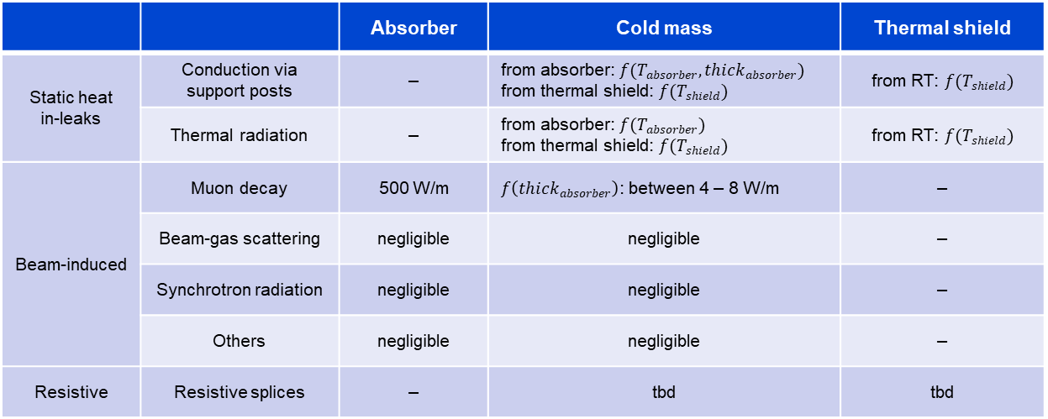
(steady-state) Heat loads in the collider magnets
Calculations based on the 10 TeV machine
 |  | Absorber | Cold mass | Thermal shield
Static heat in-leaks | Conduction via support posts | – | from absorber: $f(T_{absorber},{thick}_{absorber})$ from thermal shield: $f(T_{shield})$ | from RT: $f(T_{shield})$
 | Thermal radiation | – | from absorber: $f(T_{absorber})$ from thermal shield: $f(T_{shield})$ | from RT: $f(T_{shield})$
Beam-induced | Muon decay | 500 W/m | $f\left(thick_{absorber}\right)$: between 4 – 8 W/m | –
 | Beam-gas scattering | negligible | negligible | –
 | Synchrotron radiation | negligible | negligible | –
 | Others | negligible | negligible | –
Resistive | Resistive splices | – | tbd | tbd
Heat loads at absorber level are independent of absorber, cold mass, and thermal shield T, and of absorber thickness

Slide 7
Considerations for heat load estimation
Cold mass temperature: 2 K, 4.5 K, 10 K, 20 K (certain ΔT implied, see next slide)
Heat loads to cold mass T-dependent and absorber thickness-dependent:
  Beam-induced radiation penetrating the absorber, function of its thickness
  Thermal radiation from external shield (w/ 30 layers MLI on shield, 10 layers on cold mass)
  Conduction via external supports (cold mass “feet”) (taken from LHC supports, 7.1 W/foot at 75 K, 0.42 W/foot at 5 K)
  Thermal radiation from absorber (ε_{absorber} = 0.09, ε_{beampipe} = 0.1)
  Conduction via absorber supports (function of absorber weight, used PUMA rolls as guideline, EDMS 2443998)
  Resistive heating (splices etc) – not considered
Absorber temperature: 80 K, 100 K, 230 K, 250 K, 300 K
Heat load to absorber independent of temperature or thickness: 500 W/m
External thermal shield (around cold mass) temperature: 80 K

Slide 8
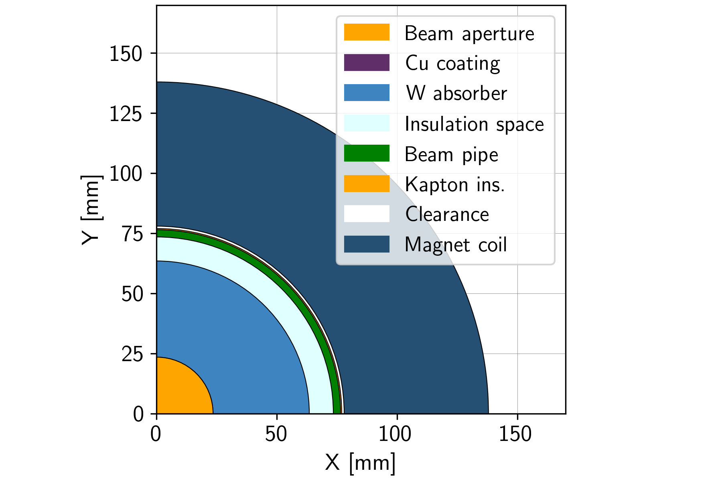
A comment on “coil/cold mass temperature”
“Coil” or “cold mass” temperature, in this exercise, refers to the temperature at the cooling interface
(i.e. the temperature of the fluid inside a cooling pipe)
When a range is given (i.e. He SC between 4.5 K and 5.5 K), it refers to the temperature gradient accepted over a certain longitudinal distance, e.g. an arc cell
Regardless of the method of cooling, there will be an additional temperature gradient in the coil pack, e.g. radial or azimuthal gradient as one moves away from the cooling source (orange arrow)
For the moment, we limit this gradient to ≈ 0.5 K

Slide 9
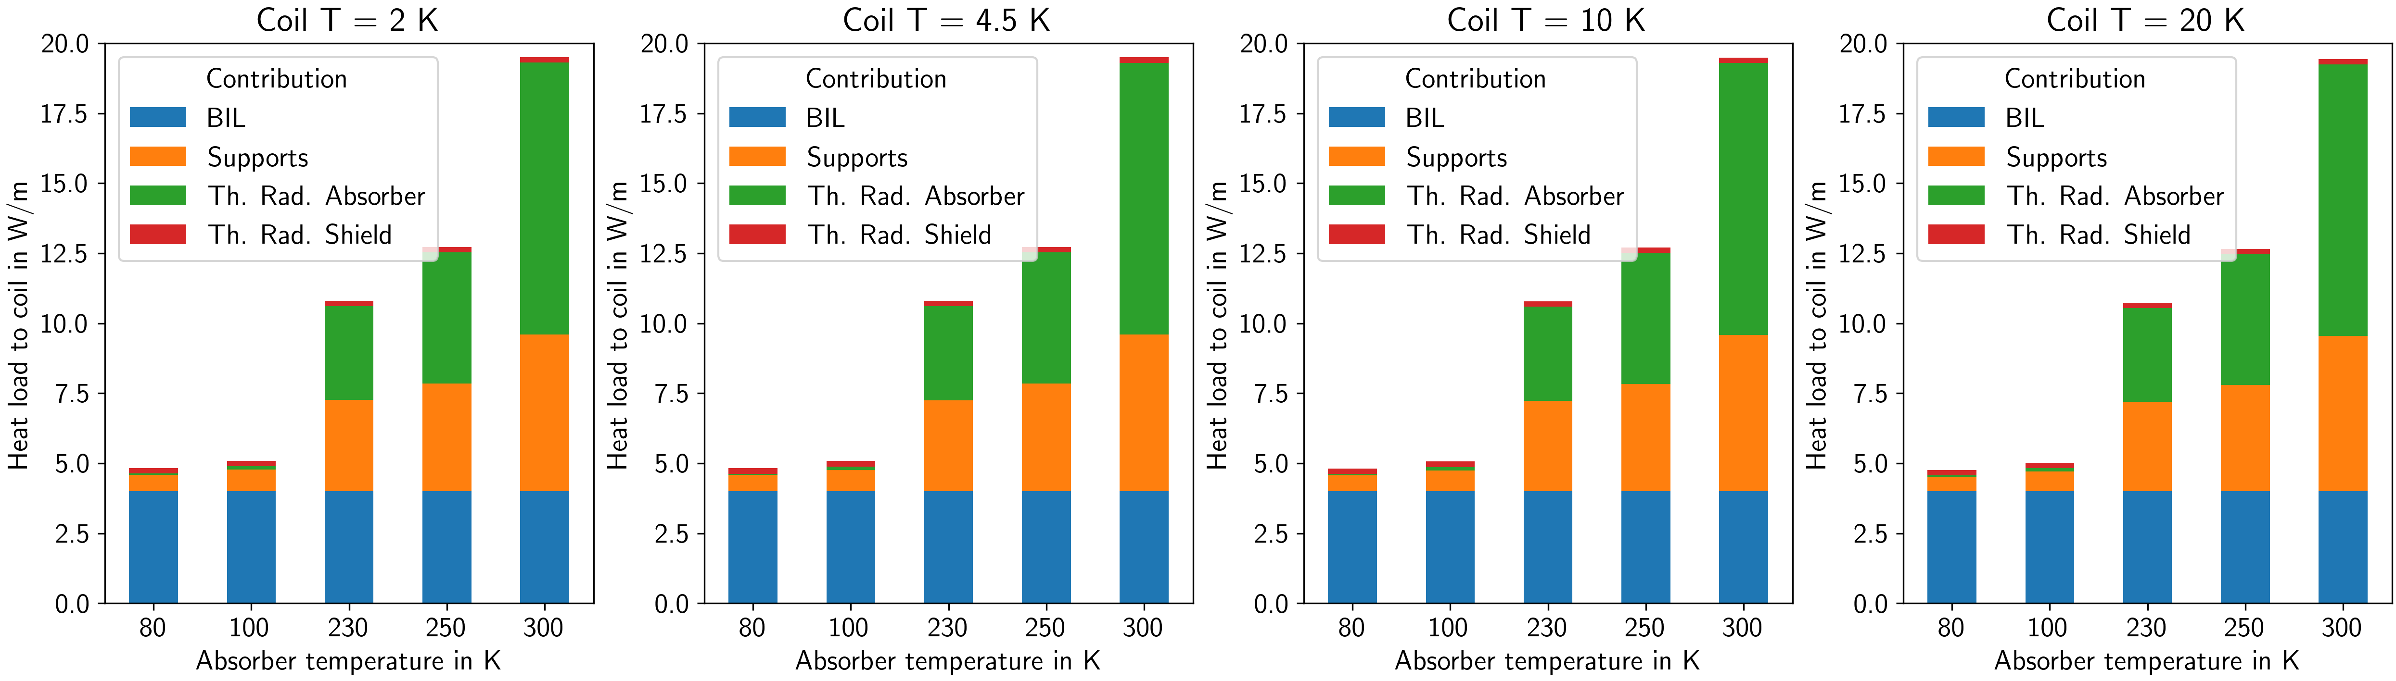
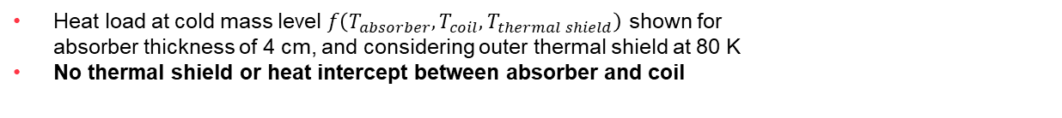
Heat load deposited at cold mass level
Baseline
Heat load at cold mass level $f\left(T_{absorber},T_{coil},T_{thermal shield}\right)$ shown for
absorber thickness of 4 cm, and considering outer thermal shield at 80 K
No thermal shield or heat intercept between absorber and coil
Heat load to the coils ~ independent of coil T,
effort to extract the heat will depend heavily on it
No heat intercept
between absorber
and coil
Excessive contribution
w.r.t. BIL
Heat load via supports
Excessive contribution
w.r.t. BIL
Optimization can have a significant impact on design (aperture)
constant 4 W/m
for 4 cm-thick absorber

Slide 10
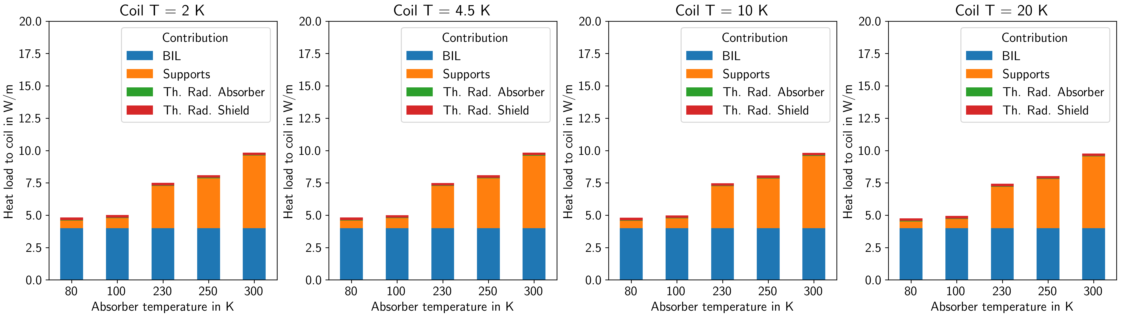
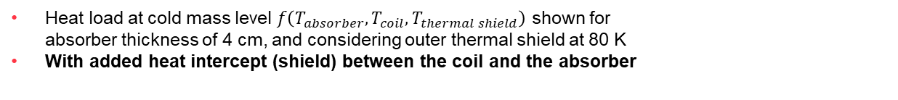
Heat load deposited at cold mass level w/ heat intercept
Heat load at cold mass level $f\left(T_{absorber},T_{coil},T_{thermal shield}\right)$ shown for
absorber thickness of 4 cm, and considering outer thermal shield at 80 K
With added heat intercept (shield) between the coil and the absorber
Heat intercept at 80 K between coil and absorber reduces heat load to coil by ~ half for absorber T > 230 K
Heat loads to the coil
with 4 cm absorber and heat intercept
Target ~ 5 – 10 W/m
Heat intercept between coil and absorber!
Supports not thermalized to this heat intercept, would possibly add too much complexity / integration issues, leading to a larger aperture

Slide 11
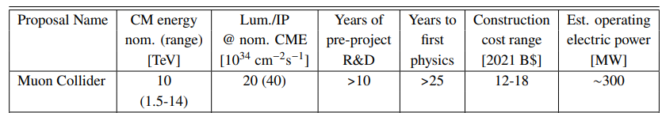
Power consumption budget for Cryogenics
Tentative objective: take the operating electrical power estimated in the Snowmass report¹ for the Muon Collider:
Assume 10% of that electrical power is used for cryogenic infrastructure → 30 MW
Of those 30 MW allocate 25 MW for the collider ring
25 MW for the 10 TeV machine
2.5 MW/km
2.5 kW/m
We aim to stay at around 2.5 kW/m of collider (lower is better! ☺)
¹ Report of the Snowmass 2021 Collider Implementation Task Force, https://arxiv.org/abs/2208.06030

Slide 12
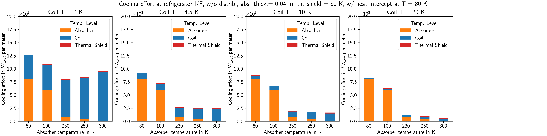
Power consumption at refrigerator I/F
4 cm absorber, w/ heat intercept
Blue: electrical power required to provide cooling power at cold mass temp. level
Orange: electrical power required to provide cooling power at absorber temp. level
Red: electrical power required to provide cooling power at thermal shield temp. level
Target:
25 MW for Cryo in collider
The larger the blue component → the more difficult the coil design (target ≤ 10 W/m)
N.B. I: For assumptions on calculation of cooling effort from heat loads, see spare slides
N.B. II: the cost to extract heat at 300 K is nearly zero, reflecting the fact that the distribution effort (circulation) is not yet included
N.B. III: although COP⁻¹ based on cryoplants using certain fluids, so far, we’re talking only about temp. level, i.e., no fluid-dependent costs considered
(as distribution, special handling, etc…)

Slide 13
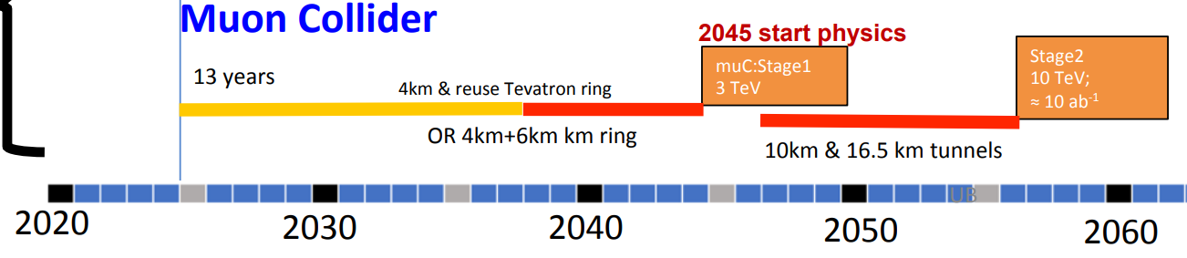
Cooling modes (I)
Cooling mode (and temperature) will depend on the choice of conductor, which depends on the maturity level of the technology and on the timescale of construction
3 TeV machine
Construction in ~15 years
Magnetic fields within Nb₃Sn capabilities
Nb₃Sn matured, usable
Cooling at 4.5 K – 5.5 K using SC He
Cooling at 4.5 K using He two-phase flow
10 TeV machine
Construction in ~25-30 years
HTS preferred for sustainable collider
Needs development
Cooling at 10 K – 15 K or above
He or H₂ possible; in-depth study needed
Hybrid solutions do not seem advantageous considering limited field-free region space – esp. if considering separate temperature levels
2PF H₂ can provide stable T along magnet string with low mass flow rates, small pipes
Safety assessment → will be considered only if critically necessary
“Hindenburg syndrome” to overcome
US proposal
Source: D. Schulte, Muon Collider (link)

Slide 14
Cooling modes (II)
Cooling mode (and temperature) will depend on the choice of conductor, which depends on the maturity level of the technology and on the timescale of construction
Limitations will be the arc cell and sector length, driven by deliverable mass flow rate and pressure drop on the magnets and distribution line
We consider 4 cm absorber, with heat intercept at 80 K between absorber and coil, and outer thermal shield at 80 K as the new baseline

Slide 15
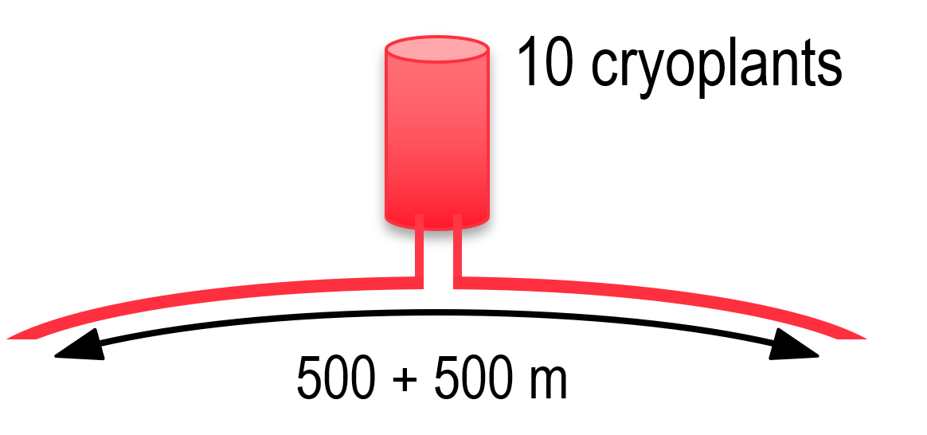

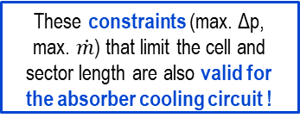


Overall cooling scheme definition (cell and sector length) is an iterative process
Availability decreases with # of cryoplants
Inversely, fewer cryoplants → longer sector length
Max. 10 cryoplants in a 10 km ring
Cost and availability
Limited $\dot{m}$/ cryoplant
Higher heat load → ${\dot{m}}_{sector}$ increases → shorter sector length
Local heat extraction
Coil design complexity increases with heat load; difficult above 10 W/m
$\dot{m}$ is directly proportional to heat load
These constraints (max. Δp, max. $\dot{m}$) that limit the cell and sector length are also valid for the absorber cooling circuit !
Max. Δp / arc cell
Δp $∝{\dot{m}}^{2}$ and $L^{3} →$ cell length dictated by max. Δp in coil
2PF: cannot go into sub-atm pressure (~50 mbar available)

Slide 16
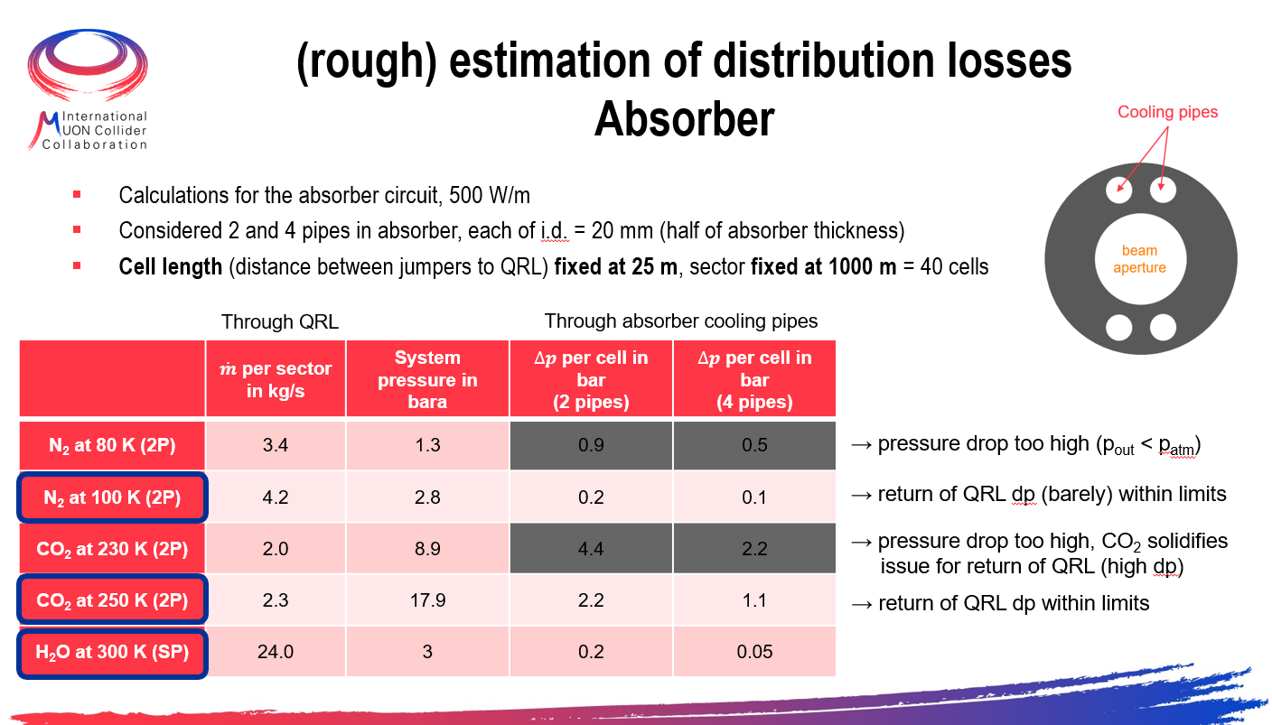

Considerations for absorber cooling options
N₂
CO₂
From initial assumptions:
Absorber temperature: 80 K, 100 K, 230 K, 250 K, 300 K
Water
Cooling effort too high
Δp too high even for short cells, CO₂ solidifies
(see spare slides)
T level | 250 K | 300 K
Fluid | CO₂ | Water
Mass flow rate | + | +/- (10x higher)
Operating pressure | +/- (60+ bara) | + (3-10 bara)
Δp | +/- | + (smaller pipes)
Heat transferred to coil | + | ▬ (20% higher)
COP⁻¹ | +/- | + (only distrib.)
Rad. hardness | + | ▬ (mitigation needed)
Risks to machine | + | ▬ (freezing; expansion)
Message: $T_{abs}$ ≥ 250 K

Slide 17
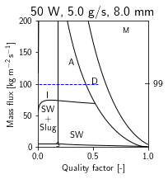
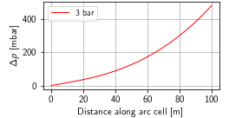
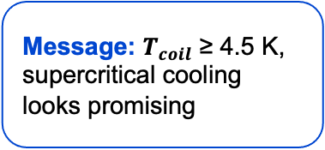
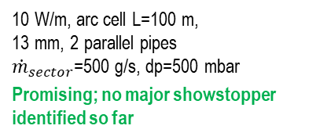

Considerations for coil cooling options
Options at T ≤ 5.5 K (Nb₃Sn, 3 TeV machine)
Message: $T_{coil}$ ≥ 4.5 K, supercritical cooling looks promising
Coil T: 2 K, 4.5 K 2PF, 4.5 K sc
Cooling effort too high
10 W/m, arc cell L=10 m,
8 mm, 2 parallel pipes
${\dot{m}}_{sector}$=1000 g/s, dp=20 mbar
Flow stability and control
10 W/m, arc cell L=100 m,
13 mm, 2 parallel pipes
${\dot{m}}_{sector}$=500 g/s, dp=500 mbar
Promising; no major showstopper identified so far

Slide 18

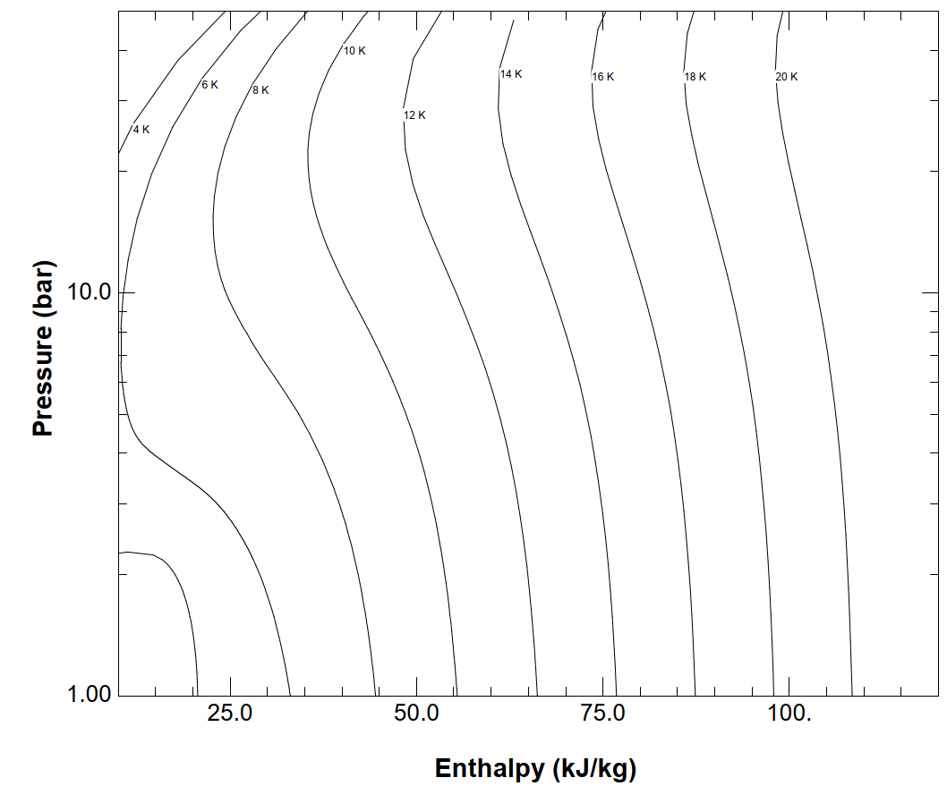
Considerations for coil cooling options
Options at T ≥ 10 K (HTS, 10 TeV machine)
Message: above 4.5 K any He-based cooling involves a sizeable ΔT
Coil T: ΔT around 10 K, ΔT around 20 K, 20 K 2PF
He gas cooling:
Large ΔT, 5 K -10 K
Heat transfer starts to break down
H₂ two-phase flow:
Possible for T > 21 K
High available enthalpy
Needs in-depth study
large ΔT

Slide 19
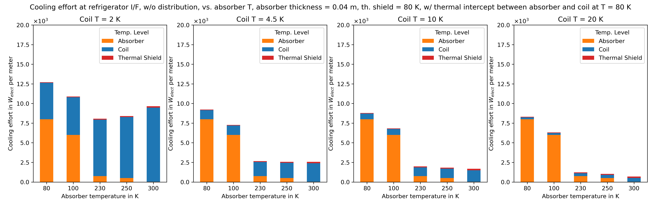
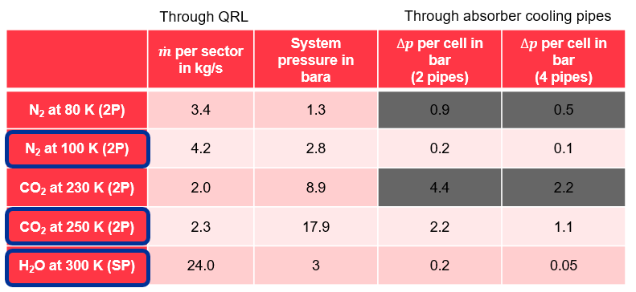
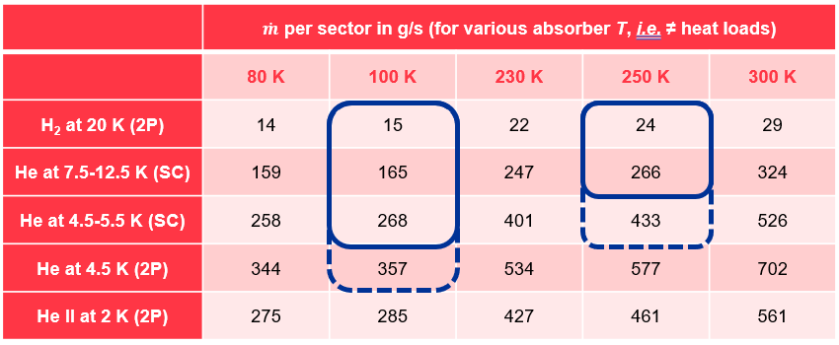
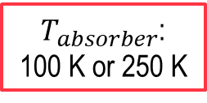
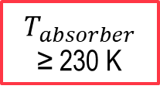
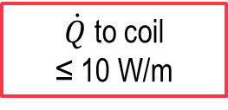
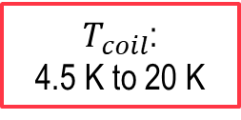
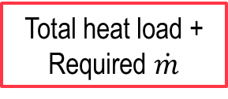
Summary
W/ heat intercept between coil and absorber!
Energy consumption
$T_{absorber}$ ≥ 230 K
≤ 2.5 kW/m
Absorber circuit
Operating T + distribution losses
$T_{absorber}$:
100 K or 250 K
Total heat load +
Required $\dot{m}$
$T_{coil}$:
4.5 K to 20 K
Coil circuit
$\dot{Q}$to coil
≤ 10 W/m
Heat intercept
between coil and
absorber needed
Coil design

Slide 20

Summary
Combining requirements from both energy consumption and what is feasible at absorber and coil levels:
$T_{absorber}$ ≥ 250 K
$T_{coil}$ ≥ 4.5 K
W_{elect} ≤ 2.5 kW/m
+ heat intercept
Energy consumption
$T_{absorber}$ ≥ 230 K
≤ 2.5 kW/m
Absorber circuit
Operating T + distribution losses
$T_{absorber}$:
100 K or 250 K
Total heat load +
Required $\dot{m}$
$T_{coil}$:
4.5 K to 20 K
Coil circuit
$\dot{Q}$to coil
≤ 10 W/m
Heat intercept
between coil and
absorber needed
Coil design

Slide 21
Thank you for your attention

Slide 22
Spare slides

Slide 23
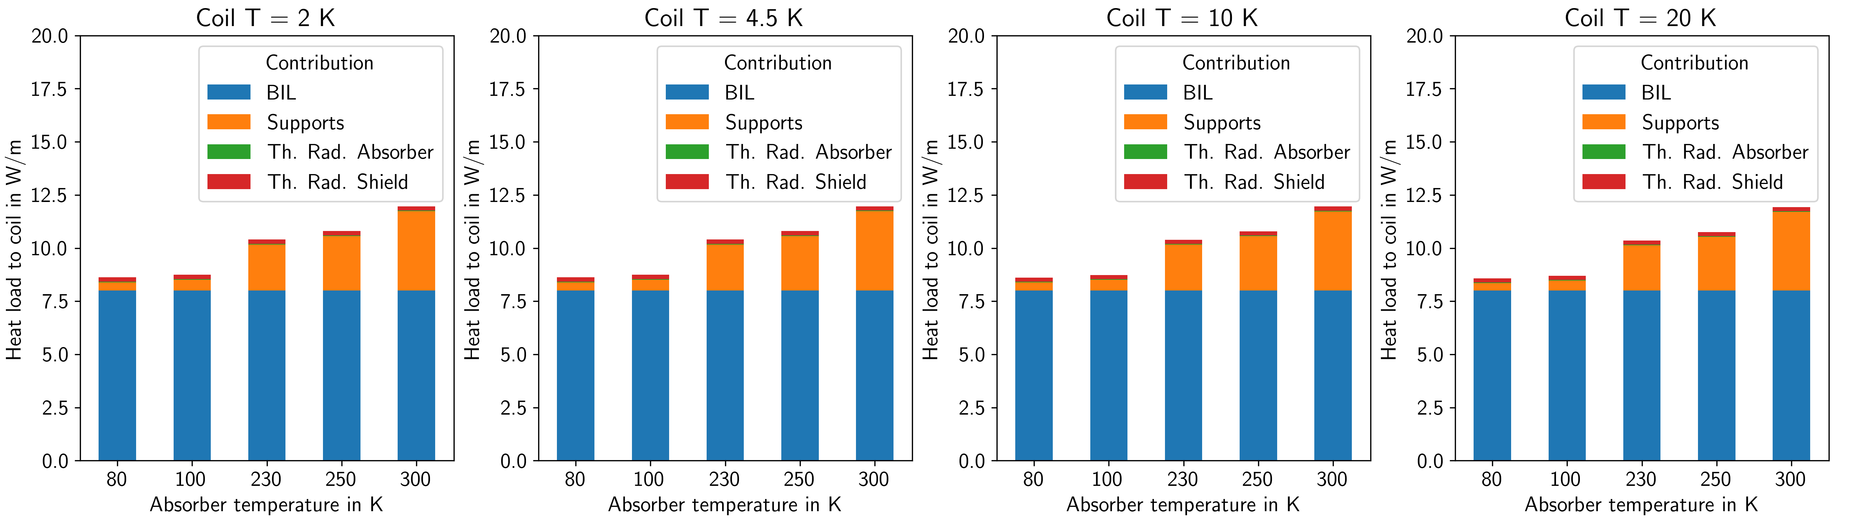
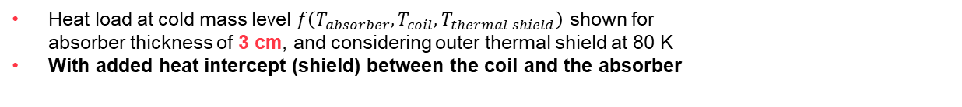
Heat load deposited at cold mass level w/ heat intercept
Heat load at cold mass level $f\left(T_{absorber},T_{coil},T_{thermal shield}\right)$ shown for
absorber thickness of 3 cm, and considering outer thermal shield at 80 K
With added heat intercept (shield) between the coil and the absorber
Heat intercept between coil and absorber!
Reducing the absorber thickness from 4 cm to 3 cm doubles the beam-induced load that penetrates shielding (blue part) while only reducing the heat load via the supports (orange part, which is weight-dependent) by 30%

Slide 24
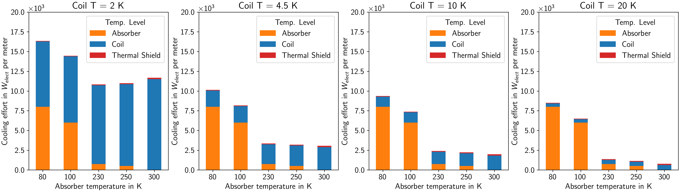
Power consumption at refrigerator I/F
3 cm absorber, w/ heat intercept
Blue: electrical power required to provide cooling power at cold mass temp. level
Orange: electrical power required to provide cooling power at absorber temp. level
Red: electrical power required to provide cooling power at thermal shield temp. level
Target:
25 MW for Cryo in collider
The larger the blue component → the more difficult the coil design
N.B. I: the cost to extract heat at 300 K is nearly zero, reflecting the fact that the distribution effort (circulation) is not yet included
N.B. II: although COP⁻¹ based on cryoplants using certain fluids, so far, we’re talking only about temp. level, i.e., no fluid-dependent costs considered (as distribution, special handling, etc…)

Slide 25
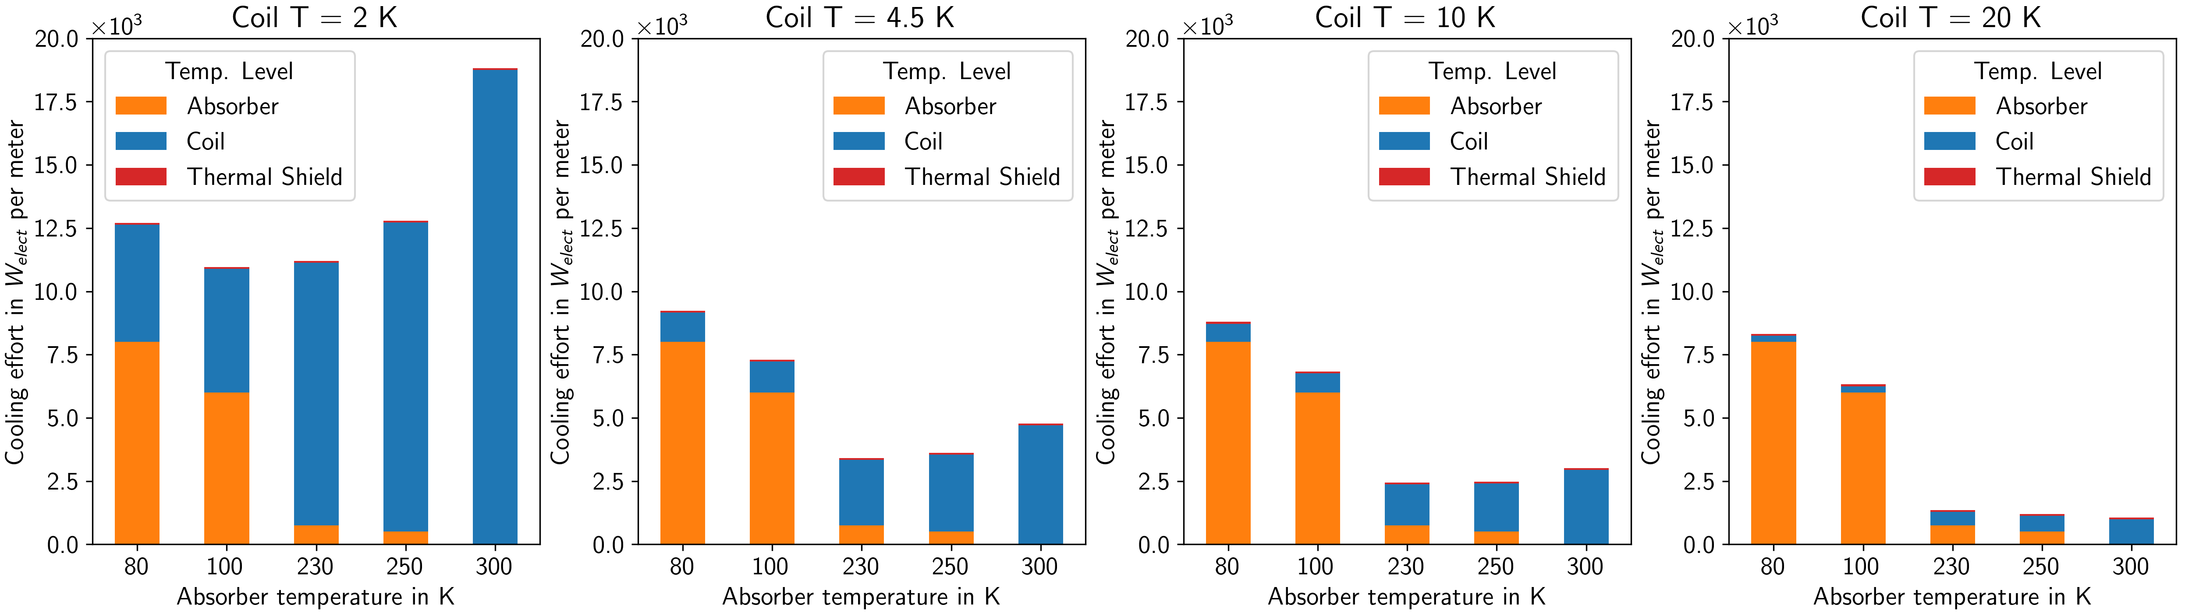
Power consumption at refrigerator I/F
4 cm absorber, baseline
Blue: electrical power required to provide cooling power at cold mass temp. level
Orange: electrical power required to provide cooling power at absorber temp. level
Red: electrical power required to provide cooling power at thermal shield temp. level
Coil 20 K, Absorber ≥ 230 K
Target:
25 MW for Cryo in collider
The larger the blue component → the more difficult the coil design
N.B. I: For assumptions on calculation of cooling effort from heat loads, see spare slides
N.B. II: the cost to extract heat at 300 K is nearly zero, reflecting the fact that the distribution effort (circulation) is not yet included
N.B. III: although COP⁻¹ based on cryoplants using certain fluids, so far, we’re talking only about temp. level, i.e., no fluid-dependent costs considered
(as distribution, special handling, etc…)

Slide 26
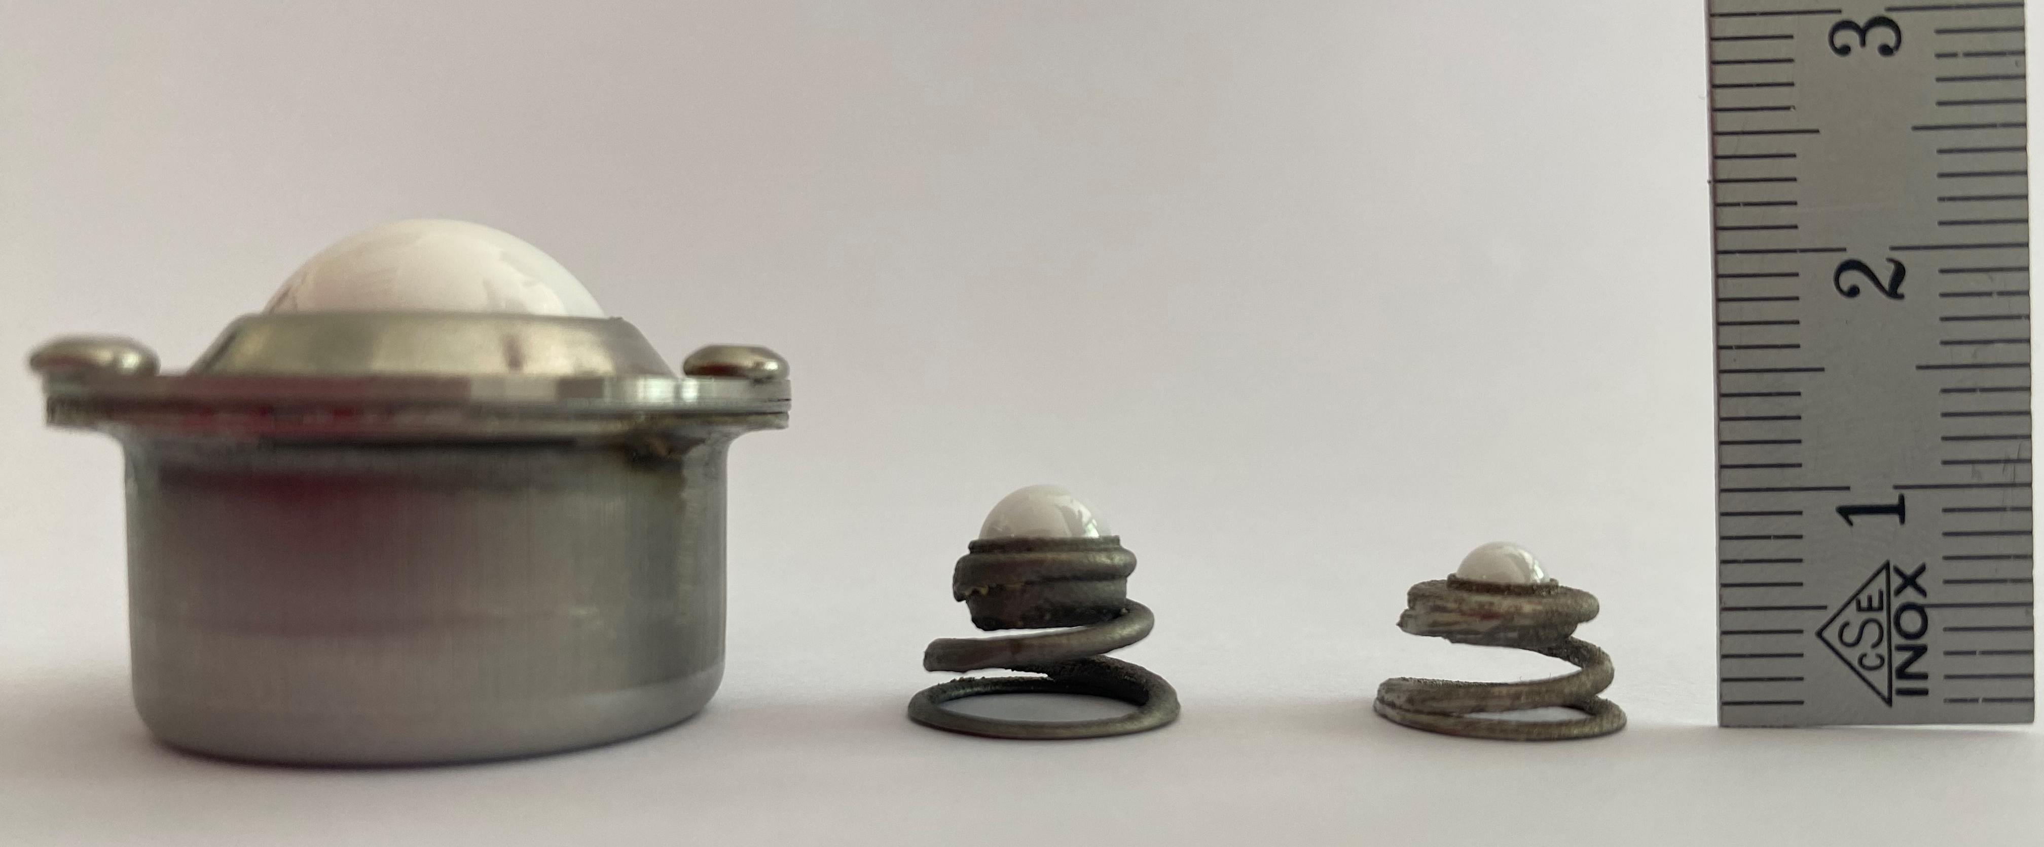
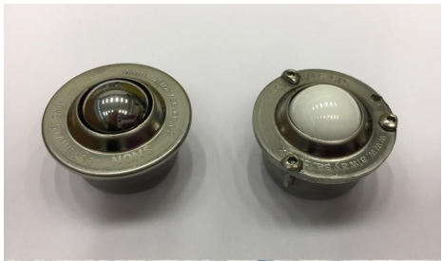
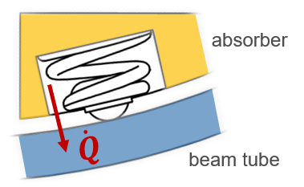
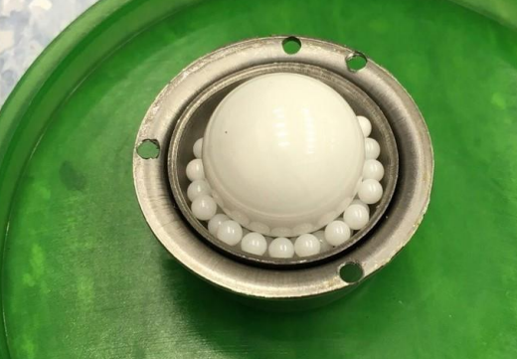
(Possible) solution for absorber supports from existing implementations
PUMA rolls
Heat transfer measurements by J. Liberadzka-Porret at the Cryolab, EMDS # 2443998 (link)
≈ 1 W/roll under 500 N from RT to LN₂
≈ 0.1 W/roll under 500 N from LN₂ to LHe
HL-LHC beam screen springs
Heat transfer measurements at the Cryolab,
EMDS # 2042522 (link)
≈ 0.05 W/roll under 15 N from RT to LHe

Slide 27

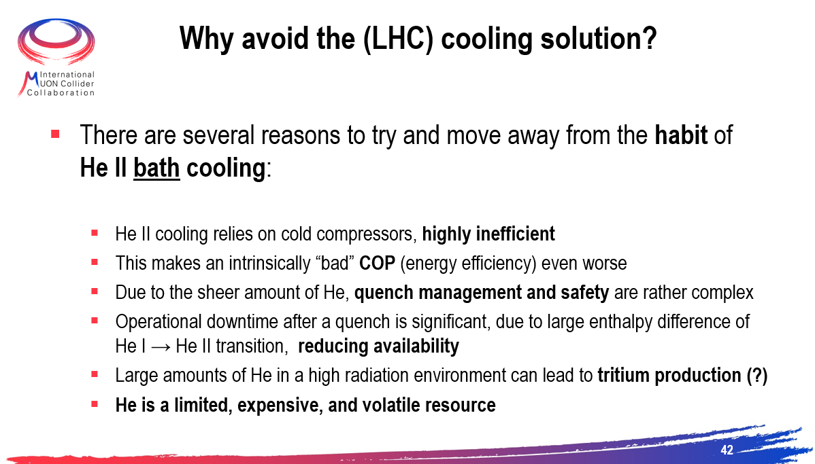
Reminder from last annual meeting
(link)

Slide 28
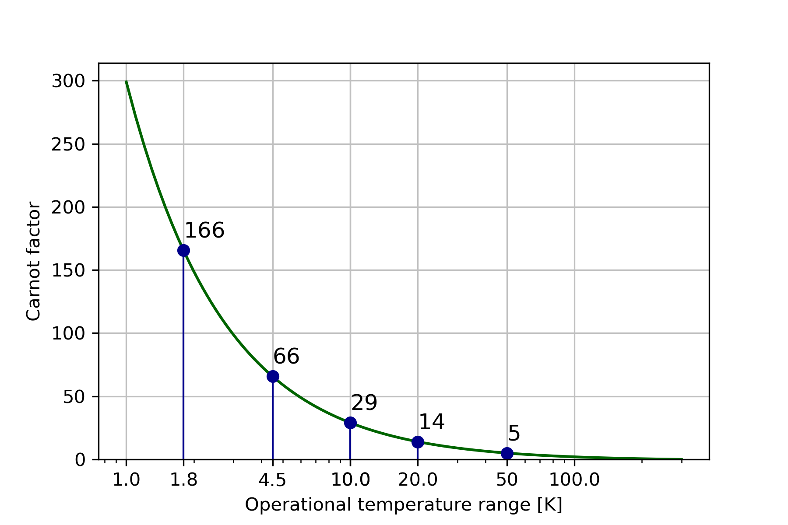
Thermodynamics of cryogenic refrigeration
Ideal Carnot ≠ Reality
Carnot efficiency gives a potential reduction in operational costs
  e.g. from 4.5 K to 10 K there is a potential factor 2.3 improvement in efficiency
But reality (process inefficiencies) needs to be considered
  Actual COP at refrigerator interface for 10 K is 150 vs. 240 at 4.5 K → factor 1.6 improvement in efficiency (W/W)
Losses on distribution and heat extraction systems still need to be added (up to 30%-50%!)
He → COP 960
He → COP 240
He → COP 150

Slide 29
Power consumption at refrigerator I/F
From heat loads to power consumption
For each temperature level of absorber, cold mass, and external thermal shield, the inverse coefficient of performance (COP⁻¹) at refrigerator interface was estimated to give a semi-realistic power consumption per meter of collider magnet.
The heat load from each temp. level (slides 9/10) is multiplied by the COP⁻¹ to give a total electrical cost
Distribution (e.g. pumps to circulate fluids) is not yet included in the “bill”
Considerations:
Temperature level | COP⁻¹ in W_{elect}/W_{cool} | Source
250 K | 1 | CO₂ plant ATLAS ITk
100 K | 12 | LN₂ plant ATLAS
80 K | 16 | LN₂ plant ATLAS
20 K | 50 | 20 K/50 kW plot Frey (see spares)
10 K | 150 | LHC cryoplant data
4.5 K | 240 | LHC cryoplant data
2.0 K | 960 | LHC cryoplant data

Slide 30
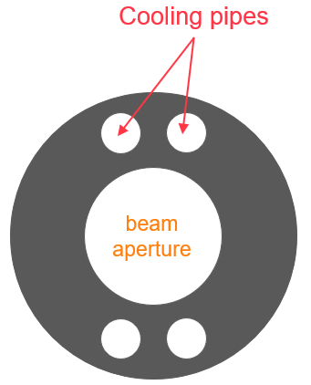
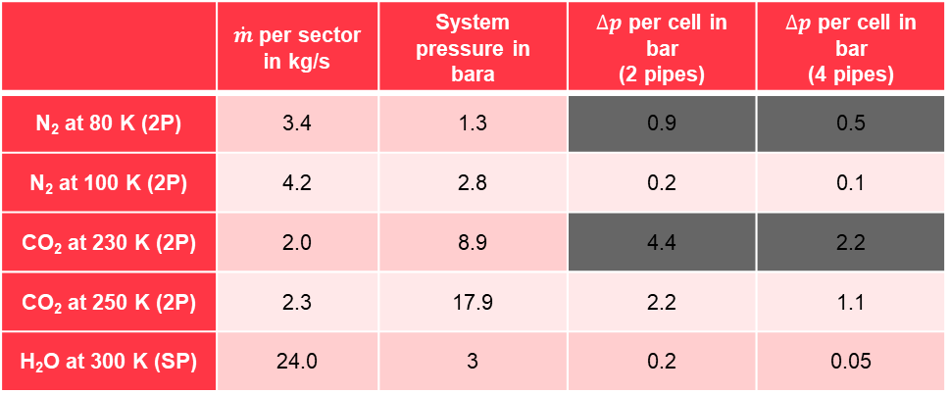
(rough) estimation of distribution losses
Absorber
Calculations for the absorber circuit, 500 W/m
Considered 2 and 4 pipes in absorber, each of i.d. = 20 mm (half of absorber thickness)
Cell length (distance between jumpers to QRL) fixed at 25 m, sector fixed at 1000 m = 40 cells
Through QRL
Through absorber cooling pipes
 | $\dot{m}$ per sector in kg/s | System pressure in bara | $∆p$ per cell in bar (2 pipes) | $∆p$ per cell in bar (4 pipes)
N₂ at 80 K (2P) | 3.4 | 1.3 | 0.9 | 0.5
N₂ at 100 K (2P) | 4.2 | 2.8 | 0.2 | 0.1
CO₂ at 230 K (2P) | 2.0 | 8.9 | 4.4 | 2.2
CO₂ at 250 K (2P) | 2.3 | 17.9 | 2.2 | 1.1
H₂O at 300 K (SP) | 24.0 | 3 | 0.2 | 0.05
→ pressure drop too high (p_{out} < p_{atm})
→ return of QRL dp (barely) within limits
→ pressure drop too high, CO₂ solidifies
issue for return of QRL (high dp)
→ return of QRL dp within limits

Slide 31
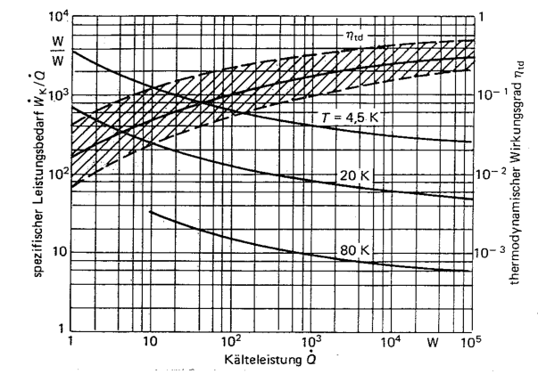
Specific power requirement of refrigerators
Figure 7-35. Specific power requirement of refrigerators and thermodynamic efficiency it of the cold power at different operating temperatures.
Specific power requirement in W_{elect}/W_{cool}
Thermodynamic efficiency
Source: Tieftemperatur–Technologie, von H. Frey und R. A. Haefer. Herausgegeben von F. X. Eder. VIII-Verlag, Düsseldorf 1981

Slide 32
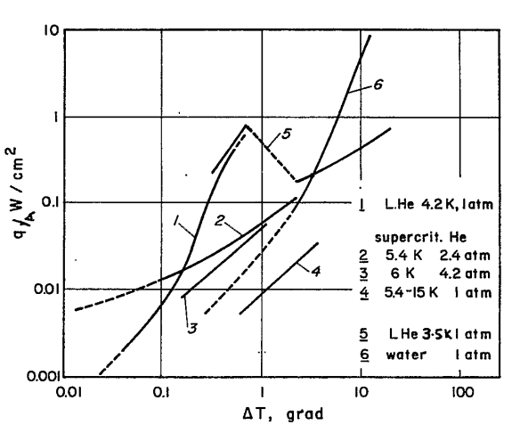
Two- vs. single-phase flow local heat extraction
Implications for magnet design
Heat transfer coefficient $α$ in liquid He is
O(1) – O(2) higher than options using high-speed, high-pressure gas/supercritical fluid
If heat exchange area is limited, choice of cooling strategy needs to be adapted to provide the best possible heat transfer coefficient
Magnet design should strive to incorporate, from the start, heat extraction pathways as close as possible to the coil and maximise heat transfer exchange area
Smith, Review of heat transfer to helium I (link)

Slide 33
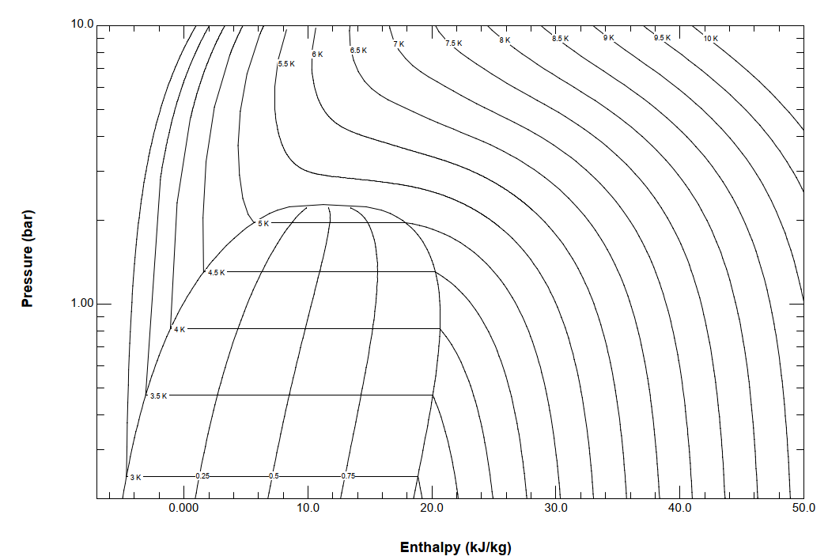
Cooling modes – options for 3 TeV (Nb₃Sn)
Helium
Two-phase option:
Expand from 3 to 1.3 bara into the two-phase region, two-phase cooling at 4.5 K
Pros: high α, negligible ΔT along arc cell
Cons: limited Δh due to onset of dry-out (see flow pattern map), complex control loop esp. if 2 parallel pipes
Supercritical option:
Use sc region from 3 to 2.5 bara allowing a certain ΔT
(shown 4.5 K to 5.5 K)
Pros: large Δh available, can use return for cooling with > 1 bar Δp available
Cons: Δp needs to be ensured, α lower, some ΔT along cell to be accepted
supply
supercritical option
shield, feet,
dist. line cooling
return

Slide 34
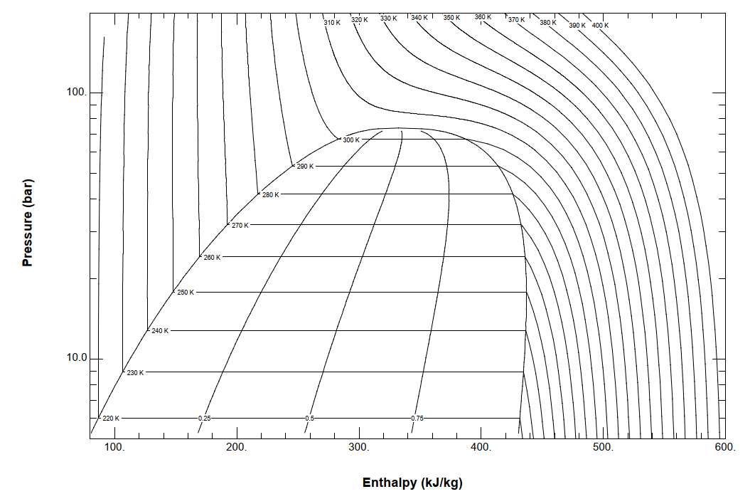
Carbon Dioxide
cooling
tunnel
Air cooling
supply
Two-phase flow
at 250 K, 20 bara,
expanded from 70 bara, 260 K
Depending how we enter the
two-phase region, cooling at “tunnel” or room temperature would be sufficient
Other cooling schemes possible, to be investigated
return

Slide 35
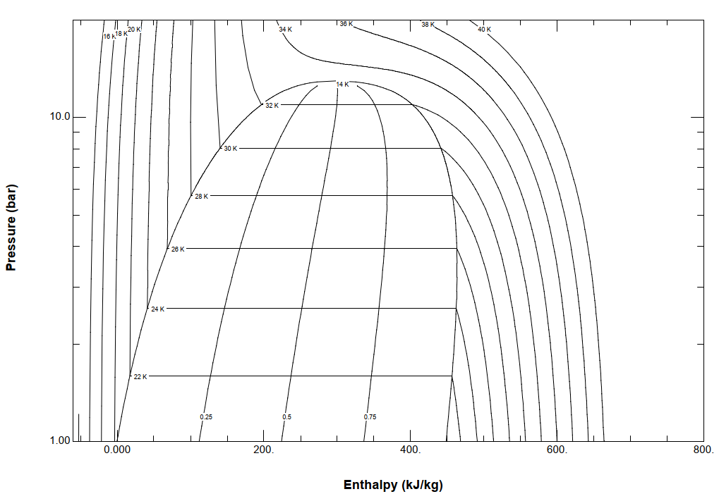
Hydrogen
Supply subcooled liquid at 4 bara, 22.5 K, expand to 1.3 bara into the two-phase region, two-phase cooling at 21.2 K
supply
22.5 K, 4 bara
return
21.2 K, 1.3 bara

Slide 36
Helium
supply
Expand from 3 to 1.3 bara into the two-phase region, two-phase cooling at 4.5 K
(red)
Use supercritical region allowing a certain temperature gradient
(shown 4.5 K to 5.5 K)
(blue)
supercritical option
shield, feet,
dist. line cooling
return

