Slide 1


Overall integration of target solenoid shielding and cryostats
C. Accettura, L. Bottura, A.Kolehmainen, J. Lorenzo, A. Portone, P. Testoni
IMCC Annual Meeting
20/06/2023, IJCLab (Orsay, France)

Slide 2
OUTLINE
Introduction and challenges
Lay-out overview
Magnets’ support concept
Cryostat
Tungsten shield & target
Integration
Conclusions

Slide 3
Introduction
“Few” challenges:
~MW target
Large solenoid
High magnetic field
High radiation load→ shield
High heat load

Slide 4
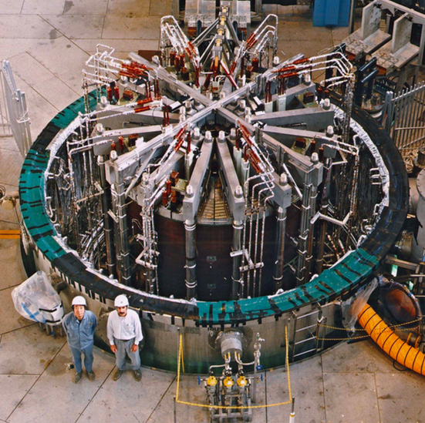
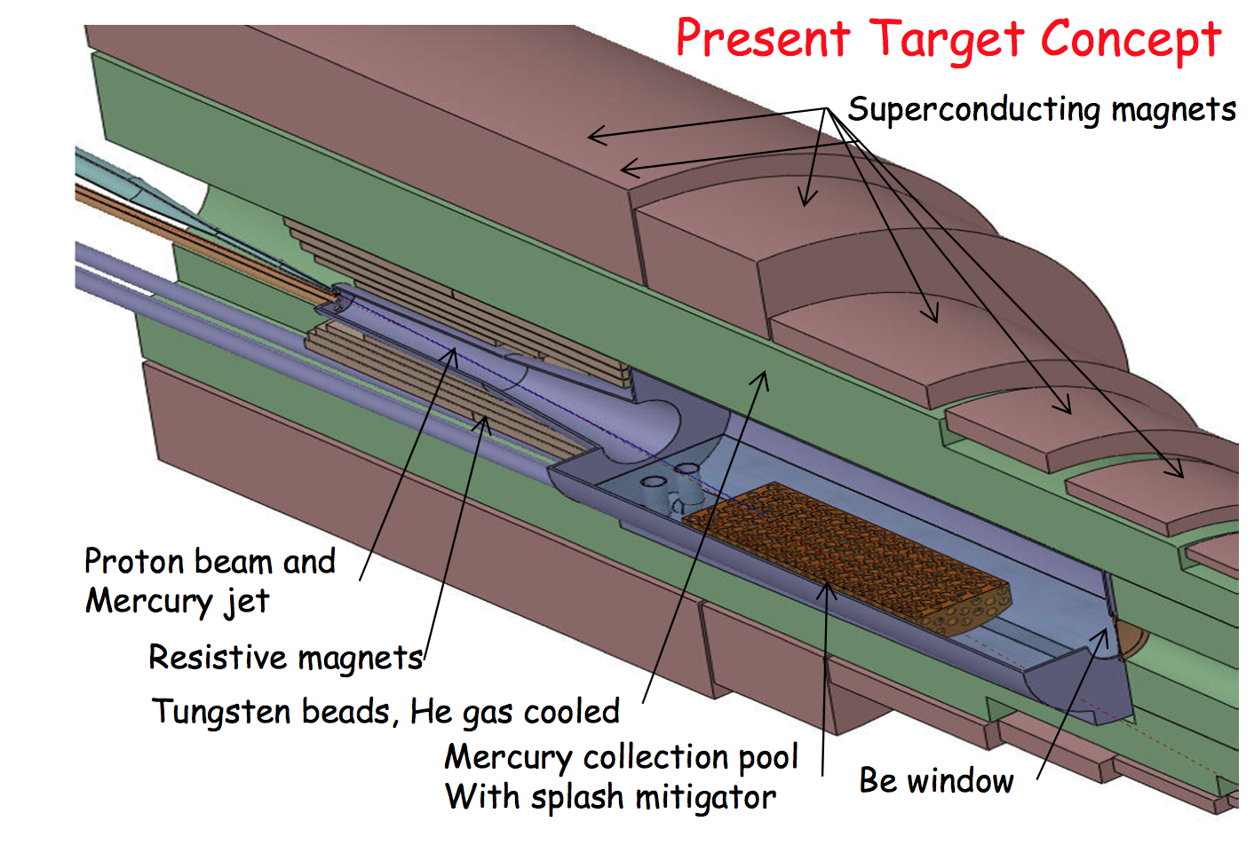
Introduction
“Few” challenges:
~MW target
Large solenoid
High magnetic field
High radiation load→ shield
High heat load
Initial inspirations
ITER central solenoid
MAP target design, K. McDonald, et al.
12…15 T
20 T

Slide 5
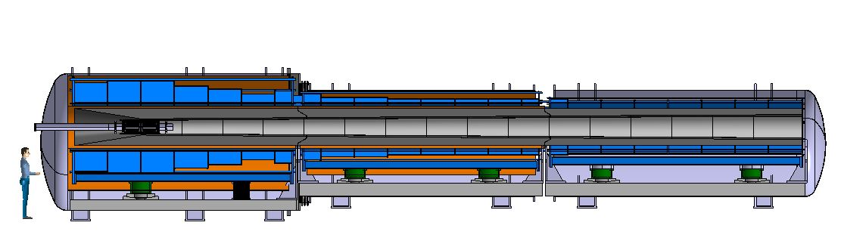
Lay-out overview
Based on magnetic design inputs
19m length
Ø4 m
Length ≈ 19 m

Slide 6
Lay-out overview: Weight
Based on magnetic design inputs
19m length + >300tons → splitting in 3 sections
Coldmass = 85000 kg
Tungsten shield = 54000 kg(as solid)
Vacuum vessel + support structure = 20000 kg
Total assembly = 159 T
Coldmass = 22000 kg
Tungsten shiels = 54000 kg(as solid)
Vacuum vessel + supports = 10000 kg
Total assembly = 86 T
Coldmass = 12000 kg
Tungsten shield = 54000 kg(as solid)
Vacuum vessel + supports = 10000 kg
Total assembly = 76 T
Ø4 m
Length ≈ 19 m

Slide 7
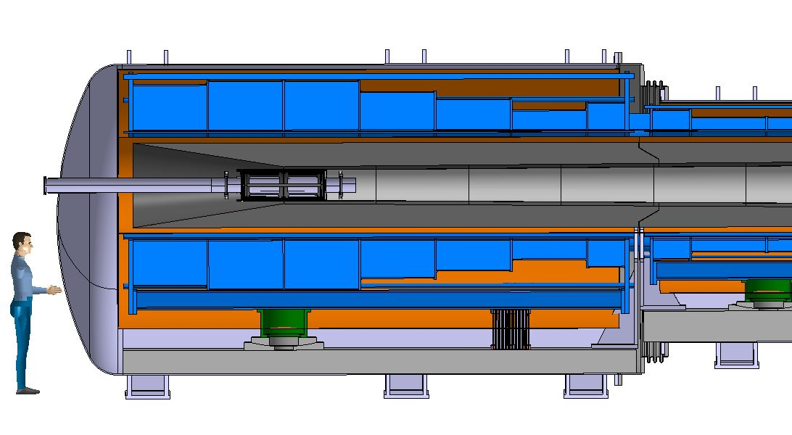
Lay-out overview: Temperature chart
15-20 K
THERMAL SHIELD
SUPPORT 300 K – 20K
MW!!
300 K
APPLIES TO ALL THREE SECTIONS!

Slide 8
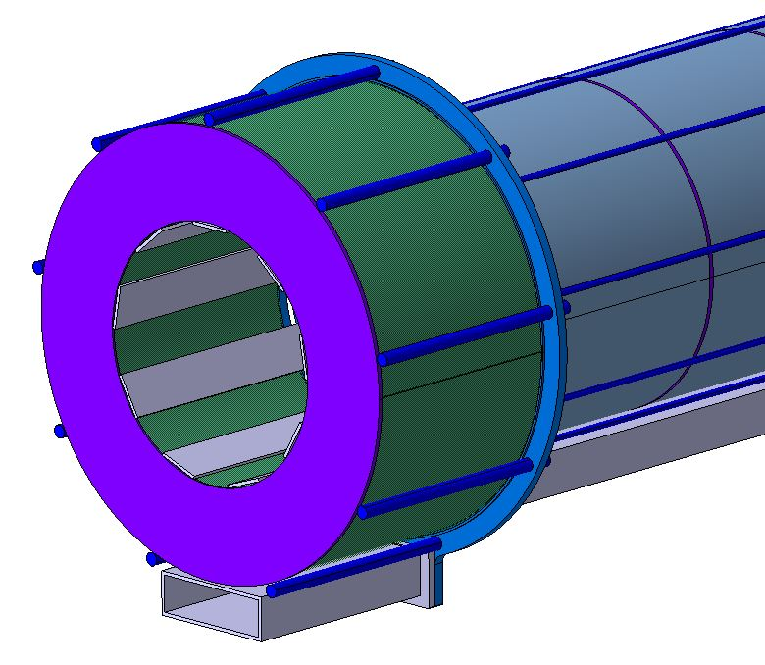
Coil assembly
2x/9x Ø60 rods/flat bars for clamp load to keep coils together until electromagnetic forces are created
Supports might need active cooling or another solution to guarantee the clamp load during cool down

Slide 9
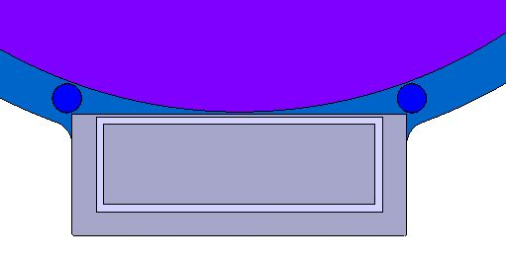
Coil assembly
Beam for support interface
2x/9x Ø60 rods/flat bars for clamp load to keep coils together until electromagnetic forces are created
Supports might need active cooling or another solution to guarantee the clamp load during cool down

Slide 10
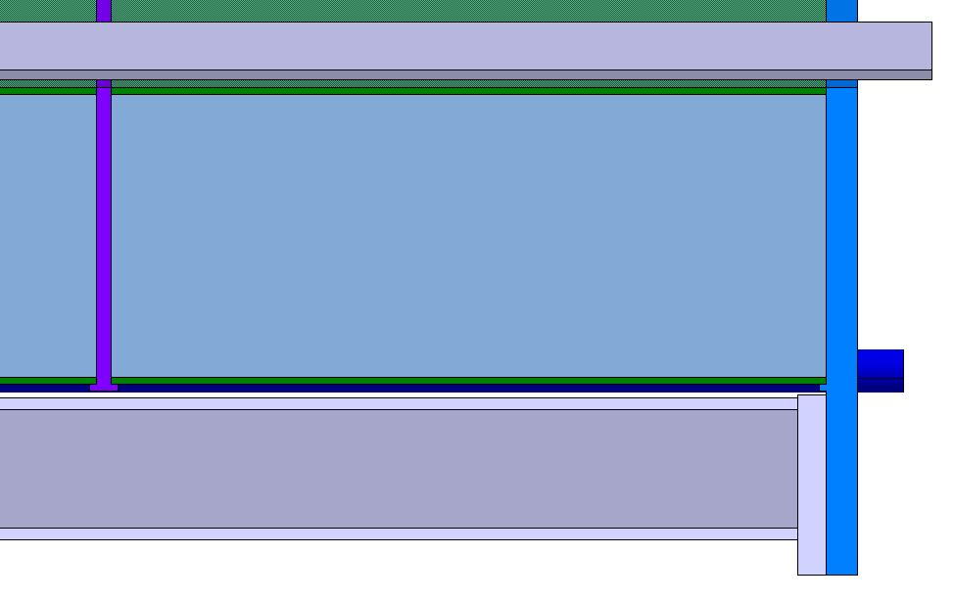
Coil assembly
Beam for support interface
Coil shims and end plates with shoulders on external diameter for coil-to-coil centring
2x/9x Ø60 rods/flat bars for clamp load to keep coils together until electromagnetic forces are created
Supports might need active cooling or another solution to guarantee the clamp load during cool down
End plates and rod tensioning probably needs more space

Slide 11
Coil assembly
Beam for support interface
MANY MECHANICAL CALCULATIONS REQUIRED!
Coil shims and end plates with shoulders on external diameter for coil-to-coil centring
2x/9x Ø60 rods/flat bars for clamp load to keep coils together until electromagnetic forces are created
Supports might need active cooling or another solution to guarantee the clamp load during cool down
End plates and rod tensioning probably needs more space

Slide 12
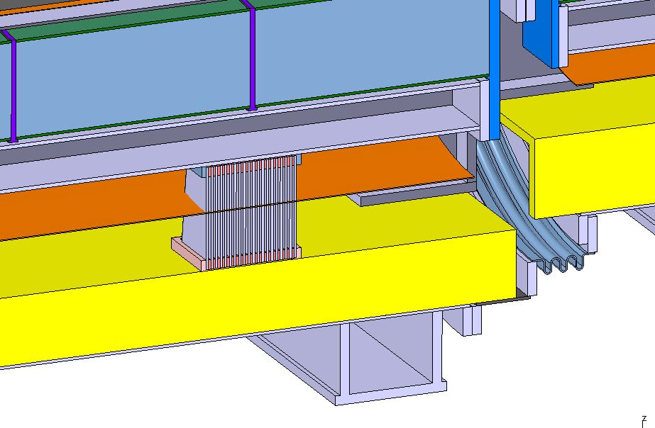
Coil assembly supporting
Support structure to transfer cold mass (and tungsten shield) load to cryostat supporting

Slide 13
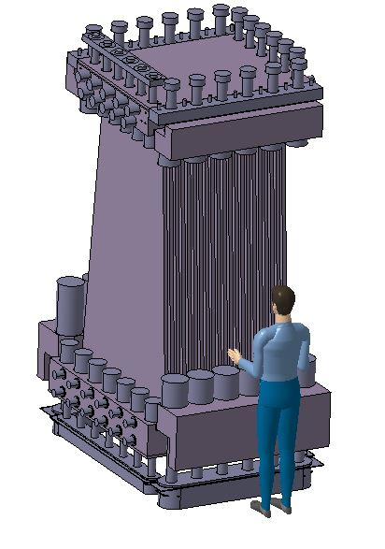
Coil assembly supporting
Support structure to transfer cold mass (and tungsten shield) load to cryostat supporting
ITER inspired flexible support = several plates together
Fixed support
Flexible support
Charge 50 T
Charge 50 T
May be swopped
Courtesy of Jose Lorenzo

Slide 14
Coil assembly supporting
Support structure to transfer cold mass (and tungsten shield) load to cryostat supporting
Thermal contraction(0.3%): 37 – 45 mm depending on the fix point
ITER inspired flexible support = several plates together
Fixed support
Flexible support
Sliding supports
Charge 50 T
Charge 50 T
Charge 15 – 6 T
May be swopped
Courtesy of Jose Lorenzo
Sliding supports = GFRE supports on spherical bearing, shim the height = LHC dipole concept(similar mass)

Slide 15
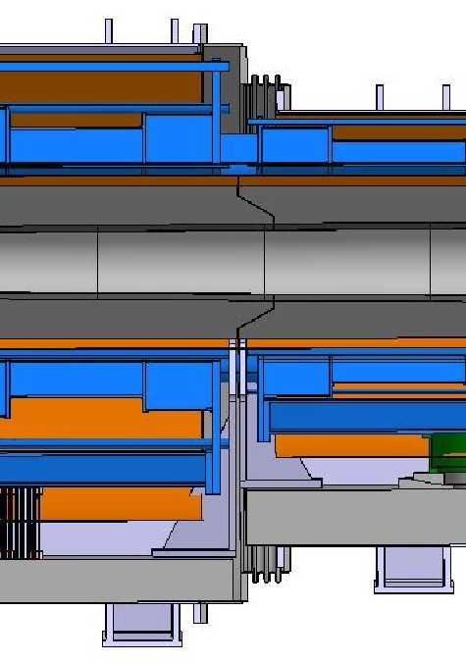
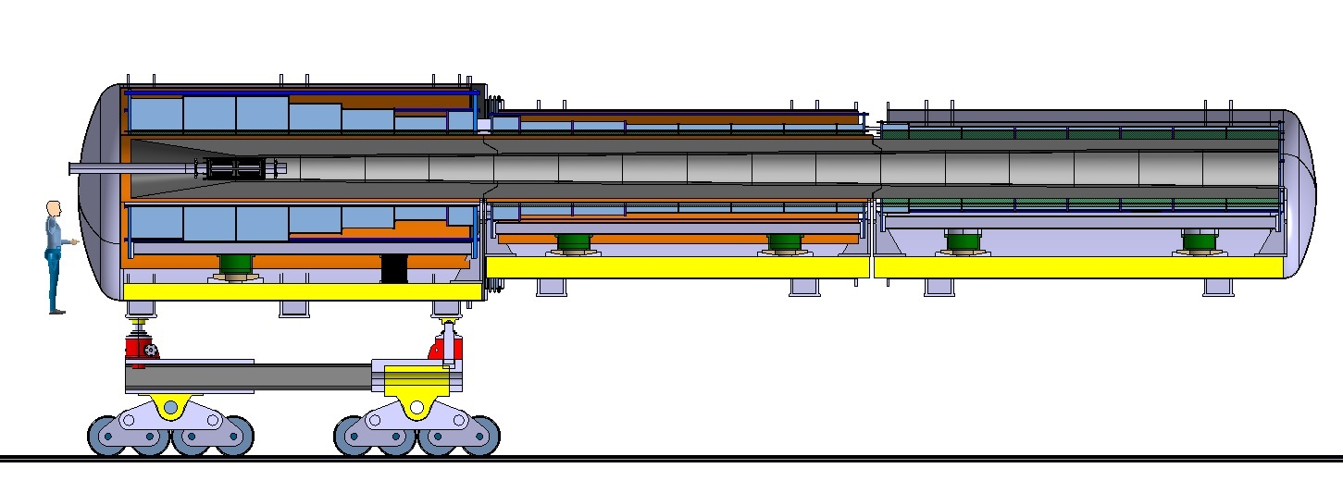
Cryostat supports
Cryostat vacuum vessel enforcements as support interface
Coils and shields carried through vacuum vessel backbone
Tungsten shield carried through vacuum vessel backbone
  All at 300K!

Slide 16
Cryostat supports
160 T!
Cryostat vacuum vessel enforcements as support interface
Coils and shields carried through vacuum vessel backbone
Tungsten shield carried through vacuum vessel backbone
  All at 300K!
Rail mounted carriage for the three sections
  May be scaled according to section weight

Slide 17
Cryostat supports
160 T!
Cryostat vacuum vessel enforcements as support interface
Coils and shields carried through vacuum vessel backbone
Tungsten shield carried through vacuum vessel backbone
  All at 300K!
Rail mounted carriage for the three sections
  May be scaled according to section weight
Jacks for height and angles
Lateral alignment system to be defined

Slide 18
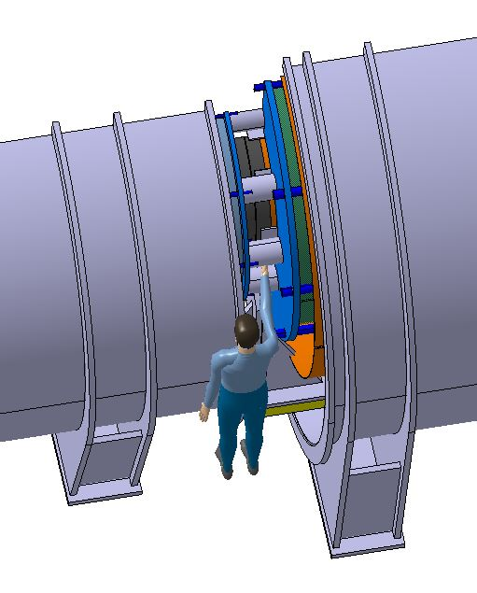
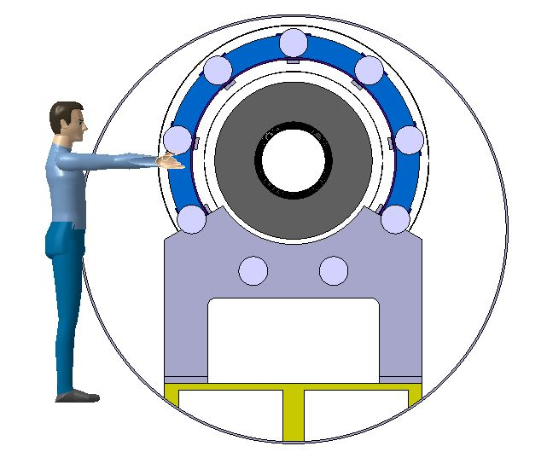
Coil gap
9x Ø168 bars for coil attraction force 40 MN(w/ zero gap) max
Thermal shielding required
Must be attached to the coil assemblies for thermal contraction w/o electromagnetic force – may lead into hyperstatic supporting!
The tungsten shielding and anything within it will be difficult to reach in the first opening
Gap = 480 mm, cannot be extended as the coldmass and tungsten shield are supported at vacuum vessel extremities

Slide 19
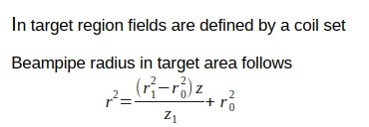
Tungsten shield
Inner radius defined by formula
Sufficient clearance between the shield and the beam pipe is required
Outer radius estimated from the surrounding coils assembly with thermal shielding
Resulting shield thickness to be assessed by radiation studies
Simplified model weights 160 T
Tungsten price > 100 CHF/kg
Cooling – see next slide

Slide 20
Tungsten shield
Inner radius defined by formula
Sufficient clearance between the shield and the beam pipe is required
Outer radius estimated from the surrounding coils assembly with thermal shielding
Resulting shield thickness to be assessed by radiation studies
Simplified model weights 160 T
Tungsten price > 100 CHF/kg
Cooling – see next slide
Split into three sections of 50 T supported through the warm structure at the bottom of the vacuum vessel
Conical interface to avoid gaps for radiation
  Align w.r.t. the magnets to guarantee fit during the final assembly of the target magnets, no assembly actions on the shield at this point
The temperature variation during operation?
  the supports system must cope with it -> may lead to complication
Mechanical behaviour, i.e. deformation to be studied
Should target for service free life – can this be achieved?

Slide 21
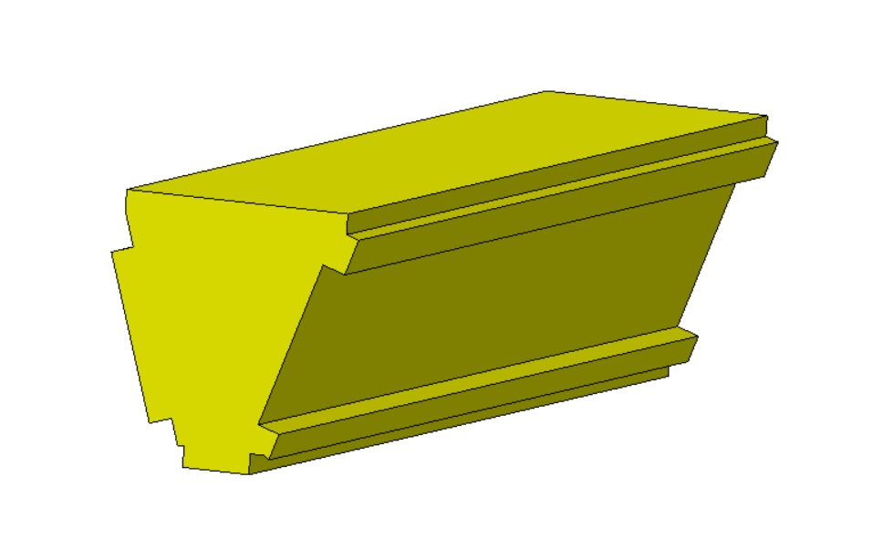
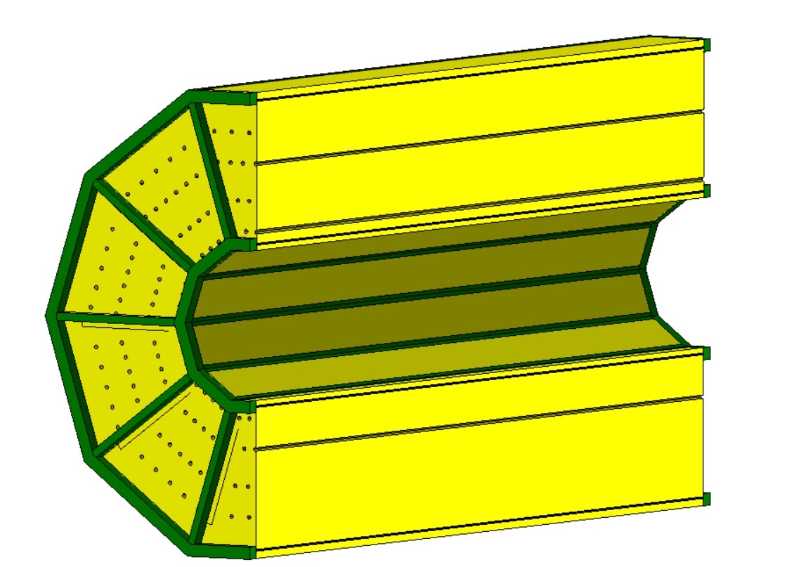
Tungsten shield
Shield made of He cooled blocks
Shield will be surrounded with vessel containing water and boron carbide layer for neutron absorption
Services need to be routed inside, and out from, the cryostat
  To be studied, if the full length of the shield requires cooling
Current target and shielding outer radius is 590 mm + vessel wall for the water volume. The internal supports of the coil assembly have a radius of 565 mm. Thermal shield and gaps around it is required. A need for a cooling circuit on the thermal shield inside remains TBC. If we preserve 15 mm for the two gaps and 5 mm for the shield, we get 530 mm for the radiation shield outer diameter. Thus we have around 65 mm clash to solve.
For further details on the target – please see the talk of R. Ximenes, Design of the target system and shielding

Slide 22
Target and beam vacuum
One conical beam vacuum chamber downstream from the target
Insert from downstream side, 15 m clearance required downstream from the cryostat
  Installation order & minimized service
Move assembly upstream to allow target service
  Must be with robot due to radiation
  Upstream equipment might have to be removed for service.
  Enough clearance between vacuum chamber and tungsten shield required
  Support system must allow this
Beam instrumentation inside the cooling channel?
Beam vacuum level and the required technology to achieve it?
  E.g. Bake-out system required?
Conical chamber downstream from the target

Slide 23
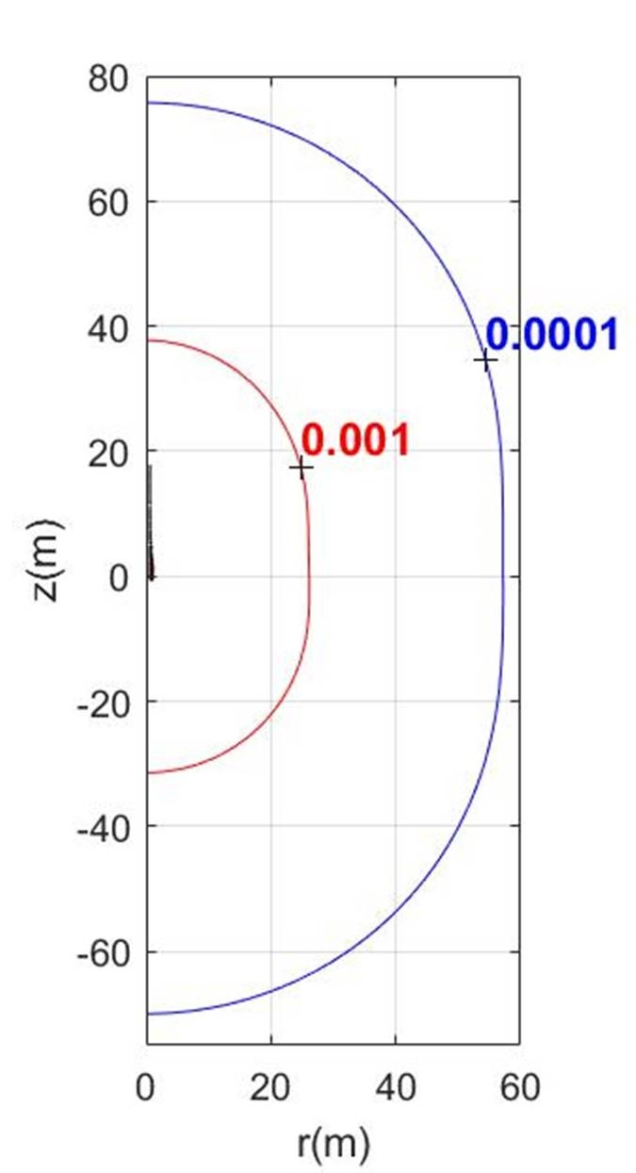
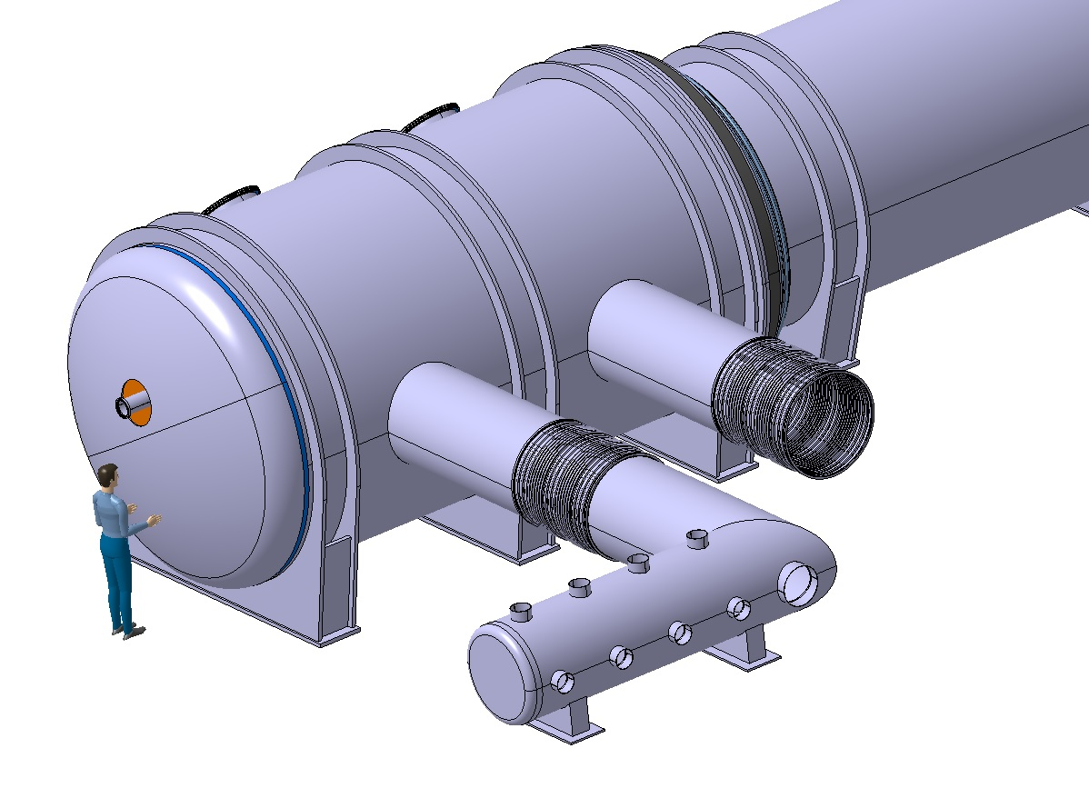
Magnetic shielding
We assume a magnetic shield is required
To be studied in detail
  Could be massive if made of iron
  Coils for magnetic shielding – no details for now
Instrumentation inside the cryostat?
Vacuum pumps and other equipment, if any, in the magnetic field – some pumps tolerate 5.5 mT
All possible equipment to be assembled on a satellite
Magnetic field around the target solenoid
Red = 1 mT
Blue = 0.1 mT
Courtesy of Alfredo Portone

Slide 24
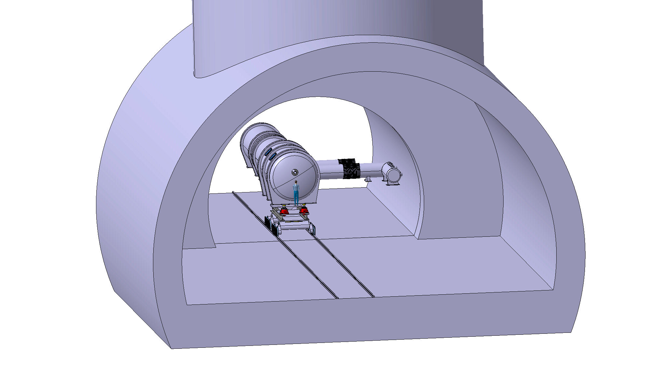
Tunnel – first look
Tunnel diameter 15 m
Tunnel height 10 m
Installation shaft diameter 16 m, can be less if defined by the first section(L ≈ 7 m) of the target and capture installation
Shaft cavern diameter 26 m
Shaft cavern height 15 m

Slide 25
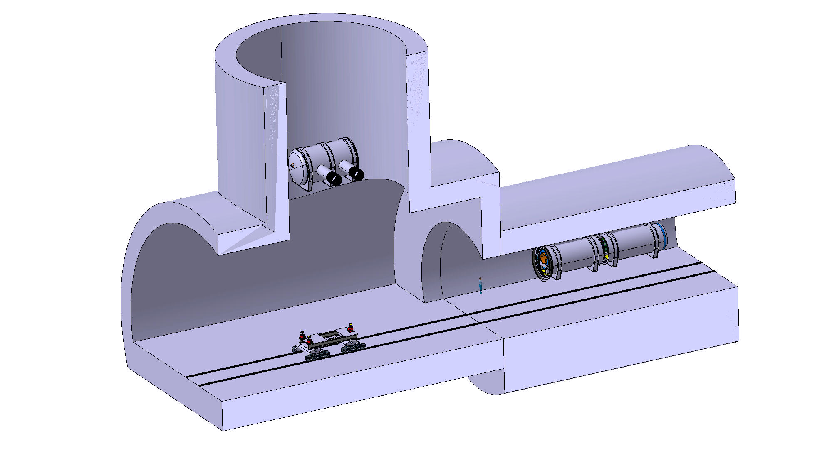
Installation
200 T crane required to lower the sections to the tunnel

Slide 26
Installation
200 T crane required to lower the sections to the tunnel
Rail carriages to transport sections

Slide 27
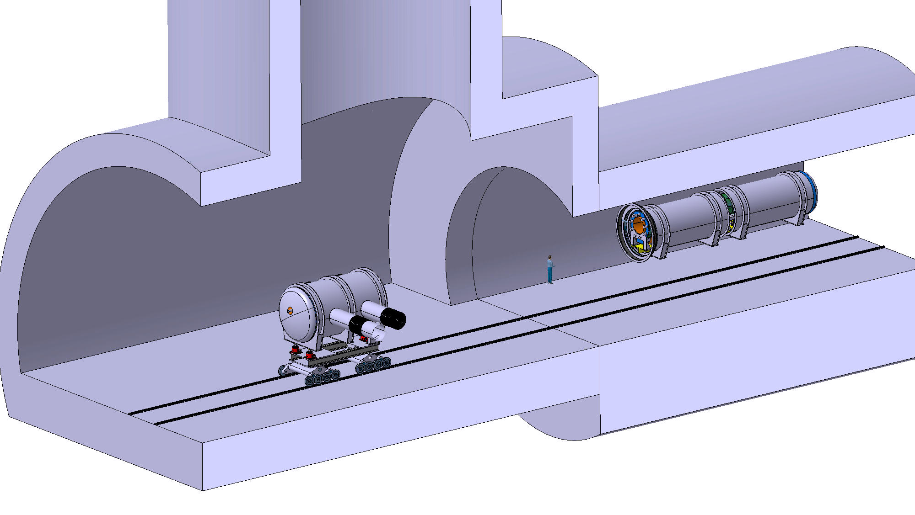
Installation
200 T crane required to lower the sections to the tunnel
Carriage drive system to be defined
Transport sections one by one to rough position
Alignment system for final positioning
Connection of the three sections and all services
Rail carriages to transport sections
Past layout studies R. F. Ximenes et. Al, 1st Muon Community Meeting

Slide 28
Conclusions
A preliminary integration study of the target solenoid assembly has been performed:
  Muon collider target and capture assembly is 19 m long and 320 - 350 T cryostat which could be divided into three sections, max 160 T, for handling and installation
  A preliminary supporting system for coil and cryostat is proposed: cold masses of 85 T, 22 T and 12 T requiring robust cold supports allowing also thermal contraction
  Coils are protected by a > 100 T tungsten shield requiring active cooling and room temperature supports inside the cryostat
  Beam vacuum system may include a 15 m chamber requiring large space for assembly, target service would also need a significant space
  Very high magnetic field may lead into issues with cryostat instrumentation and equipment
  High radiation levels are expected. How to service sub-systems during the lifetime? Disposal at the end of the life?
Updated design after defyning final parameters: maximum dose on the coil→minimum shield volume→coil aperture→ thermal shield and cryostat

Slide 29


Thank you
for your attention!
Your questions please?

