Slide 1



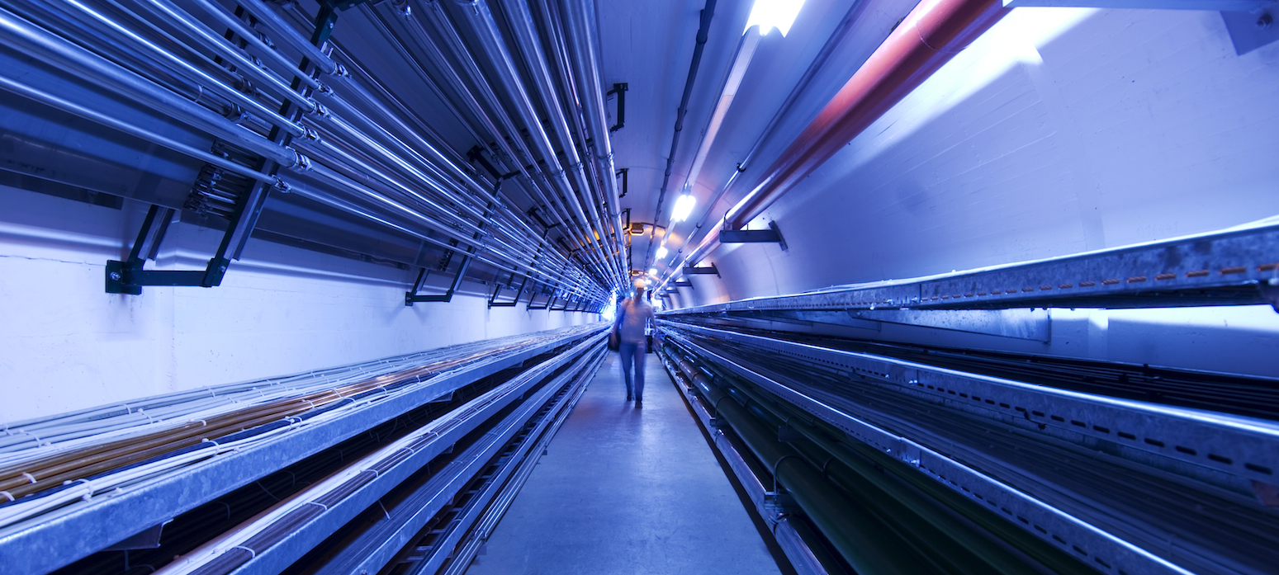
IMCC Annual Meeting 2023 - Orsay
Design of the target system and shielding
by Rui Franqueira Ximenes (CERN-SY-STI-TCD)
M. Calviani¹, F. Saura¹, Christophe Y. Mucher¹,
Anton Lechner, Daniele Calzolari
CERN – Systems Department, Sources Targets Interaction (STI), Targets Collimators Dumps (TCD)
2023/06/20

Slide 2
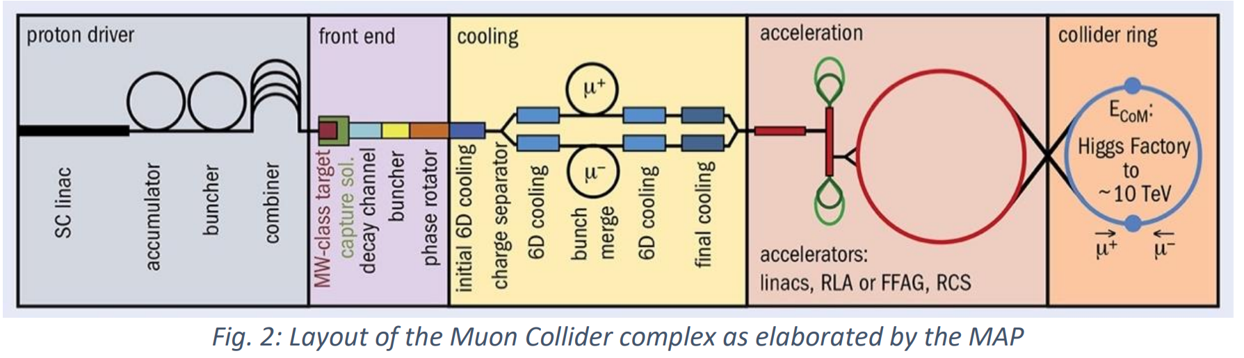
Outline
WP4.2 - Target system development
Establish a baseline target
Identify technological limits and R&D.
Define a system conceptual design
Estimate pion yield, target lifetime, heat load on the surrounding magnets.
Define the required shielding and associated magnet aperture

Slide 3
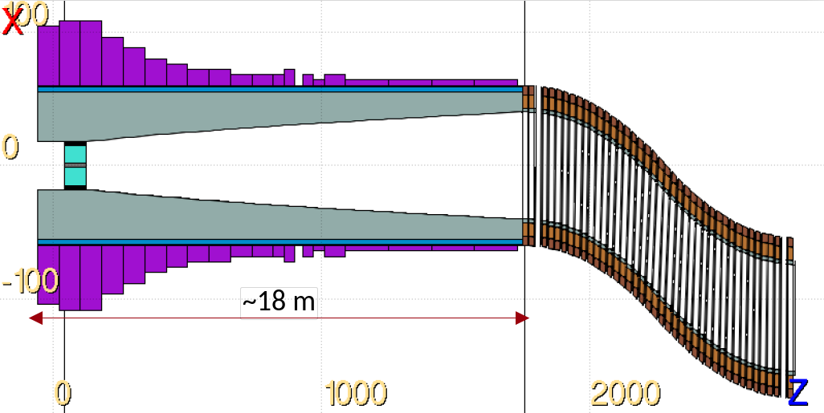
Carbon target & target systems considerations
  Energy deposition & dpa studies on the Target, windows, shielding, magnets, chicane
  Parameterization study in view of pion/muon yield optimization
  Conceptual Engineering study of Target & Target Systems, shielding, p+ dump -> feasibility
  ++ iteration loops with p+ driver, magnets, cooling
Production target
Eventually p+ dump
Chicane
Tapering region

Slide 4
TARGET SYSTEM & SHIELDING
DESIGN & INTEGRATION

Slide 5
Target System & shielding
Thermal Radiation shield
Non cooled shielding
HTS
water moderator
Neutron absorber (water and boron carbide layer)
Shielding He coolant (RT)
Shielding (Tungsten)
Stainless Steel Shielding vessel
548
590
Stainless Steel wall
Vacuum
Target He coolant (RT)
Titanium Outer Vessel
Cooling Helium
171
P+ Beam
170
Static Helium
150
R15
C-Target
Outside solenoid cryostat
To be optimized with WP4 & WP7
Inside solenoid cryostat
Target Titanium vessel
800
Target p+ beam pipe
5

Slide 6
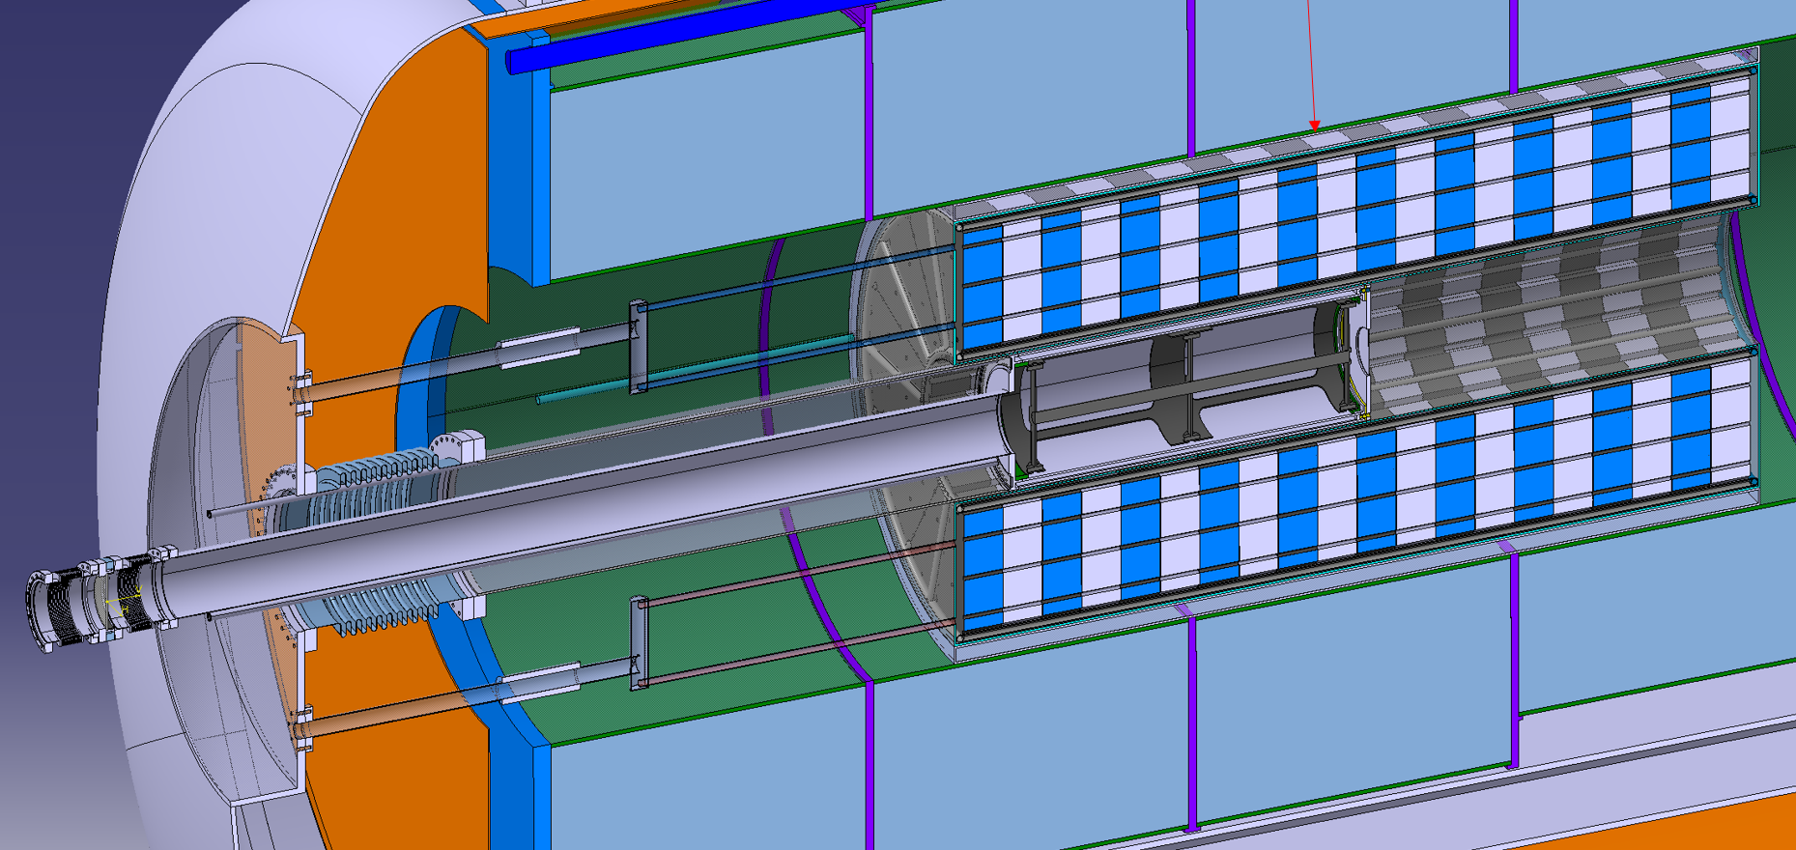
Carbon Target Systems
*Solenoid cryostat design >> See Carlotta Accettura & Antti Kolehmainen
presentation (WP7)
Integration of Target System in cryostat*
6

Slide 7
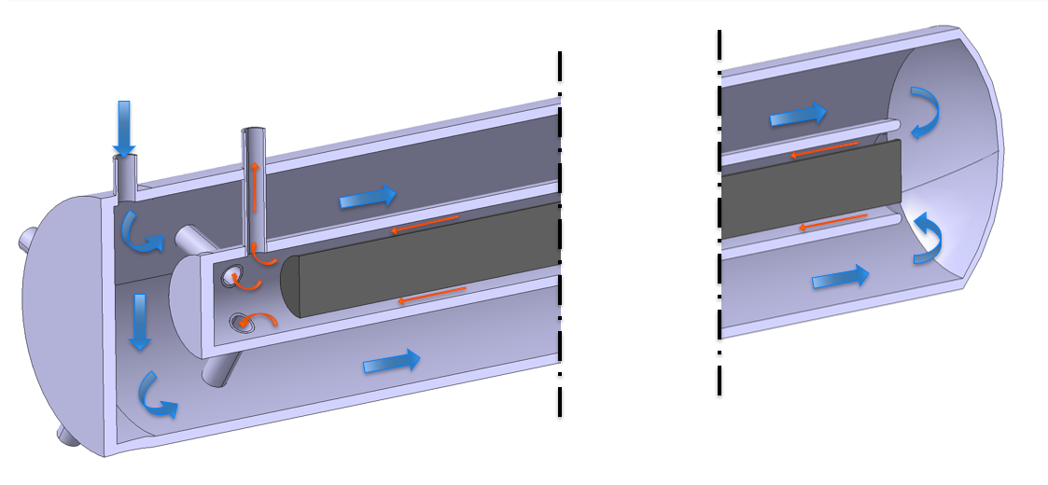
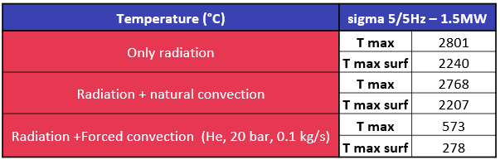
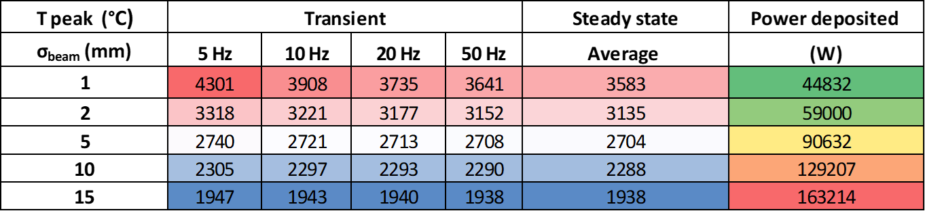
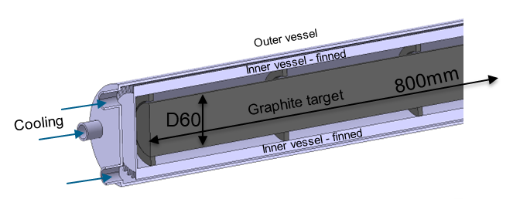
Carbon Target: engineering feasibility
Direct cooling considerations
Maximum temperature and power deposition for 1.5 MW as function of the beam sigma.
Old concepts
  Target Cooling
  Due to high T and sublimation of graphite, an enclosed ‘pressurized’ atmosphere is required.
  However, active cooling can be made indirectly. Heat dissipation mostly via radiation and natural convection. → target confinement / separation of cooling system is advantageous (maintenance, RP, disposal, cooling services requirements).

Slide 8
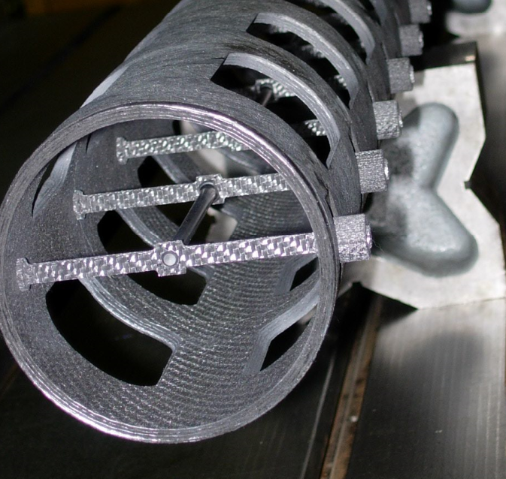
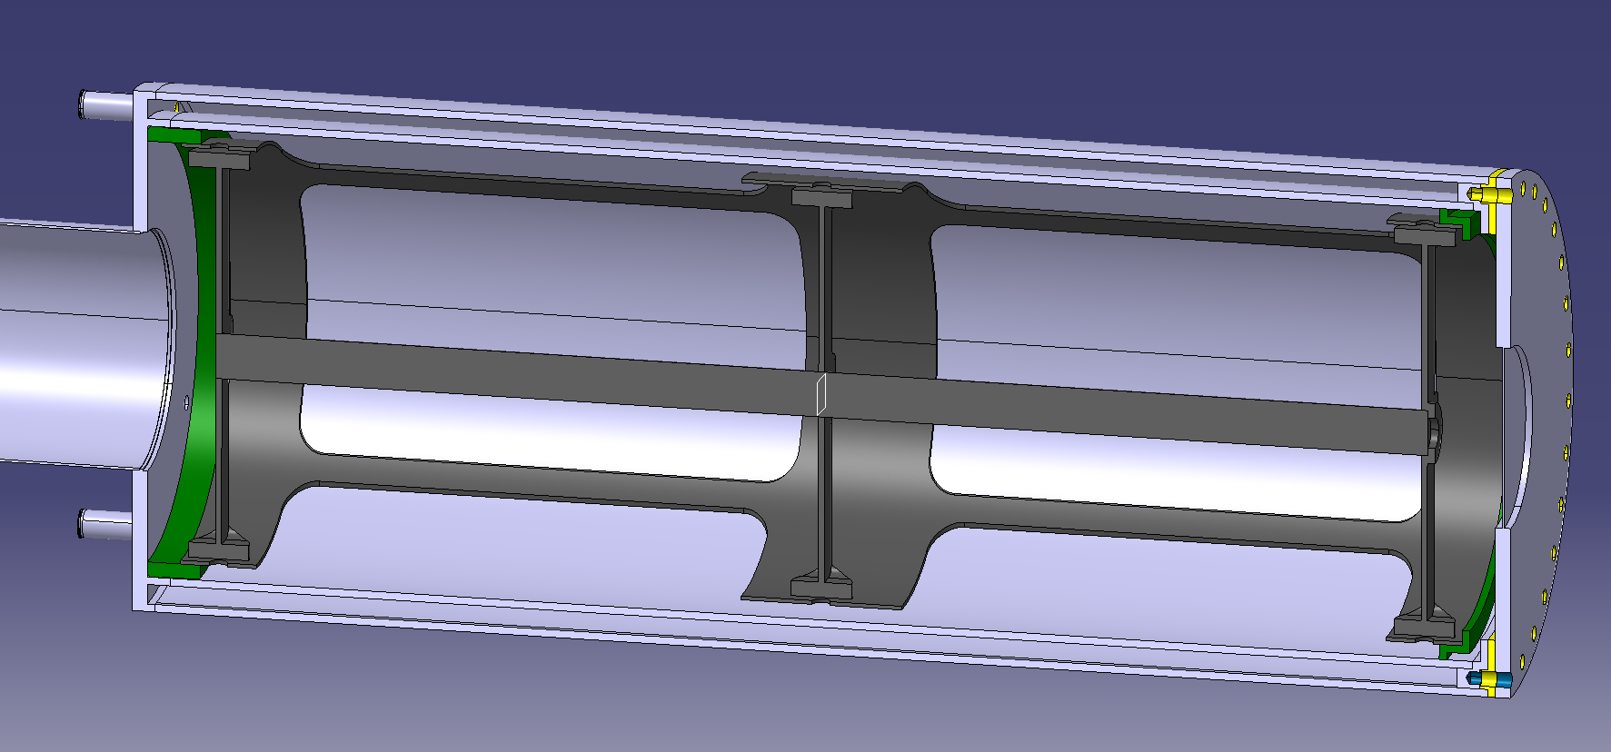
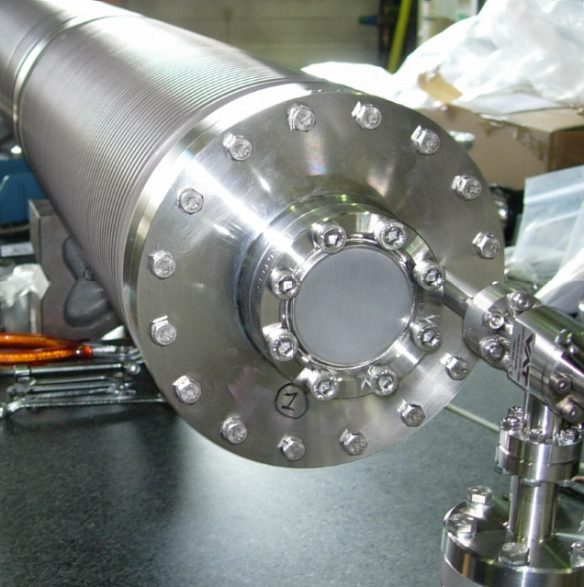
Carbon target
Water OR Helium cooling connections
Inner vessel
Outer vessel
P+ Beam
Static He
Static He
Target beam pipe
CERN’s CNGS Target
Flange
Muon/ Downstream Beam window
Welded connections
Target rod
Target support structure
Centring rings
Vessel support
8

Slide 9
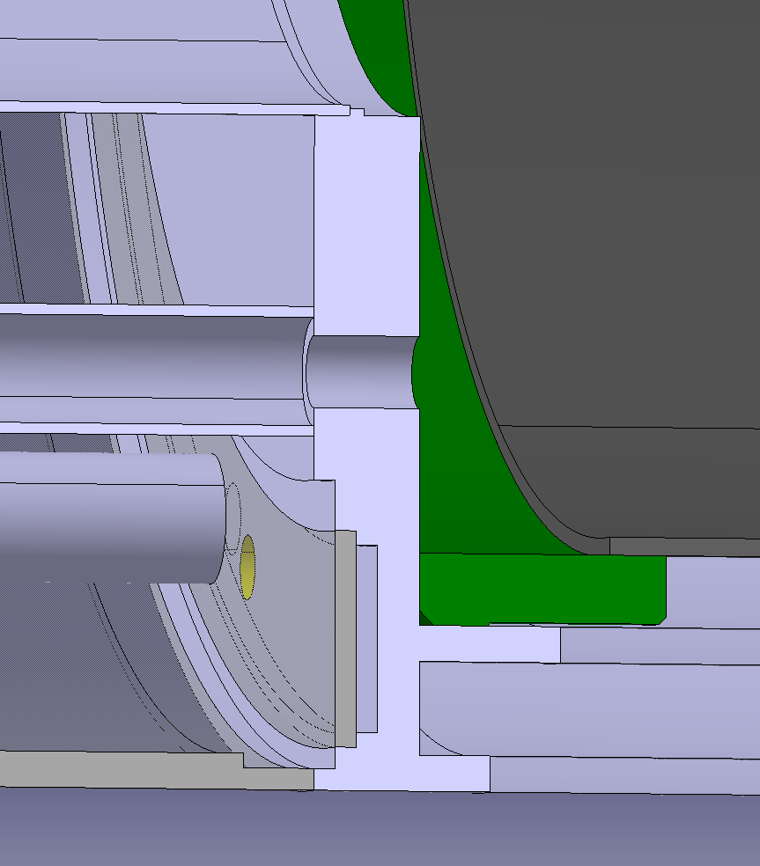
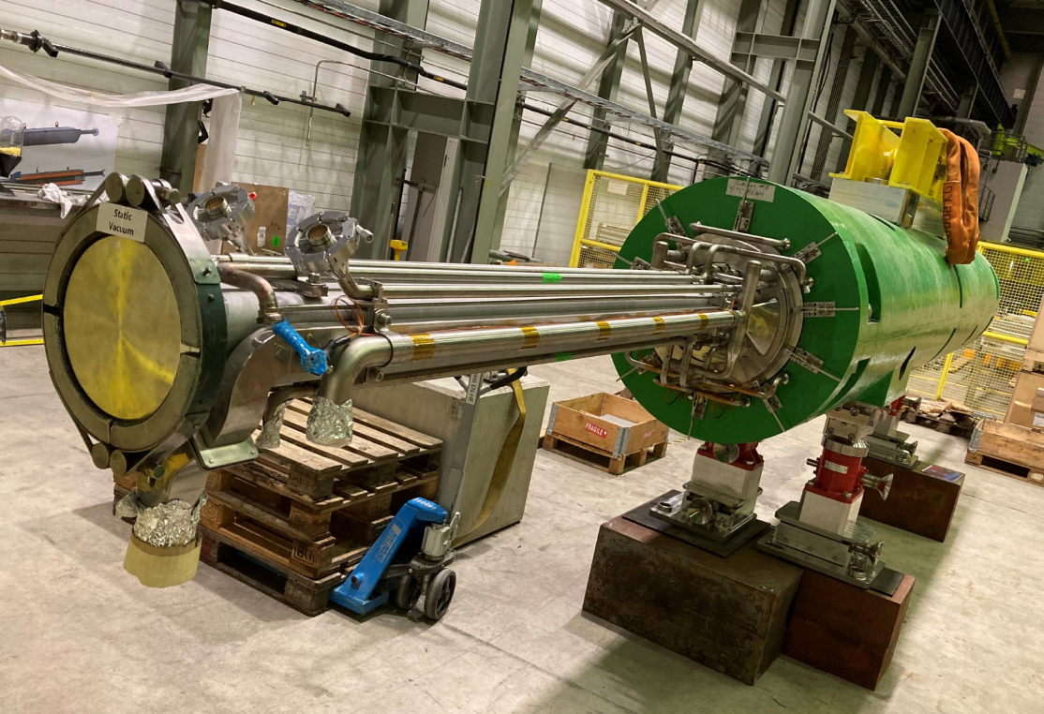
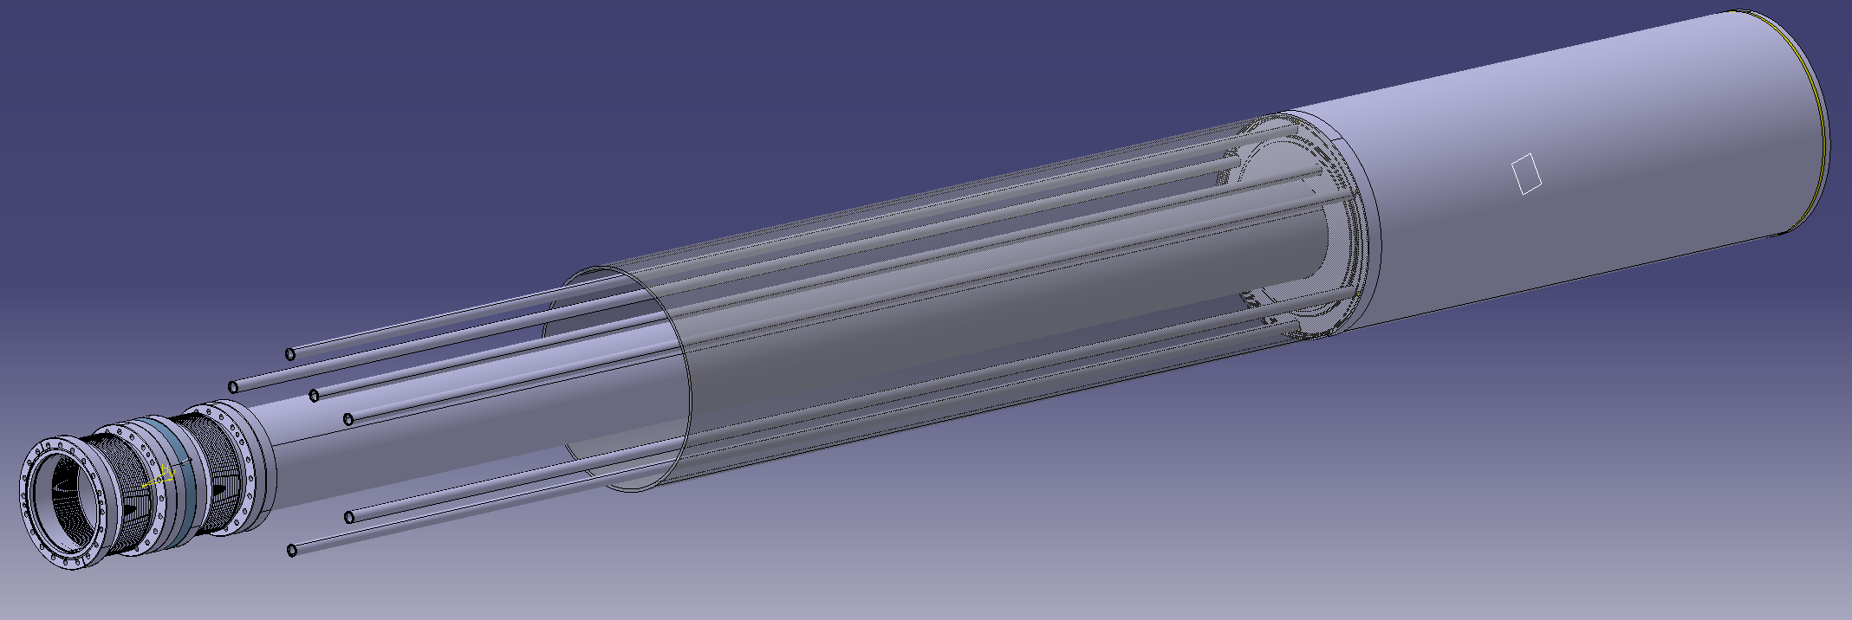
Carbon target
Look-alike services routing at CERN’s SPS internal dump (TIDVG5)
Target cooling system routed upstream.
Either contained in outer tube or “free”
All welded connections, except downstream target flange
Plenum for He distribution
Inside solenoid cryostat
P+ window outside cryostat assembly
More accessibility for maintenance, replacement, etc
Outside solenoid cryostat
9

Slide 10
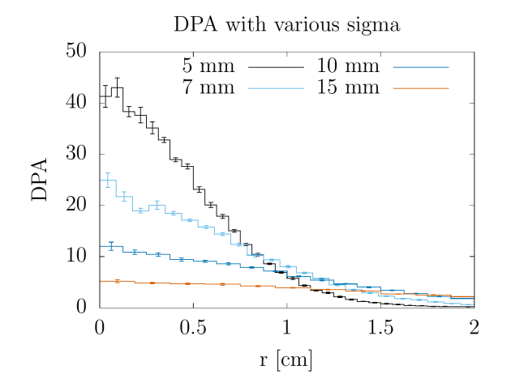
Beam windows
Carbon Target
DPA on proton beam window.
Ti, 2 MW, 200 days of operation
  For these beam parameters, C-Target seems feasible.
  However, for the p+ beam window :
  Fatigue: extensive load cycles to be experienced by the target & windows (10⁸ /y) at very high temperature.
  DPA: >>1 dpa levels on the beam windows.
    Possible strategies: windowless, blown-up beam somewhere upstream, dual bunch, rotating window “dilution”, frequent window exchange.
  High power deposition: 50-650 W (0.1 – 1 mm)
DPA on proton beam window.
Be, 2 MW, 200 days of operation is approximately 50x lower! Work on going

Slide 11
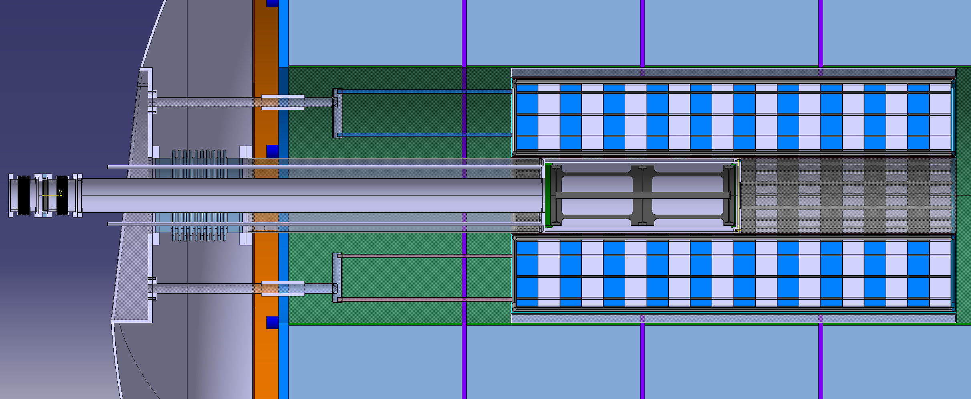
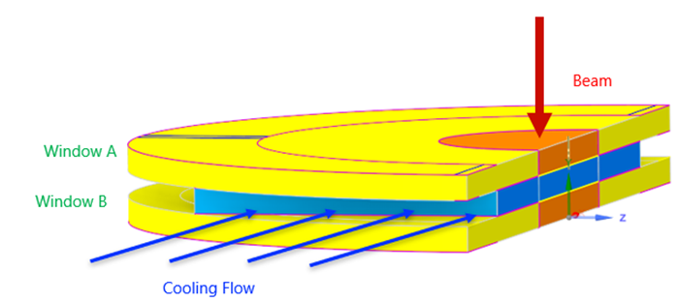
Beam windows
P+window
Location:
  P+ window outside cryostat assembly
  More accessibility for maintenance, replacement, etc
Beam dilution
  Mechanical dilution (window moves periodically)
  Beam position change
  Wide beam spot size. How much is reasonable?
  Multi bunch pulse?
Materials
  Low density. Be, Al, Glassy Carbon?
  Radiation damage robustness. Inconel 718 ?
Cooling
  Dedicated, shared with Target?
Beam window
Cryostat
P+
Carbon Target
……
11

Slide 12
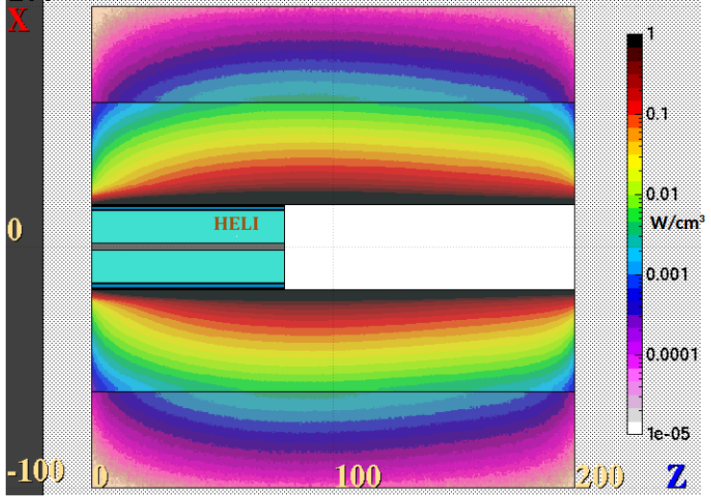
Target Shielding
Energy deposition
The energy deposited on the target is only 5.6 % (D30xL800 mm) of the total beam power
Most of the thermal energy is deposited on the shielding (33.7 %).
Parameter | Thermal power | % of Beam Power
Shielding | 674 kW | 33.7 %
Target | 111 kW | 5.6 %
Ti Vessel | 24 kW | 1.2 %
Water* | 11 kW | 0.6 %
Helium** | ~0 kW | ~0 %
TOTAL | ~820 kW | ~41 %
2 MW
Beam power
Power deposition provided by Daniele Calzolari SY-STI-BMI
https://indico.cern.ch/event/1176034/contributions/4939053
*New baseline is He cooled Target
**He coolant of the shielding

Slide 13
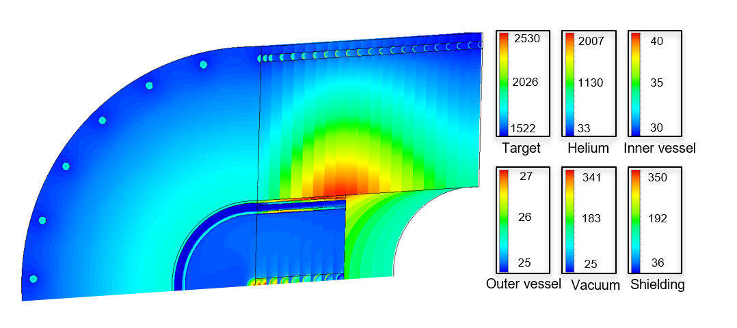
Target Shielding
Water cooled
Shielding water cooled
Cooling of the shielding is required but not a showstopper
Example of reasonable parameters: (1.5MW, initially study)
Target
Annular RT water @ 3m/s
Max T = 2530 °C
Al vessel max T: of = 40 °C
Shielding
26 pipes w/ RT water @ 3m/s
max T = 350 °C
External max T = 80 °C
Challenges
Radiolysis
Pressure bursts during pulse
Requirement of corrosion-erosion protection of W
1.5 MW (initially assessment)

Slide 14
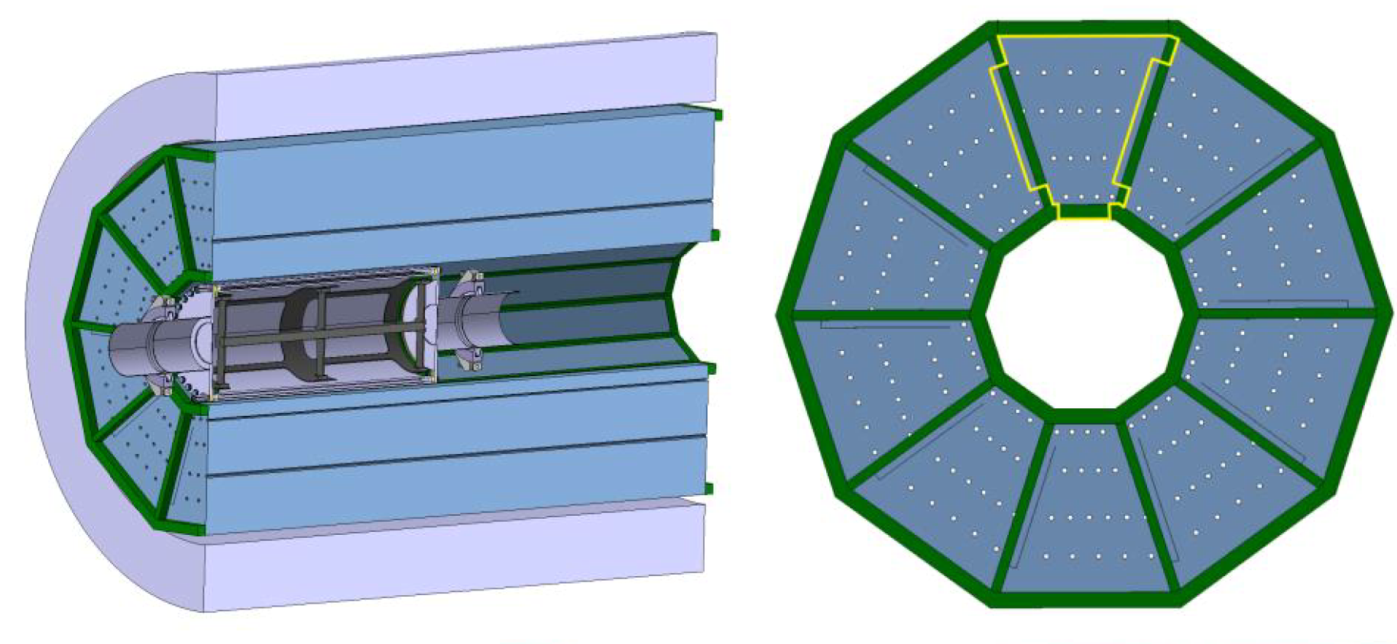
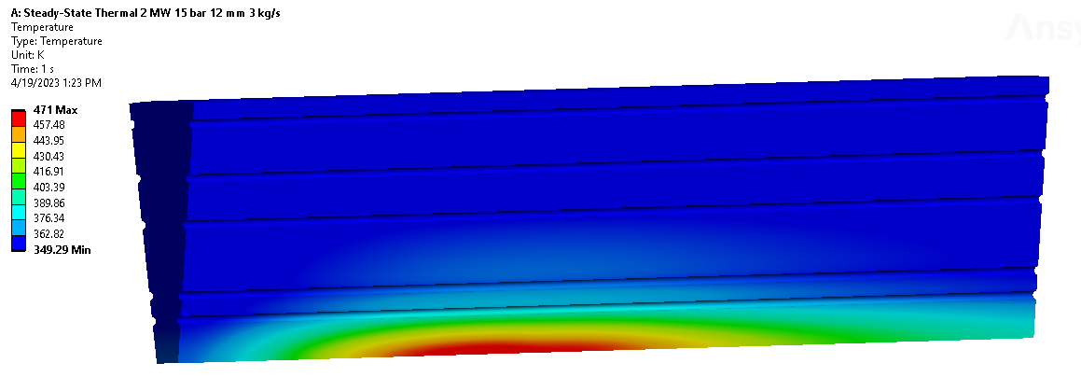
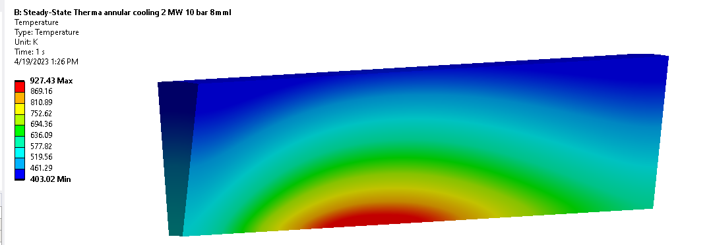
Target Shielding
Shielding He cooled: Feasible for 2 MW
Shielding “pie slices” + He via holes
He (gas cooled, 3-5kg/s at few bar)
Frame with 40 mm square SS profiles
Temperatures below 100 °C
He cooled
Shielding “pie slices” + He in outer Diameter
He (gas cooled, 3-5kg/s at few bar)
Frame with 40 mm square SS profiles
Temperatures 150 – 750 °C
Shielding “donuts” + He in pipes & outer Diameter
150x D5mm pipes; 0.0022 kg/s/pipe; 10 bar; Mach 0.1 (high HTC); 570 C max W temperature.
Tunning cooling parameters (HTC, pressure drop, speed, mass flow)
>> See Francisco Esteban presentation tomorrow

Slide 15
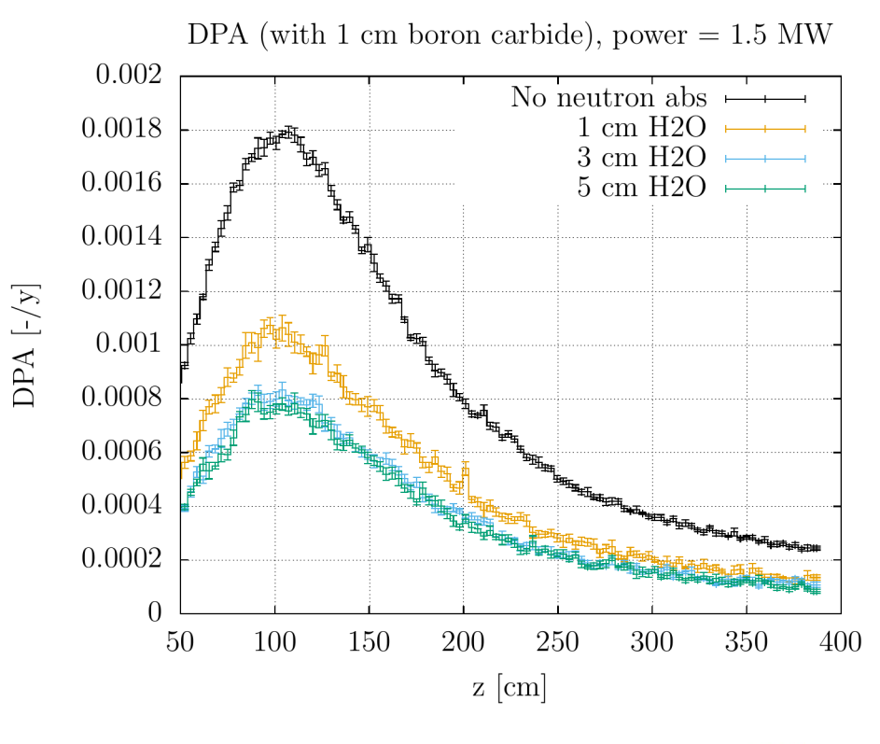
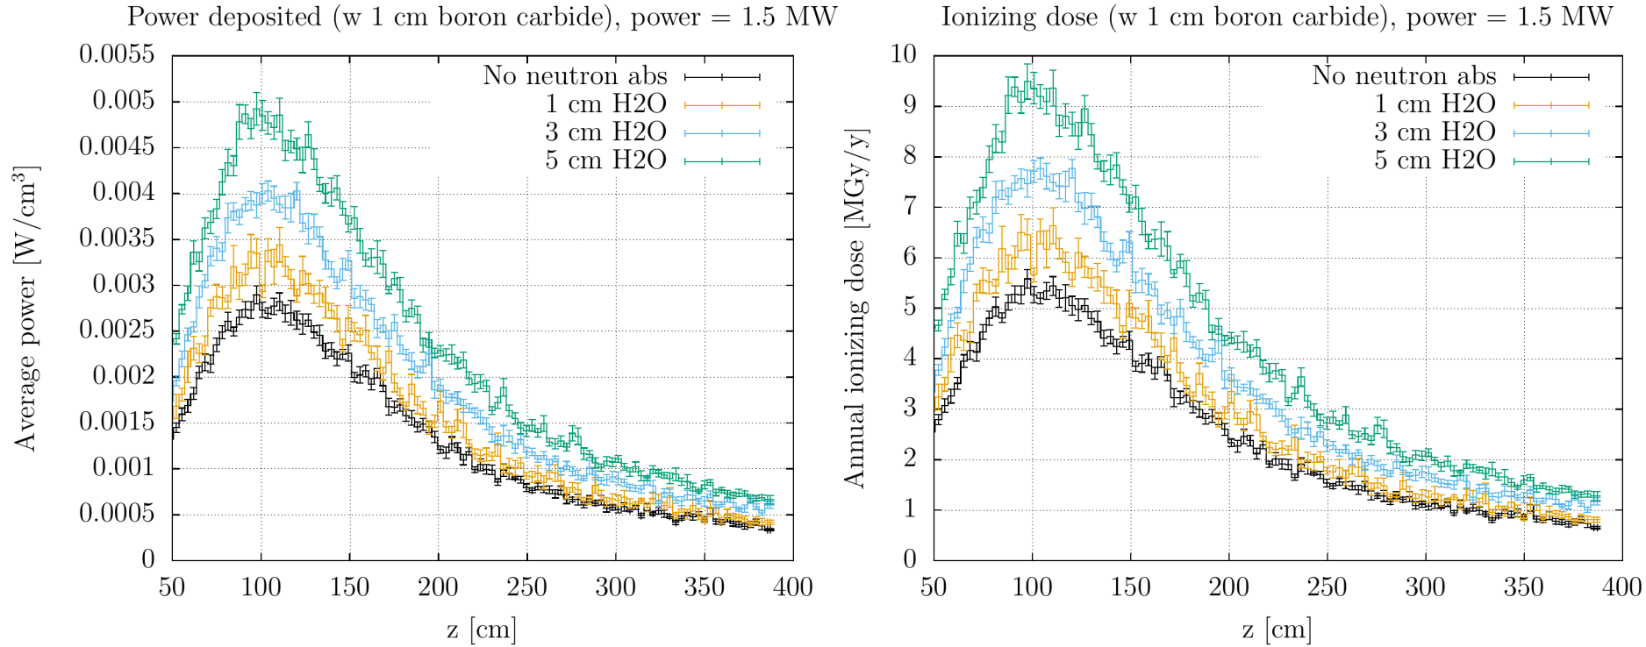
Target Shielding
Possible optimization to reduce radiation damage in HTS coils:
With neutron absorber, DPA reaches values of 8×10⁻⁴ DPA after 1 year
However, due to less W the Ionizing dose increases: >70 MGy after 10 years (3 cm H2O)
1.5 MW (initially assessment)

Slide 16
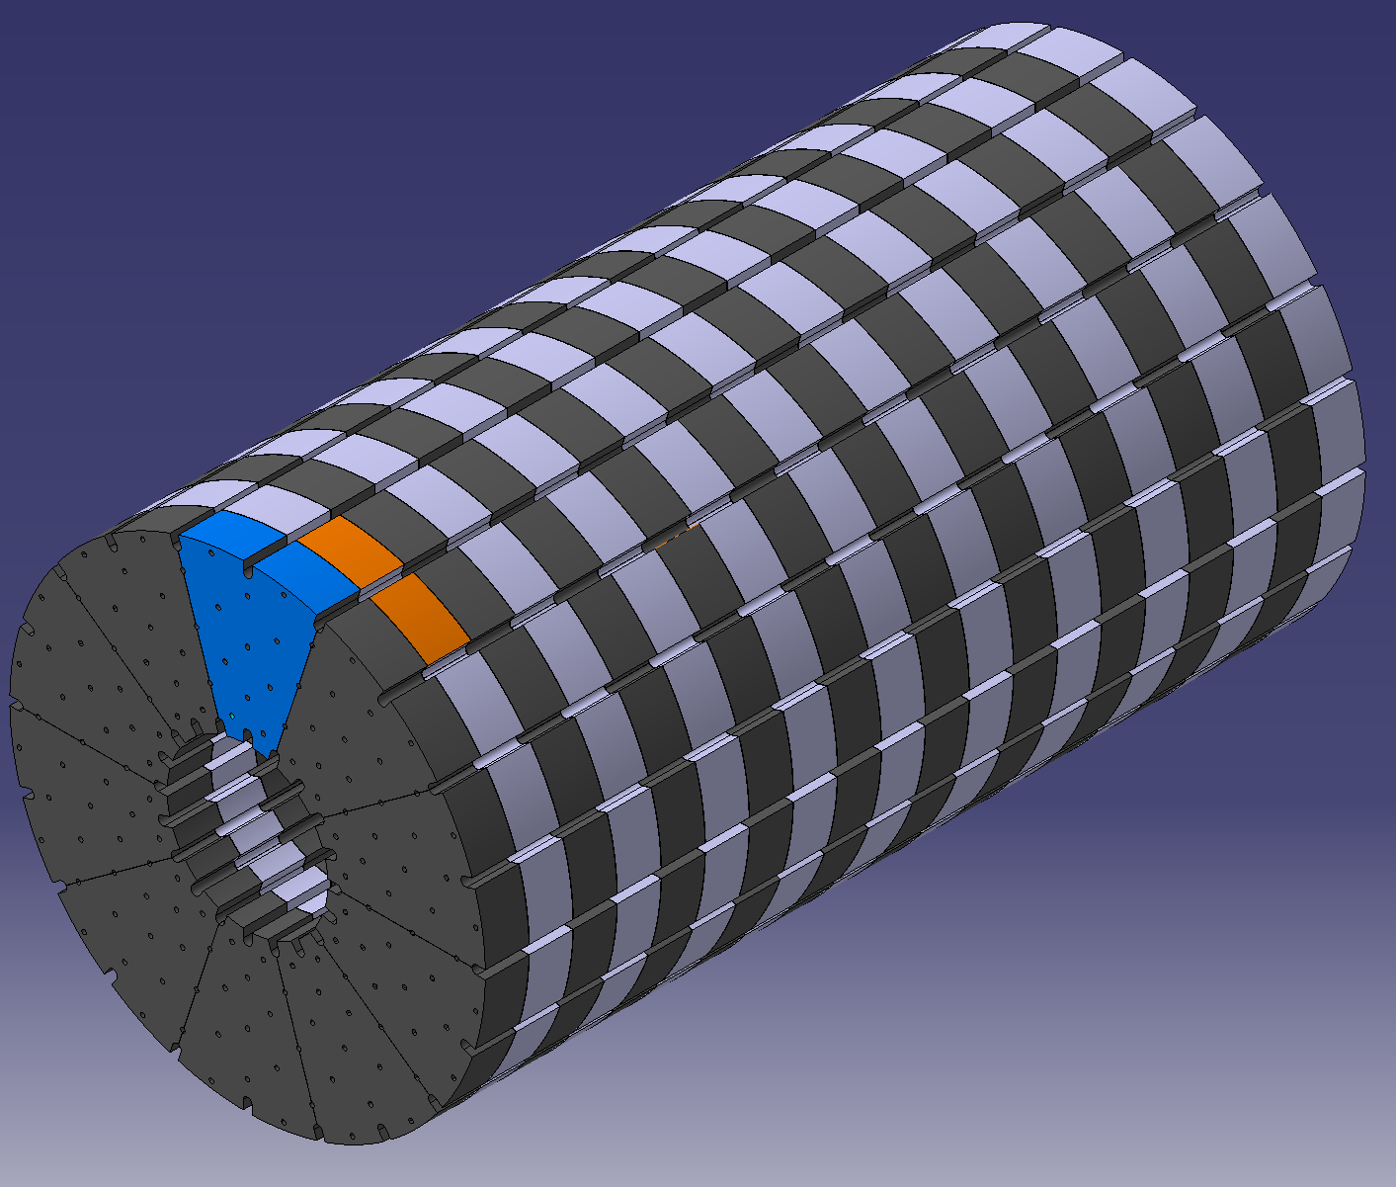
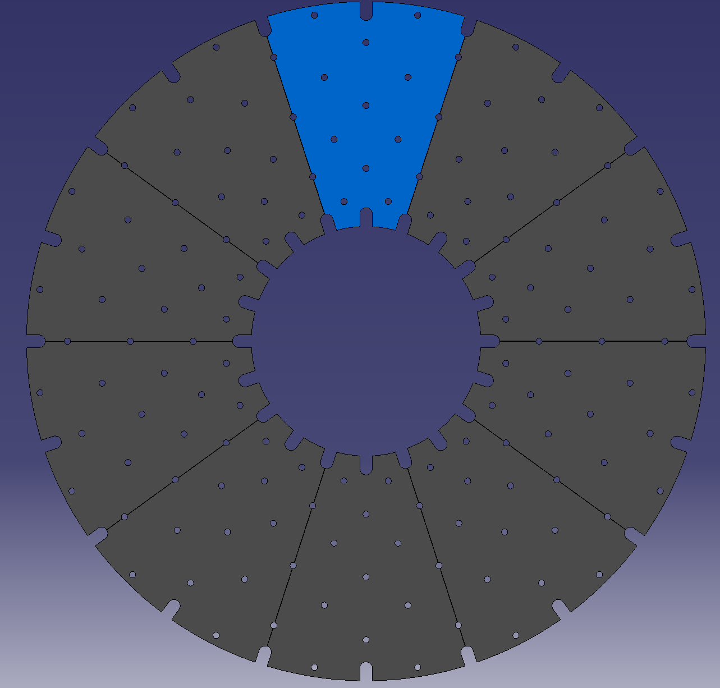
Target Shielding
Considerations
Material choice (W, W heavy alloys)
Manufacturing & machining
Handling
Integration of cooling system
Shielding assembly
Conceptual Design
Donut + Pie blocks due to manufacturing limitations & to ease assembling.
Inner holes for bulk cooling. Return circuit on the outer radius.
Longitudinal slots for locking & alignment pins.
…
16

Slide 17
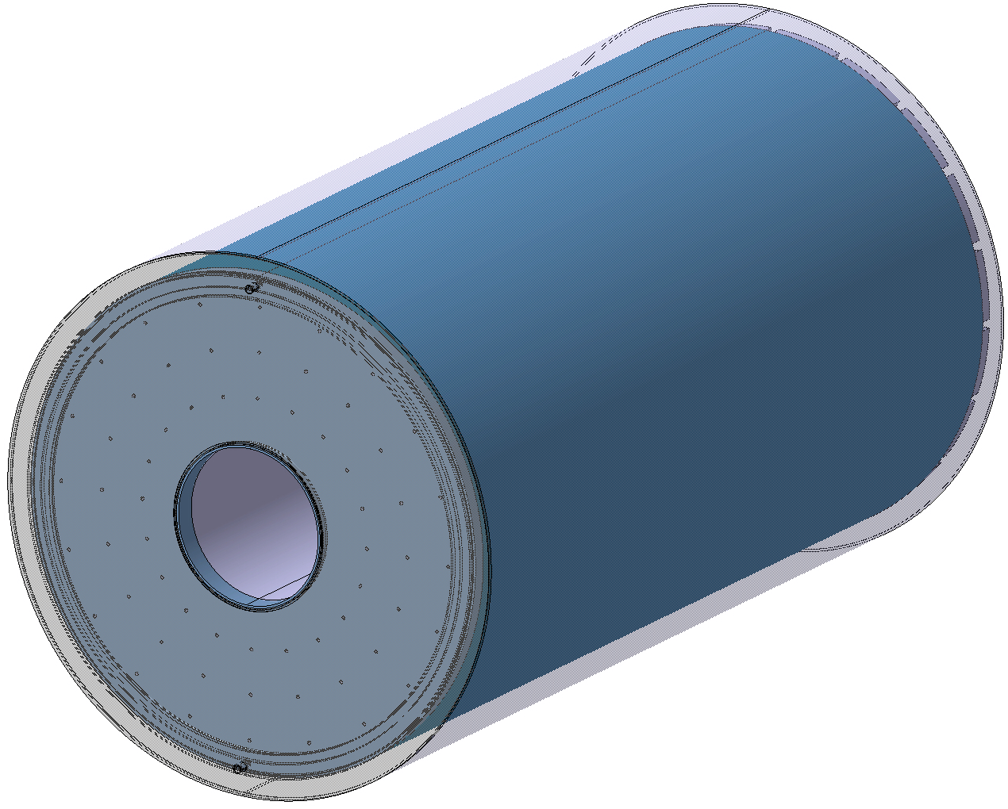
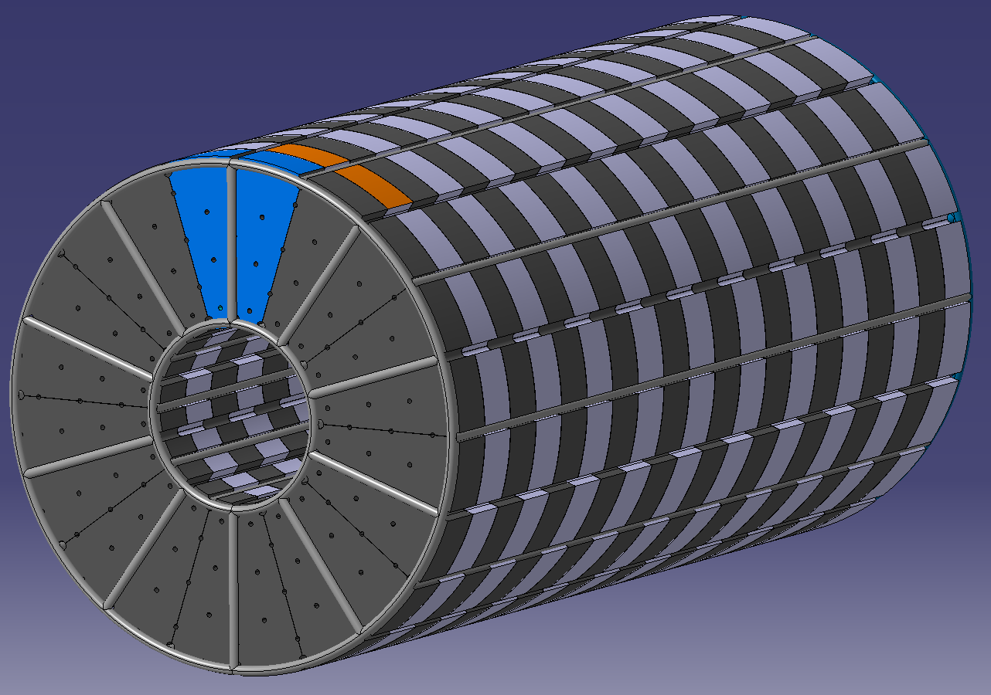
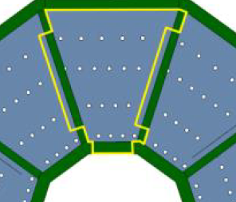
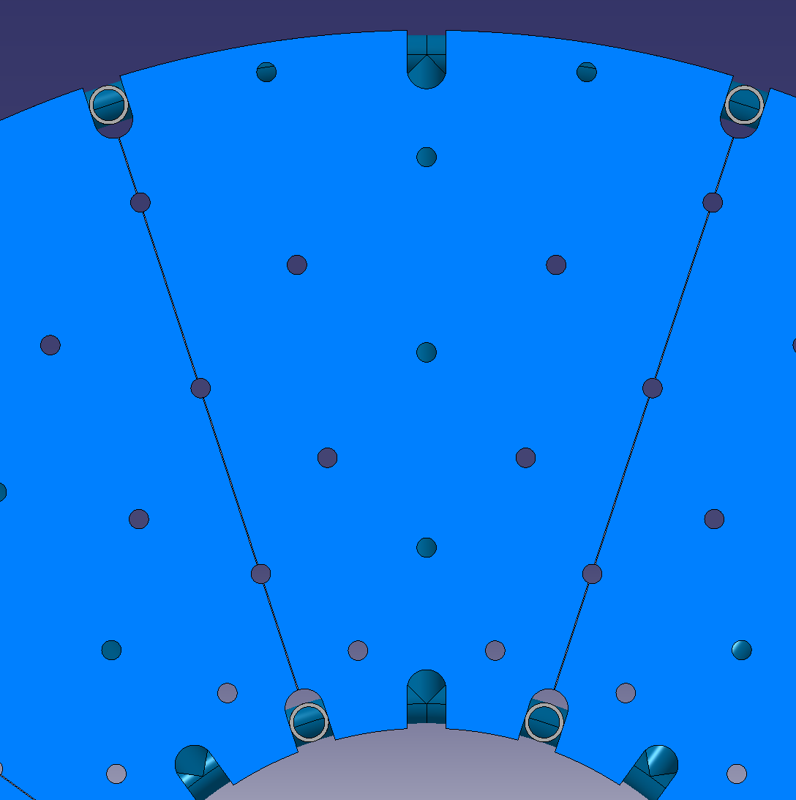
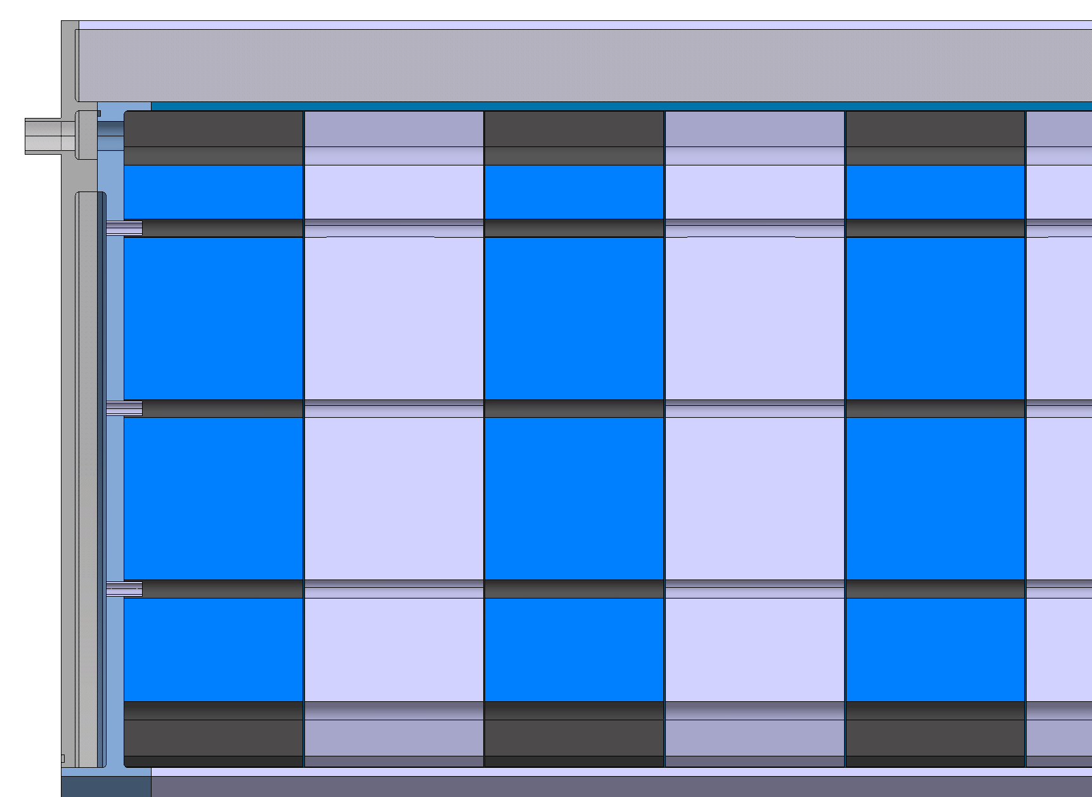
Target Shielding
Boron carbide
H2O moderator
He return outlet
Conceptual Design
Holding the assembly (23 tonnes).
  Self-holding assembly, e.g. puzzle-like shape.
  Alignment pins & structural rods
He distribution
Water moderator & neutron absorber
Inlet guide plate & tubes
He plenum
17

Slide 18
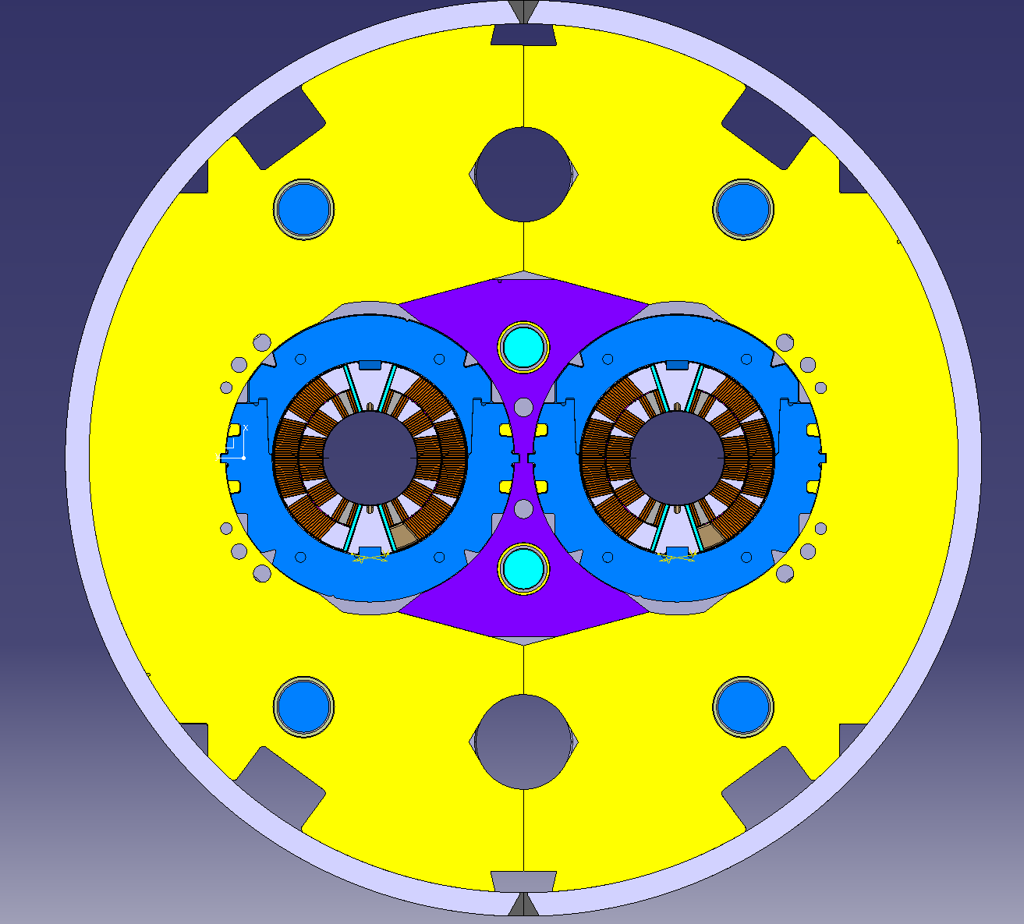
Target Shielding
Shielding vessel
Two half-shells pressed and welded; Loose fitting seamless/welded, other..
Shielding (vessel) supported via structural beam+ feet at the extremities of the cryostat. Avoid mechanical and thermal load on the solenoid
e.g. 11 tesla magnets pressed + welded half-shells
18

Slide 19
Conclusions
Main objective is to have a high-level design, integrated with WP3 and pinpoint key design, manufacturing and integration directions. Potentially identify key constrains and limitations of the whole assembly and possible prototyping directions.
Conceptual 3D design of the target systems & integration in the solenoid cryostat just started.
  Mostly de-coupled Target and shielding assemblies
  Services routed upstream. Fine integration of connections with the cryostat vessel is required
  Target assembly with p+ beam window outside cryostat for easier maintenance/replacement & possibly to allow implementing a solution for the high yearly radiation damage & thermal power during operation.
Integration of P+ dump to be addressed.
19

Slide 20

Thank you
very much for your attention

Slide 21
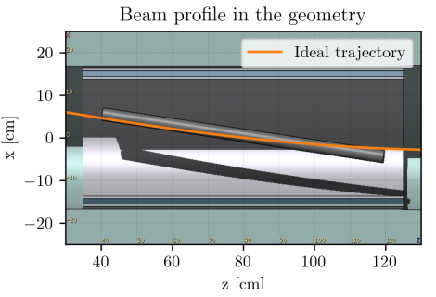
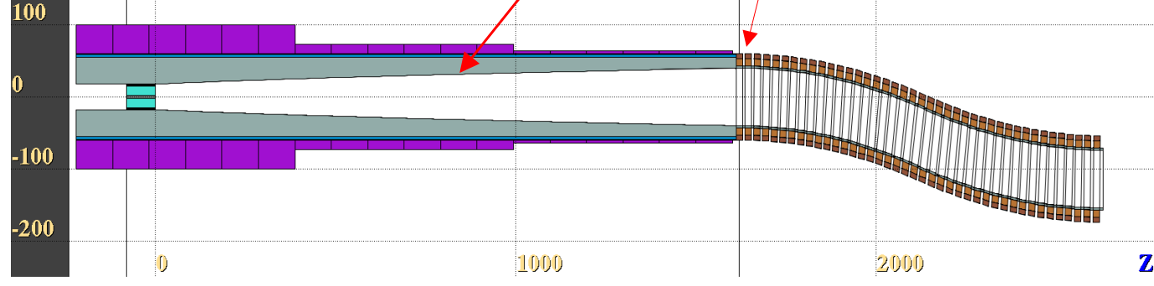
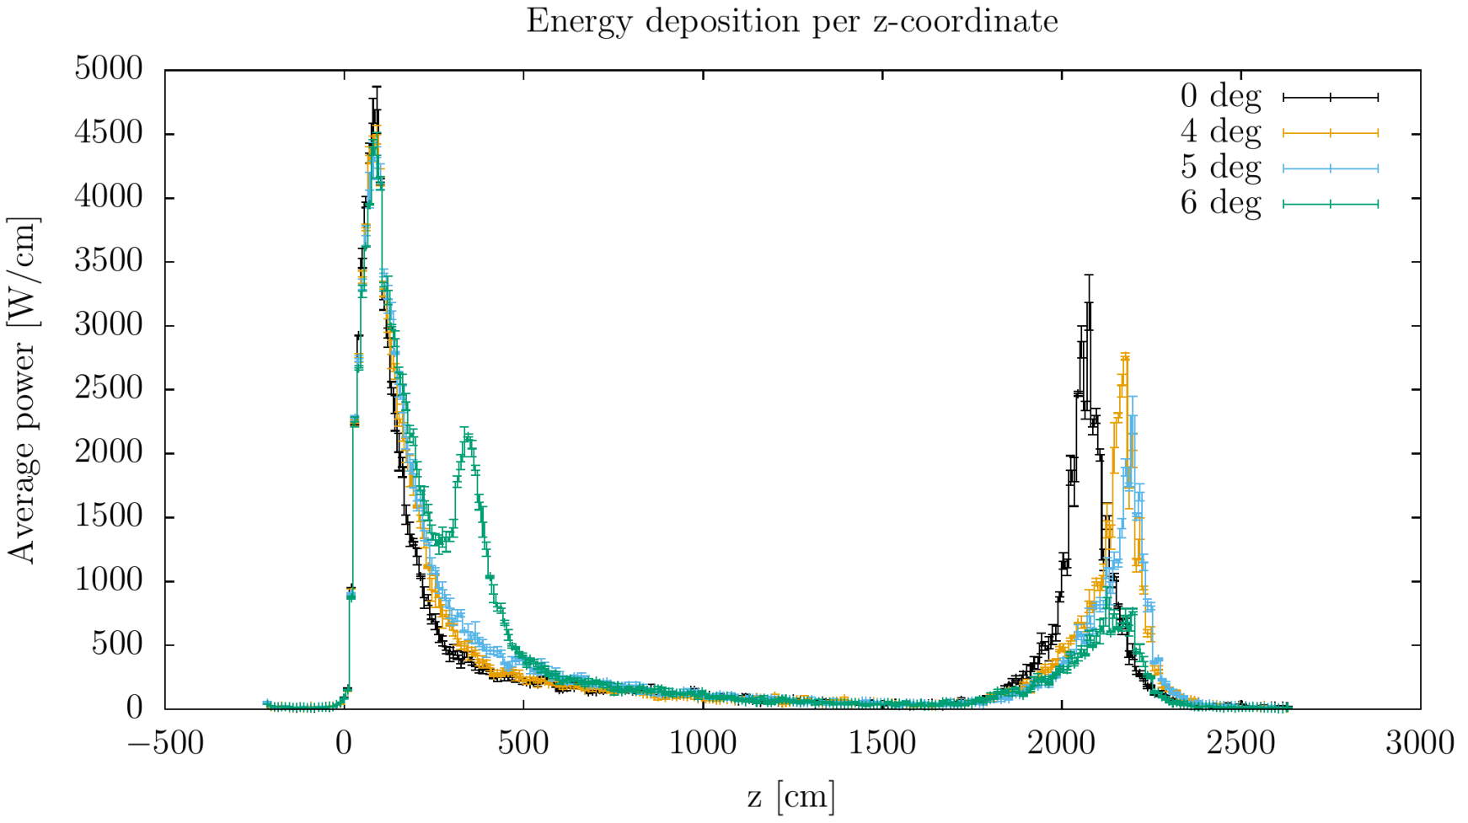
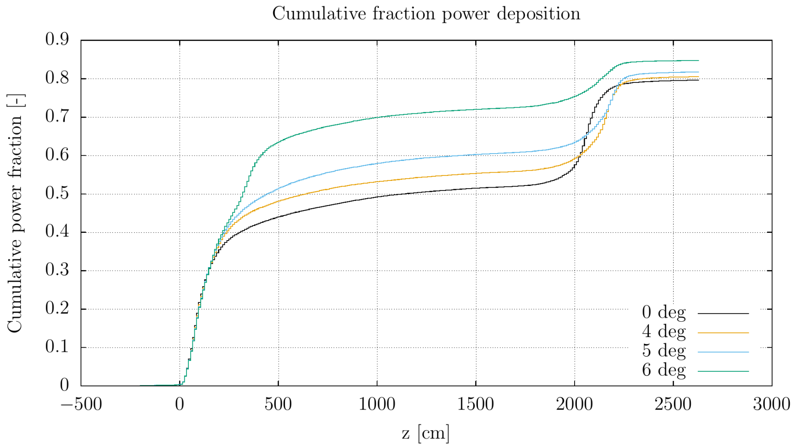
Proton dump beam extraction
  Extraction in the chicane is very challenging.
  Tilted beam required to extract in the tapering region

Slide 22
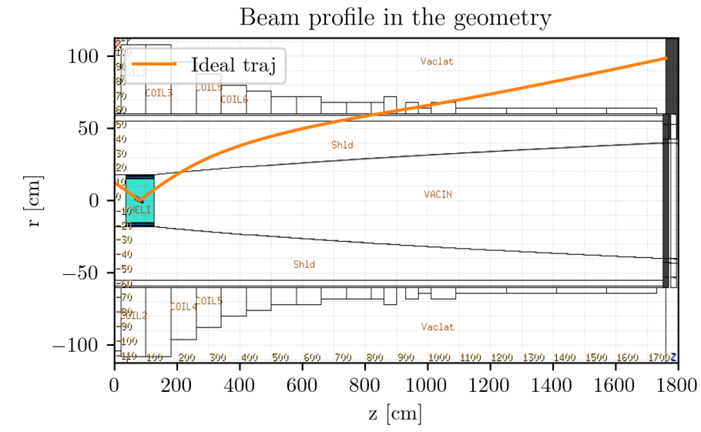
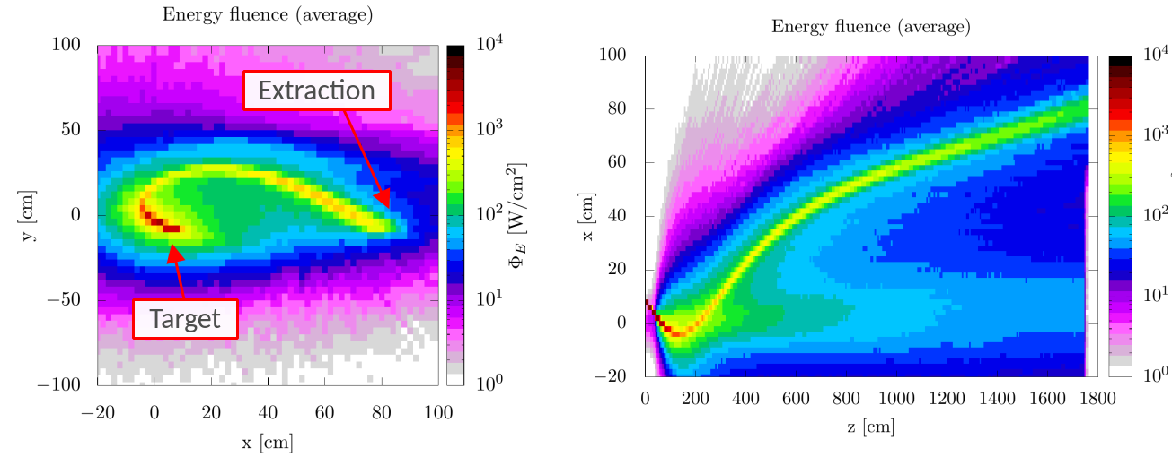
Proton dump beam extraction
  9 deg angle to extract before chicane.
  Integration with the magnets to be done (~10x10cm aperture)
  Target response to be checked
Particle fluence profile (axial direction & transverse direction)
by Daniele Calzolari https://indico.cern.ch/event/1256505/contributions/5277355/

Slide 23
Conclusions
Interaction between different groups (proton driver, magnets, target, muon cooling, service groups) is key for efficient feasibility studies and optimization.
Possible to select range of beam parameters compatible with C-Target (both thermally and structurally). Pion/muon yield near optimal range following parametric study.
Fatigue and radiation damage will be a major challenge of a solid target and of the beam windows. Topic to be discussed in the framework of the RaDIATE Collaboration
Shielding design highly coupled with Target/solenoid design and respective radiation damage limitations. (O)700kW cooling needs for 2 MW facility.
P+ dump required. Challenging integration.
Feasibility of liquid lead target being studied (ongoing collaboration between CERN-STI & ENEA). Alternative for > 2MW range operation, but with challenges to be addressed.
W powder target studies to ramp-up, built on current experience at RAL.

Slide 24
Prospects
Develop the conceptual design of the target systems (Target, Shielding, cooling, etc) and its integration in the solenoid cryostat.
Address the high levels of dpa in the proton window & cooling needs.
Assess the mechanical response of the target vessel and shielding assembly.
Continue interaction/iterations with WP7 & WP3.
Carry-on the required energy & dpa studies through the target complex & provide pion/muon yield calculations to the cooling team.
Continue the development of the liquid Pb curtain target
Ramp-up fluidized W target studies

