Slide 1
High Gradient and Q-factor SRF Performance at 1.3 GHz and 650 MHz
Daniel Bafia
IMCC’23
June 21st, 2023

Slide 2
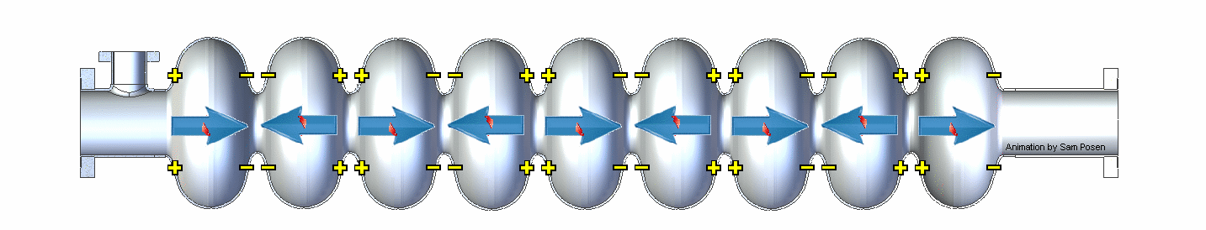
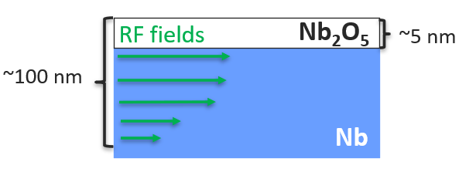
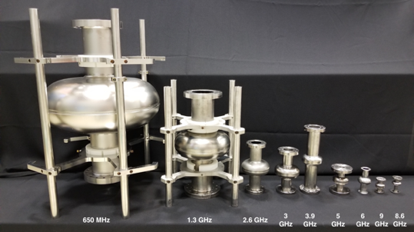
Introduction to Bulk Nb SRF Cavities
Nb SRF cavities: most efficient engineered EM resonators ever created
Mature, proven technology
  LCLS-II + HE
  EXFEL
RF power injected at resonant frequency
650 MHz – 9 GHz
Performance governed by microscopic properties within the first ~100 nm from inner surface

Slide 3
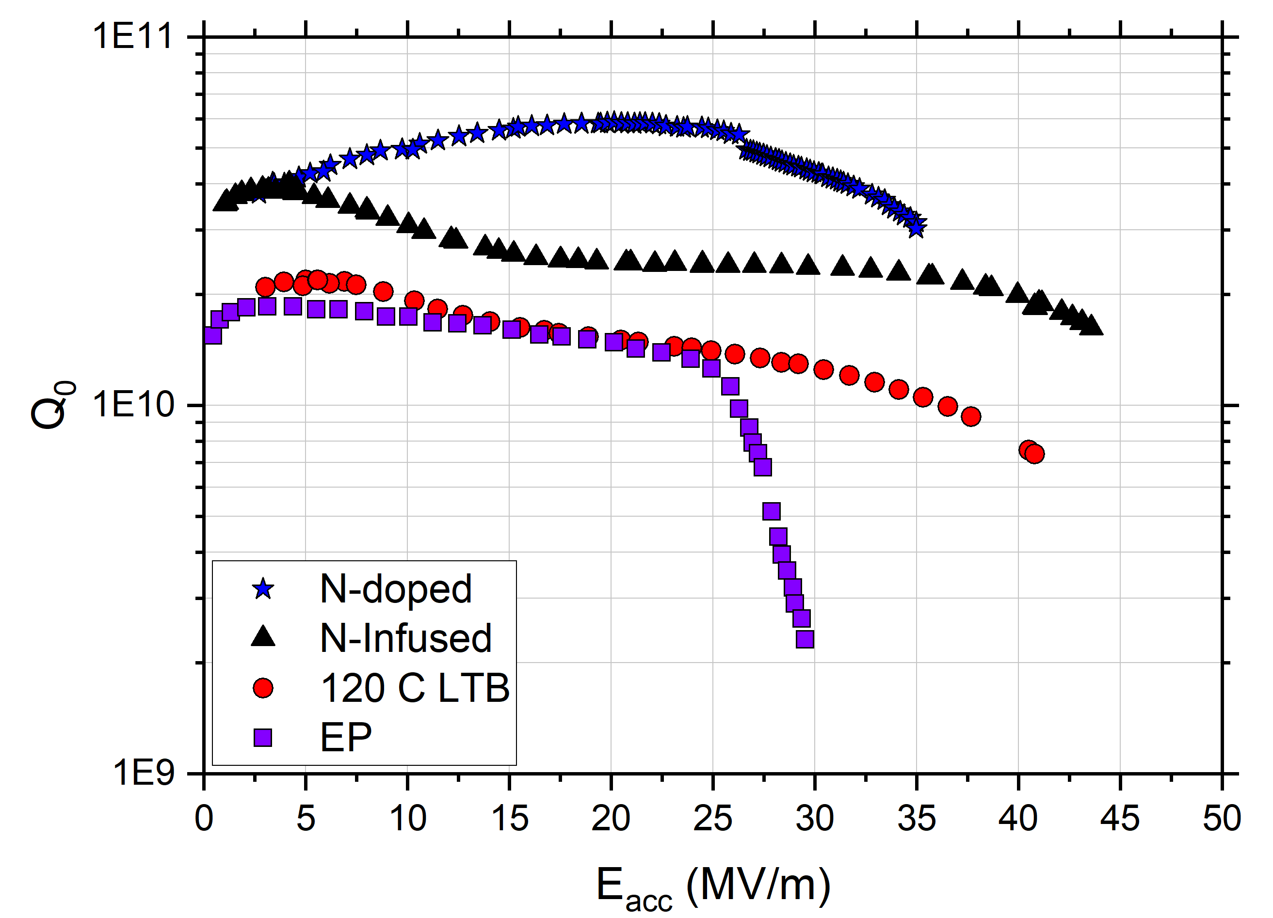
Surface Engineering of Nb SRF Cavities
Nb SRF Cavities Post State-of the-Art Surface Treatments
Goal of SRF research: tailor surface properties via chemical and baking treatments to yield high Q₀ and E_{acc}
  Higher Q → lower cryogenic costs
  Higher gradient → less $$$ OR higher energy
f₀ = 1.3 GHz
T = 2 K

Slide 4
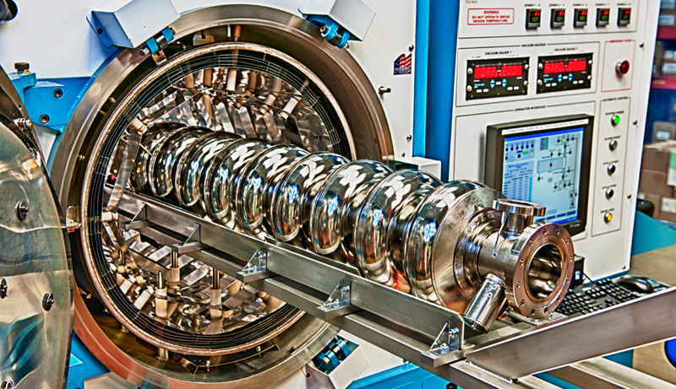
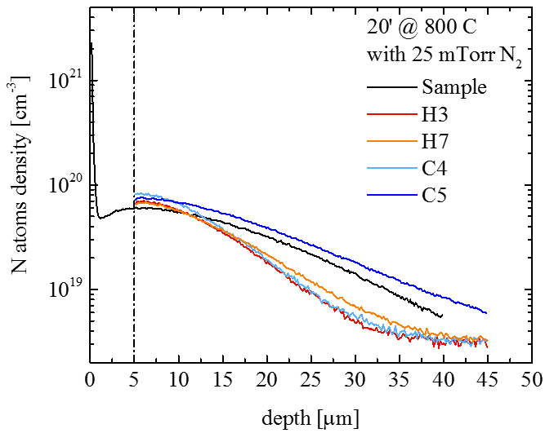
“2/6” Nitrogen-Doping Treatment
800C N₂
p = 25 mTorr 2 minutes
800C UHV, 3 hours
800C N₂
p = 25 mTorr 2 minutes
800C UHV, 6 minutes
800C UHV, 6 minutes
UHV cooling
UHV cooling
5 um EP
5 um EP
Instead of N, recently learned that we can use O!
Depth profile of Nitrogen impurities
Nb_{x}N_{y}
Final RF Surface
Nb
N
N Interstitial
Slide adapted from M. Martinello
6/19/2023

Slide 5
Outline
Introduction to SRF
Fundamental R&D Toward Improving Bulk Nb SRF Cavity Performance
  Key Materials Science findings
  Optimizing 1.3 GHz cavity performance
  Applying findings to 650 MHz cavities
  Optimizing EP for 650 MHz
Key Technological Advancements Towards High Gradients
  +50 MV/m recipe: cold EP + 2-step low-temp bake
  Extending gradients further with the traveling wave design
  Plasma processing
Conclusions

Slide 6
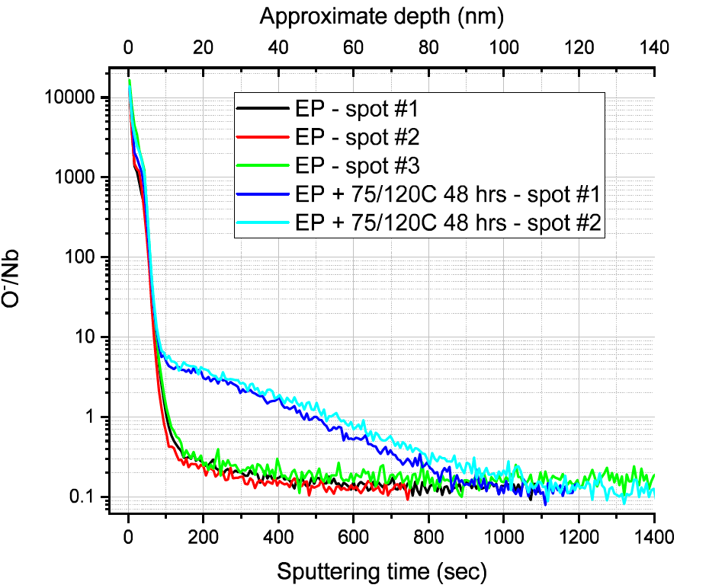
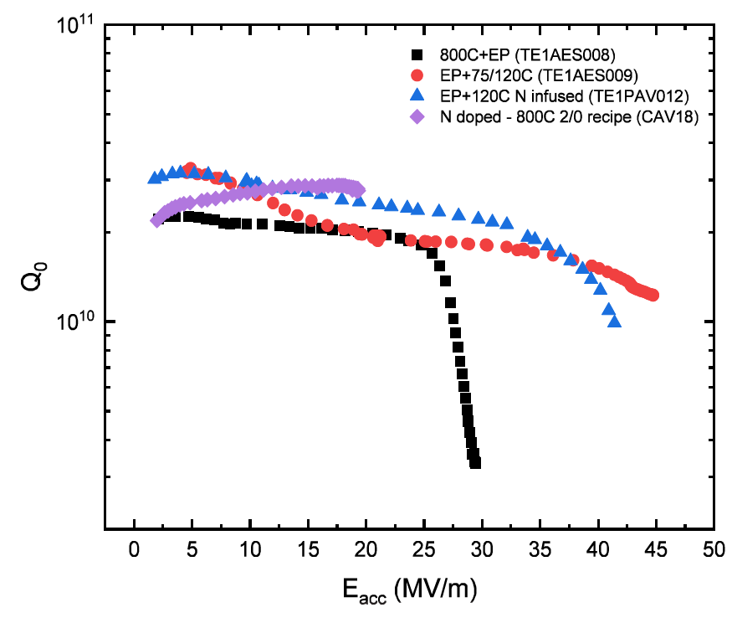
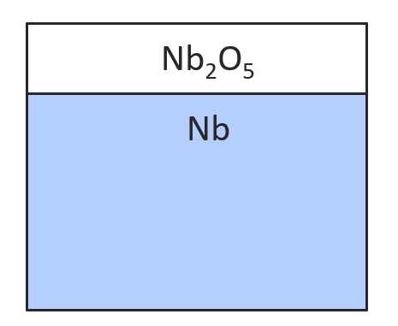
Coupling RF and Material Studies to Improve SRF Cavities
Material science is critical to understand sources of improved SRF cavity performance
Identified O as a key impurity in enabling high gradients and Q in cavities
TOF-SIMS Data on Cavity Cutouts
RF Data on Variously Processed Cavities to be Cut
LTB
EP
Can we tune cavity performance by tailoring O impurity profile?
A. Romanenko et al., SRF’19, THP014
A. Romanenko, TTC’2020, CERN

Slide 7
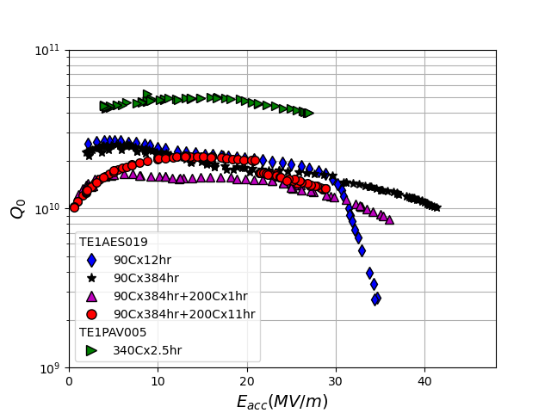
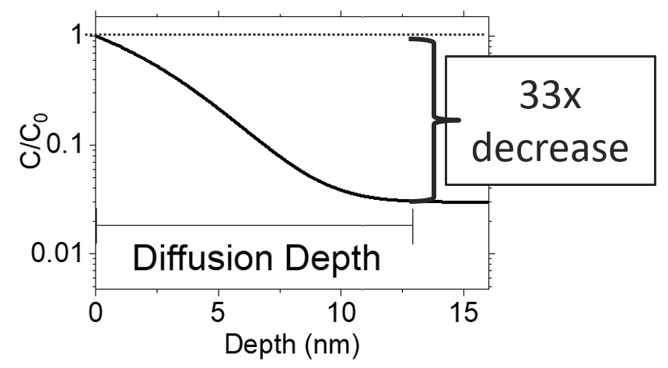
Tuning Cavity Performance with Oxygen Impurities
Q vs E Evolution with Increasing O Diffusion
Single cavity subjected to sequential baking and RF testing to study the evolution of cavity performance
O diffusion: ability to tune between high Q₀ or high gradient!
2K
1.3 GHz
One key parameter:
D. Bafia et al, Proceedings of SRF’2021, THPTEV016

Slide 8
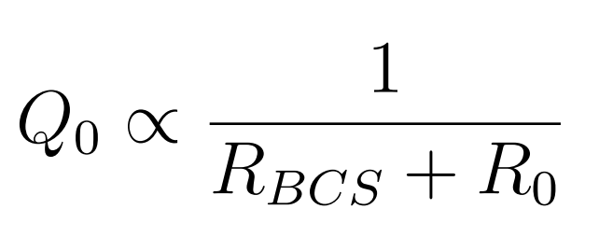

Optimizing Cavity Q₀ By Tailoring O Impurity Profile
D. Bafia, TTC’22
2 K
1.3 GHz
Maximizing Q₀ requires minimizing R_{BCS}
Gradually introduced more oxygen into the RF surface of cavities and tracked R_{BCS} evolution
  100+ cavity RF tests

Slide 9
Optimizing Cavity Gradient by Tailoring O Impurity Profile
Quench Peak
D. Bafia, TTC’22
f₀ = 1.3 GHz
Gradually introduced more oxygen into the RF surface of cavities and tracked quench
Found a peak in quench field when oxygen diffuses 46 nm!
Mid-T Bake data comes from S. Posen et al., PRA 13, 014024 (2020)

Slide 10
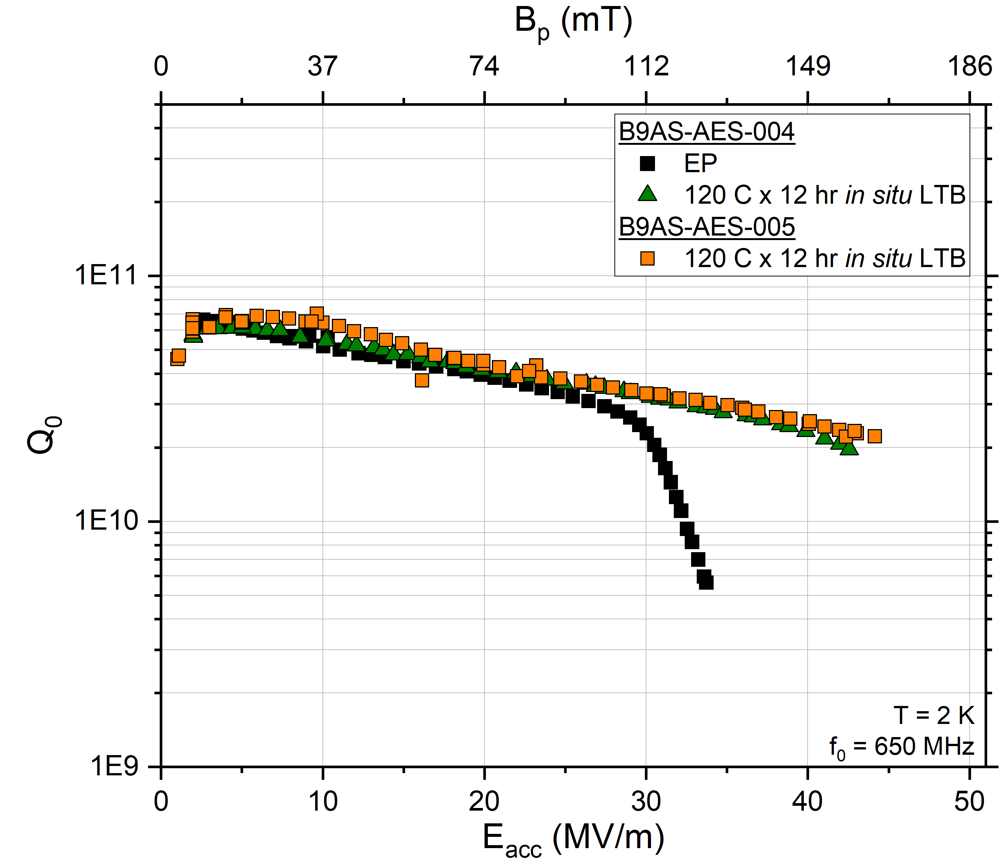
Application of Quench Peak Findings to 650 MHz Cavities
D. Bafia, LCWS’23
Subjected a 650 MHz cavity to a surface treatment which introduced O to a depth of 46 nm
From 1.3 GHz studies expect high quench field:
  We achieved get 44 MV/m!
Quench optimization studies on 1.3 GHz are applicable to 650 MHz
Non-optimal electropolishing likely limiting performance
Near record quench in 650 MHz!

Slide 11
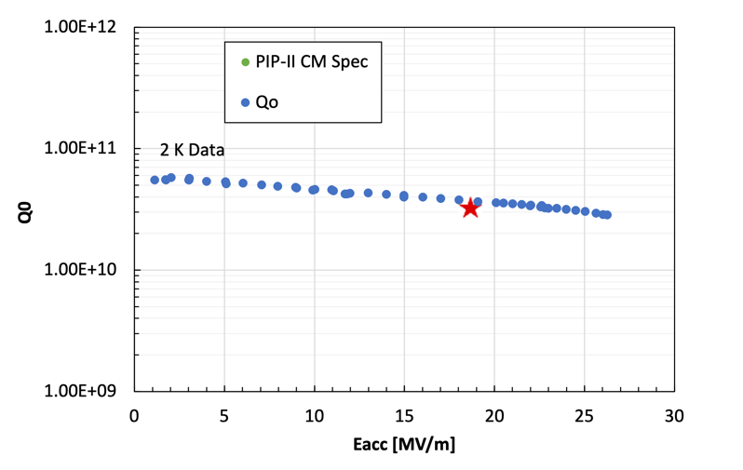
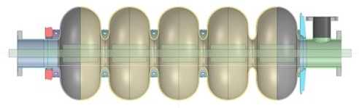
Improving 650 MHz Performance Further via Optimized EP
V. Chouhan, to be presented at SRF’23
f₀ = 650 MHz
Proper electropolishing (EP) is critical in enabling excellent cavity performance
  Smooth surface, minimal uptake of H
Developed a novel cathode and optimal EP parameters for 5-cell 650 MHz cavities for PIP-II
Cathode Structure
Optimized design and parameters yields unprecedented performance in high-β 650 MHz EP’d cavities!
Patented

Slide 12
Outline
Introduction to SRF
Fundamental R&D Toward Improving Bulk Nb SRF Cavity Performance
  Key Materials Science findings
  Optimizing 1.3 GHz cavity performance
  Applying findings to 650 MHz cavities
  Optimizing EP for 650 MHz
Key Technological Advancements Towards High Gradients
  +50 MV/m recipe: cold EP + 2-step low-temp bake
  Extending gradients further with the traveling wave design
  Plasma processing
Conclusions

Slide 13
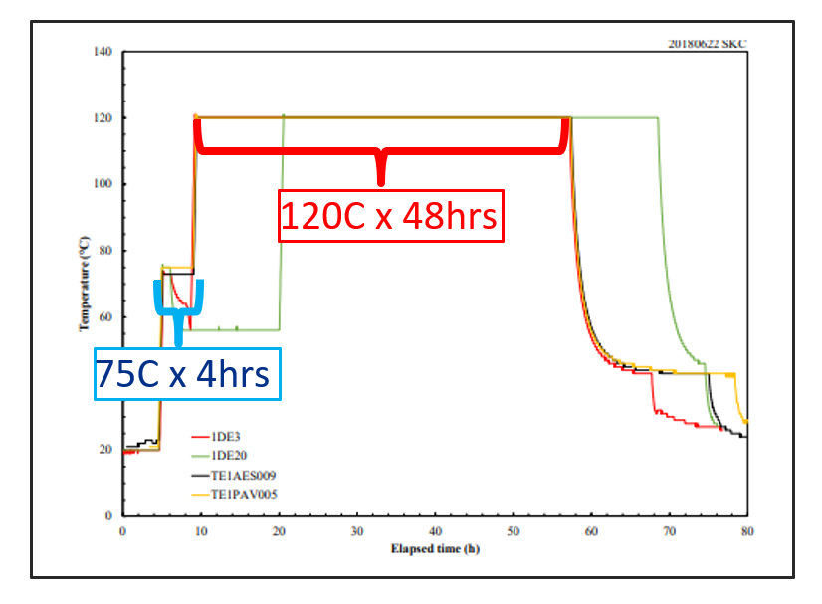
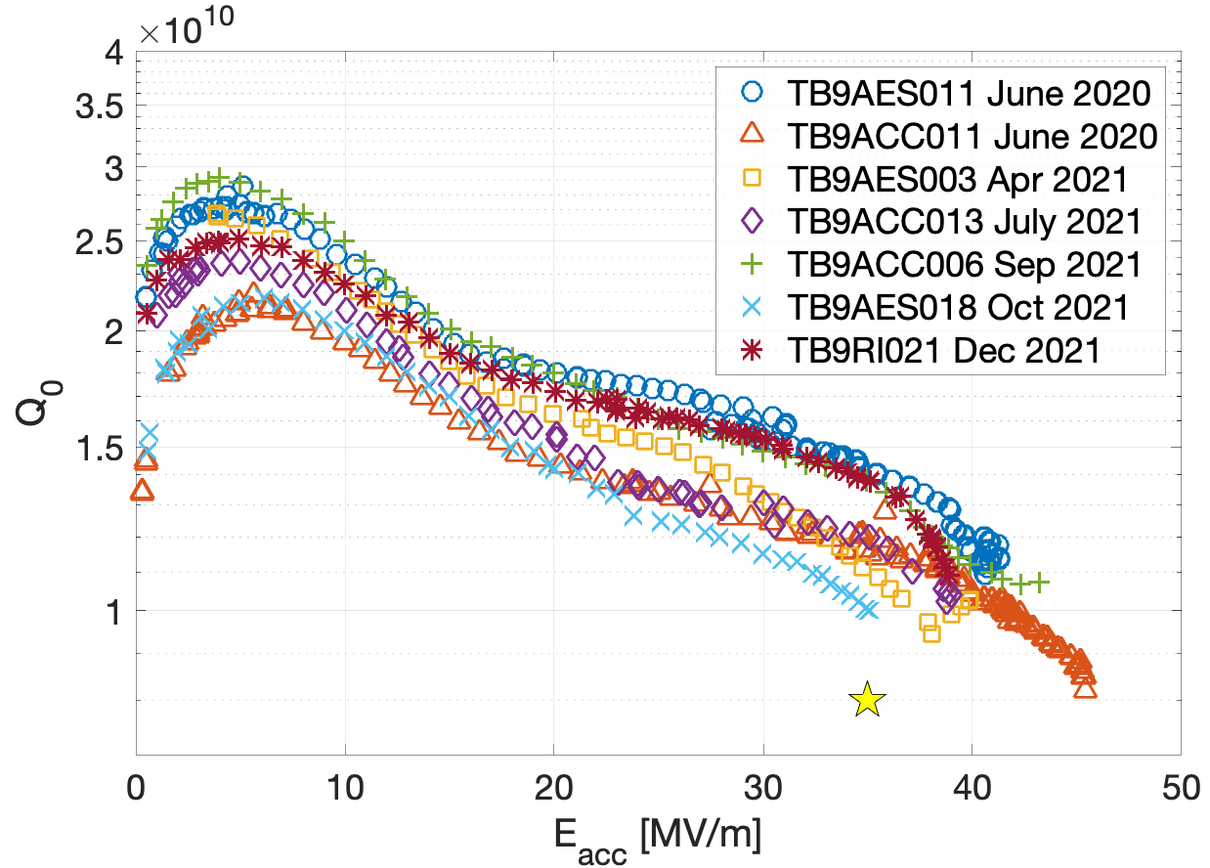
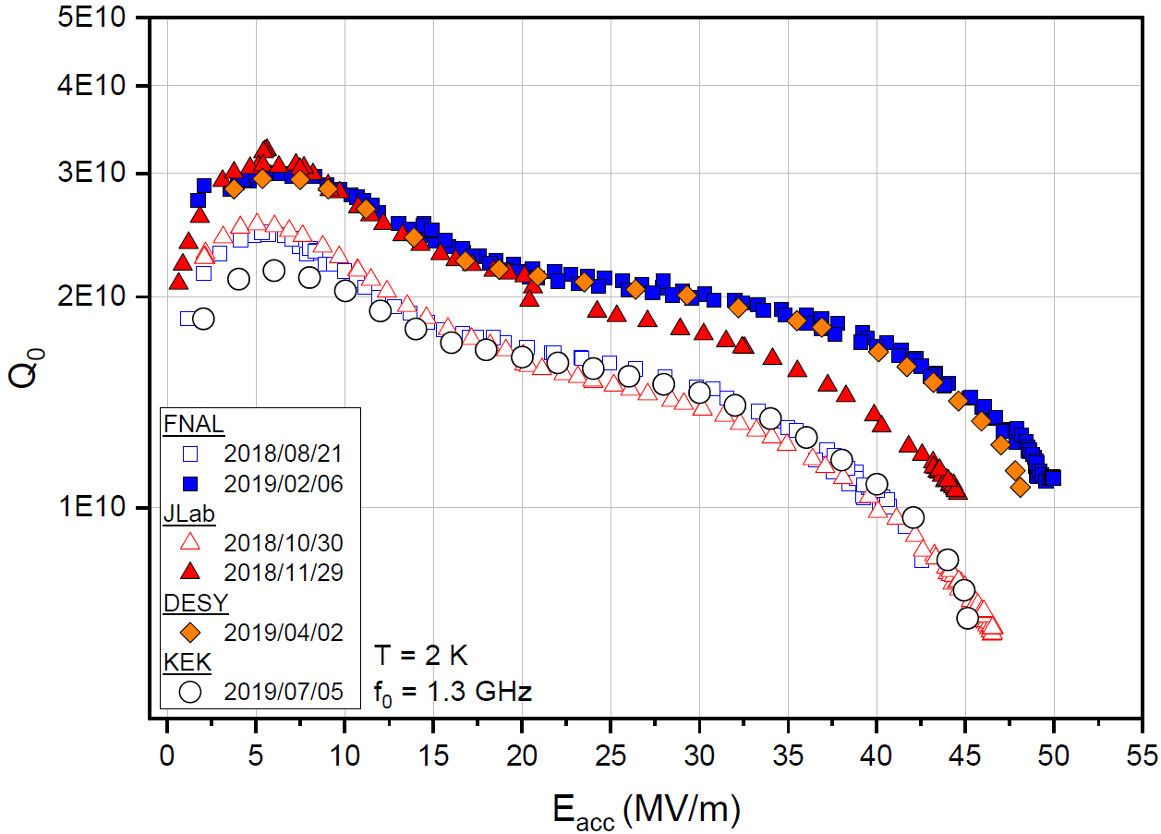
New Cold EP + 2-Step Low-Temp Bake Enabling 50 MV/m
Grassellino et al. https://arxiv.org/abs/1806.09824
Transferred recipe to 9-cell cavities as part of ILC Cost Reduction effort
Average E_{acc} = 40.4 MV/m!
Cold EP
+
Courtesy of S. Posen
=
Ultra-high gradients of 50 MV/m!
Confirmed by other labs!
1-cell cavity
9-cell cavities

Slide 14
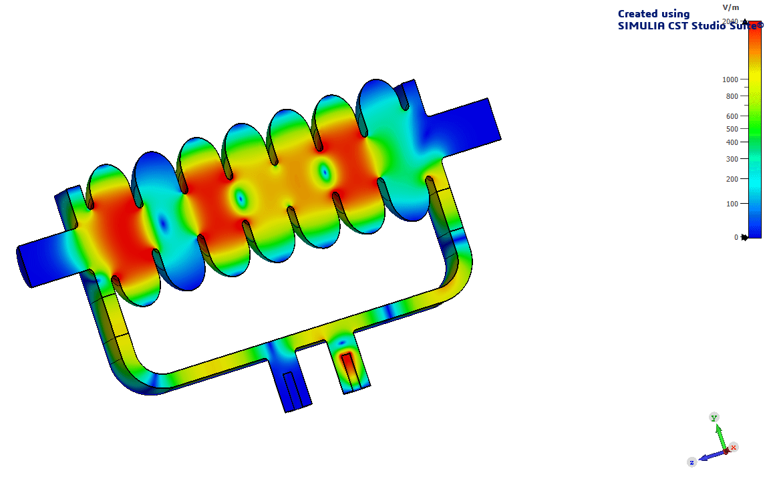
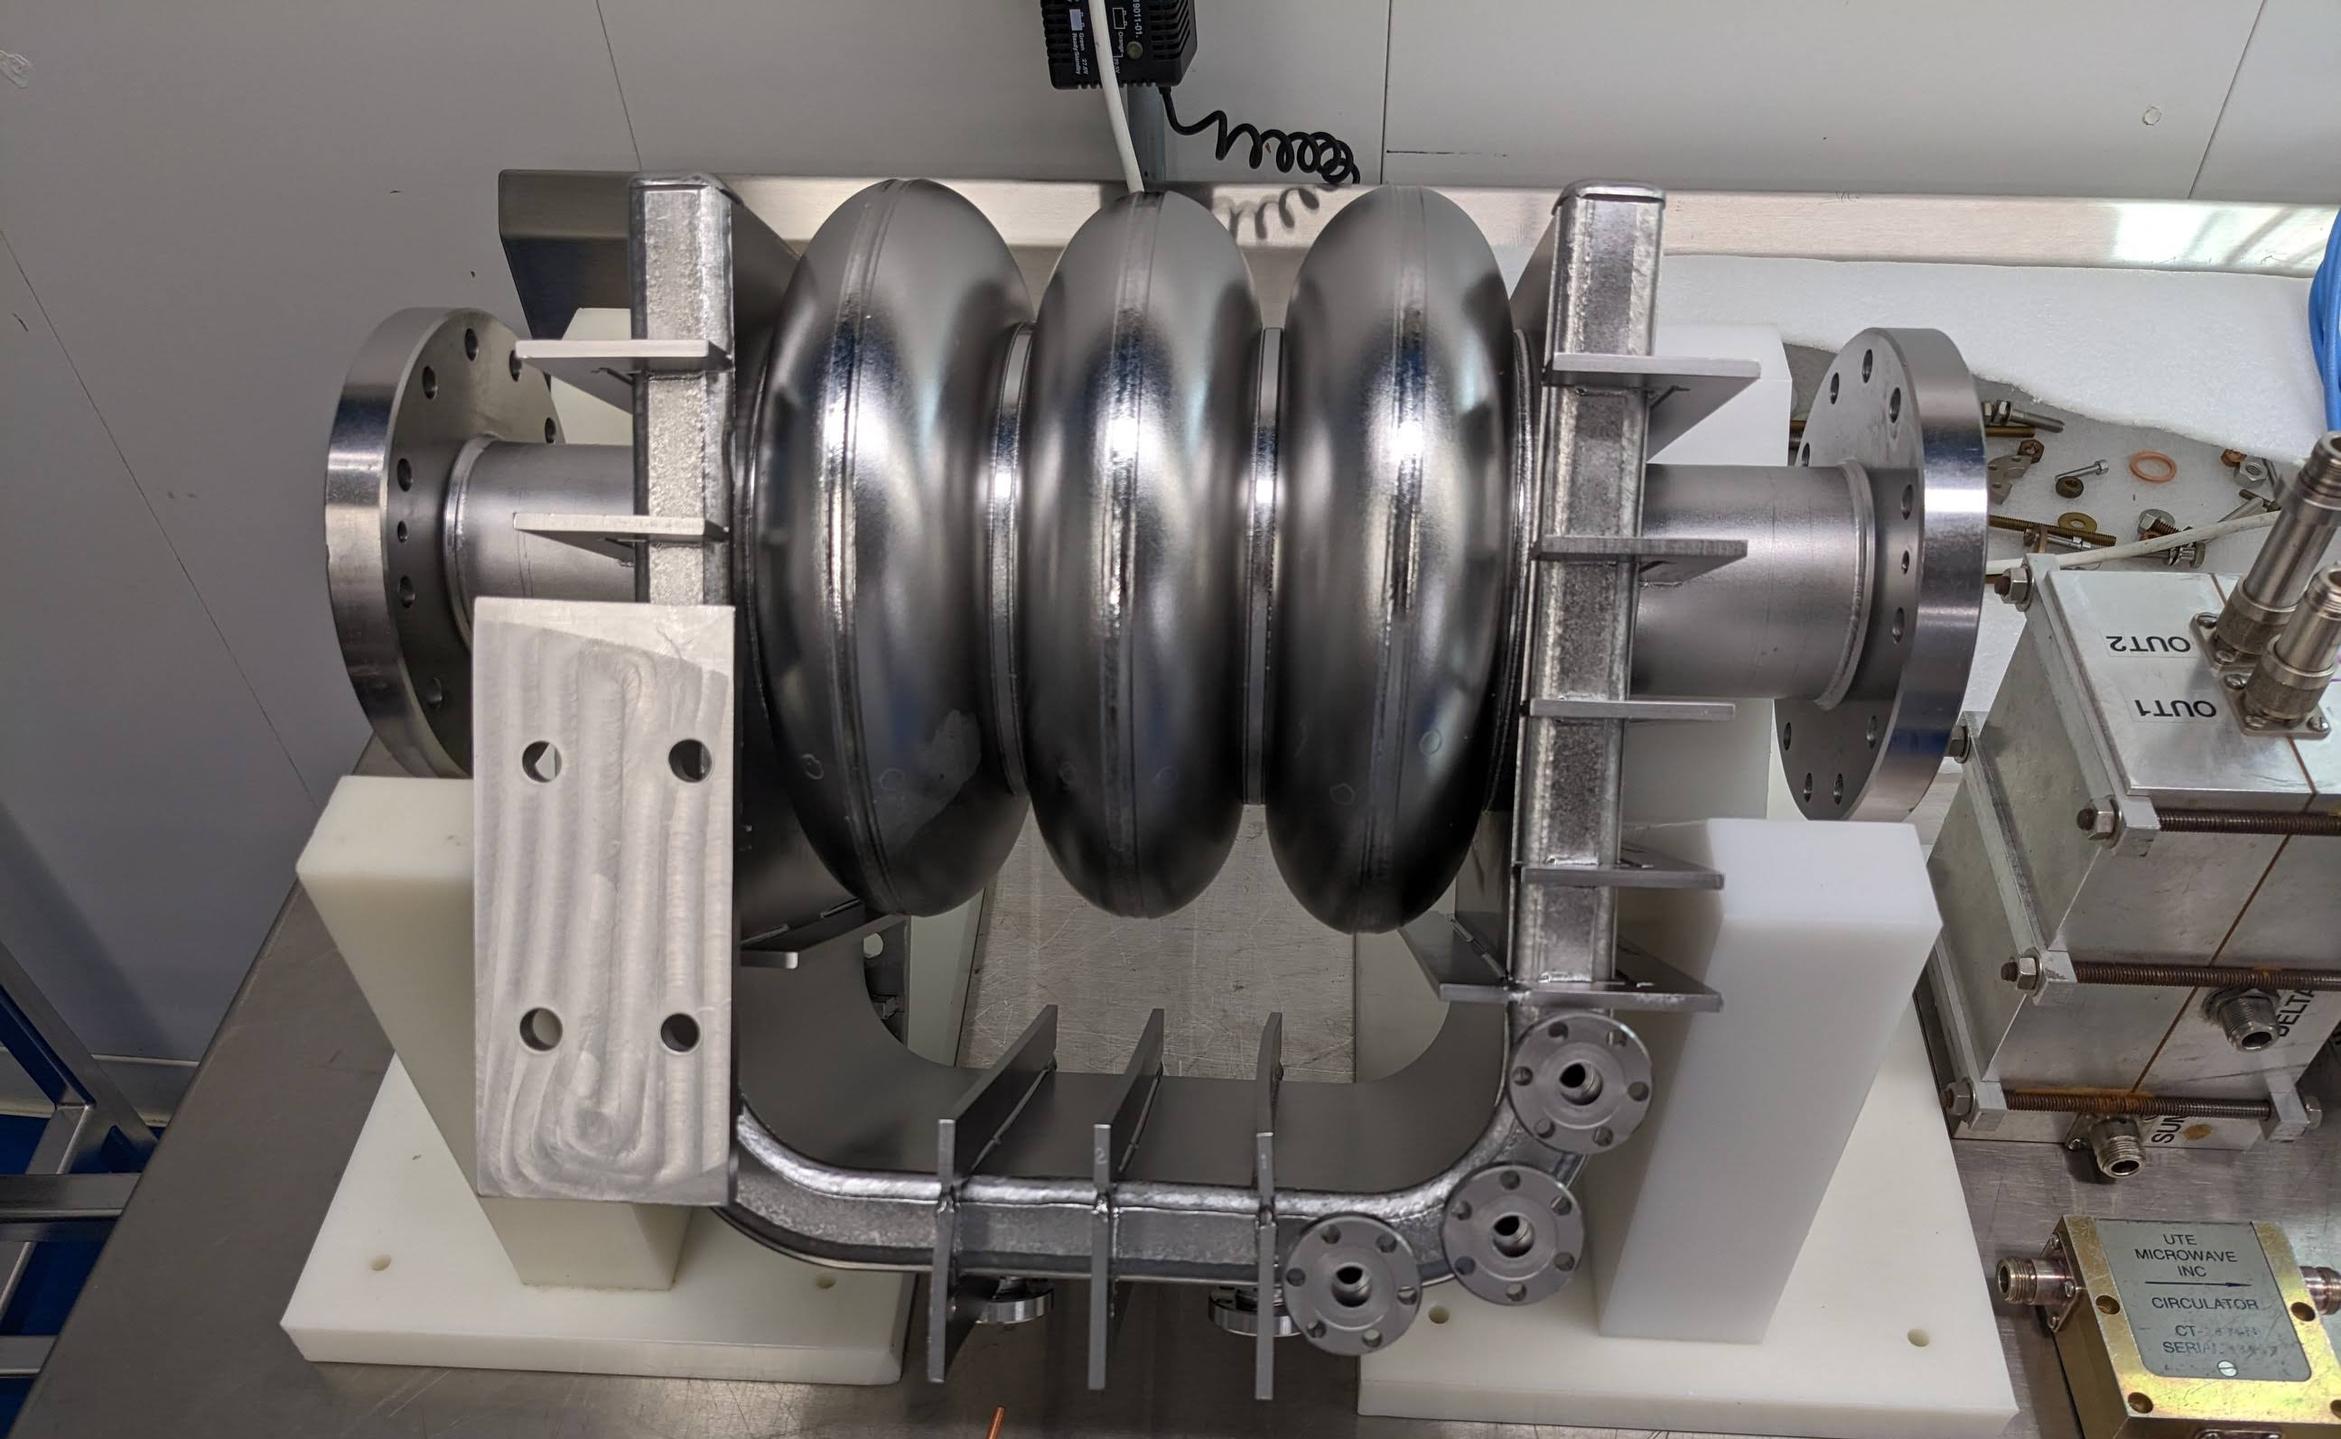
Extending Gradients Further with the Traveling Wave Design
Standing wave Nb cavities limited E_{acc} by H_{sh}
Alternative: Niobium traveling wave structure
  RF power returned via feedback Nb waveguide → Lowers peak fields in cavity
  Possible to achieve E_{acc} > 70 MV/m!!
Current Status:
1-cell: designed, treated (BCP), and tested
  Achieved 26 MV/m in RF testing
3-cell: designed and treated (BCP)
  Tuning just completed
  RF testing scheduled for this summer
  TW operation demonstrated at room temp!
0.5 m structure currently being designed in collaboration w/ Cornell
V. Yakovlev, LCWS’23
*Euclid Techlabs DOE SBIR DE-FG02-06ER84462 and DE-SC0006300.

Slide 15
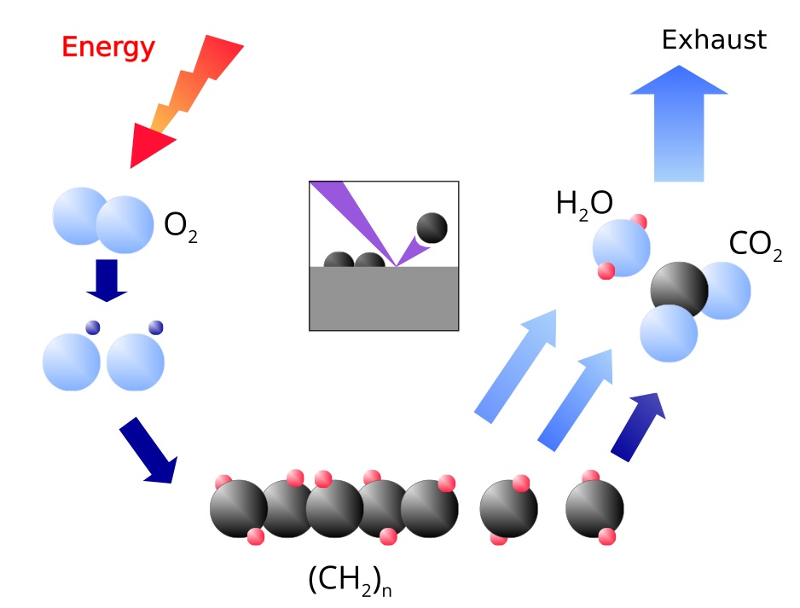
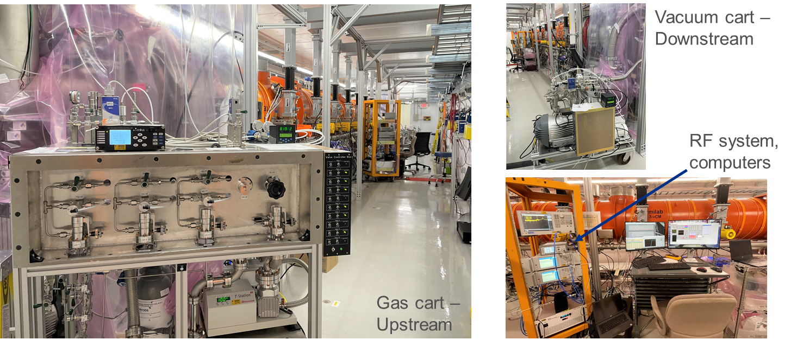
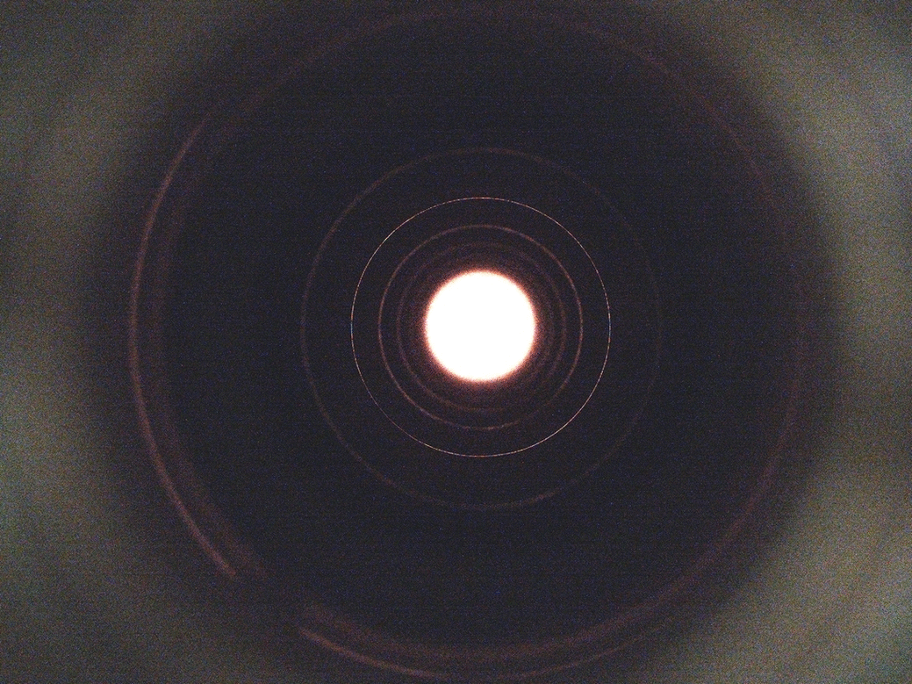
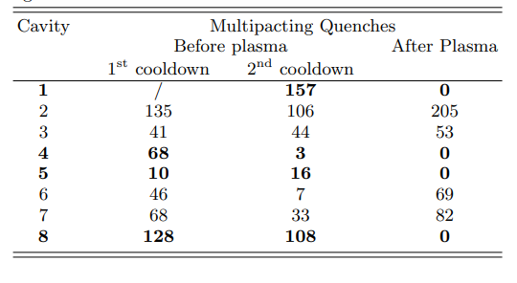
Plasma Processing Applied to LCLS-II-HE vCM
RF test after plasma processing demonstrated that:
vCM performance is preserved
Plasma processing did not introduce any contamination: vCM still FE-free
Plasma processing procedure for 1.3GHz CMs is fully validated
B. Giaccone, et al. arXiv:2201.09776 (2022)
S. Posen et al. PRAB 25, 042001 (2022)
Plasma processing can also eliminate multipacting:
Possible to address both FE and MP in situ in CMs → decreased CM testing and commissioning time, increased reliability during machine operation

Slide 16
Conclusions & Future Directions
Bulk Nb SRF cavities are a mature, ready-to-go technology for use in a muon collider
Recent advancements in R&D push the limits of cavity performance
Impurity tailoring enables tuning cavity performance for high gradient or high Q
Electropolishing optimization shown to extend gradient reach
Cold EP + 2-step baking yields gradients above 50 MV/m
Initial traveling wave cavity demonstrate promising results, opening the door to > 70 MV/m
Plasma processing enables in situ mitigation of FE and MPing in CMs

Slide 17
Thank you for your attention!

