Slide 1




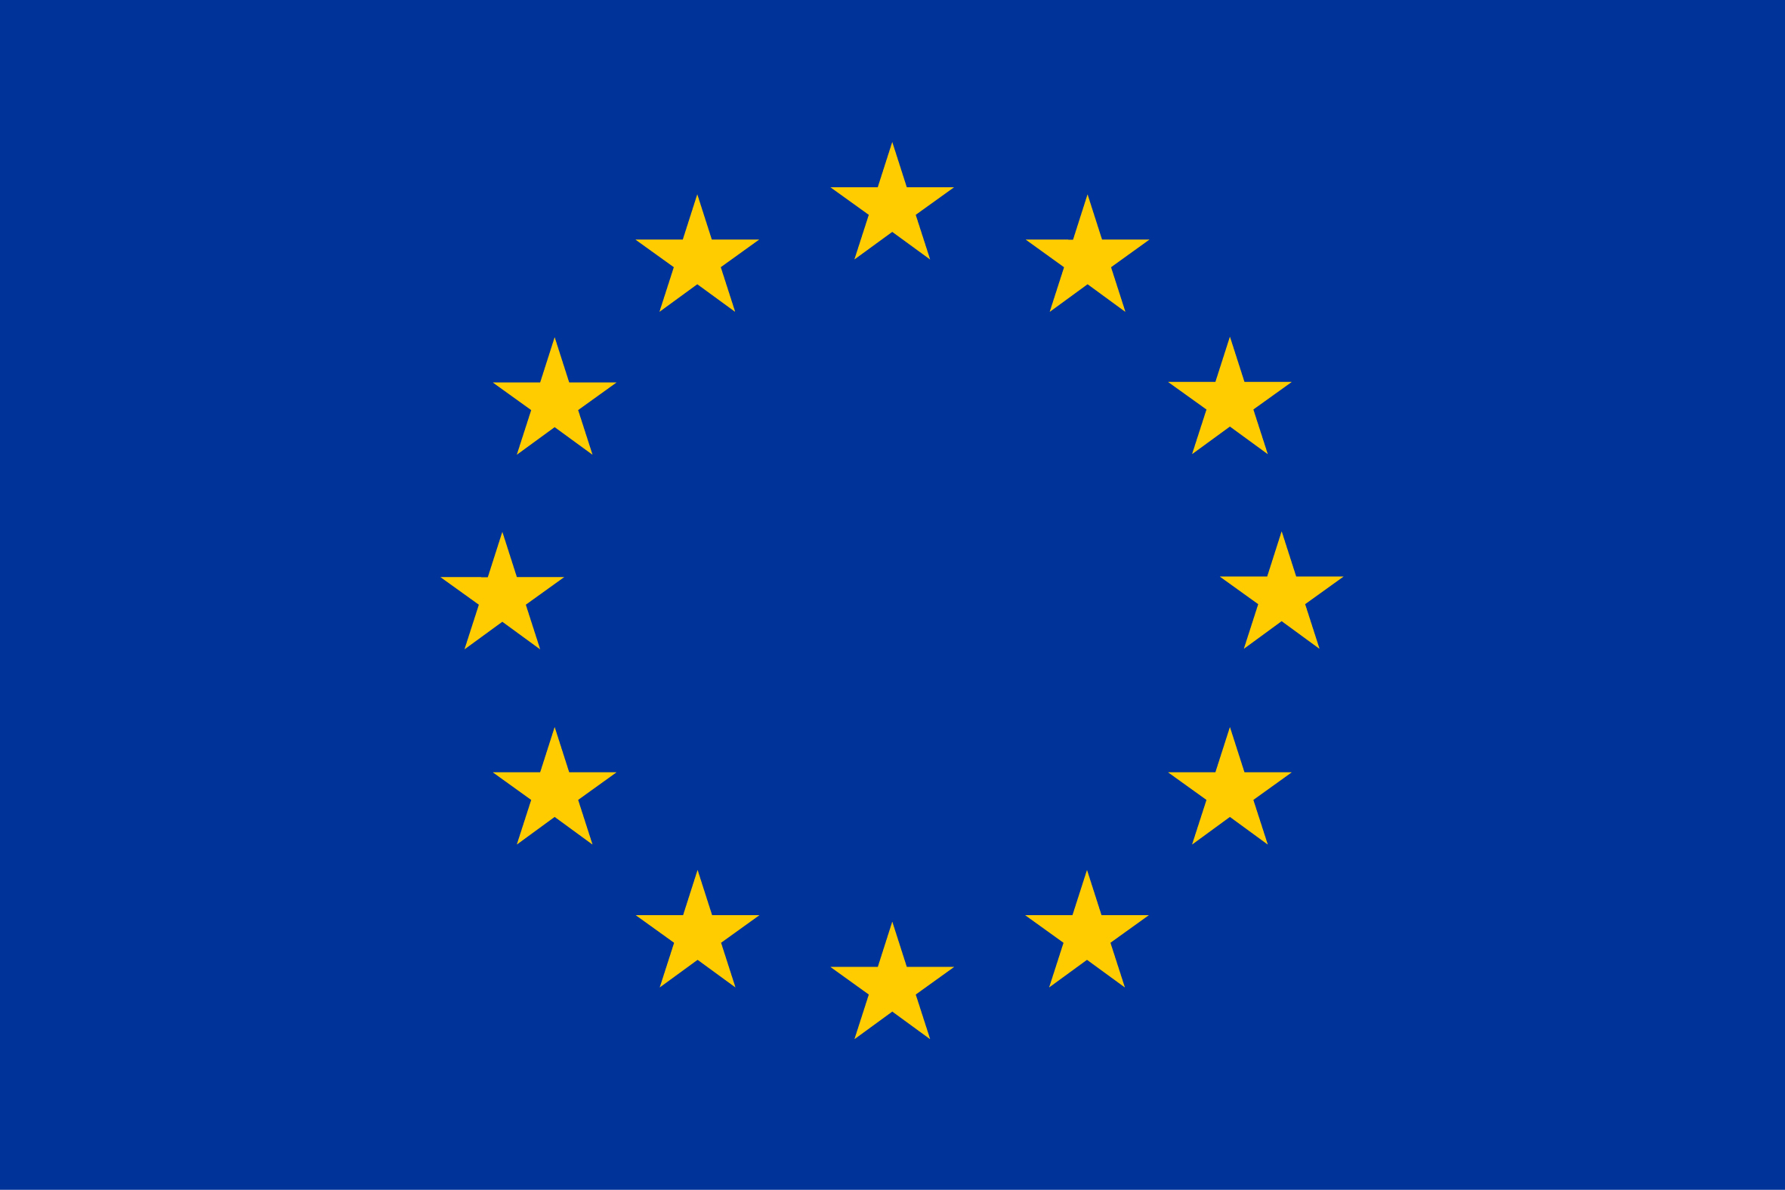

HOM impedance and power calculations for the RCS SRF cavities
IMCC Annual Meeting 2023, Orsay
21 June 2023
Sosoho-Abasi Udongwo
Funded by the European Union under
Grant Agreement n. 101094300

Slide 2
Content
Survey of low-loss cavity geometries from the literature
Analysis of NLSF cavity considering different numbers of cells and operating frequency
Preliminary study of HOM damped cavities and comparison to the transverse impedance threshold
Summary

Slide 3
Survey of low-loss cavity geometries from the literature

Slide 4
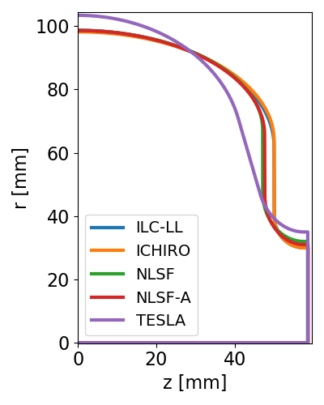
Survey of low-loss cavity geometries from the literature
Four low-loss cavities from the literature were analysed: ILC-LL, ICHIRO, NLSF, NLSF-A [1]
The TESLA cavity geometry [2] is included in the analysis
[1] N. Juntong, R.M. Jones, High-gradient SRF Cavity with minimised surface E.M. fields and superior bandwidth for the ILC, Proceedings of SRF2009, Berlin, Germany. https://accelconf.web.cern.ch/SRF2009/papers/thppo024.pdf
[2] B. Aune et al., Superconducting TESLA cavities, Physical Review Special Topics - Accelerators and Beams, Volume 3, 092001 (2000).

Slide 5
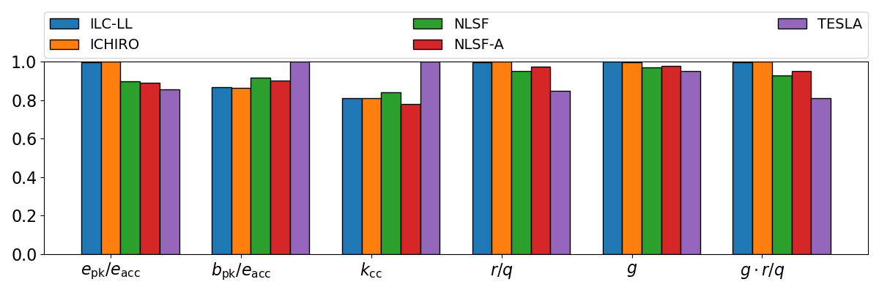
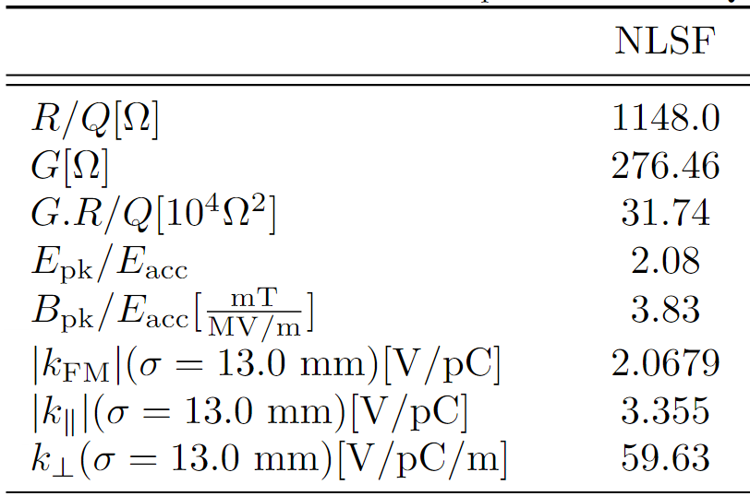
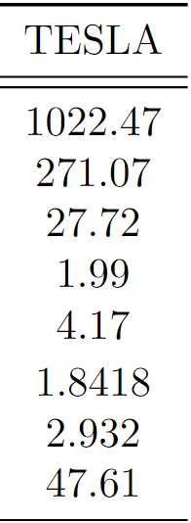
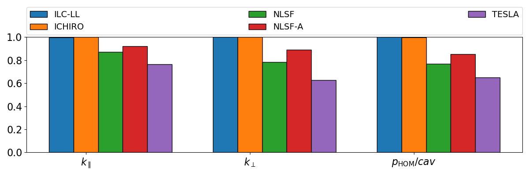
Survey of low-loss cavity geometries from the literature: FM and HOM figures of merit
No significant difference in the relevant quantities of interest of the analysed cavities except the TESLA cavity geometry properties
Bar plot of normalised fundamental mode (FM) figures of merit
Reference values: Figures of merit for the NLSF cavity geometry
Bar plot of normalised higher-order mode (HOM) figures of merit

Slide 6
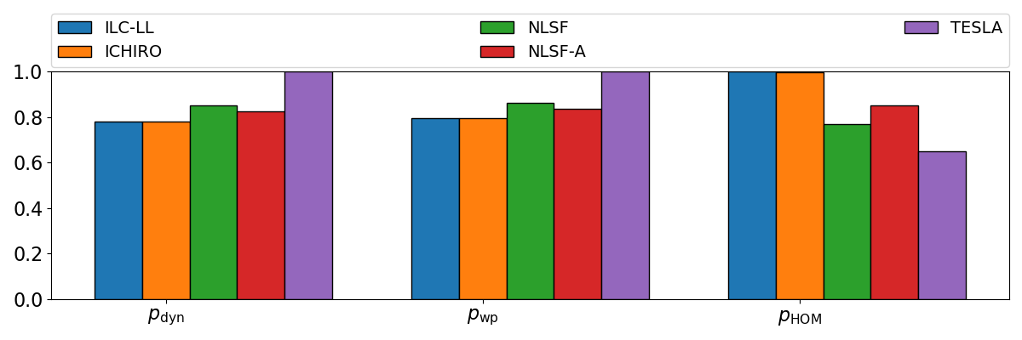
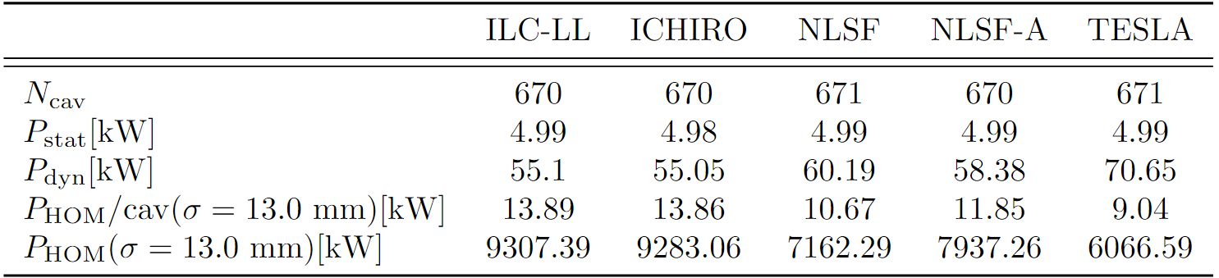
Survey of low-loss cavity geometries from the literature: HOM and Dynamic Power Loss Comparison
HOM power per cavity is around 10 kW for analysed cavities. (Caveat: values calculated for 9 mid-cells)
Bar plot of normalised dynamic power loss, wall plug power and total HOM power
RCS Stage 1: Beam current=20.38 mA; Bunch length=13 mm, $E_{acc}=30MV/m, Q_{0}=1e10$
Static, dynamic and HOM power loss

Slide 7
Survey of low-loss cavity geometries from the literature: HOM and Dynamic Power Loss Comparison
HOM power per cavity is around 10 kW for analysed cavities. (Caveat: values calculated for 9 mid-cells without beam pipe)
NLSF cavity is selected for further analysis
Bar plot of normalised dynamic power loss, wall plug power and total HOM power
RCS Stage 1: Beam current=20.38 mA; Bunch length=3 mm, $E_{acc}=30MV/m, Q_{0}=1e10$
Static, dynamic and HOM power loss

Slide 8
Analysis of the NLSF cavity geometry

Slide 9
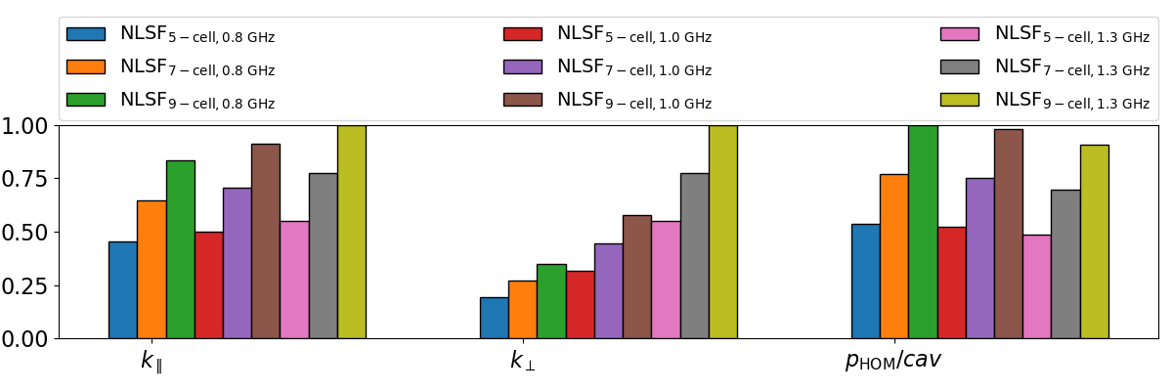
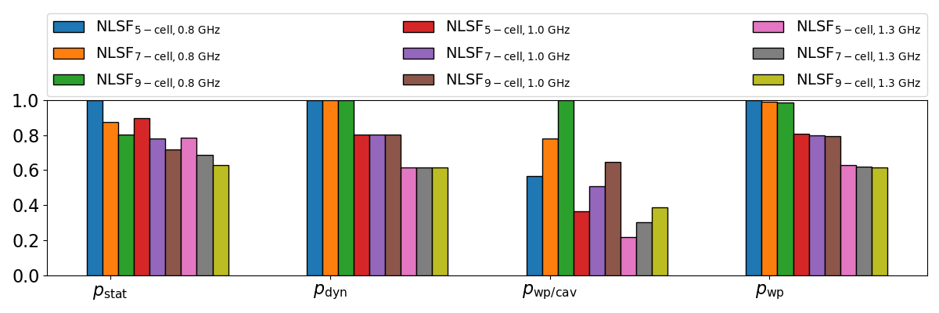
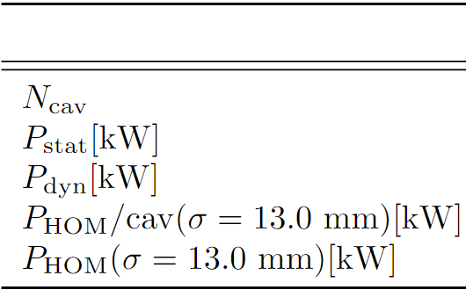
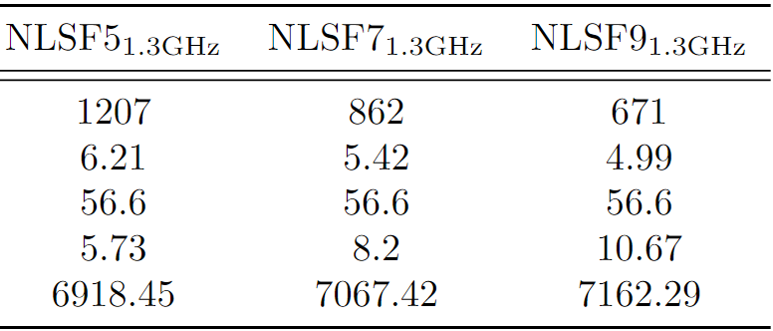
Analysis of NLSF cavity considering different numbers of cells and operating frequency
Considered frequencies
  800, 1000, 1300 MHz
Bar plot of normalised higher-order mode (HOM) figures of merit
Reference values: total static, dynamic and HOM power per caity
Bar plot of normalised dynamic power loss, wall plug power and total HOM power

Slide 10
Analysis of NLSF cavity considering different numbers of cells and operating frequency
Considered frequencies
  800, 1000, 1300 MHz
Considered number of cells
  5, 7, 9 cells
Bar plot of normalised higher-order mode (HOM) figures of merit
Reference values: total static, dynamic and HOM power per caity
Bar plot of normalised dynamic power loss, wall plug power and total HOM power

Slide 11
Analysis of NLSF cavity considering different numbers of cells and operating frequency
Higher frequencies?
  Reduced dynamic losses
  Negligible effect on HOM power/cav
Bar plot of normalised higher-order mode (HOM) figures of merit
Bar plot of normalised dynamic power loss, wall plug power and total HOM power

Slide 12
Analysis of NLSF cavity considering different numbers of cells and operating frequency
Higher frequencies?
  Reduced dynamic losses
  Negligible effect on HOM power/cav
More cavity cells?
  No effect on dynamic losses
  Increased HOM power/cav
Bar plot of normalised higher-order mode (HOM) figures of merit
Bar plot of normalised dynamic power loss, wall plug power and total HOM power

Slide 13
Preliminary Study of Damped Cavities and Comparison to Transverse Impedance Threshold
Notes:
This coupler is designed to have a relatively good transmission both in horizontal and transvese plane

Slide 14
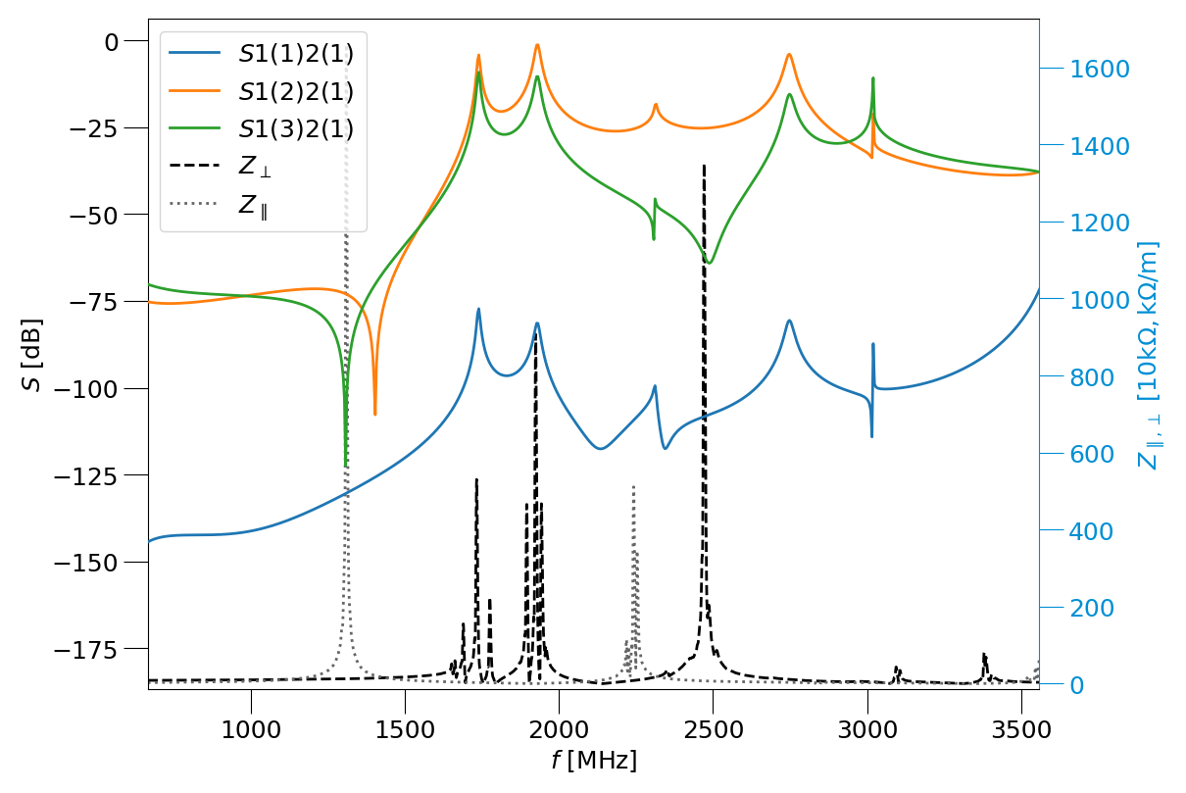
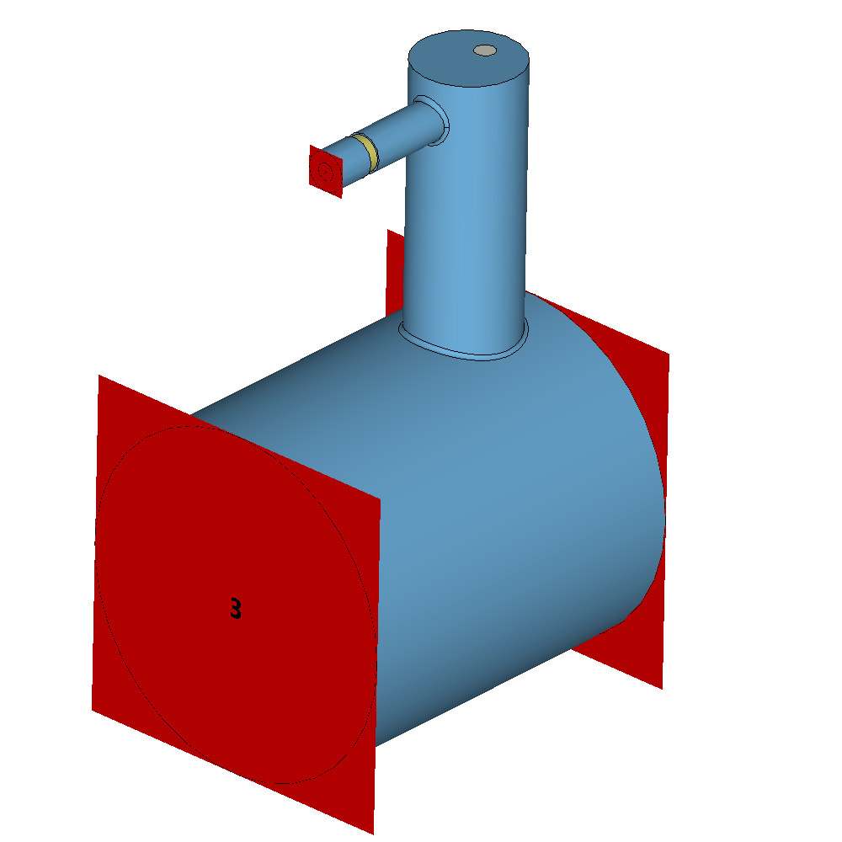
DQW HOM coupler
A double quarter wave (DQW) coupler was optimised independently
Further optimisation in a cavity+HOM coupler+FPC assembly required
2
1
3
Simulation model for the Double Quarter Wave (DQW) HOM Coupler
Transmission curves of tuned DQW HOM coupler and longitudinal and transverse impedance of NLSF cavity.
Notes:
This coupler is designed to have a relatively good transmission both in horizontal and transvese plane

Slide 15
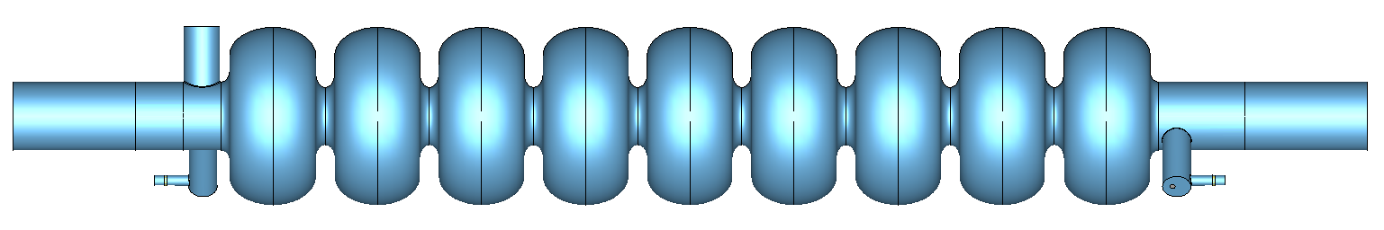
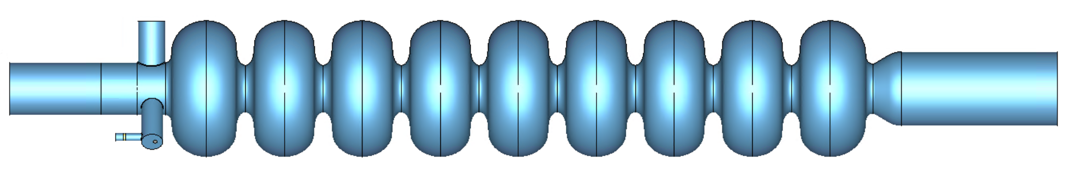
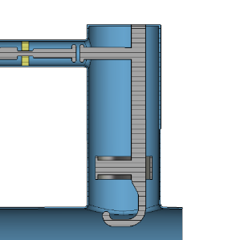

Model setup: Cavity + FPC + HOM coupler
Waveguide ports boundary condition
The NLSF is compared to the TESLA cavity
ERL [3] cavity geometry is included in the comparison because of the beampipe expansion at one end
NLSF, TESLA
Left end group:
1 FPC (TTF-III)
1 DQW coupler
Right end group:
1 DQW coupler
ERL-MA
Left end group:
1 FPC (TTF-III)
2 DQW coupler
Right end group:
Beam pipe expansion
[3] V. Shemelin, Optimal choice of cell geometry for a multicell superconducting cavity, Cornell Laboratory for Accelerator-based Sciences and Education (CLASSE), Ithaca, New York 14853, USA, 11 November 2009. https://journals.aps.org/prab/pdf/10.1103/PhysRevSTAB.12.114701.
Double Quarter Wave (DQW) HOM Coupler
TTF-III FPC

Slide 16
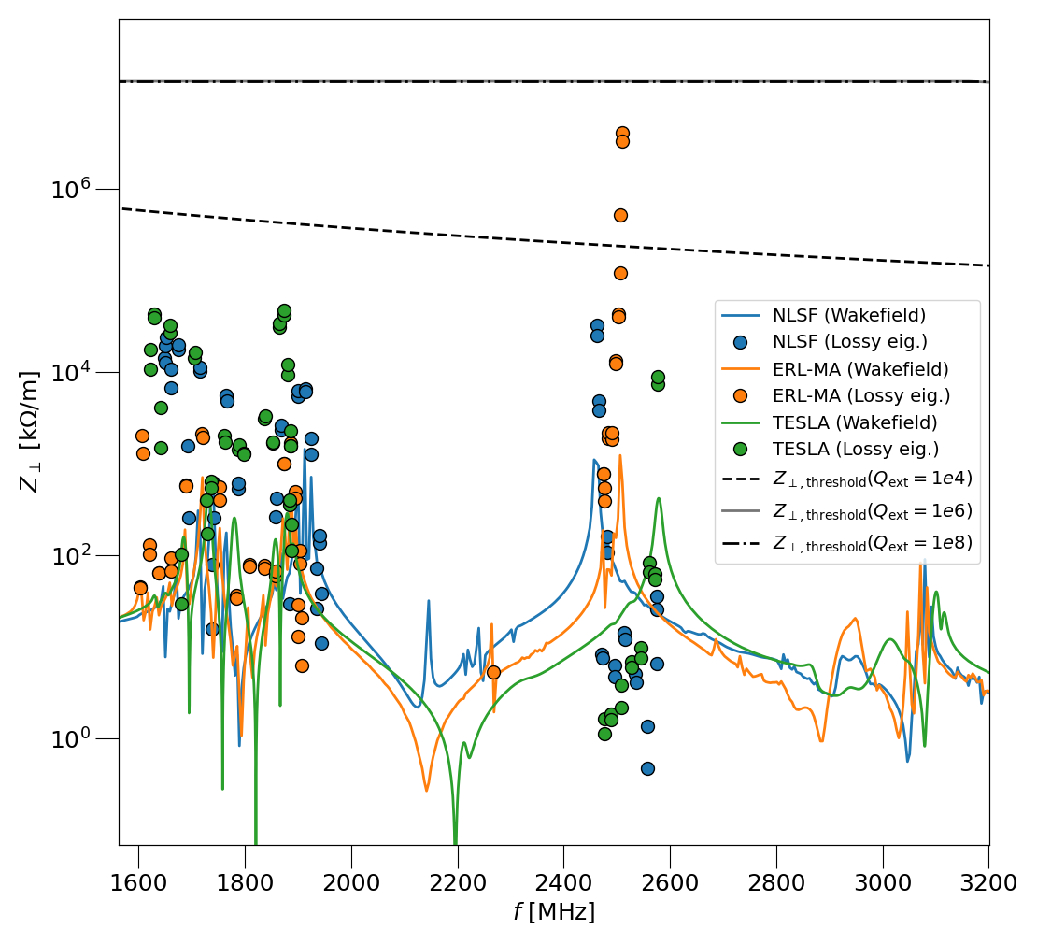
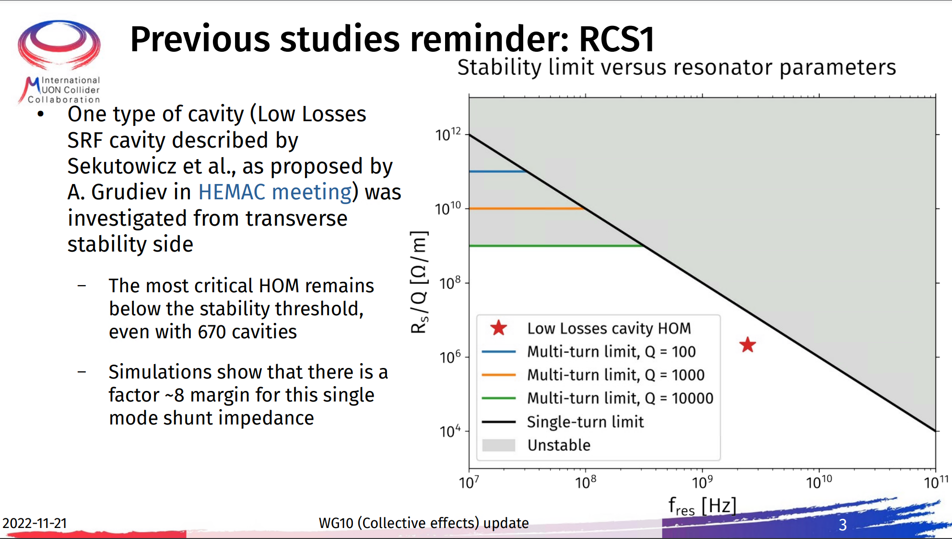
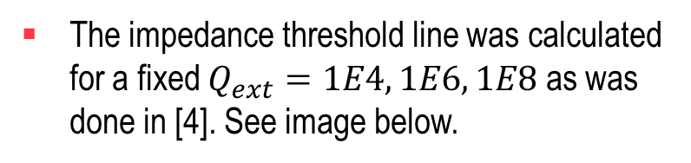
Transverse HOM impedance plot for analysed cavities
The impedance threshold line was calculated for a fixed $Q_{ext}=1E4, 1E6, 1E8$ as was done in [4]. See image below.
[4] Alexej Grudiev, Transverse stability in RCS and TESLA cavity Preliminary considerations
Lossy eigenmode and wakefield analysis transverse HOM impedance plot for analysed cavities

Slide 17
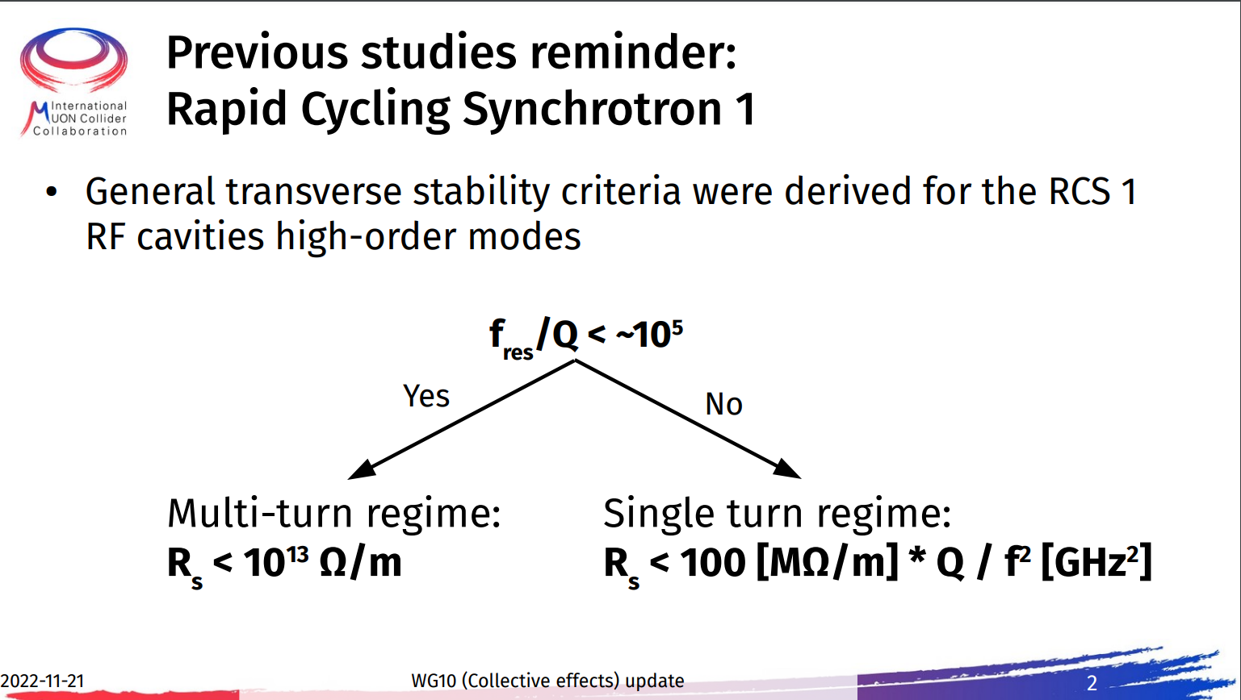
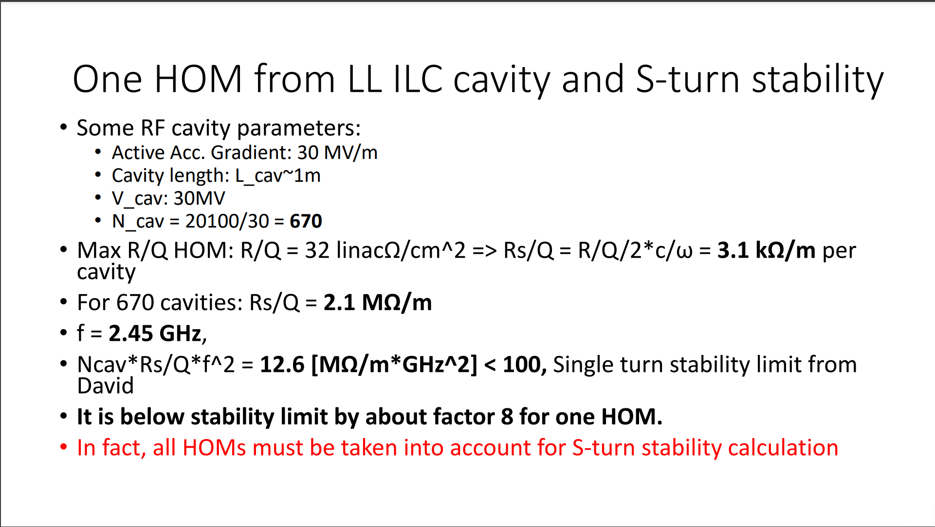
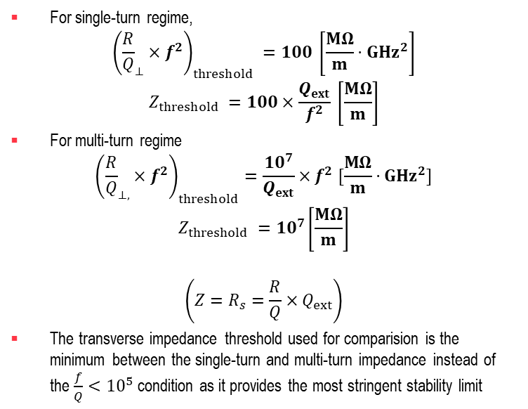
Transverse impedance stability threshold calculation
For single-turn regime,
$${\left({\frac{R}{Q}}_{⊥}×f^{2}\right)}_{threshold} =100 \left[\frac{MΩ}{m}⋅GHz^{2}\right]$$
$$Z_{threshold} =100×\frac{Q_{ext}}{f^{2}} \left[\frac{MΩ}{m}\right]$$
For multi-turn regime
$${\left({\frac{R}{Q}}_{⊥,}×f^{2}\right)}_{threshold}=\frac{10^{7}}{Q_{ext}}×f^{2} [\frac{MΩ}{m}⋅GHz^{2}]$$
$$Z_{threshold} =10^{7}\left[\frac{MΩ}{m}\right]$$
$$\left(Z=R_{s}=\frac{R}{Q}×Q_{ext}\right)$$
The transverse impedance threshold used for comparision is the minimum between the single-turn and multi-turn impedance instead of the $\frac{f}{Q}<{10}^{5}$ condition as it provides the most stringent stability limit
[5] D. Amorim, E. Métral, Working Group 10 (Collective effects) update
[6] Alexej Grudiev, Transverse stability in RCS and TESLA cavity Preliminary considerations

Slide 18
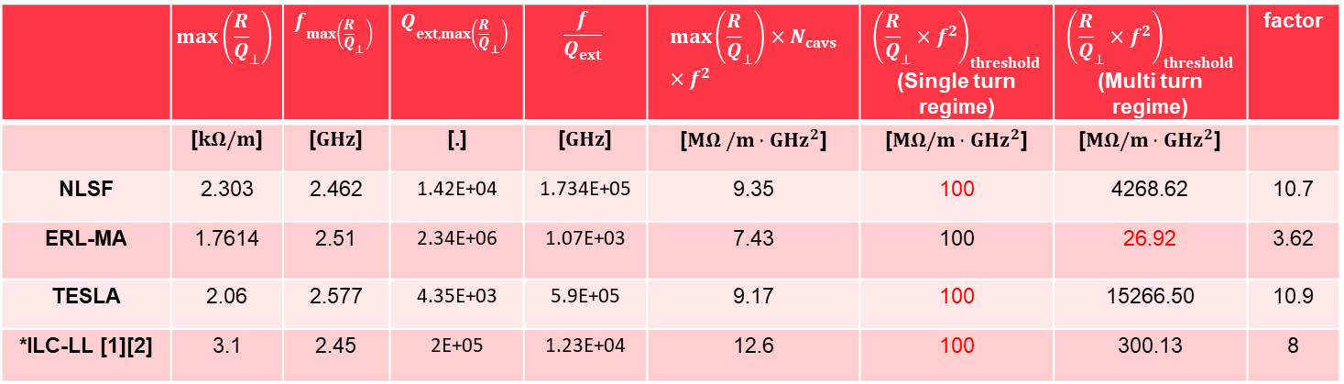
Comparision of maximum transverse R/Q mode impedance with threshold values
 | $$\max\left({\frac{R}{Q}}_{⊥}\right)$$ | $$f_{\max\left({\frac{R}{Q}}_{⊥}\right)}$$ | $$Q_{ext, max\left({\frac{R}{Q}}_{⊥}\right)}$$ | $$\frac{f}{Q_{ext}}$$ | $$\max\left({\frac{R}{Q}}_{⊥}\right)×N_{cavs}×f^{2}$$ | $${\left({\frac{R}{Q}}_{⊥}×f^{2}\right)}_{threshold}$$ (Single turn regime) | $${\left({\frac{R}{Q}}_{⊥}×f^{2}\right)}_{threshold}$$ (Multi turn regime) | factor
 | [$kΩ/m$] | [$GHz$] | [.] | [$GHz$] | [$MΩ /m⋅GHz^{2}$] | [$MΩ/m⋅GHz^{2}$] | [$MΩ/m⋅GHz^{2}$]
NLSF | 2.303 | 2.462 | 1.42E+04 | 1.734E+05 | 9.35 | 100 | 4268.62 | 10.7
ERL-MA | 1.7614 | 2.51 | 2.34E+06 | 1.07E+03 | 7.43 | 100 | 26.92 | 3.62
TESLA | 2.06 | 2.577 | 4.35E+03 | 5.9E+05 | 9.17 | 100 | 15266.50 | 10.9
*ILC-LL [1][2] | 3.1 | 2.45 | 2E+05 | 1.23E+04 | 12.6 | 100 | 300.13 | 8
*The transverse HOM impedance comparison for the ILC-LL as calculated by Alexej Grudiev is included only in this table for comparison
[1] Alexej Grudiev, SRF cavity parameter model for HEC RF system design, June 2021, https://indico.cern.ch/event/1049297/contributions/4408625/attachments/2268943/3852893/20210622_RFcavity%20parameter%20model%20for%20HE%20moun%20accelrators.pdf
[2] J. Sekutowicz, Design of a low-loss SRF cavity for the ILC, Particle Accelerator Conference, Knoxville, Tennesse, 2005, https://accelconf.web.cern.ch/p05/papers/tppt056.pdf.

Slide 19
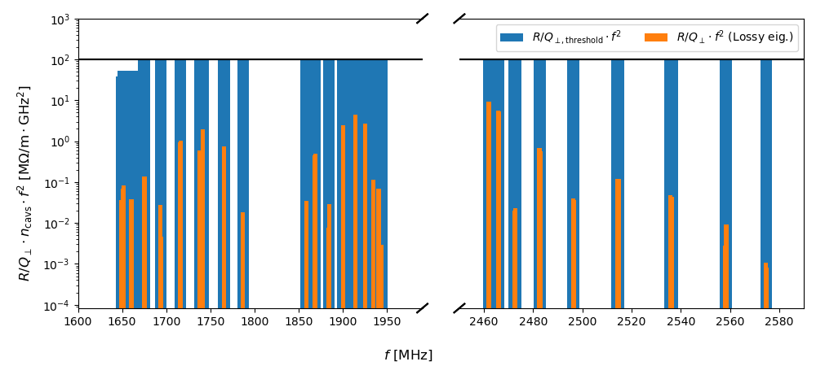
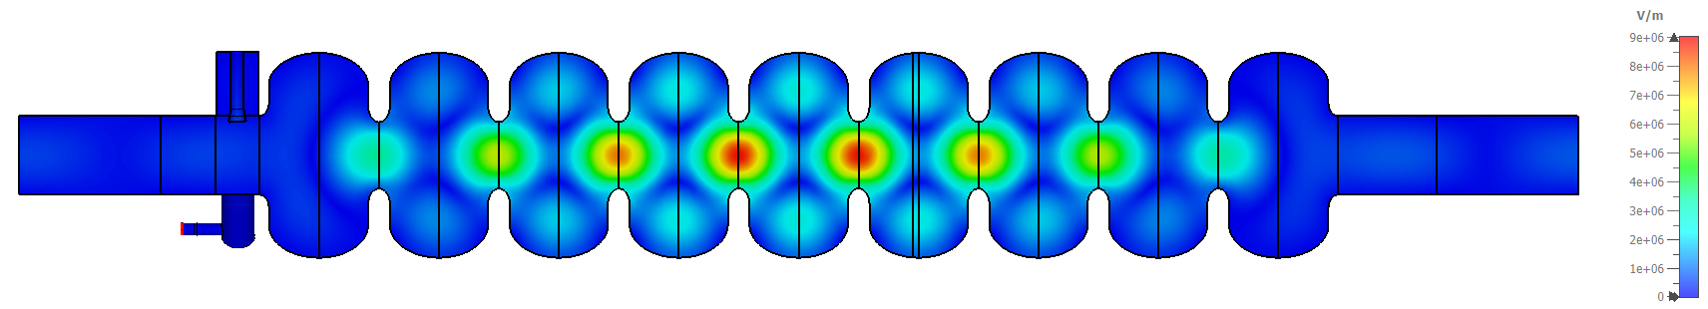
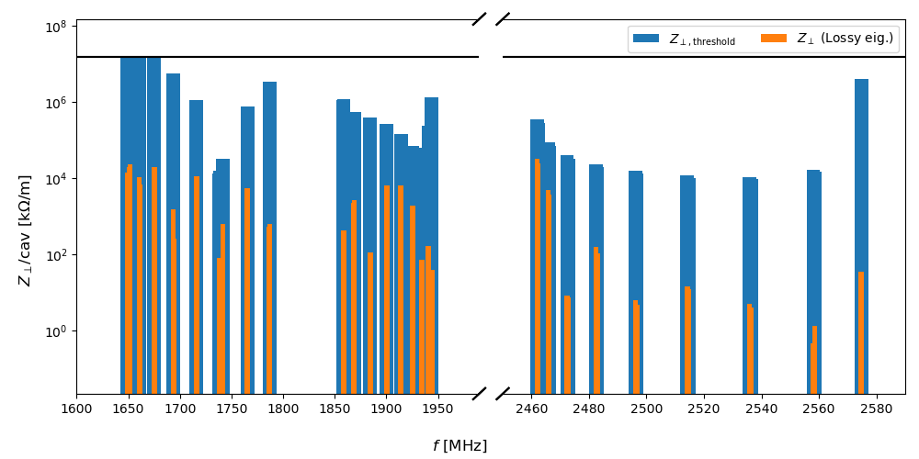
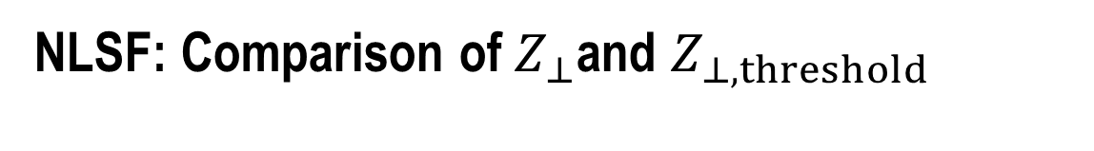
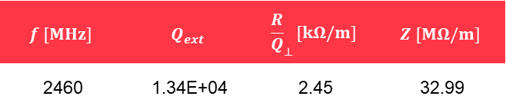
NLSF: Comparison of $Z_{⊥}$and $Z_{⊥, threshold}$
Trapped TE121 Mode
$$f [MHz]$$ | $$Q_{ext}$$ | $${\frac{R}{Q}}_{⊥}[kΩ/m]$$ | $$Z [MΩ/m]$$
2460 | 1.34E+04 | 2.45 | 32.99
Transverse impedance of dipole modes in first and second HOM dipole passband and transverse impedance threshold bar plot for the NLSF cavity geometry

Slide 20
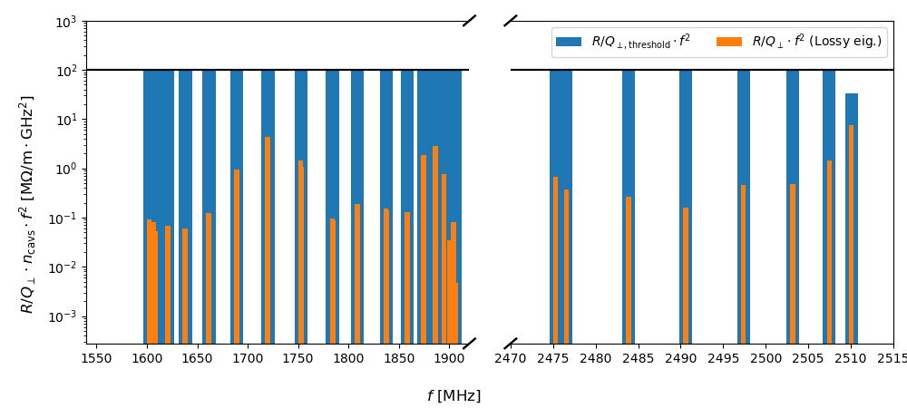
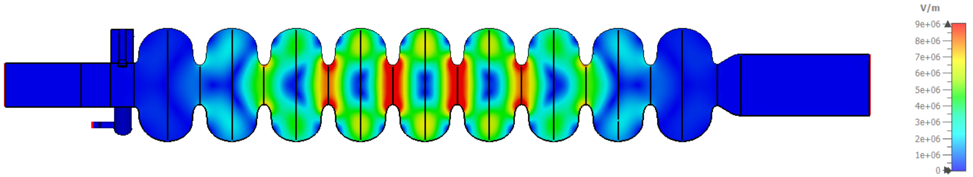
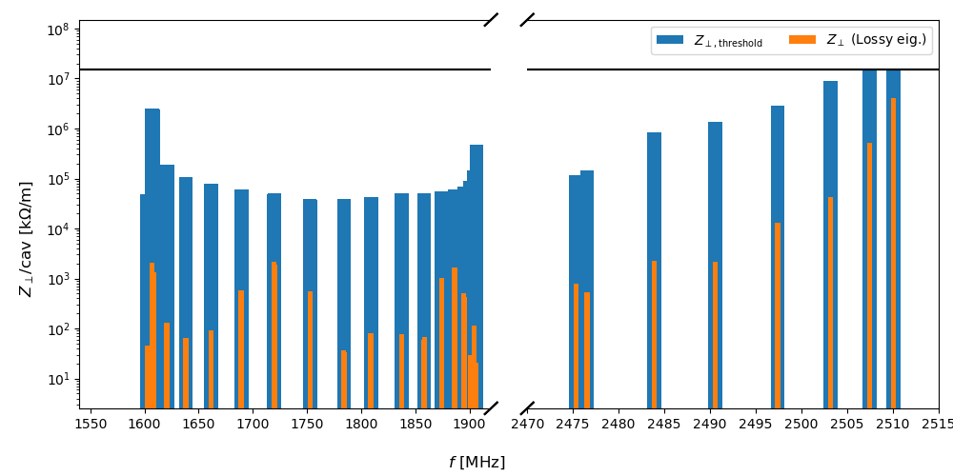
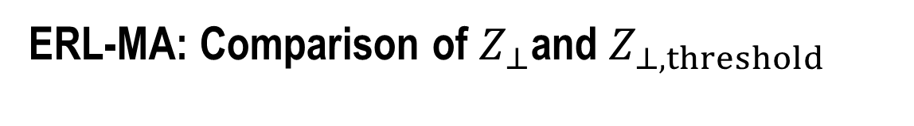
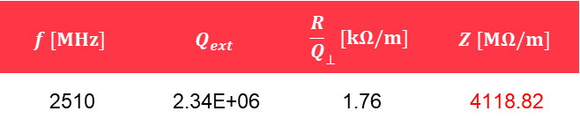
ERL-MA: Comparison of $Z_{⊥}$and $Z_{⊥, threshold}$
Trapped TE121 Mode
$$f [MHz]$$ | $$Q_{ext}$$ | $${\frac{R}{Q}}_{⊥}[kΩ/m]$$ | $$Z [MΩ/m]$$
2510 | 2.34E+06 | 1.76 | 4118.82
Transverse impedance of dipole modes in first and second HOM dipole passband and transverse impedance threshold bar plot for the ERL-MA cavity geometry

Slide 21
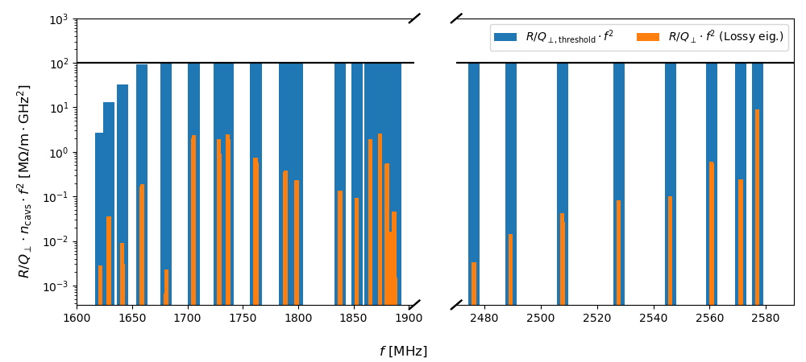
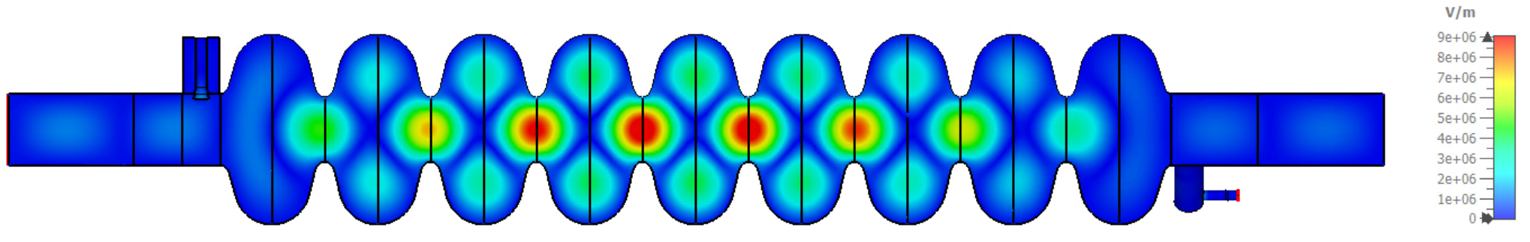
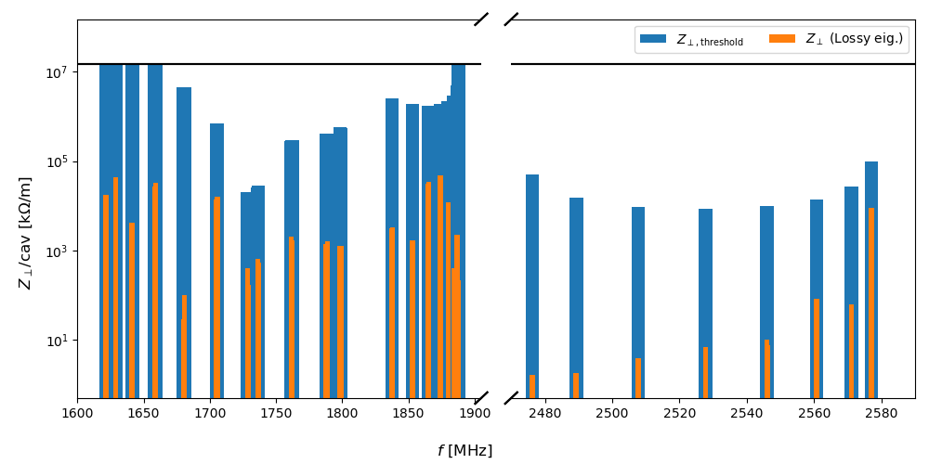
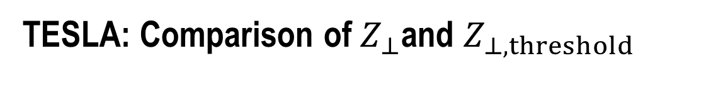

TESLA: Comparison of $Z_{⊥}$and $Z_{⊥, threshold}$
Trapped TE121 Mode
$$f [MHz]$$ | $$Q_{ext}$$ | $${\frac{R}{Q}}_{⊥}[kΩ/m]$$ | $$Z [MΩ/m]$$
2577 | 4.35E+03 | 2.06 | 8.97
Transverse impedance of dipole modes in first and second HOM dipole passband and transverse impedance threshold bar plot for the TESLA cavity geometry

Slide 22
Summary
The maximum impedance of the analysed cavities is less than the transverse impedance threshold values by different factors. The least suitable, considering the impedance threshold value, is the ERL-MA cavity geometry
The HOM impedance could be reduced further by optimising the HOM couplers and increasing the number of couplers
The TE121 mode is a trapped mode, and the cavity geometry(ies) need to be optimised to allow this mode to propagate to the end cells for proper damping
A HOM power of around10kW is expected. This value can be halved by reducing the number of cells per cavity at the cost of an increased number of cells

Slide 23
Thank you
for your attention

Slide 24
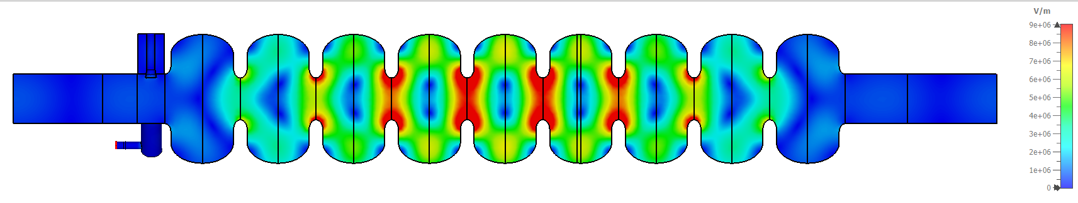
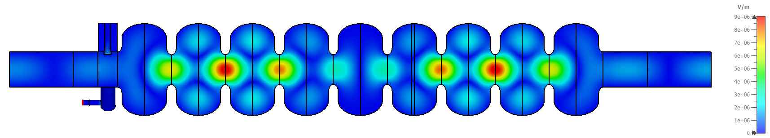
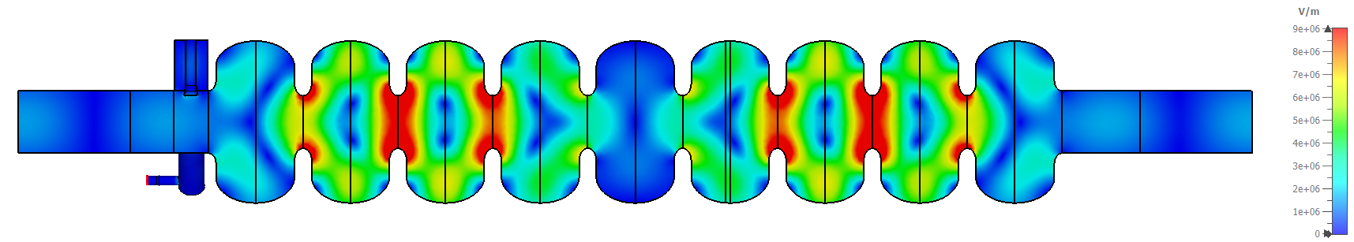
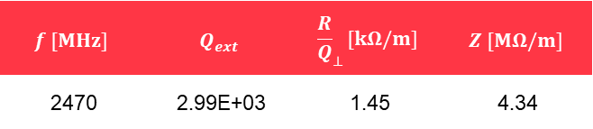

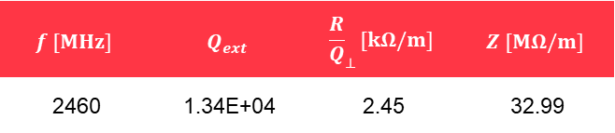

NLSF: Trapped TE121 Mode @~2470MHz
E-Fields scaled to a maximum of 9 MV/m
$$f [MHz]$$ | $$Q_{ext}$$ | $${\frac{R}{Q}}_{⊥}[kΩ/m]$$ | $$Z [MΩ/m]$$
2460 | 1.34E+04 | 2.45 | 32.99
$$f [MHz]$$ | $$Q_{ext}$$ | $${\frac{R}{Q}}_{⊥}[kΩ/m]$$ | $$Z [MΩ/m]$$
2460 | 1.18E+04 | 2.37 | 28.11
$$f [MHz]$$ | $$Q_{ext}$$ | $${\frac{R}{Q}}_{⊥}[kΩ/m]$$ | $$Z [MΩ/m]$$
2470 | 3.62E+03 | 1.47 | 5.35
$$f [MHz]$$ | $$Q_{ext}$$ | $${\frac{R}{Q}}_{⊥}[kΩ/m]$$ | $$Z [MΩ/m]$$
2470 | 2.99E+03 | 1.45 | 4.34

Slide 25
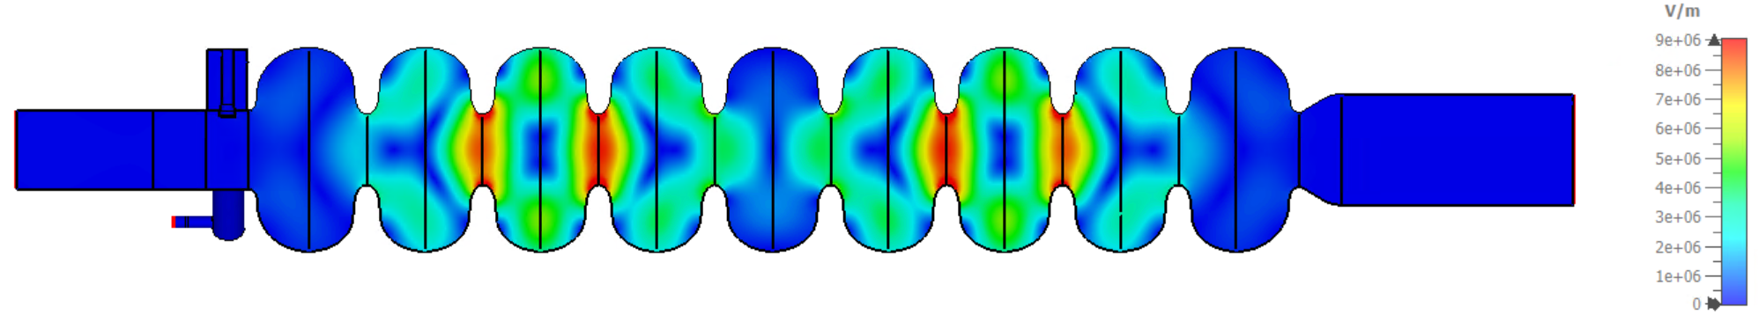
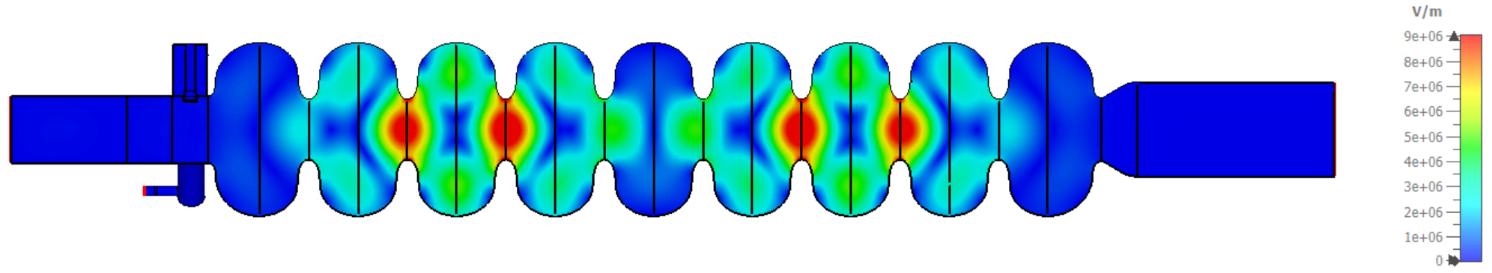
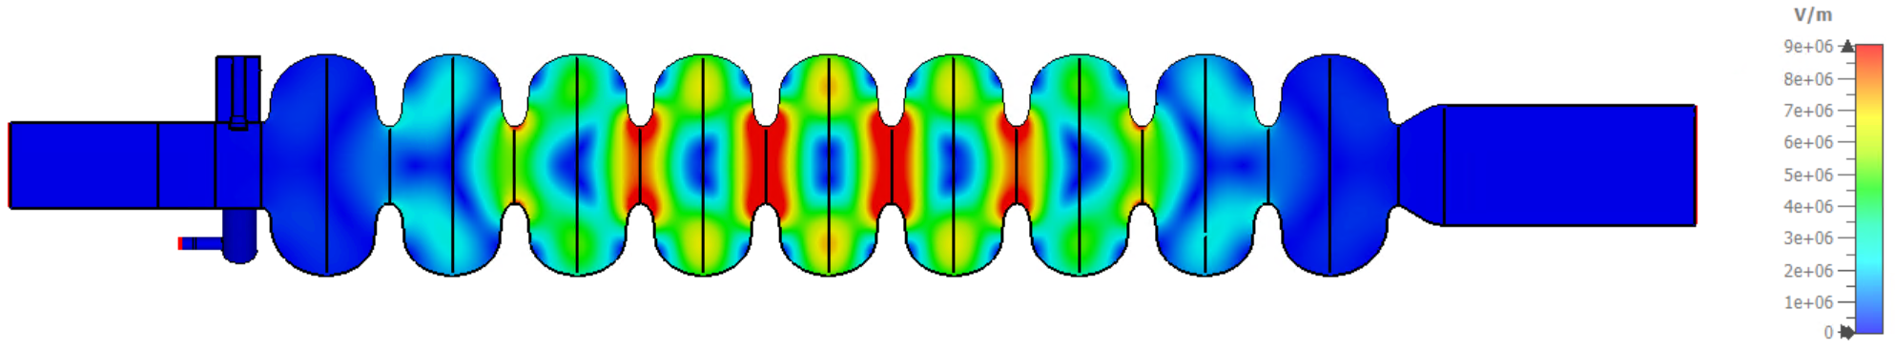
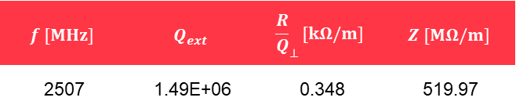

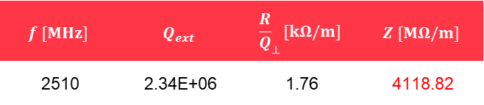
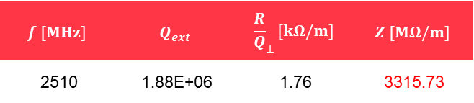
ERL-MA: Trapped TE121 Mode @~2510MHz
E-Fields scaled to a maximum of 9 MV/m
$$f [MHz]$$ | $$Q_{ext}$$ | $${\frac{R}{Q}}_{⊥}[kΩ/m]$$ | $$Z [MΩ/m]$$
2507 | 3.54E+05 | 0.345 | 122.26
$$f [MHz]$$ | $$Q_{ext}$$ | $${\frac{R}{Q}}_{⊥}[kΩ/m]$$ | $$Z [MΩ/m]$$
2507 | 1.49E+06 | 0.348 | 519.97
$$f [MHz]$$ | $$Q_{ext}$$ | $${\frac{R}{Q}}_{⊥}[kΩ/m]$$ | $$Z [MΩ/m]$$
2510 | 2.34E+06 | 1.76 | 4118.82
$$f [MHz]$$ | $$Q_{ext}$$ | $${\frac{R}{Q}}_{⊥}[kΩ/m]$$ | $$Z [MΩ/m]$$
2510 | 1.88E+06 | 1.76 | 3315.73

Slide 26
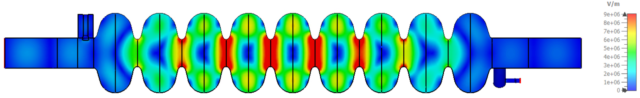

TESLA: Trapped TE121 Mode @~2577MHz
E-Fields scaled to a maximum of 9 MV/m
$$f [MHz]$$ | $$Q_{ext}$$ | $${\frac{R}{Q}}_{⊥}[kΩ/m]$$ | $$Z [MΩ/m]$$
2577 | 3.64E+03 | 2.05 | 7.47
$$f [MHz]$$ | $$Q_{ext}$$ | $${\frac{R}{Q}}_{⊥}[kΩ/m]$$ | $$Z [MΩ/m]$$
2577 | 4.35E+03 | 2.06 | 8.97

