Slide 1
Solenoids
Luca Bottura and Lionel Quettier
IMCC Annual Meeting

Slide 2
Questions
What solenoids can be used for testing RF ?
Where to find them ?
What is their cost ?
This is a partial and preliminary view

Slide 3
What solenoids for testing RF ?
Superconducting solenoid in the range of 2 T to 20 T and bore in the range of 50 mm to 200 mm are commonplace industrial products
Higher field/large bore is possible, but these are custom realizations (time, cost)
Split systems add complexity and reduce performance
In general, industry has excellent experience in solenoid engineering and construction

Slide 4
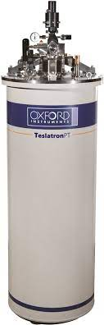
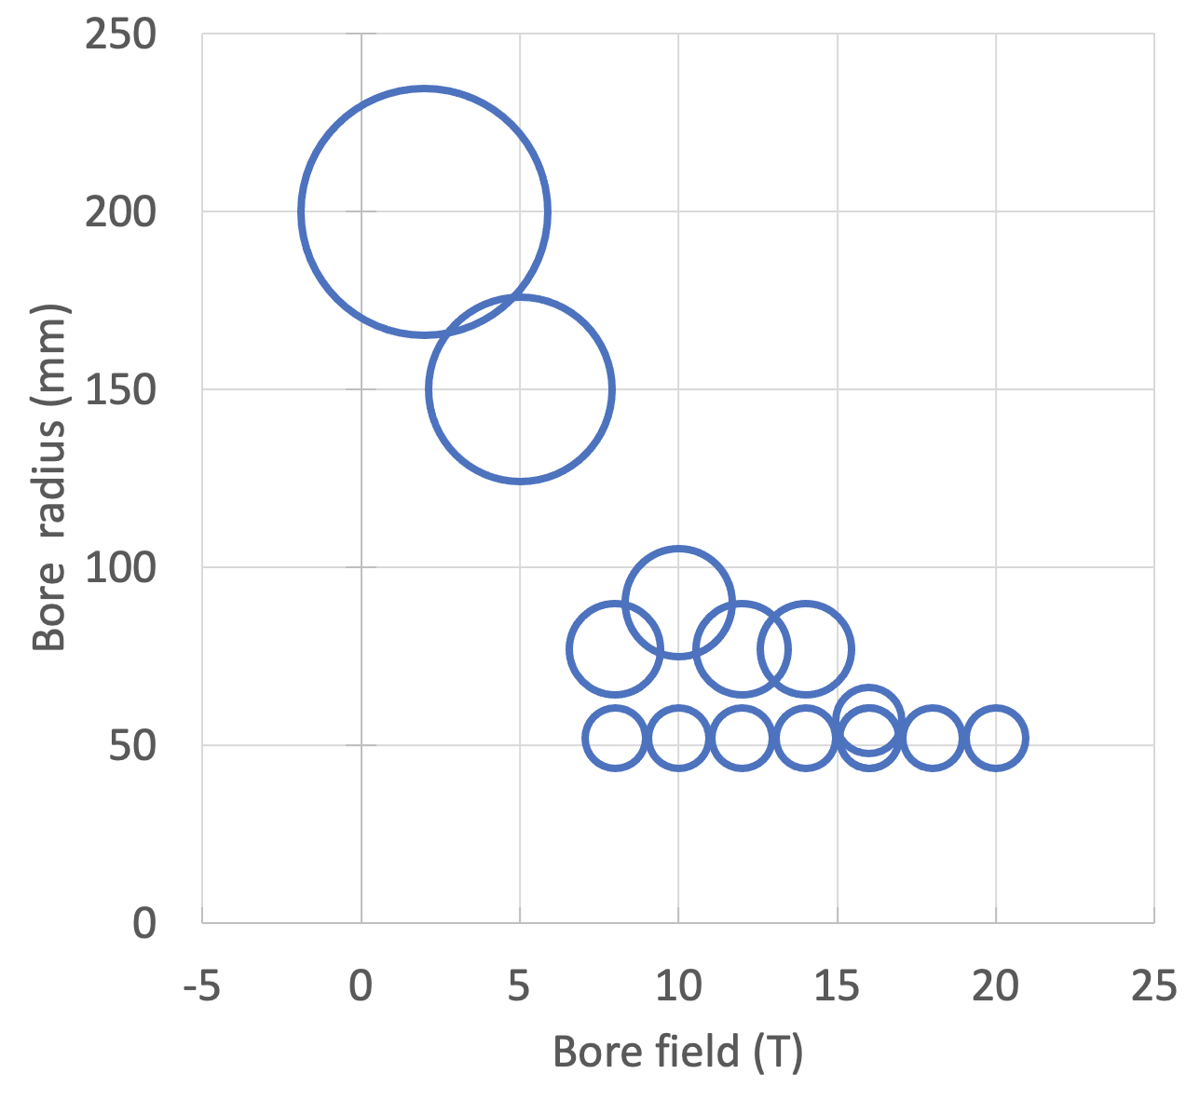
”Standard” solenoids
https://nanoscience.oxinst.com/resources/products/solenoid-magnets
An increase in bore typically calls for a decrease in field
50 mm is a standard bore for laboratory solenoids
This is just one example !

Slide 5
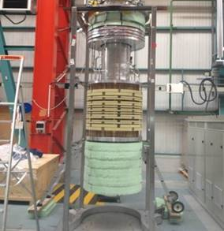
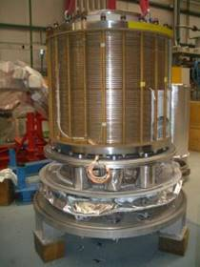

“Other” solenoids
3 T field, 350 mm warm bore
350 ppm in a 300 mm sphere
Operating cost: 15 k€ plus 6 k€/day
8 T field, 587 mm warm bore
Facility set-up: 1.2 M€
Operating cost: 10 k€/day
Available at CEA-IRFU

Slide 6

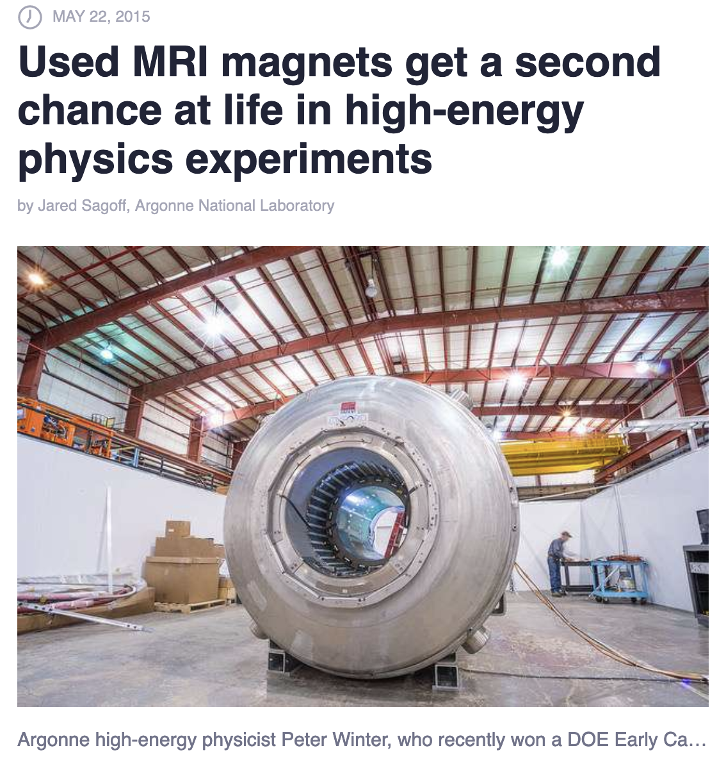
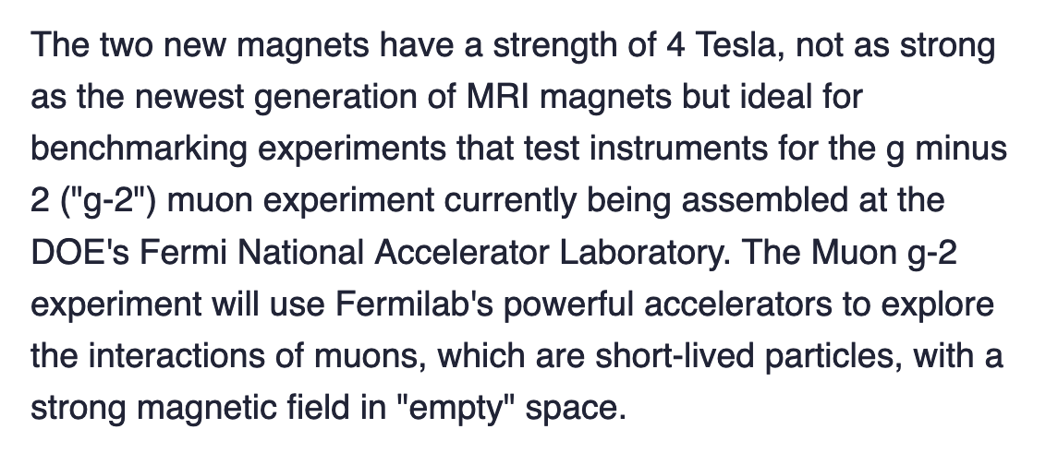
“Other” solenoids
4 T, 900 mm bore
MRI solenoid
Value 1 MUSD

Slide 7
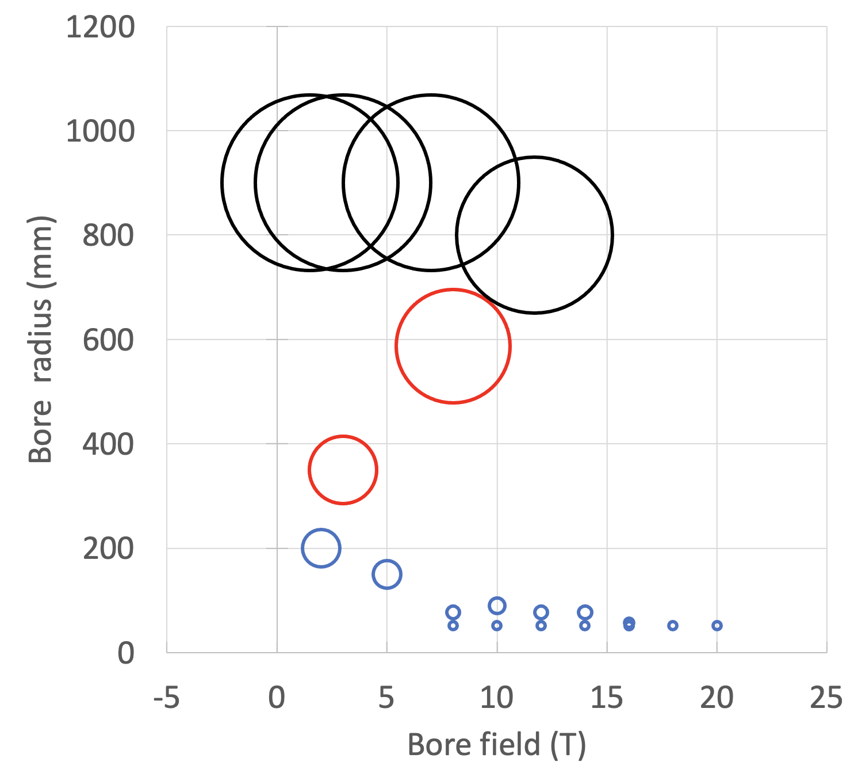
Wider overview
MRI magnets
Special laboratory magnets
Standard laboratory magnets

Slide 8
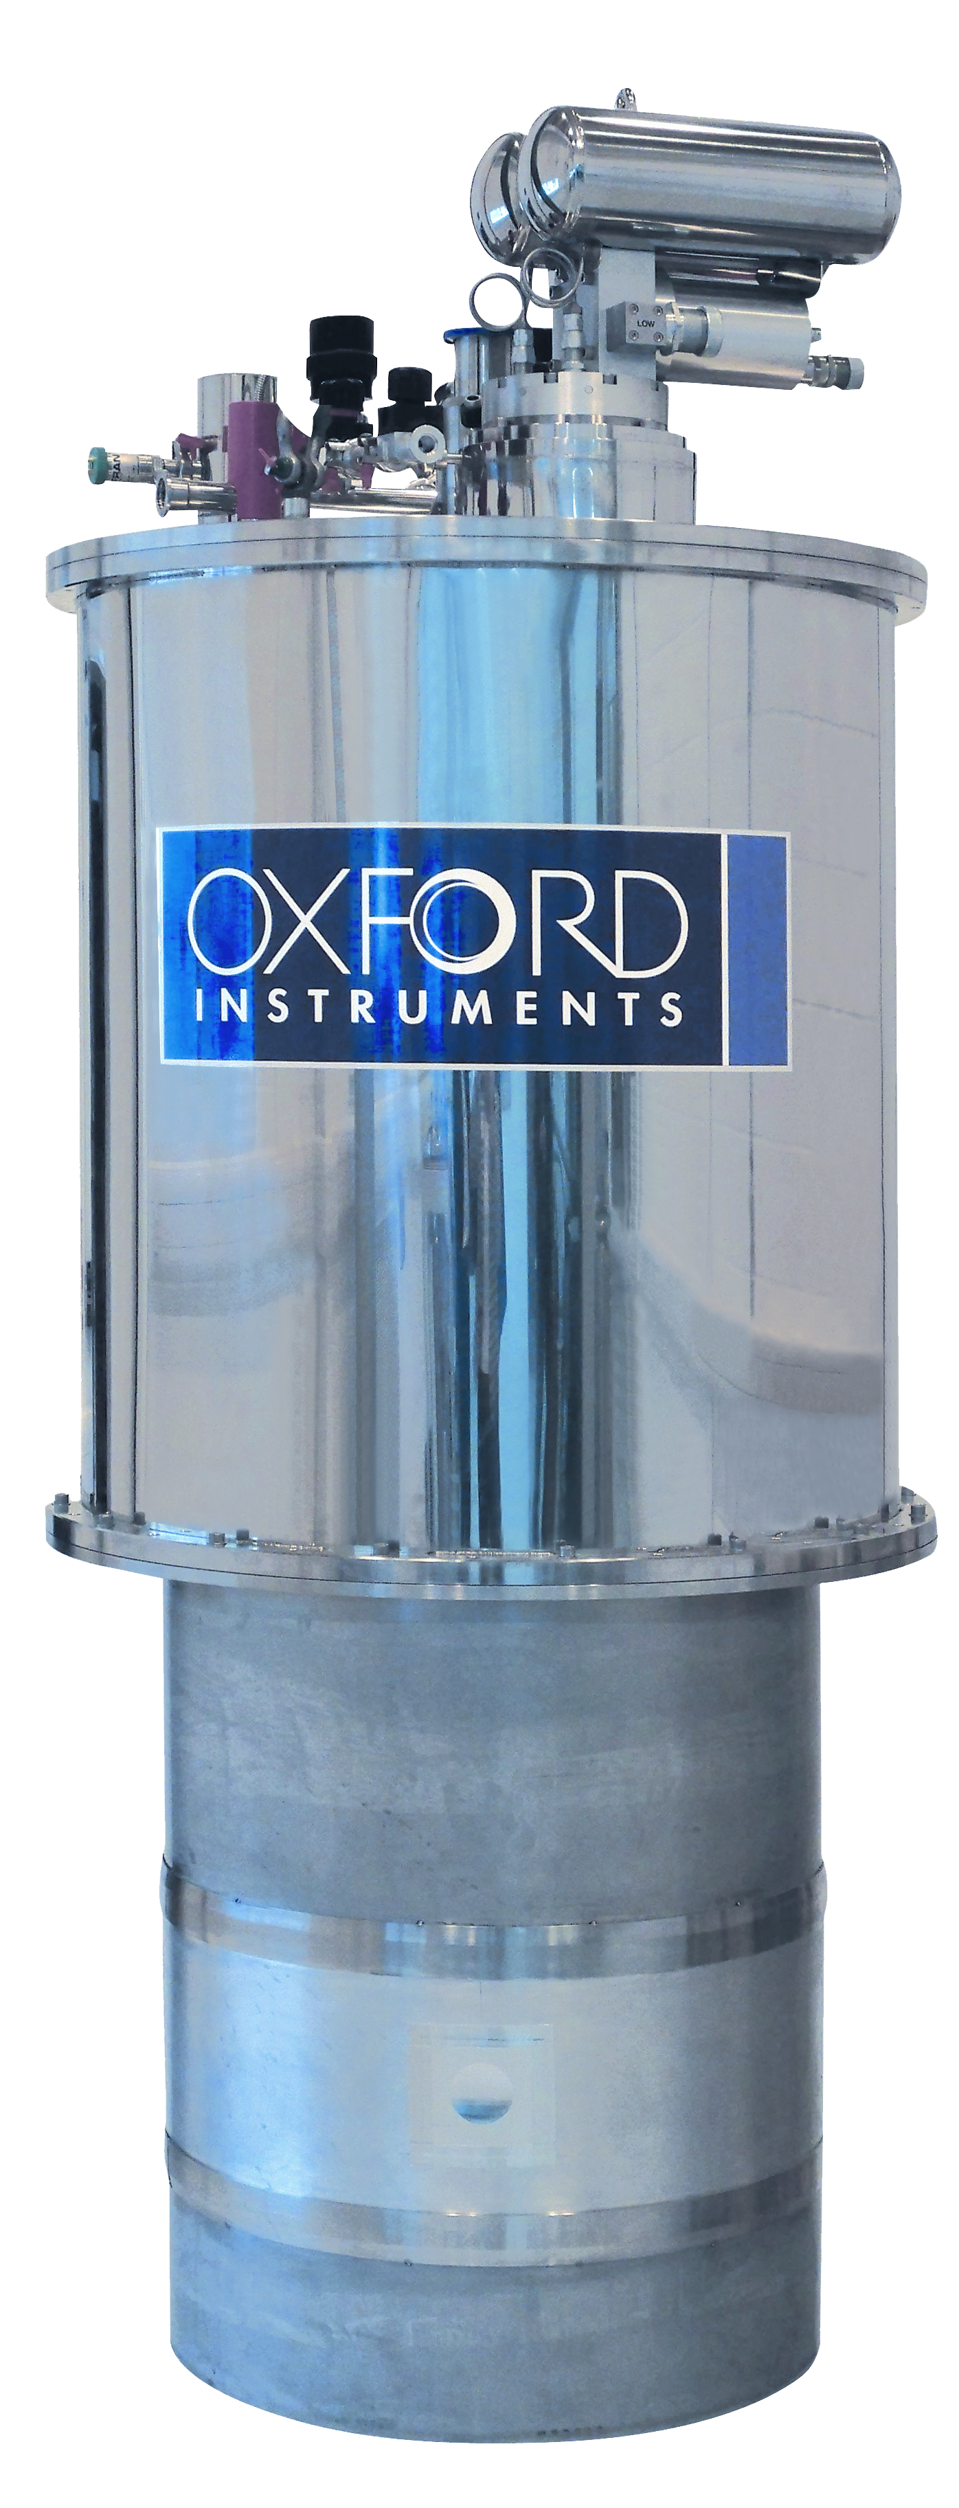
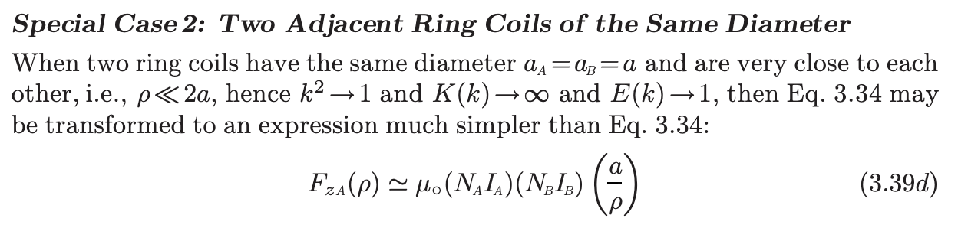
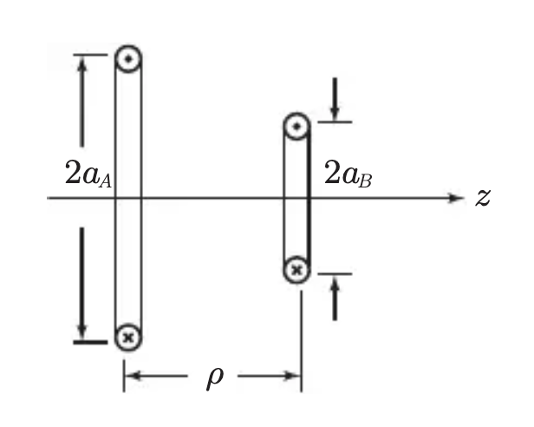
“Split” solenoids
Y. Iwasa, Case Studies in Superconducting Magnets
Split coils tend to attract(repel) each other with significant force
Example:
10 T split solenoid
150 mm x 100 mm coil
700 mm bore (2a)
100 mm gap (ρ = 250 mm)
Fz ≈ 25 MN (2500 tons)
This requires large support structures
7 to 15 T systems

Slide 9
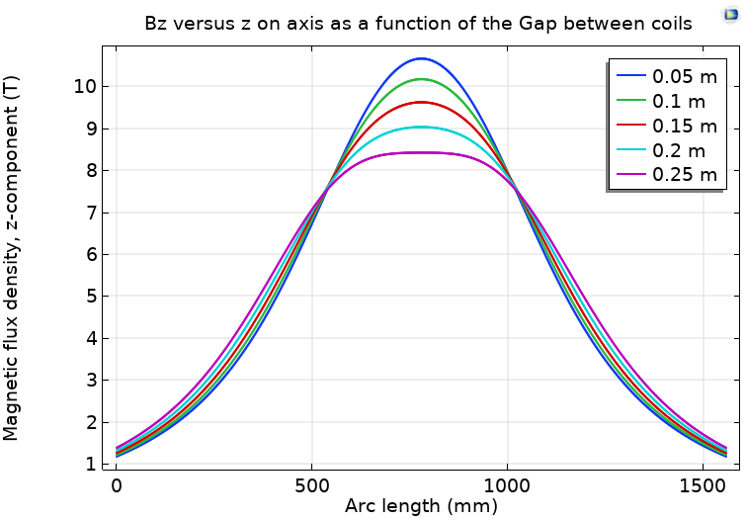
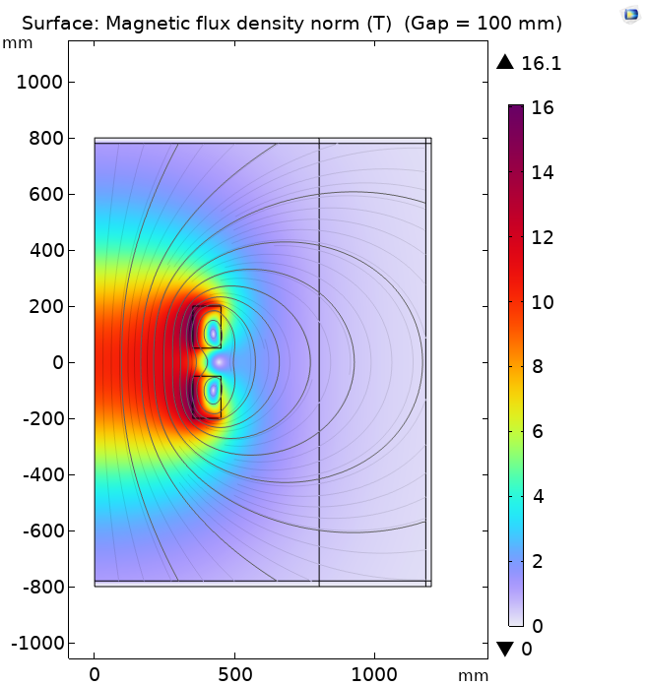
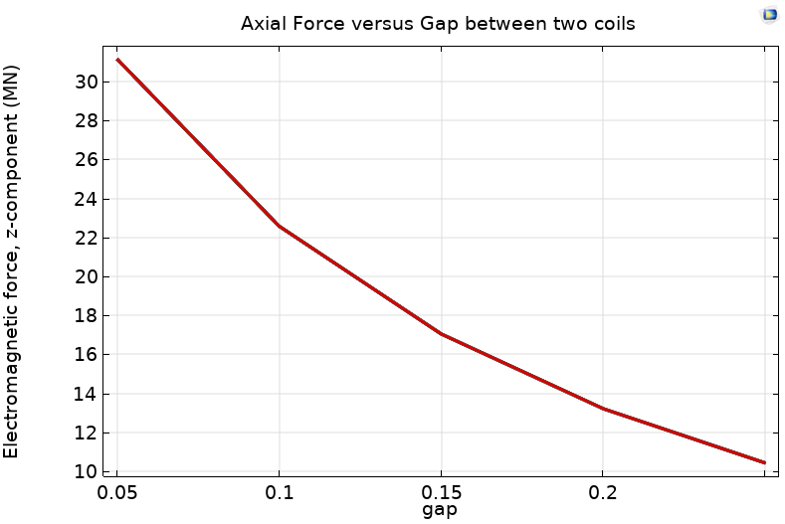
A specific split solenoid
10 T, 700 mm bore
3000 tons
Courtesy of S. Fabbri, CERN
1000 tons

Slide 10
Where to find them ?
Standard laboratory solenoids (2…20 T, 50…200 mm) are best procured in industry, who has experience in design, engineering and construction
Custom laboratory solenoids (5..10 T, 500…1000 mm) need to be purpose designed and built – this can be a very time consuming and expensive endeavor. Most effective approach is to use existing facilities
MRI-class magnets (1.5…7 T, 900 mm) could at best be found (decommissioned) or procured as “stripped” magnetic system

Slide 11
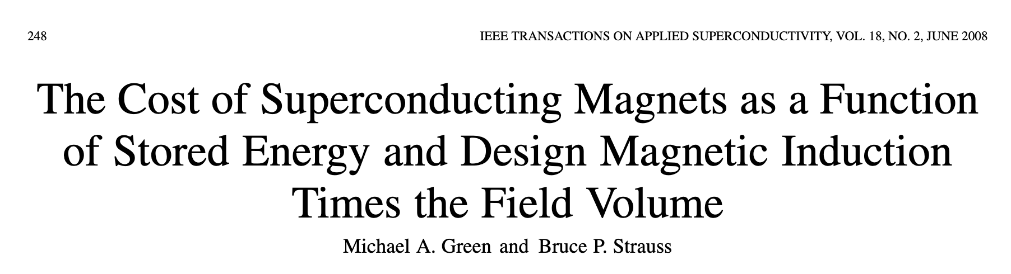
What is their cost ?
There is a large difference between the cost of the magnet and the cost of a system (cryostat and test environment, cooling, powering, protection, …)
Focus on the magnet cost only:

Slide 12
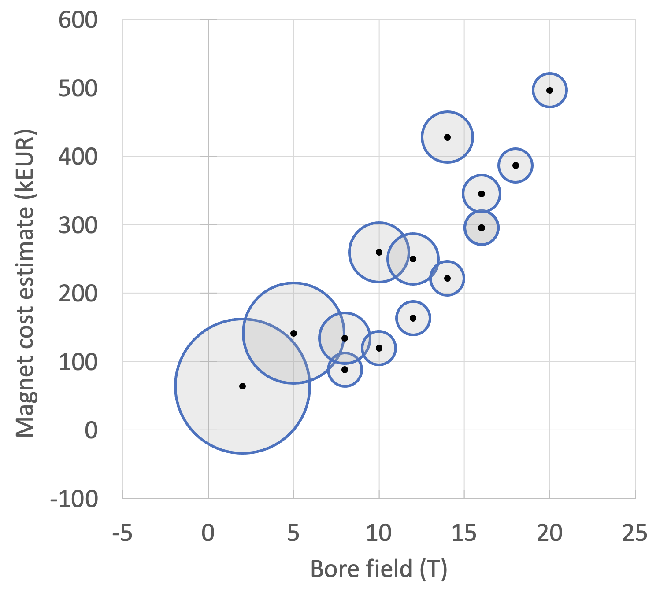

Magnet cost scaling
Indicative !
MRI magnet cost
Cost scales with magnet stored energy
Field (T) | Cost (MEUR)
1.5 | 0.5
3 | 1
7 | 5
Profiting from years of engineering, production scale-up and optimization

Slide 13
Summary questions
What magnet should we look for, among the above classes (standard laboratory, custom laboratory, recycled MRI) ? Remember:
  A test station is much more than a magnet
  In-house is generally more expensive than off-the-shelf
Is it possible to split the test demands to reduce magnet requirements ? Material testing at high field/gradient may be possible in existing, small bore test infrastructure (?), while component testing may be done in modest performance, large bore new test infrastructure (?)

