Slide 1

High Efficiency Klystrons for MuCol
G. Burt for HE project team at CERN & Lancaster:
Igor Syratchev
Nuria Catalan
Zain Un Nisa
Anis Baig

Slide 2
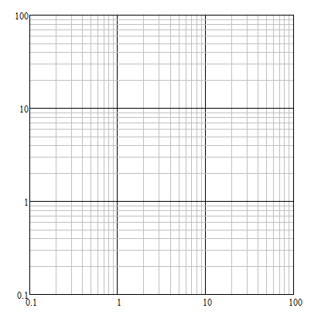
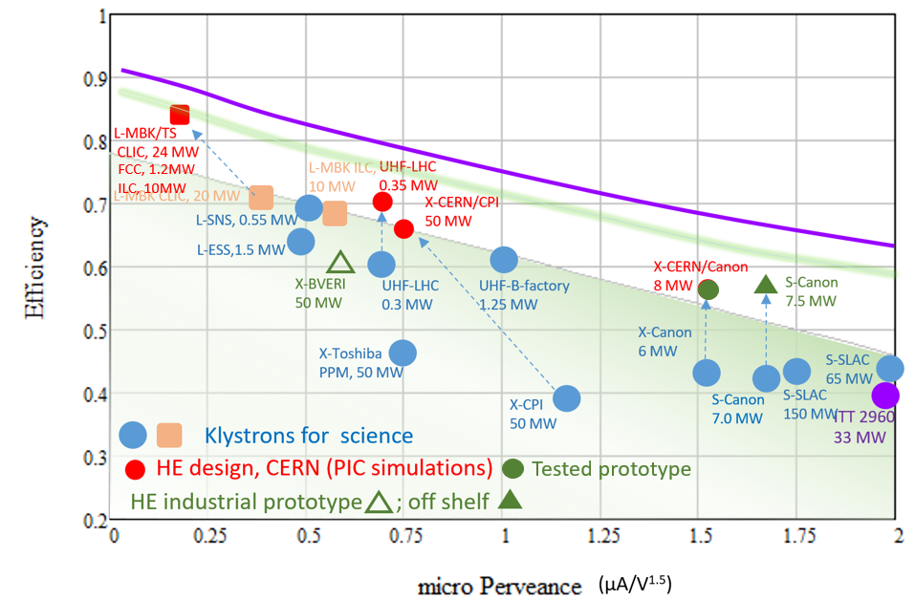
The klystron is a key element of almost all particle accelerators.
High Efficiency klystrons project at CERN is targeted to improve efficiency and performance of these devices for various applications.
electron & proton rings
SC e/p Linacs
electron Linacs
high intensity
high gradient
PAL
NLC
Muon Collider
SLAC
e-rings
injectors
PSI
SACLA
CLIC’k
DEFT
CLIC, Muon_C
MBK
Beam diagnostic,
X-FEL
FNAL
ILC
DESY
Ultimate limit
Industrial/Medical
Peak power, MW
J-PARC
LHC
ESS
Magnetron
(oscillator)
FCC_{ee}
SLAC-BF
KEK
CEPC
Tetrode
LHC
HE klystrons at CERN
Klystrons
Pulsed
Continuous Wave
In fabrication
SSA tower
IOT
single beam
Frequency, GHz

Slide 3
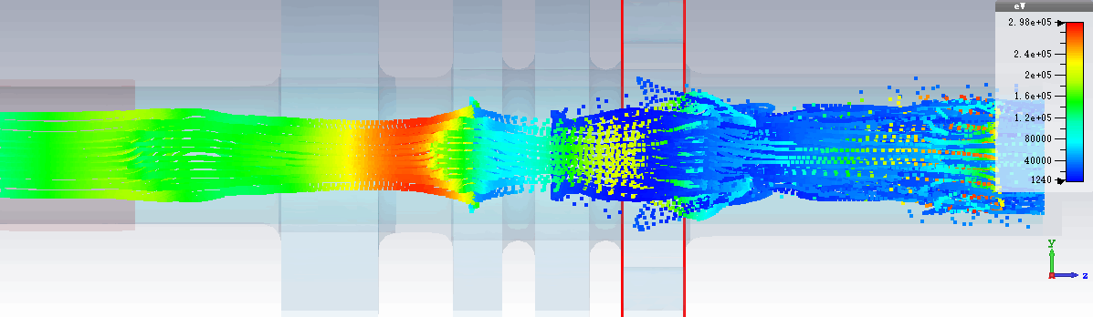
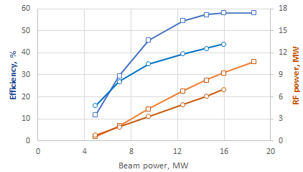

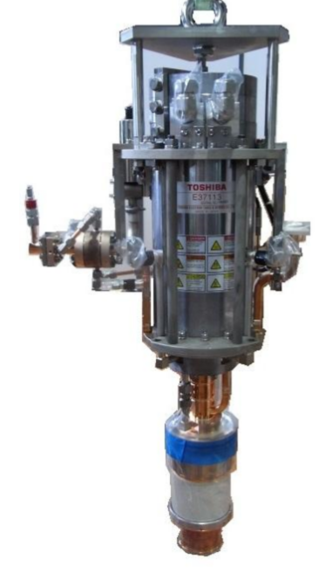
Retro-fit High Efficiency 8 MW, 12 GHz klystron. CERN/Canon collaboration.
E37113
HEX8
HEX8
E37113
Retrofit design
8-10 MW | E37113 at factory | HEX COM_M (CERN/Canon)
Voltage, kV | 154 | 154
Current, A | 94 | 94
Frequency, GHz | 11.994 | 11.994
Peak power, MW | 6.2 | 8.1
Sat. gain, dB | 49 | 48
Efficiency, % | 42 | 56.4
Life time, hours | 30 000 | 30 000
Solenoidal magnetic field, T | 0.35 | 0.42
RF circuit length, m | 0.127 | 0.127
The same modulator
Re-used solenoid
Re-used cathode
New RF window (CERN design)
Two tubes arrived at CERN and now they are being installed in the XBOX#3 test area.
VKX-8311A

Slide 4
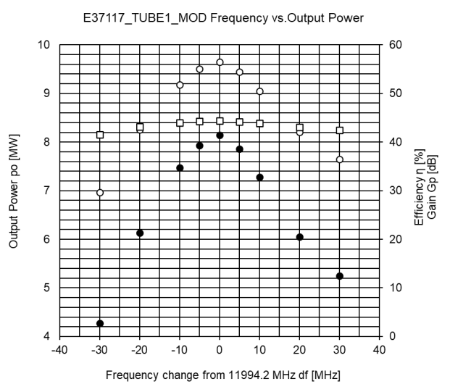
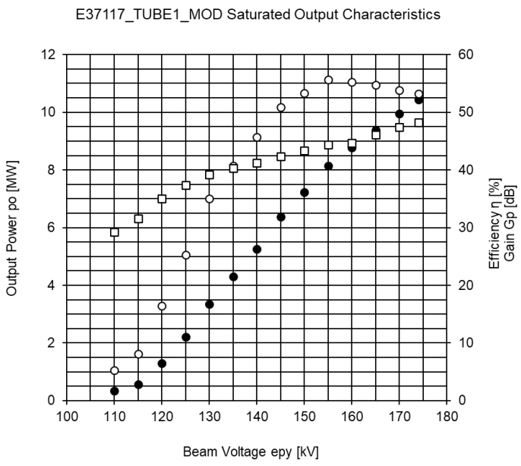
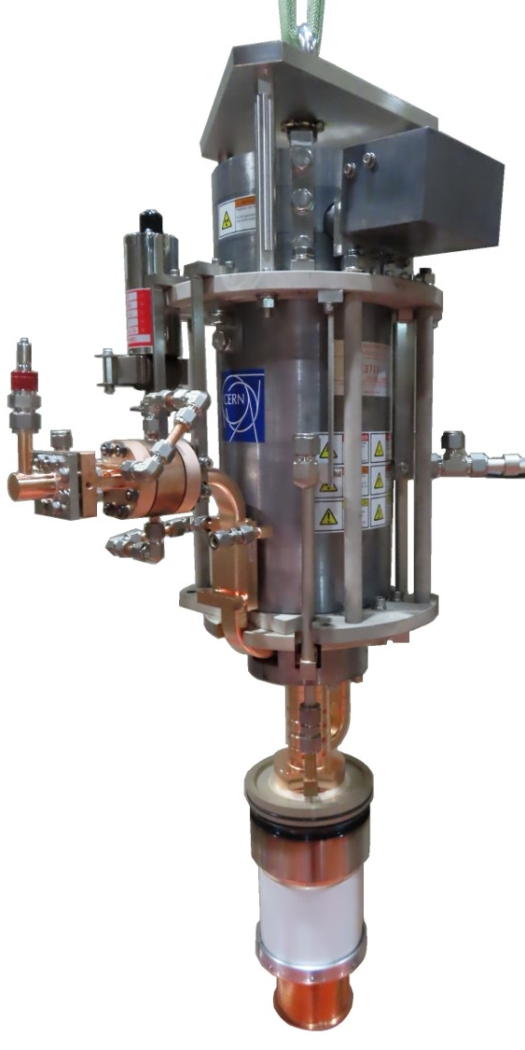
The klystron was successfully tested at Canon in December 2022 up to 10.5MW.
154kV,
Fixed Pin
In saturation
At operating frequency klystron showed 57%. That corresponds to 35% RF peak power increase compared to the original Canon tube at the same operating voltage.
Tube reached 10.5MW. Compatible with existing Xbox#3 ScandiNova modulator (with 175kV max recommended).
In a range of RF power levels from 6MW to 10.5 MW the klystron is 50%+ efficient and can be used for different application in this range by adjusting modulator type/voltage.
The tube is commercially available.

Slide 5
A. Grudiev MC RF WG meeting #9:
March 22

Slide 6
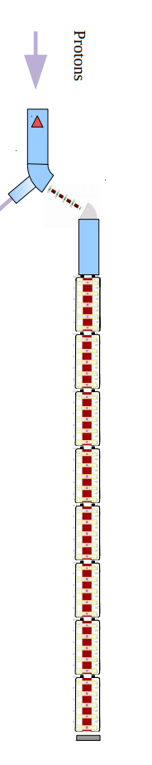
Muon cooling demonstrator layout
High peak power klystron: 24 MW
A. Grudiev and R. Losito
MC RF WG meeting #5: Sept 21
modulator
RF for cooling: Max. gradient 30 MV/m
klystron
24MW
WG distribution with phase adjustment to feed 2 x 4 cavities
RF for 144 cavities at
~30 MV/m
30mx14m
18 RF stations
Building -> Gallery :
(underground might be possible)
30m x 15m
Height: 8-10 m
32m
WG
WG
cavity
cavity
cavity
cavity
cavity
cavity
cavity
cavity
14m

Slide 7


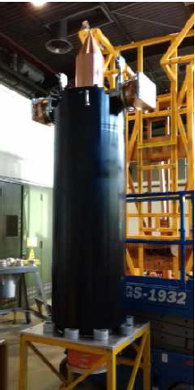
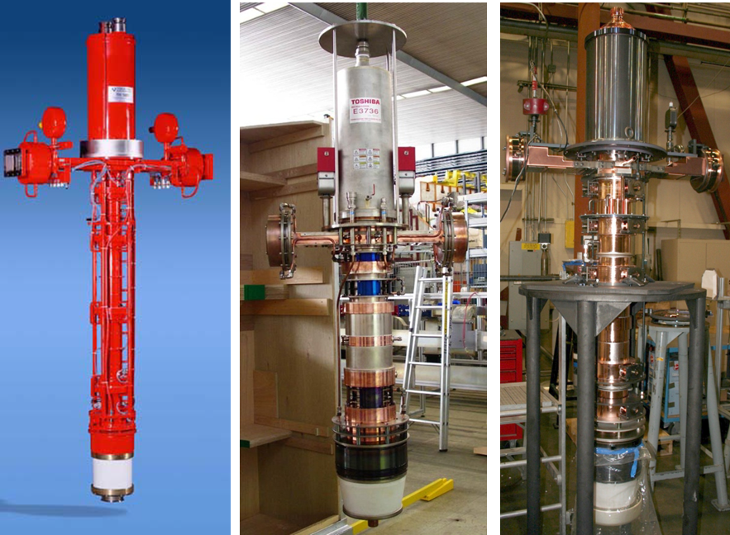
High power L-band Multi Beam Klystrons (MBK). Commercial tubes.
Canon E37503
Thales TH1803
Thales TH1801
Toshiba E3736
CPI VKL-8301
Frequency: 1.0 GHz
Peak RF power: 20 MW
Efficiency: 70%
Frequency: 1.3 GHz
Peak RF power: 10 MW
Efficiency: 65%

Slide 8

Scaling the Canon tube to 0.7GHz, 24MW and 30 µsec.
Canon E37503
6 beams MBK
Mu-tube, 0.7 GHz
6 beams MBK
F= 999,5 MHz
P max= 20.2 MW
T = 150 µsec
V= 159.4 kV
I total = 180 A
Eff.= 70.5 %
uP= 0.47 µAxV^{-3/2}/beam
Gain = 53.9 dB
P _{average} (50Hz)= 150kW
F= 700 MHz
P max= 24 MW
T = 30 µsec
V= 171 kV
I total = 200 A
Eff.= 70.0 %
uP= 0.47 µAxV^{-3/2}/beam
Gain = 53.9 dB
P _{average} (5Hz) = 3.6kW
To our experience such a scaling is a ‘low’ risk development:
For the fixed micro perveance, the tube length is proportional to the frequency
Lower cathode current density (55%) and increased life time.
Much lower average power (simpler collector)
Marginal (~10%) increase of the modulator voltage and current.
Cost and schedule:
The CLIC tube prototypes were designed/built about 10 years ago; Canon: iiiii and Thales : iiiiii. Mu-tube cost will be within this range, as the companies shall do it not from scratch, but could scale it from exiting ones. Though, today there is no market for such devices, thus the cost of ‘unique’ prototype could be even higher.
Similar to the CLIC tubes, it will take about 24 month to design, built and test the first Mu-tube prototype. Additional budget will be needed for the testing infrastructure (like RF loads etc.).
‘Quick’ extrapolation

Slide 9

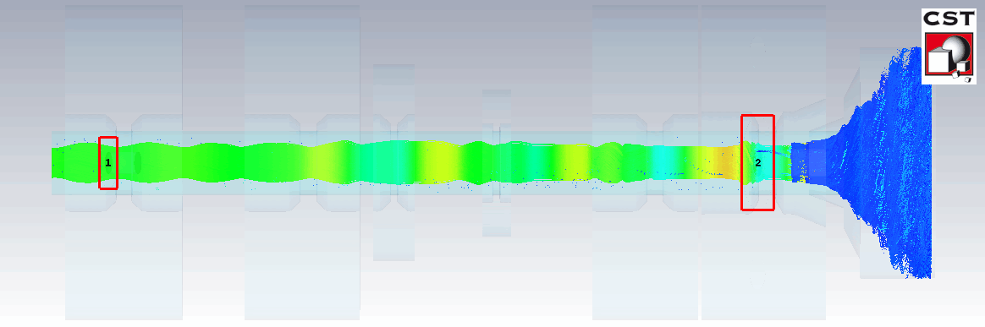
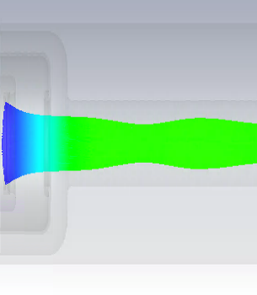
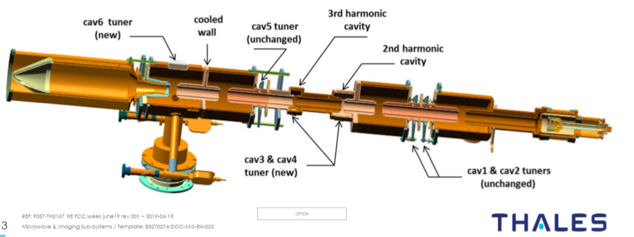
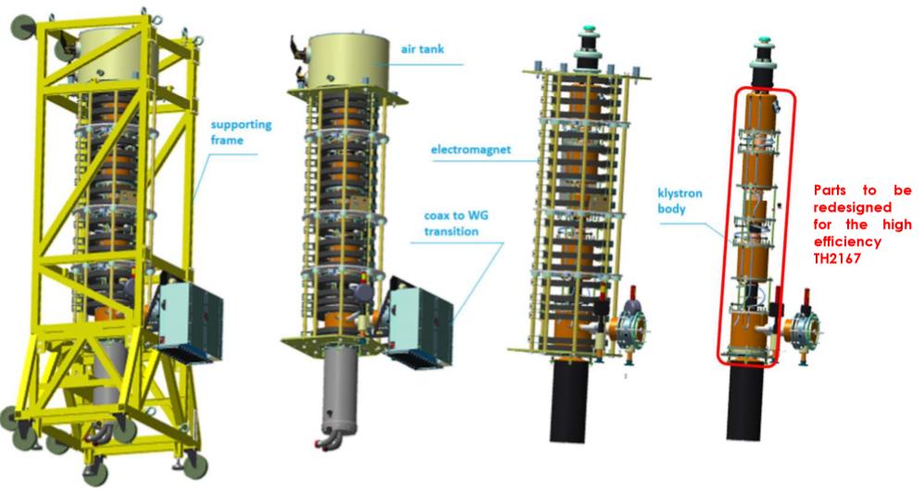
Retro-fit High Efficiency (70%) 350kW, CW, 0.4 GHz CSM LHC klystron upgrade.
(in collaboration with Thales)
 | LHC/CSM | LHC/Thales
Frequency, GHZ | 0.4 | 0.4
Beam power, MW | 0.5 | 0.5
Perveance, | 0.72 | 0.72
RF power, MW | 0.35 | 0.30
Efficiency, % | 70 | 60
Re-used housing, electron gun and solenoid
Cut-off view of the LHC CSM klystron
In fabrication. Will be tested in March 2024.

Slide 10
Existing tubes
While tubes >24 MW exist they are all above 3 GHz
There are 10-20 MW tubes developed for CLIC drive beam and ILC at 1-1.3 GHz
Nothing of this power exists at 325 or 650 MHz
Issue is typically that to get high power means high voltage which makes the tubes longer
For scaling at low frequency this used to not be feasible as length is inversely proportional to frequency for constant beam
New developments may change that……..

Slide 11





Two-Stage Multi Beam Klystron (TS MBK) technology.
Commercial HE MBK
Efficiency 70%
Specific features
GOOD FOR:
Bunching at a low voltage (high perveance). Very compact RF bunching circuit.
Bunched beam acceleration and cooling (reducing Δp/p) along the short DC voltage post-accelerating gap.
Final power extraction from high voltage (low perveance) beam. High efficiency.
V
V₁+V₂
Additional advantages:
For pulsed tubes, the second HV stage can be operated in DC mode. Thus simplifying the modulator topology. (cost/volume) and increasing the modulator efficiency.
Simplified feedback for the first stage pulsed voltage. Improved klystron RF phase and amplitude stability.
TS HE MBK
Efficiency 85%
HV insulators
Stage 1
Drawbacks:
V₁
Reflected electrons from the output cavity and collector shall be avoided at any cost.
RF radiation into DC gap has to be sealed.
Requires special HV isolated RF feedthrough to inject RF signal into input cavity.
V₂
Post accelerating gap
Stage 2

Slide 12
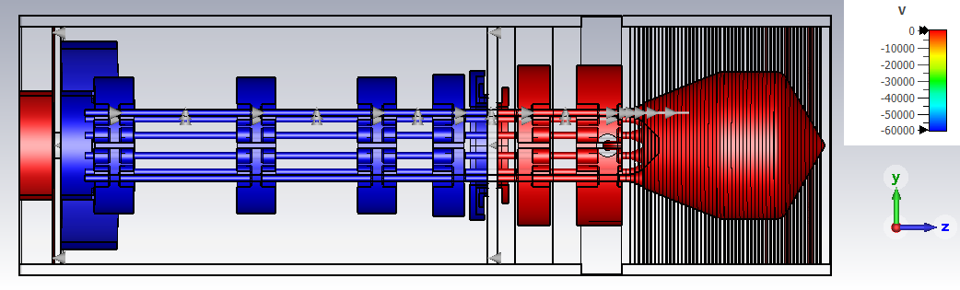
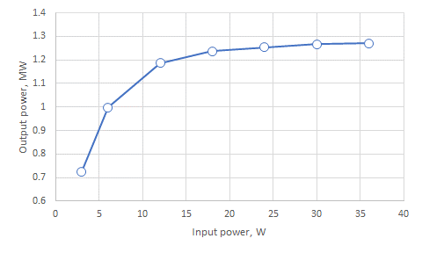
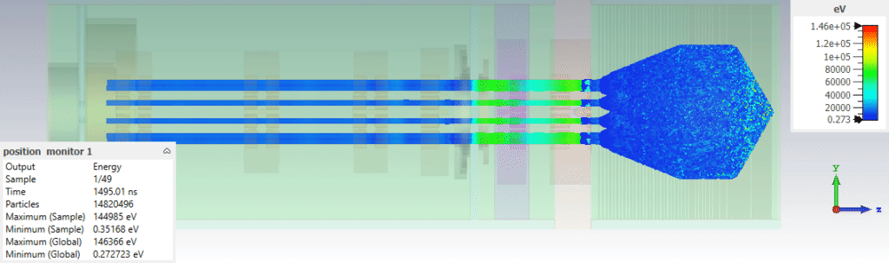
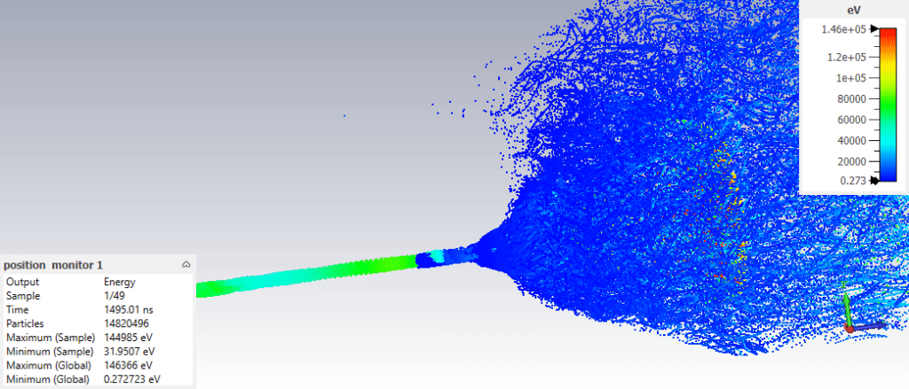
FCC Two-stage MBK klystron: CW, 400MHz, 1.28MW.
Pic 3D model
10 beams
Total current 21A
1st stage:
60kV/floating
At ground
Cathode
+12kV
Power gain curve at nominal voltage (PIC results)
RF length 1.6m
2nd stage
Collector
DC accelerating gap
Particles velocity animation
Very Efficient: 84%
Compact: ~2.5m length in total
Low voltage: 60kV+12kV
High saturated power gain: 46dB
Only single beam shown

Slide 13
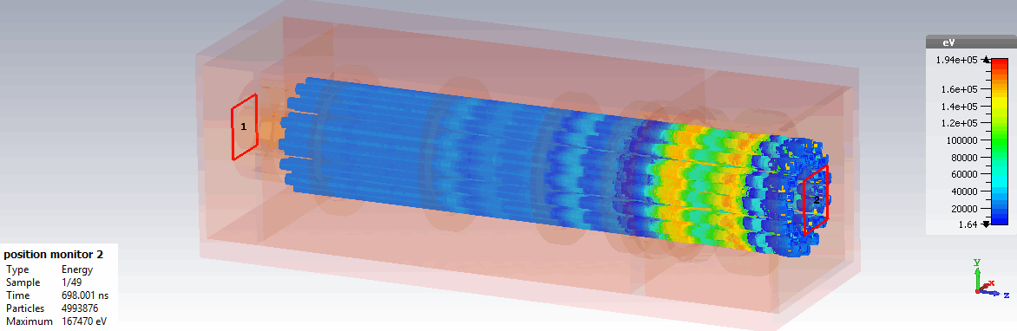
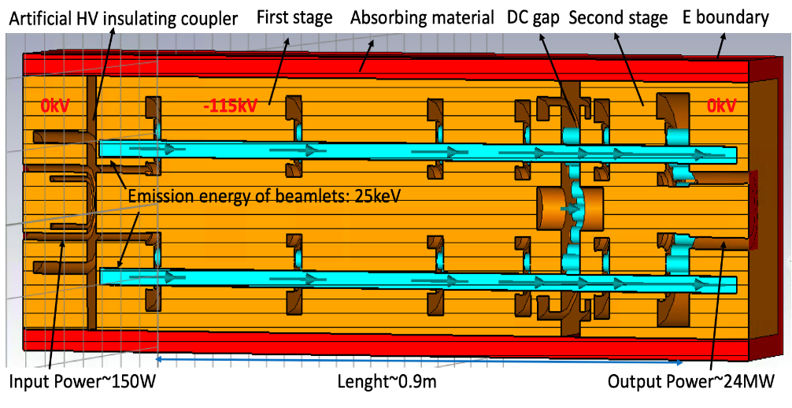
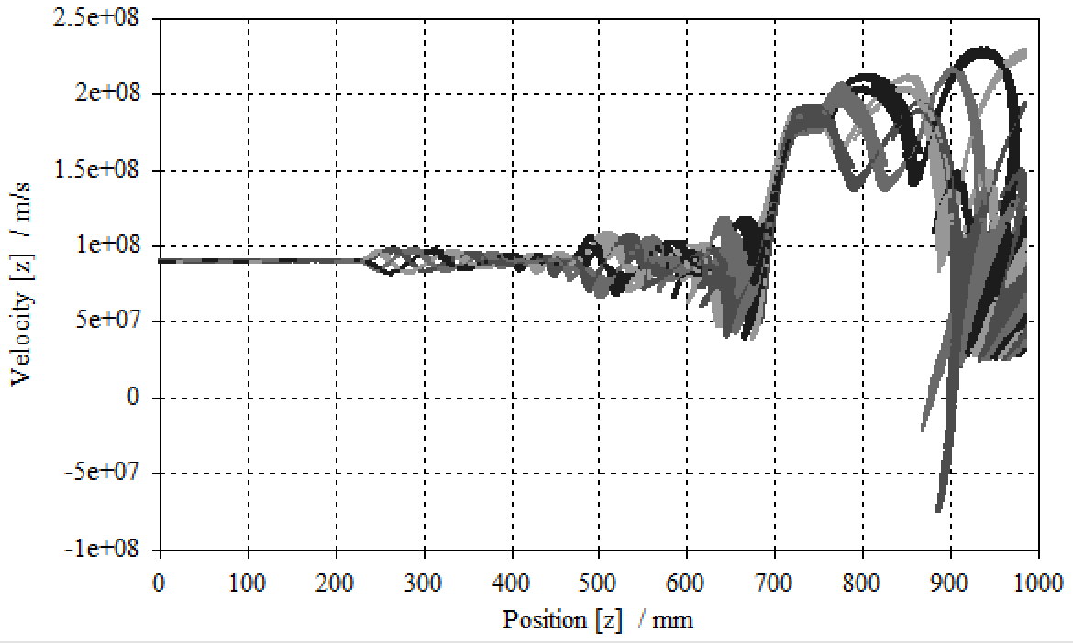
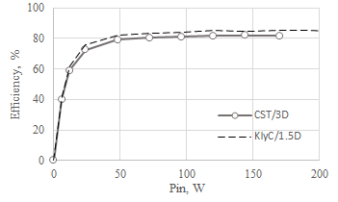
CLIC Two-stage MBK klystron: Pulsed, 1.0 GHz, 24 MW

Slide 14
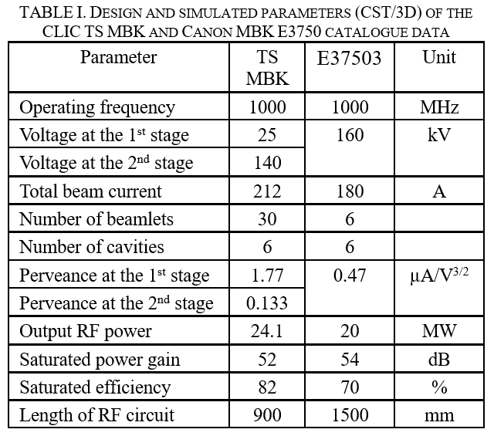
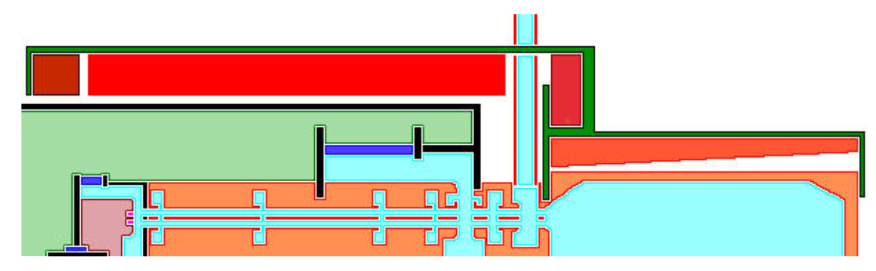
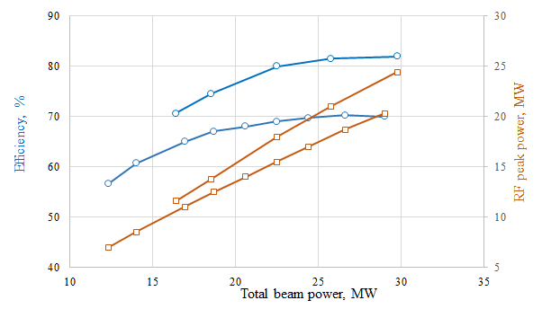
CLIC Two-stage MBK klystron: Pulsed, 1.0 GHz, 24 MW
Magnetic circuit
Local oil tank
Cathode ceramic (25 kV)
Main solenoid
1st stage
2nd HV insulating ceramic (115 kV)
2nd stage
PA gap
Output waveguide
Output coil
TS MBK
Beam collector
Collector coil
E37503

Slide 15
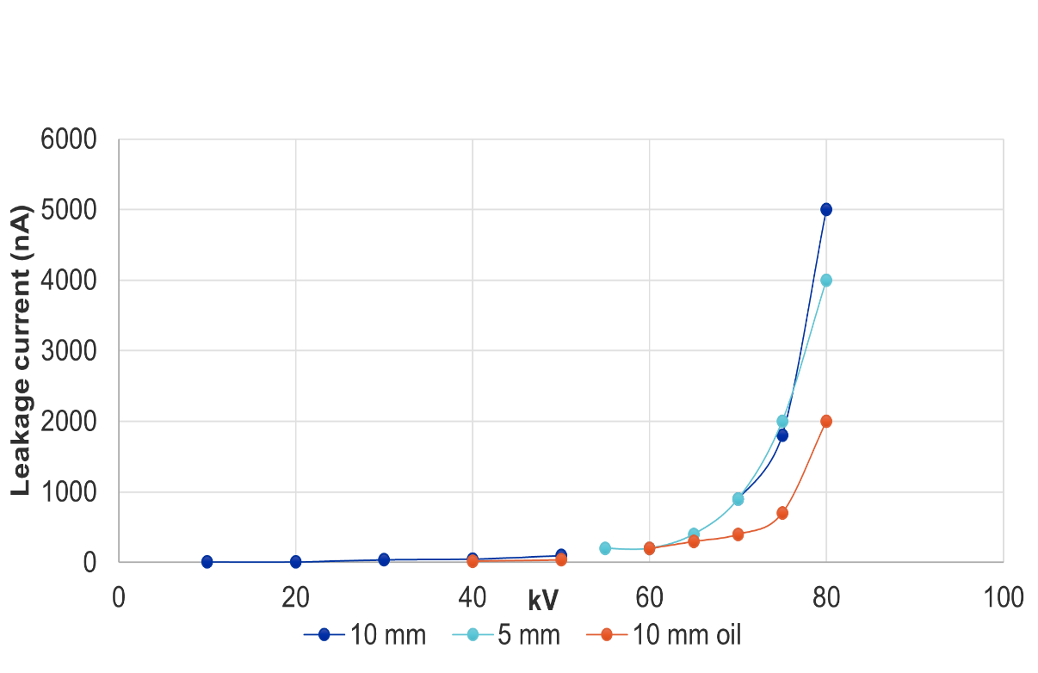
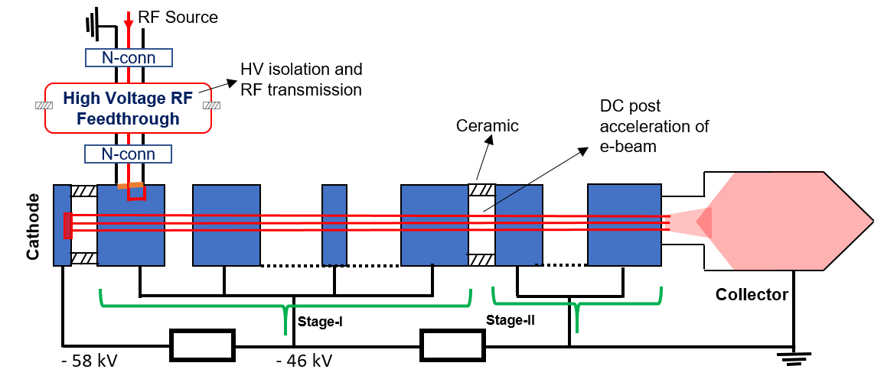
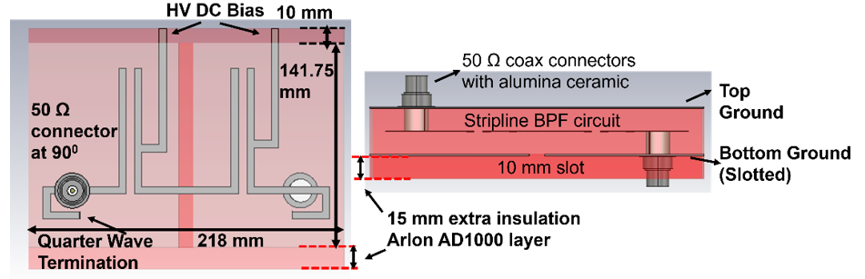
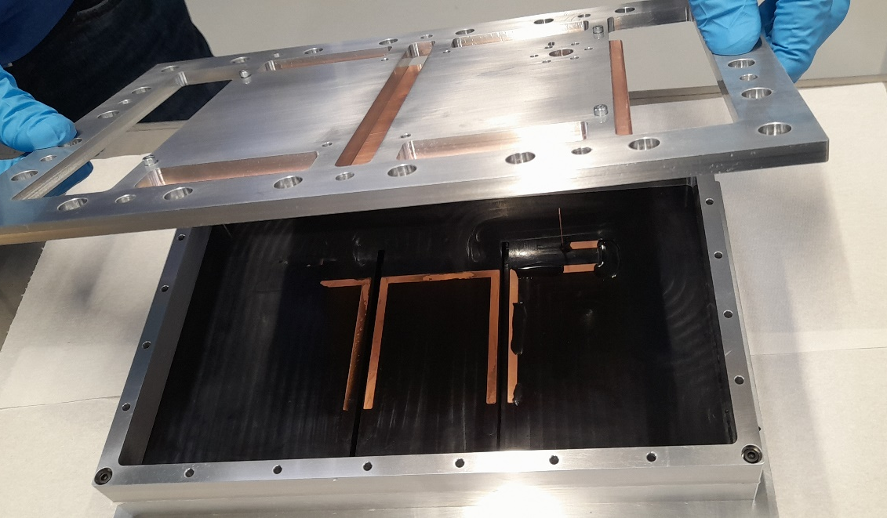
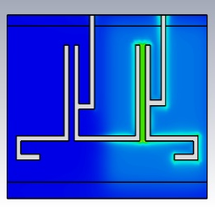
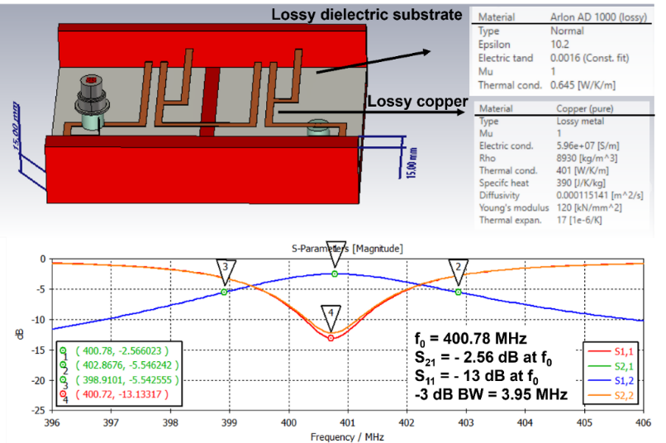
FCC Two-stage MBK klystron: HV isolated RF feed-through with strip-line topology.
Prototype HV tests.
Sustain up to ~65kV in air.
(HV)
(RF)
One of the fabrication steps
Project will be completed in October 2023

Slide 16
Conclusion
650 MHz tube may well be within scaling range of the CLIC tubes
The 325 MHz tube would be very long if scaled from the same tube
Two-stage technologies significantly shorten low frequency, high power tubes and is suitable for 325 MHz solution
Significant synergy with CLIC and FCC developments

