Slide 1


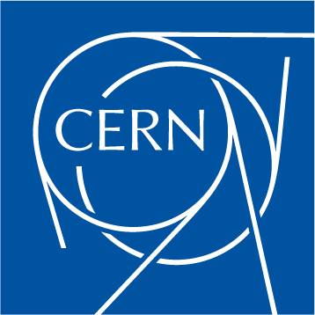

Prospects of Cryo-Cu and HTS high gradient RF cavities
Sergio Calatroni – CERN
With contributions from many Collaborators

Slide 2
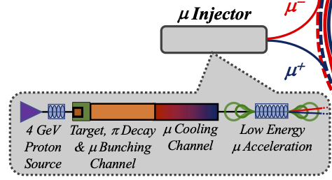
Motivation
Muon cooling system requires RF cavities operating at high-gradient AND in a strong magnetic field.
Normal conducting copper, possibly cryo: see next talks
Superconducting: High-Temperature Superconductors (HTS) ?

Slide 3
Outline
HTS cavities in a strong magnetic field
HTS cavities at high-gradient
HTS cavities in both strong field and high-gradient
Future steps

Slide 4
Outline
HTS cavities in a strong magnetic field
HTS cavities at high-gradient
HTS cavities in both strong field and high-gradient
Future steps

Slide 5
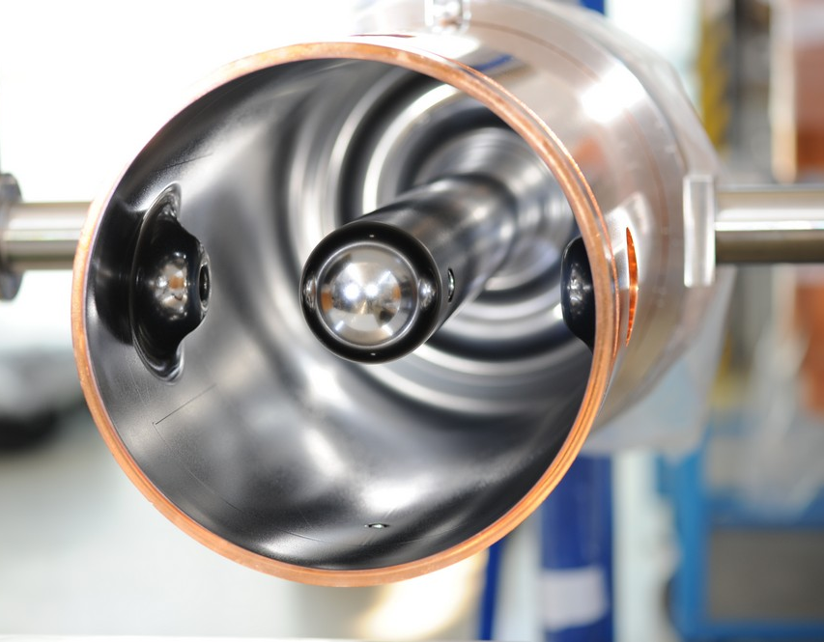
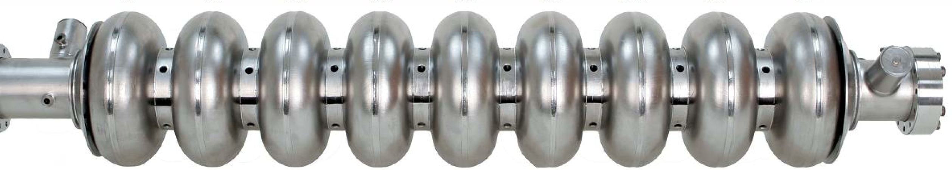
Reference case
Typical SRF accelerator cavities are made of niobium
Effect of external magnetic field on SRF accelerating cavities is mostly due to flux pinning, weak pinning in bulk Nb and strong in Nb/Cu
Niobium critical field H_{c2} < 1 T, superconductivity is lost at higher fields
Strong magnetic shielding needed
Limited or no magnetic shielding

Slide 6
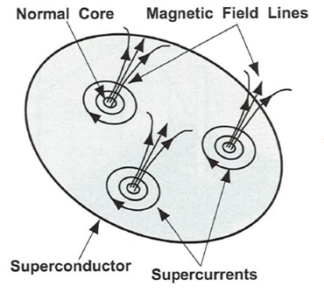
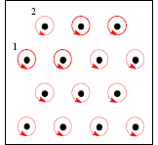
Some theory background: fluxon motion in RF
The motion of the rigid fluxon lattice behaves as a harmonic damped oscillator
(neglecting thermal creep)
d
Pinning centers
B field is normal to surface: worst case
The “depinning frequency”
Surface resistance
Gittleman and Rosenblum: Phys Rev. Lett. 16, 734 (1966)
Calatroni and Vaglio, IEEE Trans. Appl. Supercond. 27 (2017) 3500506
Coffey, Clem PRL 67, 386 (1991)
Brandt PRL 67 2219 (1991)
Silva et al, PRB 78, 094503 (2008)

Slide 7
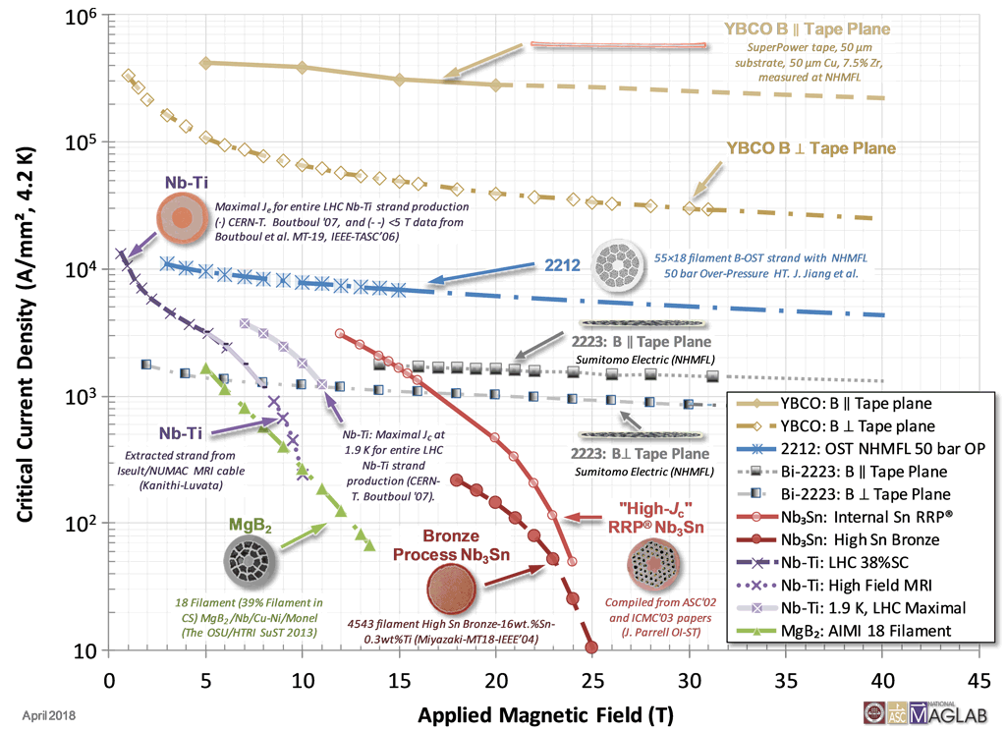
Zoo of superconductors
J_{c} may vary of orders of magnitude.
H_{c2} has much smaller variation.
YBCO most promising candidate
NbTi – NbTiN possible candidates at B < 10T
Nb₃Sn for B < 15 T
https://nationalmaglab.org/magnet-development/applied-superconductivity-center/plots

Slide 8
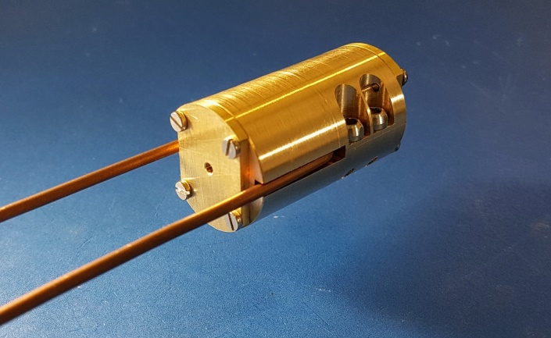
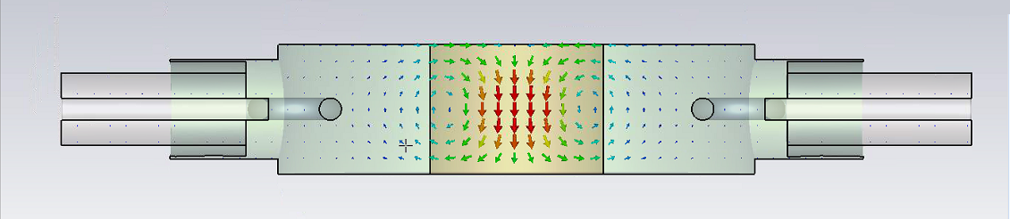
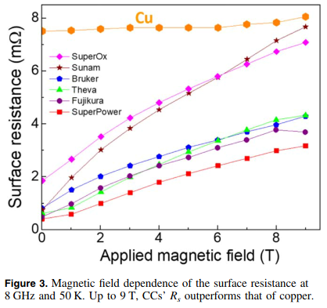
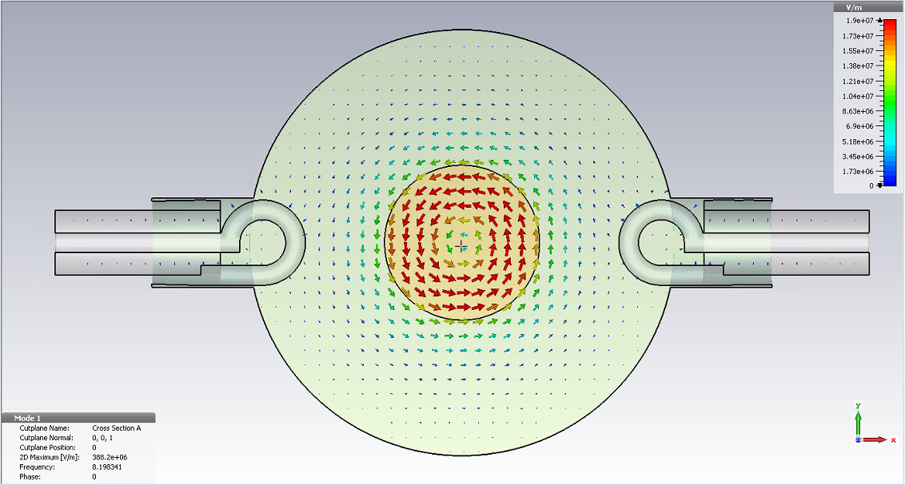

Validation of RF performance (UPC - ICMAB)
In house developed 8.05 GHz cavity resonator compatible with 25mm bore 9 T magnet at ICMAB
REBCO CCs outperform Cu at 50K and up to 9T
R_{S} is microstructure dependent
Surface currents equivalent to 0.1 MV/m of a typical accelerating cavity
Puig et al, SuST 32, 094006 (2019)

Slide 9





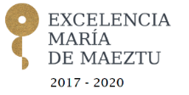
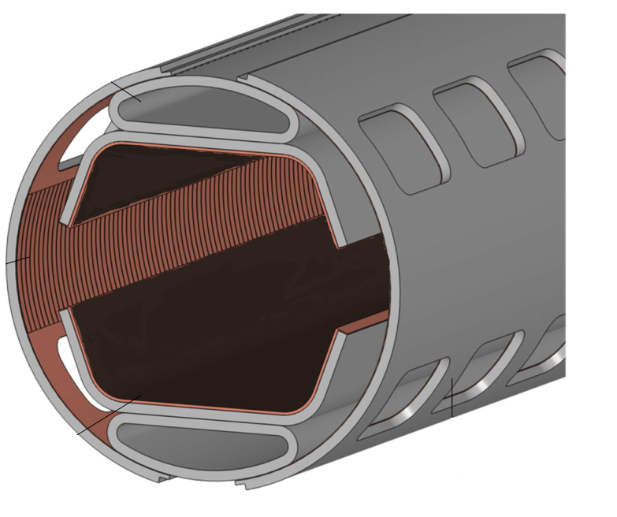
HTS coated conductor soldering and delamination
REBCO
Ag
Ag
REBCO
Cu
Buffer layers
Cu
Substrate
Solder
Surface to coat
Cu
Ag
Surface to coat
Cu
N. Lamas et al., to be published
Developed in the context of FCC-hh impedance reduction by coating the beam screen with HTS tapes

Slide 10

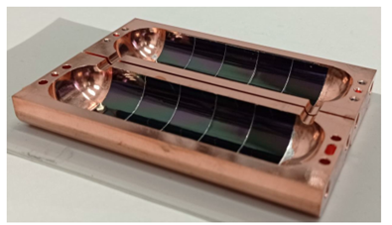
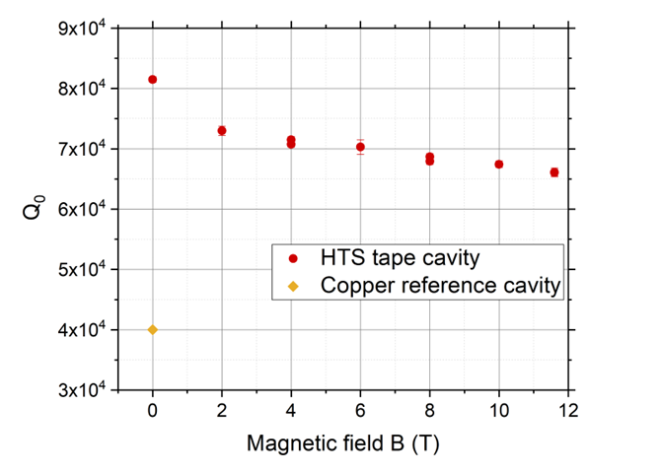
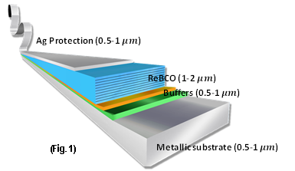
First real cavity, f≈9 GHz
We have developed a technology for applying 2D HTS tapes to 3D RF “RADES” cavities demonstrating the potential of HTS for RF applications J. Golm et al., IEEE TAS, Vol. 32, No. 4, (2022) 1500605
2x improvement of RF quality factor compared to copper
(newer prototype 5x improvement)
12 mm-wide HTS tapes
RADES cavity for axion searches

Slide 11
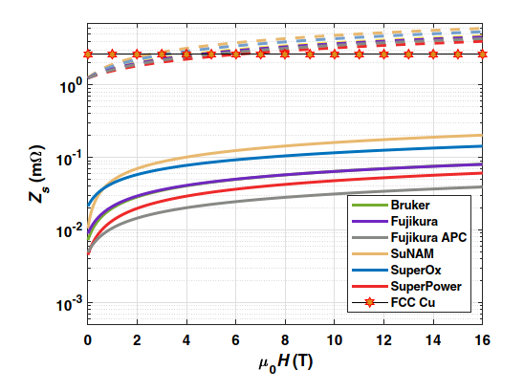

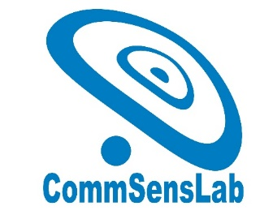
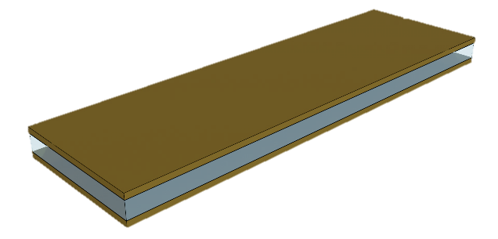
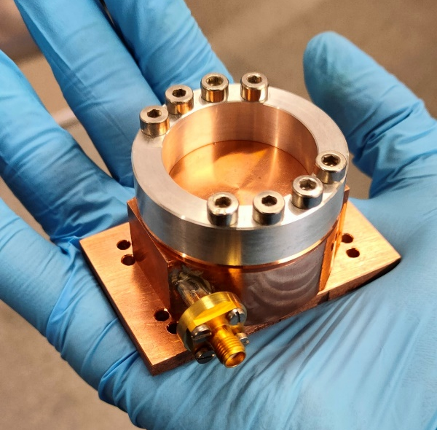

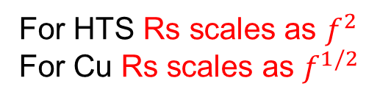
Scaling to lower frequency
REBCO scaled to 1 GHz at 50 K
A parallel-plate resonator is being commissioned to test samples at ~1 GHz
x100 improvement over Cu at 50 K
GHz
38x12 mm samples
50 mm bore
16 T
$X_{s}(T)$ at all frequencies
Romanov et al, SciRep 10:12325 (2020)
For HTS Rs scales as $f^{2}$
For Cu Rs scales as $f^{1/2}$
Will demonstrate real experimental frequency scaling on samples

Slide 12
Outline
HTS cavities in a strong magnetic field
HTS cavities at high-gradient
HTS cavities in both strong field and high-gradient
Future steps

Slide 13
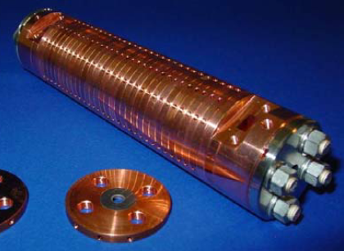
Potential motivation: linear colliders
Linear collider studies fall essentially in two categories
Linear collider studies result in roughly similar power consumption for equivalent machines (ie ILC vs CLIC)
We want to see if HTS in pulsed RF mode allows an optimal gain compared to both Nb and Cu
Superconducting niobium, CW
Normal conducting copper, pulsed

Slide 14
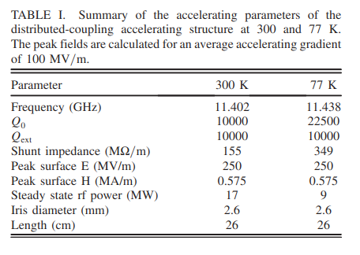
Cryo-cooled copper -> HTS ?
The C³ study aims at cryogenically cooled copper, to attain a larger gradient and save cost in the RF power stations
A further advantage could come from combining the advantage of higher gradients at lower temperatures, with the higher Q factor of HTS coatings -> energy efficiency
Cryoplant efficiency (Carnot + engineering)
SRF temperature | Ratio W_{300K}/W_{cryo}
77 K | 13
50 K | 20
4.2 K | 230
1.9 K | 920
Thanks to T. Koettig, CERN
E. Nanni et al., PRAB 24, 093201 (2021)
A factor x10 improvement in Q factor compared to copper could pave the way for significant energy savings

Slide 15
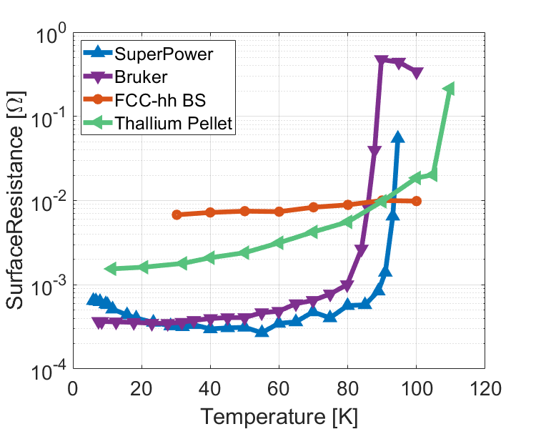
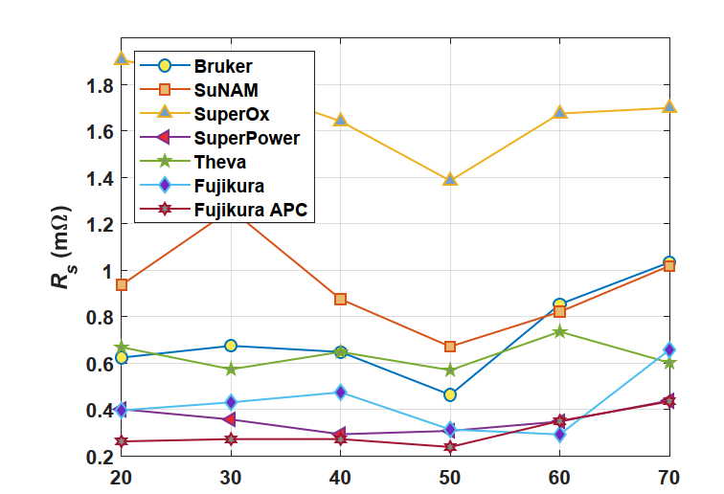
Low-power measurments
A potential improvement at least x10 compared to copper (Rs=8mΩ) has been measured on samples of tapes (8 GHz) at low RF power
Cu
(adapted from Romanov et al, Sci. Rep. (2020) 10:12325)

Slide 16
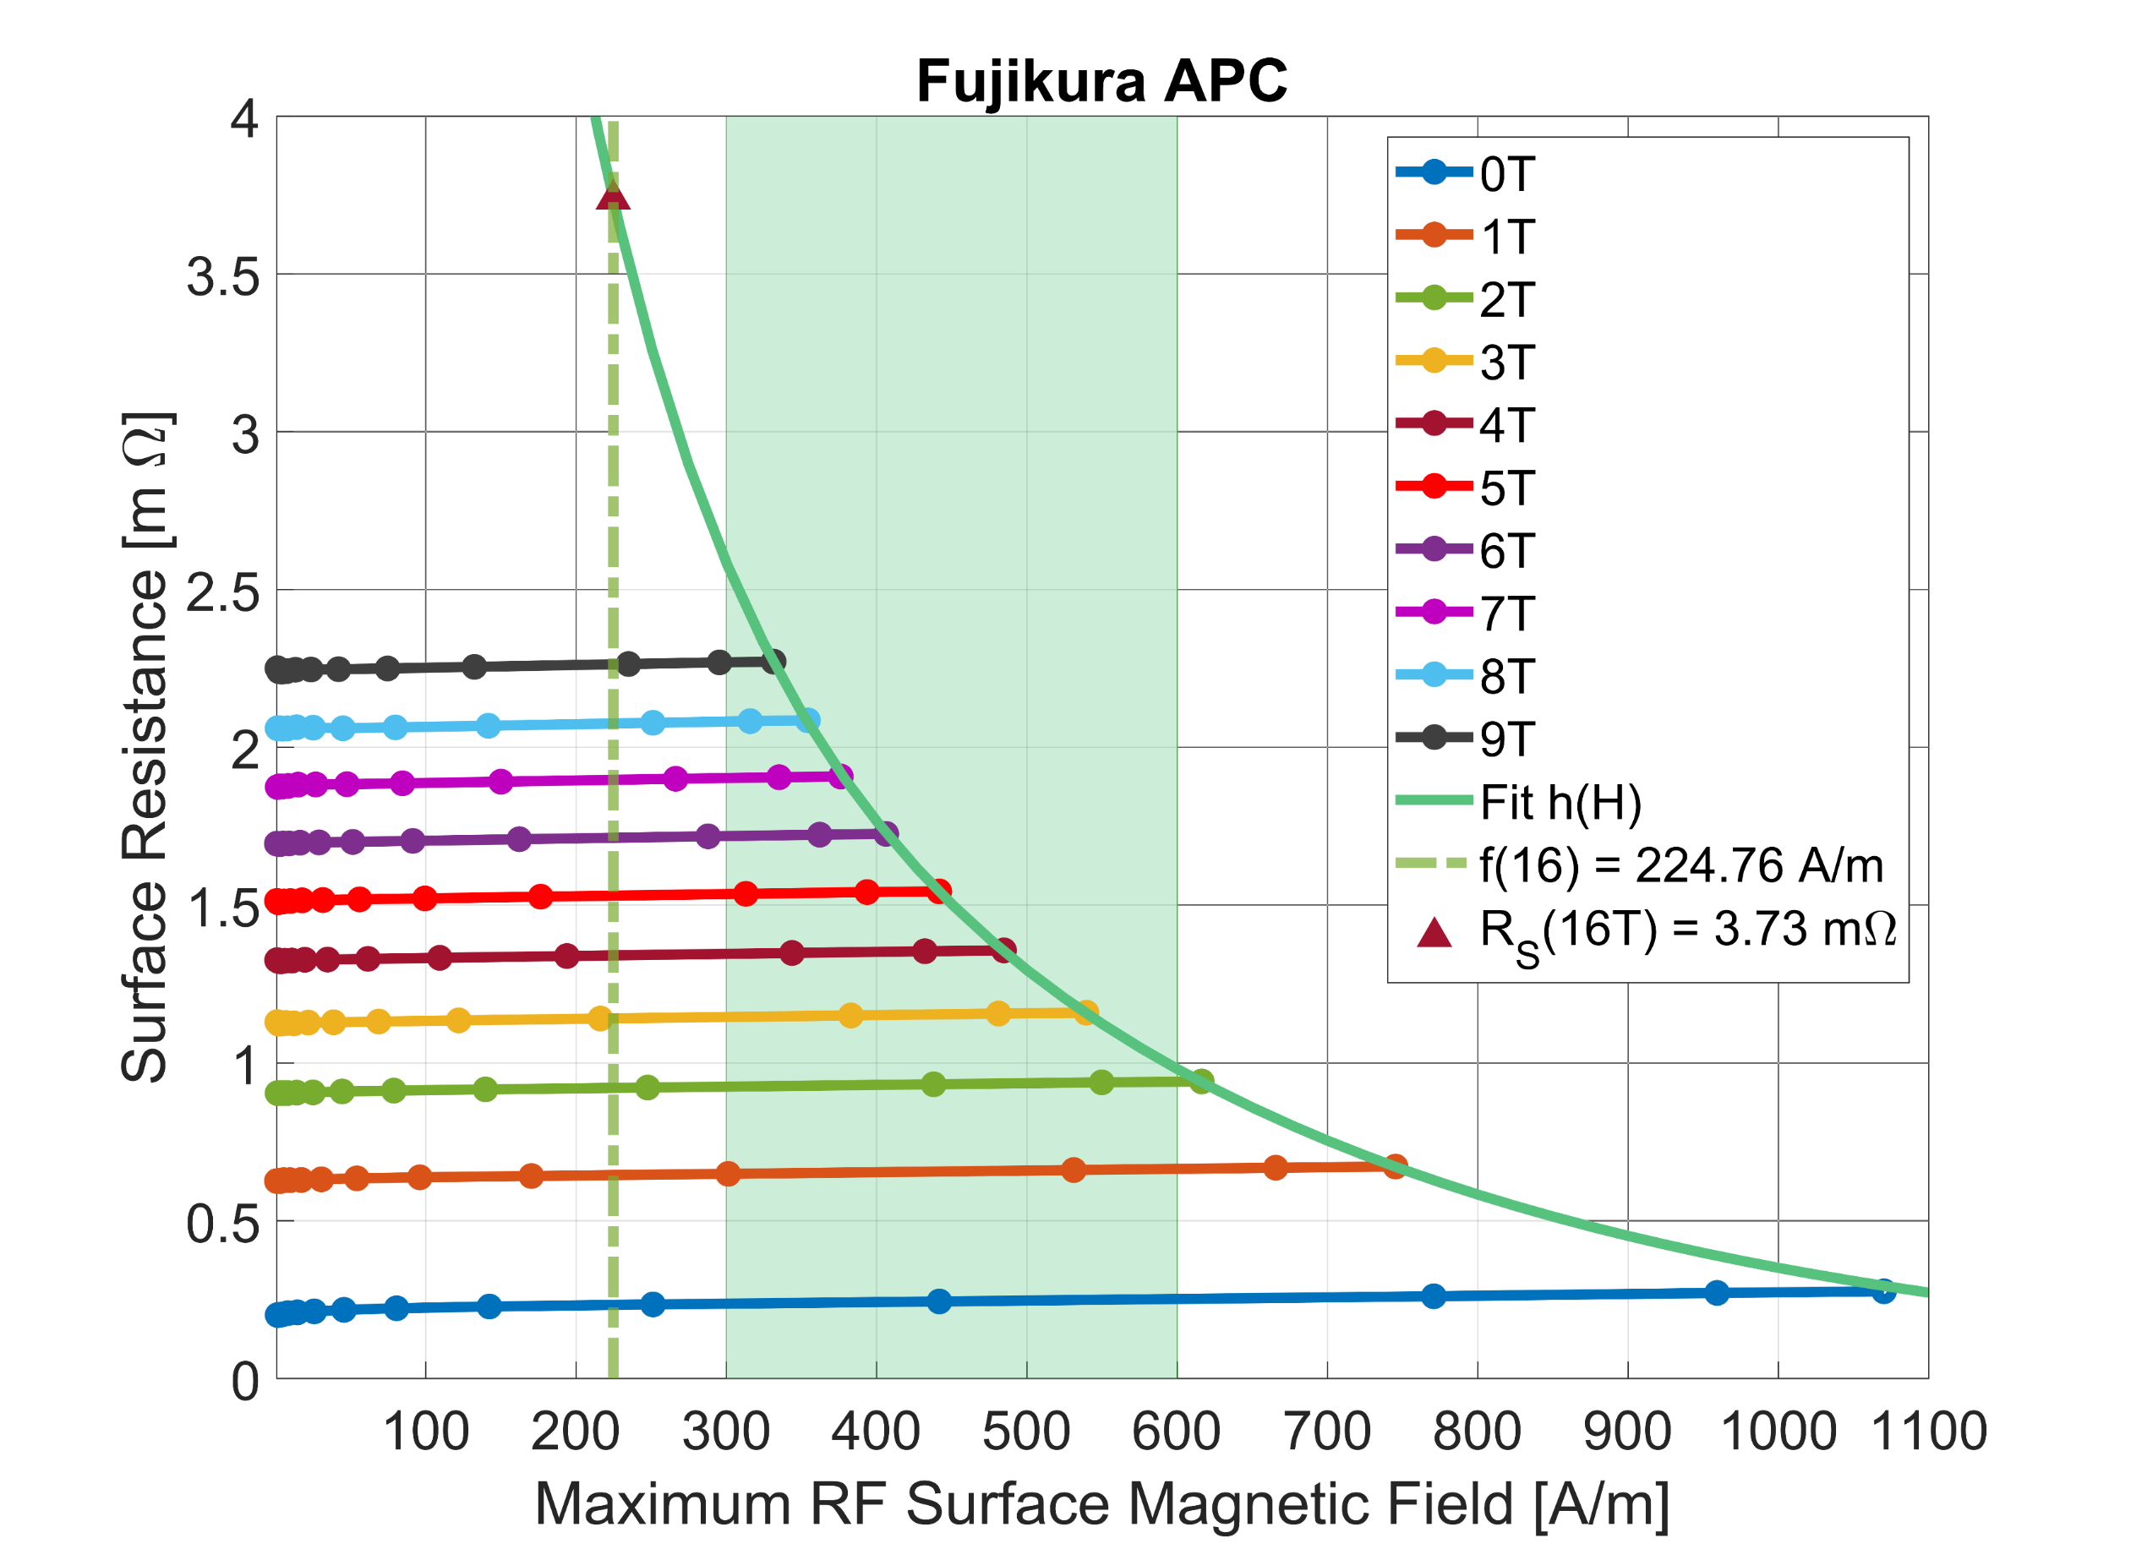
HTS tape at 8 GHz (dielectric resonator)
Patrick Krkotic, PhD dissertation, UPC Barcelona 2022

Slide 17
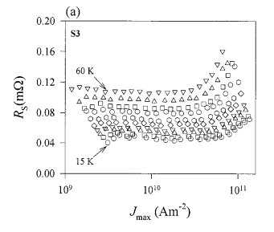
Literature review - I
There are very few measurements on HTS at high RF currents (mostly microstrip resonators). But physics is proven.
~10¹¹ A/m² RF current (microstrip resonator, 200 µm, 350 nm thick, 8 GHz)
Powell et al. Journal of Applied Physics 86, 2137 (1999)
For 1 µm thickness this is equivalent to 10⁵ A/m (≅ 0.1 T ≅ 25 MV/m)
in the “high-gradient” range

Slide 18
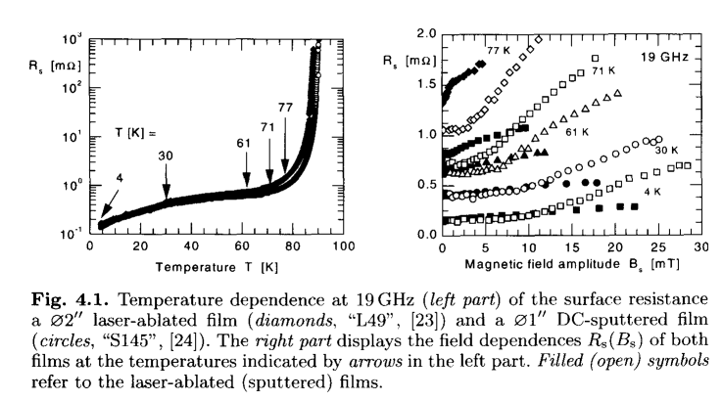
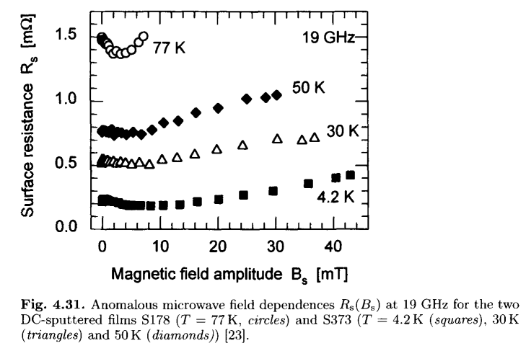
Literature review - II
From: M. Hein, “High-Temperature-Superconductor Thin Films at Microwave Frequencies” (Springer Tracts in Modern Physics, 155)

Slide 19
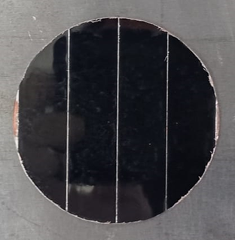
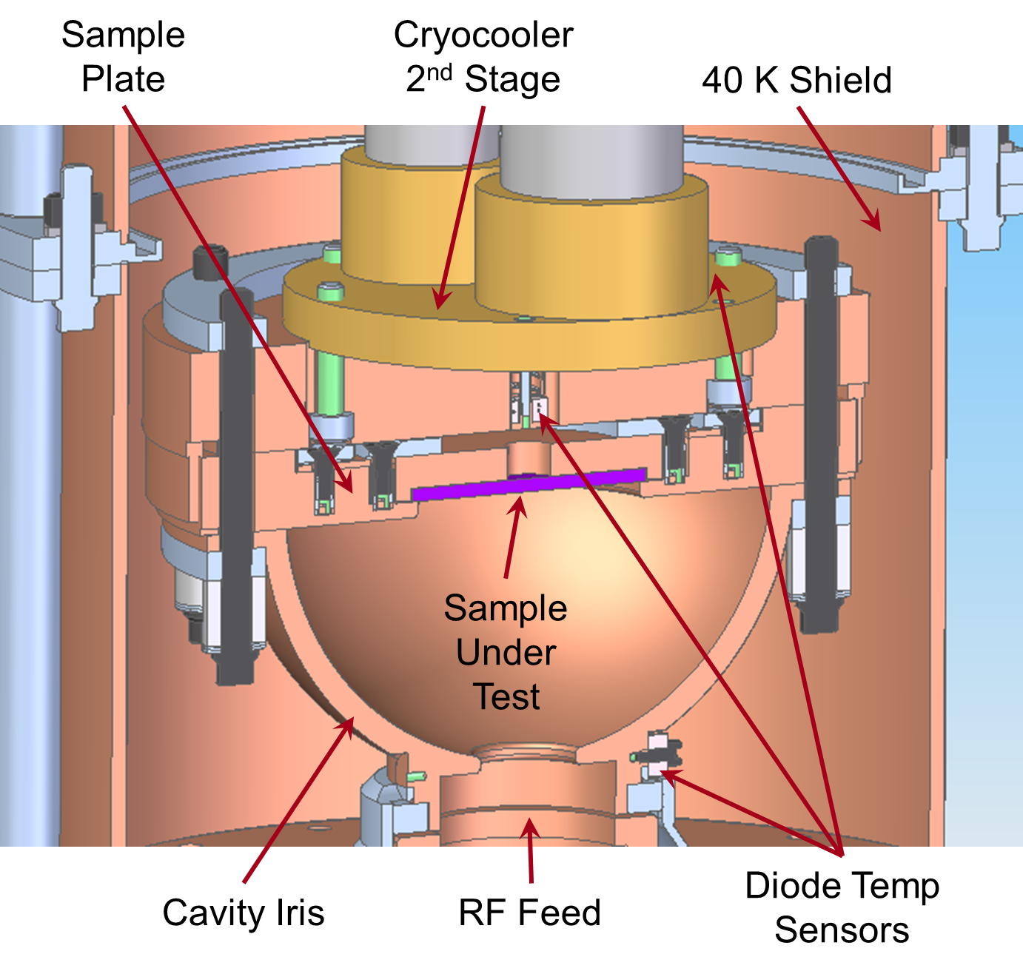
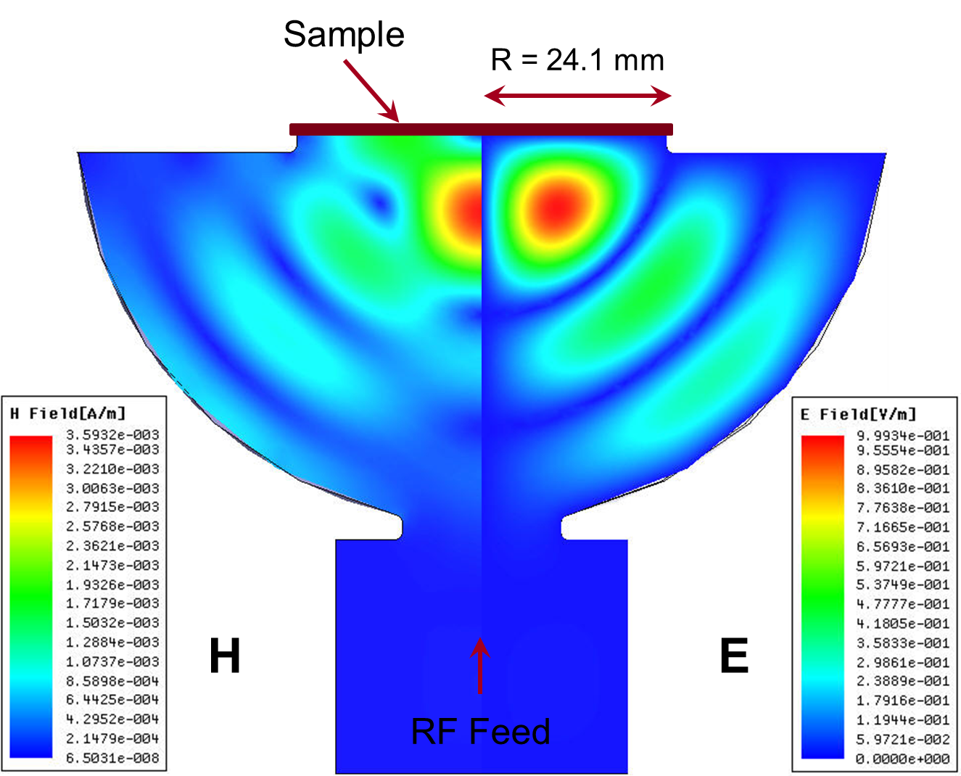
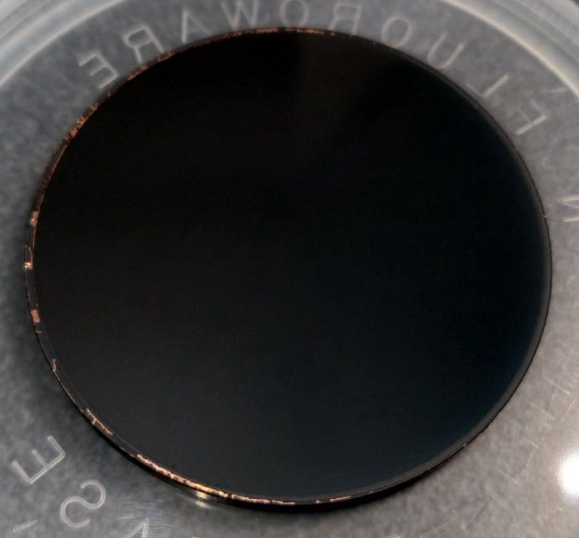


High-gradient testing at SLAC – supported by I.FAST IIF
HTS-coated with tapes
By CSIC-ICMAB
Demountable high-power RF cavity
Can achieve H_{peak} of about 360 mT using 50 MW XL-4 Klystron.
High-Q X-band hemispheric cavity with a TE₀₃₂-like mode at 11.4 GHz.
Zero E-field on the sample
Maximum H-field on the sample
Sample accounts for ⅓ of total cavity loss
HTS-coated sample
By CERACO
Goal: demonstrate high-gradient pulsed operation of HTS, at cryo-temperatures, and develop large size coatings (50 mm wide tapes)

Slide 20
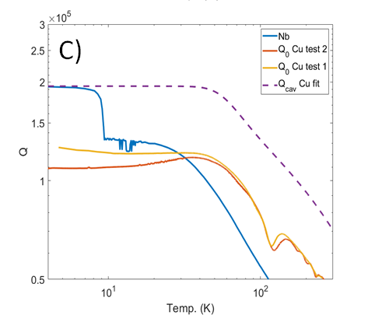
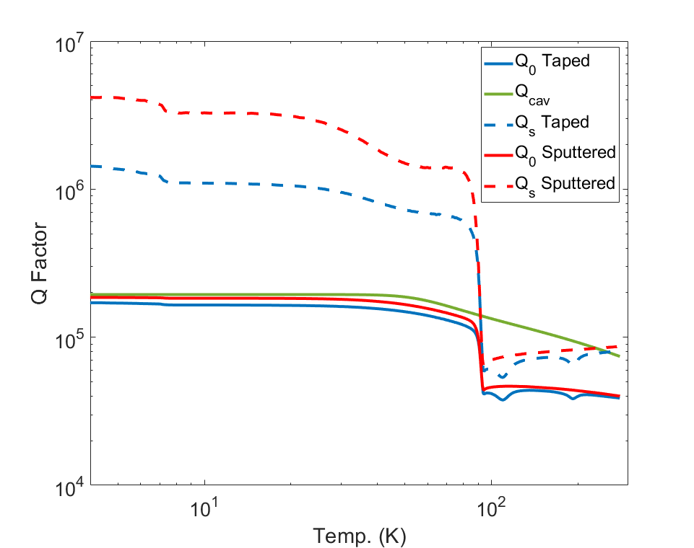
First results at SLAC
Cu and Nb reference measurements
HTS measurements
High-gradient tests foreseen shortly

Slide 21
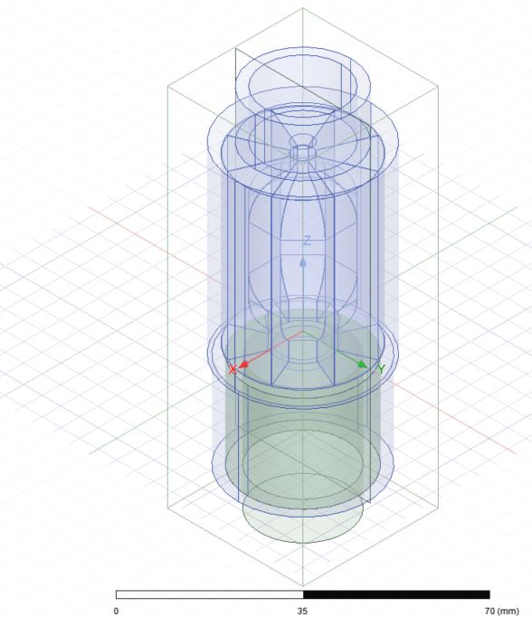
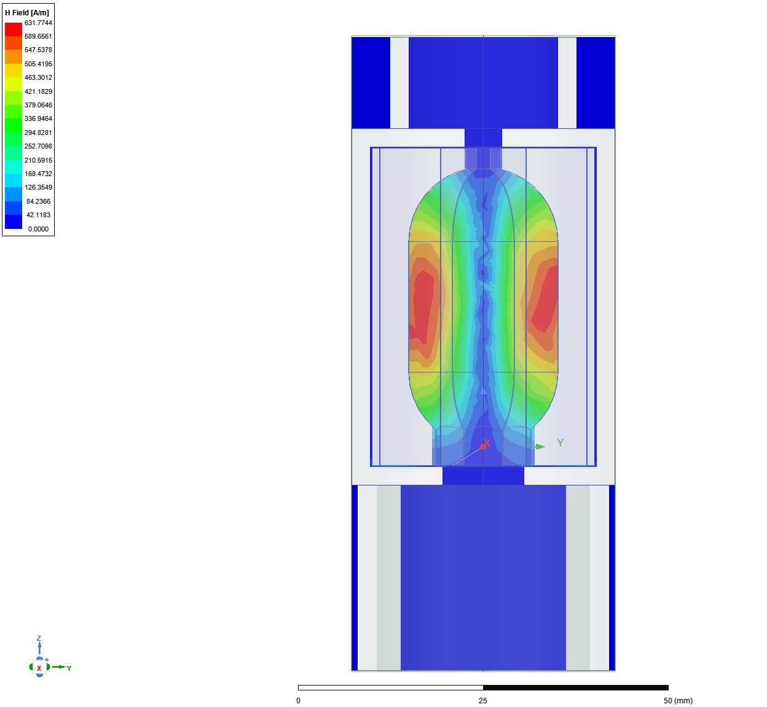
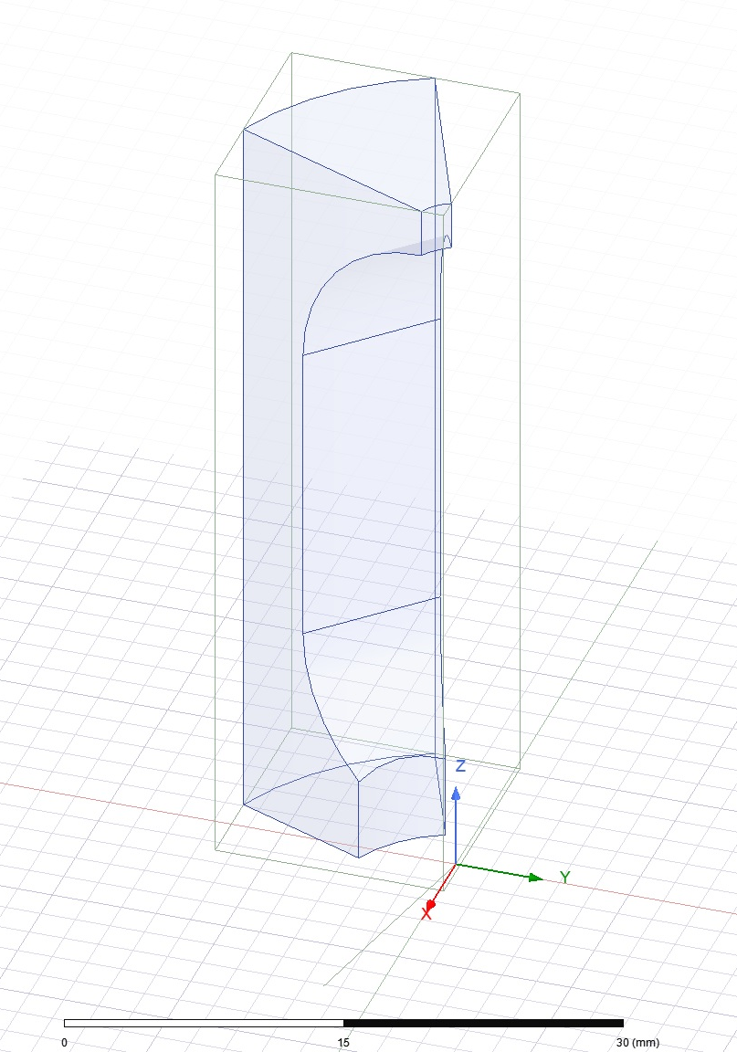

First device validation – supported by I.FAST Innovation Fund
Device approach: X-band pulse compressor (SLAC) as first “real” device
Coated with small tapes by CSIC-ICMAB for device validation
Future goal: full device with large-size tapes (or directly coated on copper, ideally)
Courtesy Greg LeSage, SLAC
Max surface field 3.126 MA/m

Slide 22
Outline
HTS cavities in a strong magnetic field
HTS cavities at high-gradient
HTS cavities in both strong field and high-gradient
Future steps

Slide 24
Outline
HTS cavities in a strong magnetic field
HTS cavities at high-gradient
HTS cavities in both strong field and high-gradient
Future steps

Slide 25

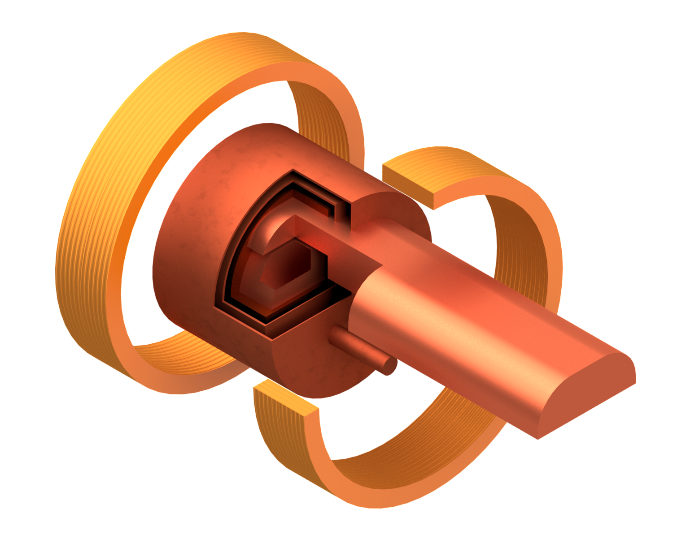
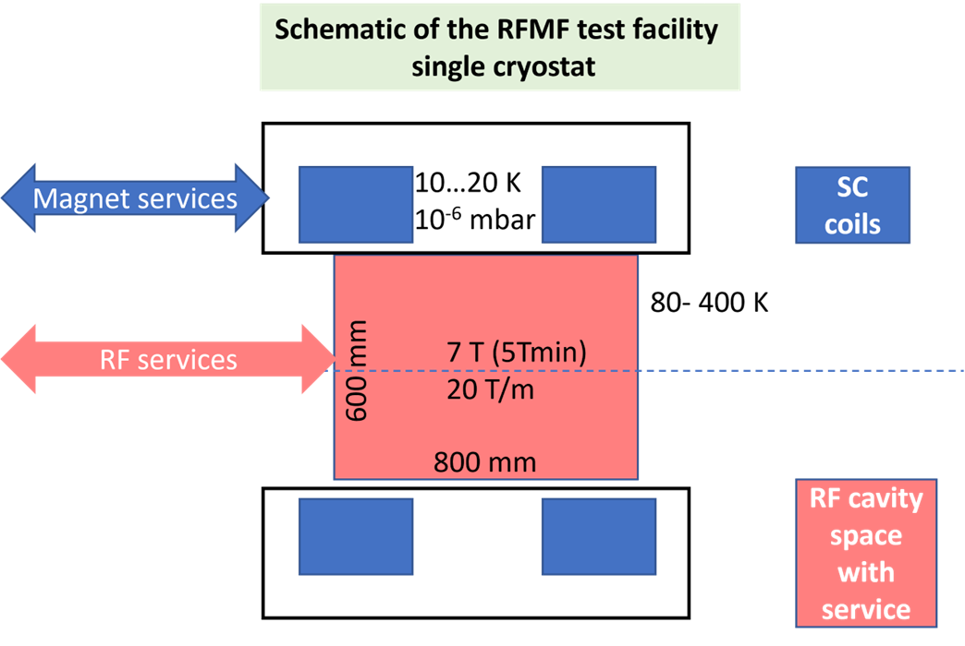
Possible test in a dedicated RF stand
See talk of Dario Giove later today
Availability of a high-field / high-gradient test stand foreseen within the MuCol study could be beneficial for the entire HTS-HFF community
SC HTS coils
Pillbox test cavity
RF Wave guide
Sc magnet/cryostat sketch by M. Castoldi & Stefano Sorti, UMIL & INFN-LASA
(RF drawing by Guillaume Ferrand –CEA)

Slide 26
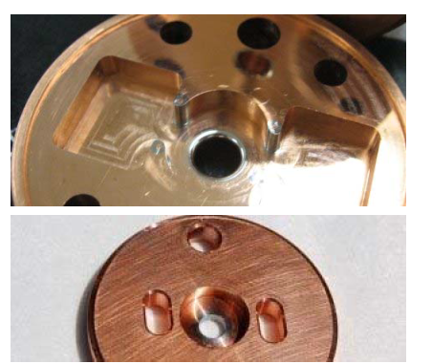

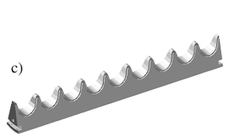
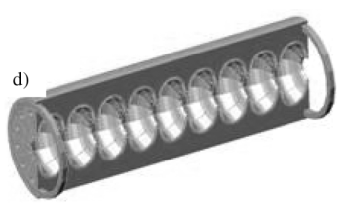
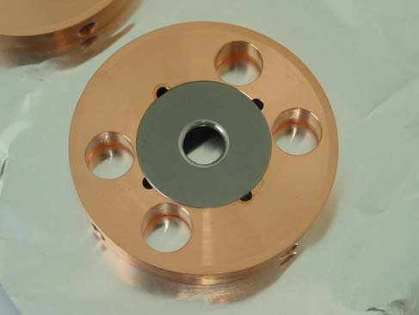
Possible practical implementation of HTS tape-coated cavities
How could a future cavity look like? Bimetallic cavities
B
SC
NC
J. Haimson, WEPMS085, PAC07 (s.steel inserts)
CLIC Mo-iris prototype
P. McIntyre et al., IEEE TAS 19 (2009) 1380
Composite cavities exist and have been demonstrated.
Joints at low-current regions are standard practice even in SRF cavities (ie QWRs)
Segmentation at zero-current region is possible, see device being designed at SLAC

Slide 27
Final remarks
No data for HTS at high-gradient and in strong magnetic field exist (either samples or cavities): experiments needed
Overall energy efficiency would have to be studied, taking into account: operating temperature, cryo-efficiency, possible Q-factor, pulsed operation
Fabrication technologies for real cavities have to be assessed: wider soldered tapes, or develop a direct HTS coating technique?

Slide 29
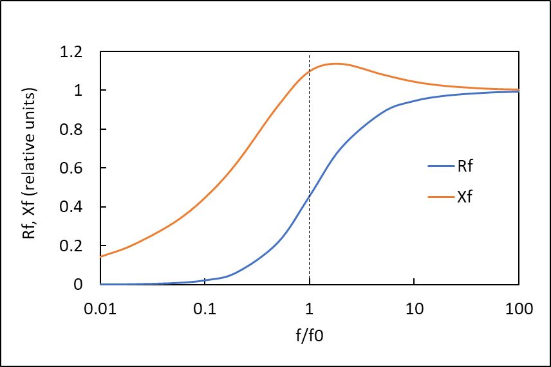
Effect of magnetic field: fluxon losses in RF
Surface resistance, reactance due to vortex motion
“safe” zone
“unsafe” zone
To maximize f₀ and minimize fluxon losses we need high J_{c} materials

Slide 30
HTS for the FCC-hh beam screen
Recent work motivated by the need of HTS materials for replacing copper in the FCC-hh beam screen, to reduce beam coupling impedance.
Beam produces RF fields
Extremely challenging requirements:
  HTS must operate at 50 K and 16 T
  Critical fields Hc₂ , H_{irr} >> 16T
  J_{c} > 25 kA/cm² (2.5x10⁸ A/m²)
  Surface resistance R_{s} better than for copper
Compatible with accelerator environment
  Minimize dipole field distortion due to persistent currents (Note 1)
  UHV compatible, low SEY, lifecycle assessment, etc..
16 Tesla !
Calatroni, IEEE TAS 26, 3500204 (2016)
Calatroni et al, SuST 30, 075002 (2017)

Slide 31
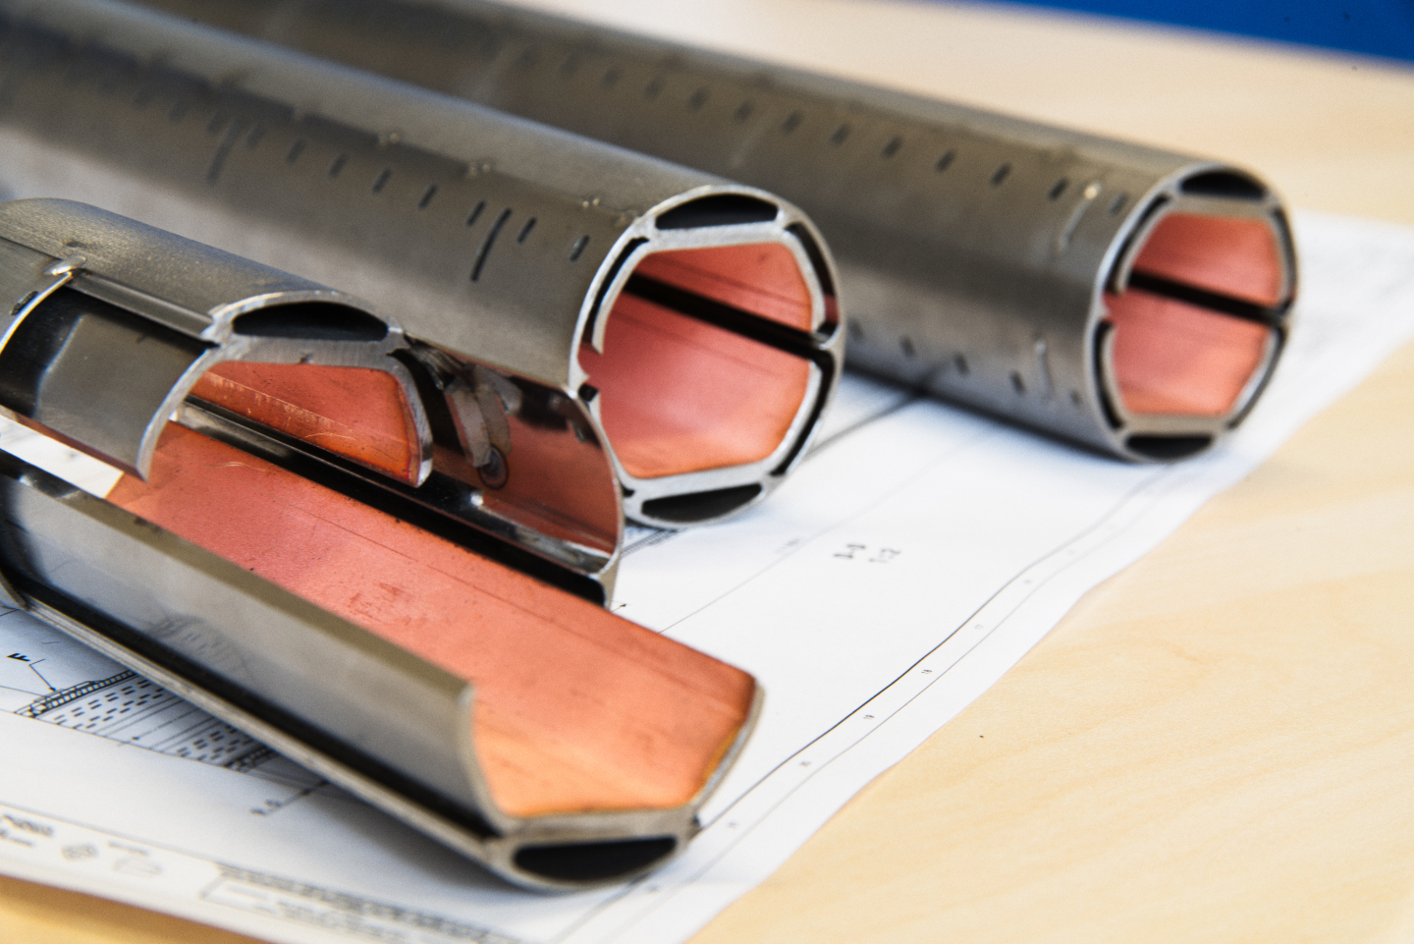
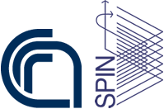






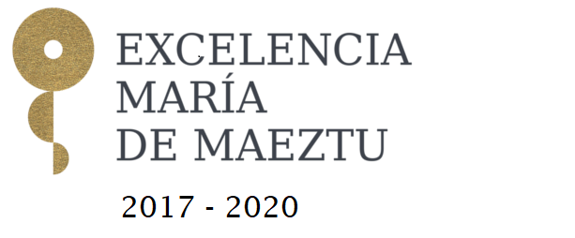


How to make it in practice ?
Manufacture the screen using REBCO tapes soldered to the screen
Coat the inside of the screen
with Tl-1223 films

Slide 32
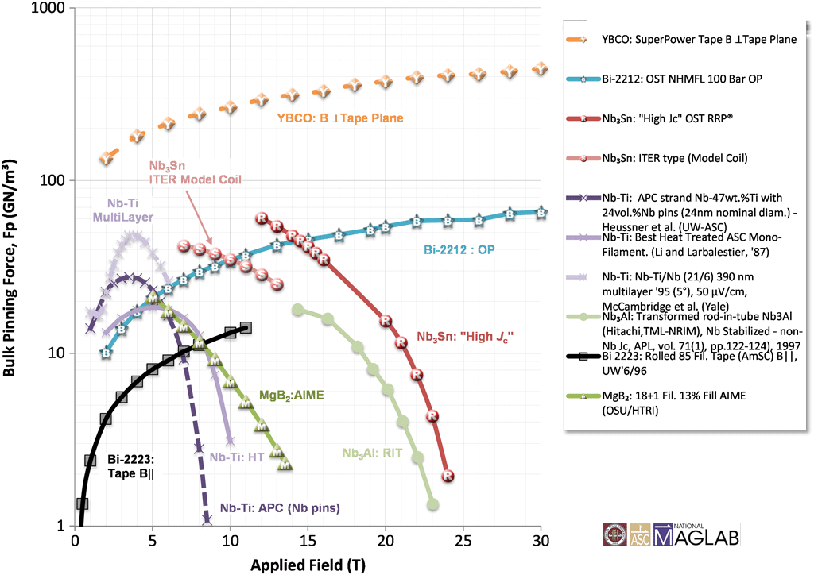
Zoo of superconductors
Pinning force
https://nationalmaglab.org/magnet-development/applied-superconductivity-center/plots

Slide 33


Predicted surface resistance of HTS in 16 T field
YBCO | T_{c}=92K | T=50K | B₀=16T | J_{c}(50,16)=7.5x10⁹Am⁻² | B_{c2}(50)=40T | ρ_{n}=60μΩcm | f₀=10GHz
Tl-1223 | T_{c}=125K | T=50K | B₀=16T | J_{c}(50,16)=1x10¹⁰Am⁻² | B_{c2}(50)=80T | ρ_{n}=80μΩcm | f₀=14GHz
For HTS the Rs scales as $f^{2}$
For Cu the Rs scales as $f^{1/2}$

Slide 34


Cryogenic losses: SRF aimed at energy saving compared to NRF
Carnot efficiency
Cryoplant efficiency
30%
Power consumption for 1 W @ 77 K | 13 W
Power consumption for 1 W @ 20 K | 50 W
Power consumption for 1 W @ 4.2 K | 230 W
Power consumption for 1 W @ 1.9 K | 920 W
Thanks to T. Koettig, CERN

Slide 35





Test of Nb3Sn films up to 12 T
15 GHz

Slide 36

HTS coating technologies
Patrick Krkotic, PhD dissertation, UPC Barcelona 2022

Slide 37




INFN: NbTi and NbTiN cavities for axion searches
x10 improvement over copper at 4.2 K

Slide 38




Nb₃Sn @ 3.9 GHz in strong magnetic field: FNAL results
Cigar-shaped cavity 3.9 GHz
1-cell ILC type 3.9 GHz
Ideally, Nb₃Sn from vapor tin diffusion should then be compared to Nb₃Sn from sputtering
S. Posen et al. ArXiv 2201.10733

Slide 39



NbTi / NbTiN and Nb₃Sn at high RF field
NbTi 500 MHz
NbTiN 500 MHz, 4.2 K
S. Calatroni et al., Proc of the SRF 91
S. Posen – FNAL (TTC 2019 talk)

