Slide 1



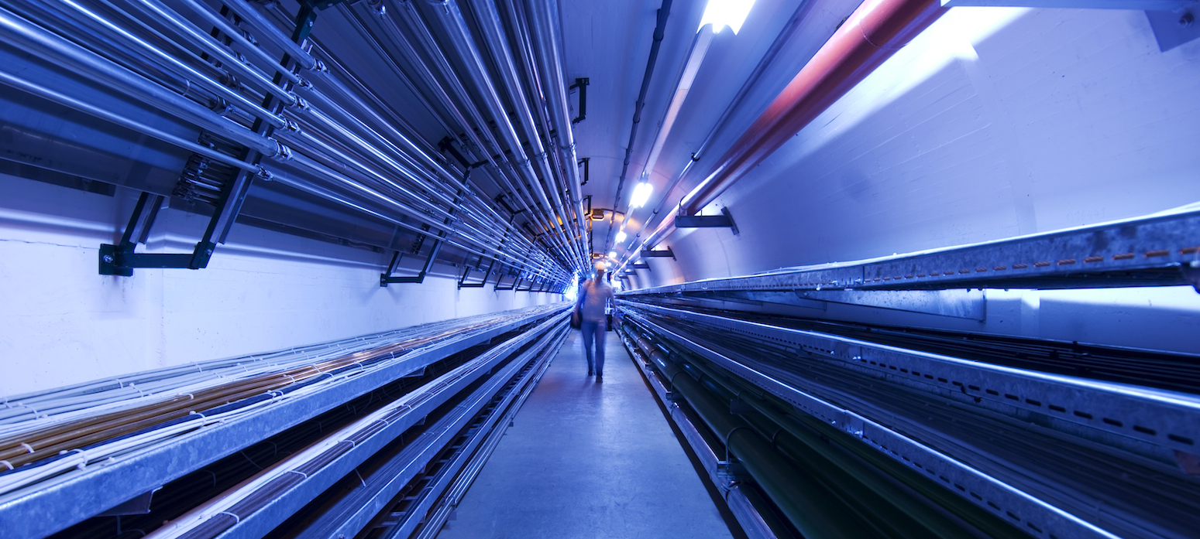
RF in strong B-field test stand motivation and requirements
Claude Marchand
CEA Paris-Saclay
IMCC Annual Meeting
June 20, 2023

Slide 2
Outline
Problematic of NC RF cavities for the muon cooling complex in high magnetic fields:
  Overview of MTA (Mucool Test Area) experimental results:
  MICE 201 MHz and Mucool 805 MHz cavities in B field up to 4T
  Model(s) that explain existing RF BD results in magnetic field
Further tests are needed to consolidate models and test new BD mitigation solutions:
  Different cavity materials, operating temperatures, frequencies, RF pulse length …
  Calls for new RF test stand(s) à la MTA: cavity, RF power source, solenoid field …
Claude Marchand / IMCC annual meeting 2023

Slide 3
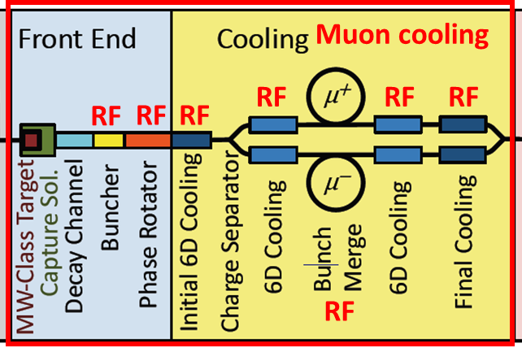
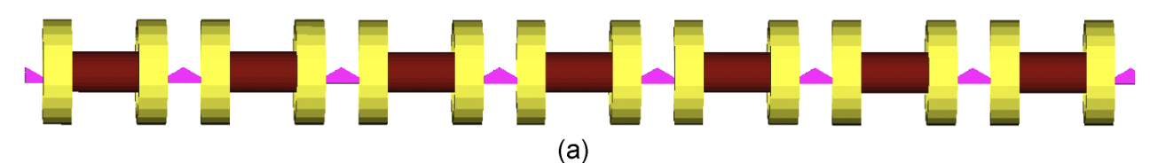
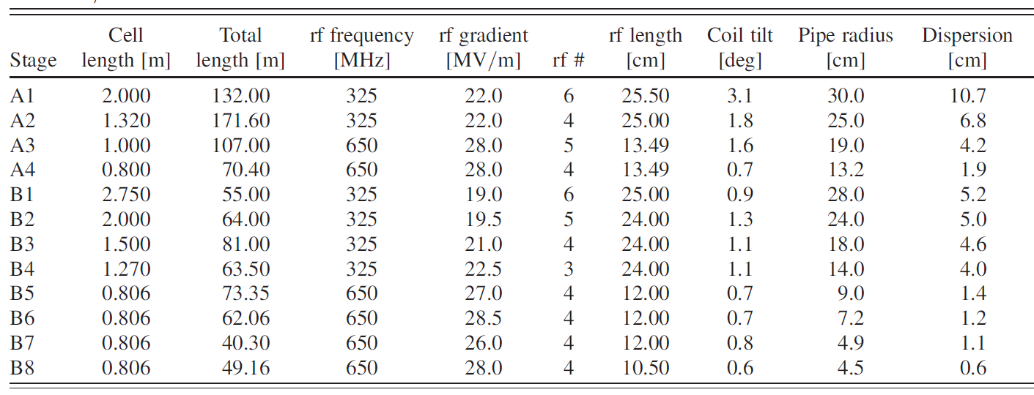
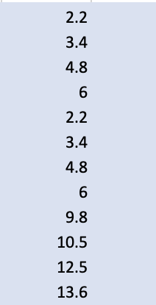
RF system for 6D cooling (MAP study)
Rectilinear channel contains some of the most challenging
NC cavity designs in terms of required RF gradient and B-field
B field
[T]
Before bunch merge
After bunch merge
Claude Marchand / IMCC annual meeting 2023

Slide 4
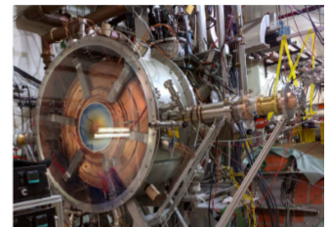
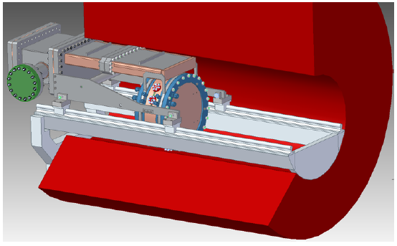
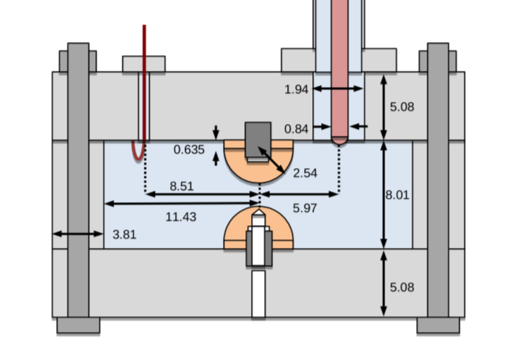
Summary of NC RF cavities tests in high B field (MTA)
(comprehensive review by Derun Li, CERN LDG meeting 2021)
State of the art (not complete):
MICE 201 MHz RF module prototype (beryllium windows):
5T fringe field, 11 MV/m, 1ms@1Hz
MUCOOL 805 MHz pill box cavity,
Cu & Be windows:
Cu: 3T, 13 MV/m, 30μs@10Hz
Be: 3T, 50 MV/m
MUCOOL Gas filled RF cavity:
  3 T, 65 MV/m 805 MHz molybdenum cavity
28.4cm
44cm
Claude Marchand / IMCC annual meeting 2023

Slide 5
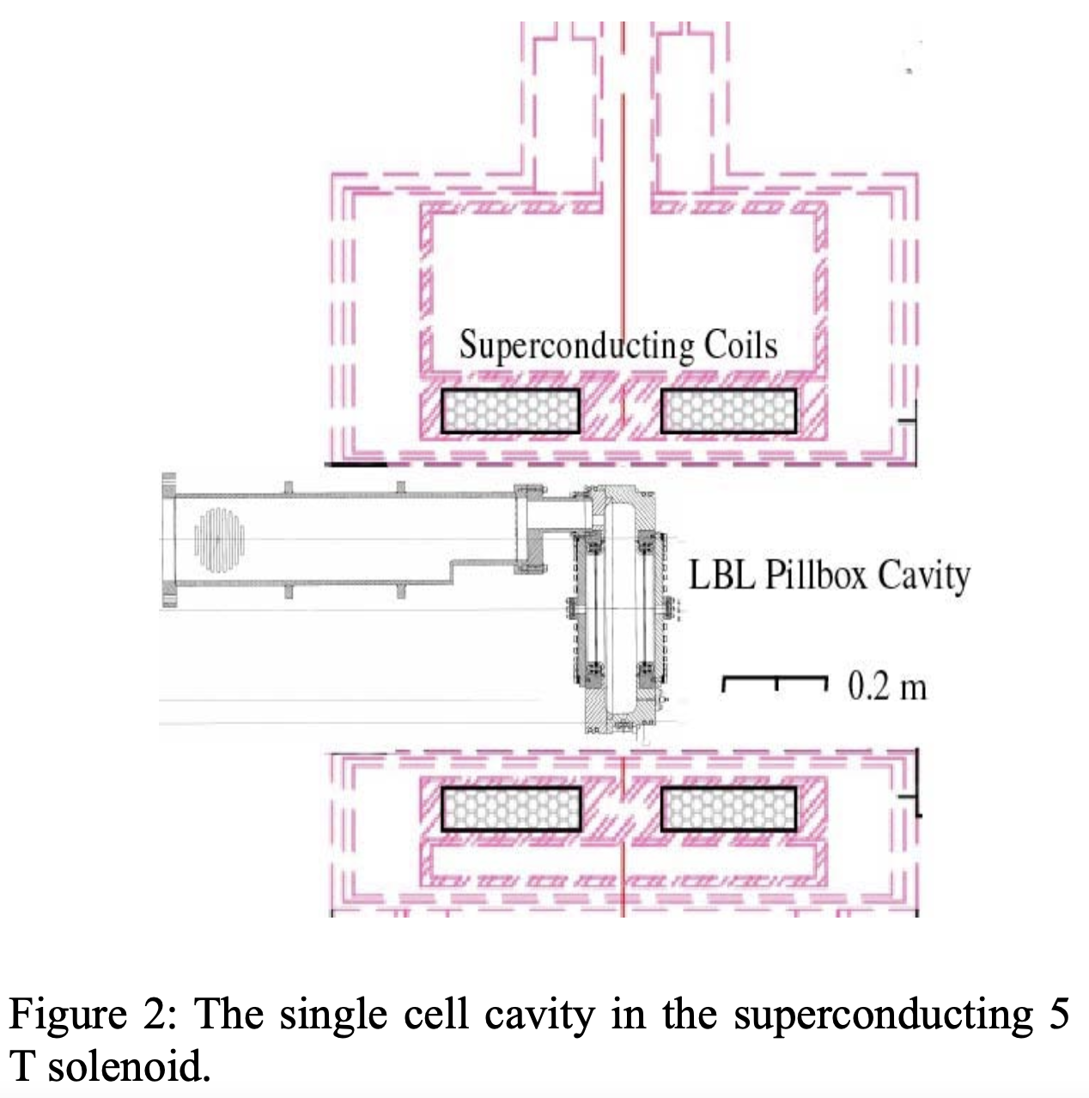
Summary of NC RF cavities tests in high B field (MTA)
(comprehensive review by Derun Li, CERN LDG meeting 2021)
State of the art (not complete):
MICE 201 MHz RF module prototype (beryllium windows):
5T fringe field, 11 MV/m, 1ms@1Hz
MUCOOL 805 MHz pill box cavity,
Cu & Be windows:
Cu: 3T, 13 MV/m, 30μs@10Hz
Be: 3T, 50 MV/m
MUCOOL Gas filled RF cavity:
  3 T, 65 MV/m 805 MHz molybdenum cavity
Claude Marchand / IMCC annual meeting 2023

Slide 6
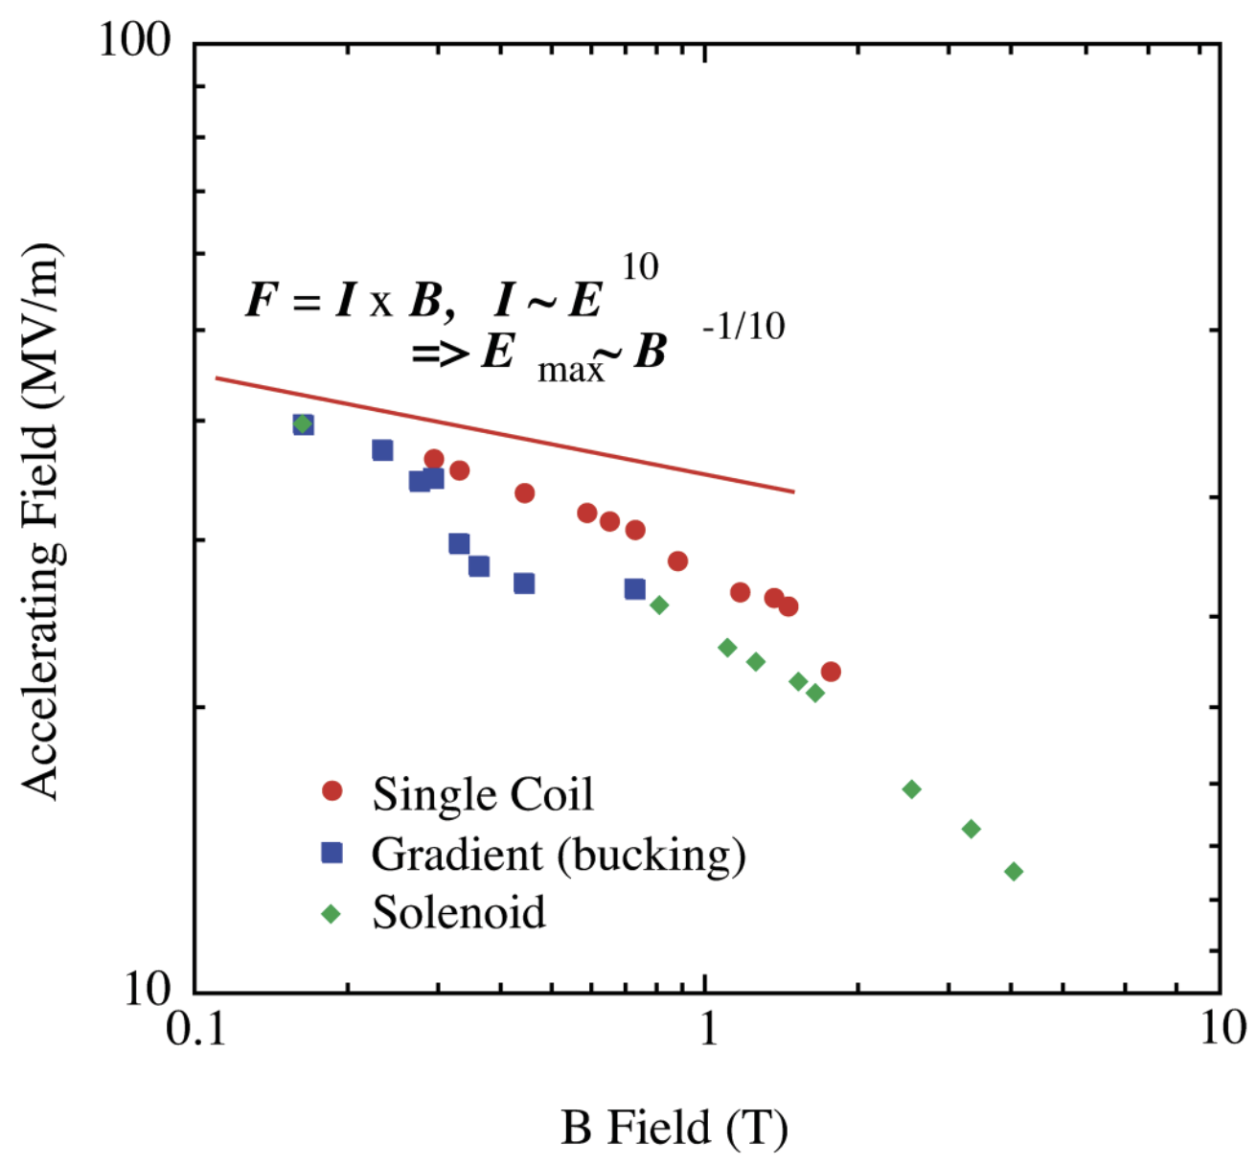
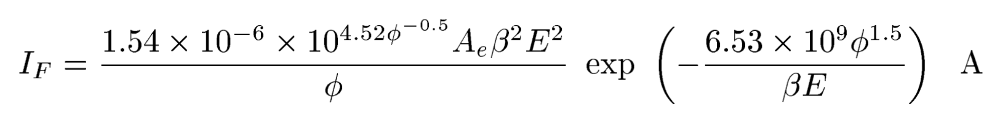
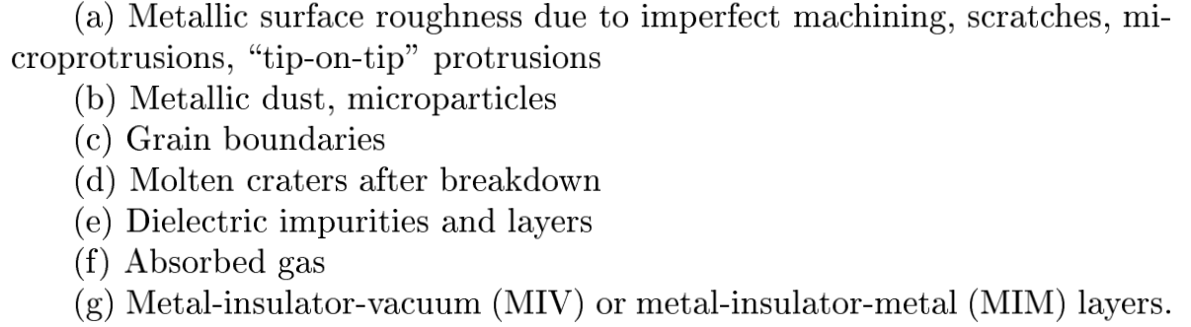
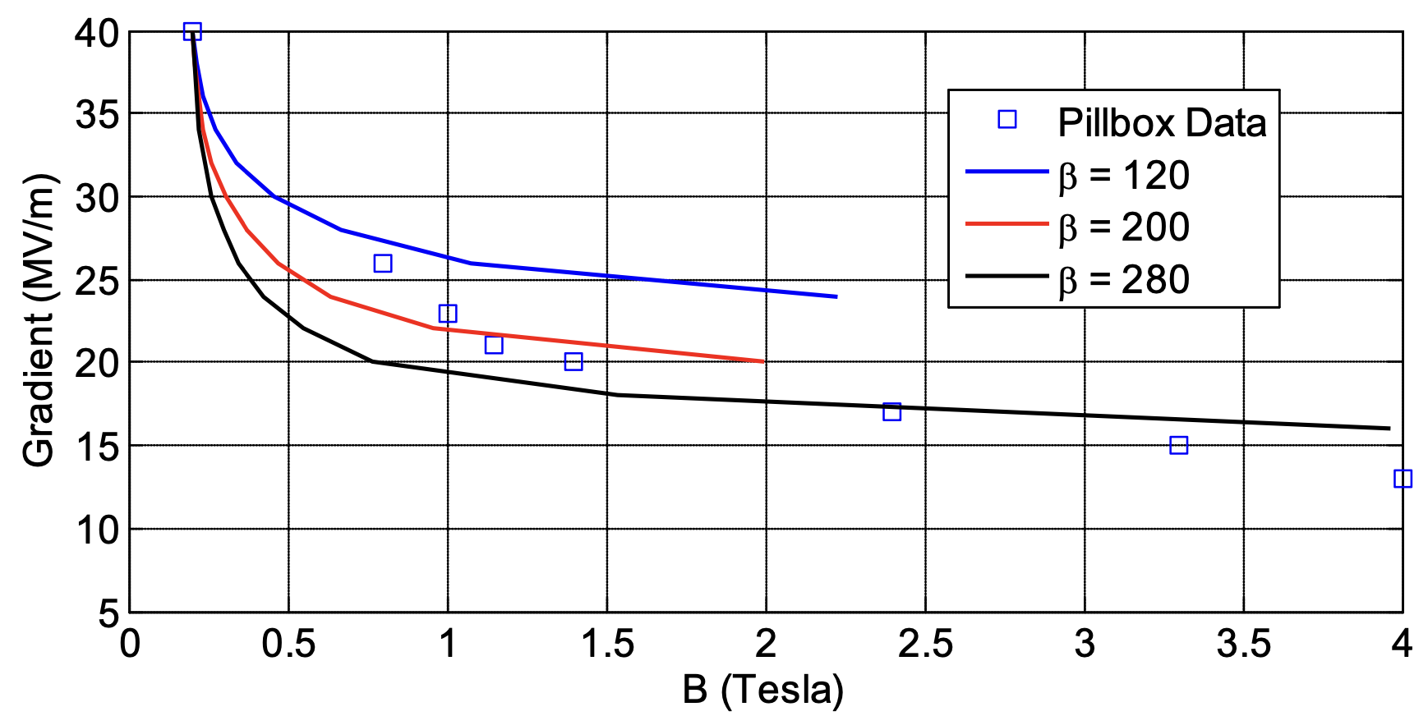

Some initial results on 805 MHz PB cavity with Cu
Fowler-Nordheim Enhanced Field Emission current:
A. Moretti et al., Phys.Rev.Acc.Beams 8, 072001 (2005)
where is the enhancement factor
due to microscopic emmiter sites
β$=E$_{m}/ $Esurf$
+
+
+
-
-
-
-
+
Claude Marchand / IMCC annual meeting 2023

Slide 7
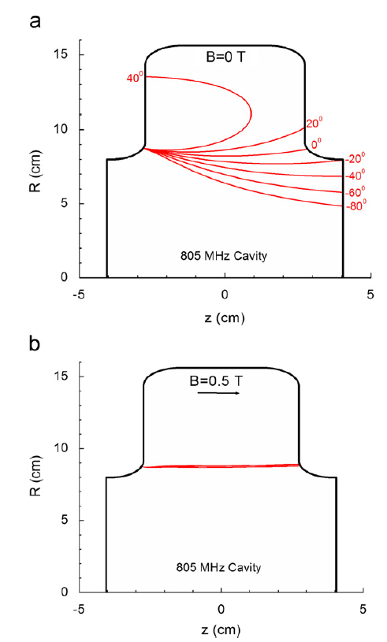
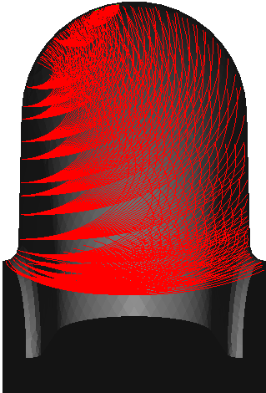
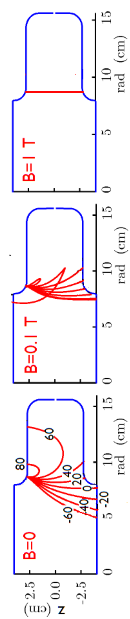
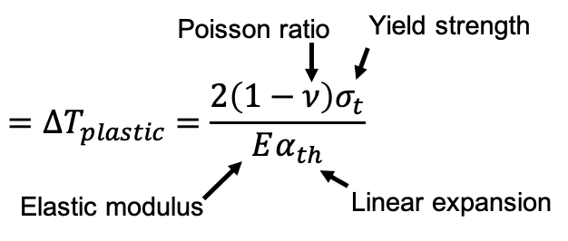
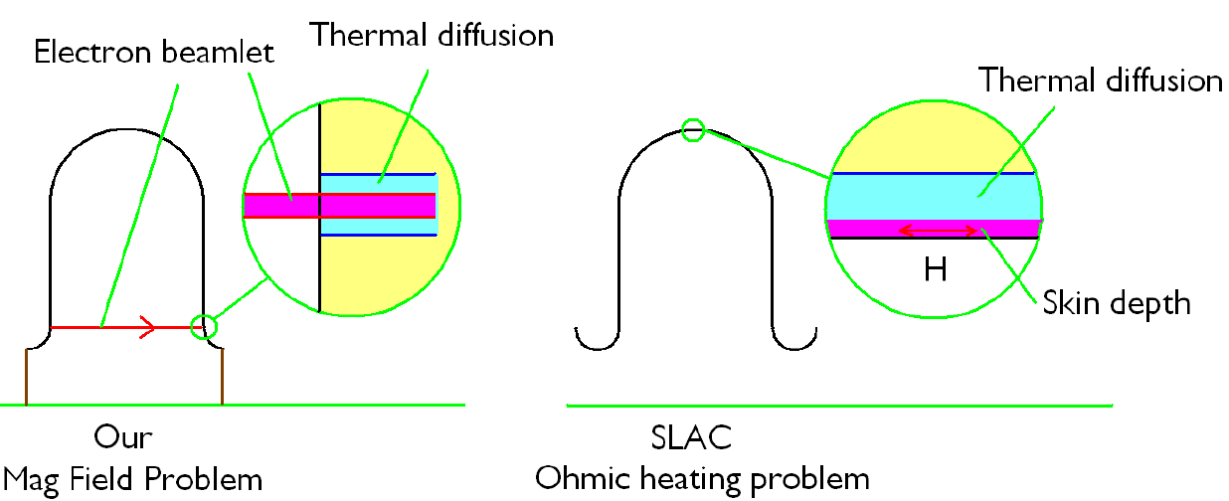
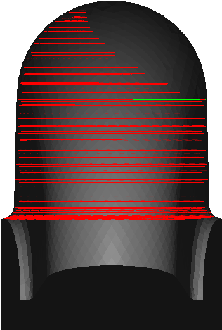
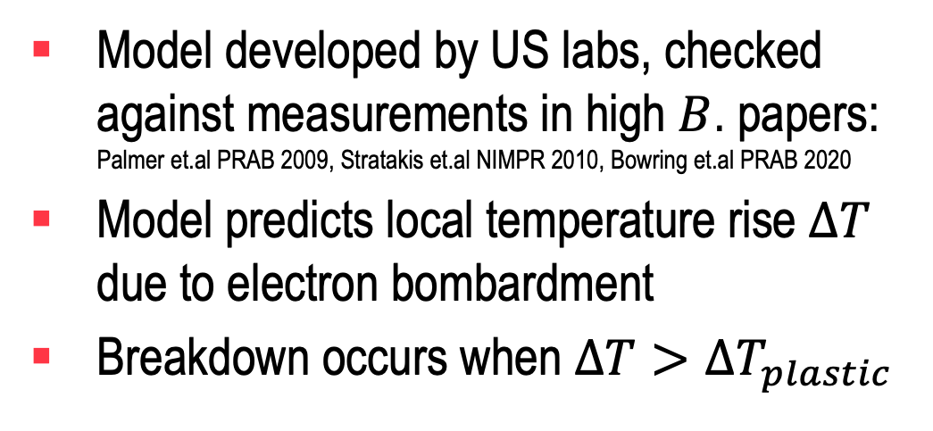
Breakdown model: beamlet focused by magnetic field
Model developed by US labs, checked against measurements in high $B$. papers: Palmer et.al PRAB 2009, Stratakis et.al NIMPR 2010, Bowring et.al PRAB 2020
Model predicts local temperature rise $∆T$ due to electron bombardment
Breakdown occurs when $∆T>∆T_{plastic}$
Numerical simulations conducted by SLAC collaborators showed trajectories of beamlets in the presence of the 805 MHz pillbox cavity
Electron beamlet
Thermal diffusion
Heating due to electron bombardment
$∆T_{plastic}$: 38 °C for Cu, 129 °C for Be, 224 °C for Al
Claude Marchand / IMCC annual meeting 2023

Slide 8
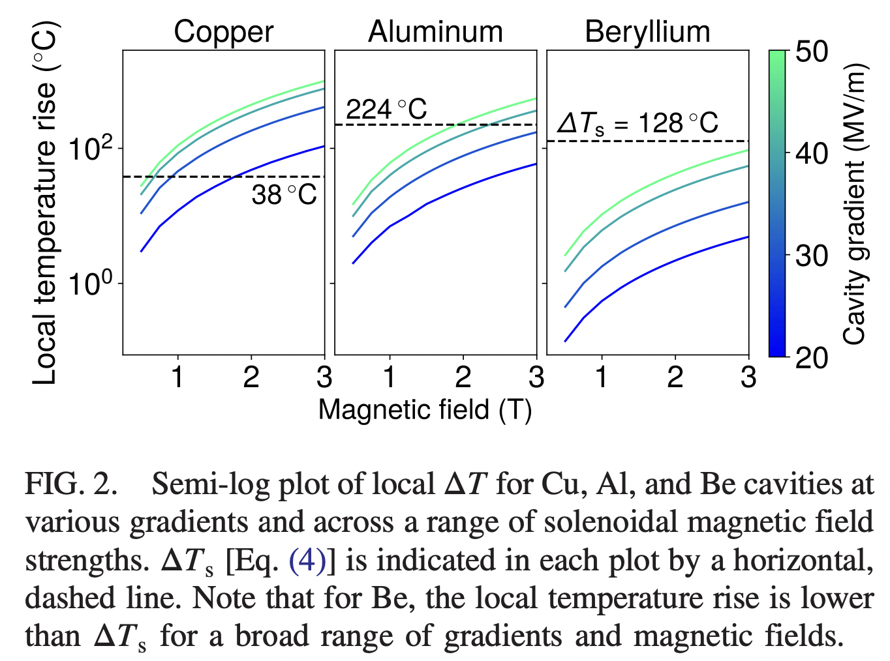
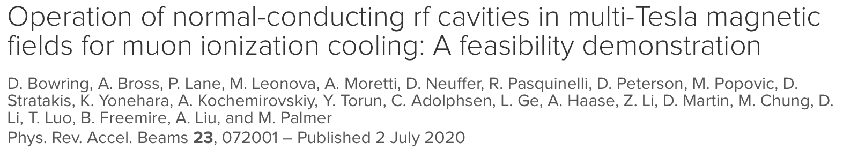
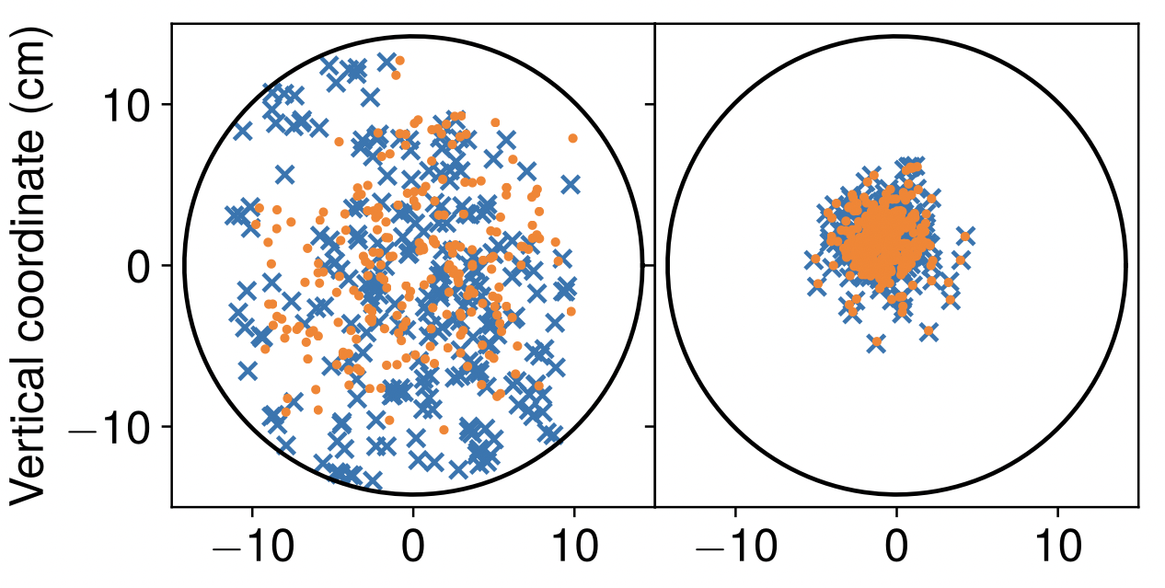
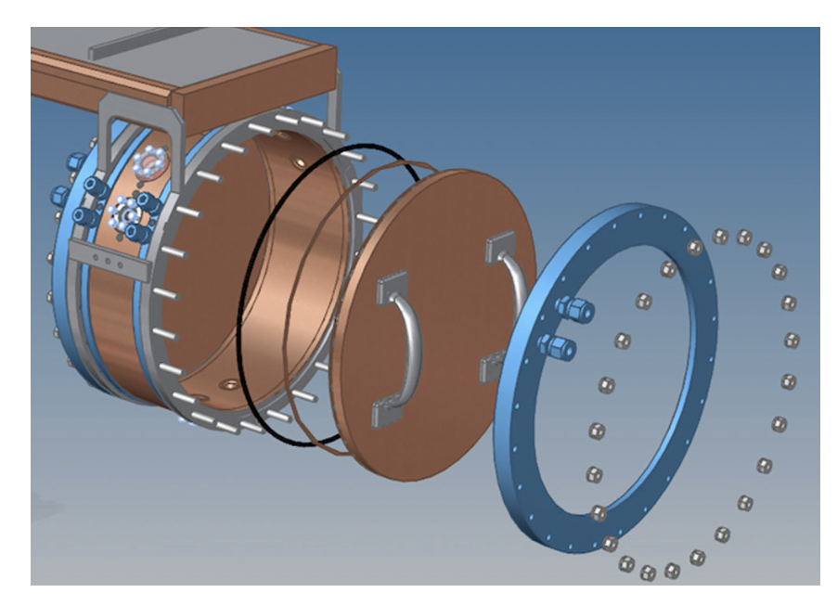
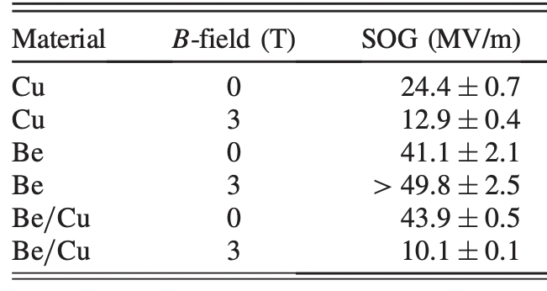
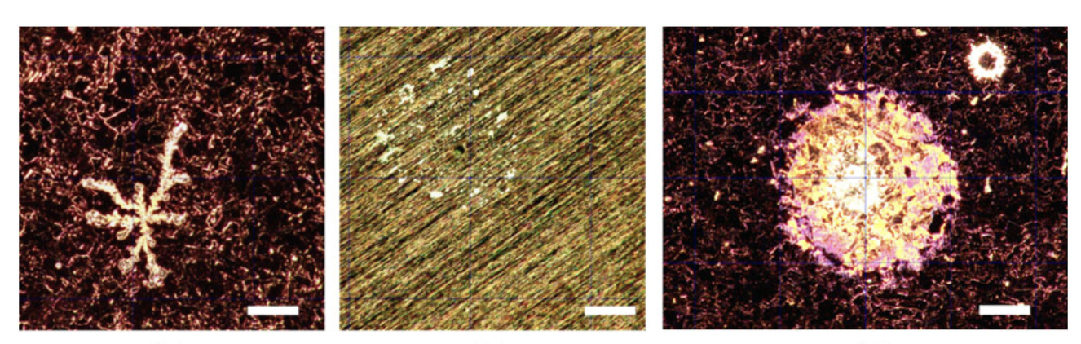
MuCool 805 MHz cavitiy test with modular plates
modular plate
Cu: 0 T
Cu: 3 T
Be: 0 & 3 T
Claude Marchand / IMCC annual meeting 2023

Slide 9
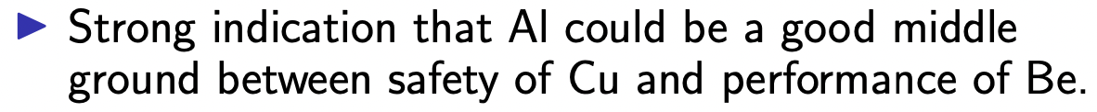
MuCool 805 MHz cavitiy test with modular plates
modular plate
Cu: 0 T
Cu: 3 T
End of the game ?
(cf. Stratakis statement yesterday):
Be: 0 & 3 T
Claude Marchand / IMCC annual meeting 2023

Slide 10
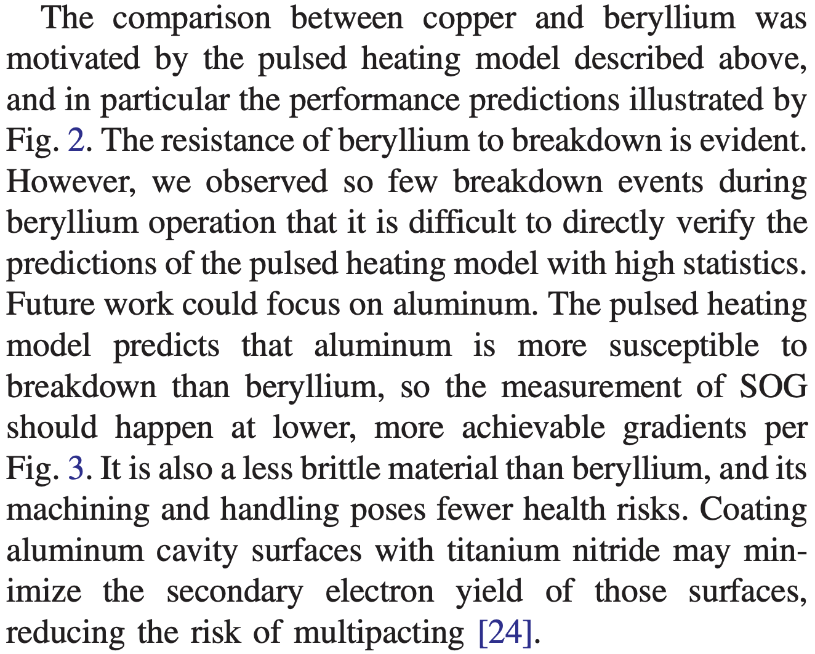
MuCool 805 MHz cavitiy test with modular plates
modular plate
Cu: 0 T
Cu: 3 T
Be: 0 & 3 T
Or need for more ?
(Bowring 2020 paper left)
Claude Marchand / IMCC annual meeting 2023

Slide 11
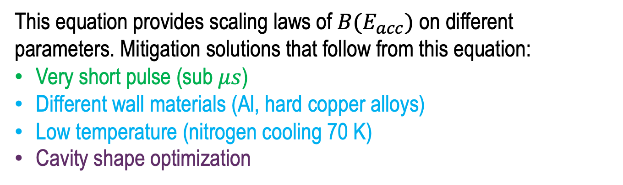



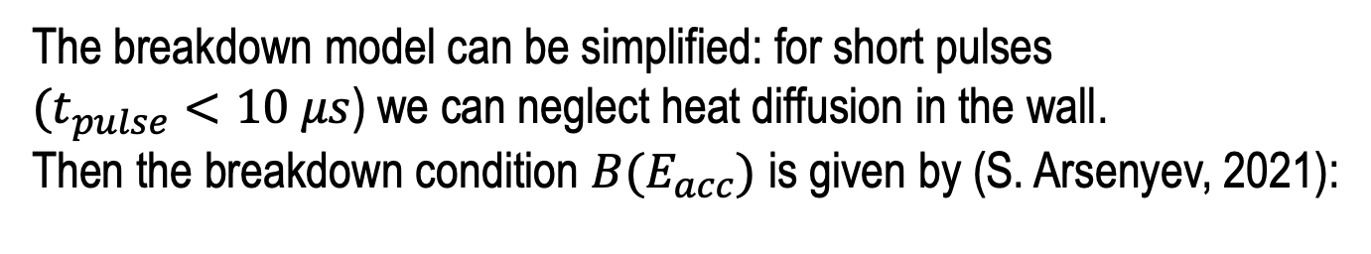
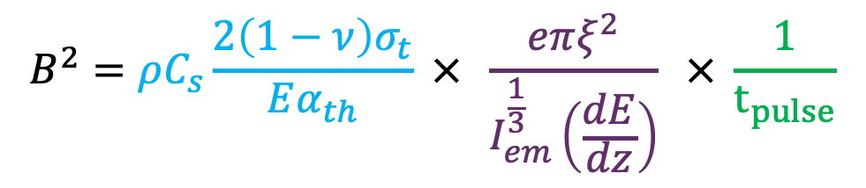

Scaling using no-diffusion beamlet model
The breakdown model can be simplified: for short pulses
$(t_{pulse}<10 μs$) we can neglect heat diffusion in the wall.
Then the breakdown condition $B(E_{acc})$ is given by (S. Arsenyev, 2021):
$$ΔT$$
Diffusion
ΔT_{plastic}
Cavity-dependent constant
$$B^{2}=ρC_{s}\frac{2\left(1−ν\right)σ_{t}}{Eα_{th}} × \frac{eπξ^{2}}{I_{em}^{\frac{1}{3}}\left(\frac{dE}{dz}\right)} × \frac{1}{t_{pulse}}$$
No diffusion
Pulse length
Magnetic field at breakdown
Wall material properties
$$\sim 10 μs$$
$$t_{pulse}$$
Electron energy loss
Field Emission current $I(E_{acc})$
This equation provides scaling laws of $B(E_{acc})$ on different parameters. Mitigation solutions that follow from this equation:
Very short pulse (sub $μs$)
Different wall materials (Al, hard copper alloys)
Low temperature (nitrogen cooling 70 K)
Cavity shape optimization
When combined, benefits from different solutions would multiply
Claude Marchand / IMCC annual meeting 2023

Slide 12
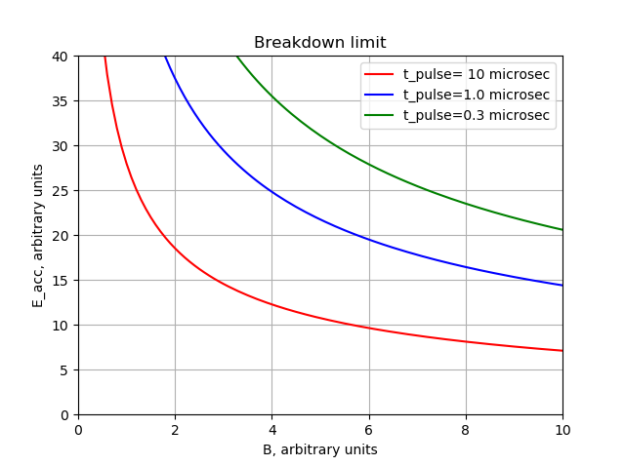


Benefits of short sub-µs pulse
Going down from 10 μs to 300 ns pulse would dramatically improve cavity breakdown performance
$×$6 increase in B
300 ns pulse length needs an over coupled cavity and a 23 MW klystron (only a factor of 2 increase from Litton 805 MHz 12 MW klystron)
$×$3 increase in E
Claude Marchand / IMCC annual meeting 2023

Slide 13
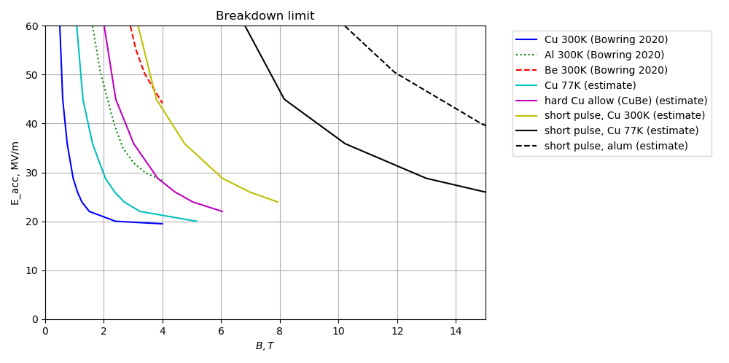
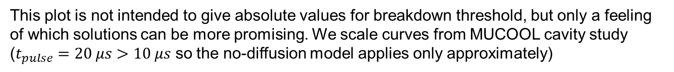
Comparing breakdown mitigation ideas
This plot is not intended to give absolute values for breakdown threshold, but only a feeling of which solutions can be more promising. We scale curves from MUCOOL cavity study ($t_{pulse}=20 μs$ $>10 μs$ so the no-diffusion model applies only approximately)
Scaled from the first 3 curves using the scaling model (slide 7)
Benefits of short pulse and aluminum multiply
Aluminum cavity with a short pulse looks very promising
Claude Marchand / IMCC annual meeting 2023

Slide 14
R&D directions for NC RF cavities tests in high B field
Need high gradient RF test stand(s) with B field up to ~10T Test cavities for technology development
  Frequency: ideally 300 to 700 MHz range
    tests at higher frequencies useful, but need some rescaling to MCC f range
  Gradients from 25 to 50 MV/m
  Short RF pulses (~μs)
  Magnetic field: 0 – ~10T, different field configurations
  Different materials: Cu, Be, Al, …
  Different temperatures: 300K -> 70K ->…
  Different cavity shapes ?
Claude Marchand / IMCC annual meeting 2023

Slide 15
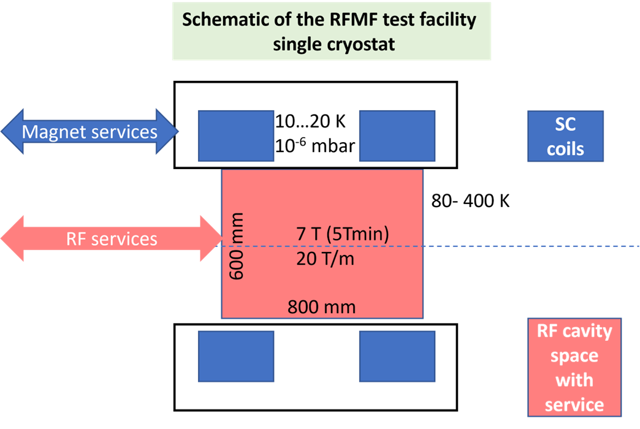
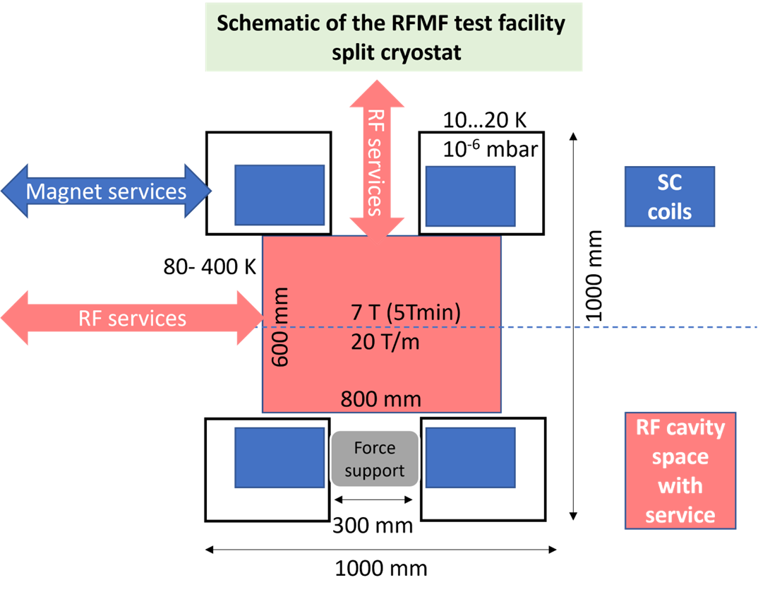
General layout of the RFMF test station
Preliminary design is aimed at fitting a cavity of the size up to a 700 MHz system
Minimum bore of the split coil
  → ∅600 RT free bore for RF → ∅700 mm minimum SC coil diameter
Scheme 1: single cryostat
Scheme 2: split cryostat
WP8 - RFMF test station - L. Rossi et al. UMIL&INFN
Claude Marchand / IMCC annual meeting 2023

Slide 16
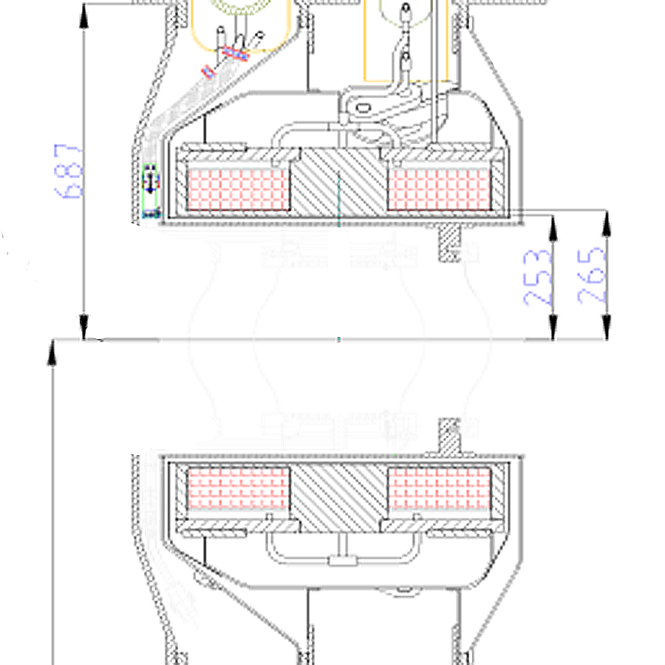
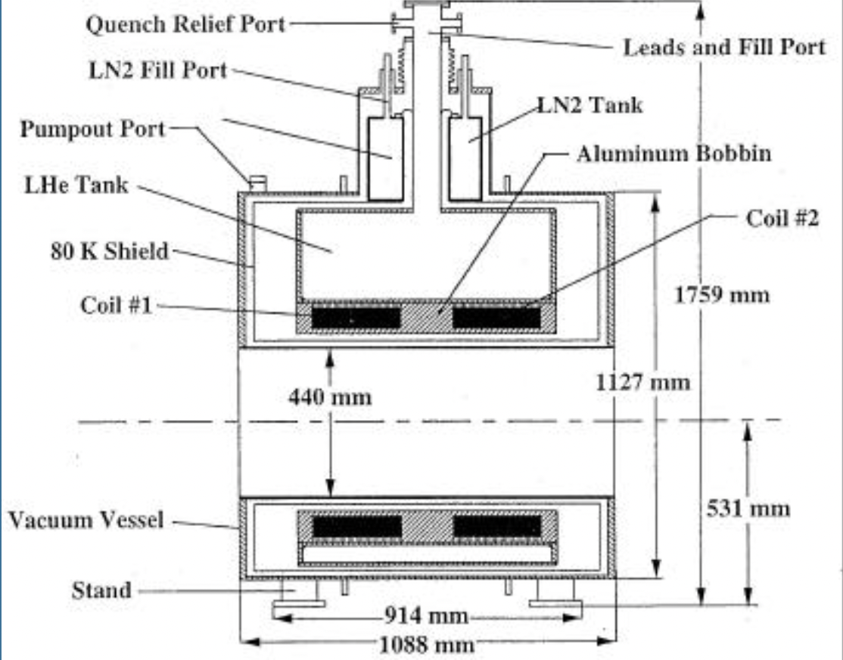
CEA setup with the 4T MICE AFC magnet
MUCOOL setup
5T magnet, 805 MHz
CEA setup
4T magnet, 704 MHz
32.6cm
B-field
47 cm
28.4cm
44cm
47 cm bore of the MICE AFC magnet will tightly fit the cavity
Claude Marchand / IMCC annual meeting 2023

Slide 17
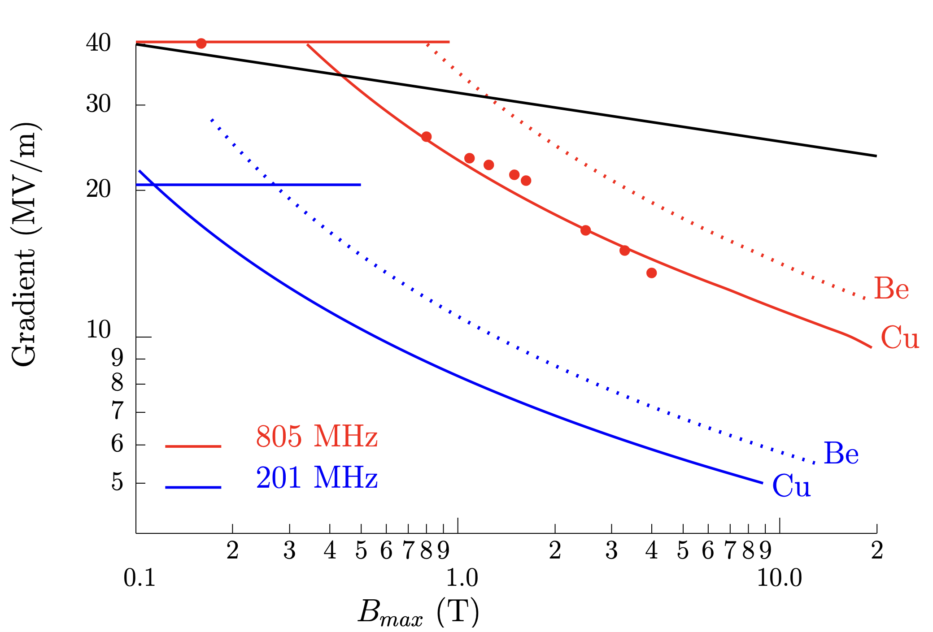
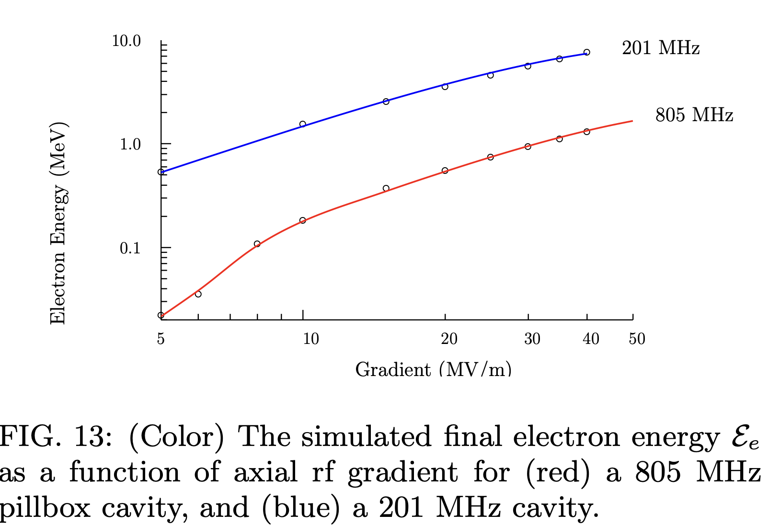

Effect of the RF frequency in beamlet model (Stratakis)
While classical RF BD
(Wang&Loew 1997) predicts less frequency dependence:
-> E₈₀₅/E₂₀₁=1.58
Factor 2.6
Claude Marchand / IMCC annual meeting 2023

Slide 18
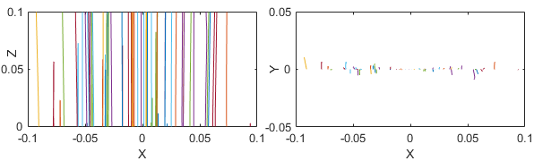
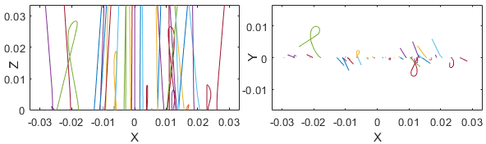
Effect of the RF frequency (G. Ferrand).
A few simulations of particle in pillboxes with Matlab. Example at 0.5 T.
Simulation at 700 MHz, 0.5 T, 30 MV/m
Simulation at 2 100 MHz, 0.5 T, 30 MV/m
At 2.1 GHz, an identical focusing of the electron beam than at 700 MHz occurs at 2xB.
Claude Marchand / IMCC annual meeting 2023

Slide 19
RF test stand requirements
Frequency:
  Ideally the ones chosen for the 6D cooling (325-352/650-704 MHz)
  But the lower the frequency, the bigger the solenoid bore diameter and $$$
  -> tempting to perform BD tests at higher f (3 GHz), but have to rely on models to rescale to MCC frequencies
Magnetic configuration:
  two coils SC solenoid, B up to 5T min, ideally 10T, same and opposite polarization (~20T/m)
  Bore diameter depends on frequency and exact cavity design (w/wo 70 K cooling)
  -> e.g. for 704 MHz, 60 cm free RF bore desired
RF power sources:
  ~10’s MW range: depends on cavity Q factor and highest needed RF gradient
  -> e.g. for a PB cavity at 704 MHz (Cu) and 50 MV/m : ~7 MW peak
  Pulses from sub μs to ~0.1 ms, the higher the rep. rate, the faster the cavity conditioning
Test stand shielding:
  Radiation shielding against high FE at highest RF gradients
  May also need magnetic shielding due to extended solenoid stray field
Claude Marchand / IMCC annual meeting 2023

Slide 20

Thank you
for attention

