Slide 1
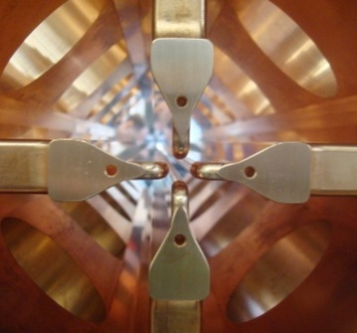
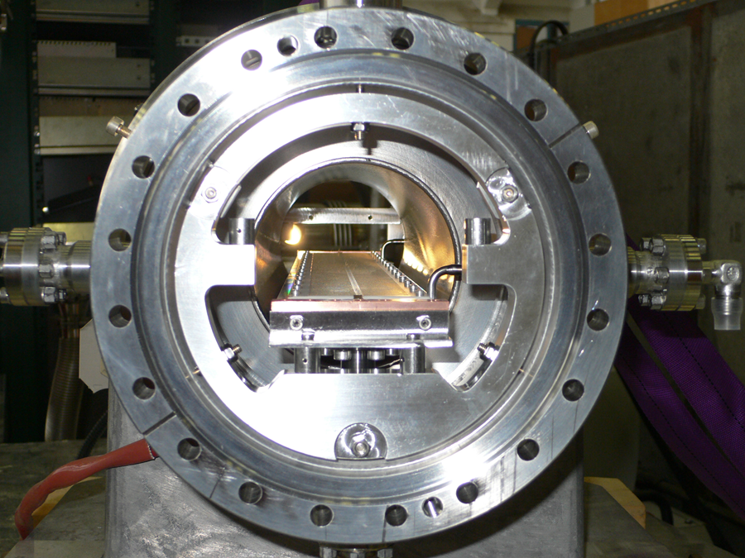
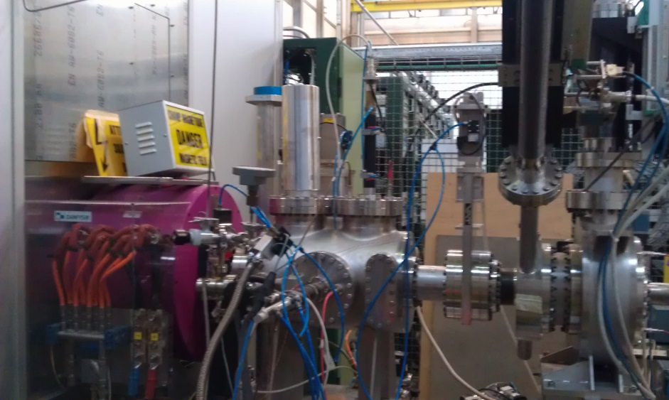

LINAC Activities at CERN
source
Solenoid
Emittance metre
Radio Frequency Quadrupole 352MHz
Fast Chopper – 1MHz
Source test stand
Alessandra Lombardi and the Hadron Sources and Linac team
The Superconducting Proton Linac (SPL)
Achievements with LINAC4
Activities on RFQ redesign
Conclusions and outlook

Slide 2
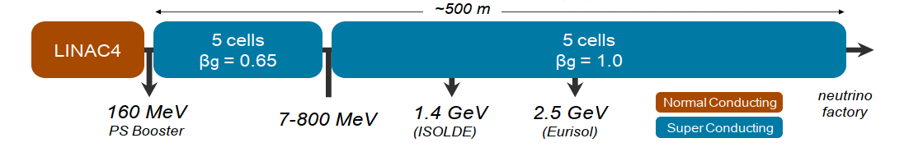

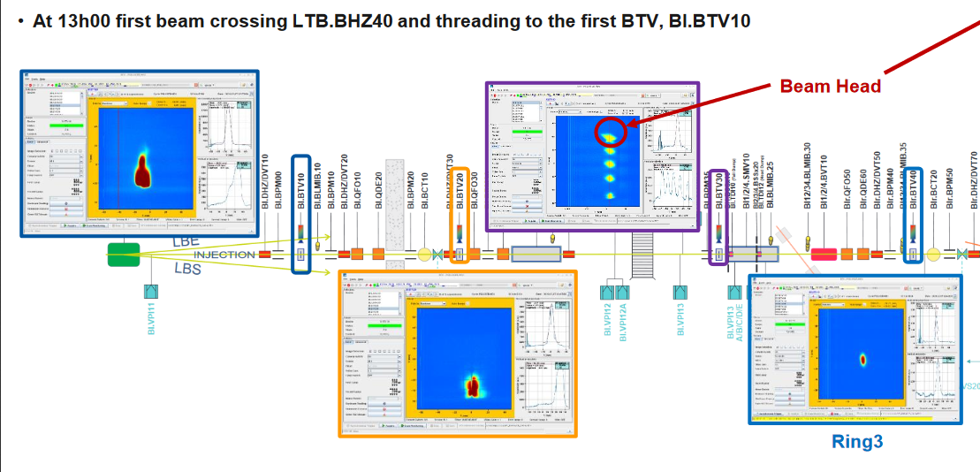
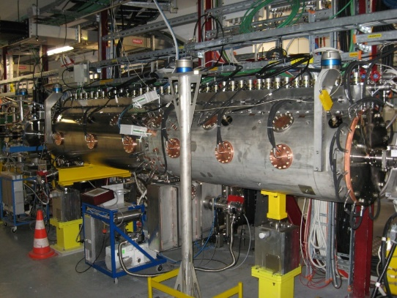
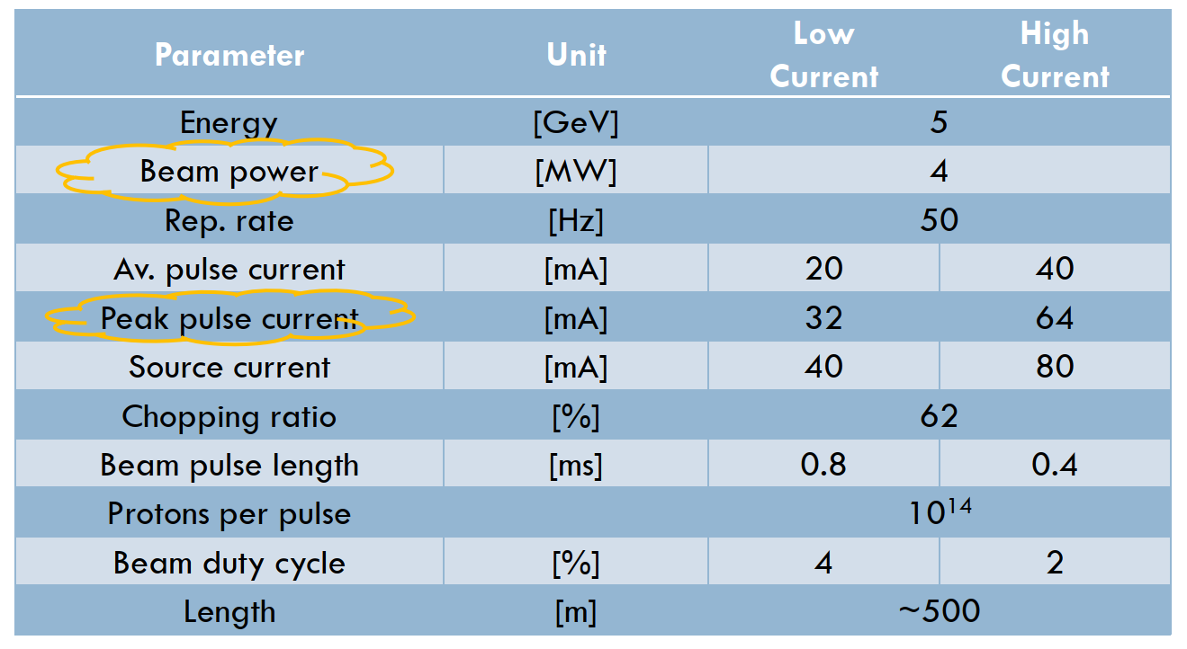

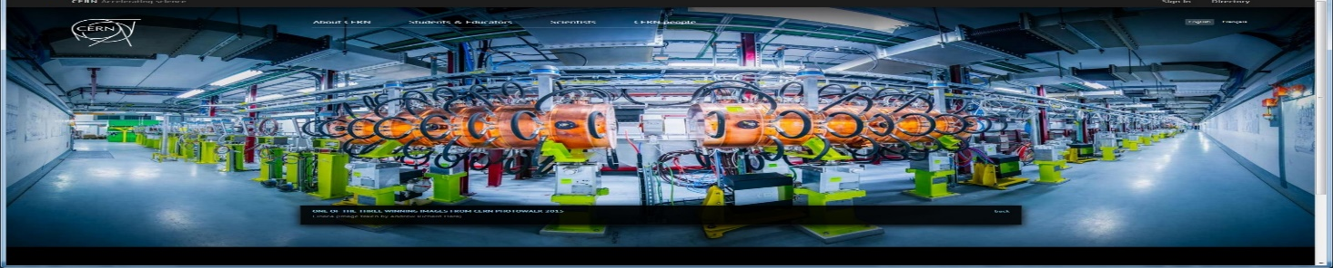
LINACs for ν-fact or µ-collider – CERN 2010
352MHz
704 MHz
SPL parameters
7 Dec 2020

Slide 3
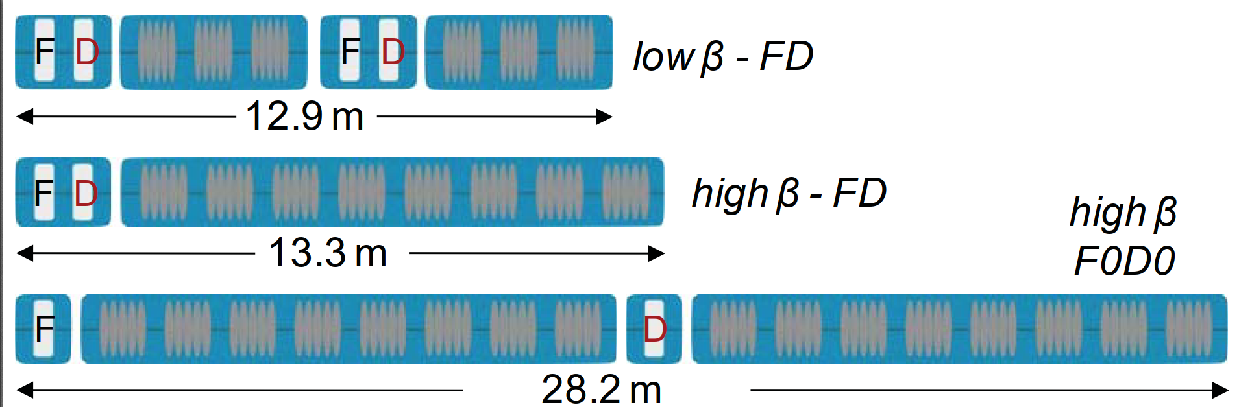
Building blocks of the superconducting part

Slide 4
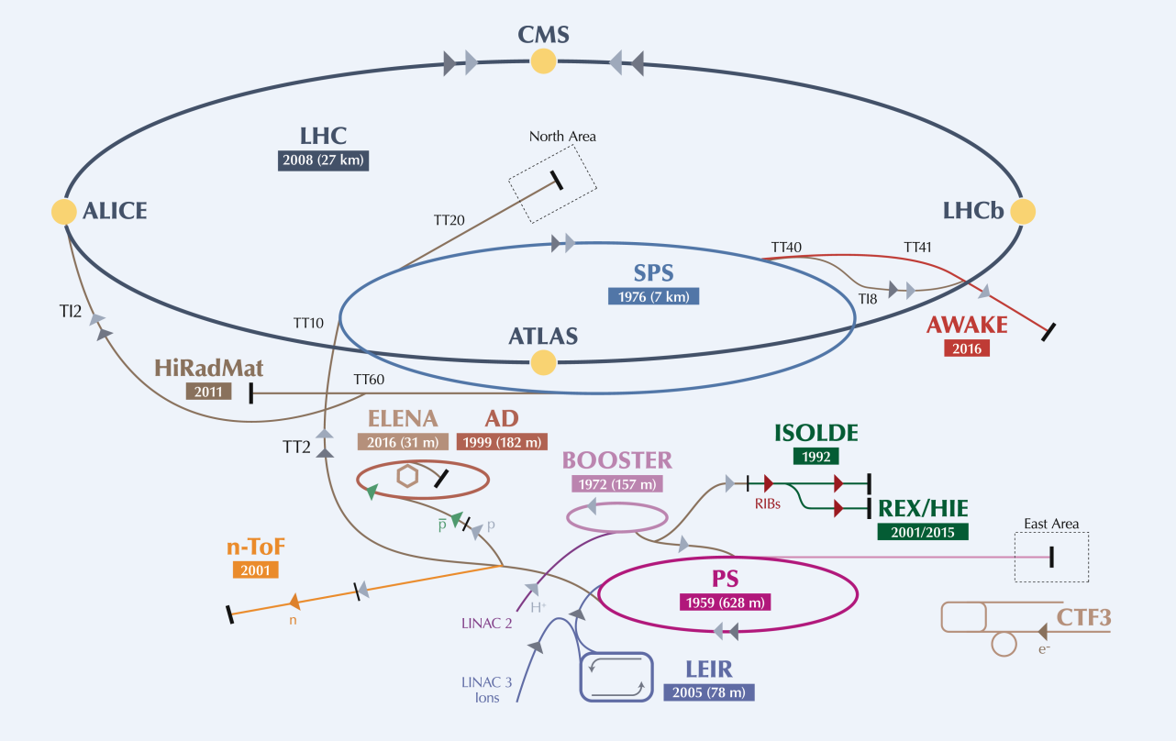
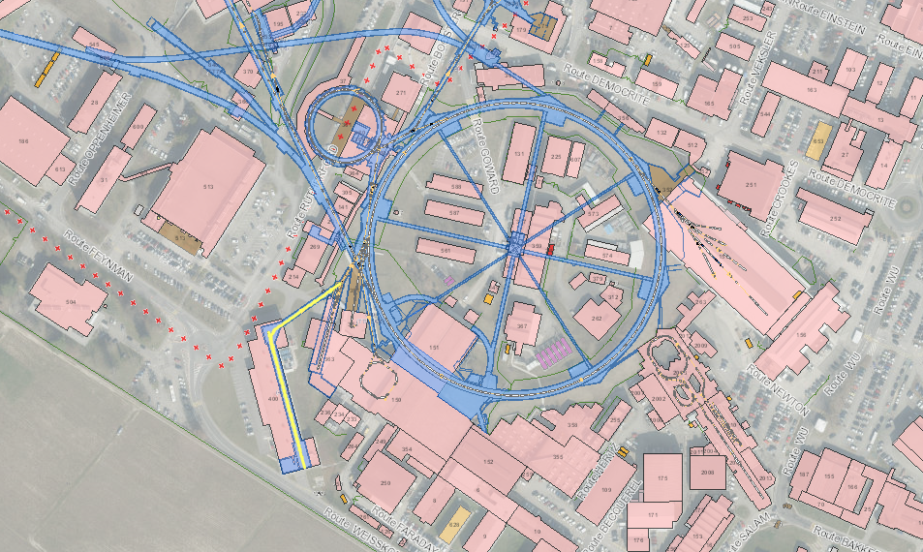
Frequency : 352 MHz
Duty cycle for PSB : 0.06 %
Max duty cycle : 5%
Located 12m underground
Notes:
Add lines to indicate the PSB and the PS

Slide 5
Baseline beam parameters
LINAC4 – CDR -2006 | LINAC4 – achieved (2016) | Comments – general | Comments – mucoll specific
H- | Stripping and more tested in Half Sector Test
70mA peak at the source 65 ma peak at 3 MeV 40 mA after chopping | 50mA peak (in twice the acceptance of the RFQ) 30 mA peak at 3 MeV (record) 20 mA after chopping | Peak current from the source Average beam current after chopping (LEBT and RFQ transmission and chopping factor) | Missing a factor 2 for the high current
160 MeV | 160.48 MeV | All RF structures performing to specs
0.4 π mm mrad | 0.3 π mm mrad (at 160MeV) | Smaller emittance , allows for more turns injected
400 µsec 1Hz (4 rings) | Up to 600 µsec 1Hz | Longer injection in the PSB (100-150turns) | Longer pulse and ducty cycle is possible
Fast Chopping at 3 MeV 2µsec inj kicker rise-time | Demonstrated , including transmitted beam quality | Unprecedented flexibility, to be exploited Beam from 1µsec to 150µsec | Repetition rate (40MHZ) not demonstrated
Energy painting with the last accelerating modules |  |  | Flexibility in the longitudinal plane

Slide 6
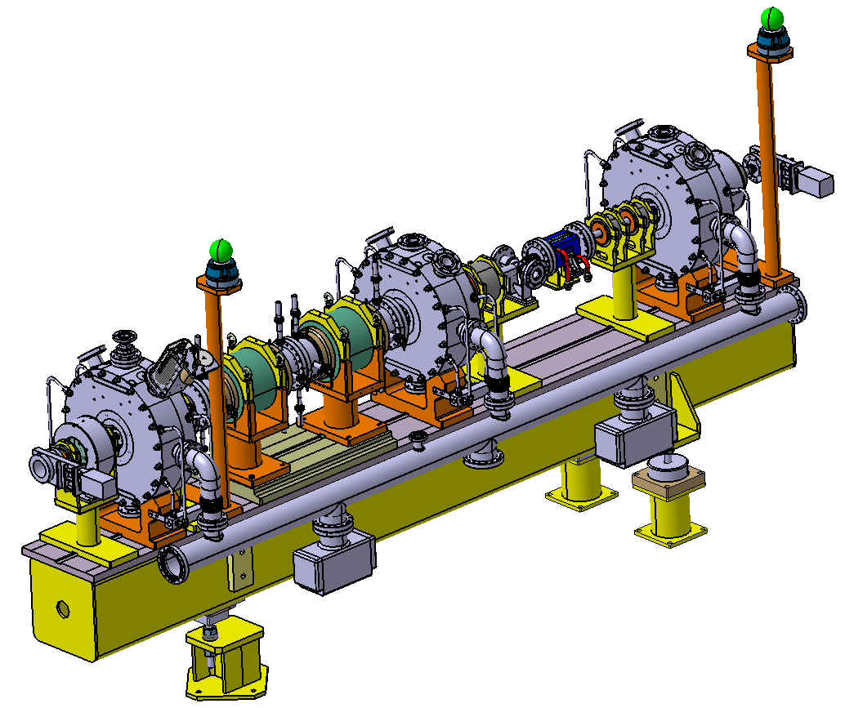
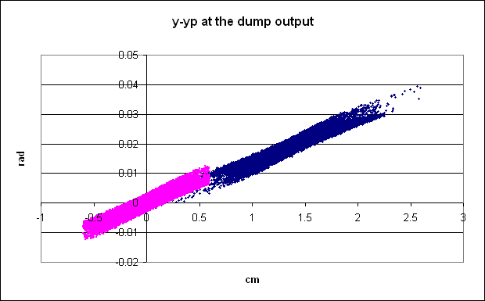
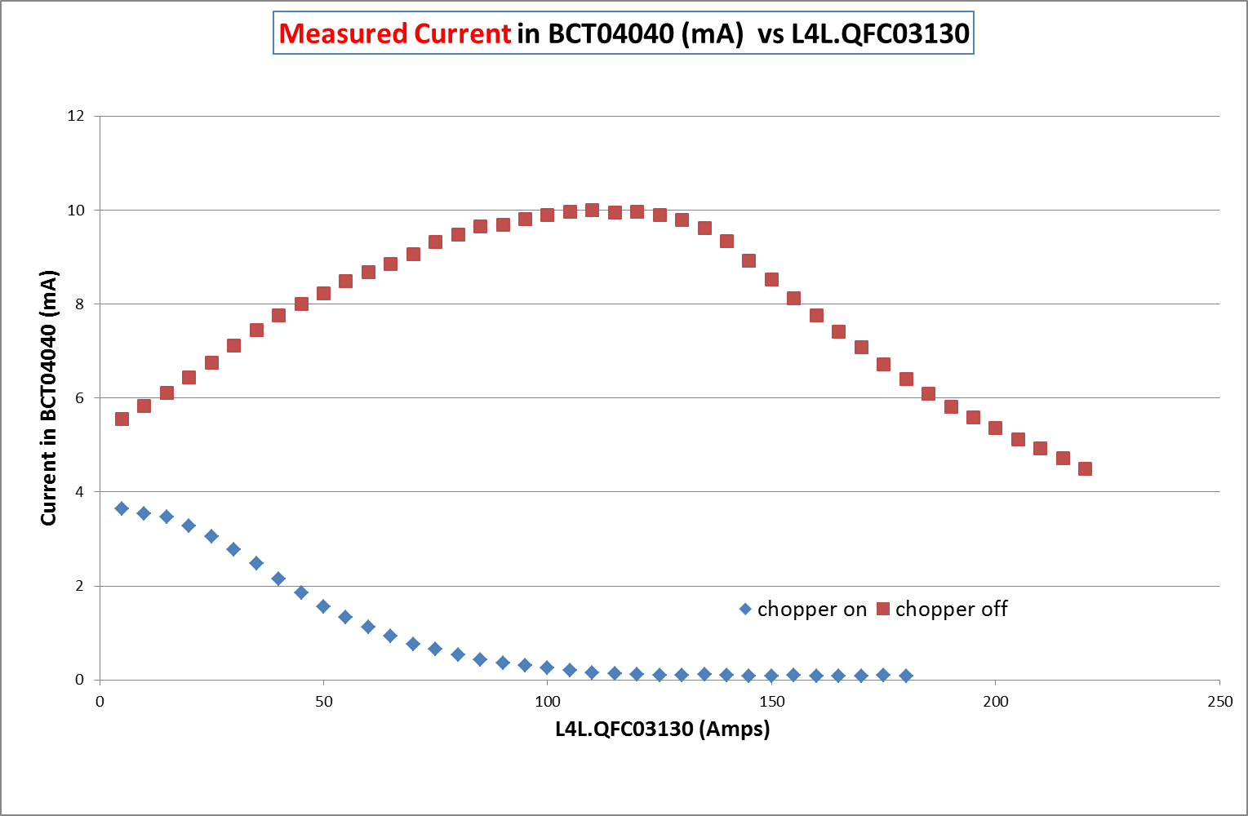
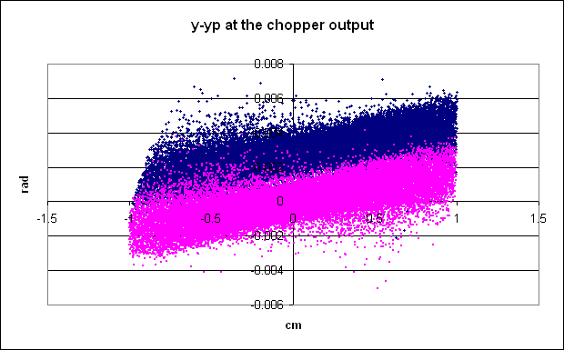
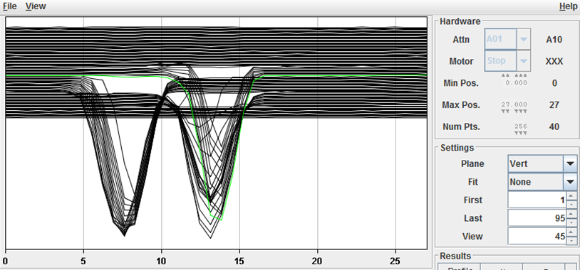
Measuring at 3 MeV : CHOPPING removing microbunches (150/352) to adapt the 352MHz linac bunches to the 1 MHz booster frequency
Match to the DTL
Match from the RFQ
Chop
Meas 2014
Beam current downstream the dump

Slide 7
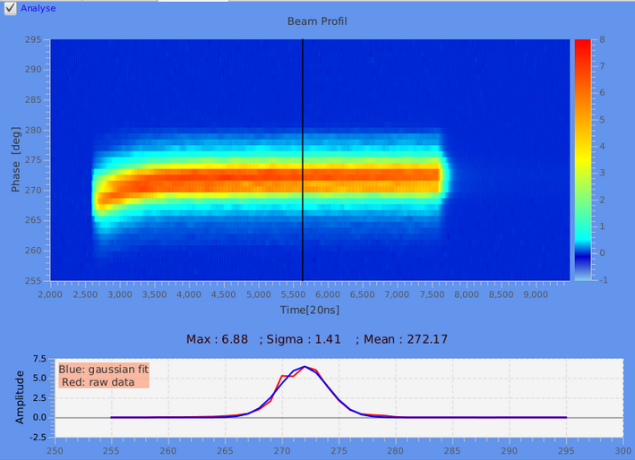
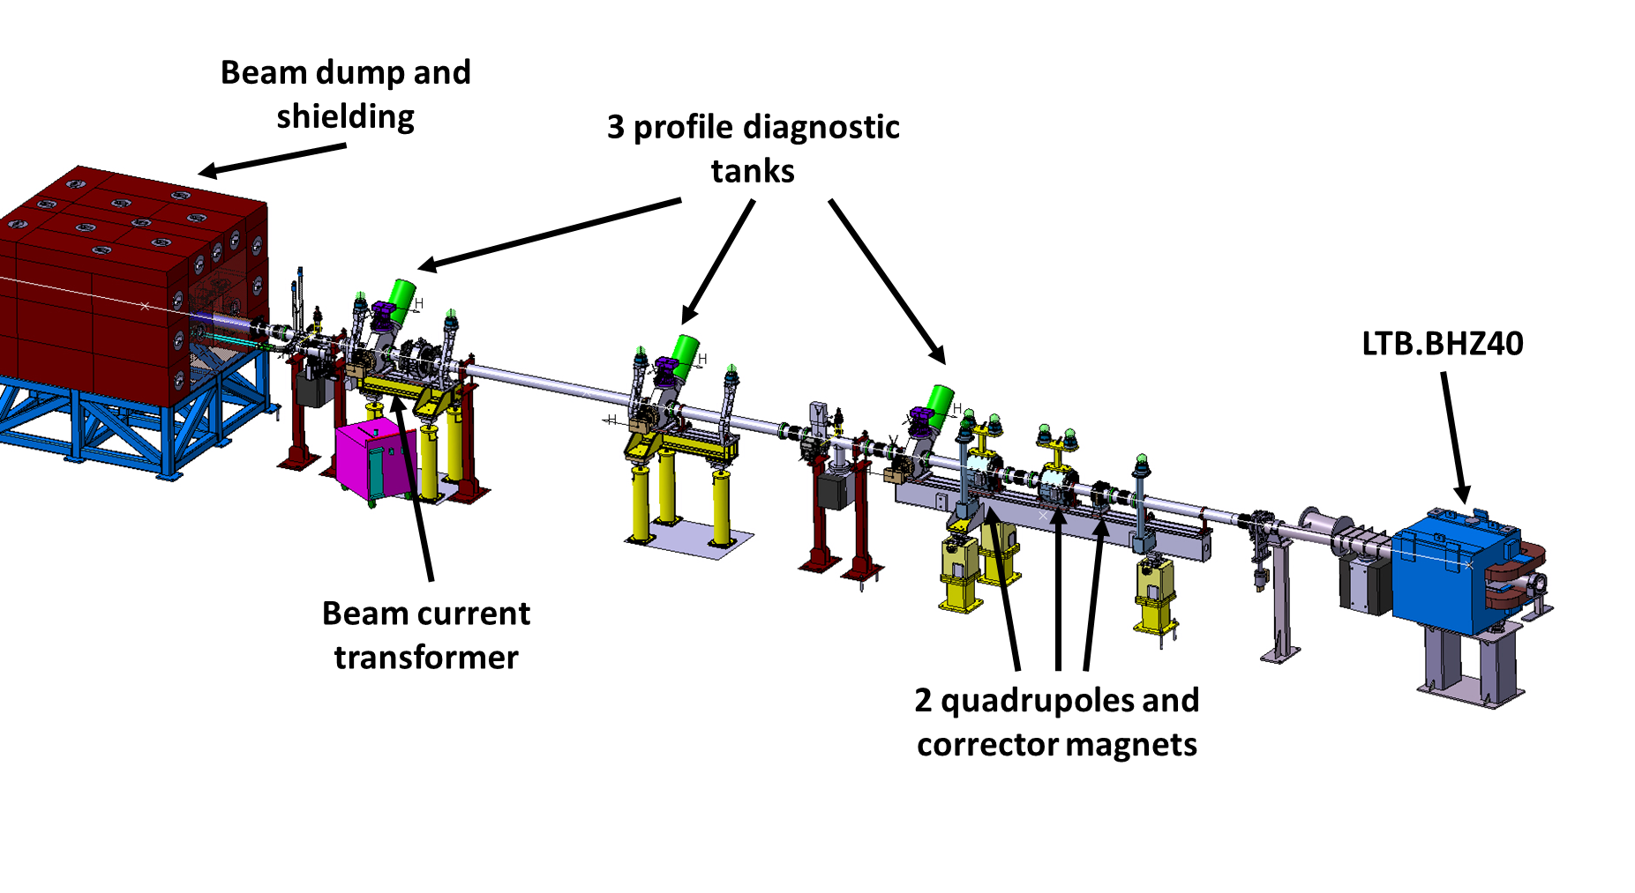
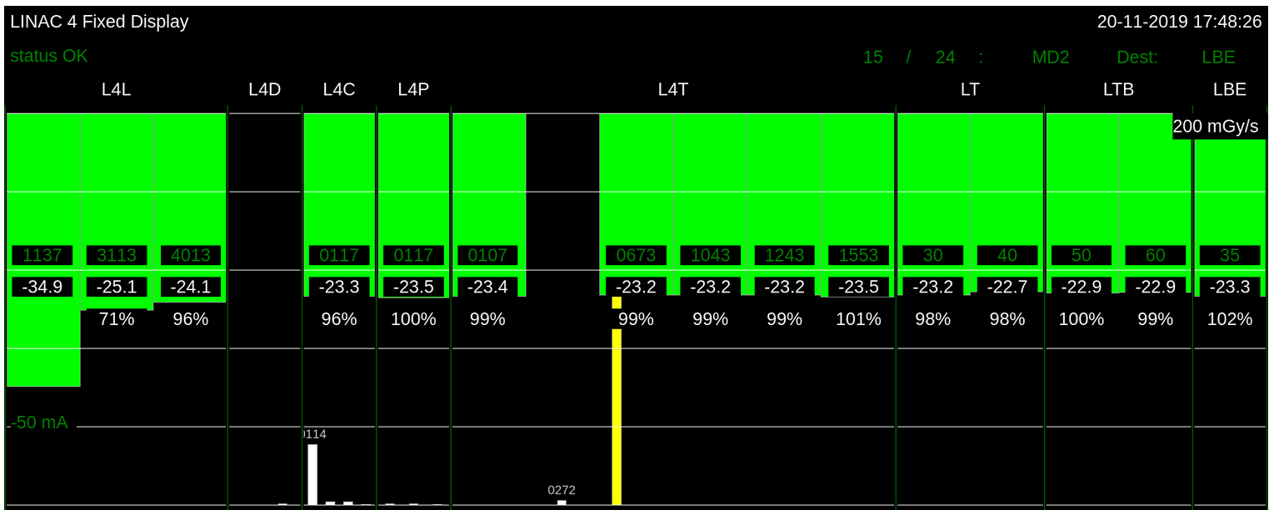
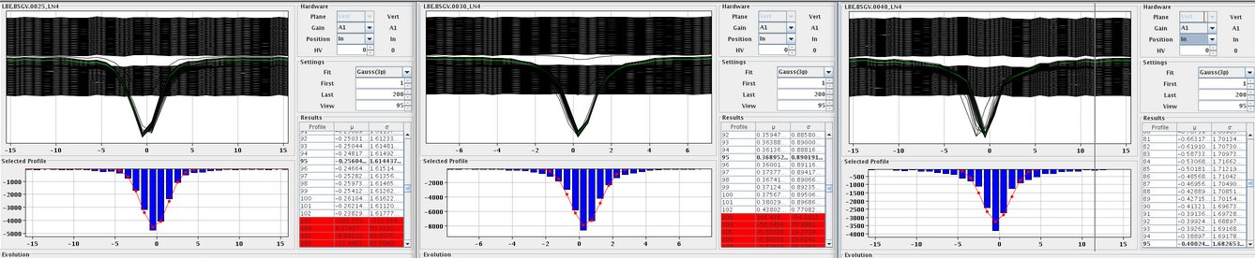
Beam to the LBE !
LBE
Availability
93.9%
Beam phase spread at 160 MeV – in specs.
Pre-injector
Accelerator
Transfer Lines
96% transmission from 3 MeV to the LBE – 23mA suitable for all pre-LS2 beams
Emittance measurements in LBE – as expected

Slide 8
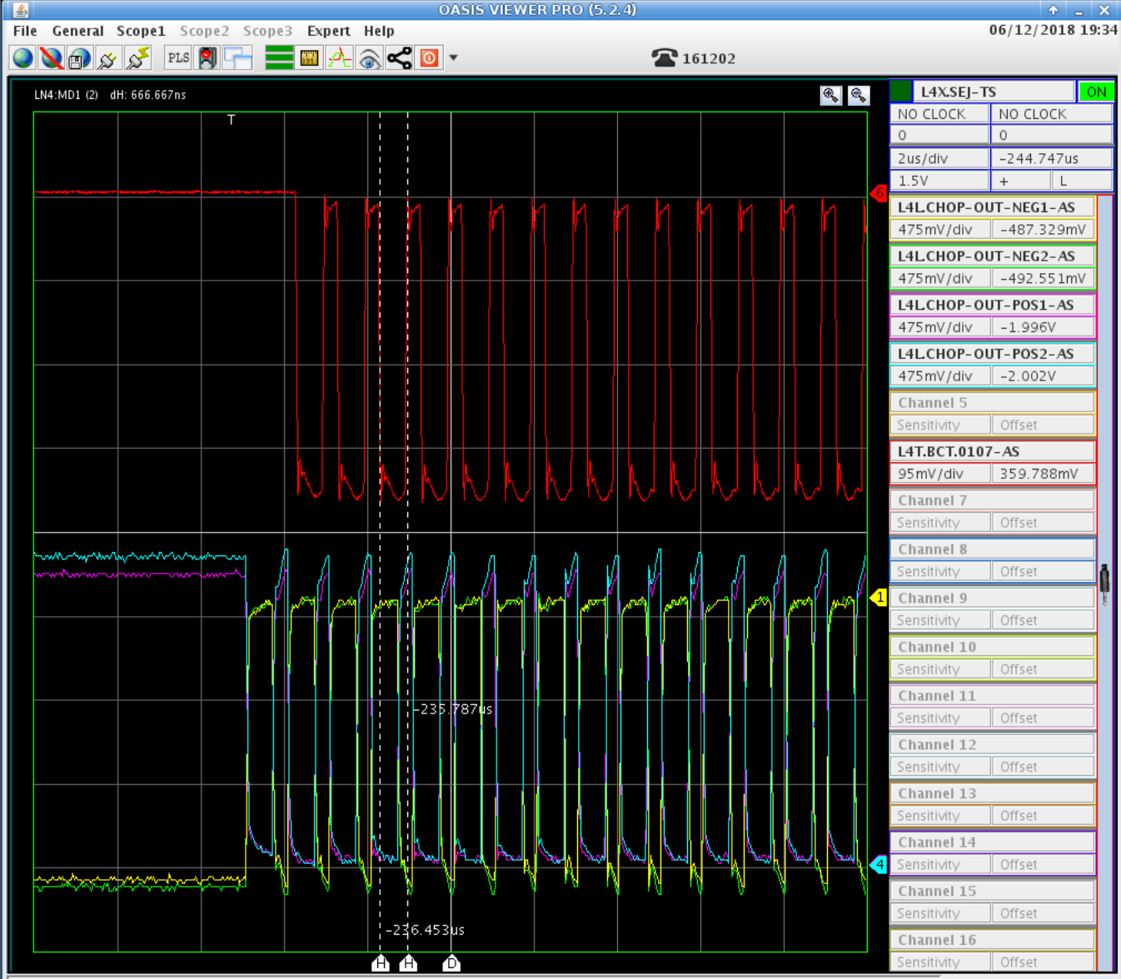
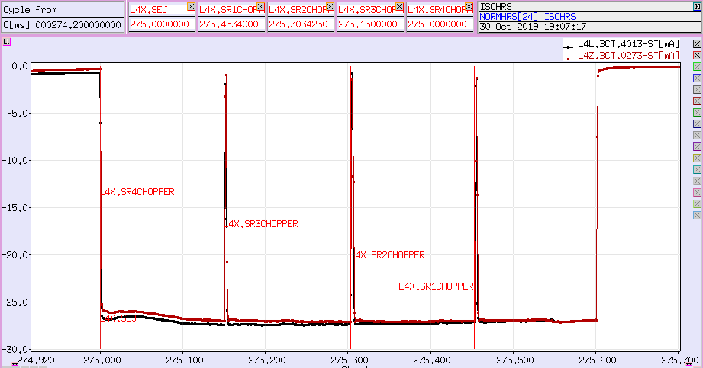
Pulse Flatness and chopping
Zoom into start of Ring 4 with nominal chopping pattern;
Top: BCT in transfer line; bottom: output voltage (neg./pos.) of chopper plates.
600 μs long 25.5 mA pulse just upstream the LINAC4 dump (red curve). The pulse flatness meets the specification for each of the 4 Booster rings

Slide 9
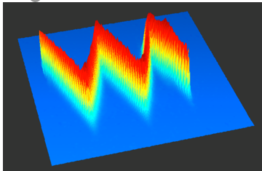
Longitudinal stability and painting
Measured phase variation for 100 μs long pulse when a energy variation is programmed along the pulse –proof of principle of energy painting
The beam phase spread along the pulse is within specs – RF regulation is ok

Slide 10
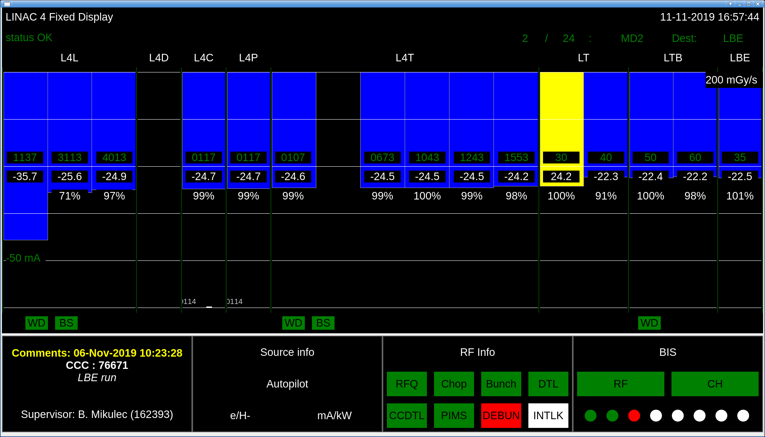
Beam Intensity and Transmission
Excellent transmission from 3 MeV to the LBE
Routinely 23mA (un-chopped) that allows the production of all the pre-LS2 beams
Pre-injector
Accelerator
Transfer Lines
H- beam intensity on the 15 transformers along the linac and transfer lines

Slide 11
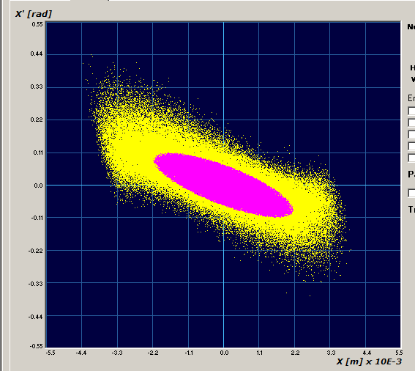
CERN 2013 : pre-injector challenge
IS-O2
(25mA in RFQ acceptance)
IS-04
(50mA in RFQ acceptance)
IS-O3
(35mA in RFQ acceptance)
Source redesign
16mA
Edgar Sargsyan talk
3m high-field (2018)
RFQ3
2021
2013: Comparison of measured emittance (yellow) and RFQ acceptance (pink). The expected transmission thru the RFQ is 75%. (PARMTEQ + TOUTATIS).
RFQ redesign

Slide 12
IS-O2
(25mA in RFQ acceptance)
IS-04
(50mA in RFQ acceptance)
IS-O3
(35mA in RFQ acceptance)
Source redesign
16mA
3m high-field (2018)
RFQ3
2021
2013: Comparison of measured emittance (yellow) and RFQ acceptance (pink). The expected transmission thru the RFQ is 75%. (PARMTEQ + TOUTATIS).
RFQ redesign

Slide 13
Common design guidelines
Input/output energy : 45 keV/3MeV;
a two-term potential vane profile, a constant average aperture radius and a constant transverse radius of curvature for an easier tuning and the possibility of machining with a 2D cutter;
Constant voltage profile;
Transmission higher than 90% for emit=0.5µm rms normalised I=70mA

Slide 14
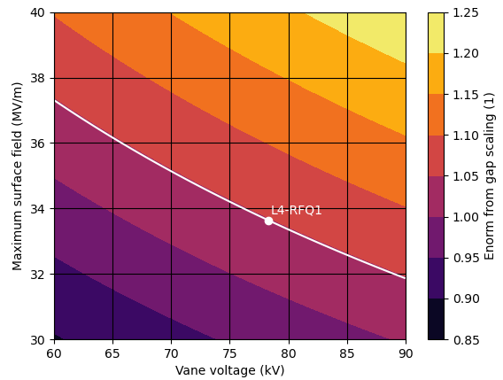
RFQ design – copper
General Guidelines:
Stay below the RFQ1 line
Transmission>90 for emit=0.5 mm mrad and I=70mA
rho/ro=0.7 -1
Two versions
  L=4.5 m to avoid dipole rods
  L=as short as possible.

Slide 15
4.5 m
RFQ parameters
Length m | 4.5
Vane voltage kV | 79
Max electric field (MV/m) | 33
Peak RF power kW | 750
Average aperture (r0) mm | 3.2
Transverse radius (ρ) | 2.7
Maximum modulation | 1.5
Minimum aperture mm | 2.5
Focusing parameter (B) | 5.87
Phase at gentle buncher deg | -35
Transmission % (70mA , 0.5 mm mrad) | 93.2

Slide 16
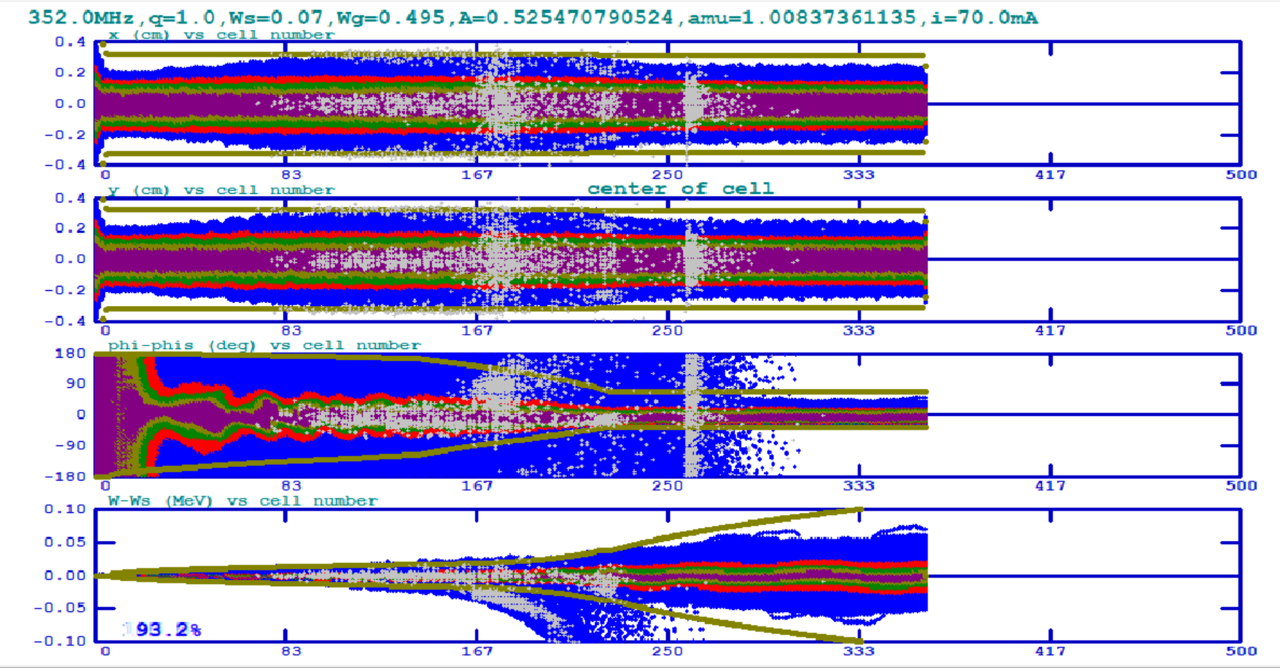
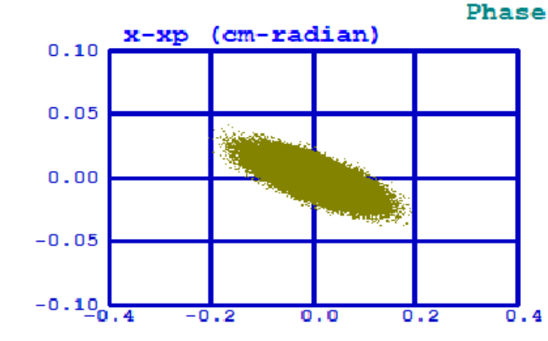
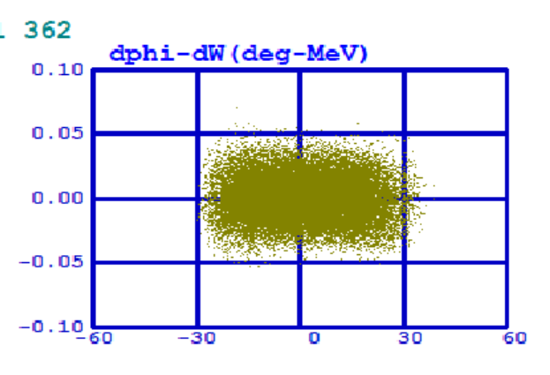
Beam dynamics – 70mA emit =0.5mm mrad
Transverse (x, y top) and longitudinal planes (phase, energy spread) along the RFQ
Beam at the RFQ output plane

Slide 17
3.9 m
RFQ parameters
Length m | 3.9
Vane voltage kV | 79
Max electric field (MV/m) | 33
Peak RF power kW | 650
Average aperture (r0) mm | 3.2
Transverse radius (ρ) | 2.2
Maximum modulation | 1.8
Minimum aperture mm | 2.2
Focusing parameter (B) | 5.76
Phase at gentle buncher deg | -32
Transmission % (70mA , 0.5 mm mrad) | 95.4

Slide 18
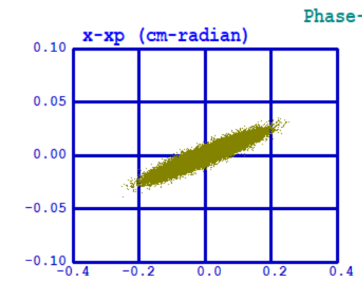
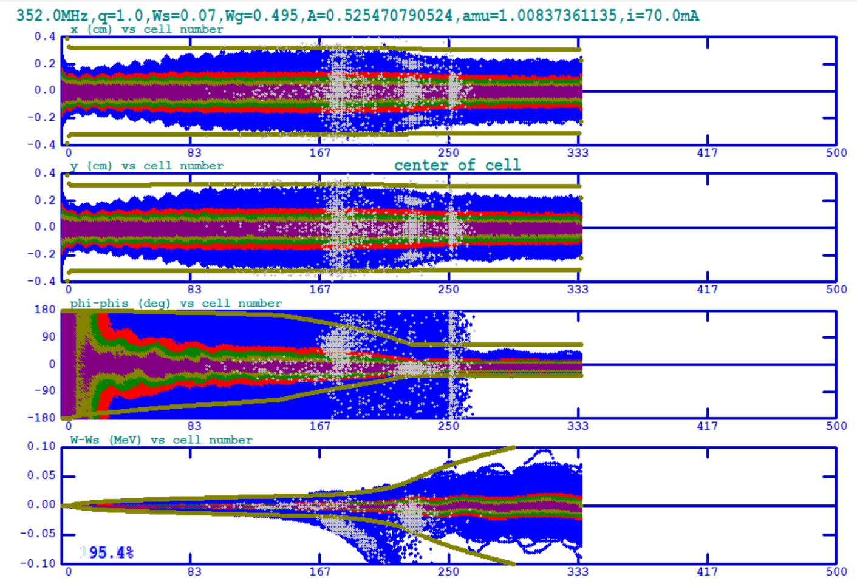
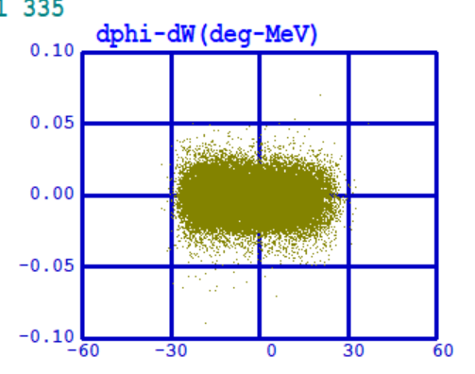
Beam dynamics – 70mA emit =0.5mm mrad
Transverse (x, y top) and longitudinal planes (phase, energy spread) along the RFQ
Beam at the RFQ output plane

Slide 19
RFQ design – new material
General Guidelines:
Field up to 50MV/m for 78 kV (cryo-copper)
Respect scaling –
  120kV and 42.3 MV/m
  140kV and 39.3 MV/m
Transmission > 90% for emit=0.5 mm mrad and I=70mA
rho/ro=0.7 -1
L as short as possible
Best beam quality

Slide 20
2.5 m 120 kV
RFQ parameters
Length m | 2.5
Vane voltage kV | 120
Max electric field (MV/m) | 44
Peak RF power kW | 960
Average aperture (r0) mm | 4.1
Transverse radius (ρ) | 4.1
Maximum modulation | 2.2
Minimum aperture mm | 2.4
Focusing parameter (B) | 5.54
Phase at gentle buncher deg | -32
Transmission % (70mA , 0.5 mm mrad) | 91.2

Slide 21
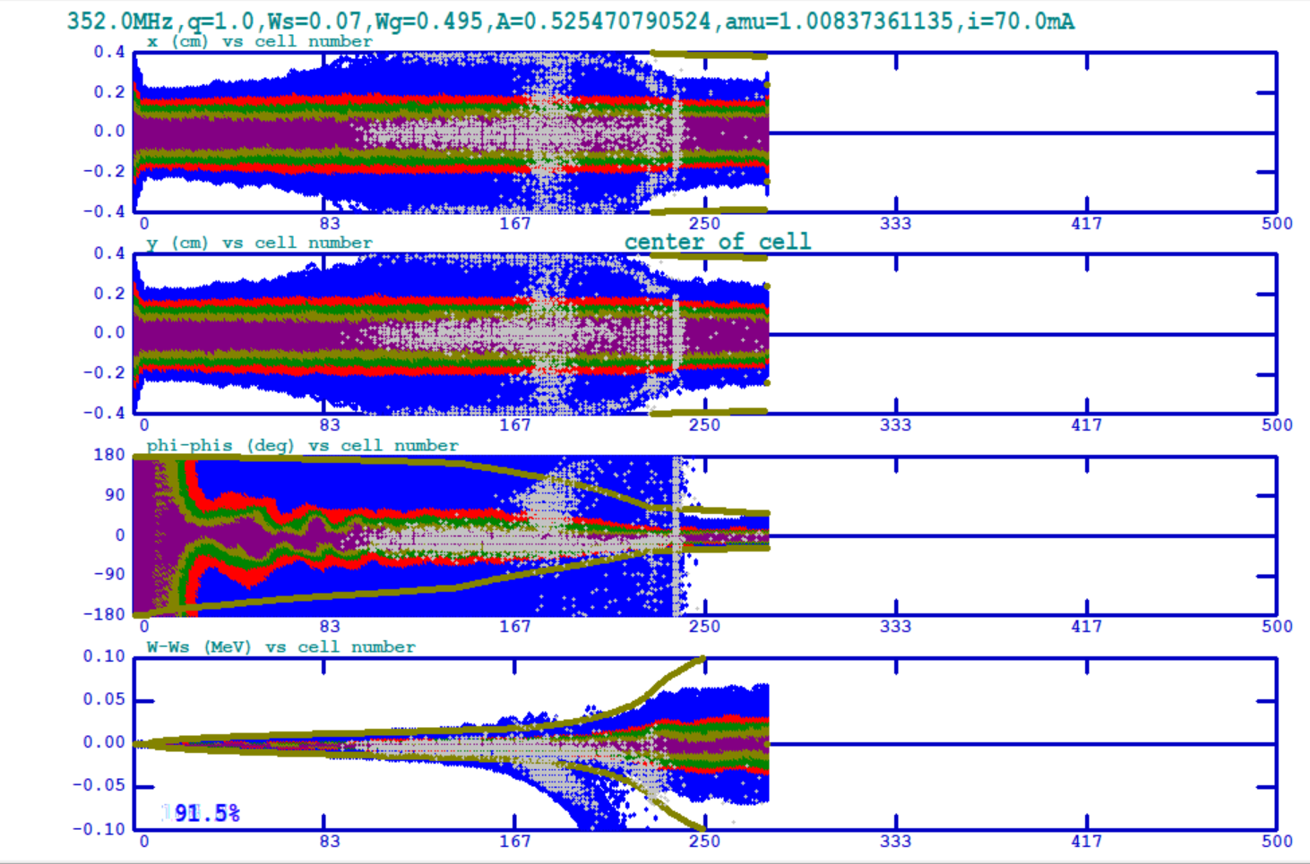
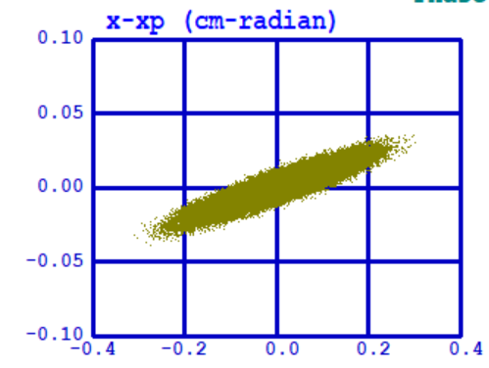
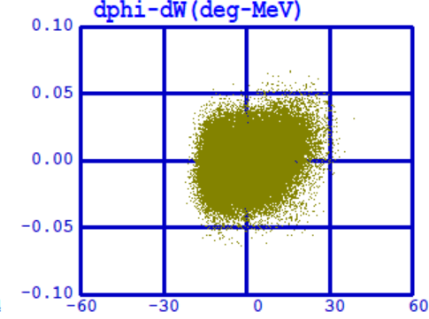
Beam dynamics – 70mA emit =0.5mm mrad
Transverse (x, y top) and longitudinal planes (phase, energy spread) along the RFQ
Beam at the RFQ output plane

Slide 22
Comparison of performance-method
Comparison of performance
    Simulations
    Current through the RFQ
Parameters :
  emittance at the RFQ input plane : 0.2 to 0.9 µm
  Matching :
  Transverse beam distribution : uniform, parabolic, gaussian
  Current : range 0-60mA
  Energy dispersion

Slide 23
Comparison of performance – results
Current of 60 mA needs to fit in an emittance of 0.4 for RFQ1 vs in an emittance of 0.8 for RFQ3 to give 48mA out of the RFQ

Slide 24
Summary
The SPL design of 2010 still holds
The normal conducting part of the proton driver (LINAC4) is almost fit for high power linac : main issue is brightness of the pre-injector.
Chopping should be upgraded to faster rep rate
Substantial progress on the source brightness : next talk by Edgar Sargsyan
There are 3 designs for an RFQ that fits the specifications of LINAC4 at higher beam current and emittance. All designs have a transmission of more than 90% for a beam of 70mA with rms emittance 0.5 mm mrad. Two of the RFQ designs are based on RF parameters similar to RFQ1 whereas a very short RFQ is based on a surface field higher than what is attainable with room temperature copper.

