Slide 1

H⁻ stripping:
Operational issues and
Challenges at high-energy,
high-intensity stripping

Slide 2
Background of this talk
A high intensity proton driver is needed for the Muon Collider.
Intensity: ~ 2 MW → Higher than existing to date.
The challenges are thus beyond those facing in the running machines to date.
A high-energy and high-intensity SC H⁻ linac with successive charge-exchange
injection into a storage ring* are in consideration.
(* A rapid cycling synchrotron (RCS) could also be an option)
Overview of the operational issues in a high-intensity proton driver
(J-PARC RCS) and high-energy stripping challenges are presented.

Slide 3
High-power H⁻ charge-exchange challenges
The H⁻ charge exchange injection (CEI) is an efficient way to increase the proton
beam power with multi-turn injection into a synchrotron or storage ring.
The beam loss can be kept sufficiently lower as compared to p injection.
A stripper foil is conventionally used for an H⁻ stripping to proton.
However, this becomes complicated and have several following issues,
especially dealing with high-intensity beam.
• Lifetime of the stripper foil.
• Maintaining and controlling the partially stripped (H⁰) and unstripped
H⁻ and their proper disposal.
• Excited state of H⁰ and the beam loss from H^{0*} decays outside the aperture.
• Stripped electron collections.
• Beam loss, especially uncontrolled ones caused by the foil scattering.
An optimum transverse painting (TP) at injection is needed to minimize
foil hitting of the circulating beam during multi-turn injection.
. . . . . . . . . . .

Slide 4
Overview of running high-intensity (MW class)
proton machines
◆ SNS in Oak Ridge: 1.4 MW designed
◆ RCS at J-PARC : 1 MW designed
Parameter | SNS in Oak Ringe | J-PARC RCS
Type | Storage ring | Synchrotron
H⁻ IS peak (mA) & inj. beam power (MW) | < 40 1.4 | > 50 0.133
Inj. pulse (ms) | 1 | 0.5
H⁻ stripping type & stripping efficiency (%) | Multi-turn H⁻ CEI by foil 95% | Multi-turn H⁻ CEI by foil 99.7%
Ein / Eout (GeV) | 1 / 1 | 0.4 / 3
Beam power (MW) | 1.4* (1.5 E14/pulse) | ~1** (~1E14/pulse)
SC tune shift | ~0.1 | ~0.15
* 1.55 MW to date. Upgrading for > 2 MW (By increasing inj. beam energy and peak current)
** ~ 1 MW to date. Demonstrated 1.5 MW potential. Studying towards 2 MW!
(By increasing injection pulse length & peak current)
● A multi-MW beam power is thus not that far!
● A higher injection energy has a significant benefit for SC mitigation.

Slide 5
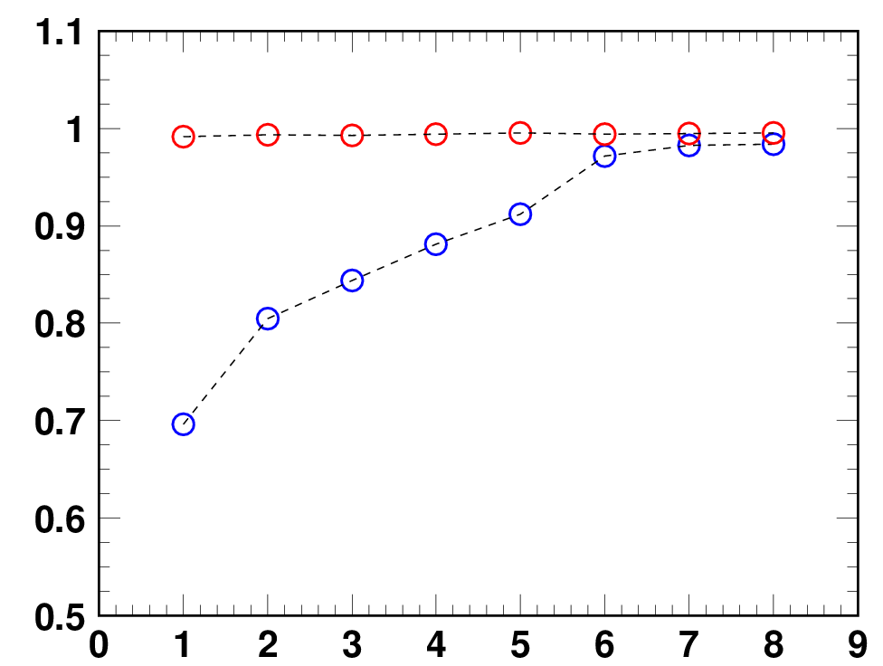
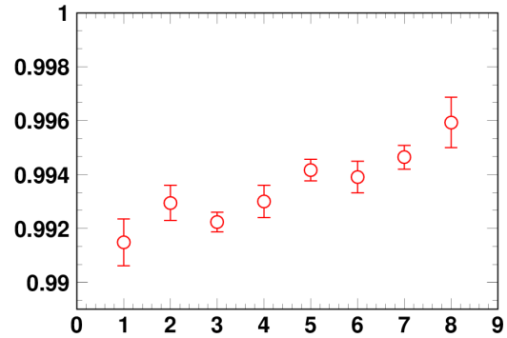
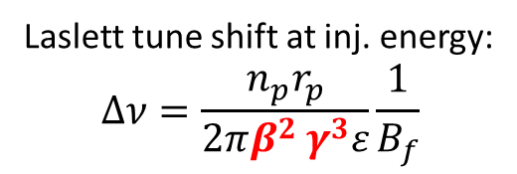
Higher injection energy benefits for SC mitigation
○ E_{inj}=181 MeV, 539 kW-eq. intensity
○ E_{inj}=400 MeV, 553 kW-eq. intensity
Laslett tune shift at inj. energy:
$$∆ν=\frac{n_{p}r_{p}}{2πβ^{2 }γ^{3}ε}\frac{1}{B_{f}}$$
By adding 100π
transverse painting
ID | ε_{tp} (π mm mrad) | RF V₂/V₁ (%) | f₂ (deg) | Δp/p (%)
1 | - | - | - | -
2 | 100 | - | - | -
3 | - | 80 | -100 | -0.0
4 | - | 80 | -100 | -0.1
5 | - | 80 | -100 | -0.2
6 | 100 | 80 | -100 | -0.0
7 | 100 | 80 | -100 | -0.1
8 | 100 | 80 | -100 | -0.2
Beam survival rate
By longitudinal
painting
Expanded view
Space-charge mitigation
by higher injection energy
No painting
Painting parameter ID
This experimental data clearly show a significant gain from a higher
injection energy as well as excellent ability of injection painting.

Slide 6
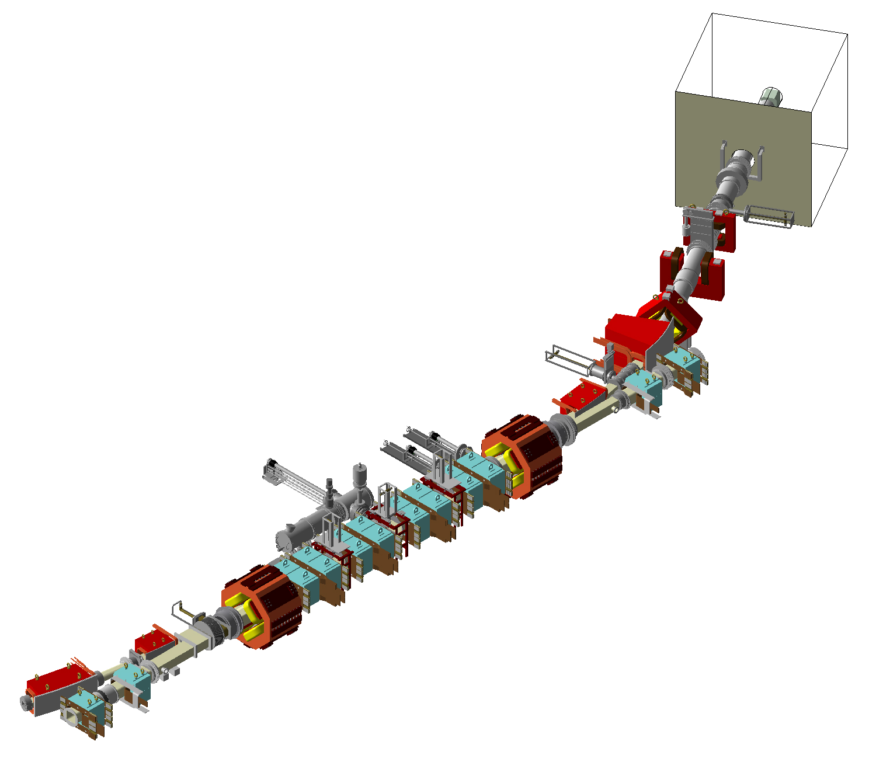
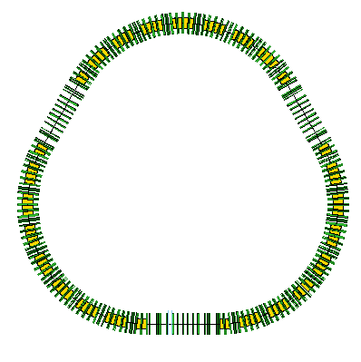
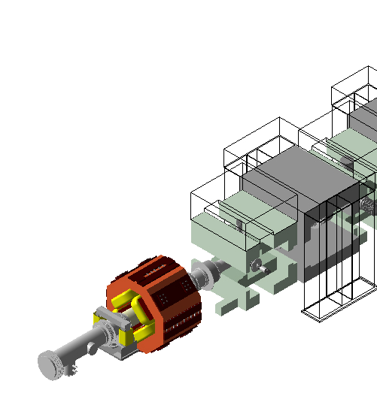
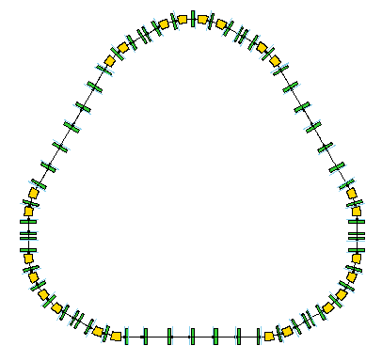
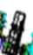

H⁻ stripping injection at J-PARC
H0 Dump
(4kW)
For HD
experiment
waste beam
Ring
Collimators
MR
3→30 GeV (p)
MLF
RCS
(H⁻ → p)
0.4→3 GeV
DUMP-Q
Stripping foil
MWPM6
DSEP2
QFM
2nd Foil
DSEP1
1st Foil
3rd Foil
PBH4
Circulating
beam
MWPM5
PBH3
MWPM4
MWPM3
H⁻ Linac
(0.4 GeV)
For NU
experiment
J-PARC 3-GeV RCS
Beam power: 1 MW
QDL
SB4
SB3
MWPM2
SB2
J-PARC Accelerator facility
H⁻ beam energy: 0.4 GeV
◆ Stripping foil thickness: 333 μg/cm²
◆ Stripping efficiency (p) : 99.7%
Partially stripping H⁰ : 0.3% (0.4 kW)
Unstripped H⁻ : 1E-5%
SB 1~4 : Chicane bump
PBH1~4 : Hori. painting bump
PBV1~2 : Vert. painting bump
ISEP2
SB1
ISEP1
PSTR2
QFL
PSTR1
PBV2
PBH2
PBV1
PBH1
H⁻ beam

Slide 7
J-PARC H⁻ stripping issues at high-intensity operation
• Unstripped H⁻ (Controlled)
Determine by the foil thickness and those missing the foil.
Initially negligible (1E-5%), but problems when a foil degradation occurs and using a
smaller size foil. Operational limit from the waste beam dump temperature.
• Partially stripped H⁰ and their excited states (H^{0*}) losses (Partially uncontrolled):
H⁰ yield depends on the foil thickness. H^{0*} decays determined by the injection chicane design.
H⁰ yield: 0.3% (400 W). H^{0*} decay outside the aperture : 6W (Extreme case)
Recently chicane bump field is reduced by 20%.
At the SNS: Foil inside a magnet. Decays immediately. Loss negligible.
Otherwise > 2000 W loss could occur!
• Stripped electron collection (Controlled):
No issues so far. (SNS had problems at earlier commissioning stage)
• Foil lifetime (Controlled so far) P.K. Saha et al., PRAB 23, 082801 (2020)
Foil degradation determines the practical foil lifetime.
Temporary solution: Inserting the foil more to the beam. Foil hitting (scattering) rate increases.
At present ~1 month at 0.9 MW opr. Foil magazine can hold 15 foils.
◆ Foil scattering beam losses (Partially uncontrolled):
Several sources/mechanisms. Determined by the foil thickness & size, and foils hits.
TP minimizes the foil hits.
ー Single Large angle Coulomb scattering: An additional injection collimator was installed in J-PARC.
ー Energy straggling, Multiple scattering, Nuclear interaction: Determined by the foil thickness.
ー Foil hitting rate of the circulating beam: Minimized by the trans. inj. painting and the foil size.
→ One of the main issues at J-PARC at high-intensity operation.

Slide 8
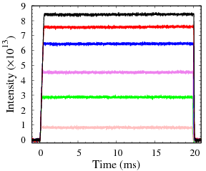
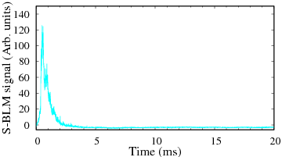
Foil scattering beam loss issues
• Already achieved the designed 1 MW beam power and tested for a short time operation.
• Maximum Longitudinal and Transverse paintings (LP and TP) are applied for SC mitigation.
• The TP creates uniform beam distributions and also minimize foil hitting rate.
A higher TP reduced foil hitting rate, but TP area depends on the machine aperture,
lattice design, realistic machine errors and imperfections.
→ Barely reached to the design TP of 216π mm mrad. The average foil hits/proton is ~ 7.
Measured circulating
beam intensity
Fast extraction
Time structure of the beam loss
­- 1 MW
- 0.87 MW
- 0.77 MW
- 0.5 MW
- 0.3 MW
- 0,1 MW
Beam loss occurs only
at injection energy (and
Localized almost at the
Collimator section).
● Estimated beam loss at 1MW: ～0.2% (0.3 kW ) << Collimator limit (4 kW)!
◆ However, residual radiation at the injection area caused by the uncontrolled beam loss due to foil scattering of the circulating beam is rather high.
◆ Reduction of the foil scattering beam loss is a top priority!

Slide 9
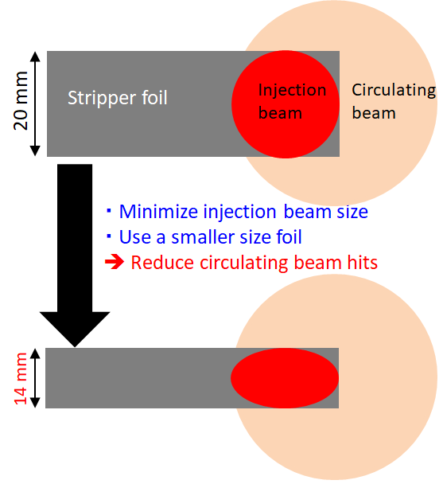
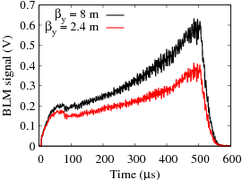
Reduction of the foil scattering beam losses
・Minimize vert. inj. beam size by manipulating
vert. beta (β_{y}) of the injection beam.
・Minimize vertical size of the stripper foil.
+
Optimize vert. transverse painting
w.r.t. the smaller inj. β_{y}.
Circulating beam
(painting emittance)
y’
y
×
×
Inj. beam
Optimization of vertical painting matching
with injection beam. (y’ : -3.3 → 2.82 mrad)
Minimize number of large amplitude particles.
➔ Reduce beam loss.
Foil hitting rate (uncontrolled beam loss) 30% reduced.
The total beam loss at the injection, collimator and 1st arc
sections are 40% reduced in average.
Measured foil scattering beam loss

Slide 10
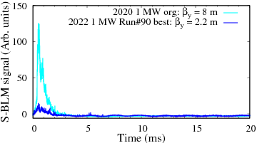
Latest beam loss mitigation at 1 MW
Based on numerical simulations and extensive beam studies following optimizations were implemented.
Minimized injection beam and the foil sizes.
Optimized betatron tunes.
Optimized transverse and longitudinal paintings.
Optimized correction of ν_{x} -2ν_{y} = -6 resonance.
Reduced 3ν_{x} = 19 effect by SB ×0.8 field
(reduced K2 field intrinsic in the SB, H0* decays)
Time structure of the beam loss
Comparison: 2020 & 2022
◆ The residual beam loss is estimated to be ~0.05%.
→ The residual beam loss is dominated by the foil scattering.
◆ We will try to further reducing the foil size.
→ Unstripped H⁻ beam power at the waster beam dump is an issue.
◆ To eliminate foil scattering beam losses and foil lifetime issues,
we are developing laser stripping of H⁻ charge-exchange injection.
1 MW operation can be achieved with a negligible
beam loss!!

Slide 11
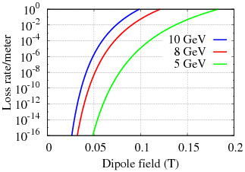
H⁻ stripping challenges at high-energy & high-intensity
MC case: 5-10 GeV, 2 MW
Earlier studies: Project-X design study at Fermilab (HB 2008, 2010 WS, David Johnson)
H- energy : 8 GeV with stripping injection
Additional concerns:
Lorentz stripping:
Curvature radius of the injection magnets
should be long enough to keep a lower
Lorentz stripping of the H⁻ beam.
Kazami Yamamoto et al., PRAB15, 120401 (2012)
Higher secondary particles, hadronic flux at
higher energy.
Residual dose rate around the foil:
1.6 times higher at 1 GeV as compared to 0.4 GeV!
Foil scattering and foil lifetime issues
should be further seriously concerned!
Needs careful injection design:
・Project-X (8 GeV) inj. case. David Johnson, HB 2008
・H2 should be moderate.
・H3 should be stronger to stripping H0* immediately.

Slide 12
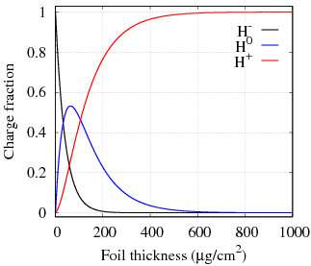
Stripping efficiency and H⁰ excited states loss
Mike Plum, HB 2016
Stripping efficiency of 8 GeV H- as a
function of foil thickness
(Cross sections ref. W. Chou et al.,
NIMA 590, 1-12 (2008))
A foil thickness of 700 μg/cm² gives
H+ : 99.79%
H0 : 0.21%
H- : ~10-6%
Some of the H0 are in excited states (H0*).
Decays passing through a magnetic field
due to E = β γ c B
E is higher for a high-energy beam.
The decay rates depend on the strength of the
magnetic field.
→ Higher at higher H- energy
At 8 GeV, H0* > 2 are subjects to concern.

Slide 13
Next generation H⁻ stripping injection
To overcome the issues and limitations associated with foil stripping
as well as to realize next-generation multi-MW proton accelerator,
we have to established an alternate method of H⁻ stripping.
→ Laser stripping?

Slide 14
Laser stripping (LS) of H⁻ beam
PRL 118, 074801 (2017)
Step 3:
photo-ionization
H^{0*} + γ → p + e⁻
Step 2:
H⁰ excitation
H⁰ + γ → H⁰* (n=3)
Step 1:
Photo-detection
H⁻ + γ → H⁰ + e⁻
p
H^{0*}
H⁰
H⁻
e⁻
e⁻
e⁻
H⁻
e⁻
p
YAG Laser
λ=1064 nm
UV laser
λ= 213 nm
YAG Laser
λ=1064 nm
10 μs
J-PARC: H⁻ stripping by using only lasers
・IR lasers for stripping. Deep UV laser (~200 nm) for H⁰ excitation.
・Demonstrated 40 μs H⁻ neutralization at 3 MeV.
・A POP test at 400 MeV stripping expected in 2024.
SNS (Oak Ridge): Laser-assisted H⁻ stripping
・High field magnets for stripping.
・UV laser (355 nm) for H⁰ excitation.
・10 μs stripping demonstrated.
・Studies for implementation are underway.
To reduced the laser energy, a multi-reflection cavity
systems has been developed at J-PARC.
Seeder energy ～1/N, where, N = no. of reflections.
N = 32 achieved. Next trail for N = 64.
David Johnson
HB 2010
8 GeV H⁰ excitation. Higher H⁻ energy is suitable.
Tiny spot focused at the IP → Higher flux
Bigger spot at the mirrors → Reduce mirror damage

Slide 15
Summary
• The H⁻ stripping injection issues associated with stripper foil at J-PARC are discussed.
• The beam loss at the designed 1 MW has been reduced to an extremely low level
to remain mainly the foil scattering beam losses.
• The foil scattering uncontrolled beam losses and the corresponding residual
radiation at high-intensity operation is one of the concerning issues.
• To overcome the foil issues, a laser stripping of H⁻ is under development.
• Based on the J-PARC and SNS results so far, a multi-MW beam power for
the MC can be achieved without serious issues.
• However, the H⁻ stripping at higher energy and higher intensity becomes more
complicated and challenging.
• The injection system has to be designed more carefully.
• A laser stripping at higher H⁻ energies would be more feasible.

Slide 16
Extra slides

Slide 17
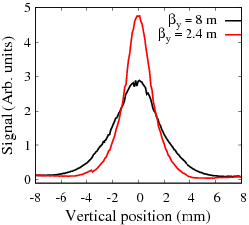
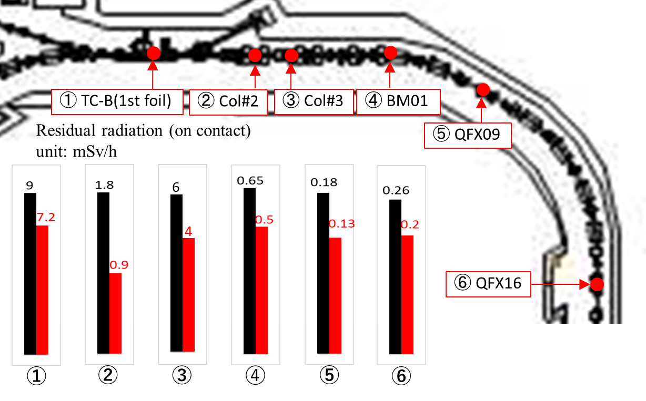
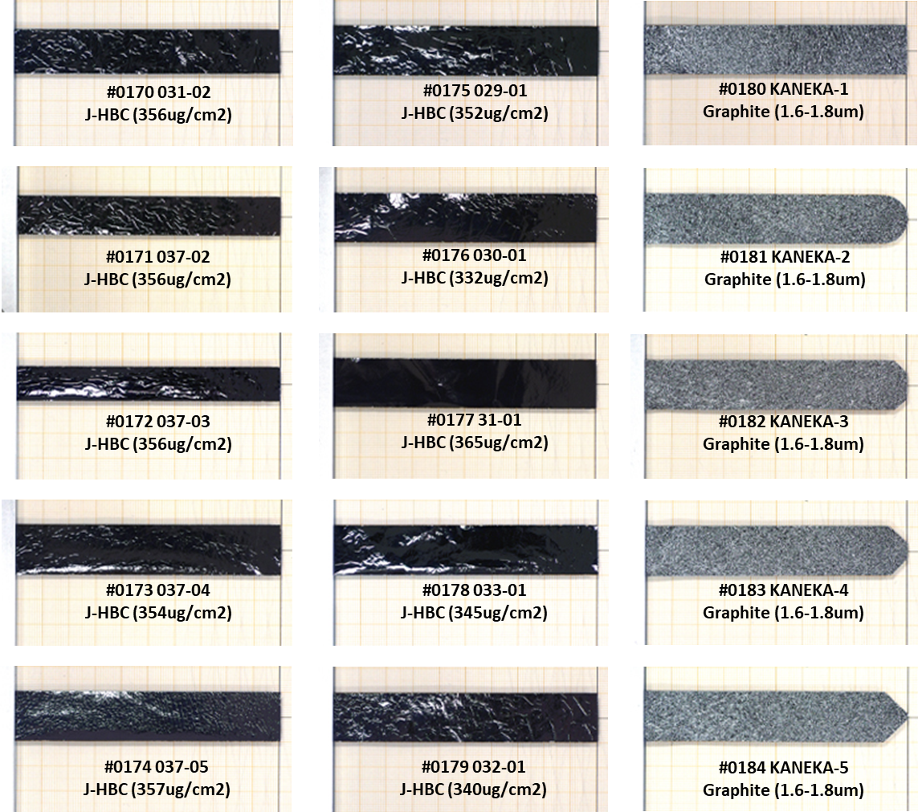
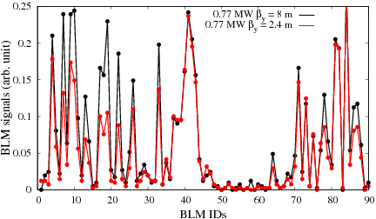
Implementation of a smaller β_{y} and a smaller foil
β_{y} = 8 m
β_{y} = 2.4 m
σ = 2 mm
σ = 1 mm
For β_{y} = 8m
20 mm
For β_{y} = 2.4m
Residual radiation
accordingly reduced
14 mm
Implemented to RCS
operation from 700 kW
Beam loss:
40% reduction at the injection, collimator and 1st arc sections.
Measured foil hits: 30% reduced
P. K. Saha

