Slide 1



Brainstorming on Possible MDs in CERN acc. Complex and for discussion
S. Gilardoni –CERN and N. Milas ESS-Lund
Jun. 2023

Slide 2
Scope of proposal
Goal: discuss possible Machine Developments studies
relevant for the accumulator/compressor and target
beam delivery
Linac covered by Alessandra

Slide 3
Relevant studies (not exaustive…)
Collective effects:
  transverse and longitudinal instabilities
  space charge at injection
  e-cloud
  ….
Minimum bunch length in high intensity regime
Beam recombination

Slide 4
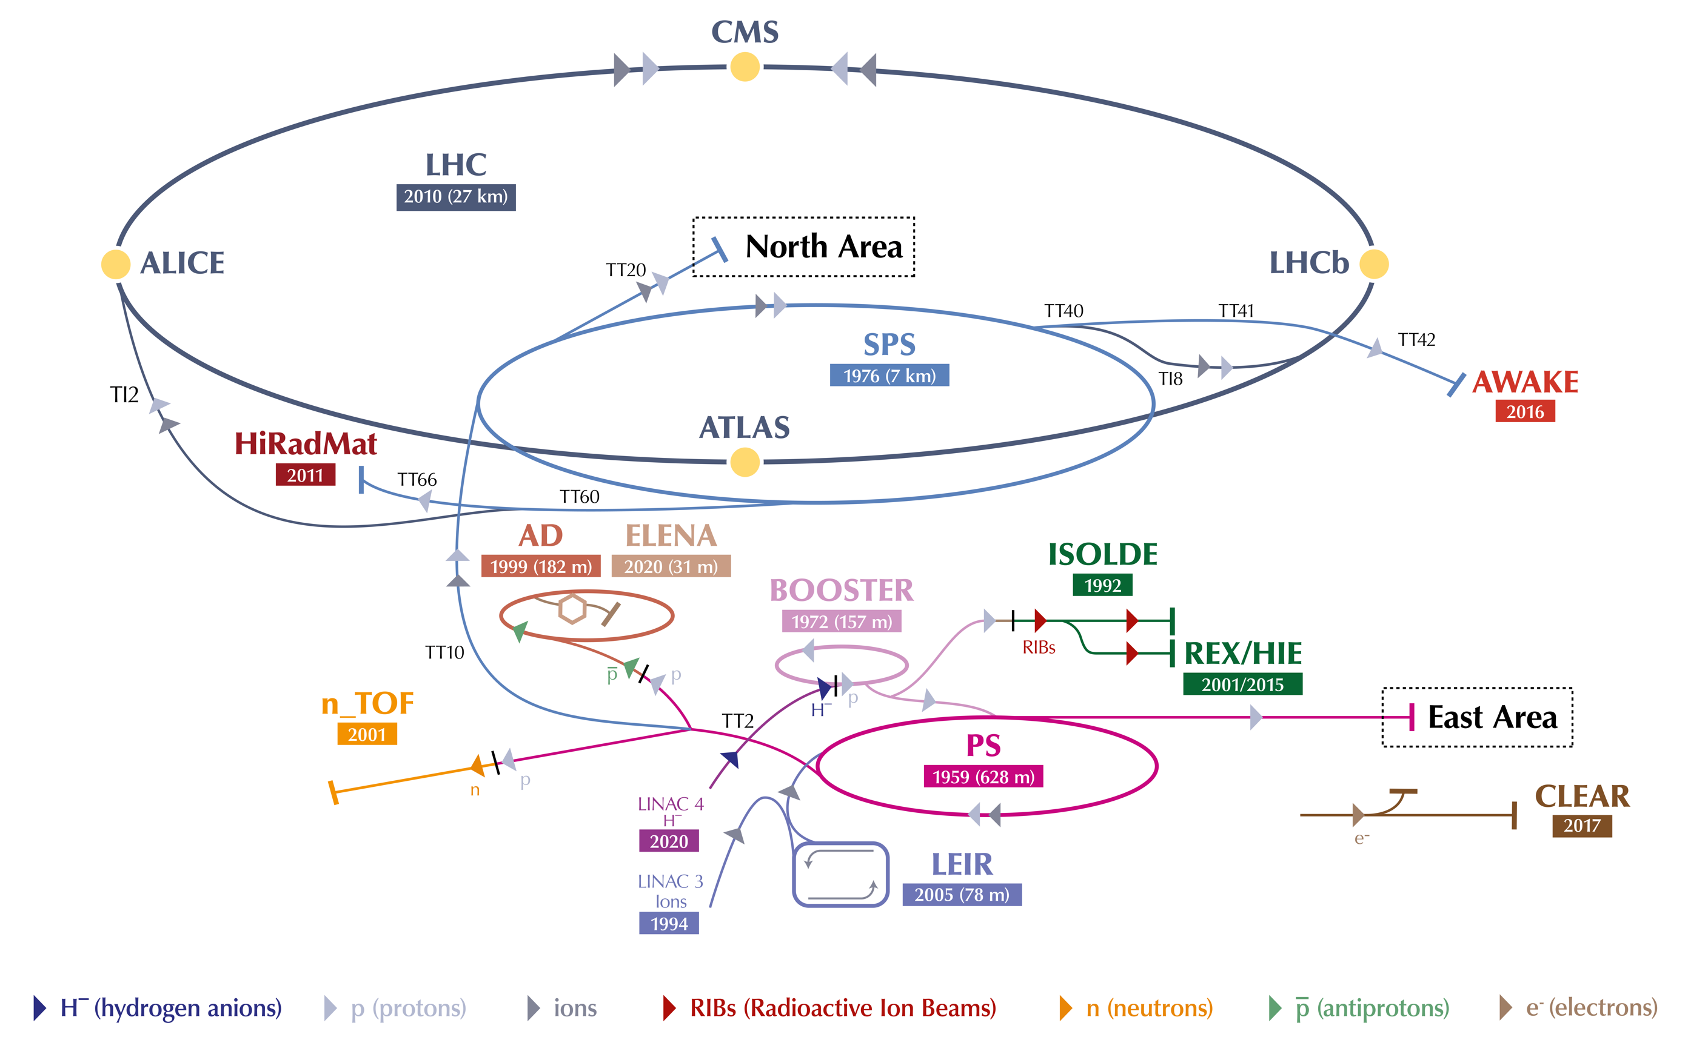
CERN accelerator complex as today

Slide 5
PSB main features
Injection
  160 MeV H⁻
  Multiturn charge exchange injection with transverse and longitudinal painting up to ~120 turns
4 superimposed ring magnetically coupled
Lattice: Triplet, FDF
  Operating below transition
Acceleration cycle
  ~ 700 ms
  1.2 cycling period
RF: Finemet
  Operation with h=1 and h=2
Extraction:
  Max : 2 GeV
  Single turn fast extraction with vertical recombination
Particles types:
  Protons, (Ions - O, S, In, Xe)
Max total intensity: ~ 4-5e13 ppp
Intensity per ring : ~ 1.2e13 ppp (h=1)
Multipoles for resonant compensation
Fully instrumented

Slide 6
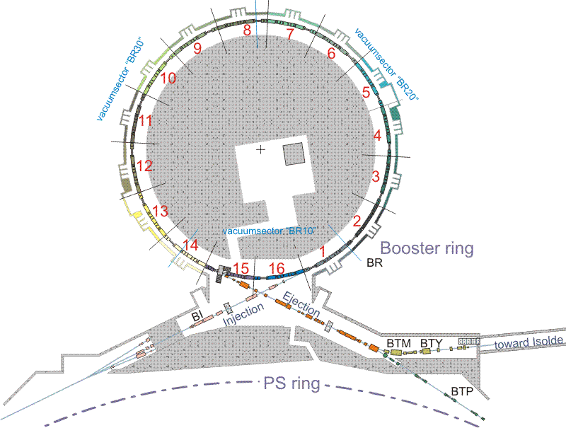
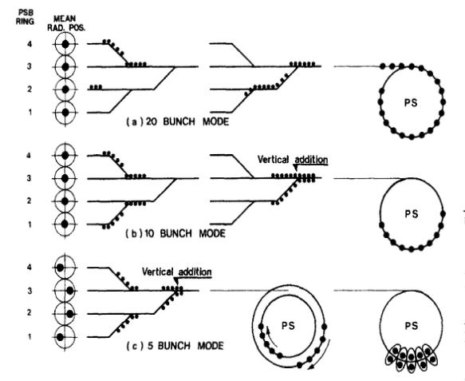
PSB MD brainstorming
Vertical recombination tests
160 MeV
2 GeV
MD@PSB:
H⁻ injection (to be explored with experts)
Vertical recombination of bunches from separated rings (up 1e13 per bunch per ring)
  Final bunch lenght
  Transverse emittance growth
  Beam can go on external beam dump or to the PS
IEEE Transactionson Nuclear Science, Vol.NS-26,No,3,June197

Slide 7
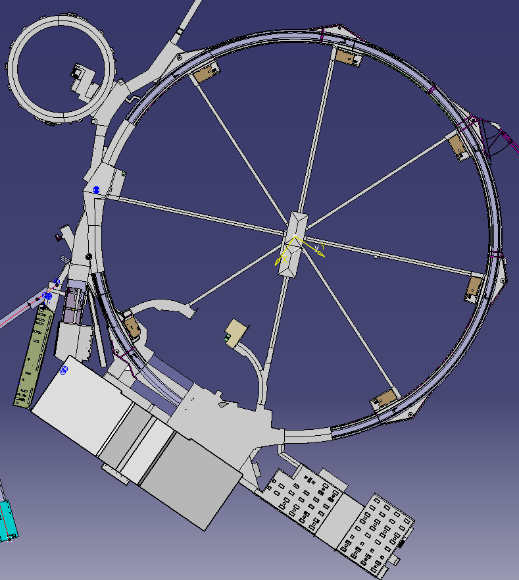
PS main features
Extraction:
  Fast extraction at 20 GeV and 26 GeV
  Multiturn (5 turns) extraction at 14 GeV
  Slow extraction 24 GeV
Particles types:
  Protons, Ions (Pb, O, S, In, Xe)
  In the past: anti-protons, e+, e-
Max total intensity: ~ 4e13
External Exp. Area: East hall, AD
Multipoles for resonant compensation
Fully instrumented
Injection
  Max: 2 GeV protons
  70 MeV/n lead ions
  Single turn injections
Lattice: FODO with combined-function MB
  Transition crossing with
  gamma-jump at 6.1 GeV
Acceleration cycle:
  Up to 3.6 s depending on final user
  1.2 cycling period
RF:
  10 MHz ferrite loaded main RF system
  20, 40, 80 MHz for LHC beams production
  200 MHz for beam recapture after de-bunching
  h=7, 8,16, 21, 42, 84,168
  Finemet as longitudinal feedback system

Slide 8
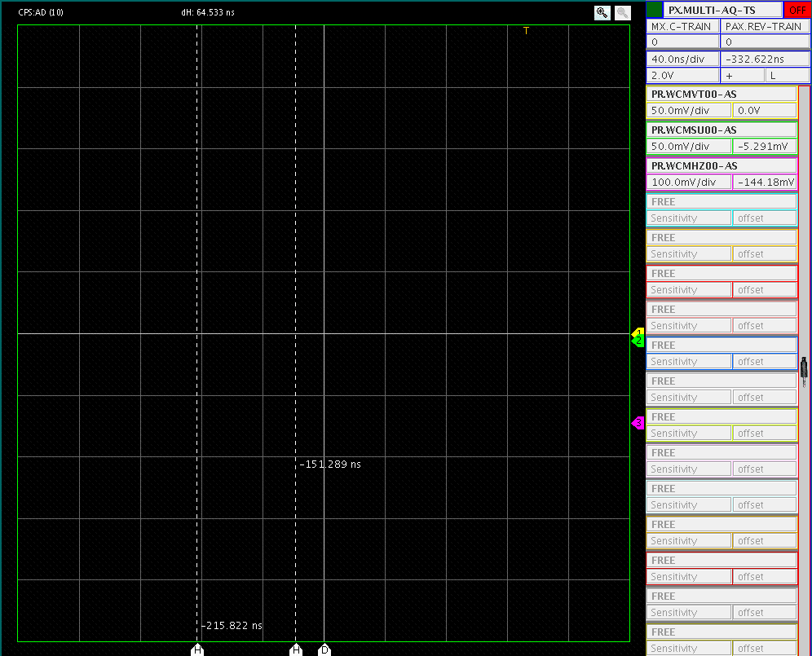
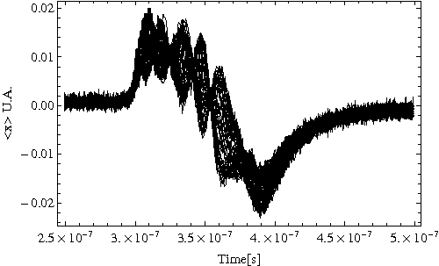
Example of measurement of impedance effects at injection
Bunch profile
Experiment on High brightness-LHC beam at injection – single bunch – 200e10 protons
Headtail instability m=4,5
See also the work of E.Metral, R.Cappi, B.Salvant
(CERN AB-2007-032 and CERN PS-95-02)
and
S.Aumon thesis
Vertical position
of the beam within a bunch
Horiz. position
of the beam within a bunch
AD beam in the PS at injection (2010)
1500e10 protons on 4 bunches
Microwave instability

Slide 9
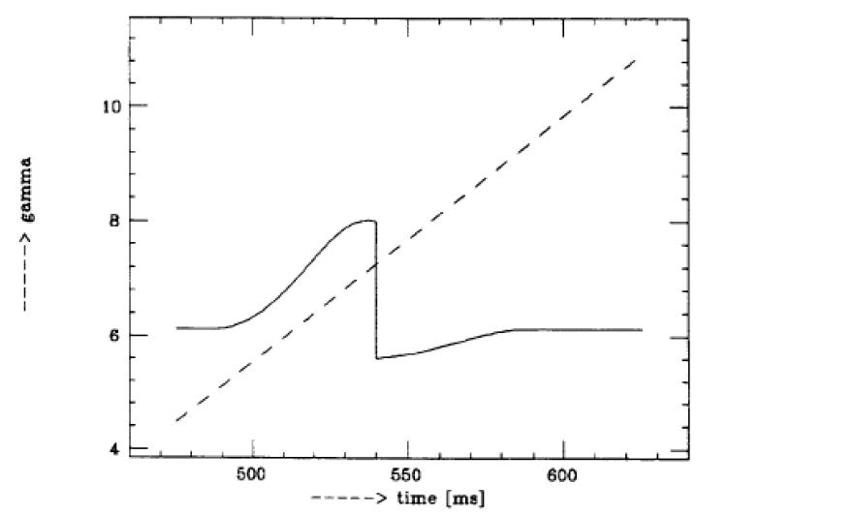
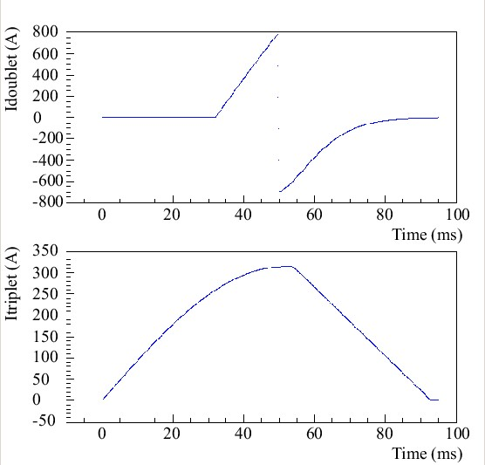
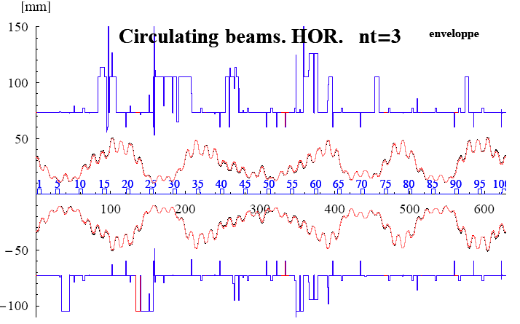
Gamma jump – transition crossing
Δγtr
See S. Aumon thesis: CERN-THESIS-2012-261

Slide 10
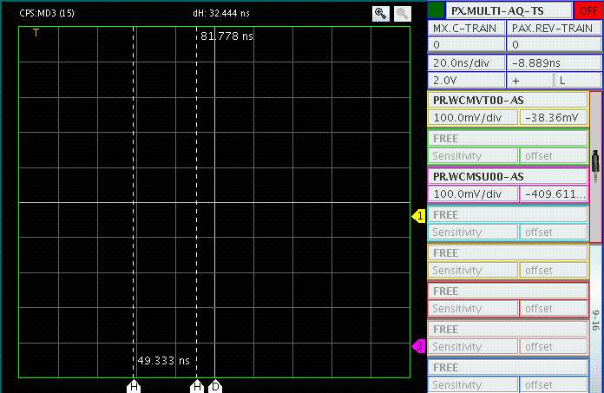
An example of TMCI meas. at transition crossing
Beam losses
A fraction of the beam touched the
vertical aperture
Vertical position
of the beam within a bunch
Bunch profile
before transition
  TMCI@PS
20 ns
1 frame = few turns
Time

Slide 11
Some ideas
Space charge limits at injection are being explored for LHC beams
  A lot can be learned from there
Minimum bunch length from bunch rotation interesting also for fixed target applications
  Today for about 8e12 ppp (single bunch) about 20 ns bunch length
Could use lattice at transition crossing or close to it exercise/study lattice with very small eta. Or with short bunch length from “isochronous” lattice
Could study bunch merging in longitudinal AND transverse plane
e-cloud driven instabilities can be induced by LHC-type beam in very controlled manner
We could think also to other machines not necessarily at CERN….

Slide 12

Thank you
very much for the discussions and inputs

