Slide 1






Longitudinal tracking studies for the entire RCS chain
Fabian Batsch, Rama Calaga,
Heiko Damerau, Ivan Karpov
Acknowledgements: David Amorim, Scott Berg, Fulvio Boattini, Luca Bottura, Christian Carli, Antoine Chancé, Alexej Grudiev, Elias Metral, Ursula Van Rienen, Daniel Schulte, Sosoho-Abasi Udongwo
Funded by the European Union under Grant Agreement n.101094300
IMCC Annual Meeting, Orsay, 21/6/2023

Slide 2

Outline
Longitudinal emittance definitions
Bunch length during acceleration
Synchronous phase optimization
Beam-induced voltages and HOM power estimates
Outlook
  emittance growth and budget
  multi-turn effects and induced voltages calculations
Summary
F. Batsch

Slide 3
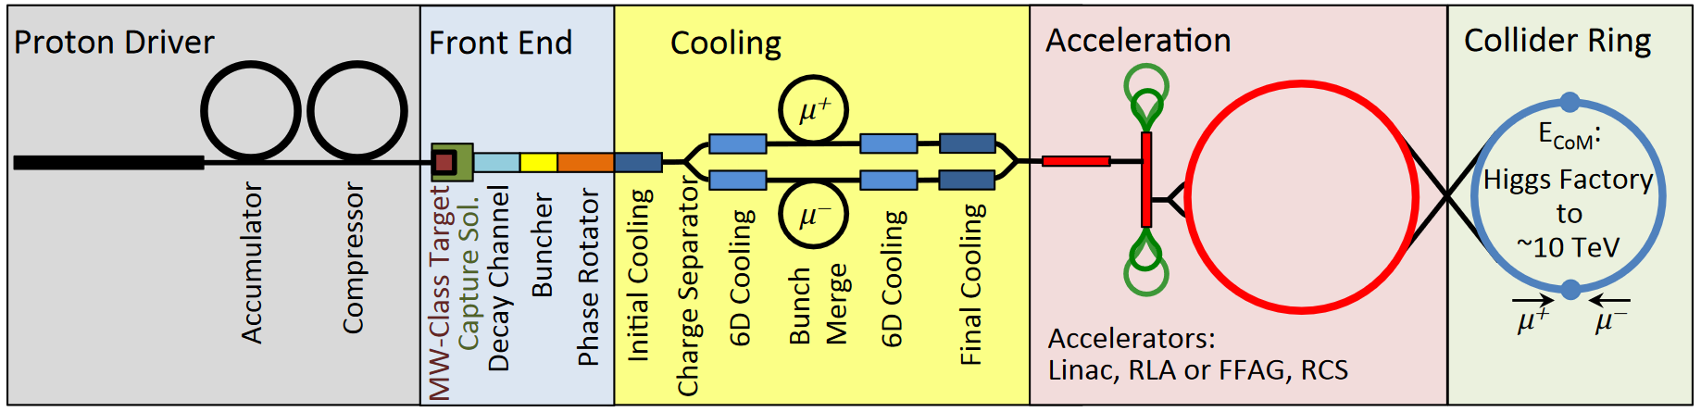
Reminder on design baselines
Base for the work is the US Muon Accelerator Program (MAP)
High energy complex consist of a chain of rapid cycling synchrotrons (RCS)
1 bunch per beam
Part of interest for us
F. Batsch

Slide 4
The RF challenges: Voltage
Installed voltages in lepton rings:
→ Even more RF voltage than any other circular collider
→ Much fewer turns
From talk by H. Damerau
 | RCS1 | LEP2 | FCC-ee
Circumference, 2πR [m] | 5990 | 26658 | 91106
Energy factor, E_{ej}/E_{inj} | 5 | 4.8 | n/a
Repetition rate, f_{rep} [Hz] | 5 (asym.) | Slow (min.) | n/a
Number of turns | 17 | few 10⁸ | 10⁸
Max. RF voltage, V_{RF} [GV] | 21 | 3.6 | 11.3
Energy gain per turn, ΔE [GeV] | 14.8 | 3.49 | 10

Slide 5
The RF challenges: Intensity
High bunch charge and current:
Average beam current more than three times (2×) above ILC
Very strong transient beam loading
During first turn in RCS1 energy gain is about 20% of beam energy
From talk by H. Damerau
 | ILC | RCS1 (and RCS2)
Number of bunches, n_{b} | 1312 | 1 each μ⁺ and μ⁻
Bunch spacing, τ_{bs} | 554 ns | T_{rev} = 20 μs
Bunch intensity, N_{b} | 2∙10¹⁰ p/b | 2.7 (2.5)∙10¹² p/b
Average beam current, I_{b} | 5.8 mA | 2 x 20 mA
F. Batsch

Slide 6
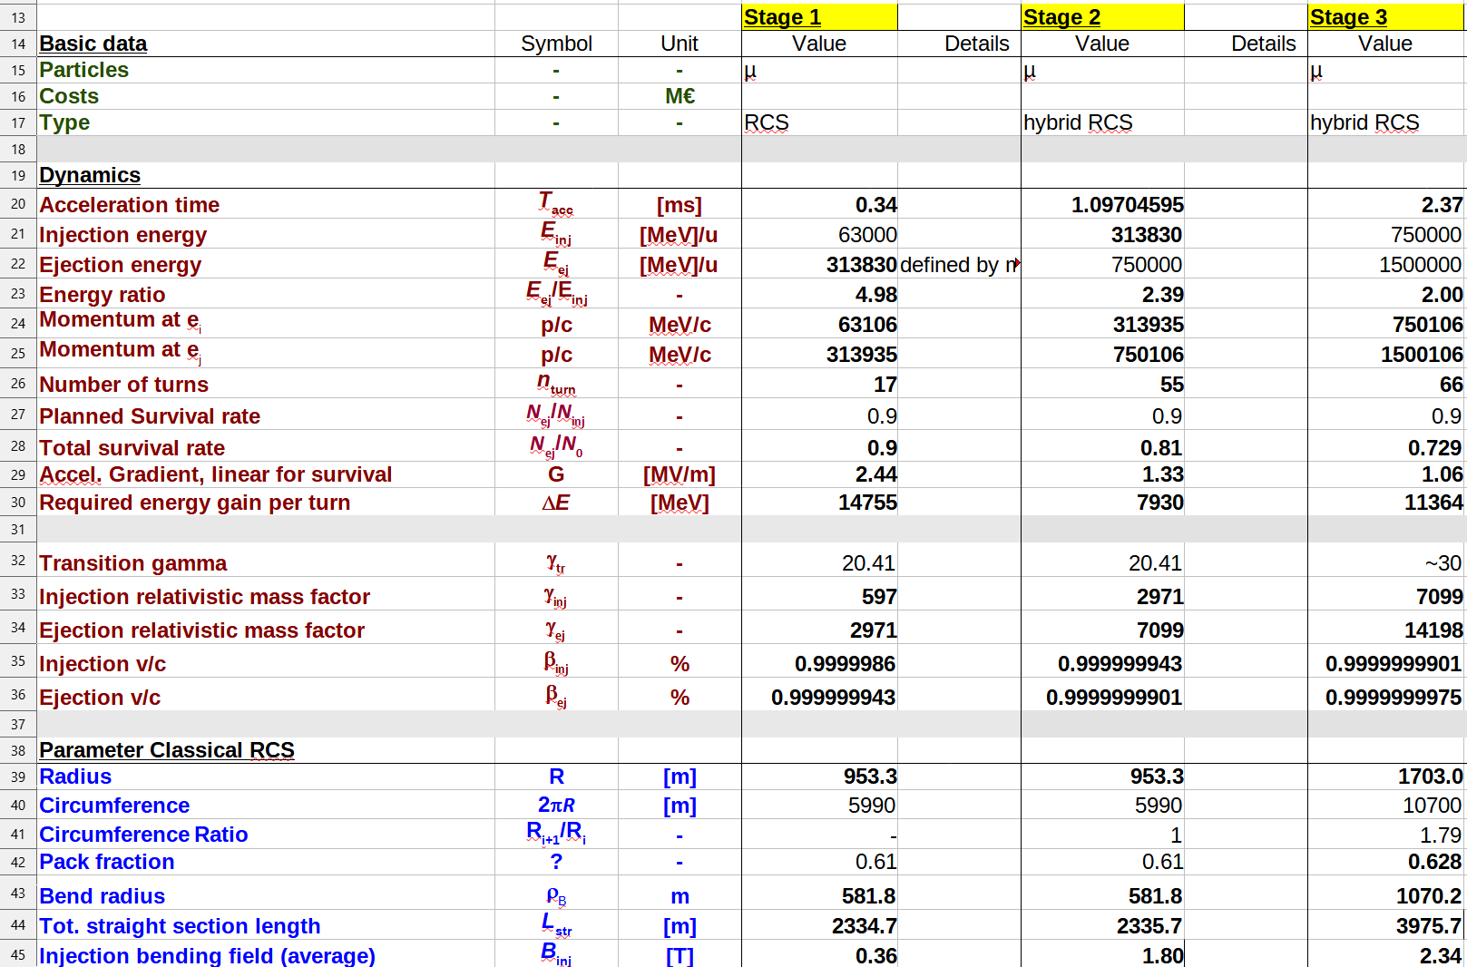
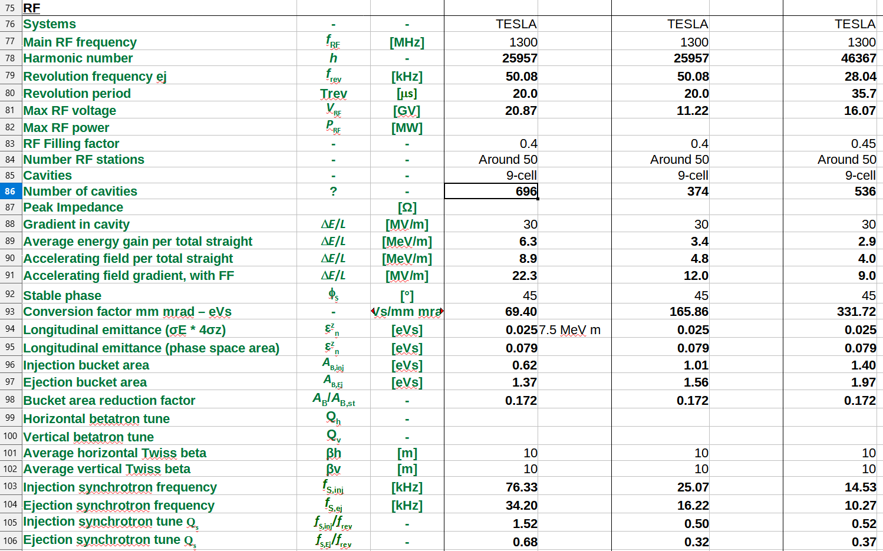
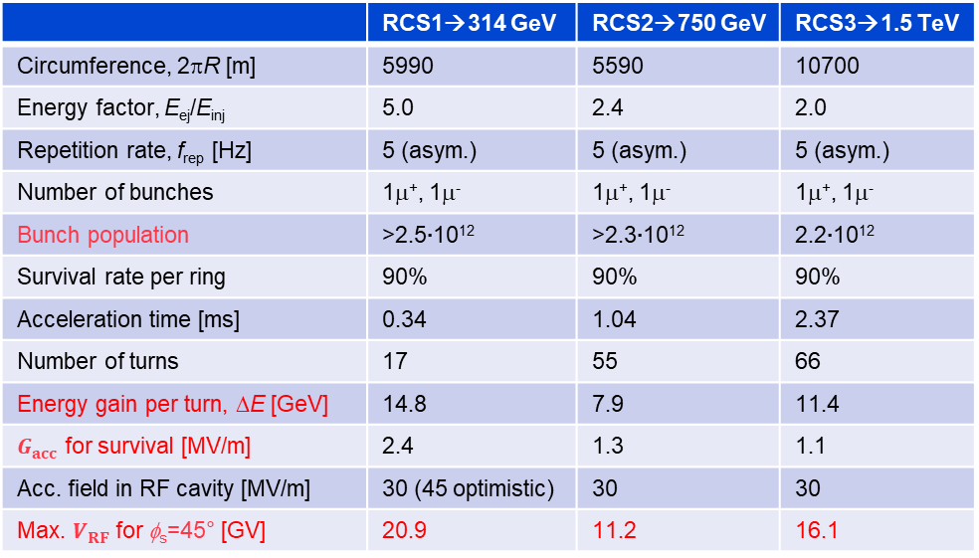
General parameter table
Detailed parameter table: https://cernbox.cern.ch/index.php/s/I9VpITncUeCBtiz
 | RCS1→314 GeV | RCS2→750 GeV | RCS3→1.5 TeV
Circumference, 2πR [m] | 5990 | 5590 | 10700
Energy factor, E_{ej}/E_{inj} | 5.0 | 2.4 | 2.0
Repetition rate, f_{rep} [Hz] | 5 (asym.) | 5 (asym.) | 5 (asym.)
Number of bunches | 1μ⁺, 1μ⁻ | 1μ⁺, 1μ⁻ | 1μ⁺, 1μ⁻
Bunch population | >2.5∙10¹² | >2.3∙10¹² | 2.2∙10¹²
Survival rate per ring | 90% | 90% | 90%
Acceleration time [ms] | 0.34 | 1.04 | 2.37
Number of turns | 17 | 55 | 66
Energy gain per turn, ΔE [GeV] | 14.8 | 7.9 | 11.4
$G_{acc}$ for survival [MV/m] | 2.4 | 1.3 | 1.1
Acc. field in RF cavity [MV/m] | 30 (45 optimistic) | 30 | 30
Max. $V_{RF}$ for φ_{s}=45° [GV] | 20.9 | 11.2 | 16.1

Slide 7
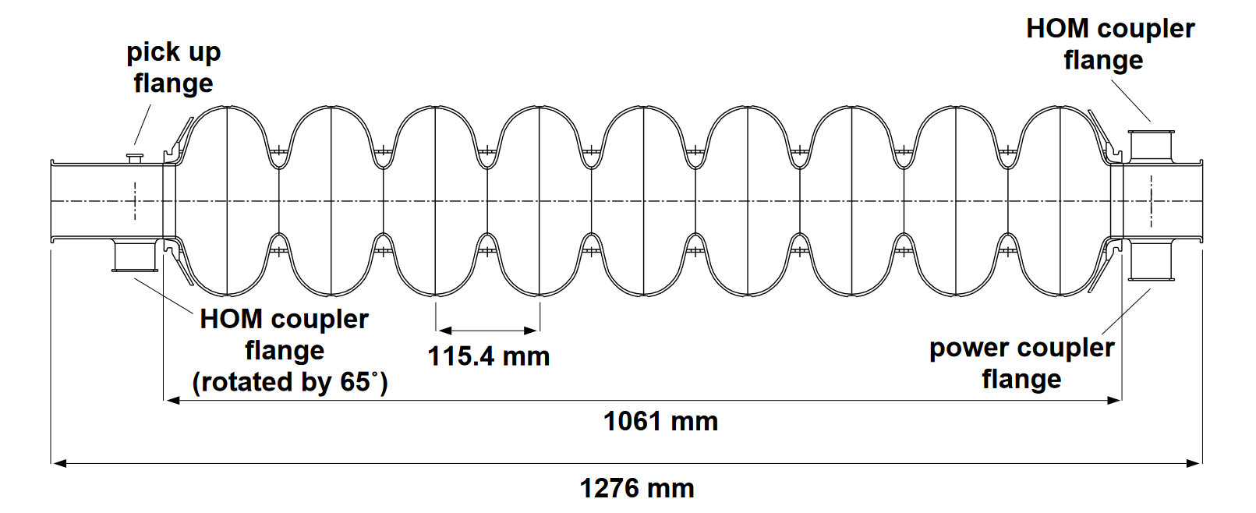
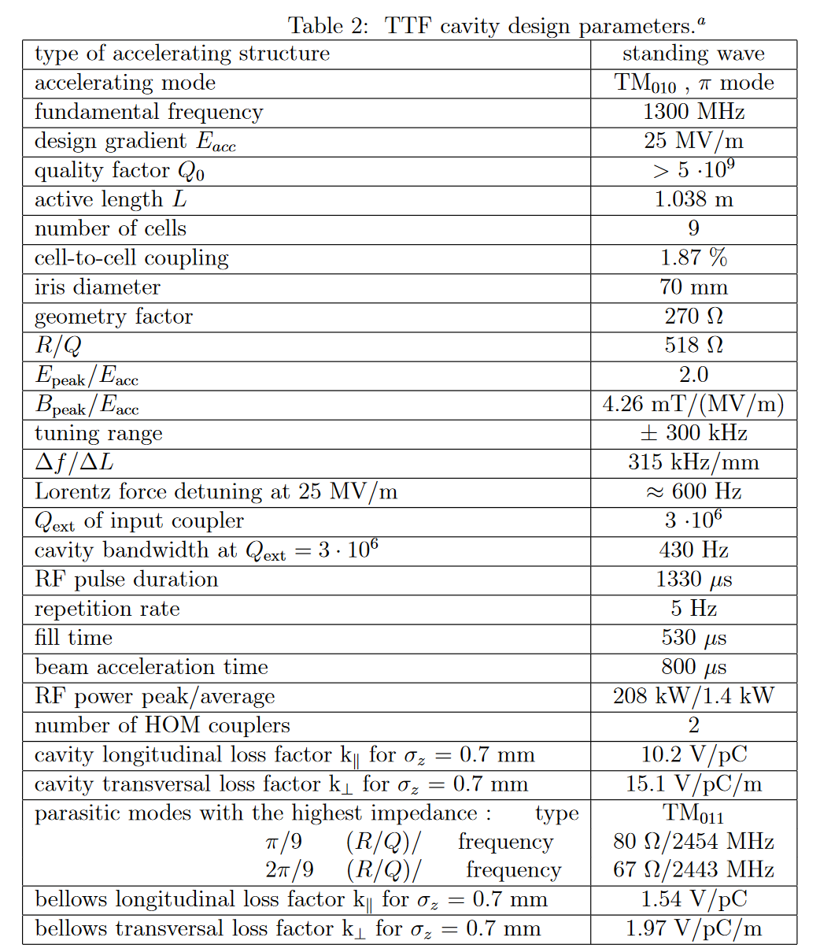
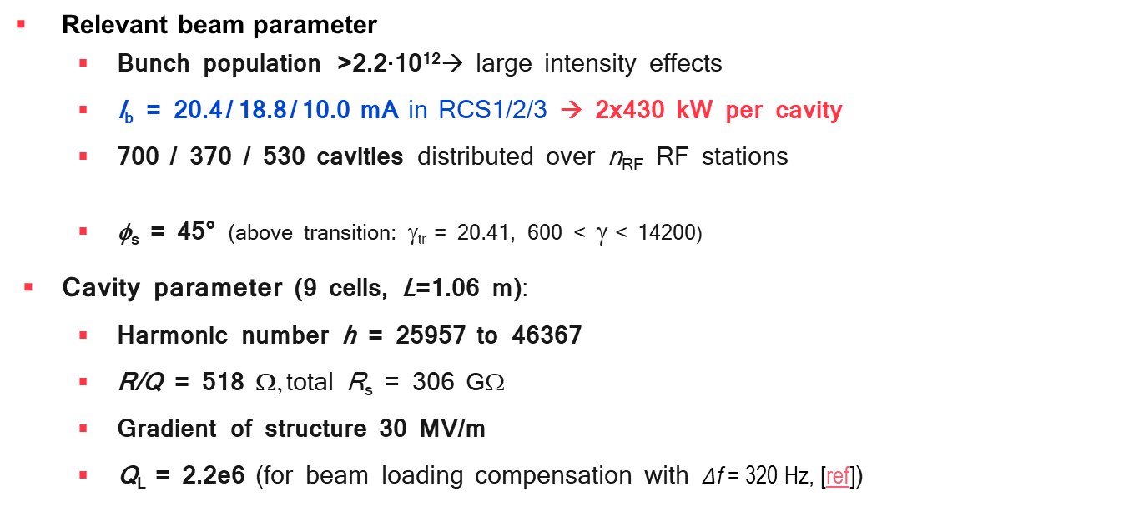
The 1.3 GHz TESLA cavity
(From design report)
Relevant beam parameter
  Bunch population >2.2∙10¹²→ large intensity effects
  I_{b} = 20.4 / 18.8 / 10.0 mA in RCS1/2/3 → 2x430 kW per cavity
  700 / 370 / 530 cavities distributed over n_{RF} RF stations
  φ_{s} = 45° (above transition: γ_{tr} = 20.41, 600 < γ < 14200)
Cavity parameter (9 cells, L=1.06 m):
  Harmonic number h = 25957 to 46367
  R/Q = 518 Ω, total R_{s} = 306 GΩ
  Gradient of structure 30 MV/m
  Q_{L} = 2.2e6 (for beam loading compensation with $Δ$f = 320 Hz, [ref])
(with G_{acc} = 30 MV/m)
From design report

Slide 8
Outline
Longitudinal emittance definitions
Bunch length during acceleration
Synchronous phase optimization
Beam-induced voltages and HOM power estimates
Outlook
  emittance growth and budget
  multi-turn effects and induced voltages calculations
Summary
F. Batsch

Slide 9
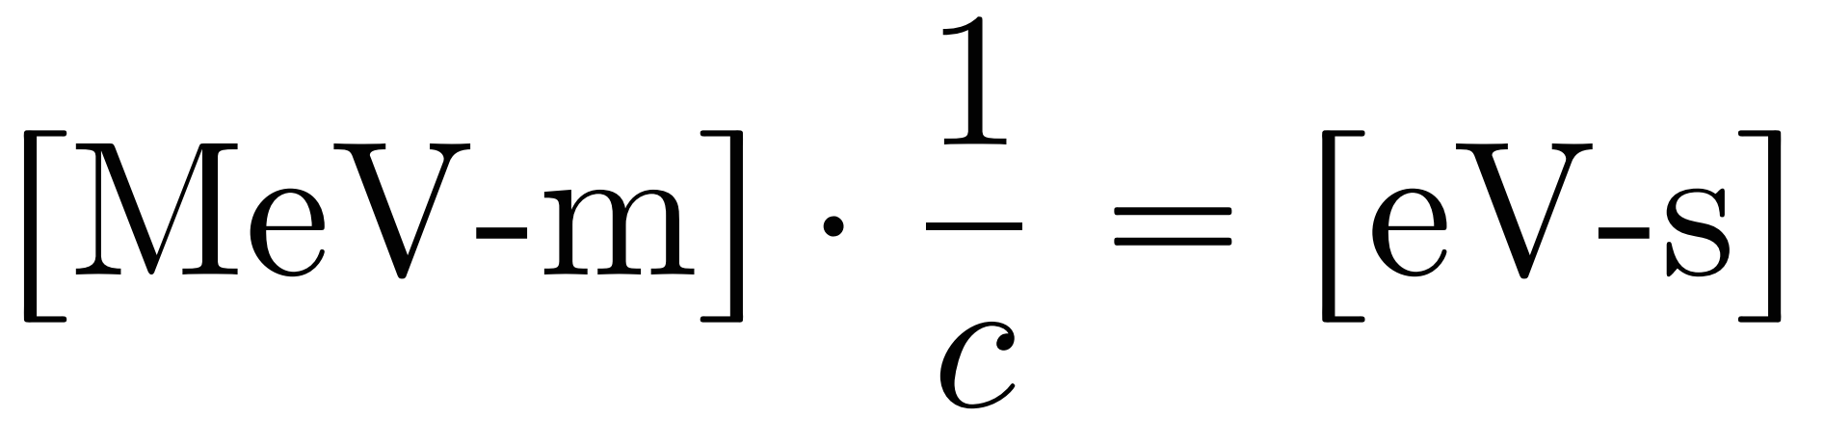
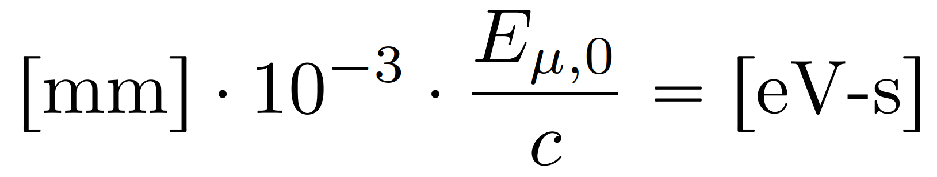
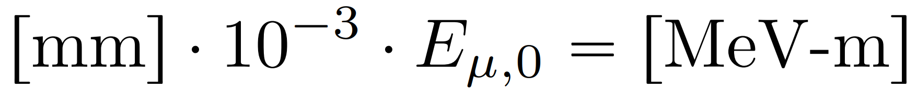
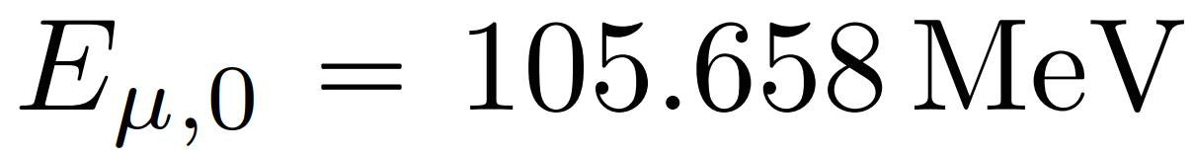
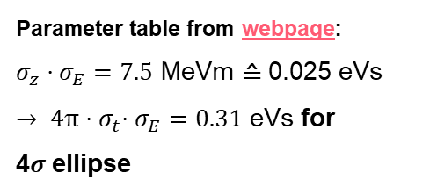
Longitudinal emittance
Different definitions of the longitudinal emittance and different units co-exist:
Encircling, 1σ, 4σ, FWHM,…
[eV-s], [MeV-m], [mm] can be converted converted:
Parameter | Unit | 3 TeV | 10 TeV
L | 10³⁴ cm⁻²s⁻¹ | 1.8 | 20
N | 10¹² | 2.2 | 1.8
f_{r} | Hz | 5 | 5
<B> (average) | T | 7 | 10.5
ε_{L} (norm, 1σ_{z}σ_{E}) | MeV m | 7.5 | 7.5
σ_{E} / E | % | 0.1 | 0.1
σ_{z} | mm | 5 | 1.5
2σ_{E}
1σ_{E}
tyh@fdg.com
Parameter table from webpage:
$σ_{z}⋅σ_{E}=7.5$ MeVm ≙ 0.025 eVs
${→ 4π⋅σ}_{t}⋅σ_{E}=0.31$ eVs for
4$σ$ellipse
1σ_{t}
2σ_{t}
tyh@fdg.com
[see technical note on unit conversion]
F. Batsch

Slide 10
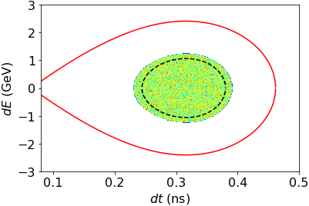
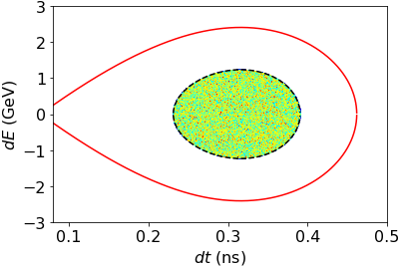
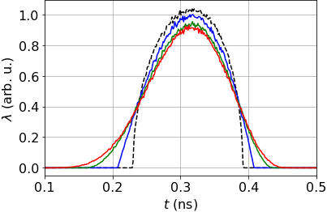

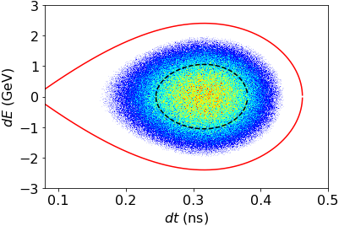
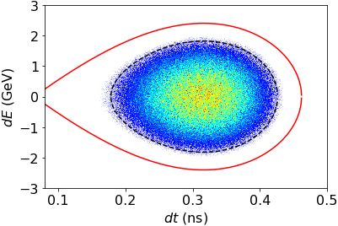

The longitudinal profile definition
The tails must be defined. Equal FWHM bunch lengths but different tail definitions give different encircling emittances:
Tails increase ε_{L} by factor of 2
→ Increased voltage requirements
to increase bucket area
ε_{L} = 0.22 eVs
ε_{L} = 0.31 eVs, 4σ_{L} = 0.16ps
µ = 0.5, τ_{L} = 4 σ_{t}
µ = 1 (parabolic)
µ = 2
µ = 3
FWHM,
µ = 1
Encircling ,
µ = 1
$$λ(τ)=λ_{0}{\left[1−{\left(\frac{τ}{τ_{l }}\right)}^{2}\right]}^{μ}$$
(^^{(µ+1/2)} in BLonD)
φ_{s} = 30°
ε_{L} = 0.22 eVs
ε_{L} = 0.69 eVs , 4σ_{L} = 0.20ps
FWHM,
µ = 2.5
4σ,
µ = 2.5
F. Batsch

Slide 11
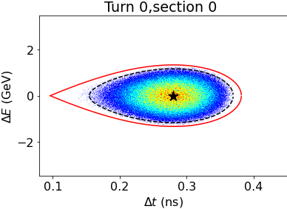
The longitudinal profile definition
The tails must be defined. Equal FWHM bunch lengths but different tail definitions give different encircling emittances:
Tails increase ε_{L} by factor of 2
→ Increased voltage requirements
to increase bucket area
ε_{L} = 0.22 eVs
ε_{L} = 0.31 eVs, 4σ_{L} = 0.16ps
µ = 0.5, τ_{L} = 4 σ_{t}
µ = 1 (parabolic)
µ = 2
µ = 3
FWHM,
µ = 1
Encircling ,
µ = 1
φ_{s} = 45°, used in simulations:
$$λ(τ)=λ_{0}{\left[1−{\left(\frac{τ}{τ_{l }}\right)}^{2}\right]}^{μ}$$
(^^{(µ+1/2)} in BLonD)
φ_{s} = 30°
ε_{L} = 0.22 eVs
ε_{L} = 0.69 eVs , 4σ_{L} = 0.20ps
FWHM,
µ = 2.5
4σ,
µ = 2.5
F. Batsch

Slide 12
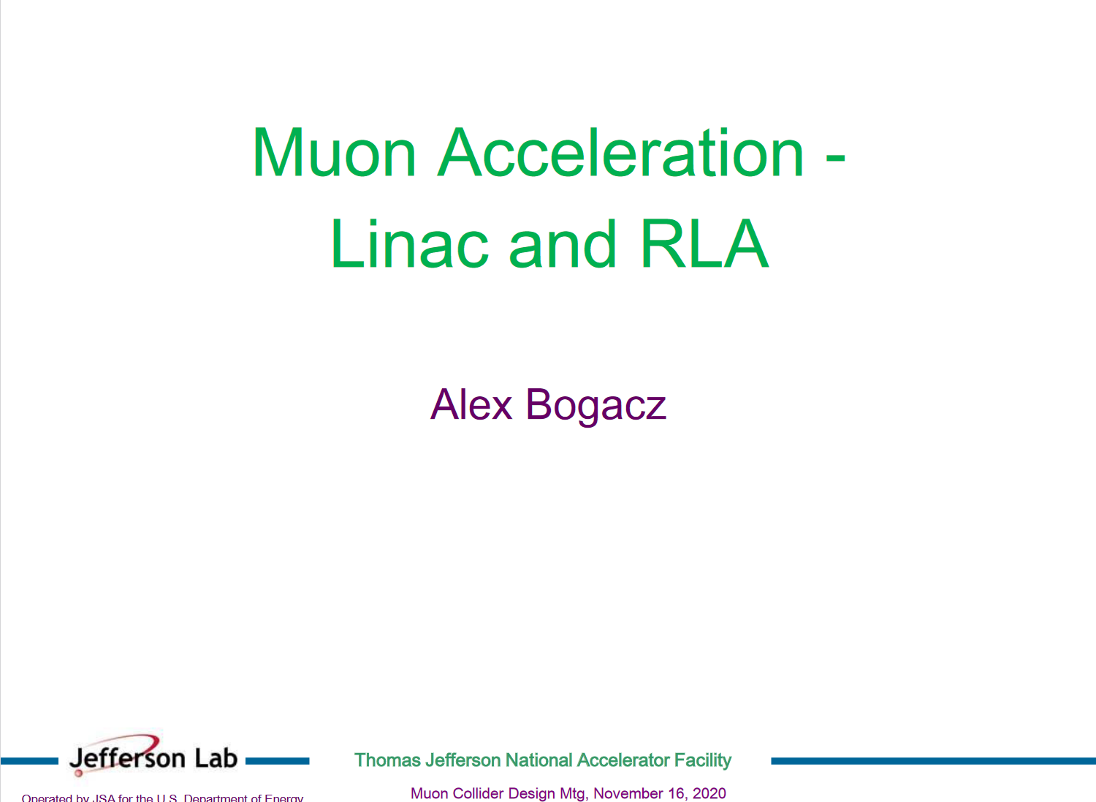
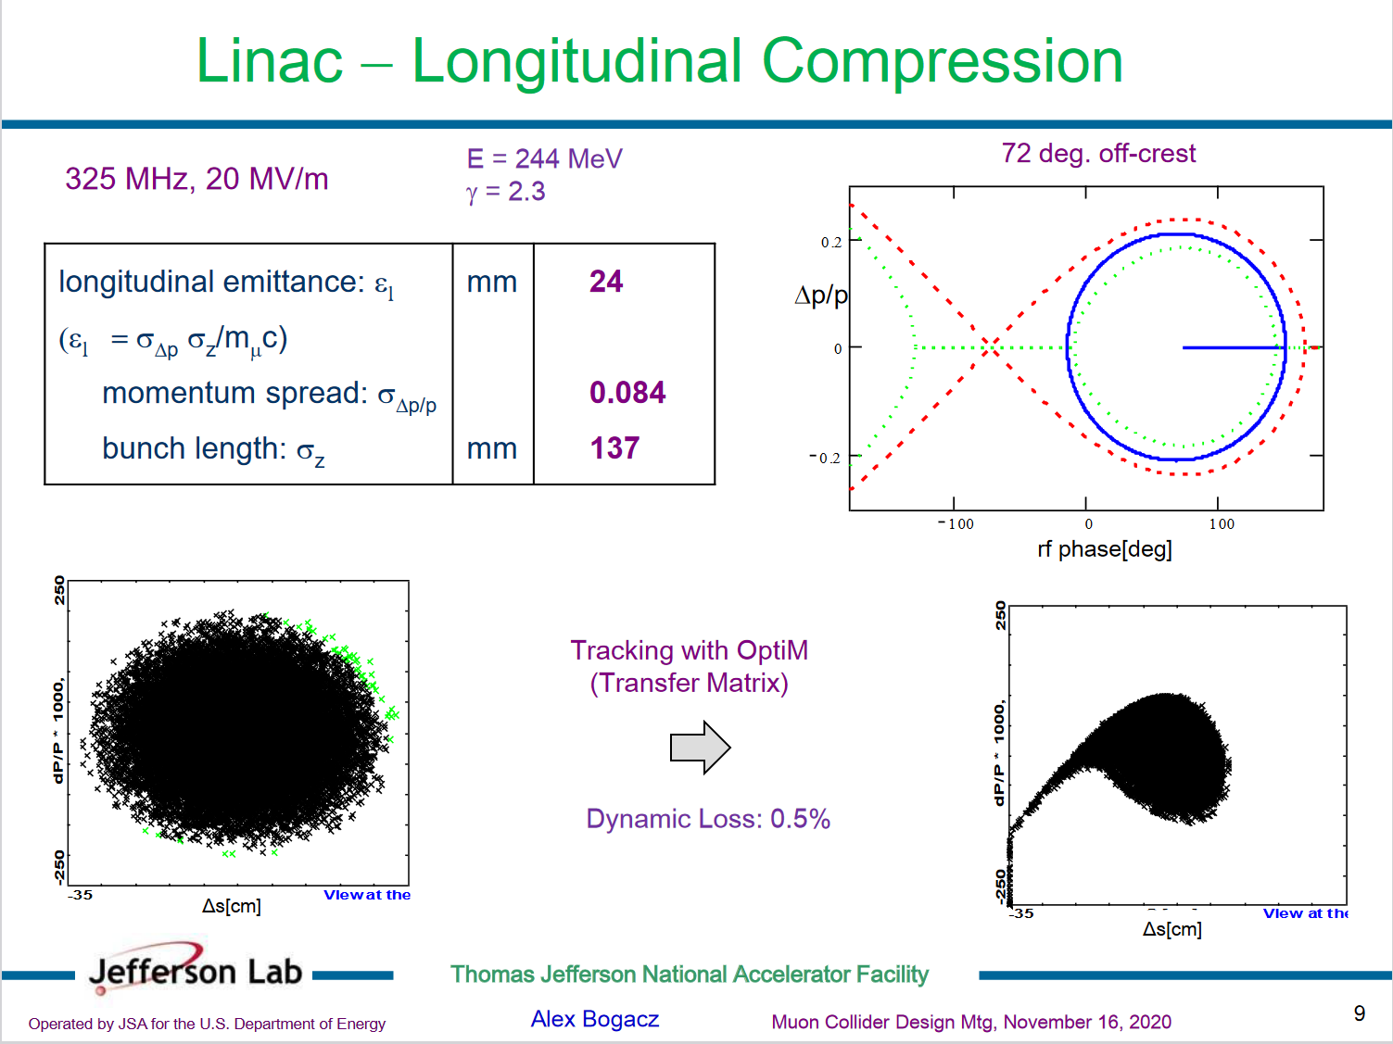
The longitudinal profile definition
Bucket at injection in RCS1
From the dynamics point-of-view, muons behave more like protons
→ Chose μ = 2.5 for now:
The longitudinal profile after cooling would be an important input
Side note: examples for muons exist but not for a collider application:
ε_{L} =βγ∗σ_{z} ∗ σ_{Δp/p} = 24 mm
[source]
F. Batsch

Slide 13
Outline
Longitudinal emittance definitions
Bunch length during acceleration
Synchronous phase optimization
Beam-induced voltages and HOM power estimates
Outlook
  emittance growth and budget
  multi-turn effects and induced voltages calculations
Summary
F. Batsch

Slide 14
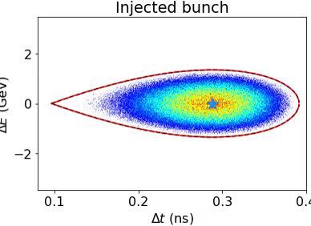
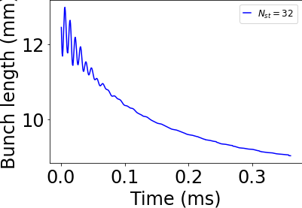
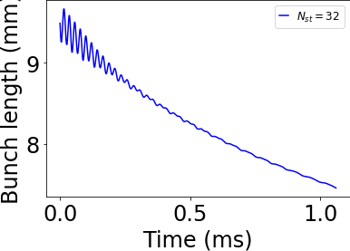
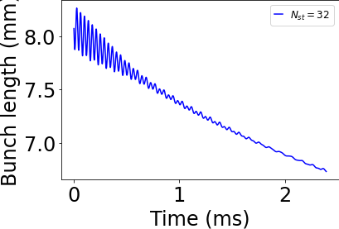
Bunch lengths during acceleration
In the 1.5 TeV collider, bunch length σ_{z} = 5 mm
In simulations, the bunch length at injection in RCS1
σ_{z} = 13 mm
The 1 sigma bunch length decreases during acceleration in all 3 RCs:
Final bunch length is σ_{z} < 7 mm, bunch rotation might be required
RCS1 RCS2 RCS3
Note: initial variations due to mismatched bunch
F. Batsch

Slide 15
Outline
Longitudinal emittance definitions
Bunch length during acceleration
Synchronous phase optimization
Beam-induced voltages and HOM power estimates
Outlook
  emittance growth and budget
  multi-turn effects and induced voltages calculations
Summary
F. Batsch

Slide 16
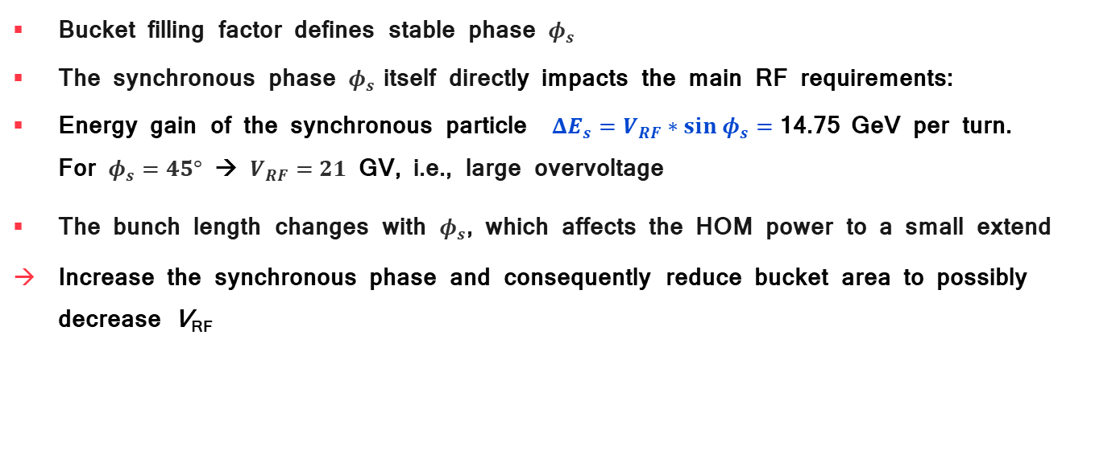
The synchronous phase and its influence
Bucket filling factor defines stable phase $φ_{s}$
The synchronous phase $φ_{s}$ itself directly impacts the main RF requirements:
Energy gain of the synchronous particle $ΔE_{s}=V_{RF}∗sin{ φ}_{s}=$14.75 GeV per turn.
For $φ_{s}=45°$ → $V_{RF}=21$ GV, i.e., large overvoltage
The bunch length changes with $φ_{s}$, which affects the HOM power to a small extend
Increase the synchronous phase and consequently reduce bucket area to possibly decrease V_{RF}
F. Batsch

Slide 17
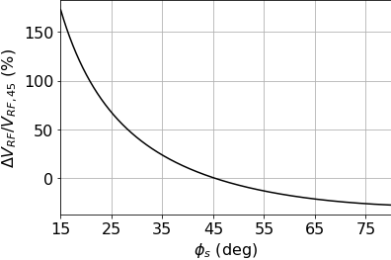
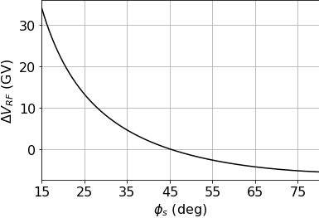

Over-voltages due to φ_{s}
Independent of the cavity frequency or RCS, the overvoltage in the RF voltage ${V_{RF}=ΔE_{s}/sin(φ}_{s})$, compared to $φ_{s}=45°$ is:
Relative change in V_{RF}
Absolute change in V_{RF}
F. Batsch

Slide 18
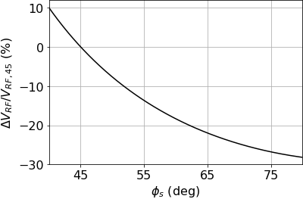
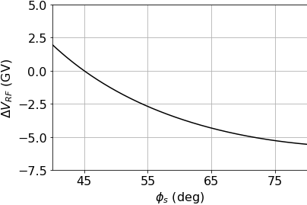
Over-voltages due to φ_{s}
Independent of the cavity frequency or RCS, the overvoltage in the RF voltage ${V_{RF}=ΔE_{s}/sin(φ}_{s})$, compared to $φ_{s}=45°$ is:
Relative change in V_{RF}
Absolute change in V_{RF}
zoomed
zoomed
F. Batsch

Slide 19
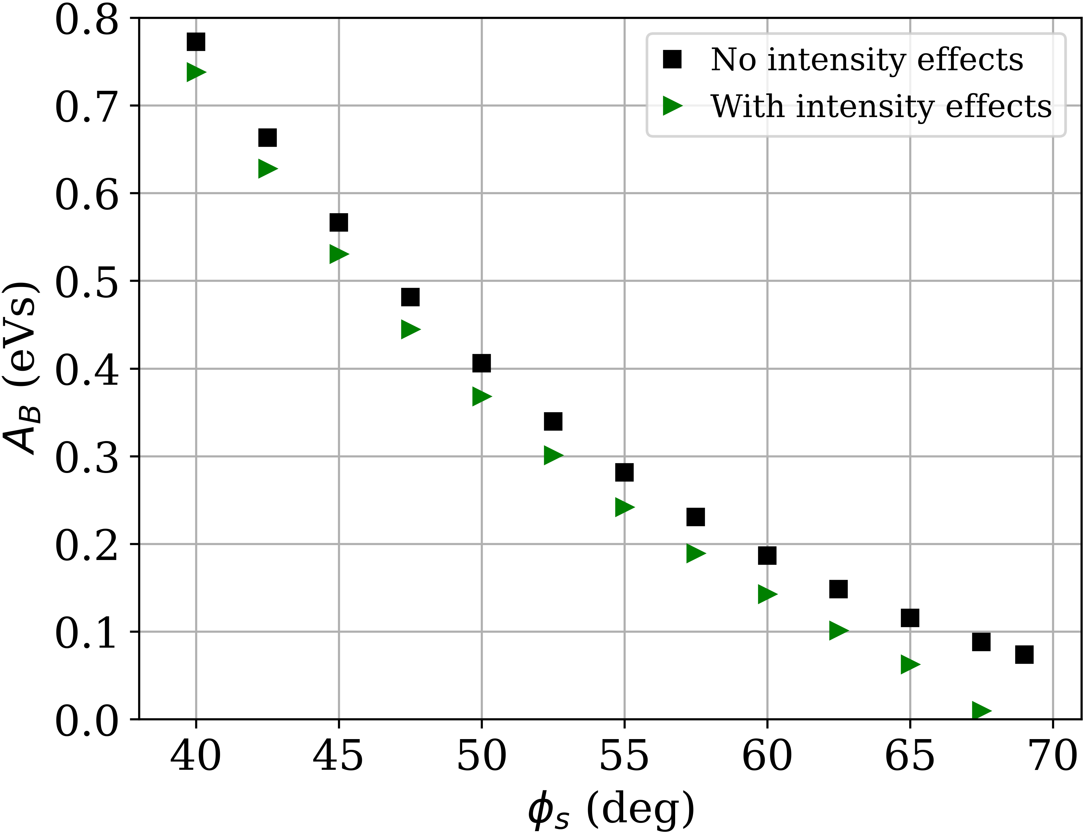
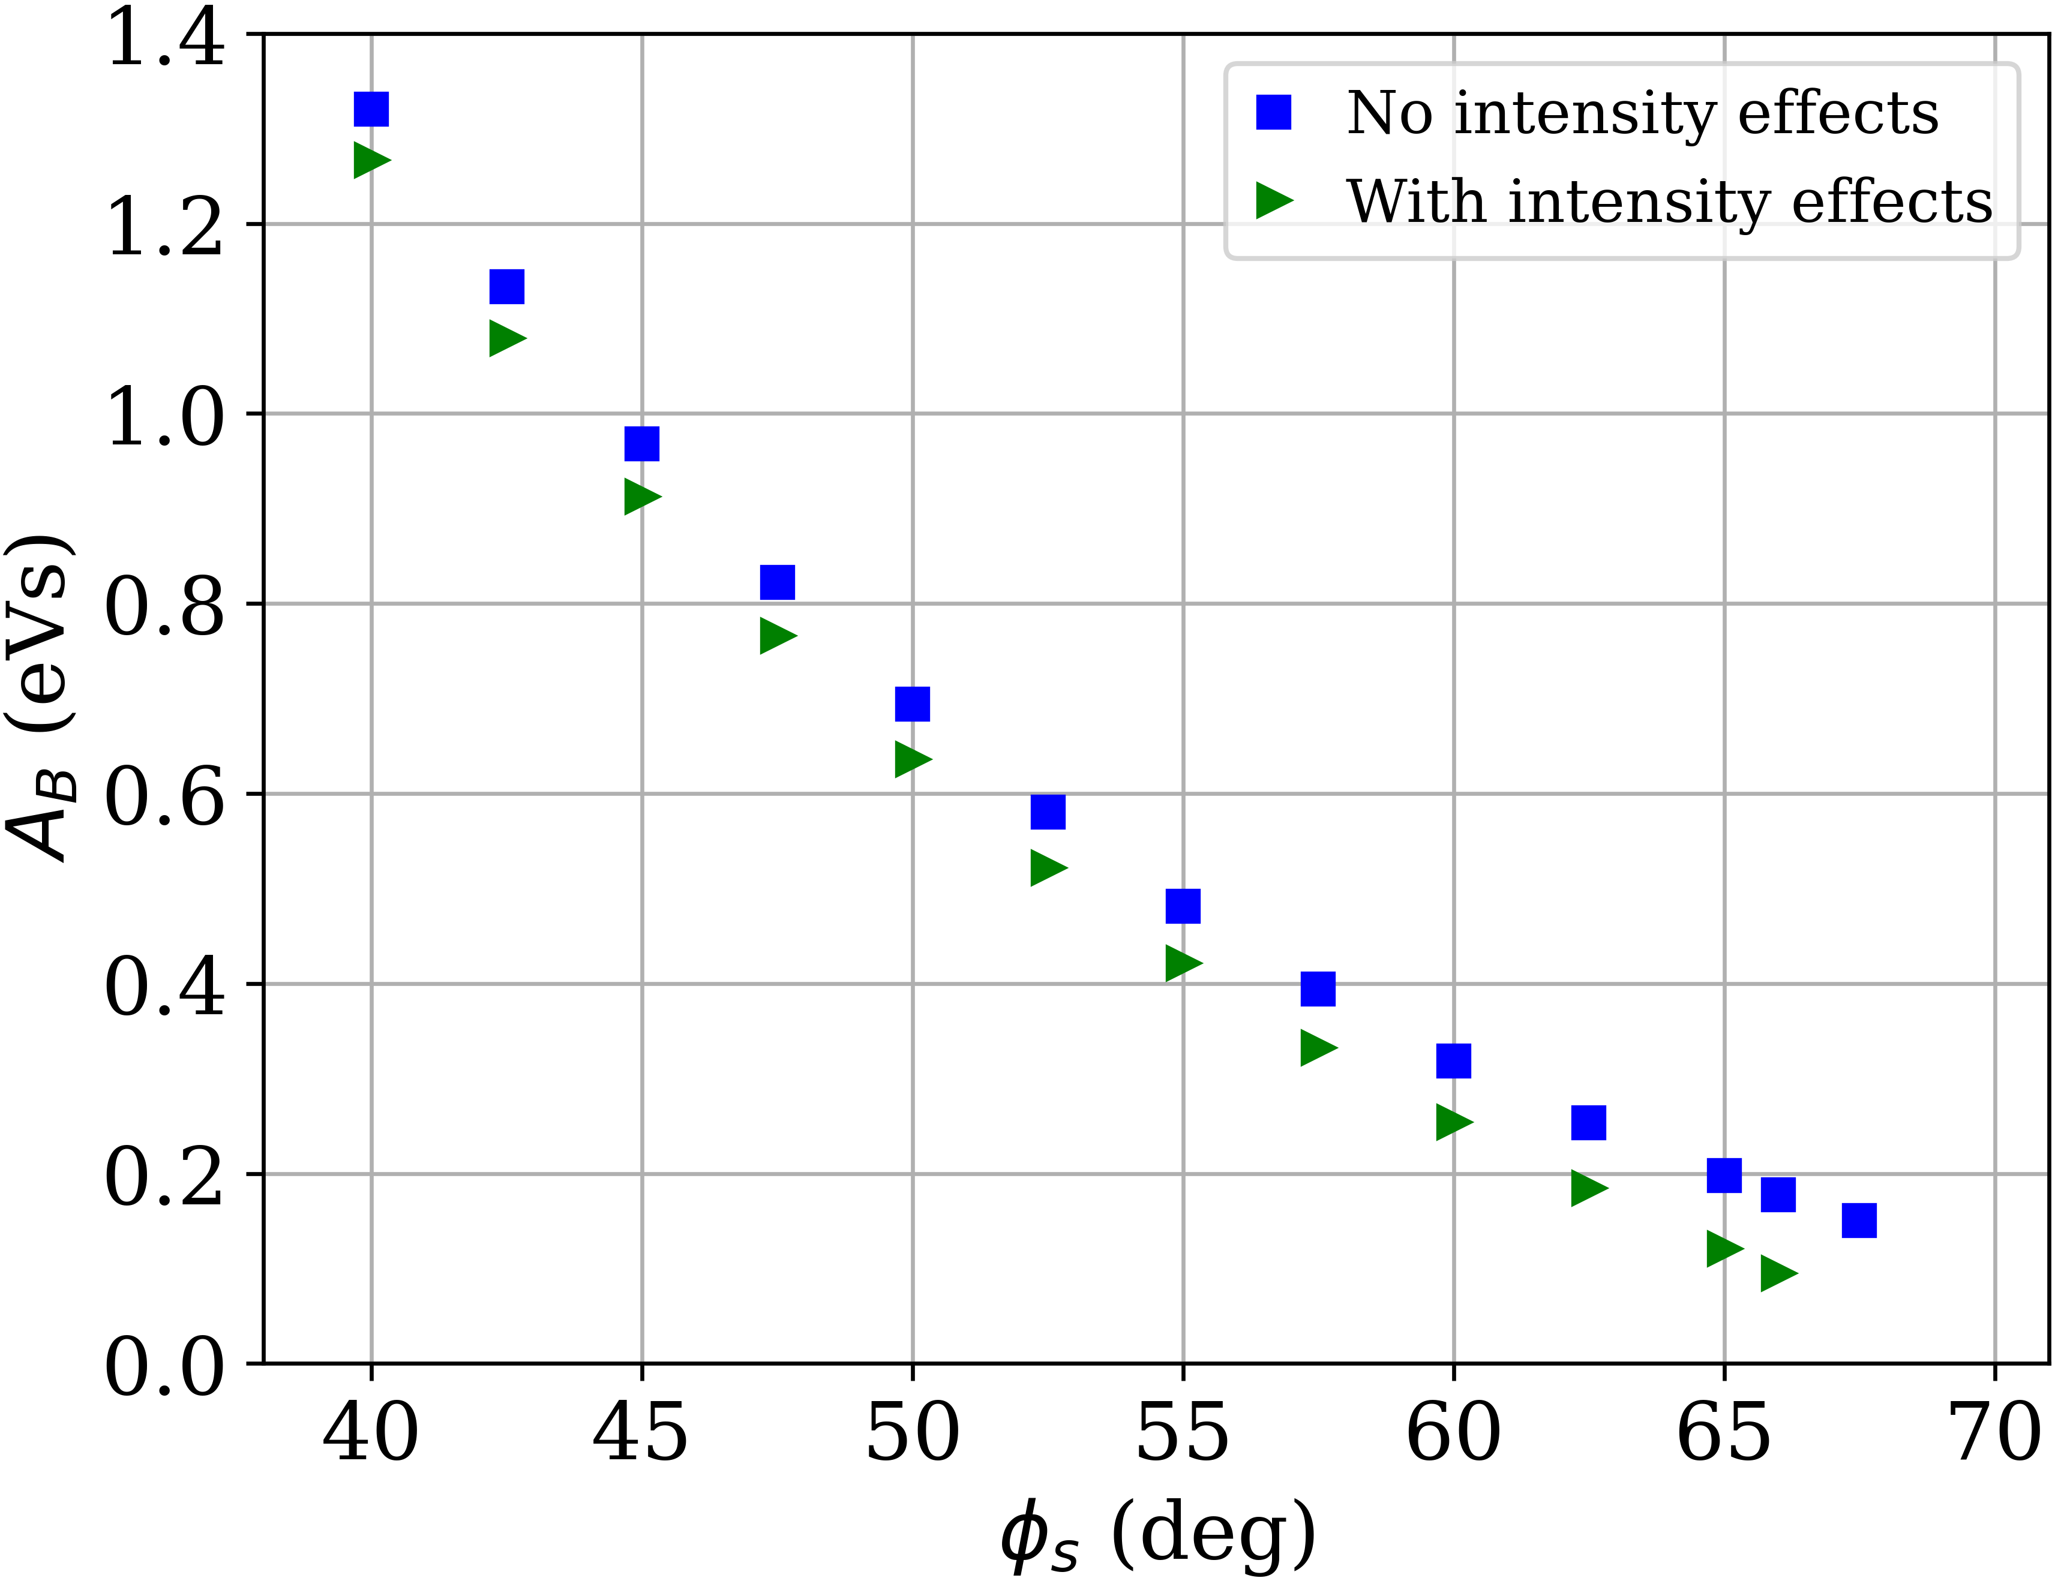
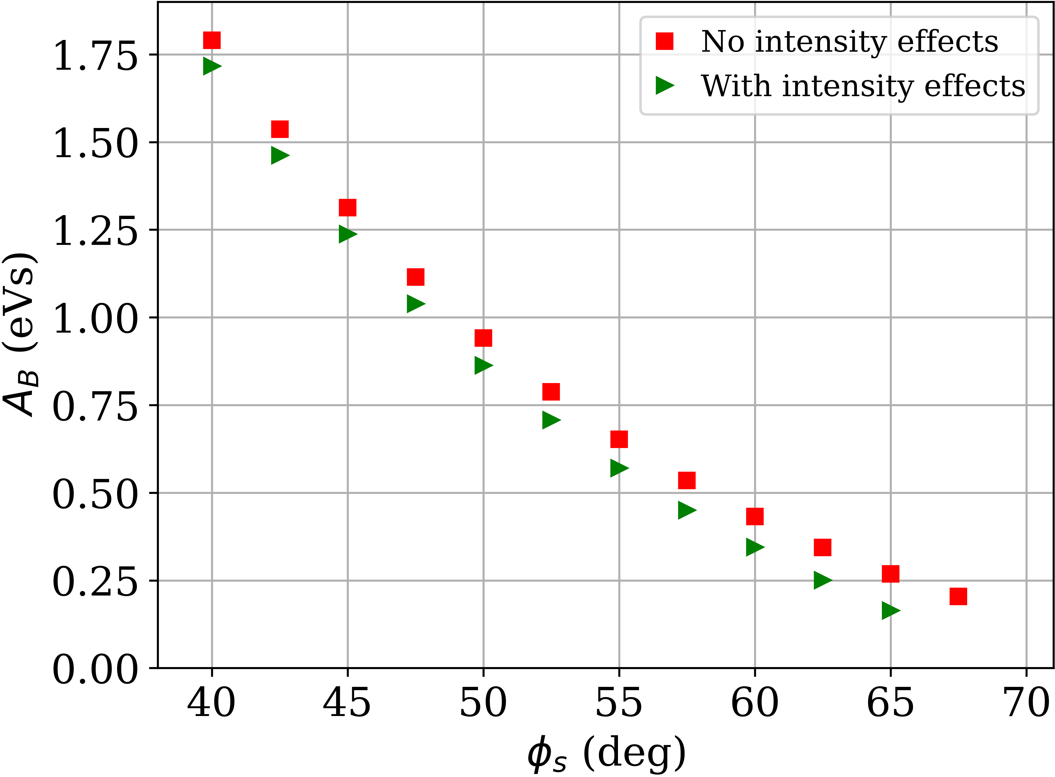


Synchronous phase optimization
Bucket areas for each RCS:
Intensity effects decrease the bucket area slightly
Relaxed voltage requirements and longer bunches (reduces HOM power)
RCS1 RCS2 RCS3
${4π⋅σ}_{t}⋅σ_{E}=0.31$ eVs
$0.31$ eVs
$0.31$ eVs
F. Batsch

Slide 20
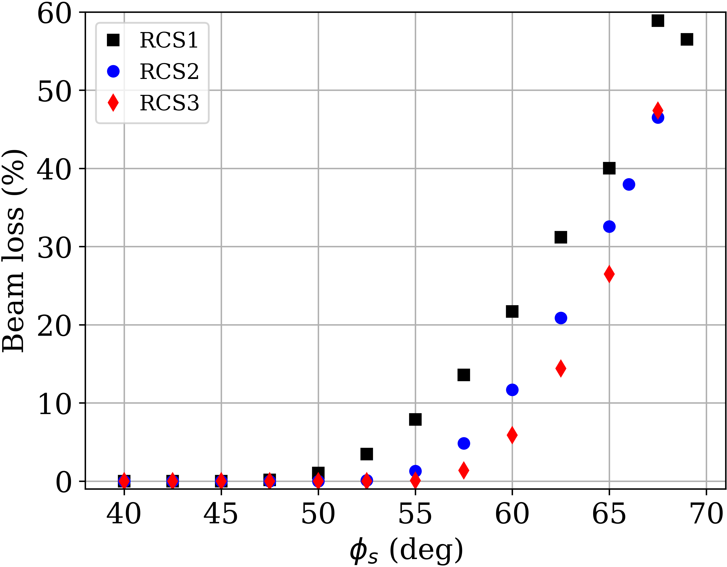
Synchronous phase optimization
Possibility to use the muon loss as a criteria
The beam losses increase gradually with the shrinking bucket
→ Used single bunch for φ_{s} = 45° and “injected” it in all cases to avoid
that the matching routine shrinks the bunch:
Between φ_{s} = 50° and 55 seems to be the limit
Further studies to come after optimization of the RF voltage and ramping
F. Batsch

Slide 21
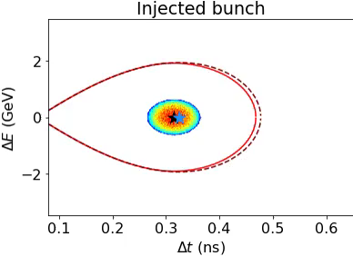
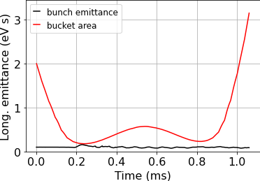
Synchronous phase for nonlinear ramping
The same scan can be repeated for nonlinear ramping function
Example of an older simulation for RCS 1, φ_{s} = 57.5°, input emittance 0.1 eVs:
This study will be repeated with updated values after optimization of the RF voltage and ramping
→ 54% of the bunch lost
F. Batsch

Slide 22
Outline
Longitudinal emittance definitions
Bunch length during acceleration
Synchronous phase optimization
Beam-induced voltages and HOM power estimates
Outlook
  emittance growth and budget
  multi-turn effects and induced voltages calculations
Summary
F. Batsch

Slide 23
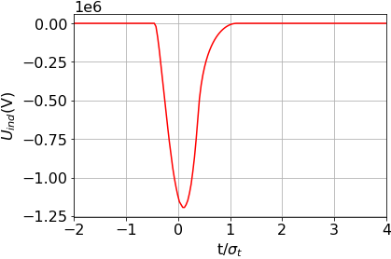
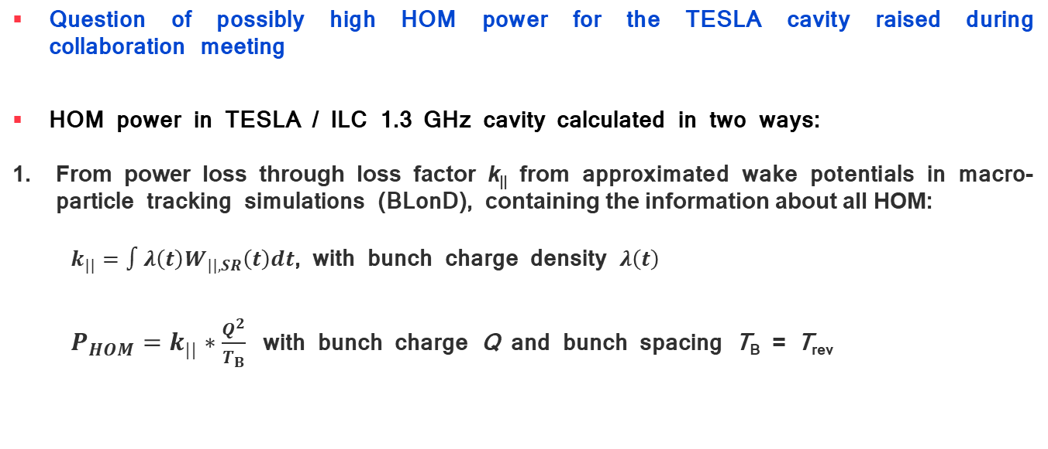
Beam-induced power losses
Question of possibly high HOM power for the TESLA cavity raised during collaboration meeting
HOM power in TESLA / ILC 1.3 GHz cavity calculated in two ways:
From power loss through loss factor k|| from approximated wake potentials in macro-particle tracking simulations (BLonD), containing the information about all HOM:
$k_{||}=∫λ\left(t\right)W_{||,SR}\left(t\right)dt$, with bunch charge density $λ\left(t\right)$
$P_{HOM}=k_{||}∗\frac{Q^{2}}{T_{B}}$ with bunch charge Q and bunch spacing T_{B} = T_{rev}
t/4σ_{t}
short-range wakefield [ref, see appendix for details]
F. Batsch

Slide 24
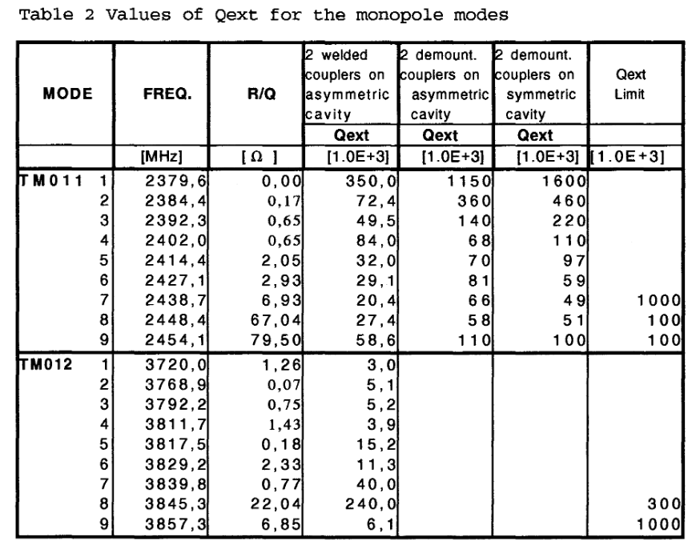
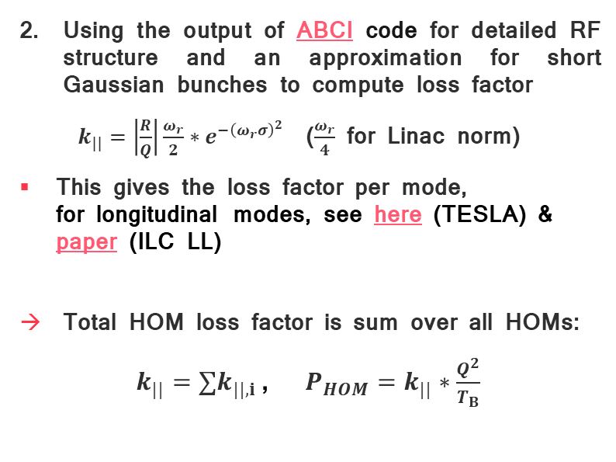
Beam-induced power from mode analysis
Using the output of ABCI code for detailed RF structure and an approximation for short Gaussian bunches to compute loss factor
$k_{||}=\left|\frac{R}{Q}\right|\frac{ω_{r}}{2}∗e^{−{\left(ω_{r}σ\right)}^{2}}$ ($\frac{ω_{r}}{4}$ for Linac norm)
This gives the loss factor per mode,
for longitudinal modes, see here (TESLA) & paper (ILC LL)
Total HOM loss factor is sum over all HOMs:
$k_{||}=∑k_{||,i}$, $P_{HOM}=k_{||}∗\frac{Q^{2}}{T_{B}}$
From
“Higher order mode coupler for TESLA”, J. Sekutowisz
F. Batsch

Slide 25
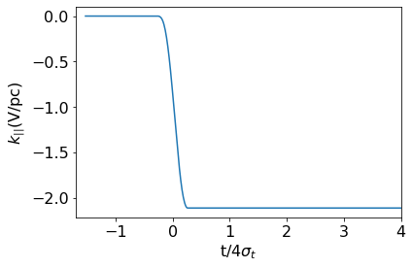
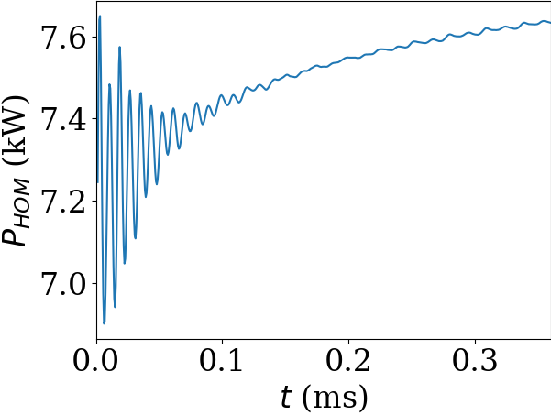
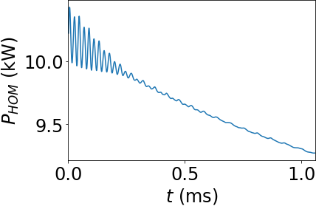
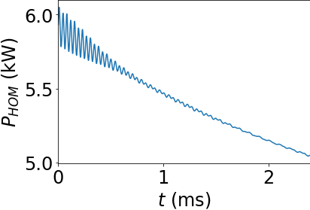

Beam-induced power losses: results
Parameters in BLonD: n_{RF} = 32 RF stations, 696 cavities, 90% survival, initial bunch length σ_{z} = 13 mm, 1 bunch, single-turn effects
E.g. $k_{||,SR}=∫λ\left(t\right)W_{||,SR}\left(t\right)dt$ = -2.11 V/pC
The HOM power loss per cavity reaches 10.4 kW
(Bunch population 2.54x10¹², T_{rev} = 20 µs → I = 20.4 mA as upper estimate)
RCS1 RCS2 RCS3
F. Batsch

Slide 26
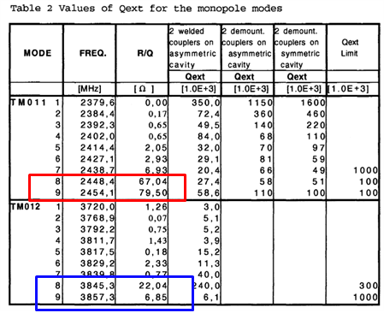
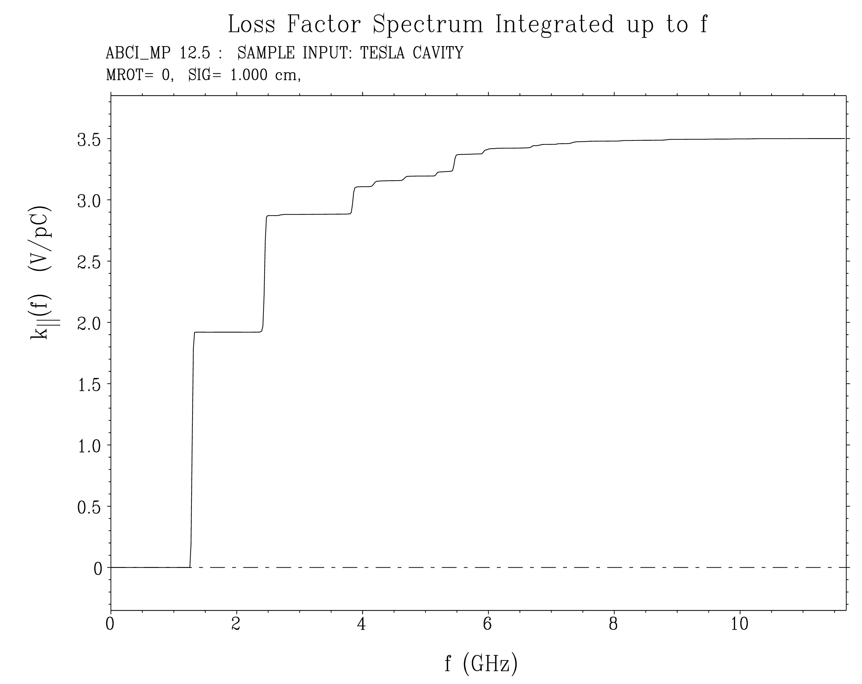
Beam-induced power losses: results
From HOMs from ABCI: (ABCI file from S.-A. Udongwo):
For RCS1:
See talk by Sosoho U. [link], detailed studies of 1.3 GHz cavity types, structures, HOMs, other frequencies
TM012
HOMs 1.5 V/pC
1.5 V/pC results in 7.9 kW
→ Consistent with BLonD
First two “strong” monopole HOM’s already contribute with 4.7 kW
fundamental mode, 2 V/pC
F. Batsch

Slide 27
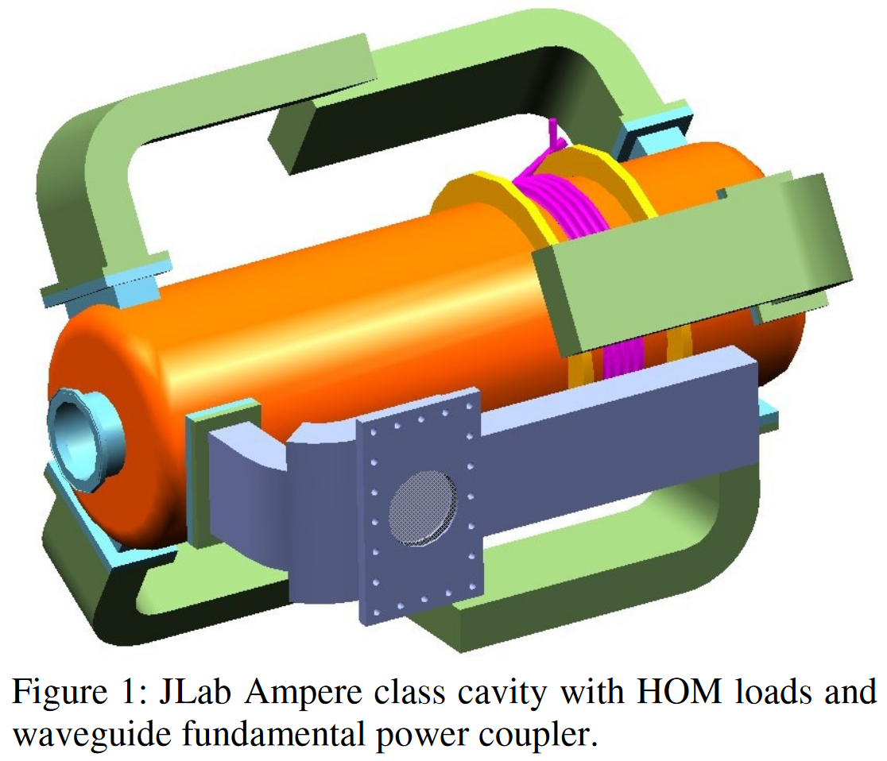
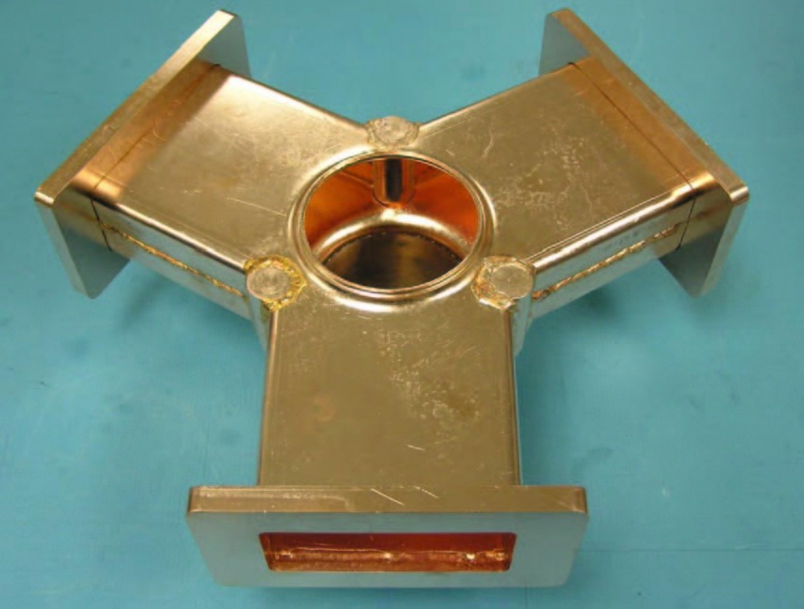
Beam-induced power losses
The induced power is very large, up to 10 kW for RCS1&2 per bunch and cavity
Bunch crossings inside the cavity increases power up to 4 times, to be avoided
Central question: What is the CW value?
10kW over 0.3 to 2.4 ms correspond to which CW power in 5Hz operation?
Example: HOM power absorber capacity limit is 1 kW, 3-4 kW under development
→ up to 20 kW per cavity estimate
Detailed studies on HOM and high-capacity power absorbers
(or larger iris, wakefields scale with 1/a², a the iris radius)
See e.g. also PhD thesis by S. Zadeh
from [R.Rimmer]
F. Batsch

Slide 28
Outline
Longitudinal emittance definitions
Bunch length during acceleration
Synchronous phase optimization
Beam-induced voltages and HOM power estimates
Outlook
  emittance growth and budget
  multi-turn effects and induced voltages calculations
Summary
F. Batsch

Slide 29
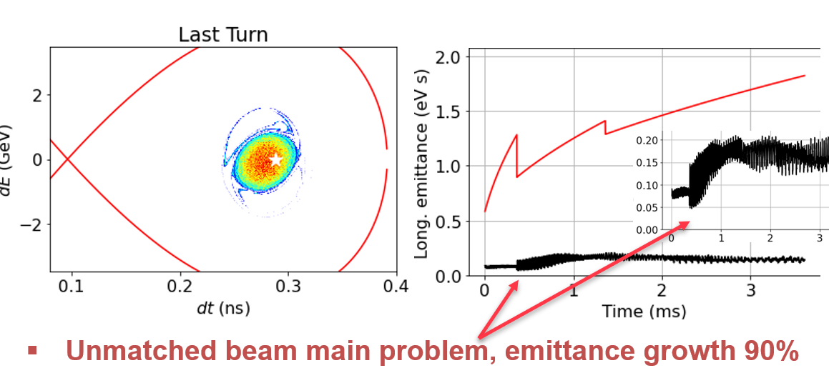
Emittance budget
The emittance budget was discussed in the Accelerator design meeting, see talk by
D. Schulte:
Challenge assuming 4% per RCS and beam transfers
Beam transfer possible source of emittance growth
Beam transfer optimized with ramping functions after
the HOM and multi-turn/bunch effects are determined
Rel. emittance blow-up | Relative tolerance | Relative luminosity
0.1% | 0.03 | 0.999
1% | 0.1 | 0.99
10% | 0.3 | 0.9
100% | 1 | 0.5
“Would assume a total budget of 10% (most relaxed acceptable tolerance)”
For the entire 5-GeV-to-1.5-TV acceleration chain!
See last annual meeting: [link]
F. Batsch

Slide 30


Multiturn effects and mode analysis
Multi-turn effects computational challenge
We compute the induced voltages only for the bucket one turn later
Currently implementing this in our code, together with an improved calculation of the induced voltages
F. Batsch

Slide 31
Multiturn effects and mode analysis
Improved calculation of the induced voltages needed:
K. Bane formulism only valid for short bunches with respect to the cavity cell
We will not differentiate between short-range (K. Bane) and long-range effects, but use the mode analysis of ABCI and resonator models of the first 10 main HOMs:
Add contributions from each mode, and later from the counterrotating bunches
F. Batsch

Slide 32

Summary
Challenging target for longitudinal emittance, its budget and its growth
Bunch length after acceleration below 7 mm to be expected
Emittance after cooling and linac systems is essential input
Synchronous phase baseline is $φ_{s}=45°$
HOM power losses are on the 10 kW range during acceleration → CW level estimates and HOM coupler development important
Working on a new calculation of the induced voltages and multiturn effects
F. Batsch

Slide 33


Slide 34

The BLonD code
(Beam Longitudinal Dynamics code)
BLonD: macro-particle tracking code, developed at CERN since 2014
Links: documentation and github
MuC-specific to multiple RF stations & muon decay
Studies of today with only one bunch, 2nd to follow
From BLonD documentation
F. Batsch

Slide 35



Extra
The beam losses increase gradually with the shrinking bucket
→ Used single bunch for φ_{s} = 45° and “injected” it in all cases to avoid that the matching routine shrinks the bunch,

Slide 36





Induced voltages: Short-range wakefields
Based on K. Bane et al., ‘Calculation of the short-range longitudinal wakefields in the NLC linac’, ICAP98, 1998
The longitudinal wake function is given by:
One can approximate this by a semi-analytically expression, valid for small bunch length s and s/L < 0.15:
The parameters for the Tesla cavity¹ gives long. wake functions on the order of 30 V/pC/m:
Adjusting inner diameter can be a powerful tool to mitigate wakefields!
The BLonD code convolutes this wake function with the beam profile to obtain the induced voltage
L= 115.4 mm
g= 82 mm
a= 35 mm
b= 103.3 mm
¹Wakefield studies for the Tesla cavity shown in TESLA Report 2003-19
21 June 2023
36
F. Batsch
36

Slide 37


Induced voltages: Short-range wakefields
The induced voltage from the short-range wakefield is as large as 1.5 MV per cavity, i.e., also 1.5 MV/m
The total induced voltage per turn is around 400 MV, thus 3-4% of the accelerating voltage
From design report
Simulation for RCS1, $n_{RF}=48, ε_{L}=$ 0.1 eVs

Slide 38



Induced voltages: Long-range wakefields
Important cavity parameters :
Gradient in cavity: 30MV/m
L=1.04m
R/Q = 518 Ω
$Δ$f = 320 Hz
Q_{L}=2.2e6
The induced voltage from fundamental beam loading for a single turn is 1.5 MV per cavity
So far for a single turn
for beam loading compensation
Simulation for RCS1, $n_{RF}=48, ε_{L}=$ 0.1 eVs

Slide 39





Induced voltages: Combined wakefields
Both effects combined: total induced voltage in a cavity is around 2.2 MV per cavity / per meter, i.e. 10-11% of the RF voltage
RF voltage
Induced voltage
Total voltage
n_{RF} = 48
n_{RF} = 48
Total induced voltage = short-range wakefield + long-range wakefield
V_{ind} (V)
V_{ind} (V)
V_{ind} (V)

Slide 40


Beam-induced power with BLonD
The geometry of the cavity defines all HOM, i.e. for single-bunch cases, the short-range wakefield from K. Bane [ref, see appendix for details] includes these, but not the long-range fundamental mode
→ Use short-range wake potential $W_{||,SR}$ to compute power
Plot shows:
bunch charge density, σ = 6.6mm
U_{ind}, short-range
U_{ind}, fundamental mode
Total U_{ind}
Wake potential from ABCI
(for RCS1, n_{RF} = 32, parameter in appendix)
F. Batsch

Slide 41
Studies for 801.58 MHz cavities
Some RCS parameter that change with the FCC-ee 5-cell cavity:
 | TESLA/ILC | FCC-ee
Frequency f_{RF} [MHz] | 1300 | 801.58
Cells | 9 | 5
Active length L_{active} [mm] | 1038 | 935
Cavity length L_{cav} [mm] | 1276 | 1291
Gradient [MV/m] | 30 (conservative) | 25
Number of cavities RCS1 | 696 | 835
Straight length RCS1 | 2334 | 2334
Straight length with RF | 38 % | 46 %
46% instead of 38% use of straight section, feasible!
F. Batsch

