Slide 1
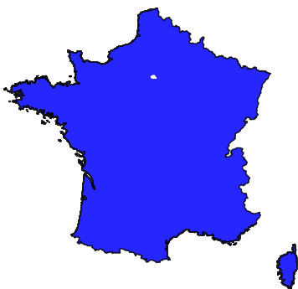



International MUON Collider Collaboration
Annual Meeting, Orsay, France 21.06.2023
Final cooling optimal path and code comparison
Bernd Stechauner^{1,2}, Jose Ferreira Somoza², Elena Fol², Andrea Latina², Chris Rogers^{3,} Daniel Schulte² & Jochen Schieck^{1,4}
¹University of Technology, Vienna
²CERN, Geneva
³STFC Rutherford Appleton Laboratory, Didcot
⁴Institute of High Energy Physics (HEHPY), Vienna

Slide 2
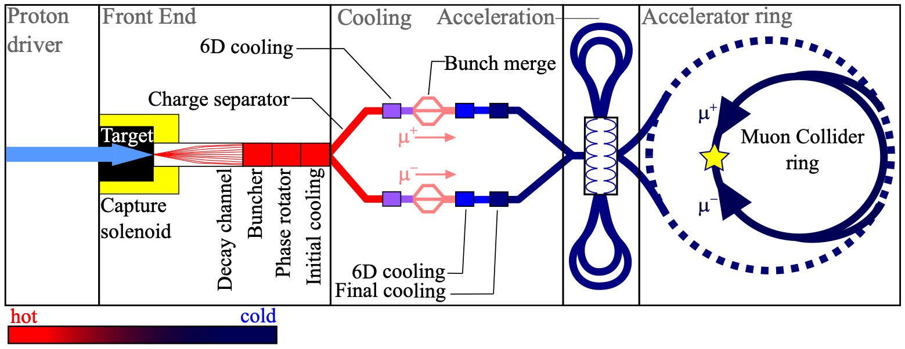
Final cooling: an overview
Single final cooling cell

Slide 3
Outline
Code comparison for ionization cooling
  RF-Track vs ICOOL / G4Beamline
  Physics implementations: overview & current status
Optimal initial beam and machine parameters for final cooling
Thermodynamical aspects of hydrogen absorbers

Slide 4

Simulation tools for Ionization Cooling (IC)
ICOOL
G4Beamline
RF-Track
[1]
[2]
[3]
ICOOL & G4Beamline (G4Bl) used for IC simulations in the past
The IMCC started to use RF-Track as a third option
  Student-friendly program
  Fast simulation tool, collective effects included
  More info. from E. Fol’s talk: https://indico.cern.ch/event/1250075/contributions/5357365/

Slide 5
Physics processes implementation in RF-Track
Energy loss
Energy straggling
Multiple Coulomb scattering

Slide 6

Energy loss in matter in RF-Track [4]
e⁻ gas
muon
Energy losses follow Bethe Bloch Equation
Energy loss of muons depends on:
Energy of the particle
Material properties
Path length
Programs have similar values for energy loss through material

Slide 7
Energy straggling in RF-Track [4]
t₁
t₂
e⁻ gas
muon
t₁ < t₂
Heave charged particles in matter can collide directly with electrons: this leads to a stochastic growth of the energy spread
Plot: 100 MeV mean energy and 5.05 MeV spread: RF-Track data in in good agreement with ICOOL and G4Bl

Slide 8
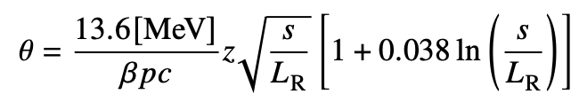
Multiple Coulomb scattering
Charged particles are deflected by the nuclei inside material
A rms scattering angle is given by the Highland formula
RF-Track:
  Muon deflection follows Gaussian number generator
  The std of the Gaussian follows Highland without log-term
[4]
Absorber nuclei

Slide 9
Multiple Coulomb scattering benchmarking [4]

Slide 10
Scattering profile analysis of liquid H₂
Tails: hard scattering effects from the absorber’s nuclei
ICOOL particle displacements are not Gaussian anymore
For very low Z, Highland over-estimates scattering

Slide 11
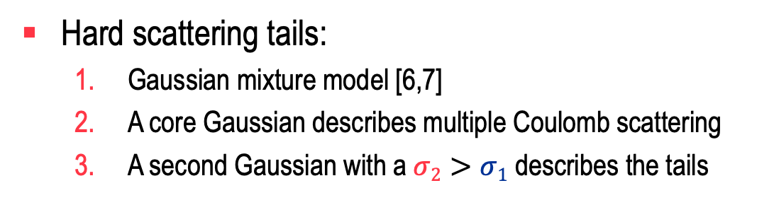
Current progresses on RF-Track
Radiation length
Testing scattering theory for low Z-materials:
  Usually with screening potential Z(Z+1)
  But hydrogen has a single electron [5]
  un-screened potentials: lower scattering due to a smaller radiation length
Hard scattering tails:
  Gaussian mixture model [6,7]
  A core Gaussian describes multiple Coulomb scattering
  A second Gaussian with a$σ2>σ1$ describes the tails

Slide 12

RF-Track can be helpful fo:
Find the recipe for final cooling
Absorber length
Initial Energy
Energy spread
Solenoid field

Slide 13
Results with ICOOL
! Decay losses were not included
Constant solenoid field, e.g. 40T
Constant longitudinal parameters
Scan over initial Ekin for different trans. emittances
ICOOL: very time-consuming simulations

Slide 14
Last cooling cell in the final cooling section
Transverse target emittance of 25 microns is achieved in the last cooling cell
Equilibrium emittance estimates the required parameters
Liquid hydrogen (LH)
Low beam energy
High magnetic solenoid field
10 MeV to 5 MeV

Slide 15
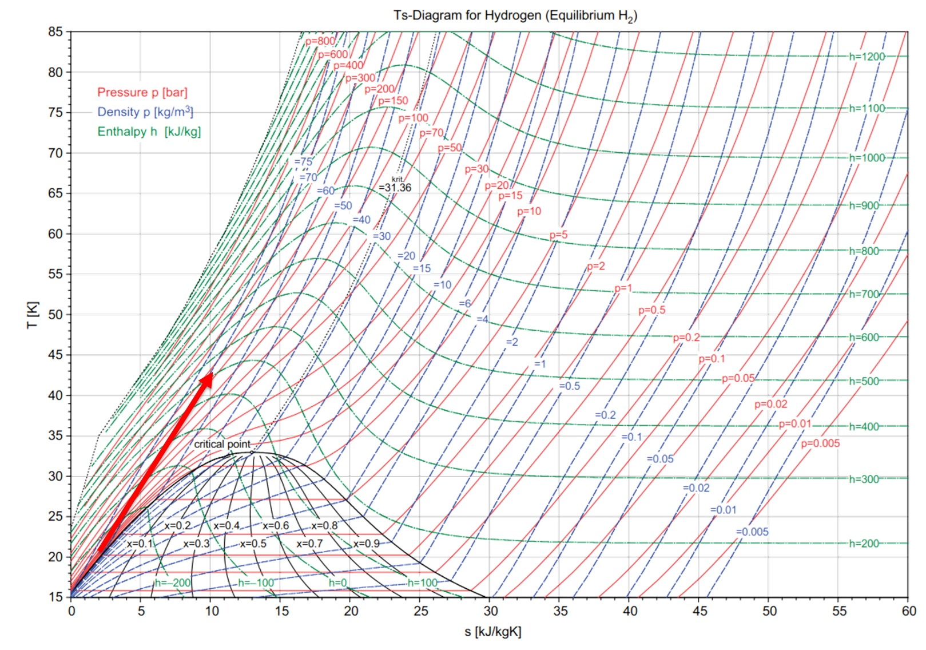
LH problematics at very low beam sizes
Contradictory requirements:
High density to limit the length of the superconducting solenoid (<50 cm)
Low density to limit the pressure increase after power deposition and allow the use of thin windows
J Ferreira Somoza

Slide 16
LH problematics
E_{kin} depositon example : From 20 MeV to 5 MeV
H₂ Absorber | Length | Max P (bar) | Max T (K) | P assuming power deposited in 3×σ_{RMS} (bar) | K assuming power deposited in 3×σ_{RMS} (K)
RT@1bar | 124 m | 1.3 | 373 | 1.04 | 303
RT@4bar | 31 m | 5.2 | 373 | 4.18 | 303
20.3K@1bar vapor | 8 m | 7.5 | 140 | 1.8 | 34
26.1K@4bar vapor | 2.1 m | 29.2 | 143 | 7 | 40
20.3K@1bar liquid | 15 cm | 833 | 128 | 125 | 35
Acknowledgement to J Ferreira Somoza

Slide 17
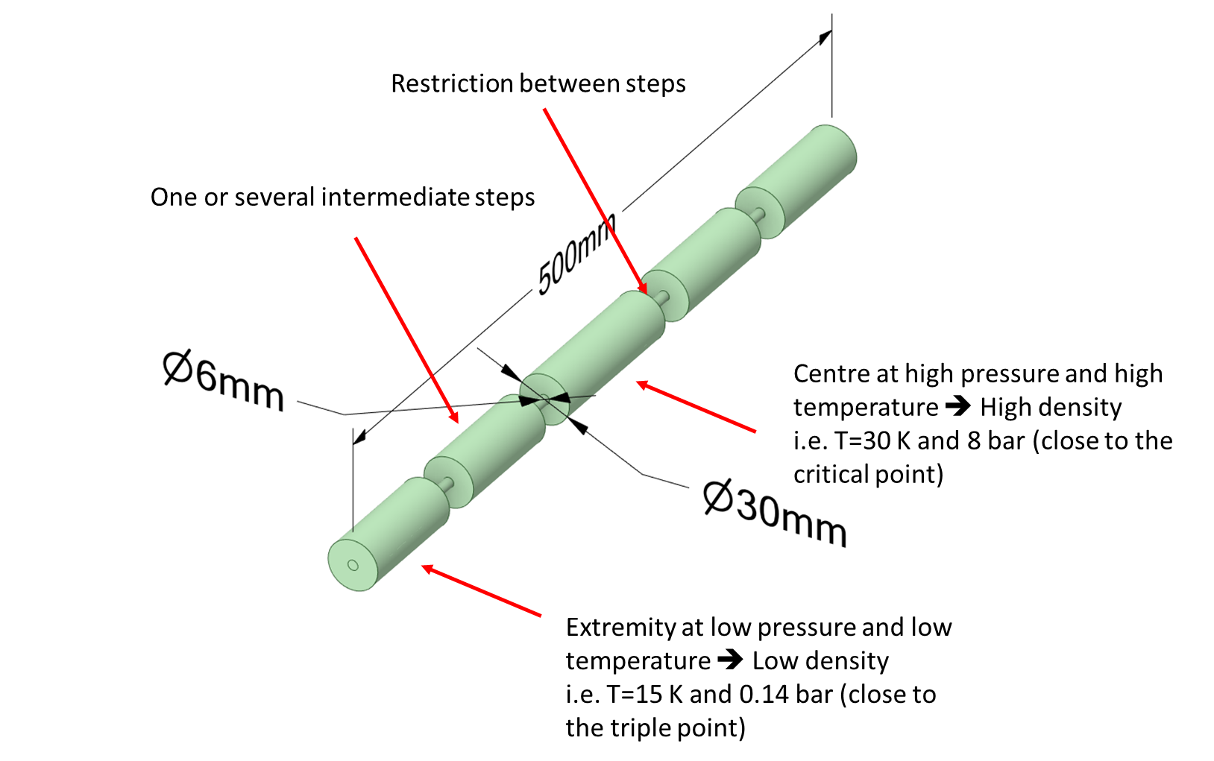
LH absorber alternatives
How to decouple the window from the absorber? Temperature gradient?
Window temperature warmer to produce H₂ bubble?
Analytical estimation from [9]:
Absorber
10 MeV
5 MeV
Acknowledgement to J Ferreira Somoza
Initial T = 27K

Slide 18
Conclusion
Ionization cooling simulations with RF-Track
  Energy loss and straggling of muons: RF-Track shows good results in comparison to ICOOL and G4Beamline
  For low-Z materials: RF-Track overestimates the scattering angle
  Under development: testing new scattering dynamics with liquid H₂, Gauss mixture model for hard scattering effects
Optimal path estimation for each final cooling cell
Thermodynamic studies for absorbers
Goal: simulate it
with RF-Track

Slide 19
Reference list
[1] R. Fernow, "COOL: a simulation code for ionization cool- ing of muon beams", Proc. of the 1999 Particle Accelerator Conference, New York, NY, USA, 1999, pp. 3020-3022 vol.5, doi:10.1109/PAC.1999.792132.
[2] T.J. Roberts, "G4beamline simulation program for matter- dominated beamline", IEEE Particle Accelerator Conference (PAC), Albuquerque, NM, USA, 2007, pp. 3468-3470, 2007, doi: 10.1109/PAC.2007.4440461.
[3] A.Latina,RF-TRACK, https://gitlab.cern.ch/alatina/rf-track-2.0.
[4] B. Stechauner, "Comparison of tracking codes for beam-matter interaction", in Proc. IPAC'23, Venezia.doi:https://doi.org/10.18429/JACoW-14th International Particle Accelerator Conference-MOPL165
[5] A. Wade et. al. Ab initio liquid hydrogen muon cooling simulations with ELMS. Journal of Physics G-nuclear and Particle Physics - J PHYS G-NUCL PARTICLE PHYS. 34. 679-685.
[6] H. Bichsel P. Saxon, "Comparison of calculational methods for straggling in thin absorbers", Physical review A, vol. 11, 1975, doi:10.1103/PhysRevA.11.1286.
[7] R. Früwirth, Mixture models of multiple scattering: computation and simulation, Comp. Phys. Comm. 141 (2001) 230-246
[8] R. Frühwirth, On the modelling of core and tails of multiple scattering by Gaussian mixture, Nucl. Instr. & Meth. in Phys. Reas. A 456 (2001) 369-389
[9] B. Stechauner, "Thermodynamic characteristics of hydrogen in an ionization cooling channel for muon colliders", in Proc. IPAC'23, Venezia.doi:https://doi.org/10.18429/JACoW-14th International Particle Accelerator Conference-MOPL163

Slide 20


Thank you for your attention

