Slide 1
Muon Collider
Magnet Technology Options
Internal Review
L. Bottura, L. Quettier and S. Fabbri,
on behalf of the MuCol Task Leaders and the Muons Magnets Working Group
21/6/2023

Slide 2
Scope of the review
The Muon Collider study aims at preparing a (pre)conceptual design for the next iteration of the European Strategy (2025-2027), which will include a consistent accelerator complex design
The present baseline poses significant challenges and calls for advances in magnet technology
We have formulated a plan of action, and selected specific solutions that appear to be attractive for the muon collider, but not only
We are presently at the beginning of this work, and we wish to have your opinion on the plan and the choices taken for the study

Slide 3
Questions to the experts
Q1: Are all critical magnet systems identified, including the true performance drivers, with no missing area ?
Q2: Is the evaluation of technology options complete and appropriate ? Specifically, are there viable options that have not been considered, or not evaluated correctly ?
Q3: Are the selection of options to be studied in detail, and the ranking of priorities, justified and appropriate for the objectives of a pre-conceptual report, due by end 2025 ?
Q4: Is the work program proposed matching the above ambitions ?
The result will be a report that we can release as part of the study (both IMCC and MuCol)

Slide 4
Muon Collider magnet “specs”
Accelerator magnets
Field: ±1.8 T (NC), < 10 T (SC)
Rate: 400 Hz (NC), SS (SC)
Bore: 100 mm(H) x 30 mm(V)
Length: 3 m … 5 m (x 1500)
Radiation heat: ≈ 3 W/m
Radiation dose: TBD
Target solenoids
Field: 20 T… 2T
Bore: 1200 mm
Length: 18 m
Radiation heat: ≈ 4.1 kW
Radiation dose: 80 MGy
6D Cooling solenoids
Field: 4 T … 19 T
Bore: 90 mm … 600 mm
Length: 1 km (x 2)
Radiation heat: TBD
Radiation dose: TBD
RCS
Final Cooling solenoids
Field: > 40 T (ideally 60 T)
Bore: 50 mm
Length: ≈ 500 mm (x 17)
Radiation heat: TBD
Radiation dose: TBD
Collider ring magnets
Field: 16 T peak (IR 20 T)
Bore: 150 mm
Length: 10 m … 15 m (x 700)
Radiation heat load: ≈ 5 W/m
Radiation dose: ≈ 20…40 MGy

Slide 5
Muon Collider magnet “catalog”
This is a first step towards building the machine configuration, as necessary to have the basis for a calculation of cost and power

Slide 6

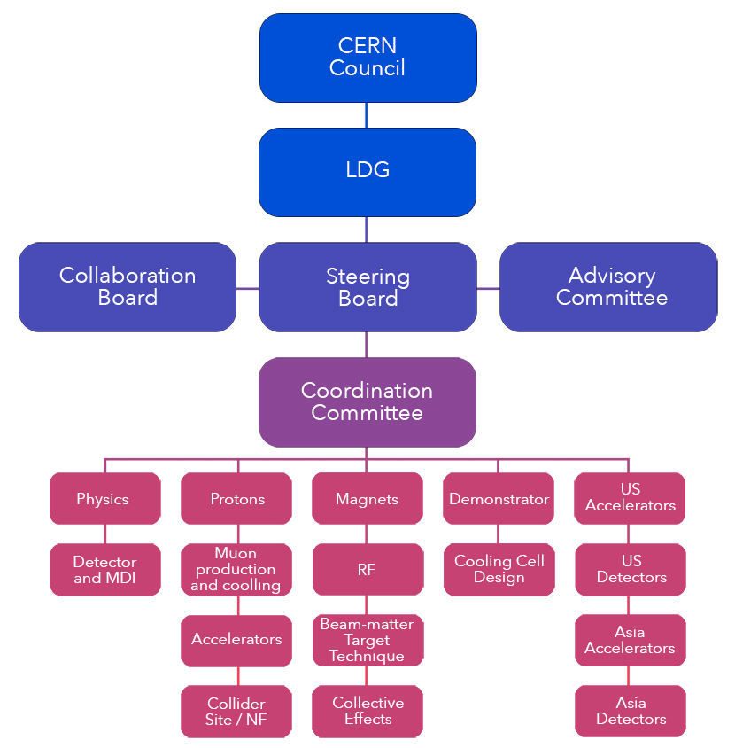
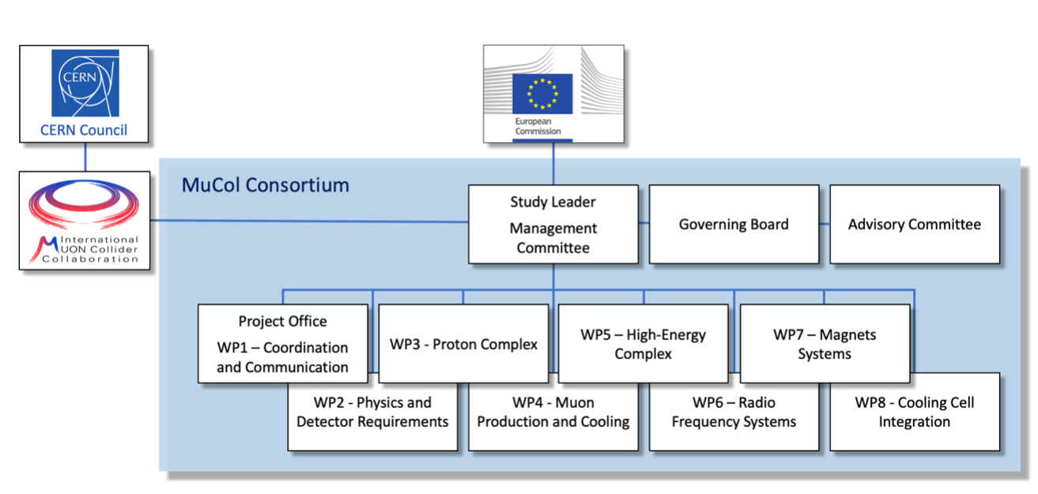

Project organization
International Muon Collider Collaboration
MuCol EU Design Study
The magnet work packages of IMCC and MuCol are in essence the same, with identical tasks and workplan.
Activities are followed-up mainly through the “muons magnets Working Group” (mmWG)

Slide 7
Muon Collider magnet “team”
CERN
INFN
CEA
CNRS
PSI
UniGE
SO’TON
uniTwente
INFN
CERN
UniMI
KIT
CERN
UniBO
TUDa
UniTwente
INFN
UniMI
CERN
TUT
CERN
F4E (Barcelona)
F4E (Garching)
RCS
Task 7.2
Task 7.3
Task 7.4

Slide 8
The plan
Activities have been defined, discussed and listed
Deliverables
  D7.1 – January 2026: Preliminary report on muon collider magnets
  D7.2 – January 2027: Consolidated report on muon collider complex magnets
Milestones
  M7.1 – March 2024: Report on solenoids and TPL experiments
  M7.2 – March 2025: Report on RCS and HCS configurations
  M7.3 – October 2025: Workshop on ultra-high-field solenoids
  M7.4 – December 2025: Report on HTS fast-cycled magnets
  M7.5 – January 2026: Report on high-field collider magnet design
  M7.6 – February 2026: Report on solenoid conceptual design
  M7.7 – September 2026: Workshop on high-field collider magnets
  M7.8 – November 2026: Report on footprint, power and cost model
  M7.9– November 2026: Report on R&D and impact

Slide 9
Logistics
Open presentation session
  Wednesday 21 June, 8:30-12:30
  Pierre Lehmann Auditorium - B. 200 - IJCLab Orsay
Panel closed session
  Wednesday 21 June, 14:00-17:30
  Salle Bleue - B. 200 - IJCLab Orsay
Report and discussion at mmWG, comments and outstanding questions
  Thursday 6 July, 15:00
  Virtual meeting
Open debrief at IMCC Design Meeting
  Monday TBD, 16:00
  Virtual meeting

