Slide 1
Technology options for the accelerator powering
F. Boattini D. Aguglia
21.June.23
1

Slide 2
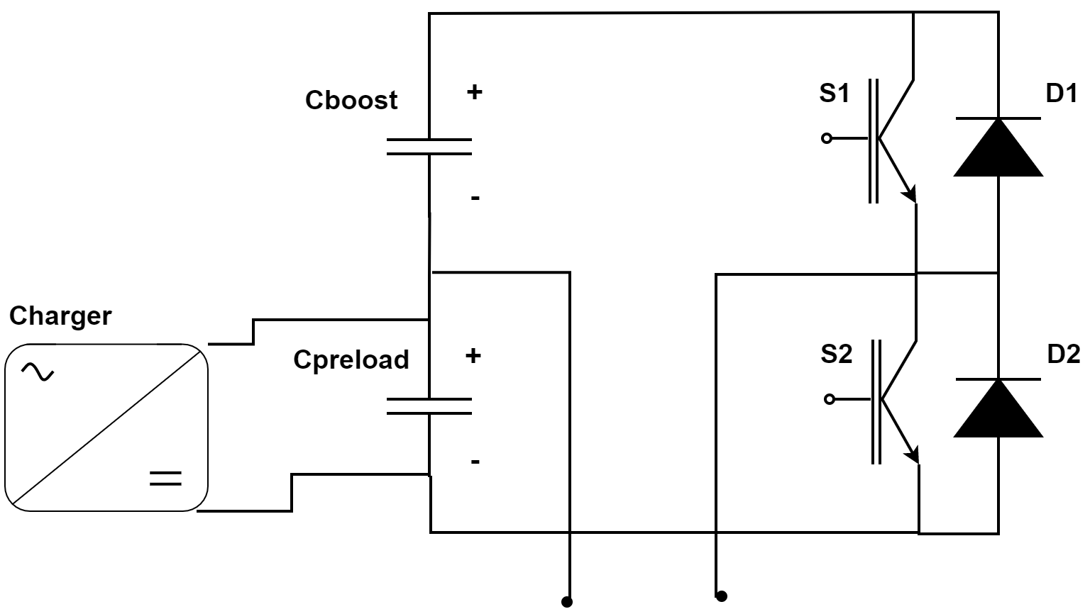
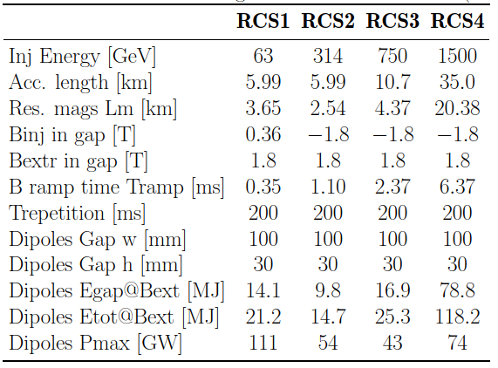
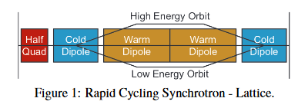
Critical systems and main- specifications
The powering system is very interlinked with the resistive magnets design
The key performance drivers are directly related to the total energy and power to be delivered to the magnets, but also to the tracking accuracy that will have to be guarantee.
This input should come from the beam studies

Slide 3
Evaluation of technology options
Technology | Pro’s | Con’s
Full Wave resonance powering scheme | Minimization of storage energy Power electronics based on thyristors. Example (with smaller power) available in the literature. | Low energy density in capacitor dimensioning Low versatility towards changing of the operating conditions. The control of the inter-sector tracking is more complicated. Higher saturation of magnet is in general required
Commutated resonance powering scheme | Unipolar only capacitor excitation. Higher energy density More versatile schema with possibility to modify the Bref shape within a range. No inductive energy store components are required | Important R&D for the development of an IGBT/IGCT based switching leg. Possibly higher losses on magnets (depending upon final layout)
Capacitor as storage elements | Very fast discharge and very high current peaks are possible, particularly in plastic capacitors | Particularly with voltage polarity reversal, the correct energy density is difficult to estimate.
Spatial harmonic distribution | Simpler pure sinusoidal discharge | Not clear how we should consider the integral field at different harmonics

Slide 4
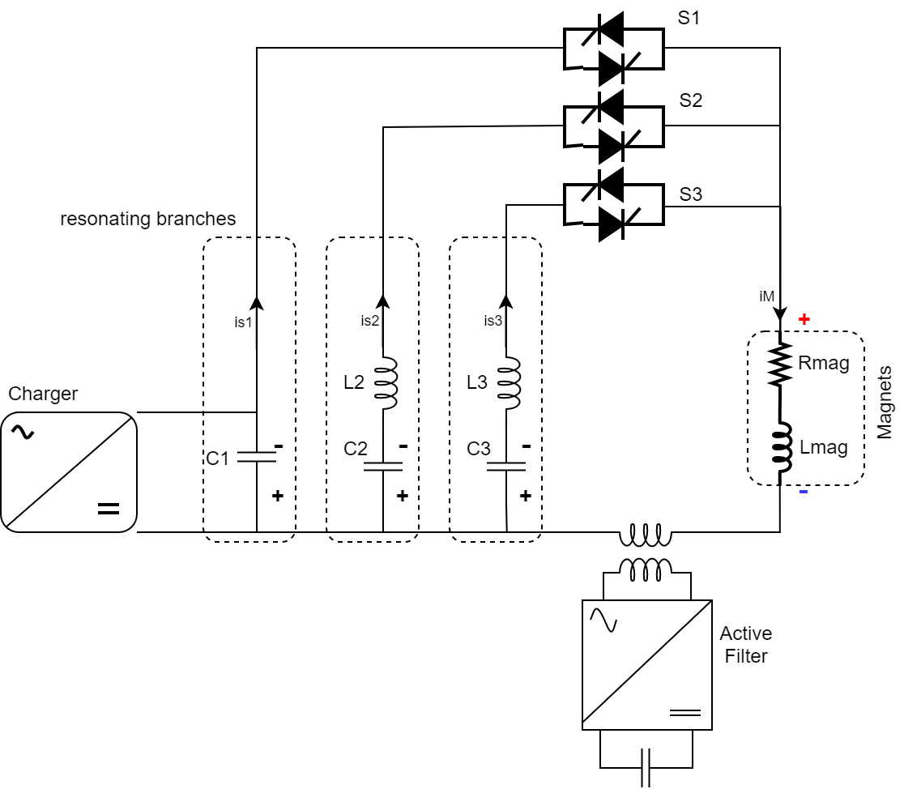
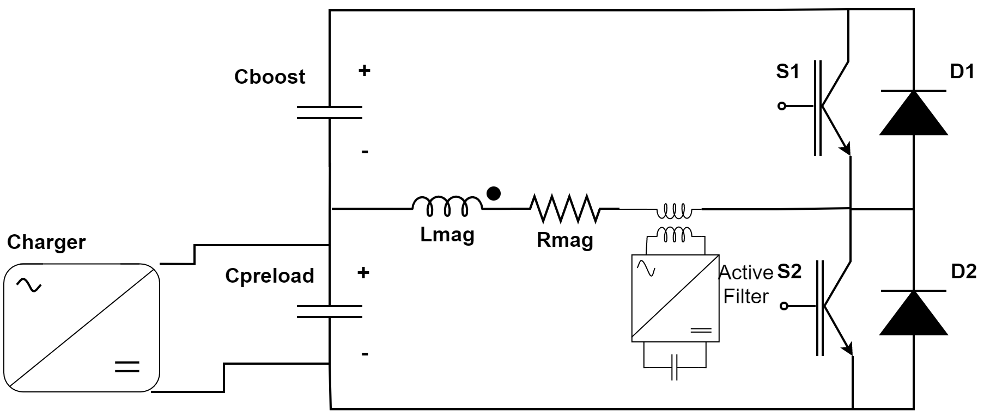
Selected options and priorities ranking
Presently both power schemes will be studied until the preliminary calculations will clearly reveal the best one in terms of cost and control capability;

Slide 5
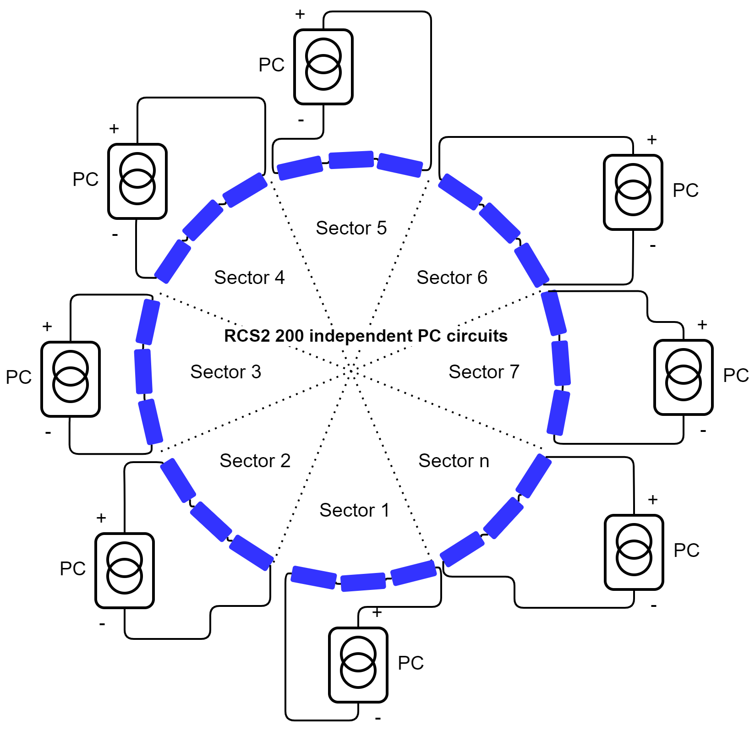
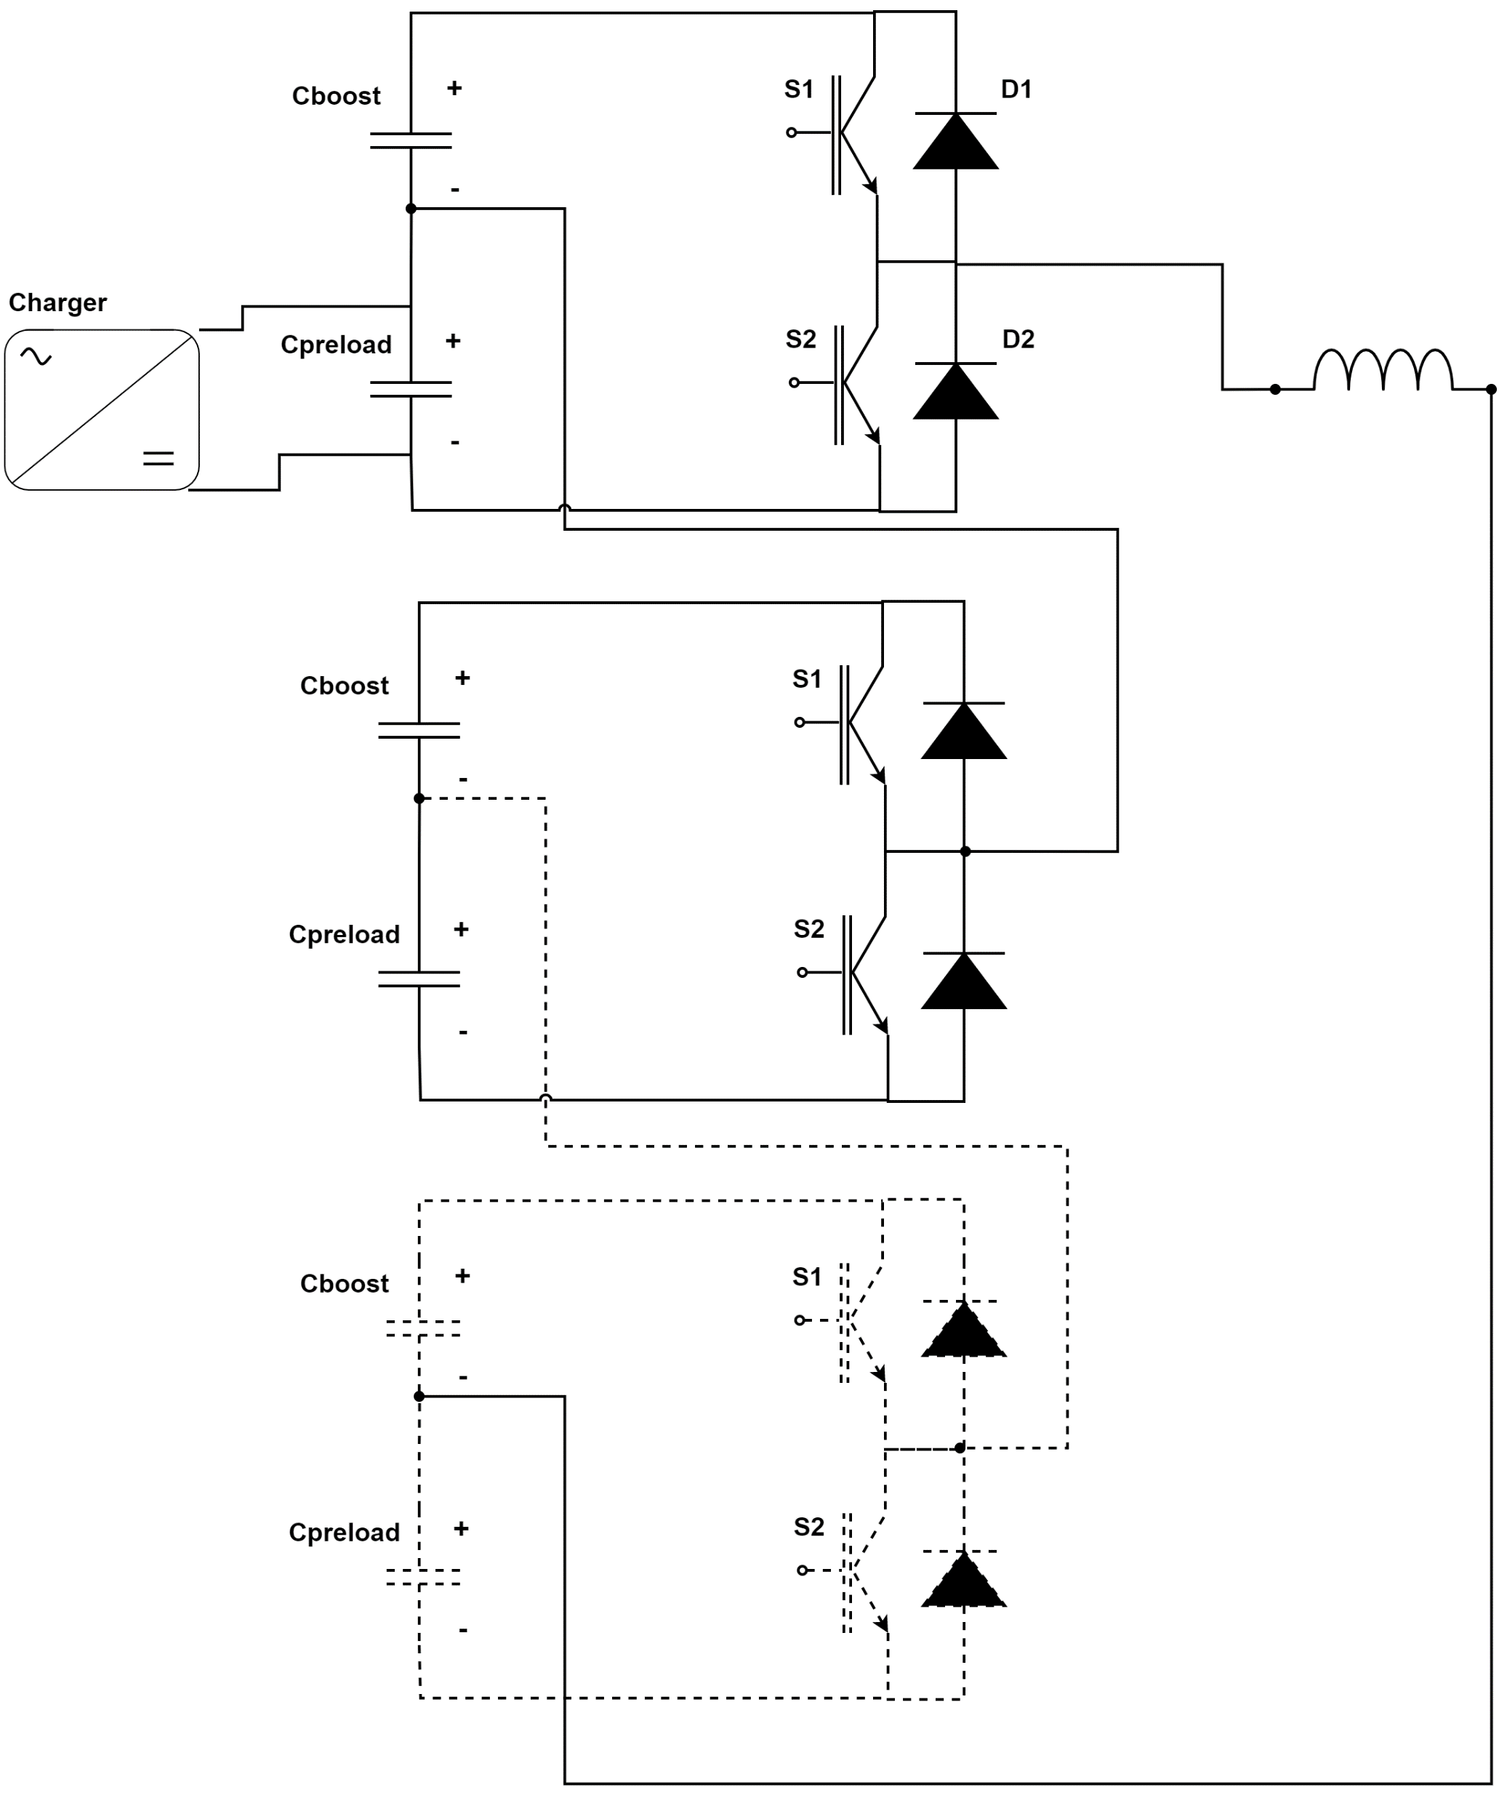
Selected options and priorities ranking
Presently both power schemes will be studied until the preliminary calculations will clearly reveal the best one in terms of cost and control capability;
Circuital simulation will be carried on to better frame the control problem.
To this goal it is of paramount importance to have an idea of the accuracy that will be required. This input should come form the physics studies.
i4
i5
i6
i3
i7
i2
in
i1

Slide 6
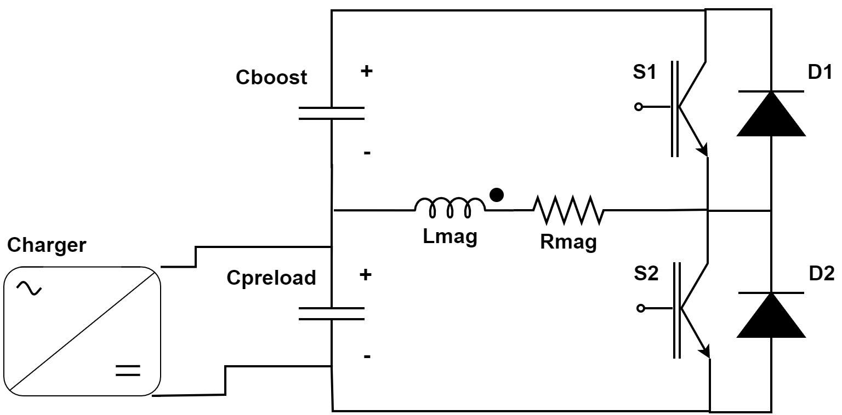
Selected options and priorities ranking
Presently both power schemes will be studied until the preliminary calculations will clearly reveal the best one in terms of cost and control capability;
Circuital simulation will be carried on to better frame the control problem.
To this goal it is of paramount importance to have an idea of the accuracy that will be required. This input should come form the physics studies.
Simplified magnet models for the calculation of the losses and the electric equivalents are under design. The use of machine learning techniques are under discussion as a mean to determine losses model of the magnets. Magnet models will be progressively employed in powering-magnets optimizators that will guide the final technical choices for both the systems.
Design of the IGCT/Thyristors switch shall proceed as the final power scheme layout becomes better defined

Slide 7
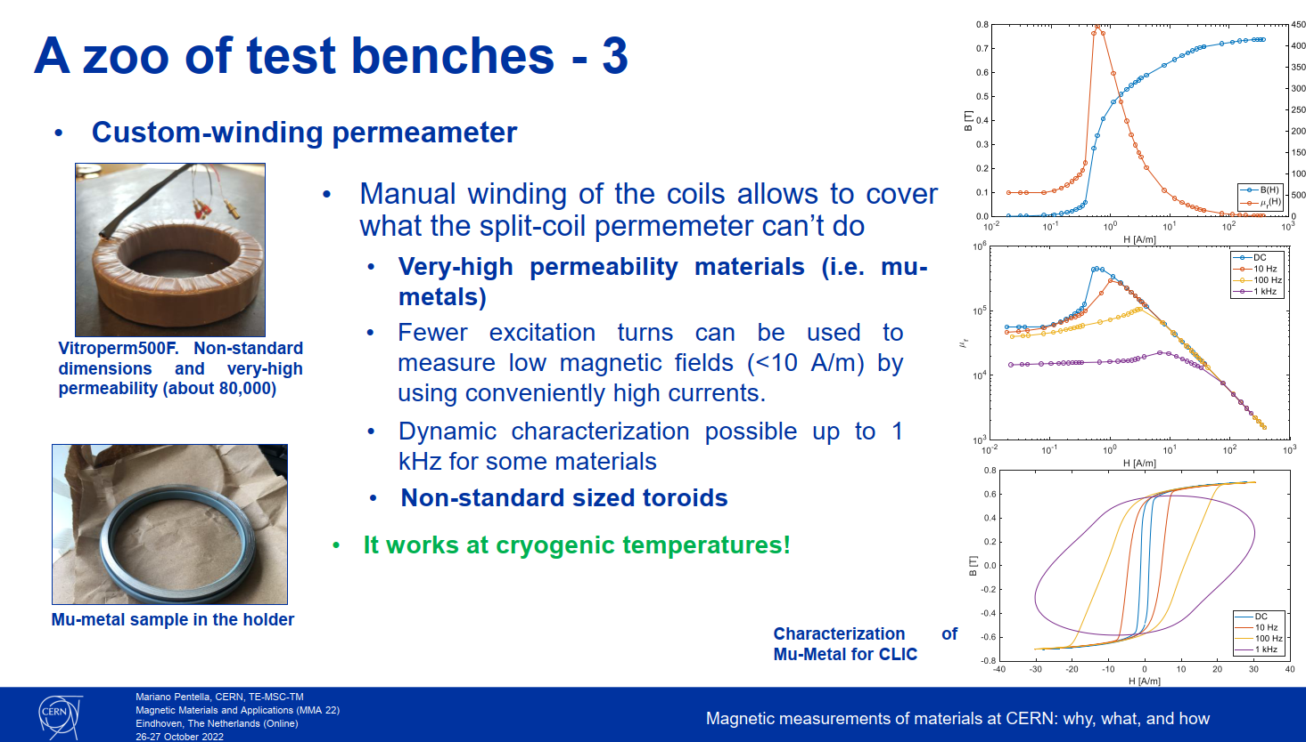
Selected options and priorities ranking
Presently both power schemes will be studied until the preliminary calculations will clearly reveal the best one in terms of cost and control capability;
Circuital simulation will be carried on to better frame the control problem.
To this goal it is of paramount importance to have an idea of the accuracy that will be required. This input should come form the physics studies.
Simplified magnet models for the calculation of the losses and the electric equivalents are under design. The use of machine learning techniques are under discussion as a mean to determine losses model of the magnets. Magnet models will be progressively employed in powering-magnets optimizators that will guide the final technical choices for both the systems.
Courtesy of Marco Buzio and his team
Design of the IGCT/Thyristors switch shall proceed as the final power scheme layout becomes better defined
In parallel to all above, magnetic material characterization tests should be organized. Methodology under discussion

Slide 8
Selected options and priorities ranking
Presently both power schemes will be studied until the preliminary calculations will clearly reveal the best one in terms of cost and control capability;
Circuital simulation will be carried on to better frame the control problem.
To this goal it is of paramount importance to have an idea of the accuracy that will be required. This input should come form the physics studies.
Simplified magnet models for the calculation of the losses and the electric equivalents are under design. The use of machine learning techniques are under discussion as a mean to determine losses model of the magnets. Magnet models will be progressively employed in powering-magnets optimizators that will guide the final technical choices for both the systems.
Design of the IGCT/Thyristors switch shall proceed as the final power scheme layout becomes better defined
In parallel to all above, magnetic material characterization tests should be organized. Methodology under discussion

Slide 9
Task3 working plan
Task3.1: Resistive magnets and power system
Optimal design of resistive dipoles and quadrupole with emphasis on minimization of energy content and losses. Basic effect of the vacuum chamber should be considered. Simplified analytical model will also developed to be used within the full optimization
  Who: (UNIBO: M. Breschi). When: first version January 2024; draft final version September 2025; final study results September 2026
Analysis of magnet optimized designs with 2D and 3D time dependent FEM simulations. These models will focus on most promising design options and address important calculations as losses, field quality, electrodynamic effects, saturation effects etc…
  Who (TUDa H. De Gersem). When: first version January 2024; draft final version September 2025; final study results September 2026
Integrated power system / magnets optimization to minimize the total power requirements / cost and land occupation (CERN, LNCMI). Evaluation of different powering concepts based on full wave and/or switched resonance.
  Who: F. Boattini (CERN), J. Beard (LNCMI). When: first version mid 2024; updated version mid 2025; final study results September 2026
Cost and power estimate
  Who: F. Boattini (CERN), M. Breschi (UNIBO), H. De Gersem (TUDa), L. Bottura (CERN), S. Fabbri (CERN), L. Quettier (CEA). When: draft version June 2025; final version June 2027
Testing of soft magnetic material at high frequency and high magnetic field. The study will help modelling the resistive magnets
  Who: The team is under formation

Slide 10
Task3 working plan
Task3.2: Superconducting magnets
Study suitable geometries and materials for fields in the hypothesis of magnetic fields in the range of 8…10T. Look at impact on accelerator layout (e.g. limiting maximum to 8 T), aperture and winding options (e.g. rectangular vs. round aperture). Basic 2D electromagnetic design
Who: L. Bottura (CERN), S. Fabbri (CERN), M.Breschi (UNIBO)
HTS option for fast pulsed dipoles. Scoping studies for dB/dt in the range of 300T/s and Bgap > 2T
Who: A. Kario, H. Ten Kate (TWENTE), FNAL cooperation
When: to be defined. Possibly for the next IMCC?

