Slide 1





IMCC Annual meeting
21 June 2023
From top level to RCS parameters
Antoine CHANCE (CEA) on behalf of the whole High-energy complex team with great help of magnet and RF colleagues

Slide 2
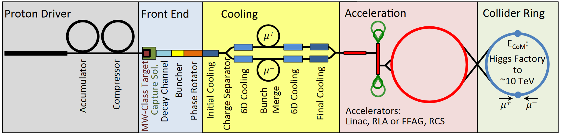
Reminder on design baselines
Base for the work is the US Muon Accelerator Program (MAP)
High energy complex consist of a chain of rapid cycling synchrotrons (RCS)
See Batsch’s presentation of Wednesday for more details on RCS parameters [here]
1 bunch per beam
Part of interest for us

Slide 3
Reminder on design baselines
Design oriented on reaching the performance parameter [webpage]
The relevant target parameters are: [presentation by D. Schulte]
Parameter | Unit | 3 TeV | 10 TeV
L | 10³⁴ cm⁻²s⁻¹ | 1.8 | 20
N | 10¹² | 2.2 | 1.8
f_{r} | Hz | 5 | 5
<B> (average) | T | 7 | 10.5
ε_{L} (norm, 1σ_{z}σ_{E}) | MeV m | 7.5 | 7.5
σ_{E} / E | % | 0.1 | 0.1
σ_{z} | mm | 5 | 1.5
Repetition rate of 5 Hz
→ RCS

Slide 4
Top level requirements for the high energy complex (RCS)
Goal: Accelerate one single bunch beam of µ+/µ-
  with a charge of about 2e12 muons/bunch.
  with a repetition frequency of 5 Hz.
  from about 60 GeV to 5 TeV.
Figure of merit:
  Fast acceleration (the muons decay).
  Feasible (if possible ;-)).
  Cost efficient (should be cheaper than a 100-km-long linac).
  Power efficient (do not use a nuclear plant to power the RCS!).

Slide 5
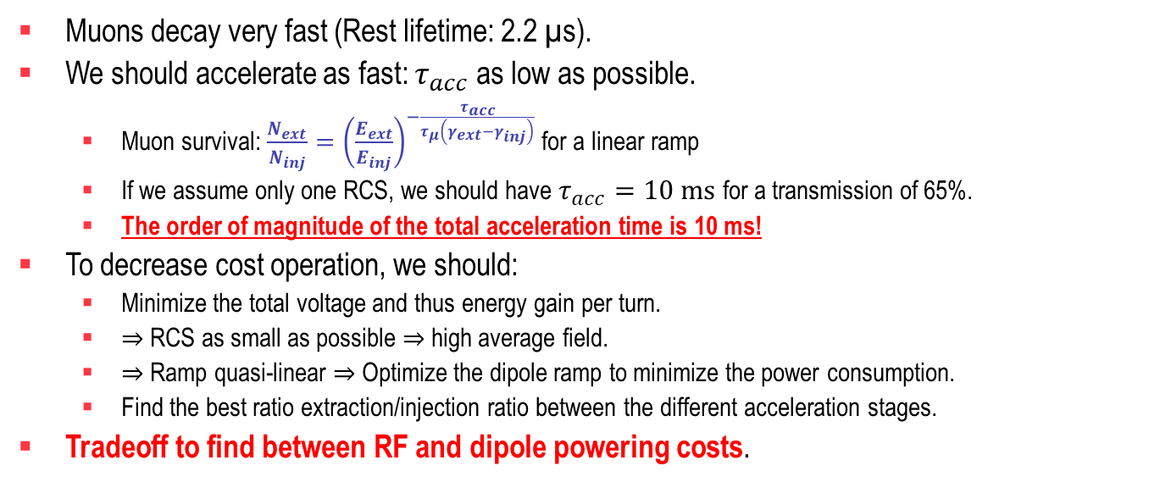
How fast?
Muons decay very fast (Rest lifetime: 2.2 µs).
We should accelerate as fast: $τ_{acc}$ as low as possible.
  Muon survival: $\frac{N_{ext}}{N_{inj}}={\left(\frac{E_{ext}}{E_{inj}}\right)}^{−\frac{τ_{acc}}{τ_{μ}\left(γ_{ext}−γ_{inj}\right)}}$ for a linear ramp
  If we assume only one RCS, we should have $τ_{acc}=10 \text{ms}$ for a transmission of 65%.
  The order of magnitude of the total acceleration time is 10 ms!
To decrease cost operation, we should:
  Minimize the total voltage and thus energy gain per turn.
  $⇒$RCS as small as possible $⇒$high average field.
  $⇒$Ramp quasi-linear $⇒$Optimize the dipole ramp to minimize the power consumption.
  Find the best ratio extraction/injection ratio between the different acceleration stages.
Tradeoff to find between RF and dipole powering costs.

Slide 6
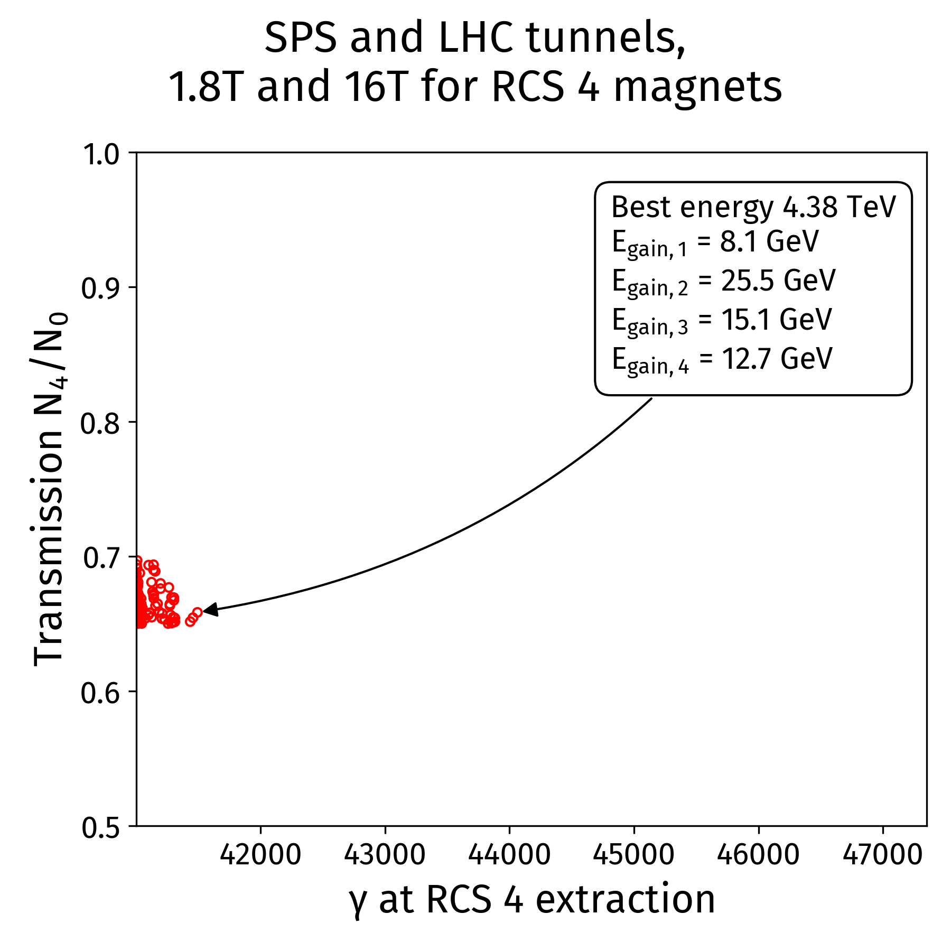
What energy swing?
First test of Genetic Algorithms for accelerator parameters optimization
Example: try to fit the RCS 4 in the LHC tunnel (27 km), the RCS 1 and RCS 2 in the SPS tunnel (7 km)
  With stronger field magnets (16 T for the SC and 2.0 T for NC magnets)
  Preserving the beam transmission through the chain
Reach 4.4 TeV per beam after rough optimization
Similar values reached by F. Batsch with parametric study
Courtesy: David Amorim

Slide 7
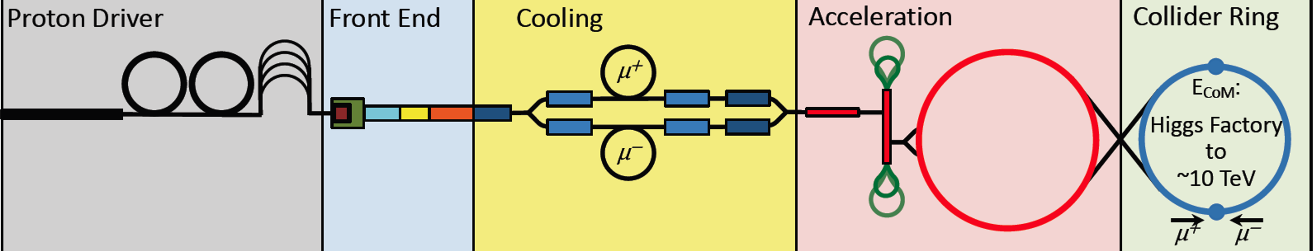
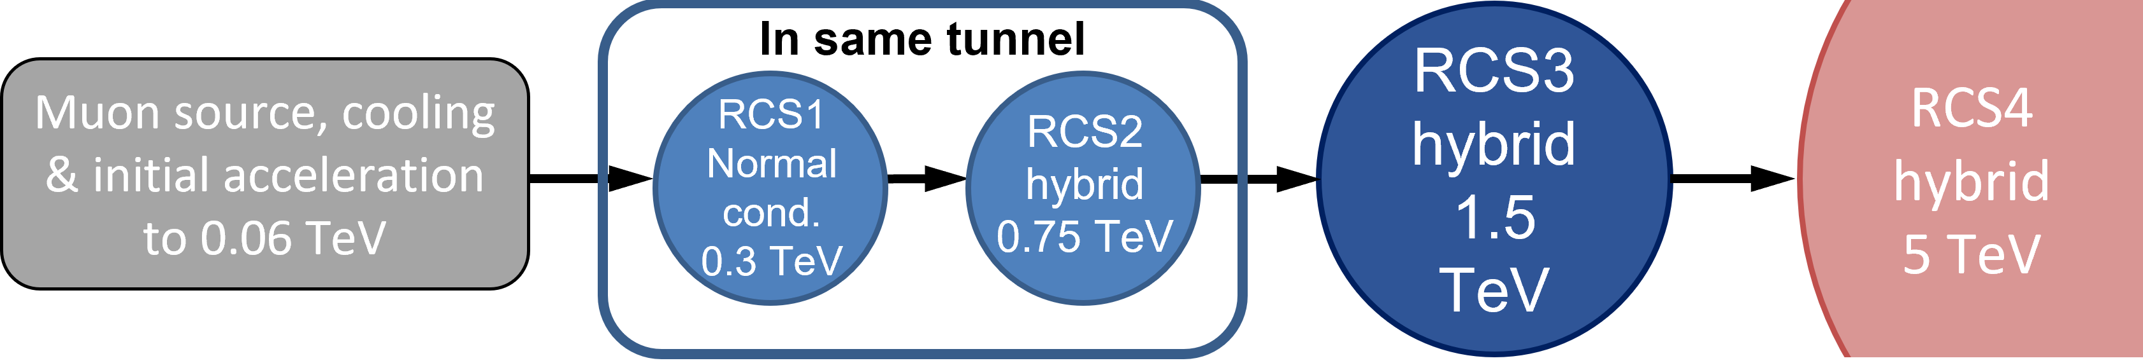
What energy swing?
Chain of rapid cycling synchrotrons, counter-rotating m+/m- beams
→ 60 GeV → 314 GeV → 750 GeV → 1.5 TeV → 5 TeV
Hybrid RCSs have interleaved normal conducting (NC) and superconducting (SC) magnets.
This would be the first hybrid RCSs in the world!

Slide 8
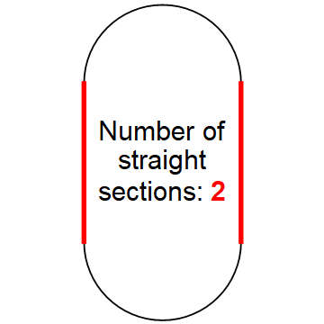
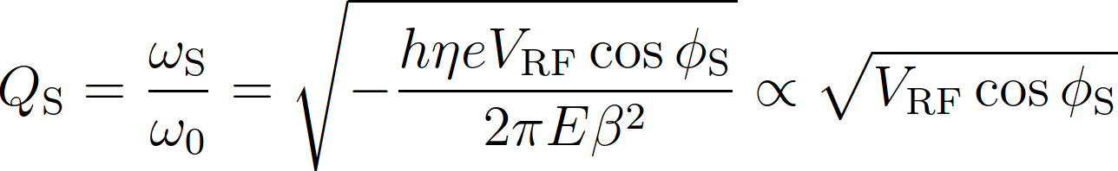
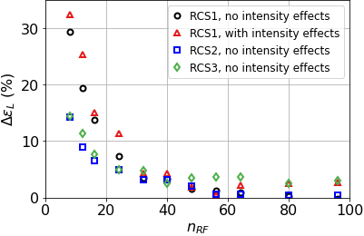
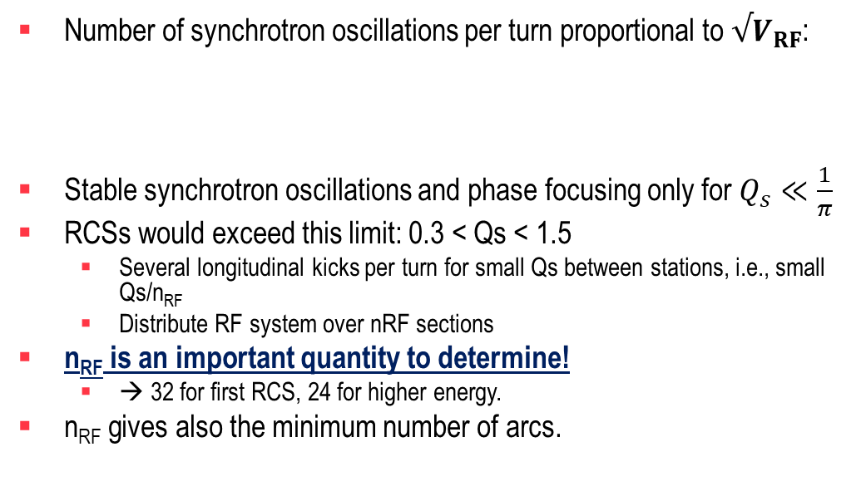
What RCS shape?
Courtesy: F. Batsch
Number of synchrotron oscillations per turn proportional to $√V_{RF}$:
Stable synchrotron oscillations and phase focusing only for $Q_{s}≪\frac{1}{π}$
RCSs would exceed this limit: 0.3 < Qs < 1.5
  Several longitudinal kicks per turn for small Qs between stations, i.e., small Qs/n_{RF}
  Distribute RF system over nRF sections
n_{RF} is an important quantity to determine!
  → 32 for first RCS, 24 for higher energy.
n_{RF} gives also the minimum number of arcs.
?
LHC: Q_{s}=0.005
(T. Suzuki, KEK Report 96-10)
8

Slide 9
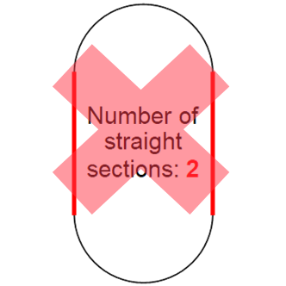
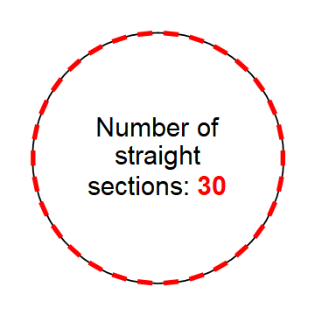
What RCS shape?
Courtesy: F. Batsch
Number of synchrotron oscillations per turn proportional to $√V_{RF}$:
Stable synchrotron oscillations and phase focusing only for $Q_{s}≪\frac{1}{π}$
RCSs would exceed this limit: 0.3 < Qs < 1.5
  Several longitudinal kicks per turn for small Qs between stations, i.e., small Qs/n_{RF}
  Distribute RF system over nRF sections
n_{RF} is an important quantity to determine!
  → 32 for first RCS, 24 for higher energy.
n_{RF} gives also the minimum number of arcs.
LHC: Q_{s}=0.005
32 for first RCS
24 for higher energy.
(T. Suzuki, KEK Report 96-10)
9

Slide 10
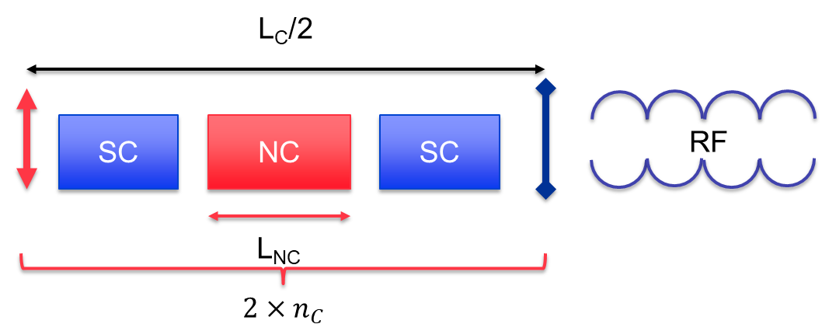
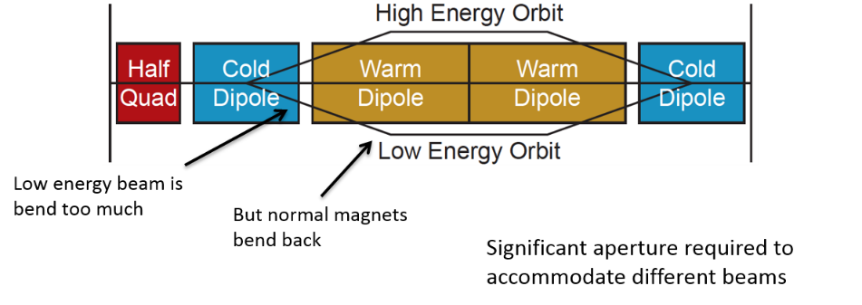
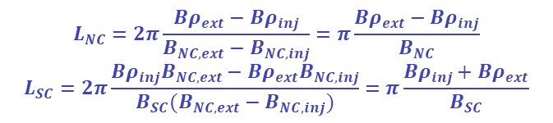
What RCS pattern?
We assume an RCS made of FODO cells with phase advances of 90°.
The number of cells has been optimized to maximize the arc filling ratio.
How many cells n_{c}? How many dipoles per cell? Which field?
$$L_{NC}=2π\frac{Bρ_{ext}−Bρ_{inj}}{B_{NC,ext}−B_{NC,inj}}=π\frac{Bρ_{ext}−Bρ_{inj}}{B_{NC}}$$
$$L_{SC}=2π\frac{Bρ_{inj}B_{NC,ext}−Bρ_{ext}B_{NC,inj}}{B_{SC}(B_{NC,ext}−B_{NC,inj})}=π\frac{Bρ_{inj}+Bρ_{ext}}{B_{SC}}$$

Slide 11
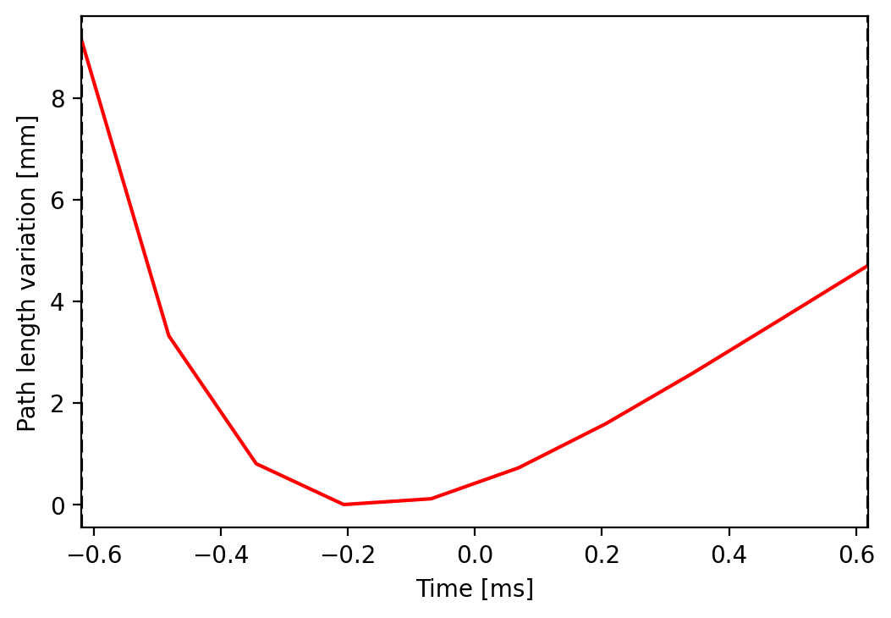
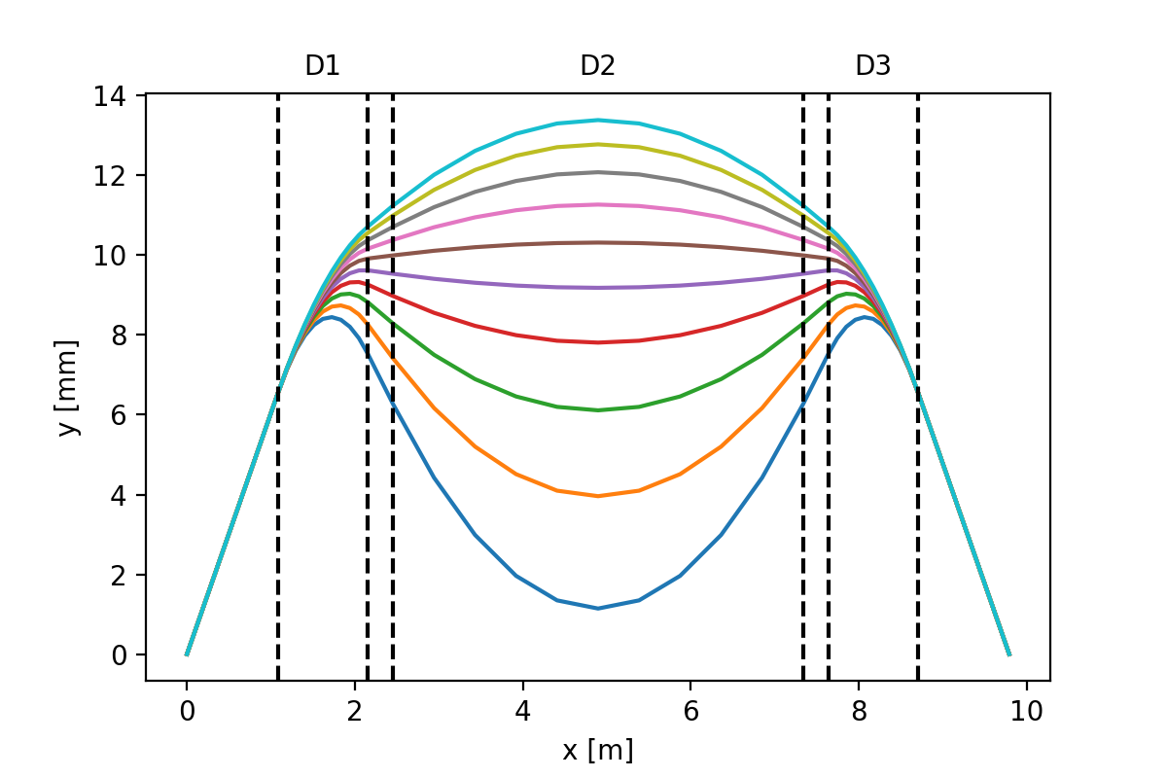
Trajectory variation in a hybrid RCS?
In a hybrid RCS, the path length is not constant.
f_{RF} tuning to be provided
What frequency range and tuning speed?
Δf/f = Δl/(2πR) ≈ 1.52 ∙ 10⁻⁶
→ Δf ≈ 2 kHz → dΔf/dt ≈ 10 MHz/s
Driver for the tuner technology change.
RCS2
From injection to extraction the trajectory goes from the inner side to the outer side.
The trajectory difference goes up to more than 13 mm.
Should be taken into account for field quality definition.
RCS2

Slide 12
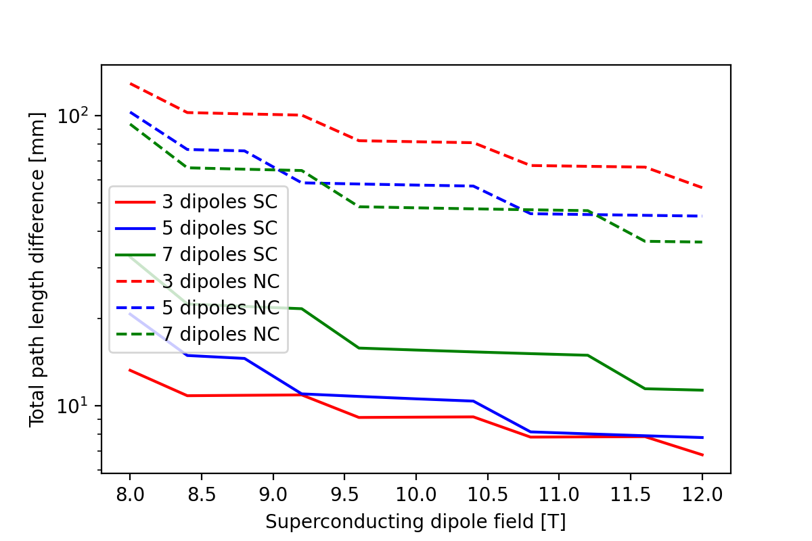
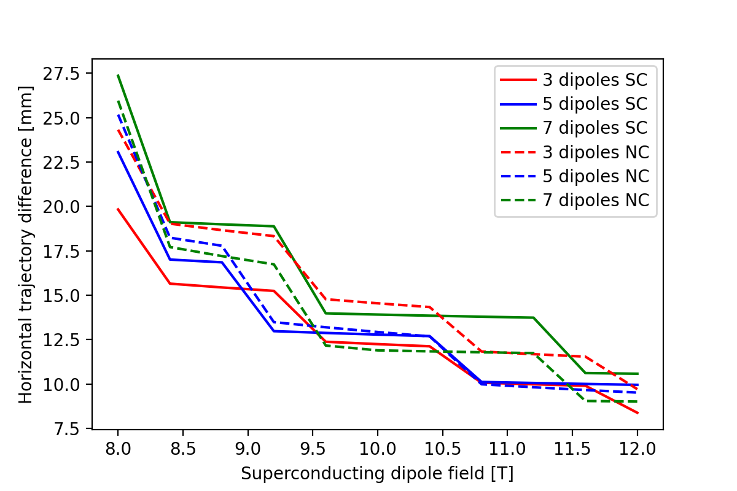
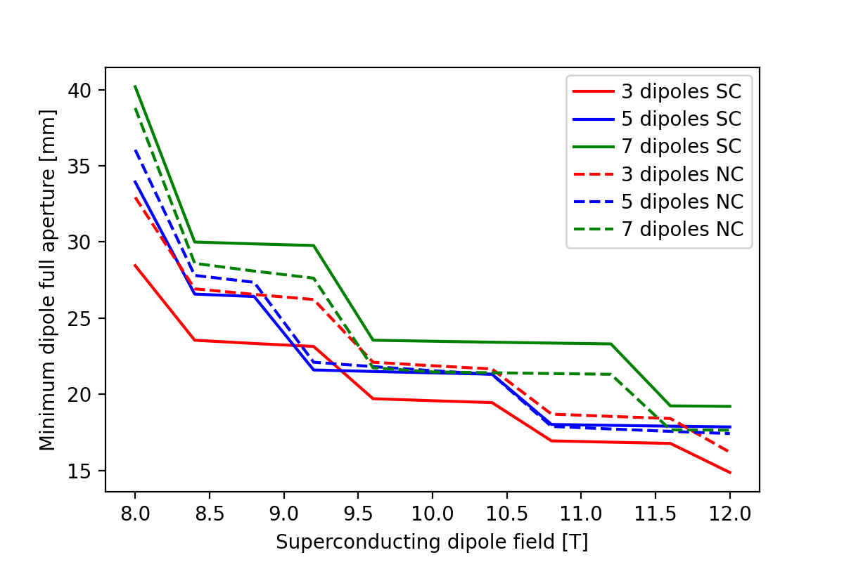
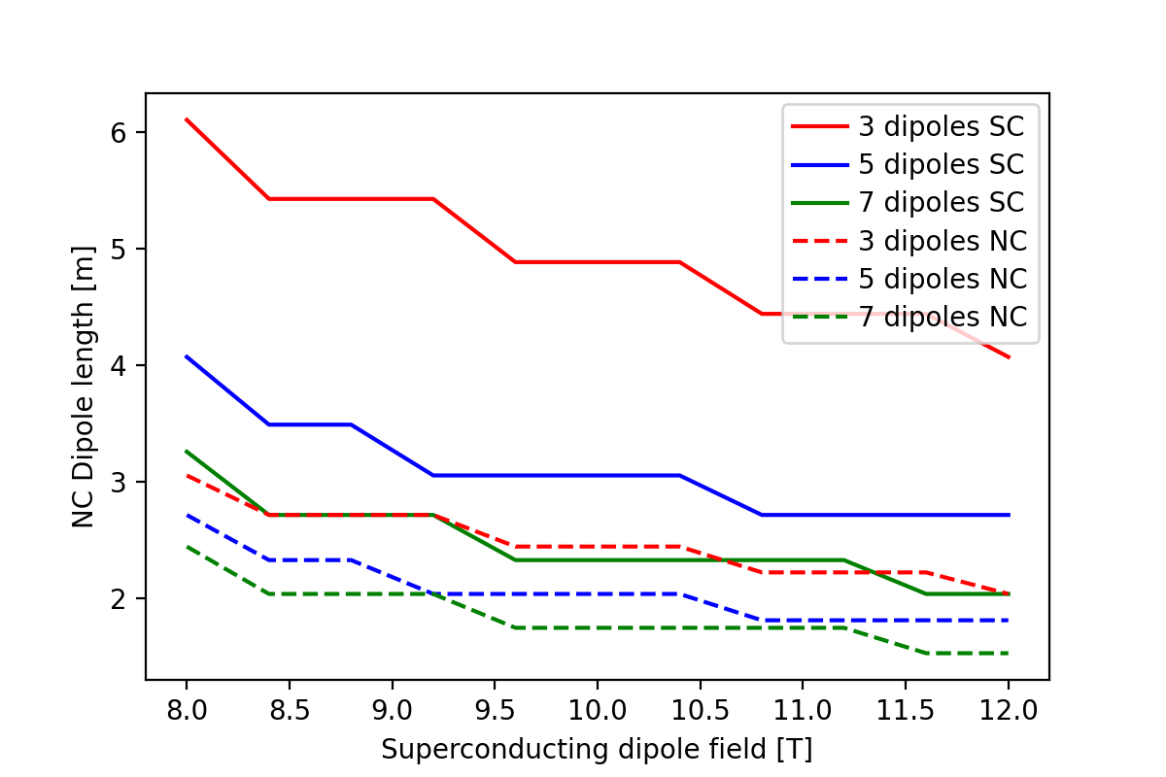
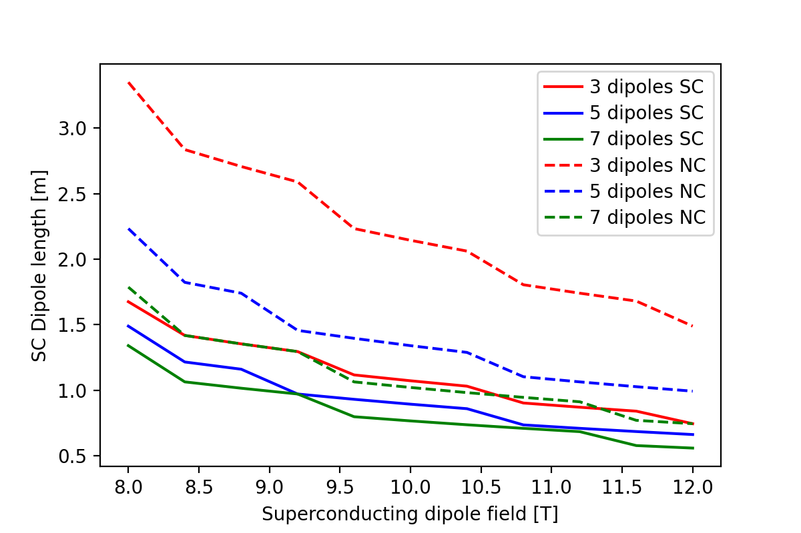
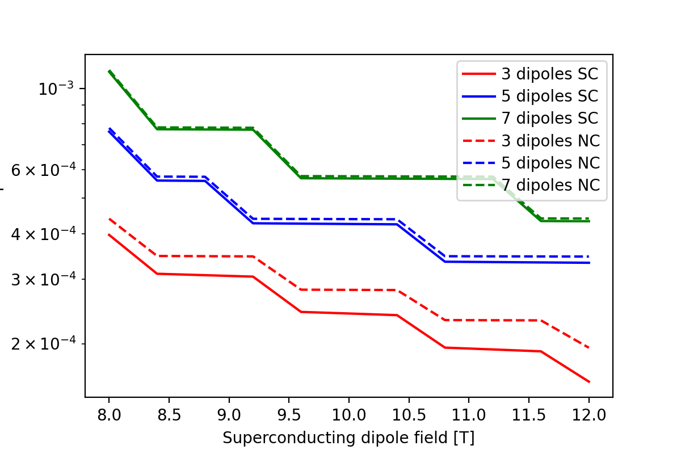
What SC dipole field?

Slide 13
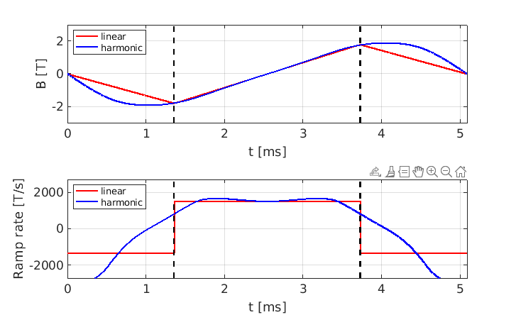
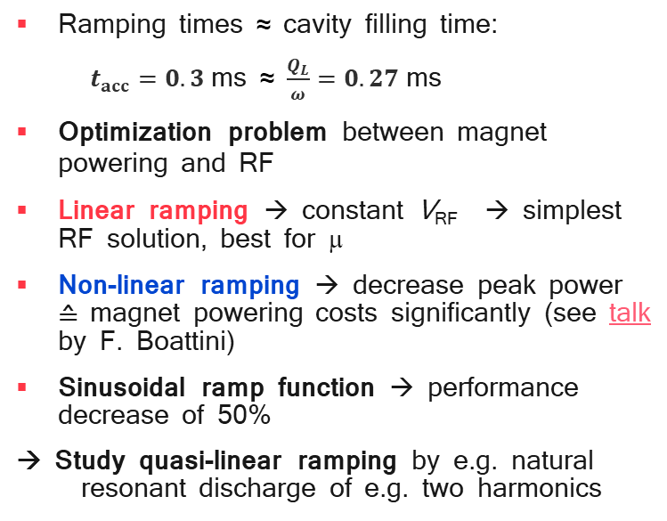
Fast ramping considerations
Courtesy: F. Batsch
Ramping times ≈ cavity filling time:
$t_{acc}=0.3$ms ≈ $\frac{Q_{L}}{ω}=0.27$ms
Optimization problem between magnet powering and RF
Linear ramping → constant V_{RF} → simplest RF solution, best for μ
Non-linear ramping → decrease peak power ≙ magnet powering costs significantly (see talk by F. Boattini)
Sinusoidal ramp function → performance decrease of 50%
→ Study quasi-linear ramping by e.g. natural resonant discharge of e.g. two harmonics
Function from F. Boattini
Example for RCS3
Injection
Ejection
22 June 2023
13
13

Slide 14
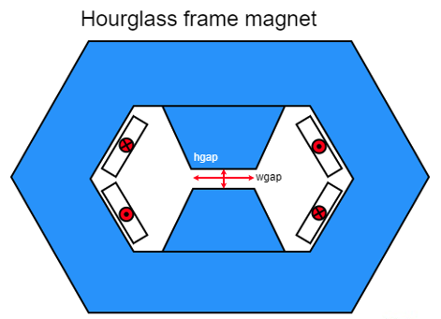
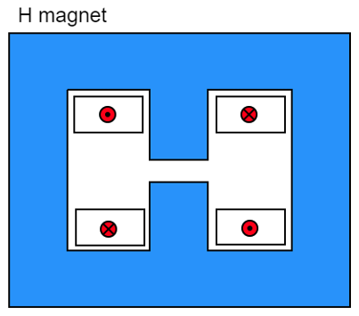
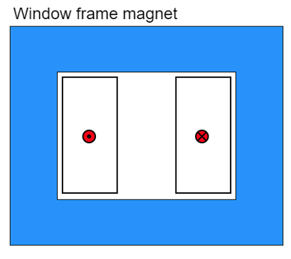
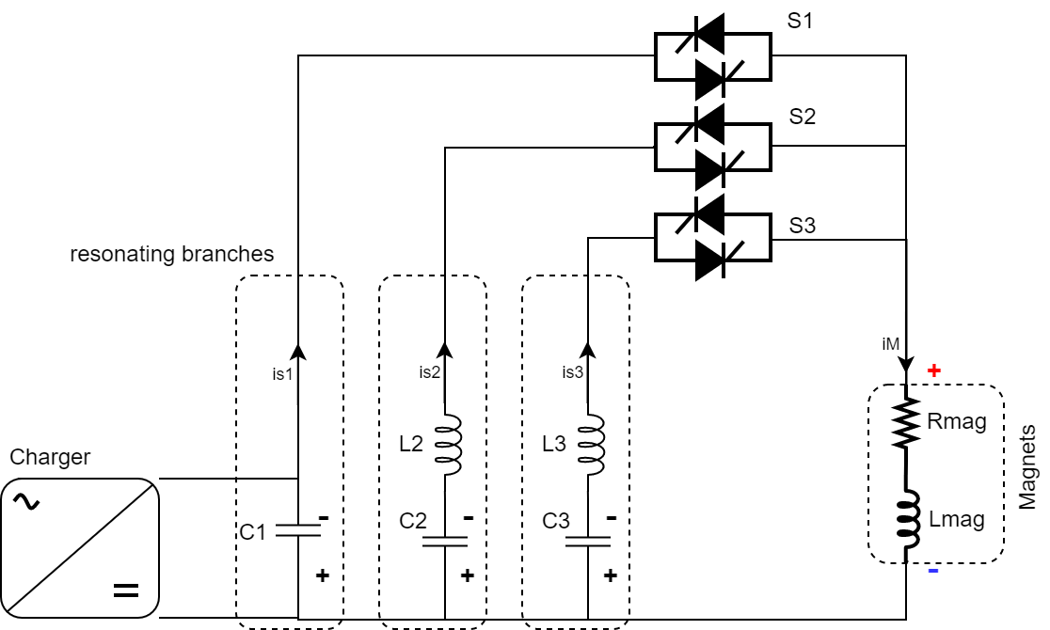
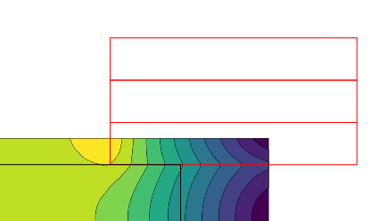
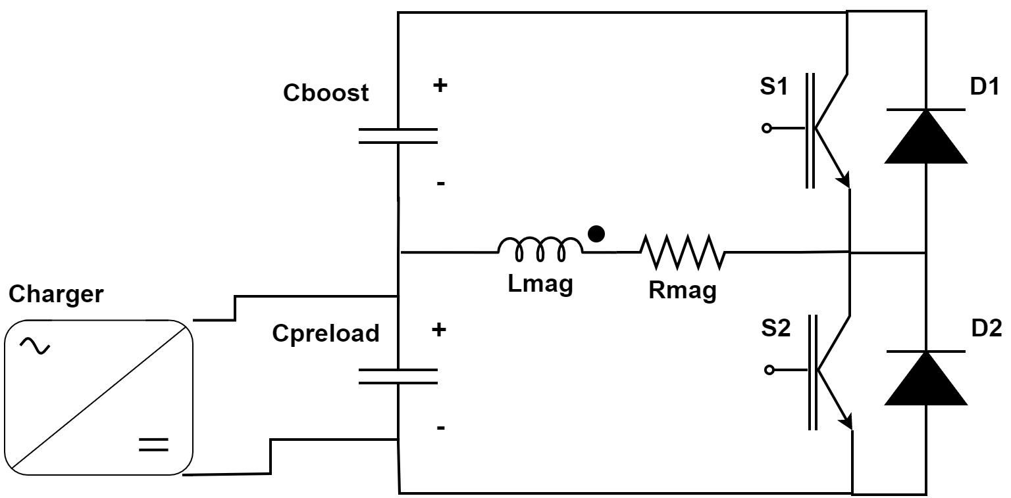
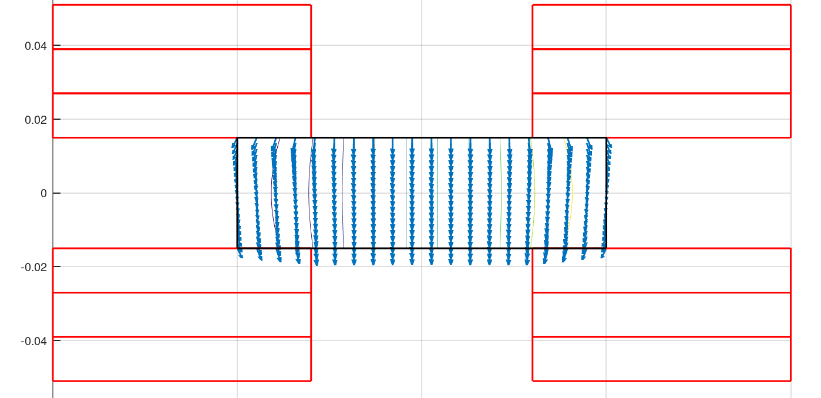
Which Fast-ramping Magnets?
F. Boattini et al.
Differerent power converter options investigated
Full wave resonance
5.07 kJ/m
5.65…7.14 kJ/m
5.89 kJ/m
Main challenge is management of the power in the resistive dipoles (several tens of GW):
Minimum stored magnetic energy
Highly efficient energy storage and recovery
Commutated resonance (new)
Simple HTS racetrack dipole could match the beam requirements and aperture
HTS flat racetracks
b3 = -7.2 units
b5 = -1.4 units
b7 = -0.03 units
peak field
10.4 T
Rectangular magnet bore 100 mm x 30 mm

Slide 15
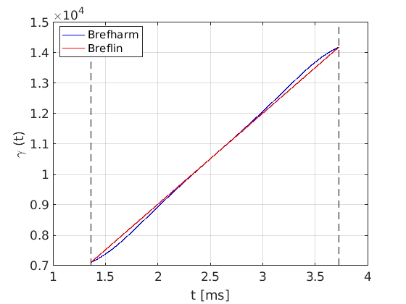
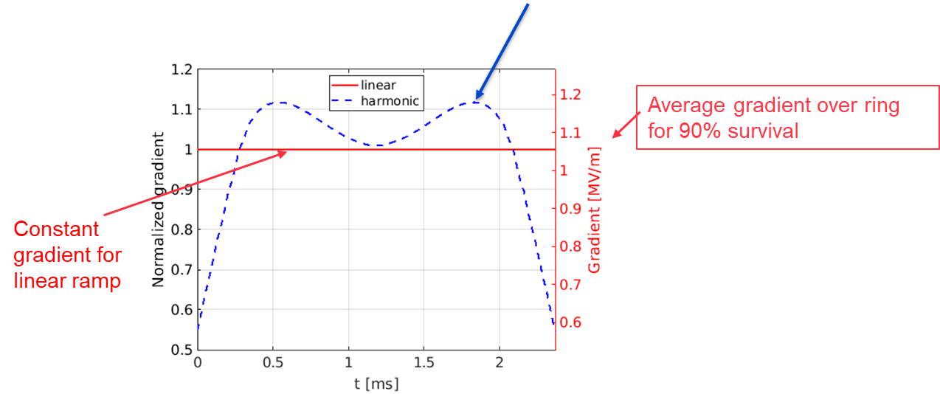
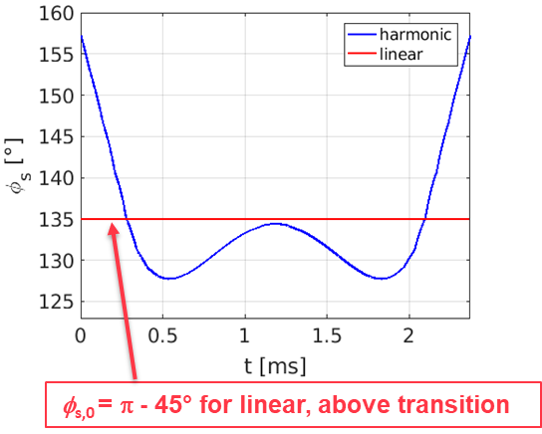

RF requirements ?
Courtesy: F. Batsch
V_{acc} and G_{acc} must be increased by 12% to achieve the same $τ_{acc}$ ⇔ ≠ 200% as for a sine-like ramp!
Powering and ramping function optimization ongoing, combined with synchronous phase and RF voltage optimization (see talk by F. Batsch and talk by F. Boattini).
Example for RCS3

Slide 16
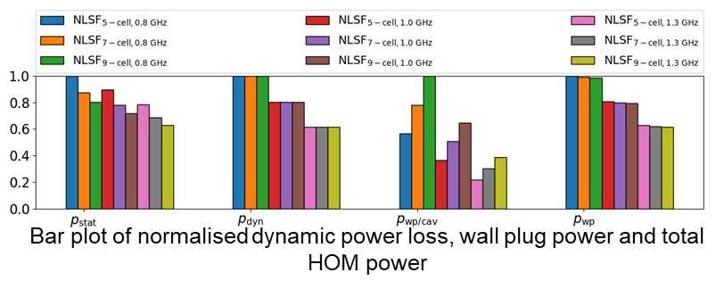
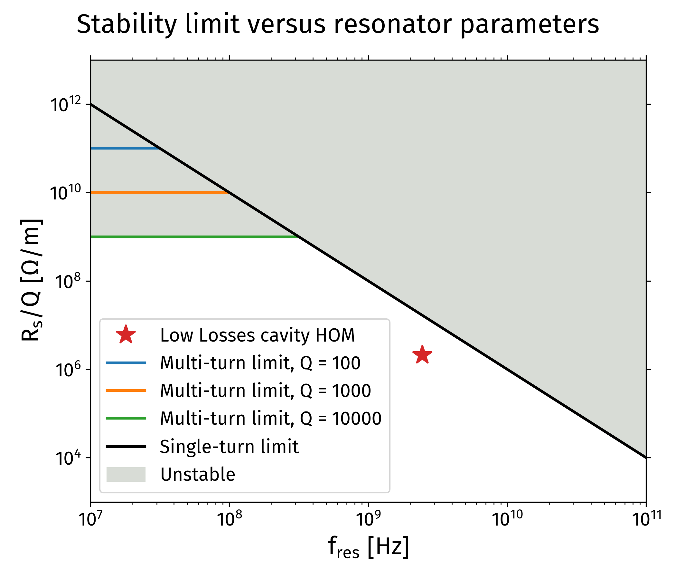
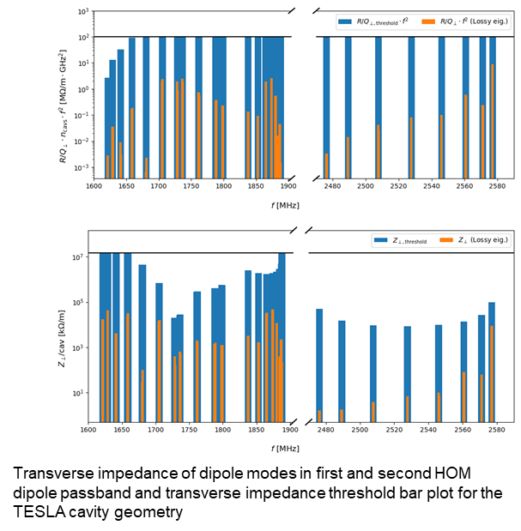
Which RF impedance?
Which RF structure and frequency?
Calculations performed WITH NO transverse offset.
Courtesy: Sosoho-Abasi Udongwo
Courtesy: David Amorim

Slide 17
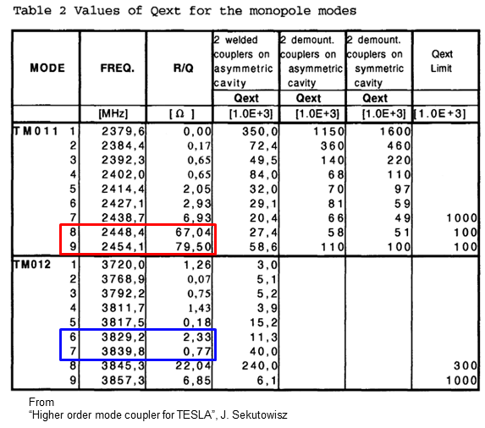
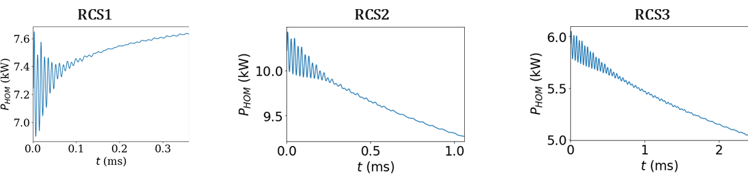
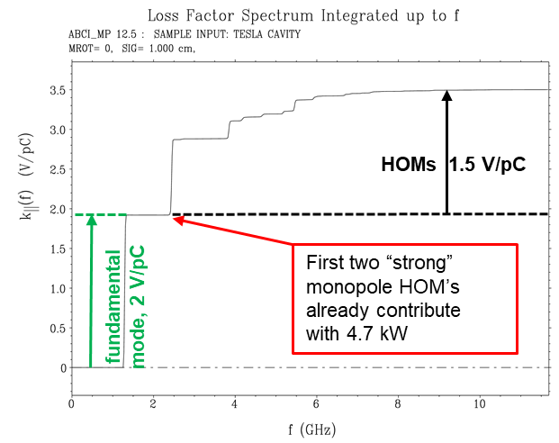
HOM power?
Example: Calculations performed for TESLA Low-loss
(ABCI file from S.-A. Udongwo)
Beam-induced power losses
Courtesy: Fabian Batsch

Slide 18
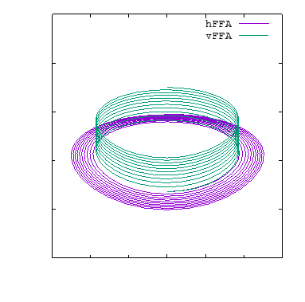
FFA as Alternatives?
Courtesy: Max Topp-Mugglestone
Why FFAs?
  Time-independent magnetic fields
  No ramp times
  Rate of acceleration limited only by RF
  Mitigates engineering challenges of designing and powering fast-ramping dipoles
  All magnets can be superconducting DC magnets
  At high energy, pulsed synchrotrons limited by the maximum field in pulsed magnets.
Limited understanding of optics
  Unique coupling behaviour
    Dominated by skew quadrupole focussing
    Solenoid components in fringe fields
  Nonplanar orbits
Challenging optimization: update foreseen end 2023.
See Scott Berg’s presentation [here]

Slide 19
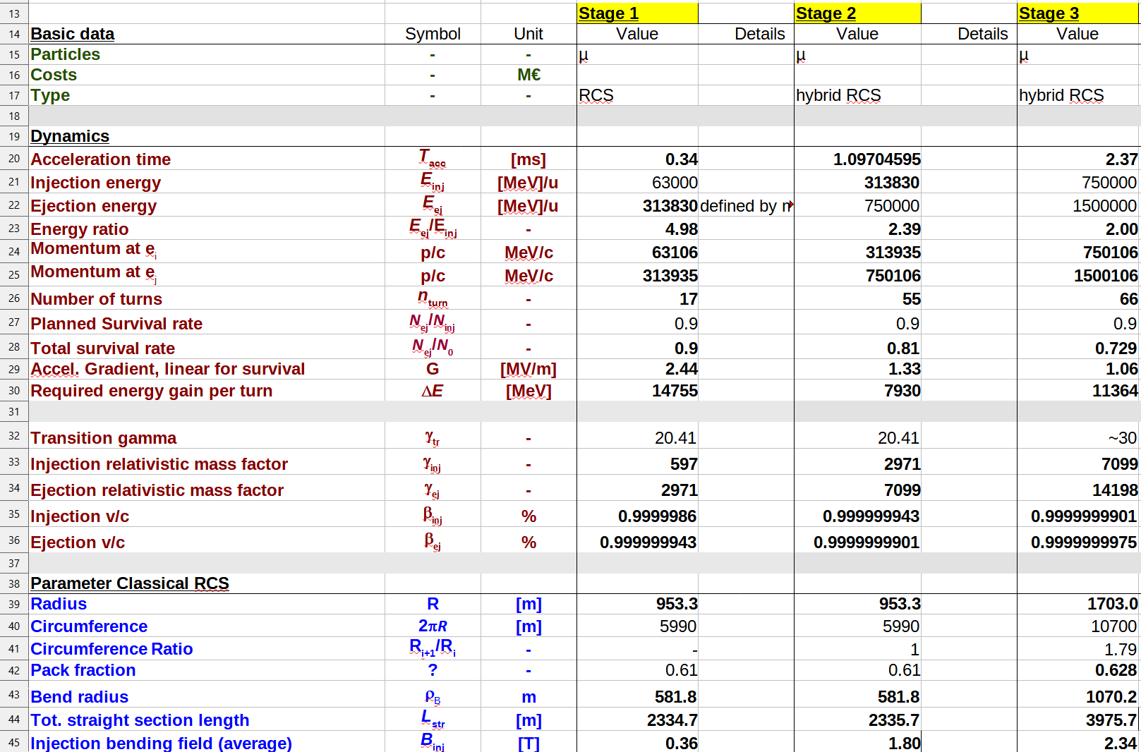
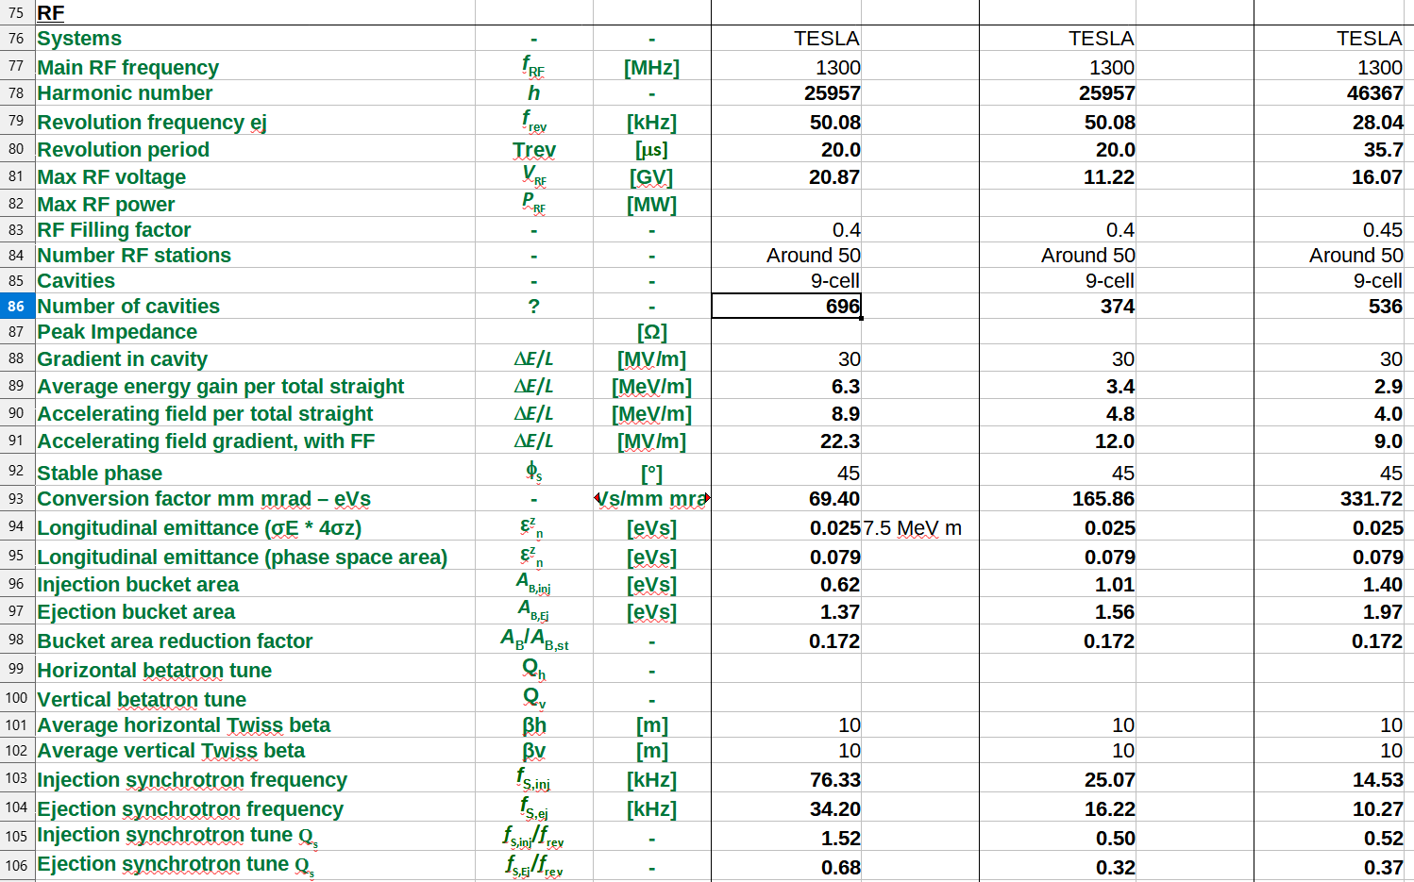
Parameters and tools.
Table under constant evolution.
Detailed parameter table: [link]
 | RCS1→314 GeV | RCS2→750GeV | RCS3→1.5TeV
Circumference, 2πR [m] | 5990 | 5590 | 10700
Energy factor, E_{ej}/E_{inj} | 5.0 | 2.4 | 2.0
Repetition rate, f_{rep} [Hz] | 5 (asym.) | 5 (asym.) | 5 (asym.)
Number of bunches | 1μ⁺, 1μ⁻ | 1μ⁺, 1μ⁻ | 1μ⁺, 1μ⁻
Bunch population | >2.5E12 | >2.3E12 | 2.2E12
Survival rate per ring | 90% | 90% | 90%
Acceleration time, t_{acc} [ms] | 0.34 | 1.04 | 2.37
Number of turns | 17 | 55 | 66
Energy gain per turn, ΔE [GeV] | 14.8 | 7.9 | 11.4
Acc. gradient for survival [MV/m] | 2.4 | 1.3 | 1.1
Acc. field in RF cavity [MV/m] | 30 (45 optimistically) | 30 | 30

Slide 20
Parameters and tools:
Table under constant evolution.
Detailed parameter table: [link]
 | RCS1→314 GeV | RCS2→750GeV | RCS3→1.5TeV
Circumference, 2πR [m] | 5990 | 5590 | 10700
Energy factor, E_{ej}/E_{inj} | 5.0 | 2.4 | 2.0
Repetition rate, f_{rep} [Hz] | 5 (asym.) | 5 (asym.) | 5 (asym.)
Number of bunches | 1μ⁺, 1μ⁻ | 1μ⁺, 1μ⁻ | 1μ⁺, 1μ⁻
Bunch population | >2.5E12 | >2.3E12 | 2.2E12
Survival rate per ring | 90% | 90% | 90%
Acceleration time, t_{acc} [ms] | 0.34 | 1.04 | 2.37
Number of turns | 17 | 55 | 66
Energy gain per turn, ΔE [GeV] | 14.8 | 7.9 | 11.4
Acc. gradient for survival [MV/m] | 2.4 | 1.3 | 1.1
Acc. field in RF cavity [MV/m] | 30 (45 optimistically) | 30 | 30
High ${ΔE=V}_{RF}⋅cos(φ_{s})$ → Unique RF requirements such as high synchrotron tune

Slide 21
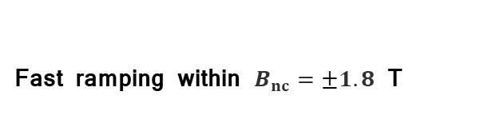
Parameters and tools:
Table under constant evolution.
Detailed parameter table: [link]
 | RCS1→314 GeV | RCS2→750GeV | RCS3→1.5TeV
Circumference, 2πR [m] | 5990 | 5590 | 10700
Energy factor, E_{ej}/E_{inj} | 5.0 | 2.4 | 2.0
Repetition rate, f_{rep} [Hz] | 5 (asym.) | 5 (asym.) | 5 (asym.)
Number of bunches | 1μ⁺, 1μ⁻ | 1μ⁺, 1μ⁻ | 1μ⁺, 1μ⁻
Bunch population | >2.5E12 | >2.3E12 | 2.2E12
Survival rate per ring | 90% | 90% | 90%
Acceleration time [ms] | 0.34 | 1.04 | 2.37
Number of turns | 17 | 55 | 66
Energy gain per turn, ΔE [GeV] | 14.8 | 7.9 | 11.4
Acc. gradient for survival [MV/m] | 2.4 | 1.3 | 1.1
Acc. field in RF cavity [MV/m] | 30 (45 optimistically) | 30 | 30
Ramp rate, Ḃ_{nc} [T/s] | 4199 | 3281 | 1518
Fast ramping within $B_{nc}=±1.8$ T

Slide 22
A lot of fruitful discussions
What ramping is optimum?
  Magnet people: Linear ramp needs a lot of power. Quasi-linear ramp for consumption minimization.
  RF people: going away from a linear ramp will ask for extra gradient and thus extra voltage.
  Optics people:
    Muon survival is mainly linked to the acceleration time rather than the ramp shape.
    Optimization of the synchronous^phase
  What is the most cost effective between more RF cavities/voltage and more powering power?
How many power stations?
  Longitudinal dynamics: we need at least 32 RF stations.
  Optics people:
    With only 32 stations, the curvature radius vary by near 1% due to the magnetic field variation while running one arc → Needs more RF stations to have a smoother energy variation!
    But if we increase the number of RF stations, we need to fully integrate the cavity in arc cells.
    Can we live with dispersion in cavities? If not, need to use multi-bend achromats → very small momentum compaction.
  Beam dynamics people:
    Keep a large momentum compaction for stability!

Slide 23
A lot of fruitful discussions
What field quality?
  Magnet people:
    Should we use harmonics or good field region?
    What tolerance on dynamic errors (powering supplies) and static errors (misaligments)?
  Optics people:
    Massive tracking studies are necessary: to use field maps. Very likely to have strong detuning of the machine because of misalignements/orbit errors in the sextupoles.
    Order of magnitude on the error spectrum?
    What are the magnitude of Eddy currents? Maybe a driver.
    Limitation on fast dipole correctors?
  Beam dynamics people:
    Collective effects will give the minimum beam pipe radius.
Interfaces with collider/muon cooling?
  What matching conditions to the colliders and between RCS? Emittance may grow by 90%!
  Needs bunch compression during the acceleration to get the collider bunch length.
  What longitudinal profile after muon cooling?

Slide 24
A lot of fruitful discussions
Which transverse HOM and cavity geometry?
  Beam dynamics:
    The October specifications were with no transverse cavity offset.
    With current HOM, we need a 2-turn damper. Otherwise, the beam is lost after a few RF cavities (less than one turn!) if a transverse error of a few tens of µm. Work in progress.
  RF people:
    HOM tolerances will be probably updated.
    Comparison of different geometries and frequencies to handle HOM power and required impedances.
Other topics: Beam instrumentation? Shielding? Vacuum?...
My final conclusion:
  That is crucial to discuss between RF, magnet, beam dynamics, shielding, and optics people!
  A hybrid synchrotron with so fast acceleration is really a unique (and exciting) machine!

Slide 25

Thank you to all the team for the great work
Thank you for your attention

Slide 26

2) What driving devices?
$$L_{NC}=2π\frac{Bρ_{ext}−Bρ_{inj}}{B_{NC,ext}−B_{NC,inj}}=π\frac{Bρ_{ext}−Bρ_{inj}}{B_{NC}}$$
$$L_{SC}=2π\frac{Bρ_{inj}B_{NC,ext}−Bρ_{ext}B_{NC,inj}}{B_{SC}(B_{NC,ext}−B_{NC,inj})}=π\frac{Bρ_{inj}+Bρ_{ext}}{B_{SC}}$$
We need fast-ramping dipoles.
  Repetition rate of 5 Hz but ramp in a few ms.
  Should be in the linear response in the beam ramp.
  Power efficient.
We need SC dipoles (with quite large aperture to manage beam losses).
  To increase the average bending magnets.
We need a lot of RF cavities to accelerate.
  Large gradient to reduce the number and the footprint.
  Good quality factor for cost operation.
  Small impedance for collective effects (discussed later)

