Slide 1


Perspective from the magnet point of view
Marco Statera, Jonathan Pavan, Lucio Rossi, Stefano Sorti,
UMIL & INFN, LASA Milano, MuCol-WP8
IMCC annual meeting
Orsay ,21 June 2023

Slide 2
Outline
Motivation
Configurations
A first draft design and considerations
Technologies R&D
Potential time schedule
Conclusions

Slide 3
Motivation
Room temperature RF testing
High fields 7 T – 10 T range
500 mm diameter bore at room temperature
Horizontal and/or radial access
Magnetic system similar to a cooling cell
Commisisonig of selected technologies (conductor, mechanics and cryogenics) -> improvement of TRL

Slide 4
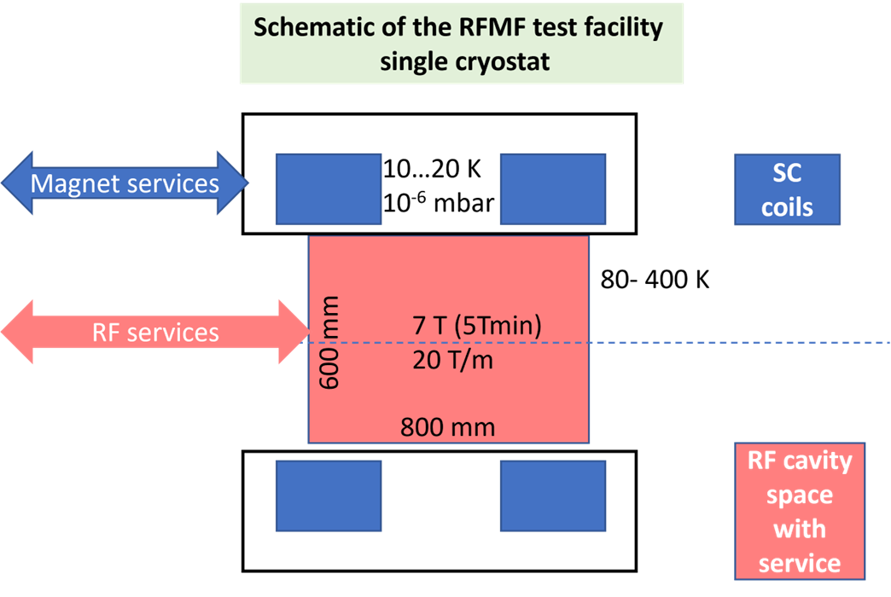
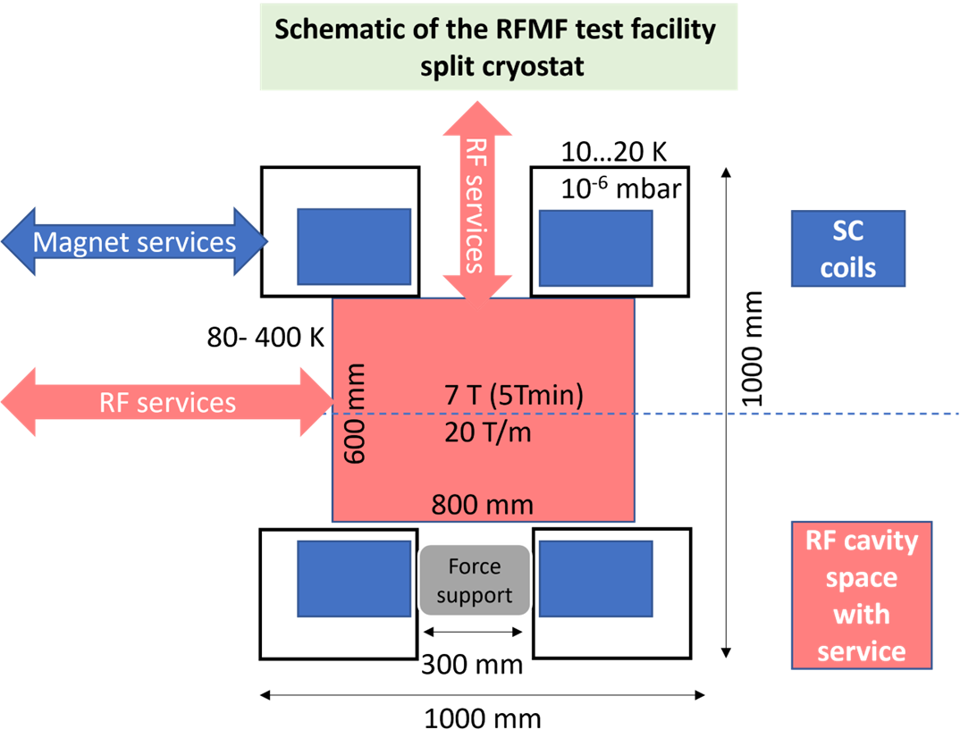
General layout of the
RFMF test station
Preliminary design is aimed at fitting a cavity of the size up to a 700 MHz system
Minimum bore of the split coil
  → ∅600 RT free bore for RF → ∅700 mm minimum SC coil diameter
Scheme 1: single cryostat
Scheme 2: split cryostat

Slide 5
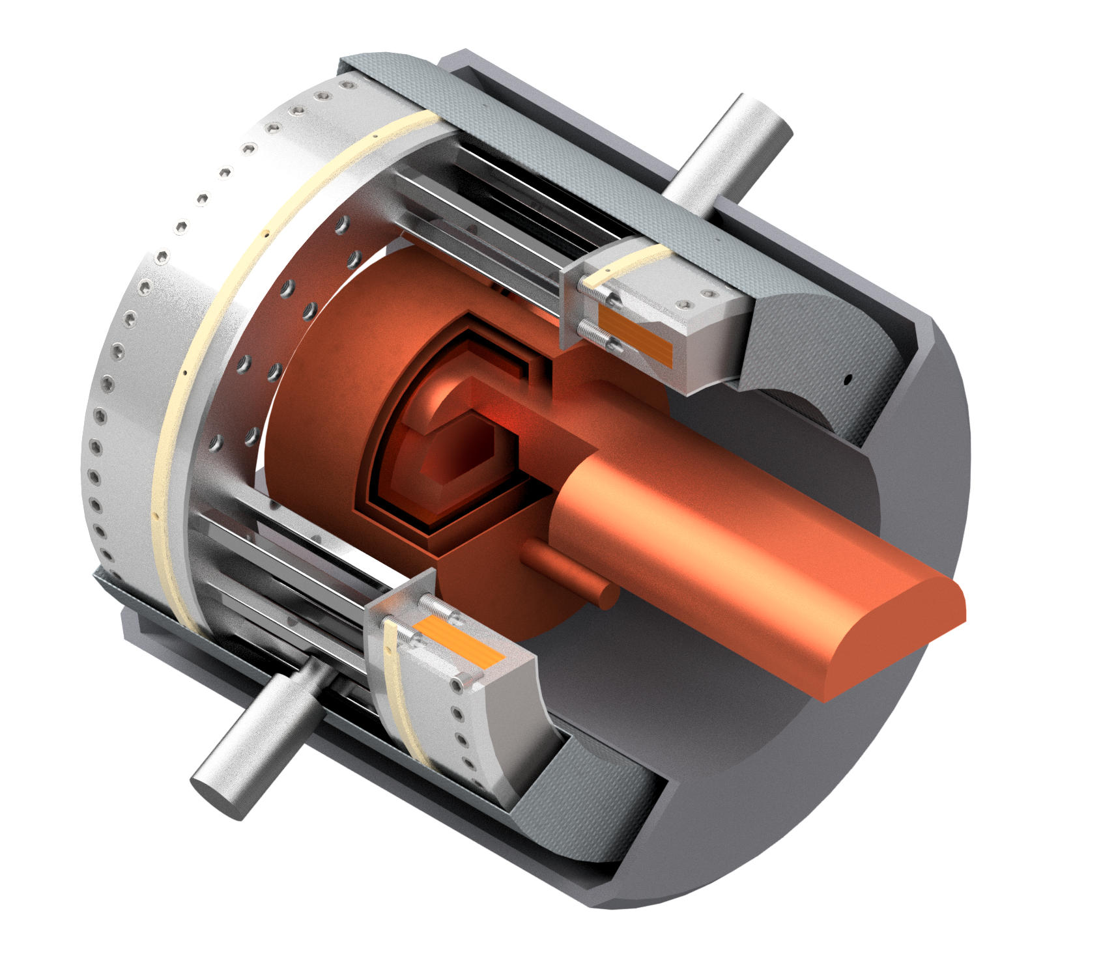
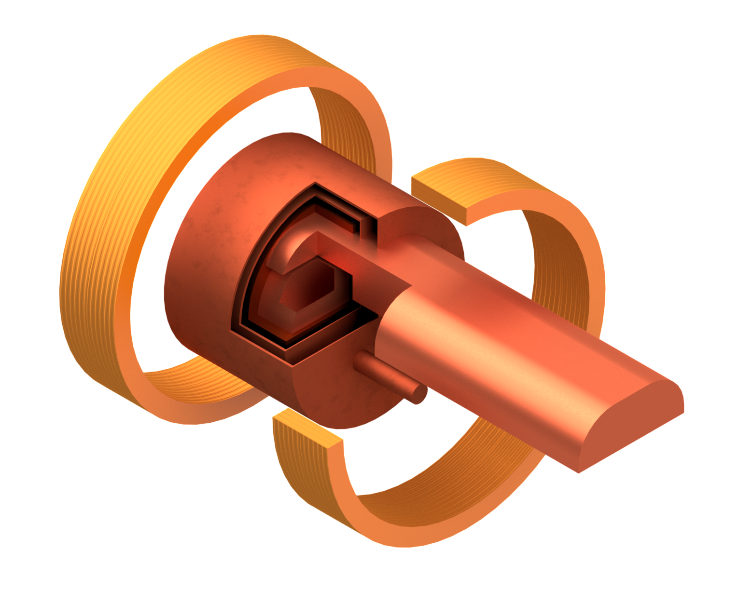
First sketch
(scheme split coils in single cryostat )
Bare coils and RF cavity
With cryostat
Two stage
cryocooler
SC HTS coils
Coil support structure
Thermal shield
Tie rods for repulsion and compression forces
Sc magnet/cryostat sketch by M. Castoldi & Stefano Sorti, UMIL & INFN-LASA
(RF drawing by Guillaume Ferrand –CEA)
RF Wave guide
Vacuum vessel
Pillbox test cavity
HTS coils
The construction of a test bed is an important push toward the definition of a baseline technology.
An intermediate construction can be the commisisonig of first design choices
B1 as aspect ratio of the cross section
B3 and A2 similar inner diameter
A4 similar field 6T, but smaller diameter

Slide 6
A few considerations
The work on magnet design just started (discussion inside WG11/WP8)
Many assumptions can be refined (space for thermal insulation etc…)
At present only scheme 1 (single cryostat) has bene studied;
  scheme 2 (split cryostat) will follow
  Compressive/repulsive forces between coils: about 5 MN (500 tons!)
The bottom line that the HTS magnet is expensive:
  45 km of REBCO tapes 12 mm cost about 3 MEur (plus taxes)!!!
  The coil manufacturing 1 MEur; the cryostat and services about 1 MEur
  5 MEur total cost (crude evaluation)
  HTS remains our basic choice in view of then MC design
The option to build also a smaller size/energy/force demonstrator has to be taken into account
Higher frequency test bench needs smaller coils, i.e. less expensive

Slide 7
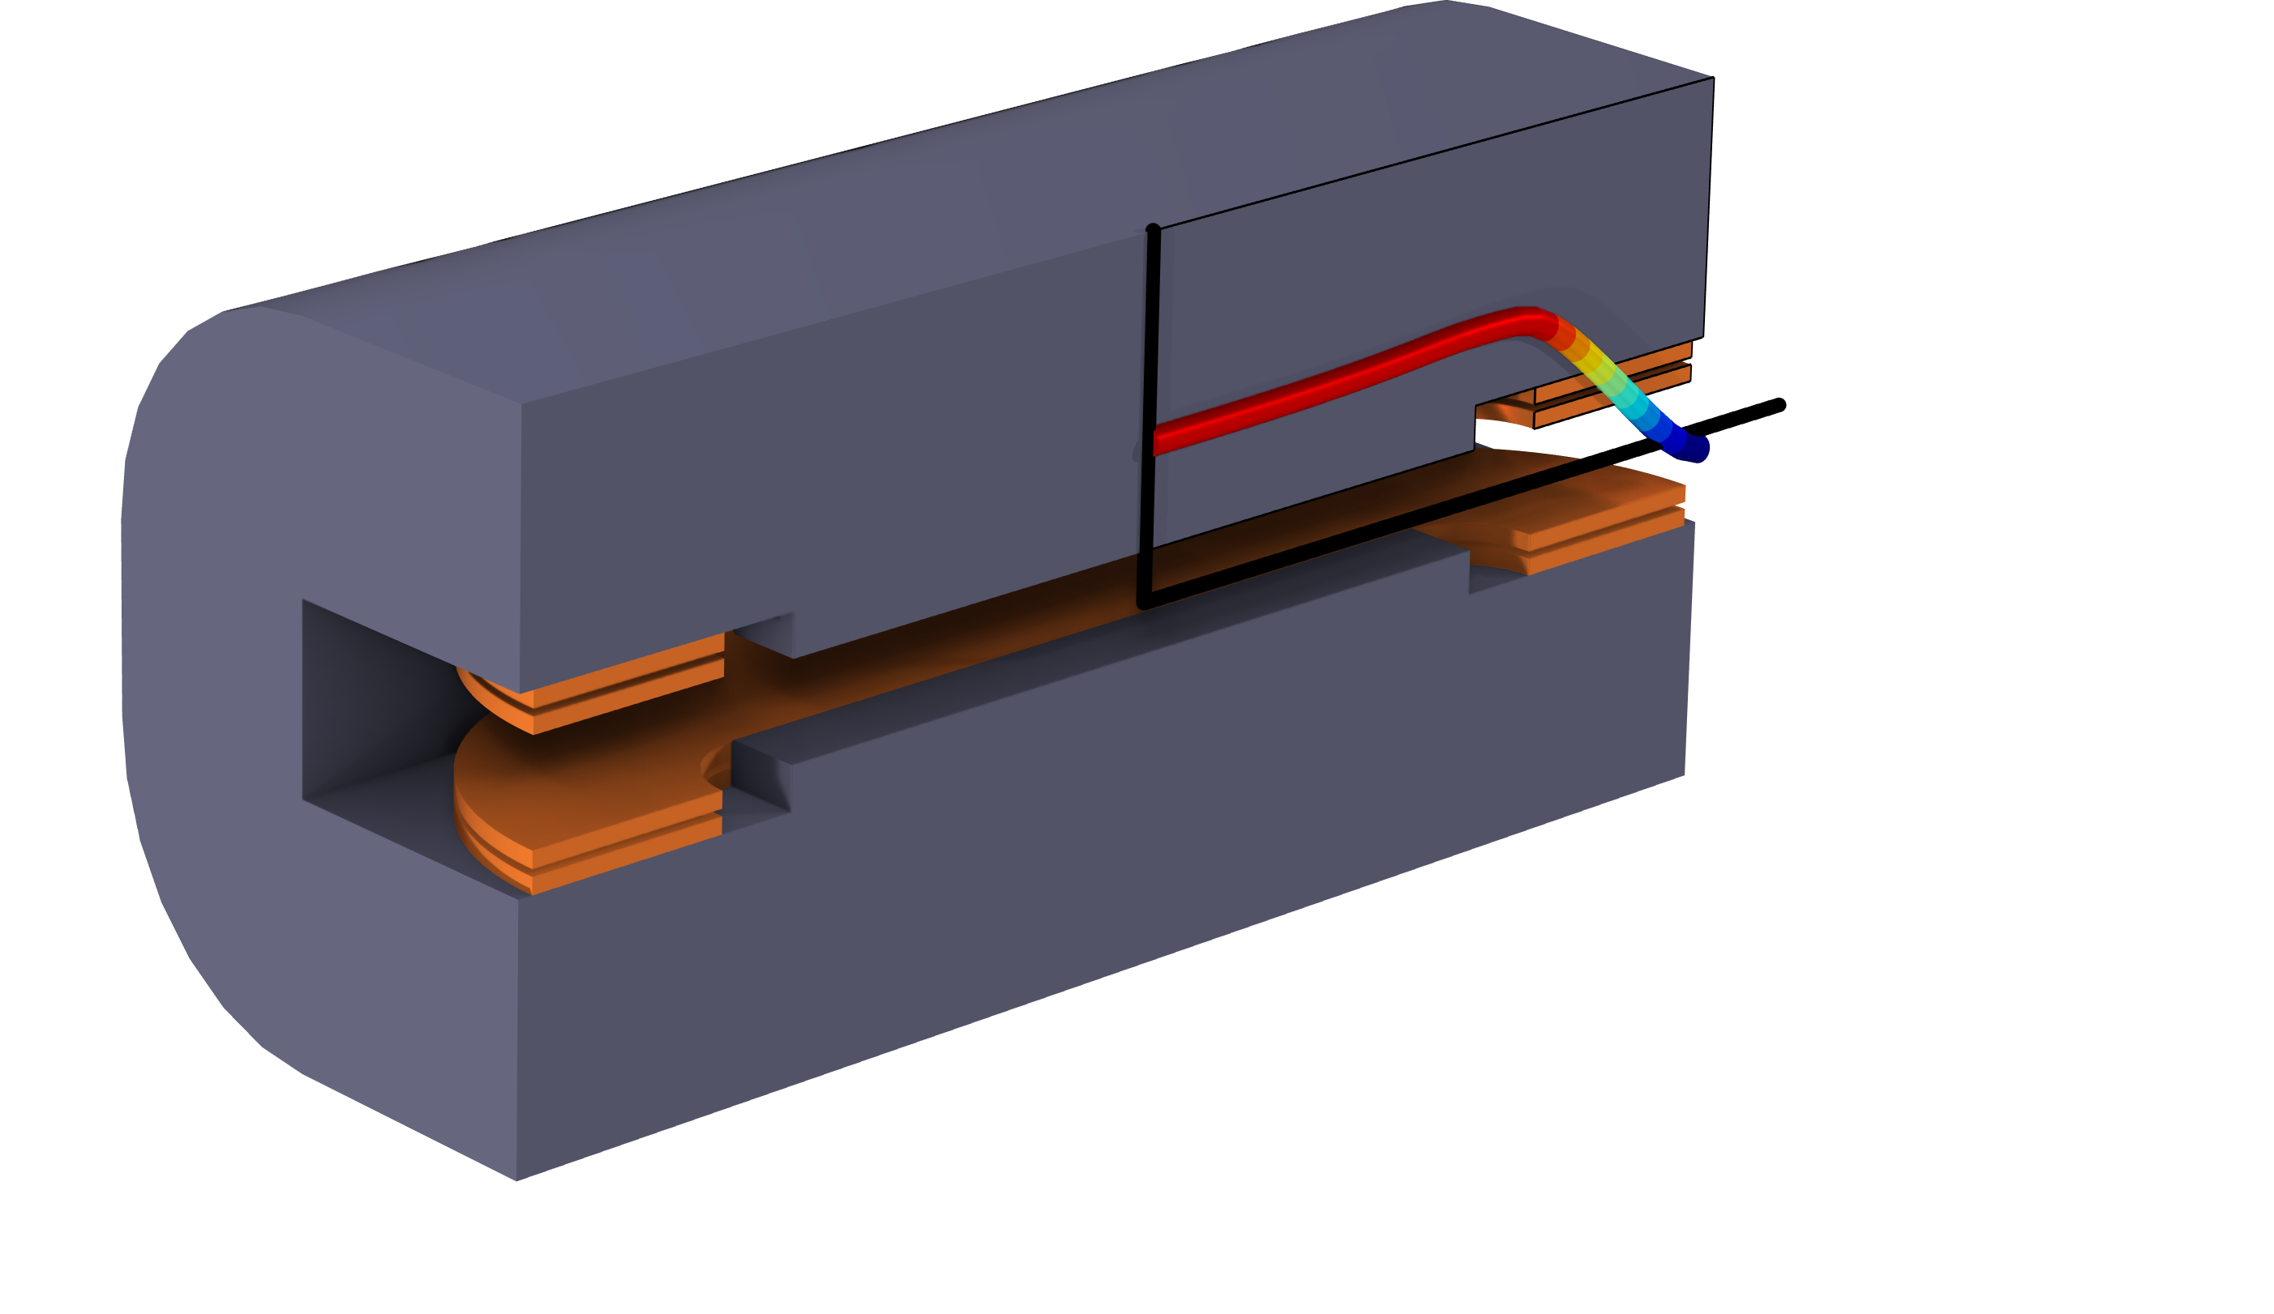

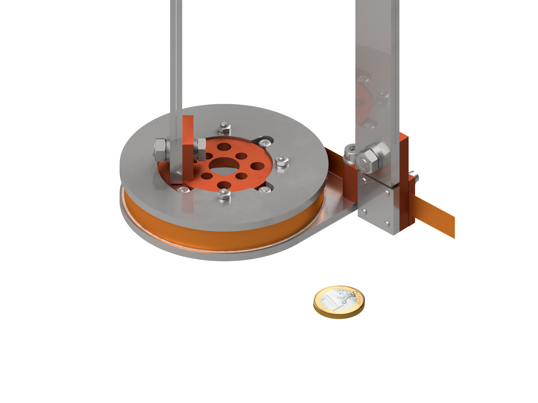
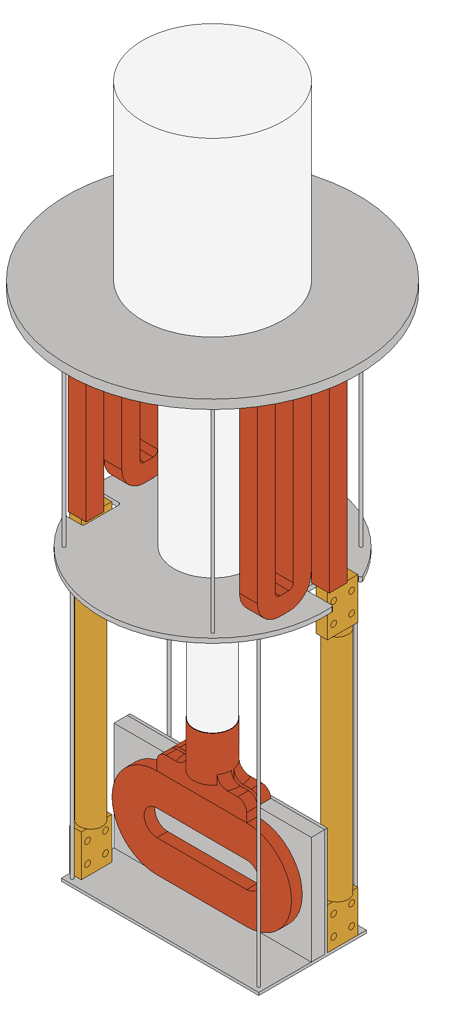
Ongoing activities from 7.2
Synergies with WP 7 task 2 solenoids and IRIS
Tape characterization
Preliminary design of coils and cell
  Design of a HTS dipole for IRIS, Next Gen EU
  Winding tests of small pancakes
  Test of small pancakes (also in field)
  Design of the RF test station (WP7 and WP8)
Coil design for the cells
  Field and forces
  Integration of cooling system
  Field quality definition and optimization

Slide 8
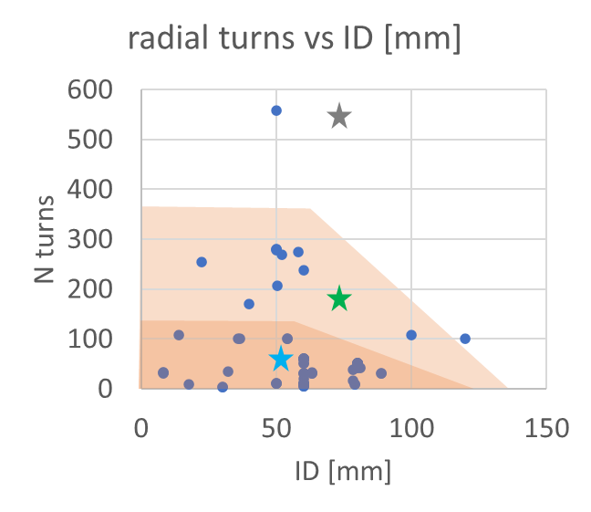
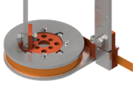
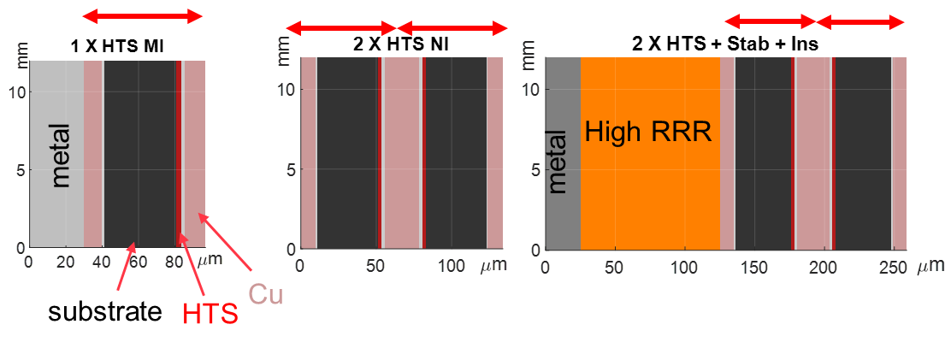
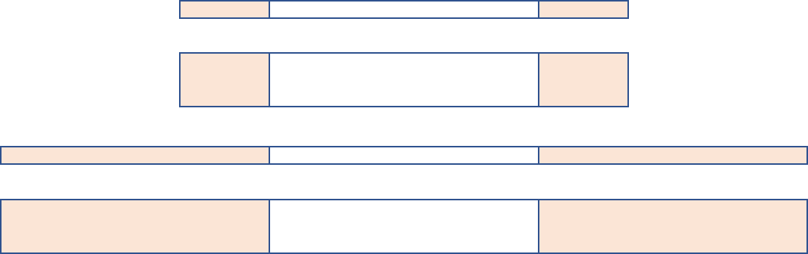
Test coils
Test coils Identical/similar configurations used at CERN, INFN, PSI
Geometry
Configuration
Tests self field and in field
Validate handling procedures and models
60 mm inner diameter
20 mm and 60 mm thickness
4 mm and 12 mm tape width
Single and double pancakes winding
One- and two-in-hand winding
Pancakes can be stacked in mini-coils
Examples of configurations
By S. Sorti

Slide 9


Test of small coils
Draft of Variable Temperature system for small coils test
Synergies with IRIS (NextGenerationEU)
  Operation at T in the range 10 K – 30 K;
  Induction of flux densities in the tesla range
  Test in field up to 20+ T
  Non-round geometries (PNRR-IRIS project)
The goal is to test magnet-like conditions for NI coils and further validate models.
Target time: begin 2024
Coils are tested in CERN, INFN LASA, PSI, LNCMI, CEA

Slide 10
Schedule for discussion
Tentative schedule with no contingency and assuming the task is approved and financed today
By now, no funding and no dedicated manpower for the executive design and construction
Design studies for single cryostat and double cryostat scheme Nov 2023
Design evaluations for higher frequencies RF and smaller diameters Dec 2023
Design choices (conductor configuration, mechanics, cryogenics) May 2024
Coil demonstrator (about half size) design Jun 2024
Demo coil production and test Apr 2025
Production of the test bench (coils, mechanics, cryostat) May 2025
Commissioning of the test bech Oct 2025

Slide 11
Conclusion
A test bench for room temperature RF cavities is a interesting device both for RT-RF development and for the HTS solenoids R&D
The magnetic system is a demonstrator for technologies for conductor, mechanics and thermal insulation. It may provide the commissionig of the selected technologies before the final coices for a demonstrator and the series production.
Many challenges in different fields
  Cost
  Cryogenics & Force management
  Quench protection
An extensive program of modeling and R&D started the framework of MC

Slide 12

THANKS

