Slide 1
MuCoI
A Design Study for a Muon Collier Complex at 10+ TeV Centre of Mass
Kick-off meeting
HORIZON-INFRA-2022-DEV-01-01
Angela Lahuerta
Project Officer
REA C.4

Slide 2
Research Infrastructures in Horizon Europe
Pillar 1
Excellent Science
Pillar 2
Global Challenges and European Industrial Competitiveness
Pillar 3
Innovative Europe
European Research Council
Health
Culture, Creativity and Inclusive Society
Civil Security for Society
Digital, Industry and Space
Climate, Energy and Mobility
Food, Bioeconomy, Natural Resources, Agriculture and Environment
European Innovation Council
Marie Skłodowska-Curie Actions
European innovation
ecosystems
Clusters
Research Infrastructures
EUR 2,4 bn
European Institute of Innovation
and Technology
Joint Research Centre
Widening Participation and Strengthening the European Research Area
Widening participation and spreading excellence
Reforming and Enhancing the European R&I system

Slide 3
Role Distribution
DG Research and Innovation
-> Definition of Policies
-> Drafting the Work Programme
European Research Executive Agency (REA)
‘Reforming European Research & Innovation and Research Infrastructures’, Unit C4
-> Implementation of calls for proposals
-> Grant Management
Coordinator
-> Monitor that the action is implemented properly
-> Act as the intermediary for all communications with REA
-> Distribution of payments

Slide 4
Research Infrastructures Work Programme 2021-2022
Destinations
INFRASERV: RI services to support health research, accelerate the green and digital transformation, and advance frontier knowledge
INFRATECH: Next generation of scientific instrumentation, tools and methods and advanced digital solutions
INFRADEV: Developing, consolidating and optimising the European RI landscape, maintaining global leadership-Research Infrastructure Concept Development- provision of integrated RIs services to enable R&I addressing major societal challenges
INFRAEOSC: Enabling an operational, open and FAIR EOSC ecosystem
INFRANET: Network connectivity in Research and Education – Enabling collaboration without boundaries

Slide 5
Projects (HORIZON-INFRA-2022-DEV-01-01)
Project Acronym | Project Title
ARGOS-CDS | ARGOS Conceptual Design Study: Designing a next-generation radio facility for multi-messenger astronomy
DAESY | DAta and services for the Earth SYstem science
ESSnuSBplus | Study of the use of the ESS facility to accurately measure the neutrino cross-sections for ESSnuSB leptonic CP violation measurements and to perform sterile neutrino searches and astroparticle physics
Euro GO-SHIP | Developing a Research Infrastructure concept to support European hydrography
EuroFAANG | A European infrastructure for farmed animal genotype to phenotype research
MDDB | Molecular Dynamics Data Bank. The European Repository for Biosimulation Data
MuCol | A Design Study for a Muon Collider complex at 10+ TeV center of mass
PRESTO | Pathfinder facility for a new class of precision-physics storage rings Pathfinder facility for a new class of PREcision-physics STOrage rings
PRO-GRACE | Promoting a Plant Genetic Resource Community for Europe
RITIFI | Research Infrastructure Technology Infrastructure For Impact
STRAITS | Strategic Infrastructure for improved animal Tracking in European Seas
WST | The Wide Field Spectroscopic Telescope

Slide 6
Relevant European RIs, projects and programmes
European Research infrastructures-ESFRI/ERICS
  EuPRAXIA, HL-LHC and European Spallation Source-ERIC
European Projects, alliances
  EURO-LABS (INFRASERV)
  IMPRESS (INFRATECH)
  European Programmes
  to ensure interoperability with and availability of data to: EOSC

Slide 7
Reporting guidelines-MuCoI

Slide 8
Periodic report
MuCoI: period 1 M1-24 (28/2/25), period 2 M25-48 (28/2/27)
WHEN
60 days after reporting period end
WHAT
Periodic Report:
HOW
via Portal
1. Technical report
- Prepared by the Coordinator
* What was done and achieved?
* Which problems were encountered?
* How can progress so far be assessed?
* Were there any deviations or corrective actions?
2. Financial report
- Individual financial statement
- Explanation of the use of resources and information on subcontracting
- The certificates on the financial statements (CFS)

Slide 9
Periodic reporting: reviews
Reviews planned at the end of final reporting period (1 month after submission of reports). Article 21 of the GA
MuCoI: months 27, 51
Present the work carried out, main achievements and use of resources.
Participation of the coordinator and WP leaders.
REA is assisted by external expert(s)

Slide 10
Overview: Reporting and Monitoring
End of reporting period
Revisions and explanations
End of reporting and payment
Within 60 days
DELIVERABLES submitted
Periodic REPORT
submitted (technical and financial)
Submission of revised version of reports (technical and financial)
ALL documents received, correct and accepted
Comments from
Project Officer and Financial Officer – clarifications and modifications may be requested
ONE iteration for intermediate reports; more than one iteration may be necessary for final report
Initiation payment
Review meeting
Review report submitted

Slide 11
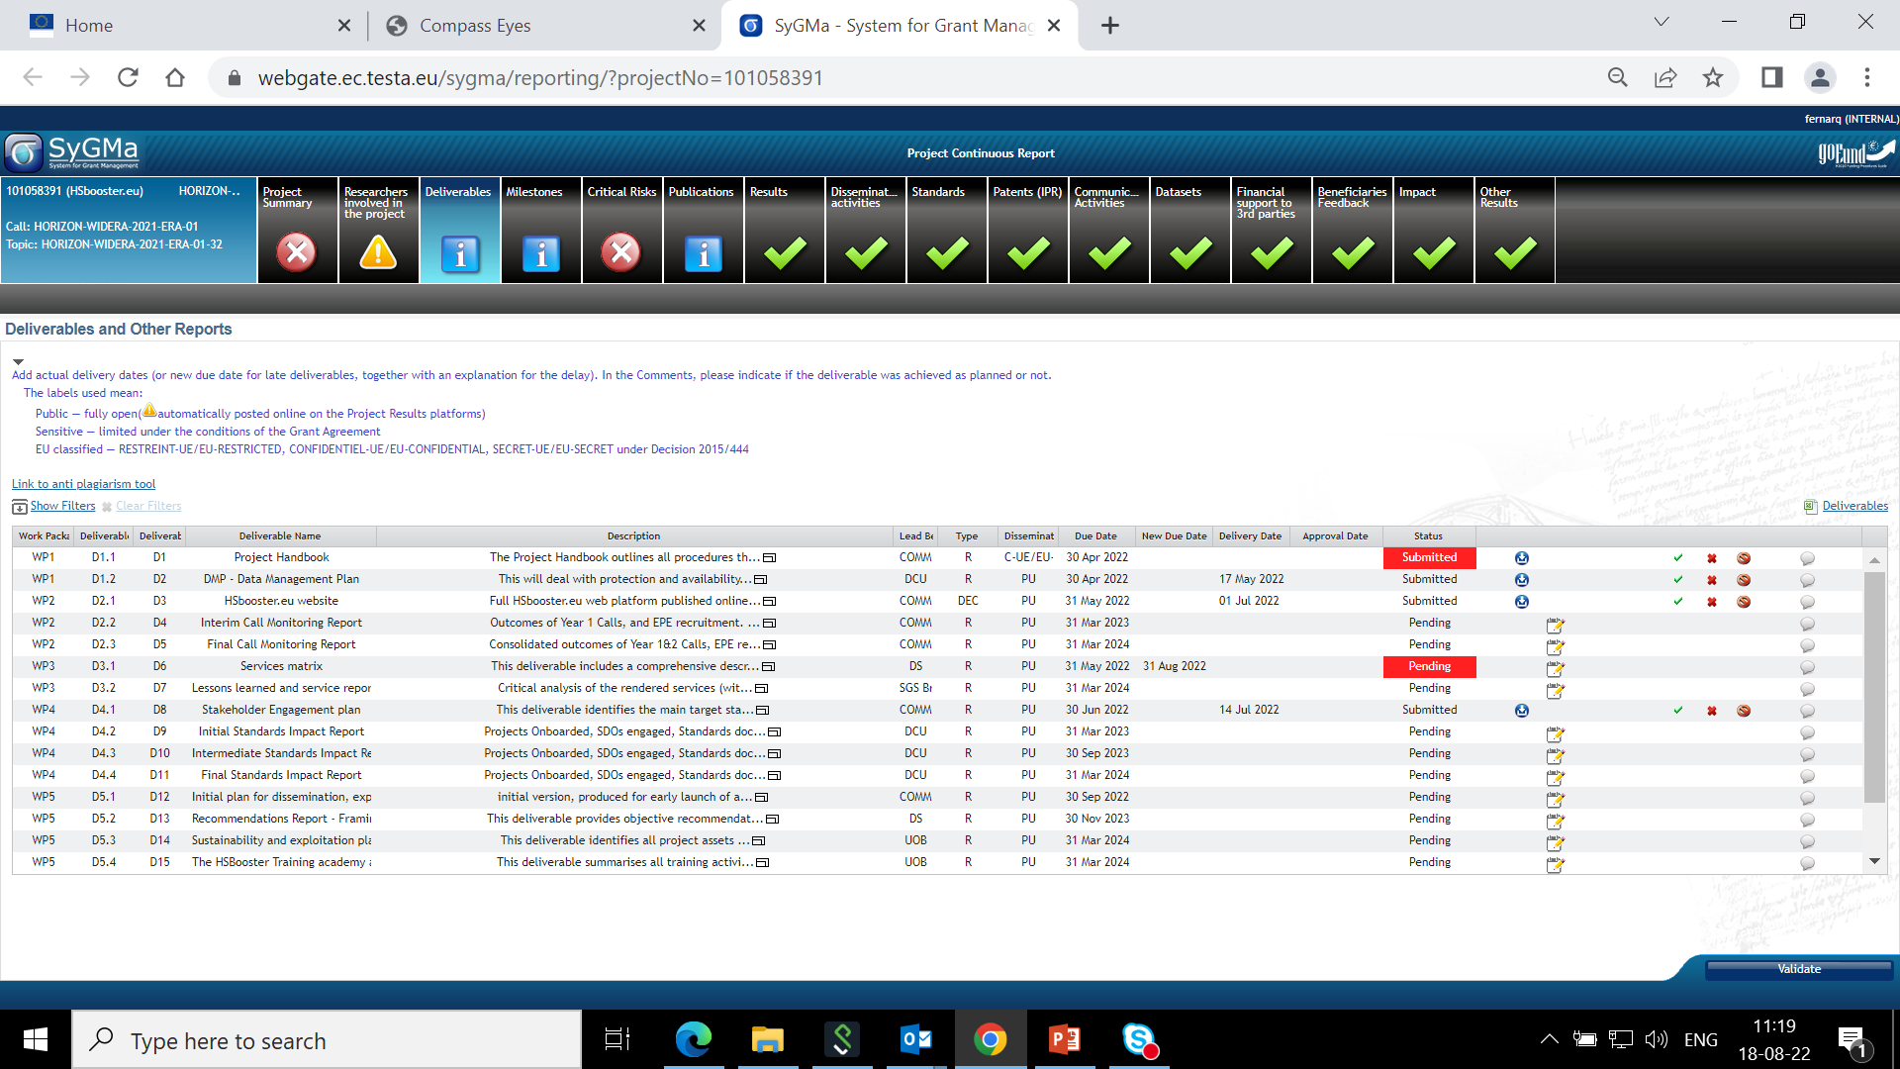

Continuous Reporting – deliverables
!!!!! All HE deliverables flagged as 'PUBLIC' will be published in Cordis
Be particularly attentive to quality of all public deliverables!

Slide 12
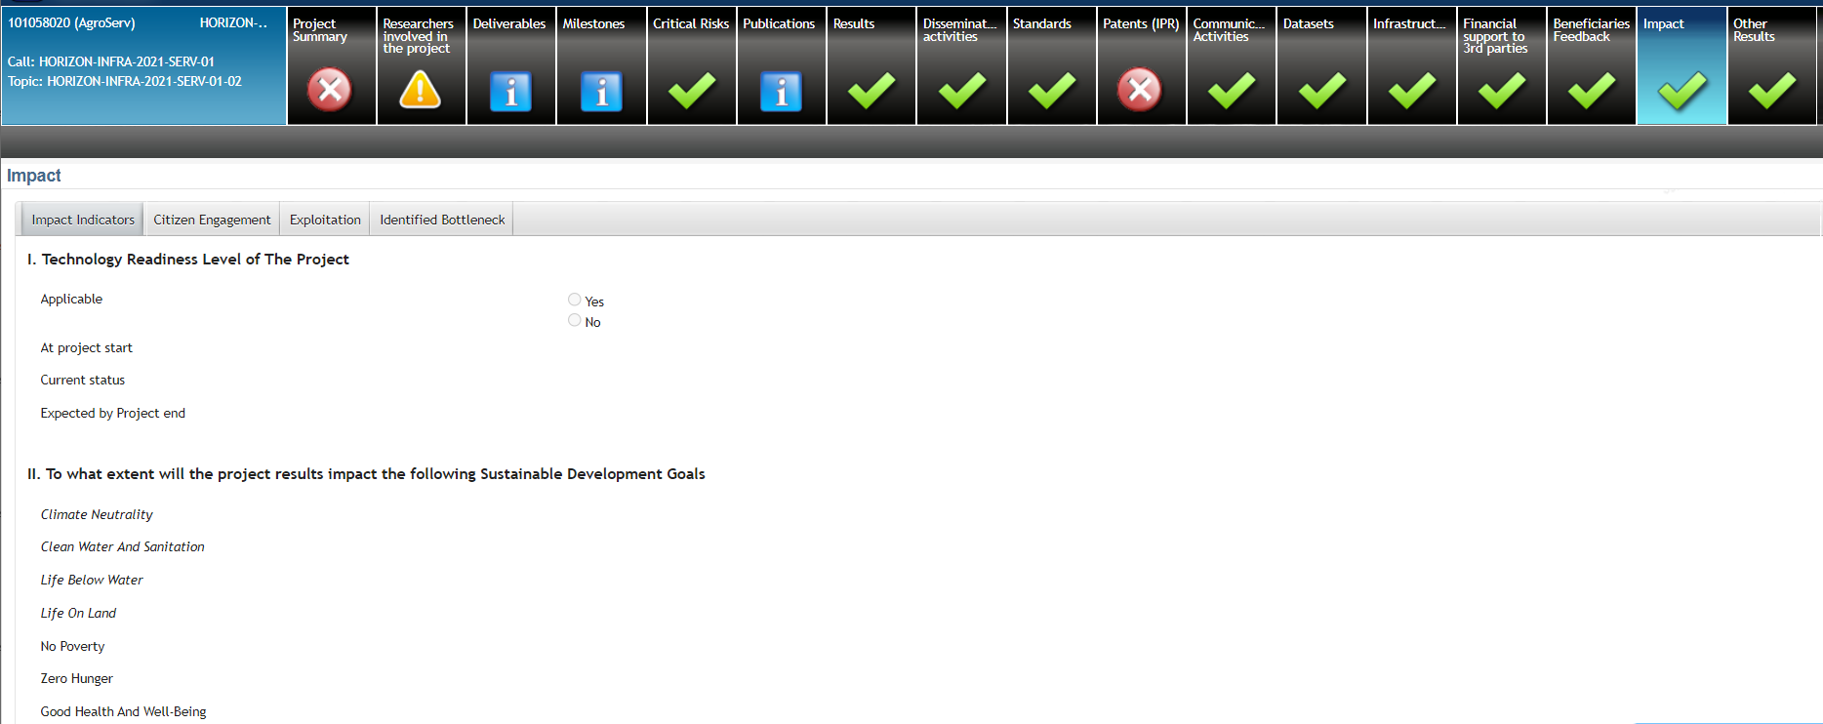
Novelties in continuous reporting - HE
Coordinators’ day autumn 2022
Title: Horizon Europe Coordinators’ Day on Grant Management
Date: 04 October 2022, from 09:30am to 12:40am (CET, Brussels time)
Event video link:
Horizon Europe Coordinators' Day: Grant Management (4 October 2022) - YouTube

Slide 13
Financial management: some advice
Personnel Costs: KEEP TIME RECORDS of the hours worked on the action (if not working full time on an EU project)
Meetings: collect participants’ signatures (especially if you reimburse or claim travel costs)
Any subcontracting?
  If you need a subcontract which is not planned in the Description of Action, ask approval to the REA project officer beforehand as this may require an AMD
Note to the coordinator if one partner overspends, it is up to the coordinator with the Consortium to decide internally how the EU contribution will be distributed (i.e. full amount if the overspending is due to anticipated work, or only the budget share agreed for the reporting period).

Slide 14
Amendments

Slide 15
Amendments
Amendment needed if:
Change of the coordinator’s bank account for payments
Addition/removal of linked third party
Change of action’s title, acronym, duration, reporting periods
Change of Annex 1 (description of action)
Change of Annex 2 estimated budget
Change of coordinator or its legal status
Change of dissemination status of a deliverables (PU→SEN or SEN→PU)
Budget transfer is allowed between beneficiaries and among existing budget categories without filing an amendment
Action to be implemented as described in Annex I
If the change is significant, an amendment to the GA is needed
Grant agreement duration is, as a rule, not extended (except Force Majeure)
TIP
Always contact the REA PO (Coordinator – PO) to discuss the typology and impact of change

Slide 16
Communication, Dissemination, Exploitation

Slide 17
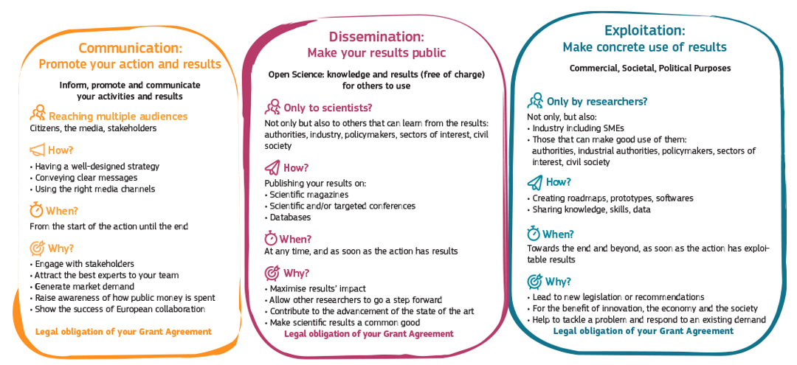
Communication, dissemination and exploitation

Slide 18



Acknowledge EU Funding
Make sure to display the European flag (emblem), do not use the European Commission logo!
Find guidance and download the EU emblem: https://europa.eu/!m83Myq

Slide 19
Disclaimer
Disclaimer GA art . 17.3 must be added in any publication/output:
” Funded by the European Union. Views and opinions expressed are however those of the author(s) only and do not necessarily reflect those of the European Union or [name of the granting authority]. Neither the European Union nor the granting authority can be held responsible for them.”

Slide 20
How can REA support you?
Has your project won an important scientific award? Have you made a ground-breaking discovery and are featured in the press?
Don’t forget to inform your project officer!
REA’s Communication team can help promote by:
• Highlighting & multiplying your news and results through our own and the Commission’s social media channels (please tag us!)
• Proposing your project’s success story for inclusion in the European Commission’s free-of-charge communication channels.

Slide 21
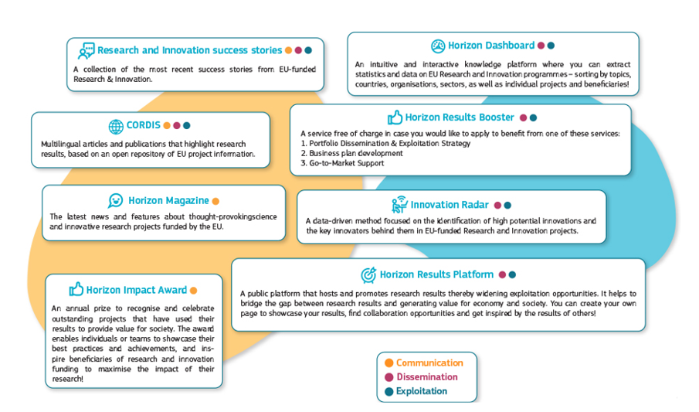
Free-of-charge European Commission dissemination tools

Slide 22
Open Science

Slide 23

Open Research Europe
Why Open Research Europe?
Support our open access policy and beneficiary capacity to adhere to it and also enables publishing post-grant
Leading by example in operationalising open science principles within scientific publishing and enabling the European Research Area
Contribute to transparency and cost-effectiveness and explore sustainable open access publishing business models
What is Open Research Europe?
A peer-reviewed publishing platform. Not a repository. Post-publication peer-review model. First you publish, then review takes place. Publication and review reports open access under CC BY licenses. Optional service for our beneficiaries at no cost to them.

Slide 24
Key points on open science in Horizon Europe
Beneficiaries must manage the digital research data generated in the action responsibly, in line with the FAIR (“Findable”, “Accessible”, “Interoperable”, Reusable”) principle
Establish + regularly update a data management plan (‘DMP’) for generated (and/or collected) data
Ensure open access ‘as open as possible, as closed as necessary'
Useful resources
Horizon Europe Annotated Model Grant Agreement
Horizon Europe Data Management Plan Template (under reference documents of the Funding and Tenders portal).

Slide 25
Open access to publications
Beneficiaries (or authors) must retain sufficient intellectual property rights to comply with the open access requirements
Publication in venue of their choice but publication fees are reimbursable only if publishing venue is full open access (publication fees in hybrid venues are not reimbursed)
Beneficiaries have the possibility to publish at no costs in Open Research Europe, the European Commission open access publishing platform

Slide 26
Audits

Slide 27
Audits
Keeping records: Keep a clear account of the project activities during the reporting period (Article 20 Grant Agreement).
Beneficiaries must keep records and other supporting documentation up to 5 years in order to prove the proper implementation and the costs declared as eligible.
Audits can be carried out during the entire lifetime of the project, by the European Commission, not later than 2 years after the payment of the balance.
Two types of audits: financial and/or technical audits

Slide 28
Links and useful information

Slide 29
HE Online Manual
https://webgate.ec.europa.eu/funding-tenders-opportunities/display/OM/Online+Manual
Grant management
Keeping records
Amendments
Reports & payment requests
Deliverables & milestones
Dissemination & exploitation
Communicating your project
Acknowledgement of EU funding
Checks, audits, reviews & investigations

Slide 30
Useful links
  HE Annotated Model Grant Agreement
  Guidance on social media for EU funded R&I projects
  Horizon Europe – Funding Programme for Research and Innovation
  Factsheet ‘Open Science in Horizon Europe’
  Communication on ‘A new ERA for Research and Innovation’
  Pact for Research and Innovation in Europe

Slide 31







Keep in touch
ec.europa.eu/info/research-and-innovation_en
europeancommission
rea.ec.europa.eu
@EuropeanCommission
@REA_research
EUTube
European Research Executive Agency (REA)
EU Spotify

Slide 32
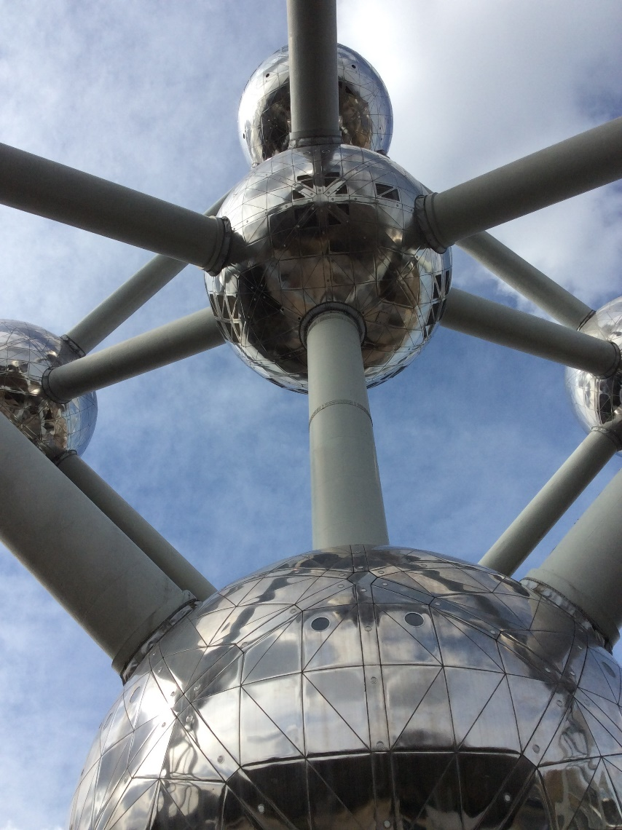

Thank you angela.lahuerta-marin@ec.europa.eu
© European Union 2020
Unless otherwise noted the reuse of this presentation is authorised under the CC BY 4.0 license. For any use or reproduction of elements that are not owned by the EU, permission may need to be sought directly from the respective right holders.

Slide 33
Extra-Slide

Slide 34
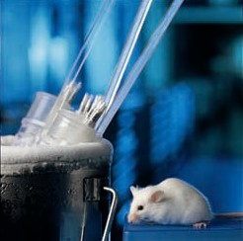
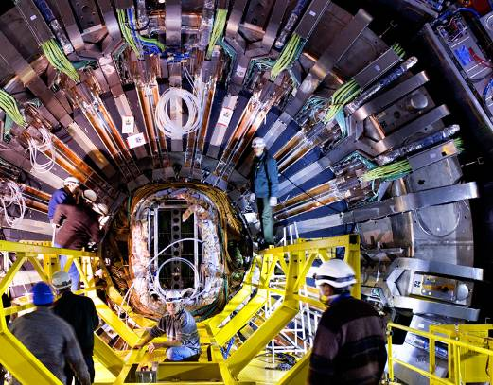
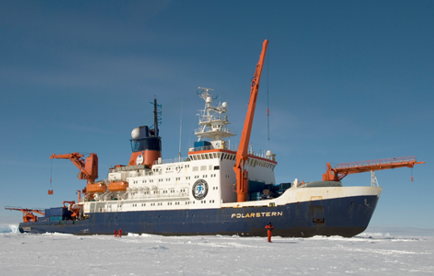
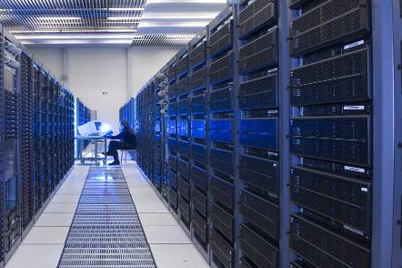
Research Infrastructures
Facilities providing resources and services for research communities to conduct research and foster innovation (single site, distributed, virtual). They provide access to external users.
Knowledge-related facilities
Major scientific equipments
ICT infrastructures
e.g.: archives, collections, data infrastructures, telescopes, research vessels, FEL, computing systems, communication networks
  Inter alia, RIs contribute to:
  Extend the frontiers of knowledge
  Exchange and transmit knowledge
  Train the next generation of top researchers
  Support industrial innovation

