Slide 1



Reports of the working group: Muon Acceleration
by Antoine Chance (CEA Paris-Saclay)
Acknowledgements:
F. Batsch, Christian Carli, H. Damerau , David Amorim , Kyriacos Skoufaris , Fulvio Boattini,
Max Topp-Mugglestone, I. Karpov, Elias Metral, Scott Berg,
Luca Bottura, Alexej Grudiev, Daniel Schulte

Slide 2
Goal: fast acceleration (after recirculating linacs) to collision energy
Pulsed synchrotrons challenging
  Very fast magnet ramping (power, eddy ..)
  Orbit variations with fixed SC and cycled NC magnets
  Circumference variations and longitudinal dynamics
  Strong collective effects
FFAs (vertical) as an alternative
A lot of iterations with other WGs on magnet design, beam loss, collective effects, radiation protection ..
63 GeV
~ 5 TeV

Slide 3
Tasks within MuCol
Task 1
Coordination and Communication
The WG « Muon Acceleration » is covered by some tasks of MuCol.
This WG is focused on parameter optimization, optics design, lattice integration.
Some activities are in close interaction with other WGs:
  Magnetic Systems (pulsed magnets)
  RF systems
  Beam-matter interaction
  Collective effects
  Matching conditions with WG Collider
Task 2
Collider design
Task 3 (CEA, CERN, JAI, BNL)
Pulsed synchrotron and FFA design
High Energy Complex
Task 4
Beam dynamics
Task 5
MDI design and background to experiment
Task 6
Radiation studies for the accelerators

Slide 4
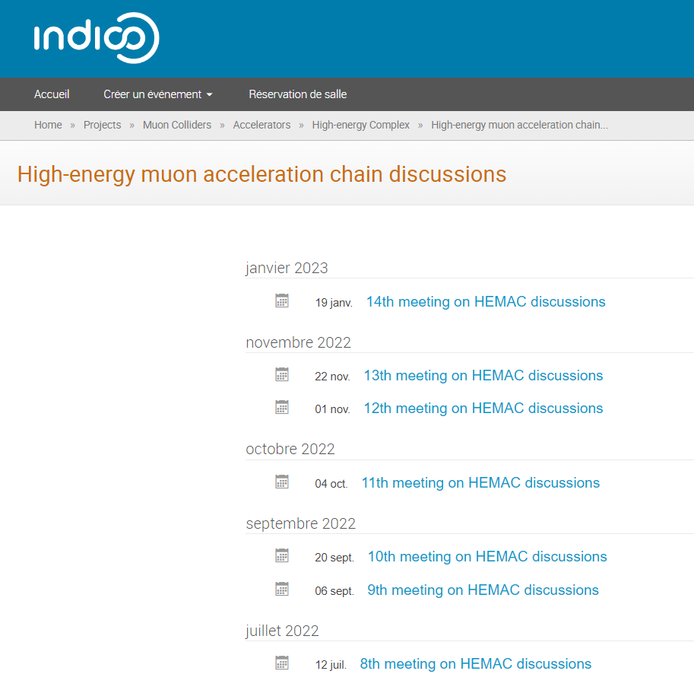
Muon Acceleration WG
14 meetings to date, with participants from most collaborating institutes and universities
Since February 2022 we meet:
  to discuss in an informal setting initial ideas and options, and
  in preparation of upcoming activities, in particular the EU MuCol
Site: https://indico.cern.ch/category/14979/

Slide 5
Rapid Cycling Synchrotron
Detailed parameter table: https://cernbox.cern.ch/index.php/s/I9VpITncUeCBtiz
hybrid
RCS
5 TeV
Chain of rapid cycling synchrotrons, counter-rotating µ⁺/µ⁻ beams
→ 63 GeV → 0.31 TeV → 0.75 TeV → 1.5 TeV (→ 5 TeV)
Hybrid RCSs have intersecting normal conducting (NC) and superconducting (SC) magnets.
The studies presented aim to determine the RF (cavity) and lattice parameter (number of RF stations, momentum compaction factor,…) → Parameteric study
Courtesy: Heiko Damerau
hybrid
RCS
1.5 TeV
norm. cond. RCS
hybrid RCS
Both in the same tunnel

Slide 6
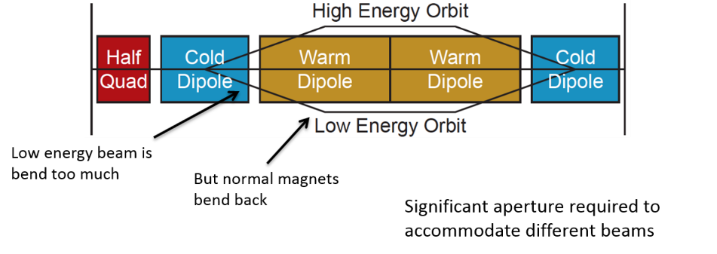
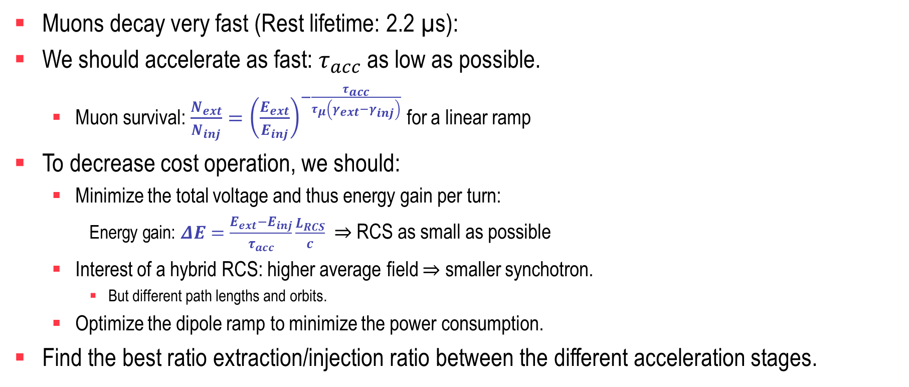
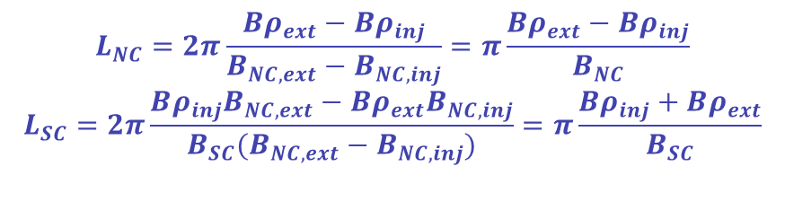
A lot of constraints
Muons decay very fast (Rest lifetime: 2.2 µs):
We should accelerate as fast: $τ_{acc}$ as low as possible.
  Muon survival: $\frac{N_{ext}}{N_{inj}}={\left(\frac{E_{ext}}{E_{inj}}\right)}^{−\frac{τ_{acc}}{τ_{μ}\left(γ_{ext}−γ_{inj}\right)}}$ for a linear ramp
To decrease cost operation, we should:
  Minimize the total voltage and thus energy gain per turn:
    Energy gain: $ΔE=\frac{E_{ext}−E_{inj}}{τ_{acc}}\frac{L_{RCS}}{c}$ $⇒$RCS as small as possible
  Interest of a hybrid RCS: higher average field $⇒$ smaller synchotron.
    But different path lengths and orbits.
  Optimize the dipole ramp to minimize the power consumption.
Find the best ratio extraction/injection ratio between the different acceleration stages.
$$L_{NC}=2π\frac{Bρ_{ext}−Bρ_{inj}}{B_{NC,ext}−B_{NC,inj}}=π\frac{Bρ_{ext}−Bρ_{inj}}{B_{NC}}$$
$$L_{SC}=2π\frac{Bρ_{inj}B_{NC,ext}−Bρ_{ext}B_{NC,inj}}{B_{SC}(B_{NC,ext}−B_{NC,inj})}=π\frac{Bρ_{inj}+Bρ_{ext}}{B_{SC}}$$
See presentation at Collaboration Meeting

Slide 7
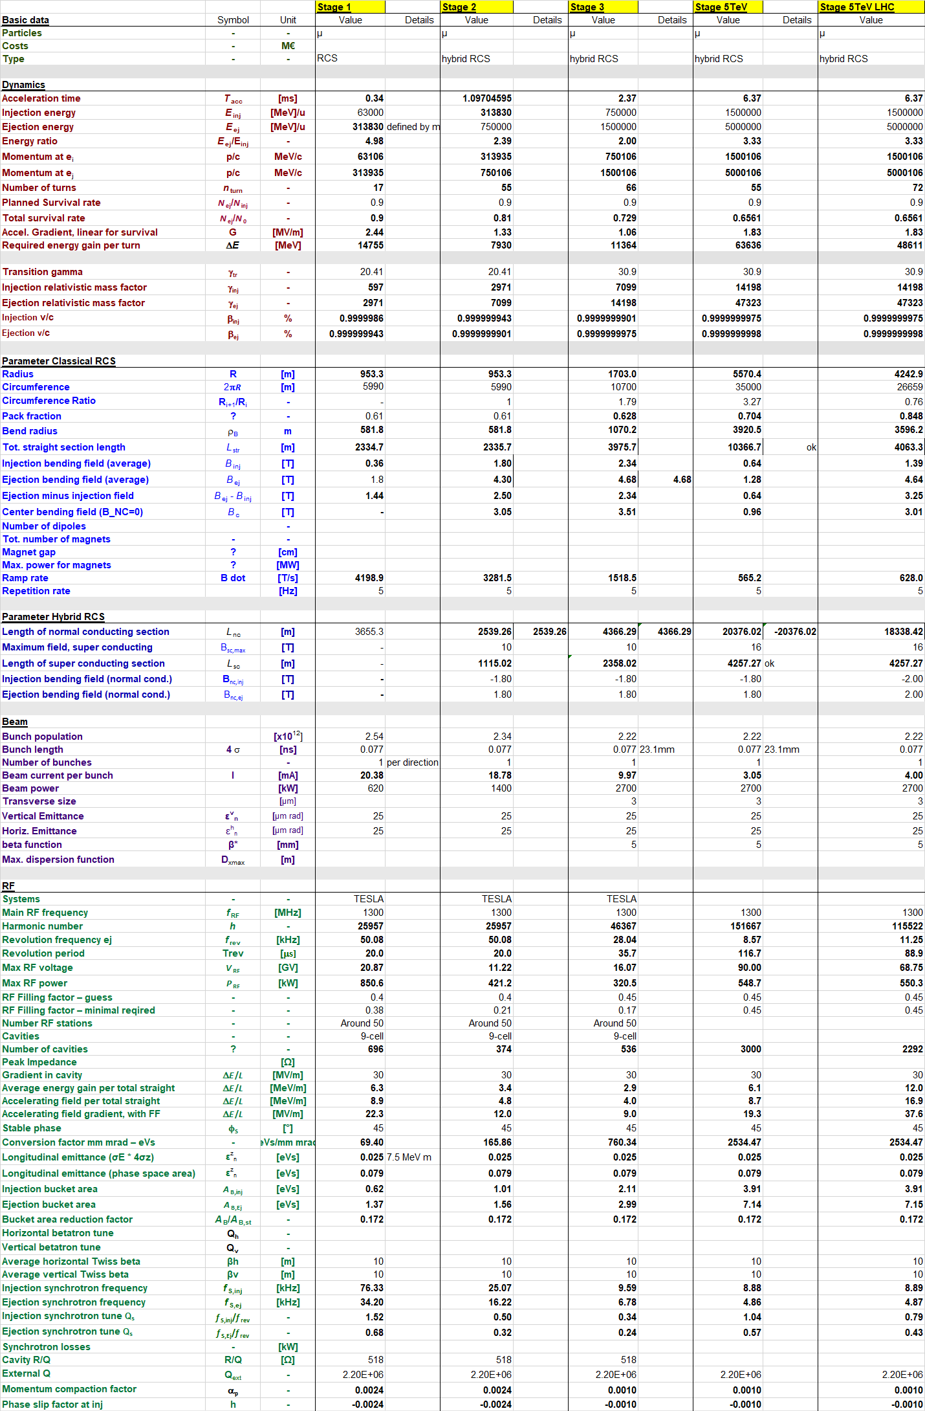
Parameters and tools:
General parameter
Courtesy: Fabian Batsch
Detailed parameter table: https://cernbox.cern.ch/index.php/s/I9VpITncUeCBtiz

Slide 8
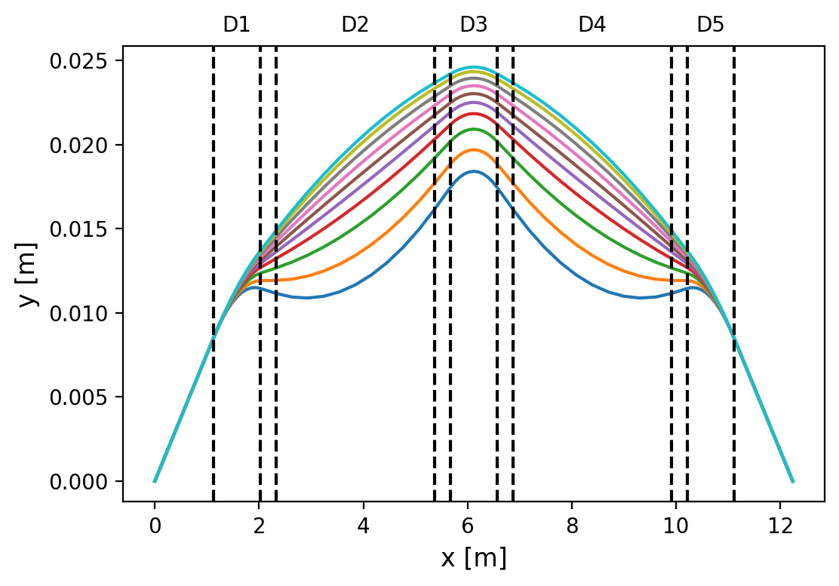
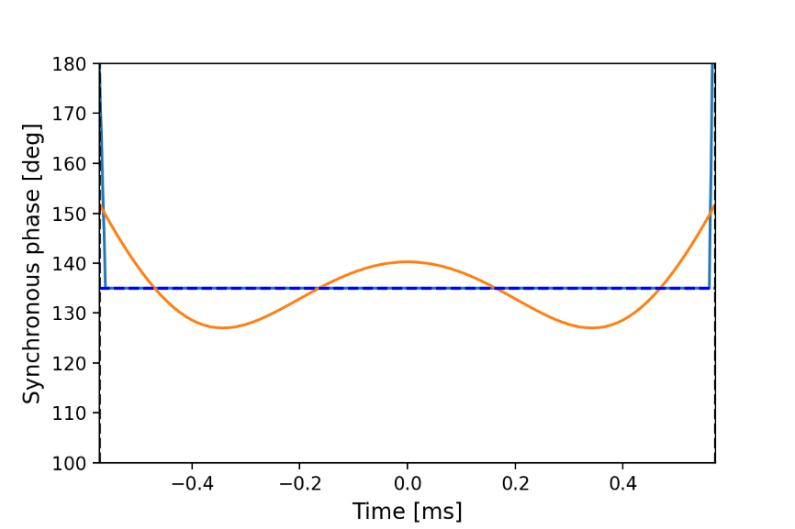
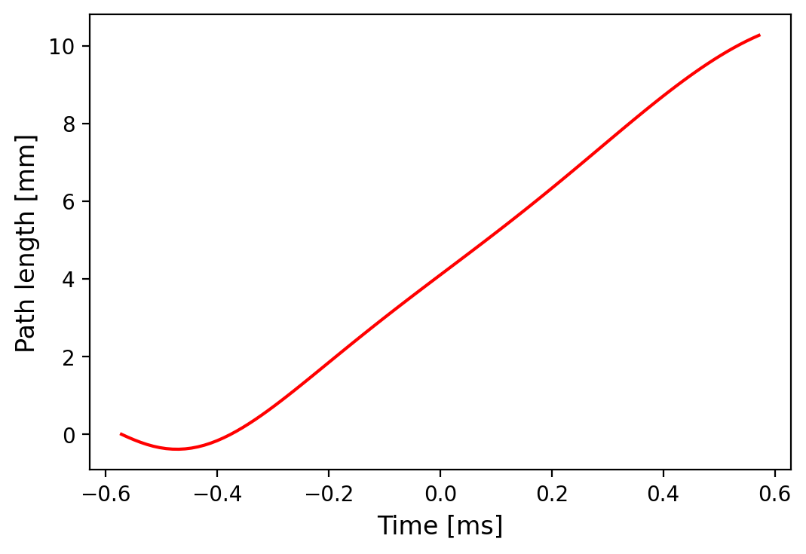
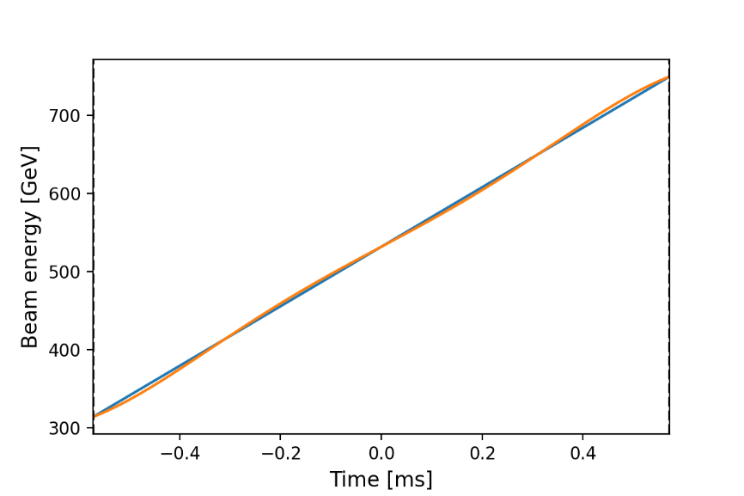
RCS2:
Case SC first with 5 dipoles and 208 cells
That is possible to get a path length variation of about 1 cm. However, the cell is very compact.
Although the energy ramp is quasi-linear, the synchronous phase varies by more than 10 degrees.
The voltage is assumed to be constant in the cavity.
See presentation at Collaboration Meeting

Slide 9
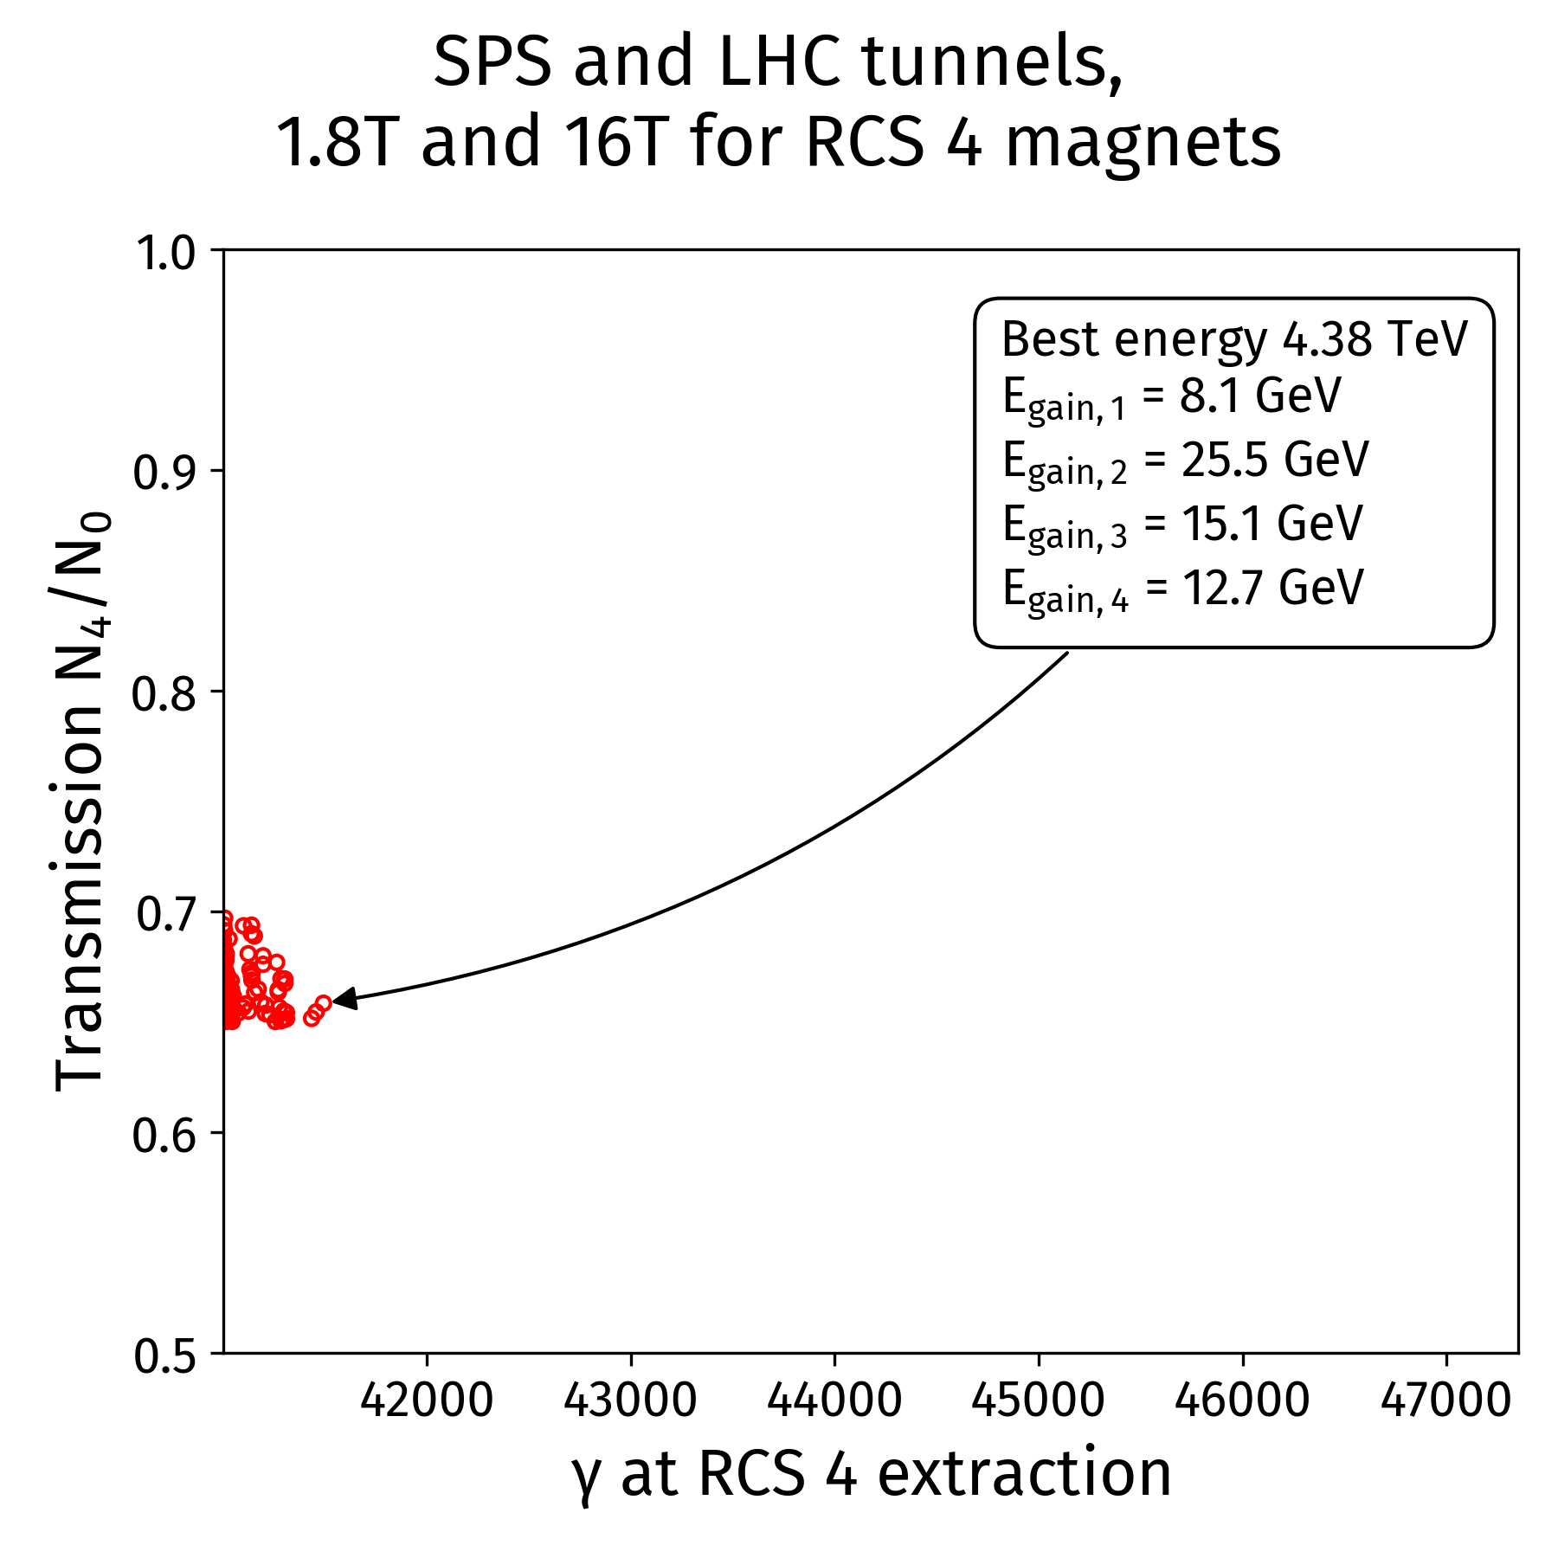
First test of Genetic Algorithms for accelerator parameters optimization
Example: try to fit the RCS 4 in the LHC tunnel (27 km), the RCS 1 and RCS 2 in the SPS tunnel (7 km)
  With stronger field magnets (16 T for the SC and 2.0 T for NC magnets)
  Preserving the beam transmission through the chain
Reach 4.4 TeV per beam after rough optimization
Similar values reached by F. Batsch with parametric study
Courtesy: David Amorim
See HEMAC meeting 13

Slide 10
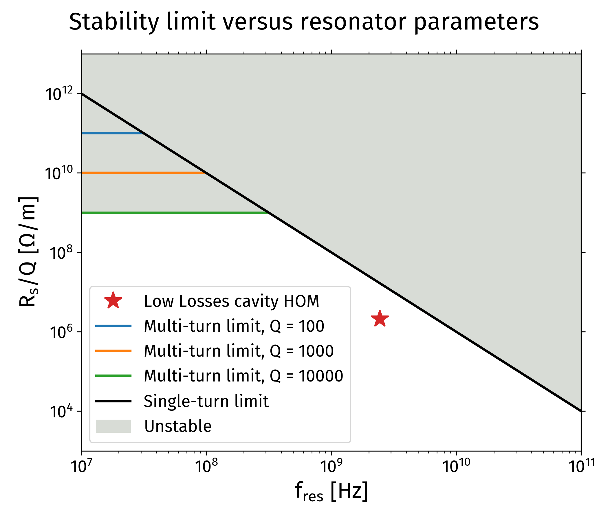
RCS 1: general stability criteria for RF cavity High Order Modes (HOMs)
Cavity HOMs will create resonant wakefields
Derived from simulations general stability criteria:
  R_{s} < 100 [MΩ/m] * Q / f² [GHz²] (single turn)
  R_{s} < 10¹³ Ω/m (multi-turn)
Example application for the most critical HOM of ILC-type cavity
  [R_{s}/Q]_{threshold} = 100/2.45² = 16.7MΩ/m
  [R_{s}/Q]_{total} = 2.1 MΩ/m
HOM below the predicted stability limit by factor 8
Courtesy: David Amorim
See presentation at Collaboration Meeting

Slide 11
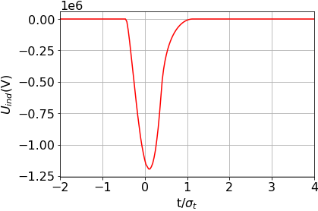
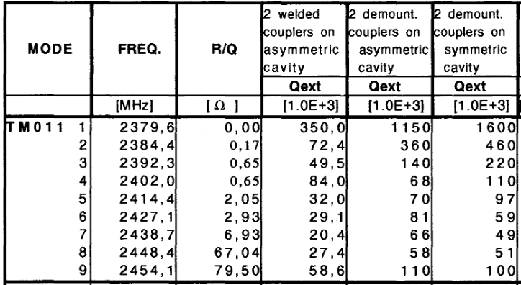


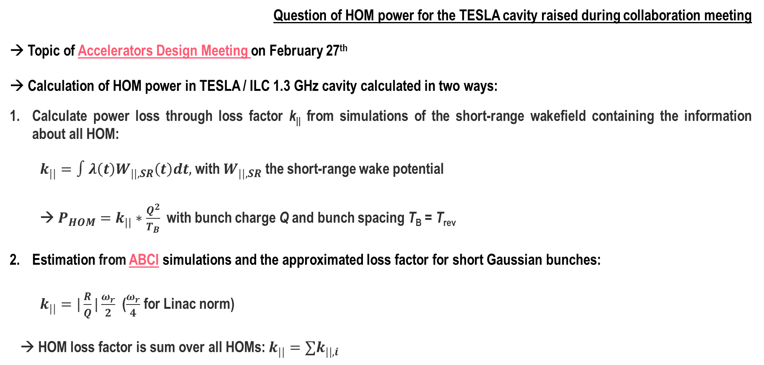
Longitudinal dynamics summary (1) – HOM power
Courtesy: Fabian Batsch
Question of HOM power for the TESLA cavity raised during collaboration meeting
→ Topic of Accelerators Design Meeting on February 27th
→ Calculation of HOM power in TESLA / ILC 1.3 GHz cavity calculated in two ways:
Calculate power loss through loss factor k|| from simulations of the short-range wakefield containing the information about all HOM:
$k_{||}=∫λ\left(t\right)W_{||,SR}\left(t\right)dt,$ with $W_{||,SR}$ the short-range wake potential
→ $P_{HOM}=k_{||}∗\frac{Q^{2}}{T_{B}}$ with bunch charge Q and bunch spacing T_{B} = T_{rev}
Estimation from ABCI simulations and the approximated loss factor for short Gaussian bunches:
$k_{||}=|\frac{R}{Q}|\frac{ω_{r}}{2}$ ($\frac{ω_{r}}{4}$ for Linac norm)
→ HOM loss factor is sum over all HOMs: $k_{||}=∑k_{||,i}$
Short-range wakefield
t/4σ_{t}
From
“Higher order mode coupler for TESLA”, J. Sekutowisz
See here (TESLA) & paper (ILC LL)

Slide 12
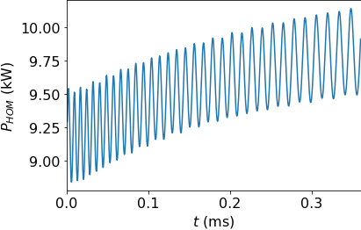
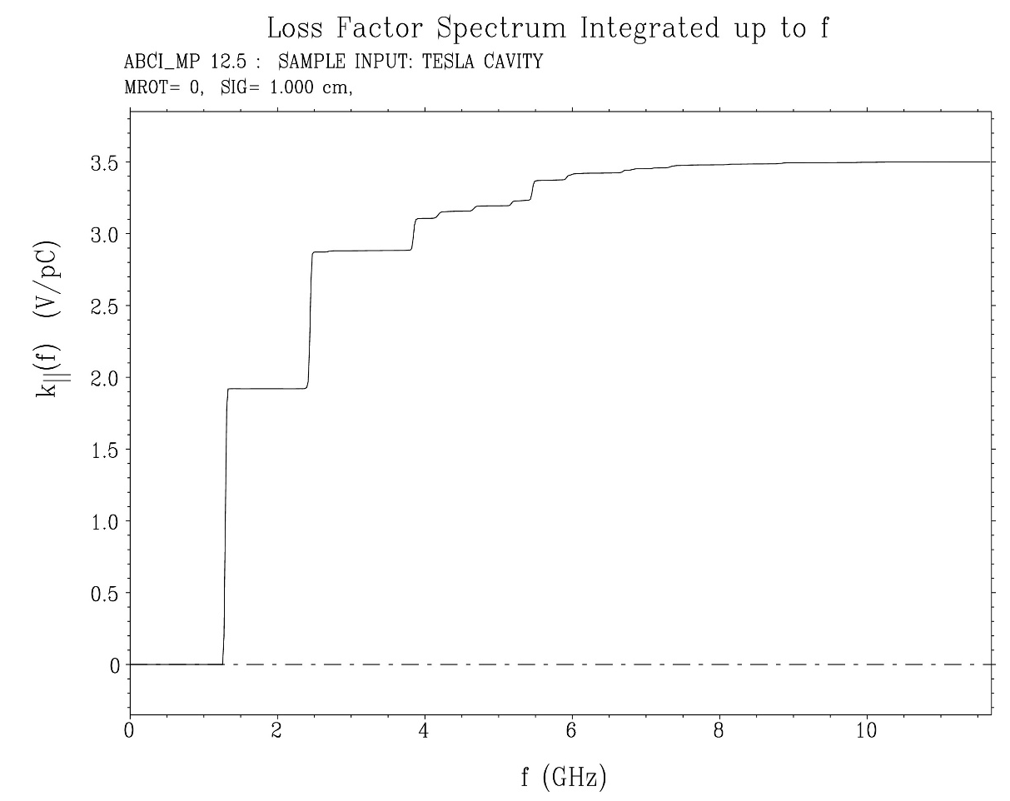
Results for HOM power
Courtesy: Fabian Batsch
From BLonD, for the induced voltage of 1.1 MV/m per cavity, we obtain around 10 kW per bunch and cavity for RCS1!
(Bunch population 2.54x10¹², Q=407 nC, T_{rev} = 20 µs → I = 20.4 mA)
From HOMs from ABCI: (ABCI file from S.-A. Udongwo):
1.5 V/pC results in 7.9 kW!
→ Consistent with BLonD
TM012
HOMs 1.5 V/pC
Large 10 kW HOM power per bunch is a current concern, extremely challenging to handle
HOM power coupler for 3-4 kW under development → up to 20 kW per cavity estimate
The present parameter tables are based on the ILC cavity (1.3GHz), but a lower frequency, e.g. 800MHz, might be required if the power cannot be handled
12
First two “strong” monopole HOM’s already contribute with 4.7 kW
fundamental mode, 2 V/pC

Slide 13
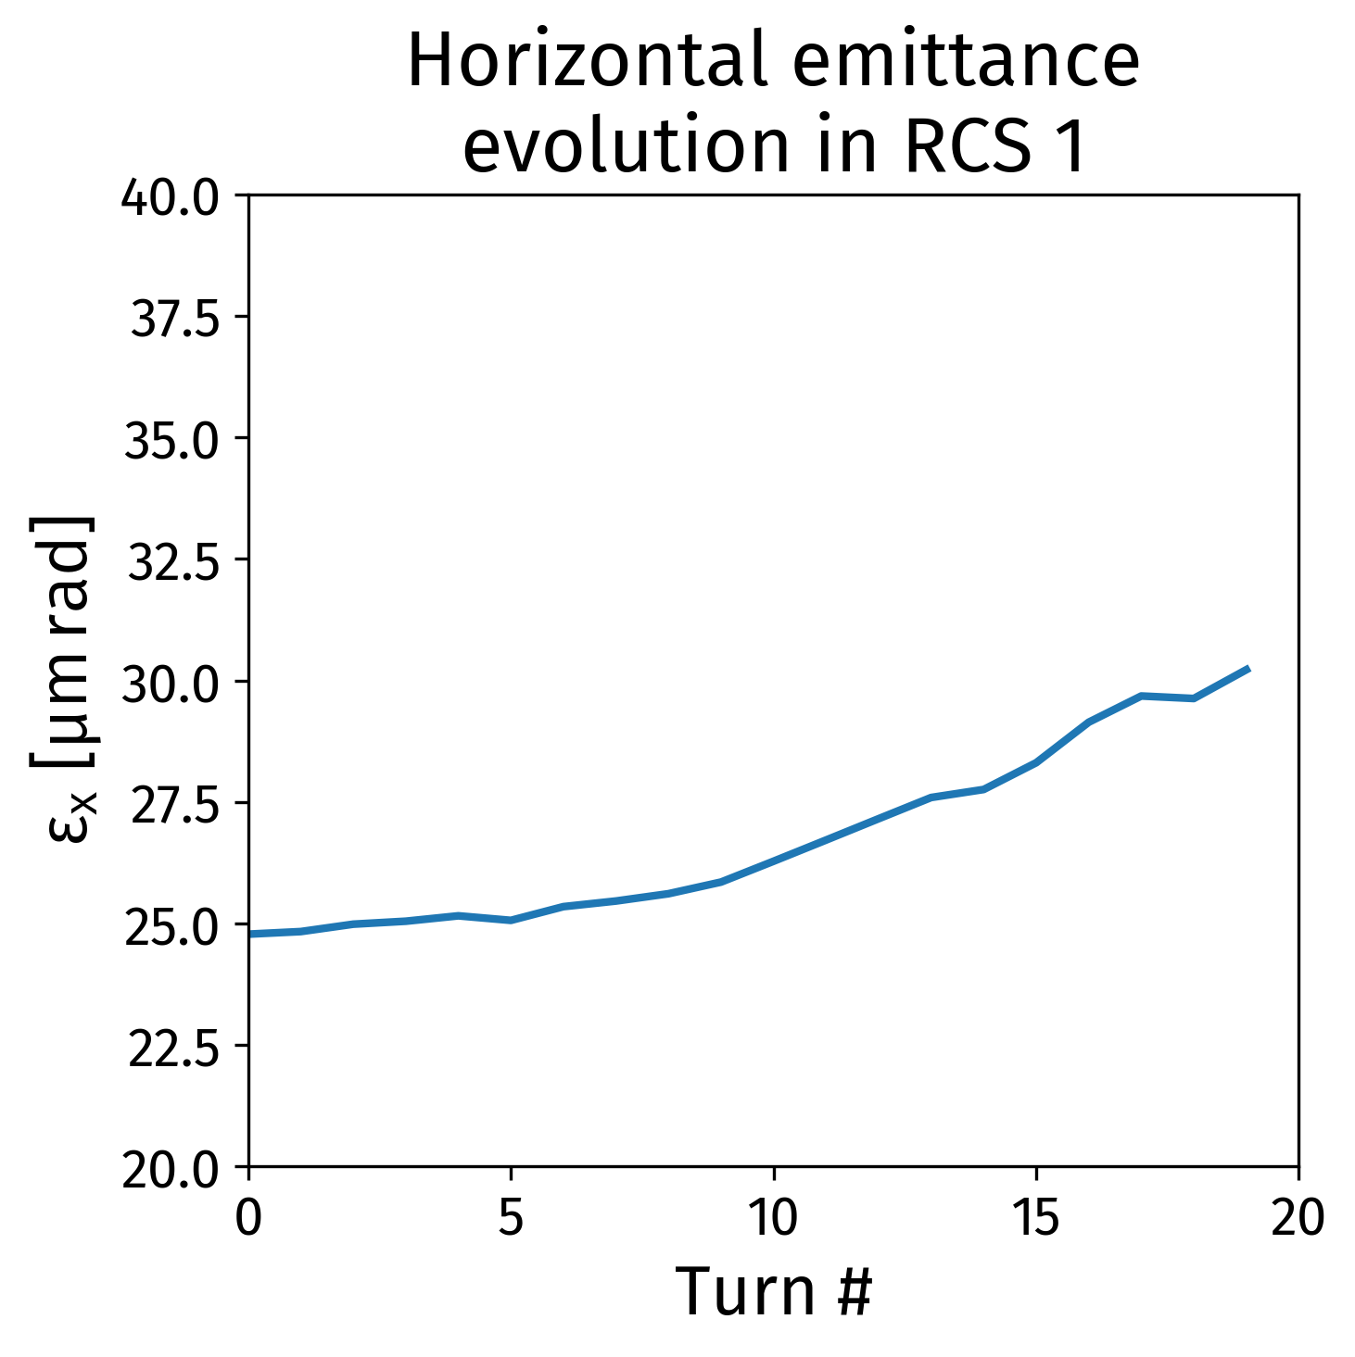
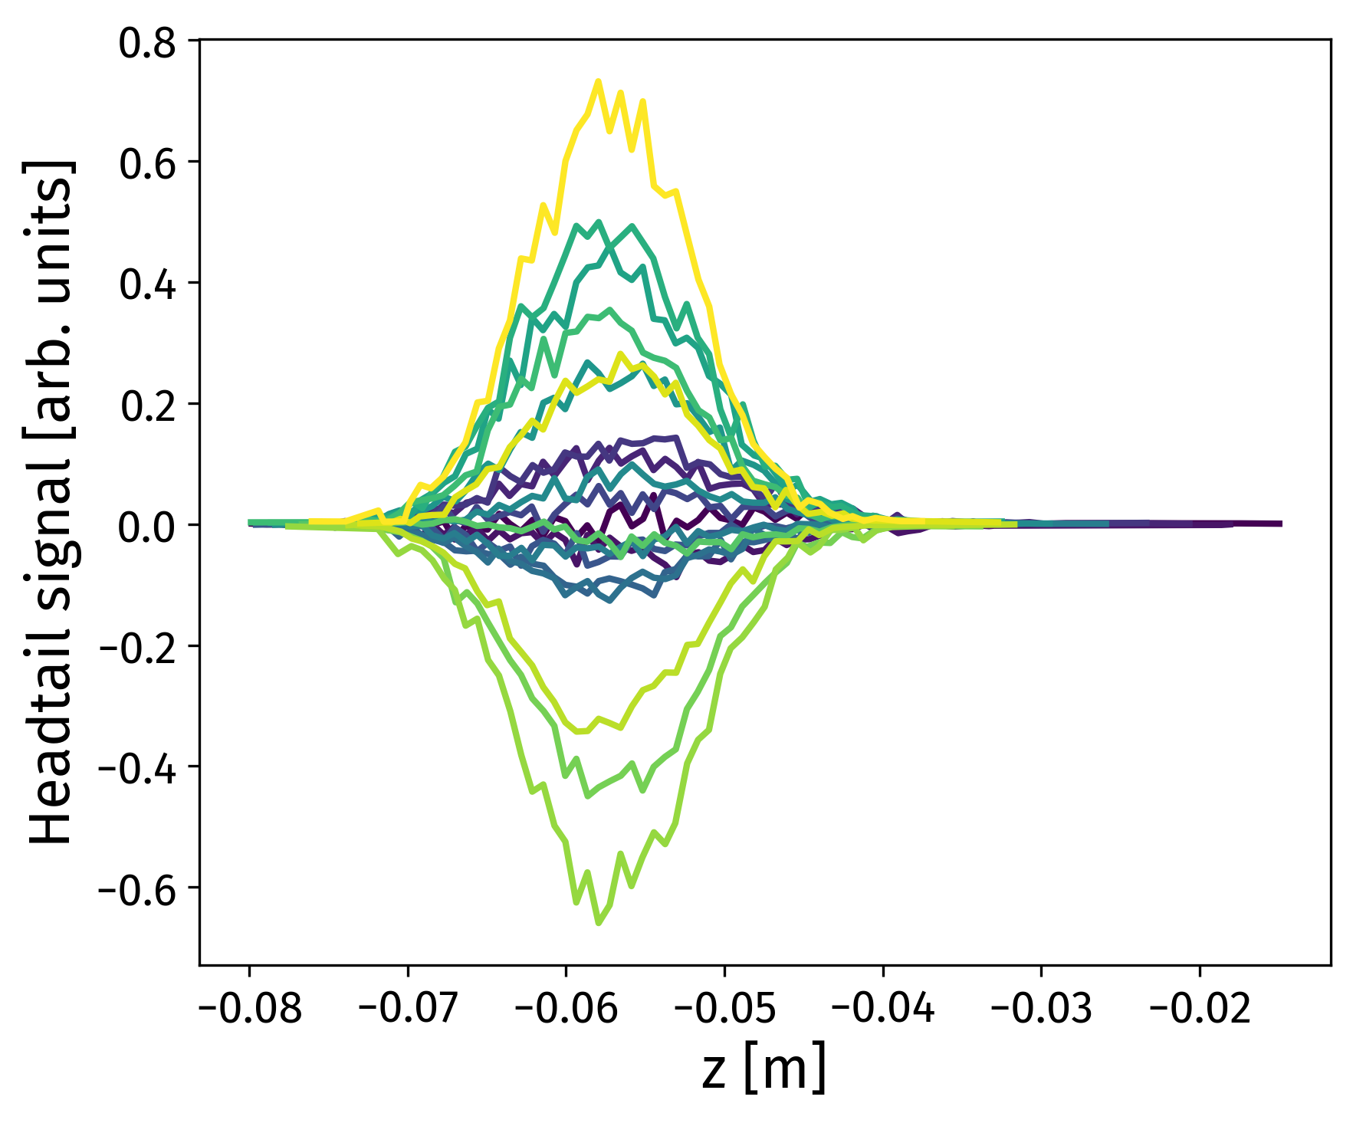
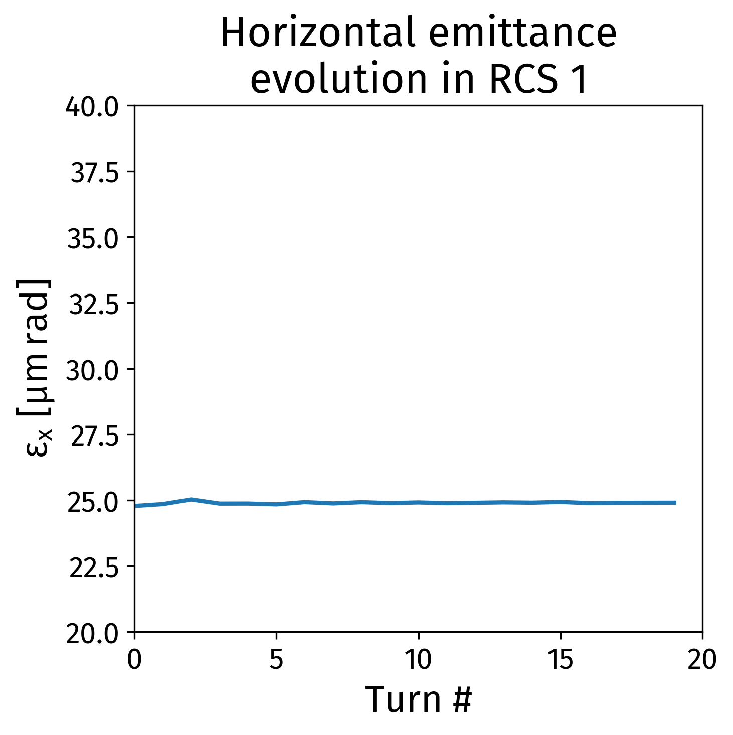
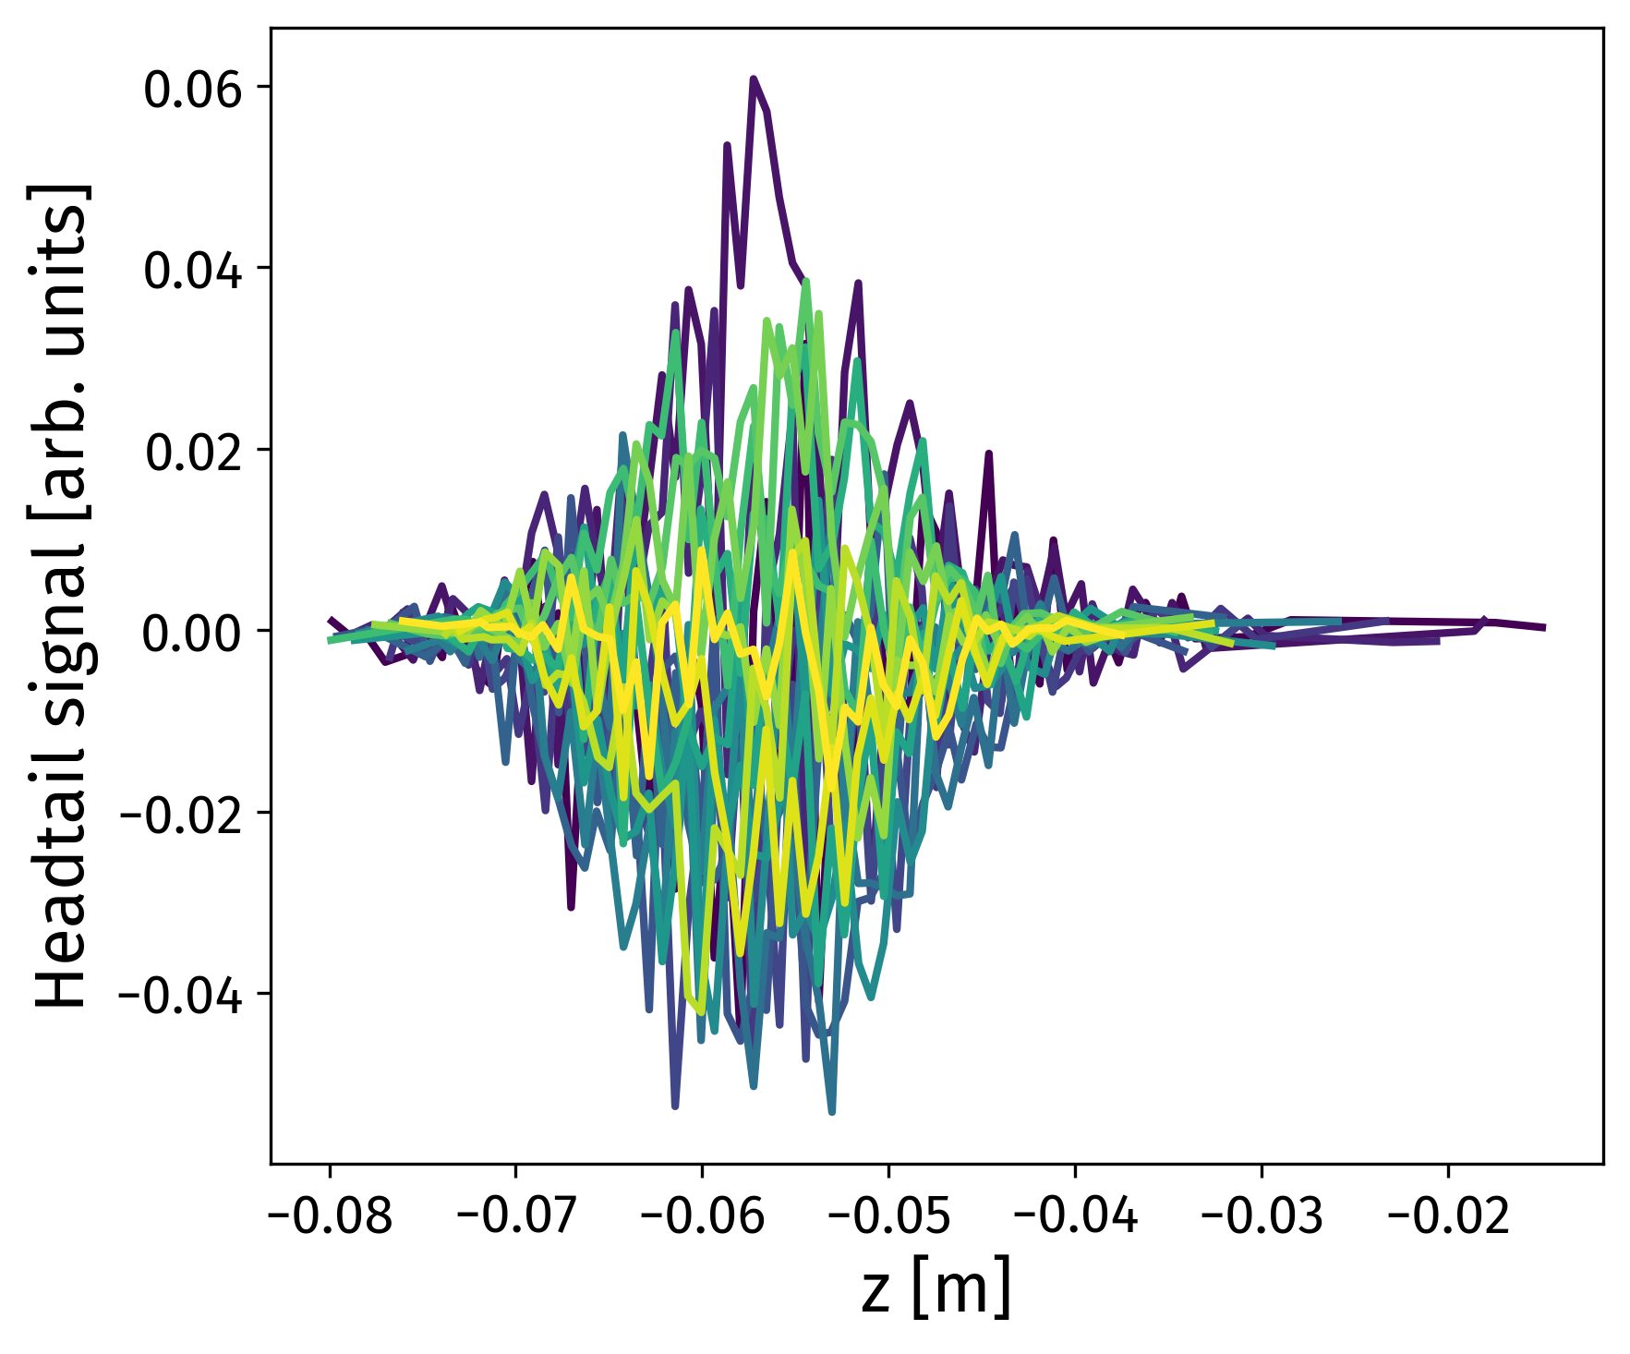
RCS 1: Effect of chromaticity on transverse beam stability
Q’_{x}=-19
Q’_{x}=-19
Simulation with a factor 2 on the impedance model
Check the effect of chromaticity
  In particular for the natural chromaticity Q’=-Q
  Could we operate without sextupoles?
Visible emittance growth and headtail
  motion with Q´=-19
Q’_{x}=0
Q’_{x}=0
Courtesy: David Amorim
See Accelerator design meeting 21/11/2022

Slide 14
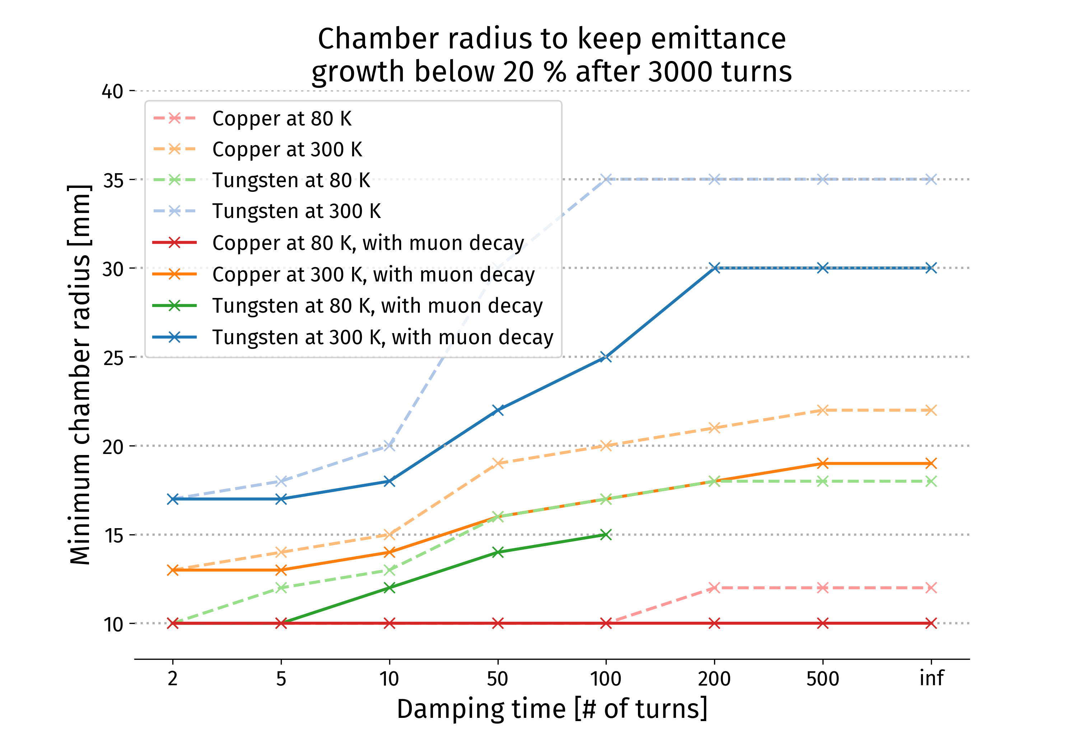
10 TeV collider: Minimum chamber radius achievable versus material
Courtesy: David Amorim
Investigate different materials for the vacuum chamber
  Tungsten 300 K and 80 K, Copper 300 K and 80 K
Find the chamber radius such as the emittance growth stays below 20 % for different damper gains.
With 100-turn damper: 17 mm radius required with Copper at 300 K, versus 25 mm with Tungsten at 300 K
See presentation at Collaboration Meeting

Slide 15
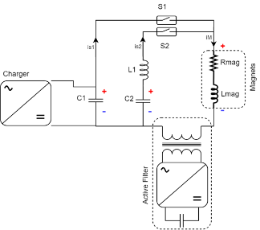
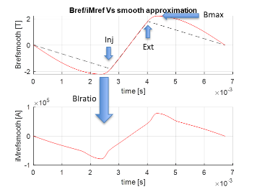
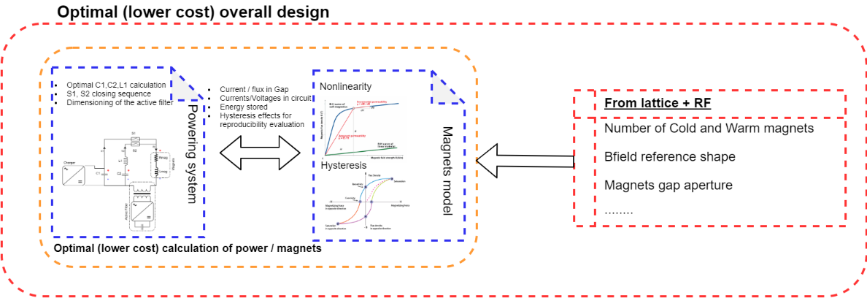
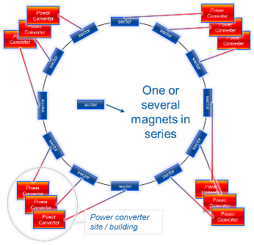
Accelerator magnets and powering system status
Preliminary results
Due to the considerable level of peak power required by the acceleration stage, the best approach is to use LC discharge circuits. Dual harmonics discharge circuits have been analyzed. They can provide close to linear Bref shapes during the acceleration. A pure linear acceleration profile will probably be extremely expensive because of the huge correcting power that the power electronics would be called to provide via the active filter.
However, the total power must be divided into several sectors (~100). So many LC circuits will probably all resonate differently due to differences in the LC parameters (and temperature effects). The active filter role would then be to correct the differences among all circuits which boils down to defining the required control accuracy.
It is important to optimize the design of the accelerating magnets and the power system together, in order to find an optimal solution with an acceptable cost.
Courtesy: Fulvio Boattini

Slide 16
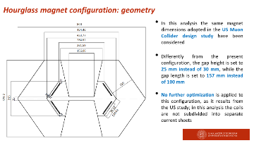
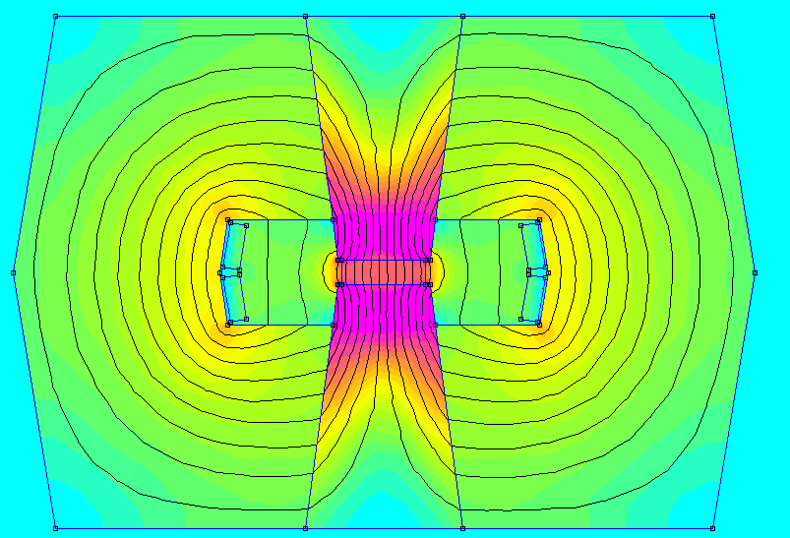
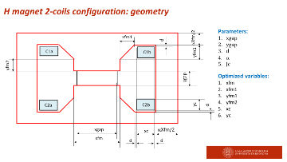
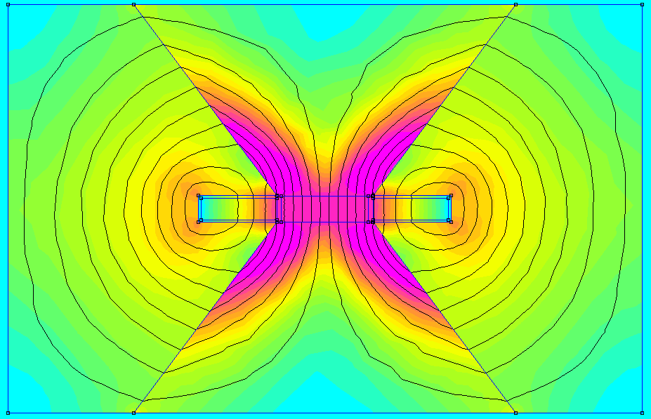
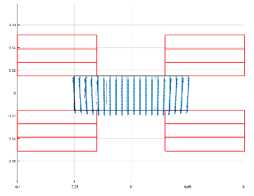
Accelerator magnets and powering system next steps
Courtesy: Fulvio Boattini
Resistive Magnets
Comparison of different Dipoles designs with different steel materials (CERN/UNIBO):
Comparison will be made based on:
Total NRG Vs Gap NRG ratio
Losses in Iron and copper
Material volume and cost
Integrated design of magnets and power systems requires magnetic models that consider saturation of magnetic materials and hysteresis (CERN/TUD)
Superconductive Magnets
Exploring SC magnet concepts that may profit from a rectangular aperture
Simplify magnet design, profiting from the small aperture (30 mm x 100 mm)
Adapt coil geometry
Attempt to use uniform technology through the collider complex
  HTS windings (for robustness)
  High current density (for cost reasons)
  Operation at high temperature (for energy efficiency)
We need to confirm beam decay losses (average 3W/m?)
Flat racetracks
12 mm tape
J_{E} = 650 A/mm²
B = 10 T
Calculations at Rref = 10 mm
B1 = 10.355
b3 = -7.2 units
b5 = -1.4 units
b7 = -0.03 units

Slide 17
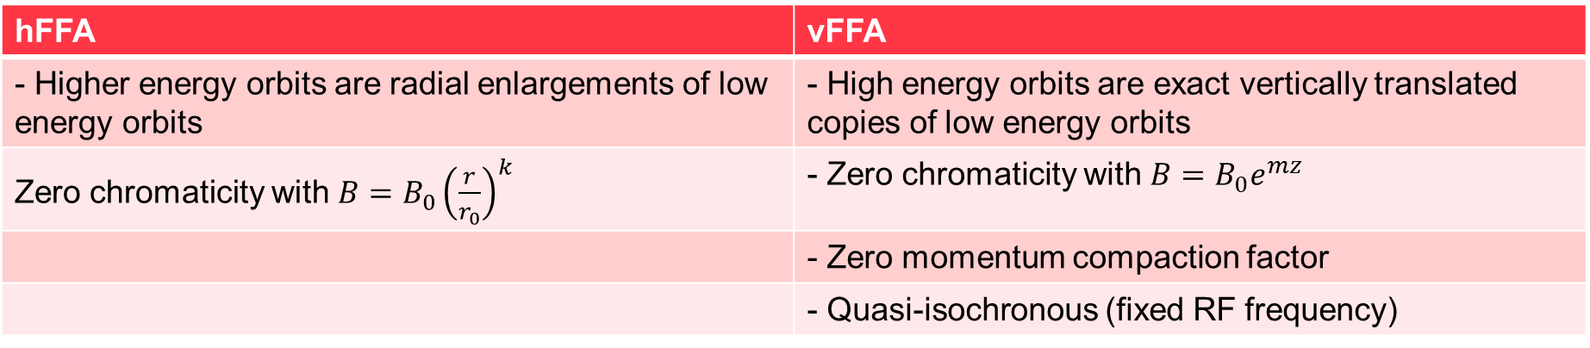
FFAs for muon acceleration
Courtesy: Max Topp-Mugglestone
Why FFAs?
Time-independent magnetic fields
  No ramp times
    Rate of acceleration limited only by RF
    Mitigates engineering challenges of designing and powering fast-ramping dipoles
  All magnets can be superconducting DC magnets
hFFA | vFFA
- Higher energy orbits are radial enlargements of low energy orbits | - High energy orbits are exact vertically translated copies of low energy orbits
Zero chromaticity with $B=B_{0}{\left(\frac{r}{r_{0}}\right)}^{k}$ | - Zero chromaticity with $B={B_{0}e}^{mz}$
 | - Zero momentum compaction factor
 | - Quasi-isochronous (fixed RF frequency)

Slide 18
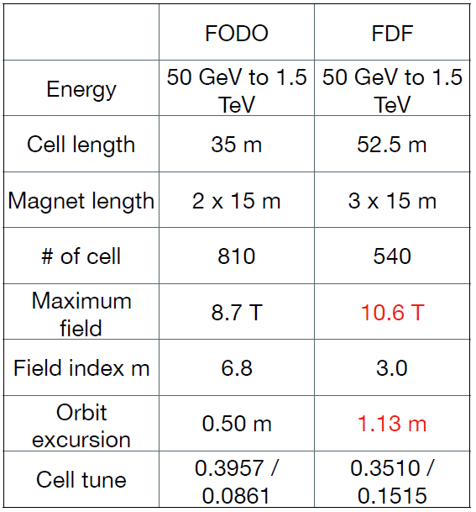
Drawback of the vFFA
Courtesy: Max Topp-Mugglestone
Limited understanding of optics
  Unique coupling behaviour
    Dominated by skew quadrupole focussing
    Solenoid components in fringe fields
  Nonplanar orbits
Challenging optimisation
Current research field: develop understanding of vFFA and optimise vFFA lattice for muon acceleration
  Reduce ring size
  Reduce excursion
  Maximise dynamic aperture
Table: early vFFA muon accelerator design parameter exercise (S. Machida, 2020)

Slide 19
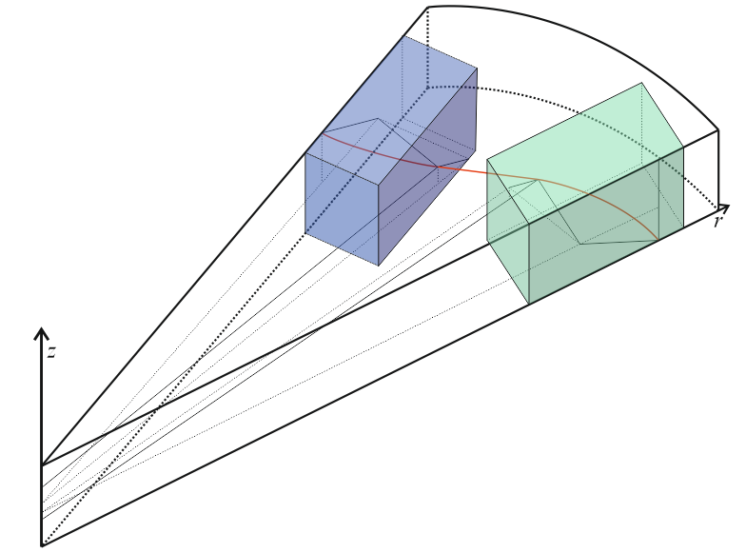
Update of vFFA study
Courtesy: Max Topp-Mugglestone
Analytic model of vFFA optics for large-ring
FODO lattices has been developed
  Non-planar orbit geometry
  Parameters of closed orbit derived
  from geometric constraints
  4d decoupled tunes and stability of
  candidate lattices can be evaluated
  without numerical simulation*
  Numerical crosscheck of new model is not complete!
Next steps:
  Numerical benchmarking of analytic model
  Use analytic model to optimise vFFA lattices for muon acceleration
    Optimising for lowest peak B-field, lowest excursion (difference in orbit position between injection and extraction) for given energy sweep.
Physical prototype of vFFA magnet due for construction
Figure: 3d geometry of the closed orbit model for a vFFA FODO half-cell. The red line shows the closed orbit; the blue and green boxes represent the D and F magnets respectively. The z-axis is positioned at the machine centre

Slide 20
Summary and next steps
The main goal of this WG is to gather information (from other WGs) to get a coherent parameter table for a chain of pulsed synchrotrons or FFA. We get regular meetings in this aim.
A parameter table is regularly updated here: https://cernbox.cern.ch/index.php/s/I9VpITncUeCBtiz
  The current baseline has 4 RCS to go up to 5 TeV with possible reuse of LHC tunnel.
  Genetic algorithms are considered also to optimize the different stages (already a good agreement with current table).
We have a margin of 8 on stability due to (ILC-like) cavity impedance.
  Nevertheless, the HOM power is huge: 10 kW.
  We will consider another frequency like 800 MHz to see the improvement.
Stability studies show that we should correct the chromaticity in RCS1.
For the collider, resistive wall impedances require a beam screen radius of 17 mm with Copper at 300 K against 25 mm with Tungsten at 300 K. The studies need to be updated for the acceleration chain.
Dual harmonics discharge circuits can provide close to linear Bref shapes during the acceleration.
We have first design of the resistive and SC magnets. The work is on-going.
Analytic model of vFFA optics for large-ring has been developed. The next steps are numerical benchmarking, lattice optimization and magnet protype construction.

Slide 21

Thank you
for your attention

Slide 22
Backup

Slide 23
Strong interaction with other WPs
Physics
Collider
Muon production and cooling
Cooling cell
Muon acceleration
Detector and MDI
Beam-matter interaction
Protons
Magnets
Collective effets
RF
Demonstrator

Slide 24
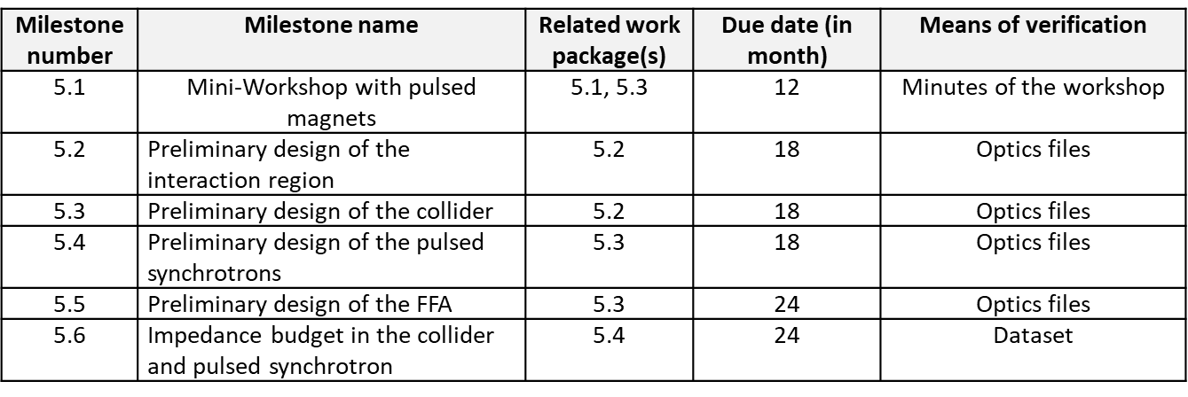
MuCol
Milestones

Slide 25
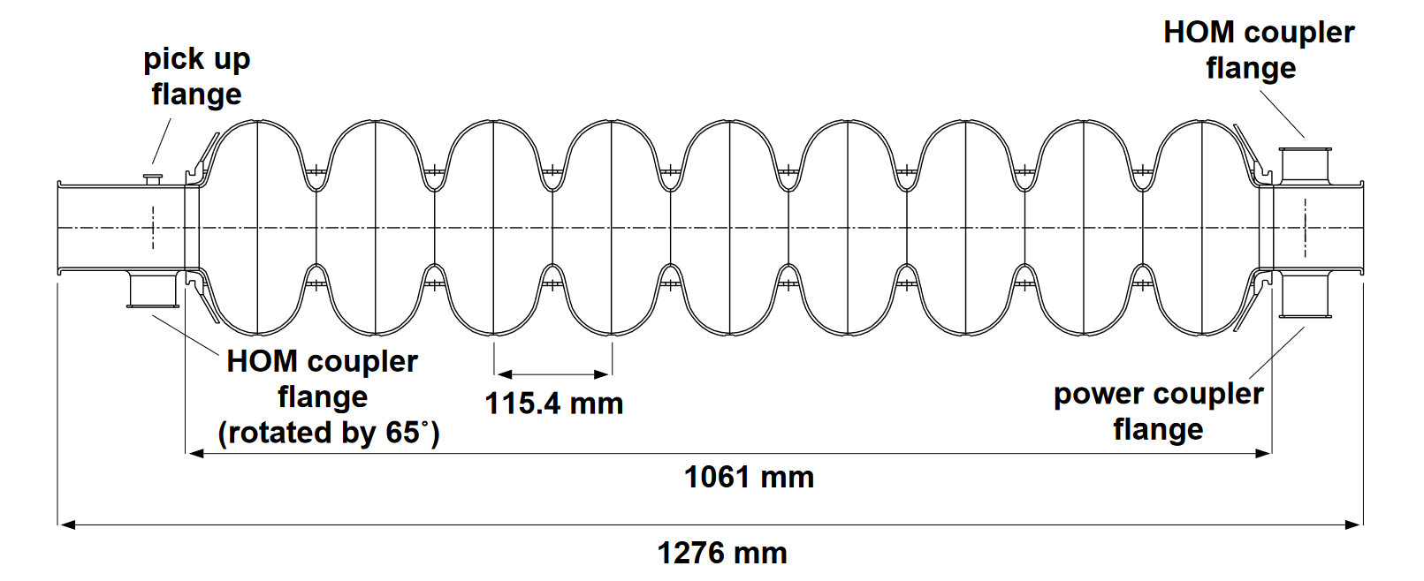
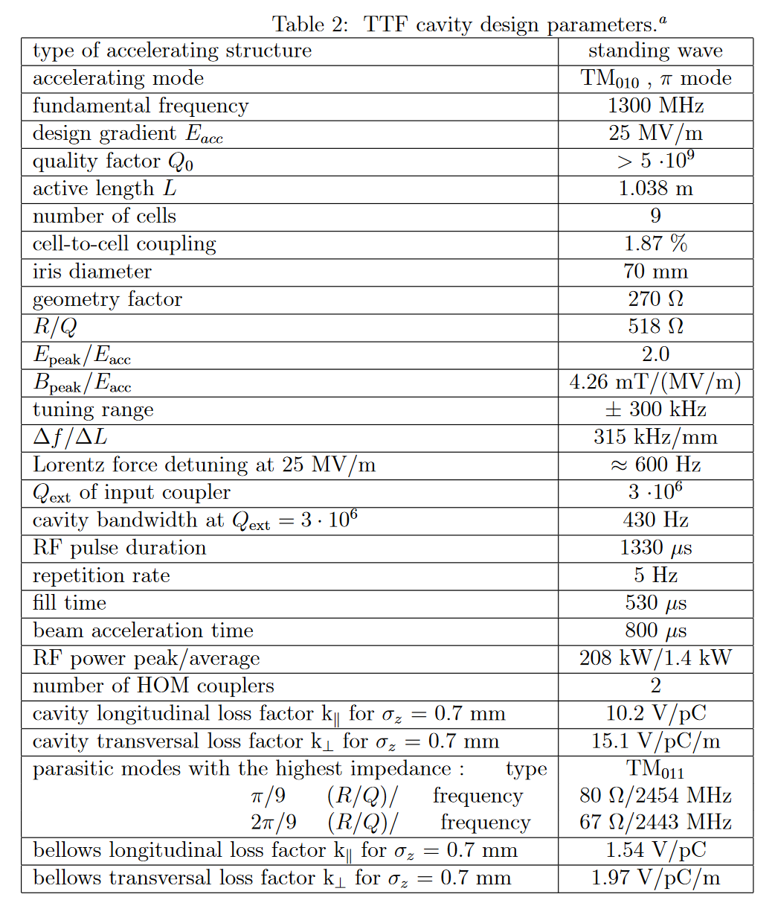

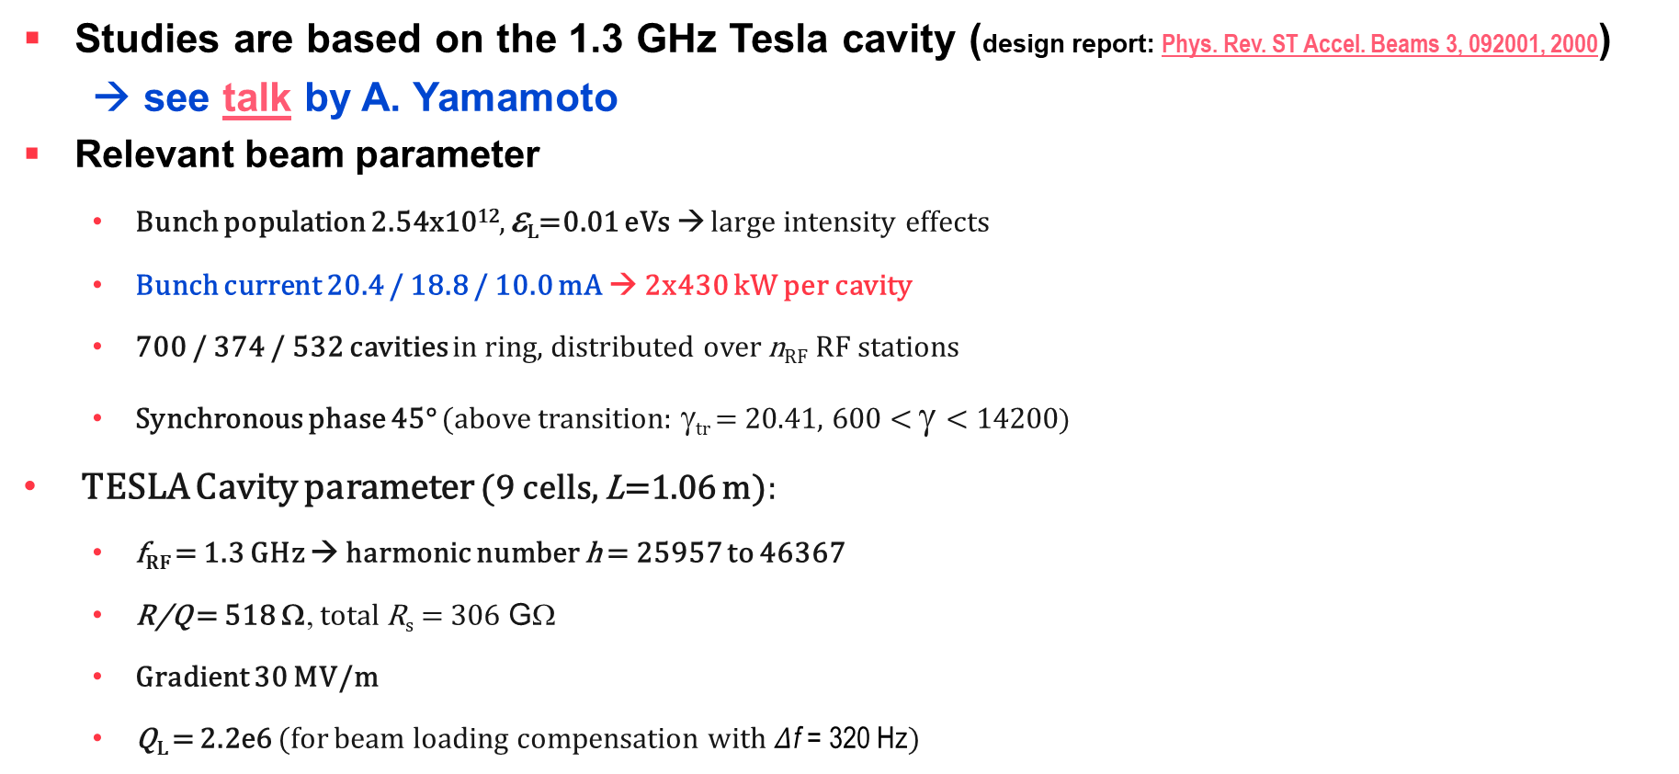
Parameters and tools:
RF – The TESLA cavity
From design report
Studies are based on the 1.3 GHz Tesla cavity (design report: Phys. Rev. ST Accel. Beams 3, 092001, 2000)
→ see talk by A. Yamamoto
Relevant beam parameter
  Bunch population 2.54x10¹², ε_{L}=0.01 eVs → large intensity effects
  Bunch current 20.4 / 18.8 / 10.0 mA → 2x430 kW per cavity
  700 / 374 / 532 cavities in ring, distributed over n_{RF} RF stations
  Synchronous phase 45° (above transition: γ_{tr} = 20.41, 600 < γ < 14200)
TESLA Cavity parameter (9 cells, L=1.06 m):
  f_{RF} = 1.3 GHz → harmonic number h = 25957 to 46367
  R/Q = 518 Ω, total R_{s} = 306 GΩ
  Gradient 30 MV/m
  Q_{L} = 2.2e6 (for beam loading compensation with $Δ$f = 320 Hz)
(with 30 MV/m accelerating gradient)
Courtesy: Fabian Batsch
From design report

