Slide 1

4th PLC Based Control systems workshop
7th September 2023

Slide 2
Organisation
CERN, Beams Department, Industrial Controls Systems Group
Jeronimo ORTOLA
Enrique BLANCO
Brad SCHOFIELD

Slide 3
Objectives
Create collaborative atmosphere
Promote exchange of expertise, methods, tools, solutions, lessons learned…
Seek for collaboration opportunities.

Slide 4
Scope
Control systems specification: Formalisation
Engineering: standardisation, automated code generation, versioning.
Testing and verification: methods, automated testing, virtual commissioning.
Maintenance: Obsolescence, upgrades.

Slide 5
Workshop participants
19 institutes
Australian Nuclear Science And Technology Organization
CEA Paris-Saclay. France
CERN. Switzerland
ELETTRA Synchrotron Trieste. Italy
European Spallation Source. Sweden
European XFEL (X-Ray Free-Electron Laser Facility). Germany
Helmholtz. Germany
INFN-LNL. National Institute for Nuclear Physics. Laboratori Nazionali di Legnaro. Italy
Institute of High Energy Physics, CAS. China
Institute of Modern Physics, Chinese Academy of Sciences. China
King Faisal Specialist Hospital And Research Centre. Saudi Arabia
Lawrence Livermore National Laboratory. United States
LNLS. Laboratório Nacional de Luz Síncrotron. Brazil
Oak Ridge National Laboratory. United States
iThemba Laboratory for Accelerator Based Sciences (NRF-iThemba LABS). South Africa
SLAC National Accelerator Laboratory. United States
UKRI. UK Research and Innovation. UK
PARTREC. Particle Therapy Research Center. Netherlands
SARAO. South African Radio Astronomy Observatory
1st | Barcelona 2017 | 45
2nd | New York 2019 | 34
3rd | Shanghái 2021 | 57
4th | Cape Town 2023 | 55
7 companies
AWE
Beckhoff
Medaustrron
FMBFeinwerk Und Messtechnik
PROCON
Observatory Sciences Ltd.
Nusano

Slide 6
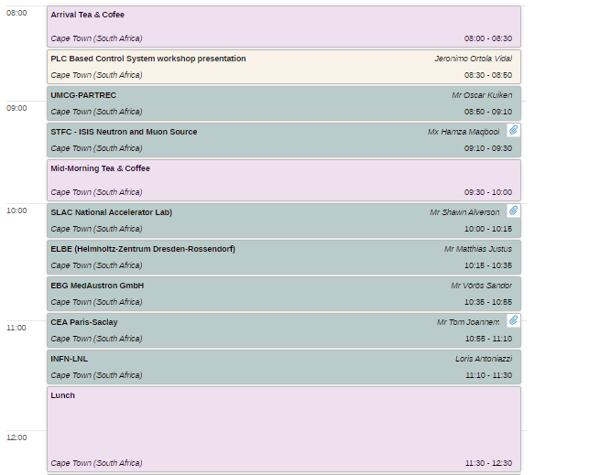
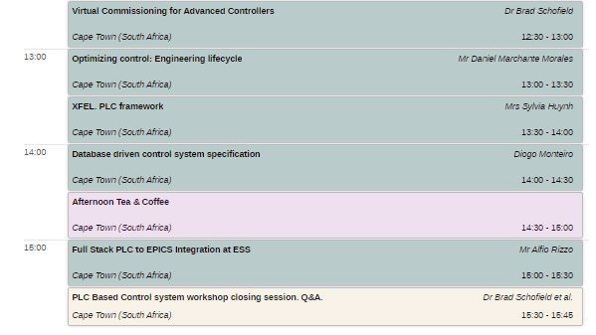
Agenda

Slide 7
Please sign up to the workshop event in INDICO
https://indico.cern.ch/event/1250169/
Thanks for your contribution and participation!

