Slide 1
Controls at the
ISIS Neutron and Muon Source
Hamza Maqbool
Target Controls Engineer
hamza.maqbool@stfc.ac.uk
Rutherford Appleton Laboratory, Oxfordshire UK

Slide 2
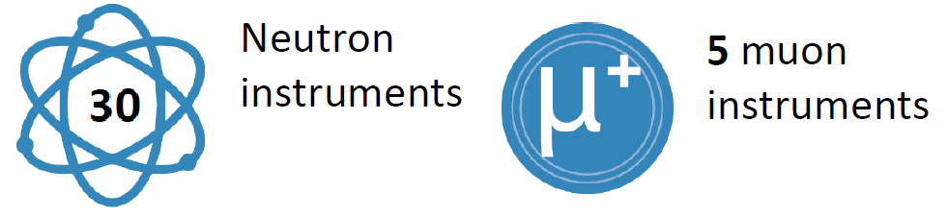


ISIS NEUTRON AND MUON SOURCE
World leading materials science research centre near Oxford, serving the UK and international scientific community
First neutron spallation in 1984
Study materials at the atomic level using a suite of advanced scientific instruments

Slide 3
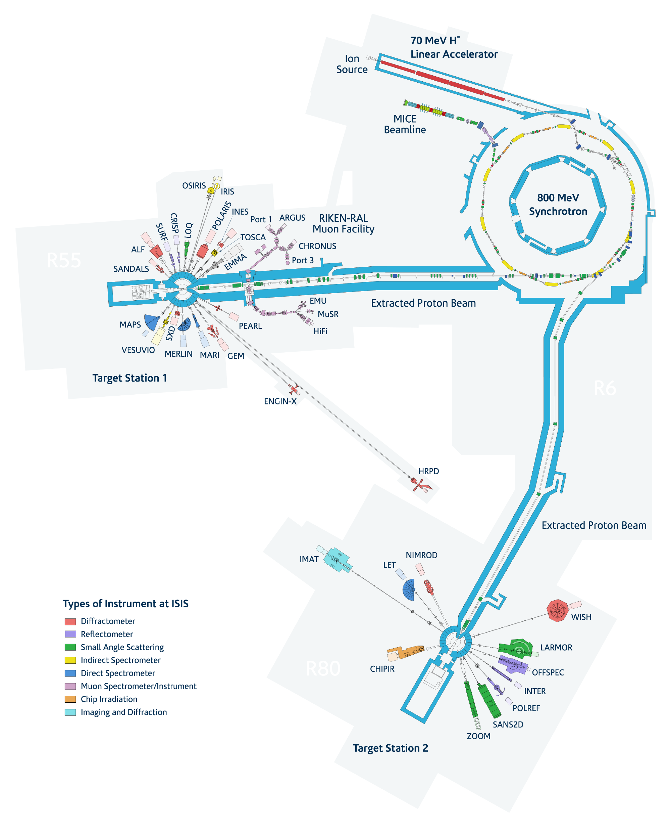
THE FACILITY
Accelerated Proton beam to impact various Targets for generating Neutrons and Muons
Negative Hydrogen ions are generated in the ion source
A Radio Frequency Quadrupole (RFQ) and four Drift Tube Linac (DTL) cylinders in series accelerate the ions further
The ions are converted into protons and the synchrotron performs the final acceleration
The protons are sent to the two Target stations where they generate Neutrons and Muons for use in Instruments

Slide 4
EXPERIMENTAL HALLS
Target Station 2
Target Station 1

Slide 5
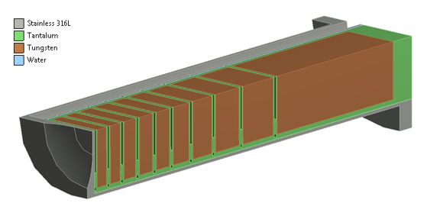
TARGET CONTROLS
Design and Operational Support
Tungsten Targets
Triple Water-cooling circuits
Cryogenics: Methane and Hydrogen moderators
Beryllium Reflectors
TRaM
Target

Slide 6
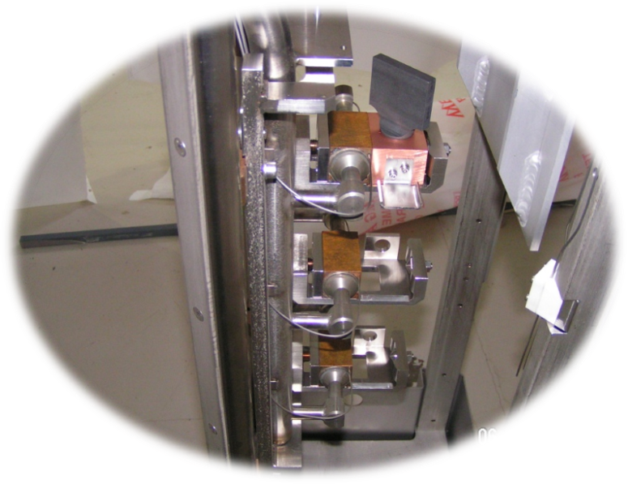
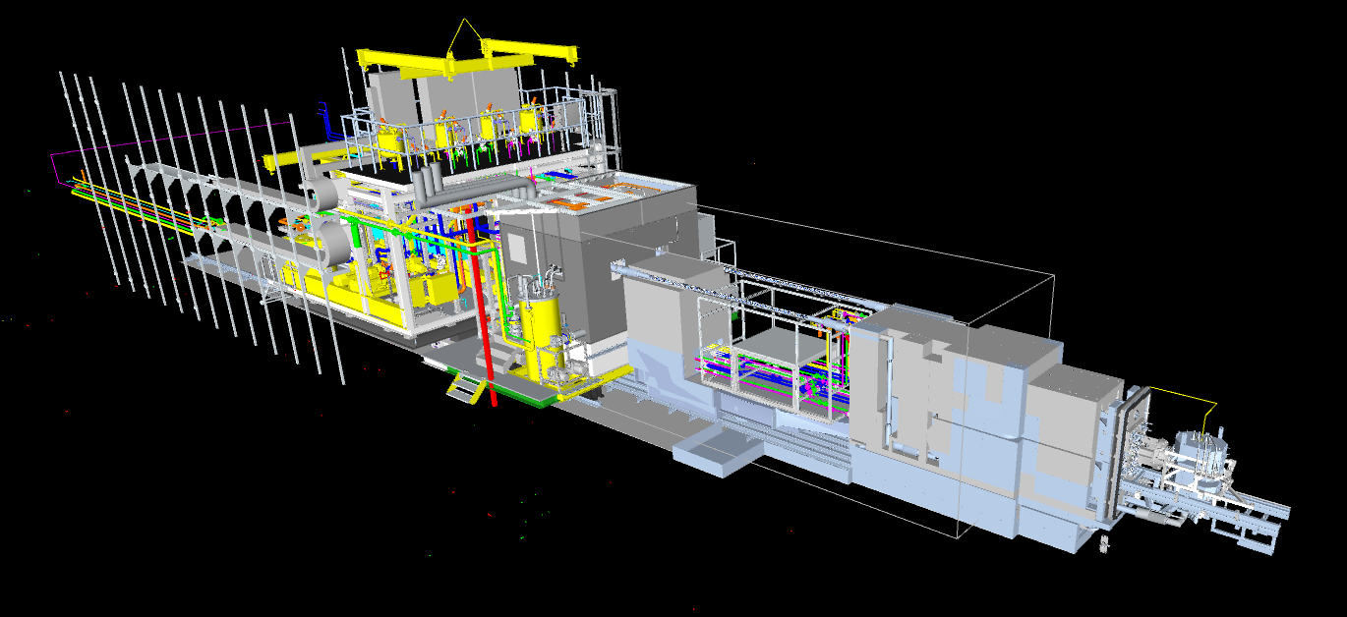
OTHER SYSTEMS
Target Services Area with Void Vessel in the front
Graphite Muon Target

Slide 7
TECHNOLOGY
Bespoke electronics in early days
Control by Omron PLC
  Originally designed on C500, CS PLC
  Most systems transitioned to CJ PLC
  EtherNet/IP, with DeviceNet for Remote I/O
Some turnkey solutions on Siemens S7-300 in Target Station 2
Interfaces
  Process Instruments via PR, Pepperl+Fuchs converters
  Radiation monitoring (radiation count, alarms)
  Vacuum Pump control (Roughing/TMP) directly from PLC/HMI
  Cryogenics, Water cooling pumps controlled by ABB drives
  Safety PLCs for beam trip (Omron/Pilz/Allen Bradley)

Slide 8
RECENT UPGRADE
Target Station 1 mechanical upgrade
Transition to Omron NJ PLC on base systems (Cryogenics/Cooling)
  Tag based addressing
  EtherCAT for Remote I/O
  EtherNet/IP to connect with Main Control Room, HMI, DC Power Supplies in cabinet
  Online edits via network gateway
  Sysmac Studio: one software instead of previous CX-One suite, one program file
Ladder Logic, ST (inline), Functional Blocks (safety)
Documentation
  Drawing database on Autodesk Vault
  Digital User Manuals (critical information on HMI help prompts)
EPICS integration

Slide 9
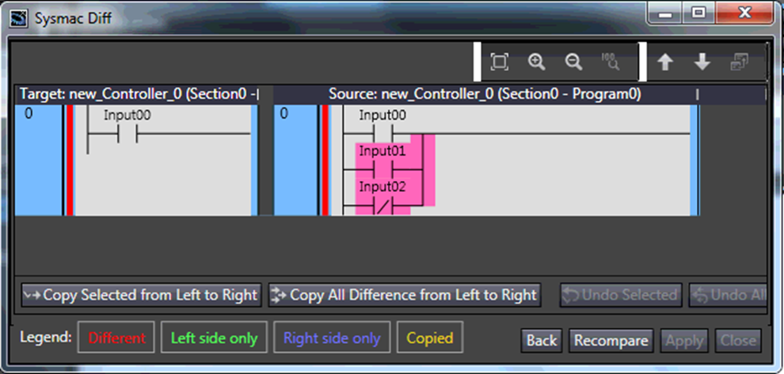
ONGOING PROJECTS
Using code blocks standardized in upgrade
TS1 auxiliary systems (RGA, shutters)
Intermediate Target upgrade
TS2 existing Siemens S7 turnkey solution to Omron
New Version Control in Sysmac Studio
Collaborations for planned ISIS-II facility (Investigating Reinforcement learning, Data-driven, MPC)
Sysmac Version Control

Slide 10
CHALLENGES
Reverse Engineering (Upgrading Turnkey solutions)
  Some code blocks locked as contractor IP so needed to call them for servicing
  Not written to standards
  Lack of proper documentation
Limitations of smart, complicated electronics in Radiation areas
Balancing design work with operational support hinders speed of upgrades

Slide 11
THANK YOU

