Slide 1
Medicine. Research. Hope.
Particle Therapy at MedAustron
Sandor VÖRÖS, MSc
Controls Engineer

Slide 2




About medaustron
  Center for particle therapy for cancer treatment and for research.
Is one of only six comparable centers worldwide.
  Helps cancer patients with an advanced and rare treatment method.
  Improves particle therapy and creates more evidence through research.
  Has expertise in designing, building, commissioning, certifying & operating an accelerator.

Slide 3











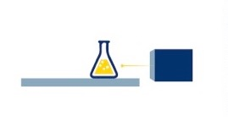



Company History
Ground breaking
Reorientation: MedAustron – therapy and research
EIA process
Company foundation
EBG
CE certification & 1st patient
MedAustron feasibility and design studies
Building finished
2005
2009 - 2010
2011
2013
1989 - 1994
1996 - 2000
2014 - 2016
2016
1995
1998 - 2004
2007
2012
2007 - 2012
  Signing basic agreement on realisation
  Rep. of Austria - Federal State of Lower Austria – city of Wiener Neustadt
Start accelerator installation
AUSTRON feasibility study
(research facility neutron spallation)
Start research program
Proton-Ion Medical Machine Study
  Cooperations
  CERN & CNAO:
  design, tendering, manufacturing of accelerator components
Commissioning, preparation certification

Slide 4
Particles in particle therapy
2
1
H
6
C
He
Hydrogen
1,008
Carbon
12,011
Helium
4,003
PROTONS
Up to 250 MeV
CARBON IONS
Up to 430 MeV/u
HELIUM IONS
Sparing of organs at risk and healthy tissue
Possible future canditate – currently subject of research
Higher dose in the tumor / application in radioresistant tumors
Notes:
Protons up to 800 MeV for NCR, 250 MeV for clinical treatment
Carbon Ion up to 430 MeV

Slide 5

Indications treated at medaustron
Central Nervous System
Head & Neck
Re-Irradiation
Pediatrics
Sarcoma
Skull Base
Prostate
Gastrointestinal (upper)
Gastrointestinal (lower)
Gynecological Tumors
Urogenital Tumors
Breast/Mamma-Ca<
26%
20%
16%
16%
11%
6%
3%
2%
<1%
<1%
<1%
<1%
Total planned 2023:
550
Patients
11,000
Single Fractions
Values (rounded) as of May 2023
Notes:
CNS…Central Nervous System

Slide 6
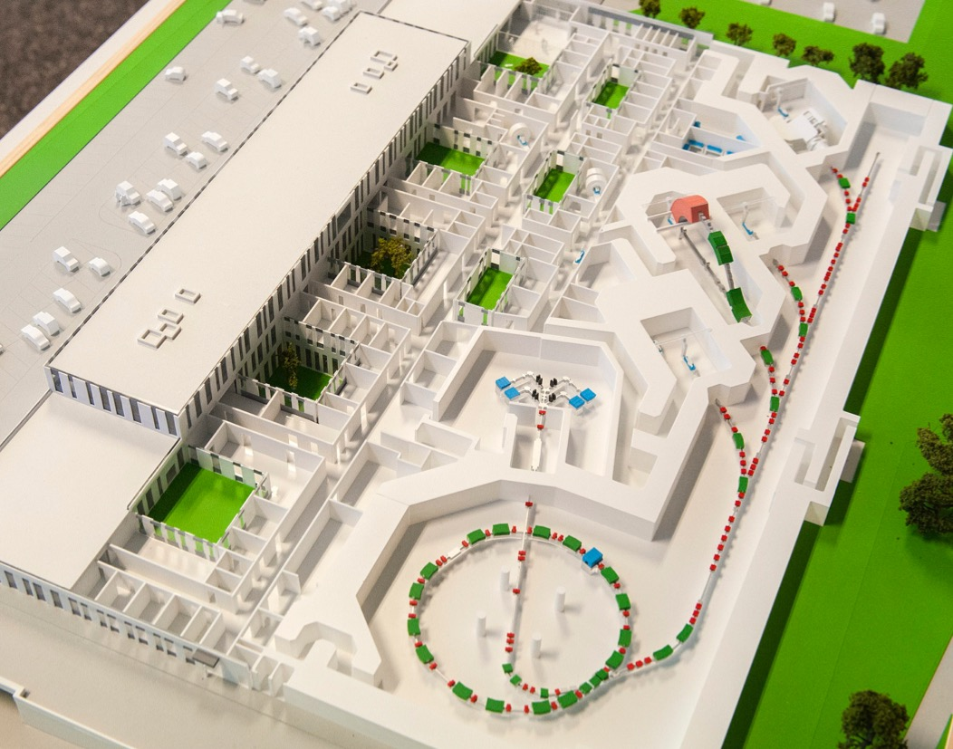
Facility overview
  Irradiation Rooms
  Three rooms for patient treatments
  Research
  Irradiation room for non-clinical use
  Ion Sources
  and linear accelerator
  140 m
  Synchrotron
  = circular accelerator

Slide 7
PLCs in the Medaustron control System

Slide 8
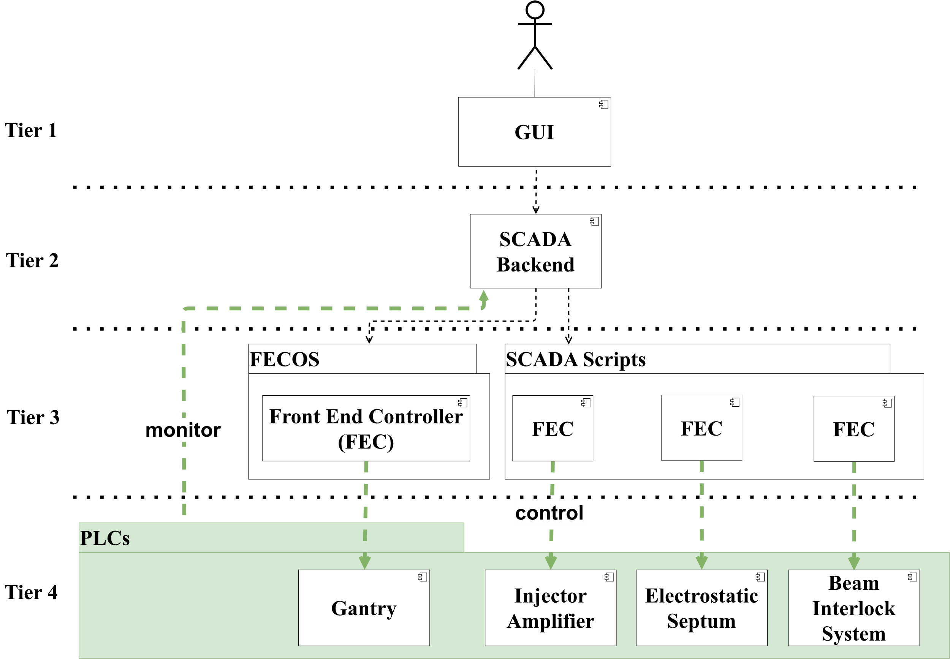
Architecture

Slide 9
Ongoing challenges

Slide 10
Operational Safety system
Purpose
  Protection of personal against unintended irradiation
  Device protection
Key features
  Separated into 2 main PLCs
    Beam Interlock System
    Patrol Control System
  2x SIMATIC S7 CPU 417-5H
  Protection of personal up to SIL 2 according to IEC 62061 (TÜV certified)
  Distributed communication via Profibus over 23 racks
  Connected to 900 different devices via 1600 inputs and 1000 outputs
  Protection of personal programmed in Continuous Function Chart
  Device protection programmed in Instruction List (script generated)

Slide 11
MAJOR challenges
Single CPU for the entire accelerator
  Service activities and changes are exclusive of machine time in case of a CPU stop
Difficult to ensure that only indented source code is changed
  Lack of regression testing makes code refactoring almost impossible
Site Acceptance Test is a lengthy task occupying the entire accelerator
  Lack of factory acceptance tests

Slide 12
MAJOR challenges – Single CPU
Option 1 – Separation of concerns
Advantages
  Parallel commissioning
  Reduced downtime in case of a failure
  Better traceability of code changes
Disadvantages
  Increased cost – 14 CPUs instead of 2

Slide 13
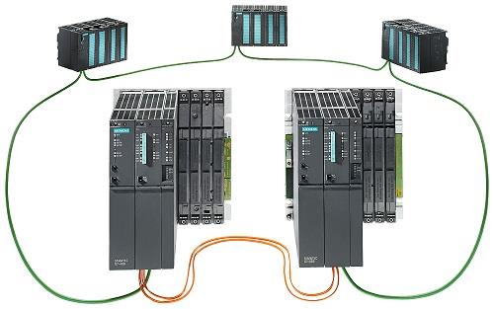
MAJOR challenges – Single CPU
Option 2 – Redundancy
Advantages
  Switchover during program changes
  Increased availability
Disadvantages
  Increased cost – 4 CPUs instead of 2
1

Slide 14
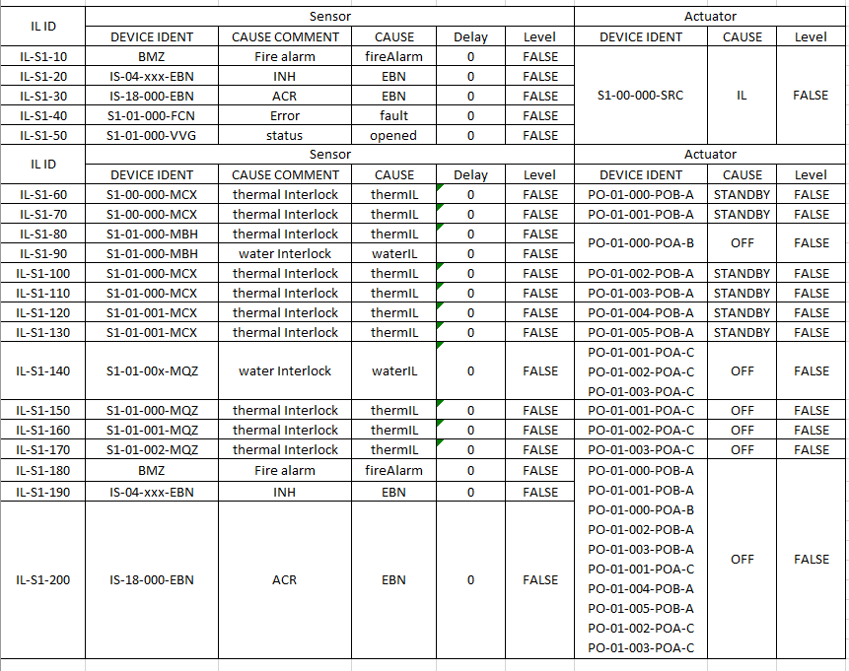

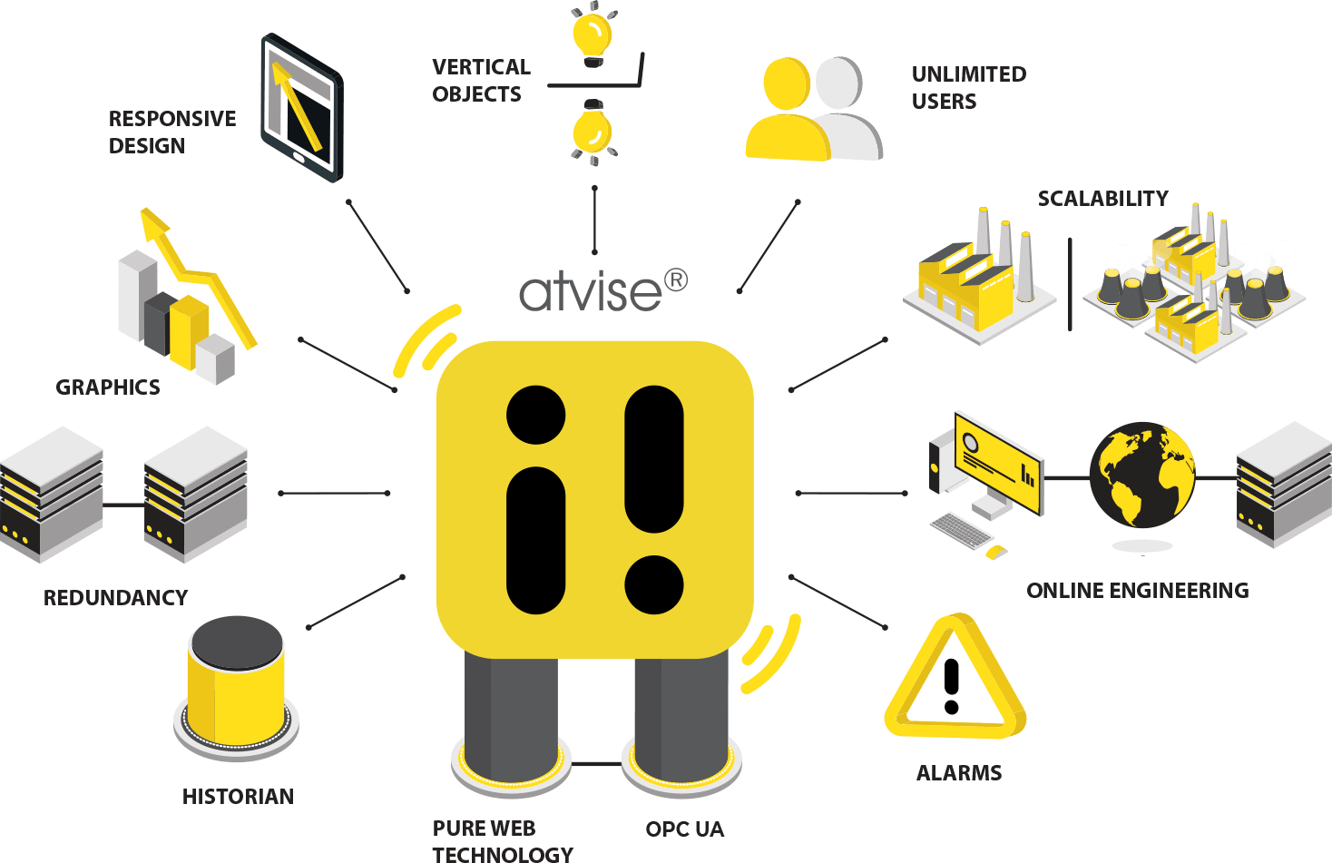
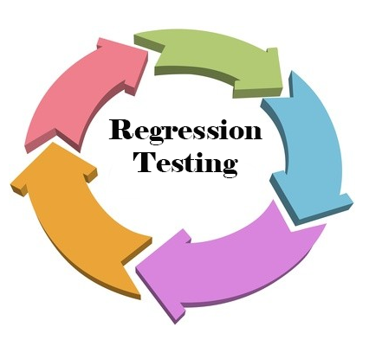

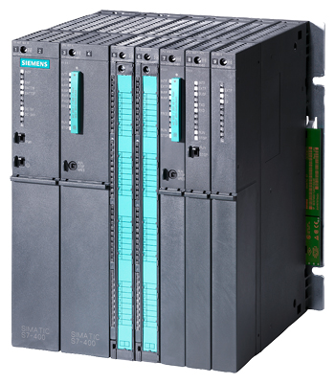
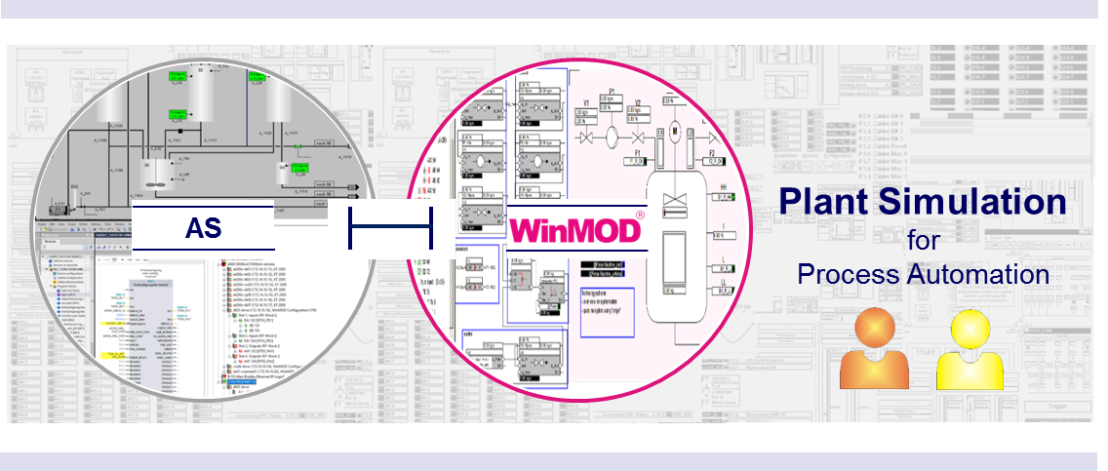

MAJOR challenges – Regression tests & FAT
CAUSE & EFFECT TABLE
5
2
OPC UA
TCP/IP
OPC UA
FAT
1
3
4
TCP/IP

Slide 15
Thank you for your attention!

Slide 16
References and sources
https://www.siemens.com/global/en/products/automation/systems/industrial/plc/simatic-s7-400.html
https://atvise.vesterbusiness.com/
https://www.winmod.de/english/utilizations/plant-simulation/
https://www.iconbunny.com/icons/banking-record-clearance-line-green-black-icon
https://www.360logica.com/blog/wp-content/uploads/2014/05/Importance-of-Regression-Testing-in-Software-Development.png

