Slide 1
CEA Paris-Saclay
PLC based control systems
Tom Joannem

Slide 2
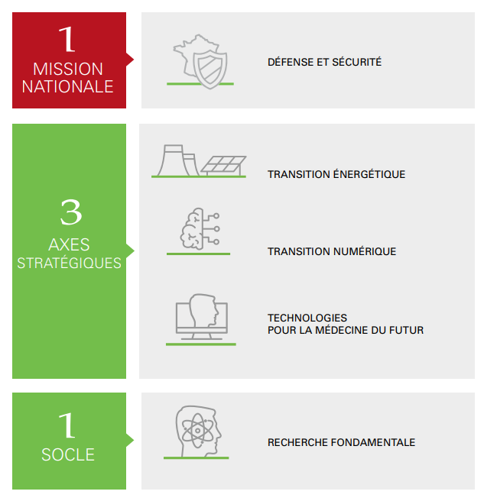
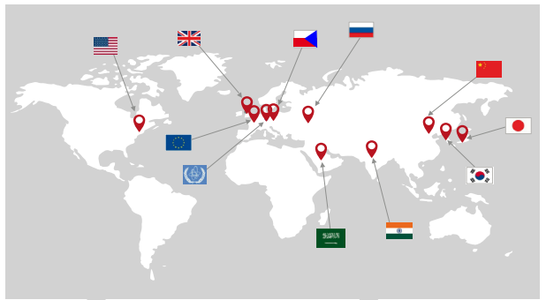
CEA
1
NATIONAL
MISSION
Defence and security
Energy transition
3
STRATEGIC
AXES
Numeric transition
Next generation medecine technologies
1
BASE
Fondamental research

Slide 3
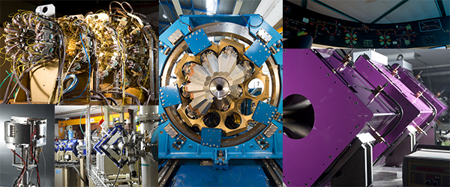
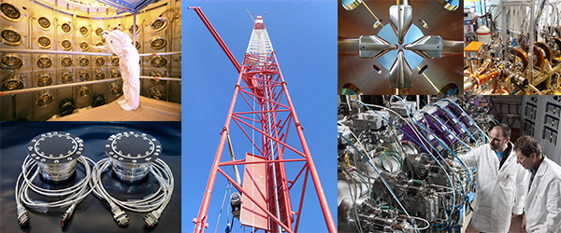
IRFU institute
  Research institute on the fundamental laws of the universe
    Department of Accelerators, Cryogenics and Magnetism
    Department of Astrophysics
    Department of Detector Electronics and Computing for Physics
    Department of Systems Engineering
    Department of Nuclear Physics
    Department of Particle Physics
    GANIL particles accelerator

Slide 4
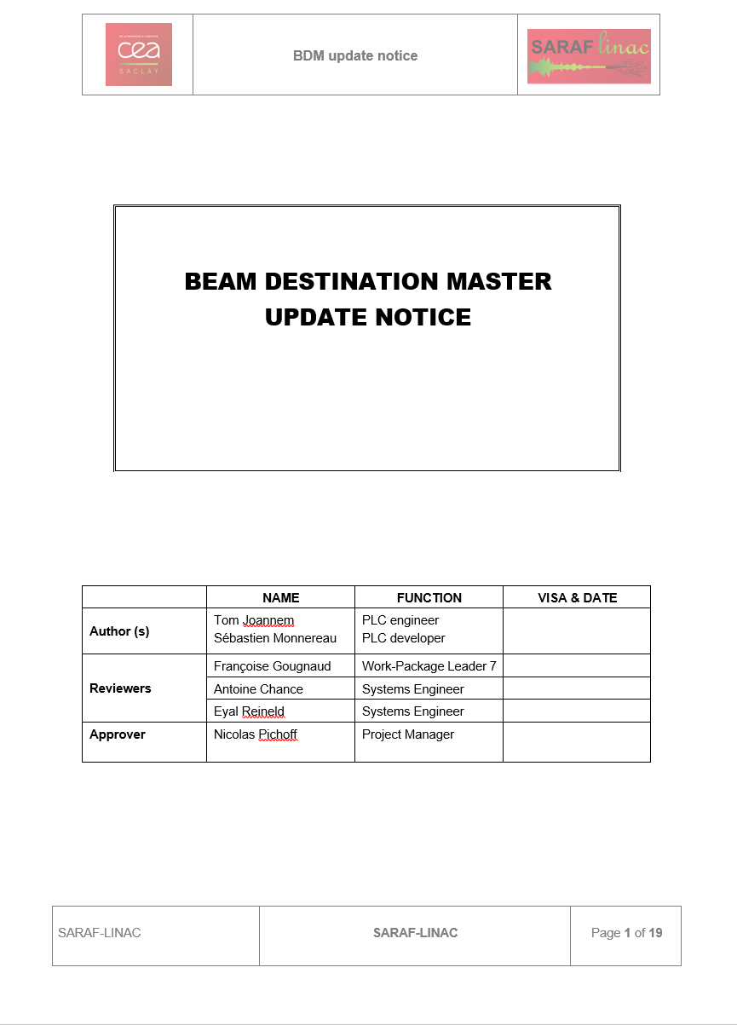
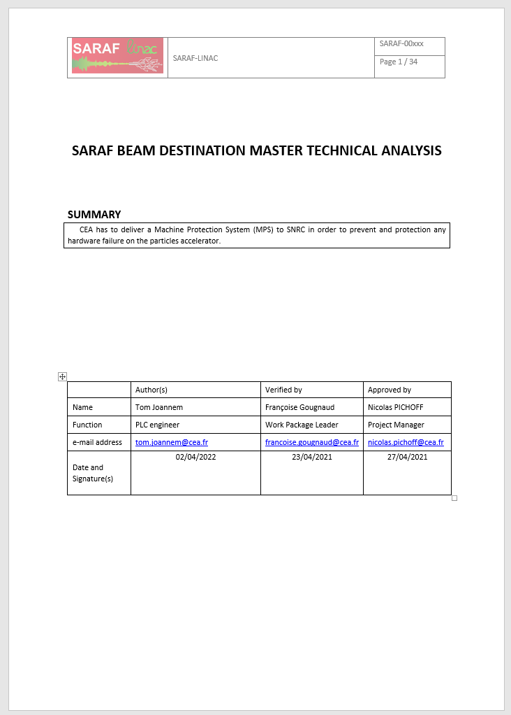
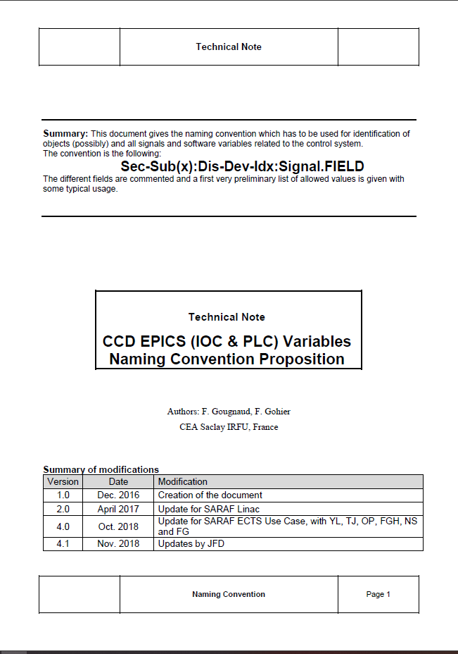
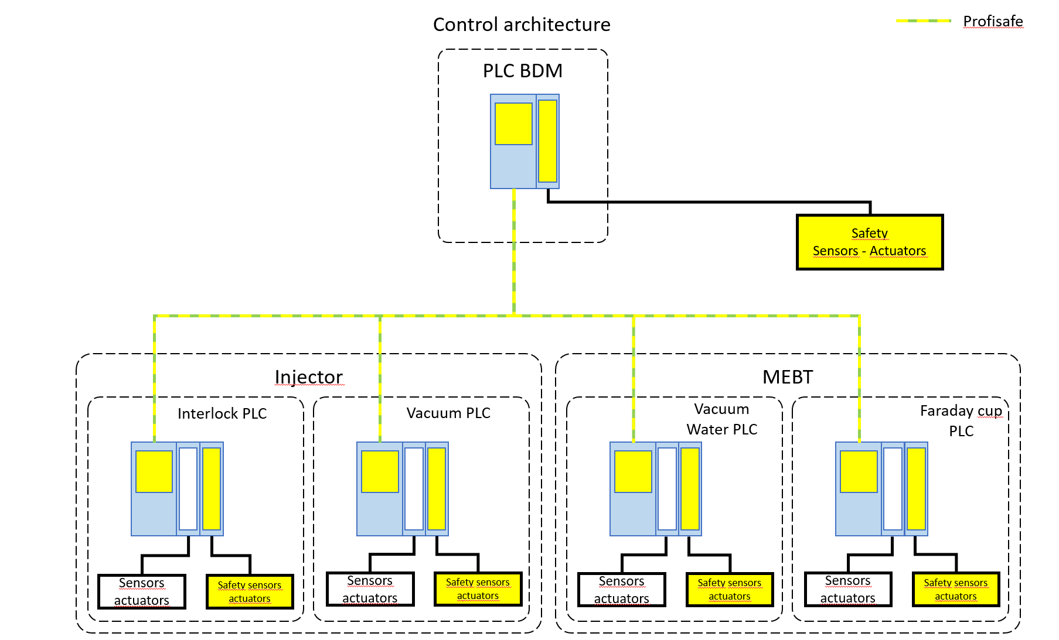
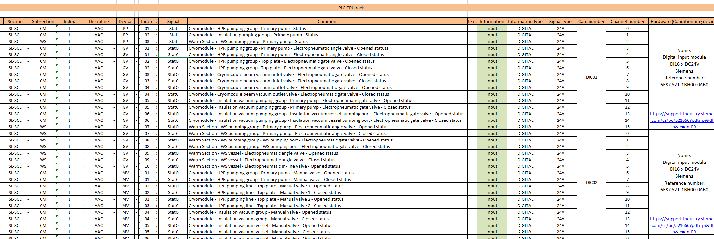
Control System Specification
  Standard laboratory documents:
    Signal specification document
    Control architecture document
    Naming convention
    Functionnal analysis
    User manual

Slide 5
Control System Specification
  Standard laboratory documents:
    Naming convention
      EPICS name definition for electrical expert, EPICS expert, PLC expert,
      cryogeny and vacuum expert
    Signal specification document
      EPICS name, description, signal range, PLC card and references

Slide 6
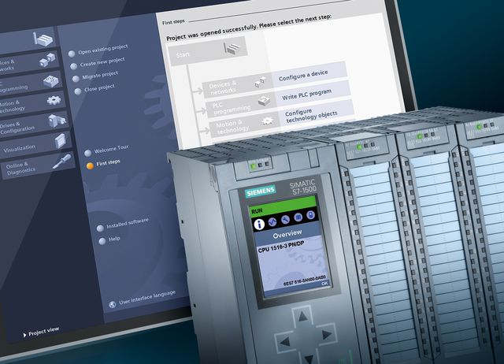


Project development
  Standard laboratory hardware:
    Siemens 1500 CPU and cards, MP format
    Siemens 1500 CPU and cards, SP format
    Siemens TouchPanels
  Standard laboratory software:
    Siemens TIA Portal V16/V17
    Siemens WINCC UA
    EPICS Phoebus
    Conversion tool from Autocad to EPICS
    Conversion tool from PLC database to EPICS IOC
    (PLCParserTool)
  Standard laboratory function library:
    Siemens TIA Portal V16 library
    Signal conversion function
    Specific and advanced functions

Slide 7
Project development
  Language choices:
    SCL for signal conversion
    SCL for communication management
    Ladder for main purposes
    Grafcet for automatic procedures
  Coding conventions:
    Standard TIA Portal project
    Project architecture
    Laboratory function (EPICS server)
    Internal data naming convention

Slide 8
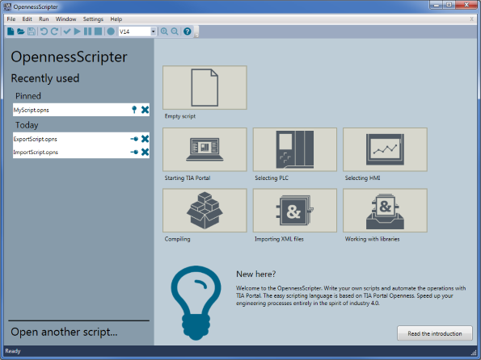
Project development
  Automatic code generation (Possible R&D):
    Analysis of signal specification document
    Laboratory function library
    Use TIA Portal Openness for TIA Portal project generation
    Database generation, function integration and EPICS server parameters definition

Slide 9

Project development
  OPC UA server with EPICS (R&D):
    Simple OPC UA server configuration in PLC CPU
    Simple OPC UA database generation to EPICS OPC UA driver
    Secure communication with certificate
    Tests of EPICS communauty drivers

Slide 10
Testing and verification
  Methodologies and tests (FAT, SAT)
    Each channel is tested from PLC to cabinet interface connector (FAT)
    Each channel is tested from PLC to sensor/actuator (SAT)
    Each scenario is defined and tested (SAT)

Slide 11
Testing and verification
  Simulation, virtual commissioning
    Simulation test bench is available in lab:
      PLC
      EPICS PC
      Specific devices
    Simulation mode can be activate in PLC
      Physical reactions of actuators movement is apply to sensors
        If a cryogenic valve is open, nearest temperature sensor decrease fast
        If a cryogenic valve is open, farest temperature sensor decrease slow
        Device error can be set
        Automatic procedure can be test
        Sensors and actuators managed (example):
          Pressure sensor
          Temperature sensor
          Level sensor
          Analog valve
          Digital valve

Slide 12
Application management
  Sharing code and builds
    Current situation: PLC code archives are stored on a network disk
    Looking to use TIA Portal Multi-User:
      Possibility to work in collaboration
      Single place to share and get last version of PLC code

Slide 13
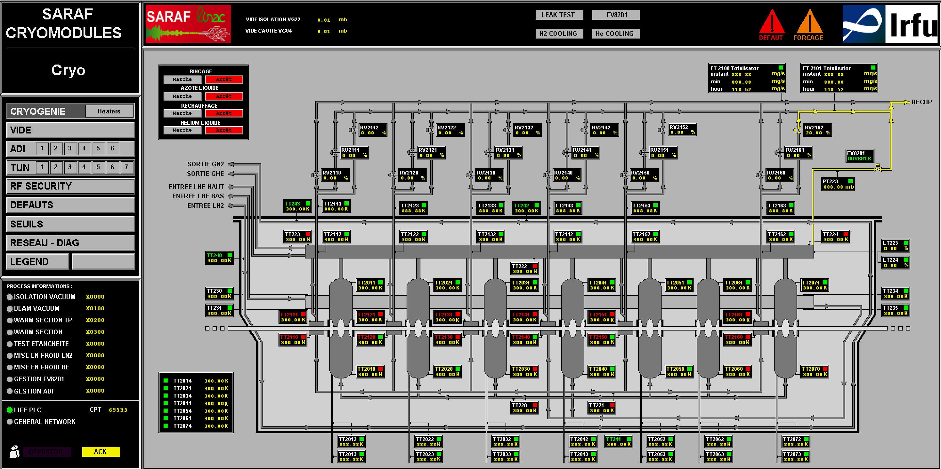
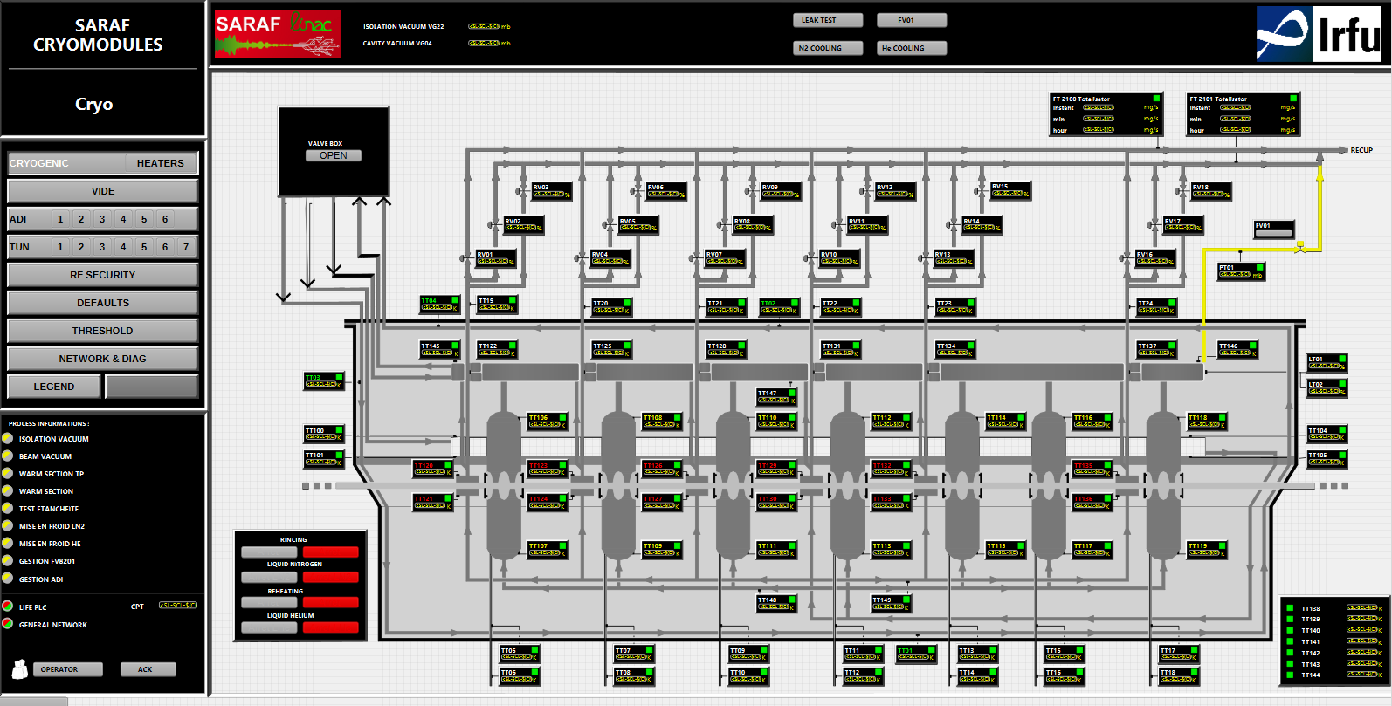
Home made tools: GUI from Muscade to Phoebus
  GUI draws with Autocad because of cryogenic PID
  Previous SCADA: Muscade
  New SCADA: EPICS Phoebus,
  Conversion tool from Muscade to EPICS Phoebus

Slide 14
Home made tools: Generating EPICS code from DB description
  EPICS IOC database conversion tool from TIA Portal files: PLCParserTool
  TIA files managed: .sdf, .xlsx, .db, .awl
  EPICS IOC database generation for CSS and Phoebus
  PLC-EPICS communication: Modbus-TCP
.sdf
.xlsx
.db
.db
.cmd
(IOC)

Slide 15
Thank you

Slide 16
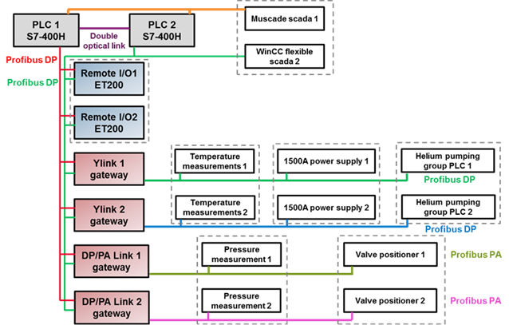
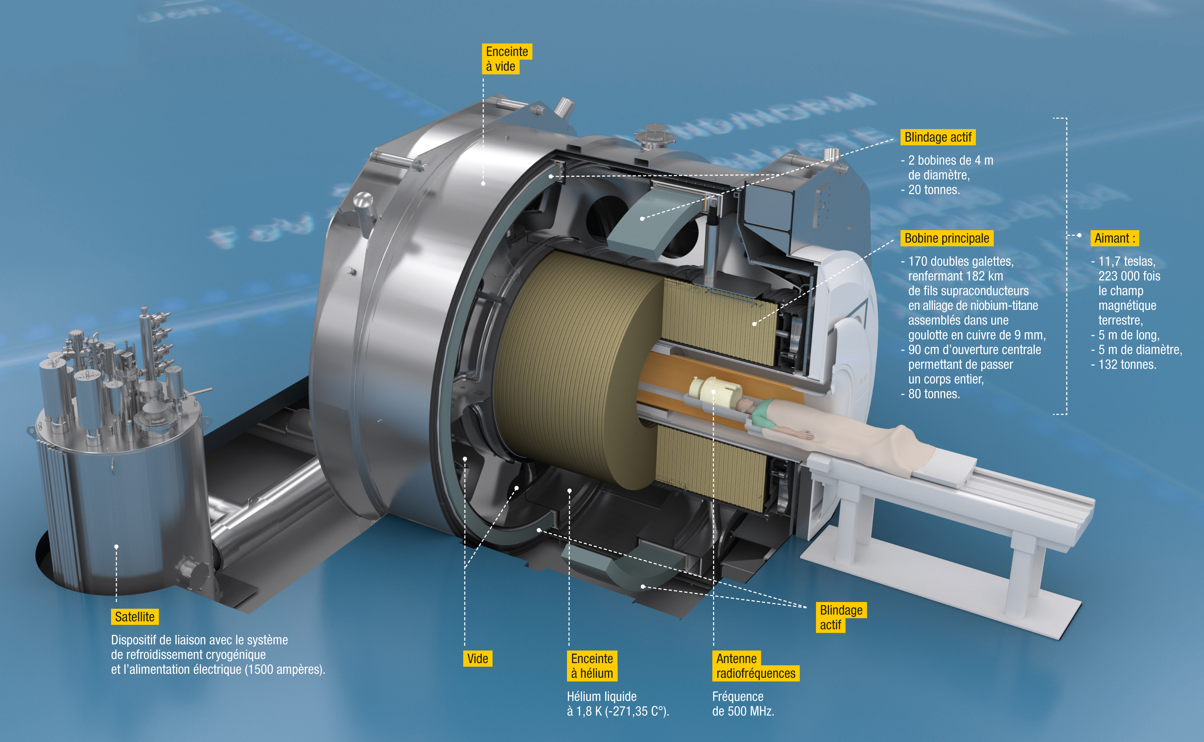
Control architecture example
  Iseult: Most powerful MRI in the world for human purposes
    Redundant cryogenic and electrical architecture

Slide 17
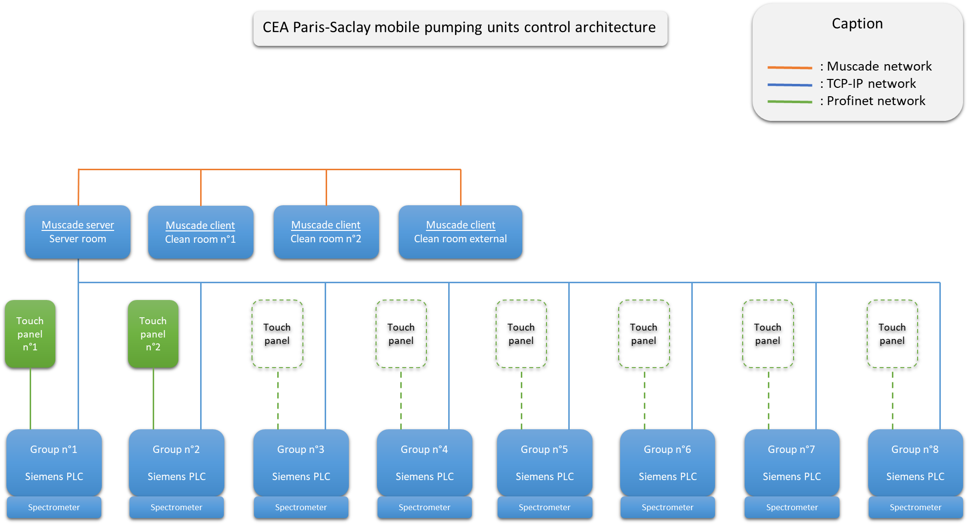
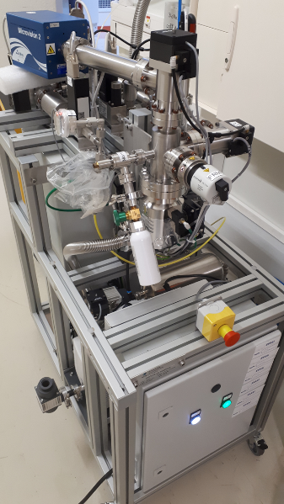
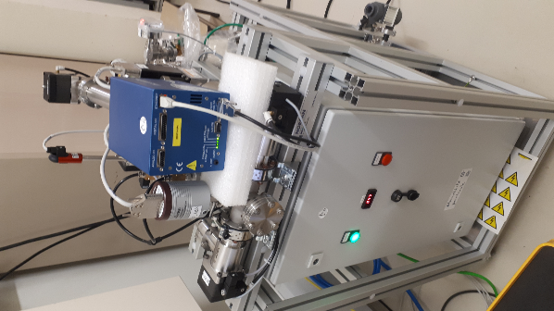
Control architecture example (Poster TUPDP009)
  Mobile pumping units: Vacuum pumping system for beam particle free
    Embedded and reliable control system

Slide 18
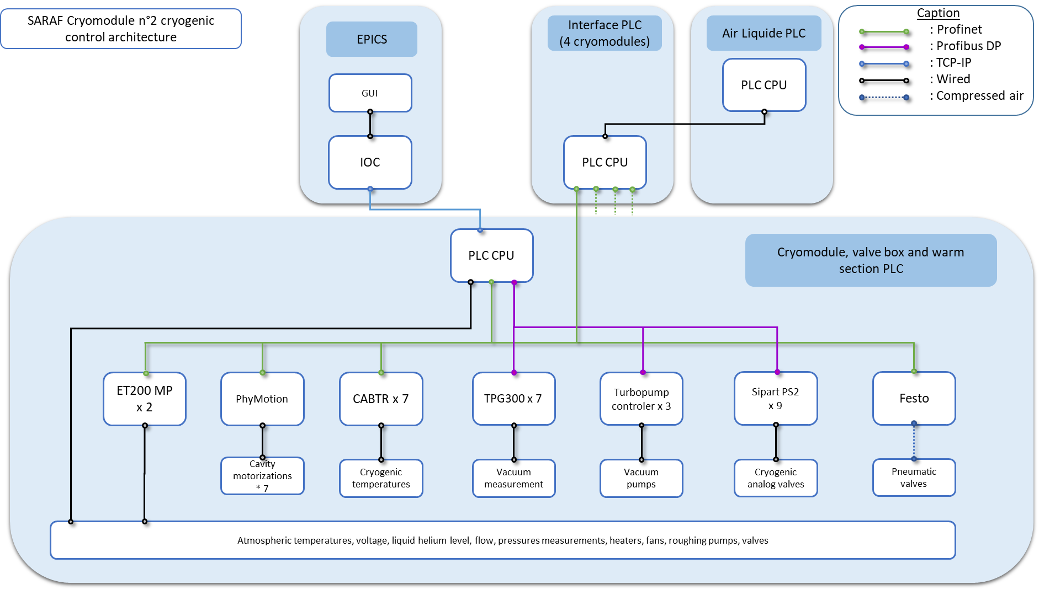
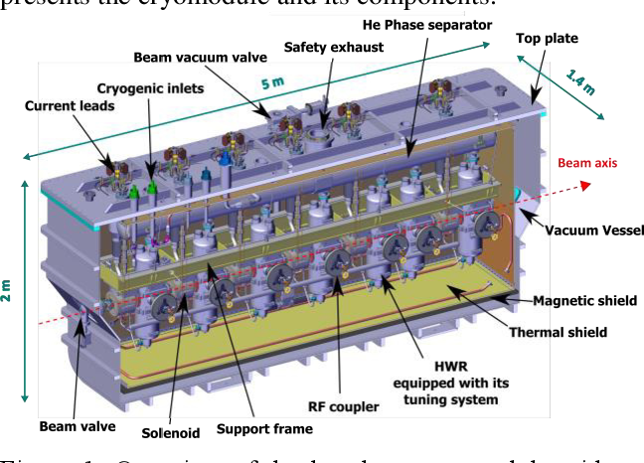
Control architecture example (Poster ABCDE123)
  SARAF cryomodules: Linac elements of the SARF particles accelerator
    Cryogenic, vacuum, cavities tuning and interlocks control architecture

Slide 19
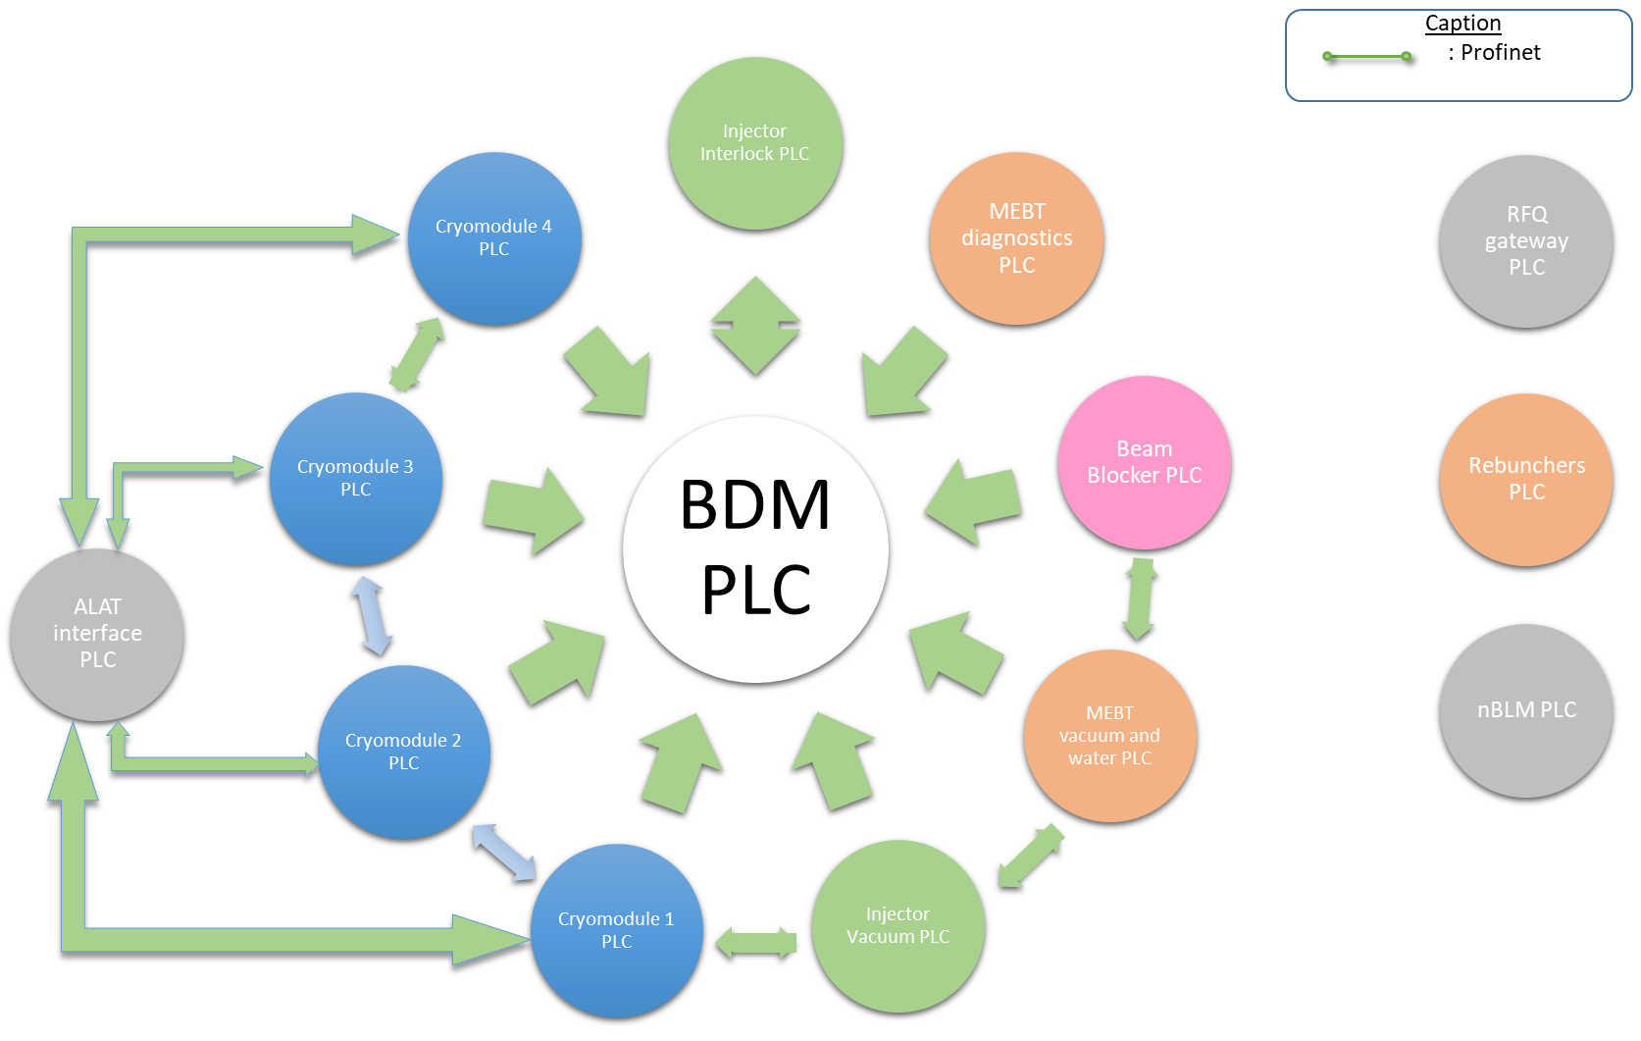
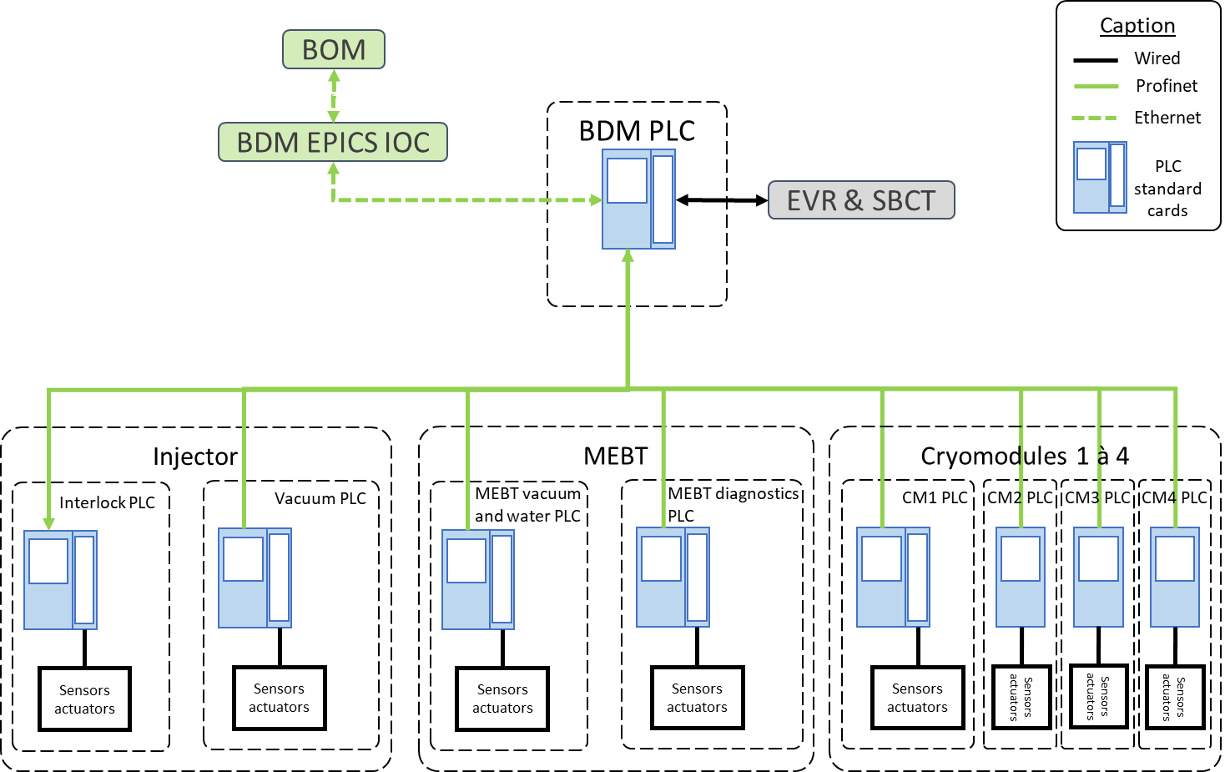
Control architecture example (Poster ABCDE123)
  MPS: Machine protection system for SARF particles accelerator
    Network control of remote device

