Slide 1
PLC Framework at the EuXFEL
Sylvia Huynh
PLC Developer and Support Engineer
ICALEPCS 2023
Cape Town, 06.10.2023
Notes:
12 minutes
3 minutes for questions

Slide 2
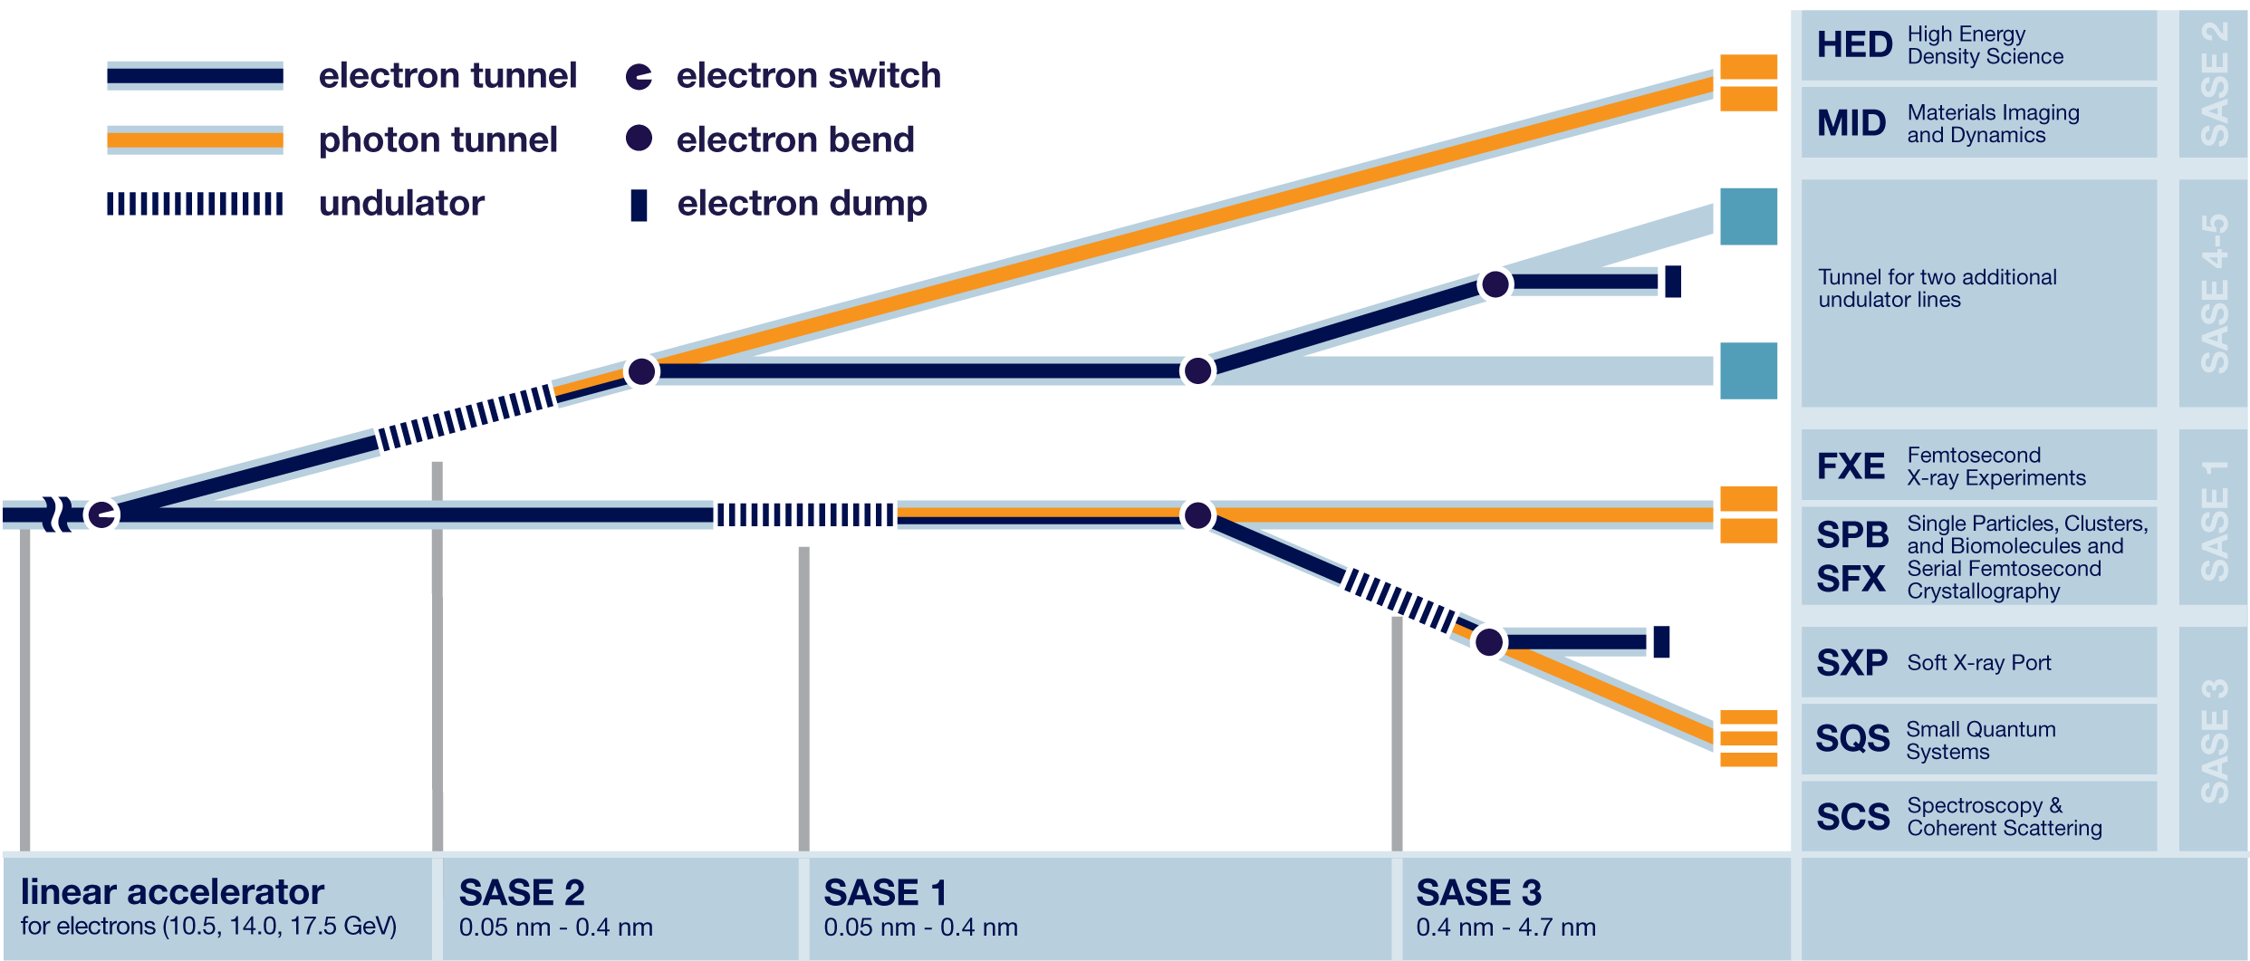
European XFEL at a glance
Two main groups, each team managing ~100 PLCS
Beckhoff 2.0 & 3.0
Pilz and Siemens for safety systems
Language: ST
Image credit to : https://www.xfel.eu
Notes:
EuXFEL is home to over a hundred PLCs, and thousands of devices.
We use Beckhoff PLCs for remote control within the multiple photon beamlines.

Slide 3
Current PLC Framework and Processes
Core team of developers working on a custom PLC library and associated tools
  PLCMS – EPLAN, CSV for Interlocks, Postgres BD, Python
  PLC Project Builder – Beckhoff XAE
  DocStrings and RTD for documentation
  Client tool for parameter saving and writing – Python
  Git CI/CD for versioning and deployment.
Operations team generate the PLC projects
  Partial automatic generation using the developed PLC teams

Slide 4
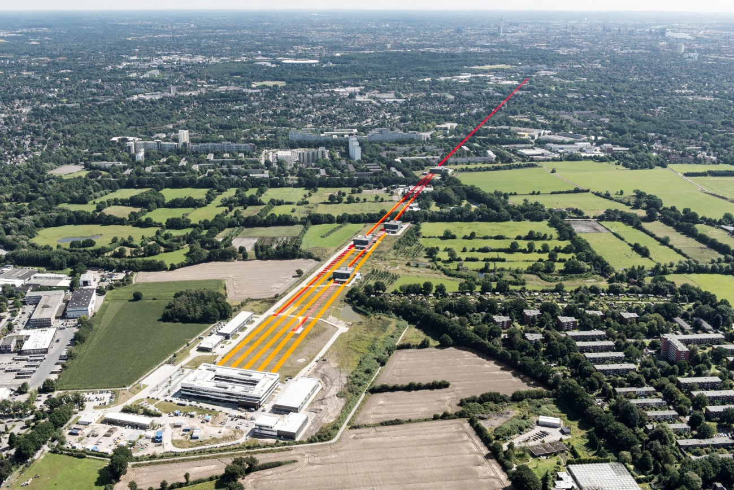
Current Works
PLC development has predominately been performed by those in mechanical or electrical engineering
Technical debt has resulted in the need for redevelopment
Incorporating a more software engineering driven approach can bring about many benefits to the PLC
Image credit to : https://www.xfel.eu
Notes:
What that means to us -
What we are seeing here, is something that went from a pure electrical and mechanical system, slowly shifting into the realm of Software and Software Engineering.

Slide 5
Architectural Design Records
Understanding the justification of what was done.
ADR provide a template in a simple, straight forward manner, and doubles as documentation.
An ADR comprises of:
  Topic – What is the decision for – eg. Array Boundary declaration
  Description - A short description of the design topic
  Decision – What was decided
  Status – Proposed, Accepted, Rejected, Superseded, Deprecated
  Assumptions – Underlying assumptions such as cost, technology etc
  Constraints – Additional constraints that are imposed upon the decision
  Positions – All the positions considered, and their pros and cons
  Justification – The reason this particular decision was made.
  Implications – Foreseeable implications of this decision
  Related resources or decisions – Any related resources for further reading, or related ADRs

Slide 6
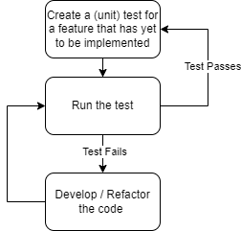
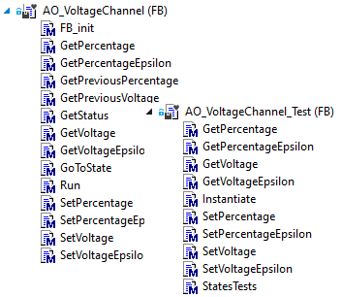
Test Driven Development
Testing PLC code can be challenging, especially when the equipment may not be accessible
Test Driven Development ensures a high code coverage leading to a more robust and stable framework
TcUnit:
  Framework for easy integration
  Incorporated into Git CI/CD

Slide 7
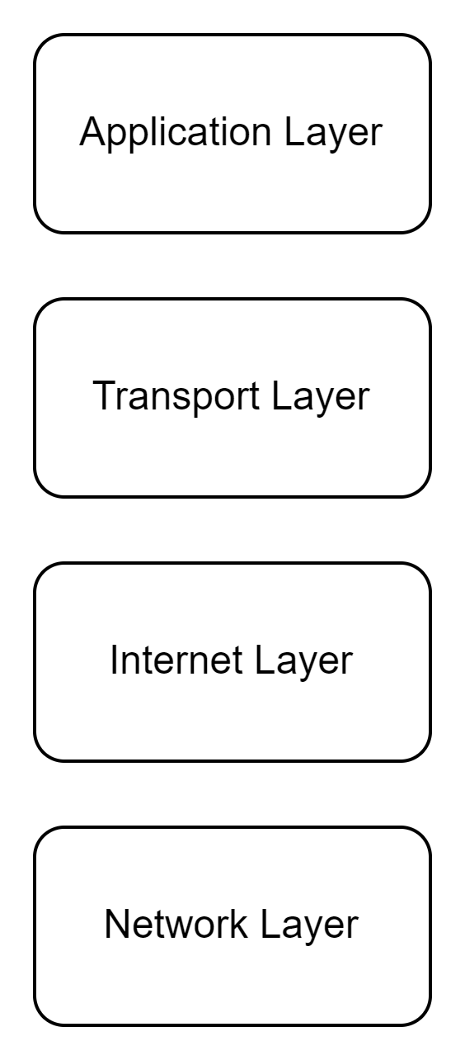
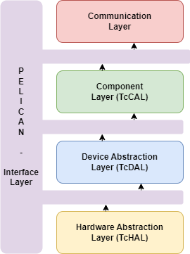
Layered Architecture Pattern
A Layered architecture provides a separation of concerns
  Easier to develop when there is a limited scope
  Knowledge required can be restricted to the immediate layer, opening up development opportunities to others
Each layer is responsible for a specific function
  Changes between layers do not impact the other
  Prevents code entanglement
  Limits the dependencies when dealing with refactoring
TCP Protocol

Slide 8
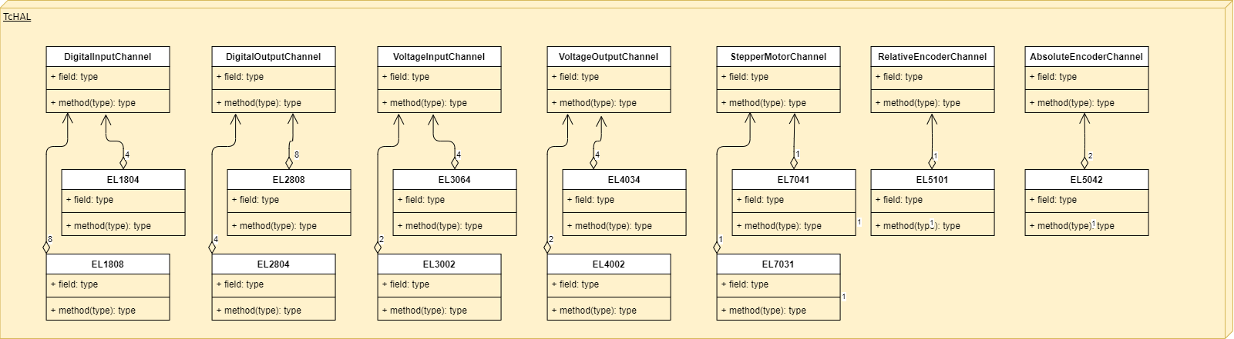
Hardware Abstraction Layer (TcHAL)
Pelican
Representation of the fieldbus device – EtherCAT terminals, EtherCAT devices etc
Extracts all the information associated to that signal
Encapsulates configuration and handling of the signal value into a SI unit
Communication
TcCAL
TcDAL
TcHAL

Slide 9
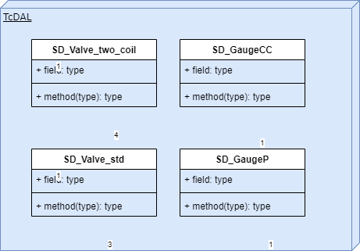
Device Abstraction Layer (TcDAL)
Pelican
This layer provides the software representation of a device. A key benefit to a layered approach here is that on this layer, the developer can solely focus on:
How the device behaves
  What functions are available on the device
  What properties are available on the device
  All the execution in how the behavior is defined is encapsulated within the object or POU.
The collection of signals that expected, without concerning themselves with where the signal is coming from
Communication
TcCAL
TcDAL
TcHAL

Slide 10
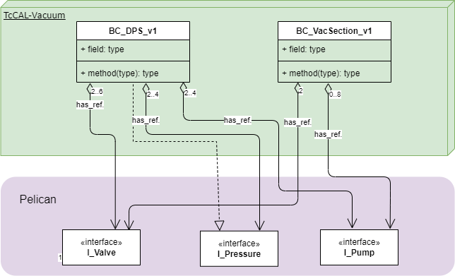
Component Abstraction Layer (TcCAL)
Pelican
The Component layer brings together a group of devices from the TcDAL layer, and treats them as a single entity. Similar to how a single TcDAL device incorporates several signals from the TcHAL.
Defines the primary controlling device
All secondary devices relinquish control to the primary
Components can then be used as building blocks in the PLC projects
Communication
TcCAL
TcDAL
TcHAL

Slide 11
Communication Layer
Pelican
To provide a means for the SCADA system to interact with the PLC, a communication protocol must be established. The handling of this protocol is defined within the communication layer.
A single library is developed to handle one communication protocol
The PLC can then interface with any communication protocol, or multiple protocols simultaneously.
A library can be easily swapped out or added to provide the set of functions as needed.
Communication
TcCAL
TcDAL
TcHAL

Slide 12
Interface Concept
An interface defines how one data structure can interact with another.
  Available attributes and properties
  Available functions
Provides the developer with an outline of what information is available, making it easier to know what they can do in regards to implementation, without having to concern themselves with any of the technical details.
Notes:
Once we have the layers defined, the way the layers interact with each other must also be defined.

Slide 13
Pelican
Pelican
The Pelican holds all of the interface definitions.
The interface defines what functions and attribute are available, and how they can be interacted with.
All layers communicate between each other via the Pelican.
The Interface Manager also lies within the Pelican
  Helps maintain control over which devices in one layer are being interfaced to in another.
Communication
TcCAL
TcDAL
TcHAL

Slide 14
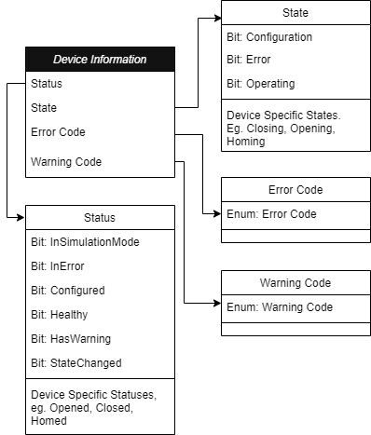
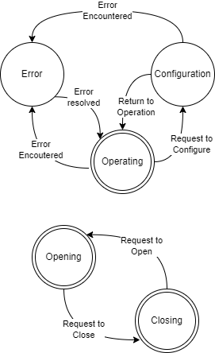
Finite State Machines in the quest of Modularity
Every object is implemented as a device
  Made up of a generic set of Device Information
  Combined with any device specific features. E.g. Filtering on a 24V signal
Core set of Operating States and Process States.
  The transition between the Operation States for all devices is the same
  Attention and focus is placed on the encapsulated device specific states.
Simplifies interacting with objects cross the entire PLC libraries.

Slide 15
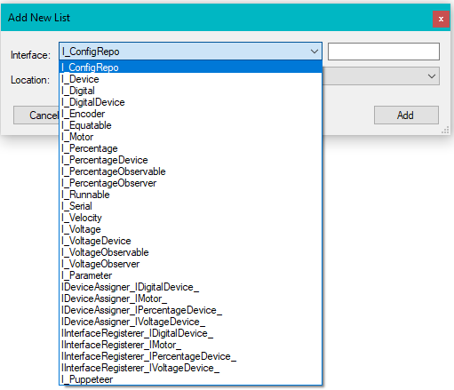
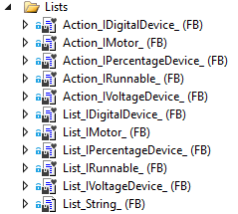
Visual Studio Extensions I
Utilising Visual Studio extensions to generate skeleton code based on a pre-existing template.
Code specifics can be filled in by the developer
Expedites development and reduces the opportunities for error

Slide 16
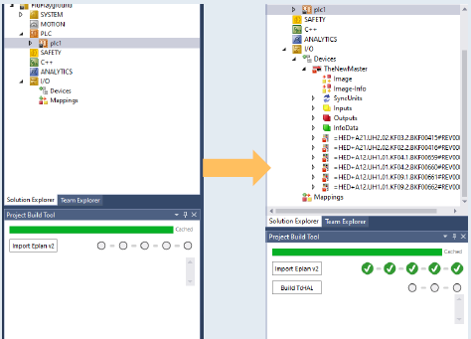
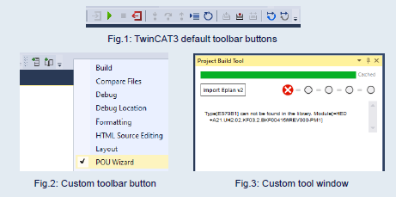
Visual Studio Extensions II
Modify existing POUs
The tooling developed can be enacted as a wizard, guiding the user through a series of steps.
  E.g. Modifying the TwinCAT hardware tree to match the EPLAN design export for a PLC project

Slide 17
Support of Legacy Code – The Adapter Pattern
Until it becomes possible to fully migrate an entire code base, legacy code will remain.
In order to continue working on a new framework while maintaining the old, an adapter is required, bridging the two together.
An adapter pattern describes how to connect two systems together in a way that the code designed is re-usable.
This was achieved in order to adapt the I/O of the old framework into the TcHAL, which not only means we can run two frameworks simultaneously, but we can also utilise the feature set of the TcHAL within the legacy framework.

Slide 18
Sylvia Huynh
PLC Developer and Support Engineer
European XFEL sylvia.huynh@xfel.eu
Questions?

Slide 19
