Slide 1
Towards DB Driven Specifications for Industrial Control Systems
Motivation, work done and share of experience
Diogo Monteiro, Controls Engineer at CERN
PBCS Workshop – ICALEPCS’23
7/10/2023

Slide 2
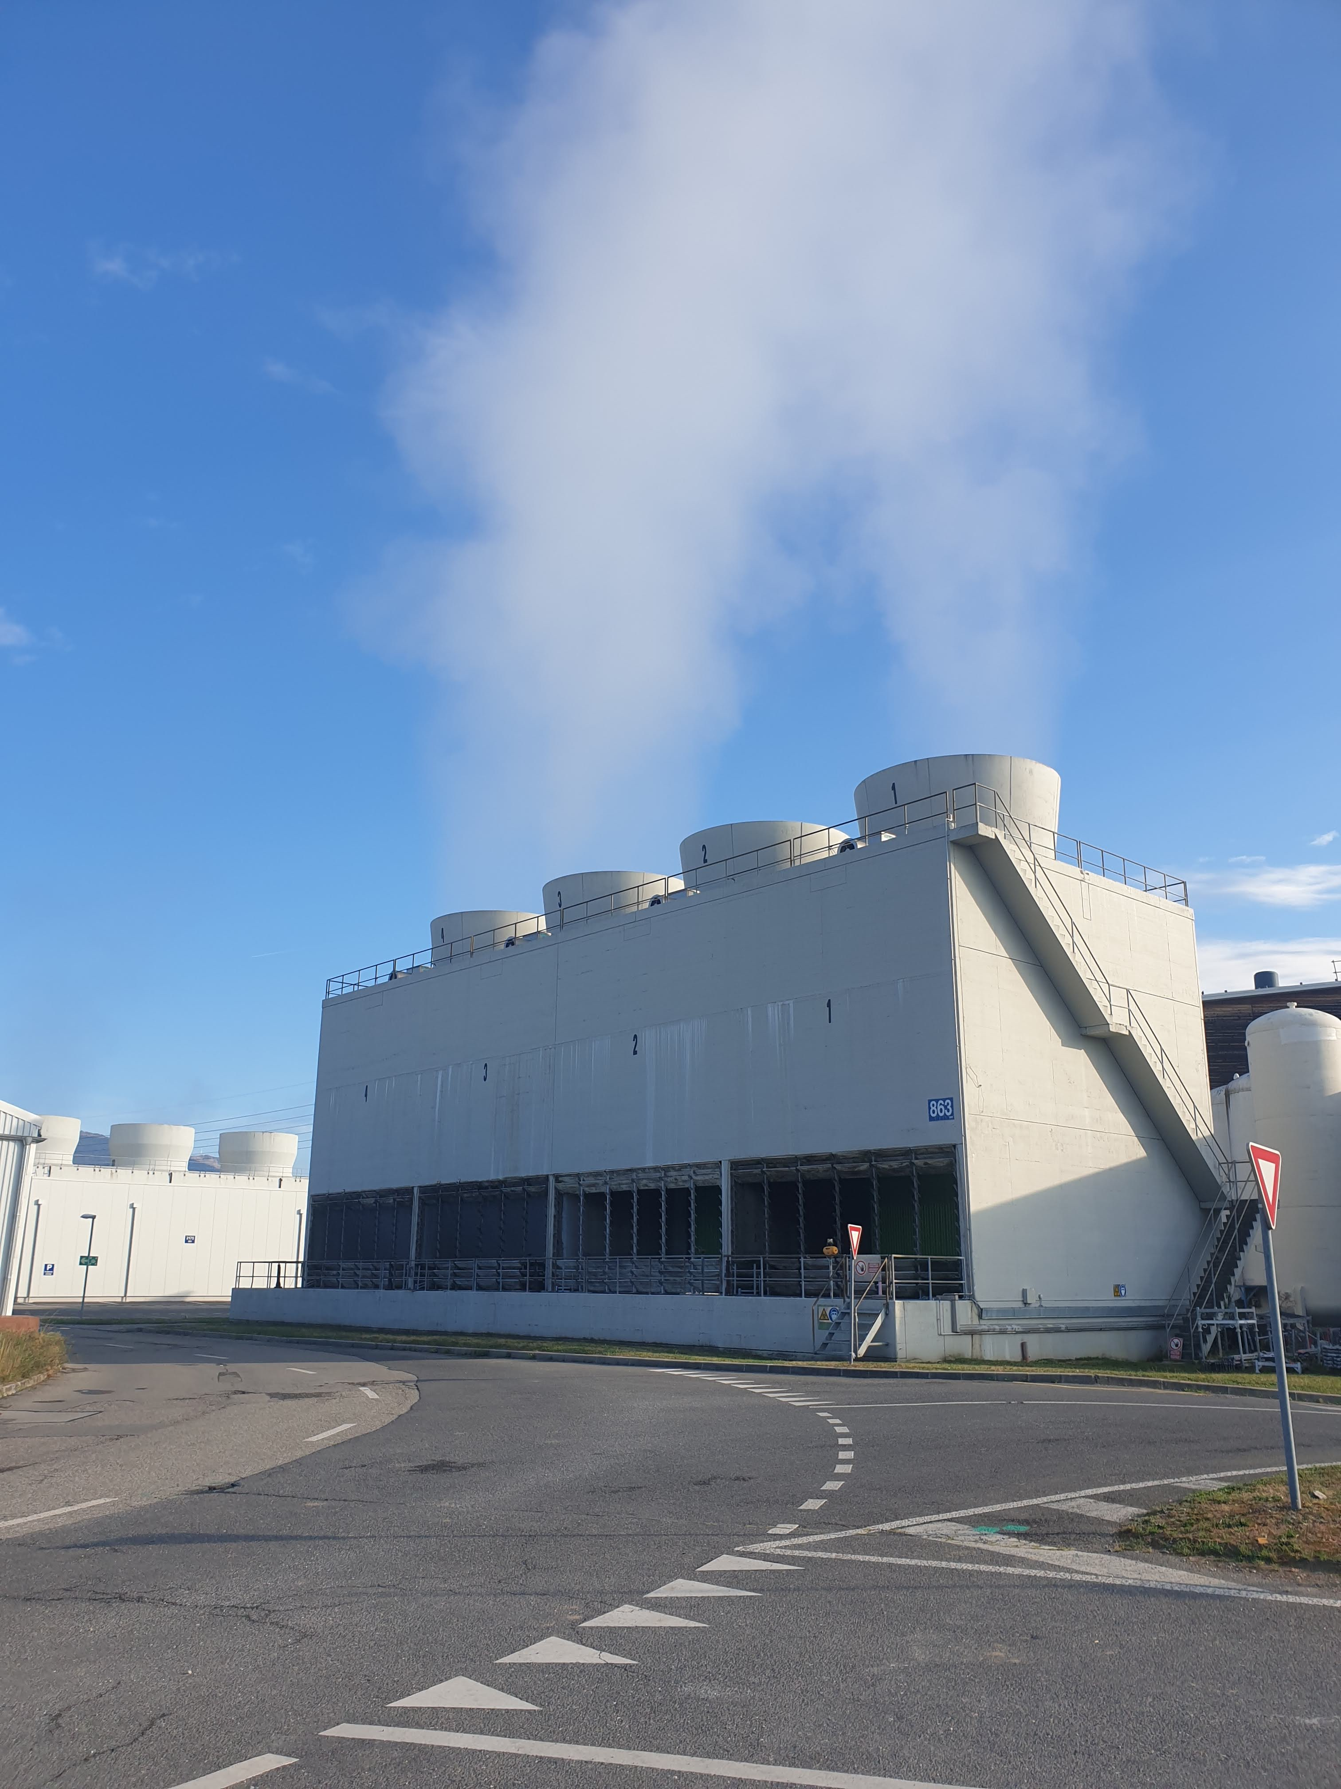
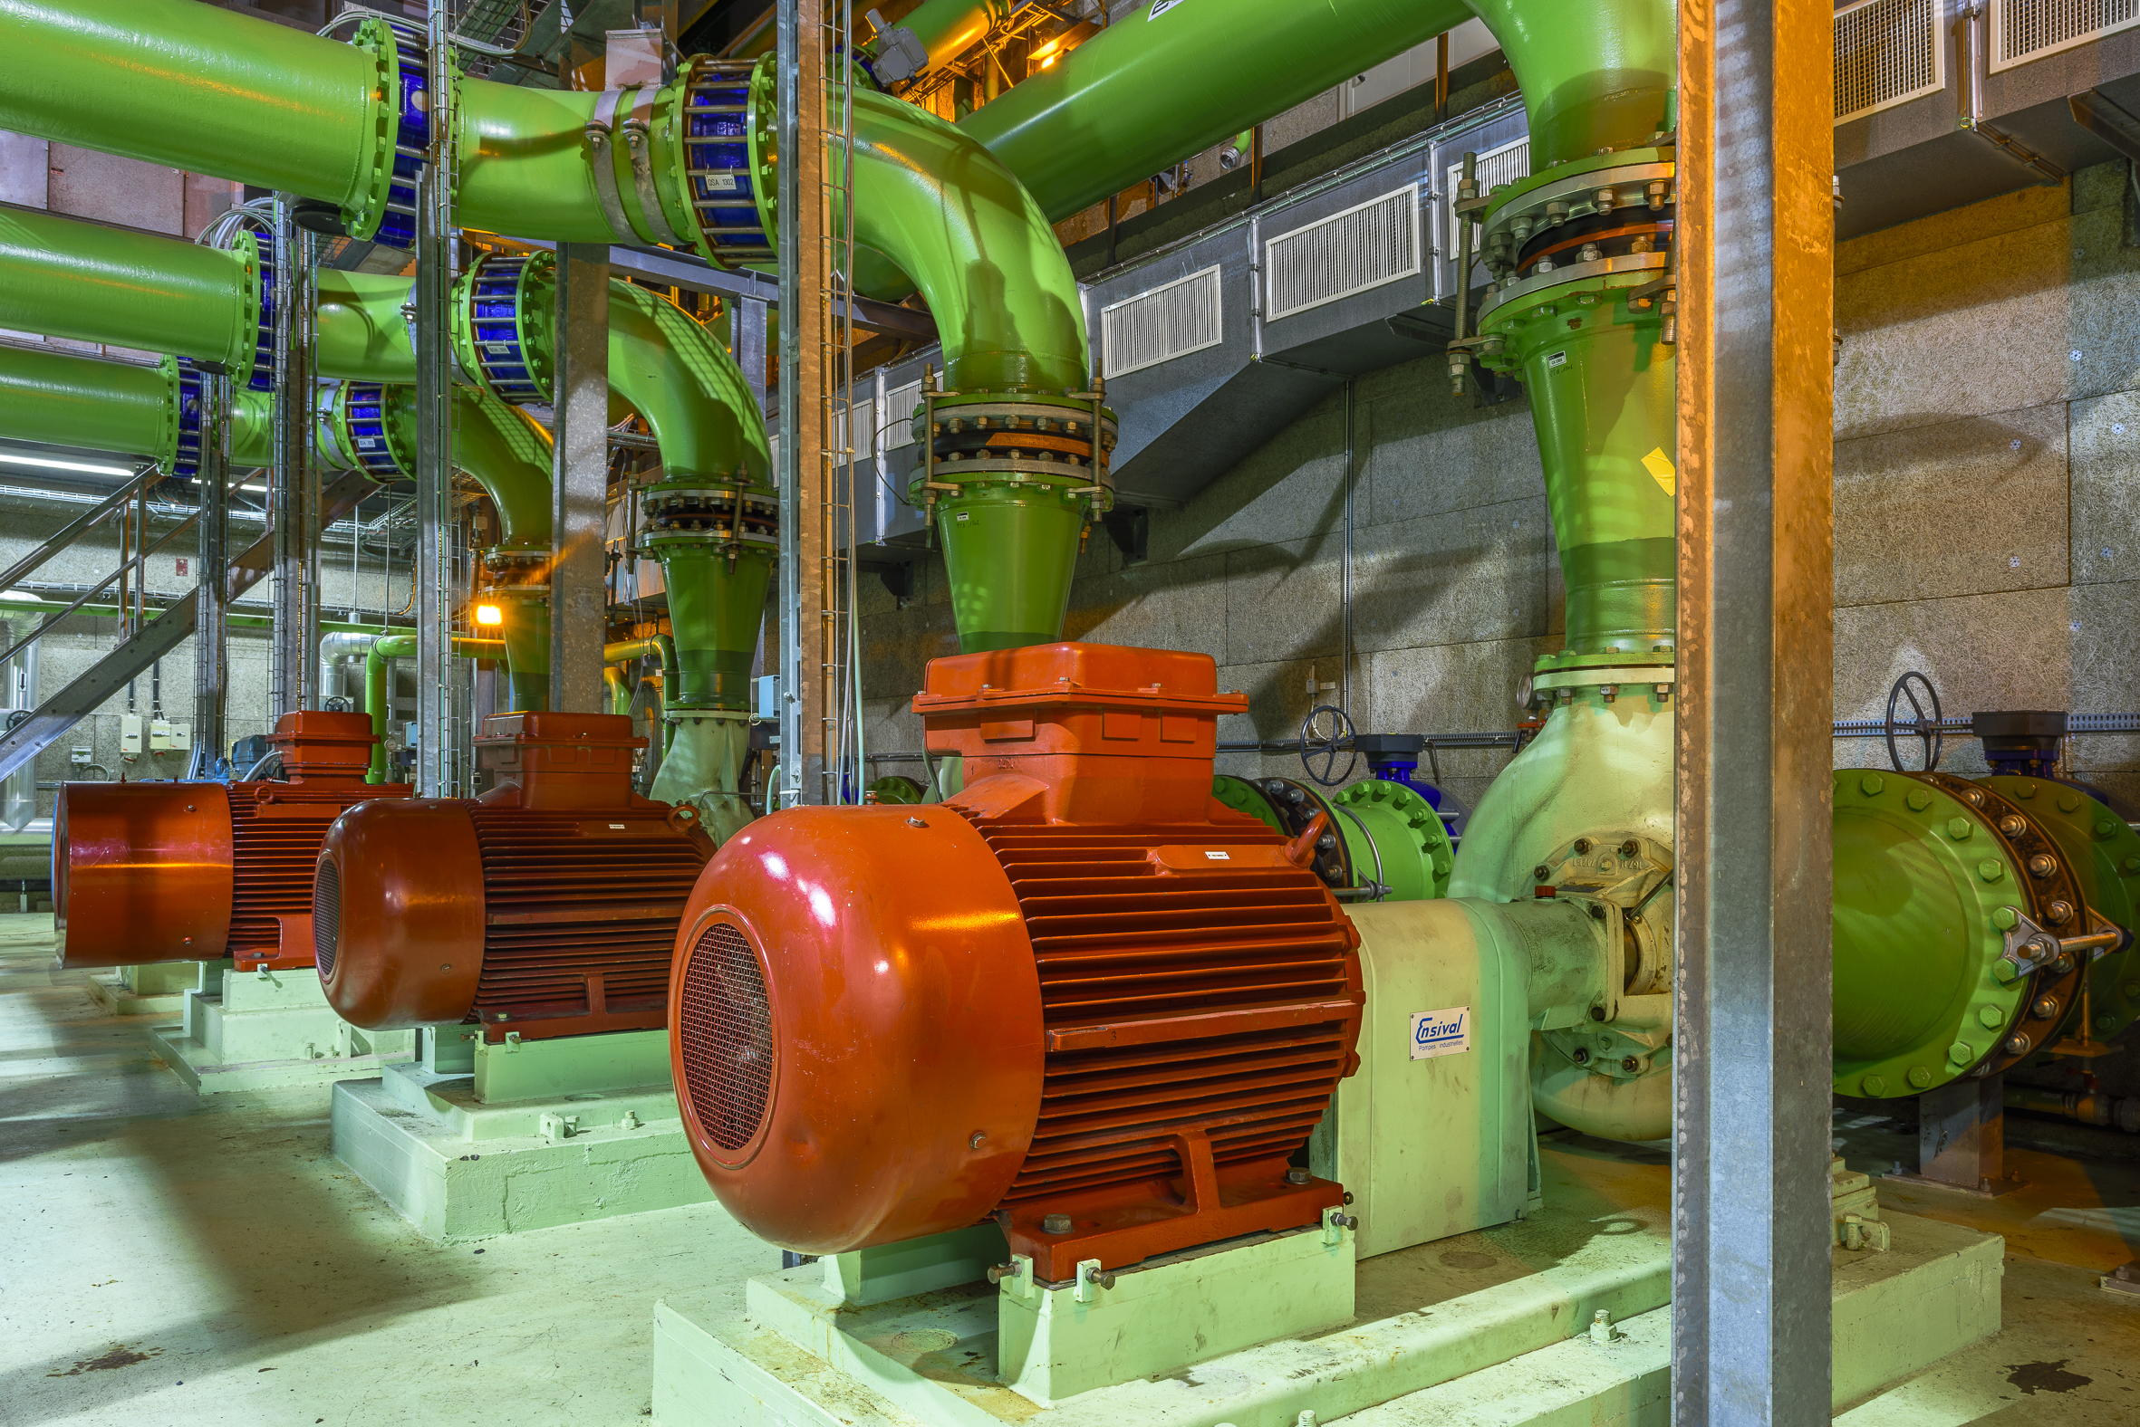

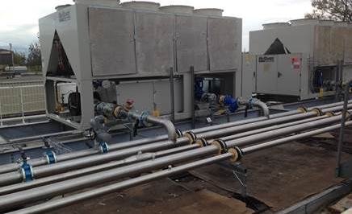
Cooling and Ventilation Group at CERN (EN-CV)
Cooling
Fluid Distribution
Air Conditioning
Notes:
Operation and maintenance for CERN’s accelerator complex and experimental areas.

Slide 3
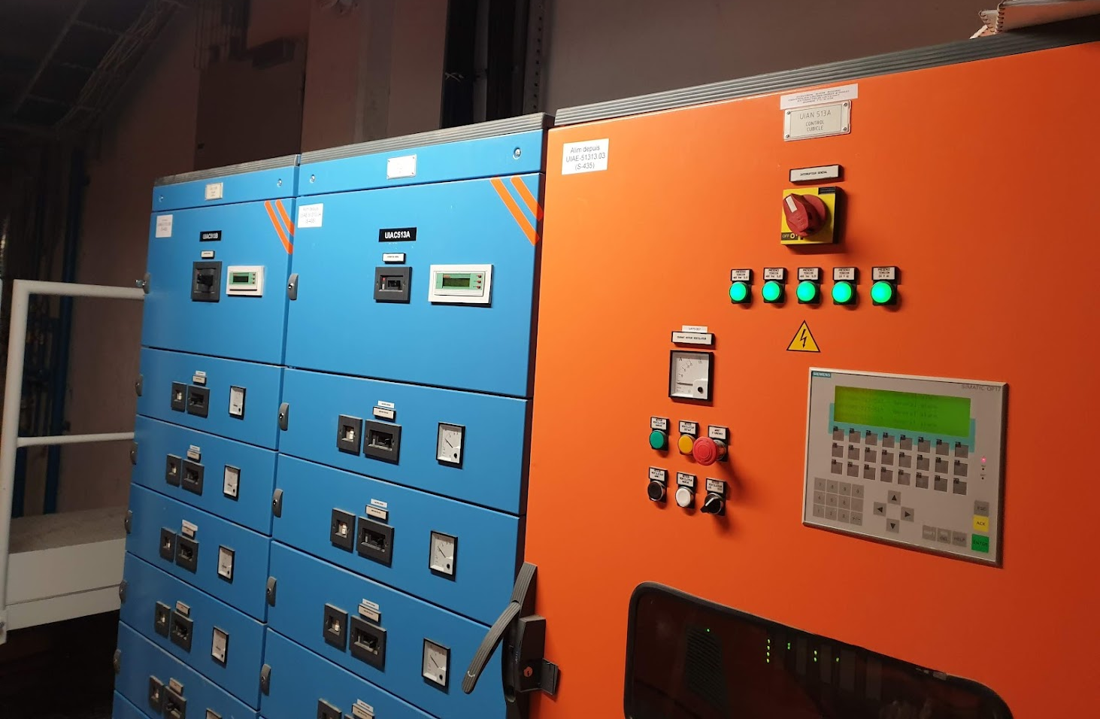

Controls infrastructure for CERN’s cooling & HVAC
Number of PLC applications: > 650
  Split between Schneider and Siemens PLCs
  (+ some residual legacy hardware)
New PLC applications/year: +30
Team’s mandate:
  Controls development (specification, testing and commissioning)
  Supervise PLC code development (mostly outsourced)
  Controls maintenance along plant’s life-cycle
  Management of controls’ assets

Slide 4


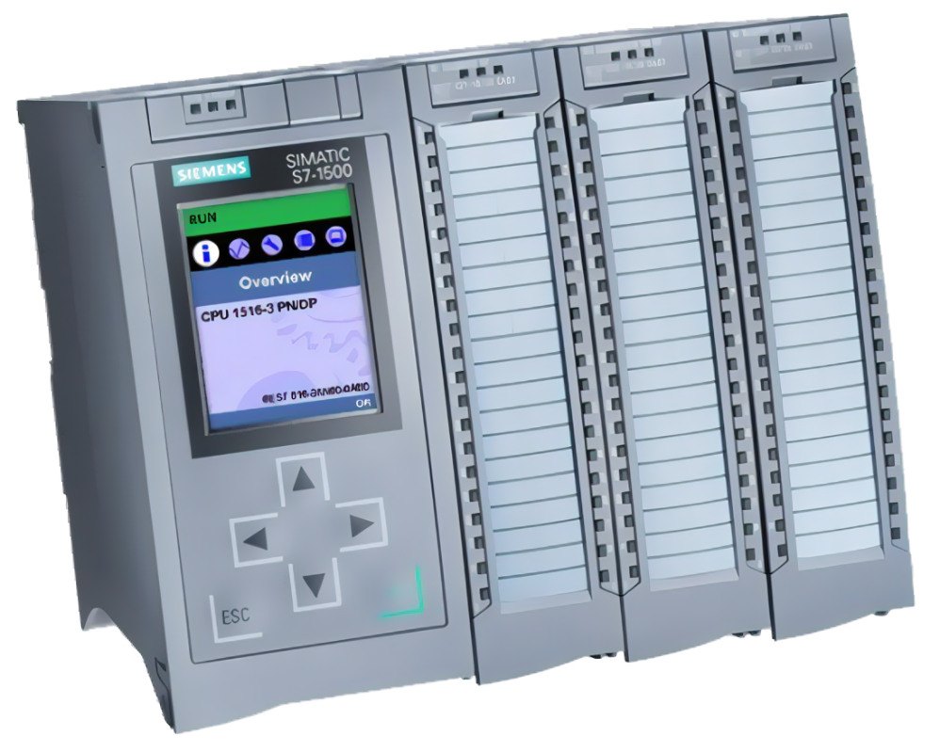
Specifications for Industrial Control Systems 1/2
Main input for the development & operation of control systems
It (usually) contains:
  Key information about the controlled process
    Actuators
    Sensors
    Regulation loops
  Definition of functional decomposition
  Description of the system’s automatic behavior
  Specification of alarms & interlocks
  etc
Specs
PLC
Code Development
Notes:
- etc: it can be more or less detailed depending on the final intent of the document and practices of each team

Slide 5
Specifications for Industrial Control Systems 2/2
Specifications require about 1/3 of the controls development effort (!)
Some pains we experience:
  Readers have heterogenous background: needs common language
  Low-value elements take a good share of the effort (e.g. formatting)
  Standardization is difficult
  Document is hardly exploitable for automatic code generation
  Version comparison is not user-friendly
Is there an alternative? Let’s look at DB-driven specs!
Notes:
Low-value elemens: Who has never suffered to add a simple index to a word document ? or fitting a table correctly ? It takes time from the actual controls specification. Specifier loose focus from the content.
Standardization. The challenge is two-fold: 1) Any imposed structure is easily breakable and 2) Re-use of specification elements
Hardly exploitable: it’s not only limiting the efficient of specifiers as it also limits the potential of automatic code generation
- Version comparison: remember that the specifications will be there during the whole life-cycle of the plant, as such it’s regularly update

Slide 6
Database Driven Specifications
Main expectations:
Structured
Content focused
Ideal for code generation tooling
… but, we still need:
User-friendly editor
Text based output
CORE
an in-house tool for DB driven specifications
Notes:
Editor : industrial controls engineer are process experts not computer scientists
PDF:

Slide 7





CORE – a DB driven specifications tool at CERN 1/2
Overview of workflow:
Project timeline & resources:
Controls/Process
Expert
2021
2022
2023
2024
CORE
Tool development (1 FTE)
Testing by users, fixes & improvements (0.6 FTE)
(LaTeX)
API | JSON
PLC Code Developer
Notes:
Editor : industrial controls engineer are process experts not computer scientists
PDF:

Slide 8
CORE – a DB driven specifications tool at CERN 2/2
First positive impressions:
Less time in formatting, more time in content
Standardization is straightforward
Enforced structured -> focus on the essential
Facilitates automatic code generation
… and challenges to tackle:
Reduced flexibility
Parts of specification remain difficult to structure
Steeper learning curve for newcomers
Resources required for tool development & maintenance
Notes:
Editor : industrial controls engineer are process experts not computer scientists
PDF:

Slide 9
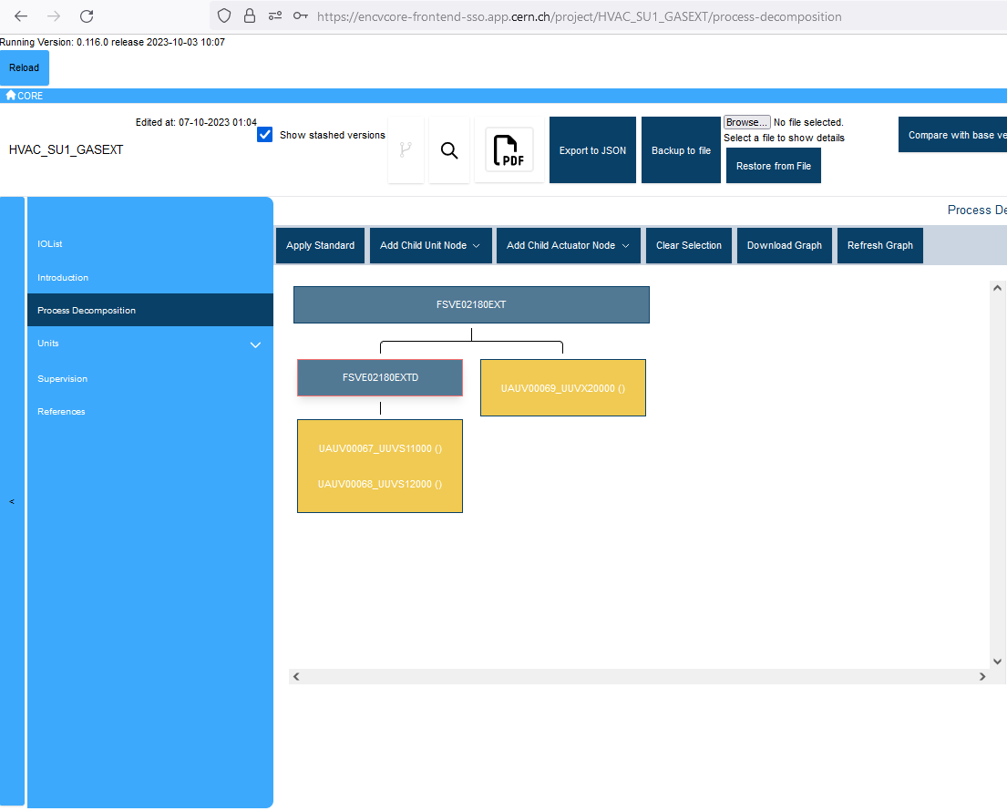
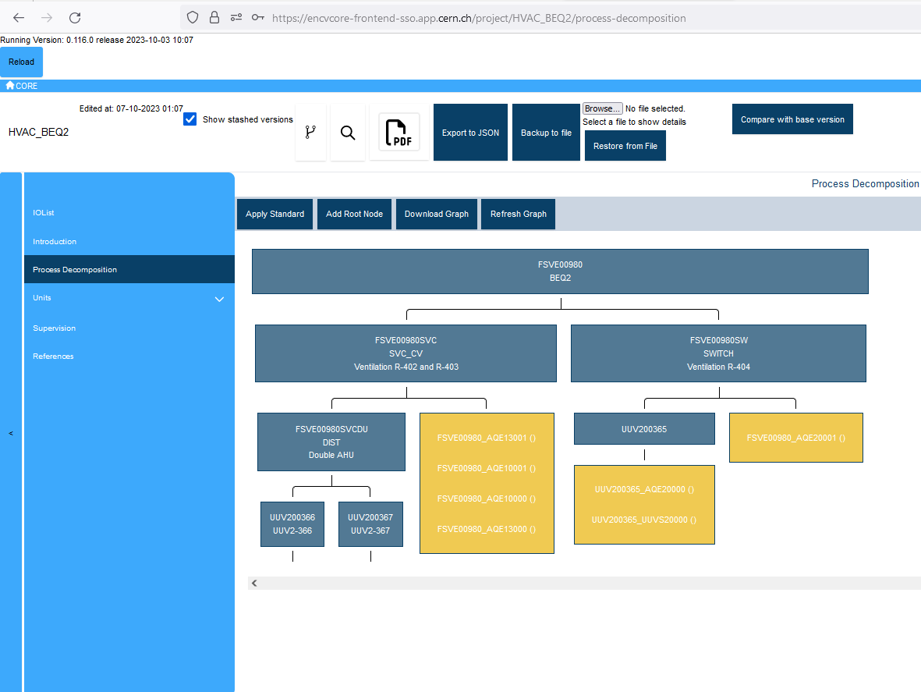
CORE – Sneak Peek 1/3
Functional decomposition for plant’s control system

Slide 10
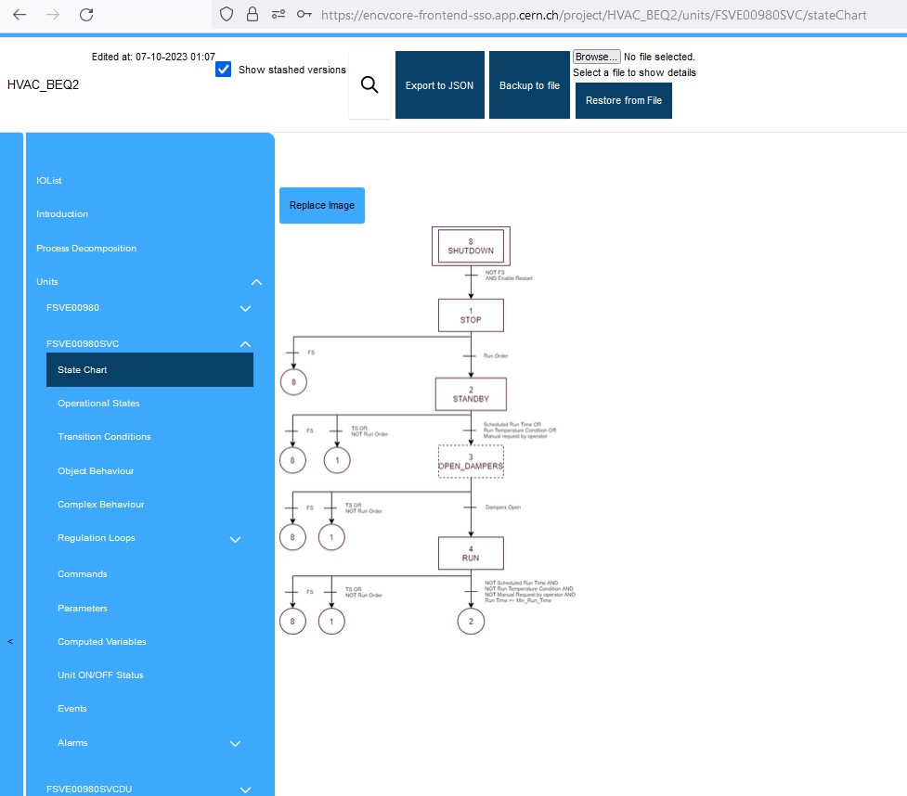
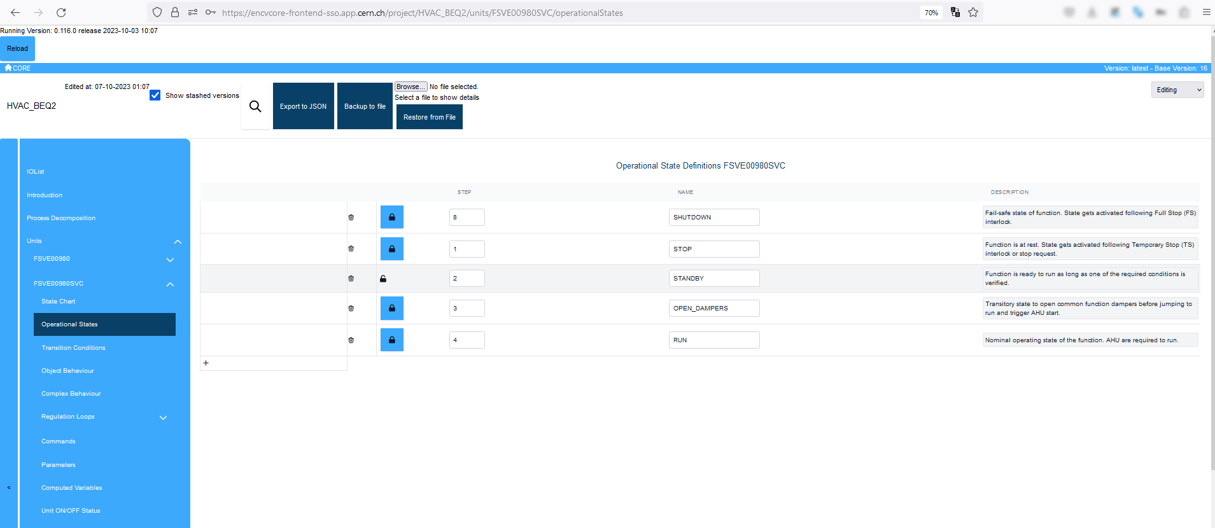
CORE – Sneak Peek 2/3
Specification of sequential function charts (SFC)

Slide 11
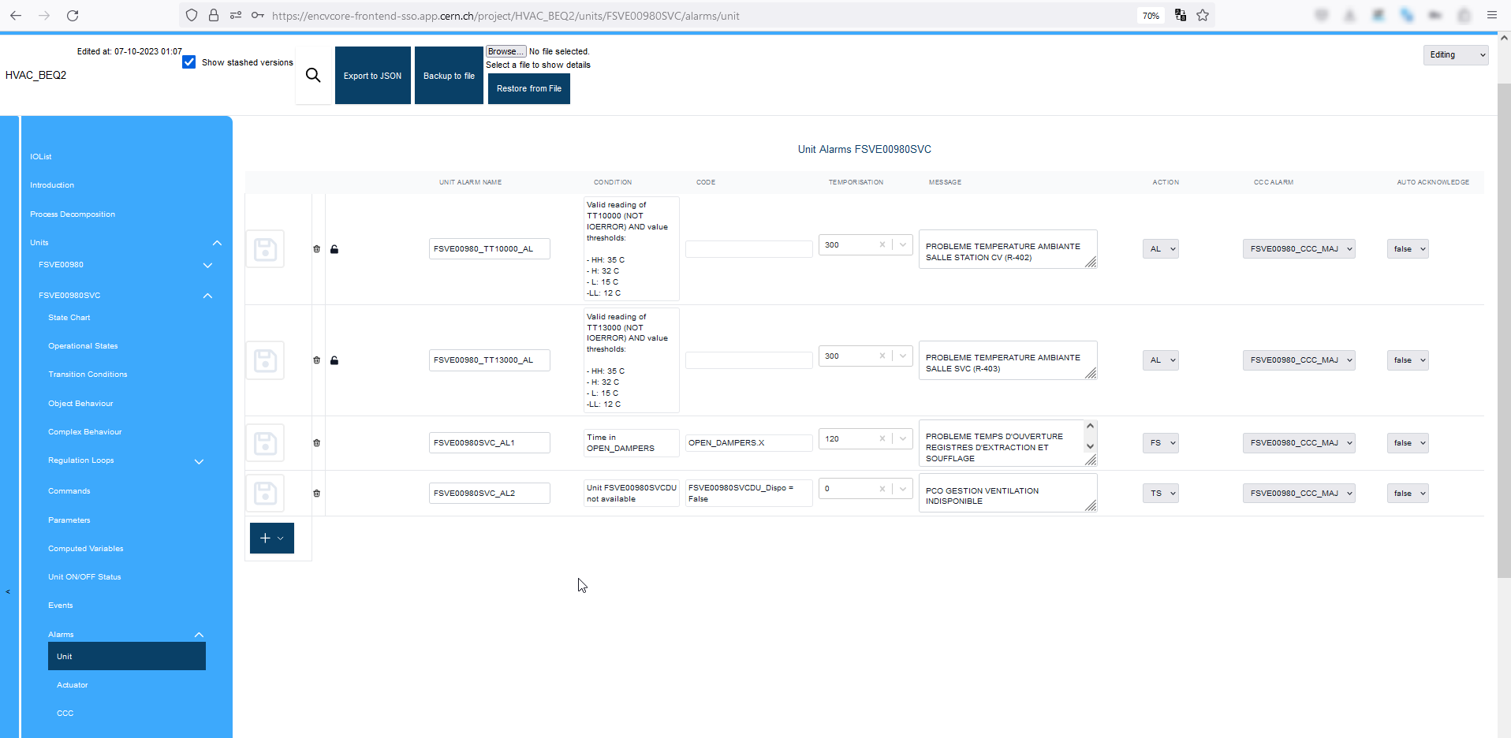
CORE – Sneak Peek 3/3
List of alarms & interlocks

Slide 12
Conclusion
MS Word based specs have blocking drawbacks:
  Diverges author attention from the essential
  Any imposed structure is easily breakable
  Standardization is difficult
  It’s not adapted to automatic code generation
Our team is exploring DB-driven specifications as an alternative:
  Content oriented
  Unbreakable structure
  Facilitates automatic code generation via API/JSON
Some challenges remain:
  In-house solution required: resources & infrastructure
  Not all elements are easily “structurable”
Questions ?

