Slide 1
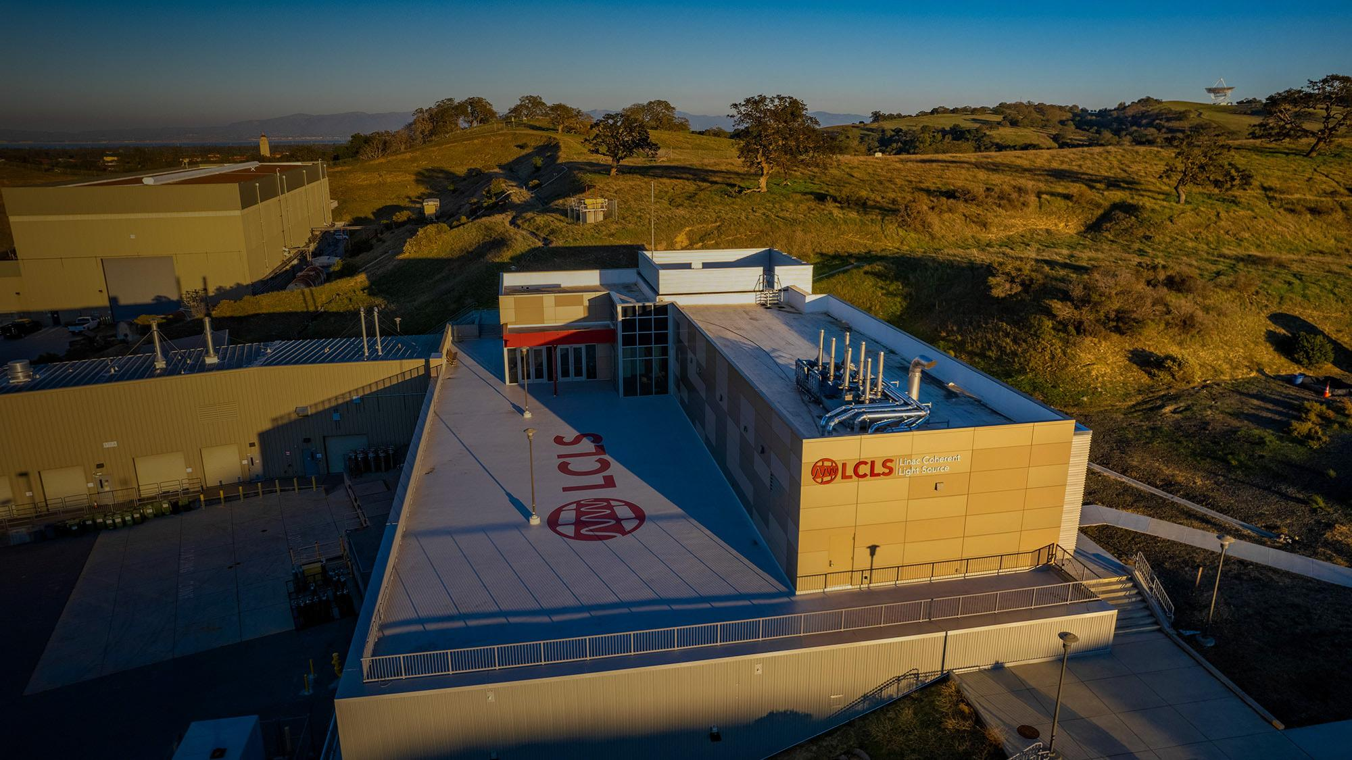


LCLS Experiment Control Systems Platform Development
ICALEPCS2023 - PLC Workshop Presentation
Alex Wallace / Dept. Head / ECS PD
07 October 2023

Slide 2
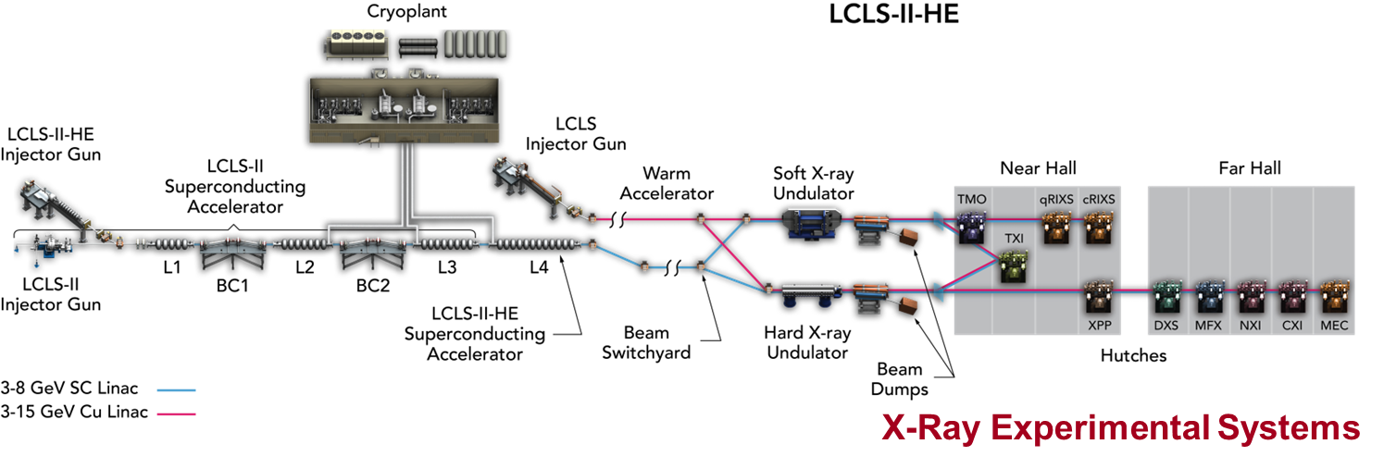

LCLS Instrument Suite

Slide 3
LCLS Instrument Suite
LCLS-I Controls
LCLS-II Controls

Slide 4
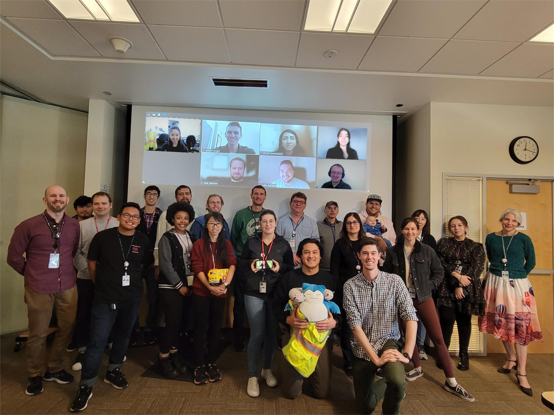
Experiment Control System Division Background
Background
~25 control system engineers with a wide range of expertise
Supporting day-to-day operations, experiment setup, XFEL beam delivery, and major projects
In existence since roughly 2010, originally called the Photon Controls and Data System (PCDS) group

Slide 5
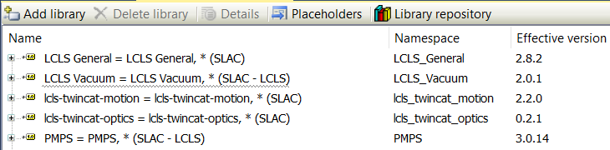
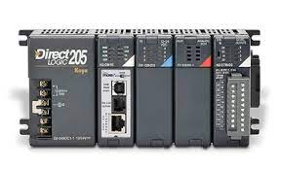
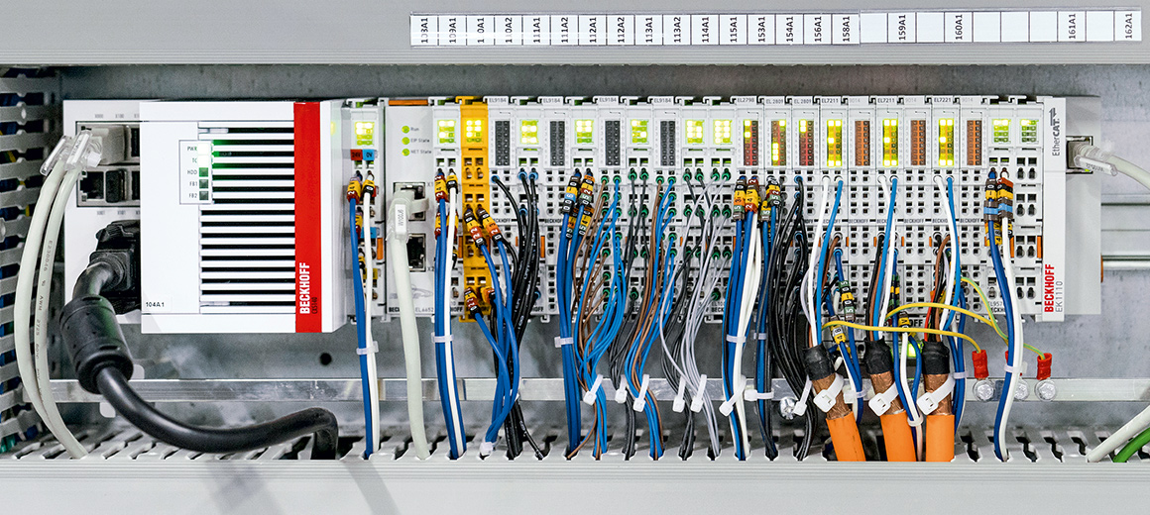


Migrated towards a single PLC platform
30-50 Beckhoff PLCs deployed, 7 Automation Direction in legacy areas.
Legacy Automation Direct, phasing out
Beckhoff PLC and TwinCAT 3 in all new areas and any new projects
Structured Text everywhere (Ladder in the Automation Direct legacy systems)
Common libraries, Vacuum, Motion, Machine Protection, Optics, General

Slide 6
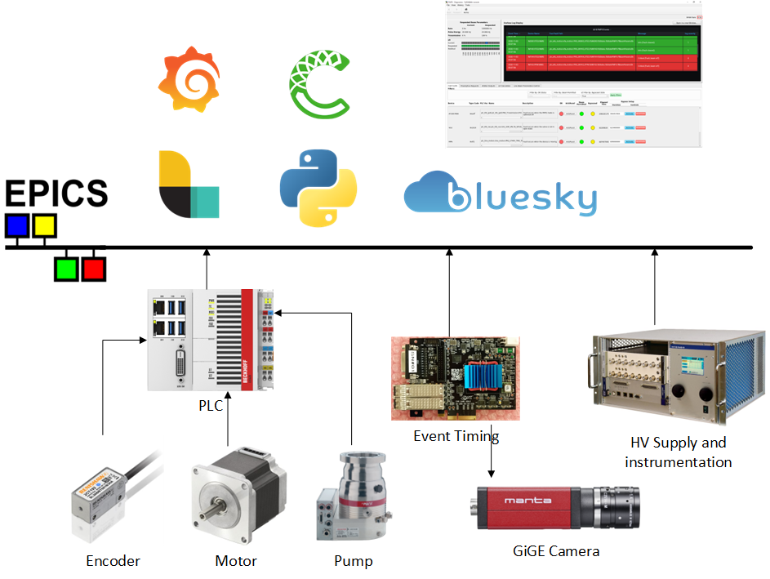
Experiment Control Systems is a SCADA
Subsystems using PLCs
Vacuum
Stepper Motors
Diagnostics
Optics
Machine protection
Sample Delivery
Optical laser delivery
etc.
Subsystems not using PLCs
High speed DAQ
Camera systems
Piezo Motors
Timing systems (event, precision)
Misc. instrumentation and diagnostics

Slide 7
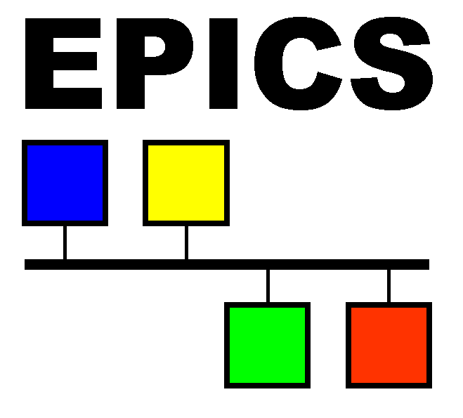




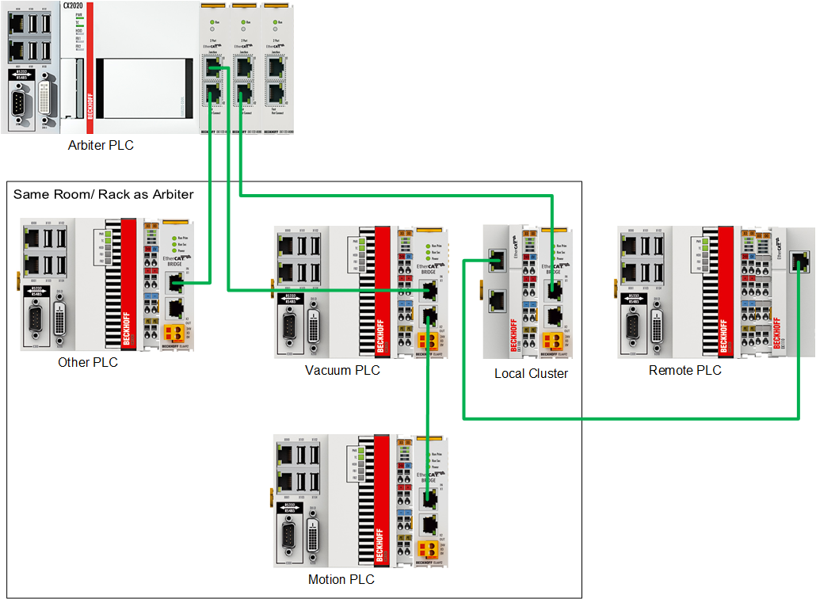
ECS uses Beckhoff and EPICS and a Python-based framework
Beckhoff PLC
ECS maintains a network-based distributed controls system built on top of EPICS.
Control system is primarily Beckhoff PLCs
  Mostly 2 part numbers CX5010 and CX5020
  Consolidating to CX5240 on Tc/BSD
EPICS
  Beckhoff communication interface over TCP/IP: ADS (Automation Device Specification)
  Automatic IOC generation

Slide 8
Automatic EPICS IOC Generation from PLC Source Code
IOCs made easy: pytmc pragmas
IEC 61131-3 pragma annotating the following line - the variable declaration of “fValue”
PLC Project
EPICS IOC Database
{attribute 'pytmc' := '
pv: IOC:PV:NAME
'}
fValue: LREAL;
record(ai, "IOC:PV:NAME")
{
field(DESC, "fValue")
field(INP, "@asyn...")
...
}
$ pytmc db
Uses Structured Text to mark PLC Variables for exposing data to the EPICS IOC layer
Our tooling looks at a build artifact from TwinCAT (.tmc) to generate an IOC database file (.db)
  ADS communication allows for access by way of symbol (PLC variable) name
  Creating an IOC becomes an automated process!
  No more modbus address maps or keeping separate mappings of PLC variable/symbol names to PV names
TwinCAT PLC Coding: Pragmas
Notes:
https://confluence.slac.stanford.edu/display/PCDS/ECS+TwinCAT+Standards+and+Style+Guide#ECSTwinCATStandardsandStyleGuide-PytmcPragmas
https://confluence.slac.stanford.edu/display/PCDS/Beckhoff+Training+Materials?preview=%2F377731607%2F377731788%2FPragmas.pdf

Slide 9
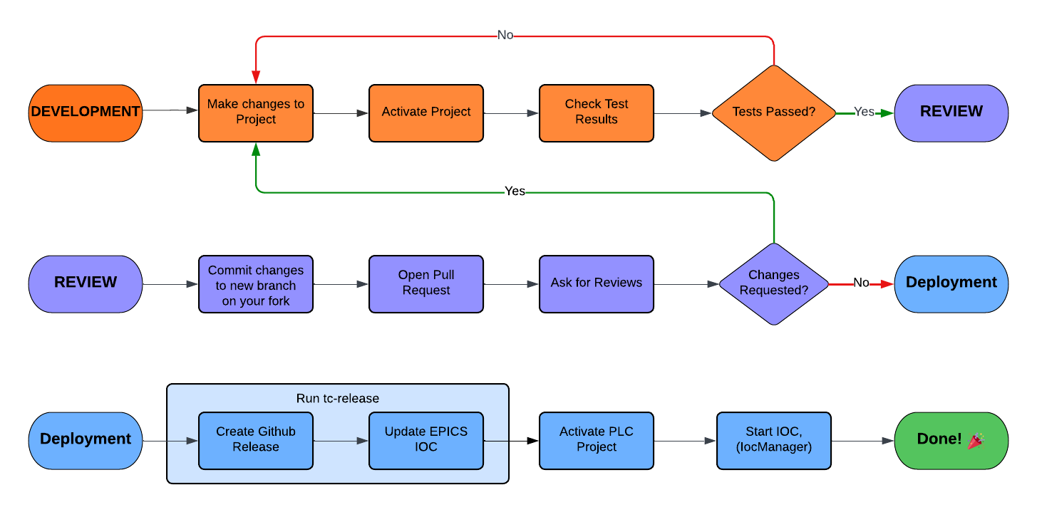
PLC code development uses a common software development workflow, fork-pull.
TwinCAT PLC workflow
TwinCAT PLC Workflow
Notes:
https://lucid.app/lucidchart/9436372b-21e8-4776-8ffd-3e5ebcfcc0be/edit?viewport_loc=-561%2C153%2C1617%2C1464%2C0_0&invitationId=inv_60aea002-6a26-482a-b743-8af5a67da684
lucidchart is fancy
PLC up before IOC, which expects PLC to be online, in run-mode, with project loaded

Slide 10
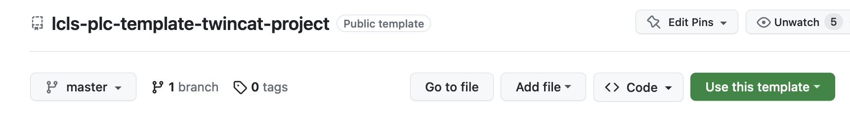
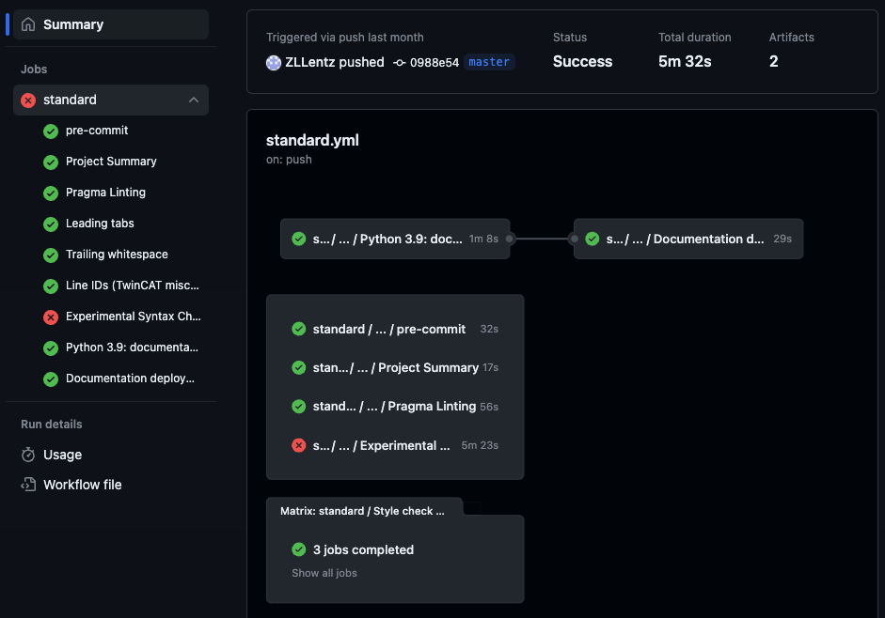
We use the Github template system for new project templates
https://github.com/pcdshub/lcls-plc-template-twincat-project
Using the template is as easy as clicking a button:
Includes
Pre-commit configuration
Standard GitHub actions
  Pre-commit
  pytmc summary (inspects .tsproj files)
  pytmc pragma linting
  Style, syntax checks
Documentation building, template
Beckhoff Development Setup: Template Projects

Slide 11



Github works well for source control, could be even better
ECS uses GitHub
Progression:
TwinCAT 3
  Started with Beckhoff integrated SVN
    Worked OK
  Git shows up, much better than SVN
  Beckhoff integrates git into TwinCAT
    Works OK
  Went back to using standalone git, either git-bash, or GitHub’s nice GUI system
    Works best
Moved everything to GitHub
  We made a nice system for viewing TwinCAT projects in web pages hosted by GH
  Actions automatically update these pages with repo commits; see testing slides!
  Currently investigating ways to make GitHub identify and display .xml TwinCAT project files nicer/natively

Slide 12
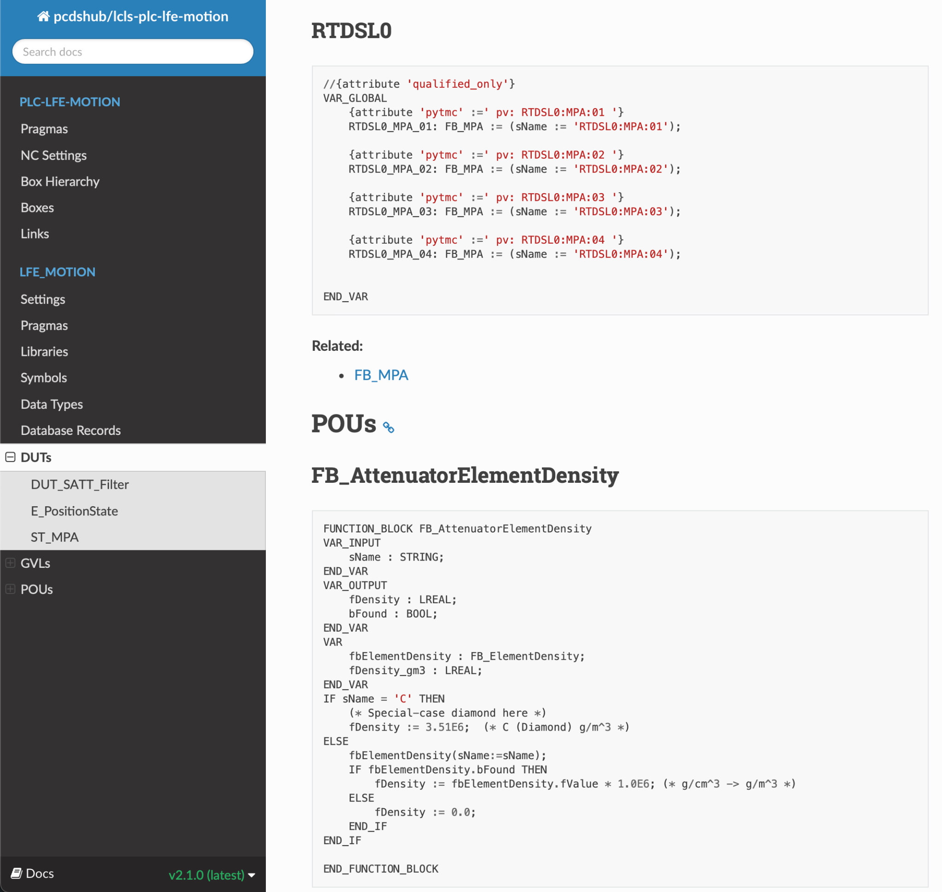
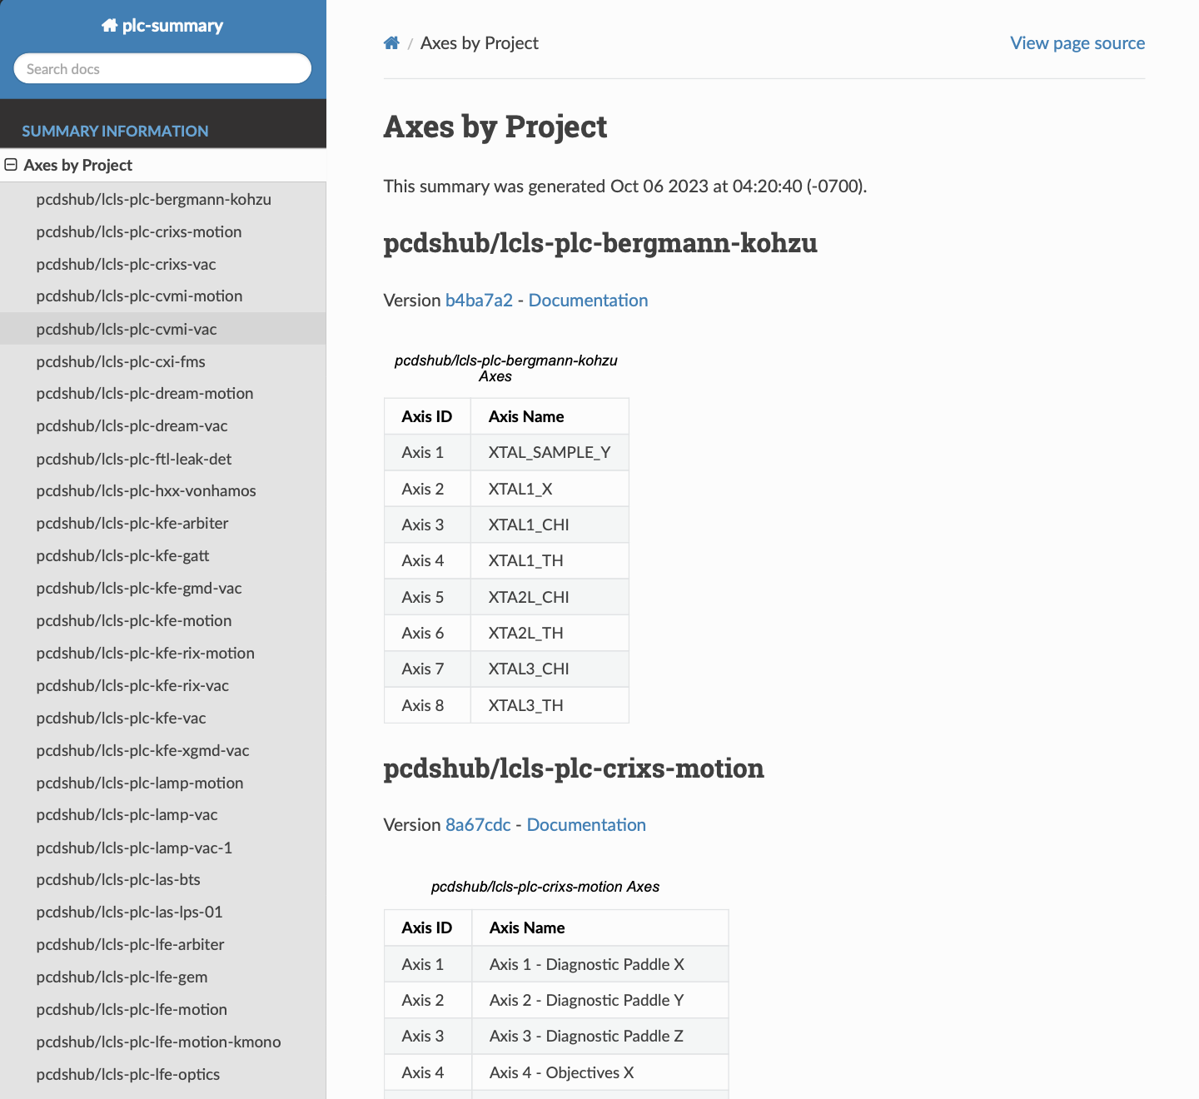
GitHub Pages PLC Code View
Per-PLC project web view “documentation” of sorts, plus facility-wide summary

Slide 13
Development and deployment systems
TwinCAT development environment installs and updates for free
Managing TwinCAT target versions vs. development environments can be tricky
We use a centralized development environment and deploy to any PLC via the network
Uses a hypervisor provided Windows Server instance which is utilized by the whole team simultaneously
    We’ve seen up to ~10 simultaneous users
  Originally used a “fleet” of 4 machines which we tried to keep synchronized
    Very difficult
    Environments quickly diverged
    Load balancing doesn’t quite work
  The centralized environment maintains consistency between our engineers
  Generally runs OK
    Headcount has grown; issues are starting to occur more frequently
    This is not a “supported” way of using TwinCAT
  This machine sits inside a secure enclave
    Accessed via rdesktop
    Uses a proxy for GitHub access

Slide 14
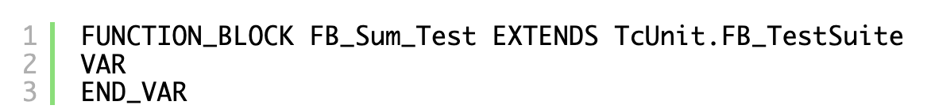

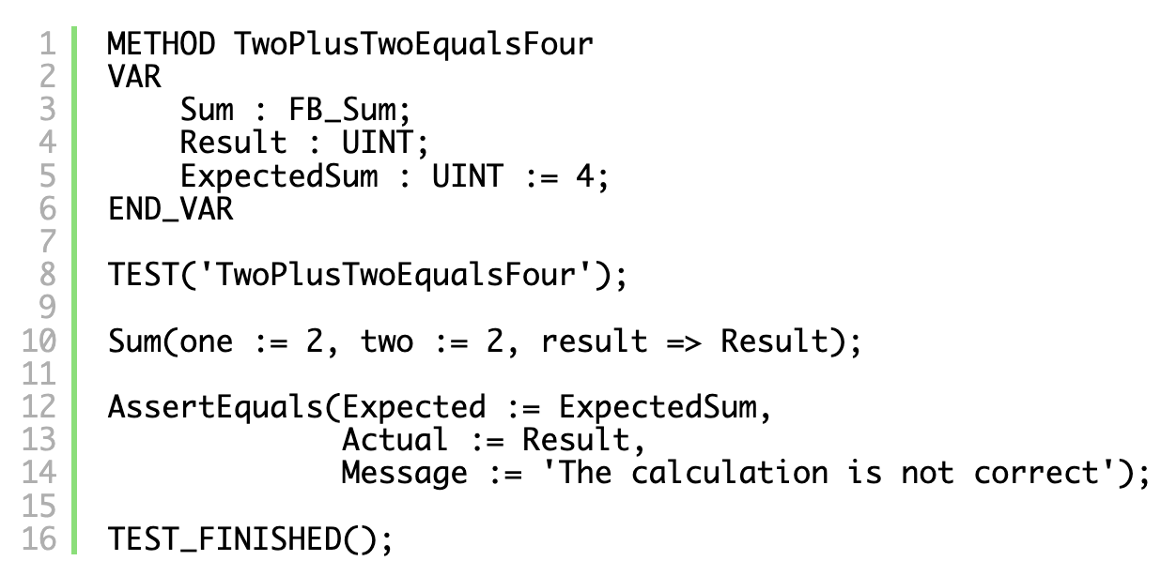
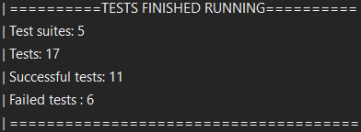
Testing
Most testing is done via procedure during qualifications, but some is automatic
Linting, or making sure the ST code is formatted consistently
Some of our core libraries are covered by TcUnit tests which are embedded in runtime projects included in the library
  So a developer can deploy a “library” to a PLC and run it and receive a list of the test results
  PLC code unit tests look a lot like an ordinary software unit test

Slide 15
Automated testing with TcUnit
TcBSD and GitHub Actions holds some promise for Continuous Integration for PLC code
Currently collaborating with J. Sagatowski on a proof of concept for a continuous integration “pipeline” for automated execution of TcUnit test suites and other code quality checks.
The concept:
  An engineer commits a change to a library or implementation project git branch
  The new code (including tests) is deployed to either a virtual PLC, or a physical testing PLC
  The tests run, and results are returned to GitHub
  The results are displayed inline with the branch
  Can gate the integration of the code change into the main branch by the tests
Physical PLCs for testing
  Future may include virtualized PLC instances (TcBSD) for hardware-less testing

Slide 16
Acknowledgements
ECS Team and our collaborators
Margaret Ghaly
  Will give a talk about our vacuum controls systems!
Tyler Johnson
  Will give a talk about our laser timing control systems!
Ken Lauer
  Posters about TcBSD, our PLC logging system, and an EPICS parser.
Jakob Sagatowski
  Originator of the TcUnit framework, extremely knowledgeable of all things Beckhoff
ESS
  Original authors of the EPICS device support for our PLCs

