Slide 1


High Efficiency X-band klystrons development
Igor Syratchev for HE klystrons project team:
Zaib Un Nisa
Anis Baig
Nuria Catalan
Graeme Burt

Slide 2
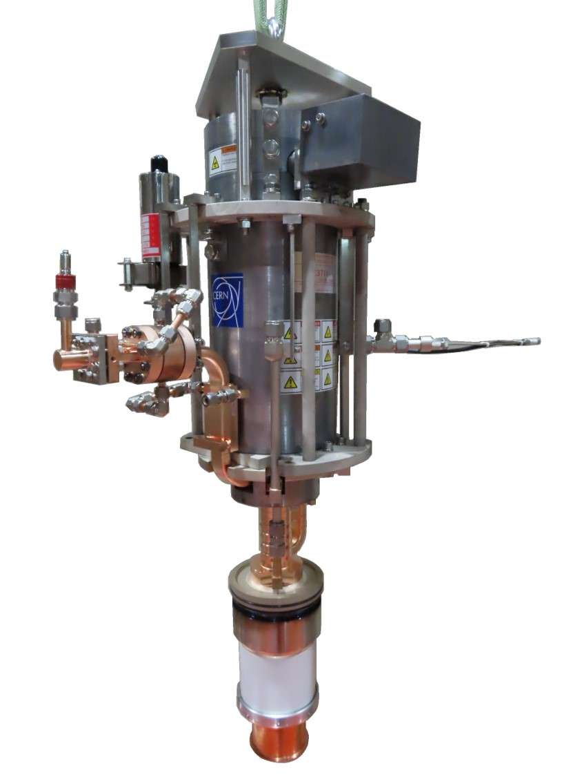
10 MW class HE X-band klystron.
CERN-Canon ETD collaboration

Slide 3
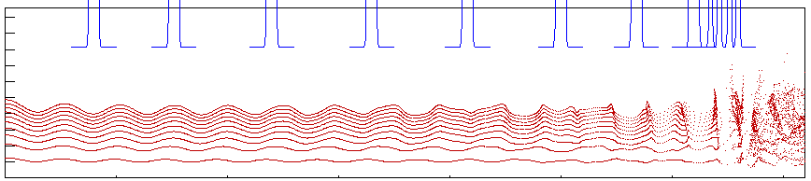
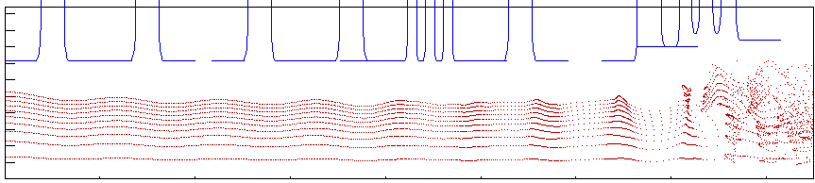
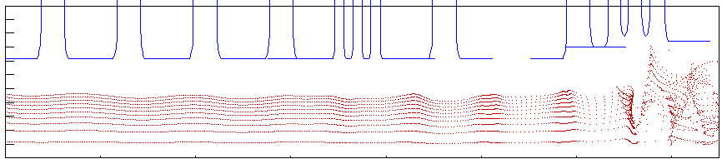
Klystron RF Circuit
Design 1
Long COM circuit
New solenoid
2019
Eff. = 58.6%
Design 2
Short COM circuit
2nd harmonic
New solenoid
Eff. = 56.4%
Design 3
Short circuit (same as existing 6-MW tube)
2nd harmonic
Existing solenoid
Eff = 56.4%
We decided to fabricate this tube.
2020

Slide 4
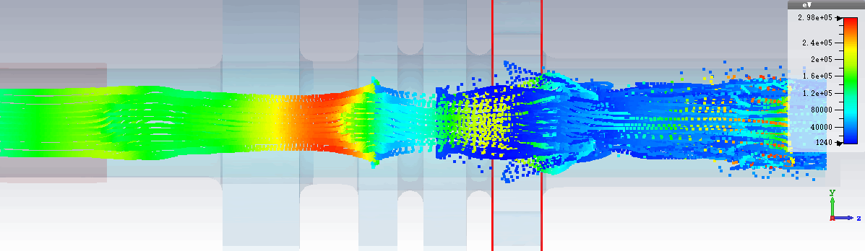
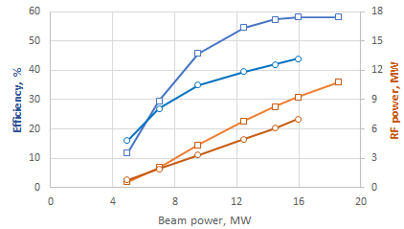

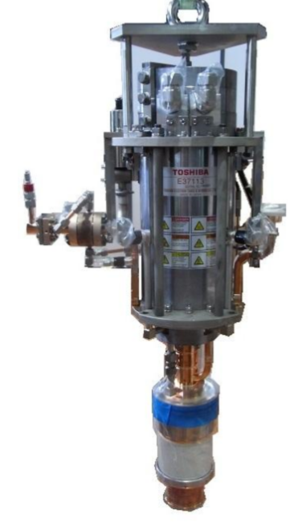
Retro-fit High Efficiency 8 MW, 12 GHz klystron
E37113
HEX8
HEX8
E37113
Retrofit design
8-10 MW | E37113 at factory | HEX COM_M (CERN/Canon)
Voltage, kV | 154 | 154
Current, A | 94 | 94
Frequency, GHz | 11.994 | 11.994
Peak power, MW | 6.2 | 8.1
Sat. gain, dB | 49 | 48
Efficiency, % | 42 | 56.4
Life time, hours | 30 000 | 30 000
Solenoidal magnetic field, T | 0.35 | 0.42
RF circuit length, m | 0.127 | 0.127
The same modulator
Re-used solenoid
Re-used cathode
VKX-8311A

Slide 5
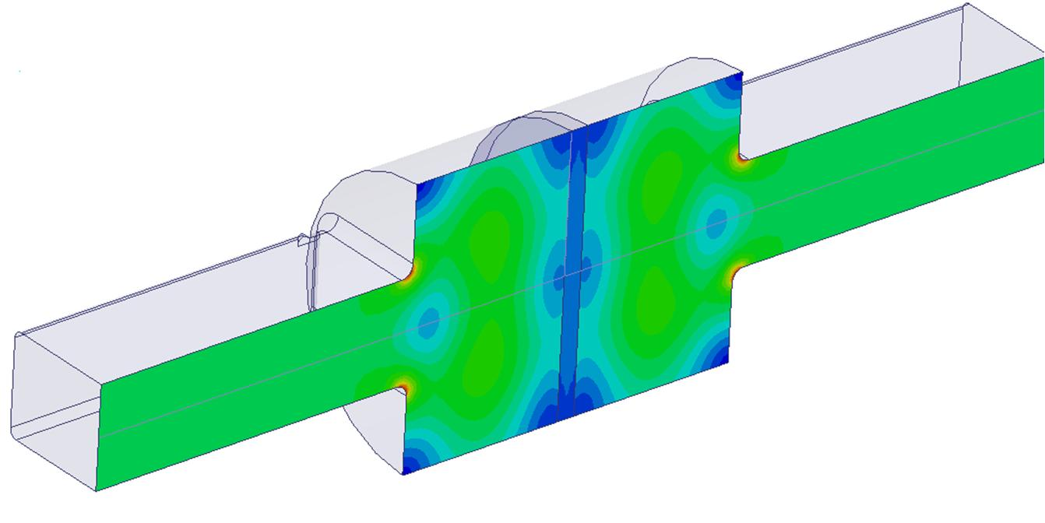
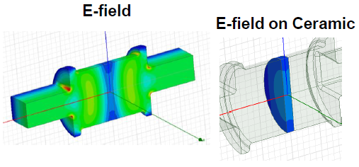
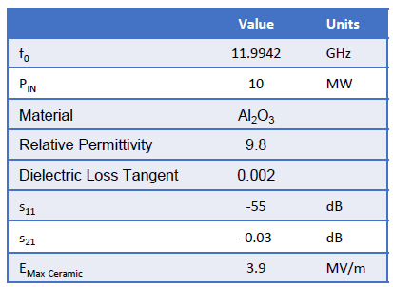
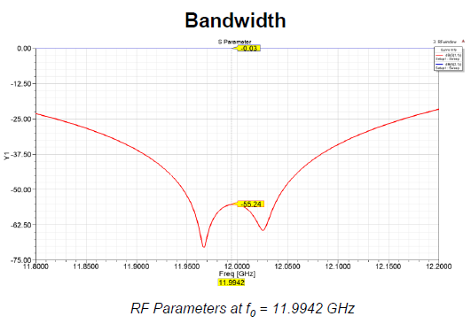
New RF window with increased peak RF power capacity
Compact RF window with TW in ceramic was designed at CERN to decrease the electric field strength on ceramic. At Canon, it is now commercialized as a separate RF device.
Conventional long pillbox window
4.3 MV/m at 6 MW
4.9 MV/m at 8 MW
Designed for
6-MW klystron
E field strength on ceramic surface decreased by 30%
Compact window with TW in ceramic
3.5 MV/m at 8 MW
3.9 MV/m at 10 MW

Slide 6
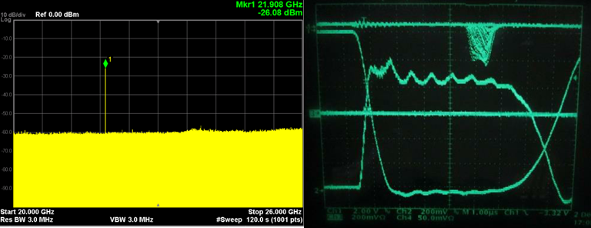


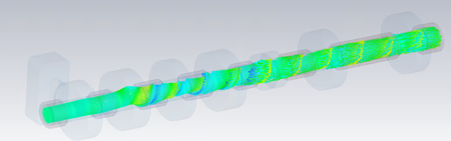

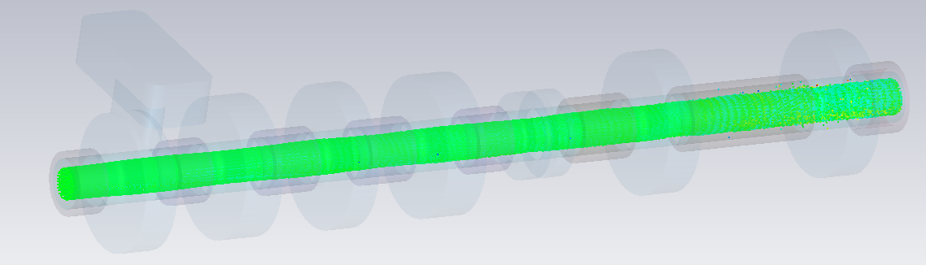
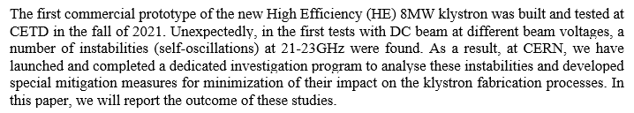
The first prototype was built and tested at Canon in December 2021.
Unexpectedly, in the first tests with DC beam at different voltages, a number of instabilities (self-oscillations) at 21-23GHz were found!
unstable
All the instabilities were analyzed/understood and mitigated by correcting the cavities impedances and other special measures [https://cds.cern.ch/record/2812566?ln=en].
stable

Slide 7
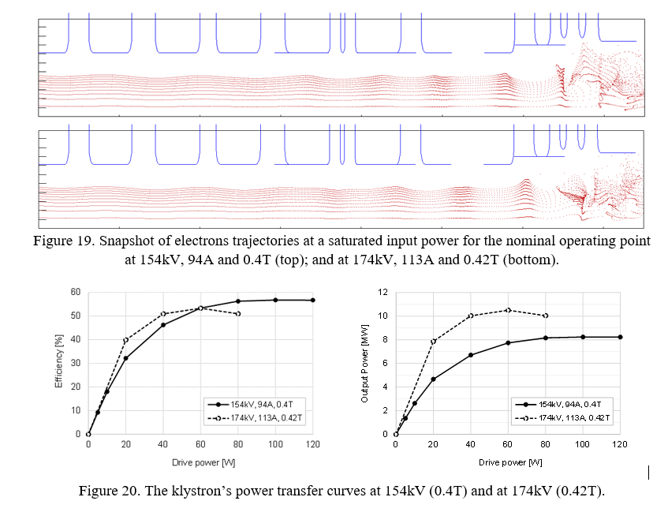
The new and stable (up to 170kV; 10 MW) klystron RF circuit design.

Slide 8

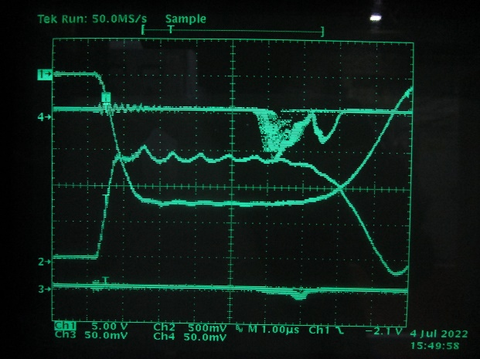
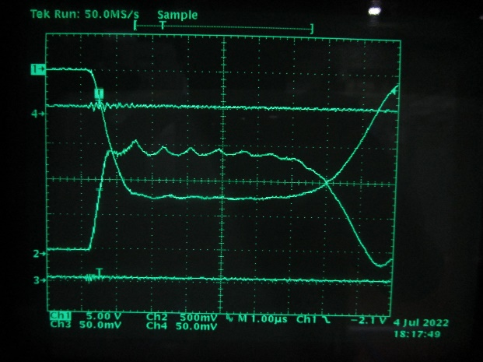
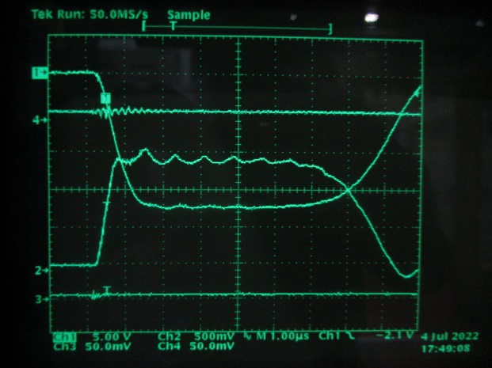
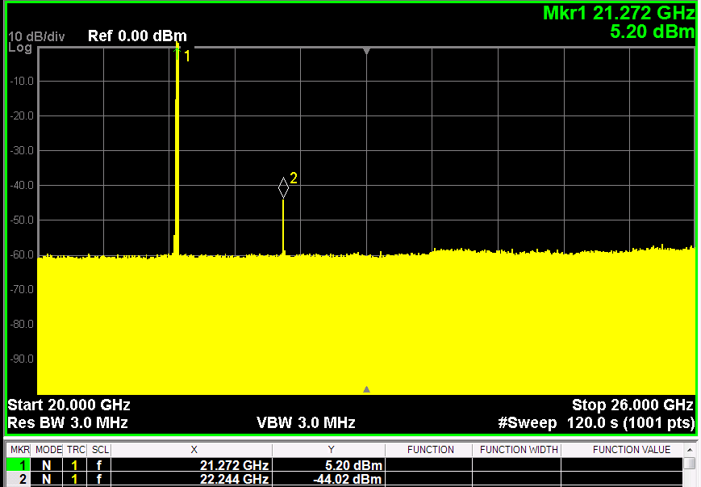
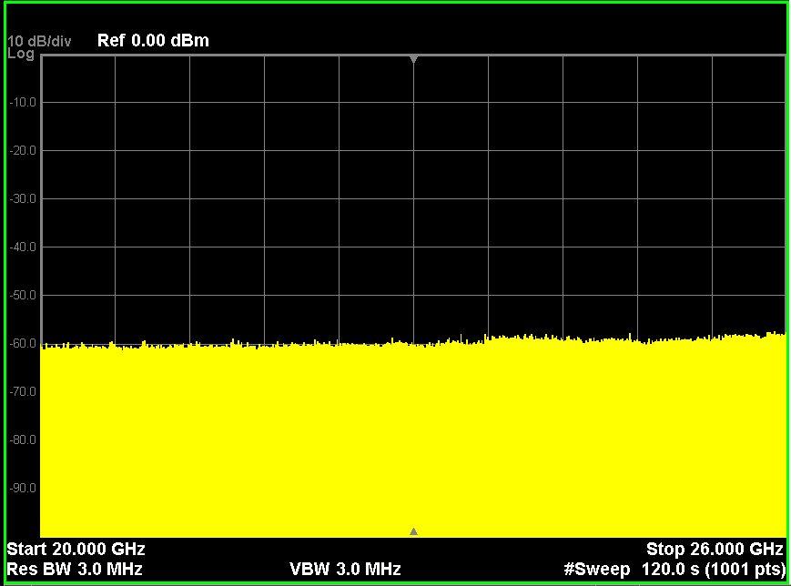

The tube#2 was built and tested at Canon in July 2022. As it was predicted in simulations, above 170kV (>10MW RF power), oscillations were successfully eliminated by increasing main coil current or counter coil current of focusing magnet.
174kV
No oscillation signal
No oscillation signal
stable
stable
I_{main}=30A, I_{counter}=7A
I_{main}=30→32A, I_{counter}=7A
I_{main}=30A, I_{counter}=7→11A
Original solenoid (0.4T) coils settings
Adopted solenoid (0.42T) coils settings

Slide 9
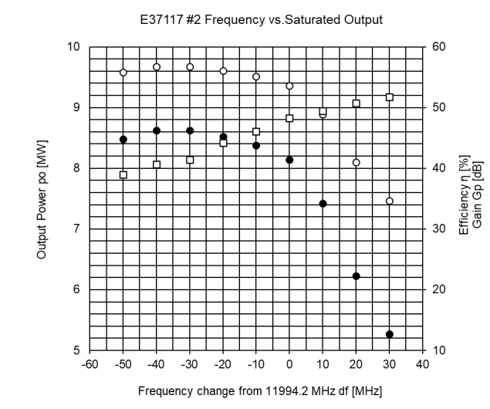
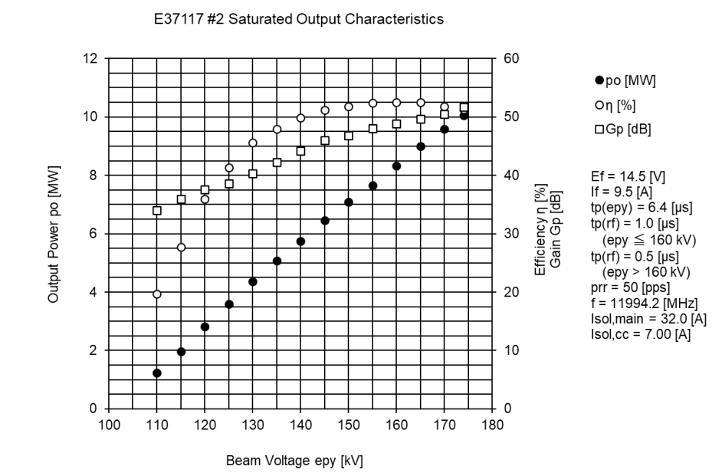
The second tube was a success and showed expected performance in terms of power production, yet at a lower frequency!
FAT
FAT
-30 MHz
However at 11.994GHz efficiency is still high: 53.3%. It will be installed in Xbox#3 in 2023.

Slide 10
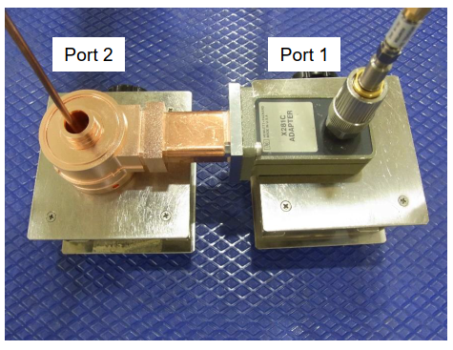
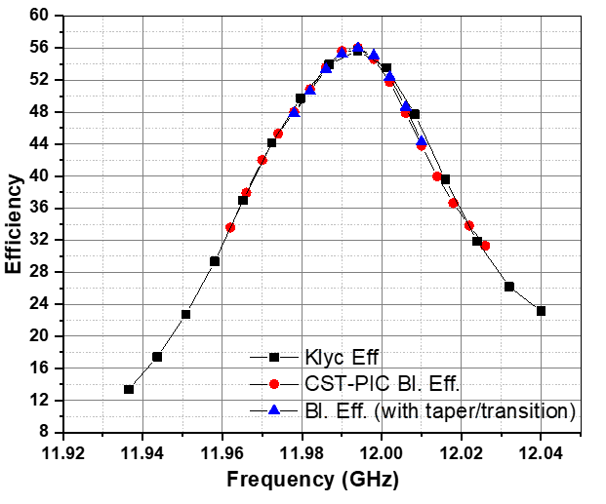
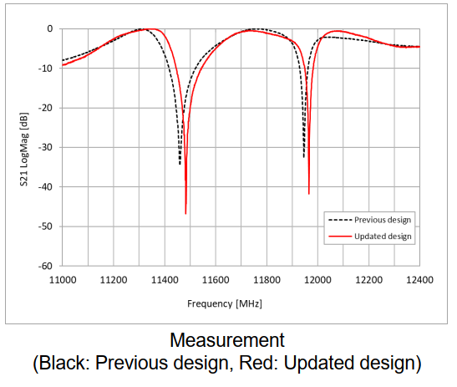
The problem with detuning was identified. It concerned the method used at Canon on how to adjust the frequency (dimension) of individual cell in the multi-cells coupler using HFSS simulations. The new dimension were calculated and verified in PIC simulation at CERN. Following, the new coupler was built for the refurbished klystron #1.
Predicted klystron performance in simulations with different codes used at CERN
154kV,
Fixed Pin

Slide 11
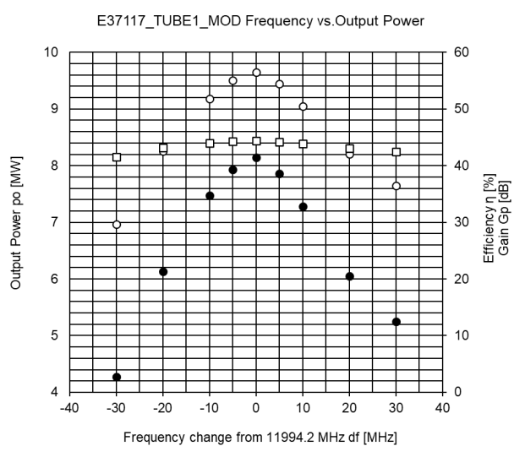
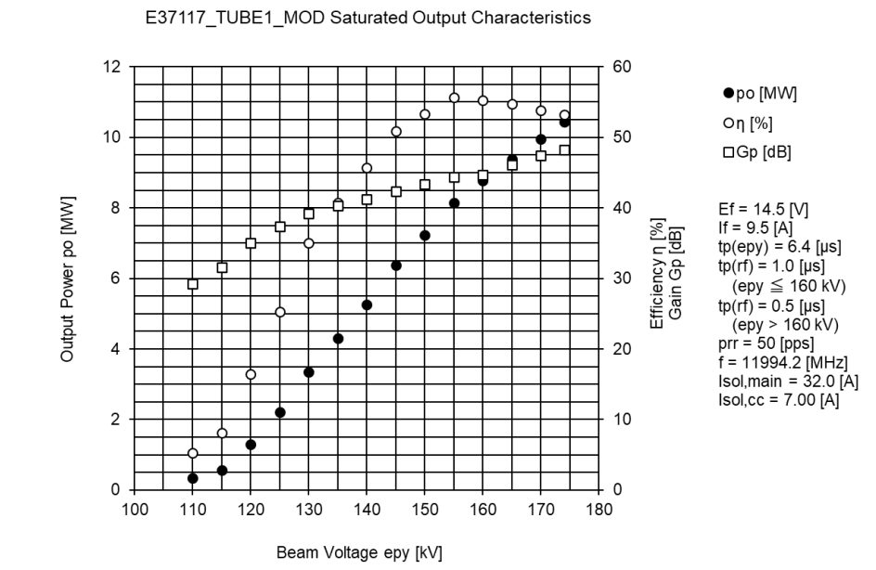
The klystron#3 (refurbished klystron#1) was tested at Canon in December 2022.
154kV,
Fixed Pin
At operating frequency klystron showed 56.2% (cf. simulated 56.4% in original design). That corresponds to 35% RF peak power increase compared to the original Canon tube at the same operating voltage.
Tube can reach 10.5MW with existing Xbox#3 ScandiNova modulator (with 174kV max recommended).
In a range of RF power levels from 6MW to 10.5 MW the klystron is 50%+ efficient and can be used for different application in this range by adjusting modulator type/voltage.

Slide 12
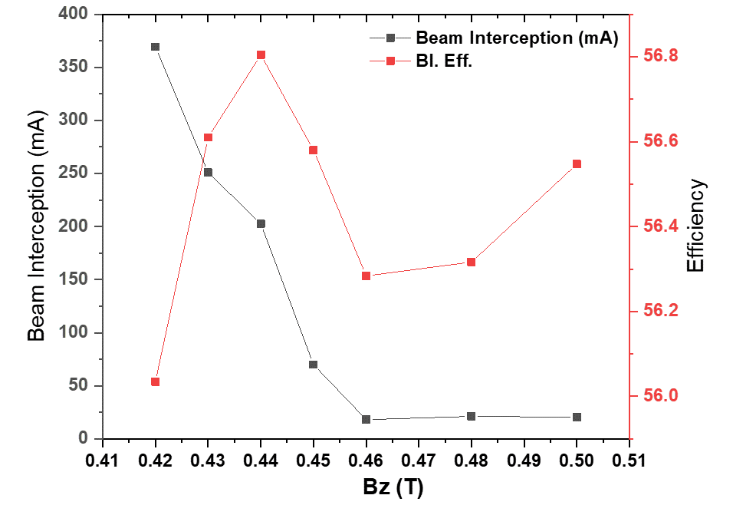
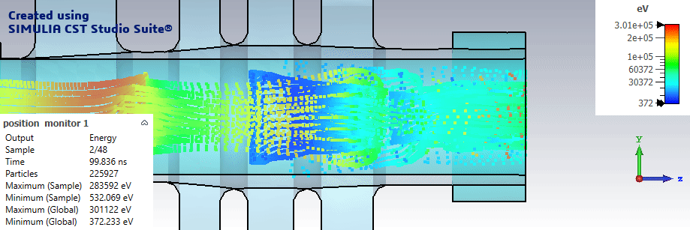

…and still this was not the end...
Q. Igor (CERN): … may I suggest one measurement if you can do it. Following our simulations, we saw that efficiency can be increased by almost 1%, if magnetic solenoidal field will be increased up to 0.44T (33.5A) from 0.42T (32A)?
A. Toshiro-san (Canon): …We have additionally tested the performance at solenoid current of I main=33.5A (and I cc=7A).
The output power increased a bit as you say:
154 kV, 93.6 A, Pout=8.2MW, Eff=56.9%.
We found in PIC simulations (it was not expected), that by another and small increase of solenoidal field from 0.42T to 0.44T, the efficiency gains another 0.8% and also it provides even less beam interception.

Slide 13


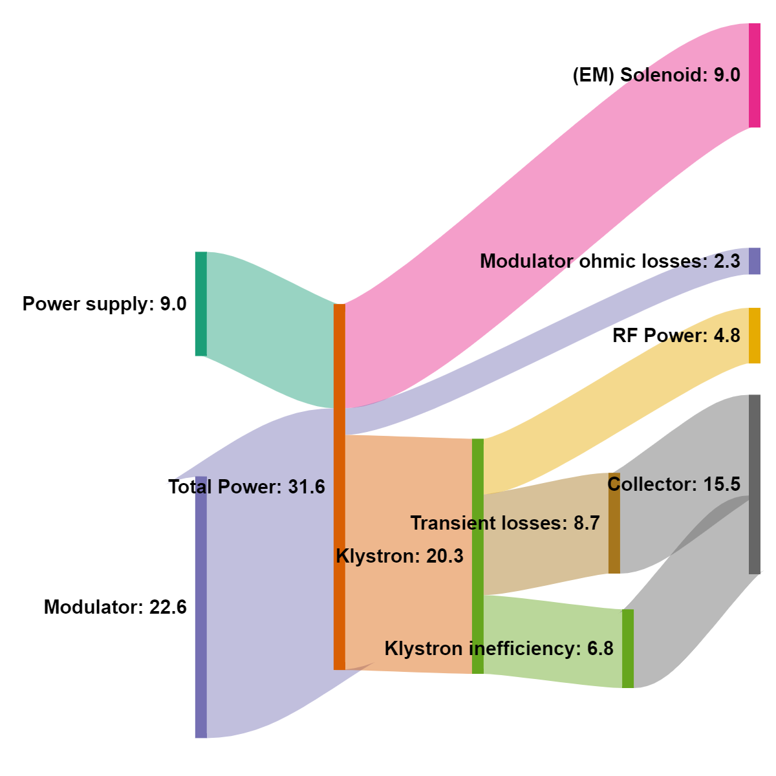
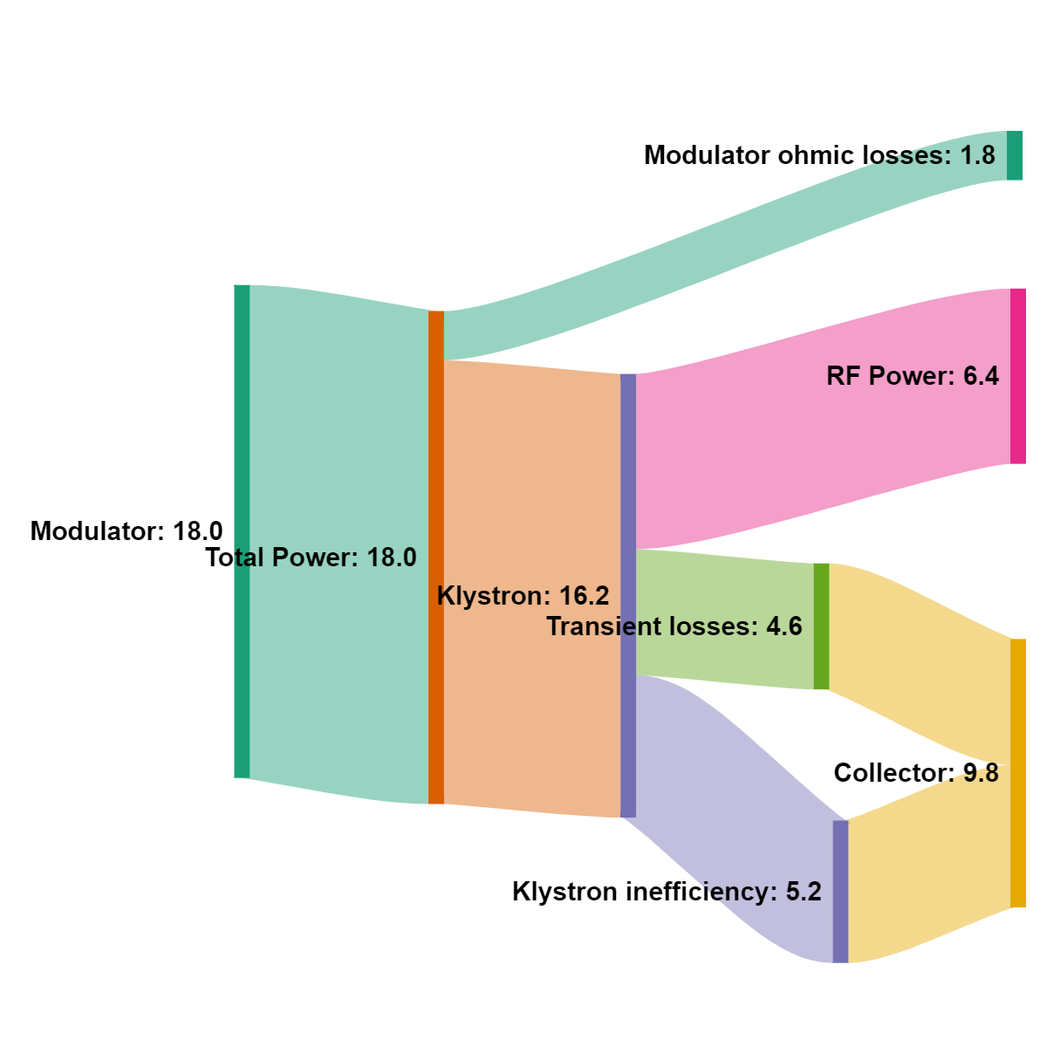
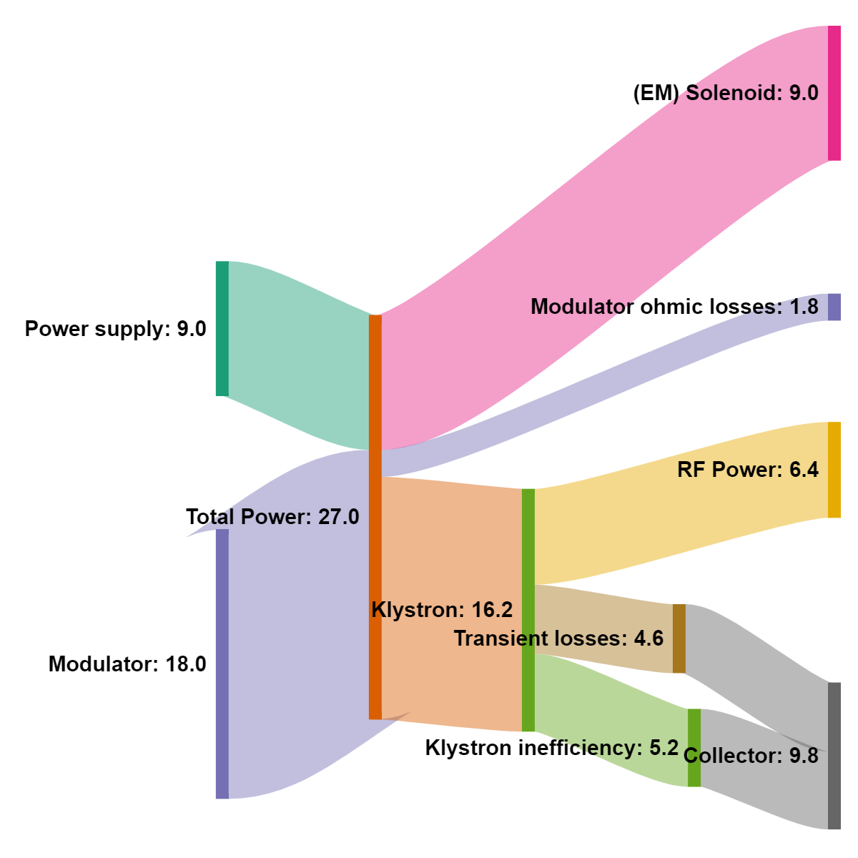
Submitted by:
Nuria Catalan Lasheras
Senior physicist SY/RF
Original Canon tube
Plug-to-RF efficiency 15.2%
HE Canon tube
Plug-to-RF efficiency 23.7%
HE Canon tube + PM solenoid
Plug-to-RF efficiency 35.5%

Slide 14

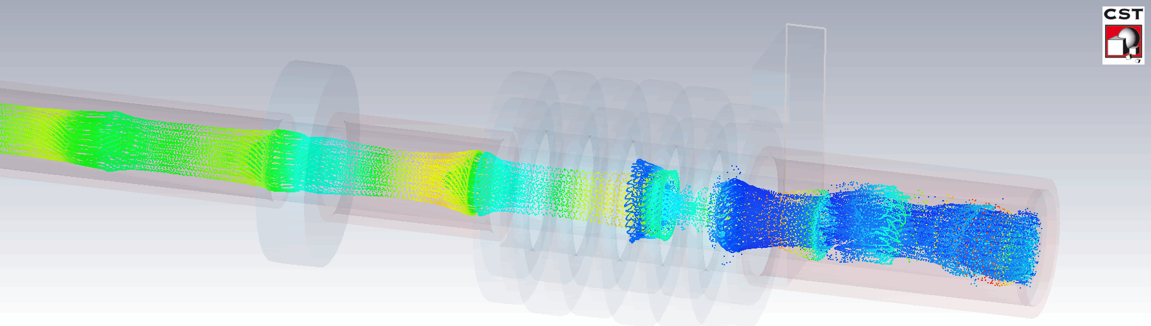
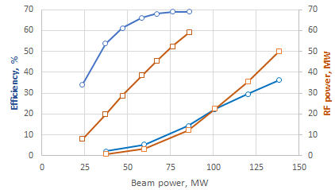
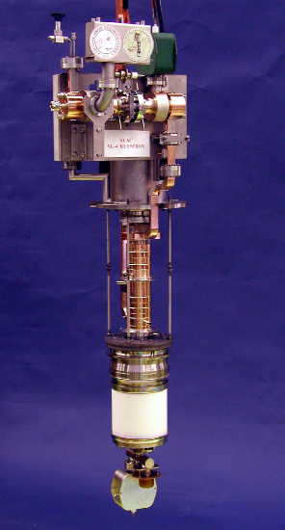

High Efficiency (66%) 50 MW, 12 GHz klystron (CERN- CPI collaboration).
Saturated efficiency & RF power
3D Particle-in-Cell (PIC) simulations
HEX
VKX-8311A
 | VKX-8311A | HEX (CERN/CPI)
Voltage, kV | 420 | 420
Current, A | 322 | 204
Frequency, GHz | 11.994 | 11.994
Peak power, MW | 49 | 58
Sat. gain, dB | 48 | 59
Efficiency, % | 36.2 | 66
Life time, hours | 30 000 | 85 000
Solenoidal magnetic field, T | 0.5 | 0.5
RF circuit length, m | 0.32 | 0.32
Re-used solenoid.
Increased life time (> factor 2)
Reduced modulator power (~ factor 2)
Increased power gain (10 dB)
New optics design
Prototype fabrication is under negotiation between CPI and INFN.
VKX-8311A

