Slide 1


An Inverse Compton Scattering source based on CompactLight
Compact
Vlad Musat, Andrea Latina
04/04/2023

Slide 2
Contents
Introduction
Electron beamline optimisation
Fabry-Pérot cavity optimisation
Conclusions

Slide 3
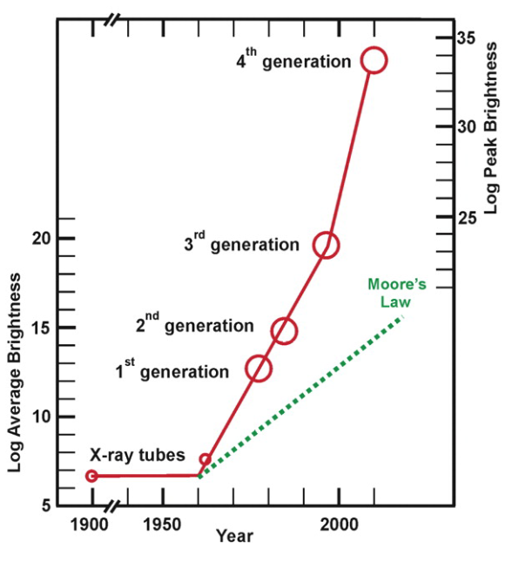
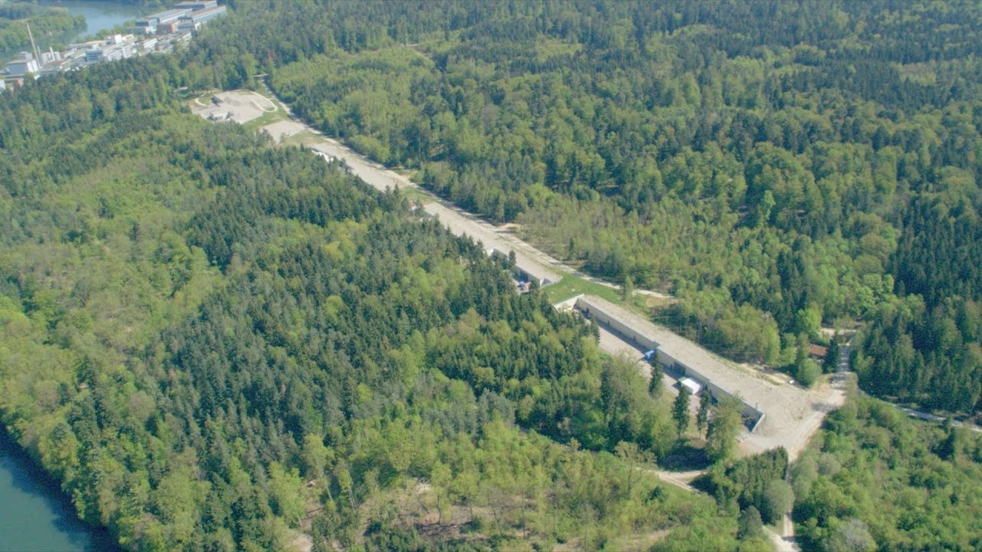
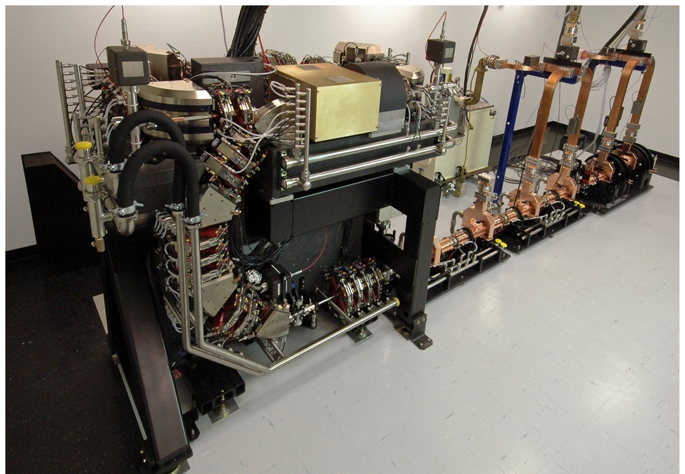


ICS as an alternative to large-scale light sources
Current light sources represented by:
  Synchrotrons (2nd gen)
  Storage rings with undulators (3rd gen)
  Free Electron Lasers, MBA storage ring (4th gen)
  Current light sources are, however, housed in large-scale structures, with limited beamtime.
K. Wille, The Physics of Particle Accelerators: An Introduction, Oxford University Press, Oxford, UK (2000).
J. B. Parise and G. E. Brown, Jr., Elements, 2, 37-42 (2006).
$∼700$ m
$∼7$ m

Slide 4
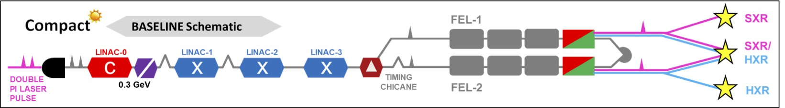
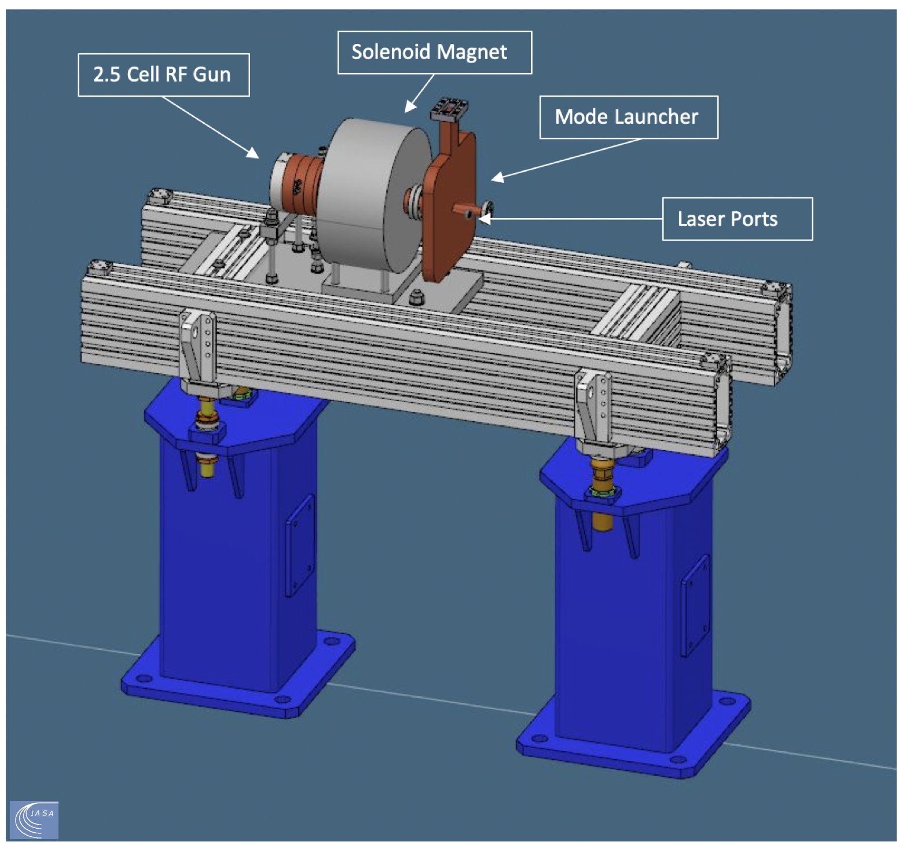
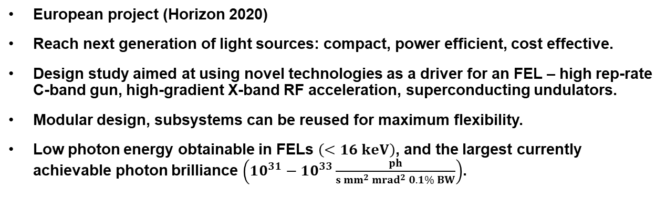

CompactLight (XLS) design study
Main linac length $∼250 m$
European project (Horizon 2020)
Reach next generation of light sources: compact, power efficient, cost effective.
Design study aimed at using novel technologies as a driver for an FEL – high rep-rate C-band gun, high-gradient X-band RF acceleration, superconducting undulators.
Modular design, subsystems can be reused for maximum flexibility.
Low photon energy obtainable in FELs $\left(<16 keV\right)$, and the largest currently achievable photon brilliance $\left(10^{31}−10^{33}\frac{ph}{s mm^{2} mrad^{2} 0.1\% BW}\right)$.
XLS photo-injector:
  kHz rep-rate injector
  C-band gun

Slide 5
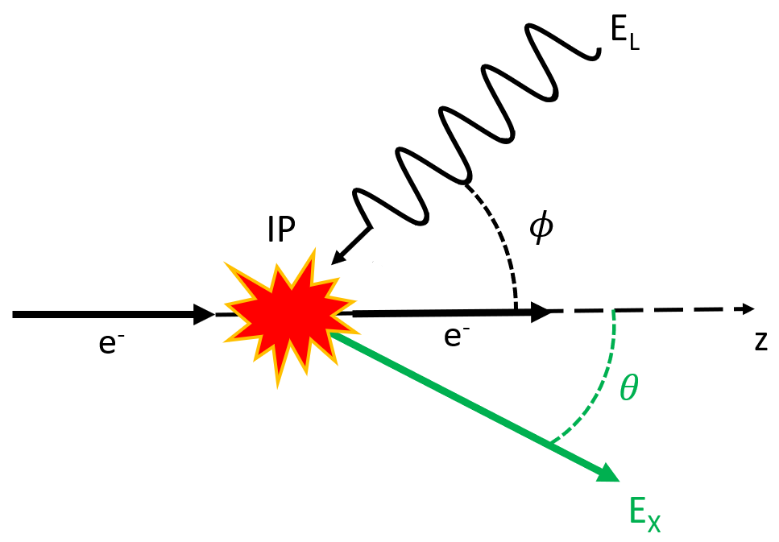
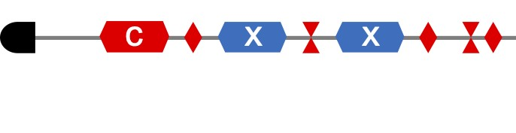
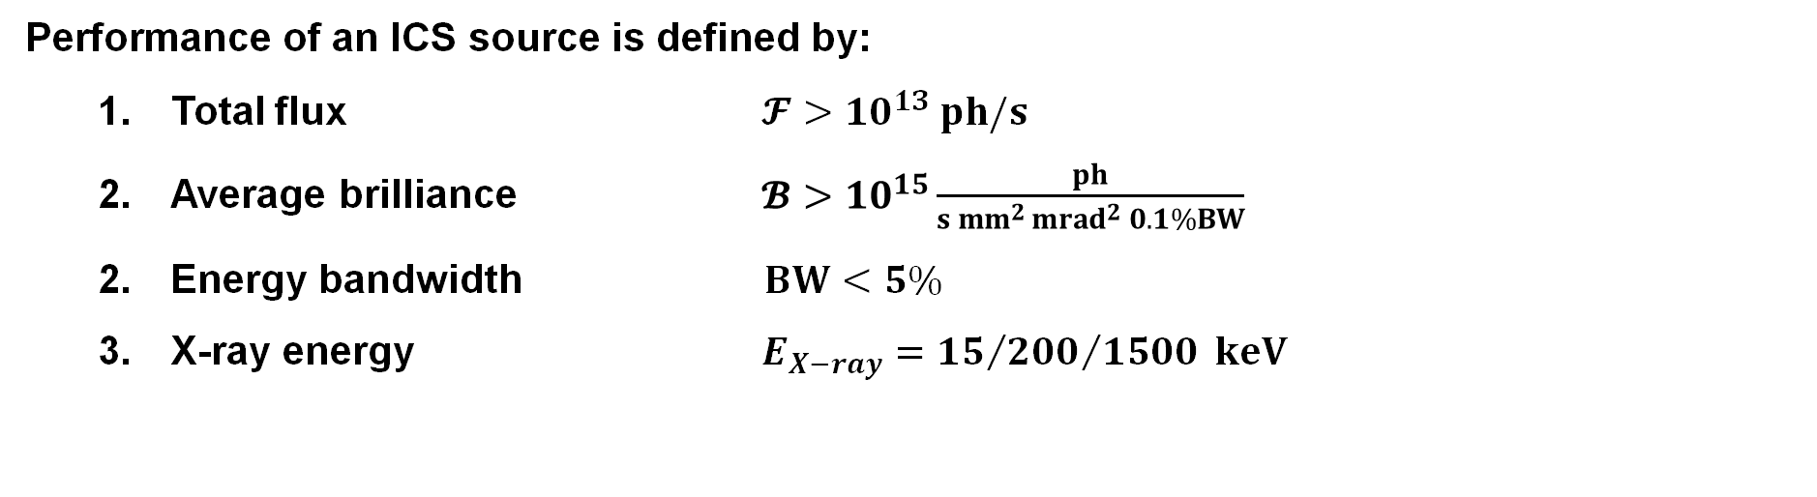

ICS source based on XLS
Performance of an ICS source is defined by:
  Total flux $𝓕>{10}^{13} ph/s$
  Average brilliance $𝓑>{10}^{15}\frac{ph}{s mm^{2 }mrad^{2} 0.1\%BW}$
  2. Energy bandwidth $BW<5\%$
  3. X-ray energy $E_{X−ray}={15}/{{200}/{1500}} keV$
C
C
Max Length: $∼15$ m (300 MeV)

Slide 6
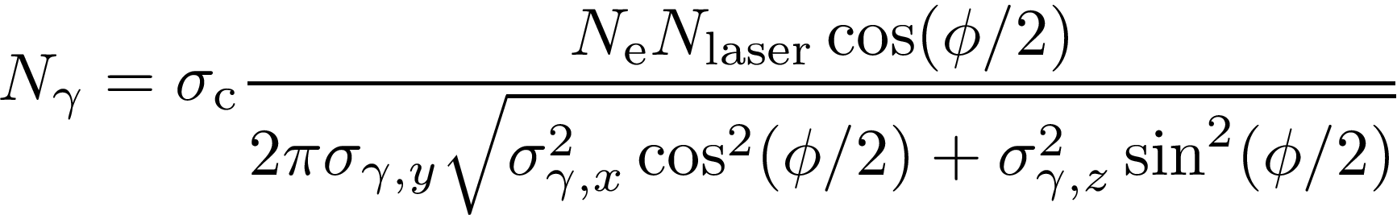


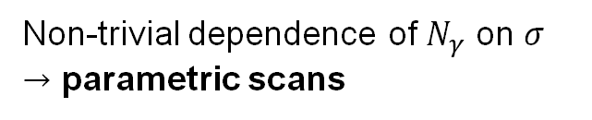
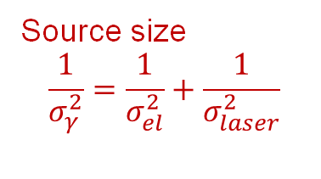
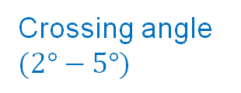

How can we maximise photon flux
Crossing angle $(2°−5°)$
$∼$ Bunch charge
$∼$ Laser pulse energy
Source size
$$\frac{1}{σ_{γ}^{2}}=\frac{1}{σ_{el}^{2}}+\frac{1}{σ_{laser}^{2}}$$
$$ℱ≈N_{γ}f_{eff}$$
Non-trivial dependence of $N_{γ}$ on $σ$
$→$ parametric scans

Slide 7
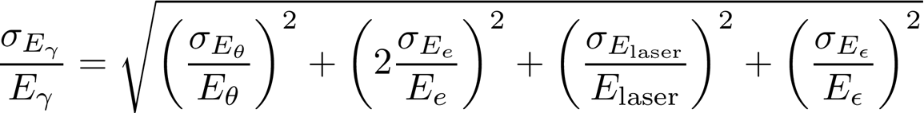
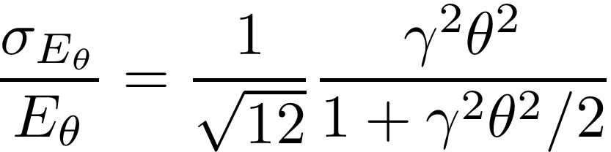
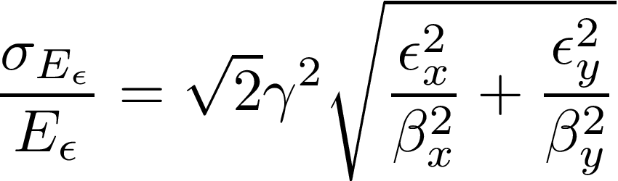
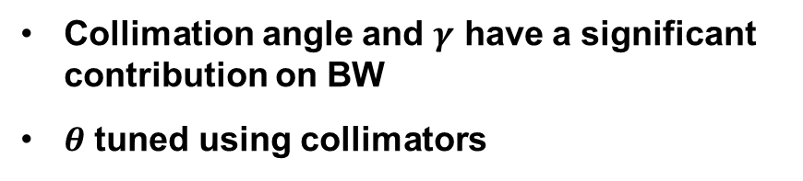


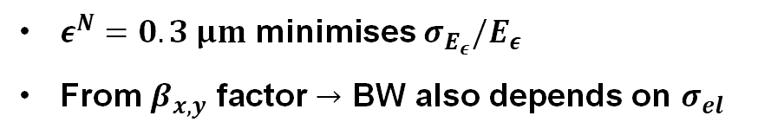
How can we minimise photon bandwidth
Tune collection angle and electron IP spot size to find low BW solution
Keep $σ_{E_{γ}}/E_{γ}$ under 5% for most applications
$∼5$‰
$∼1$‰
Collimation angle and $γ$ have a significant contribution on BW
$θ$ tuned using collimators
$ε^{N}=0.3 μm$ minimises $σ_{E_{ε}}/E_{ε}$
From $β_{x,y}$ factor $→$ BW also depends on $σ_{el}$

Slide 8
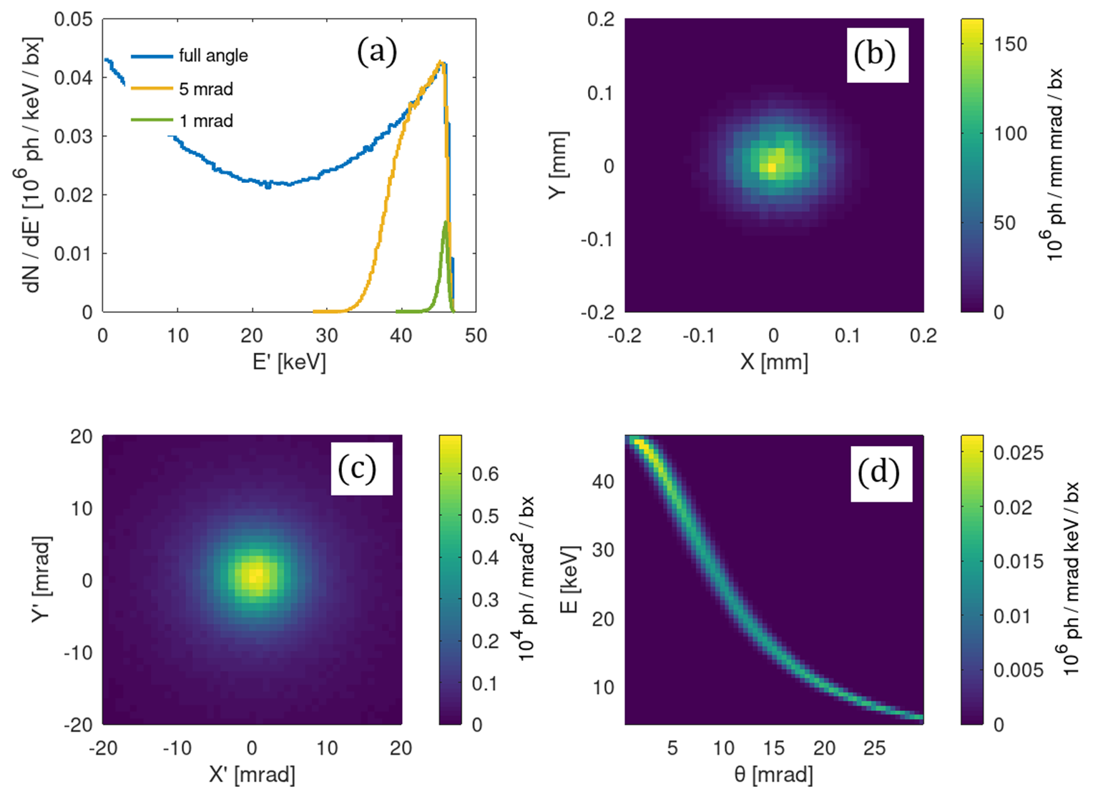
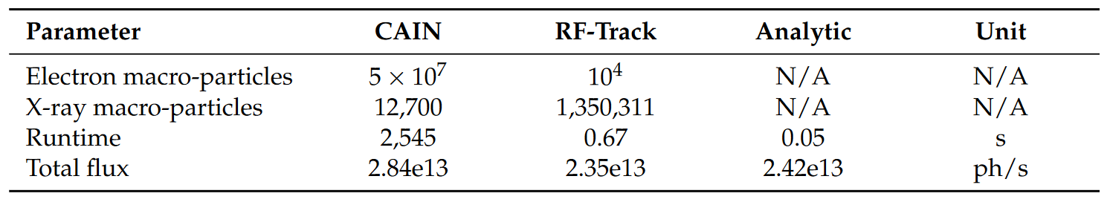
Use CERN-developed RF-Track to simulate ICS
RF-Track [1] was used to simulate ICS sources at the laser and electron beam interaction point (IP).
Pictured are RF-Track and CAIN simulation results for ThomX [2].
RF-track achieved a much shorter runtime than CAIN.
%% Create the bunch
B0 = Bunch6d(RF_Track.electronmass, Q_pC*RF_Track.pC, -1, Pref, Twiss, 30000);
E0 = B0.get_phase_space();
%% Define lattice
L = Lattice();
L.append(FP); % Add the FPC cavity to the lattice
%% Tracking
B1 = L.track(B0);
%% Post-processing
M1 = B1.get_phase_space('%x %xp %y %yp %t %Pc %m %N');
M1_w = M1(:,7)==0.0; % pick the photons
E1 = M1(~M1_w,:); % electrons
P1 = M1( M1_w,:); % gammas
ThomX: RF-Track
[1] Andrea Latina, "RF-Track Reference Manual", CERN, Geneva, Switzerland, June 2020.
[2] A. Variola, J. Haissinski, A. Loulergue, F. Zomer, (eds ). ThomX Technical Design Report. 2014, 164

Slide 9
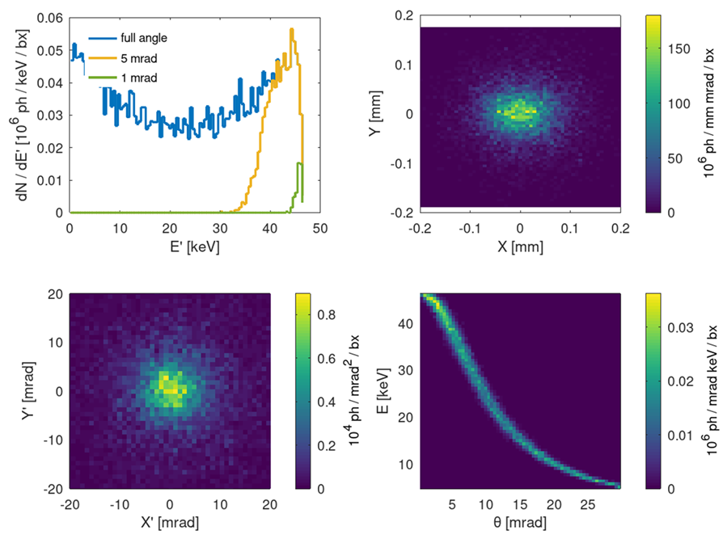
Use CERN-developed RF-Track to simulate ICS
RF-Track [1] was used to simulate ICS sources at the laser and electron beam interaction point (IP).
Pictured are RF-Track and CAIN simulation results for ThomX [2].
RF-track achieved a much shorter runtime than CAIN.
%% Create the bunch
B0 = Bunch6d(RF_Track.electronmass, Q_pC*RF_Track.pC, -1, Pref, Twiss, 30000);
E0 = B0.get_phase_space();
%% Define lattice
L = Lattice();
L.append(FP); % Add the FPC cavity to the lattice
%% Tracking
B1 = L.track(B0);
%% Post-processing
M1 = B1.get_phase_space('%x %xp %y %yp %t %Pc %m %N');
M1_w = M1(:,7)==0.0; % pick the photons
E1 = M1(~M1_w,:); % electrons
P1 = M1( M1_w,:); % gammas
ThomX: CAIN
[1] Andrea Latina, "RF-Track Reference Manual", CERN, Geneva, Switzerland, June 2020.
[2] A. Variola, J. Haissinski, A. Loulergue, F. Zomer, (eds ). ThomX Technical Design Report. 2014, 164

Slide 10
Contents
Introduction
Electron beamline optimisation
Fabry-Pérot cavity optimisation
Conclusions

Slide 11
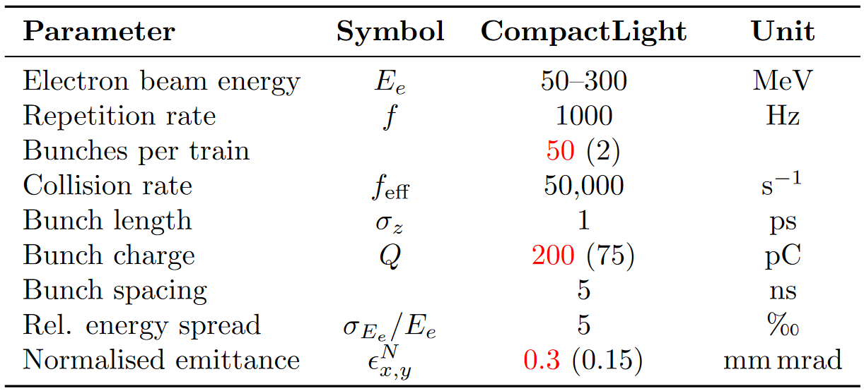
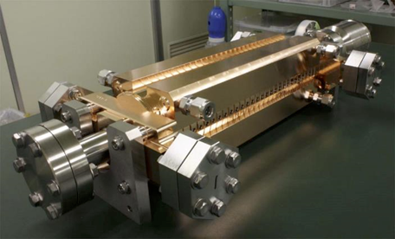
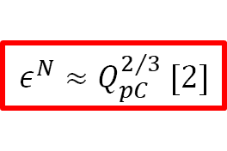

XLS preliminary parameters
Optimal electron and laser parameters were derived for flux maximization.
The CompactLight photo-injector was adapted for ICS use.
Multi-bunch beam-breakup avoided through HOM damping, similarly to the CLIC X-band structures [1].
$$30−300$$
$$ε^{N}≈Q_{pC}^{2/3} [2]$$
Total length: < 20 m
[1] Zha Hao et al. 2016. “Beam-Based Measurements of Long-Range Transverse Wakefields in the Compact Linear Collider Main-Linac Accelerating Structure.” Physical Review Accelerators and Beams. https://doi.org/10.1103/PhysRevAccelBeams.19.011001.
[2] Di Mitri Simone et al. 2020. “Scaling of Beam Collective Effects with Bunch Charge in the Compactlight Free-Electron Laser.” Photonics 7:4. https://doi.org/10.3390/photonics7040125.

Slide 12
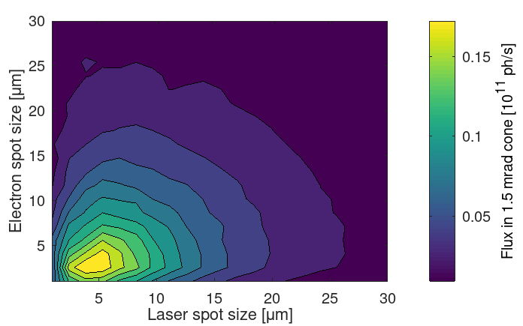
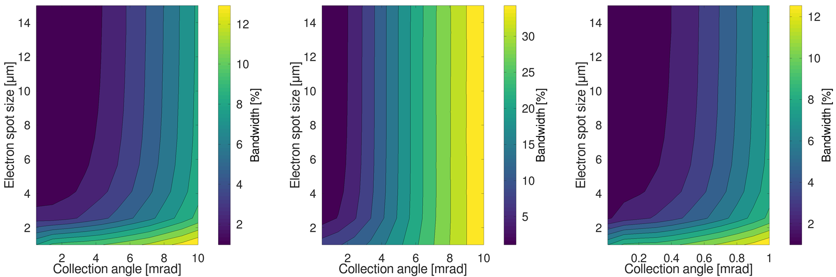
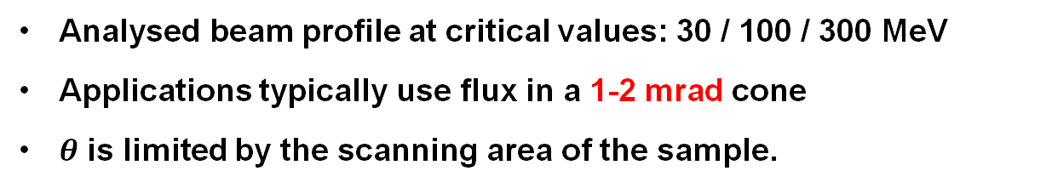
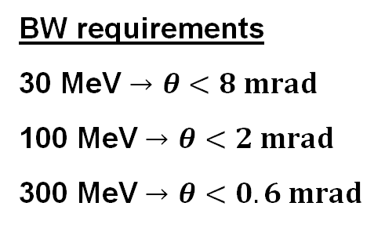
Parametric scans of flux and BW
Analysed beam profile at critical values: 30 / 100 / 300 MeV
Applications typically use flux in a 1-2 mrad cone
$θ$ is limited by the scanning area of the sample.
30 MeV
100 MeV
300 MeV
BW requirements
30 MeV $→$ $θ<8 mrad$
100 MeV $→$ $θ<2 mrad$
300 MeV $→$ $θ<0.6 mrad$

Slide 13
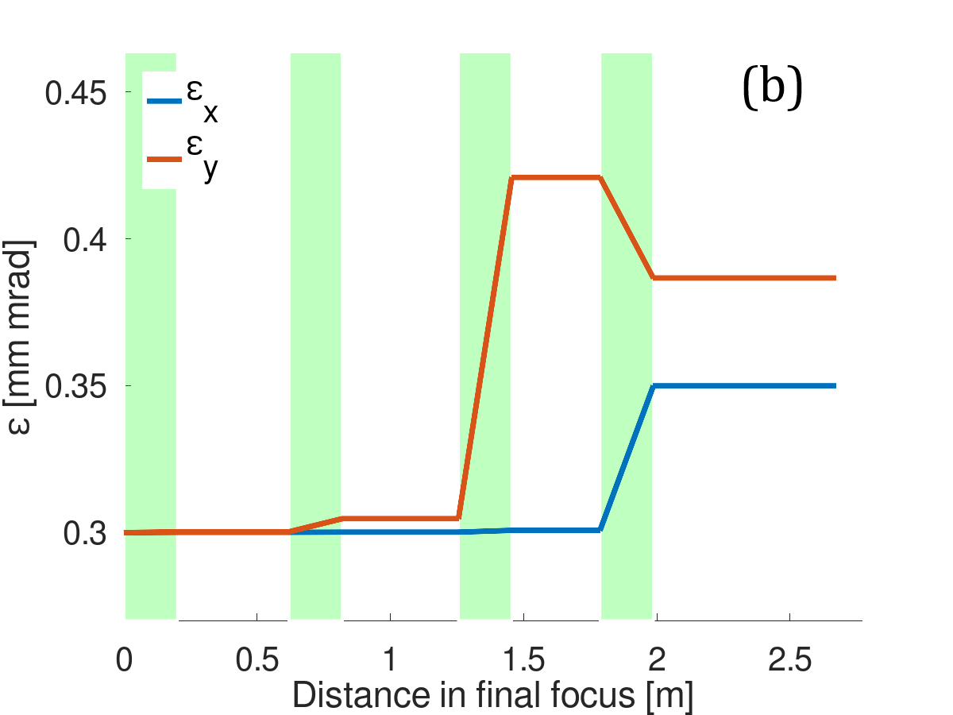
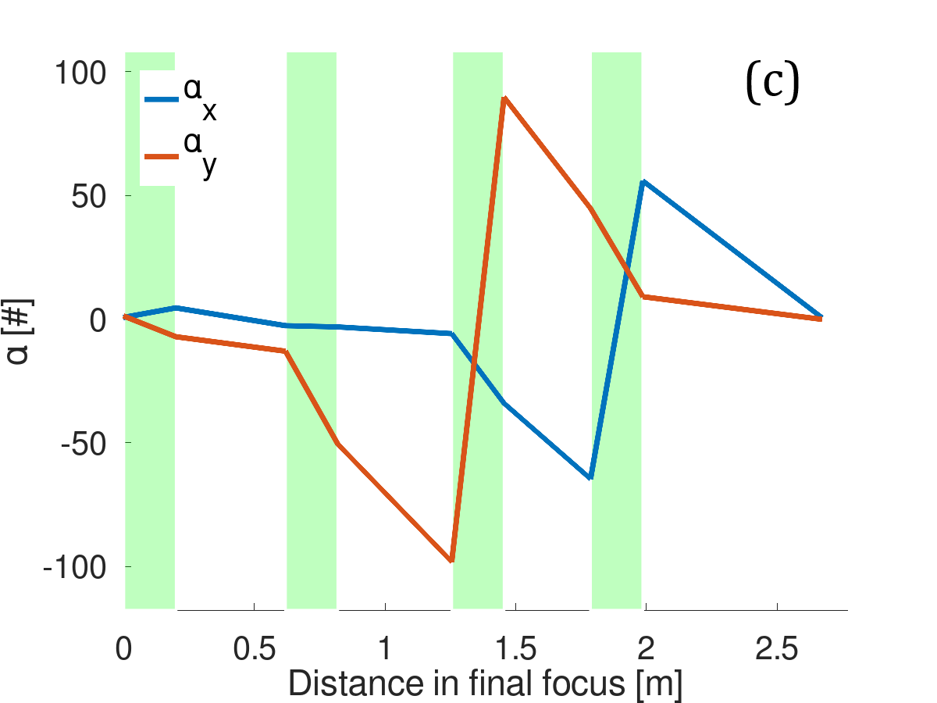
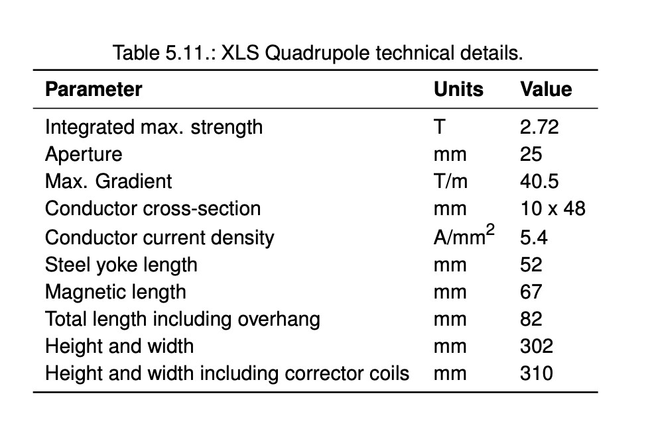
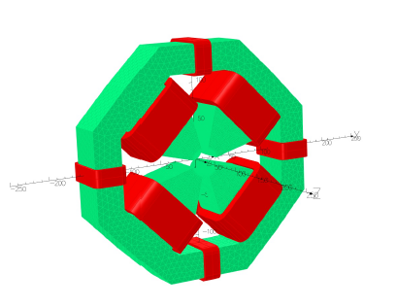
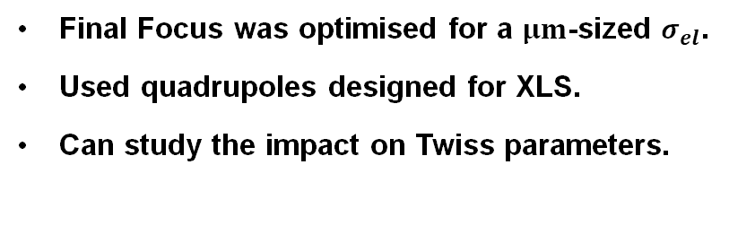
Set-up of the final focus
Final Focus was optimised for a $μm$-sized $σ_{el}$.
Used quadrupoles designed for XLS.
Can study the impact on Twiss parameters.
Sets limit on quadrupole strength
Quadrupole design for the XLS linac

Slide 14
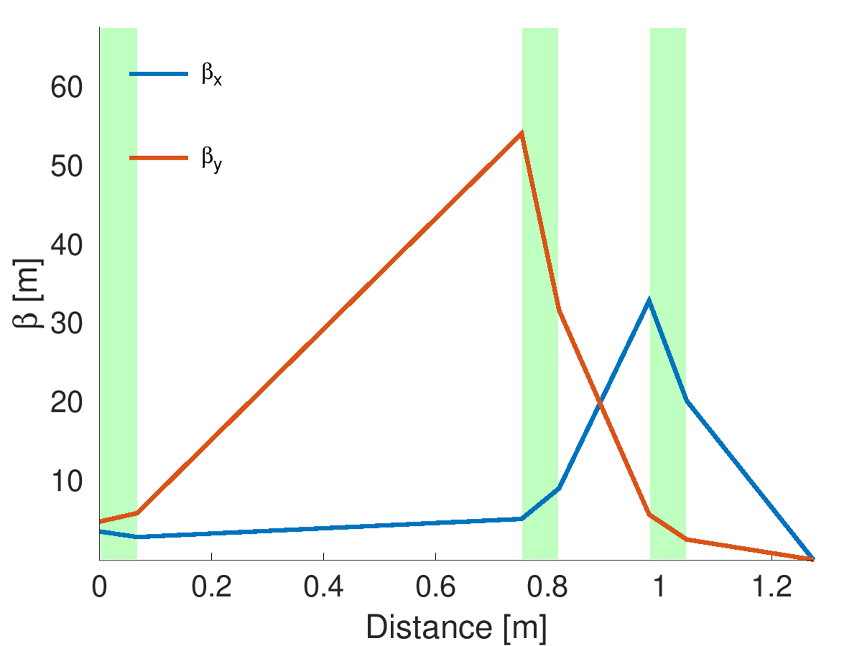
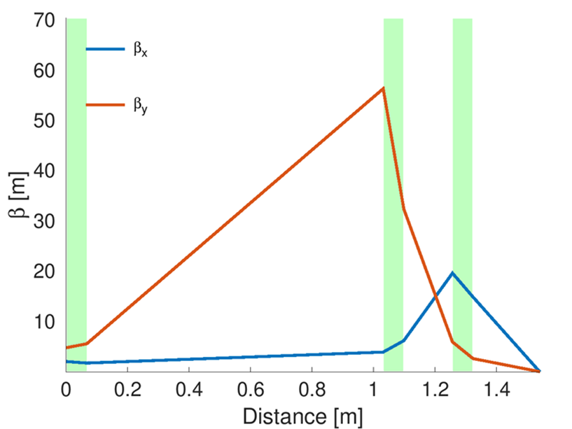
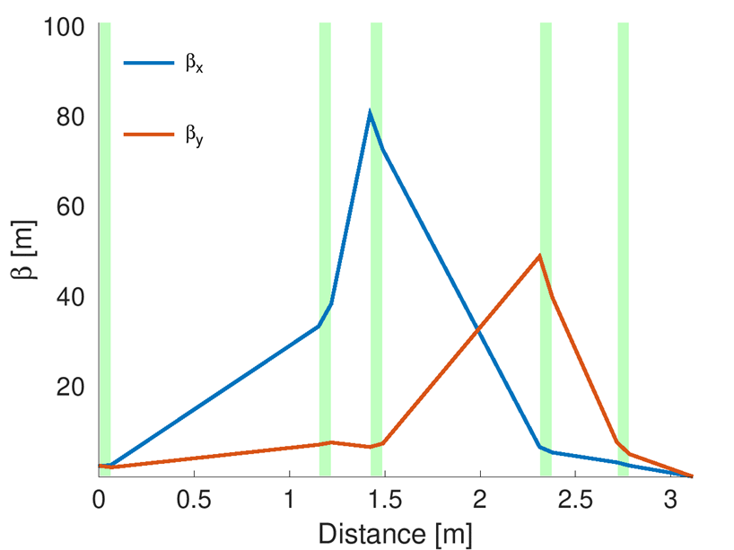
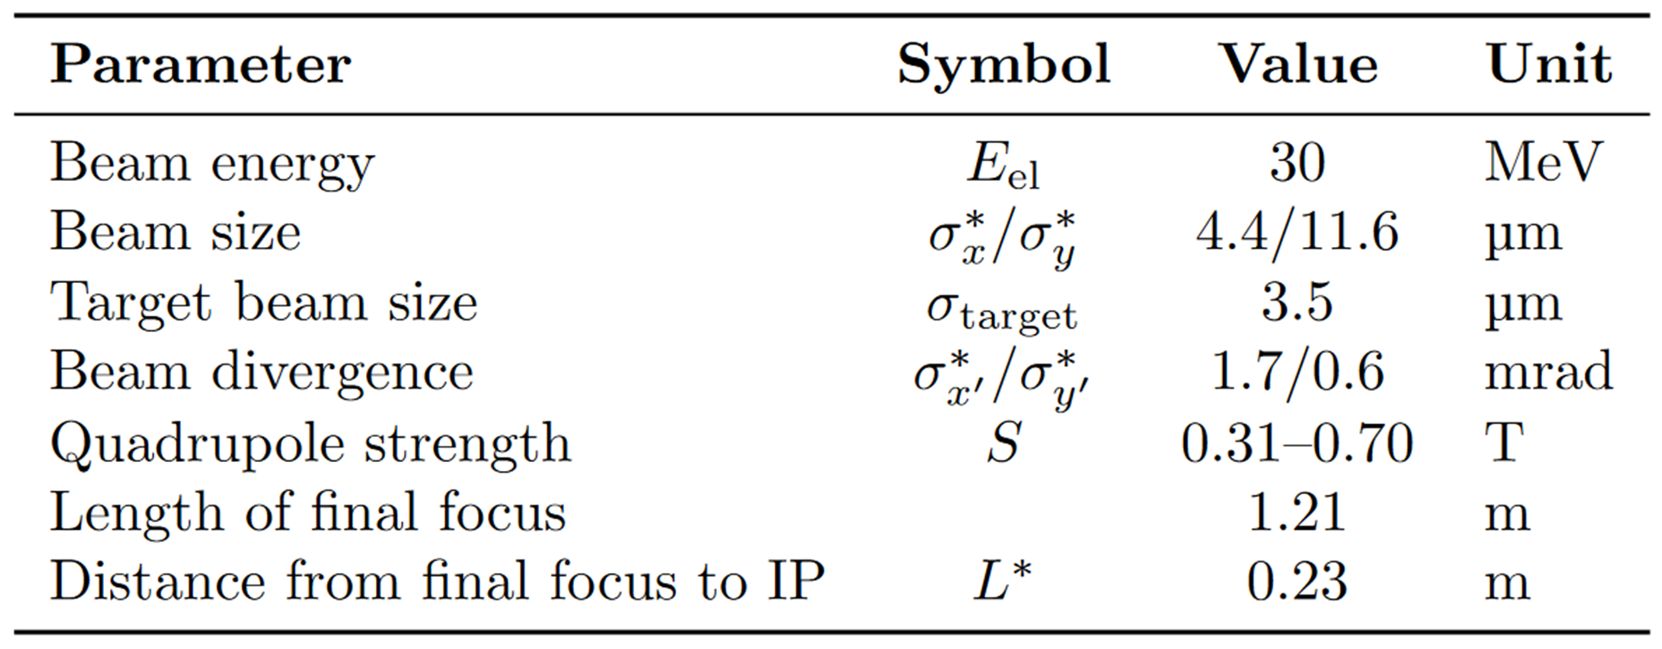
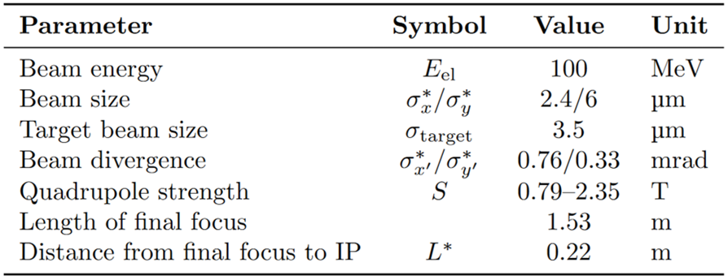
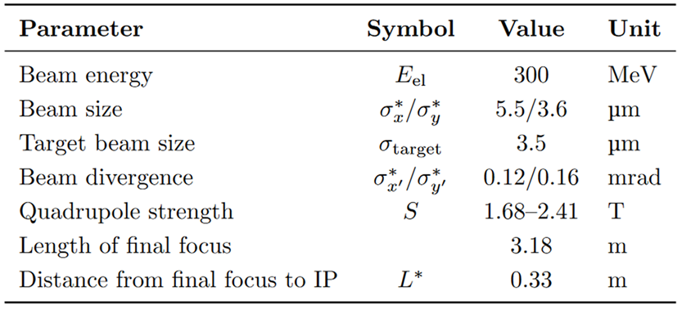
Small final focus design
30 MeV
100 MeV
300 MeV

Slide 15
Contents
Introduction
Electron beamline optimisation
Fabry-Pérot cavity optimisation
Conclusions

Slide 16
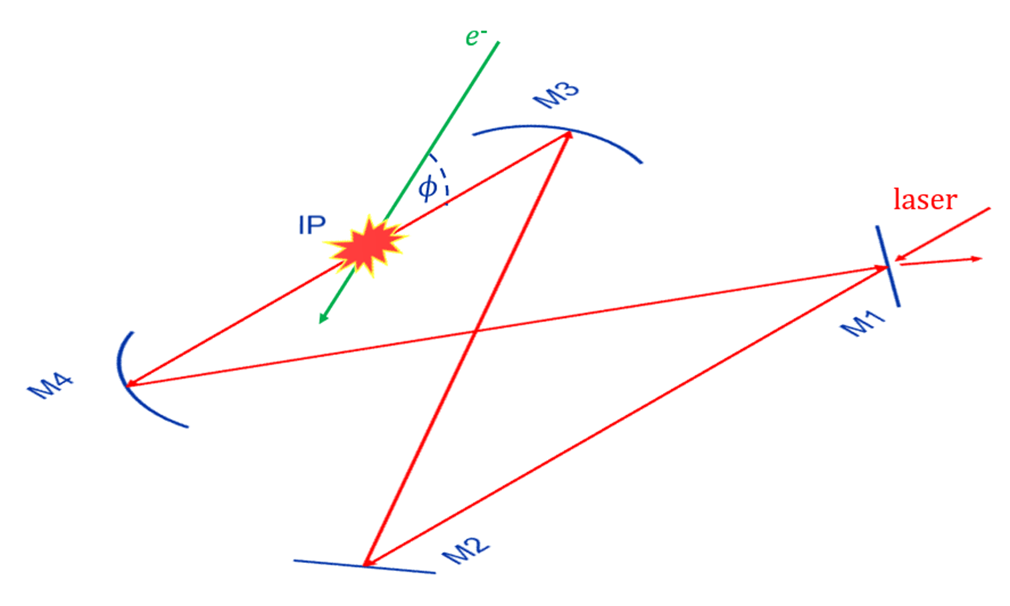
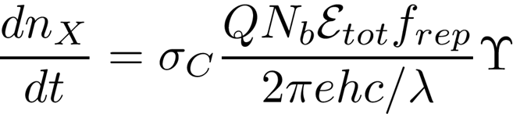
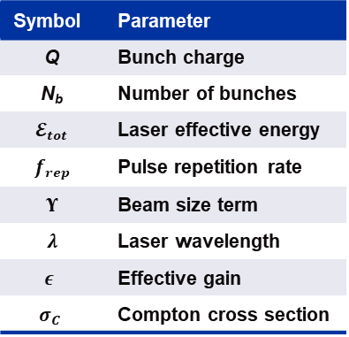
Fabry-Perot cavities
The geometry and burst parameters of an FPC were optimised for an XLS-based ICS source.
Fabry-Perot cavities (FPCs) are optical resonators made of mirrors with high reflectivity.
Burst mode operation prevents mirror coating thermal load by reducing the lower average power inside the cavity.
Previous study showed the total flux can be significantly increased using a burst mode-operated FPC [1].
Symbol | Parameter
Q | Bunch charge
N_{b} | Number of bunches
$𝓔_{tot}$ | Laser effective energy
$f_{rep}$ | Pulse repetition rate
$Υ$ | Beam size term
$λ$ | Laser wavelength
$$ε$$ | Effective gain
$$σ_{C}$$ | Compton cross section
[1] Martens, Aurélien, et al. "Optimization of a Fabry-Perot Cavity Operated in Burst Mode for Compton Scattering Experiments." Physical Review. Accelerators and Beams 21.12 (2018): 121601.

Slide 17
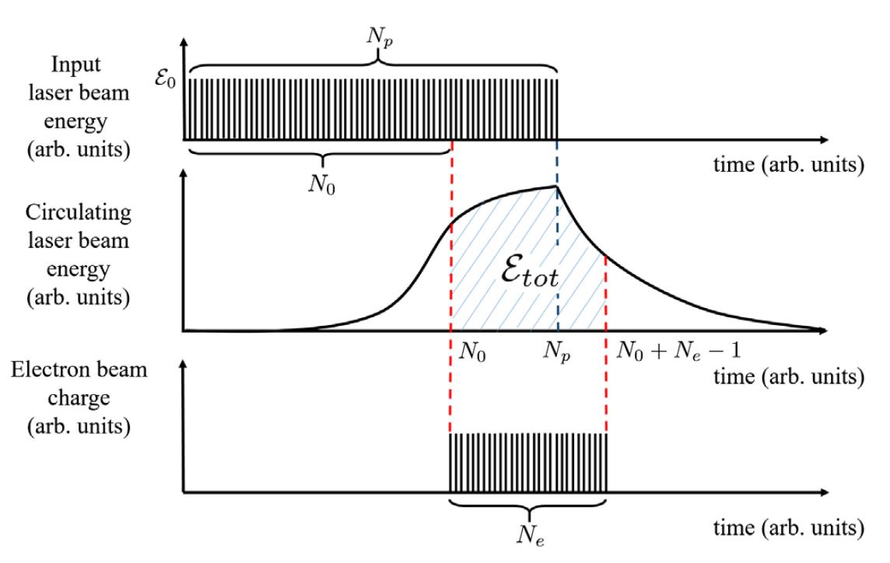
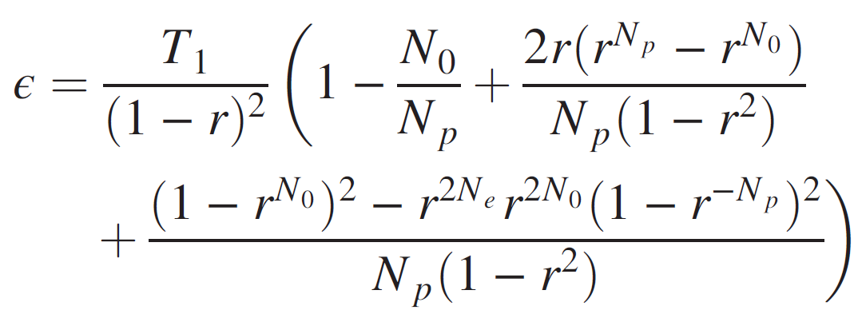
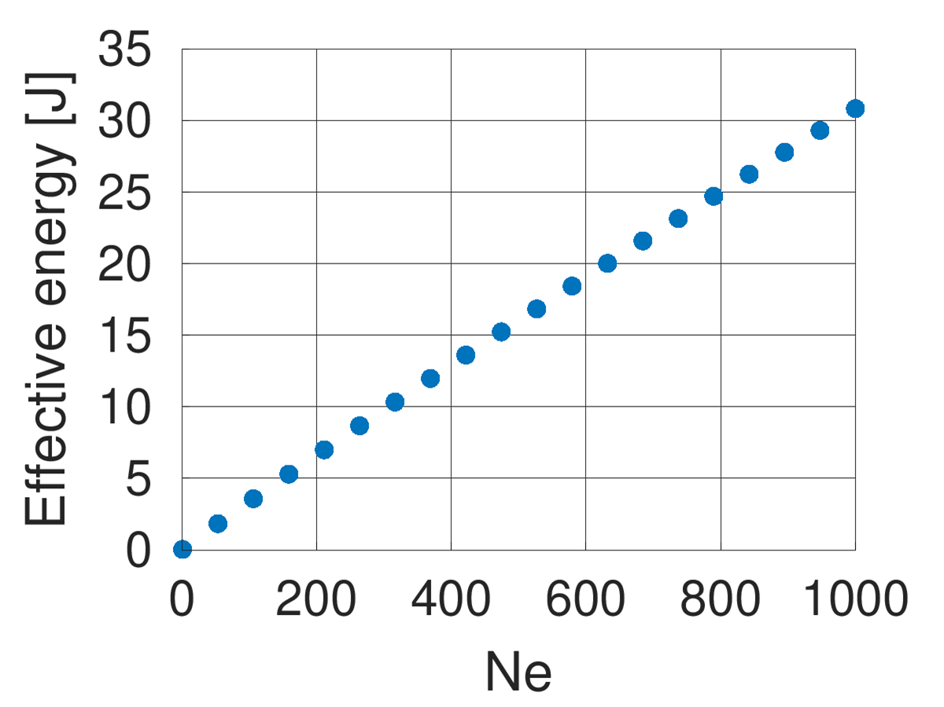
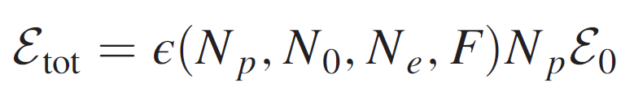
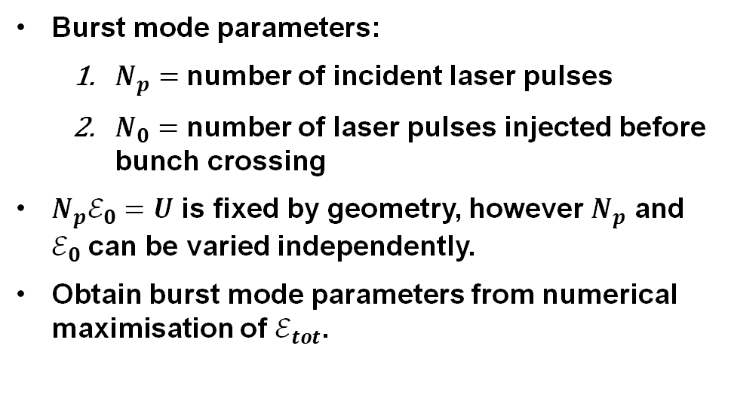
Effective energy-based burst mode optimisation
Burst mode parameters:
  $N_{p}=$ number of incident laser pulses
  $N_{0}=$ number of laser pulses injected before bunch crossing
$N_{p}ℰ_{0}=U$ is fixed by geometry, however $N_{p}$ and $ℰ_{0}$ can be varied independently.
Obtain burst mode parameters from numerical maximisation of $ℰ_{tot}$.

Slide 18
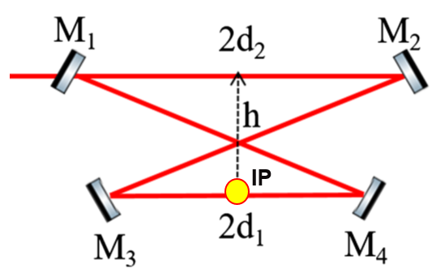
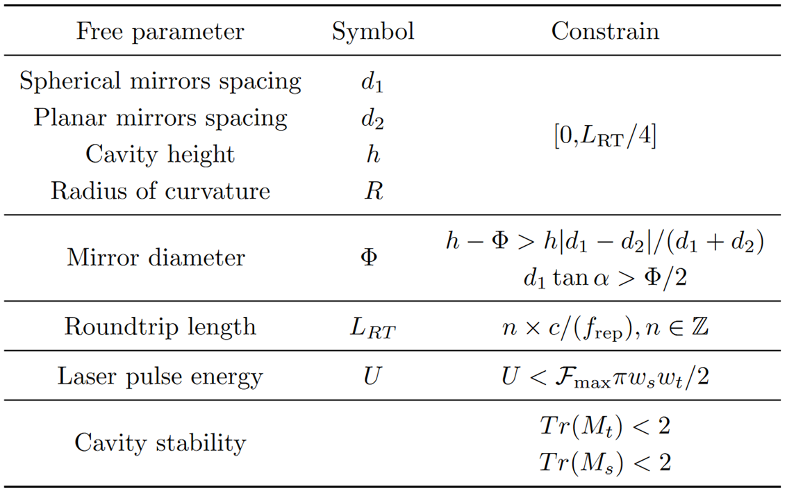
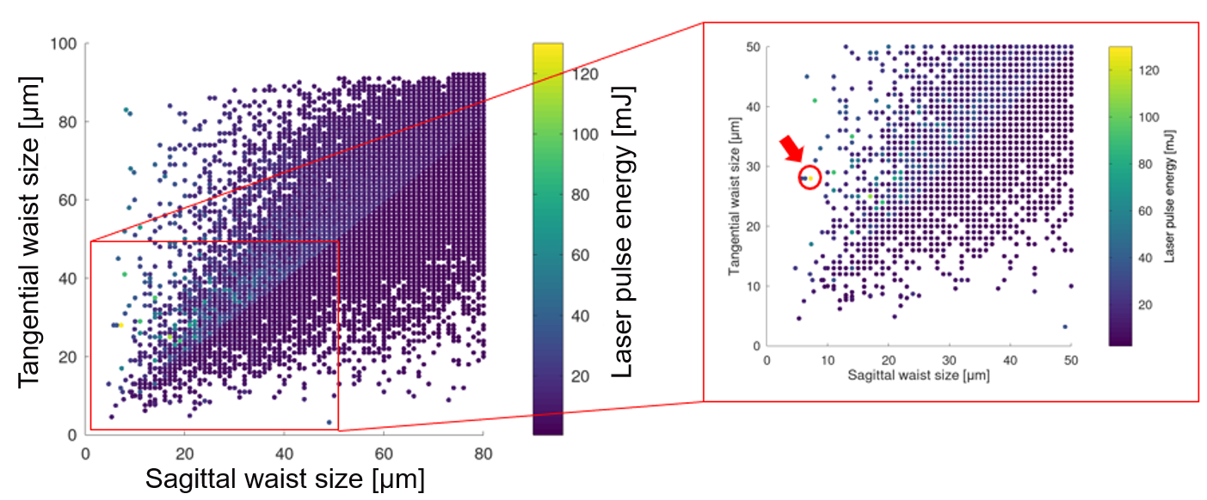

Geometry optimisation based on simplex algorithm
Geometrical optimisation for h, 2d₂, 2d₁ done using:
  Monte Carlo method
  Simplex algorithm
Generate multiple FPC geometries with random parameters and select configuration with the largest flux.
Perform a simplex-based optimization of the FPC geometry with a merit function set to maximise flux.

Slide 19



Parameters of Fabry-Perot cavity for XLS source
The optimisation of the geometrical and burst parameters of a Fabry-Perot cavity allowed for a significant increase in the effective energy provided at the interaction point.
Required lasers available on the market (e.g., 3D-Micromac, ALT Lasertechnik, Flexiburst).
Geometrical parameters
Burst mode parameters
Laser-defining parameters

Slide 20
Contents
Introduction
Electron beamline optimisation
Fabry-Pérot cavity optimisation
Conclusions

Slide 21




ICS optimisation led to a significantly increased flux
A more realistic estimate for flux could be computed.
Critical electron beam energies ($E_{el}=30, 100, 300 MeV$) were studied.
$$E_{el}=30 MeV$$

Slide 22


ICS optimisation led to a significantly increased flux
A more realistic estimate for flux could be computed.
Critical electron beam energies ($E_{el}=30, 100, 300 MeV$) were studied.
$$E_{el}=100 MeV$$

Slide 23


ICS optimisation led to a significantly increased flux
A more realistic estimate for flux could be computed.
Critical electron beam energies ($E_{el}=30, 100, 300 MeV$) were studied.
$$E_{el}=300 MeV$$

Slide 24

Landscape of ICS sources
The XLS-based source would have the highest intensity of any proposed source
Storage Ring
Linac
ERL
* Design
** Commissioned
*** Existing

Slide 25


Potential applications
Ref: Kulpe, S., Dierolf, M., et al (December 10, 2018). K-edge subtraction imaging for coronary angiography with a compact synchrotron X-ray source. Plos One, 13, 12.)
ICS sources offer a more compact and accessible method to conduct experiments currently run at synchrotrons.
The main challenge is achieving high intensity and high energy photons, comparable to synchrotrons.
Tomographies have been extensively studied at the MuCLS.
Ref: Reischig, P., et al (March 09, 2009). A note on medieval microfabrication: The visualization of a prayer nut by synchrotron-based computer X-ray tomography. Journal of Synchrotron Radiation, 16, 2, 310-313.

Slide 26


Conclusions
Electron beam parameters based on the CompactLight photoinjector were determined
Laser parameters were based on state-of-the-art high power compact designs.
https://www.mdpi.com/2304-6732/9/5/308
Optimisation of the FPC geometry resulted in flux values of ${10}^{13}$ph/s XLS, among the largest photon intensity of commissioned ICS sources.
A small final focus of the electron beam was designed. XLS allowed for $∼5 μm$ sizes to be reached at IP.

