Slide 1
Microbunching Instability in FELs:
Present and Future Perspectives
Brynes, S. Di Mitri
Elettra-Sincrotrone Trieste
CompactLight Final Meeting
03/04/2023
Notes:
Slide 2: Title of the Presentation
Before you start editing the slides of your talk change to the Master Slide view:
Microsoft Office :Menu: View > Slide Master;
Macintosh – View > Master > Slide Master
Edit the following items:
On the Slide Master (first master slide) – lower area
a) On the left Delete the text and write the title of the event/Conference, Location
b) On the right delete the text and write the name and surname of the speaker and the date (day, month , year)
Close Master View
To start adding slides insert a new slide and select a Layout:
For Title & Subtitle
For text with bullet points
For Text
For Picture, graphs, visuals
Two columns
Blank

Slide 2
Contents
Introduction – Causes and Consequences of Microbunching
Modelling Microbunching
Measuring Microbunching
Mitigating Microbunching
Conclusions and Future Perspectives

Slide 3
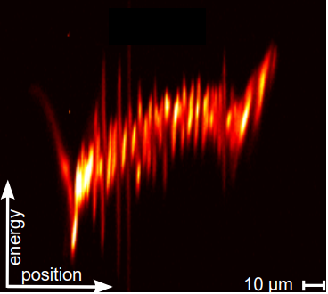
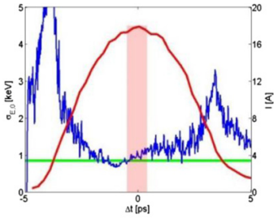
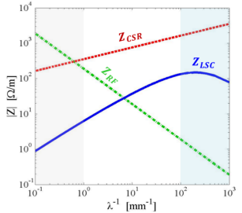
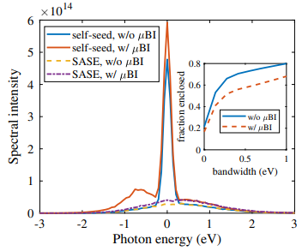
Causes and Consequences of Microbunching
Microbunching instability (MBI) is a broad-band modulation of a particle bunch arising from collective effects.
What is it?
Microscopic energy-time correlations in the particle bunch.
What causes it?
Imperfections in the injector bunch.
Modulations are amplified due to longitudinal space charge, coherent synchrotron radiation and wakefields.
What are its effects?
Reduced FEL intensity.
Degradation of FEL spectrum.
Di Mitri et al., New J. Phys. 22, 083053 (2020)
Ratner et al., PRSTAB 18, 030704 (2015)
Di Mitri, CAS Lectures (2016)
Zhang et al, PRAB 23, 010704 (2020)

Slide 4
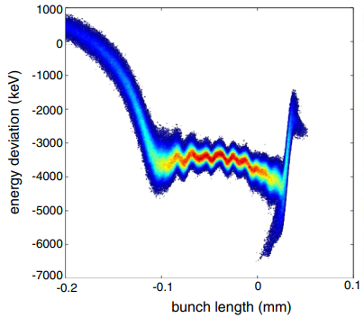
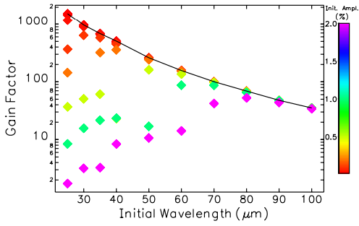
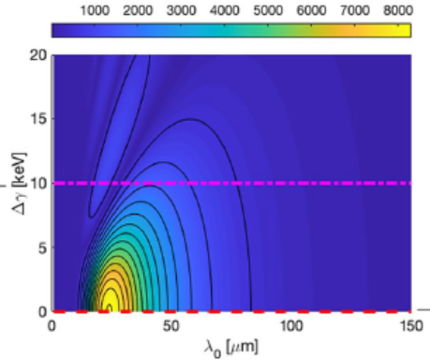
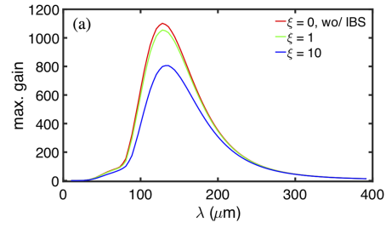
Modelling Microbunching
Requirements
Knowledge of the injector bunch properties:
  Slice energy spread
  Current profile
  Accurate simulation of gun / low energy dynamics.
Accurate physical models of collective effects:
  Coherent synchrotron radiation (CSR)
  Longitudinal space charge (LSC)
  Intrabeam scattering (IBS)
  Wakefields
Multi-particle Simulations
Some codes are able to simulate large numbers of particles with (simplified models of) collective effects – ELEGANT, IMPACT, etc.
(Semi-)Analytic Methods
Much faster methods can approximate the amplification of modulations, given some realistic initial conditions.
Qiang et al., PRSTAB 17, 030701 (2014)
Borland, PRSTAB 11, 030701 (2008)
Di Mitri & Perosa, Sci. Rep. 11, 7895 (2021)
Tsai et al, PRAB 23, 124401 (2020)

Slide 5
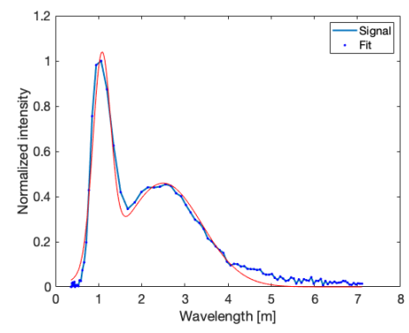
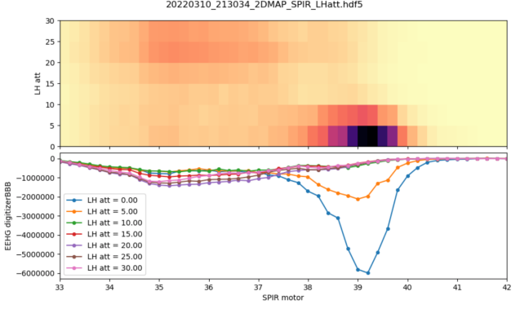
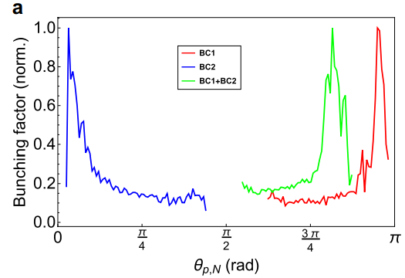
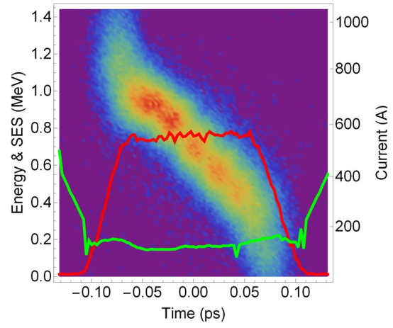
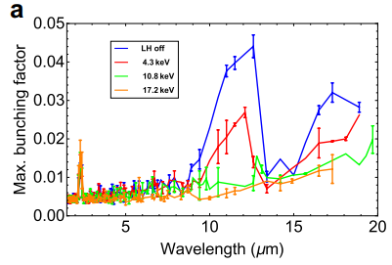
Measuring Microbunching - Direct
For typical FEL parameters, MBI gain is peaked at ~1 – 10 μm.
It is hard to measure MBI directly:
Longitudinal phase space measurement
IR spectrometer
Direct measurement can yield more detail than indirect methods:
Bunching factor
Plasma oscillation phase
IR spectrometer
Perosa et al., in preparation
2D Fourier analysis
Brynes et al., Sci. Rep. 10, 5059 (2020)

Slide 6
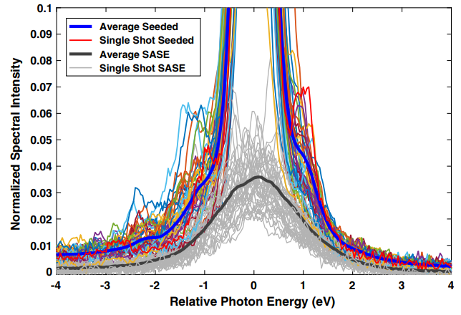
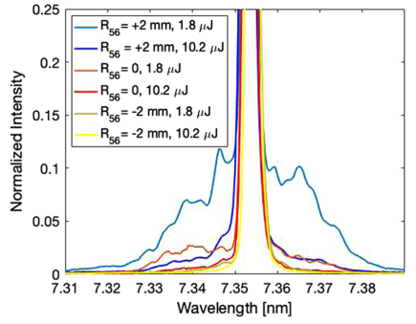
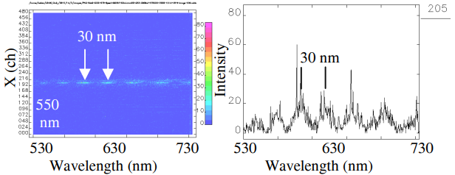
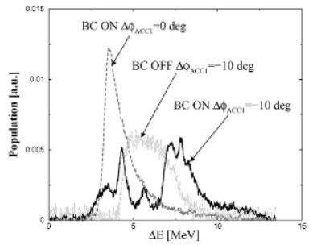
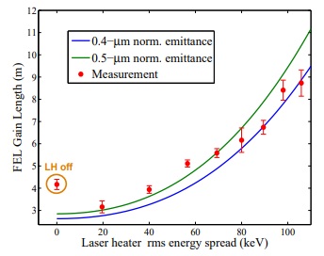
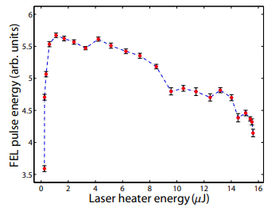
Measuring Microbunching - Indirect
Sidebands in FEL spectrum
For FELs, the figure of merit is the FEL itself!
We can also measure MBI via COTR.
Marcus et al., PRAB 22, 080702 (2019)
Perosa et al., PRAB 23, 110703 (2020)
Coherent OTR
Lumpkin et al., FEL09, TUPC47 (2009)
Longitudinal phase space fragmentation
Hüning et al., NIM A 475, 348 (2001)
FEL Performance
Huang et al., PRSTAB 13, 020703 (2010)

Slide 7
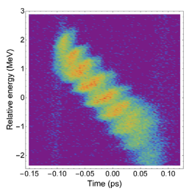
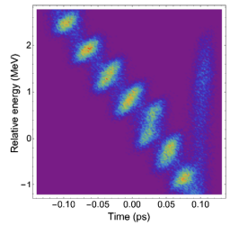
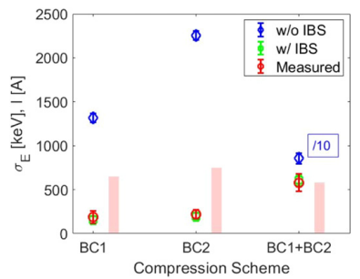
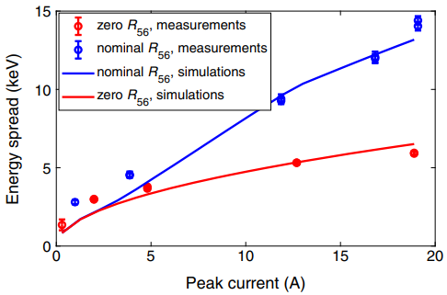
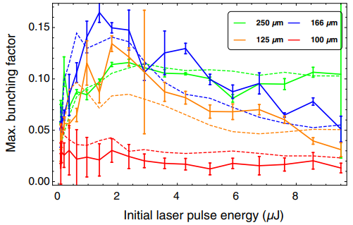
Comparing Models to Experiments
Particle Tracking
By imposing modulations on the bunch at a known frequency we can benchmark simulation models.
Measurement
Simulation
How well does our theory (inc. approximations) of MBI gain match measurements?
Pretty well!
Semi-Analytic Model
When we include the effect of intrabeam scattering the predicted slice energy spread matches experimental values.
Di Mitri et al., New J. Phys. 22, 083053 (2020)
Prat et al., PRAB 25, 104401 (2022)
Brynes et al., PRAB 23, 104401 (2020)

Slide 8
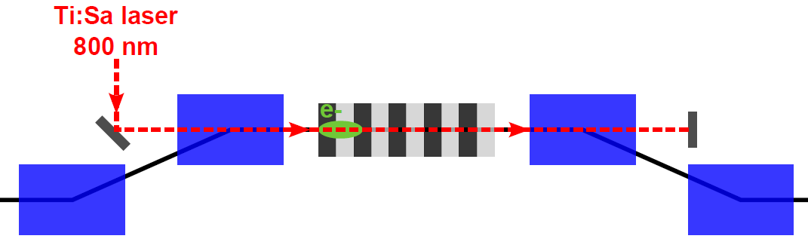
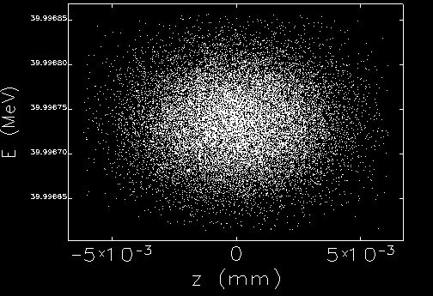
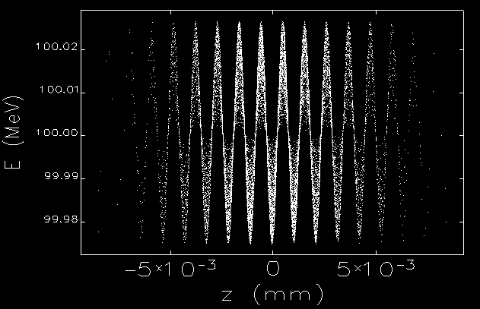
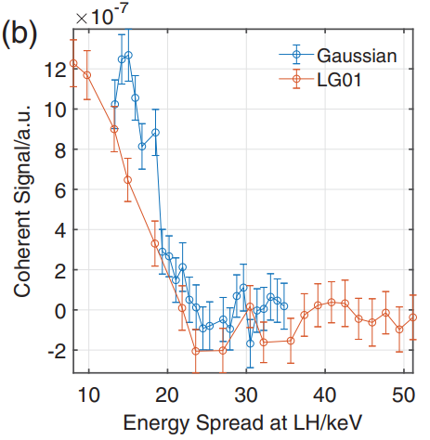
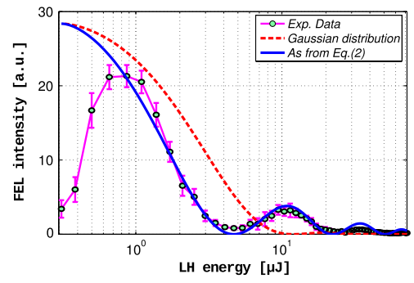
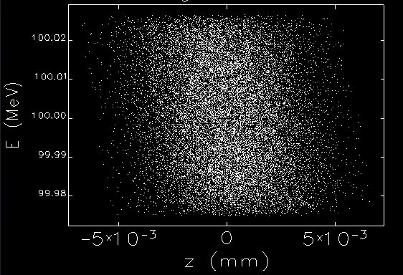
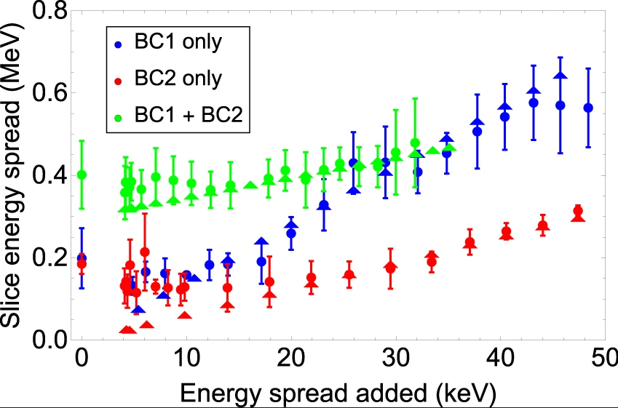
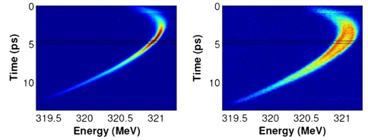

Mitigating Microbunching – Laser Heater
Saldin et al., NIM A 528, 355 (2004)
XLS Laser heater
The standard method: Laser Heater
If we increase the energy spread at low energy, MBI is suppressed.
Tang et al., PRL 124, 134801 (2020)
Ferrari et al., PRL 112, 114802 (2014)
$$λ_{L}$$
Brynes et al., Sci. Rep. 10, 5059 (2020)
Spampinati et al., PRSTAB 17, 12705 (2014)
However: Increasing the energy spread is bad for the FEL!
Are there other methods?

Slide 9

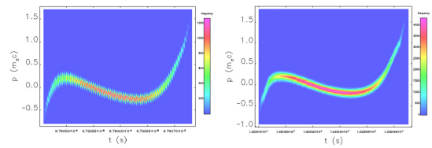
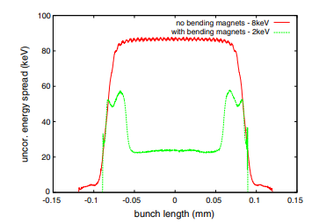
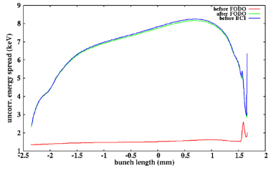
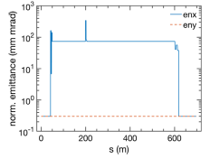
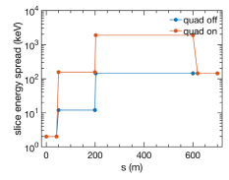
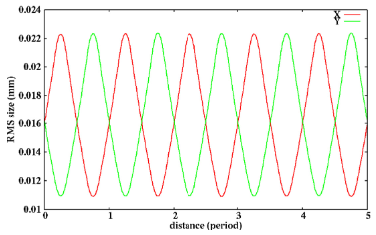
Mitigating Microbunching - Alternatives
Proposed
There are many ideas yet to be implemented that could
remove MBI without the use of a laser heater
Longitudinal mixing using
bending magnets
Qiang et al., PRL 111, 054801 (2013)
Using a transverse gradient undulator before compression
Feng et al., New J. Phys. 17, 073028 (2015)
Reversible energy spread increase
by leaking dispersion
Exploiting IBS through strong focusing
Li et al., PRAB 23, 014403 (2020)
Qiang, NIM A 1048, 167968 (2023)

Slide 10
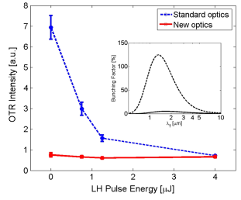
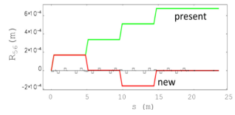
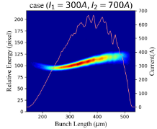
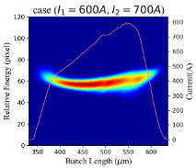
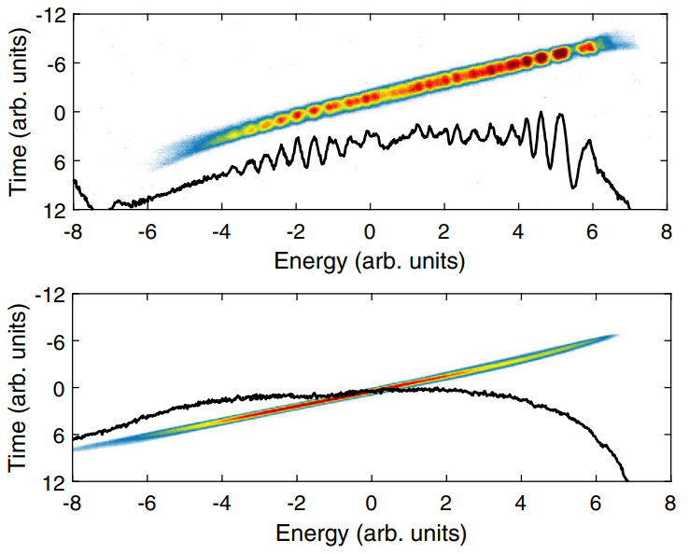
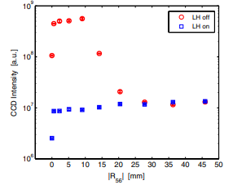
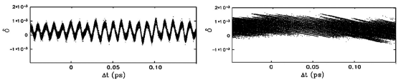
Mitigating Microbunching - Alternatives
Realised
Numerous experimental demonstrations of MBI
suppression – is the LH required for a new FEL?
Control of linear optics in the
spreader line
Di Mitri et al, PRAB 20, 120701 (2017)
Adjusting bunch
compression ratio
Copper (above) vs. Cs₂Te (below) cathode
Cheng et al, NIM A 1050, 168145 (2023)
Bettoni et al., PRAB 23, 024401 (2020)
Longitudinal phase-mixing
in a bunch compressor
Di Mitri et al, PRL 112, 134802 (2014)

Slide 11
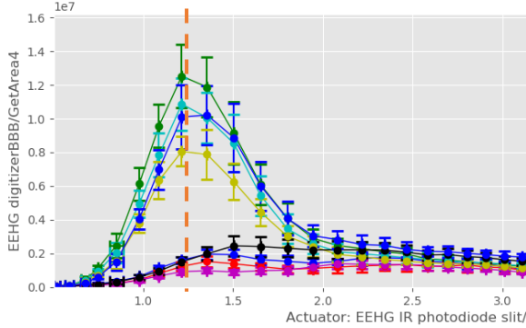
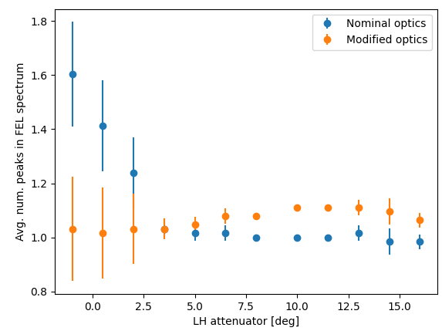
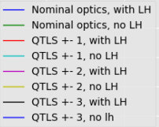
Summary and Future Outlook
The microbunching instability has long been studied as a source of problems for FELs.
A good agreement has been found between models and experiments in recent years.
New developments have shown numerous methods for mitigating – and even exploiting – microbunching.
Planned facilities should take this recent work into account when considering this phenomenon, although the laser heater is a tried-and-tested method.
Tenative results:
Transverse optics
control in the spreader
reduces microbunching
signal

Slide 12
Notes:
Last Slide 1: Thanks to the audience

