Slide 1

Status of the STFC Helical Superconducting Undulator project
Ben Shepherd
CompactLight Follow-up Meeting
4 April 2023

Slide 2
The HSCU collaboration
Sam Allum^{[1]}, Josef Boehm^{[2],} Peter Brixey^{[1]}, Simon Canfer^{[3]}, Liam Cooper^{[4]},
Ben Green^{[2]}, Tim Hayler^{[4]}, Phillip Jeffery^{[4]}, Craig Macwaters^{[5]}, Barnaby Matthews^{[4]}, Stephen Milward^{[6]}, Zsuzsanna Mozsary^{[3]}, Harry Plaisted^{[1]}, Richard Smith^{[1]}, Dave Wilsher^{[1]}.
STFC Technology Department, Rutherford Appleton Laboratory (RAL)
[1] Manufacturing Facilities
[2] Cryogenics
[3] Composites and Materials Testing
[4] Projects and Mechanical Engineering
[5] Electronic Systems Support
[6] Diamond Light Source (DLS) (Head of Insertion Devices)
Jim Clarke (Director of ASTeC & Project Sponsor), Alex Hinton^{[7]},
Kiril Marinov^{[7]}, Ben Shepherd^{[7]}, Neil Thompson^{[7]}.
STFC Daresbury Laboratory (DL), Daresbury Science and Innovation Campus, WA4 4AD
[7] Accelerator Science and Technology Centre (ASTeC) - Magnetics and Radiation Sources (MaRS) Group
Image © STFC John Dawson
Notes:
PLEASE DELETE/REPLACE PHOTO CREDIT IF CHANGING THE IMAGE.

Slide 3
Project Summary
Project to develop a short period, small bore helical superconducting bifilar undulator (HSCU)
Work includes design of undulator and supporting cryogenic and vacuum systems required for operation
Uses superconducting technology to achieve higher fields than competing technologies
Design targeted to meet the requirements of future X-ray light sources
Parameters based on CompactLight study
Period | 13 mm
Inner winding diameter | 5 mm
Beam pipe inner diameter | 4 mm
Photon energy range | 8-16 keV
Deflection parameter K | 1.33 at 8 keV 0.62 at 16 keV
Peak on-axis field | 1.09 T
Electron beam energy | 5.5 GeV
Undulator length | 1.1 m
Image © STFC John Dawson
Notes:
PLEASE DELETE/REPLACE PHOTO CREDIT IF CHANGING THE IMAGE.

Slide 4
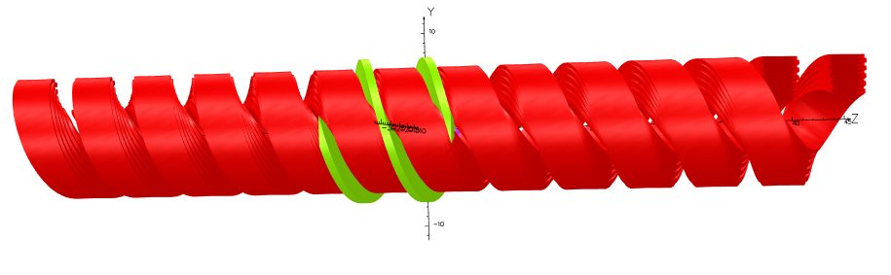
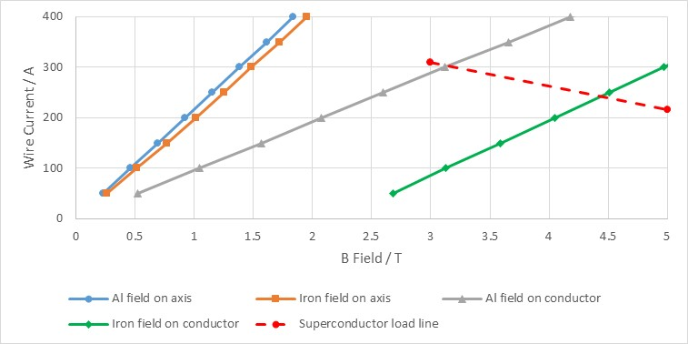
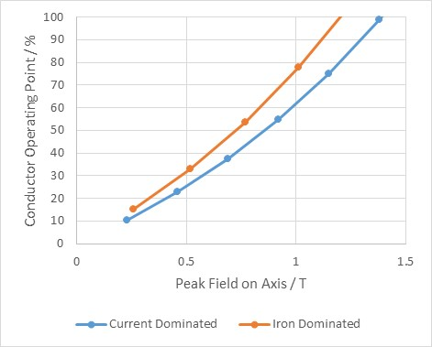
Magnetic Design
Choice of superconducting wire – 0.44 mm insulated diameter VSF-642 very small filament niobium titanium (NbTi) wire from Supercon Inc.
Load lines for different wire stack configurations evaluated at 4.2 K
Target peak field of 1.09 T could be achieved at lower operating point without iron poles
Final design used aluminium former - eased mechanical and cryogenic design as well as superconductor load lines
Target field achieved at 79% of critical current for stack configuration of 10 layers alternating 9 and 8 turns per coil
Image © STFC John Dawson
Notes:
PLEASE DELETE/REPLACE PHOTO CREDIT IF CHANGING THE IMAGE.

Slide 5
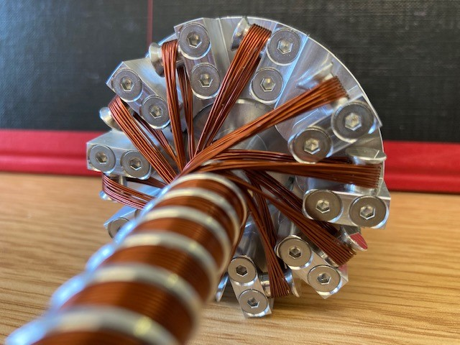
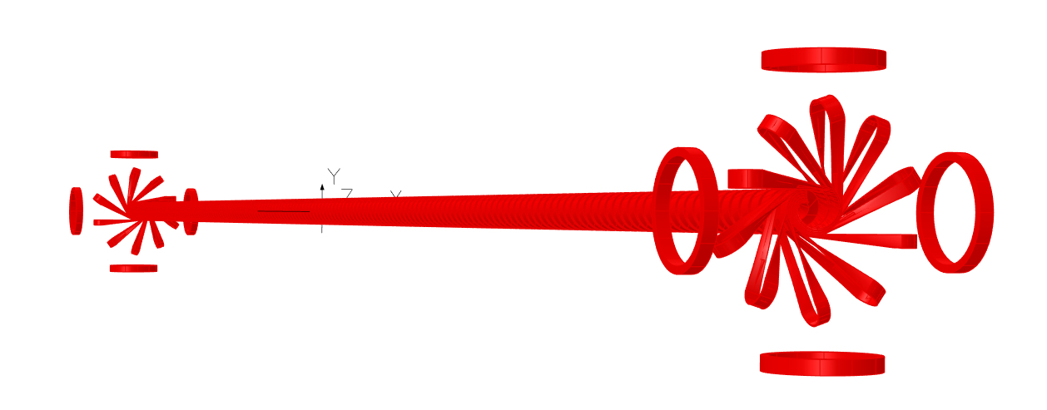
Turnaround Design
Turnaround scheme developed to wind the undulator from a continuous length of superconducting wire
No resistive joints – removes potential heat source in the cryostat
Field from turnarounds gives undesired kick to electron beam at either end
Design must include dipole corrector coils to minimise beam trajectory wander
4 pairs of coils wound from 0.44 mm diameter NbTi superconducting wire for correction of first and second field integrals in horizontal and vertical planes
Maximum integral correction: 0.25 T.mm

Slide 6
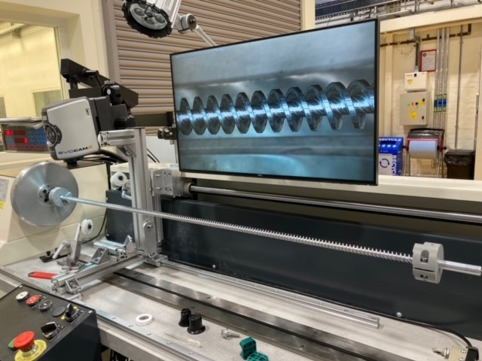
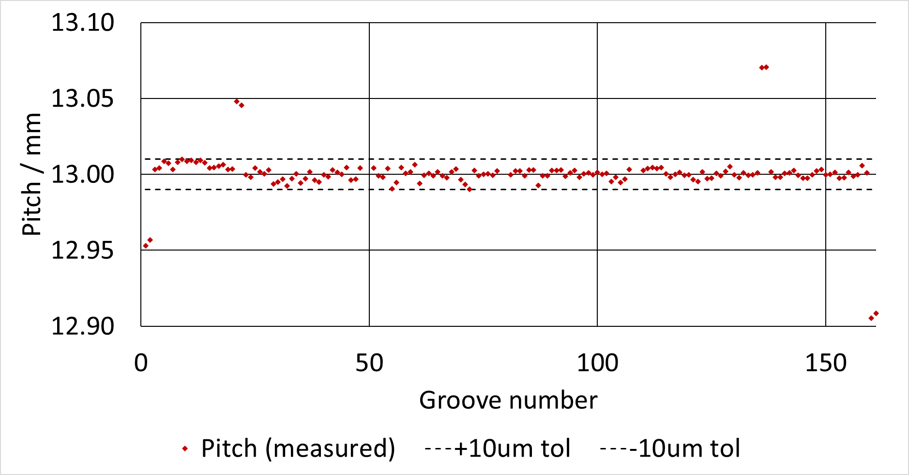
Former Machining
Short 325 mm and full length 1.1 m long prototype Al formers have been machined at STFC
A machining jig was designed to ensure that the axes of the machine work piece and of the bored HSCU former were coincident in order to maintain tight tolerances on the machined former pitches
The pitches of the formers have been consistently manufactured to within a tolerance of ±10 μm
A strong back has been designed for potting the wound HSCU and providing mechanical support

Slide 7
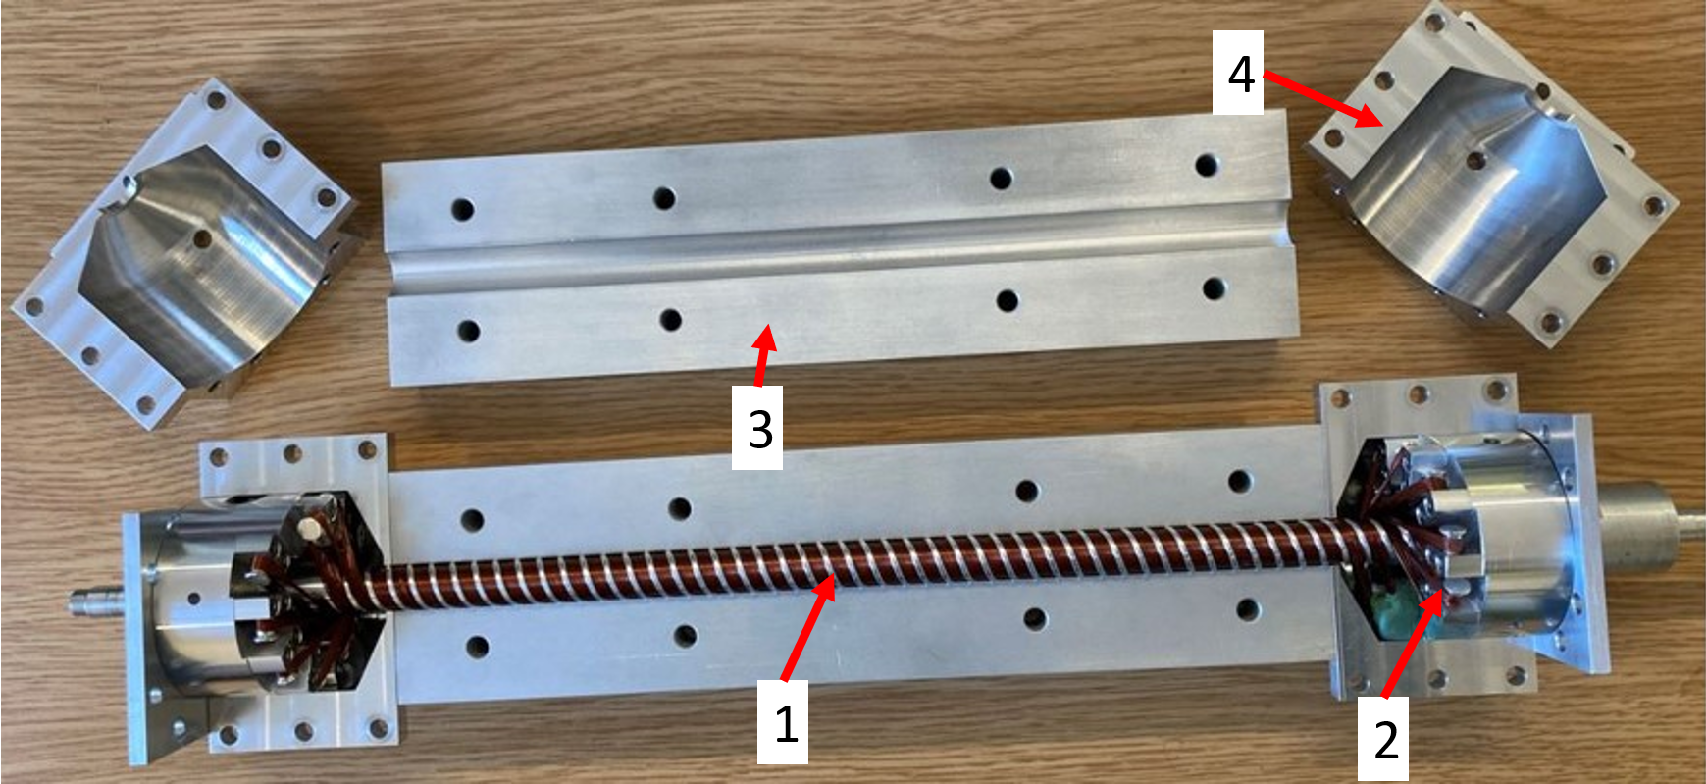
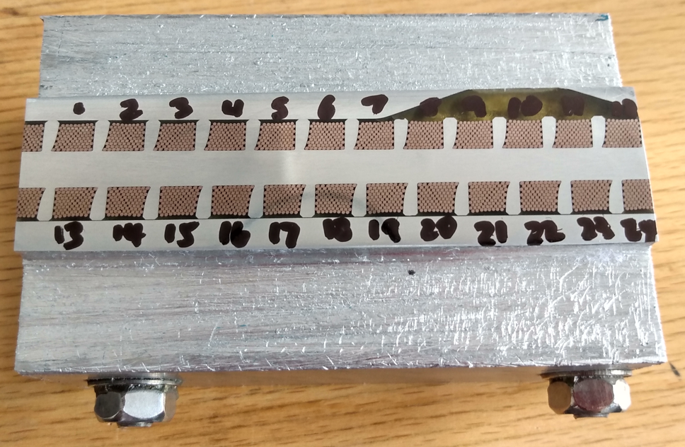
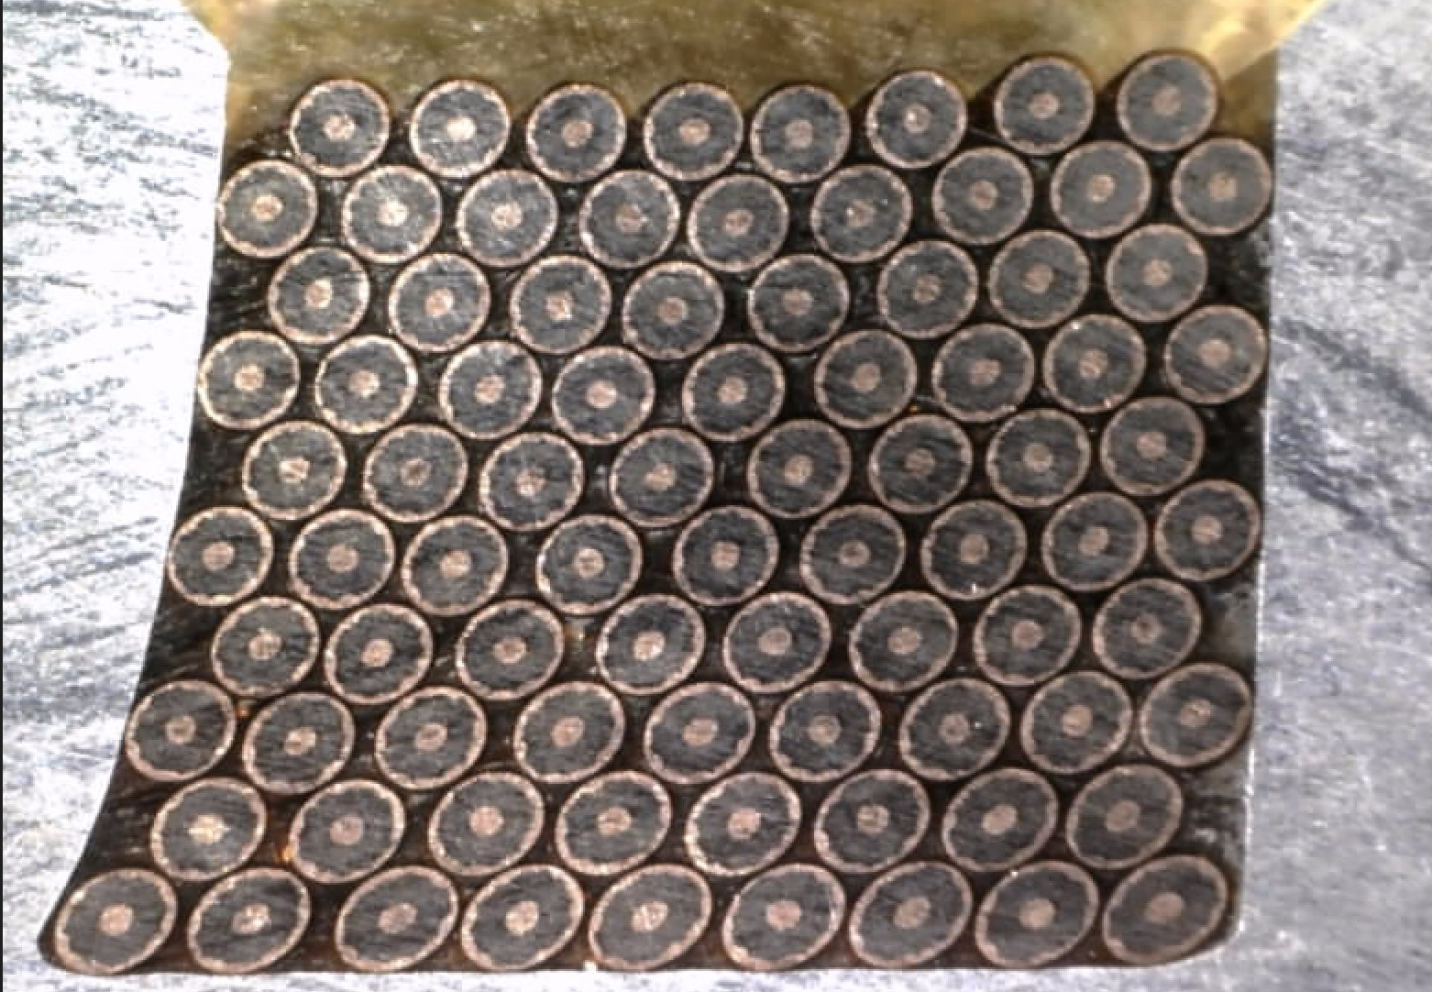
Winding Trials
Winding trials have been ongoing to improve the process of winding the undulator and to optimise the turnaround design and former groove widths
Accurately winding the wire is key to maintaining good field quality
Wires potted in epoxy resin for mechanical stability and better thermal contact with
cooled former
Wound formers sectioned with wire cutter to show internal
wire stack
Wound 325 mm HSCU in strong back; 1- Wound HSCU former, 2- Turnaround pins, 3-Potting jig strong back, 4- Potting jig turnaround section.
Image © STFC John Dawson
Notes:
PLEASE DELETE/REPLACE PHOTO CREDIT IF CHANGING THE IMAGE.

Slide 8
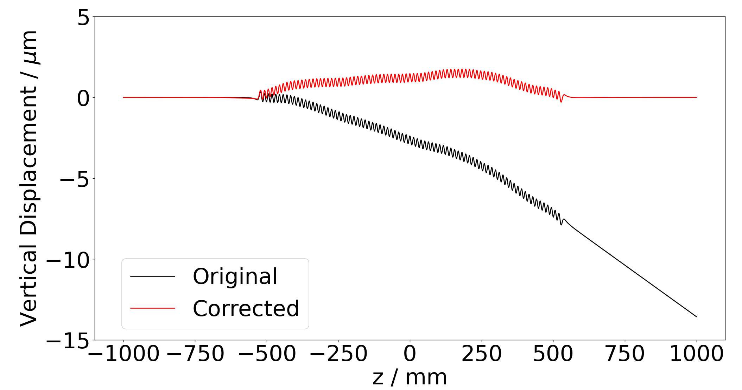
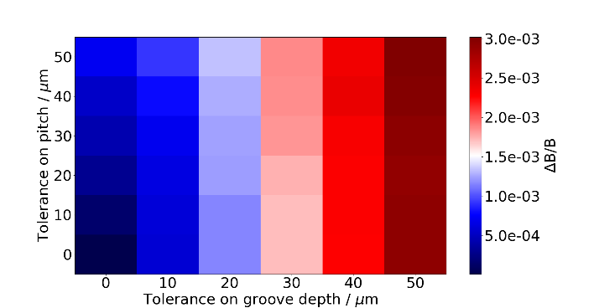
Tolerance Studies
Tight manufacturing tolerances are required to achieve good field quality and optimal light production
Normalised peak field errors
<10⁻³ to avoid 5% change in
output power
Trajectory wander must be
<5 μm to avoid 10% degradation in output power
Machining and winding tolerances simulated in Opera 3D models
Correction coils can be used to correct trajectory errors
Electron trajectory through an example model with 50 μm manufacturing tolerances and corresponding corrected trajectory
Measured pitches on a 1.1 m long former are within a tolerance of ±10 μm. The corresponding allowable tolerance on the groove depth is ±15 μm, which is greater than the design tolerance of ±10 μm.
Image © STFC John Dawson
Notes:
PLEASE DELETE/REPLACE PHOTO CREDIT IF CHANGING THE IMAGE.

Slide 9
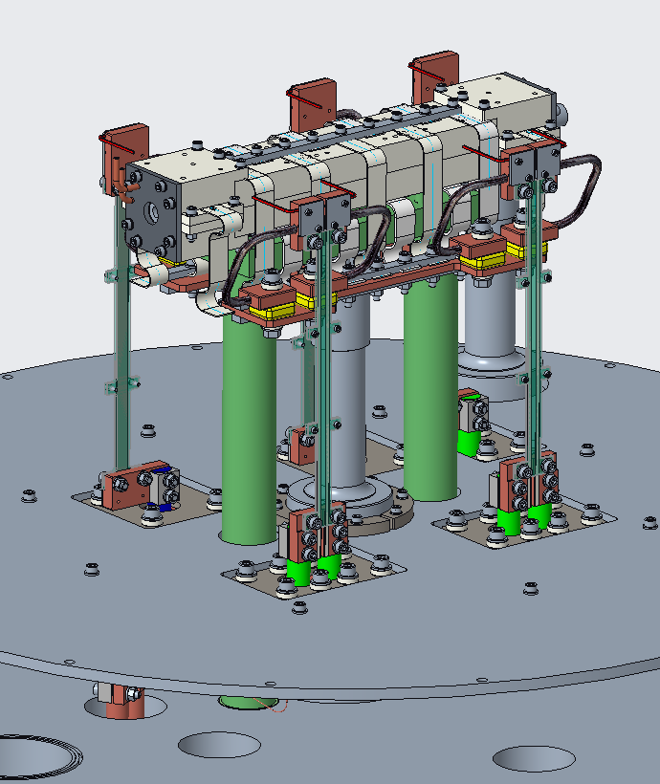
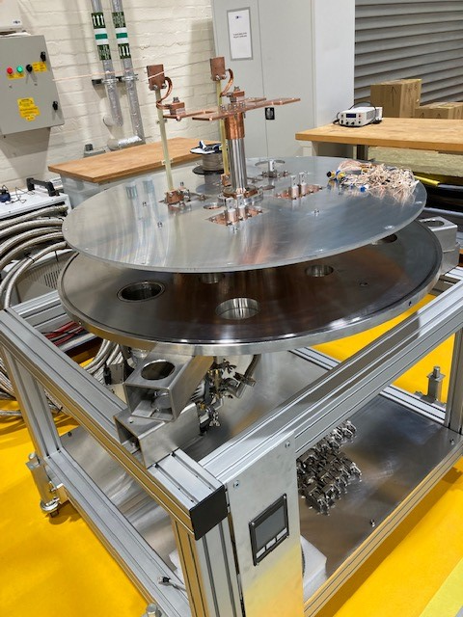
The test cryostat
The test cryostat is being designed for the 325 mm long formers
The cryostat will be used to test if the HSCU can be cooled to 4 K and if it can reach the maximum current requirement of 250 A
Will include temperature sensors, voltage taps and static Hall probes

Slide 10
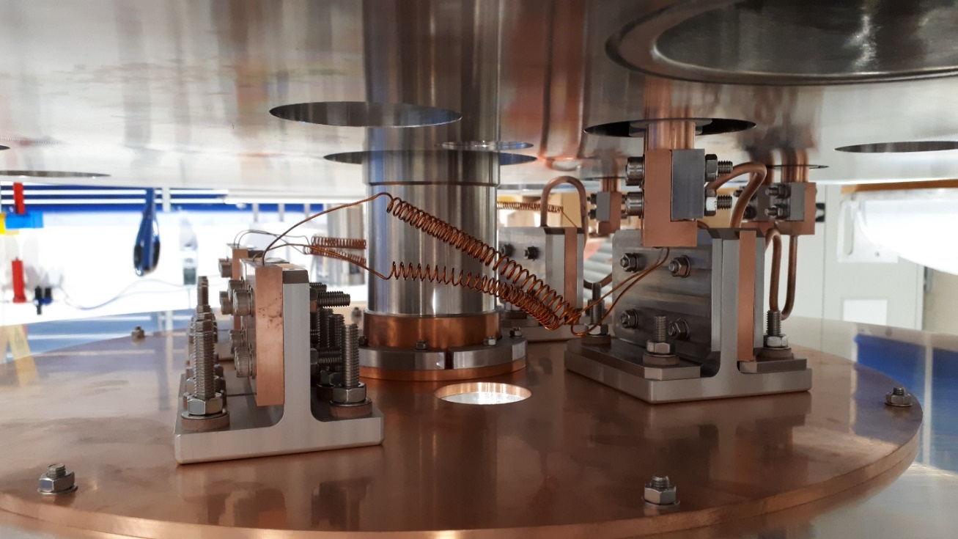
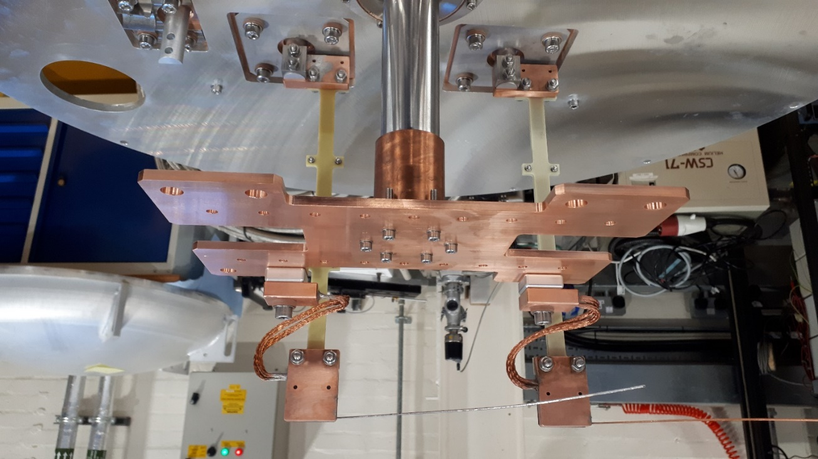
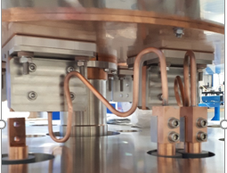
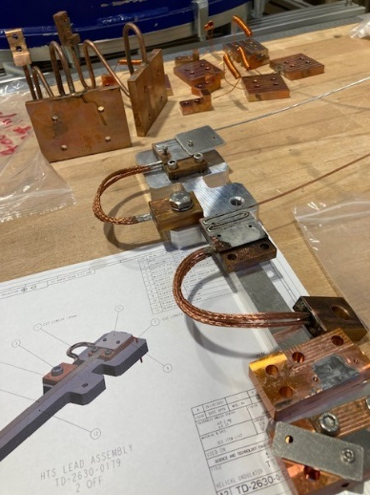
HSCU current lead design
Electrically isolating and thermally conductive joints
Making low resistance soldered joints
Current leads will be tested in the test cryostat

Slide 11
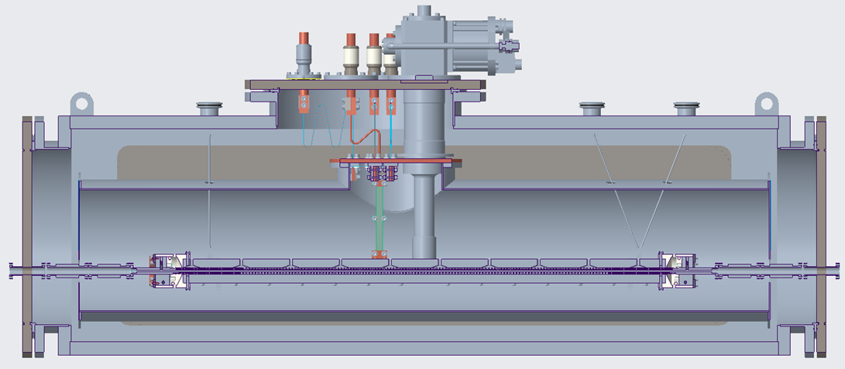
Outer Vacuum Chamber
Work is ongoing on the general arrangement for the outer vacuum chamber to house and test a full length 1.1m long undulator module
Image © STFC John Dawson
Notes:
PLEASE DELETE/REPLACE PHOTO CREDIT IF CHANGING THE IMAGE.

Slide 12
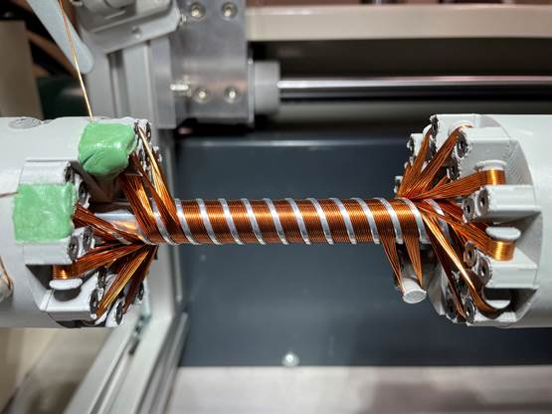
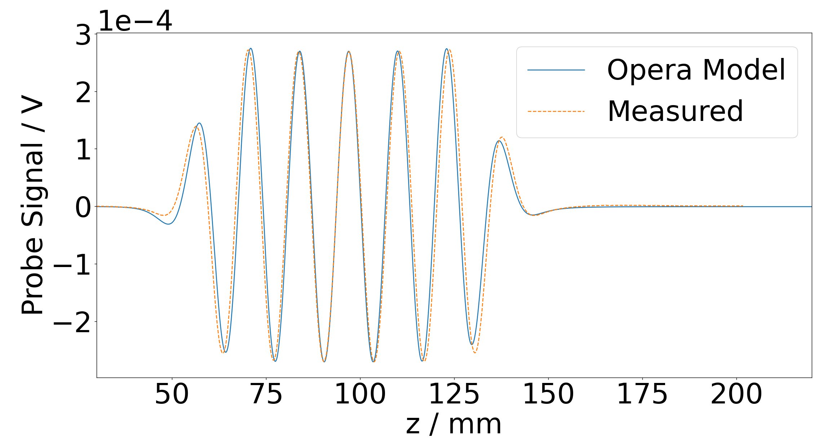
First Measurements
5 period undulator was wound with copper wire
Powered to 1 A at room temperature
Fields measured with Hall probe
Good agreement between measured data and fitted model in centre; poorer prediction of end fields
Plan is to measure fields of HSCU wound with superconducting wire at room temperature powered to ~1 A with a calibrated Hall probe
Fields expected to scale linearly with current due to
non-ferromagnetic former
Will need to check repeatability of field integral measurements to set corrector coil currents
Can repeat measurements at higher current in liquid nitrogen bath
If repeatability is poor due to low signal-to-noise ratio, will need to develop measurement techniques in the cryostat

Slide 13
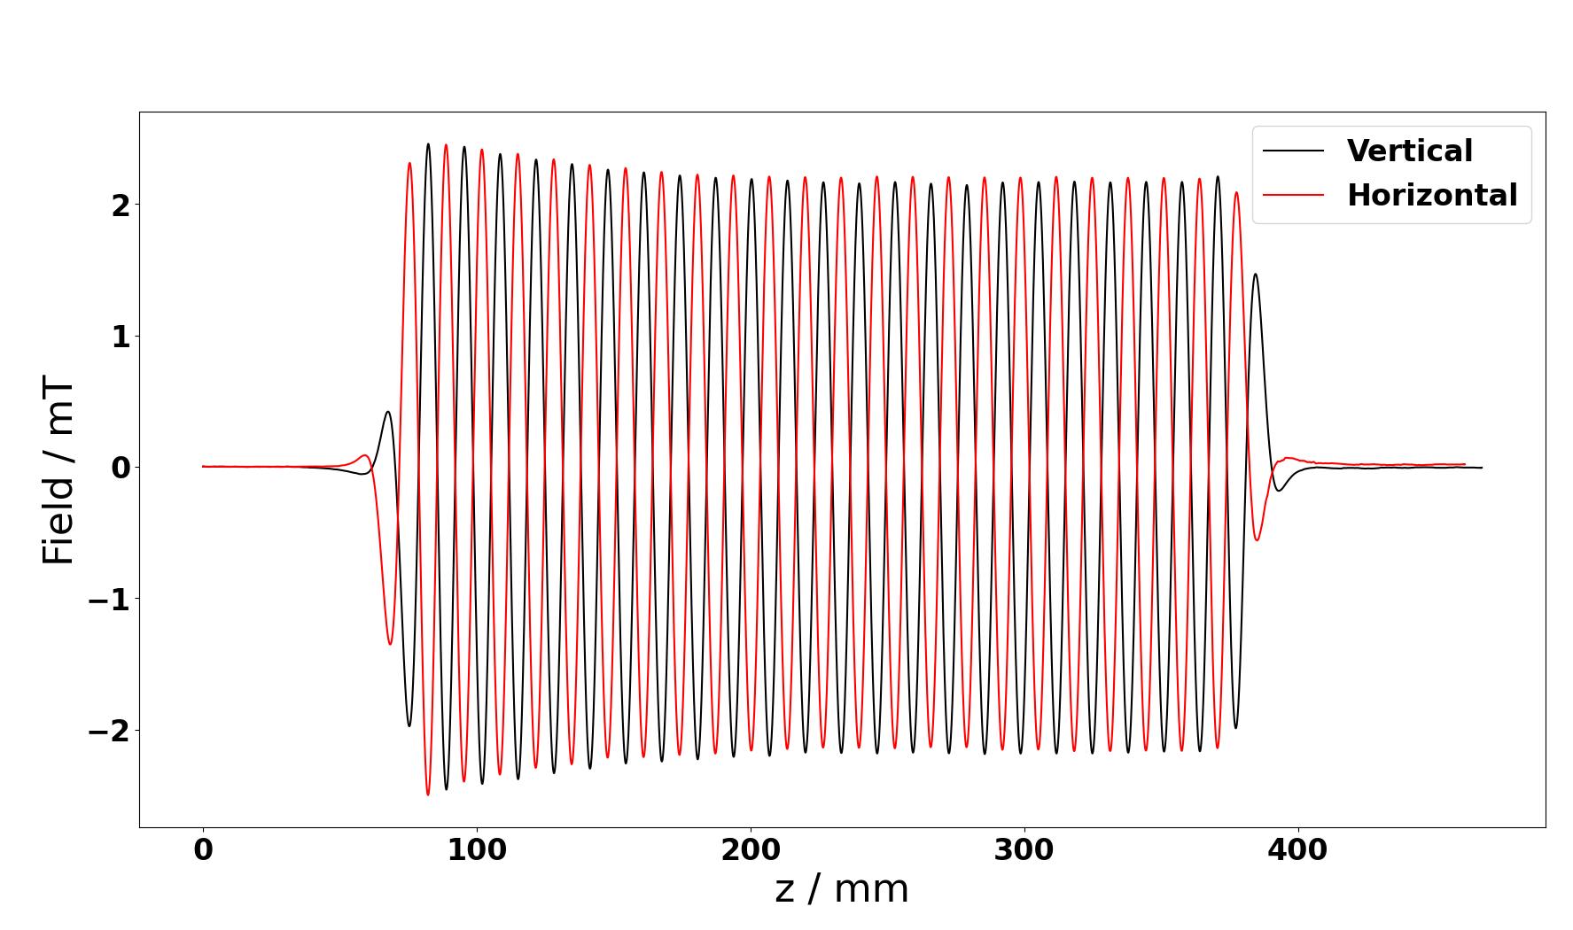
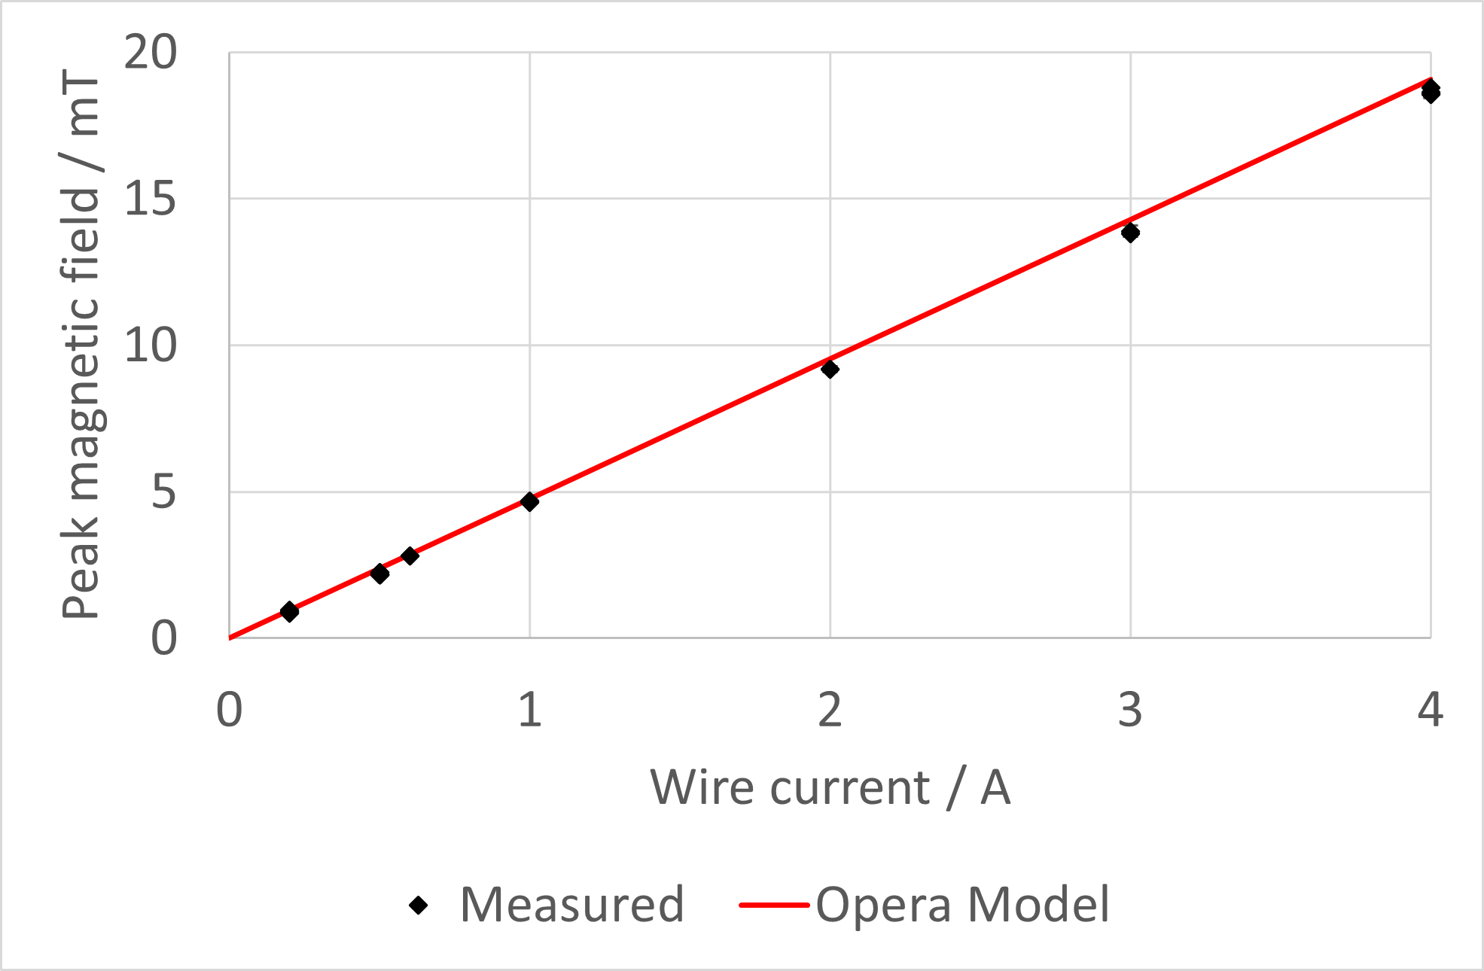
Measurements with SC wire
325 mm former wound with superconducting wire
Hall probes calibrated at
298 K, 77 K, 4 K
Fields mapped at room temperature up to 0.6 A
Measurements repeated in liquid nitrogen bath up to 4 A
Coil is resistive – current carried by copper matrix
Measured field peaks in good agreement with Opera model

Slide 14
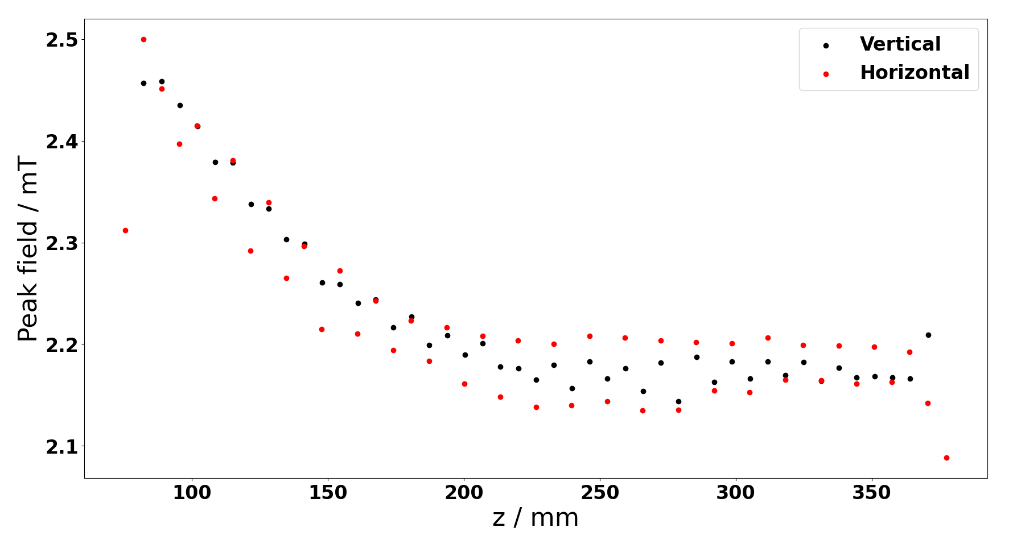
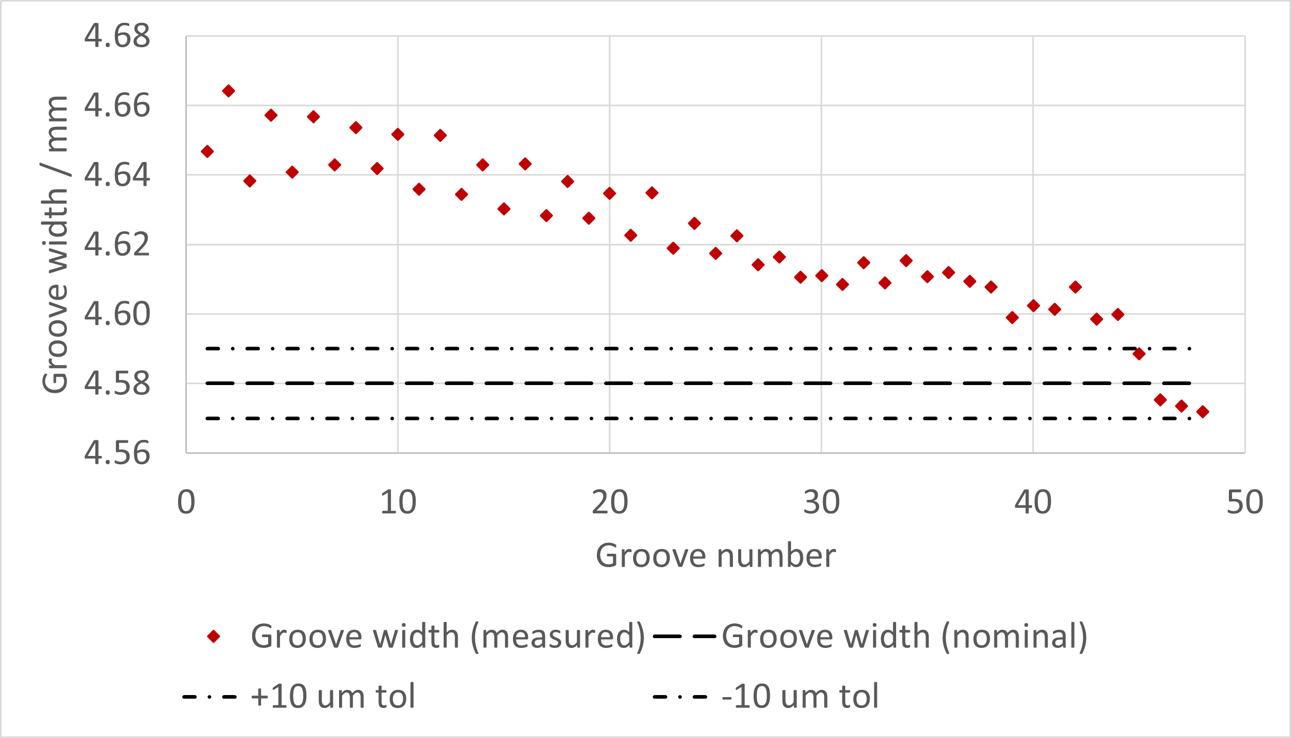
Field Peaks
Distribution of field peaks is
non-uniform
Systematic rise in peaks seen at one end of former
Corresponds to out of tolerance manufacture of former groove widths
Where former grooves are too wide, wires can slip down in the groove, contributing to a larger on-axis field
Manufacturing techniques are under investigation to reduce machining tolerances
Centreless grinding has been shown to reduce tolerances from ±50 μm to ±10 μm

Slide 15
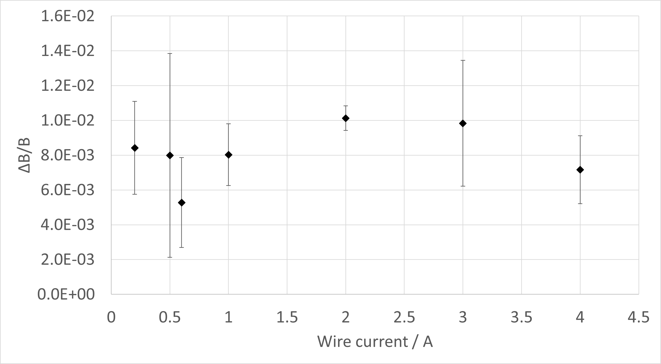
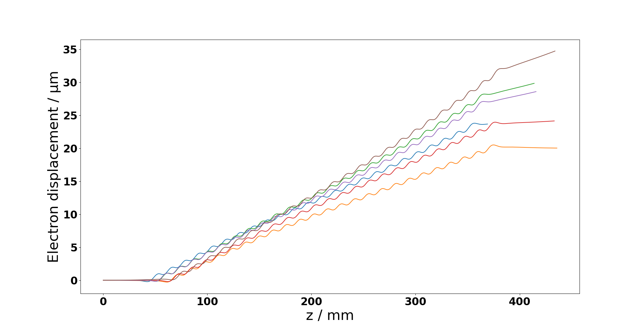
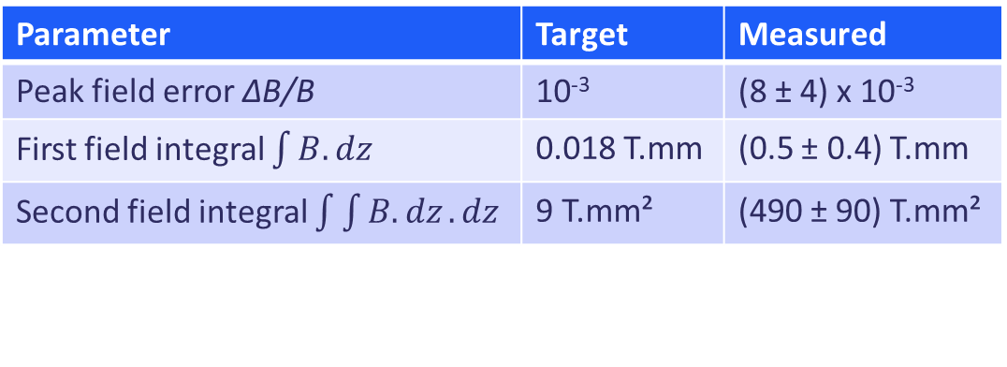
Measurement Repeatability
Undulator fields scale linearly with current
Field quality and integral measurements at low current are representative of quantities at 250 A
Measurement uncertainties exceed target values due to poor signal to noise ratio
Parameter | Target | Measured
Peak field error ΔB/B | 10⁻³ | (8 ± 4) x 10⁻³
First field integral $\int{B.dz}$ | 0.018 T.mm | (0.5 ± 0.4) T.mm
Second field integral $\int{\int{B.dz}.dz}$ | 9 T.mm² | (490 ± 90) T.mm²

Slide 16
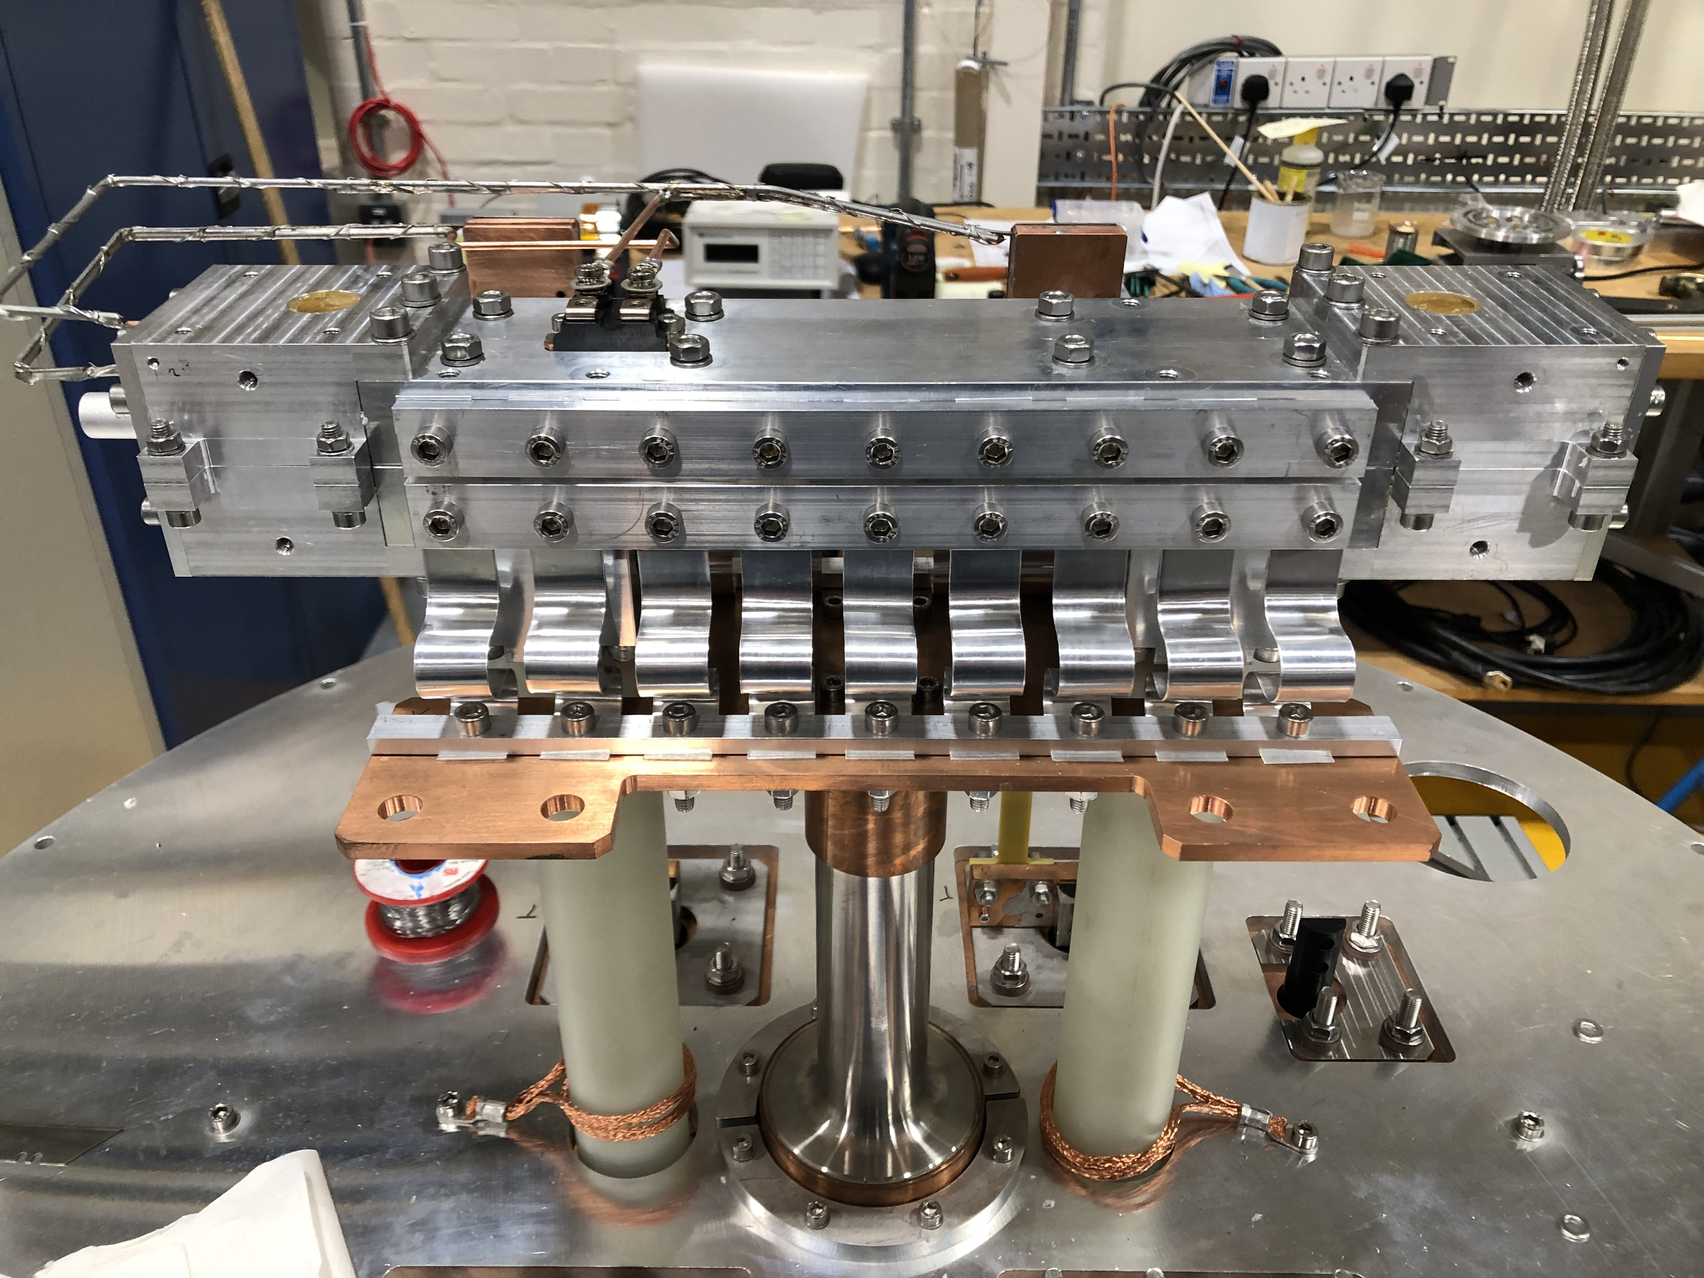
Towards Cryogenic Measurements
Room temperature measurements give good qualitative understanding of field profile
Can be used to identify clear manufacturing or winding issues
Not sensitive enough for reliable field quality and integral measurements
Field measurements must be taken of the SCU at full current at cryogenic temperatures
Techniques under investigation to actuate a Hall probe in the undulator bore in the test cryostat for field mapping

Slide 17
Future Work
First SCU coil measured at room temperature will be tested in the test cryostat in the coming weeks
Tests to investigate cryogenic behaviour of former and whether the former can reach the full operational current of 250 A
Methods to implement field mapping in the test cryostat for quantification of field quality are under investigation
Experience manufacturing and testing 325 mm formers will be applied to 1 m long formers which will need to be tested
Ultimate goal of the project is to develop a 2 m cryomodule containing 2 x 1 m SCU units which could be used in an undulator line on an XFEL facility
 | 2023 |  |  | 2024 |  |  |  | 2025 |  |  |  | 2026 |  |  |  | 2027
 | Q2 | Q3 | Q4 | Q1 | Q2 | Q3 | Q4 | Q1 | Q2 | Q3 | Q4 | Q1 | Q2 | Q3 | Q4 | Q1 | Q2 | Q3
325 mm | Testing at 4K |  |  |  | Prototype complete ●
1.1 m |  |  |  |  | Manufacture |  | Testing at 4K |  |  |  | Prototype complete ●
Full module |  |  |  |  |  |  |  | Design complete ● |  |  |  | Assembly |  |  | 4K testing |  | Beam tests

