Slide 1

HL-LHC motorized jacks
Progress meeting #26
Jaime Pérez Espinós
HL-LHC progress meeting – 09/02/23

Slide 2
Last news and sequence of actions
06/12/22: acceptance tests of batch #1 finalized → first report delivered by M. Noir;
08/12/22: discussion on acceptance tests of batch #1 during the HL-LHC jacks progess meeting #24 Jacks (see minutes) → some values out of requirement → decision to have an ad-hoc meeting to define strategy wrt NCs;
12/12/22: ad-hoc meeting for NCs → following decisions are taken:
  NCR will be written with corresponding investigation of root causes and an action plan to solve the corresponding NCs and prevent future ones;
  UNIOR will be informed that the OK for the manufacturing of batch #2 is postponed until some investigations are finished (hopefully by end-January ‘23);
  The project accepts a delay on the supply of batch #2 according to the time cumulated for the reply to UNIOR;
16/12/22: meeting with UNIOR to inform about decisions, next steps and their agreement to strategy → OK given by UNIOR;
19/12/22:
  submission for approval of NCR LHC-HQHL-QN-0001 v.0.1 "NCR - Deviations found during Site Acceptance Test of Batch #1” (EDMS #;
  Start of acceptance tests after re-assembly process of jack #1;
18/01/23: finalization and report of acceptance and semi-functional tests following dismounting and re-assembly of jack #1 delivered by UNIOR
30/01/23: presentation of FINAL results and decision to give OK for manufacturing (not assembly) of batch #2 to UNIOR; 2x additional jacks (#002 and #003) disassembled for visual inspection without relevant comments on them
31/01/23: meeting with UNIOR; OK given for manufacturing of batch #2
  CERN to release drawings with modifications by 03/02/22
  UNIOR to provide a new planning for manufacturing of batch #2 by 14/02/23; rough machining can start
  New meeting CERN-UNIOR to be planned for 14/02/23
  Modifications of annexes to technical specification for assembly and acceptance tests to be updated before assembly process starts at UNIOR → SHOULD BE READY by end-February 2023
NCR (EDMS #2807814 v.1.0) regarding jack #001 (batch #1) finalized and sent for release → payment of batch#1 to be released

Slide 3
Actions
TBC

Slide 4
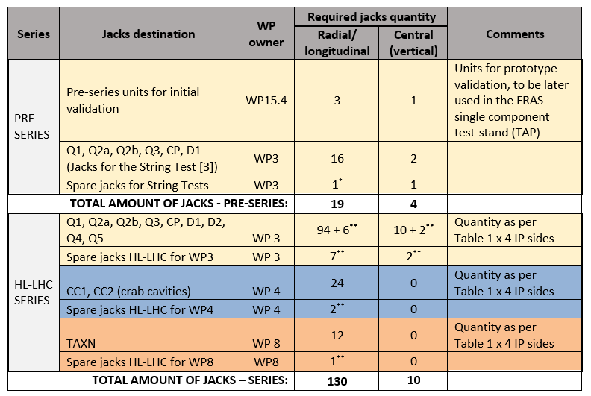
Allocation of jacks
Batch #1
Payment of pre-series allocated to WP3!!!
If OK, EN-MME to dispatch 3+1 jacks of batch #1 to WP15.4 ⇒ WP15.4 to related documentation as equipment owner

Slide 5
Actions linked to lubrication
Provide you with technical documentation on Moresco grease (Dominika) DONE
  Ask different suppliers about suitability of Moresco solution, and about the most adapted consistency, RG-42R-1 or RG-42R-2 (Tuukka) DONE
Organize a meeting with Tukka/Simon to decide on the Moresco consistency (Dominika) -> if no essential difference is observed or doubts remain, then RG-42R-1 is the reference DONE
  Provide Matteo/Dominika with reference of grease used on closed constructions of jack bearings and components. If available, provide also recommendations from suppliers for open construction (Tuukka) DONE
Provide Simon with 100g of either grease (Dominika) DONE → TYPE RG-42R-2
Ask Moresco for free samples of RG-42R-1, RG-42R-2 and GK-1 or 2. If needed, ask for a quote (Matteo) DONE
Ask Lubrilog for suitable products, ask for free samples, or ask for a quote if needed (Dominika) DONE
Draft an irradiation test specification (Matteo) MOSTLY DONE BUT details concerning containers and greases not yet receptioned are still to be integrated
Buy G Rapid paste, 2nd paste + Molykote BR2 Plus if Mateusz wants to collaborate (Jaime? Mateusz? Dominika? – Expected cost < 350 CHF, we can take care of this if you give us a budget code) DONE
  Confirm 2nd paste option (Jaime) DONE (no 2nd paste is finally chosen as chemical composition of proposals is not well adapted)
Finalise the test specification document (Jaime + R2M + Mateusz?) TO BE STARTED ONCE THE DRAFT FOR THE IRRADIATION TEST SPEC. IS COMPLETE
Ask for quote for irradiation test (Matteo) DONE (one quotation is already received and used as reference for cost estimation)
Agree on cost split (Jaime + STI + Mateusz?) DONE
  Depending on need, type and number of tests on Molykote BR2 Plus, PETAMO GHY 133 N, MORESCO RG-42R-1 and/or -2 DONE
Prepare samples (R2M) NOT STARTED
- The technical specification for the irradiation of greases for the HL-LHC jacks is finished.
A new offer for irradiation tests is received and a DAI created (TBC).
A new planning is to be generated and released by R2M in the following days, including the irradiation tests and other planned tests (friction coefficient under high load and long static period, infrared spectroscopy, total acid number, cone penetration and rheological measurements)
DEADLINE PROVIDED BY THE PROJECT WAS SEPTEMBER 2023 → END OF 2023 IS CONSIDERED A MAXIMUM BOUND

Slide 6
Thank you for your attention

