Slide 1
Jacks for HL-LHC
Batch#1 Tests Results
Simon Barrière, Michel Noir, Mateusz Sosin, Patrick Bouvier, Jaime Perez Espinos
31/01/2022

Slide 2
Last discussions (16-12-2022)
Following non-conformities on CERN test results, we proposed to disassemble, check and re-assemble one of the longitudinal jacks (UN00001)
Assembly took place the last week of December, and then new testing campaign started
  Ram backlash “radial free play”
  Gear backlash
  Actuation torque

Slide 3
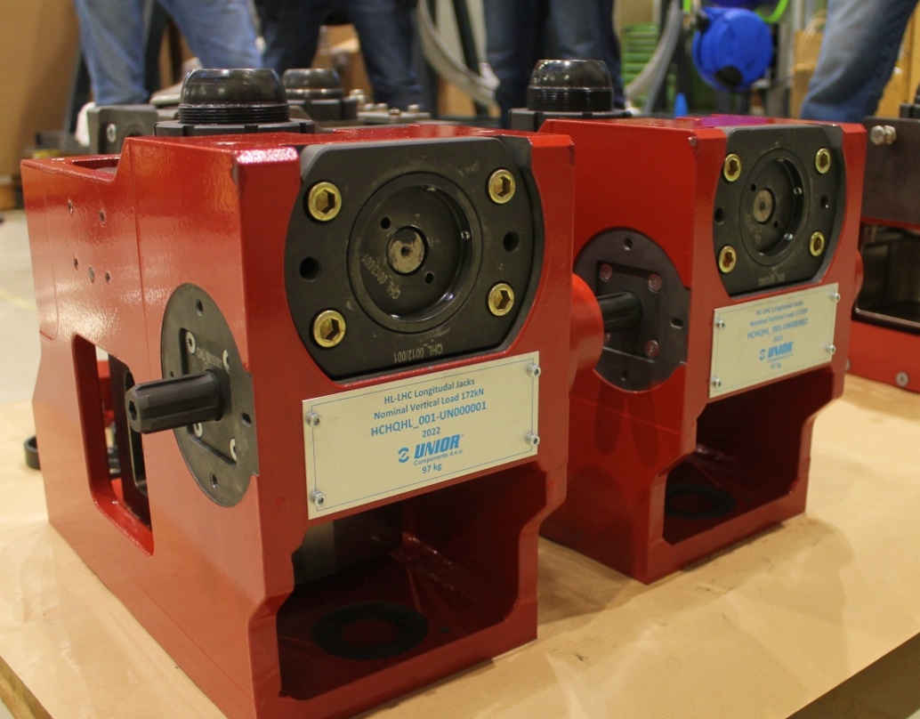
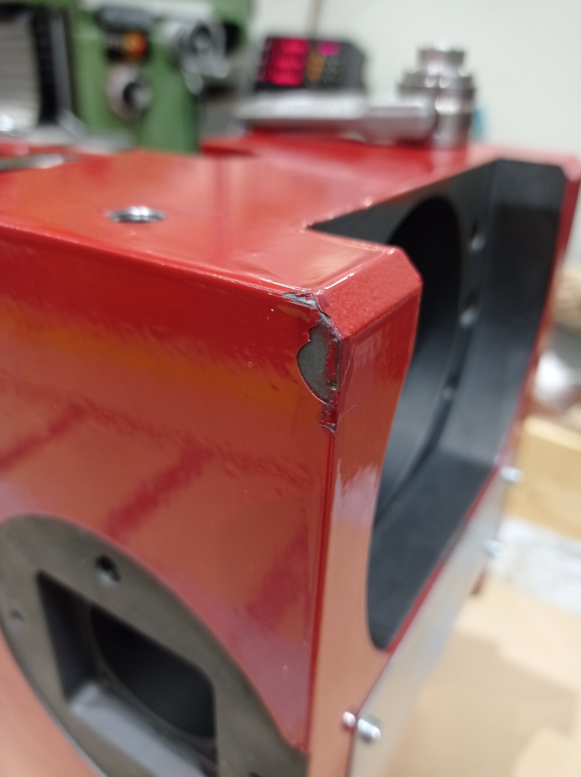
Visual Inspection – All Jacks
General feedback OK, 2 points to be improved
Paint quality to be improved (already damaged at reception)

Slide 4
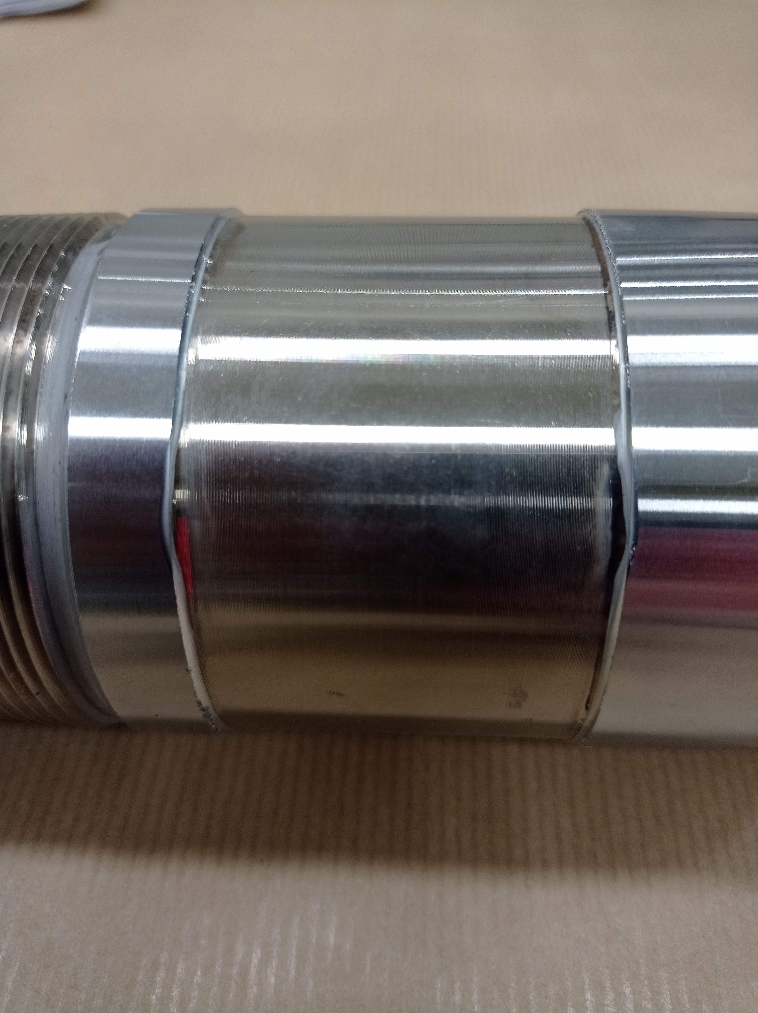
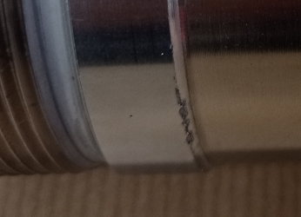
Visual Inspection – All Jacks
General feedback OK, 2 points to be improved
Burrs on the ram must be removed (picture after machining and treatment?)

Slide 5
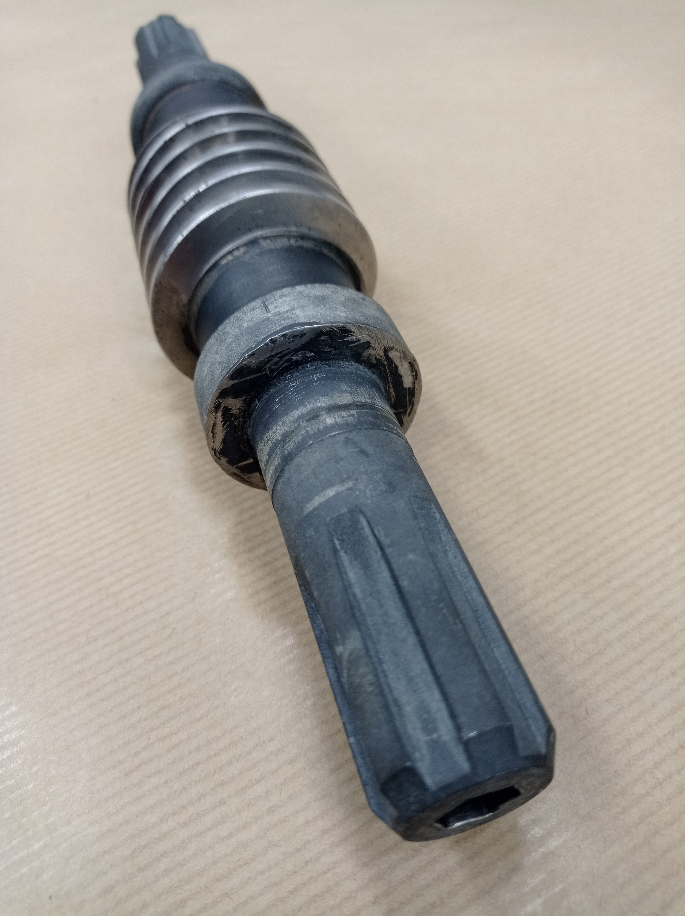
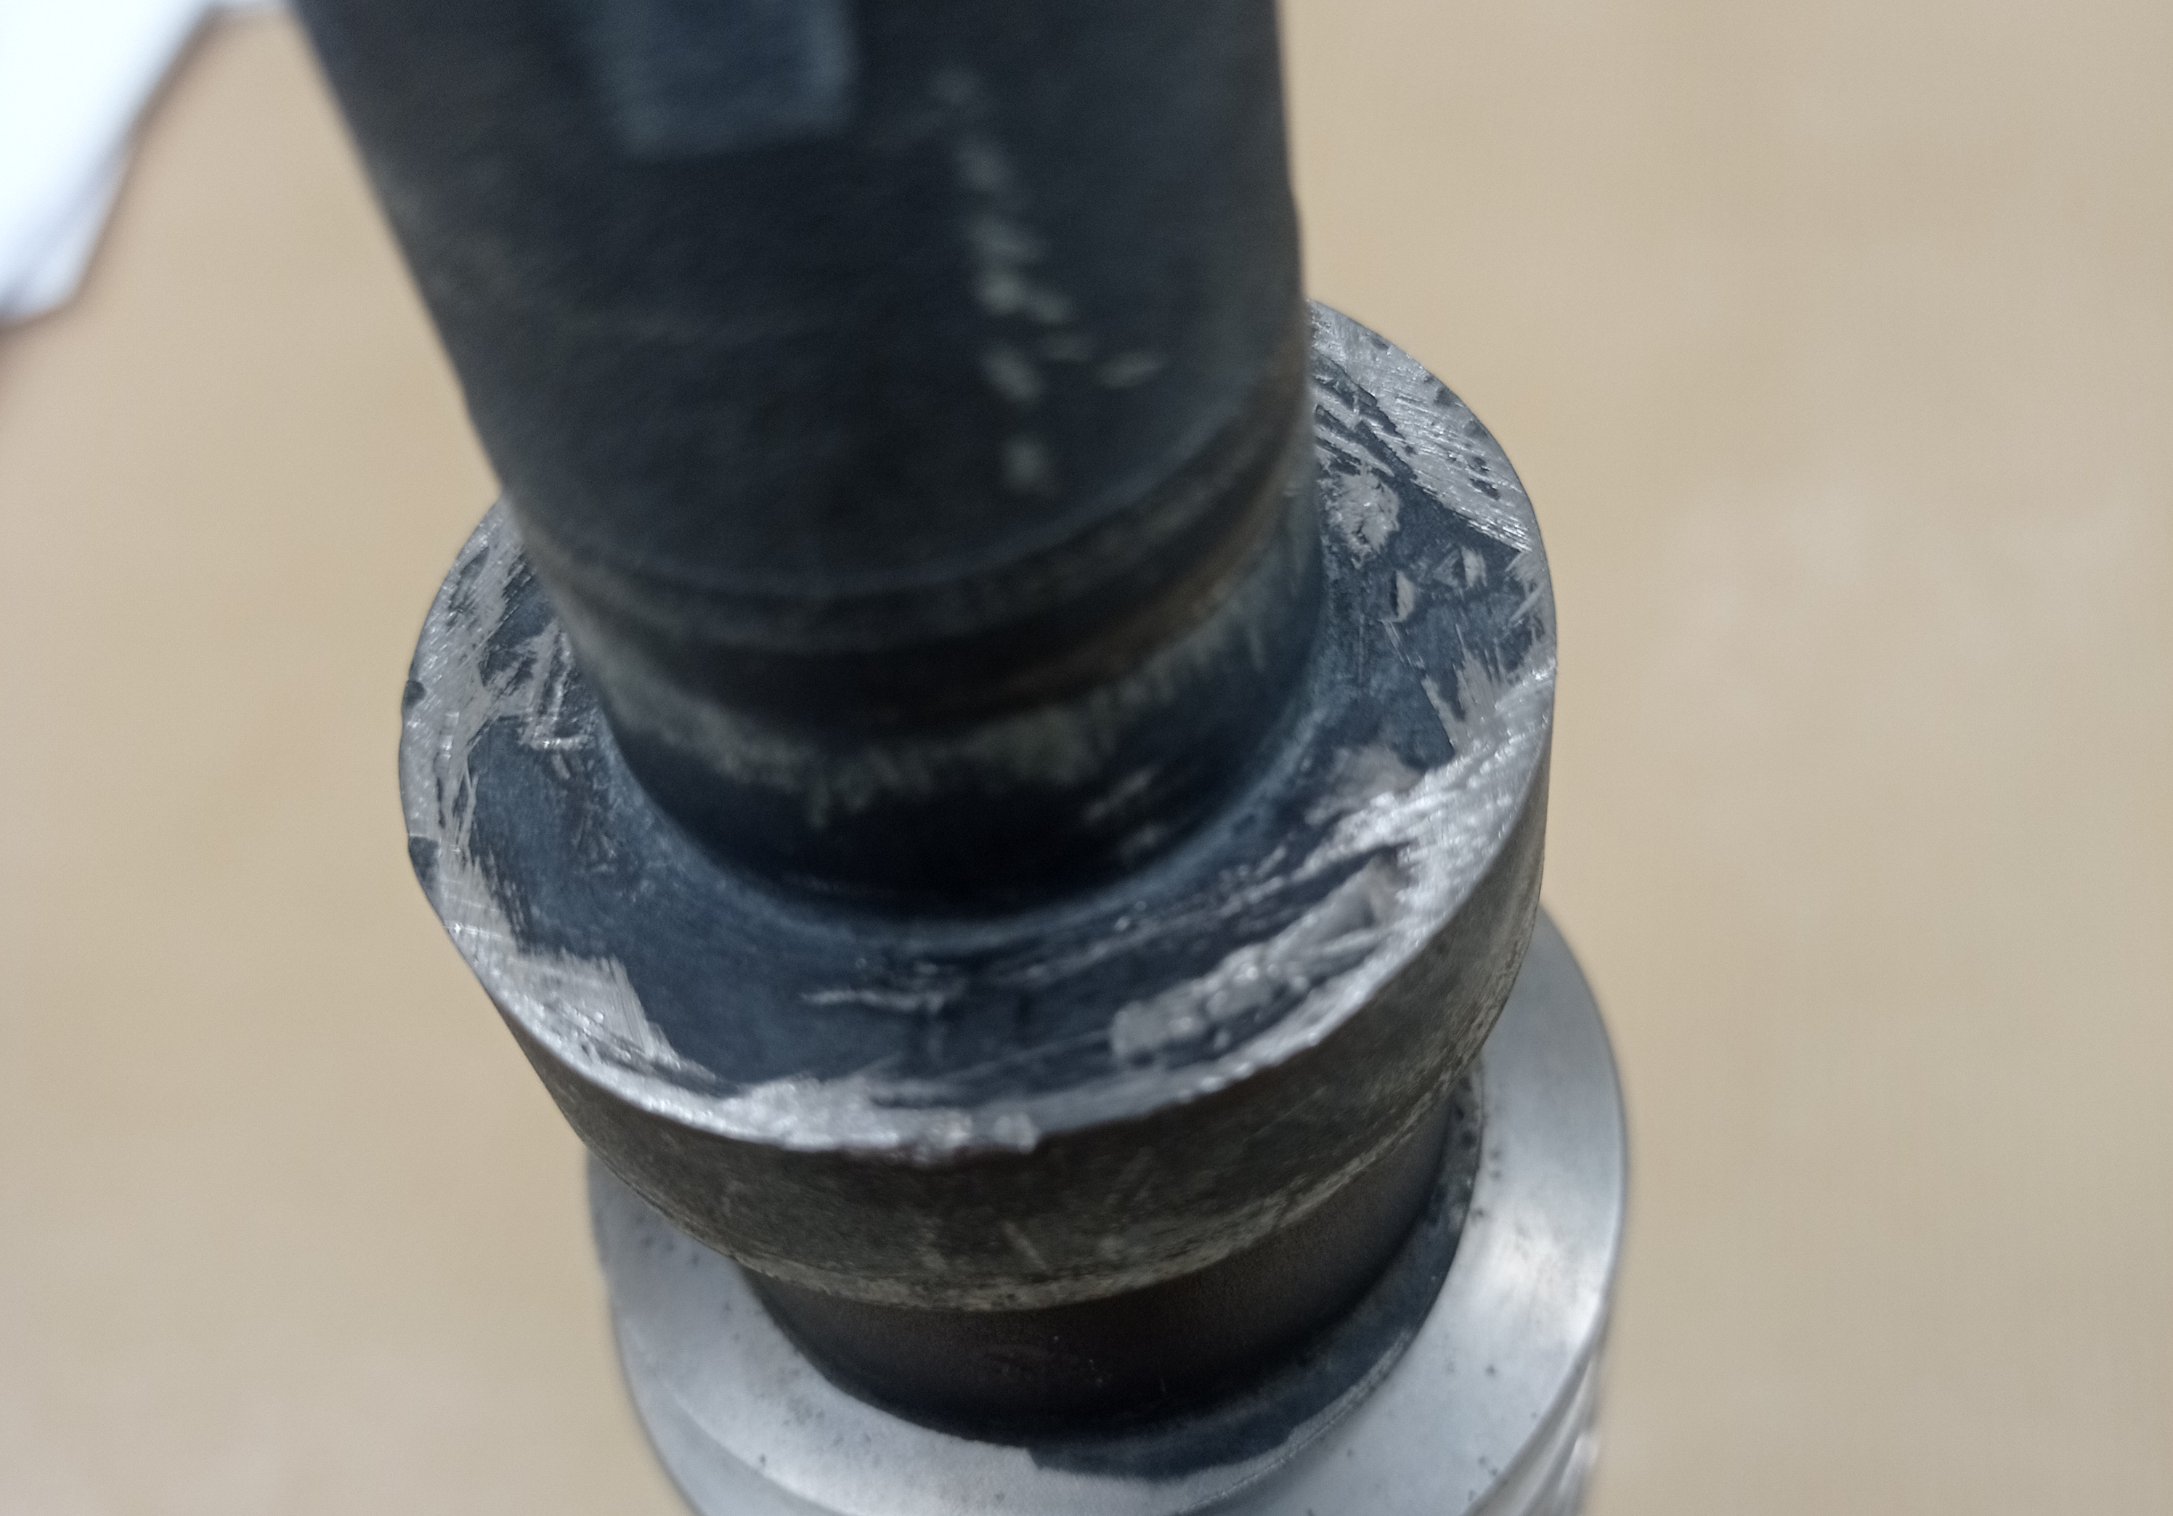
Visual Inspection – Jack #1
Worms of Jack #2 and Jack #3 are visually OK
Worm damaged: deep scratches, traces of grinding
surface flatness/finishing not conform to specification
For Batch #2 we will require pictures of all bearing interfaces before assembly

Slide 6
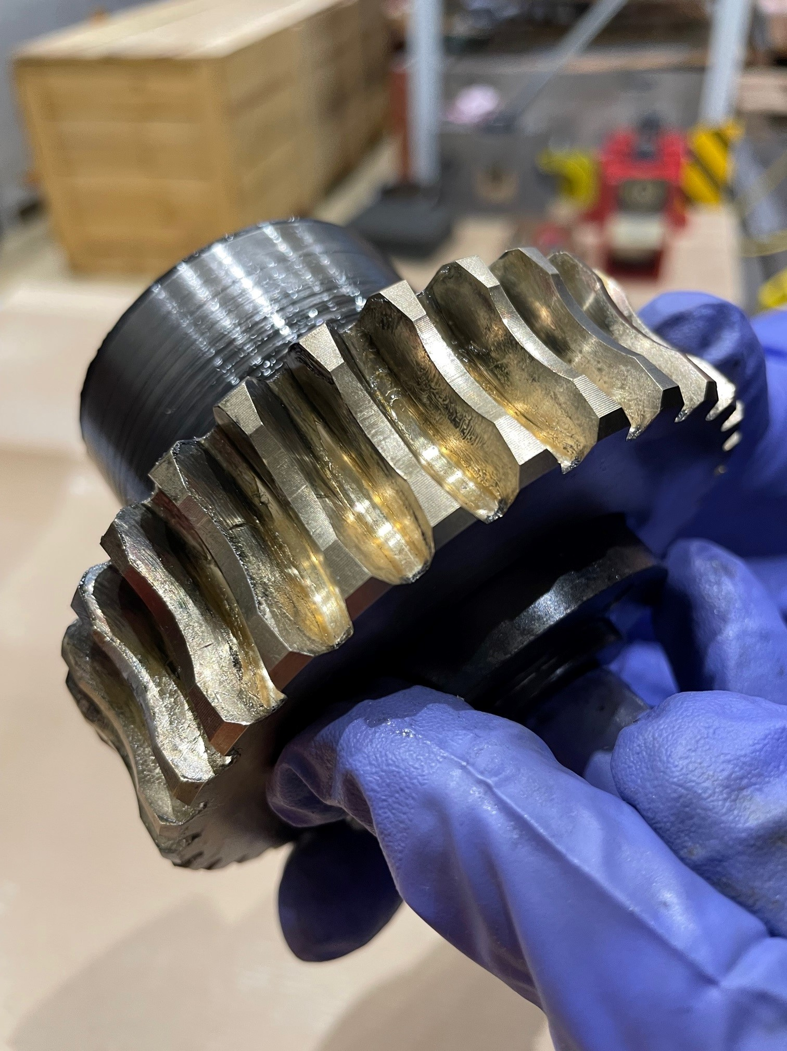
Visual Inspection – Jack #1
Lubrication not sufficient – likely to be the cause of high torques in the mechanism
CERN is working on a more detailed procedure for lubrication (Annex 5)

Slide 7
RAM Backlash → “Radial Free play”

Slide 8
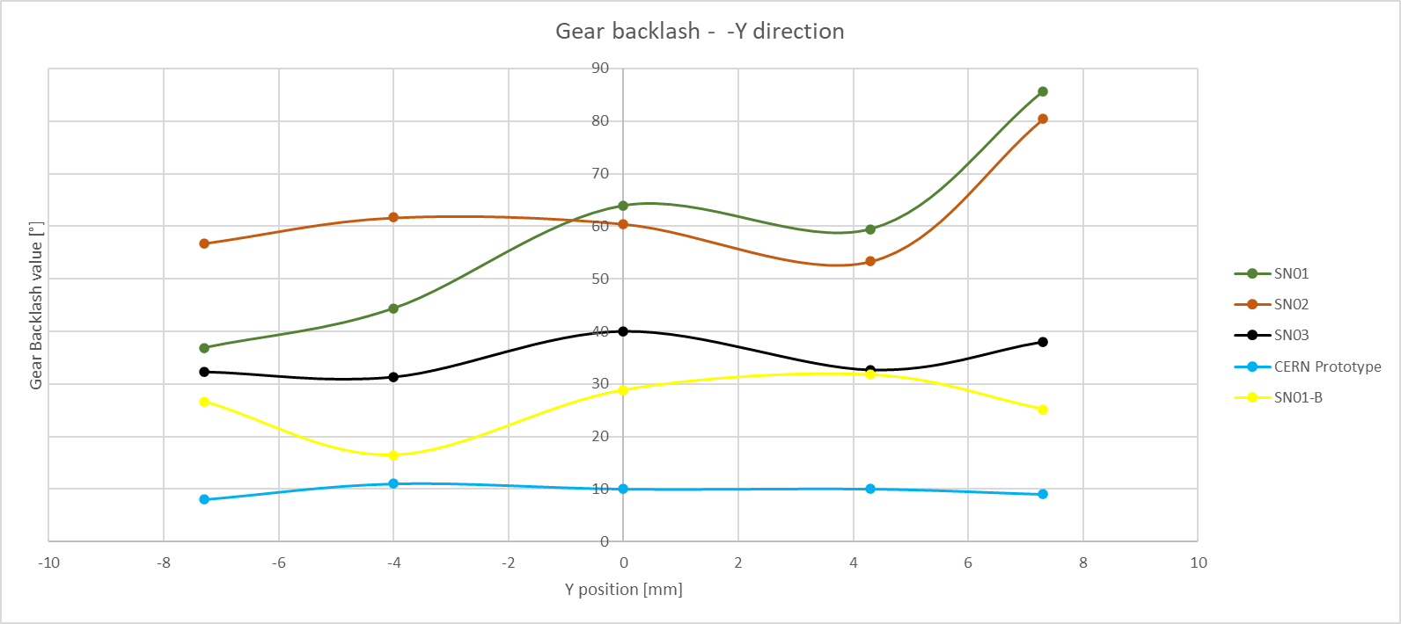
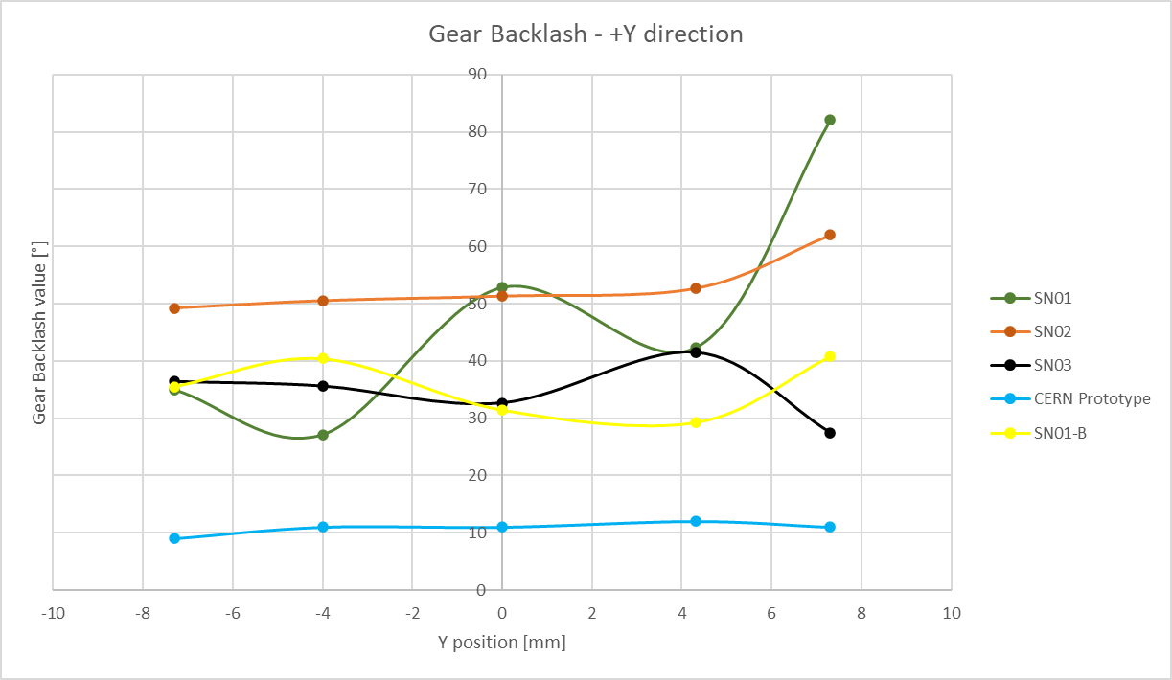
Gear Backlash - Nominal
Some values are still above the 30 defined limit – but improved significantly after the new assembly

Slide 9
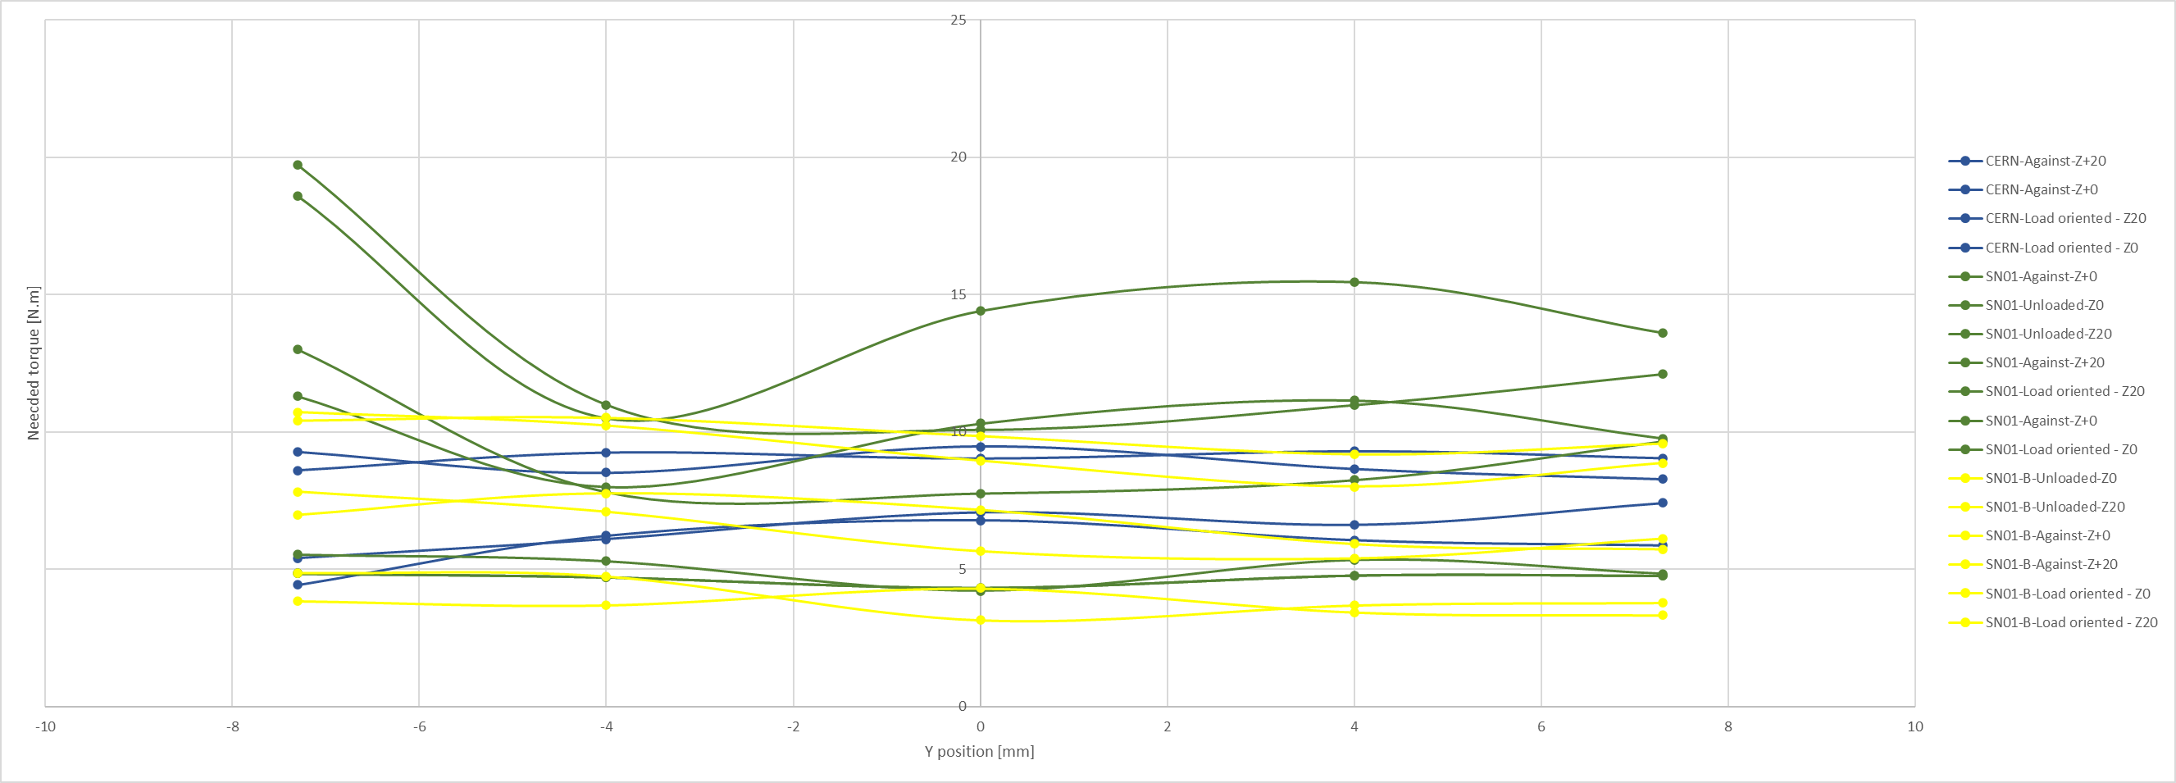
Actuation torque under 110% load

Slide 10
Conclusion
Assembly procedure is a key parameter of jacks functionality – Dimensional cross-checks shall be done at CERN.
Lubrication was not sufficient in the UNIOR jacks – To be improved for next batch following revised CERN procedure
CERN gives greenlight for machining of Batch #2 components, not for assembly yet
Specification attention shall be paid by UNIOR on surface quality, pictures will be required
As discussed, minor design modifications are needed for Batch #2 - updated drawings will be provided this week (Frame, Push-pull ring, Ram)

