Slide 1
Cancer statistics and indication profile in the Baltic States.
Status of radiotherapy technologies in the Baltic States
Erika Korobeinikova (Lithuanian Society for Radiation Therapy / Lithuanian University of Health Sciences)
Kristaps Palskis (Riga Technical University, CERN)
Manjit Dosanjh (CERN, University of Oxford)

Slide 2
Outline
Introduction to particle therapy, number of facilities in the world
Similar studies on particle therapy feasibility. Introduction to ART study
Statistics in the Baltics: Radiotherapy technology availability
Statistics in the Baltics: Cancer incidence, need of data stratification
Extended data collection survey. Final comments

Slide 3
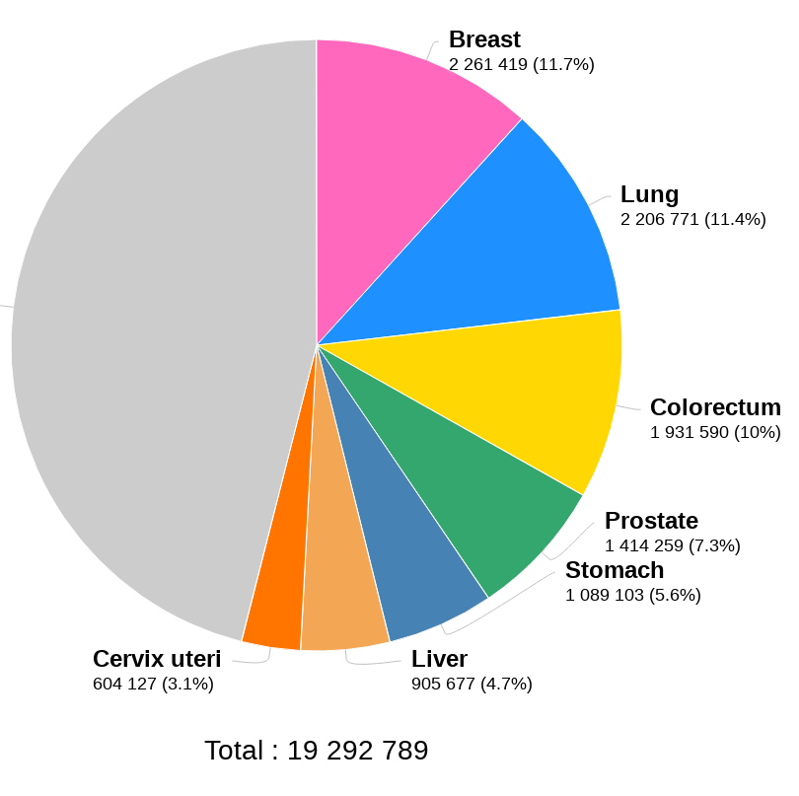
Cancer is a growing global challenge
Globally 19.3 million new cases per year diagnosed and 9.96 million deaths in 2020
This will increase to 27.5 million new cases per year and 16.3 million deaths by 2040
70% of these deaths will occur in low-and-middle-income countries (LMICs)
Radiation therapy is a key tool for treatment for over 50% patients

Slide 4
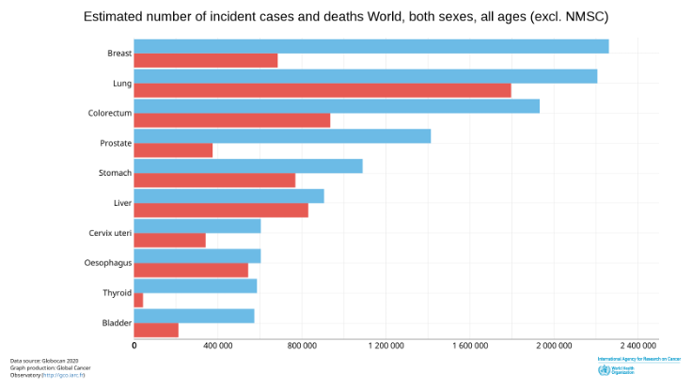
Cancer is a growing global challenge
Eventually compare with Baltic data

Slide 5
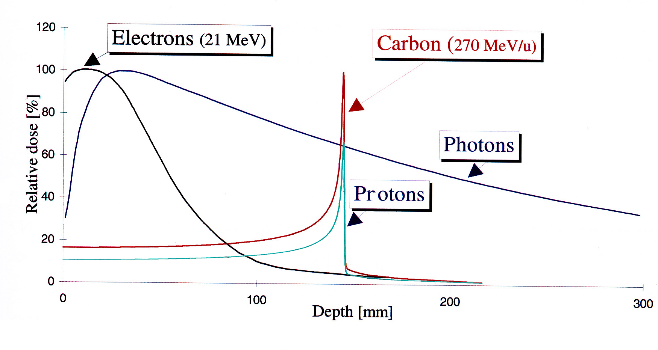
Radiation therapy is a key tool for treatment
Aims of Radiotherapy:
Irradiate tumour with sufficient dose to stop cancer growth
Avoid complications and minimise damage to surrounding tissue
Current radiotherapy methods:
5-25 MV photons
5 - 25 MeV electrons
50 - 300 MeV/u hadrons

Slide 6
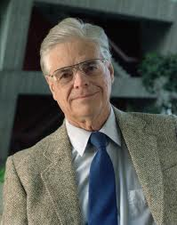
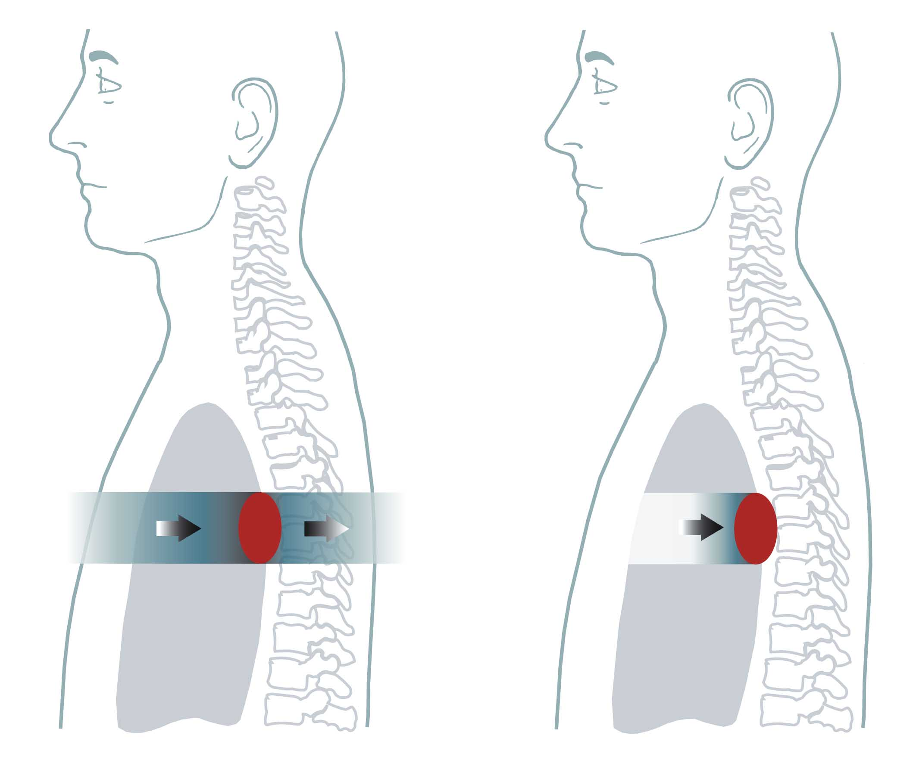
Hadron Therapy
In 1946 Robert Wilson:
  Protons can be used clinically
  Accelerators are available
  Maximum radiation dose can be placed into the tumour
  Particle therapy provides sparing of normal tissues
Robert Wilson
Fermi Lab
Depth in the body (mm)
Conventional: X-Rays Ion Radiation

Slide 7
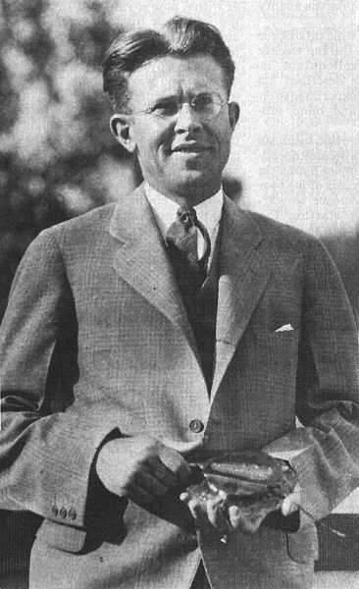
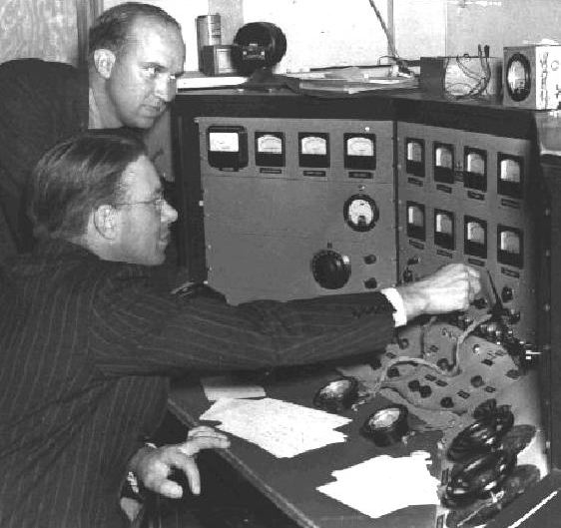
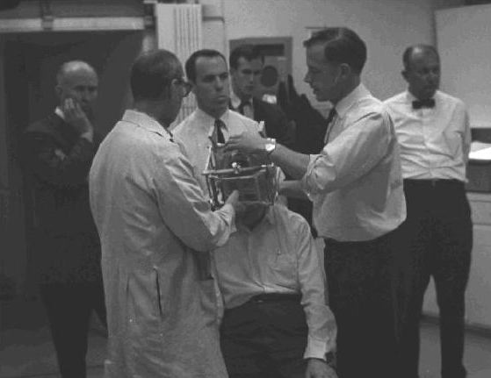
E. Lawrence
First cyclotron
Lawrence brothers
Physicist and Doctor
Sept 1954 – Berkeley
Treats first patient
Importance of collaboration………..

Slide 8
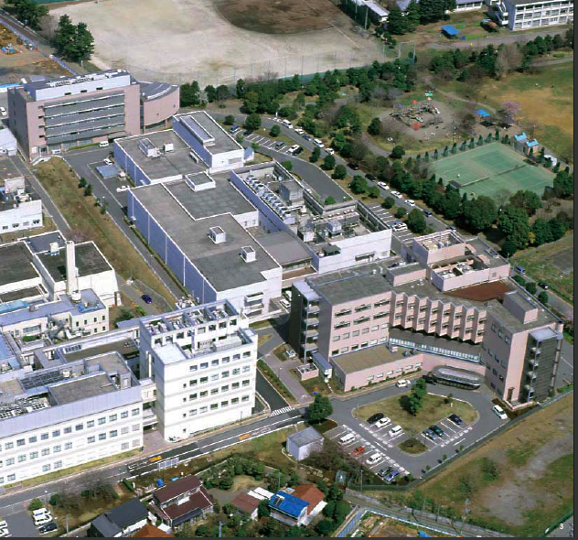
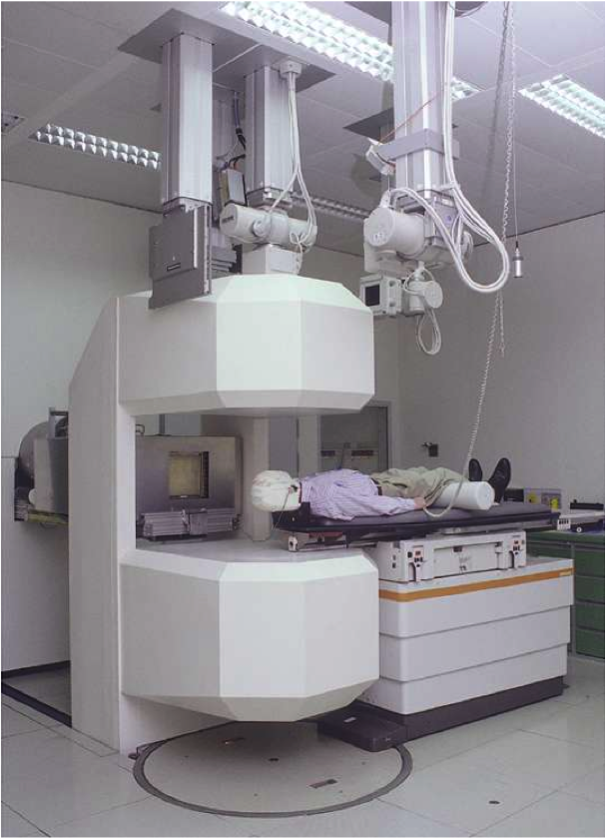
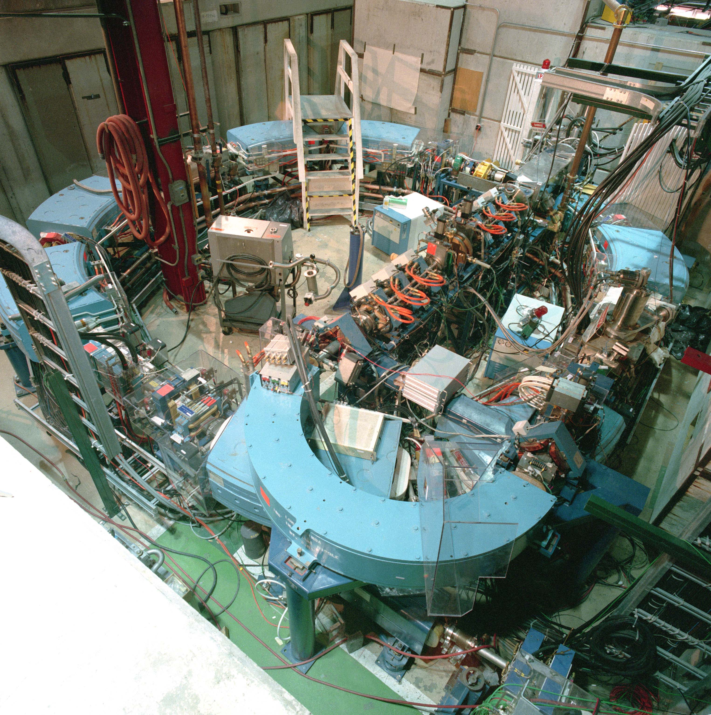
1993- Loma Linda
USA (proton)
1994 – HIMAC/NIRS
Japan (carbon)
1997 – GSI
Germany (carbon)
First dedicated clinical
facility
Three crucial years for PT………to clinics
………often takes a long time to clinic

Slide 9
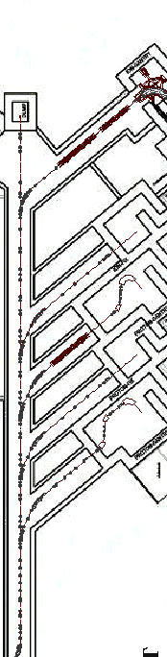
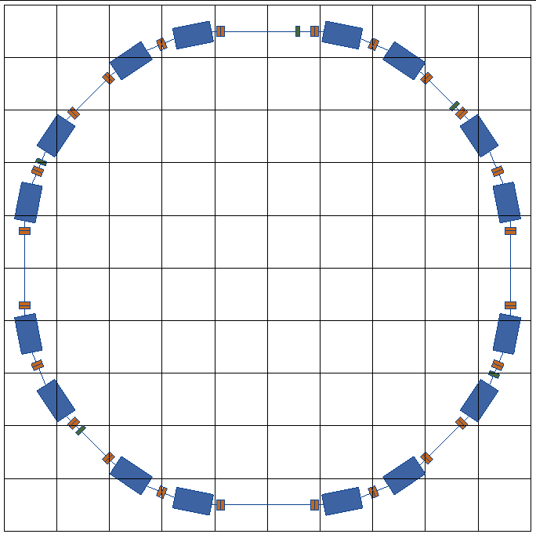
PIMMS Study - trigger for ENLIGHT
400 MeV/u synchrotron
p
p
p
C
C
RF cavity
Resonance sextupole
Sextupole horiz. chromaticity
Sextupole vert. chromaticity
Betatron
core
Circumference C = 76.84 m
Tune horizontal Q_{x} = 1.67
Tune vertical Q_{z} = 1.72
Sextupole vert.
chromaticity
Sextupole horiz. chromaticity
Electrostatic septum
PIMMS: 1996-2000
Injection septum
Extraction septum

Slide 10
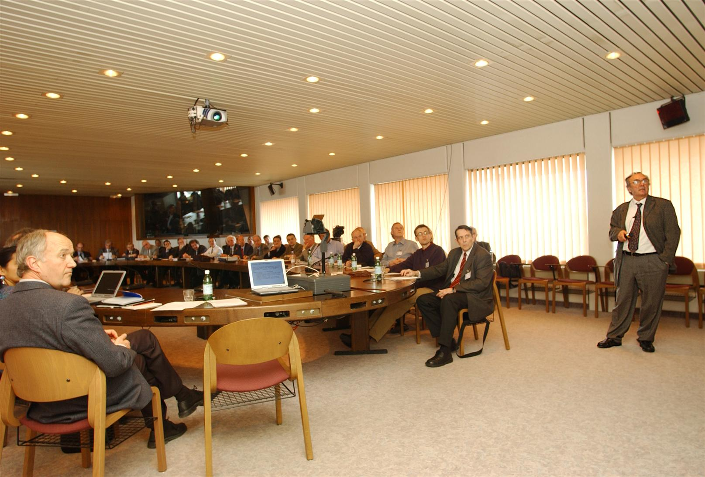
The beginnings of ENLIGHT
2001
The idea germinated in 2001 after ESTRO- Med-AUSTRON meeting
In October 2001 the proposal for a Thematic Network was submitted to EC
ENLIGHT was launched In February 2002 at CERN
Funded: 1 million Euros in 2002
Driving Force:Ugo Amaldi
DG: Luciano Maiani
Organisers: Manjit Dosanjh & Hans Hoffmann

Slide 11
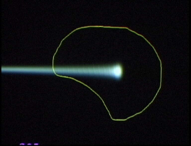
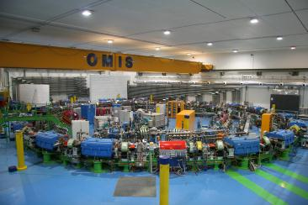
ENLIGHT was established to ………
  Create common multidisciplinary platform
  Cancer treatment
  Identify challenges
  Share knowledge
  Share best practices
  Harmonise data
  Provide training, education
  Innovate to improve
  Lobbying for funding
Leveraging Physics collaboration
philosophy into a multidisciplinary medical environment

Slide 12
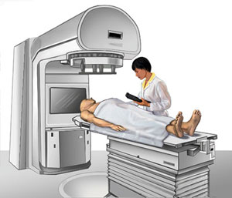
ENLIGHT: patient centric
Epidemiologists
Imaging centres
Biologists
Research institutes
Hospitals
Physicists
& Medical physicists
ICT
Funding agencies
Academic institutes
Industry
Policy makers
Doctors

Slide 13
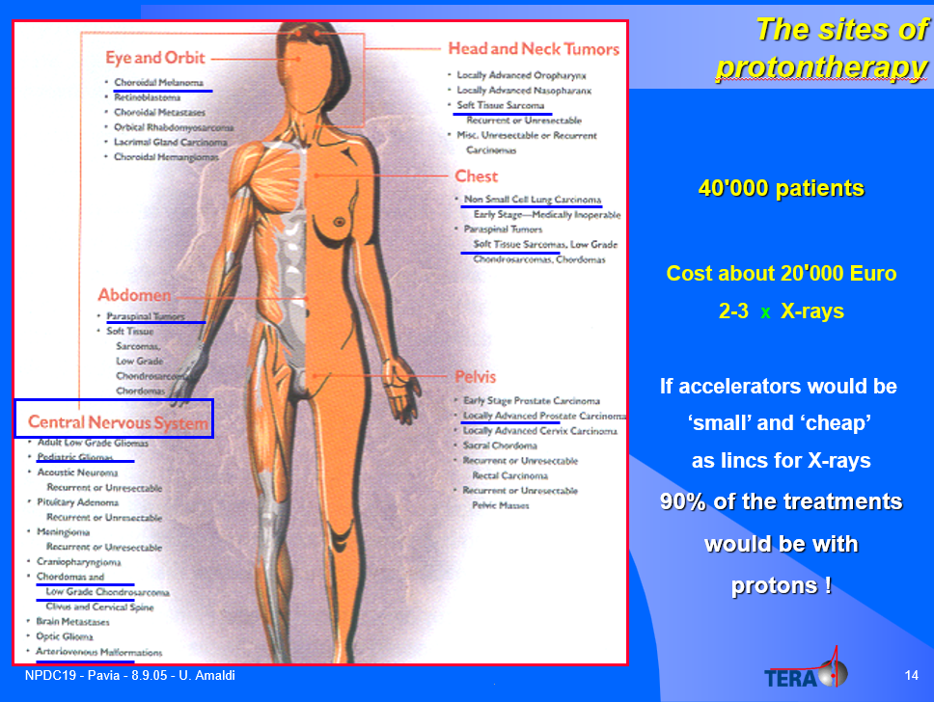

Slide 14
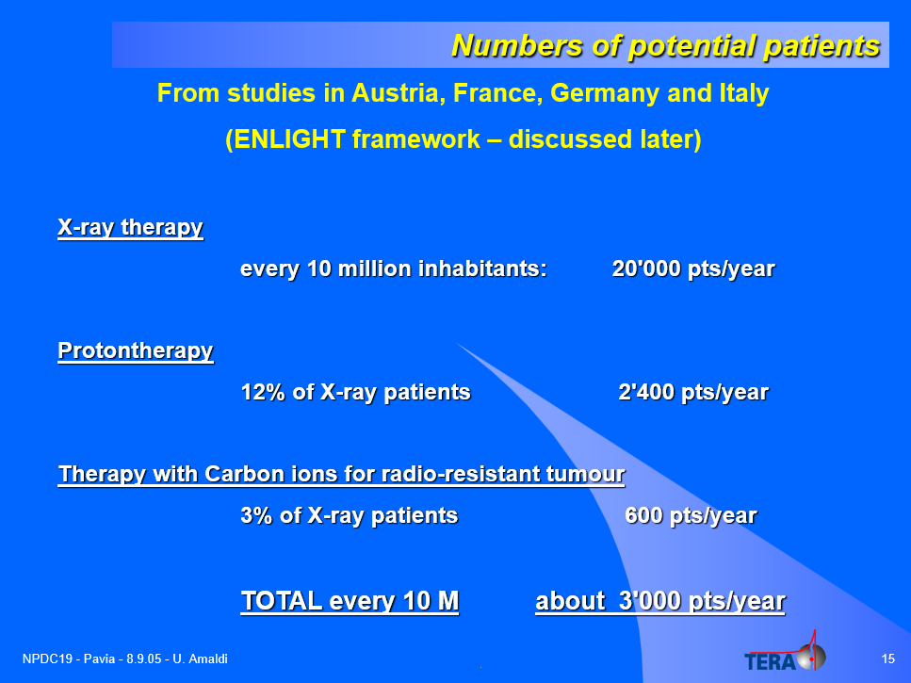

Slide 15
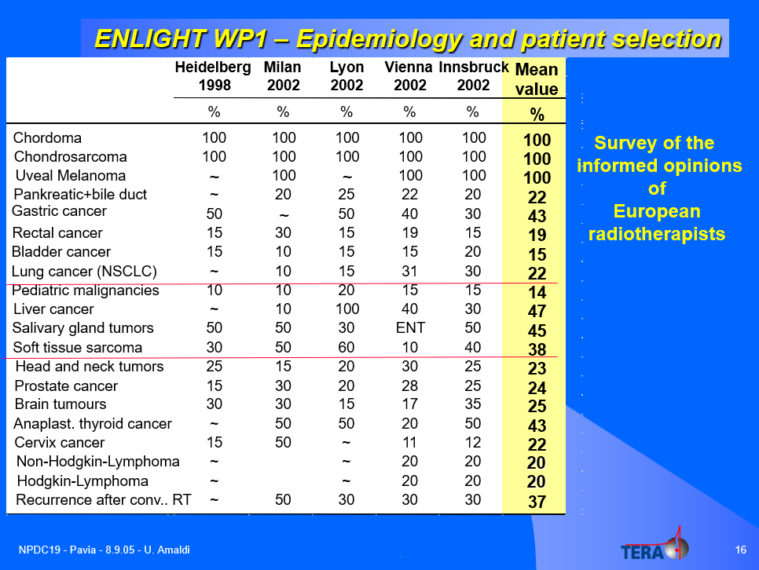

Slide 16
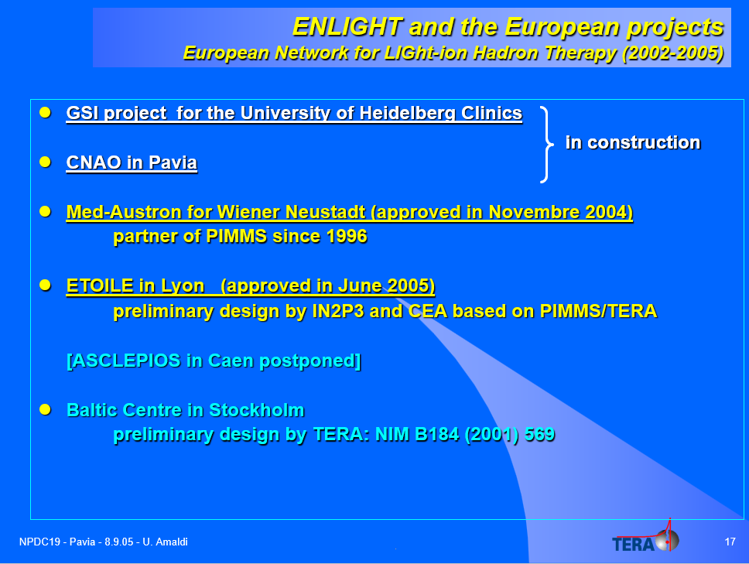

Slide 17
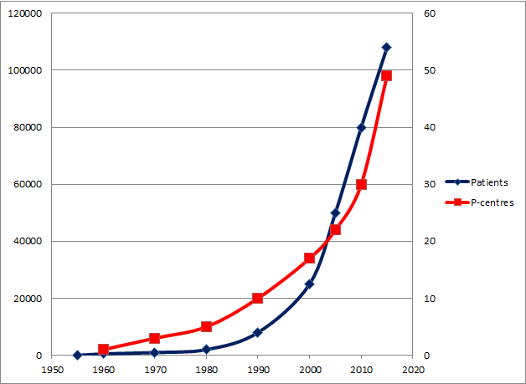
Data from www.ptcog.ch
Research centres
Hospitals

Slide 18
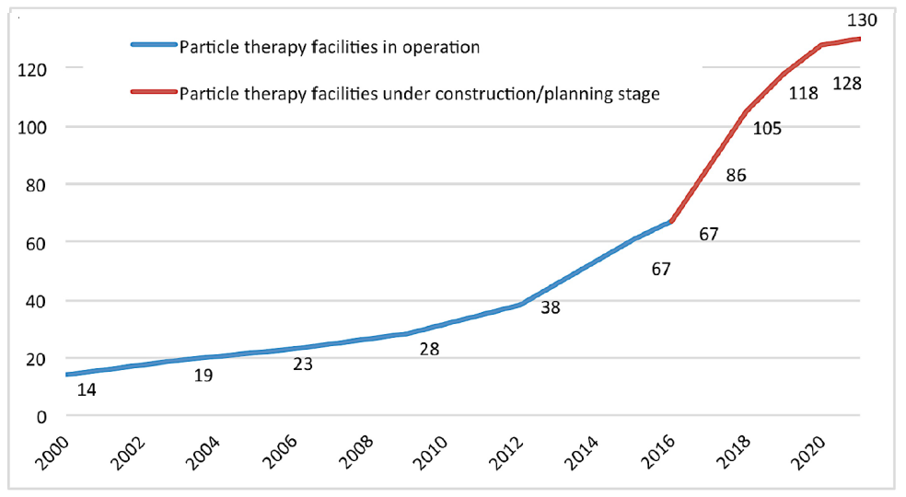
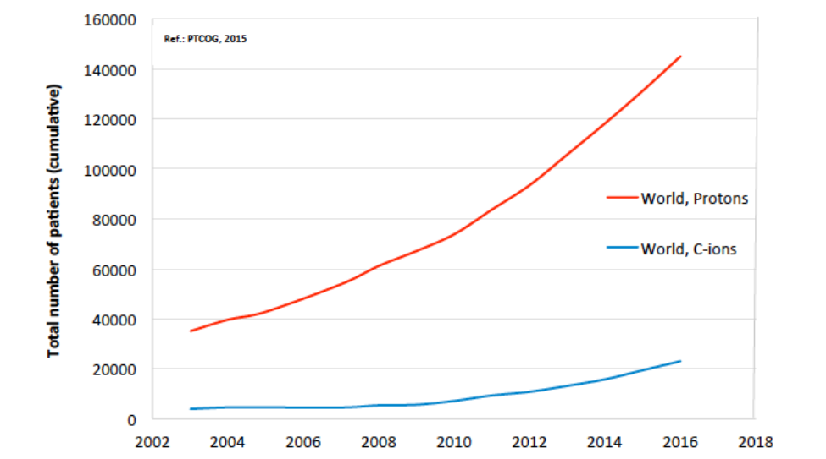
Momentum: Centres and patients worldwide
p:280,000
C: 40,000

Slide 19
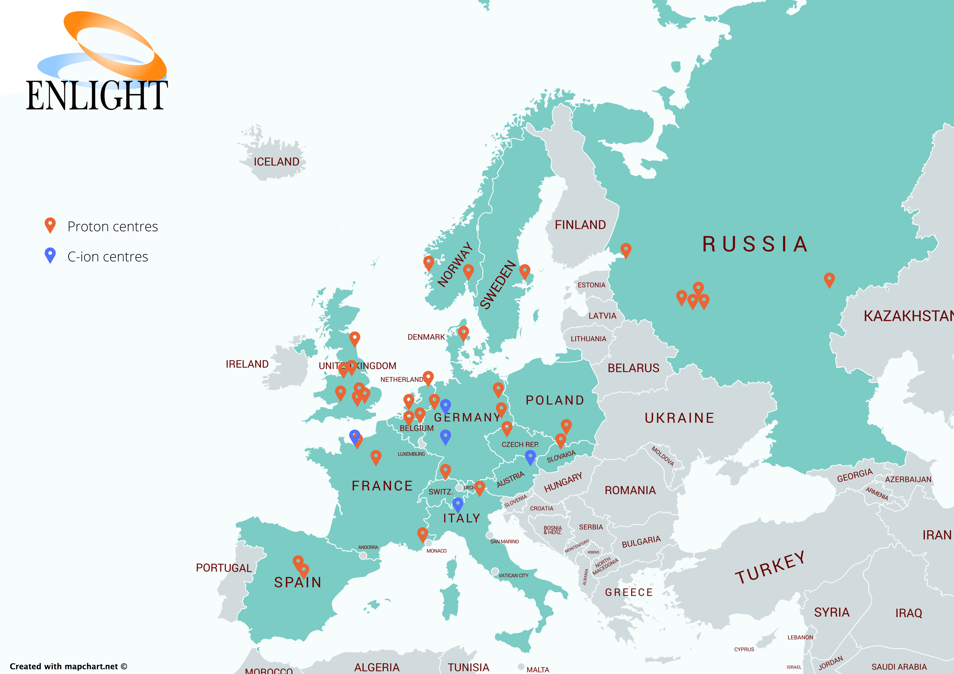
Facilities in Europe: why Baltics project

Slide 20
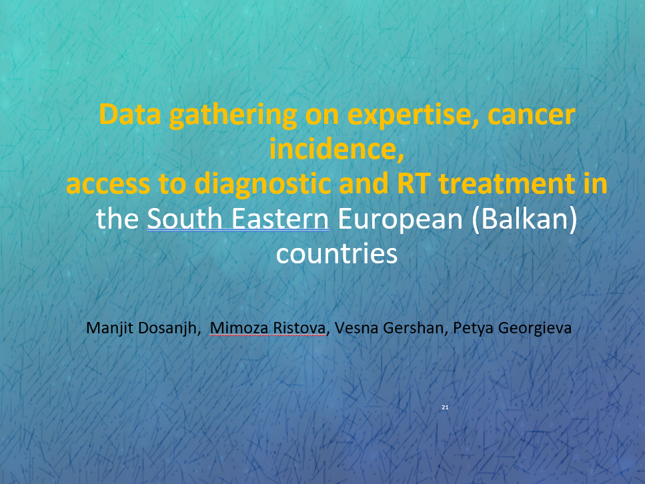
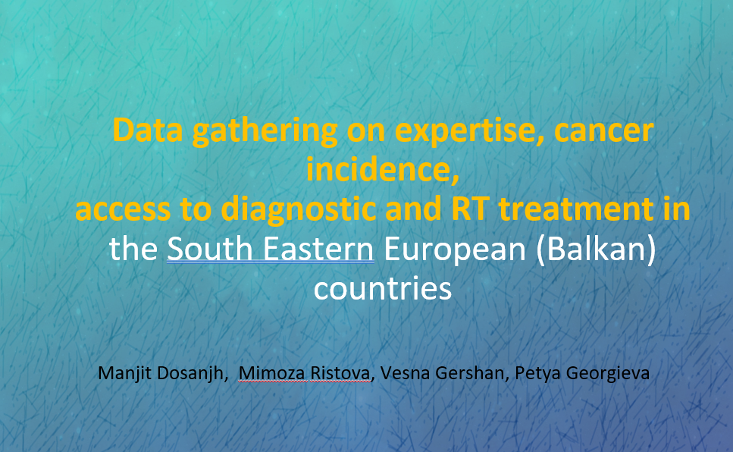

Slide 21
Cancer Incidence in SEE and
Mortality-to Incidence ratio (MIT)

Slide 22
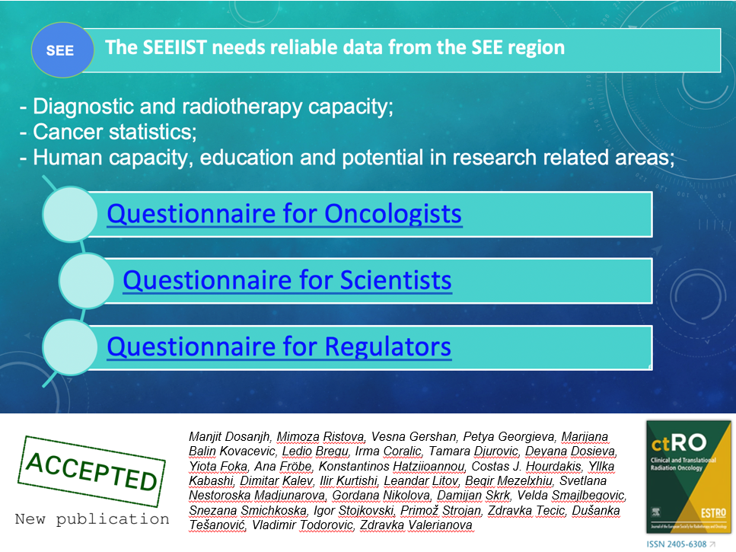

Slide 23
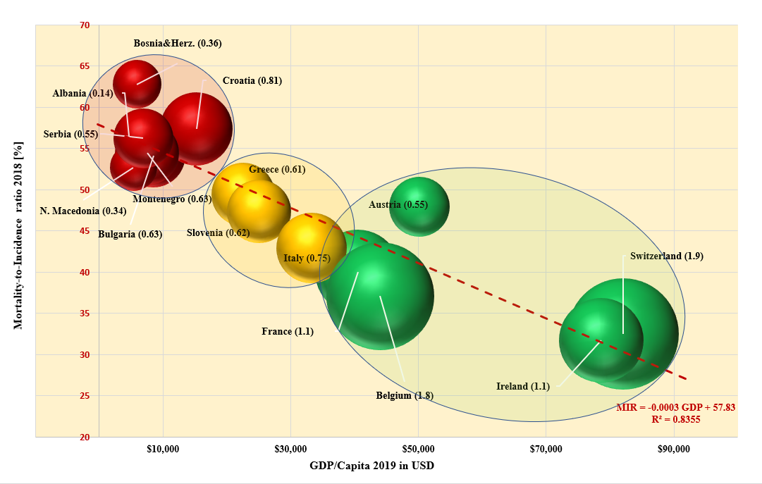
How successfully one country tackles with cancer?
Mortality to Incidence ratio

Slide 24
Cancer patients from SEE region that could be successfully treated with Particle Therapy (projections)
Mimoza Ristova – ART Project Conference - Almaty - SEEIIST

Slide 25
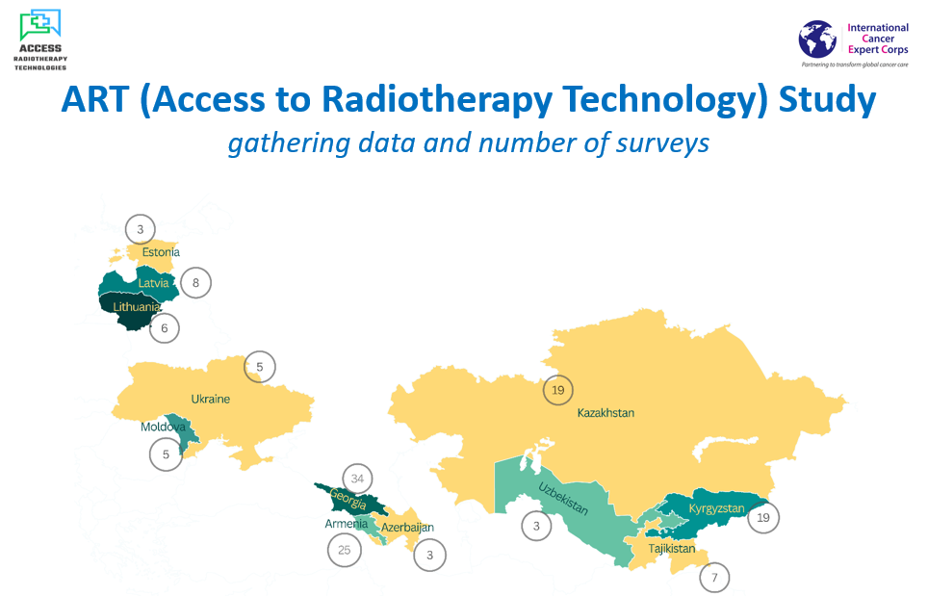

Slide 26
ART study participation
Last year the 3 Baltic States took part in the Access to Radiotherapy Technologies Study
The questionnaire looking at the key aspects regarding conventional radiation therapy: number of treated patients, number of RT equipment, human capacity etc.
Participation and/or data from ALL of the radiotherapy facilities in the Baltic States
Our first, initial data set to work with !

Slide 27
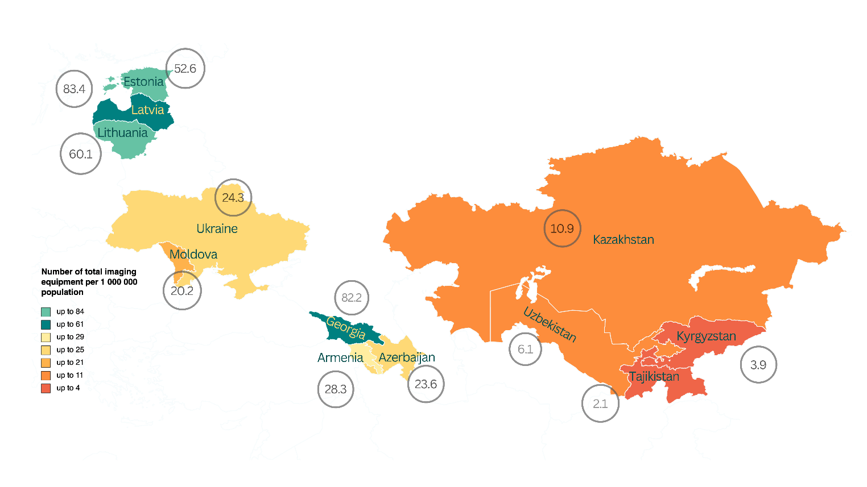
Technology availability: Diagnostics
 | Lithuania | Latvia | Estonia
CT | 70 | 71 | 28
Mammography | 42 | 51 | 18
MRI | 46 | 30 | 18
SPECT | 8 | 2 | 3
PET | 2 | 3 | 3
Amount of anatomical and functional imaging units can be deemed sufficient
Although some of the RT facilities have indicated the necessity of clinic specific MRI and PET with the main function for RT treatment planning

Slide 28
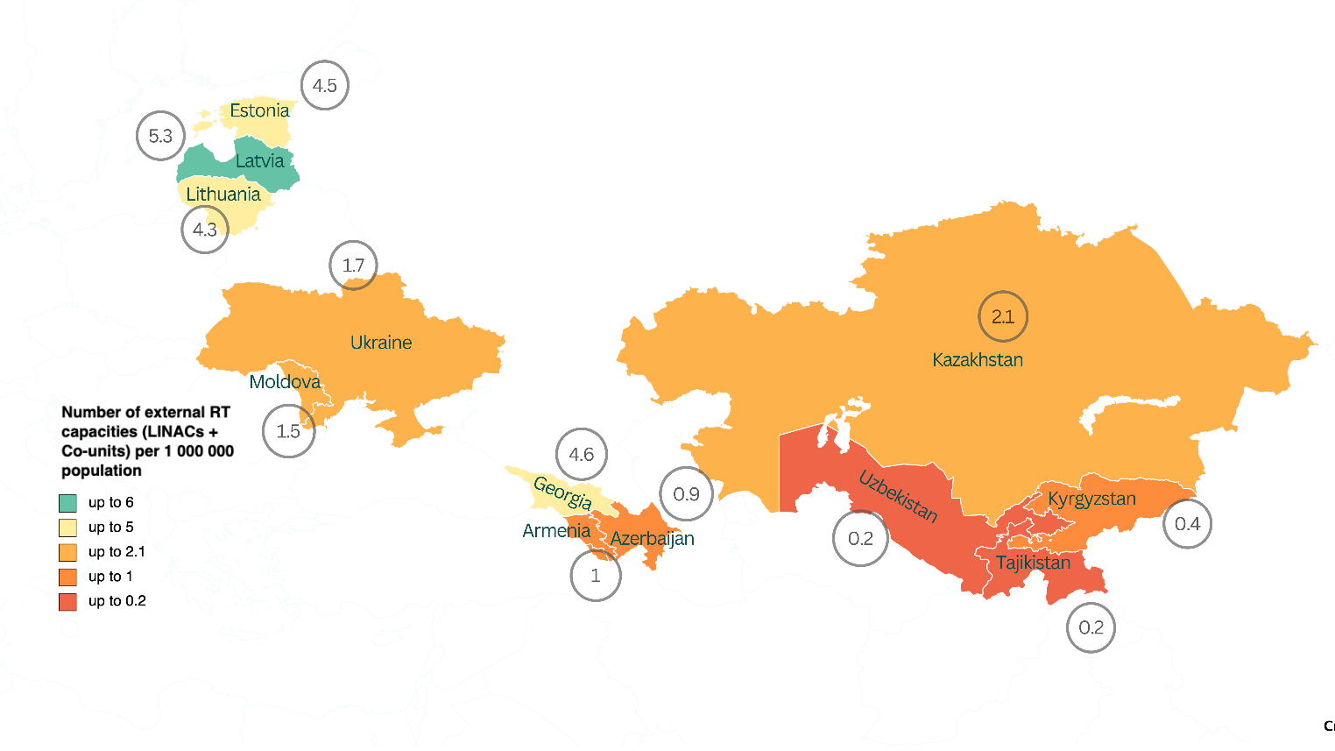
Technology availability: RT equipment
 | Lithuania | Latvia | Estonia
LINACs | 11 | 9 | 6
Brachytherapy | 4 | 1 | 2
Cobalt-60 – long out of clinical practice
Almost all of the clinics – 26 (27) state-of-art LINACs, practicing IMRT and VMAT, as well stereotactic techniques
A variety of dedicates machines as GammaKnife, CyberKnife and an installation of a MRI-integrated LINAC

Slide 29
Cancer incidence and mortality rate
 | Lithuania | Latvia | Estonia
Registered cancer cases | 17073 | 12051 | 8907
Registered cancer deaths | 8168 | 5892 | 3840
Cancer incidence rate | 611 | 637 | 669
Cancer mortality | 292 | 311 | 288
Data as of 2020 or 2021
With the total number of inhabitants of 6.02 million –
the average incidence rate of 632 per 100 000
the average mortality of 297 per 100 000

Slide 30
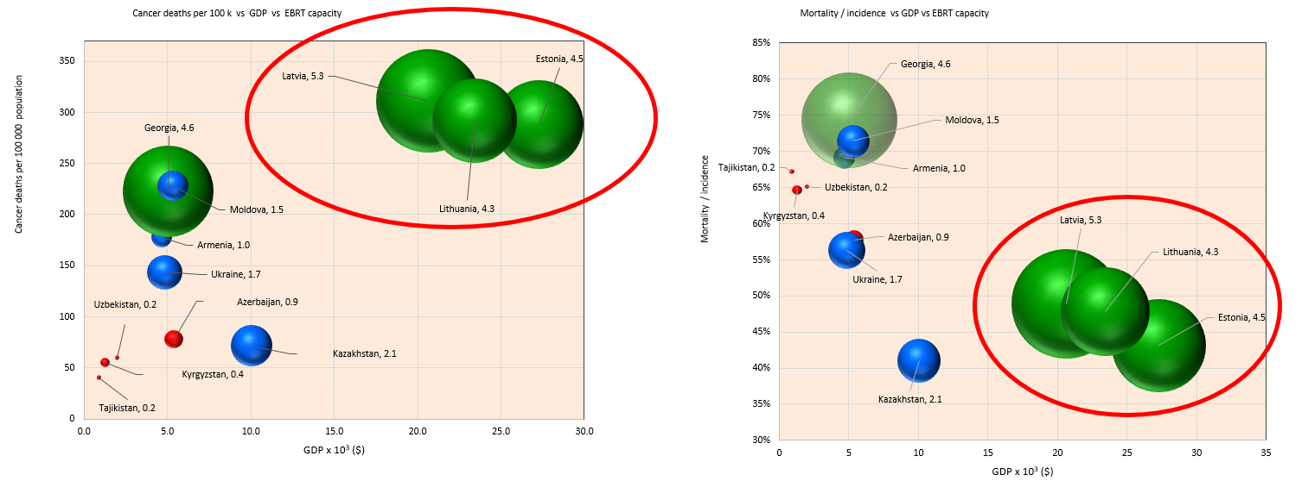
Cancer mortality and mortality /incidence ratio and in correlation with GDP and available EBRT equipment per 1 million inhabitants.
The overall data do show that we are “well-shaped” in conventional radiotherapy, yet there are improvements to be made in terms of Mortality/Incidence compared to higher income countries.
Number of diagnostic equipment – seems sufficient, question for the root cause . . .

Slide 31
Patients receiving conventional RT
 | Lithuania | Latvia | Estonia
Number of patients receiving RT | 6343 | 4146 | 2556
Percentage | 37.2 % | 34.4 % | 28.7 %
Data as of 2020
As of 2020, 13045 patients have received radiation therapy treatment (external beam or brachytherapy ) – accounting to
34.3 % of all registered cancer cases

Slide 32
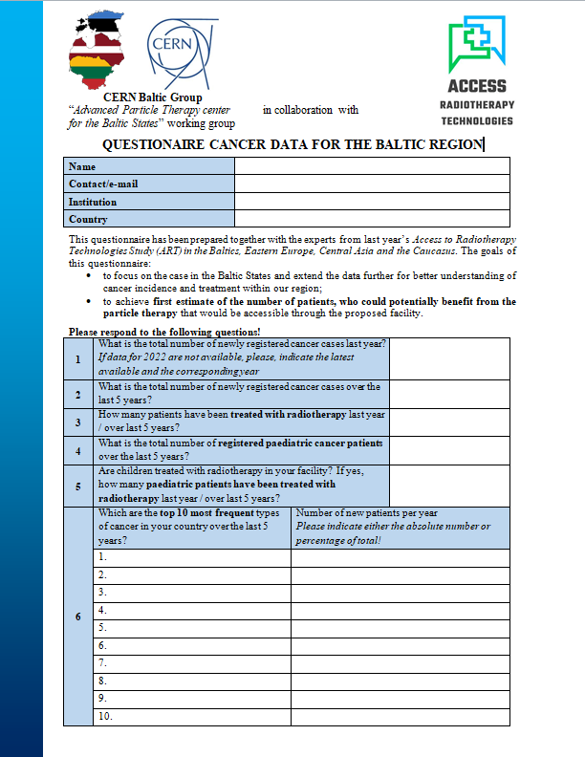
Need of data stratification.
Development of questionnaire.
Dataset of Access to Radiotherapy Technologies Study did not explicitly look into the profile of cancer types most prevalent and general stratification of different cancer types – crucial for proton and particle therapy
Based on previous, similar studies and general consensus statements and guidelines – an addititional questionnaire has been developed with the focus also on localizations indicative of proton therapy
Preliminary data – to be discussed and extended over the summer.
Thank you to Manjit Dosanjh, Erika Korobeinikova, Eduard Gershkevitsh, Dace Bogorada-Saukuma and Asta Zileviciene
Do let us know for any additional comments and ideas!

Slide 33
Most common cancer localizations
 | Lithuania | Estonia
Prostate | 13 % (2267) | 12.9 % (1132)
Non-melanoma skin | 13 % (2209) | 15 % (1323)
Lung, trachea, bronchus | 9 % (1557) | 9.6 % (842)
Breast | 9 % (1486) | 9.2 % (808)
Colon | 6 % (960) | 7.2 % (632)
Stomach | 5 % (816) | 4.3 % (376)
Rectum | 4 % (707) | 4.2 % (370)
Kidney | 4 % (691) | 3.8 % (336)
Corpus uteri | 4 % (650) | 2.7 % (239)
Pancreas | 3 % (561) | 3.3 % (287)
As there is no cancer registry currently in Latvia, data acquisition is more difficult, though the most common cancer types remain similar

Slide 34
Cancer types with highest mortality
Lung, bronchus
Colorectal
Stomach, Liver
Haematological
Pancreas
Prostate
Breast
Rectum
Oral cavity, pharynx
Kidney

Slide 35
Pediatric cancers
 | Lithuania | Estonia | Latvia
Incidence (over 5 years) | 405 (2015-2019) | 234 (2016-2020) | ~ 384
Receiving RT (over 5 years) | 48+69 | 40 (NEMC) | 54 (LOC)
Receiving RT (recent year) | 10+15 | 7 (NEMC) | 9 (LOC)
Most common indications:
Lithuania: Leukaemia (28%), Brain/CNS (17%), Bone, connective and soft tissue (13%), Non-Hodgkin lymphoma (9%) and retroperitonium (7%)
Estonia: Leukaemia, Hodgkin lymphoma, Colon, Kidney, CNS
Latvia: CNS, Leukaemia, Lymphoma

Slide 36
Incidence for main PT indications (over 5 years)
 | Lithuania | Latvia | Estonia
Brain | 1383 | 217 (RT treat) | 559
Head & Neck | 3251 | 1362 (RT treat) | 998
Glioblastoma | 622 | N/A | N/A
Pancreas | 2782 | 26 (RT treat) | 1435

Slide 37
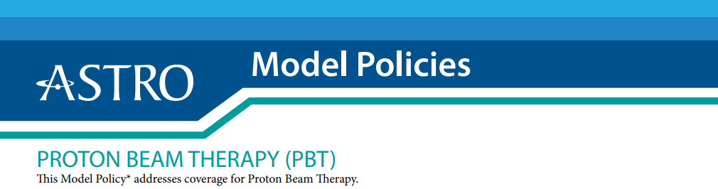
1. The target volume is near one or more critical structures and a steep dose gradient outside the target must be achieved to avoid exceeding the tolerance dose to the critical structure(s), which would portend a higher risk of toxicity.
2. A proton-based technique would decrease the probability of clinically meaningful normal tissue toxicity by lowering an integral dose-based metric and/or organ at risk dose volume constraint associated with toxicity.
3. The same or an immediately adjacent area has been previously irradiated, and the dose distribution within the patient must be sculpted to avoid exceeding the cumulative tolerance dose of nearby normal tissue.

Slide 38
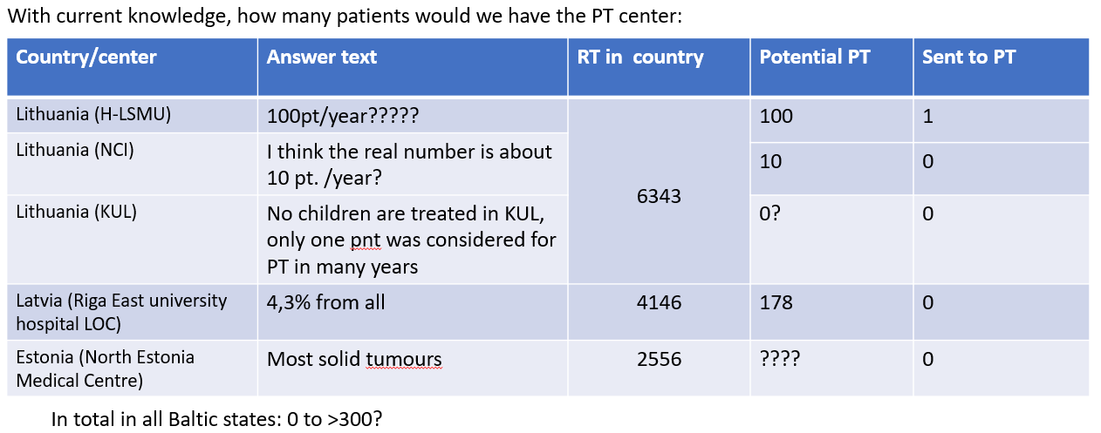
Number of patients to benefit from the facility

Slide 39
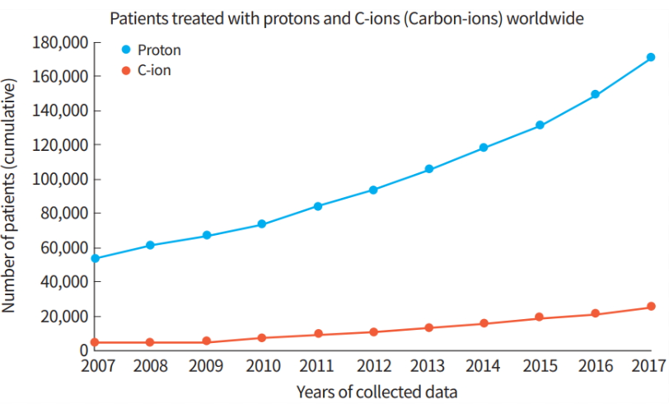
Current PT statistics
In US in 2018 2.2% of irradiated (EBRT) cancer patients treated with PT (1,9% for all cancer patients diagnosed in 2018).
In England in 2018 1.5% of irradiated cancer patients treated with PT.
In 2021 cumulative count reached 280.000
Burnet et al. BJR 2022; Ebner at al. JNCCN 2022; Dyba et al. Eur J Cancer 2021; Lalani et al. Curr Oncol 2023

Slide 40
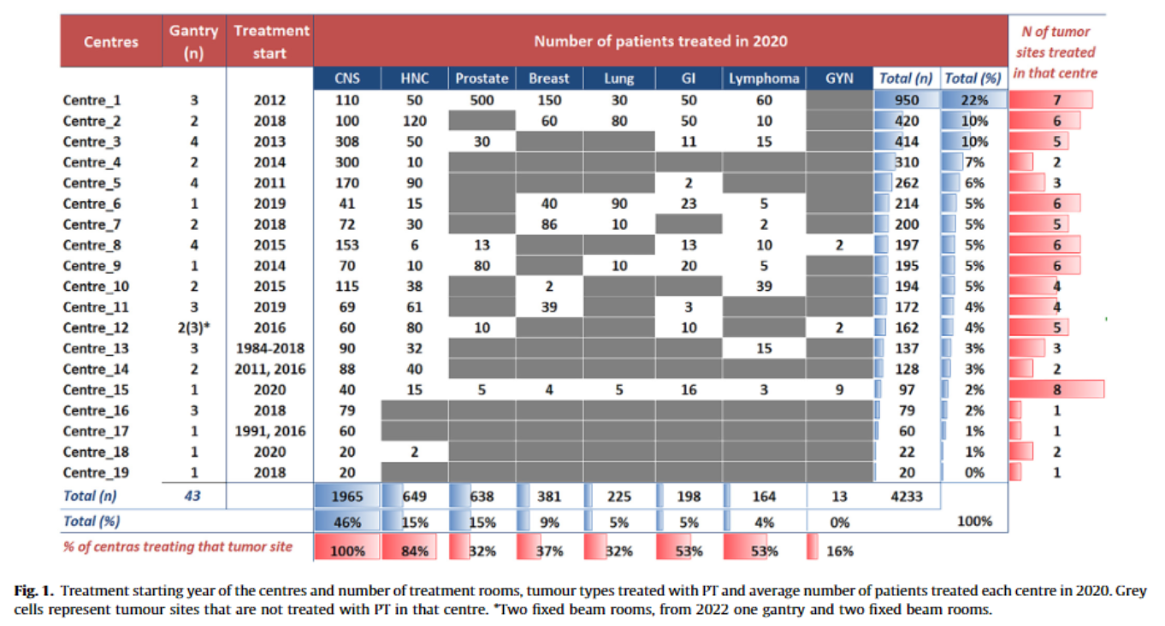
What are the numbers of pts. in European PT centers
Average for 2020 - 223 adult patients per center.
+ approx. 1-150 children
Tambas et al. Radiotherapy and Oncology 2022.

Slide 41
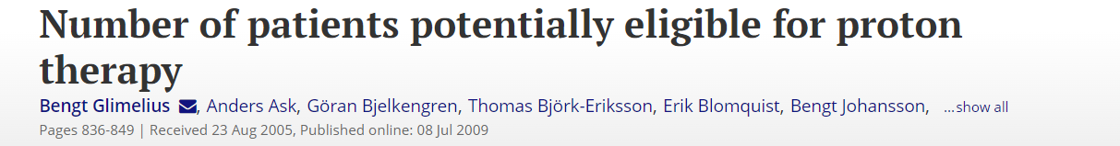
Tumour type¹⁾ | No. new cases in Sweden per annum | No. radiotherapy treatments in Sweden per annum ²⁾ | Suitable no. patients proton therapy | Percent from newly diagnosed cases
Intraocular melanoma | 75 | ? | 15 | ?
Skull-base chordoma/chondrosarcoma | 30 | ? | 20–25 | 100%?
Meningeoma | 300 | 40 | 30–40 | 75-100%
AVM | 70 | ? | 20–25 | ?
Medulloblastoma | 30 | 30 | 20 | 67%
Reirradiations |  | ? | 150–400 | ?
Paediatric cancer (not incl. medulloblastoma) | 300 | 90–100 | 60–80 | 67-80%
ENT cancer-nasopharynx/sinus | 80 | 80 | 60 | 75%
Sarcoma | 375 | 175 | 40 | 23%
ENT cancer-others | 920 | 570 | 240 | 42%
Oesophageal cancer | 400 | 150 | 80 | 53%
Rectal cancer | 1800 | 830 | 150 | 18%
Breast cancer | 6300 | 3370 | 300 | 9%
Thymoma | 30 | ? | 20 | ?
Lung cancer | 2850 | 485 | 350 | 72%
Gynaecological cancer | 2700 | 650 | 50 | 8%
Malignant gliomas | 375 | 200 | 50–75 | 25-38%
Cancer of the liver | 400 | 70? | 65 + | 93%
Mesothelioma | 100 | ? | 20 | ?
Prostate cancer | 7800 | 1420 | 300 | 21%
Malignant lymphomas | 2000 | 460 | 20 | 4%
Pancreatic cancer | 800 | 50 | 50? | 100%
14–15% of all irradiated patients

Slide 42
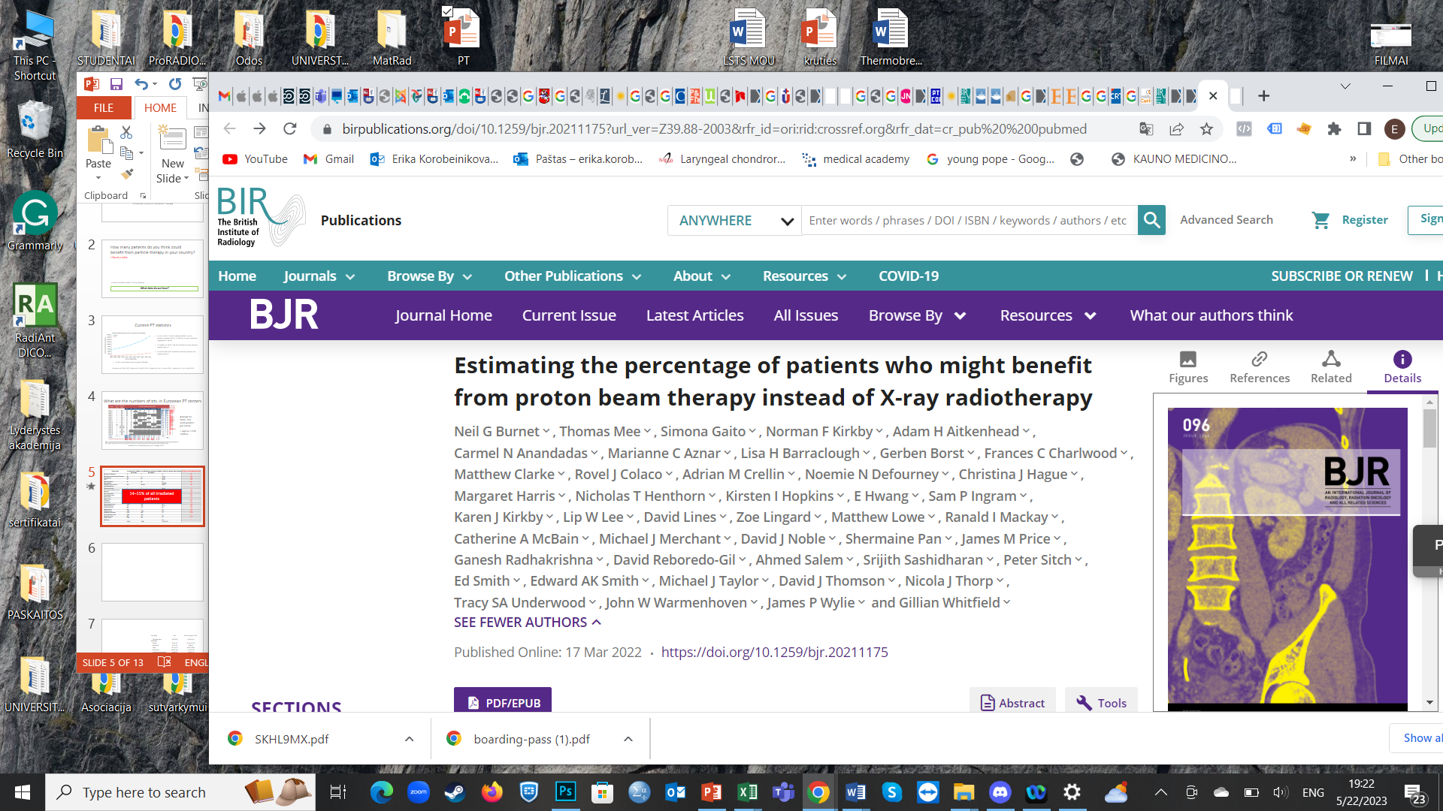
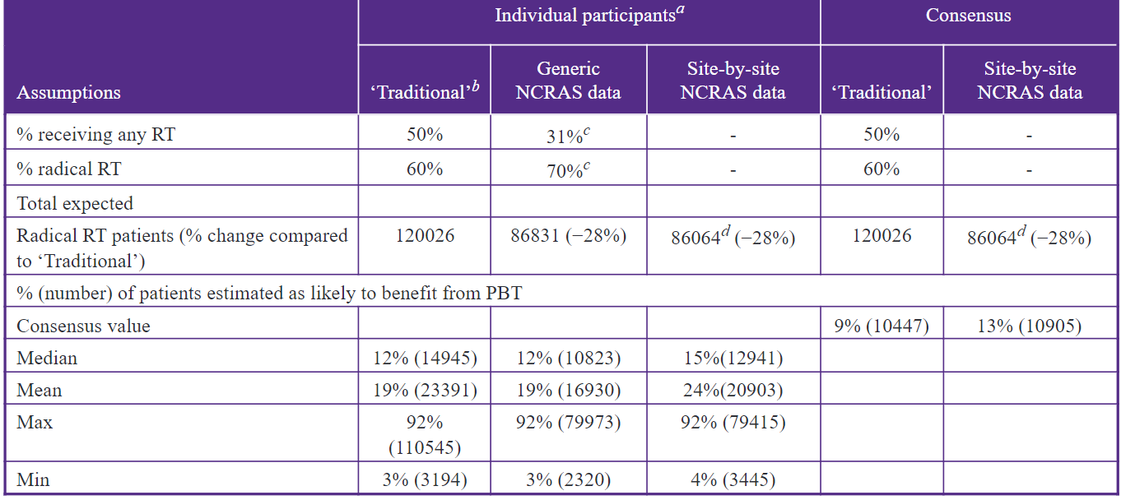
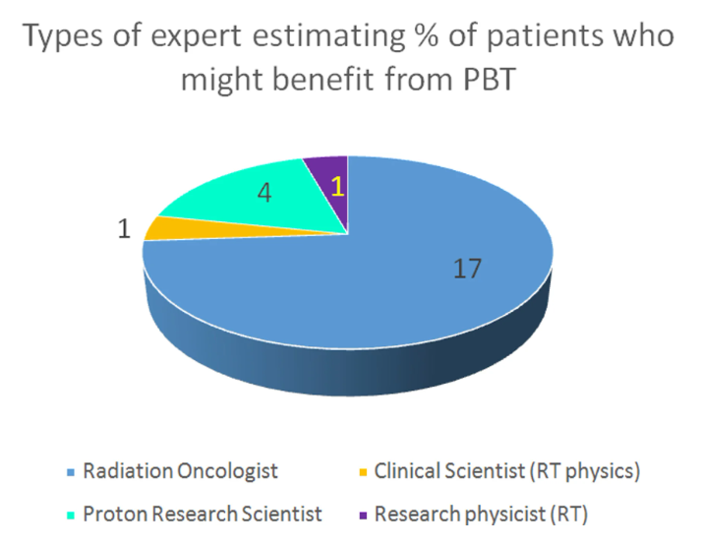
Agreed by 95% of the 23 respondents at 4.3%

Slide 43
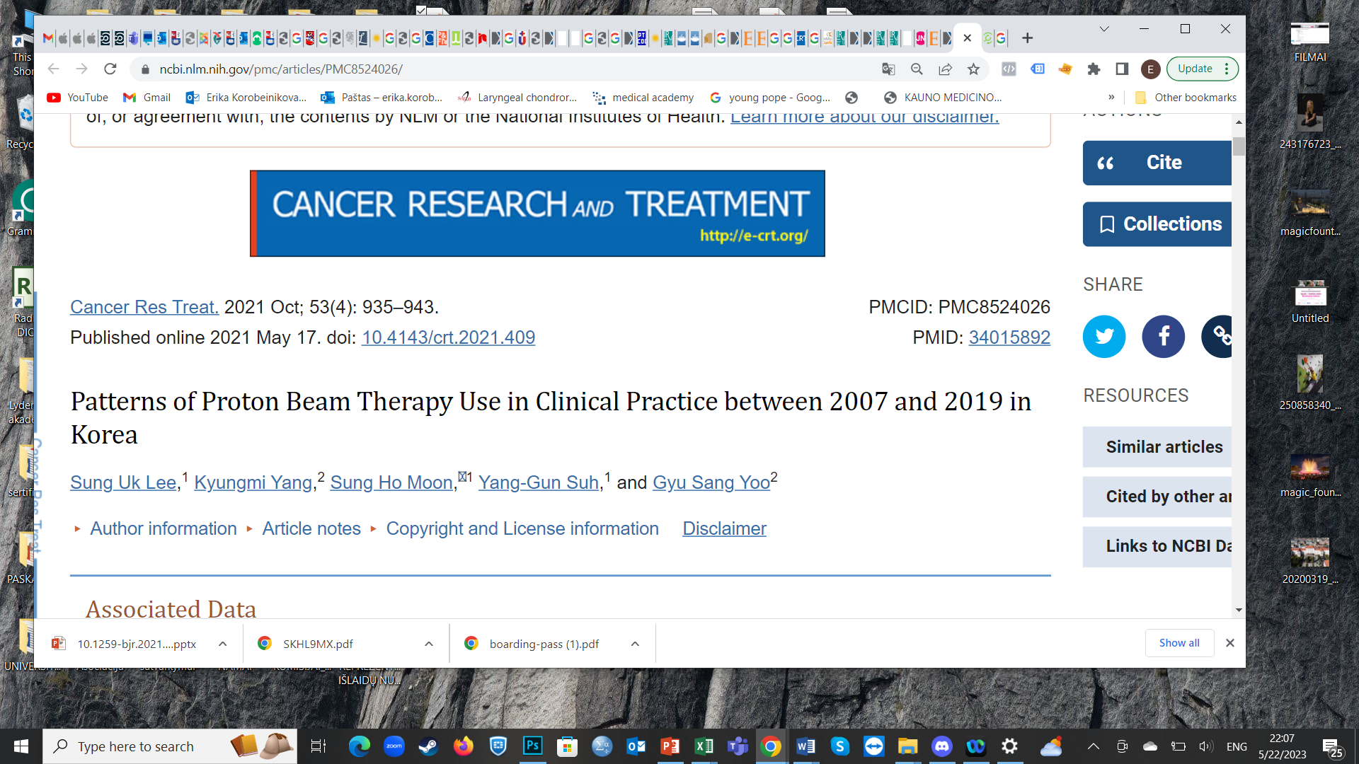
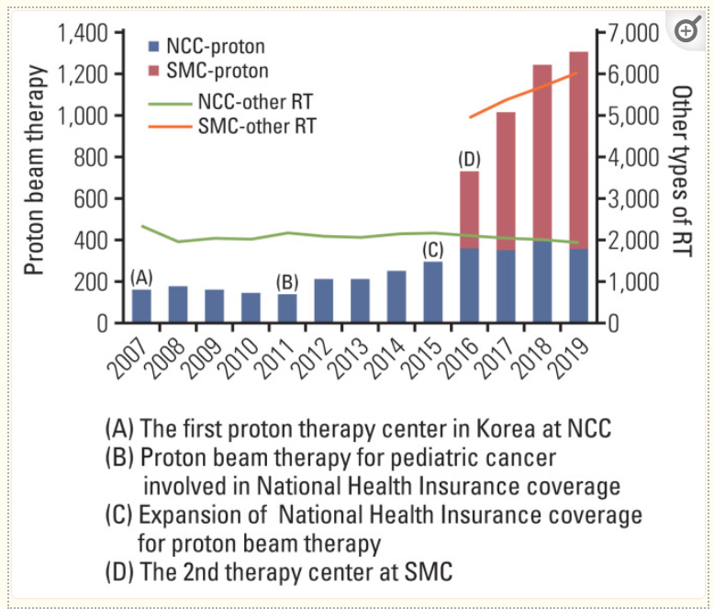
10% of patients in two centers with available PT
Variable | PBT | Other types of RT | %
Genitourinary (prostate) | 528 (9.8) | 2,967 (6.1) | 15%
Breast | 98 (1.8) | 15,332 (31.5) | >1%
Eye/Orbit | 83 (1.5) | 38 (0.1) | 69%
Lung | 741 (13.7) | 9,423 (19.4) | 7%
Brain/CNS | 650 (12.0) | 1,379 (2.8) | 32%
Lymphoma/Leukemia | 44 (0.8) | 1,398 (2.9) | 3%
Liver | 1,479 (27.4) | 3,391 (7.0) | 30%
Pancreas/Biliary | 303 (5.6) | 1,661 (3.4) | 15%
Head and neck | 572 (10.6) | 2,654 (5.5) | 17%
Thyroid | 7 (0.1) | 286 (0.6) | 2,5%
Gynecology | 148 (2.7) | 2,812 (5.8) | 5%
Colon and rectum | 207 (3.8) | 3,480 (7.2) | 6%
UGI | 230 (4.3) | 1,943 (4.0) | 12%
Sarcoma | 180 (3.3) | 1,507 (3.1) | 10%

Slide 44
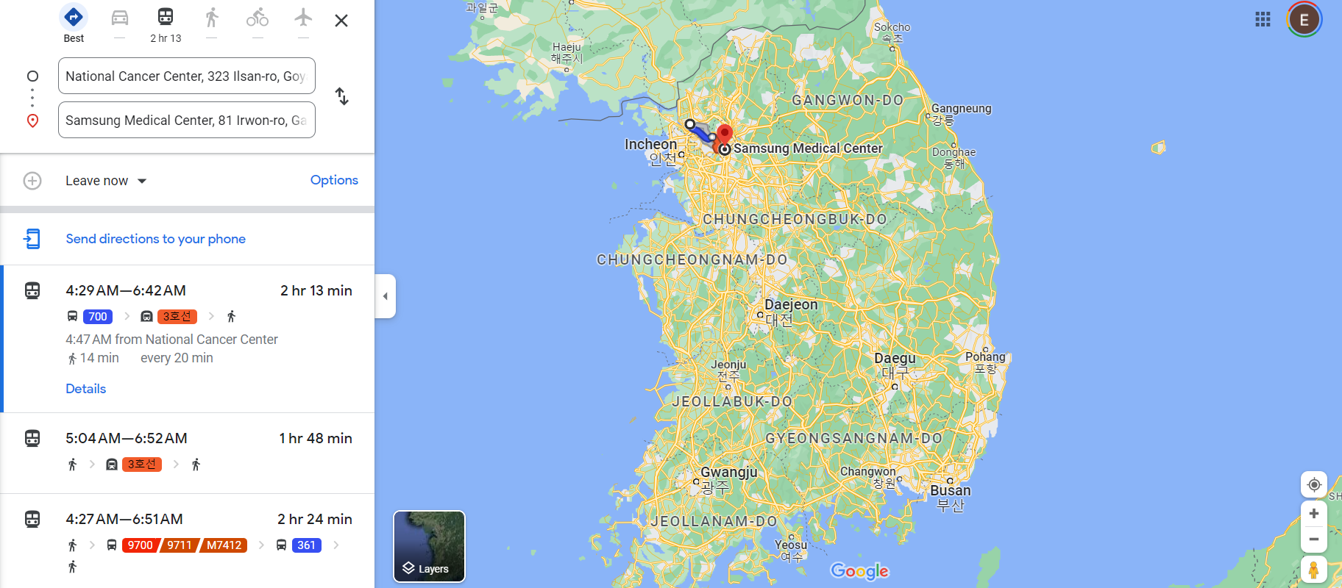

Slide 45
Our statistics
With the data from the ART study of 13045 patients receiving radiotherapy, what we can estimate:
At 4.3 % - 561 patient
At 15 % - 1957 patients
The best process for patient eligibility – still to work and evolve on that

Slide 46
Problems to refer patients to existing PT centers
Proton Therapy has significant benefits in pediatric cancers due to a high rate of curability, remaining lifespan, and the added cost of side effects over time from standard radiation therapy in developing tissues.
In Kaunas Clinics during 15 years with over 200 irradiated children only one was referred to PT center, despite the fact, that the treatment might be reimbursed (and no adults to our best knowledge).
The reasons:
  Complicated reimbursement system.
  Organizational aspects take at least several months.
  Strict treatment protocols do not allow any delays.

Slide 47
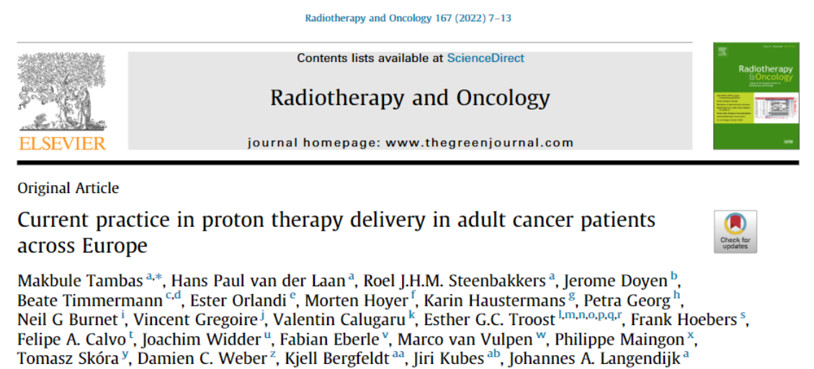
Reasons for not treating certain tumour types with PT are:
  Lack of evidence (30%)
  Reimbursement issues (29%)
  Technical limitations (20%).
Male sex, very young or old age, stage I–II disease, residency in non-capital areas, a definitive setting, a curative treatment aim, enrollment in a clinical trial, re-irradiation and insurance coverage were significantly associated with the receipt of PBT (all p < 0.05).

Slide 48
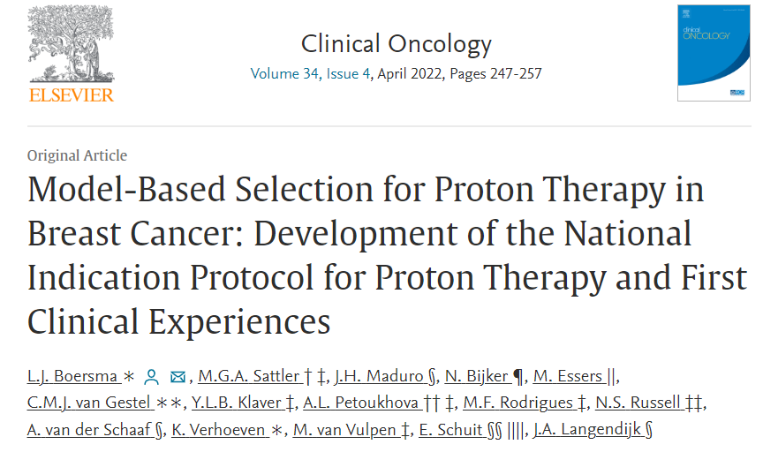
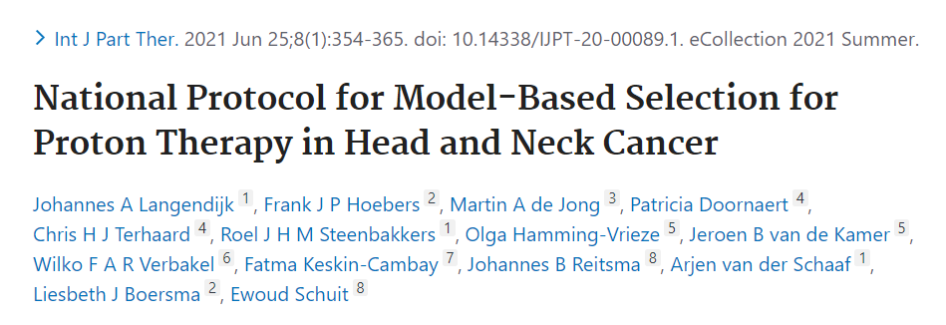
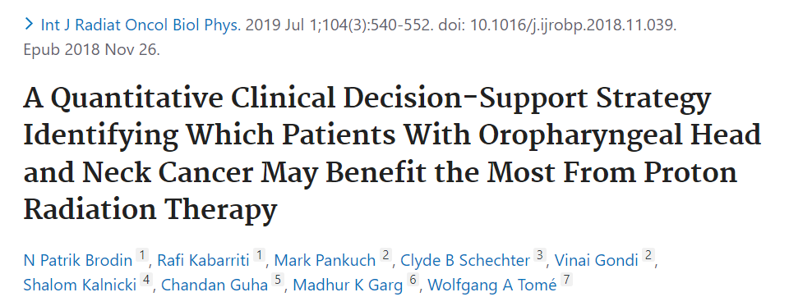
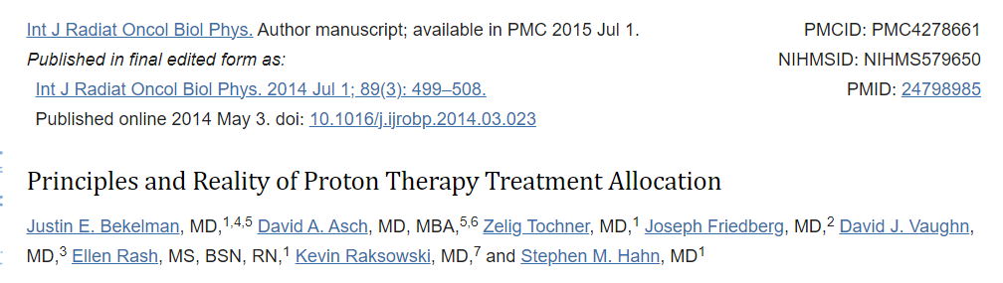
Ways to engage patients (and increasing evidence)
France
The Netherlands
US
Proton Priority System (PROPS) - US

