Slide 1
Session II: Clinical indications for proton and particle therapy. Existing clinical evidence and on-going clinical trials
25 May 2023
Workshop: Particle therapy - future for the Baltic States? State-of-play, synergies and challenges
Moderator: Dr. Erika Korobeinikova
Speaker: Dr. Anna Maria Camarda

Slide 2
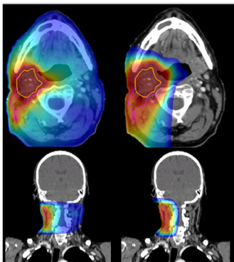
PROTON THERAPY: dosimetric properties and physical selectivity
Dose to OARs
Potential optimization of local tumor probability by increasing dose to the tumor without increasing the dose to OAR
No changes in dose prescription but reduction of the likelihood of radiation induced toxicity
Photons
Protons

Slide 3
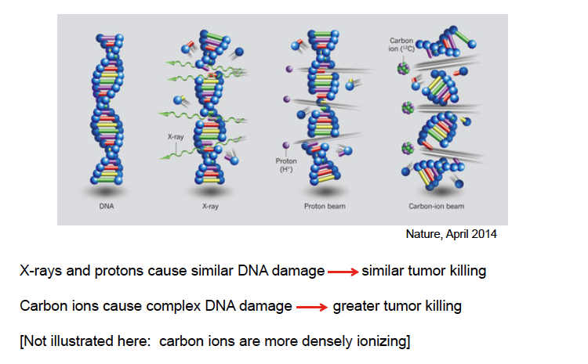
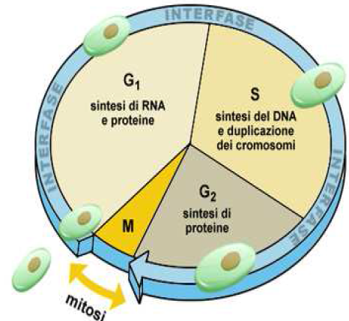
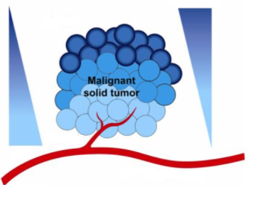
CARBON ION THERAPY: 3Rs (Rare), Radioresistant, Recurrent
C-ions: High Linear Energy Transfer (LET) radiation
Repair
No Repair
1.
High radiobiological effectiveness (RBE) >
Effective for radioresistant tumors
Low cell-cycle dependence: increased lethality in the target because cells in radioresitant phase (S) are sensitized
2.
Hypoxia
Radioresistance
Low OER:
Effective against hypoxic tumor cells
3.
[O₂]
Normoxia
Tinganelli , Cancers, 2020
Notes:
3

Slide 4

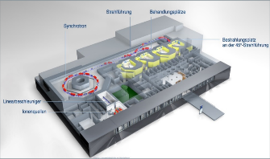
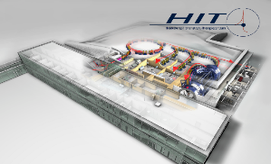
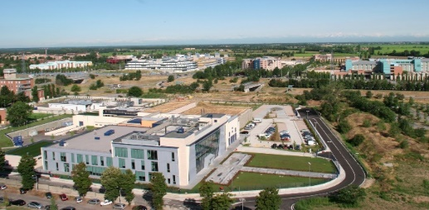
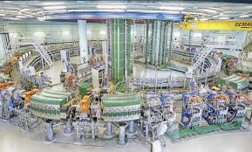
140 clinical facilities (operational phase) of protons and 13 centers of carbon ions in the world, 6 multi-particle (protons and carbon ions)
In Italy
Centro Nazionale di Adroterapia Oncologica CNAO; Pavia
Centro di Protonterapia, Trento
Centro di AdroTerapia ed Applicazioni Nucleari Avanzate, Catania
MIT – Marburg (G)
HIT- Heidelberg (G)
3 centers in China
6 centers in Japan
CNAO – Pavia (I)
MedAustron – Wien (A)

Slide 5
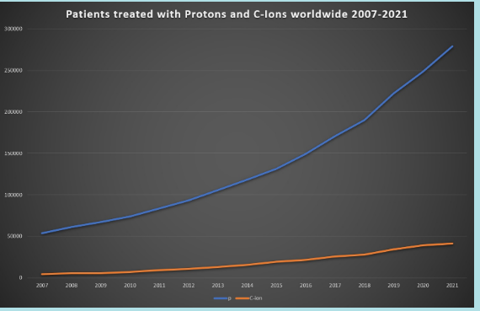
Patients treated with Particle therapy worldwide (2007-2021)
PTCOG Website

Slide 6
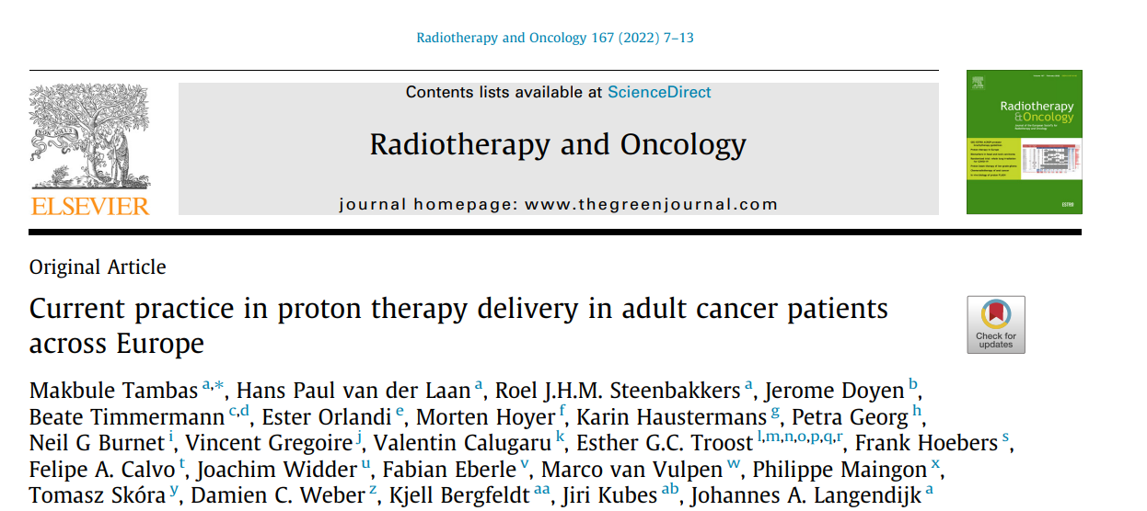
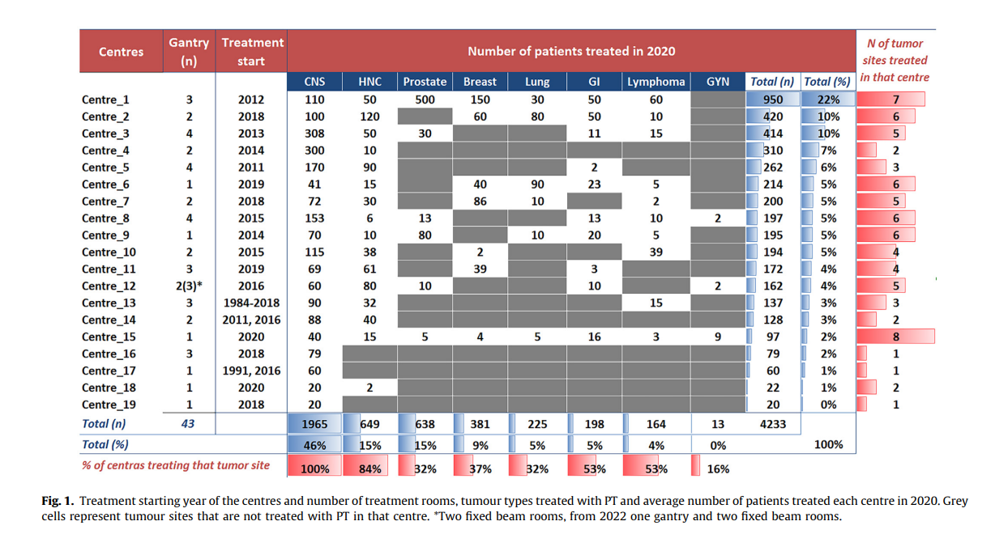

Slide 7
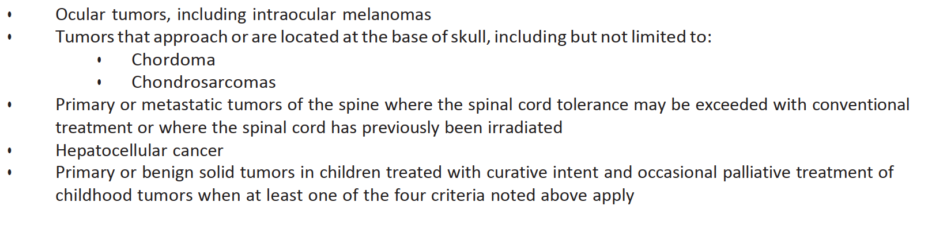
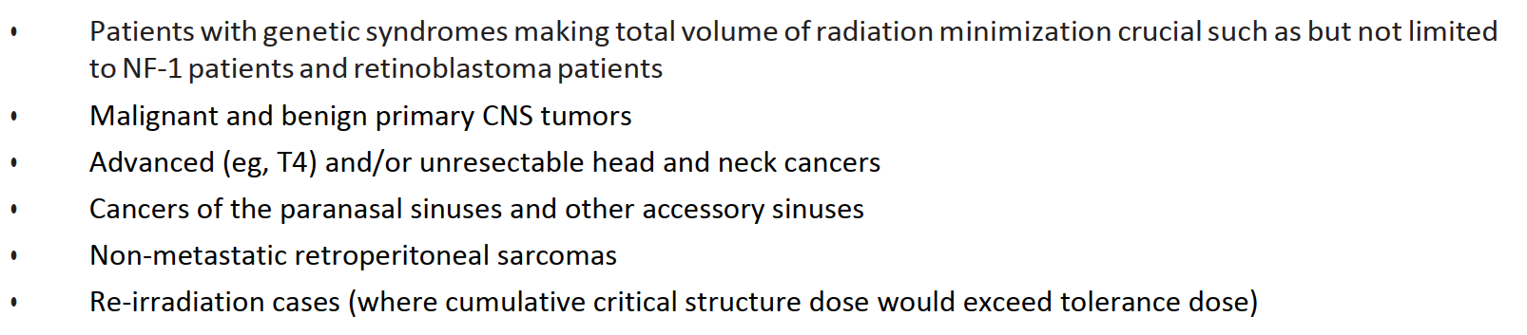
CLINICAL INDICATIONS FOR PARTICLE THERAPY
USA: ASTRO PBT Model policy Group1
UK
JAPAN

Slide 8
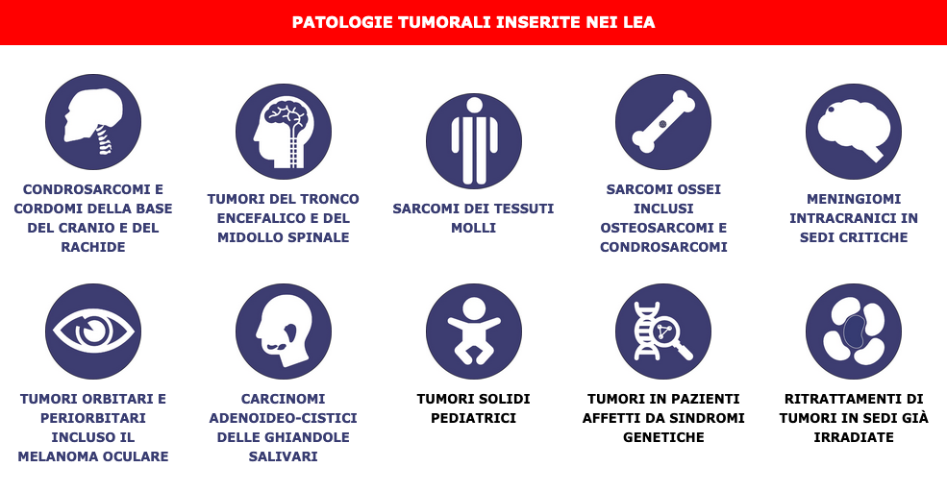
WHAT ABOUT ITALY?

Slide 9

INDICATIONS for non-epithelial skull base tumors
Skull base chordomas and chondrosarcomas
Chordomas are sarcomas that originated from embryonic notochord remnant cells.
Chondrosarcomas are a heterogeneous group of slow-growing neoplasms originating from cartilage-producing cells in areas of enchondral ossification.
Chordomas and chondrosarcomas are relatively radioresistant and respond best to high radiation doses above 70 Gy.
The mainstay of treatment is maximal tumor resection, when feasible and sequelae are accepted by the patient.
This presents a challenge when using conventional RT because of the close proximity to dose-limiting neural structures (ie, brainstem, spinal cord, and optic structures).
Stacchiotti S, Best practices for the management of local-regional recurrent chordoma: a position paper by the Chordoma Global Consensus Group. Ann Oncol. 2017 Jun 1;28(6):1230-1242
Mendenhall WM, Mendenhall CM, Lewis SB, Villaret DB, Mendenhall NP. Skull base chordoma. Head Neck. 2005;27(2):159-165.
Delaney TF, Kepka L, Goldberg SI, et al. Radiation therapy for control of soft-tissue sarcomas resected with positive margins. Int J Radiat Oncol Biol Phys. 2007;67(5):1460-1469

Slide 10

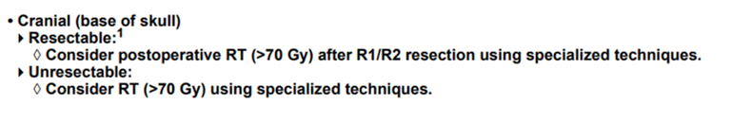
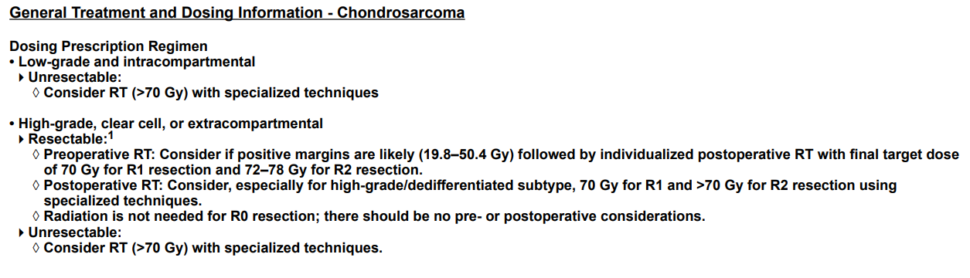

Slide 11
Fractionation schedules with Particle Therapy in SB Chordoma: CNAO experience
Skull Base Chordoma:
R0/R1 margins:
Proton Therapy: 74 Gy[RBE] CTV HR, 54 Gy[RBE] CTV LR (2 Gy [RBE]/fr).
R2 or biopsy or recurrent disease after surgery:
Carbon Ions: 65,6 - 70,4 Gy [RBE] CTV HR, 36,9-39,6 Gy[RBE] CTV LR, 16 fractions (4,1-4,4 Gy[RBE]/fr). Fractionation schedule depends on extension of the disease and proximity to critical structures.
Proton Therapy: 74 Gy[RBE] CTV HR, 54 Gy[RBE] CTV LR (2 Gy [RBE]/fr).

Slide 12

Single institutional reports on PT and CIRT for CHORDOMA of the skull base
Author Year | Particle | Number of patients | Prescription dose (GyRBE) | Median time of follow-up (months) | LC (%) | OS (%)
Hug, 1999 (Loma Linda University) | Ph + Protons | 33 | 71.9 (range 66.6 – 79.2) | 32.2 | 3y: 67 5y: 59 | 3y: 87 5y: 79
Munzenrider, 1999 (Massachusetts General Hospital—Adults) | Ph + Protons | 169 | Range 66 - 83 | 41 | 5y: 73 10y: 54 | 5y: 80 10y: 54
Noel, 2005 (Centre de Protontherapie d'Orsay, France) | Ph + Protons | 100 | 67 (range 60 – 71) | 31 | 4y: 53 | 4y: 90
Mozoe, 2009 | Carbon ions | 33 | Range 40 – 60.8 | 53 (mean) | 5y: 85 10y : 64 | 5y: 88 10y : 67
Uhl, 2014 | Carbon ions | 155 | 60 (range 54 -70) | 38 | 3y: 82 5y: 72 10y: 54 | 3y: 95 5y: 85 10y: 75
Weber, 2016 (Paul Sherer institute-Switzerland) | Protons | 151 | 72.5 | 50 (mean) | 5y: 78 7y: 70.9 | 7y: 72.9
Fung, 2018 | Protons | 106 | Range 68.4 – 73.8 | 61 | 4y: 78.3 5y: 75.1 | 4y: 90.2 5y: 88.3
Iannalfi 2020 ° | Protons Carbon ions | 135 70 65 | 74 (range 72 – 74) 70.4 | 44 | 3y: 89 5y: 84 3y: 77 5y: 71 | 3y: 93 5y: 83 3y: 90 5y: 82

Slide 13
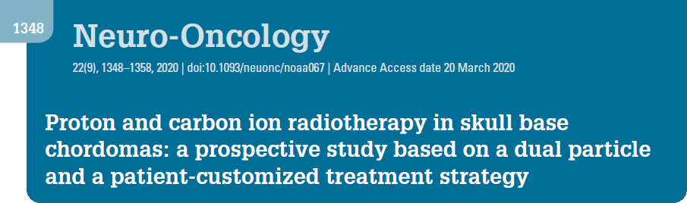
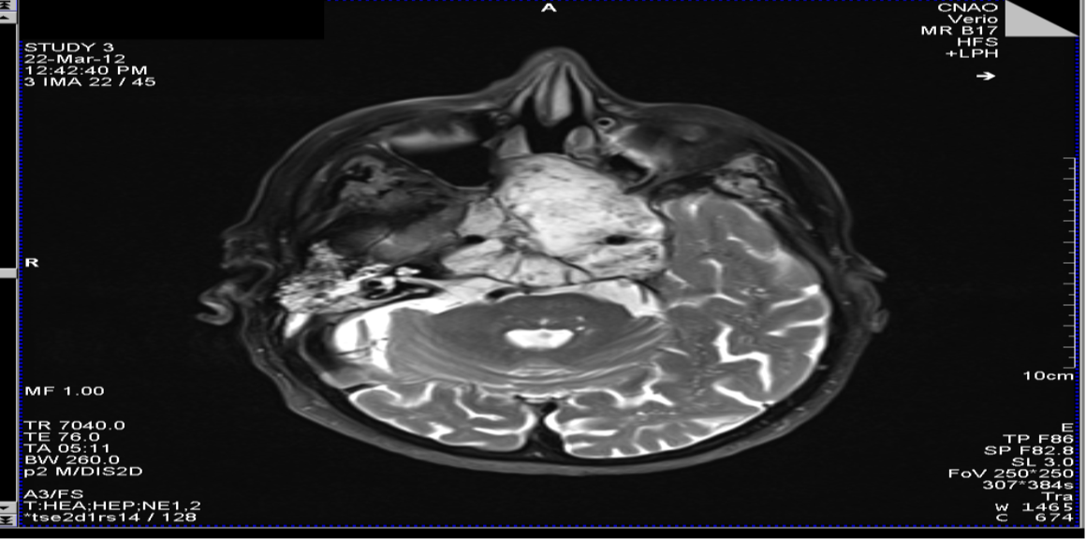
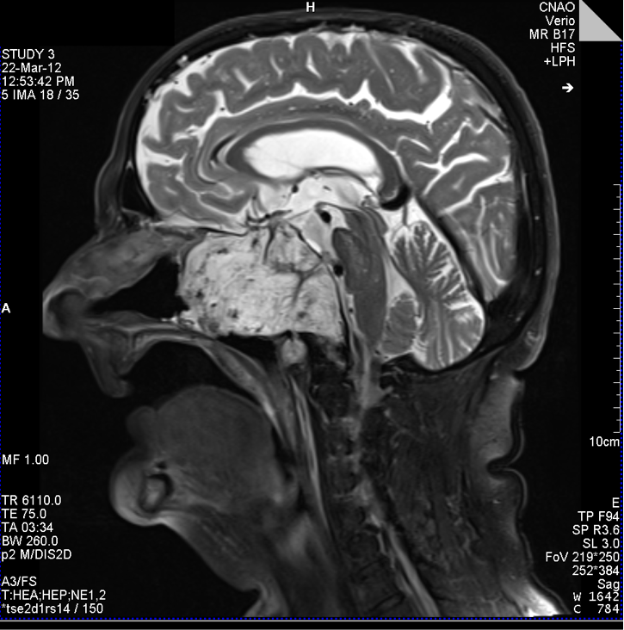
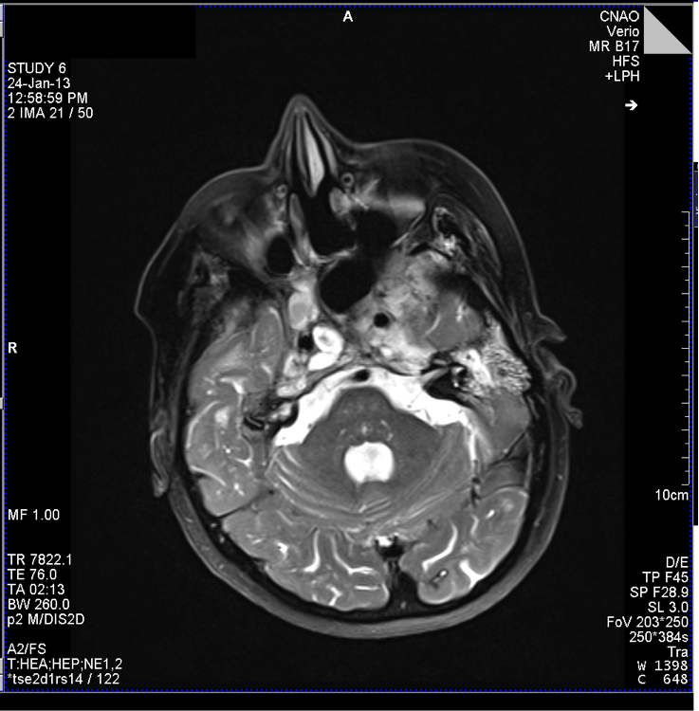
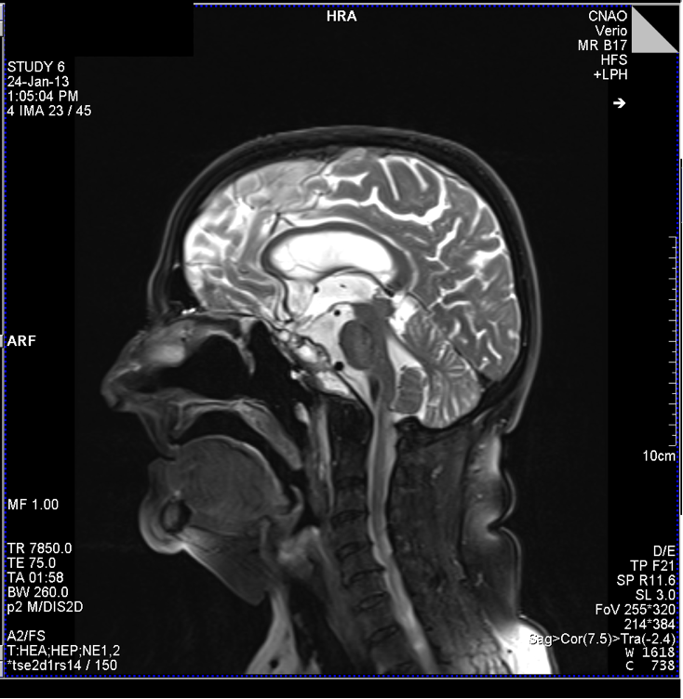
Skull Base Chordomas
Iannalfi A, Neuro-Oncology 2020
experience
135 patients
From November 2011 and December 2018
CIRT (70.4 Gy RBE in 16 fr): 65 pts (unfavourable)
PT (74 GyRBE in 37 fr): 70 pts
5-year LC:
71% in CIRT; 84% in PT.
5-year OS:
82% in CIRT; 83% in PT.
10 months F-UP
On multivariate analysis, gross tumor volume (GTV), optic pathways, and/or brainstem compression and dose coverage are independent prognostic factors of local failure risk.

Slide 14
Fractionation schedules with Particle Therapy in SB Chondrosarcoma: CNAO experience
Skull Base Chondrosarcoma Low grade (G1)
R0 margins: no adjuvant RT.
R1 margins:
Proton therapy: 70 Gy[RBE] CTV HR, 54 Gy[RBE] CTV LR (2 Gy [RBE]/fr).
R2 or biopsy or recurrent disease after surgery:
Carbon Ions: 70,4 Gy [RBE] CTV HR, 36,9-39,6 Gy[RBE] CTV LR, 16 fractions (4,1-4,4 Gy[RBE]/fr). Fractionation schedule depends on extension of the disease and proximity to critical structures.
Proton Therapy: 70 Gy[RBE] CTV HR, 54 Gy[RBE] CTV LR (2 Gy [RBE]/fr).
Skull Base Chondrosarcoma Medium-High grade (G2-G3)
R0/R1 margins:
Proton Therapy: 70 - 74 Gy[RBE] CTV HR, 54-56 Gy[RBE] CTV LR (2 Gy [RBE]/fr).
R2 or biopsy or recurrent disease after surgery:
Carbon Ions: 70,4 - 76,8 Gy [RBE] CTV HR, 39,6-43,2 Gy[RBE] CTV LR, 16 fractions (4,4 - 4,8 Gy[RBE]/fr).
Proton Therapy: 70-78 Gy[RBE] CTV HR, 54 Gy[RBE] CTV LR (2 Gy [RBE]/fr). Evaluate if expected toxicity is high.

Slide 15
Single institutional reports on PT and CIRT for CHONDROSARCOMA of the skull base
Author Year | Particle | Number of patients | Prescription dose (GyRBE) | Median time of follow-up (months) | LC rate | Late Toxicity
Hug 1999 | Protons | 25 | 70.2* (median) | 33.2* | 3y LC: 94% | 7% (G3-G4)
Munzenrider 1999 (Massachusetts General Hospital) | Protons | 229 | 72* (mean) | 41* | 5y LC: 98% | -
Ares 2009 | Protons | 22 | 68.4 (median) | 34 * | 5y LC: 94% | 6.2%
Fuji 2011 | Protons | 8 | 63* (median) | 42* | 3y LC: 86% | No G ≥3
Weber 2016 (Paul Sherer Institute-Switzerland) | Protons | 71 | 72.5* (median) | 50 * | 5y LC: 93.6% | 8.1 % (G3-G4)
Mattke 2018 | Protons Carbon ions | 22 79 | 70 (median) 60 (median) | 30.7 43.7 | 4y LC: 100% 4y LC: 90.5% | No G ≥3
Holtzman 2019 | Protons | 43 | 73.8 (median) | 44 | 4y LC: 89% | 4.6 % (G3) + 9% G3 expected hear loss
Riva 2021 ° | Protons Carbon ions | 32 16 | 70 70.4 | 31 66 | 3y LC: 100% 3y LC: 94% | 8% (G3) No G4-G5

Slide 16
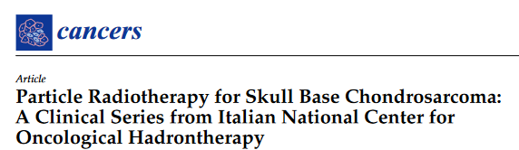
Skull Base Chondrosarcomas
Riva et al. Sept 2021
experience
48 patients
3-year LC : 98%.
2% G3 acute toxicity; 8% G3 late toxicity.
White-matter brain changes 46% patients, but only 7 needed steroids (G2). No patients had G3 brain toxicity.
No G4–5 complications
67% PT (70 GyRBE in 35 fractions)
33% CIRT (70.4 GyRBE in 16 fractions)
From September 2011 to July 2020
PT and CIRT appeared to be effective and safe treatments for patients with SB-CHS, resulting in high LC rates and an acceptable toxicity profile.

Slide 17

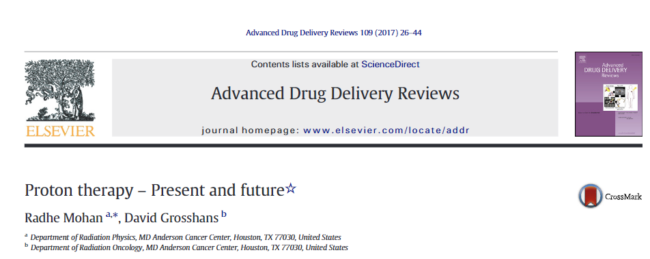
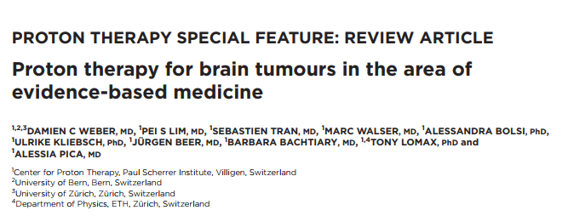
INDICATIONS FOR BRAIN TUMORS
2020
Proton therapy has shown promise for brain tumors due to its potential for reduced adverse effects, particularly cognitive dysfunction.
Its role is particular defined in meningiomas in critical sites (close proximity to the optic pathways and brainstem) and patients with favorable prognosis such as those with benign/low grade brain tumors.
Adeberg et al. evaluated the relative benefit of protons for five typical brain tumor locations and suggested that in general parietal tumors seem to benefit the most in terms of brain sparing.

Slide 18
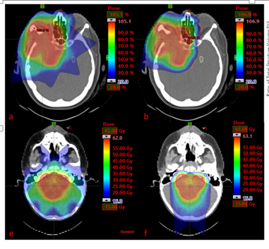
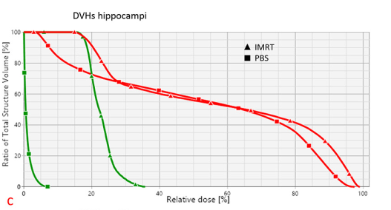
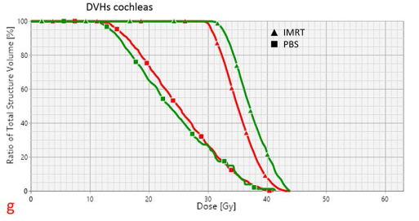
INDICATIONS FOR BRAIN TUMORS
2020
Even for very complex target volumes involving large parts of the brain, such in whole ventricular RT for intracranial germ cell tumours, a dosimetric comparison study showed an approximately one-third reduction in integral dose to the brain, and also a better sparing of the circle of Willis with PT.
Decrease of dose delivered with PT as opposed to IMRT to the hippocampus and cochleas’ for a supra- and infratentorial tumor, respectively.
IMRT
PBS
Preliminary evidence suggests that this PT dosimetric gain also translates into a clinical benefit such as, for example, reduced neuro-cognitive disability and improved quality of life.

Slide 19
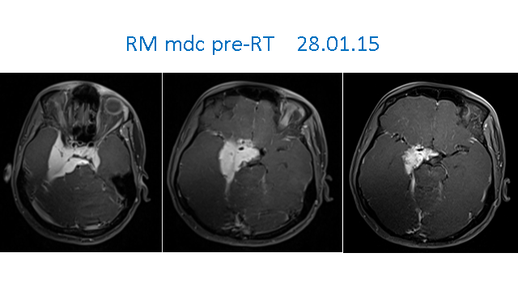
Intracranial meningiomas in critical sites (close proximity to the optic pathways and brainstem)
Total surgical resection is the treatment of choice for symptomatic/progressive meningioma.
However, not all meningioma are suitable for surgery and therefore radiation therapy is often indicated.
In particular, patients with residual non-benign, recurrent or high-grade tumours are candidates
for radiation therapy.
Large and complex shaped meningioma located close to brainstem, optical nerve, pituitary gland and cochlea may present however a therapeutic challenge and proton may provide dose escalation possibilities for non benign meningiomas.
Weber et al. 2020

Slide 20

Indication/selection criteria for Particle therapy (RT naive patients)
Intracranial meningiomas
WHO I (histologically prove or radiologically presumed): Cases requiring conventional fractionation
Confirmed RT indication regardless RT modality
Exclusive therapeutic option in unresectable tumors OR postoperative in uncompletely-resected tumors OR post-surgery recurrence
Large/very large/giant sized (eventual extra-cranial involvement): often complex/irregular shaped tumors
Lesions located in close proximity of o directly involving critical organs at risk
(optic-pathways and brainstem)
Particle Radiotherapy (exclusive proton or photon + proton):
5-years Local Control ≥ 95 %
(Wenkel et al. 2000 ; Noel et al. 2005 ; Slater et al. 2012; Murray et al. 2017 ; El Shafie et al. 2018)

Slide 21
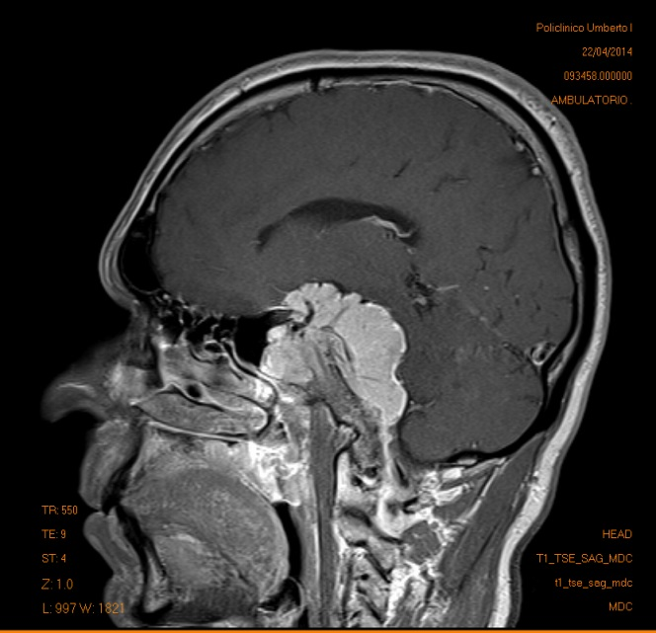
Skull base WHO-I Meningioma: Proton therapy at

Slide 22
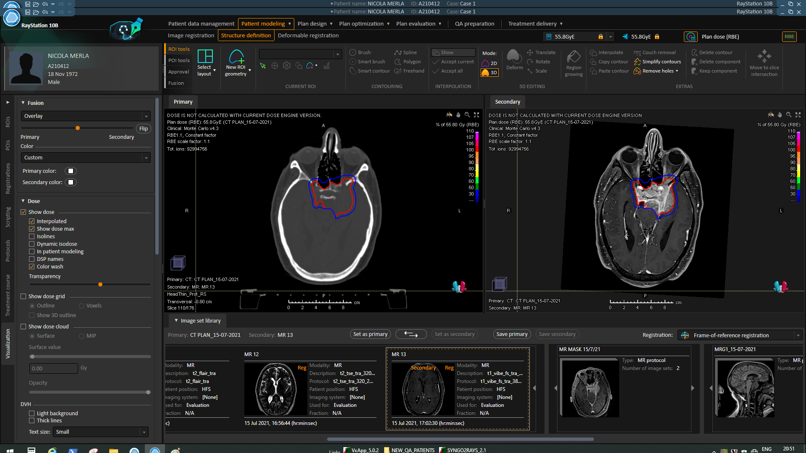
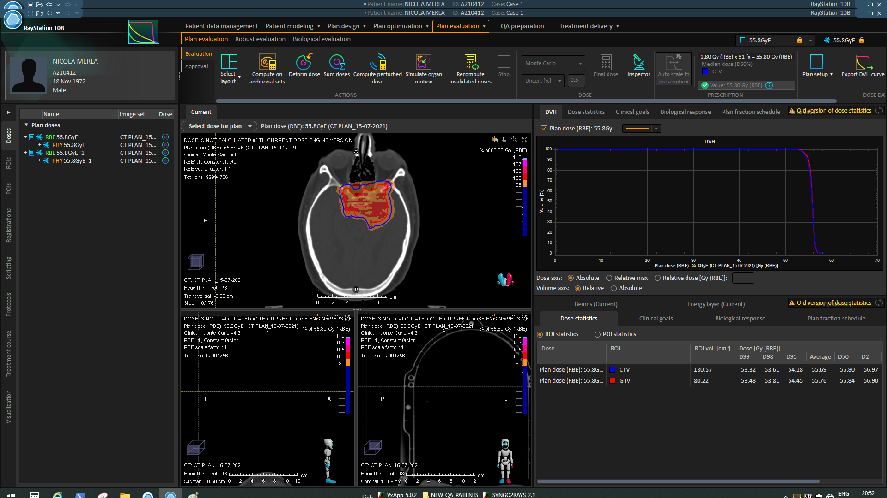
WHO II -WHO III Meningiomas (regardless tumor location)
Indication for First Radiotherapy (RT naive patients) regardless RT modality
RT fractionated dose schedule should be adopted (EANO guidelines , 2021)
HIGHER RT dose level (≥ 60 Gy) required
(Hug et al , 2000 ; Boskos et al , 2009 ; Kaur et al, 2014 ; Aizer et al, 2014; Jenkinson et al, 2014; Hwang et al, 2017 ; Weber et al 2018 ; Lee et al, 2019; Rogers et al, 2020 )

Slide 23
Glioma tumors: any role for particle therapy?
Proton therapy for low-grade gliomas has also been evaluated.
Investigators from the MGH first utilized mixed photon/proton treatments for dose escalation studies including patients with grades II and III gliomas.
Investigators from the University of Heidelberg, which employs scanning beam proton delivery technology, have also reported on 19 patients treated for lowgrade gliomas. Similar to photon-based treatments, their initial results suggest high rates of tumor control and acceptable toxicity rates
in a recent study Shih, et al. reported results of a prospective trial, which enrolled patients with grade II gliomas and assessed cognitive function and quality of life following proton therapy
With a median follow-up of 5.1 years, measures of cognitive function were stable to improved compared to the baseline
Mohan R et al. Adv Drug Deliv Rev. 2017
Fitzek MM et al. Int J Radiat Oncol Biol Phys. 2001
Hauswald H. et al. Radiat Oncol. 2012
Shih HA et al. Cancer. 2015

Slide 24
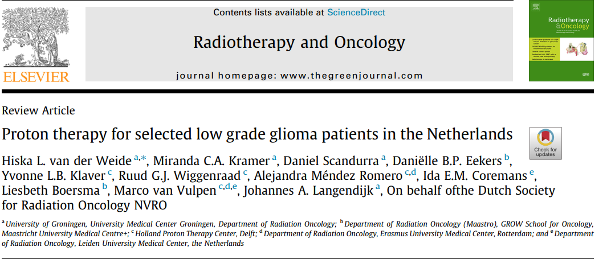
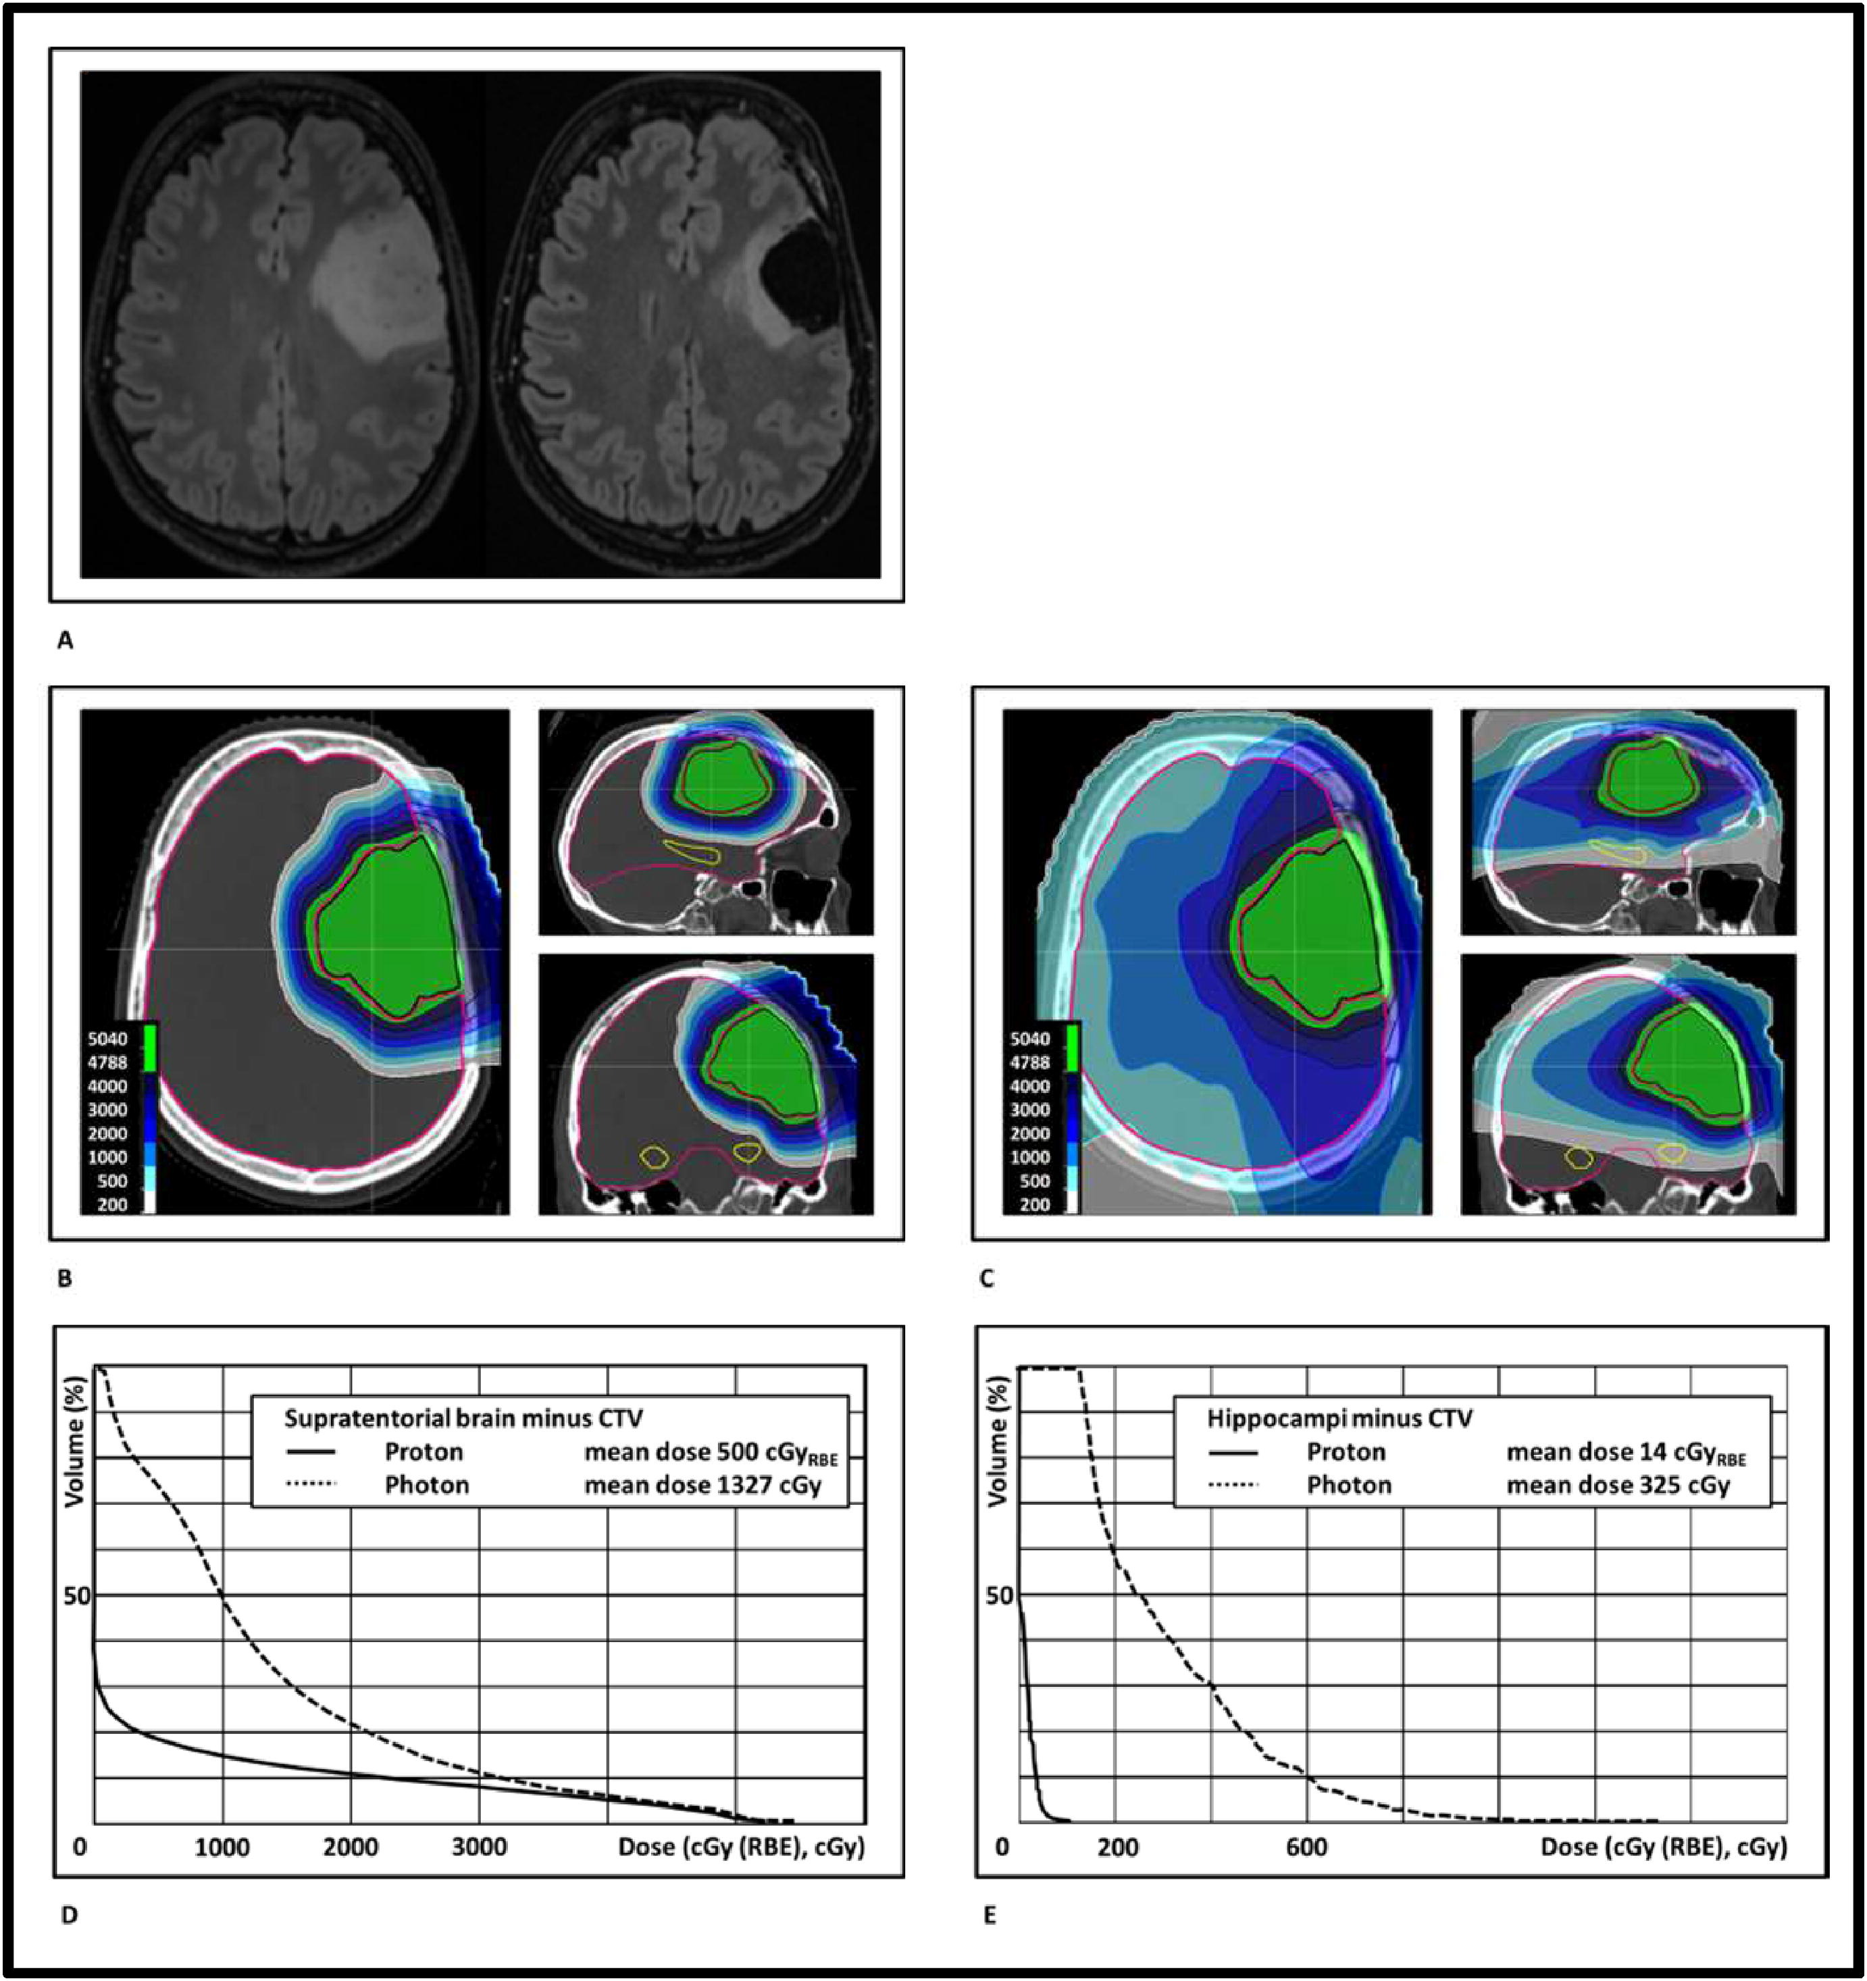
2020
Neurocognitive function is a difficult clinical endpoint to evaluate and quantify, and currently high-quality NTCP-models for NCF outcome, necessary to give clinical meaning to the superior dose distribution of protons, are lacking
In the Netherlands, the most favourable LGG patients with an indication for radiotherapy are eligible for proton therapy.

Slide 25
2020
Eligibility criteria are:
good prognosis, defined as an expected 10-year survival of 50% or higher;
(2) good clinical and neurocognitive status prior to radiotherapy, defined as a Karnofsky performance status of 80 or higher and iADL independent function;
(3) dose benefit of proton therapy over photon therapy, defined as more than 5%
dose reduction to the supratentorial brain and/or both hippocampi outside the target volume
In the coming years collaborative efforts will be made to prospectively evaluate and
register NCF outcome data with the intention to develop NCFbased NTCP models to enable model-based selection in the future.

Slide 26
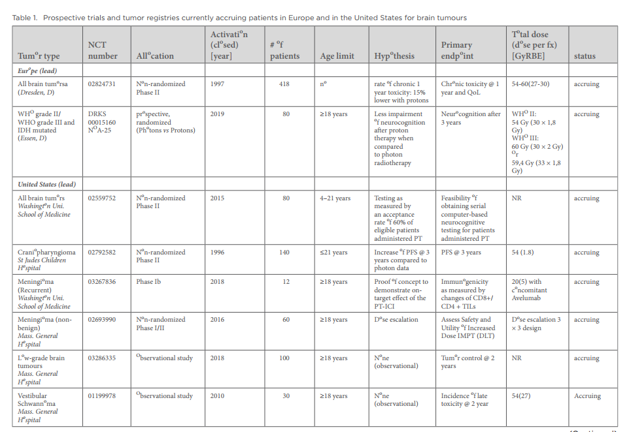

Slide 27
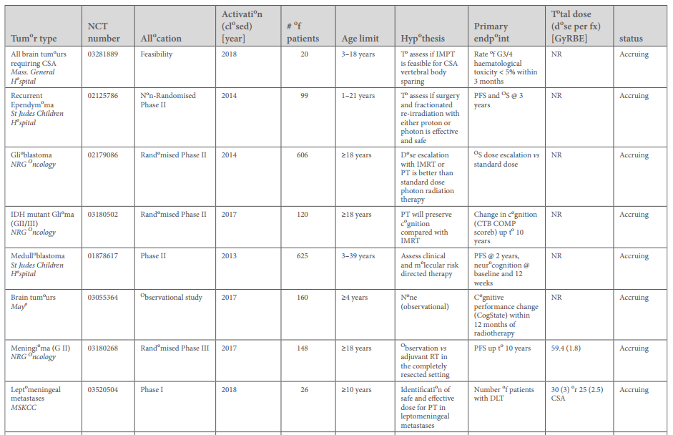

Slide 28
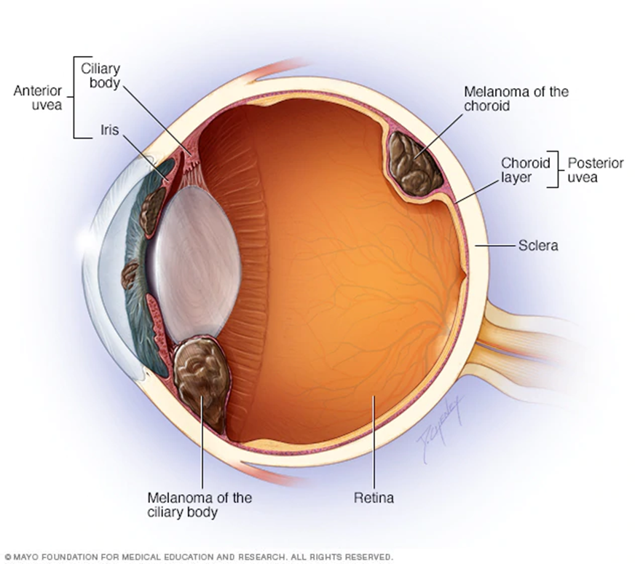
OCULAR MELANOMA
Most common intraocular tumor in adults
Rare malignancy arising within melanocytes of the uveal tract: iris, ciliary body and choroid.
Historically, surgery has been the mainstay of treatment for primary melanoma.
From 1970s eye-preserving treatment modalities gradually replaced the radical approach.
The radiotherapy techniques of globe-conserving therapy:
radiotherapy: plaque brachytherapy
external beam radiotherapy with photons
helium ions
PROTON RT
carbon ions RT

Slide 29
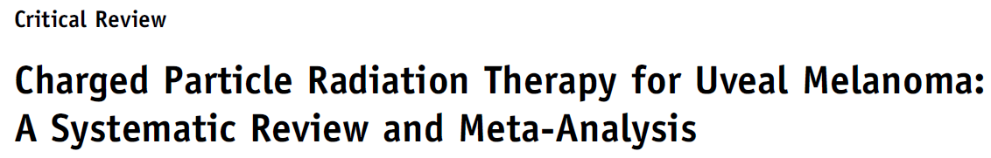
Particle therapy
Standard care group
6718 pts proton therapy
623 helium ions therapy
116 received carbon ion therapy
1352 patients
enucleation
iodine-125 brachytherapy
Main findings
the risk of local recurrence was markedly lower with CPT
lower incidence of cataract and radiation retinopathy with CPT.
CPT was associated with a 47% reduction in the risk of enucleation , this reduction did not reach statistical significance

Slide 30
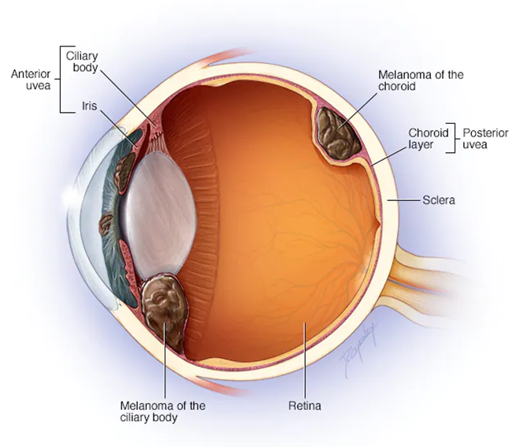
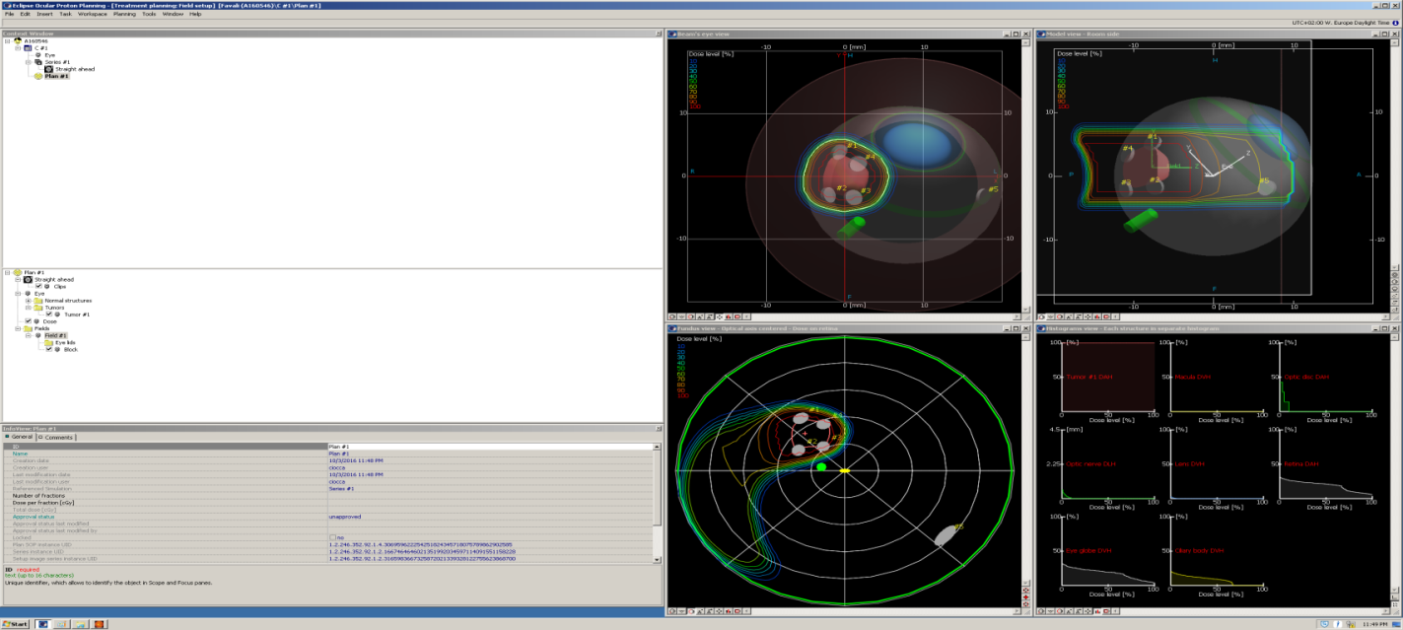
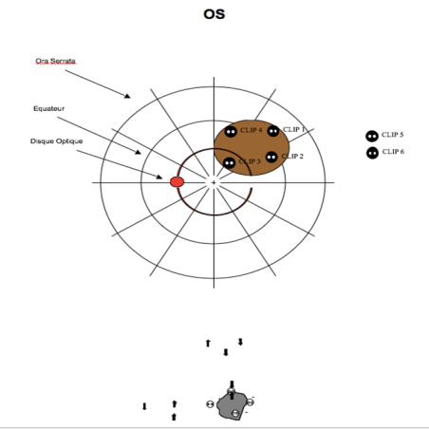
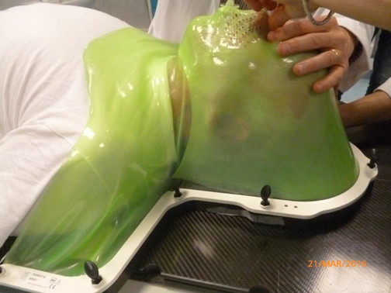
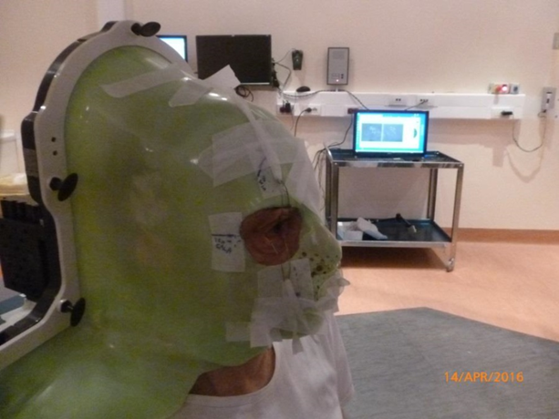
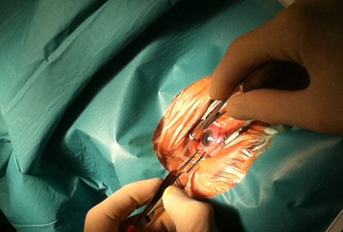
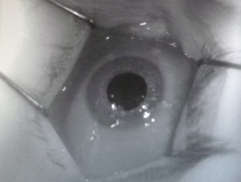
Ocular Melanoma
experience
> 200 patients
Protons: 60 GyE ( 4 fx)
Local Control >95%
Eye preservation >90%
Visual function >45%

Slide 31




INDICATIONS FOR HEAD AND NECK CANCER
orbital and periorbital tumors (e.g. paranasal sinuses)
adenoid-cystic carcinoma of the salivary glands
Re-irradiation

Slide 32
INDICATIONS FOR HEAD AND NECK CANCER
The superior dosimetric conformity and organ-sparing capabilities appear to correspond with improved patient outcomes when compared with IMRT per the existing literature
Locally advanced Head and neck cancers: IMPT, compared to VMAT, significantly reduced toxicities (feeding tube placement and dependence, narcotics use, xerostomia) and hospitalization (∼30% to ∼8%) within 60 days post-RT, improve QOL, better financial toxicity.
Different indications for proton therapy vs CIRT. CIRT in radioresistant tumors, unresectable or unfit for surgery. Emerging evidence suggests to avoid demolitive surgery deemed to be R2 in favour of radical CIRT. Protons to reduce toxicity in tumors in difficult locations (orbit and paranasal tumors)

Slide 33
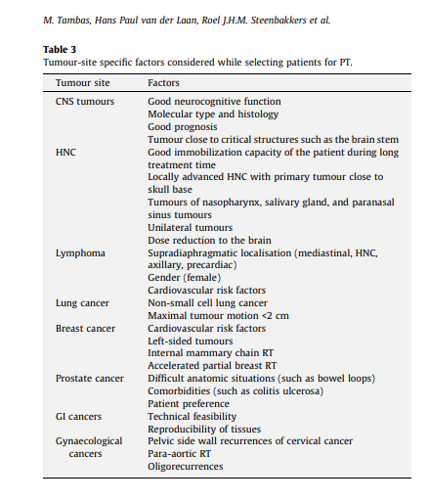
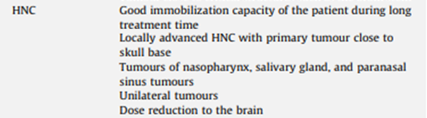

Slide 34
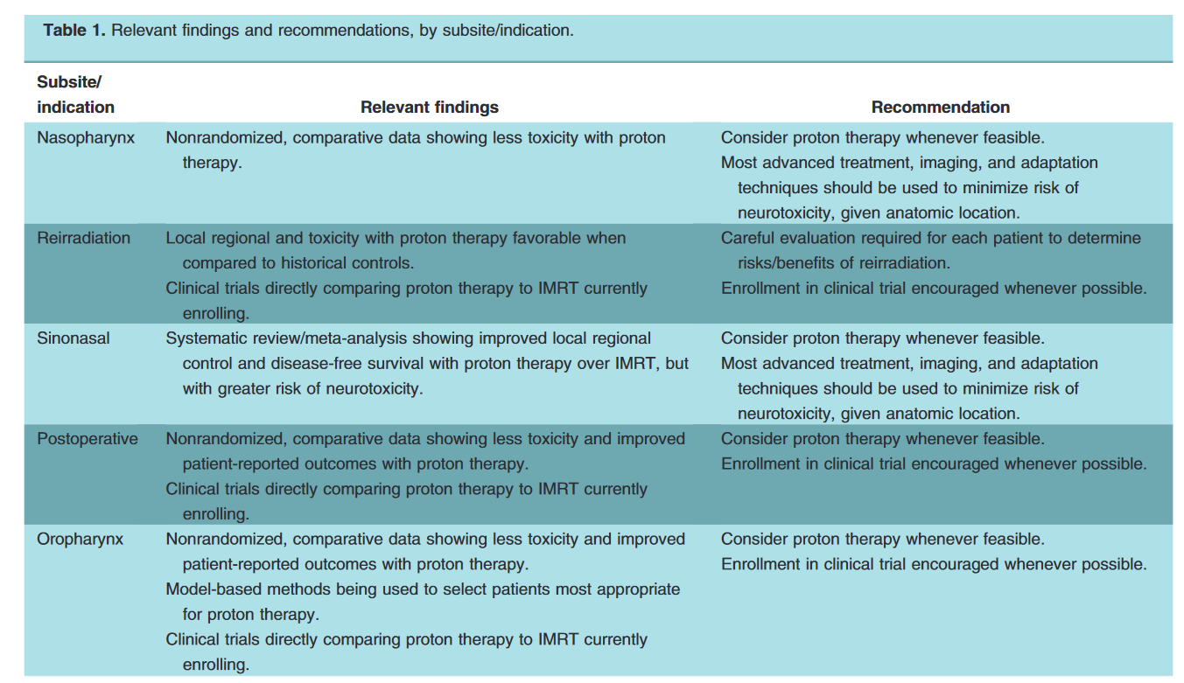
PROTON THERAPY

Slide 35
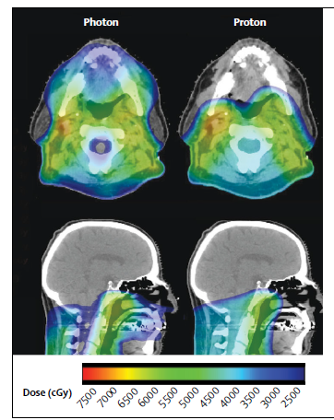
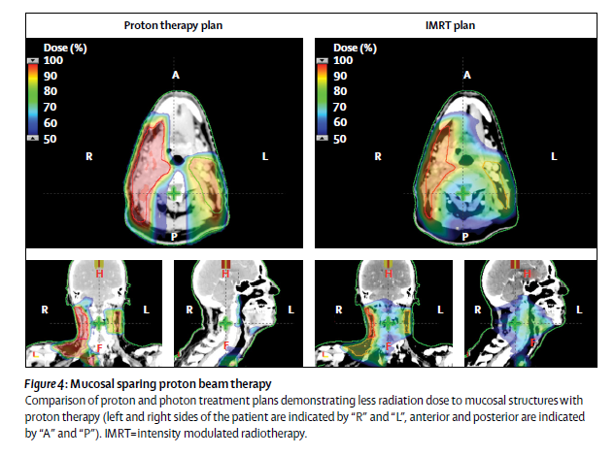
OROPHARYNGEAL CANCER
sparing of multiple critical organs including the oral cavity (in particular the anterior mucosa) , major salivary glands and mandible; reduction or elimination of the dose to uninvolved controlateral oropharyngeal and nasopharyngeal mucosa.
Mitigation of late toxicities in HPV + disease with good prognosis.
A phase III randomized IMPT versus IMRT trial for stage III-IVB oropharyngeal cancer (NCT01893307) just completed accrual (N = 518), the results of which are awaited and expected to be more convincing
Perkins SM 2012, Zhang W, 2017, van de Water TA , 2011, 2012; Cozzi L 2001, Holliday EB 2016

Slide 36
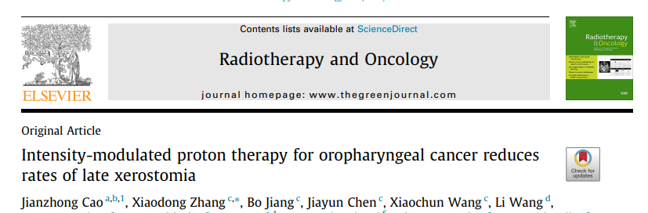



Prospective registry
2016
The top 5 symptoms were food taste problems, dry mouth, swallowing/chewing difficulties lack of appetite, and fatigue
According to the MDASI-HN, symptom burden was lower among the IMPT patients than among the IMRT patients during the subacute recovery phase after treatment
IMPT was associated with less late xerostomia than was IMRT in OPC patients

Slide 37


UNILATERAL HEAD AND NECK IRRADIATION
Reduction of 10 times of higher to critical medline (oropharyngeal mucosa) and contralateral OARS.
PT
IMRT
Press et al. 2021, Kandula S 2013, Stromberger C 2016

Slide 38

PROTON THERAPY FOR NASOPHARYNX
Rare, unique epidemiological and histological features
RT is the milestone of the treatment, with or without chemotherapy (CHT) in different settings (concurrent and or adjuvant and or neoadjuvant) according to disease stage and EBV-plasma load
IMRT represents the current standard RT technique
However, toxicity rate are still relevant, especially for advanced clinical stages, with substantial effects on quality of life
Lower doses to multiple OARs, including major salivary glands, spinal cord, brainstem and optic chiasm; reduction of the averaged mean dose to OARs by a factor of 2–3; reduction of low-to medium dose volumes.
PT could be an alternative to VMAT, reducing radiation-induced side-effects to OARs while guaranteeing highly conformal coverage of the target.
IMRT
PT
PTCOG Consensus Guidelines on Particle Therapy for the Management of Head and Neck Tumors, Lin et al. (2021)
(Widesott L, 2008) (Liu SW, 2010; Lewis GD 2016)

Slide 39



Intensity-modulated proton therapy (IMPT) may significantly improve the toxicity profile for NPC
IMPT
IMRT
Li X, Jama Network Open 2021

Slide 40



SINONASAL MALIGNANCIES
Primary tumors of the nasal cavity and paranasal sinuses are uncommon
Molteplicity of histological types (SCC, ADK, SNUC, ESBN, MMM, ACC..)
In the majority of cases of LA-SNCs, the therapeutic strategy relies on the combination of surgery, radiotherapy (RT) and chemotherapy. For unresectable disease or inoperable patients, definitive RT is proposed, often with concurrent chemotherapy.
Intensity-modulated radiotherapy (IMRT-VMAT) is the standard RT technique.
Data on the efficacy of Protons (PT) and carbon ions (CIRT) is recentlessly growing.
NCCN 2023

Slide 41

PARANASAL SINUSES CANCERS: can particle therapy improve LC and survival?
TOXICITY
PT studies more detailed on toxicity vs photon (92% vs 57%; p=0·03).
Challenging cases sent to PT instead of photons
Higher biological and phyiscal doses delivered in PT studies compared to photon
OS
5 ys OS
5 ys DFS
LRC
Need for international PT register for comparison or randomized trials with independent and prospective enrolment and rigorous collection of prognostic variables.

Slide 42

Which patients for protons?
In silico comparative study , 22 LA or unresectable SNUC
Over 22 patients, 17 would benefit from PT (77,3%)

Slide 43


SALIVARY GLAND CANCER
2-6 % of all H&N cancers
Wide variability in histology (>20 subtypes) and natural history
Challeging scenario for RO community for their historically known radioresistance.
Requires a high radiation dose to be controlled.
RT primarily applied in post-operative setting.
Advances in radiation techniques, IMRT, PT and CIRT have led to more strategic planning and delivery with higher RT doses potentially minimizing toxicity.
Despite the lack of randomized evidence, PT or CIRT should be taken into account, when available, as first option for inoperable, macroscopically residual or recurrent SGCs.
VMAT
IMPT

Slide 44



1% of malignant H&N tumors
Unpredicatable, slow and indolent course
Radioresistance with frequent LRR and DM
Standard treatment consists of surgical resection with adiuvant RT (T sixe, N, Rclose/R1, VI, PNI, high grade).
Typical perineural invasion to cranial nerves
CIRT
Salivary Gland. Photon beam and particle radiotherapy: Present and future Ester Orlandi et al. 2016 Oral Oncology

Slide 45
ADENOID CYSTIC CARCINOMA: comparing experiences
Institutions | No of patients | Treatment | Local Control (%) | Overall Survival (%)
Iowa, 2009 | 54 10 | Surgery alone Photon alone | 72 (5y) 27 (5y) | 85 (5y) 25 (5y)
Florida, 2004 | 101 | Photon alone | 27 (5y) | 25 (5y)
MGH, 2006 | 23 | Proton +/- surgery | 93 (5y) | 77 (5y)
GSI, 2005 | 34 29 | Photon alone Photon + carbon boost | 25 (4y) 78 (4y) | 78 (4y) 76 (4y)
NIRS, 2011 | 151 32 119 | Carbon alone (all pats) Carbon alone (T1-T3) Carbon alone (T4 or recurrence) | 74 (5y) 96 (5y) 71 (5y) | 72 (5y) 92 (5y) 69 (5y)
HIT, 2015 | 58 37 | Photon + carbon boost Photon (IMRT) | 59.6 (5y) 39,9 (5y) | 76.5 (5y) 58,7 (5y)
Japan (4 centers), 2018 | 289 | Carbon alone | 74 (5y) | 68 (5y)
(unpublished confidential data) | 184 | Carbon alone | 75 (3y) 53 (5y) | 85 (3y) 65 (5y)

Slide 46


MUCOSAL MELANOMA OF HEAD AND NECK
less than 1.3% of all melanomas, worst and unpredictable prognosis
Half arise in the H&N, typically in the nose, paranasal sinuses, oral cavity, pharynx, and/or larynx
Notable epidemiologic variation exists between races
Surgery is the mainstay of treatment, though it traditionally yields >50% recurrence
Focused particle radiation improves therapeutic ratio with a goal to overcome radioresistance, while high-LET irradiation has been theorized to further offer improved immunogenicity, leading to enhanced systemic response
CIRT

Slide 47
MALIGNANT MUCOSAL MELANOMA: : comparing experiences
Author, year of publication | No of patients | Treatment | Local Control (%) | Overall Survival (%)
Gilligan et al. 1991 | 28 | Photon | 70 (1y) | 18 (5y)
Wada et al. 2004 | 31 | Photon alone (n=21) Surgery and photon (n=10 R2) | 61 (1y all pts) 39 (2y all pts) | 73 (1y all pts) 33 (3y all pts)
Krengli et al. 2006 | 74 | Surgery alone (n=17) Surgery and photon (n=42) Photon alone (n=11) | 57 (3y) 71 (3y) n.d. | 41 (3y) 14 (10y) n.d.
Yanagi et al. 2009 | 72 | Carbon alone | 84 (3y) 84 (5y) | 46 (3y) 27 (5y
Zenda et al. 2016 | 32 | Proton alone | 75.8 (1y) | 55.9 (2y)
Koto et al. 2016 | 260 | Carbon alone | 83.9 (2y) 72.3 (5y) | 69.4 (2y) 44.6 (5y)
Takayasu et al. 2019 | 21 | Carbon alone | 92.3 (2y) 92.3 (3y) | 56.2 (2y) 49.2 (3y)
confidential unpublished data | 40 | Surgery and carbon (n=28) Carbon alone (n=10) ‘’Sandwich modality’’ (n=2) | 84.5 (2y all pts) 84.5 (3y all pts) | 58.6 (2y all pts) 53.3 (3y all pts)

Slide 48



CLINICAL CASE: LOCALLY ADVANCED MUCOSAL MELANOMA
RM pre-RT
CT simulation
CR after 3 months from CIRT

Slide 49


Oral Oncol. 2020 Nov;110:104879.

Slide 50


INDICATIONS for sarcoma
INDICATIONS for sarcoma
Tumors of mobile spine
chordomas of spine and sacrum
Soft tissue sarcomas

Slide 51
PRIMARY SPINE TUMORS
Chordoma, CS, sarcoma..
are uncommon tumors characterized by
Locally aggressive growth pattern
High local recurrence rates
Most frequent sites after skull base is spine and sacrum
Most frequent histologies: chordoma, chondorsarcoma
Less frequent: osteosarcoma , Ewing sarcoma et al.
Peculiar aspect is the proximity to structures deputed to relevant functions

Slide 52





Slide 53

SPINE TUMORS
En bloc resection appeared to improve both local recurrence and disease free survival in chordoma and chondrosarcoma patients.
Radiation therapy as an adjuvant treatment for chordoma and chondrosarcoma of the spine, when there had been incomplete resection or an intralesional margin (recommended with dose >60 Gy)
Dose < 60 Gy with photon radiation therapy have hystorically led to poor outcome: recurrence rate >70%
Particle therapy has been employed to overcome dose-limiting structures
Boriani 2006
Delaney 2018
Notes:
53

Slide 54
RECURRENCES /REIRRADIATION
Dose/particle defined on previous RT
Primary Spine tumors
NO surgery
SURGERY
R1
protons 74 Gy (RBE)
2 Gy(RBE)/fx
R2
CIRT
65.6-70.4 Gy (RBE)
CIRT
65.6- 70.4 Gy (RBE)
Notes:
54

Slide 55




47 pts sarcoma..
35 pts primary tumor
12 pts recurrence after surgery
CIRT median dose 64 GyE (52.8 GyE-70.4GyE)/16 frx
F-UP mediano 25 mo
5 yr LC 100%
5 yr LC 79%
5 yr LC 67%
5 yr OS 52%

Slide 56


Sacral chordoma
Higher local control associated
with wide surgical margin

Slide 57


Wide margin surgery it is not always possible
S1-S2 extension → RT as an alternative to be considerated because of invalidating sequelae
Permanent urinary/rectal disfunction → RT
High risk of severe sequelae → patients preference
based on expected QoL
Low risk of severe sequelae,
40% of recovering possibility
Depending on S2 nerve roots
Involved → surgery
Not expected severe sequelae → surgery

Slide 58







experience after 1 year

Slide 59




Spine- Sacrum Chordomas and Chondrosarcomas
experience
Unresectable
Carbon ions: 70.4 – 73.6 Gy(RBE) 4.4 – 4.6 Gy(RBE)/fx/16 fx
Response rate 86%
1 anno
SAcral Chordoma (SACRO): studio randomizzato e osservazionale sulla chirurgia in confronto alla radioterapia nella malattia primitiva localizzata INTISG

Slide 60
Titanium implants

Slide 61



Carbon fiber stabilization devices lead to less image alteration and consequently reduced contouring uncertainties together with a significantly higher dosimetric treatment planning accuracy.
Carbon fiber resulted dosimetrically more suitable than titanium implants
Titanium
Carbons fiber
Physica Medica 44 (2017)

Slide 62



Underdosage OAR
Surgical bowel displacement

Slide 63

Soft tissue sarcomas
Cuccia F (CNA), Outcome and Toxicity of Carbon Ion Radiotherapy for Axial Bone and Soft Tissue Sarcomas, Anticancer Res. 2020 May;40(5):2853-2859

Slide 64



Delaney et al, Advances in Radiation Oncology (2017) 2, 85-93
IMPT and SIB, 28 fractions
CTV1: GTV + adjacent tissues at risk of subclinical disease
50.4 GyRBE , 1,8 GyRBE/fr
CTV2: high risk area for positive margins
60.2 GyRBE, 2.15 GyRBE/fr
61.6 GyRBE 2.20 GyRBE/fr
63.0 GyRBE 2.25 GyRBE/fr → maximum tolerate dose
NCT01659203 trial -phase II
Still recruiting patients
Foreseen conclusion 08.2025
IMPT dose escalation feasible

Slide 65





Serizawa et al 2009 Int. J. Rad Oncol Biol. Phys., 75, 4
24 pts: 16 primitive/8 recurrence
median follow-up 36 months (6-143 m)
70.4 -73.6 Gy RBE; 16 fr
Clinical target volumes
57 cm³ to 1,194 cm³ (median, 525 cm³)
LC rate 2 yrs 77%
LC rate 5 yrs 69%
2 yrs OS 75%
5 yrs OS 50%
Histologic subtype | n
MFH | 6
Liposarcoma | 3
MPNST | 3
Ewing/PNET | 2
Other | 10
Histological grade
G3 (high grade) | 15
G2–3 (high grade) 2 | 2
G2 (intermediate grade) 3 | 3
G1 (low grade) 0 | 0
Unknown 4 | 4
Total | 24

Slide 66





Axial and pelvic bone and
soft tissue sarcoma
experience
50 patients
January 2013 to September 2018
Median follow-up: 24 (range = 4-61)
76% first diagnosis
Most common tumor site: pelvis
Retroperitoneal rhabdomyosarcoma after 5 years
Sacral osteosarcoma after 5 years
OUTCOME:
3y LC rate: 67.4%:
3y OS rate 64%
4% late G3 Neuropathy

Slide 67


Clinical case: DDLS
6 months later

Slide 68




Clinical case: MPNST
Pre-CIRT
15 month later
8 years

Slide 69
Any role of particle therapy for gastrointestinal malignancies?

Slide 70
Rationale for PBT is sparing uninvolved liver
PBT should be considered if dose liver constraints cannot be achieved with XRT
PBT strongly recommended for
• At least CP-B cirrhosis
• High tumor-to-liver ratio
• Larger tumor size
• Smaller uninvolved liver volume
• Higher number of tumors
• Prior RT to the liver
Clinical decision making
-treatment planning comparisons PBT vs XRT
- NTCP models?
Consensus that PBT is expected to dramatically improve clinical outcomes for some, but not all liver cancer patients compared to XRT.
Future studies should focus on identifying which patient subgroups achieve the greatest clinical advantage from PBT to guide treatment decision making.
Front. Oncol. 2019

Slide 71
For primary hepatocellular carcinoma (HCC), cholangiocarcinoma, and isolated hepatic metastases, the normal tissue sparing with proton therapy allows escalation of dose. Such escalation shows great promise, especially for large tumors that are a huge challenge to treat with photons without severe radiation-induced liver disease.
An HCC randomized trial “Radiation Therapy with Protons or Photons in Treating Patients with Liver Cancer” (NCT03186898) is being conducted within the auspices of NRG

Slide 72

WHAT ABOUT ESOPHAGEAL CANCERS?
For esophageal cancers, retrospective studies suggested reduced toxicity but no difference in survival; “Phase III Randomized Trial of Proton Beam Therapy versus IMRT for the Treatment of Esophageal Cancer” (NCT03801876)

Slide 73
Any role of particle therapy for gynecological malignancies?

Slide 74


Literature data: Mucosal Malignant Melanomas
Gynecological Mucosal Malignant Melanoma and CIRT
Retrospective analysis of 37 patients
Median follow-up periods: 23 months (range: 5–103 months) for all patients and 53 months (range: 16–103 months) for survivors
Within 6 months : 19 CR, 14 PR and 4 SD
Murata et al Cancers (Basel). 2019

Slide 75
CYCLE
Carbon ion radiation therapy in the treatment of mucosal melanomas of the female lower genital tract
Study Design | Monocentric, prospective phase II study
Statistical Considerations | Fleming one stage design
Treatment | The low-dose CTV (clinical target volume) will receive a total dose of 43 GyRBE in 10 fractions, 4 fractions per week. The high-dose CTV will receive a total dose of 68.8 GyRBE in 16 fractions, 4 fractions per week.
Endpoints | The primary endpoint of the study is to estimate 2-year PFS in patients diagnosed with mucosal melanoma of the lower genital tract, treated with carbon ion radiation therapy. Secondary endpoints: Overall survival (OS) Toxicity according to Common Terminology Criteria for Adverse Events (CTCAE version 5.0) Objective response rate (ORR) according to RECIST Evaluation of the association between the clinical-radiological response at 6 weeks and the late response (> 6 months) Quality of life.

Slide 76
INDICATIONS reirradiation
Re-irradiation of large-complex recurrent meningiomas
Re-irradiation salivary gland cancer
Re-irradiation of rectal recurrences
Re-irradiation of gynecological recurrences

Slide 77
RE-IRRADIATION OF SKULL BASE MENINGIOMA WITH PARTICLE RT
Large/Very Large and complex shaped
recurrent tumors: very difficult situation
to treat effectively in reirradiation setting
Carbon ions RT to be considered in order
to overcome radioresistance
El Shafie et al (2018) particle RT series
from Department of Radiation Oncology, University Hospital of Heidelberg :
available all advanced photon techniques
further than particle RT.

Slide 78




Reirradiation of salivary gland tumors
experience
November-2013-September2016
51 pts
Median CIRT dose 60 Gy[RBE]/ 3Gy[RBE] FS
Median follow-up: 18 months
PFS 1y/2y: 71.7% e 52.2%
OS 1y/2y: 90.2% e 64%

Slide 79



Re-irradiation of rectal recurrences: literature data
35 pts treated with CIRT (70.4GyE/16 fx) vs 31 treated with XRT (median dose 50 Gy/25fx)
CIRT showed better control, better overall survival and lower severe late toxicity rate
Chung, Seung Yeun et al., Scientific reports vol. 12,1 1845 (2022)

Slide 80




Re-irradiation of rectal recurrences: literature data vs CNAO experience
Yamada, Annals of surgical oncology 2022
77 pts treated with CIRT (70.4GyE/16 fx) after a prior XRT on the pelvis (median dose of 50.4Gy (range 20–74 Gy)
14 pts treated with CIRT (35-76.8 GyE/ 15-20 fx) after a prior XRT on the pelvis (median dose:58.5 Gy)Gy)
3-y LC (all): 69 % (95 % CI 56–79 %)
5-y LC (all):62% (95 % CI
51–73 %)
3-y OS: 61 % (95 % CI 49–71 %)
5-y OS:38% (95 % CI
26 –49 %)
3-y PFS: 33 % (95 % CI 22–44 %)
5-y PFS: 33 % (95 % CI
22–44 %)
Median follow-up : 18 months
Overall Survival: 1-year OS 100%; 2-year OS 76.2%
Local Control: 1-year LC 78%; 2-year LC 52%
No G≥3, no pelvic infection → pre-CIRT surgery with spacer implantation by open surgery in 4 cases
Acute grade 3 toxicities (10 %) and late grade 3 toxicities (21 %)
Re-irradiation with CIRT could be an evaluable option,
Prognostic factors for the outcome needed to be elucidate
Barcellini, In vivo 2020

Slide 81


Literature data: local recurrence
CIRT as re-irradiation for gynecological recurrences
Retrospective series of 16 cases
Unresectable recurrence at the edge of the previously irradiated field
Median age 57 years (range=35-79 years)
Median tumor size was 27 mm (range=14-80 mm)
Total dose range: 48-57.6 GyE
Shiba et al., Anticancer Res. 2017

Slide 82


Literature data: local recurrence
CIRT as re-irradiation for gynecological recurrences
Two patients had local recurrence, and 7 patients had distant metastases
Shiba et al., Anticancer Res. 2017

Slide 83


CYCLOPS

Slide 84


Dilemma: how to select patients to particle therapy?
P

Slide 85
HOW TO SELECT PATIENTS TO CIRT?
Biological factors
High LET radiation should be selectively used for radiobiological reasons in tumors that are hypoxic, slowly proliferating; that have a high capacity for damage repair, genetic/biological, microenvironmental features that promote radioresistance.
High LET radiation should be used in those histologies which have been shown to be highly resistant to conventional photon-based RT (recurrent disease, very extensive disease).
Anatomical constraints:
Difficult location:
inability to irradiate with a curative dose
without overdosing the organs at risk;
inability to resect the tumor with negative
margins or with the impair of important structures.
(radioresistant, unresectable disease)
Fokas 2009, Schlaff 2014, Durante 2012,
Tinganelli 2020, Griffin 1988, Debus 1999

Slide 86

HOW TO SELECT PATIENTS TO PROTON THERAPY?
National treatment capacity
Cancer epidemiology
Patient

Slide 87

Example of dosimetric selection : Denmark (Aarhus Hospital)
Based on national treatment capacity
  Capacity to treat 100 breast cancer patients with proton each year
  = 11% of all breast cancers with adjuvant locoregional irradiation indication
Based on dosimetric evaluation of treated patients, proton therapy is indicated in Denmark when :
  Mean heart dose (MHD) ≥4 Gy with optimal photon RT plans → not the case for PBI
  Ipsilateral lung V17Gy/V20Gy ≥ 37% with optimal photon RT plans
Stick et al., ctro, 2021

Slide 88




HOW TO SELECT PATIENTS TO PROTON THERAPY?
2018
2020
Model-based approach (NTCP): to estimate the potential clinical benefit for protons over photons in terms of reduction in normal tissue complication probability (NTCP) for each individual patient and assign the patient to PBT only if the reduction in toxicity is above a specified threshold (precision medicine).
Evidence based medicine: Randomized controlled trials (RCTs) randomization of the study population into photon and proton treatment. RCTs run the risk of being ethically compromised.
Prospective institutional national and international registries.
Ramaekers, 2012
Blanchard 2017
Lagendjik 2013

Slide 89



2020

Slide 90
NTCP differences (ΔNTCP) were calculated for 11 models predicting: brain necrosis, delayed recall, temporal lobe injury,
hearing loss, tinnitus, blindness, ocular toxicity, cataract, endocrine dysfunction, alopecia, and erythema.
Results:
PBT substantially reduced the dose in almost all investigated OARs, especially in the low and intermediate dose ranges and for contralateral organs.
Considering ΔNTCP of all models, 80 patients (87.0%) would have been selected
for PBT in this in-silico study, mainly due to predictions of a model on delayed recall (51 patients).
Dutz et al, Radiotherapy and Oncology , 2021

Slide 91


Lung cancer challenging disease sites. Conflicting results A multi-institutional randomized phase III study “Comparing Photon Therapy To Proton Therapy To Treat Patients With Lung Cancer” (NCT01993810) is underway through NRG and is nearing completion. Another phase II randomized trial “Image-Guided, Intensity-Modulated Photon or Proton Beam Radiation Therapy in Treating Patients with Stage II-IIIB Non-small Cell Lung Cancer” (NCT01629498) is also being conducted.
Breast….. For breast cancer, one of the malignancies most commonly treated with radiation therapy, there are relatively few reports involving proton therapy. However, increasingly there is interest in utilizing proton therapy both for patients having undergone lumpectomy as well as those requiring adjuvant radiation following mastectomy
Prostate..
Lymphoma….
Re-irradiation…

Slide 92
CONCLUSIONS
Despite the high potential of proton therapy, the clinical evidence supporting the broad use of protons is mixed.
It is generally acknowledged that proton therapy is safe, effective and recommended for many types of cancers (pediatric, ocular melanomas, chordomas and chondrosarcomas).
Although promising results have been and continue to be reported for many other types of cancers, they are based on small studies.
General consensus is that there is a need to conduct randomized trials and/or collect outcomes data in multi-institutional registries to unequivocally demonstrate the advantage of protons.

Slide 93


THANKS FOR YOUR ATTENTION

